Slide 1
Diagnostic Activities at the Developmental Testbed Center
Mrinal K Biswas¹, Jonathan Vigh¹, Ligia R Bernardet² and Shaowu Bao²
¹National Center for Atmospheric Research
²CIRES, NOAA/ESRL/GSD
HFIP Diagnostics Workshop, August 10, 2012

Slide 2
Sensitivity of HWRF Forecasts to Cumulus Parameterizations

Slide 3
Goals and Experimental Setup
Increase HWRF’s ability to use alternate physics
Evaluate sensitivity of HWRF to cumulus parameterization
Evaluate alternate schemes for physics-diversity ensemble
Acronym | Scheme
HPHY | HWRF SAS (no shallow convection)
HNSA | SAS implemented by YSU (with shallow convection)
HTDK | Tiedtke
HKF1 | Kain Fritsh
Runs used HWRF 2012 pre-implementation code as of Feb 2012 (27/9/3 km)

Slide 4
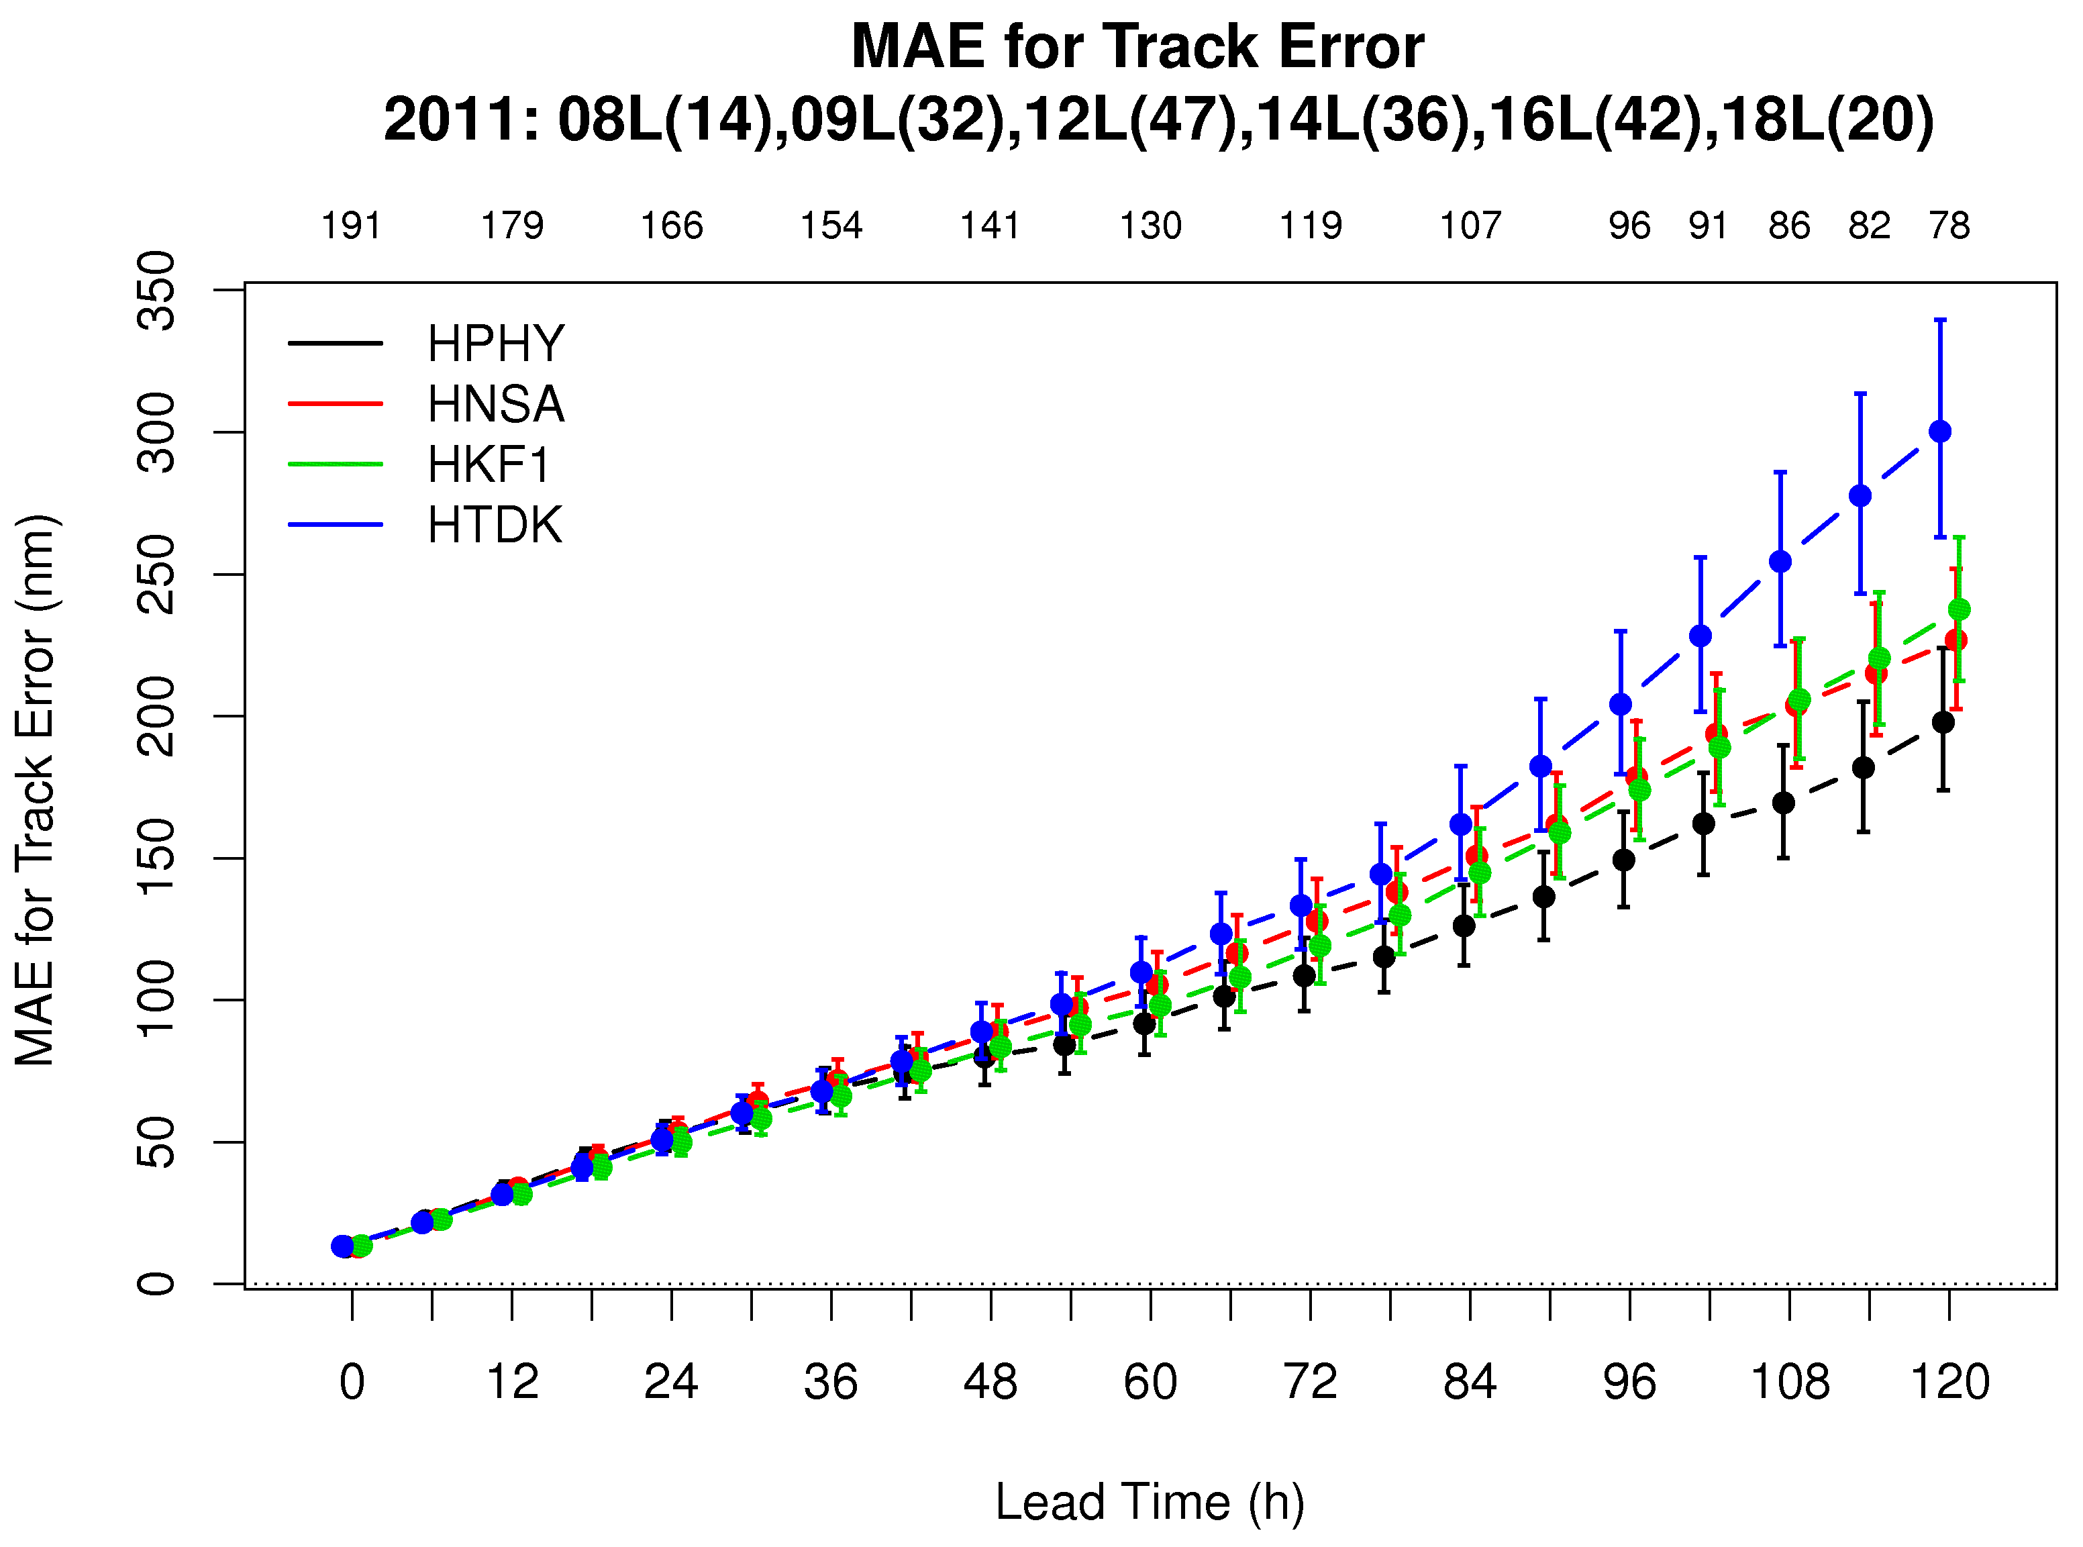
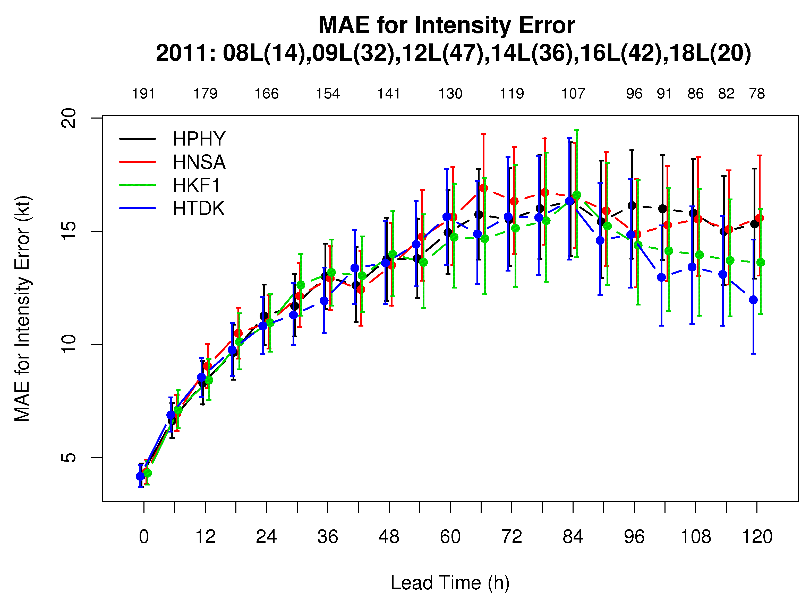
Track and Intensity Errors Atlantic Basin
Track
 | 12 | 24 | 36 | 48 | 60 | 72 | 84 | 96 | 108 | 120
HNSA
HKF1
HTDK
Statistical Significance 95%
Green= HPHY better
Red = HPHY worse
Intensity
 | 12 | 24 | 36 | 48 | 60 | 72 | 84 | 96 | 108 | 120
HNSA
HKF1
HTDK

Slide 5
HWRF Mini-Ensemble (HPMN)
HPHY performs best for track.
HPMN suffers from high Tiedtke errors.
HPMN outperforms HPHY at all lead times – not tested for SS

Slide 6
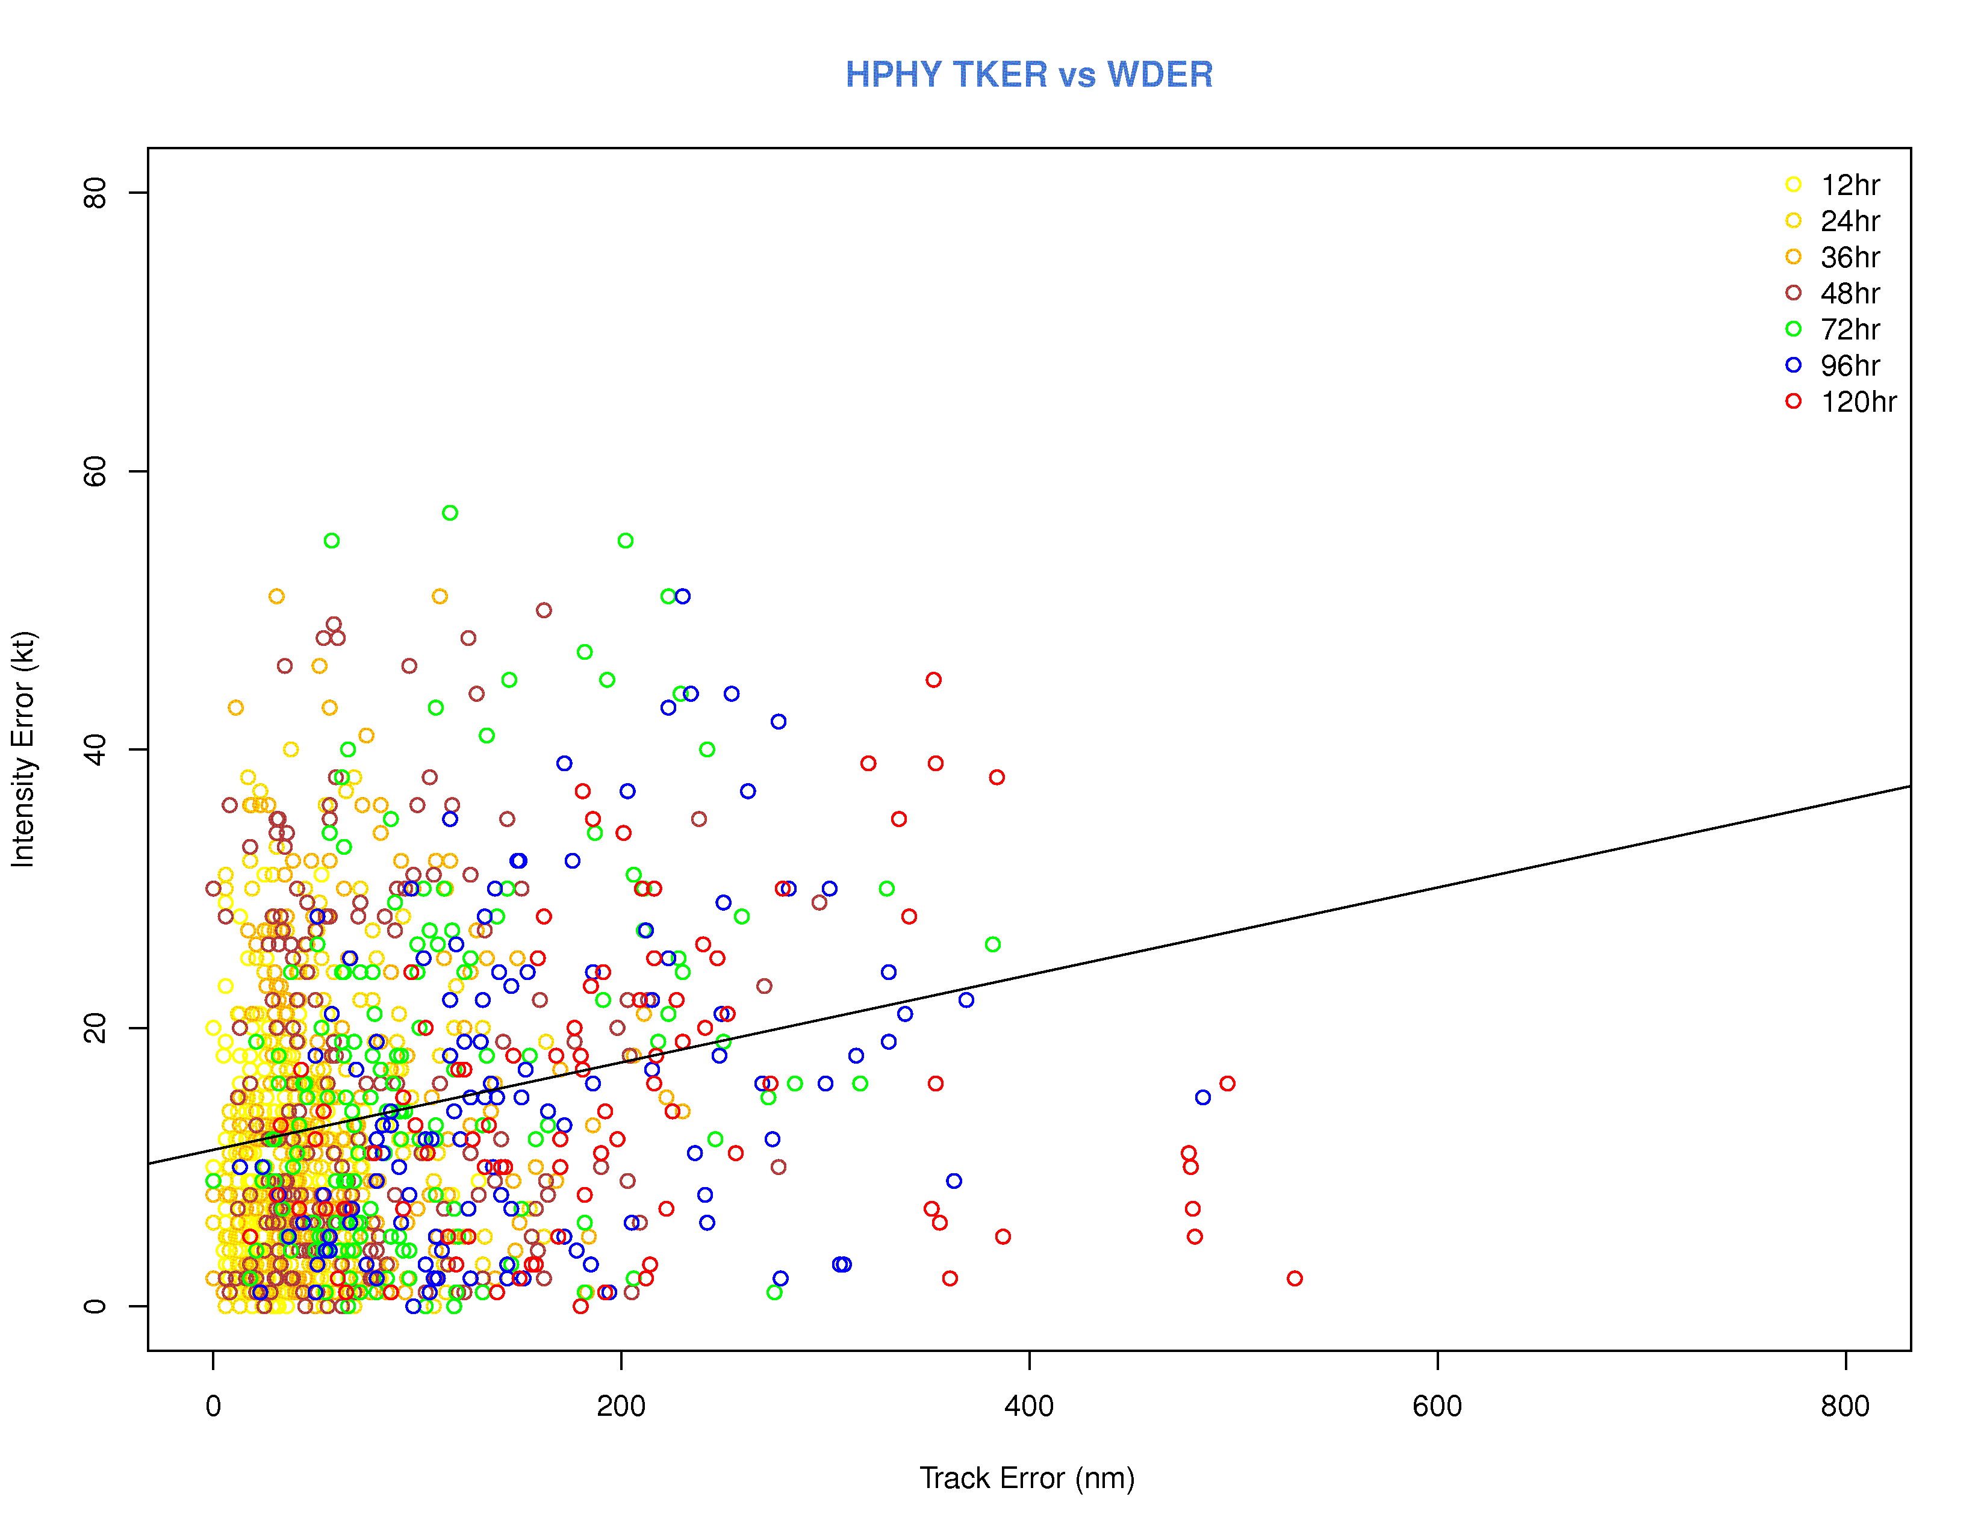
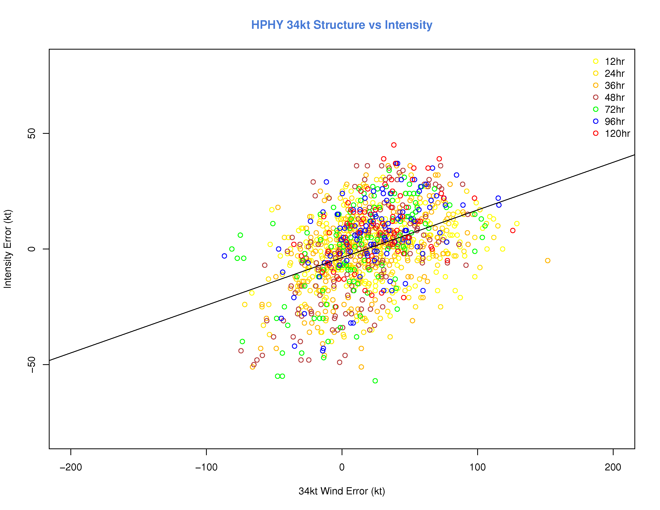
Error Correlation (by lead time)
HPHY – Intensity vs Track
No definite relationship, except good correlation between track error and forecast lead time
Weak relationship between structure and intensity error
In general, larger storms too intense, smaller storms too weak
HPHY – Intensity vs 34-kt
Similar for other schemes

Slide 7
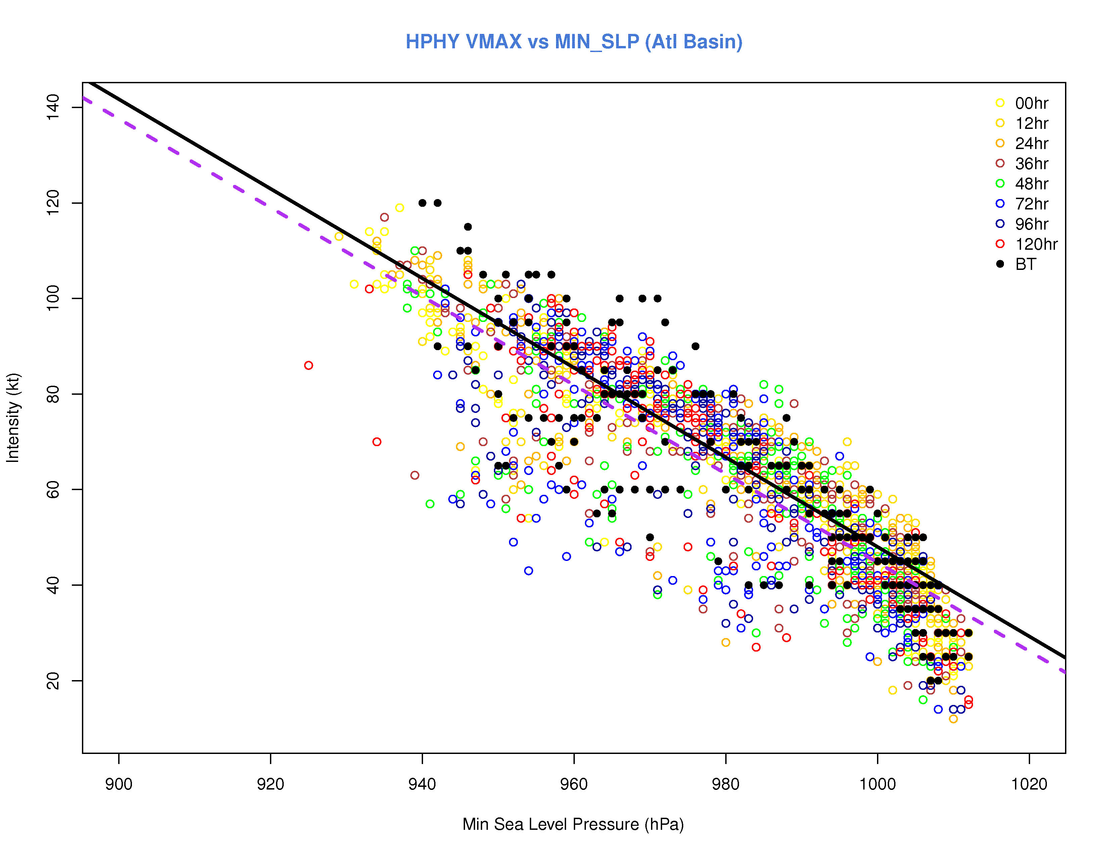
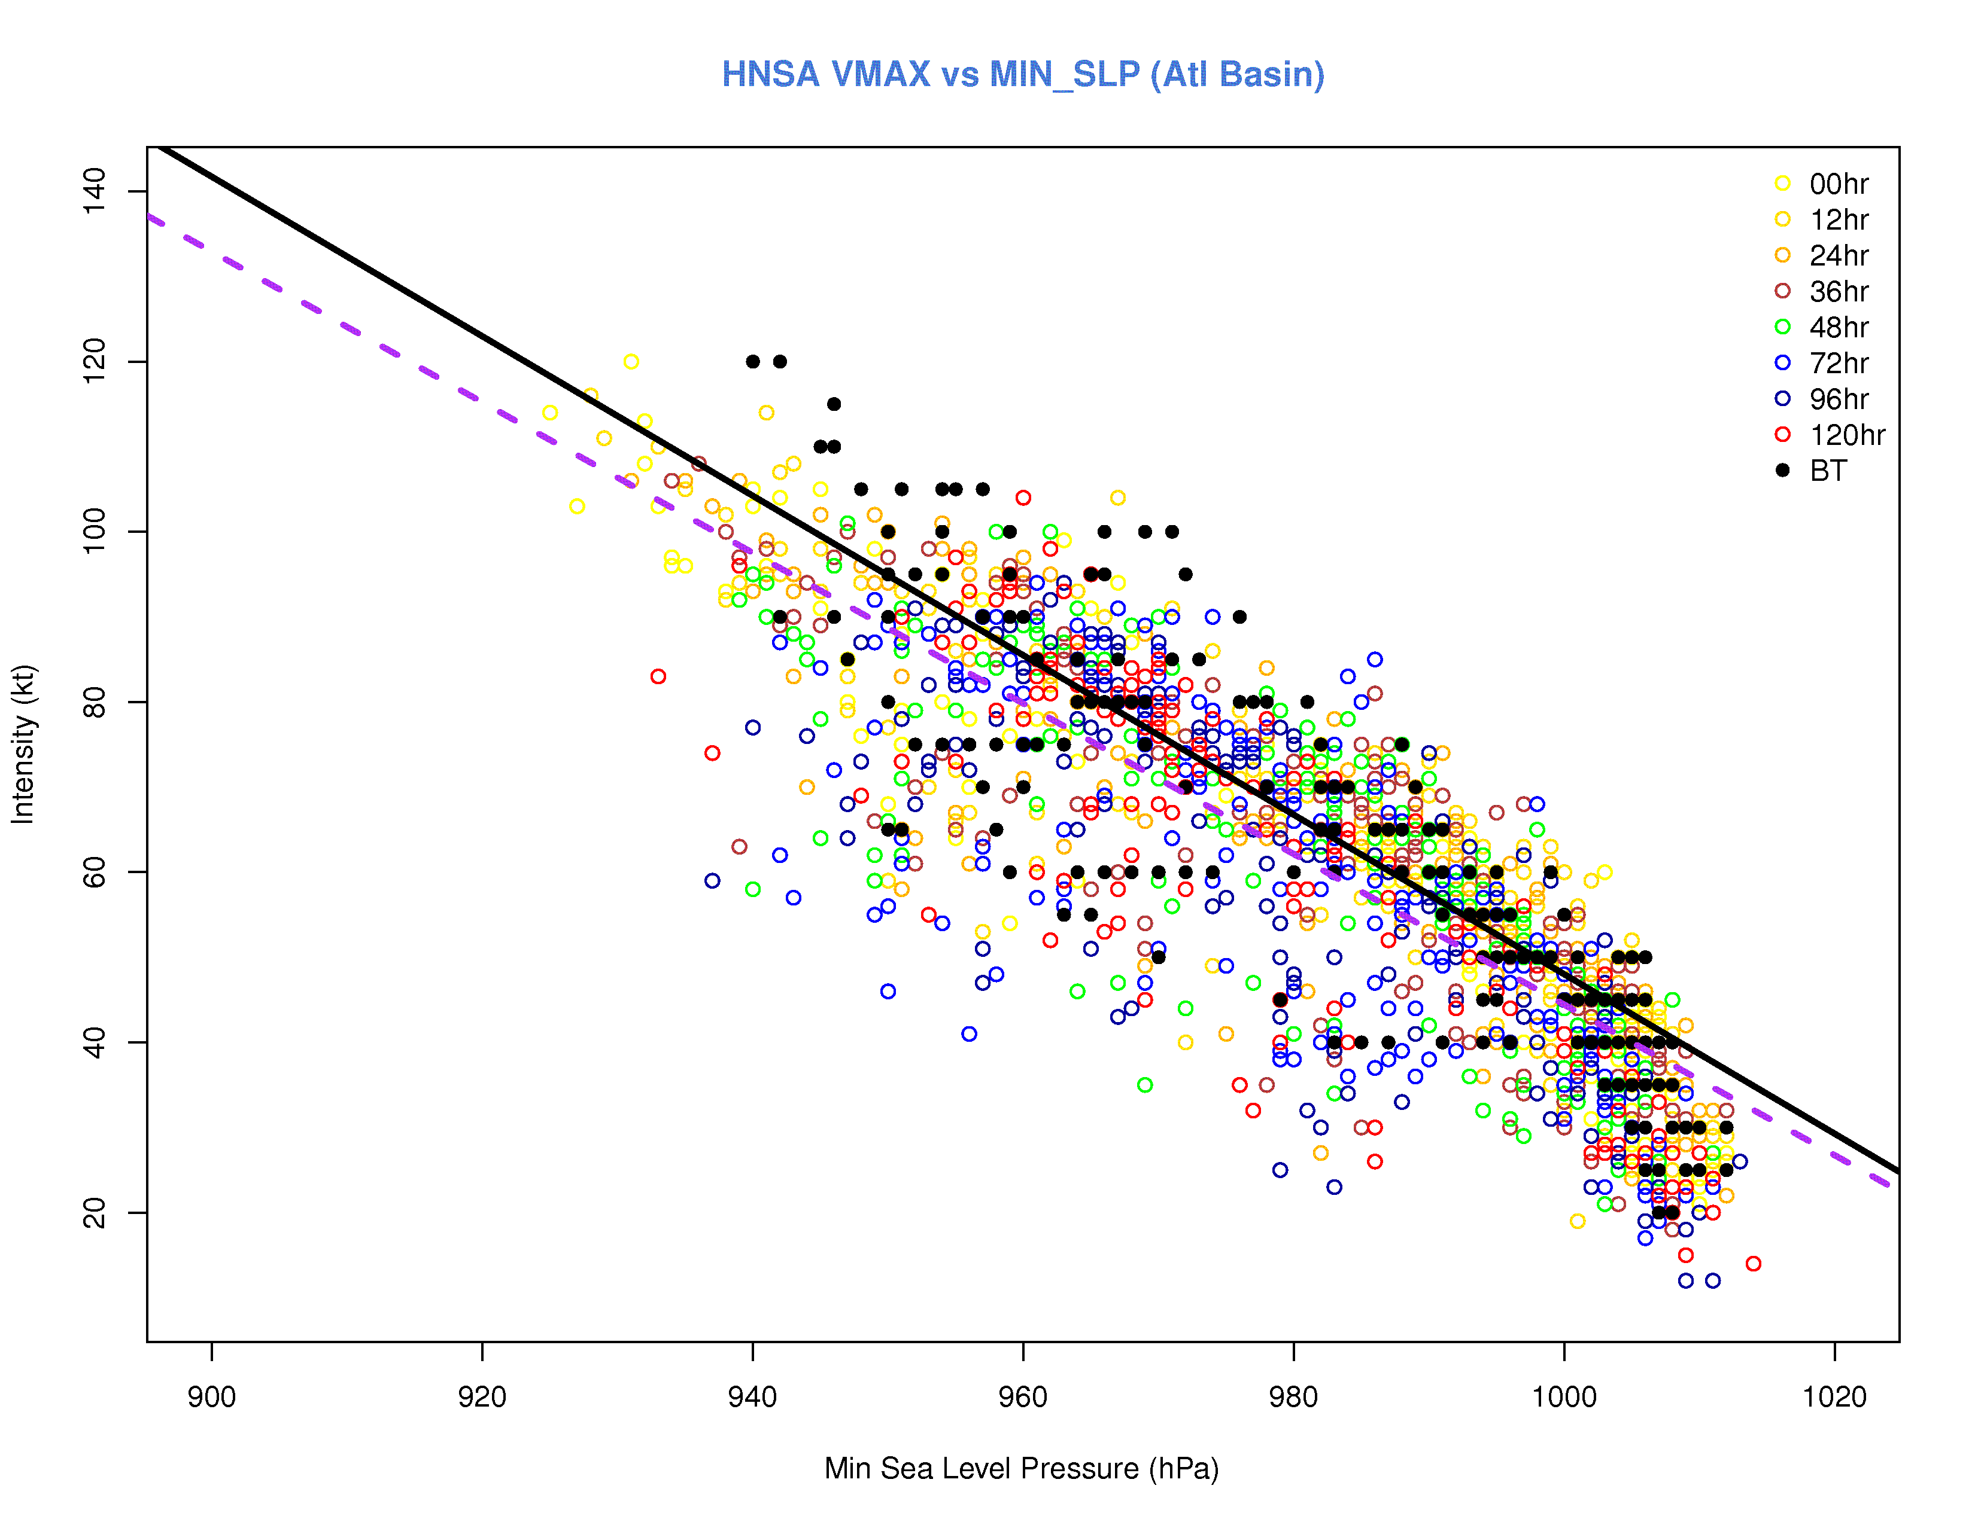
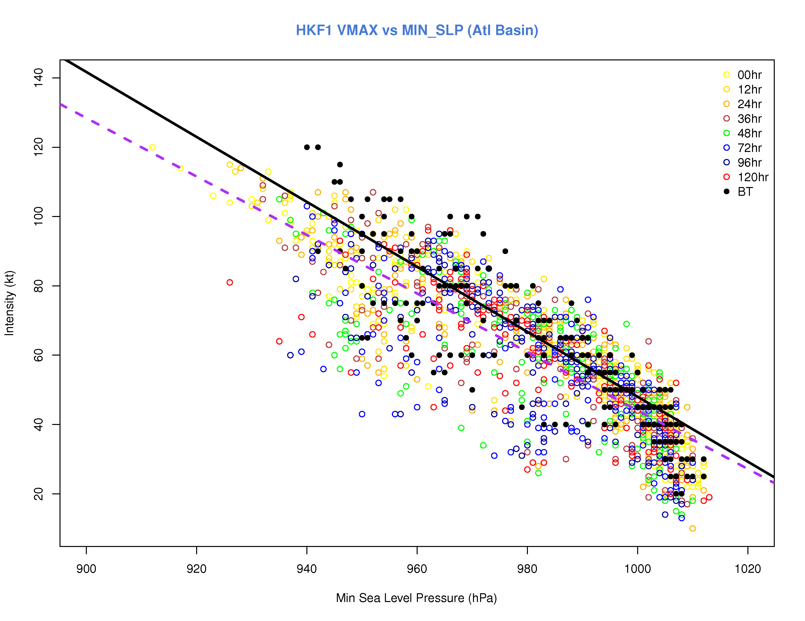
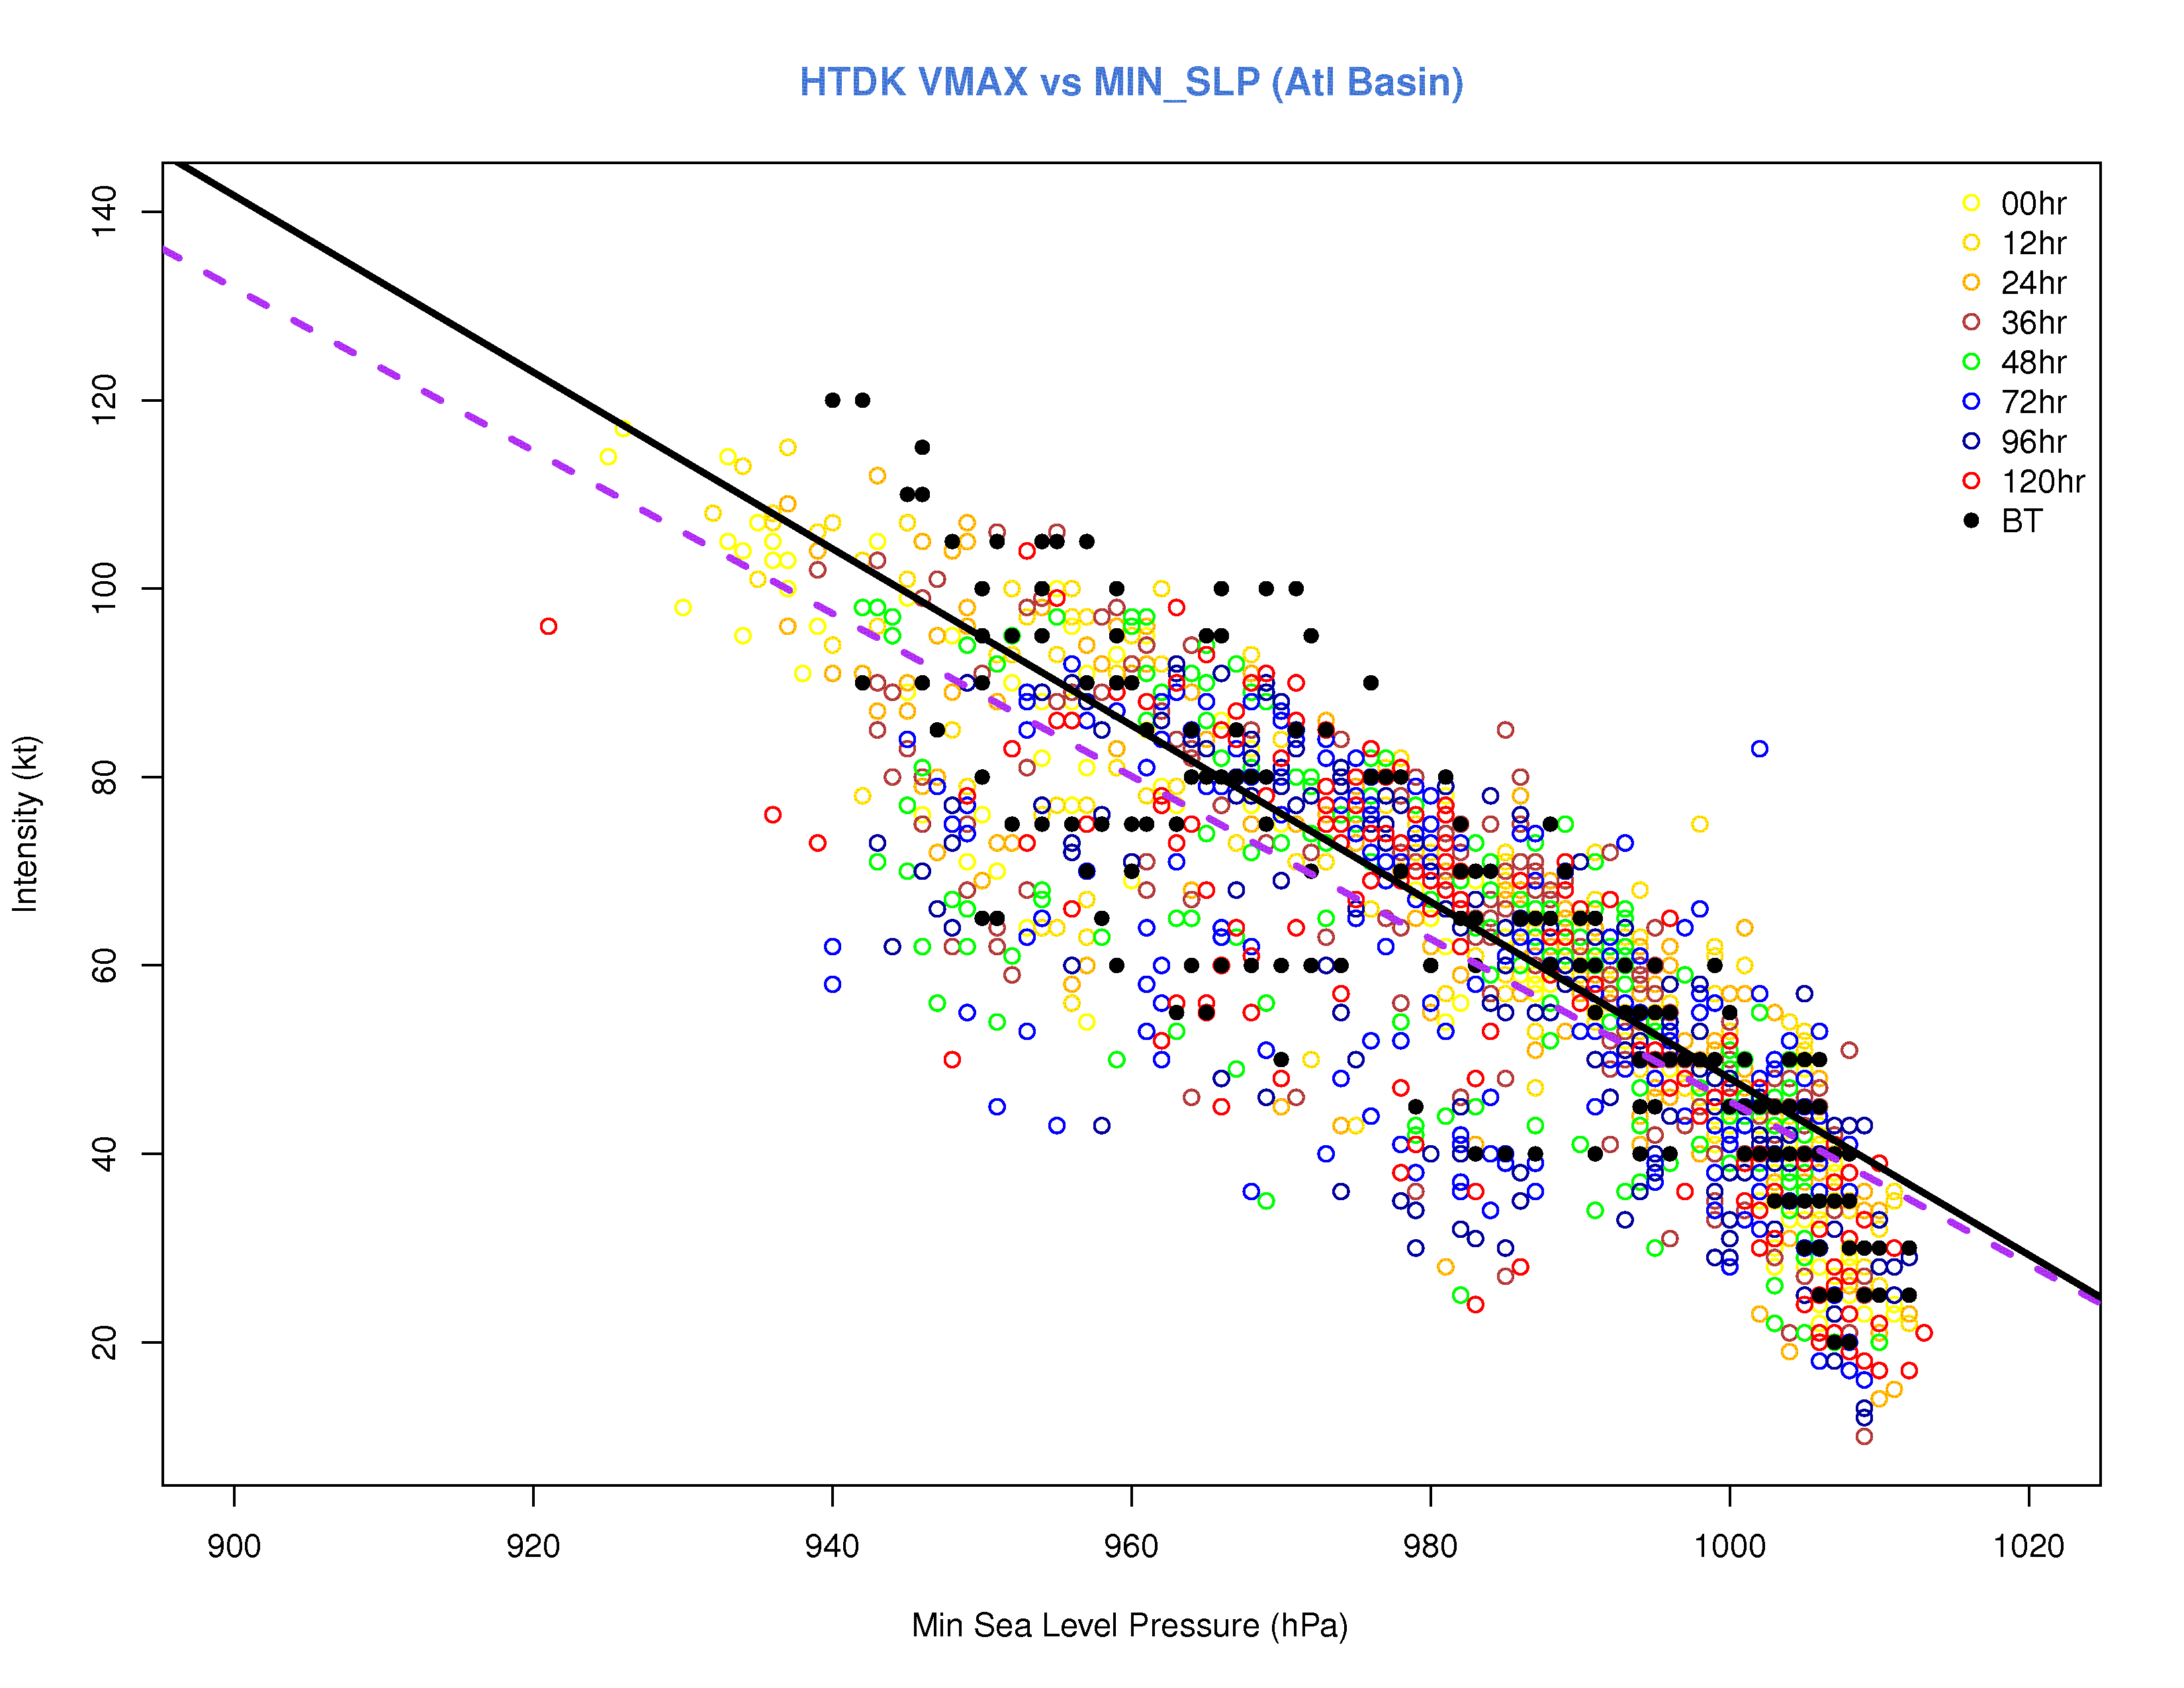
Wind vs Pressure (Atlantic)
HPHY
HNSA
No substantial difference between schemes
HKF1
HTDK
Pressure-wind relationship not strongly dependent on lead time

Slide 8
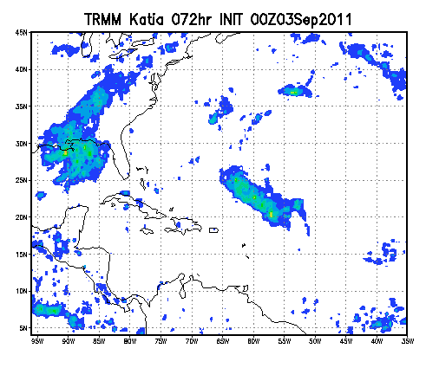
Large scale precipitation 72 h Init
TRMM
HPHY
HNSA
All schemes overdo precip
HKF1
HTDK
Katia init 2011090300

Slide 9
Intensity Change Diagnostics

Slide 10
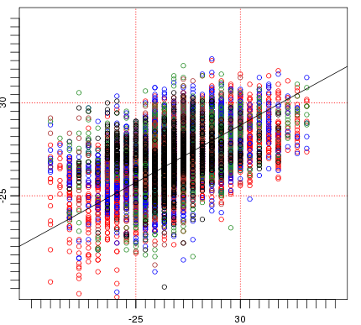
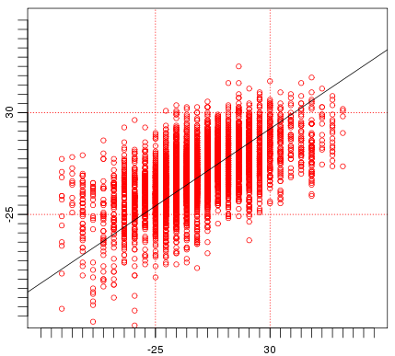
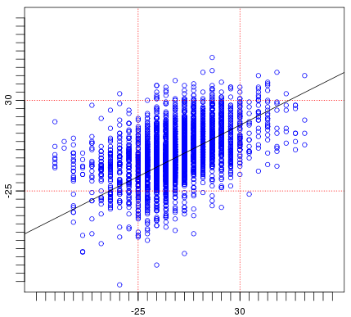
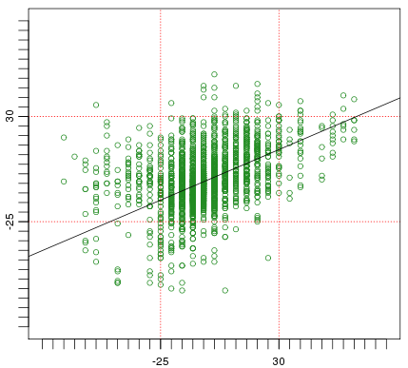
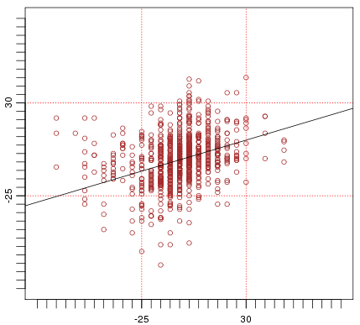
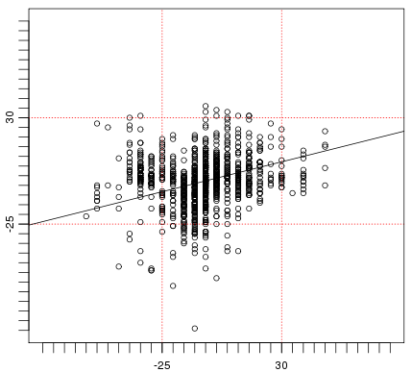
Intensity Change Verification (kt/day)
Stratification by track error (T) (nm)
T< 50 nm
51< T < 100
Low correlation between forecast and observed intensity change
Forecast
Corr=0.49
Corr=0.58
Corr=0.47
Obs
101< T < 150
151 < T < 200
T > 200 nm
Correlation higher when low track error
Corr=0.40
Corr=0.30
Corr=0.20
H212 (1265 retrospective cases) – run by EMC – Atlantic and Pacific basins
From Bao, Bernardet, Biswas and Kieue, 2012
Notes:
This is a scatter diagram of observed versus forecast intensity change in kt per day.
The dataset used is the H212 run by EMC.
We see that the correlation 0.49.
When we highlight intensity change greater than 30 kt/ day, or rapid intensification, we see that the model is challenged.
In these other diagrams, we stratified the results by track error, from less than 50 nm to greater than 200 nm.
The intensity change forecast is better when the forecast storm is in the right place, but the correlation is still only 0.58.
Every image has lines showing the -25 kt/24h and +30 kt/24h, which are the usual thresholds for Rapid Intensification (RI) and Rapid Weakening (RW).

Slide 11
HWRF Large Scale Diagnostics

Slide 12
Motivating Questions
What are the error characteristics of the basin-scale HWRF’s large scale climatology?
Can regional errors be tied to certain physical processes?
Are there systematic errors in model physics that aren't obvious near the hurricane, but which affect the model's forecast?

Slide 13
Methodology
BHWRF
forecast
fields
~730 possible forecast cases from
2011060318 to 2011112506
GFS analysis
fields
570 forecast cases
615 forecast cases
Cold-started from GFS analysis
Compute paired differences
PRE13HI
3D temp
3D u and v
3D rel. hum.
3D sp. hum.
3D geopotential
Accumulate differences by forecast lead time
cloud water
precipitable water
precipitation
surface pressure
skin temperature
eVAR = MSE – BIAS²

Slide 14
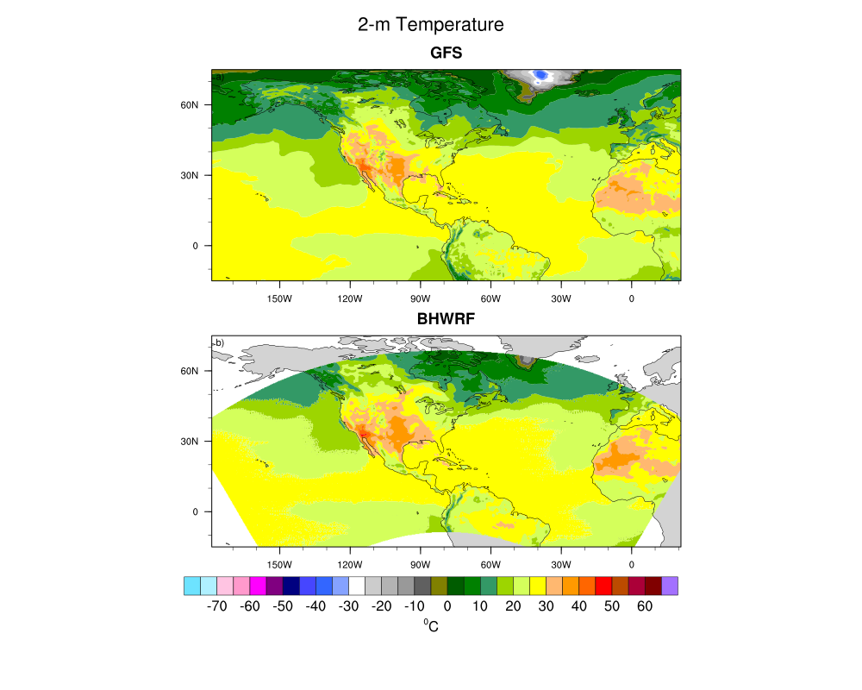
2011082500
analysis
2011082400
24-h forecast

Slide 26
Future

Slide 27
Future Diagnostic Activities in DTC
Funded activity
Implements and test alternate microphysics schemes in HWRF – start with Thompson
Pending funding…
Expand large scale evaluation to ECMWF analysis, demos and future retro runs of the Basinscale
Continue intensity change diagnostics

