Slide 1
NHC Activities, Plans, and Needs
HFIP Diagnostics Workshop
August 10, 2012
NHC Team: David Zelinsky, James Franklin, Wallace Hogsett, Ed Rappaport, Richard Pasch

Slide 2
NHC Activities
Activities where NHC is the lead:
6.1.2 Provide real-time HWRF model-derived satellite imagery products for NHC forecasters. (completed)
6.1.3 Provide real-time high temporal resolution HWRF track/intensity/structure diagnostic products to NHC forecasters. Extend products to other regional models as data is made available. (completed)
6.1.4 Develop experimental vertical shear text diagnostic product for various layers within select operational global and regional models. (GFS prototype developed, now extending to other models)
6.1.5 Conduct a TC structure verification study comparing regional model simulated satellite/radar with satellite observations. (Ongoing, preliminary results in late August or early September. Full results by the HFIP annual meeting)
Developed GrADS scripts for displaying deterministic regional and global model fields on the HFIP products website.

Slide 3
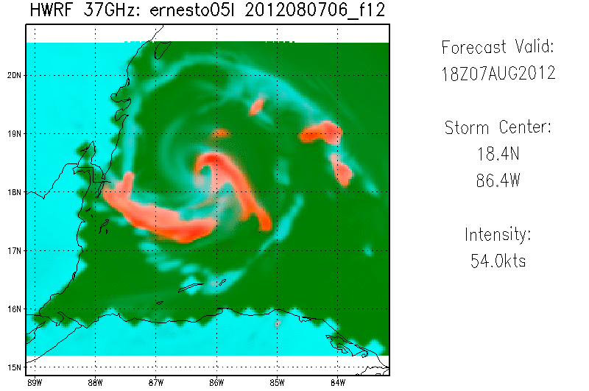
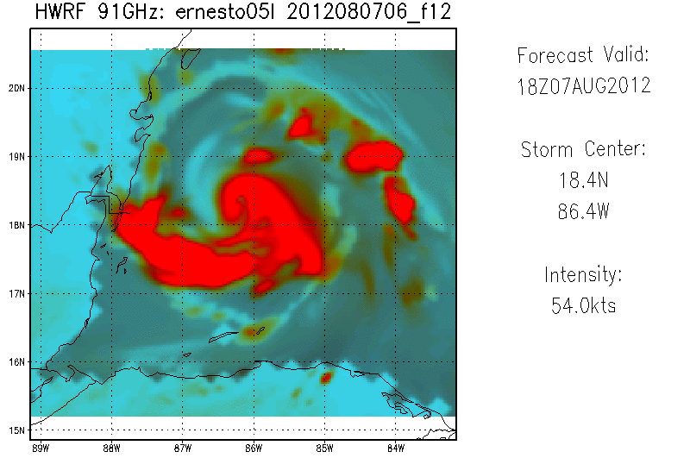
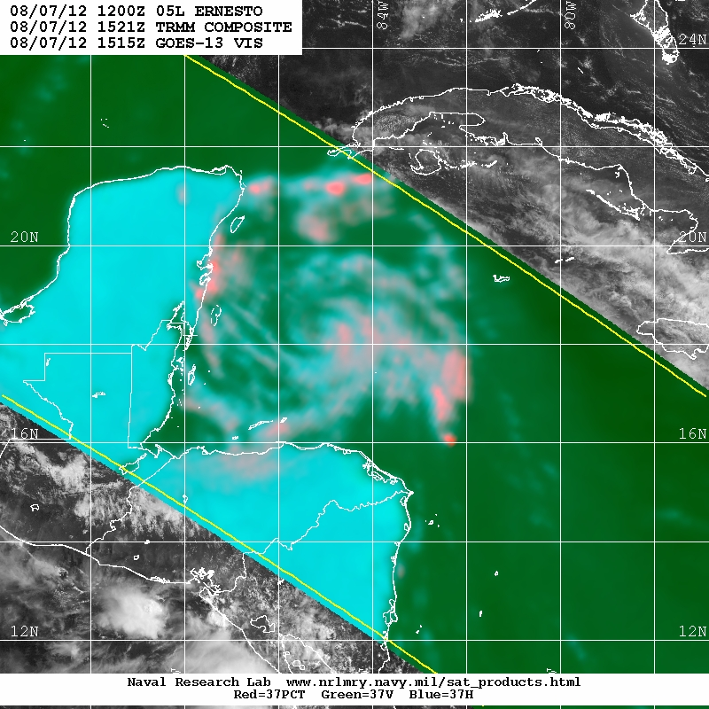
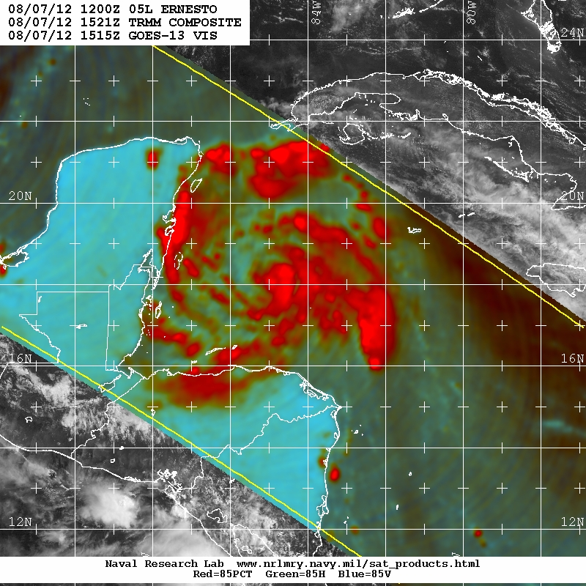
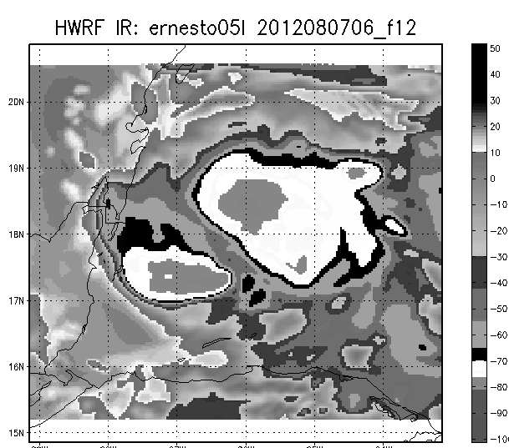
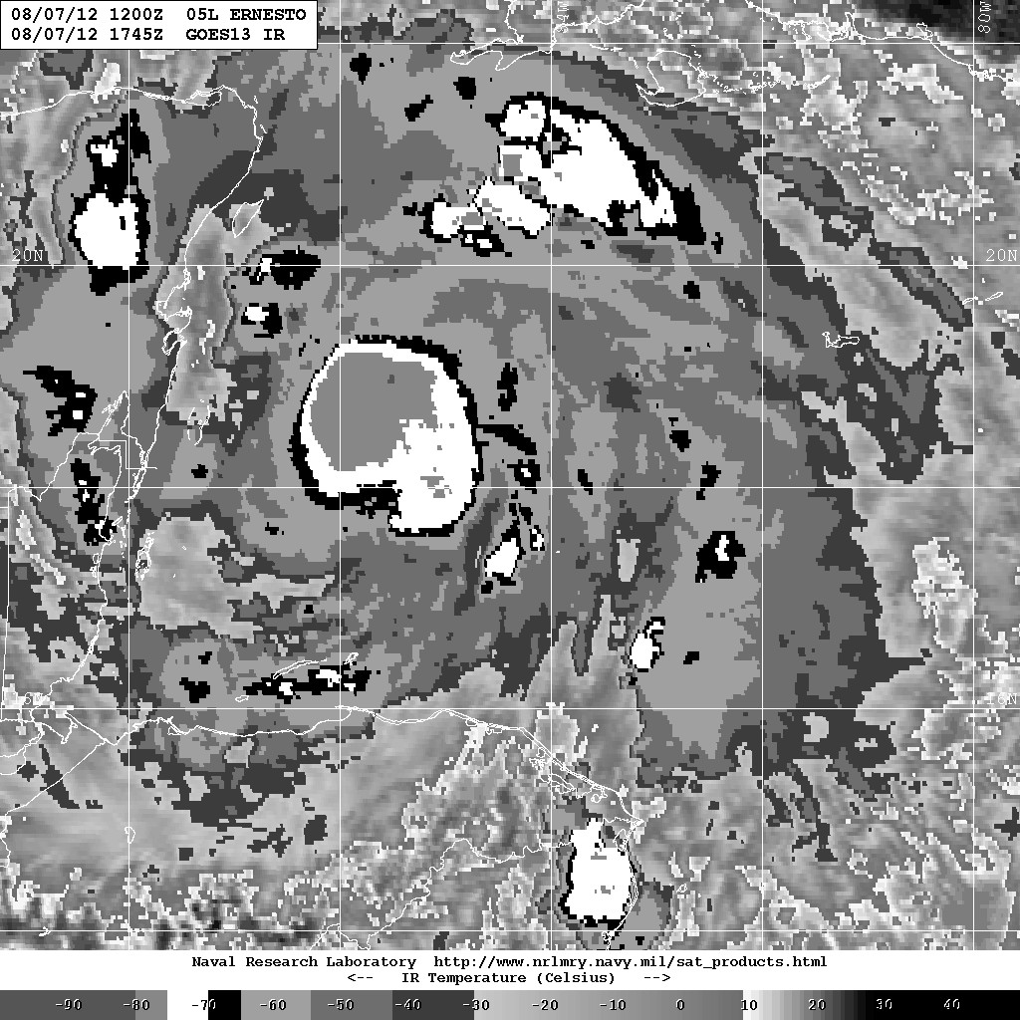
6.1.2 Provide real-time HWRF model-derived satellite imagery products for NHC forecasters.
TRMM:
1515 UTC
TRMM:
1515 UTC
GOES-13:
1745 UTC
Products were delivered beginning June 1.
All products available in real time via NHC’s intranet.
EMC also producing some imagery, which is available on the EMC-HWRF website
Downtime is currently experienced. whenever developmental CCS machine is down for maintenance or parallel testing.

Slide 4
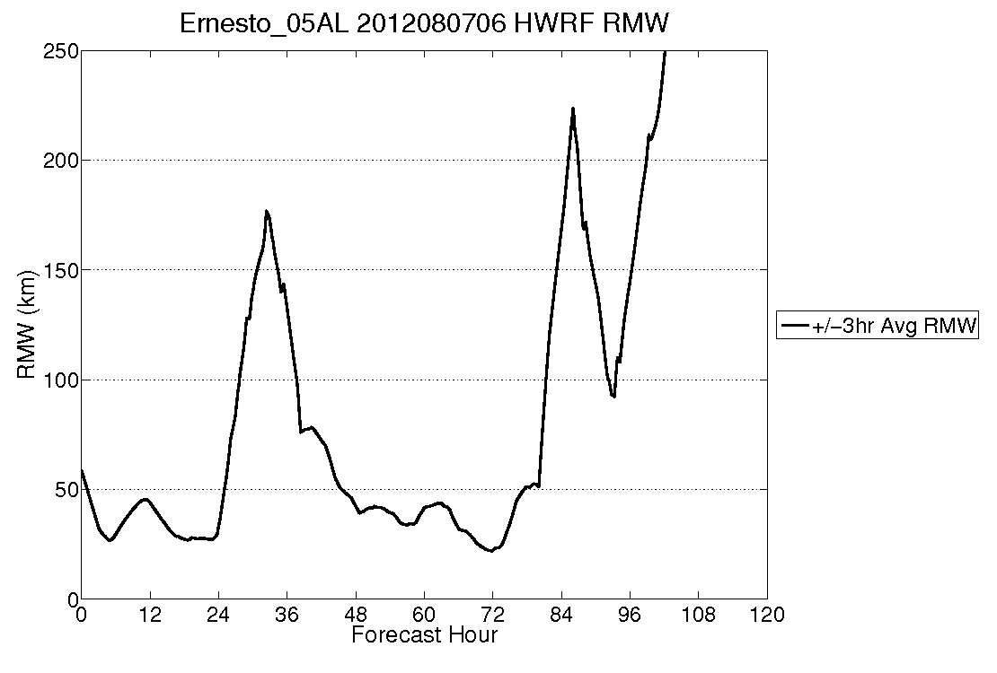
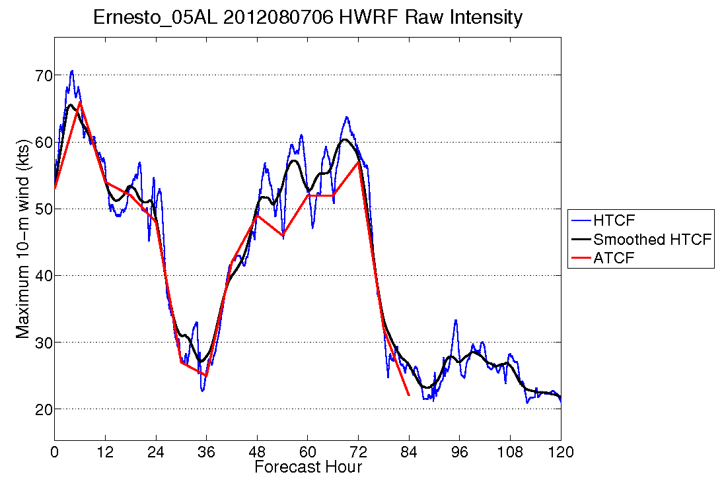
6.1.3 Provide real-time high temporal resolution HWRF track/intensity/structure diagnostic products to NHC forecasters. Extend products to other regional models as data is made available.
HWRF products were delivered beginning June 1.
All products available in real time through NHC’s intranet.
Products also available on the HFIP website.
AHW4 and UWN8 are also providing data; all products are currently available on the NHC intranet, and will be added soon to the HFIP website

Slide 5
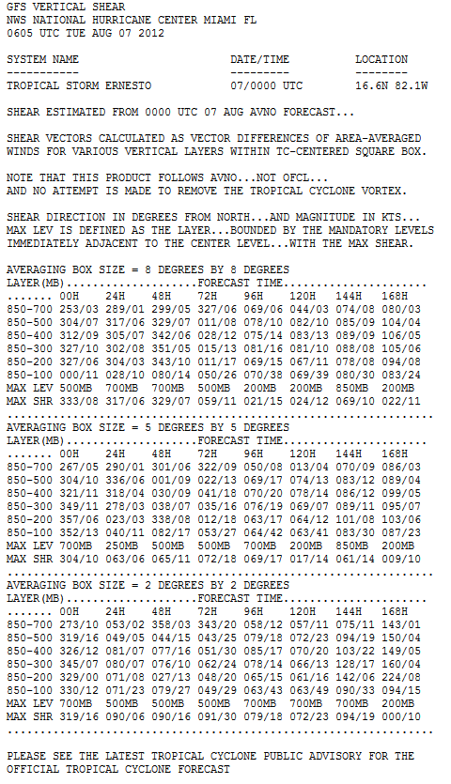
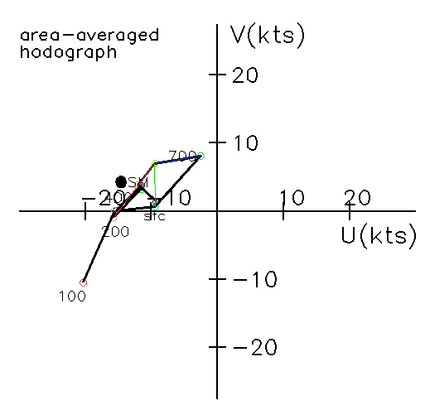
6.1.4 Develop experimental vertical shear text diagnostic product for various layers within select operational global and regional models.
Prototype for the GFS is currently running in real time, and is actively used by forecasters.
Accompanying graphics have been developed.
  Multi-layer streamline analysis
  Hodograph
Product also being developed for the ECMWF, and eventually the HWRF and GFDL.

Slide 6
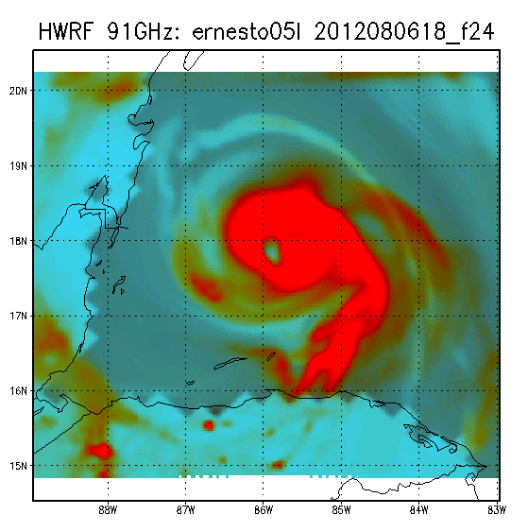

6.1.5 Conduct a TC structure verification study comparing regional model simulated satellite/radar with satellite observations. (Ongoing, preliminary results in late August or early September.)
Evaluating operational HWRF structure by verifying synthetic satellite microwave imagery against real satellite observations.
Utilizes color composites to minimize the impacts of resolution, assumptions in the BT generation, and instrument differences.
Verification done by quantifying the presence of an eyewall (in tenths) and/or a primary band (using a Dvorak log-10 spiral) in 24, 48, and 72 hour forecasts, against the closest available satellite pass.

Slide 7
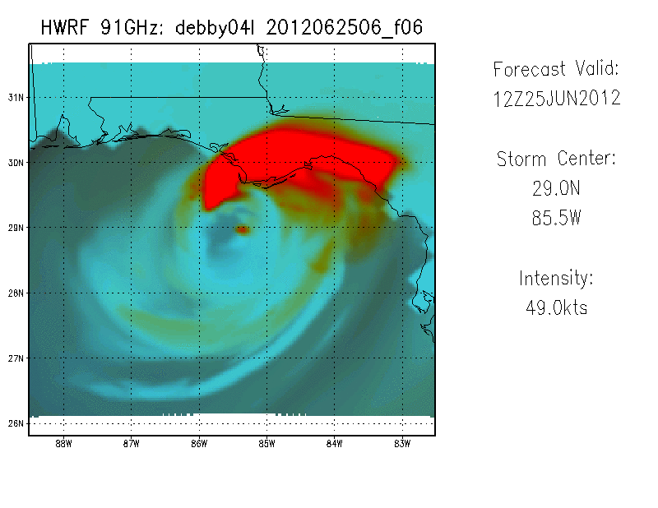
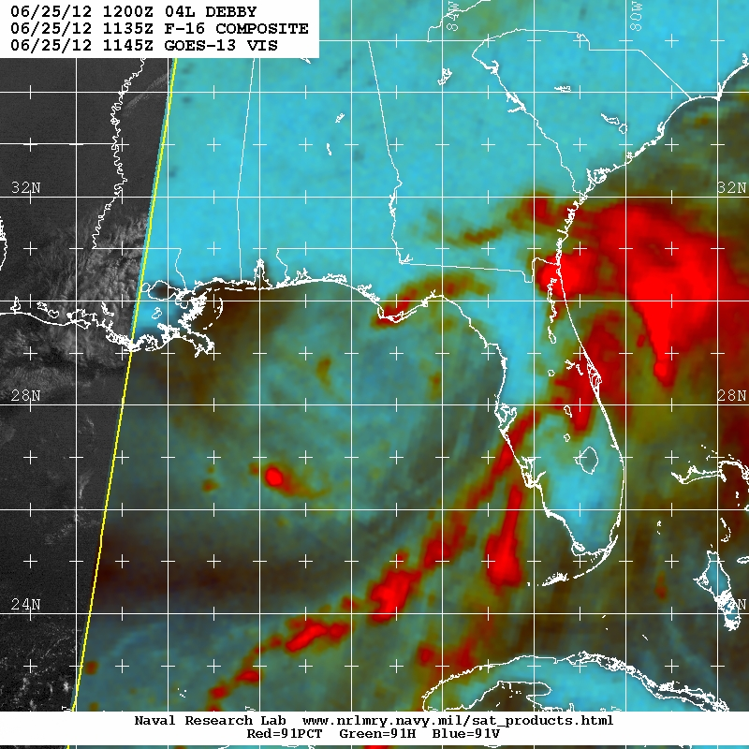
Sample Forecast: Debby HWRF forecast (above) and observed microwave images (right)

Slide 8
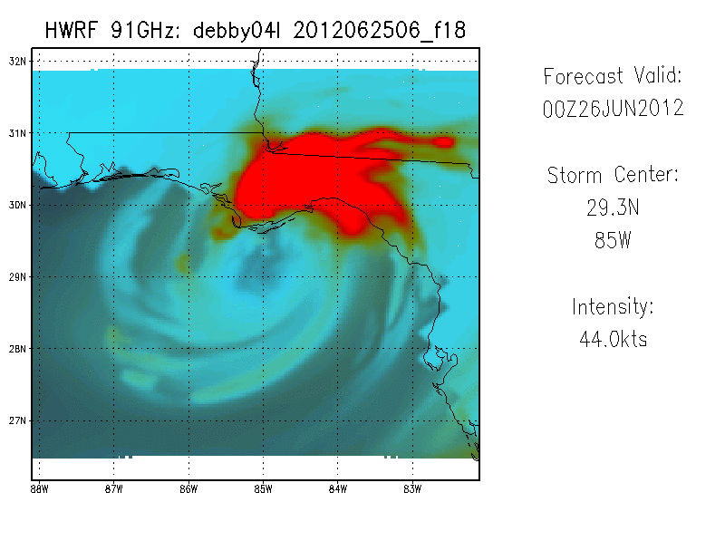
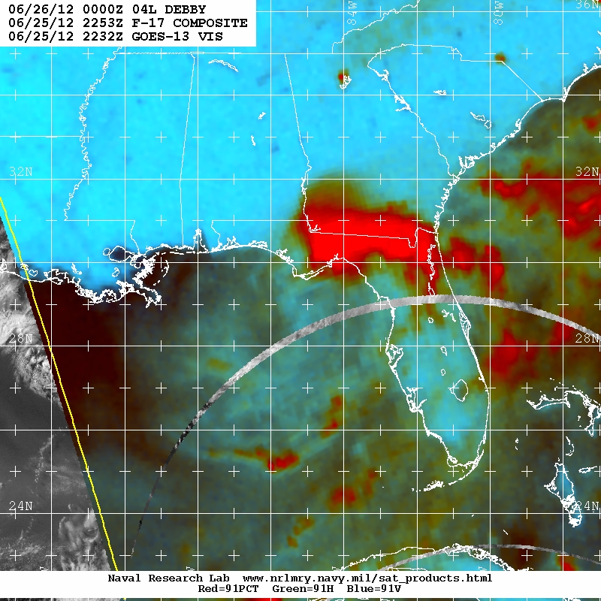
Sample Forecast: Debby HWRF forecast (above) and observed microwave images (right)

Slide 9
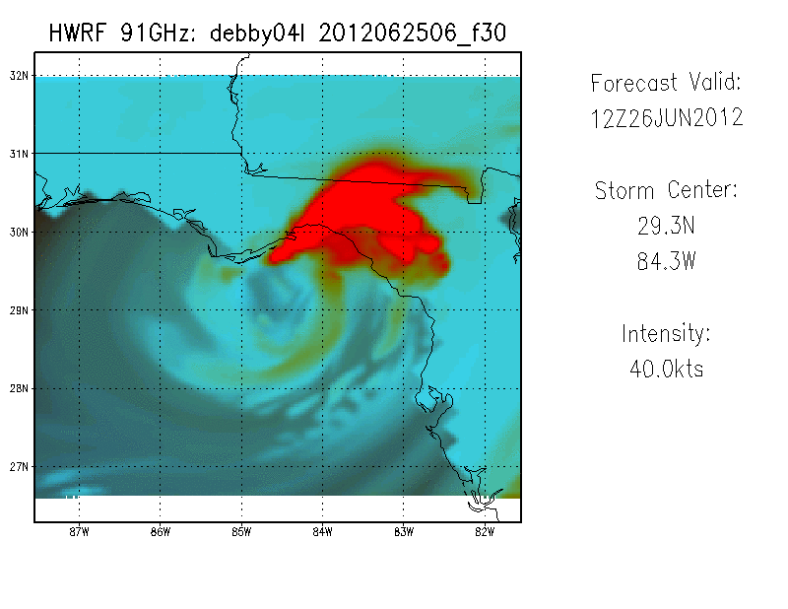
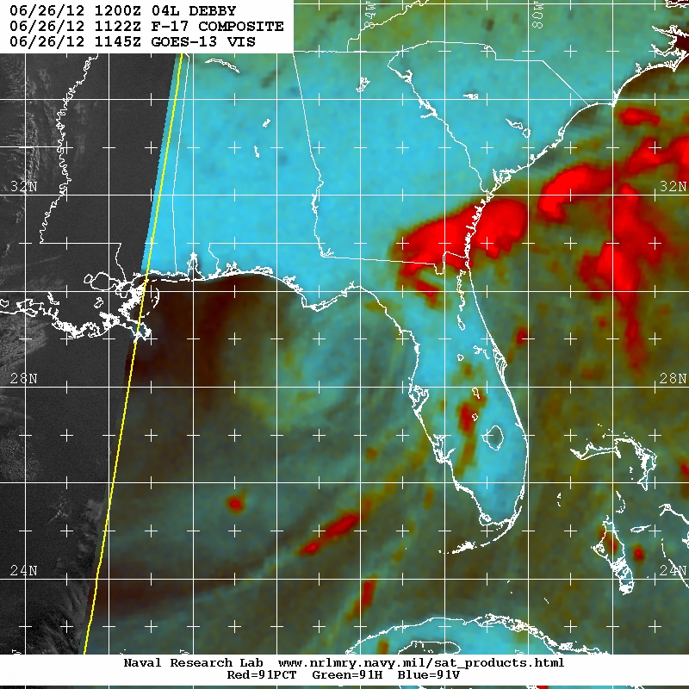
Sample Forecast: Debby HWRF forecast (above) and observed microwave images (right)

Slide 10
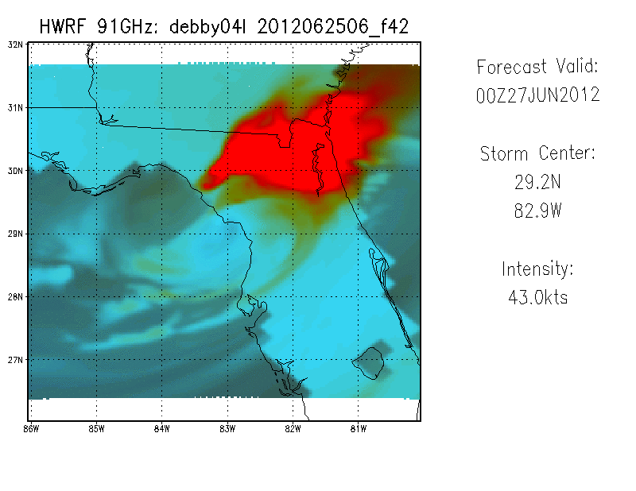
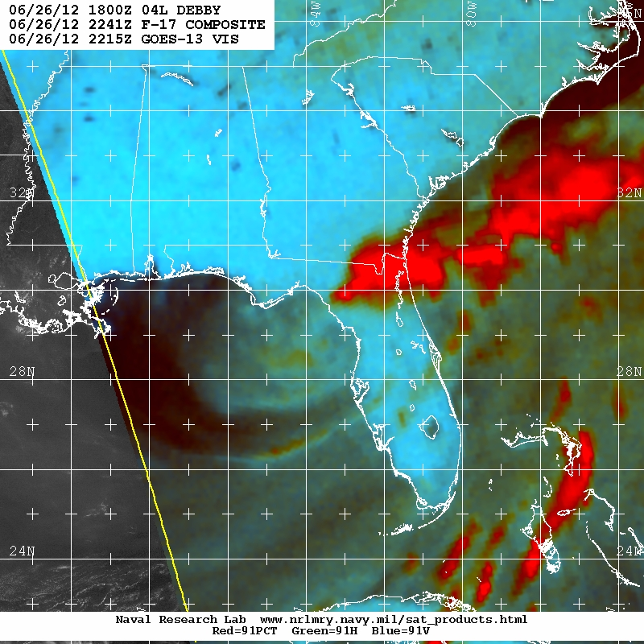
Sample Forecast: Debby HWRF forecast (above) and observed microwave images (right)

Slide 11
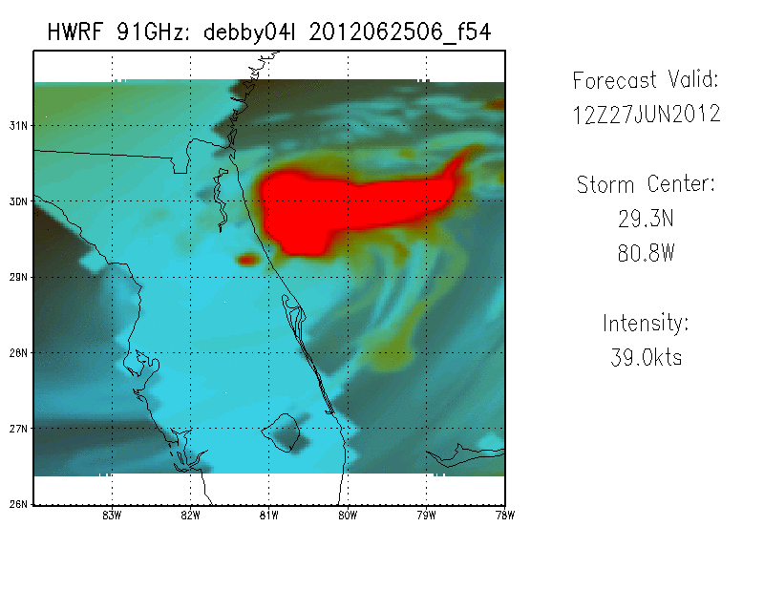
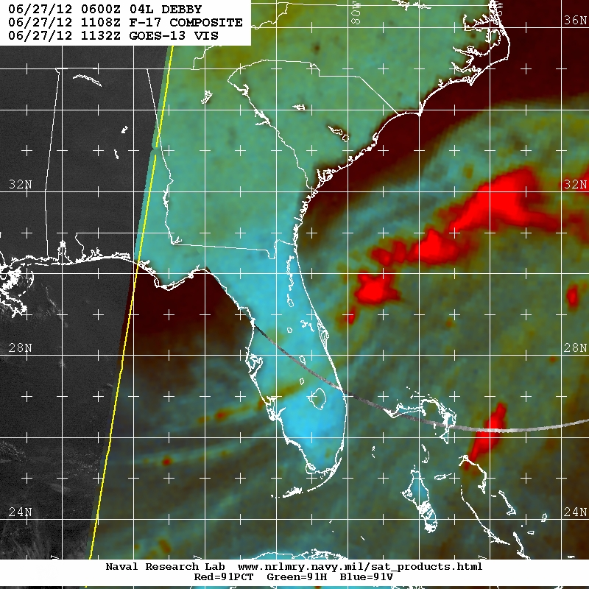
Sample Forecast: Debby HWRF forecast (above) and observed microwave images (right)

Slide 12
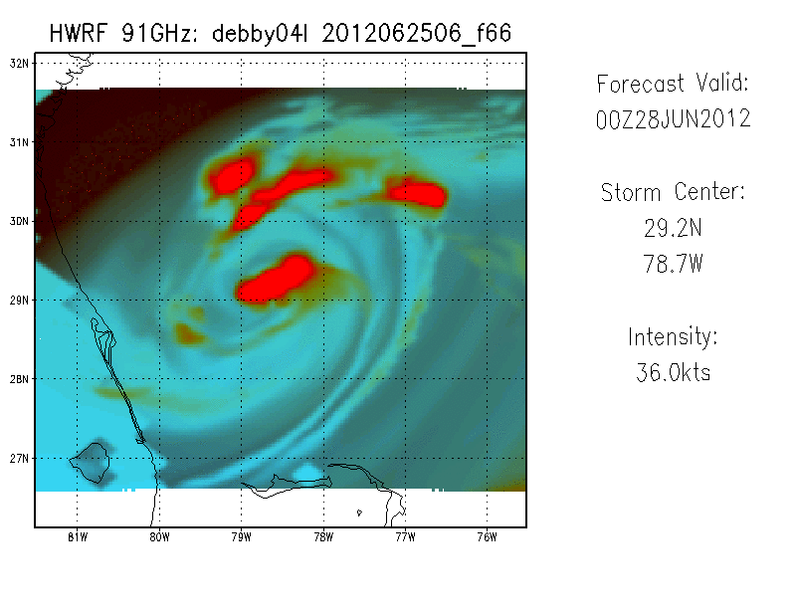
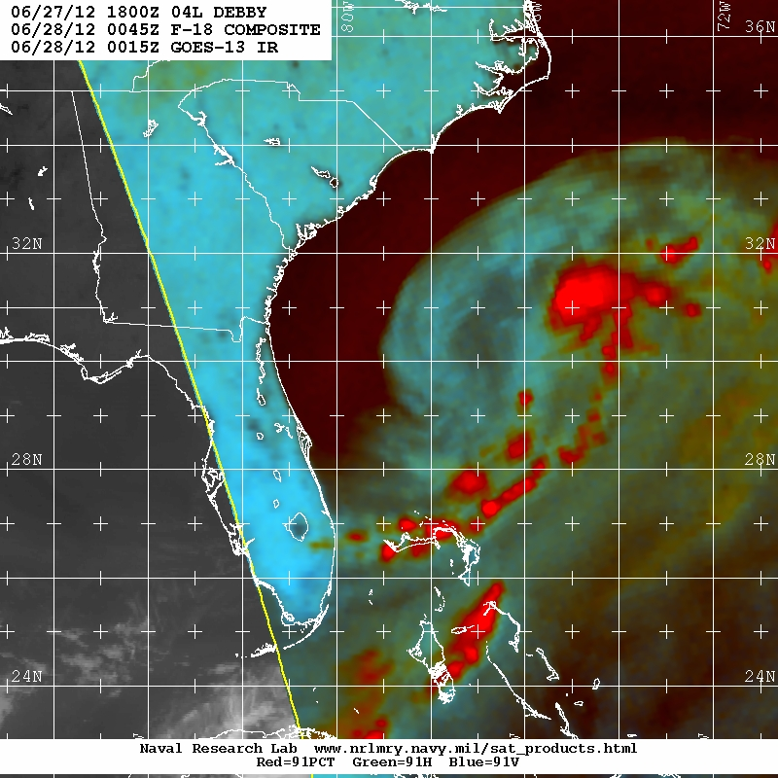
Sample Forecast: Debby HWRF forecast (above) and observed microwave images (right)

Slide 13
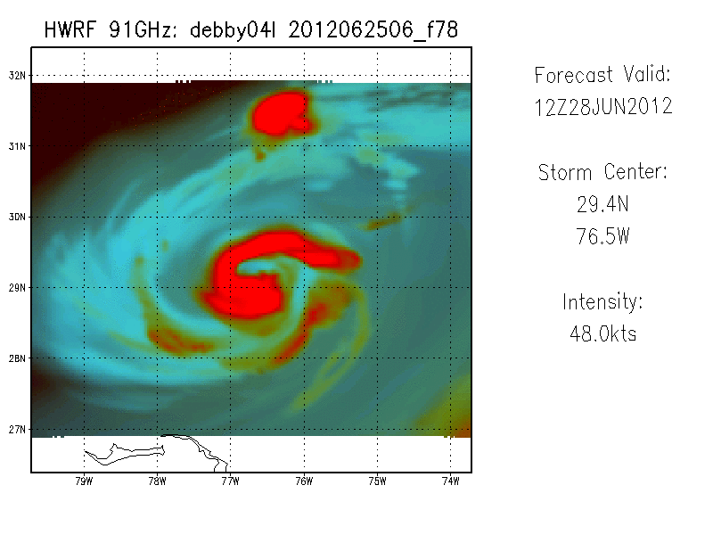
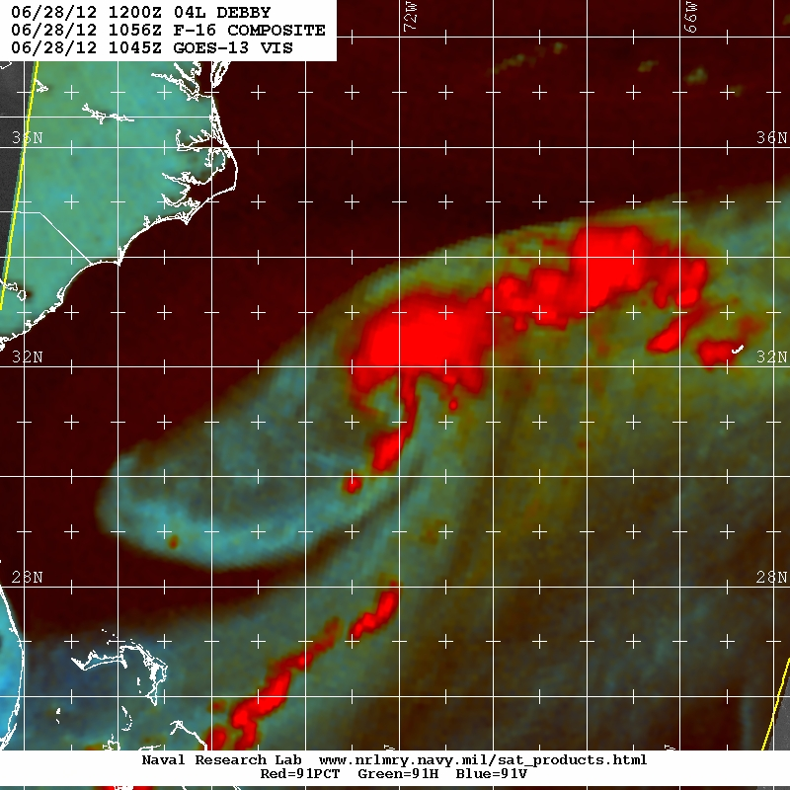
Sample Forecast: Debby HWRF forecast (above) and observed microwave images (right)

Slide 14
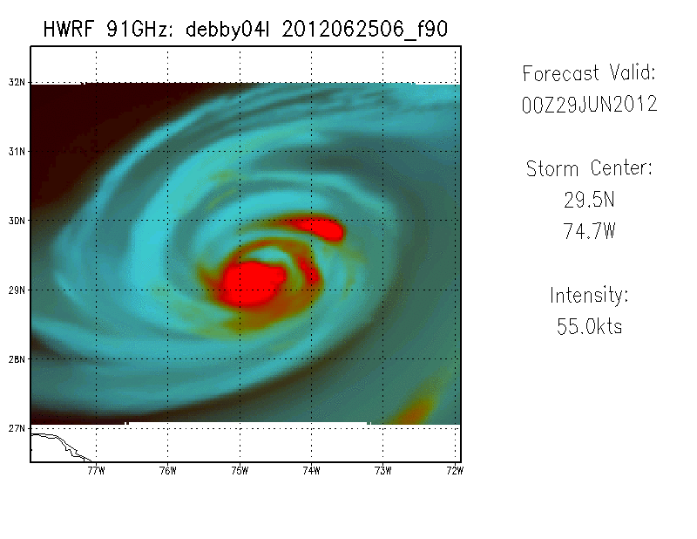
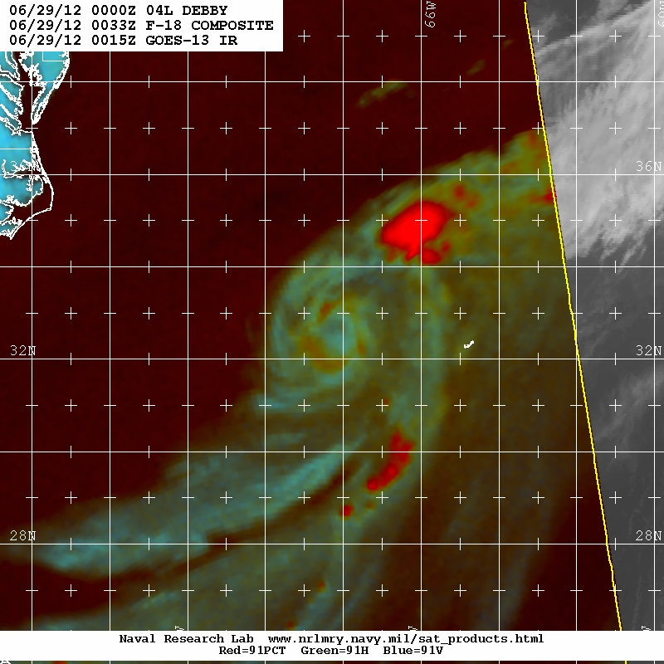
Sample Forecast: Debby HWRF forecast (above) and observed microwave images (right)

Slide 15
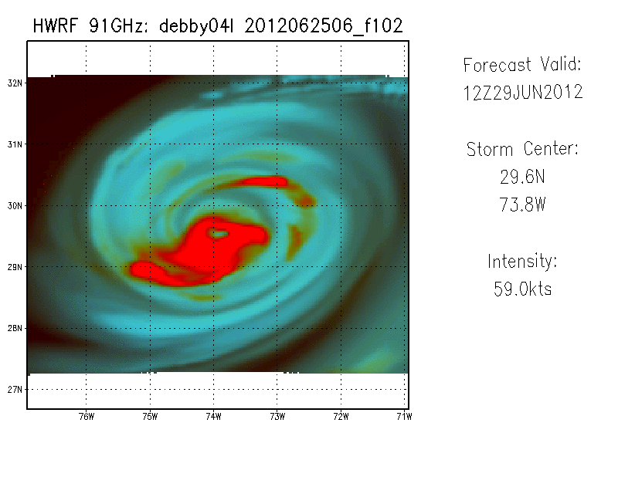
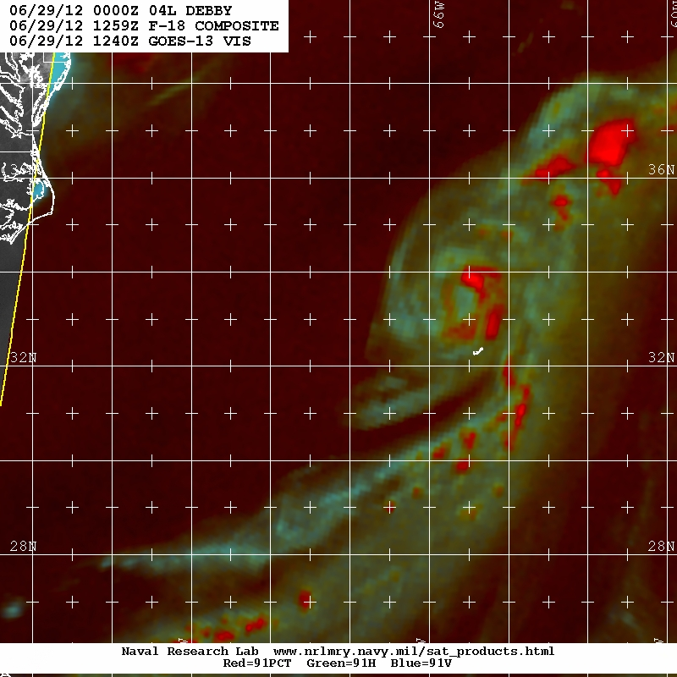
Sample Forecast: Debby HWRF forecast (above) and observed microwave images (right)

Slide 16
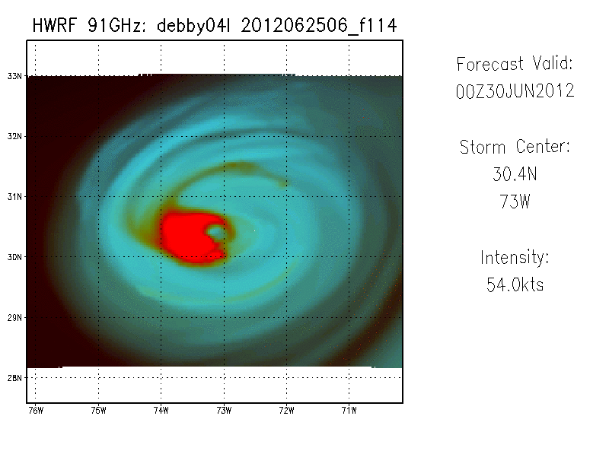
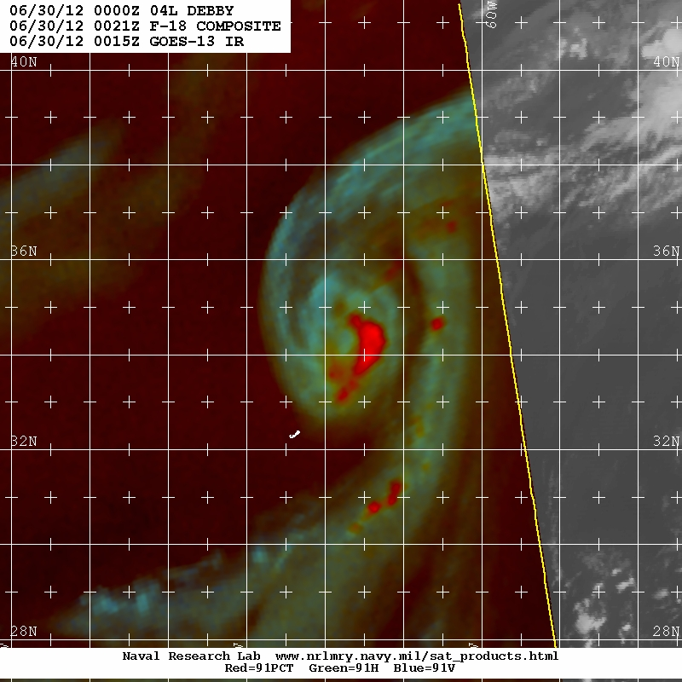
Sample Forecast: Debby HWRF forecast (above) and observed microwave images (right)

Slide 17
NHC Plans
Continue to develop and expand the shear diagnostic text product and accompanying graphical products
Continue HWRF structure verification using synthetic satellite data and present results at the HFIP annual meeting

Slide 18
NHC Needs: HSU Wish List (Part 1)
*** Green = Item is being addressed; Red = not addressed ***
Shear analysis for forecaster-specified layers (6.1.4)
User-selectable vertical cross sections of any field or combination of fields (Addressed internally)
Genesis probabilities derived from ensemble forecasts of global ensembles and possibly high resolution pre-TC models (Tim Marchok’s HFIP product)
a) Magnitude and location of maximum 1-minute sustained 10m wind speed for each minute through integration for operations and diagnostics (6.1.3)
b) Full wind field at hourly intervals; radius of 34, 50, 64 kt winds in each quadrant at hourly intervals (some groups produce surface data at hourly intervals, but 3D fields too computationally expensive)
Probability distribution of intensity change for ensembles, multi-model or single model, including RI (6.1.11 or 6.1.13?)
Guidance to NHC operations on the best locations for additional observations, eg supplemental soundings, G-IV dropsondes, C-130 data. (6.1.11)
Ensemble-based probabilistic guidance for track, intensity, wind structure, storm surge, rainfall, wind speed probabilities, and new products identified during the HFIP process. (6.1.9 ; Many of these currently, or soon to be available on HFIP website)

Slide 19
NHC Needs: HSU Wish List (Part 2)
Structural analyses using the mass and motion forecast fields to help diagnose tropical, subtropical, and extratropical stages (e.g. phase space). (Partially addressed by Bob Hart’s Phase Space Diagrams for the GFS. HSU requests the expansion of this methodology to other models, and the development of additional products for diagnosing cyclone structure)
Capability to make model comparisons (contemporary and sequential runs of any combination of models) (Ability coming in AWIPS2)
Global model tropical cyclone formation index/indicator and verification methods. (JHT project to address this)
Simulated radar/microwave imagery (6.1.2 and 6.1.5)
Center locations at multiple vertical levels and depiction of vertical coherence (Addressed in part by vertical cross sections)
Ensemble mean track (6.1.1, 6.1.6, and HFIP website)
Surface mapping of accumulated forecast rainfall (already available for operational models internally)

