Slide 1
Analysis of Model ICs
Wallace Hogsett, NHC

Slide 2
Introduction
Part I: Overview of the NHC model diagnostics effort
I will discuss what NHC is doing and where we’re going.
Examples of model vortex structure diagnostics for 2010 storms.
Toward the next level of model analysis. More than P_{min} and V_{max}.
Part II: Results
By comparing the initial near-surface and vertical vortex structures among GFS/GFDL/HWRF/H*wind/P3radar, we can learn some things about the various model initializations.

Slide 3
Part I: NHC Diagnostics
NHC has developed and is running a real-time diagnostic system.
The system processes operational model data, primarily at t = 0, and creates inter-model comparisons of vortex structure.
Output are figures used to compare the vortex structure.
HPLOT is operational at NHC and may serve as foundation for future operational diagnostic products.
More to come on this in the coming year…

Slide 4
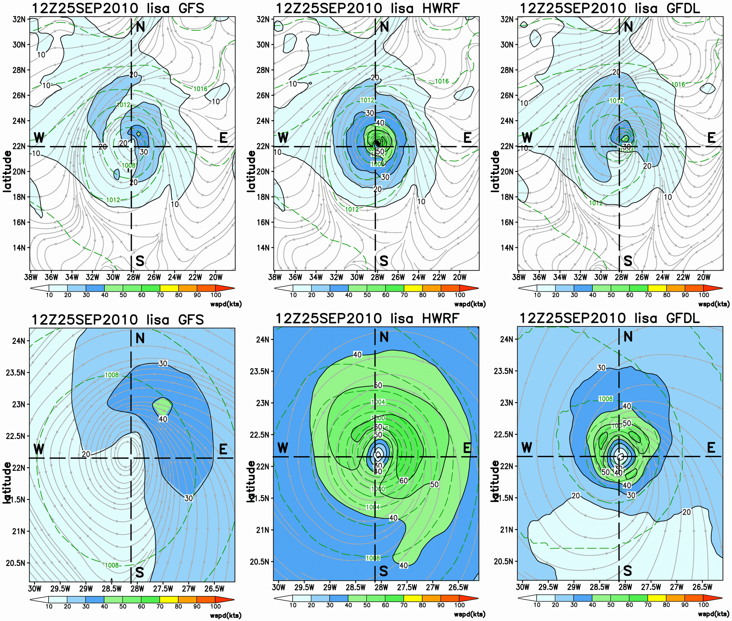
Example real-time output: Lisa (2010)
Parent grid
(lg scale)
Nested grid
(vortex scale)
Above: Near-surface wind field (shaded, kts) for the large-scale (top panel) and vortex-scale (bottom panel) structure of Lisa.

Slide 5
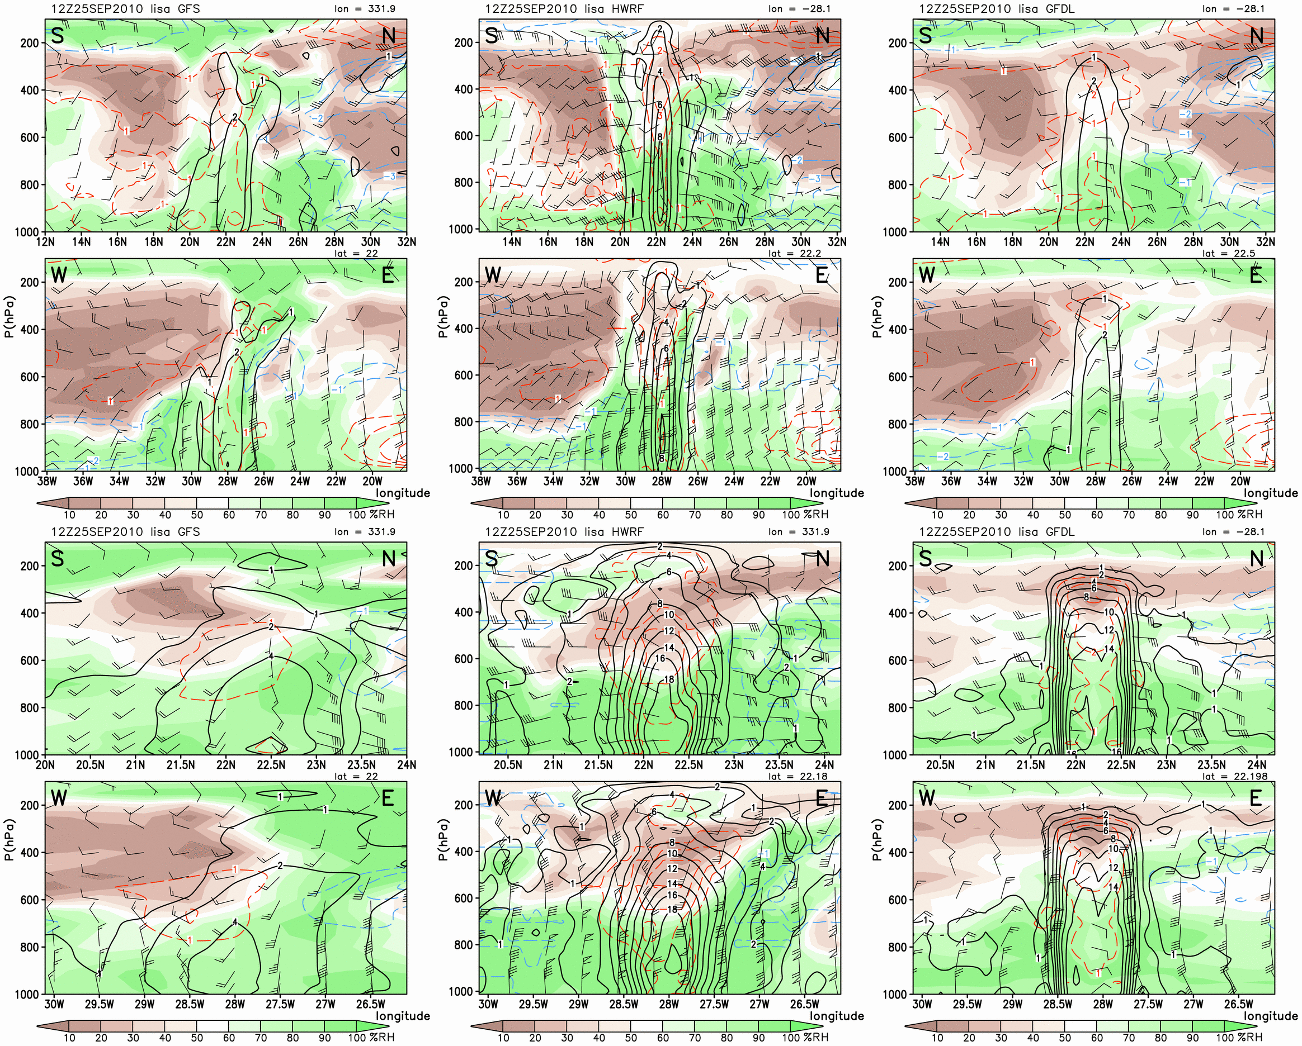
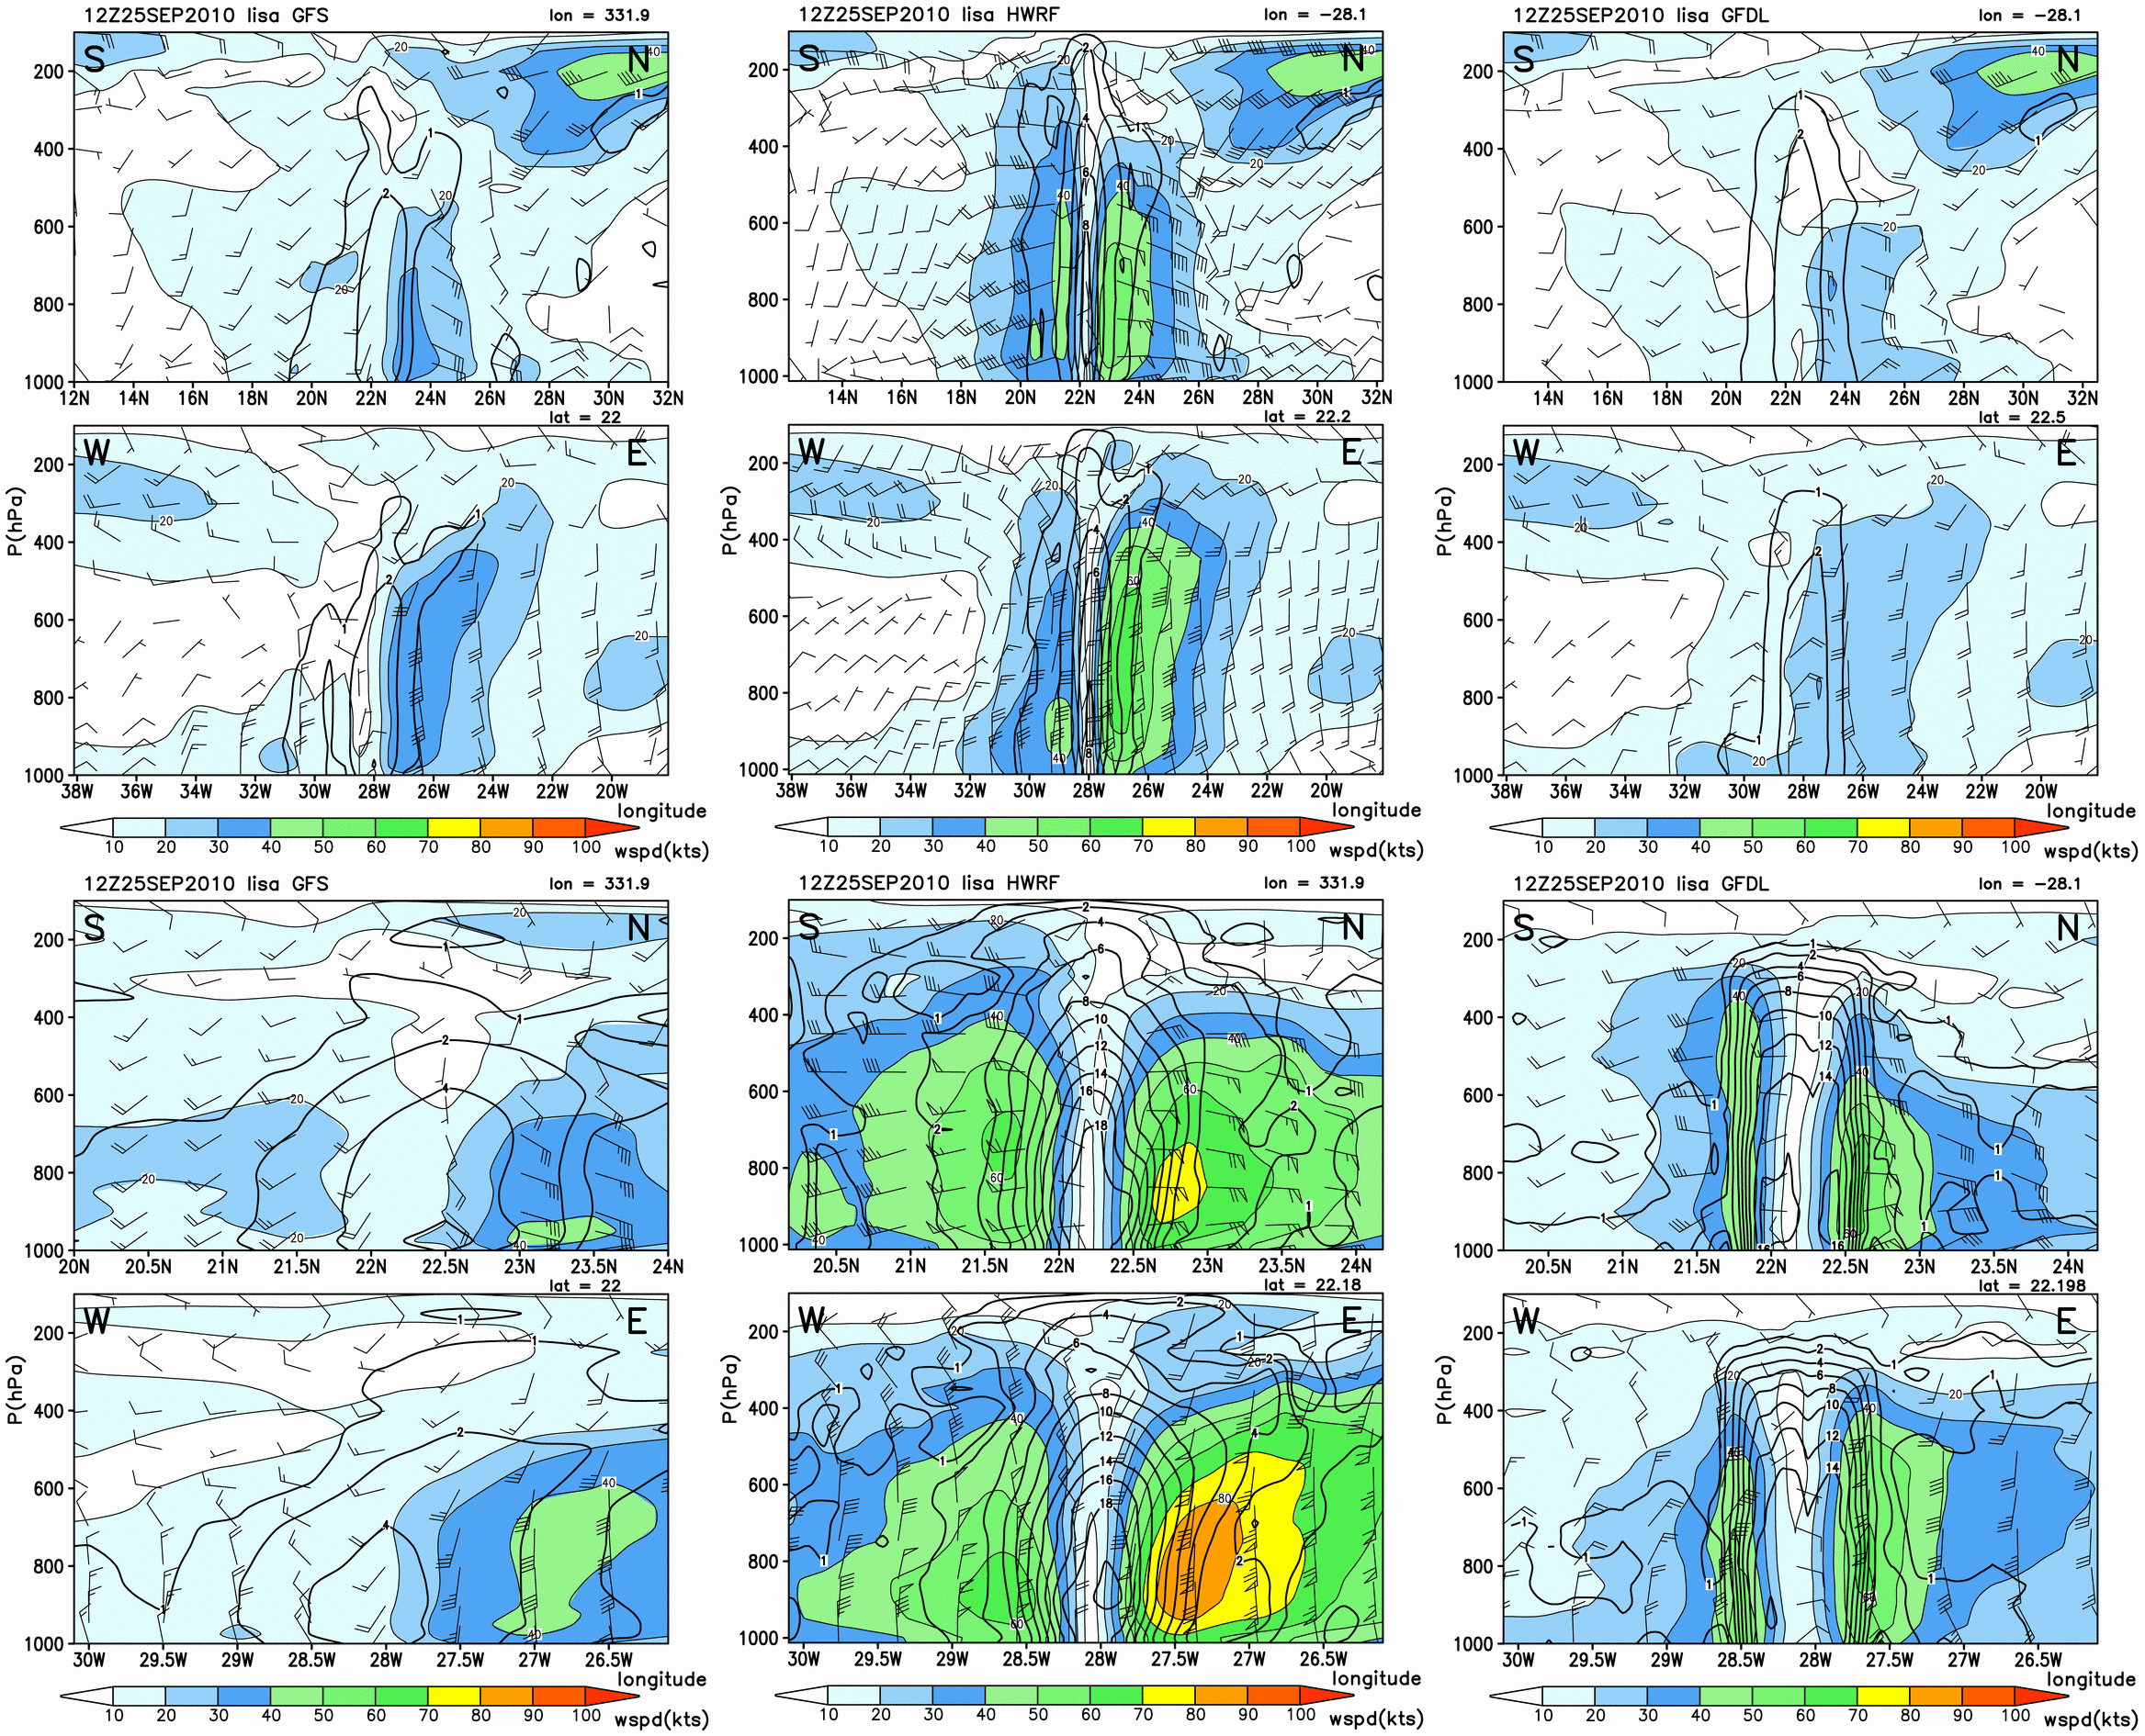
Example real-time output: Lisa (2010)
RH (shaded)
T’
Above: South-north (top) and west-east (bottom) vertical cross sections of wind speed (shaded, kts), horizontal wind barbs (kts), and vertical vorticity (contoured, x 10⁻⁴ s⁻¹) taken through the center of the GFS (left), HWRF nest (middle), and GFDL nest (right) initial conditions.

Slide 6
Part I Summary
NHC has developed and is running a real-time diagnostic system.
Initial vortex structure is the primary focus
All products are archived throughout the season
More to come on HPLOT, which essentially is a GUI for GFDL/HWRF data...

Slide 7
Part II: Results using diagnostic output
Now I’m going to use these GFS, GFDL, and HWRF products to look at various storms of interest and show how the model ICs compare to available observations.
Here I choose several cases from 2010, and compare the inner-core vortex structure on the finest grid possible.

Slide 8
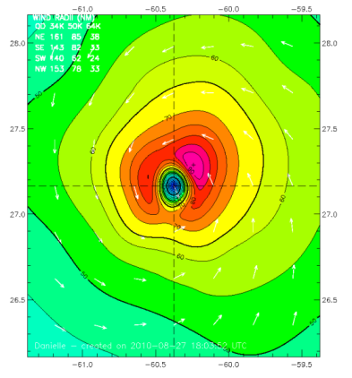
Intensifying Danielle (965mb) – Variety in the ICs
R_{70kt} winds
Danielle ICs (near-sfc wspd) -27 Aug 00Z
HWind
GFS HWRF GFDL
Above: near-surface winds (shaded, kts), streamlines, and surface pressure (green dashed, hPa) from the GFS (left) and HWRF inner nest (center), and GFDL inner nest (right) ICs.
HWRF wind field is too large vs Hwind (GFDL also too large).
RMW = 37km, r50kt = 167,111,93,139km
**Note, Hwind figure is scaled for direct comparison with other figures; however color scale is slightly (5kts) different.

Slide 9
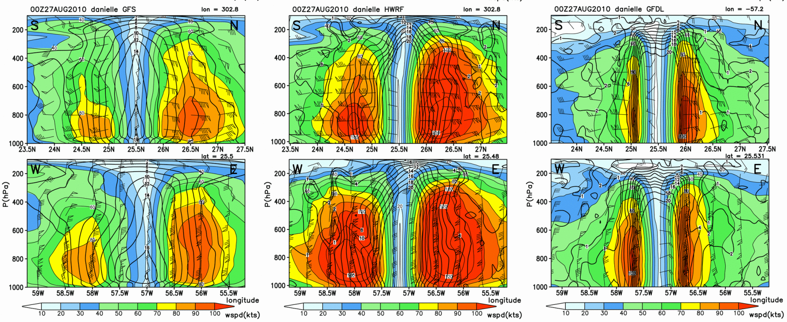
Intensifying Danielle - Vertical Structure
Danielle IC -27 Aug 00Z
GFS HWRF GFDL
GFDL shows a much more compact vortex.
HWRF vortex is very broad.
No observations of this structure.
Above: South-north (top) and west-east (bottom) vertical cross sections of wind speed (shaded, kts), horizontal wind barbs (kts), and vertical vorticity (contoured, x 10⁻⁴ s⁻¹) taken through the center of the GFS (left), HWRF nest (middle), and GFDL nest (right) initial conditions.
Notes:
Now if we move to the vertical structure of this wind field, again the HWRF is much more broad.

Slide 10
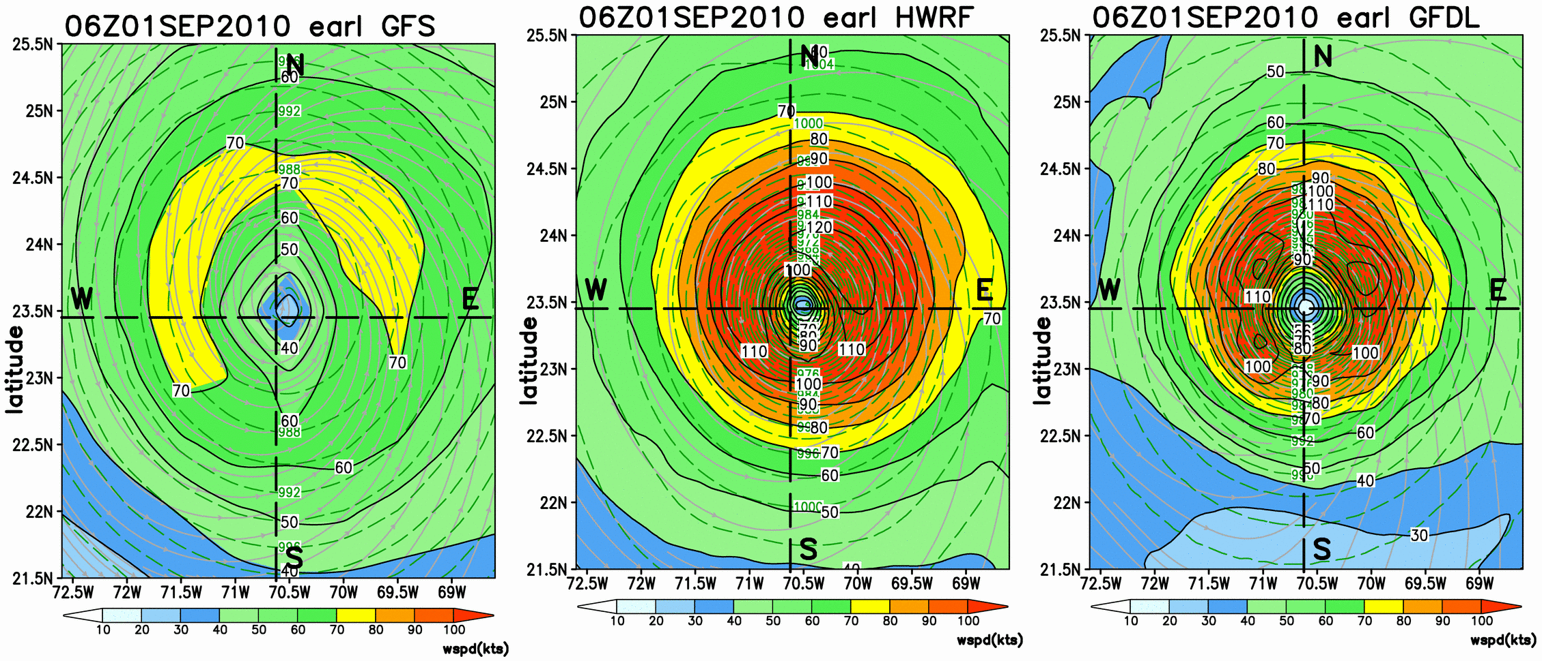
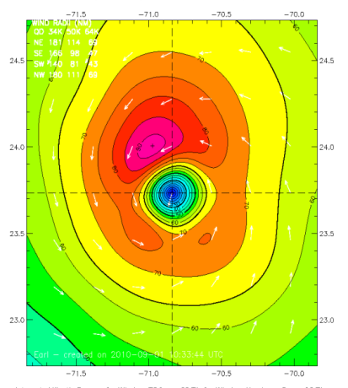
Earl – Strong Hurricane Maintains Intensity
Earl IC - 1 Sep 06Z
HWind
GFS HWRF GFDL
GFS HWRF GFDL
GFDL and HWRF again appear similar, with HWRF exhibiting a slightly larger wind field.
Compared to the GFS (left), HWRF and GFDL correct the RMW and Vmax well.
RMW = 37km, r50km = 222, 222, 139, 167km

Slide 11
Earl: Different Vertical Structures
Earl IC - 1 Sep 06Z
GFS HWRF GFDL
Though similar in the horizontal, HWRF exhibits a stronger wind field aloft.
- HWRF is broader and Vmax is 20kts higher than GFDL.
An obvious question is: Which is more representative of the real wind field?
Notes:
In the vertical, the HWRF has a broader and stronger vortex. So the big question is which is correct?

Slide 12
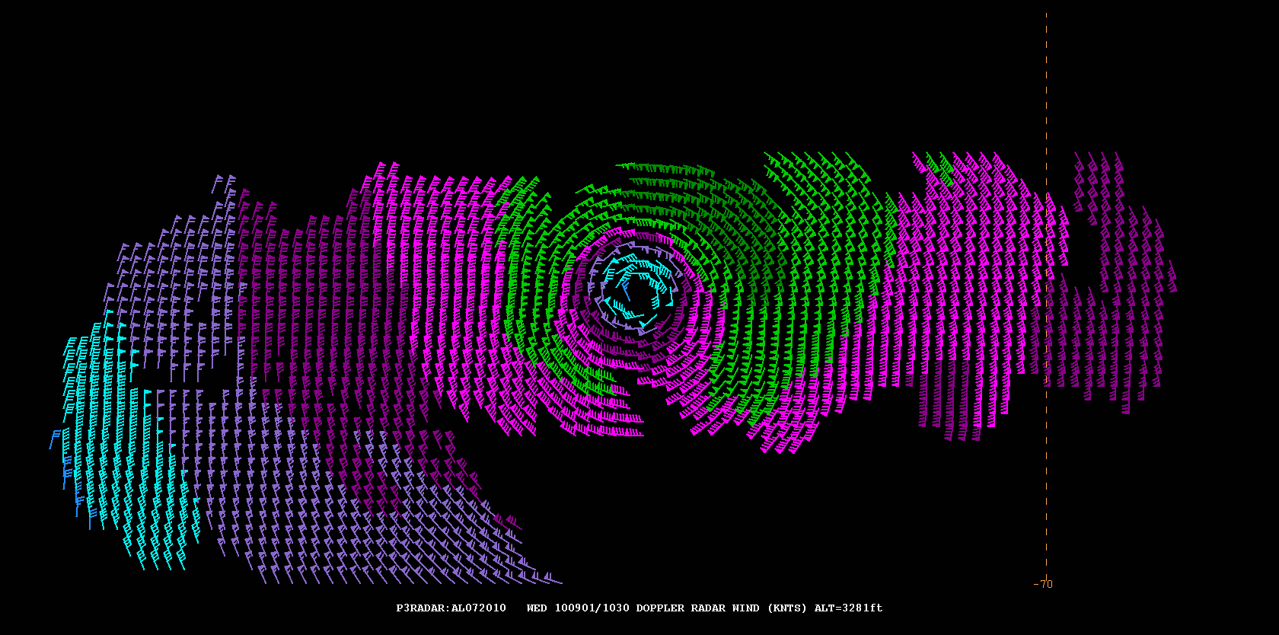
Earl #2: P3 Radar Validation
Earl IC - 1 Sep 06Z
400km
~70kt
~90kt
winds at r=100km
GFS HWRF GFDL
P3 winds (at z = 1km) suggest that 100kt winds extend only 50km (70km) to the west (east).
Thus, the more compact wind field (i.e., GFDL) is most representative of the observed Earl (at least at this time).
**note: observation time is 4hrs later than model analysis time on previous slide.
Notes:
Well, we have a swath of P3 radar winds… These data show that the 100kt winds extend less than 100km

Slide 13
Part II: Prelim. Conclusions
Significant vortex-scale differences exist in the various models’ ICs.
HWRF sometimes exhibits a wind field that is larger than observed. Spin-down of the winds may be related to a balance adjustment of the ICs.
To correct the spin-down issue, the storm size must be better constrained by available data (e.g. 34kt radii, ROCI, etc.)
Next steps… ADD team moving toward unified diagnostics framework.

