Slide 1
HURRICANE DIAGNOSTICS
T.N. Krishnamurti
Mrinal Biswas, Anu Simon, A. Thomas

Slide 2
ERROS IN THE CONVECTIVE HEATING IN HWRF

Slide 3
9mn forecast – Hurricane Celia 2010 – 18z 22 June
Inner Domain res ~ 9Km

Slide 5
WIND PRESSURE RELATIONSHIP

Slide 6
KATRINA 2005
Model Run at 1.33km

Slide 12
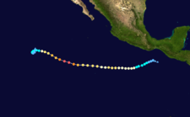
Meteorological history
Storm path
Hurricane Celia (2010)
19-29 JUN
MAX WIND (MPH) 160

Slide 13
Post processing of Hurricane Ensemble Forecasts
T. N. Krishnamurti and Mrinal K Biswas
28 September 2010

Slide 14
Model Descriptions for Mesoscale Models for ensemble forecasts
Models | Nesting Horizontal resolution (km) | Vertical levels | Cumulus Parameterization | Microphysics | PBL | Land Surface | Radiation | Initial and boundary conditions | Initialization
HWRF | 2 27/9 | 43 | Simplified Arakawa Schubert | Ferrier | GFS Non-Local PBL | GFDL Slab Model | Schwarzkopf and Fels (1991) (longwave) / Lacis and Hansen (1974) (shortwave) | GFS | Advanced vortex initialization that uses GSI 3D-var assimilation of Doppler radar data to run in development parallel.
HWRF | 2 13.5/4.5 | 42 | Simplified Arakawa Schubert | Ferrier | GFS Non-Local PBL | GFDL Slab Model |  | GFS
HWRF-X HRD version of HWRF | 2 9/3 | 42 | Simplified Arakawa Schubert | Ferrier | GFS scheme | NCEP LSM | RRTM (longwave) / Dudhia (shortwave) | GFS | HWRF
WRF ARW (NCAR) | 2 12/4 | 36 | New Kain Fritsch (12 km only) | WSM5 | YSU | 5-layer thermal diffusion soil model | RRTM (longwave) / Dudhia (shortwave) | GFS | EnKF method in a 6-hour cycling mode
COAMPS-TC | 3 45/15/5 (15/5 km following the storm) | 40 | Kain Fritsch | Explicit microphysics (5 class bulk scheme) | Navy 1.5 order closure | Force and restore slab land surface model | Harshvardardet et al. (1987) | NOGAPS | 3D-Var data assimilation with synthetic observations
GFDL | 3 30/15/7.5 | 42 | Arakawa Schubert | Ferrier | GFS Non-Local PBL | Slab Model | Schwarz-kopf-Fels scheme | GFS | GFDL synthetic bogus vortex
WRF ARW | 2 12/4 | 27 | Simplified Arakawa Schubert | WSM5 | YSU | 5-layer thermal diffusion soil model | RRTM (longwave) / Dudhia (shortwave) | GFS (initial and boundary condition) | GFS

Slide 15
Correlation based model ensembles
Observed increment values (Lat, Lon, Int) for each lead time
Model increment forecasts (Lat, Lon, Int) for each lead time
Correlation coefficients for each model for Lat, Lon, Int at each lead time
Training phase
2008 and 2009 storm cases (Total 164 cases)
The storm to be forecasted is taken out (if it is in the training period) to calculate the correlation coefficients
Normalize the coefficients using available member models for Lat, Lon, Int at each lead time
Utilize the above coefficients during the forecast phase and construct a new forecast

Slide 16
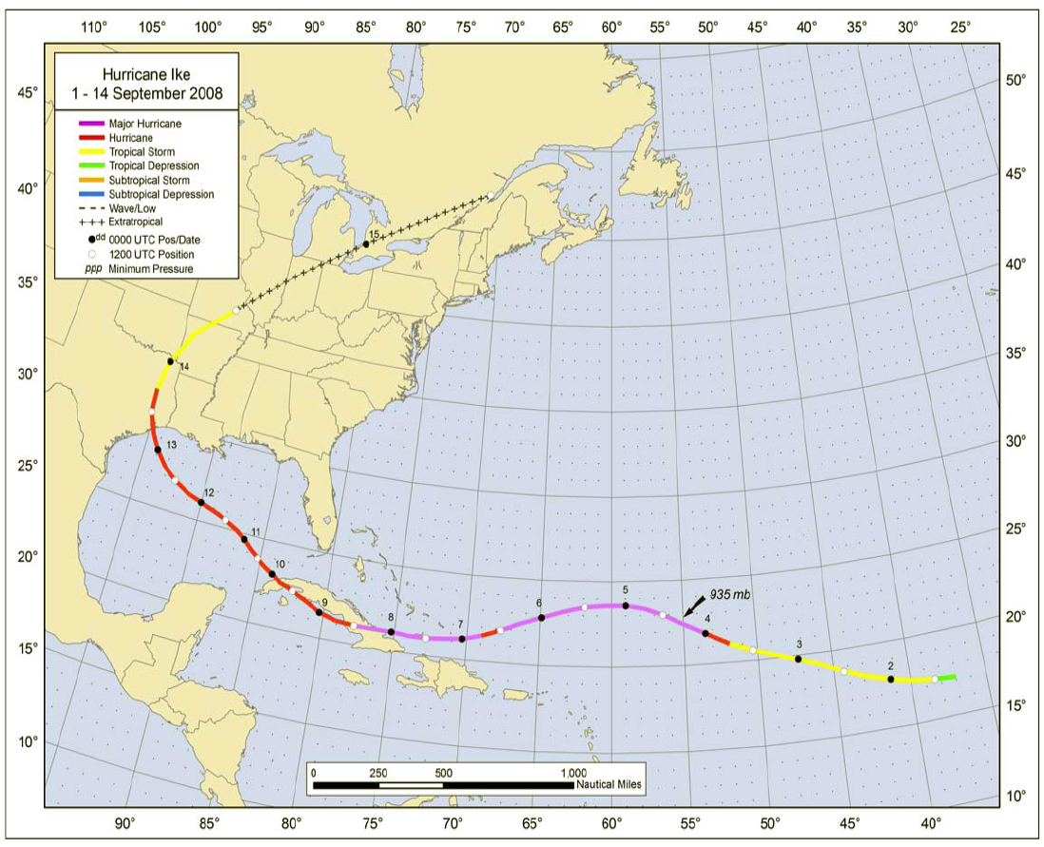
Hurricane Ike (2008)
Sep 1-14

Slide 17
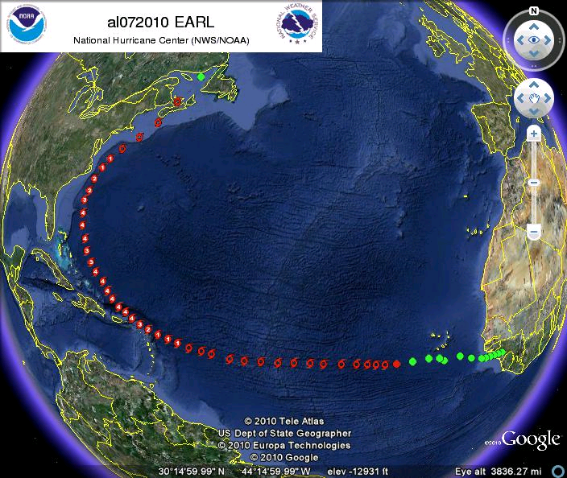
Hurricane Earl (2010)
(22 Aug-5 Sep)

Slide 18
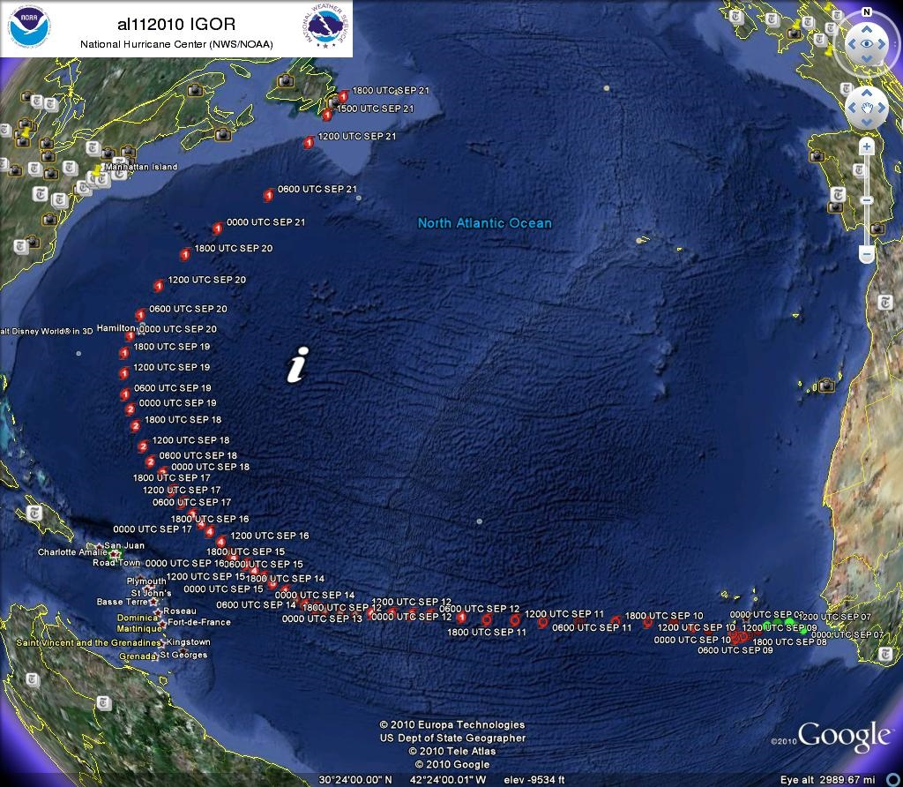
Hurricane Igor (2010)
(Sep 7-21)

Slide 19
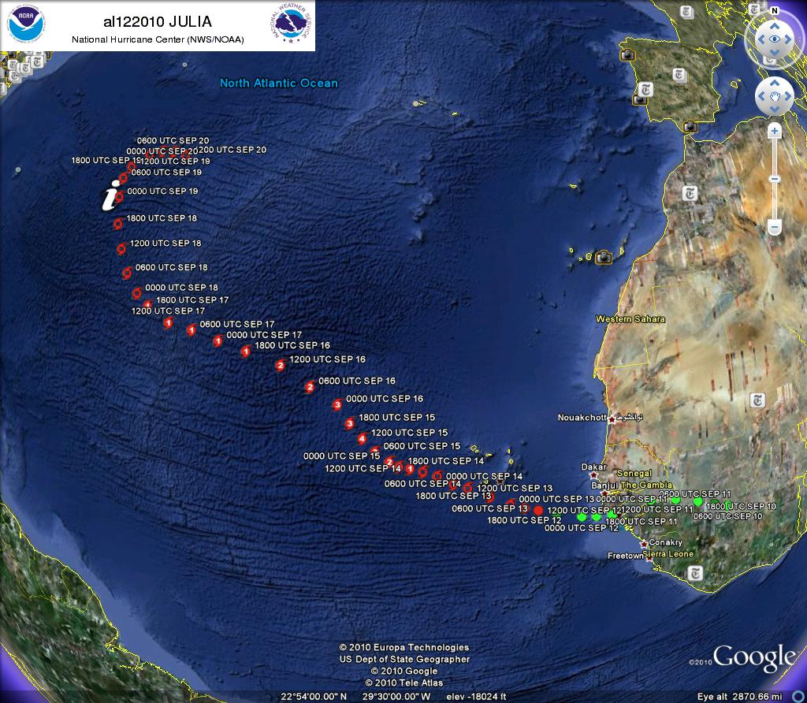
Hurricane Julia (2010)
(Sep 9-24)

