Slide 1
Summary of HFIP Application Development and Diagnostics Team
Mark DeMaria
NESDIS/StAR/RAMMB
Advanced Diagnostics for Hurricane
Models Workshop
NCEP/EMC September 28, 2010

Slide 2
Outline
Summary of ADD Team Plan
Schematic of model diagnostic system
Preliminary RAMMB/CIRA results from 2010
Possible ADD contributions to general diagnostic effort

Slide 3
The HFIP ADD Team
Primary tasks
  Advanced diagnostics to guide model improvements
  Post-processing to optimize use of HFIP advanced by operational forecast offices
Focus areas
  Regional and global models including ensembles
  Diagnostics from model output
  Comparisons with observations
    Atmosphere and ocean
    In situ and remotely sensed
  Environment, vortex and cloud scale
Agencies
  Co-leads Ed Rappaport and Mark DeMaria
  NHC, NESDIS/RAMMB, CIRA, ESRL, HRD, DTC, TCMT, NRL, EMC

Slide 4
Primary ADD Tasks in 2010
Relevant to Regional Models
NHC
  Defining stream 1.5
  Prototype forecaster products from HWRF, GFDL, GFDN
NESDIS/RAMMB and CIRA
  Large- and vortex-scale diagnostics for HWRF and GFDL
  Comparison of synthetic and real GOES data
  Ensemble products
ESRL
  Large scale diagnostics and products, global model emphasis
  ensemble methods, products and downscaling

Slide 5
Primary ADD Tasks in 2010
Relevant to Regional Models
HRD
  Large, vortex and convective scale diagnostics
  Comparison with radar and aircraft data
  Development of forward models for microwave imagery
    Emphasis on HWRFx
DTC and TCMT
  Collection and distribution of ATCF data for stream 1.5
  Collection and distribution of tier 2 and large-scale diagnostics files
NRL
  Diagnostics and products for COAMPS-TC and GFDN
  ATCF upgrades for HFIP
EMC
  Diagnostics and products for HWRF and GFDL
  Generation of synthetic GOES data from HWRF
  Upgrading the operational models

Slide 6
2010 HWRF Upgrades
Fixing known bugs in HWRF model (mostly related to radiation)
  Led to definition of new baseline configuration for HWRF
Improved initialization (Additional data in GSI near the storm environment)
Surface Physics Changes (Cd/Ch coefficients calculated based on observations)
Gravity Wave Drag Parameterization
Notes:
2010 Update from IHC (Vijay)
2009 Update
6

Slide 7
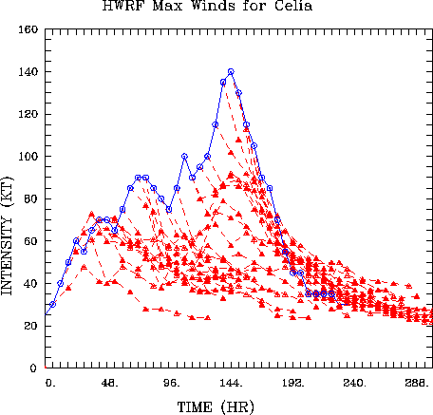
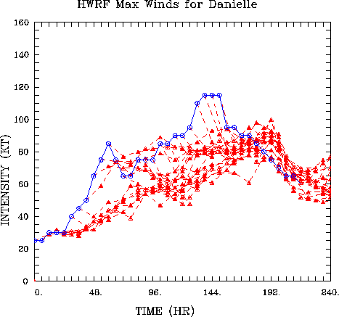
HWRF Forecasts for 2010 Hurricanes
Celia (EPAC) and Danielle (ATLC)

Slide 8
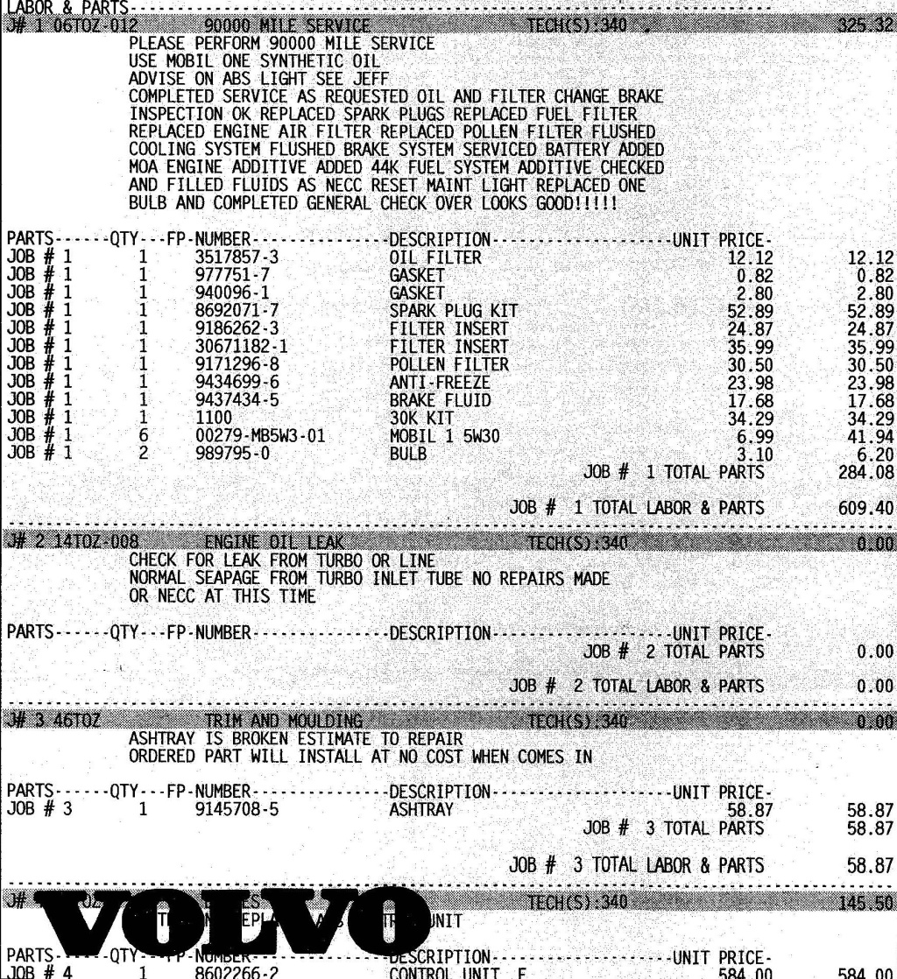
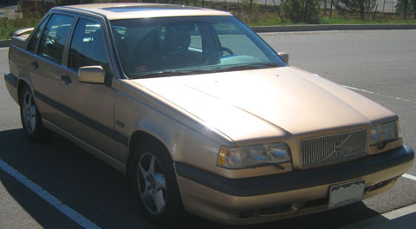
Automotive Diagnostics

Slide 9
Schematic of Advanced Model Diagnostics System
Selection of Sample and Tests
Read Model Forecasts
Routine Verification:
ATCF variables, Synthetic geo imagery, SST, Large-scale variables
Intermittent Verification:
Various model parameters
ATCF A-decks, Tier 2 data, Full model fields
ATCF B-Decks, GOES imagery, SST, verifying analyses
Aircraft data, radar, polar satellite data, in situ , ocean
Model Diagnostics
Simple to advanced
Verification and Diagnostic Reports

Slide 10
Possible ADD Contributions to the Diagnostic System
Verification Component
  Track and maximum wind errors and biases (best track)
  RMW, radii of 34, 50 and 64 kt winds (best track)
  Model-generated GOES IR brightness temperatures
  Precipitation (compare with radar, satellite, in situ)
  Convective statistics (radar)
  3-D vortex structure (radar, in situ)
  Ocean response (satellite, in situ)
Diagnostic Component
  Basic input to statistical models
    SST, vertical shear, vertical instability, MPI, steering layer
  Balanced model diagnostics
  Lorenz energetics
  Angular momentum budgets
  PV analysis

Slide 11
Synthetic Satellite Imagery
Use forecast model output as input to forward radiative transfer model
Simulated GOES imagery generated by EMC for HWRF and GFS
  Posted on HWRF web page
Simulated microwave imagery under development by HRD
  Examples available from HWRFx
CIRA project
  Collect real GOES data for comparison
  Put synthetic and real data in common projections
  Develop validation system

Slide 12
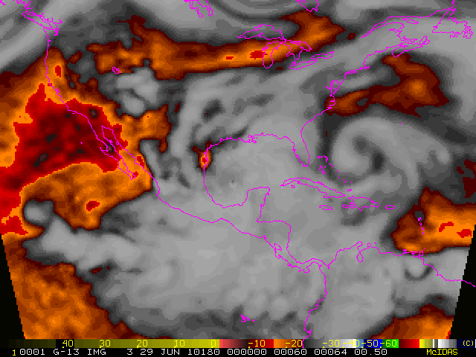
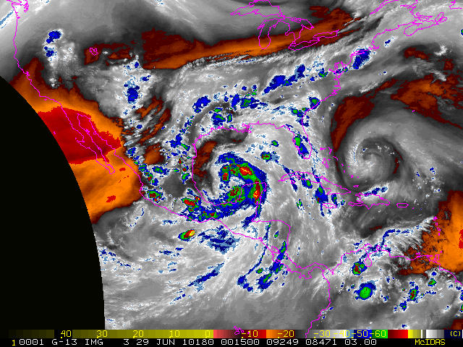
Synthetic and Real GOES WV
Imagery for Hurricane Alex

Slide 13
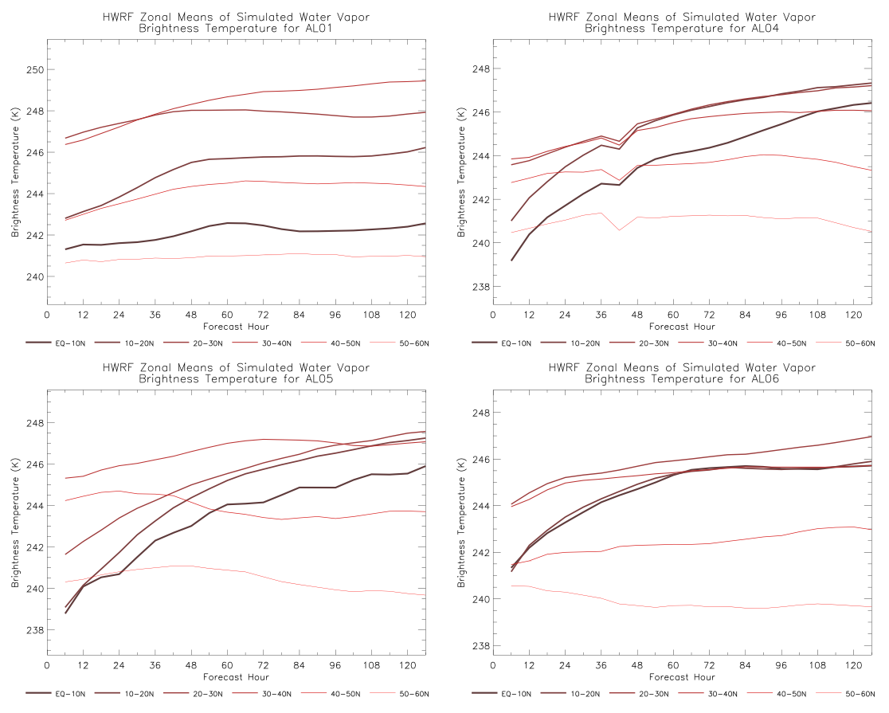
Biases in HWRF Synthetic WV Imagery
Alex Colin
TD05 Danielle

Slide 14
HWRF, GFDL Large-Scale Diagnostics
Basic Parameters for Statistical Models
  Storm track
  SST along track
  850-200 hPa vertical shear
  Environmental vorticity and divergence
  Environmental T, RH, u, v soundings
Common file format and naming convention

Slide 15
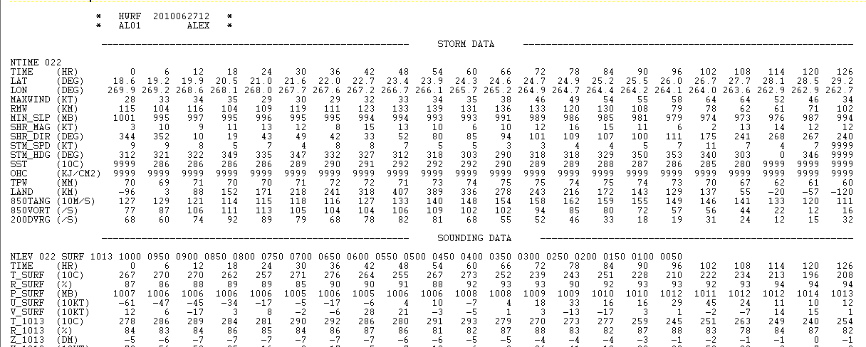
Model Diagnostics File

Slide 16
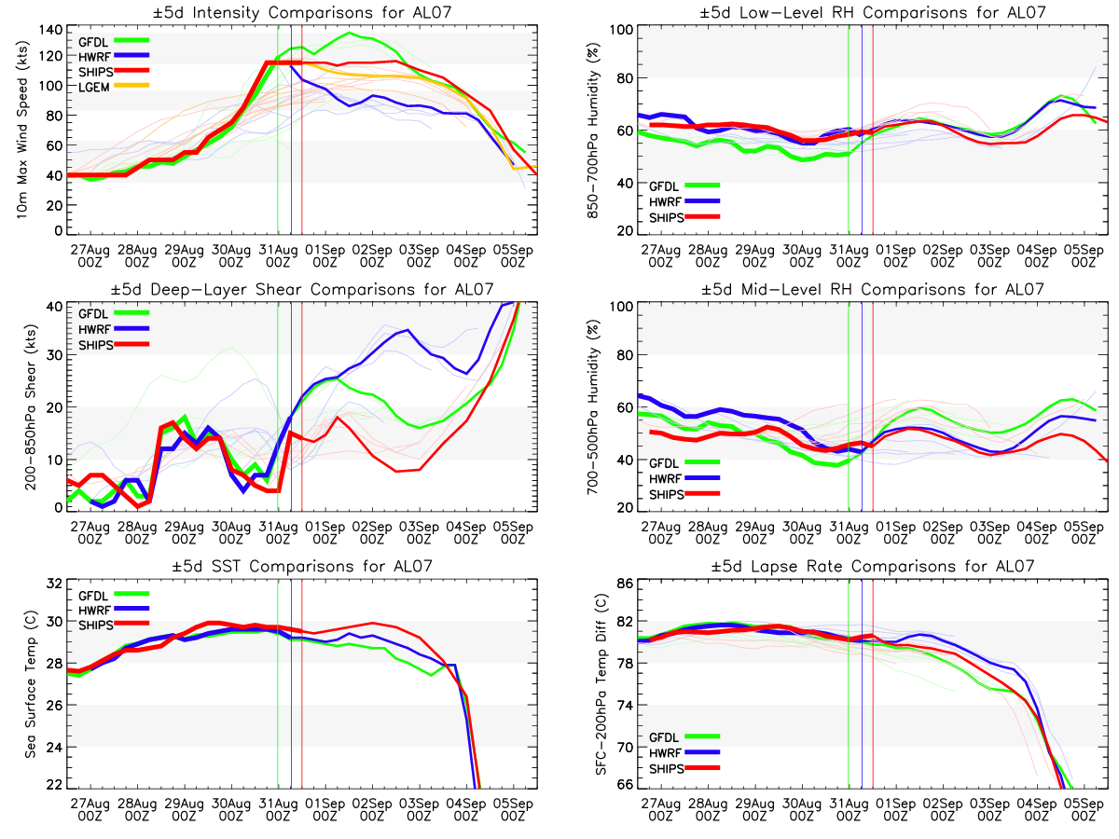
Real-Time Quick Look Model Inter-Comparison Product
Hurricane Earl 2010 0831 12 UTC
Max Wind Low-Level RH
Shear Mid-Level RH
SST Lapse Rate
http://einstein.atmos.colostate.edu/~mcnoldy/tropics/diag

Slide 17
SHIPS/LGEM Forecasts Run Off Other Models
K. Musgrave developed “stand alone” SHIPS/LGEM subroutine
  Input “McNoldy” diagnostic file
  Tested on GFDL and HWRF input
M. Fiorino is providing diagnostic files for NOGAPS, UKMET, FIM, ECMWF
May add GFDN, COAMPS

Slide 18
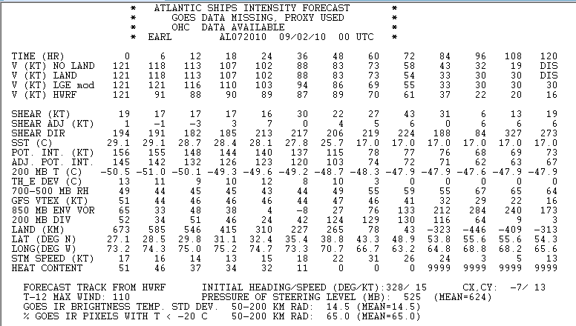
Sample SHIPS/LGEM File with HWRF Input

Slide 19
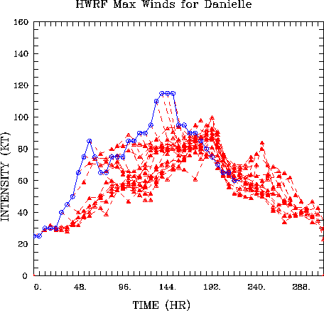
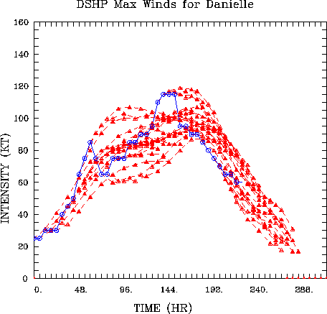
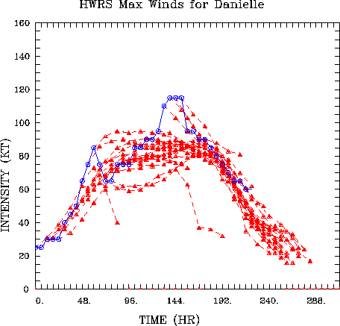
Hurricane Danielle Intensity Forecasts
HWRF SHIPS SHIPS w\ HWRF Input

Slide 20
Intensity Forecast Skill
2010 Cases Alex through Mathew

Slide 21
Balanced Model Diagnostics
Start with Eliassen (1952) balanced vortex model
  Neglect baroclinic terms, assume static stability constant, and assume inertial stability a function of radius only
Solve for geopotential tendency equation (instead of secondary circulation) – use separation of variables to solve the elliptic PDE, assume the heating is confined to the first internal mode
  Reduces to a second-order boundary value problem, in which the radial distribution of the Rossby length, ℓ, needs to be specified
Complicated distributions of ℓ need to be solved numerically

Slide 22
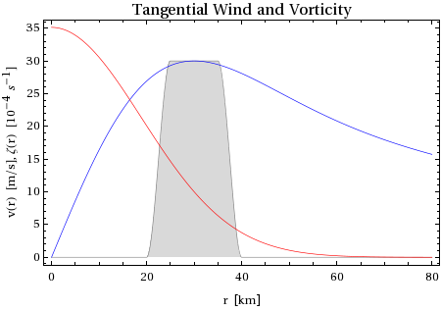
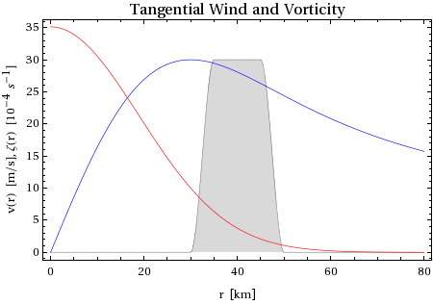
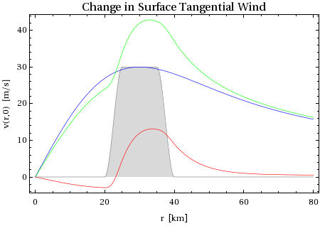
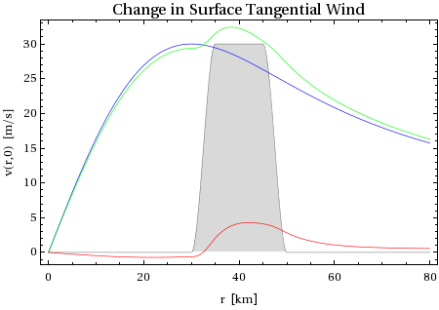
Solutions for Idealized Profiles
DH Outside RMW,
Inside Vortex Skirt
DH Across RMW
Initial Profiles
RMW
RMW
Profiles after 6 hr
RMW
RMW

Slide 23
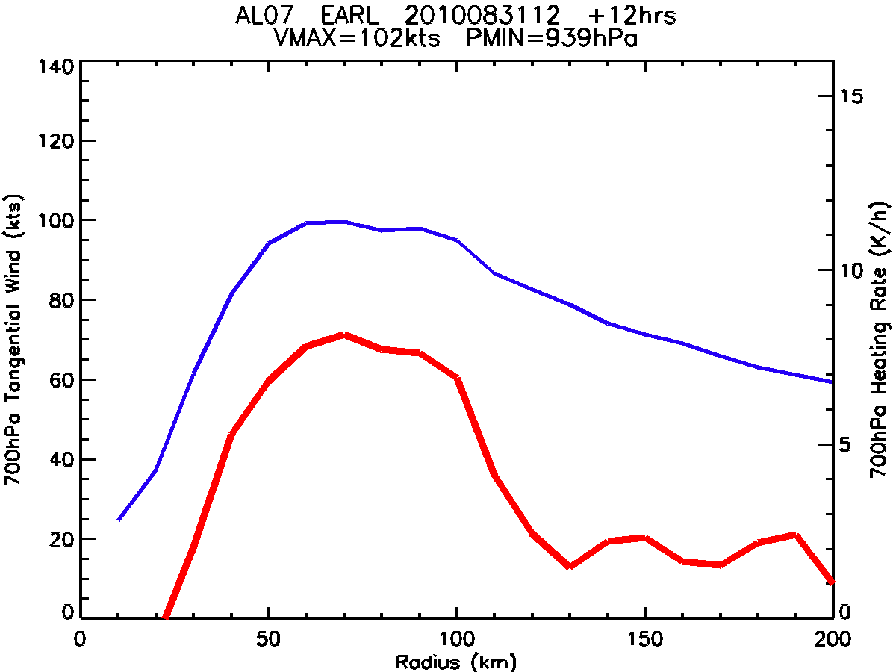
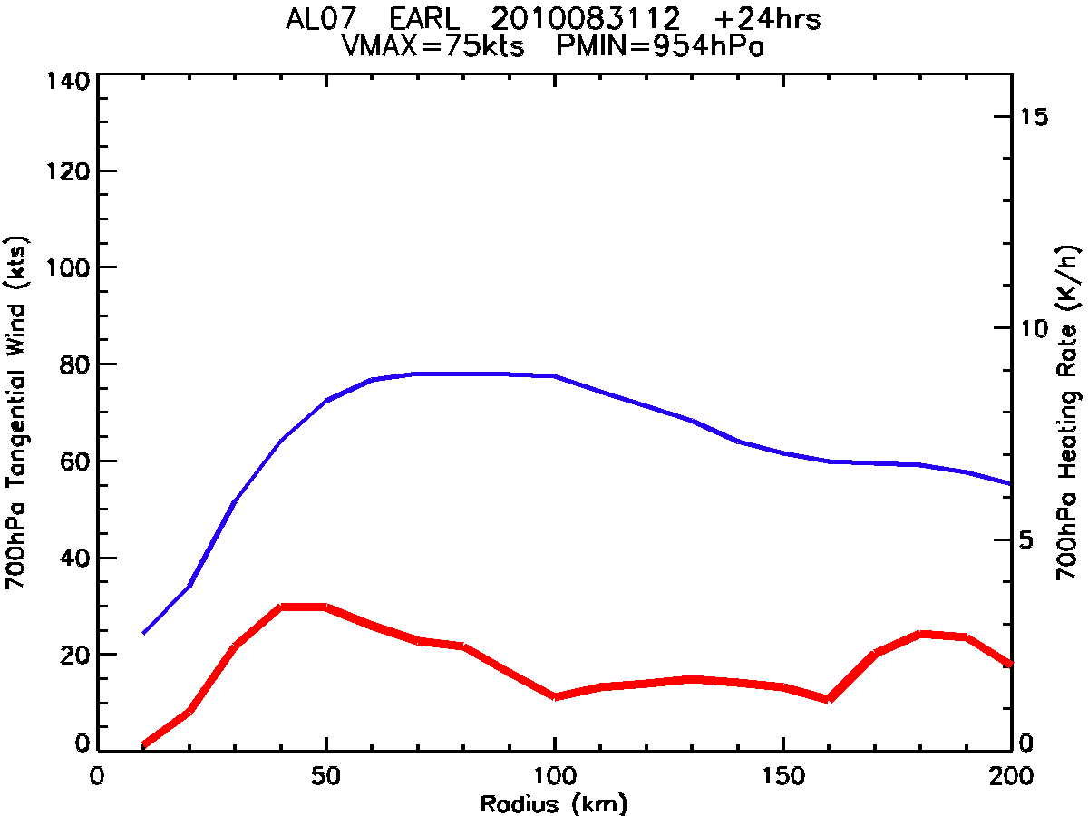
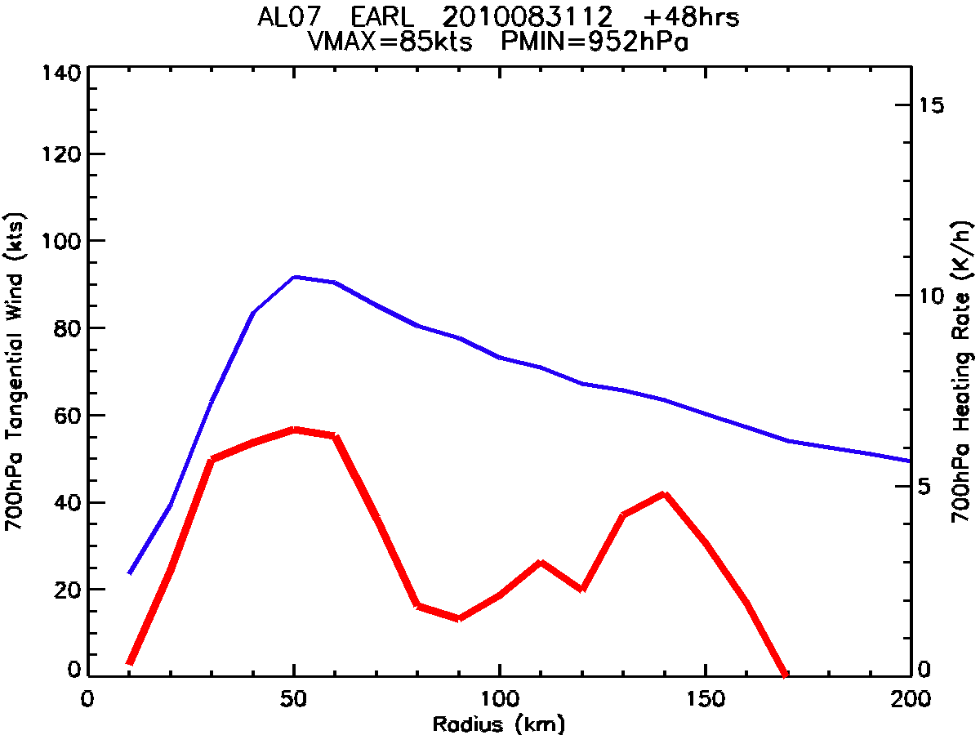
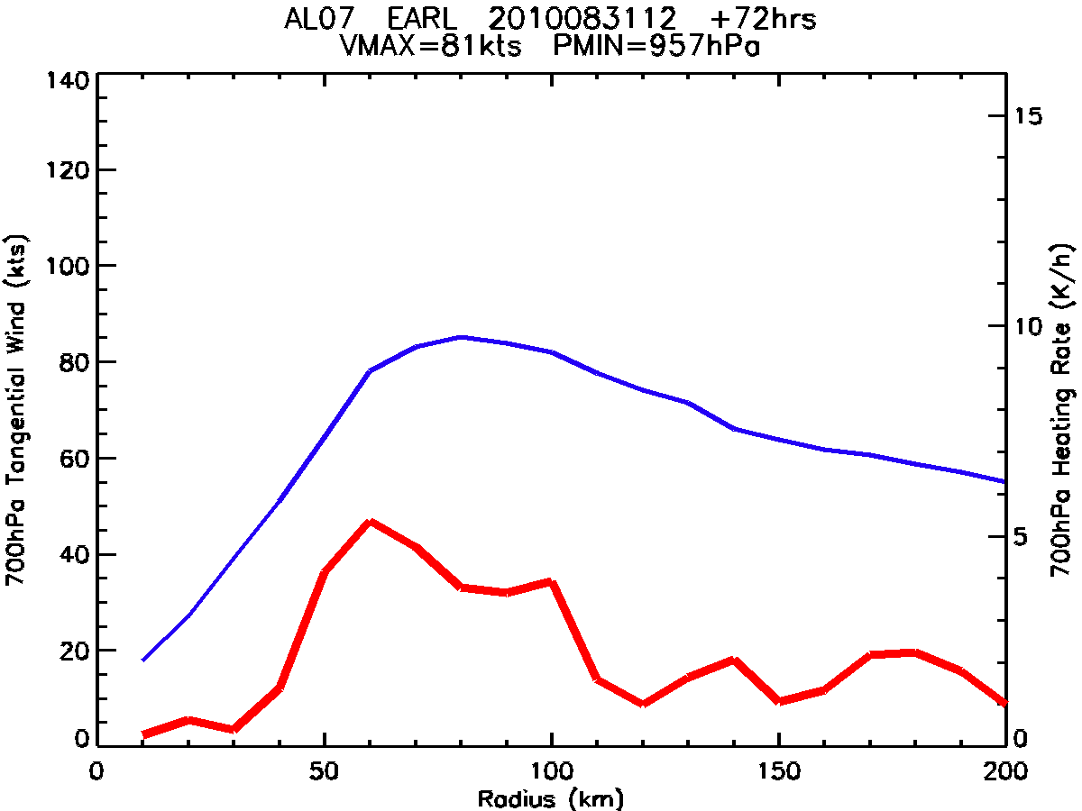
Symmetric 700 hPa Diabatic Heating and Tangential Wind
Hurricane Earl 2010 0831 12 UTC
t = 12 hr t = 24 hr
t = 48 hr t = 72 hr

Slide 24
Tools needed For Diagnostic System
Model output readers
Verification datasets and readers
Numerical operations
  Coordinate transformations
    z to P, map projections to cylindrical, etc
  Derivative and integral operators
  Interpolation operators
  Subsets of model subroutines, forward models
Statistical tools
Graphical output generation

Slide 25
Existing Diagnostic Utilities in HFIP
NHC Annual Verification
  Input: ATCF files Software: Fortran
NHC Product Tools
  Input: GRIB, NetCDF Software: N-AWIPS, grads
DTC and TCMT
  Input: ATCF files, Tier 2 Software (?)
NESDIS/CIRA
  Input: GRIB, McIDAS Software: Fortran, IDL
HRD Diapost
  Input: Binary, Software: Fortran, grads?
ESRL
  Input: GRIB Software: grads
EMC
  Input GRIB Software: Fortran(?), grads
NRL, FSU, NCAR, others

Slide 26
Back-Up Slides

Slide 27
NESDIS 2010 HFIP Tasks
Supporting role
  NHC prod development
  New verification tools
  Stream 1.5 concept of operations
Primary role
  Synthetic satellite imagery analysis (L. Grasso, D. Lindsey)
  HWRF and GFDL model diagnostics (B. McNoldy)
  Statistical models run with regional, global model input (K. Musgrave, M. Fiorino)
  Ensemble forecast applications (P. McCaslin, K. Musgrave, A. Schumacher)
  Predictability study (M. DeMaria)

Slide 28
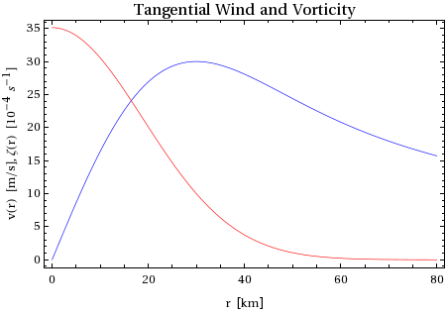
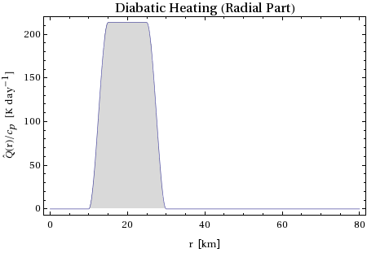
Vortex Specification
Problem simplifies down to specifying two things: the vorticity profile and the diabatic heating profile
  Vortex: assume Gaussian vortex, can be defined by Vmax and RMW
  Diabatic heating: assume annulus of DH, need radii over which to extend
V_{max}
RMW

Slide 29
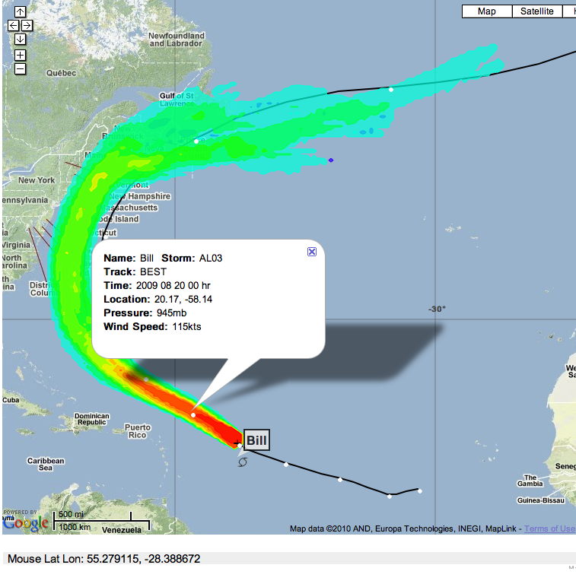
NOAA ESRL – HFIP Ensemble Products
Paula McCaslin
Display HFIP forecast data on Google Maps (zoom features, GIS details, etc)
First product: plotting ATCF tracker for ensemble forecasts
Subsequent products: dynamically interacting with the data in a Web 2.0 approach allowing interrogation and interaction with data by user
Can read ATCF text and CXML format
Shows ensemble tracks, official forecasts, and observational tracks in same plot
Can show wind intensity, pressure, and/or cross-section of 10m winds at any marker point along track
Developing strike probability and storm position probability distribution products
Will work with datasets and input from M. DeMaria, K. Musgrave and Co.

Slide 30
NOAA ESRL – HFIP Ensemble Products
Paula McCaslin
Display HFIP forecast data on Google Maps (zoom features, GIS details, etc)
First product: plotting ATCF tracker for ensemble forecasts
Subsequent products: dynamically interacting with the data in a Web 2.0 approach allowing interrogation and interaction with data by user
Can read ATCF text and CXML format
Shows ensemble tracks, official forecasts, and observational tracks in same plot
Can show wind intensity, pressure, and/or cross-section of 10m winds at any marker point along track
Developing strike probability and storm position probability distribution products
Will work with datasets and input from M. DeMaria, K. Musgrave and Co.

Slide 31
NOAA PROBABILISTIC PRODUCT GENERATION
NESDIS and GSD Collaboration – Mark DeMaria and Zoltan Toth
Objectives / metrics for probabilistic forecasts
  Reliability
    Forecasts statistically consistent with reality (analysis and/or observations)
  Statistical resolution
    Highest possible skill – as sharp as possible while maintaining reliability
Alternative approaches pursued
  Approach 1 - NESDIS
    Use only minimal & trusted info from NWP system
      E.g., ‘official’ forecast
    Build probabilistic info around that based on error statistics of official forecast
  Approach 2 – GSD
    Use NWP ensemble
    Statistically correct basic characteristics of system
      Mean and spread of track & intensity, etc
    Keep other characteristics from ensemble
      E.g., covariances across variables, etc
Compare results from alternative approaches
  Find optimal amount of info to be used from NWP system
  Best statistical approaches to enhance forecasts from NWP system

Slide 32
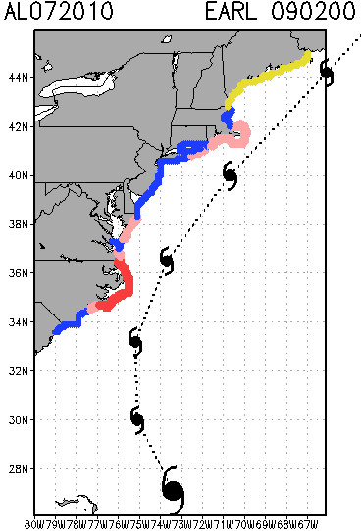
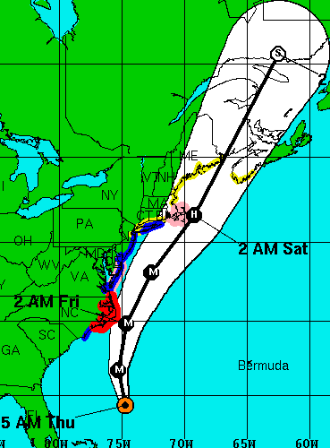
NHC Advisory for Earl: Sep 2 5am (AST)
Yellow = TS Watch Blue = TS Warning Pink = Hurr Watch Red = Hurr Warning
Automated watch/warning
guidance from statistical
Wwnd speed probability model
NHC Watches
and Warnings

Slide 33
Predictability Study
How much improvement is possible from statistical intensity models?

Slide 34
Expected Deliverables from the 2010 Season
Large-scale diagnostics files for HWRF, GFDL and global models
  Model diagnostic inter-comparison study
Ensemble SHIPS/LGEM forecasts
  Possible stream 1.5 model for 2011 season
Synthetic GOES imagery validation system
Preliminary study of utility of balanced model diagnostics
Initial plan for merging statistical and dynamical ensemble approaches
Possible initial version of automated diagnostic routine for analysis of HWRF annual upgrades
  Coordination with EMC, HRD and ESRL

