Slide 1


FV3GFS (GFS V15.0) Pre-Implementation T&E Status Update
Briefing to NHC, 08/16/2018
Vijay Tallapragada and Fanglin Yang
NOAA/NWS/NCEP/EMC

Slide 2
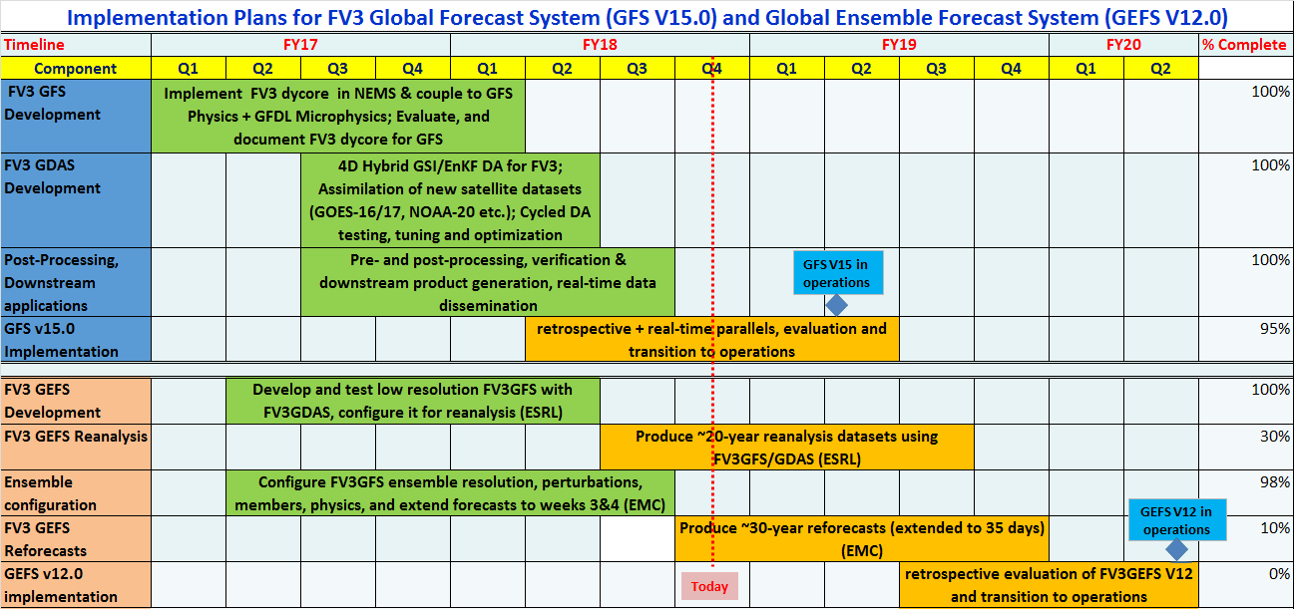
FV3GFS and FV3GEFS Implementation Plans

Slide 3
First Version of NGGPS FV3GFS for Transition to Operations
FV3GFS is being configured to replace spectral model (NEMS GSM) in operations in Q2FY19
Configuration:
FV3GFS C768 (~13km deterministic);
FV3GDAS C384 (~25km, 80 member ensemble);
64 layer, top at 0.2 hPa;
GFDL Microphysics + Rest of GFS Physics
Uniform resolution for all 16 days
Schedule:
3/7/18: code freeze of FV3GFS-V1 (GFS V15.0)
3/30/18: Public release of FV3GFS-V1 code
4/1 – 1/25/19: real-time EMC parallels
5/25 – 9/05/18: retrospectives and case studies (May 2015 – September 2018; three summers and three winters)
9/24/2018: Field evaluation due
9/27/2018: OD Brief, code hand-off to NCO
12/20/2018-1/20/2019: NCO 30-day IT Test
1/24/2019: Implementation

Slide 4
FV3GFS: Infrastructure and Physics Upgrades
New parameterization of middle atmospheric water vapor photochemistry
a revised bare soil evaporation scheme.
Updated Stochastic physics
Improved NSST in FV3
Use GMTED2010 terrain to replace TOPO30 terrain
Integrated FV3 into NEMS
Added IPD in NEMSfv3gfs
Newly developed write grid component -- write out model history in native cubed sphere grid and Gaussian grid
Replaced Zhao-Carr microphysics with the more advanced GFDL microphysics
Updated parameterization of ozone photochemistry with additional production and loss terms

Slide 5
Data Assimilation – GSI, Interfaces, and Observation
Improved GSI efficiency
Update GSI IO to ingest FV3GFS forecasts and provide analysis for FV3GFS.
Update GSI to process additional cloud species from GFDL microphysics
Compute increments of layer pressure and thickness hydrostatically from increments of surface pressure and temperature.
Increase in ensemble resolution from roughly 39km to 25km.
Adaptation of stochastic physics parameterizations from NEMS GSM with the exception of SKEB to provide model uncertainty estimate.
Observations: add IASI moisture channels , ATMS all-sky radiances, Megha-Tropiques Saphir data, ASCAT data from MetOp-B, newNOAA-20 CrIS and ATMS data

Slide 6
POST and Downstream Processing
Precipitation products with both 6-hour bucket and continuous accumulation are provided
Velocity from FV3GFS is dz/dt in m/s instead of omega in pa/s. Omega is diagnosed in the UPP and provided to users.
More cloud hydrometers predicted by the advanced microphysics scheme are included in the products.
Radar reflectivity derived using these new cloud hydrometers will also be added to GFS products.
Height, pressure, and vertical velocity will be non-hydrostatic computed in model instead of being derived hydrostatically in Unified Post Processor.
This Google Sheet contains a complete list of product changes.

Slide 7
Workflow Unification
Almost all scripts adopted from the NEMS GFS were rewritten for the FV3GFS
The old psub/pend job submission system is replaced by Rocoto drivers
The 4-package superstructure workflow was merged into one package with a flat structure
All JJOBS were rewritten. Both EMC parallels and NCO operations will use the same JJOBS
EMC parallels and NCO operations follow the same file name convention and directory structure
An important achievement to simplify and unify the GFS systems between the development (EMC) and operations (NCO)

Slide 8
Status of Real-Time and Retrospective Parallel Experiments
 | Stream | Planned Period | Current Status | Machine | Products/Remarks
0 | Real-Time Parallel (fv3rt1) | 05/25/2018 ~ 01/25/2019 | real-time | WCOSS: CRAY →DELL | GFSMOS, GEMPAK, AWIPS, BUFRSND
1 | 2017/18 Winter-Spring (fv3q2fy19retro1) | 11/25/2017 ~ 05/31/2018 | Completed | WCOSS DELL Venus | GFSMOS, BUFRSND
2a | 2017 Summer-Fall (fv3q2fy19retro2a) | 05/25/2017 ~ 08/31/2017 | Completed | WCOSS CRAY Luna
2b | 2017 Summer-Fall (fv3q2fy19retro2a) | 08/02/2017 ~ 11/30/2017 | Completed | WCOSS Dell Venus | GFSMOS, BUFRSND
3 | 2016/17 Winter-Spring (fv3q2fy19retro3) | 11/25/2016 ~ 05/31/2017 | Completed | WCOSS DELL Venus
4a | 2016 Summer-Fall (fv3q2fy19retro4a) | 5/22/2016 ~ 08/25/2016 | Completed | WCOSS CRAY Luna
4b | 2016 Summer-Fall (fv3q2fy19retro4b) | 08/17/2016 ~ 11/26/2016 | Completed | WCOSS Dell Mars
5 | 2015/16 Winter-Spring (fv3q2fy19retro5) | 11/25/2015 ~ 05/31/2016 | Completed | WCOSS DELL Mars
6 | 2015 Summer-Fall* (fv3q2fy19retro6) | 5/03/2015 ~ 11/28/2015 | In Progress, 10/10/2015 | WCOSS DELL Mars | Expected completion: 9/5/18
*The original plan was to port FV3GFS to Gaea and Jet to run one to two streams there. Due to various difficulties the porting still has not completed. No parallels can be run on Gaea and Jet yet.

Slide 9
Evaluation Web Pages
http://www.emc.ncep.noaa.gov/users/Alicia.Bentley/fv3gfs
Overall evaluation page (MEG)
http://www.emc.ncep.noaa.gov/gmb/emc.glopara/vsdb/prfv3rt1/
http://www.emc.ncep.noaa.gov/gmb/emc.glopara/vsdb/fv3q2fy19retro1
http://www.emc.ncep.noaa.gov/gmb/emc.glopara/vsdb/fv3q2fy19retro2b
http://www.emc.ncep.noaa.gov/gmb/emc.glopara/vsdb/fv3q2fy19retro3
http://www.emc.ncep.noaa.gov/gmb/emc.glopara/vsdb/fv3q2fy19retro4b
http://www.emc.ncep.noaa.gov/gmb/emc.glopara/vsdb/fv3q2fy19retro5
http://www.emc.ncep.noaa.gov/gmb/emc.glopara/vsdb/fv3q2fy19retro6
http://www.emc.ncep.noaa.gov/gmb/emc.glopara/vsdb/gfs2019 (including all streams)

Slide 10
Verification Statistics with All Streams Combined
May 2015 ~ August 2018

Slide 11
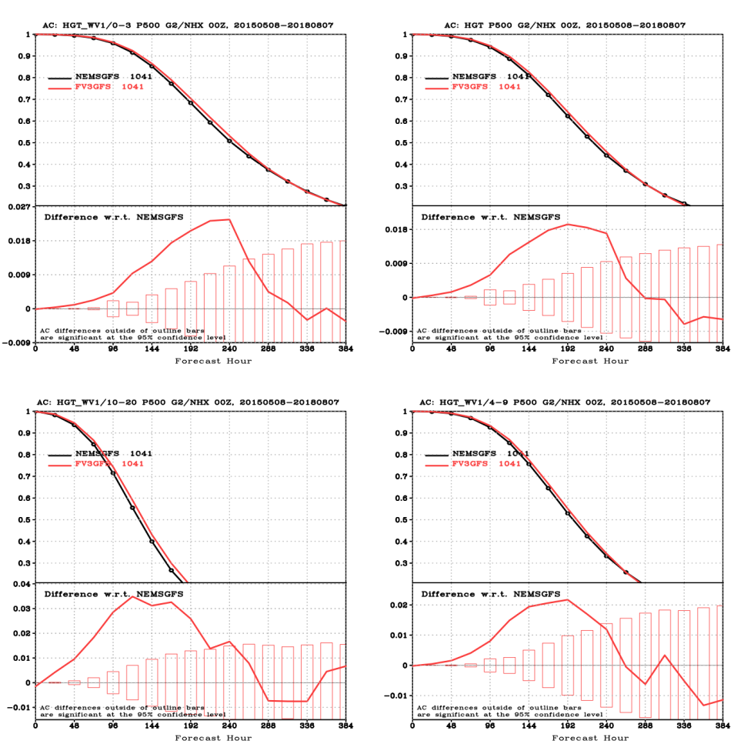
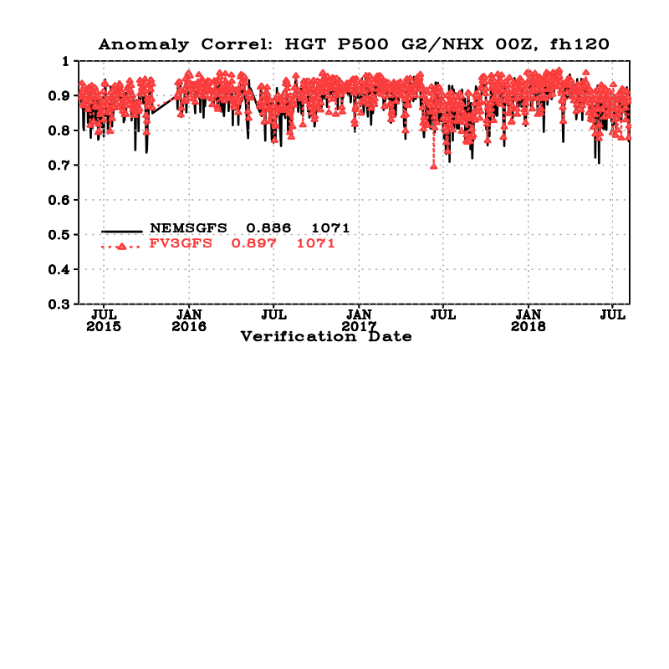
NH 500 hPa HGT ACC

Slide 12
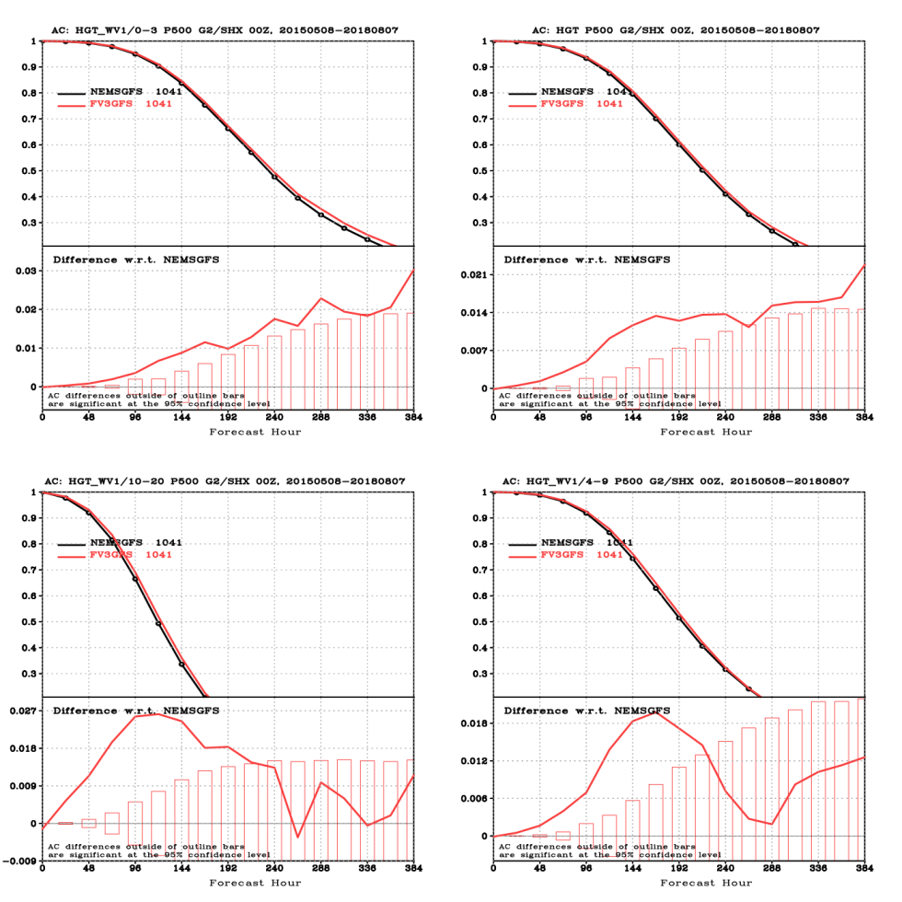
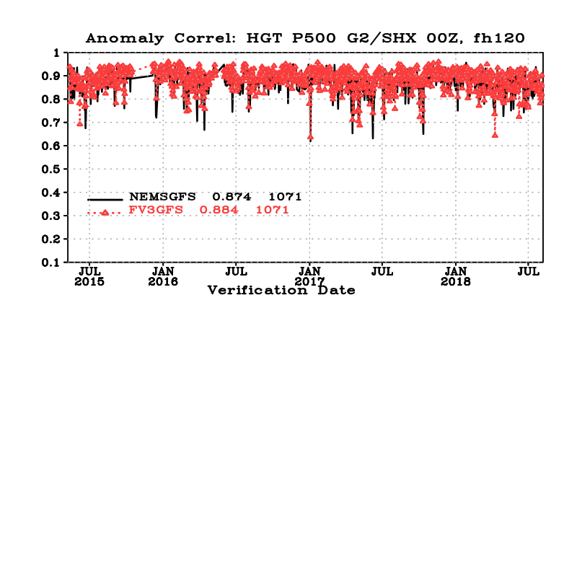
SH 500 hPa HGT ACC

Slide 13
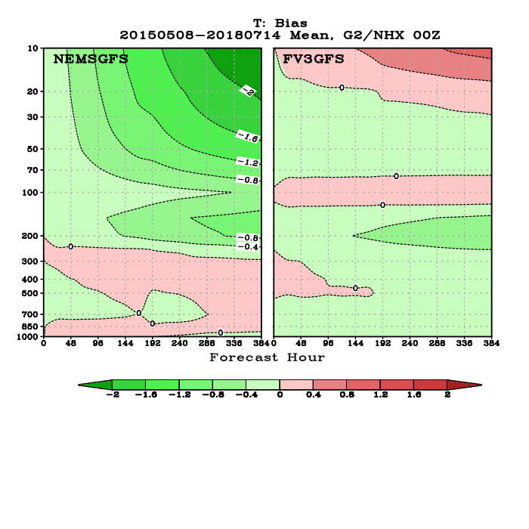
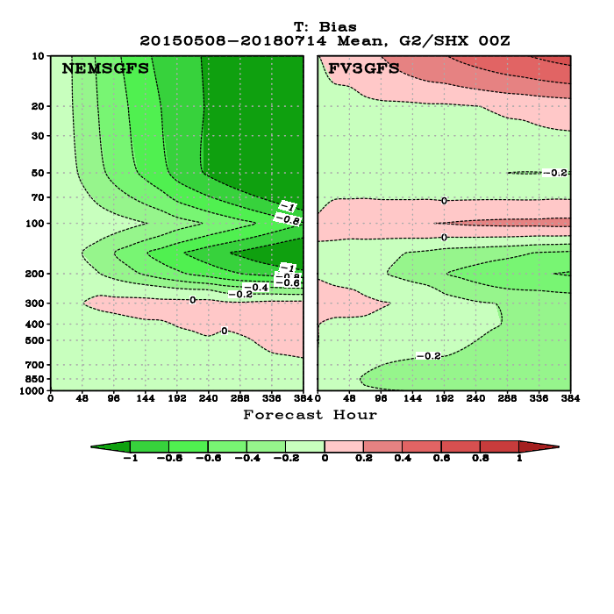
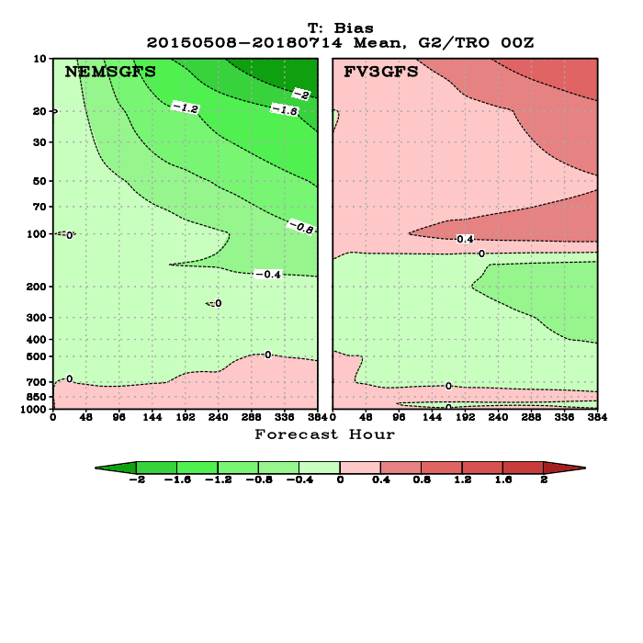
Temperature Bias
NH
SH
Tropics

Slide 14
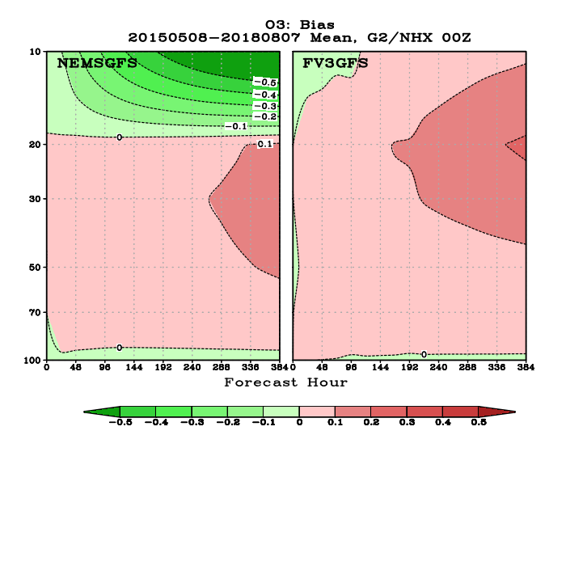
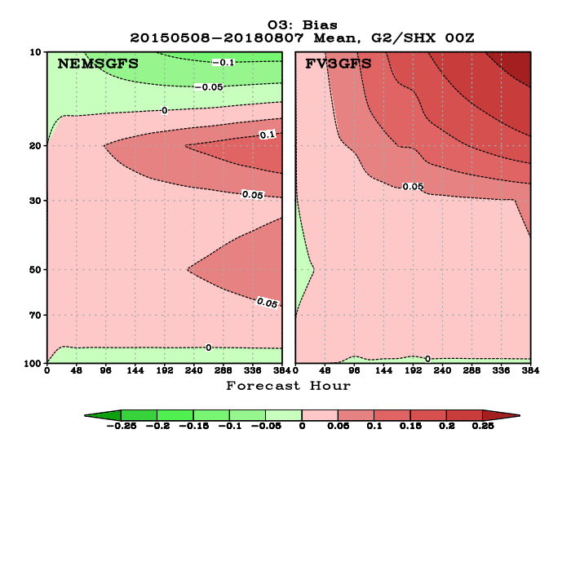
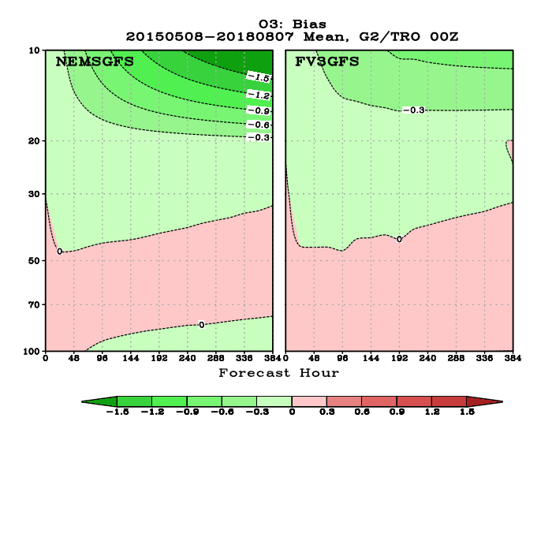
Ozone Bias
NH
SH
Tropics

Slide 15
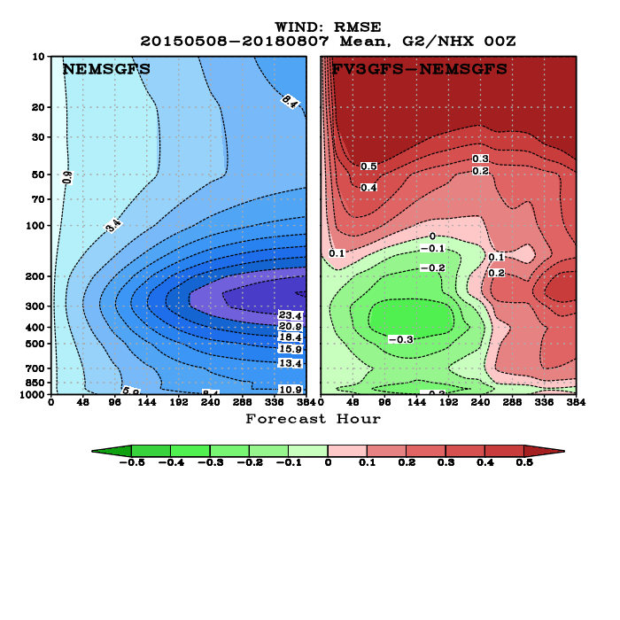
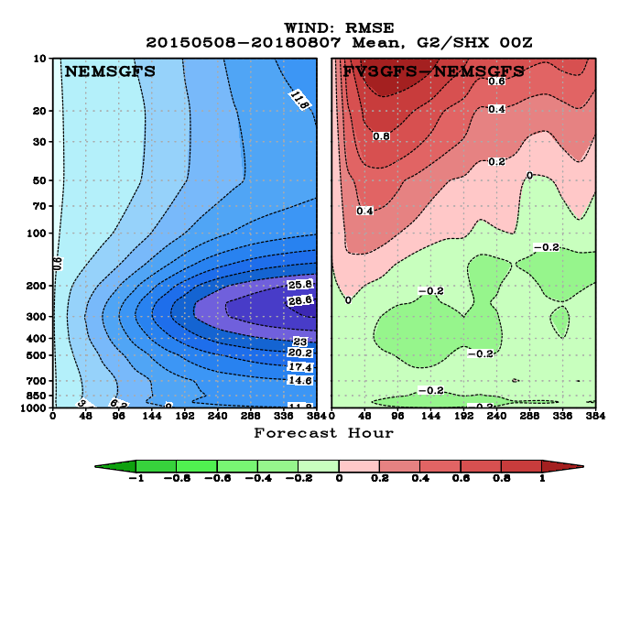
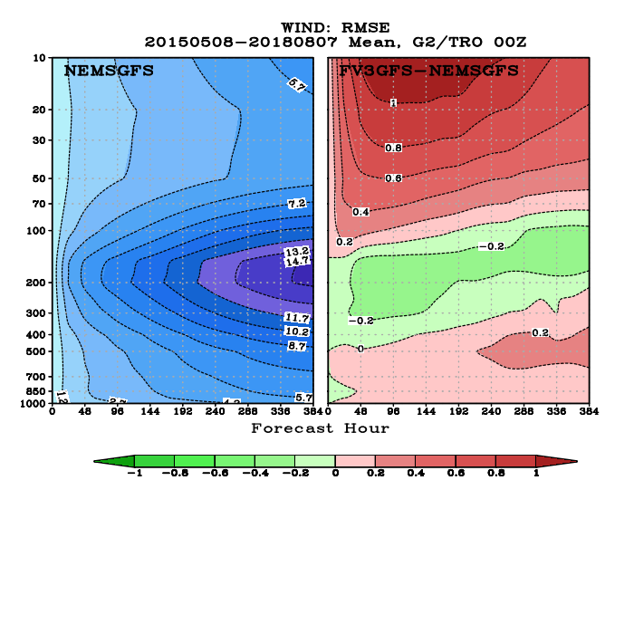
Wind RMSE
NH
SH
Tropics

Slide 16
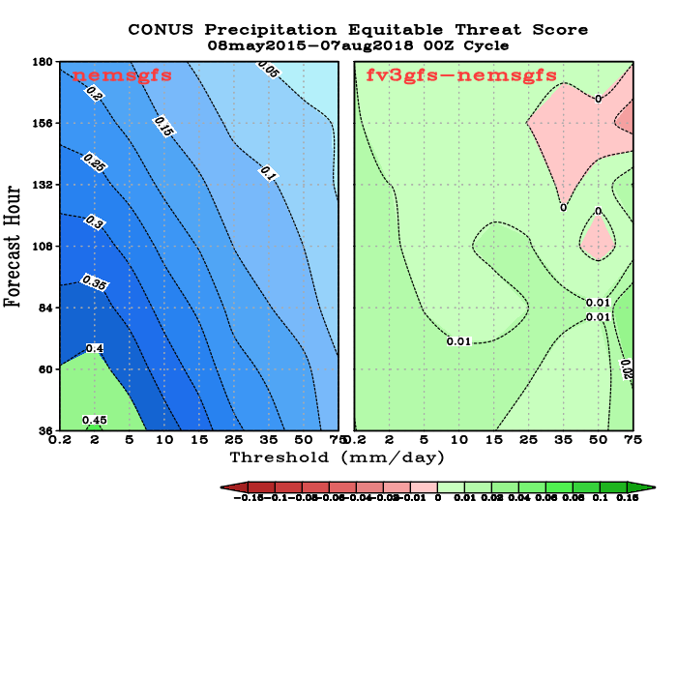
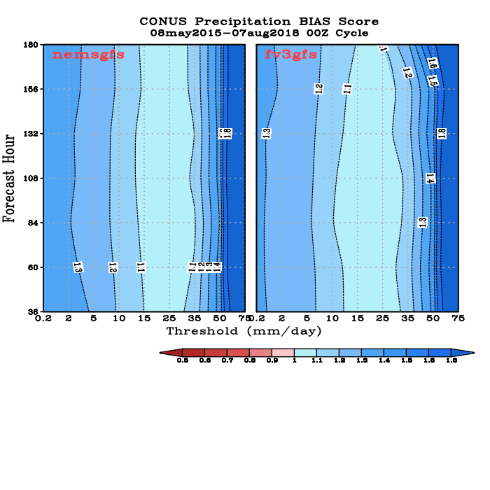
CONUS PRECIP ETS and BIAS Scores

Slide 17
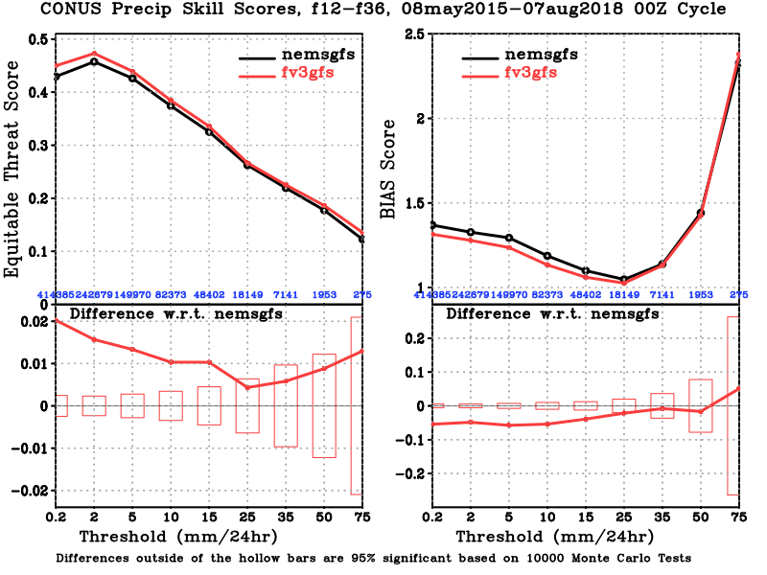
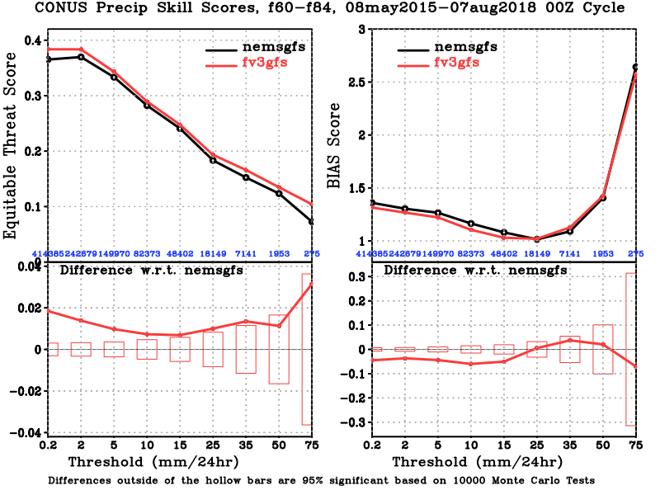
CONUS PRECIP ETS and BIAS Scores

Slide 18
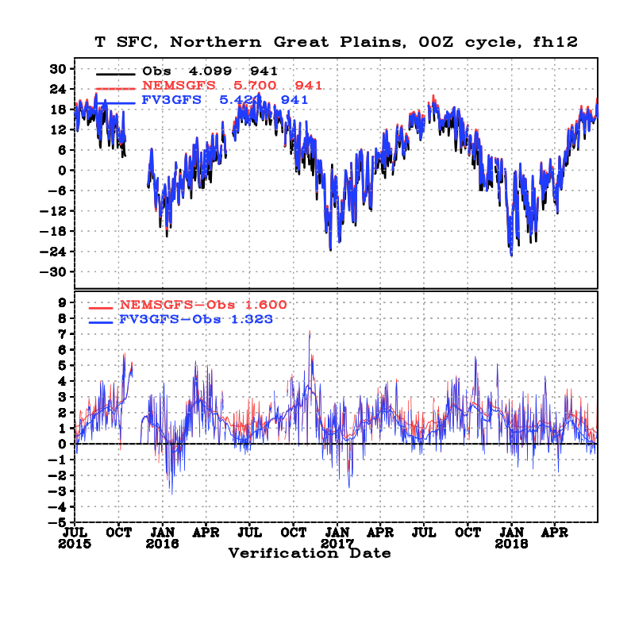
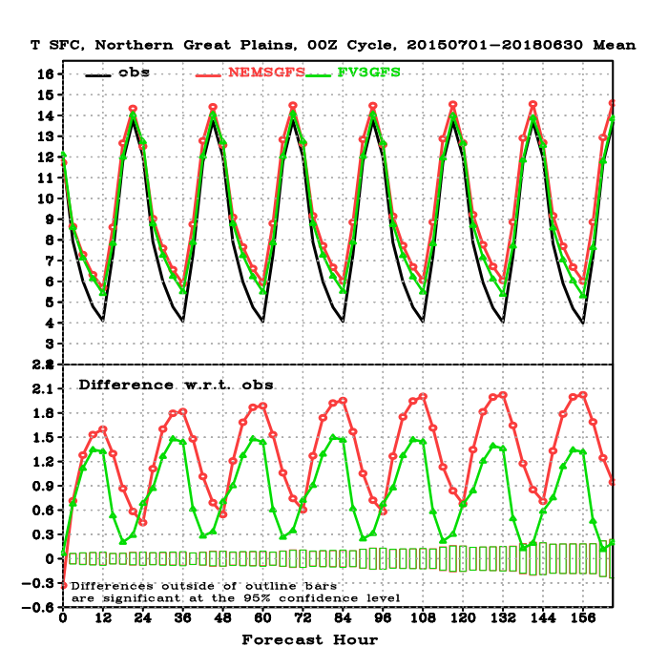
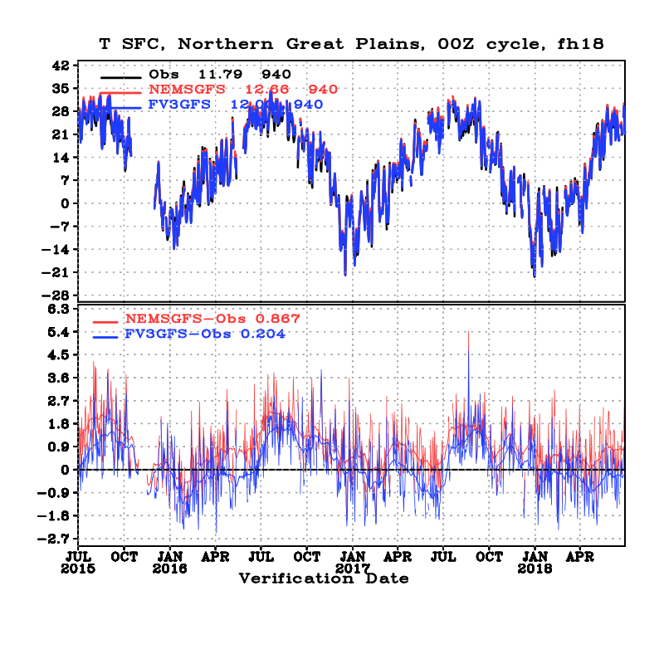
FIT2OBS, 2-m Temp, Northern Great Plains

Slide 19
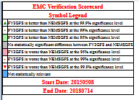
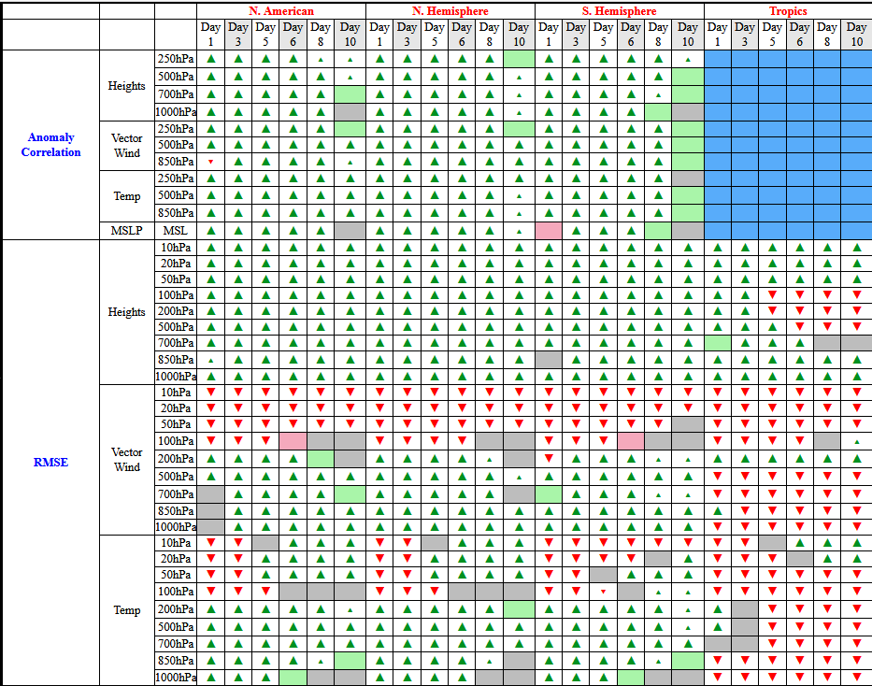
Scorecard

Slide 20
Hurricane Track and Intensity

Slide 21
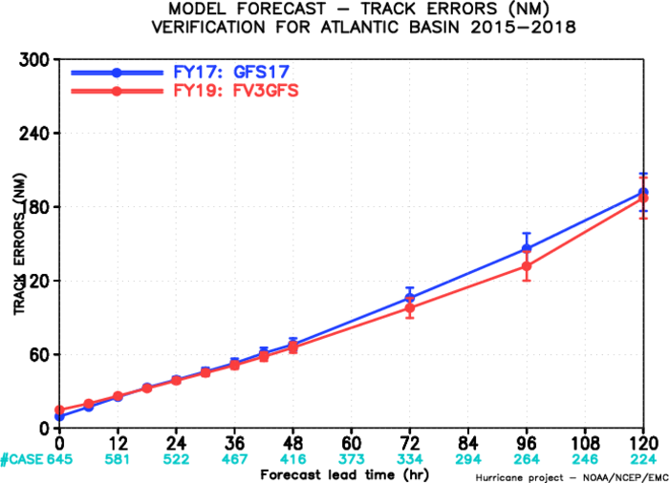
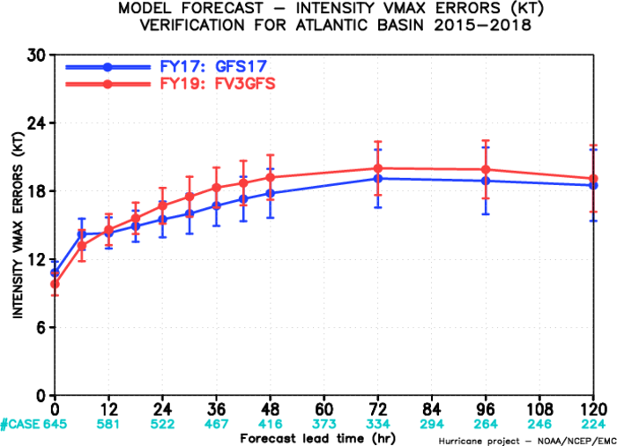
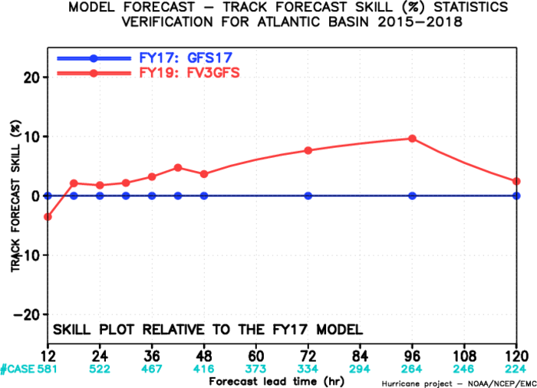
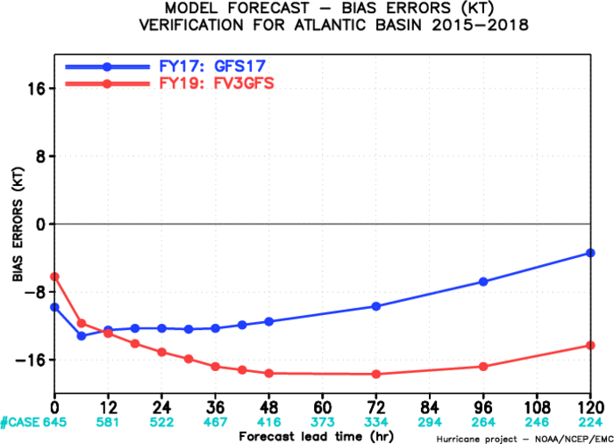
Atlantic Basin; 2015-2018
Track Errors
Intensity Errors
Intensity Bias
Track Skill Improvement

Slide 22
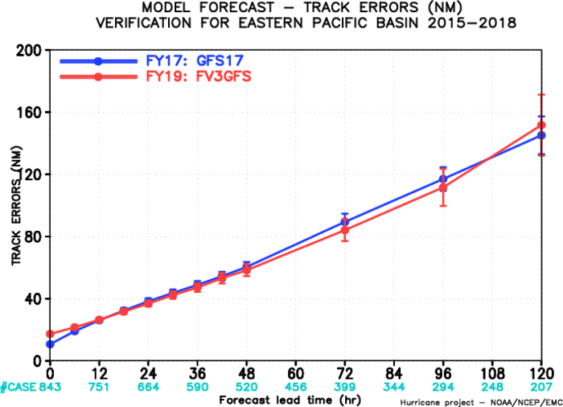
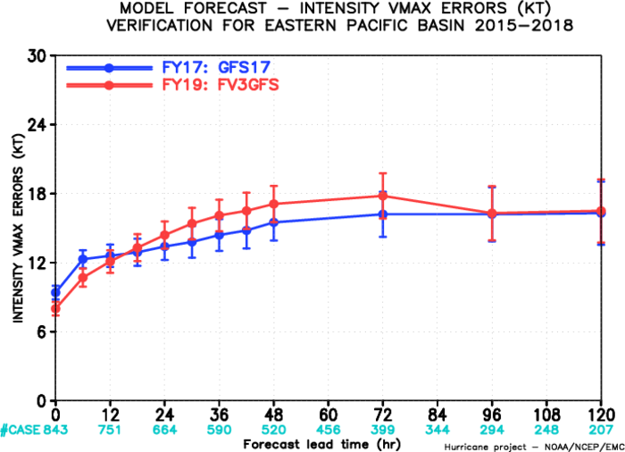
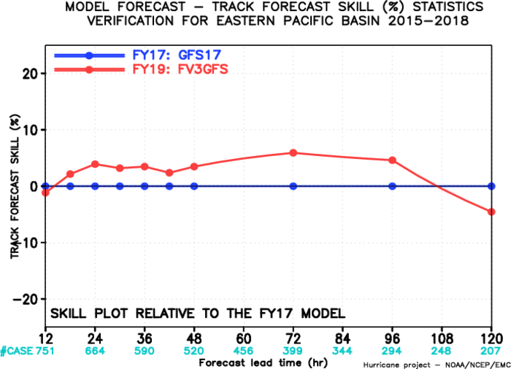
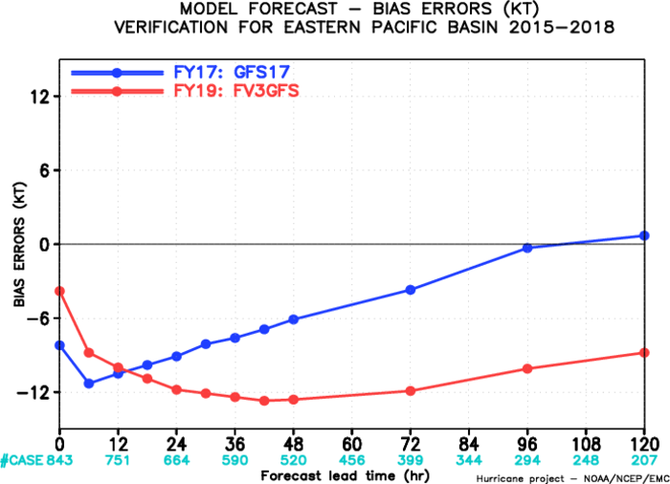
East Pacific Basin; 2015-2018
Track Errors
Intensity Errors
Intensity Bias
Track Skill Improvement

Slide 23
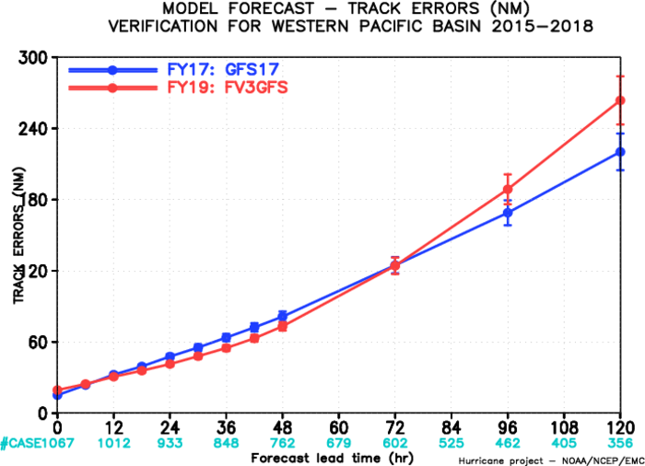
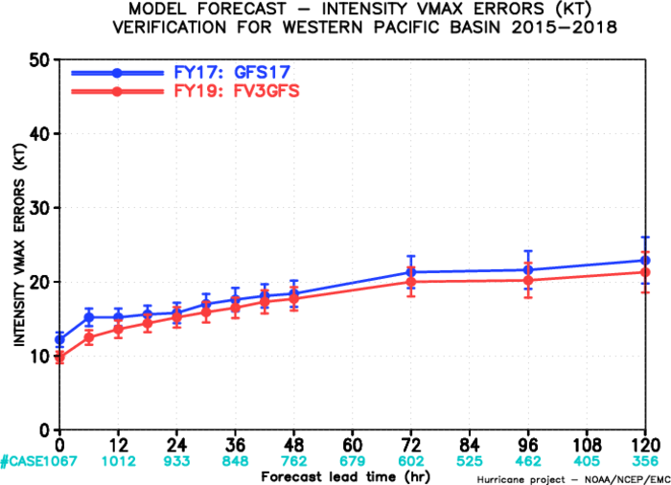
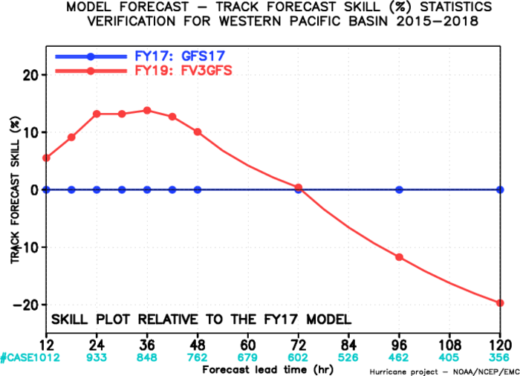
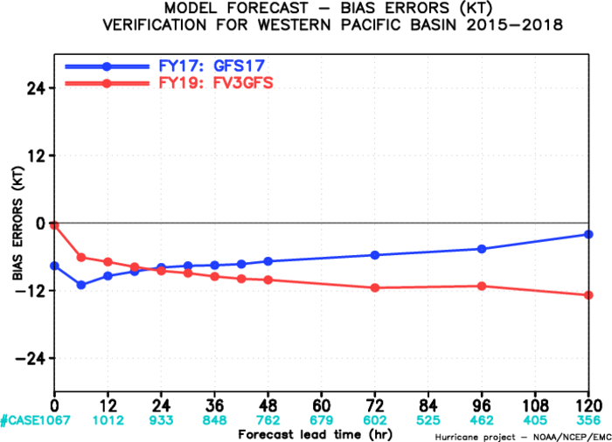
West Pacific Basin; 2015-2018
Track Errors
Intensity Errors
Intensity Bias
Track Skill Improvement

Slide 24
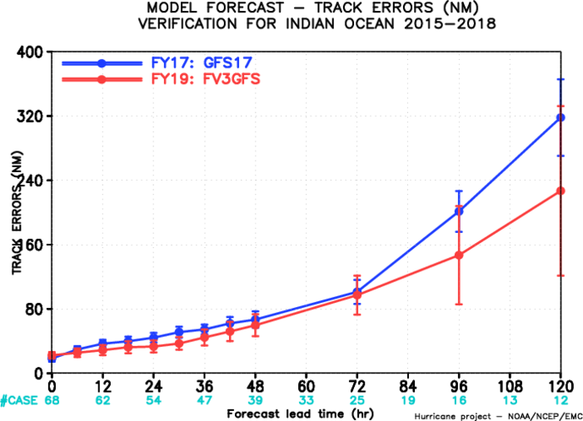
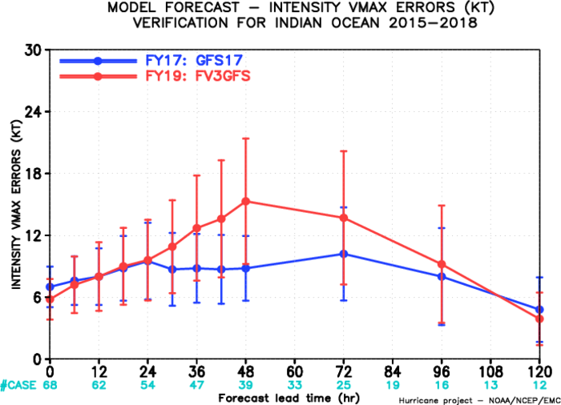
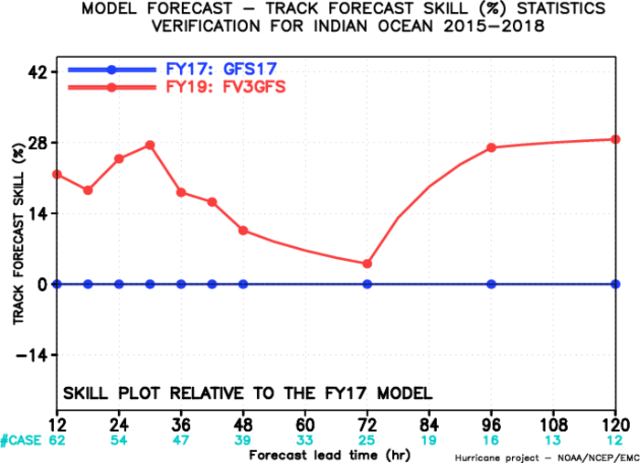
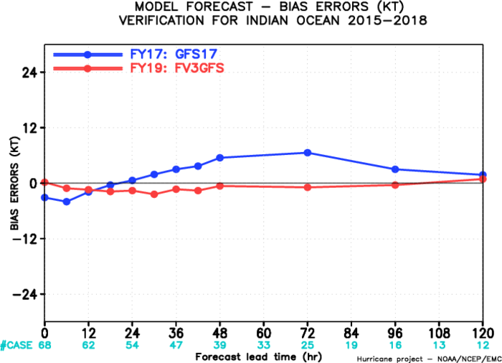
North Indian Ocean Basin; 2015-2018
Track Errors
Intensity Errors
Intensity Bias
Track Skill Improvement

Slide 25
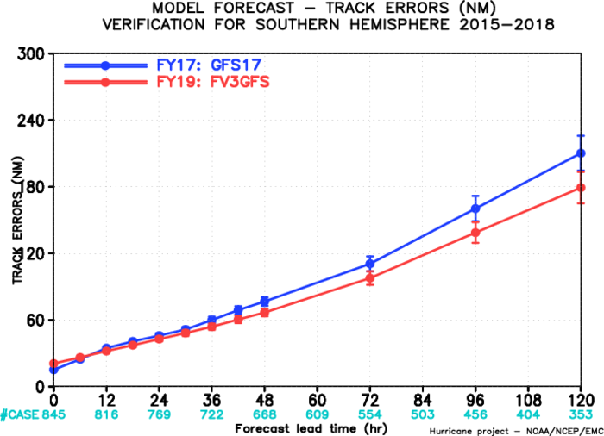
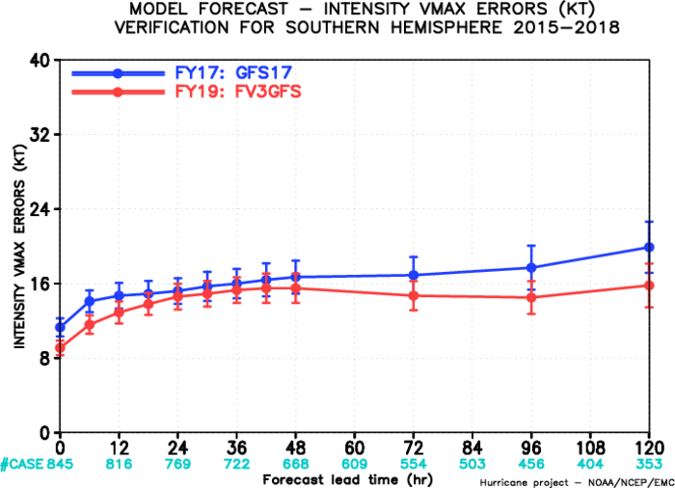
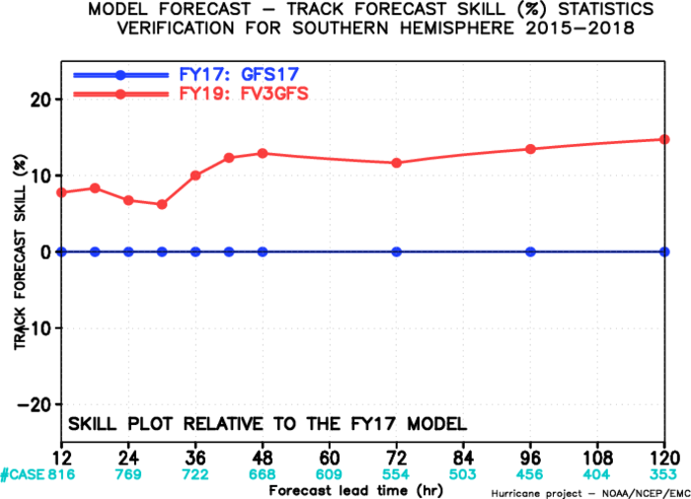
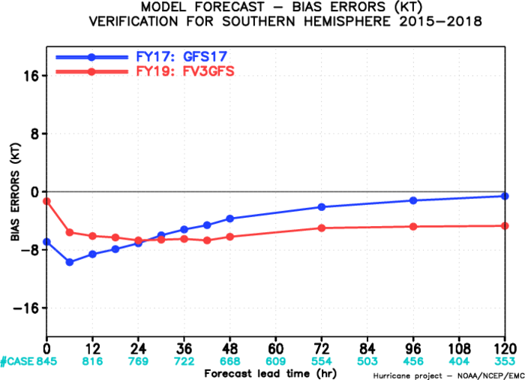
Southern Hemisphere; 2015-2018
Track Errors
Intensity Errors
Intensity Bias
Track Skill Improvement

Slide 26
Comparing FV3GFS with current operational GFS:
Large-scale verification stats are improved, including ACC and precip ETS scores
Hurricane tracks are improved over Atlantic and Eastern Pacific basins.
Hurricane intensity is too weak
Upper air RMSE/Bias scores are worse than operational GFS
Actions Taken:
Consulted with GFDL. SJ-Lin stated that using the advection scheme hord=6 gives better ACC scores but weaker storms, while using hord=5 gives better storm intensity but lower ACC.
Hord=5: Unlimited Colella and Woodward (1984) Piecewise-parabolic method, using Hunyh’s second constraint to enforce monotonicity
Hord=6: unlimited “fifth-order” PPM. This option may be useful for 4D-DA.
SJ Lin recommended to run GDAS cycle with hord=6, and GFS forecast with hord=5
Compare FV3GFS upper air scores with ECMWF scores; Verified against rawinsondes

Slide 27
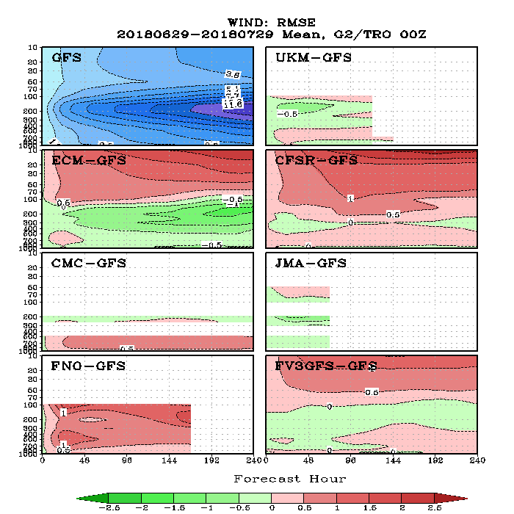
FV3GFS Wind RMSE compared to ECMWF and Ops GFS

Slide 28
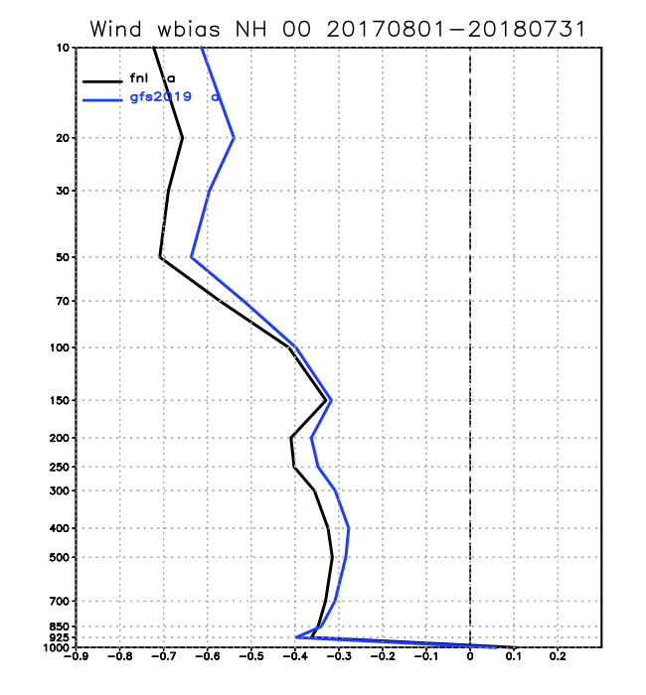
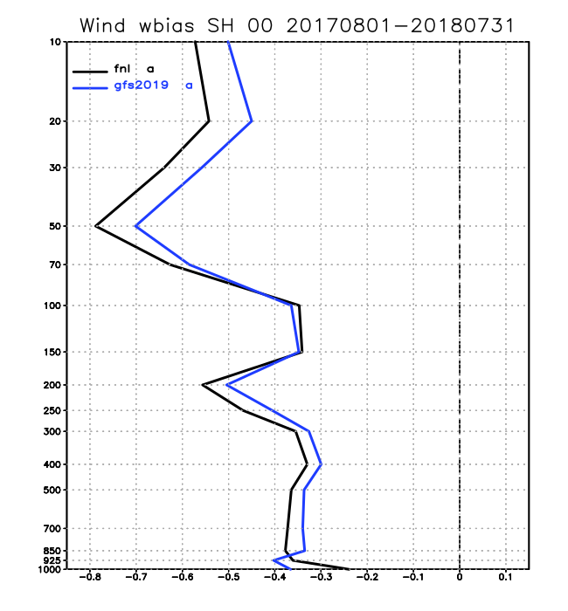
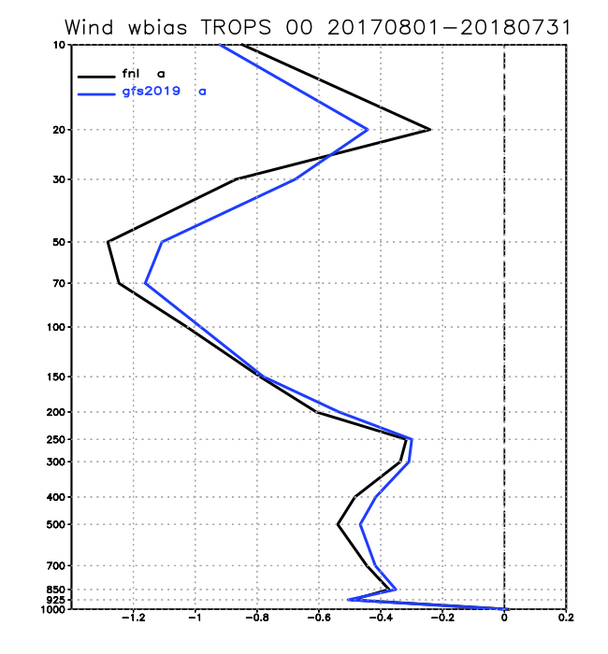
WIND BIAS Verified against Rawinsondes
FV3GFS winds are stronger and fits better to raobs

Slide 29
Actions taken to address hurricane intensity issue:
Hurricane intensity is too weak in FV3GFS parallels. A new forecast-only experiment was set up to run for all hurricane seasons with an alternate advection scheme (hord=5), which is less diffusive. Preliminary results showed that hurricane intensity was improved. Hurricane track did not change. Large-scale skill scores are similar to that of the original experiment with hord=6.
Concerns were raised about the impact of this change on winter storms.
HWRF and HMON will use these reruns with hord=5 to perform fv3gfs downstream evaluation.
Set up another forecast-only experiment to cover the 2017/18 winter/spring season to investigate the impact of hord=5 on cold season forecast skill scores and individual winter storms.

Slide 30
FV3GFS Comparison of hord=5 with hord=6
http://www.emc.ncep.noaa.gov/gmb/emc.glopara/vsdb/fv3q2fy19retro2c/

Slide 31
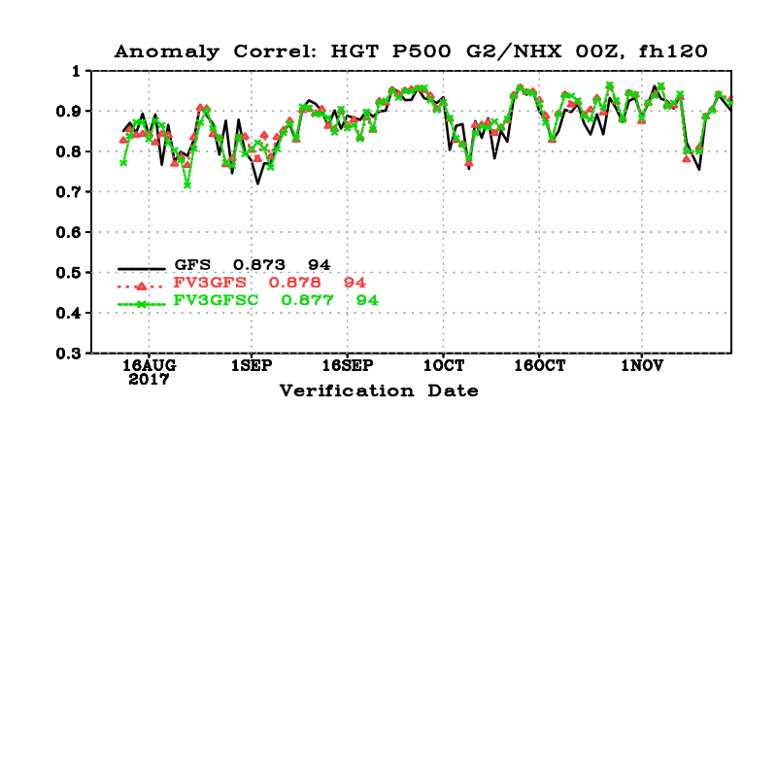
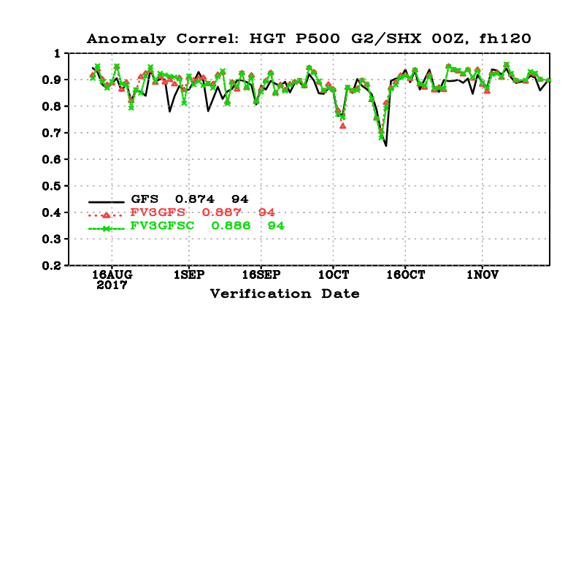
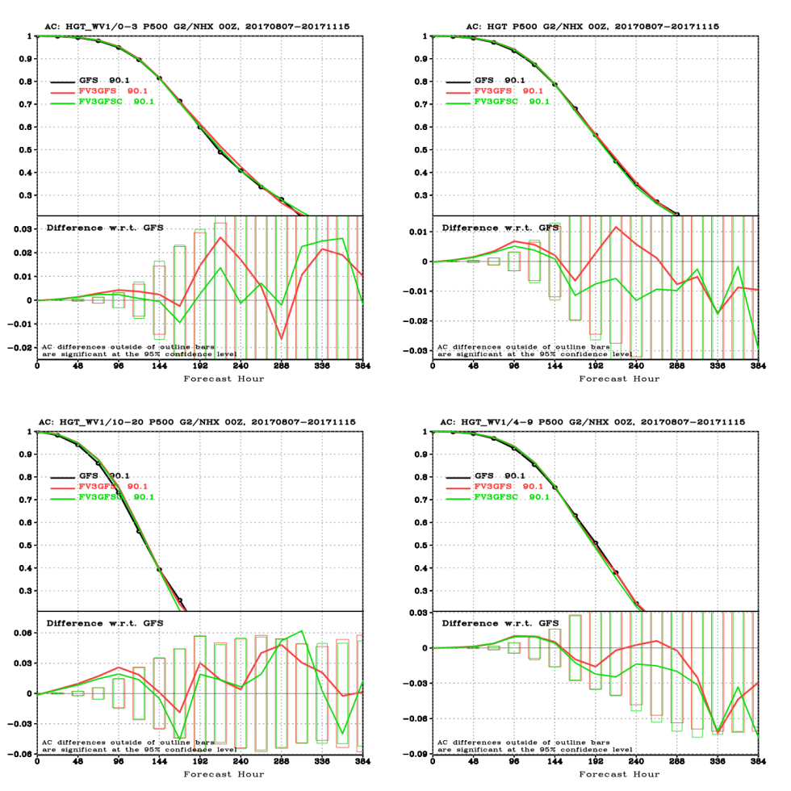

500 hPa HGT ACC
Black: ops GFS; Red: fv3gfs, hord=6; green: fv3gfsc, hord=5
NH
SH
Slightly worse ACC, not significant
No difference

Slide 32


CONUS PRECIP ETS and BIAS Scores
Hord=5 slightly better than hord=6
Hord=5 slightly drier

Slide 33

Atlantic
Hord=6
Hord=5

Slide 34

Eastern Pacific
Hord=6
Hord=5

Slide 35

Central Pacific
Hord=6
Hord=5

Slide 36

Hord=6
Hord=5
Western Pacific

Slide 37

Hord=6
Hord=5
North Indian Ocean

Slide 38

Southern Hemisphere
Hord=6
Hord=5

Slide 39

W-P Relationship
Much improved W-P relationship with FV3GFS (hord=5) compared to operational GFS and older runs of FV3GFS (hord=6)

Slide 40
Summary:
Comparing hord=5 with hord=6 :
There is no significant differences in ACC, RMSE and precip skill scores
Running FV3GFS with hord5 significantly improves hurricane intensity in the Atlantic, EPAC and WPAC.
Has slightly positive impact on hurricane track.

Slide 41
2. 2017/18 cold season – Compare hord=5 with hord=6
(20171201 ~ 20180531)
http://www.emc.ncep.noaa.gov/gmb/emc.glopara/vsdb/fv3q2fy19retro1c/

Slide 42




500 hPa HGT ACC
Black: ops GFS; Red: fv3gfs, hord=6; green: fv3gfsc, hord=5
NH
SH
No difference
No difference

Slide 43


NH Temperature Bias
NH Wind Bias
No difference
No difference

Slide 44


CONUS PRECIP ETS and BIAS Scores
Hord=5 slightly worse hord=6 for long lead forecast
No difference

Slide 45
INITIAL CASE SUMMARY OF HORD=5 TEST RUNS
By Geoffrey Manikin

Slide 46


FORMAT OF SLIDES
ORIGINAL FV3 RUN
HORD=5 FV3 RUN
OPS GFS
ORIGINAL RUN - TEST
TEST RUN - ANALYSIS
OPS GFS is used for analysis

Slide 47
HARVEY

Slide 48


TEST RUN ~5 mb deeper, but both
FV3 cycles are too far north with
landfall

Slide 49


TEST RUN ~5 mb weaker; both
FV3 cycles are too far north with
landfall

Slide 50


TEST RUN ~10 mb deeper, much
closer to GFS intensity

Slide 51


TEST RUN ~10 mb deeper, although
still not as strong as GFS

Slide 52
MARIA

Slide 53


All runs too far east; TEST RUN much
closer to ops GFS and to analysis

Slide 54


Both FV3 cycles too fast, but TEST RUN
is closer in intensity to GFS and to
analysis

Slide 55
JANUARY 2018 BOMB CYCLONE

Slide 56


TEST RUN similar in intensity to
original FV3 run – both are weaker
than GFS and analysis; TEST RUN
has a well-defined and apparently
erroneous secondary center

Slide 57


Both FV3 runs are correctly further
west; TEST RUN is slightly stronger
than original run

Slide 58


TEST RUN ~10 mb deeper than original
and too deep compared to analysis;
TEST RUN is noisier with SLP field than
original run

Slide 59
TEST RUN ~7 mb deeper than
original run and GFS; too deep
compared to analysis – original
run had good intensity

Slide 60


TEST RUN similar to original run;
both too deep

Slide 61
RECOMMENDATIONS REGARDING HORD=5 CHANGE
Seems positive with regards to tropical cyclone intensity – almost always yields a stronger storm than HORD=6 run, and it’s usually in the right direction with its forecast of a stronger storm
Will look at a few more winter storm cases
NCEP Director Approved changing hord=6 to hord=5 starting with 18Z on August 15th for real-time parallel.

Slide 62
2016/2017 Atlantic and East Pacific
TC genesis 2-day forecast verification
GFS-PROD vs. GFS-FV3
By Jiayi Peng

Slide 63
Two steps are used for searching TC genesis:
The first step: we track every vortex by checking:
850hPa/700hPa/surface relative vorticity maximum center
850hPa/700hPa geopotential height minimum center
Sea level pressure (MSLET) minimum center
850hPa/700hPa/surface wind speed minimum center
SLP gradient checked (≥ 0.0015mb/km), Wind speed at 850hPa checked (≥ 1.5m/s)
Closed SLP contour checked
The second step: we filter the vortex based on the following criteria:
Surface maximum wind speed ≥ 10kts
850hPa maximum vorticity ≥ 10**(-4) 1/s
300-500hPa temperature anomaly ≥ 0.5c
For GFS-prod and GFS-FV3, the invest storms (AL90-AL99, EP90-EP99) are checked to see the vortex surface maximum wind speed larger than 25kts in the next 2-days. If this condition is met, the TC genesis probability is 100%. Otherwise is 0%.

Slide 64
 |  | AL2016 | AL2017 | EP2016 | EP2017
# Cases | Ops GFS | 145 | 119 | 234 | 100
 | FV3GFS | 161 | 172 | 227 | 116
Hit (POD) | Ops GFS | 60% | 92% | 65% | 63%
 | FV3GFS | 63% | 73% | 77% | 70%
Miss | Ops GFS | 40% | 8% | 35% | 37%
 | FV3GFS | 37% | 27% | 23% | 30%
False Alarm | Ops GFS | 49% | 64% | 28% | 57%
 | FV3GFS | 52% | 56% | 56% | 67%
FV3GFS has overall higher POD,
but also higher false alarm rate.

Slide 65
Impressions/Feedback from MEG Evaluation
EMC’s Model Evaluation Group has been leading the formal evaluation of the FV3GFS since it began in mid May.
6 webinars to cover issues and information related to the upgrade; Monitoring real-time runs
Construct a list of cases covering a wide spectrum of warm and cool season high-impact events of interest to us and to the field; Plotting FV3GFS/GFS comparisons for these cases and sharing them with the field
The retrospective assessment is still in its infancy, so comments are limited to the real-time parallel.
Overall, while large day-to-day differences between the GFS and FV3GFS forecasts occur, we have not seen significant systematic differences.
The hot 2m temperature bias in the GFS during the warm season, enhanced over urban areas, may be very slightly mitigated in the FV3GFS, but the FV3GFS forecasts also have shown a warm bias.
The GFS has a problem with developing multiple surface low pressure centers with tropical systems. We have seen some evidence that this is improved in the FV3GFS.
While we have seen some anecdotal evidence that the FV3GFS is more progressive (too fast) with upper systems, the 500 mb anomaly correlation scores have shown improvements
Scrutinizing output parameters from the FV3GFS:
The simulated reflectivity fields, which are new in the FV3GFS, have so far had major issues with lack of coverage. Working with the post and physics groups to fix a bug with instantaneous precip rate and connect convective precip to the model simulated reflectivity has significantly improved the appearance of the reflectivity, but more work needs to be done. We will retain composite reflectivity in the output, and remove 1km AGL products. The FV3GFS visibility experienced similar problems, but greatly improved after the bug fix.

Slide 66


Computation Resource Requirement -- HWM
FV3GFS
operational
NEMS GSM
Cycled system (FV3GDAS) needs 850 nodes at peak time
Cycled system (GDAS) needs
360nodes at peak time
High-res FV3GFS forecast needs 148 nodes to meet 7.4 min/day operational requirement
High-res GFS uses 64 nodes

Slide 67
HPCRAC Request: Changes in Disk Usage -- one cycle
~160% increase
 | anl+forecast | products & misc | total
ops gfs | 1.70 TB | 0.30 TB | 2.0 TB
ops GDAS | 0.157 TB | 0.029 TB | 0.186 TB
ops ENKF | 1.831 TB | 0.043 TB | 1.874 TB
ops total |  |  | 4.06 TB
FV3 GFS | 4.0 | 0.70 | 4.7
FV3 GDAS | 0.295 | 0.05 | 0.3
FV3 ENKF | 5.4 | 0.3 | 5.7
FV3 total |  |  | 10.7 TB
Ops GDAS and ENKF are run at T574 (1152x576), while FV3GFS is run at C384, e.g. T766 (1532x768). This is equivalent to a 77.7% increase in forecast file size. Factoring in the increase of output variables, ENKF and GDAS file size will increase by 200%.

Slide 68
Thanks for your attention!
Questions?

