Slide 1
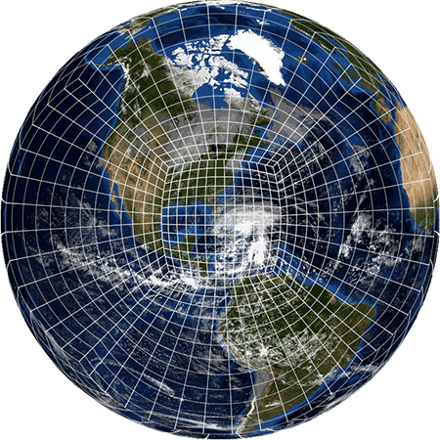
Conclusion of the FV3GFS Evaluation
27 September 2018 MEG Briefing
Logan Dawson Alicia Bentley
Tracey Dorian Geoff Manikin
EMC Model Evaluation Group

Slide 2
Topic
Conclusion of the FV3GFS evaluation
Review of official evaluation comments and recommendations from NWS Regions and NCEP Centers
Examination of three primary concerns:
  Progressive upper troughs
  Cold SST and 2-m temperature biases in Alaska Region
  Day 6-7 track forecasts for TCs in the Atlantic Basin

Slide 3
Official Evaluations

Slide 4
Western Region
FV3GFS performs on the whole as well as the operational GFS
FV3GFS retro runs performed on the whole as well as the operational GFS
Differences from time to time, but neither model was consistently more correct than the other
Bulk statistics were similar
Commented that the emergency HORD change to address the initial hurricane intensity problem was a good move, but new runs were still not home runs
Neutral to the proposed implementation

Slide 5
Central Region
FV3GFS is an improvement over the operational GFS
FV3GFS retro runs showed overall improvement over the operational GFS
Improvement in QPF fields (notably, fewer QPF bullseyes than GFS)
Improvement in how the model handles convective cold pools
Slightly better job with less diurnal convection lingering in the mountains during the overnight
Good job on a case with an Arctic front plunging into the Plains
Improvement in winds for Pacific NW windstorm retro cases suggests some promise for Northern Rockies/High Plains wind season (Oct. to Mar.)
Expressed some apprehension about how the FV3GFS will perform in the cool season given the warm season evaluation period and the limited number of cool season retro cases
Neutral to the proposed implementation

Slide 6
Eastern Region & Southern Region
FV3GFS performs on the whole as well as the operational GFS
FV3GFS retro runs performed on the whole as well as the operational GFS
Southern Region
Most verification stats and information from the real-time parallel are comparable to the operational GFS
Both regions recommended implementation

Slide 7
Pacific Region
FV3GFS is an improvement over the operational GFS
FV3GFS retro runs showed overall improvement over the operational GFS
Despite HORD change, still some interesting issues in Southern Hemisphere TCs
Would like to see additional MEG case reviews during Southern Hemisphere TC season
FV3GFS tended to do much better with intensity in most cases (relative to GFS, which typically overdeepens storms)
Sees no reason to delay implementing the FV3GFS
Recommended implementation

Slide 8
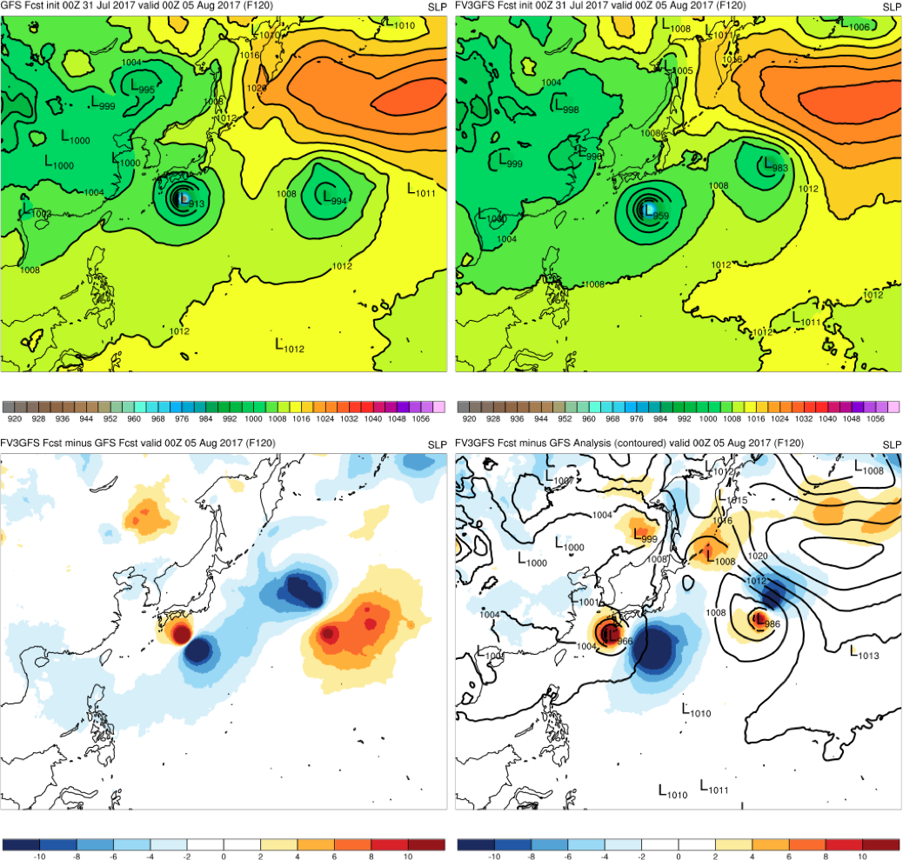
FV3GFS Doesn’t Overdeepen TCs Like the GFS
GFS:
913 mb
FV3GFS:
959 mb
Typhoon Noru
00Z 7/31/17 Cycle
120-h Forecast
KEY:
Blue = FV3GFS
is stronger
(lower MSLP)
Red = FV3GFS
is weaker
(higher MSLP)
GFS ANL: 966 mb; FV3GFS - ANL
FV3GFS−GFS

Slide 9
Alaska Region
FV3GFS performs on the whole as well as the operational GFS
FV3GFS retro runs performed on the whole as well as the operational GFS
Did not see significant degradation or improvement in the overall synoptic pattern
Precipitation fields appear more smoothed than the operational GFS
FV3GFS is capable of capturing turbulence events induced by mountain waves during strong downslope wind events
Most significant concern is strong cold bias in SSTs in shallow waters like Cook Inlet near Anchorage and Norton Sound near Nome due to impact seen on nearby 2-m sfc temps
  Expressed additional concern for winter weather forecasts and the impact on MOS at PANC, the NBM, and the overall forecast process
Did not recommend implementation
  Would recommend with SST fix prior to implementation

Slide 10
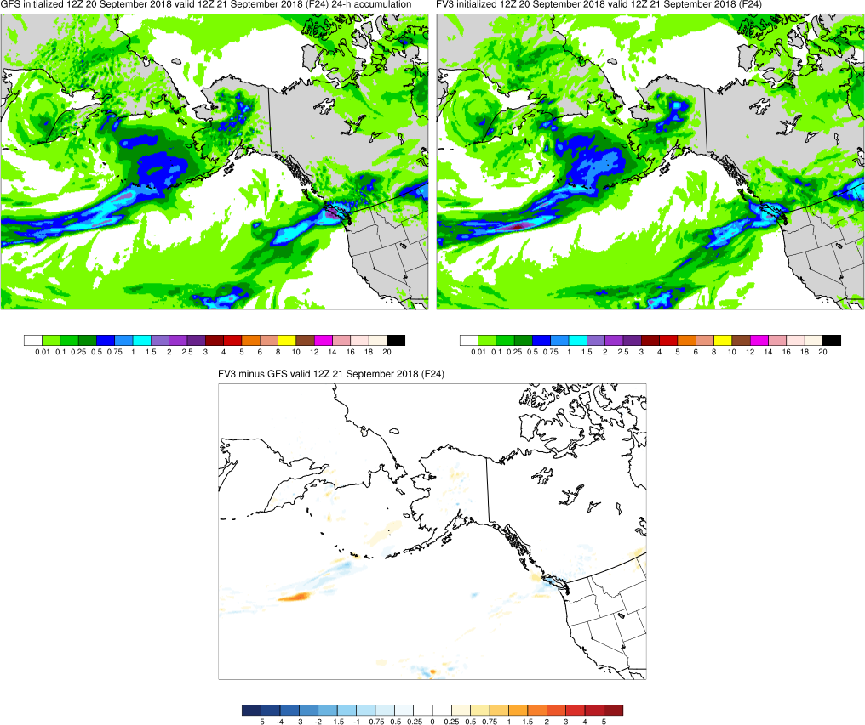
Smoother Appearance of Precipitation Over Terrain
GFS has more detail in QPF over terrain of interior Alaska
Paradoxical given higher-resolution terrain data in FV3GFS

Slide 11
MDL, OWP, and ARL
FV3GFS performs on the whole as well as the operational GFS
MDL
Testing revealed no serious issues or degradation to MOS or LAMP
Recommended implementation
OWP
Most concerned about dry bias at higher precipitation thresholds, especially at longer forecast lead times
Neutral to proposed implementation due to mixed results
ARL
FV3GFS surface winds were comparable to GFS
Using DZDT instead of VVEL caused different dispersion/transport results
Recommended implementation

Slide 12
SPC
FV3GFS performs on the whole as well as the operational GFS
FV3GFS retro runs performed on the whole as well as the operational GFS
Evaluation based on statistical verification and examination of severe cases
Thunderstorm proxy forecasts (combination of instability and precipitation) from the FV3GFS have slightly higher POD and CSI
Expressed concern that the GFS low biases in instability and 2-m dewpoint appear to be worsened in the FV3GFS during the warm season over the CONUS
Expressed concern that (as expected) the FV3GFS over-mixes in the PBL along/near moisture gradients in the Plains
Neutral to the proposed implementation

Slide 13


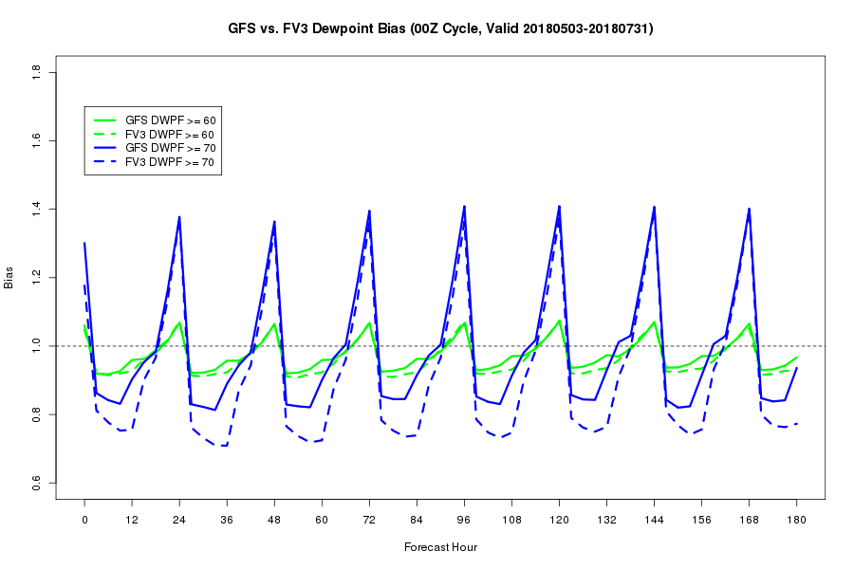
SPC FV3GFS Evaluation
2-m Dewpoint Bias: May-July 2018
over CONUS compared to sfcOA
For the warm season of 2018, the low frequency bias of 2-m dewpoint is slightly worse in the FV3GFS, especially during the overnight & morning hours (03-15Z)
13

Slide 14
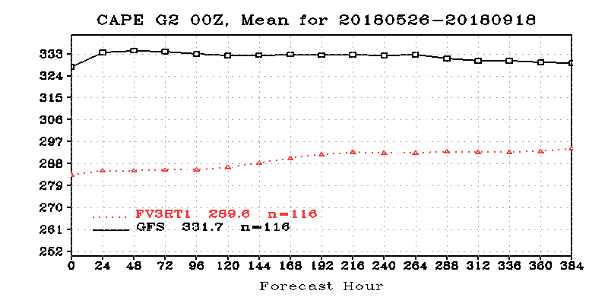
SPC FV3GFS Evaluation
Global Mean CAPE: May-Sep 2018
Courtesy of EMC
A global mean reduction in forecasts of CAPE magnitude by >10% for the FV3GFS seems notable, especially given the low instability bias for the GFS over the CONUS
14

Slide 15
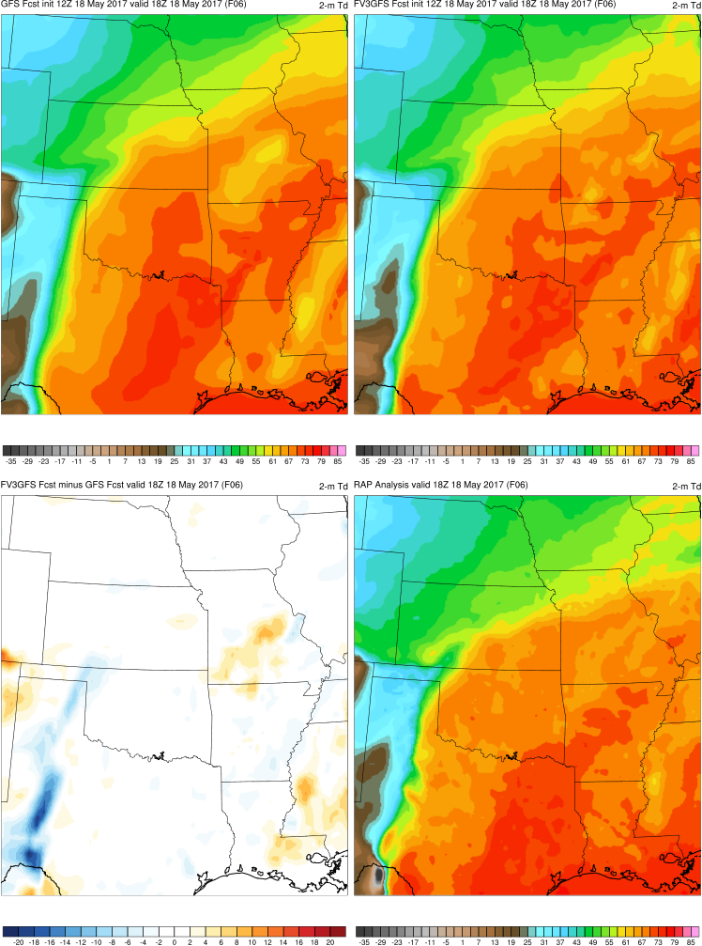
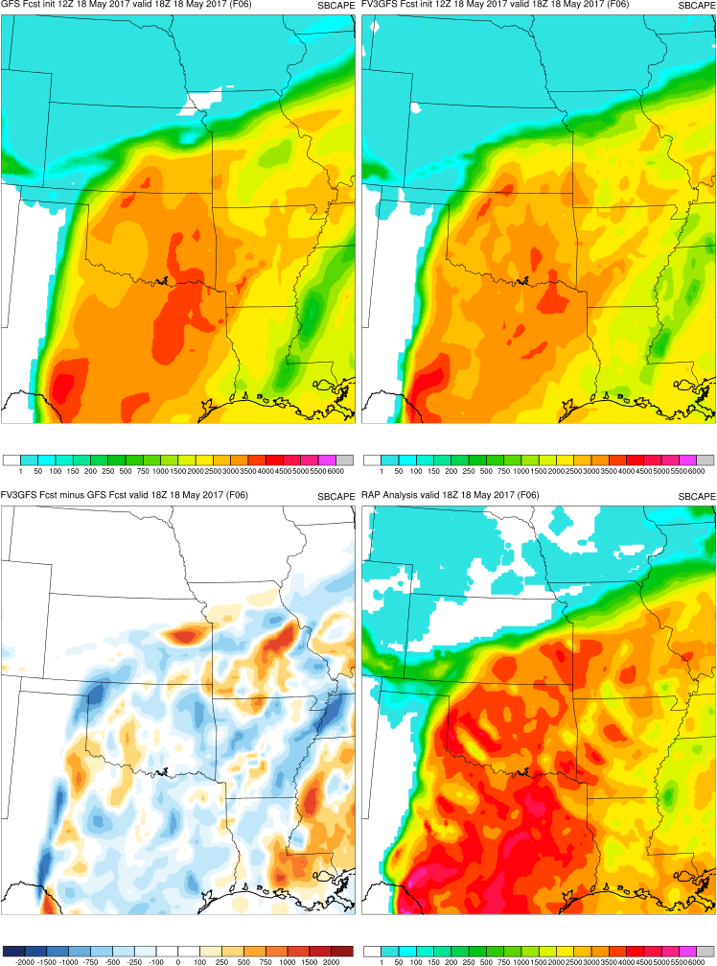
18 May 2017 High Risk
6-h 2-m Td and SBCAPE Forecasts Valid 18Z
An eastward dryline-position bias (i.e., overmixing of PBL) is more pronounced in the FV3GFS than the GFS for this case as well.
GFS
FV3GFS
GFS
FV3GFS
2-m Td
SBCAPE
FV3GFS - GFS
RAP Analysis
FV3GFS - GFS
RAP Analysis
Notice higher CAPE magnitudes in RAP analysis than GFS & FV3GFS forecasts
Courtesy of EMC MEG
Courtesy of EMC MEG
15

Slide 16
AWC
FV3GFS performed on the whole as well as the operational GFS
Wind and other state variables seem consistent with operational GFS
Florence track seemed better 3-4 days out
Expressed concern about GTG not producing realistic results below 400 mb (has been addressed by EMC)
Expressed some concern about degradation of the visibility product
Requested some attention be paid to these post-processing problems given that the FV3GFS state variables appear comparable to the GFS
Neutral to proposed implementation

Slide 17
CPC
FV3GFS performs on the whole as well as the operational GFS
FV3GFS retro runs showed overall improvement over the operational GFS
FV3GFS forecast skill in predicting the MJO was similar to GFS skill for the real-time parallel and most recent retro period
FV3GFS ACs and RMSE are very similar to the operational GFS for daily, D+8, and Week 2 forecasts of Z500 and T850 in the extratropical NH and the PNA
FV3GFS forecasts of stratospheric specific humidity are much more realistic, and total ozone forecasts are better outside polar regions
Other stratospheric forecasts are largely similar, including the 2018 SSW event
Recommended implementation

Slide 18
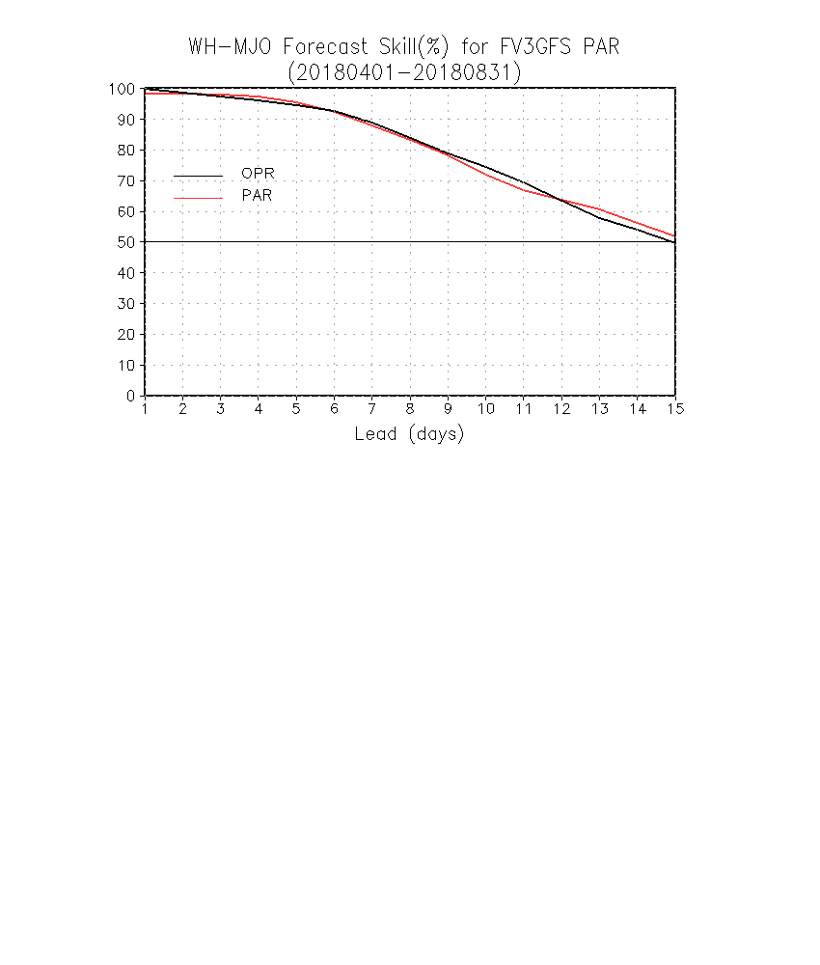
MJO Forecast Skill for Parallel Run
FV3
Following slides from CPC
FV3GFS forecast skill was similar to GFS skill for parallel and most recent retro period
FV3GFS retrospective skill was superior to forecasts from prior GFS versions

Slide 19
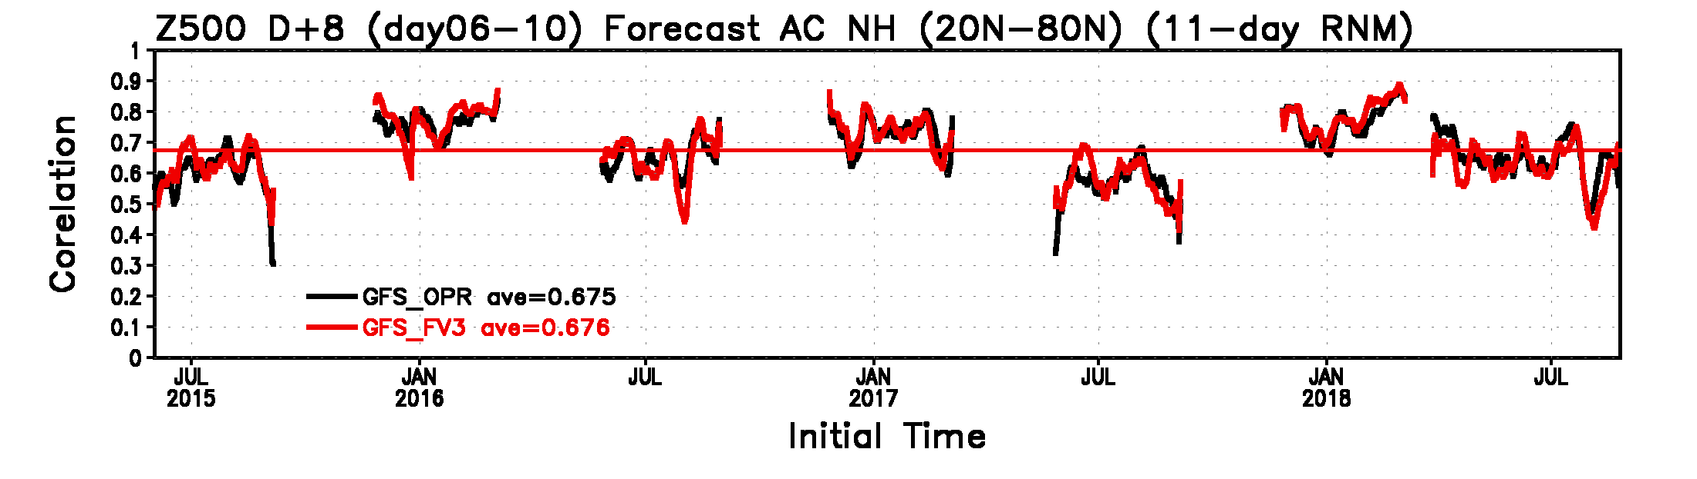
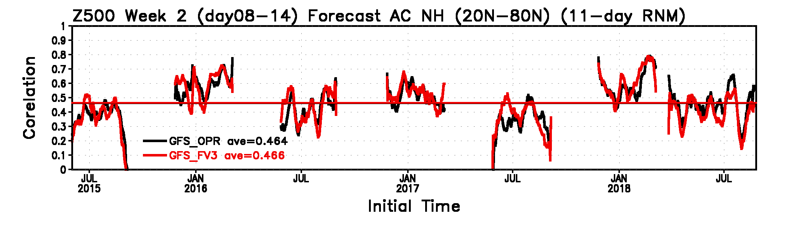
Time Series of the Spatial Correlation over NH and PNA
FV3GFS ACs are slightly improved for Day 6-10 and Day 8-14 averaged forecasts of 500 mb heights

Slide 20
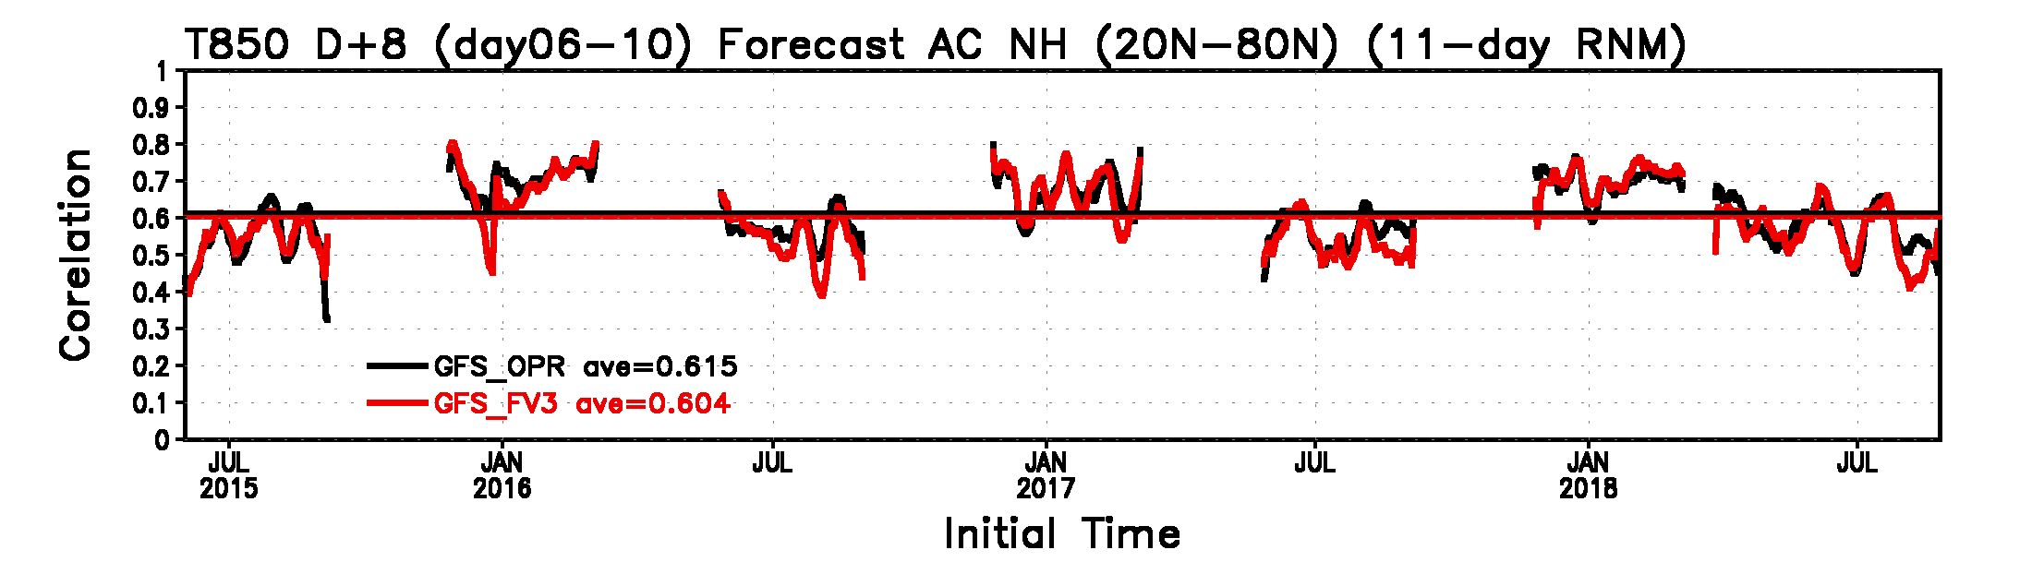
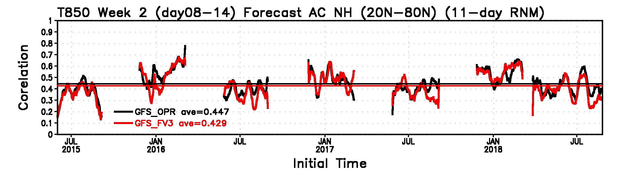
Time Series of the Spatial Correlation over NH and PNA
FV3GFS ACs are slightly worse for Day 6-10 and Day 8-14 averaged forecasts of 850 mb temperatures (consistent with low T850 bias shown during 9/20 MEG)

Slide 21
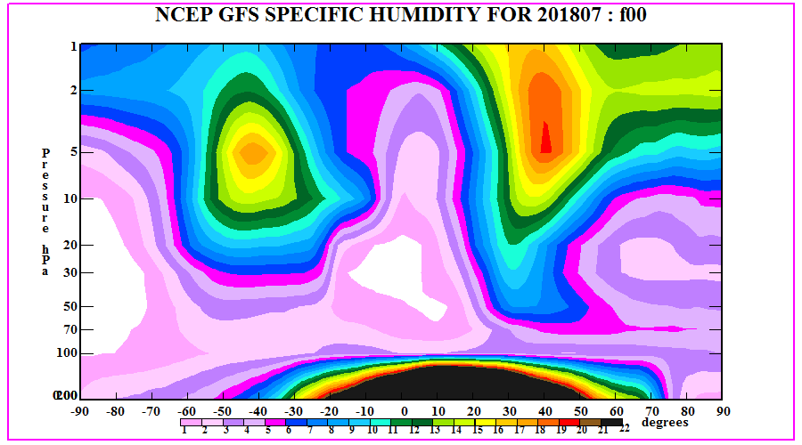
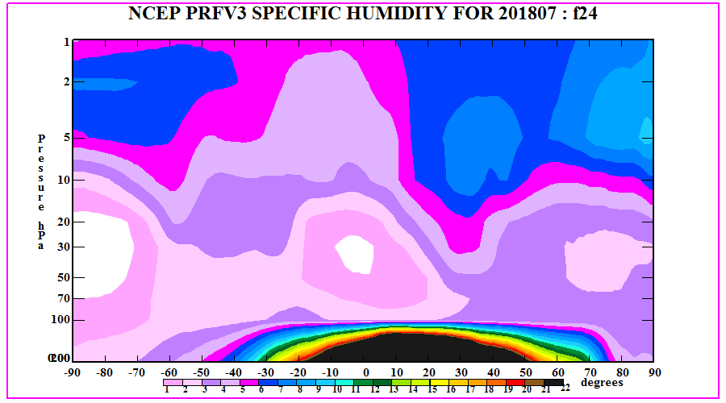
GFS / PRFV3 Zonal Mean SPFH and SPARC Climatologies
July 2018
Unrealistically high values
Values agree more with climatology

Slide 22
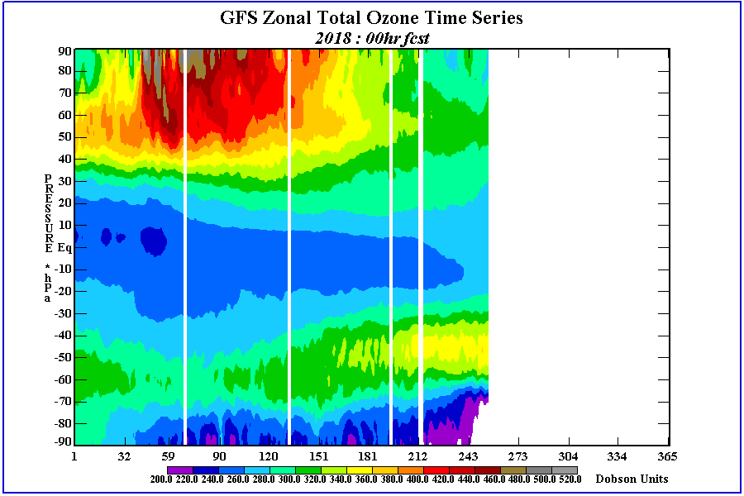
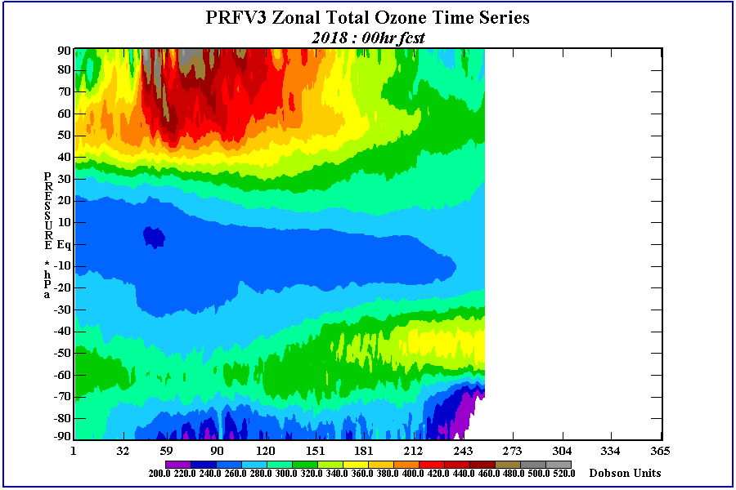
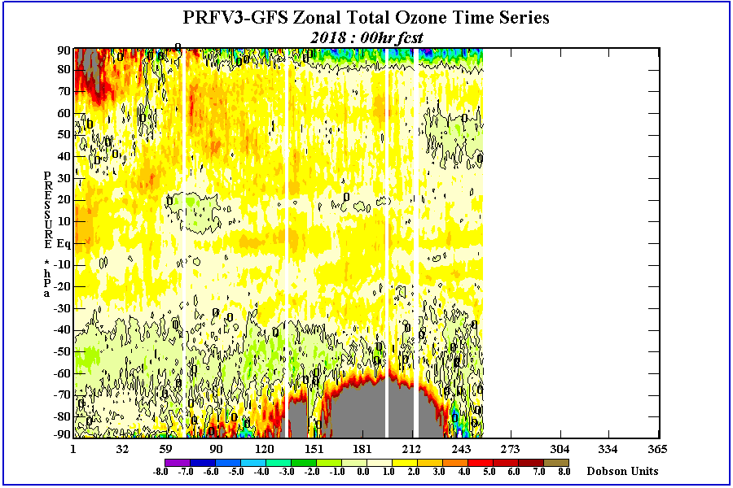
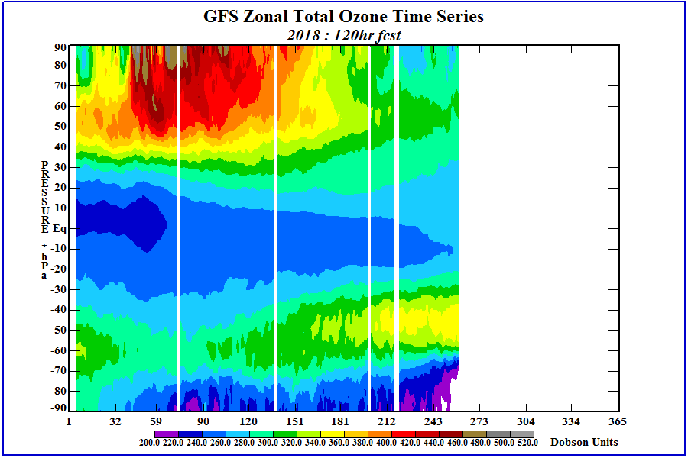
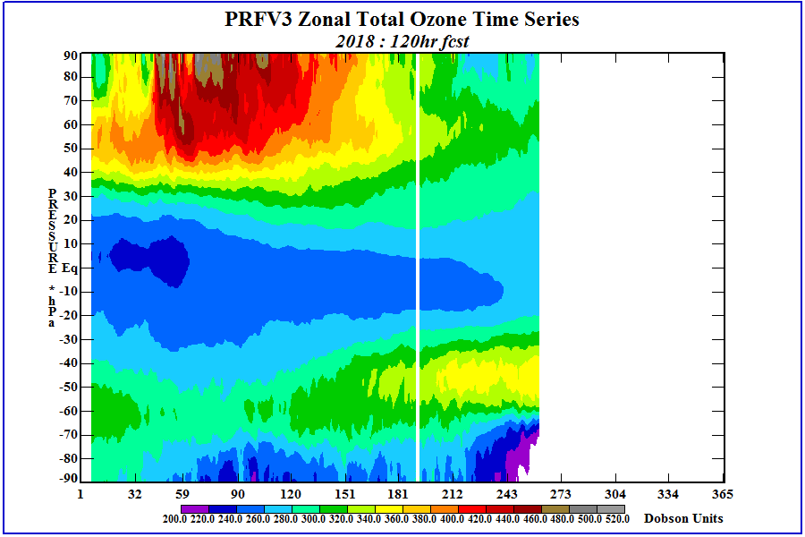
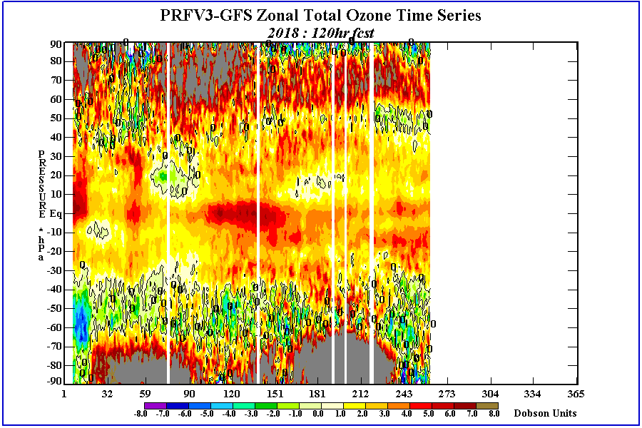
GFS / PRFV3 Total Ozone Time Series and Diff
f00
f120
PRFV3 has much larger total ozone amounts in south polar region during winter months.
PRFV3 total ozone forecasts have more ozone than GFS (known for losing ozone).

Slide 23
WPC*
FV3GFS performs on the whole as well as the operational GFS
FV3GFS retro runs performed on the whole as well as the operational GFS
Evaluated by forecasters, development staff, and participants in WPC WWE and FFaIR testbed experiments
Mass fields were generally similar through Day 5, then differences increased. Neither the operational or parallel model consistently outperformed the other
During a few significant events for the 2018 cool season, the FV3GFS was more progressive, and the slower GFS was superior
24-h QPFs for Days 1-3 showed more substantial differences than mass fields, but again neither the operational or parallel model consistently outperformed the other
FV3GFS had universally smoother precipitation over higher terrain. Maxes generally remained, but ops GFS showed more detail
*WPC slides also include feedback and the recommendation from the FV3 Evaluation and Dissemination National SOO Team

Slide 24
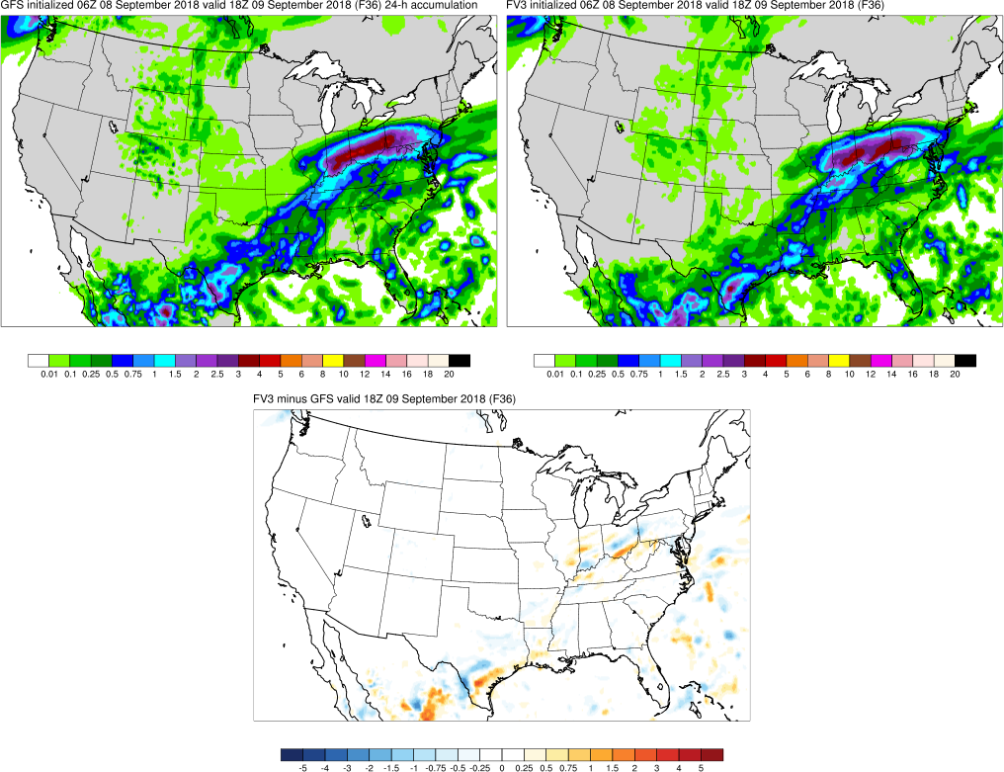
Smoother Appearance of Precipitation Over Terrain
GFS has more detail in QPF over the Rockies
Paradoxical given higher resolution terrain data in FV3GFS

Slide 25
WPC (cont’d.)
FV3GFS showed a low bias for heavier (0.50”+) QPF in several cases like Florence
  Typically more prevalent in weakly-forced scenarios
FFaIR participants noted stated that the FV3GFS “did exceptionally well capturing the areal extent and location of precipitation events”
WWE participants were generally satisfied with the identification of precipitation type transition zones
FV3GFS under-forecasted sleet and freezing rain
FV3GFS had a tendency to erode low-level cold air too quickly
  Both are issues common to the GFS and FV3GFS

Slide 26
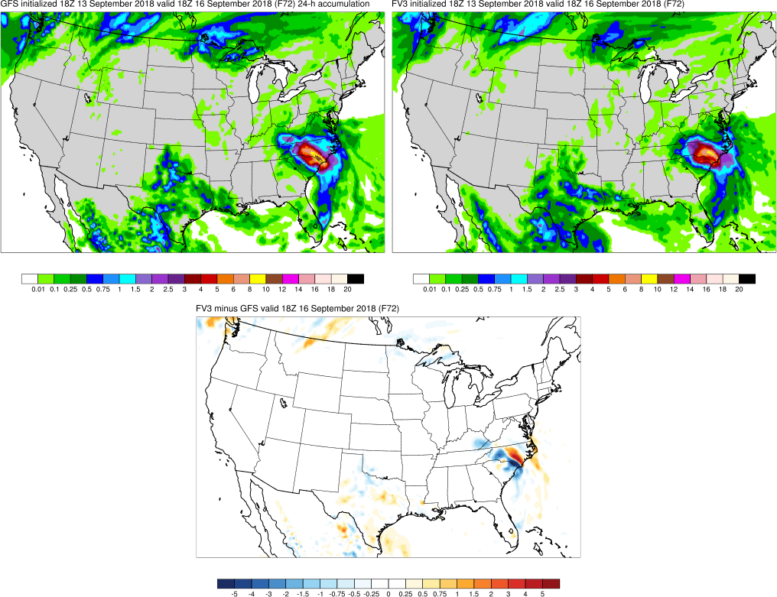
FV3GFS QPFs Were Underdone During Florence
FV3GFS generally has a lower spatial coverage of 24-h QPF exceeding 6”
GFS axis maxes out in 10-12” range
FV3GFS maxes out around 8-10”

Slide 27
WPC (cont’d.)
FV3GFS corrected the well-known northward QPF bias due to displacement of organized convection of the GFS
FV3GFS also better represented convective cold pools
QPF from high-level moisture (in the West) correctly showed less coverage, especially when low elves were initially dry
Most concerned with the 1) progressive bias of upper troughs, 2) dry bias at mid-upper range QPF thresholds, and 3) smoother appearance of QPF over terrain
Overarching conclusion is that the FV3GFS and the operation GFS are at about the same level of performance
WPC and the National SOO team recommended implementation

Slide 28
OPC
FV3GFS is an improvement over the operational GFS
FV3GFS retro runs showed overall improvement over the operational GFS
500 mb AC scores are a clear improvement and the principal basis for the overall impression
Retros such as Joaquin show clear improvement at critical forecast times
Not concerned with secondary or spurious lows in midlatitude ocean storms
Pleased with improved extratropical cyclone tracks
Expressed concern about Days 6 and 7 track errors for Atlantic TCs
Expressed concern about the model tending to mix out shallow inversions, which are critical for wind forecasts north of the Gulf Stream in late winter and spring
Could have easily said “performs just as well as ops GFS”
Recommended implementation

Slide 29
NHC
FV3GFS performs on the whole as well as the operational GFS
FV3GFS retro runs performed on the whole as well as the operational GFS
FV3GFS showed incremental improvements in forecasting TC genesis, with a significant reduction in false alarms but a small decrease in POD

Slide 30
NHC (cont’d.)
East Pacific Basin
FV3GFS retros showed about 2% improvement in short-term track forecasts
FV3GFS intensity forecasts were improved out to 60 hours
FV3GFS had a positive effect on HWRF track forecasts out to 60 h, but were degraded by 5% after
FV3GFS led to degradation in HWRF intensity forecasts (about 10% out to 72 h and 3-5% on Days 4 and 5)
FV3GFS led to about 3-5% improvement in HMON track forecasts
FV3GFS led to generally degraded HMON intensity forecasts through Day 4, but improved by 5-10% at Day 5
FV3GFS improved HCCA intensity forecasts at most lead times
FV3GFS improved HCCA track forecasts through 60 h, but slightly degraded after

Slide 31
NHC (cont’d.)
Atlantic Basin
FV3GFS retros showed 3-5% improvements in short-to-medium term track forecasts
FV3GFS intensity forecasts were improved by 10-15% at all lead times
FV3GFS had a positive effect on HWRF track forecasts out to Day 5, but a negative impact after
FV3GFS led to slight (3%) improvements in HWRF intensity forecasts
FV3GFS led to large (>10%) improvements in HMON track forecasts
FV3GFS degraded HMON intensity forecasts by about 8% on Day 1 with slight improvements on Days 2-5
FV3GFS improved HCCA intensity forecasts at most lead times
FV3GFS improved HCCA track forecasts through Day 4, with slight degradation at Day 5

Slide 32
NHC (cont’d.)
Most concerning is the large (> 20%) degradation in Atlantic TC track forecasts on Days 6-7
Degradation in track forecasts was seen at all lead times for Atlantic hurricanes, with track errors as much as 50% larger on Day 7
Appears to be due to large cross-track errors and potentially a large storm bias
Fast bias was noted for stronger storms
FV3GFS would degrade multi-model track consensus by about 14% at Day 7
Neutral to proposed implementation

Slide 33
Common Positive Remarks

Slide 34
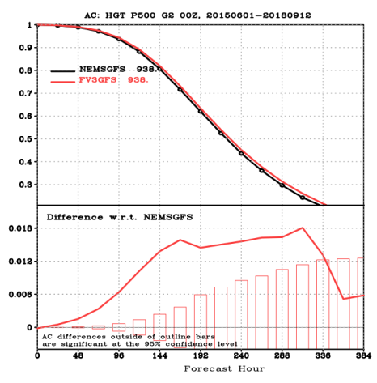
1. Overall Improved or Similar Synoptic Stats
500 mb ACs are significantly improved
CONUS-averaged sensible weather stats are comparable

Slide 35

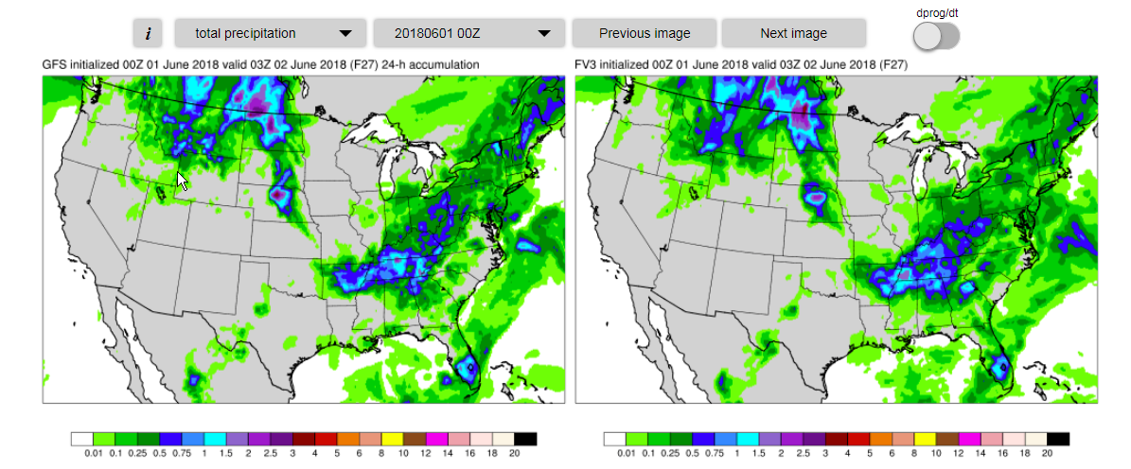
GFS/FV3 Precip. Comparison (Good)
Case Study #1 (Init. Jun 1 00Z, Valid Jun 2 03z)
Both Models handled the QPF well
GFS
FV3GFS
2. Representation of Convective Cold Pools
From Rob Cox (WFO CYS)

Slide 36
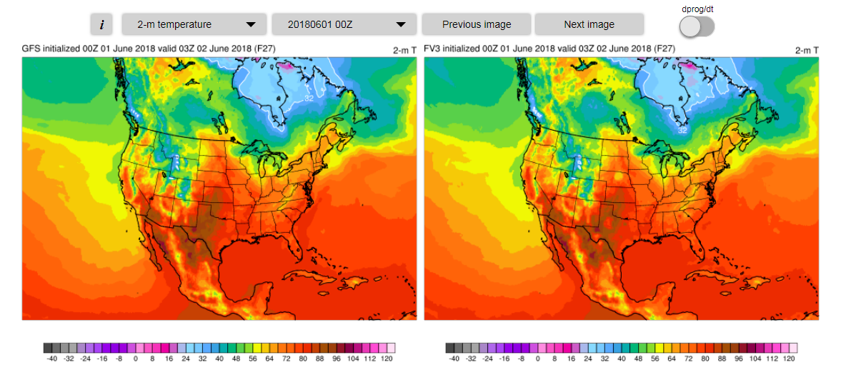
Cold Pool Caught during Convection (FV3 Good)
Case Study #1 (June 2nd 03z)
GFS
FV3GFS
2. Representation of Convective Cold Pools
From Rob Cox (WFO CYS)

Slide 37
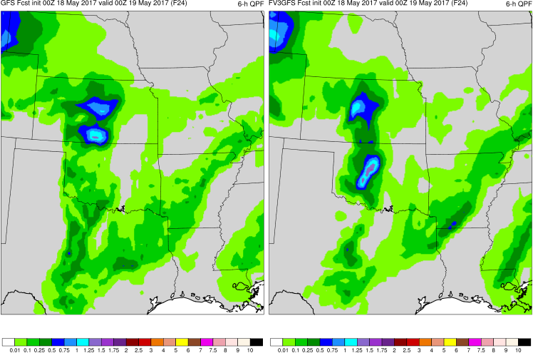
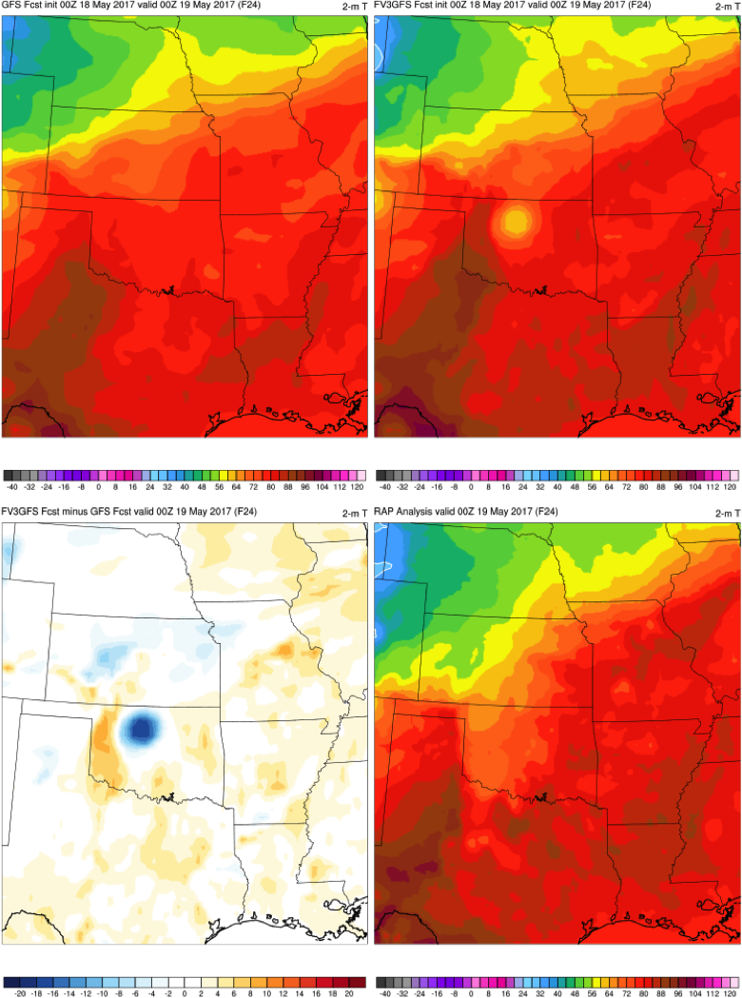
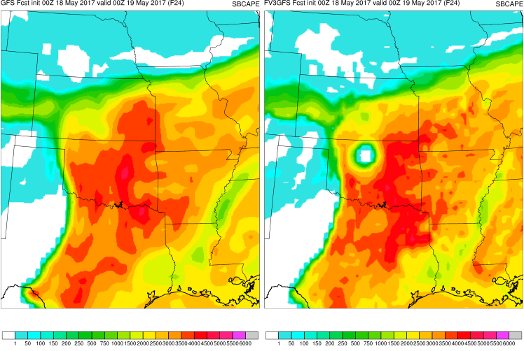
2. Representation of Convective Cold Pools
6-h Precip
2-m Temp
GFS
FV3GFS
GFS
FV3GFS
SBCAPE
2-m Temp
GFS
FV3GFS
FV3GFS - GFS
RAP ANL

Slide 38
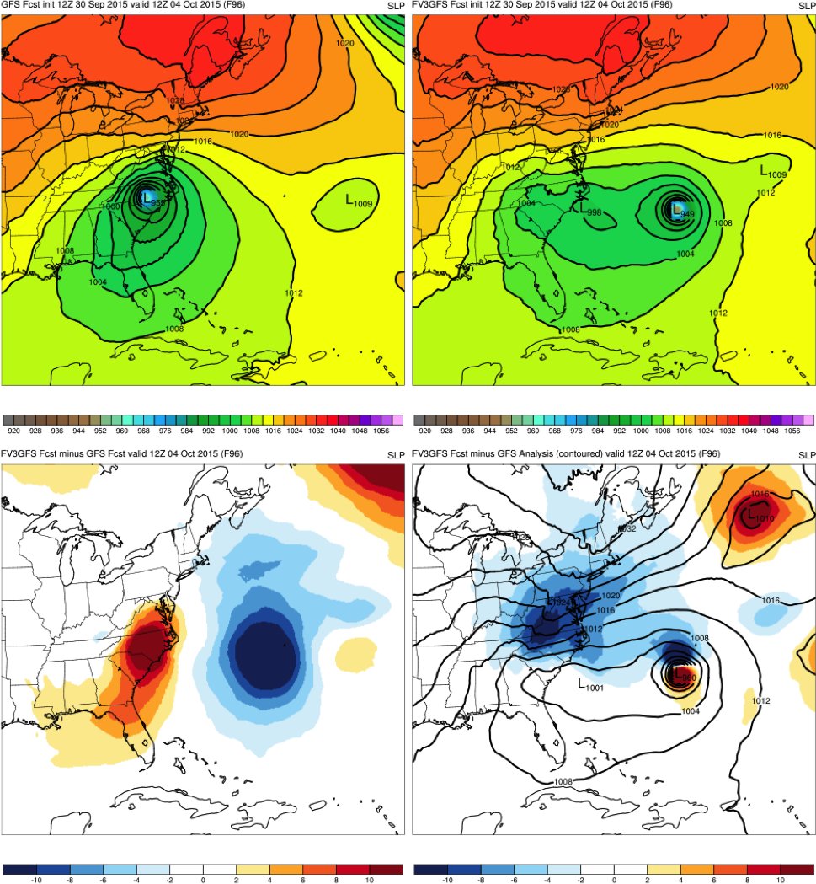
3. Ability to Match or Exceed GFS Performance for High-Impact Cases
Hurricane Joaquin
12Z 10/4/15 Cycle
96-h Forecast
Massive improvement with the FV3GFS keeping Joaquin out to sea
GFS
FV3GFS
KEY:
Blue = FV3GFS
is stronger
(lower MSLP)
Red = FV3GFS
is weaker
(higher MSLP)
GFS ANL; FV3GFS - ANL
FV3GFS−GFS

Slide 39
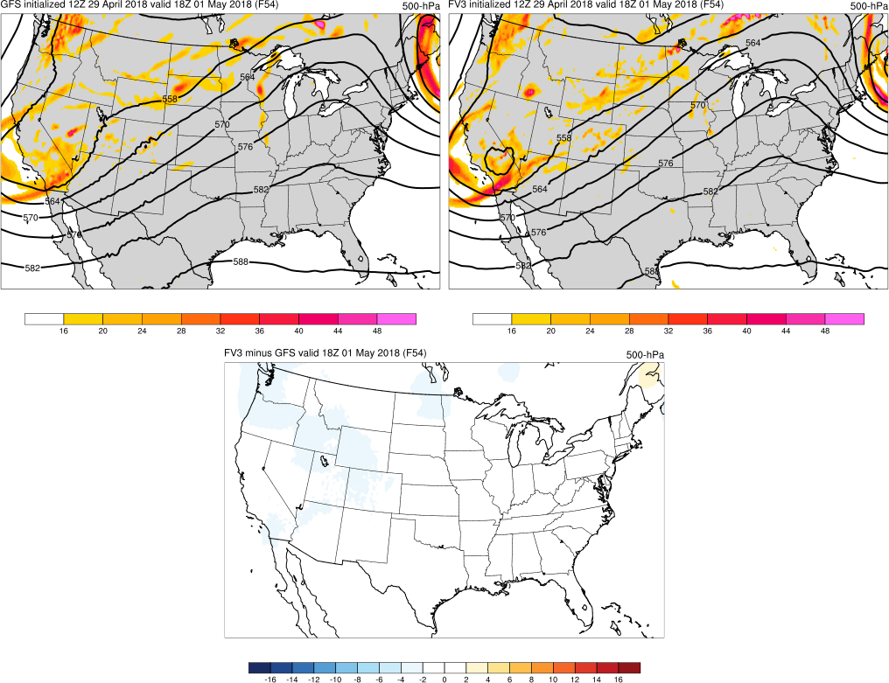
01 May 2018 Moderate Risk
54-h 500-mb Height Forecasts Valid 18Z
500-mb forecast is still similar 54-h out, with slightly lower heights in FV3GFS (consistent with FV3GFS low-height bias).
GFS
FV3GFS
FV3GFS - GFS
Courtesy of EMC MEG
39

Slide 40
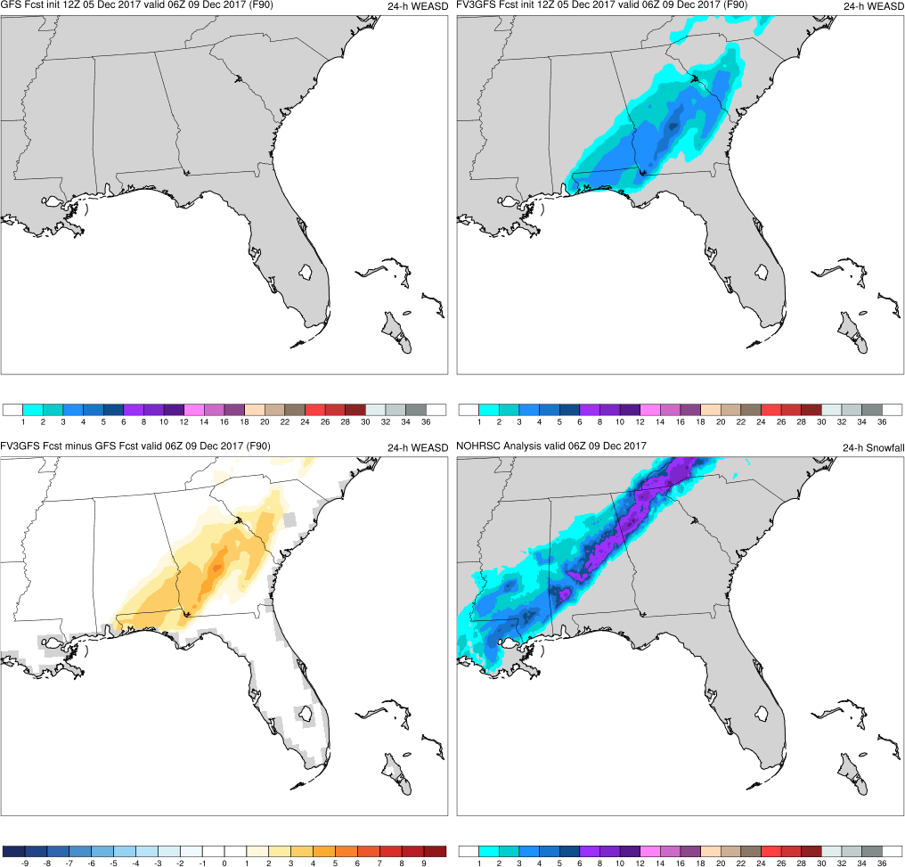
3. Ability to Match or Exceed GFS Performance for High-Impact Cases
Southeast US Snowstorm
12Z 12/5/17 Cycle
90-h Forecast
FV3GFS captures snowfall across the southeast U.S. before the GFS
GFS
FV3GFS
KEY:
Blue = FV3GFS
has less snowfall
than GFS
Red = FV3GFS
has more snowfall
than GFS
FV3GFS−GFS
NOHRSC

Slide 41
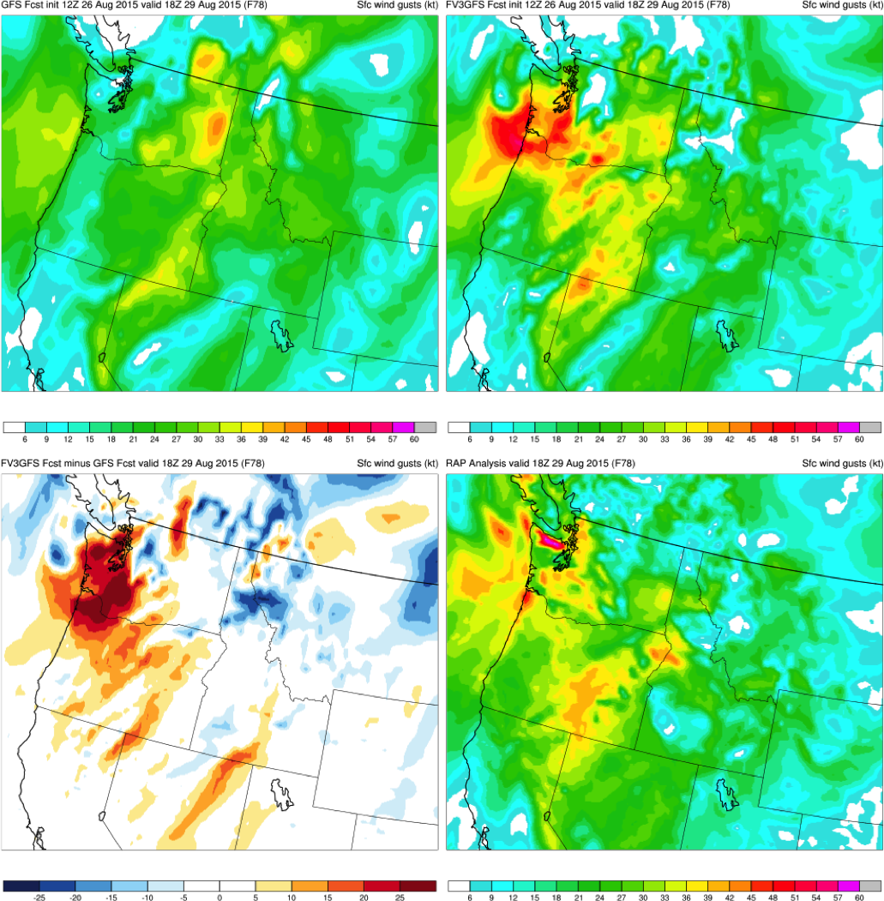
3. Ability to Match or Exceed GFS Performance for High-Impact Cases
Pacific Northwest Windstorm
12Z 8/26/15 Cycle
78-h Forecast
FV3GFS forecasts windstorm 78-h prior, but GFS does not
Location of strongest sfc gusts too far east due to low’s position
GFS
FV3GFS
KEY:
Blue = FV3GFS
gusts are weaker
(slower winds)
Red = FV3GFS
gusts are stronger (faster winds)
FV3GFS−GFS
RAP ANL

Slide 42
Common Concerns

Slide 43
Common Concerns and Major Issues
Common Concerns
Dry bias at mid-upper range QPF thresholds
Smoother appearance of QPF in areas of complex terrain
Like the GFS, low bias in 2-m dewpoints (primarily in the West) and CAPE
Like the GFS, the FV3GFS struggles with mixing out shallow inversions, which has significant implications for:
  Forecasting winds within the boundary layer
  Maintaining low-level cold air in mixed precipitation type regimes
  Maintaining strong moisture gradients in severe weather events

Slide 44
Common Concerns and Major Issues
Major Concerns (highlighted in following sections)
Progressiveness of upper troughs
Cold SST and 2-m temperature biases in Alaska Region
Significant degradation of Day 6-7 Atlantic hurricane track forecasts

Slide 45
1. A Look at Progressive Upper Troughs

Slide 46
Test:
Plot a month’s worth of Day-6 forecasts over North America and look for progressiveness
Forecasts initialized every 24 h
during March 2018
NEMSGFS vs. FV3GFS (hord = 5)
http://www.emc.ncep.noaa.gov/users/Alicia.Bentley/fv3gfs/retros/march2018_hord5/day6_fcst.php

Slide 47
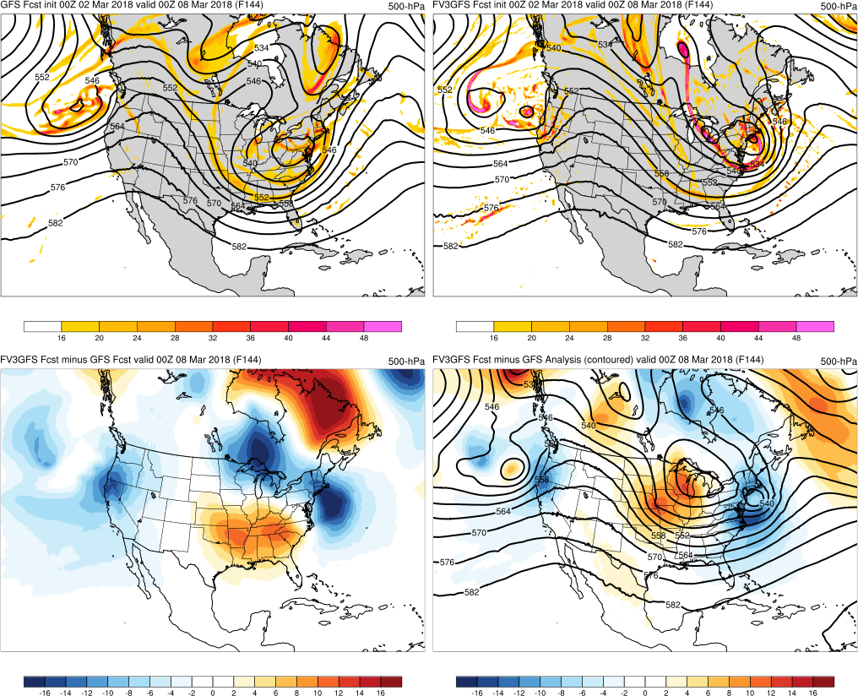
(Example 1) Initialized: 00Z 3/02/2018
GFS
FV3GFS
FV3GFS−GFS
FV3GFS−GFS Anl.
FV3GFS is commonly more progressive than the GFS ANL
Also a problem of the ops GFS
Focusing here on FV3GFS forecast versus GFS forecast

Slide 48
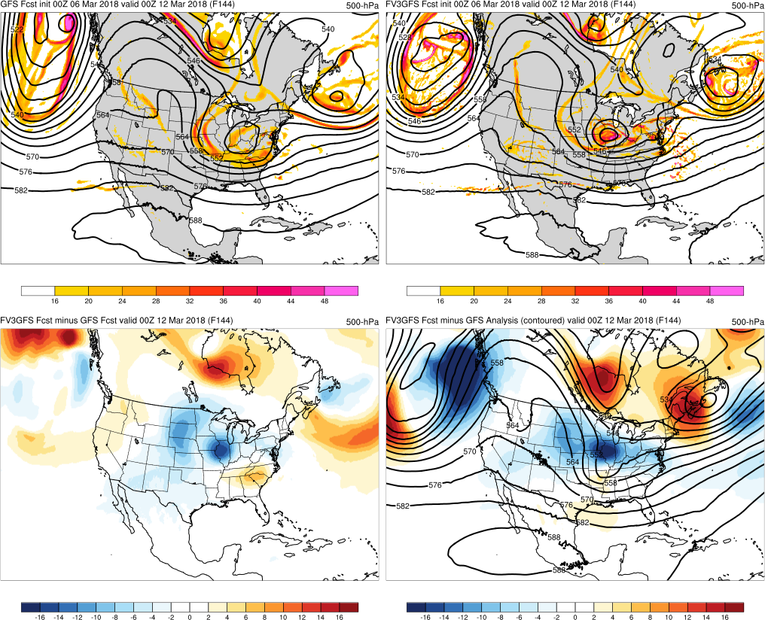
(Example 3) Initialized: 00Z 3/06/2018
GFS
FV3GFS
FV3GFS−GFS
FV3GFS−GFS Anl.

Slide 49
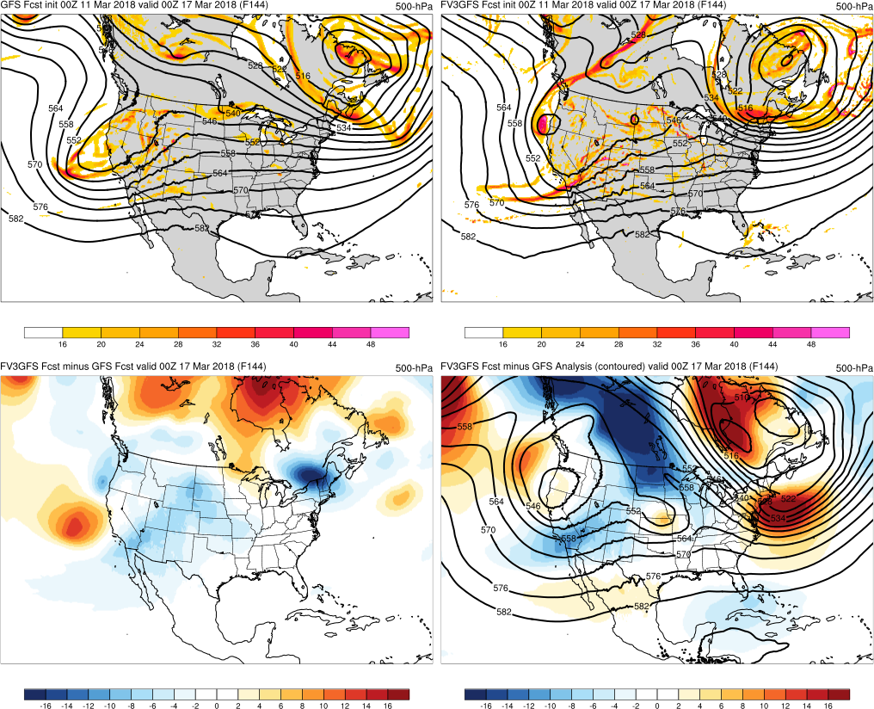
(Example 5) Initialized: 00Z 3/11/2018
GFS
FV3GFS
FV3GFS−GFS
FV3GFS−GFS Anl.

Slide 50
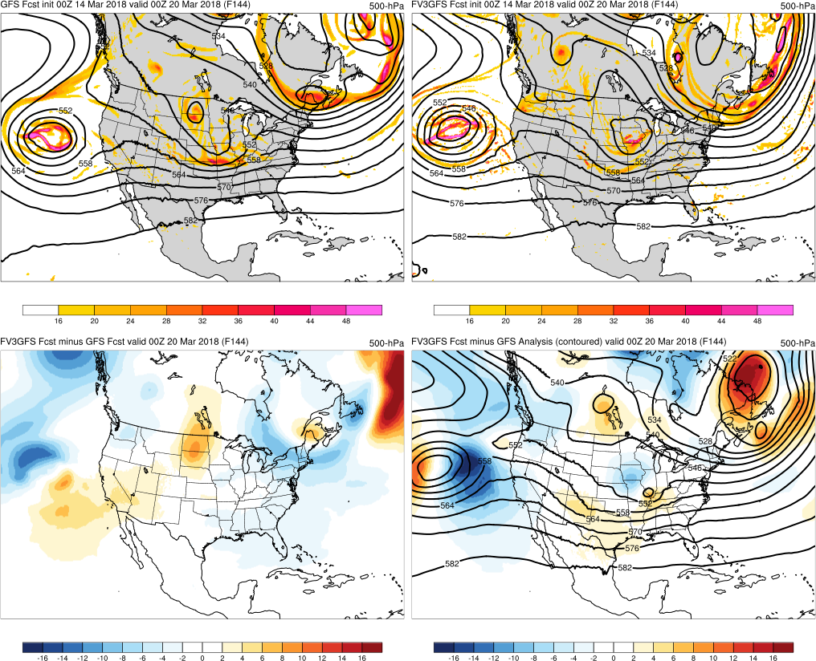
(Example 7) Initialized: 00Z 3/14/2018
GFS
FV3GFS
FV3GFS−GFS
FV3GFS−GFS Anl.

Slide 51
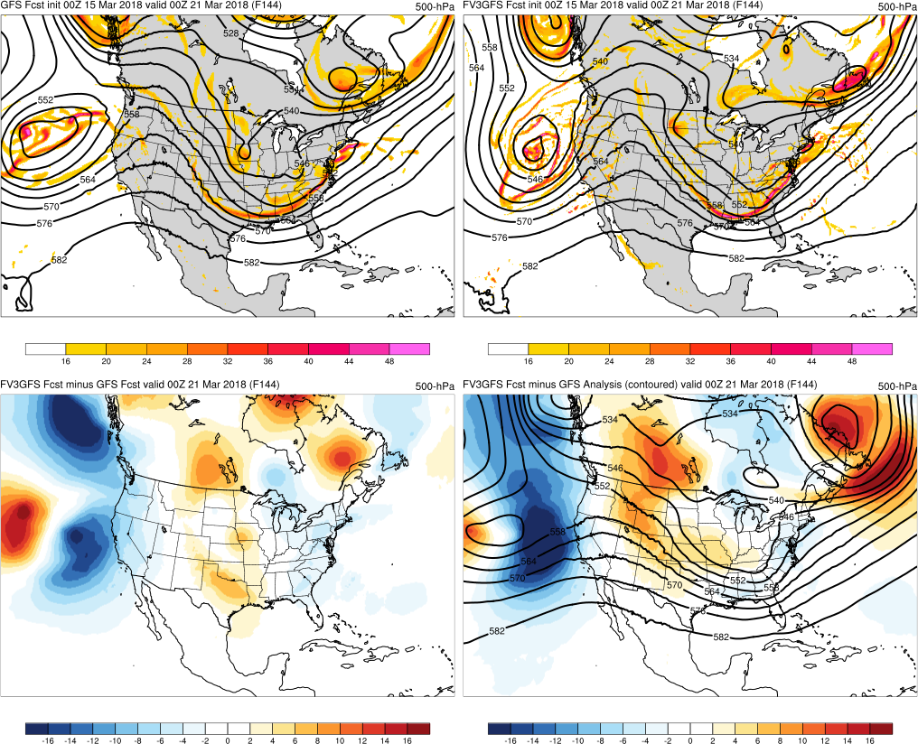
(Example 8) Initialized: 00Z 3/15/2018
GFS
FV3GFS
FV3GFS−GFS
FV3GFS−GFS Anl.

Slide 52
Results:
Out of a month’s worth of Day-6 forecasts over North America, FV3GFS was too progressive
20 out of 31 days
FV3GFS was more progressive than GFS for
9 of its 20 progressive days (almost even split)
Progressiveness can be subtle, possibly explaining lack of reflection in Northern Hemisphere AC scores

Slide 53
2. Cold SST and 2-m Temperature
Biases in Alaska Region

Slide 54
Mean SSTs in Northern Pacific Ocean Are Clearly Colder in the FV3GFS

Slide 55
2m TEMPS
NORTH ALASKA
OBS GFS FV3GFS
SOUTH ALASKA
Have introduced a clear cold bias during warmest and coldest times of day; largest in afternoon

Slide 56
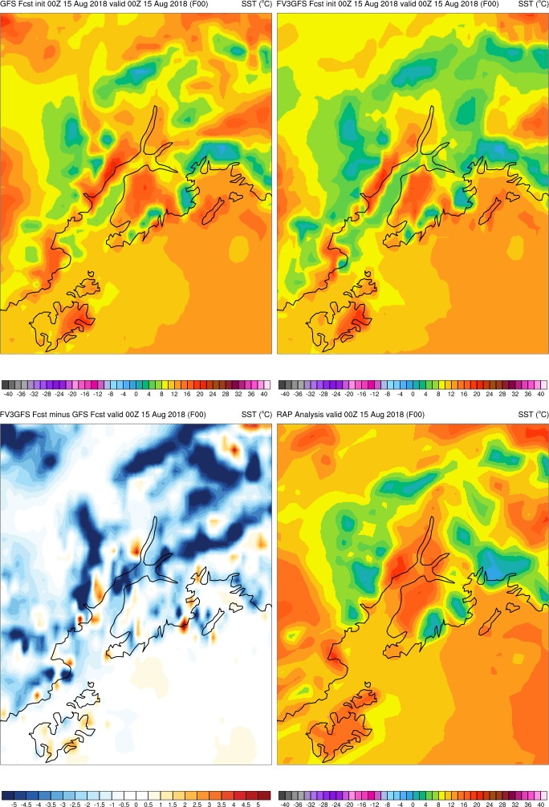
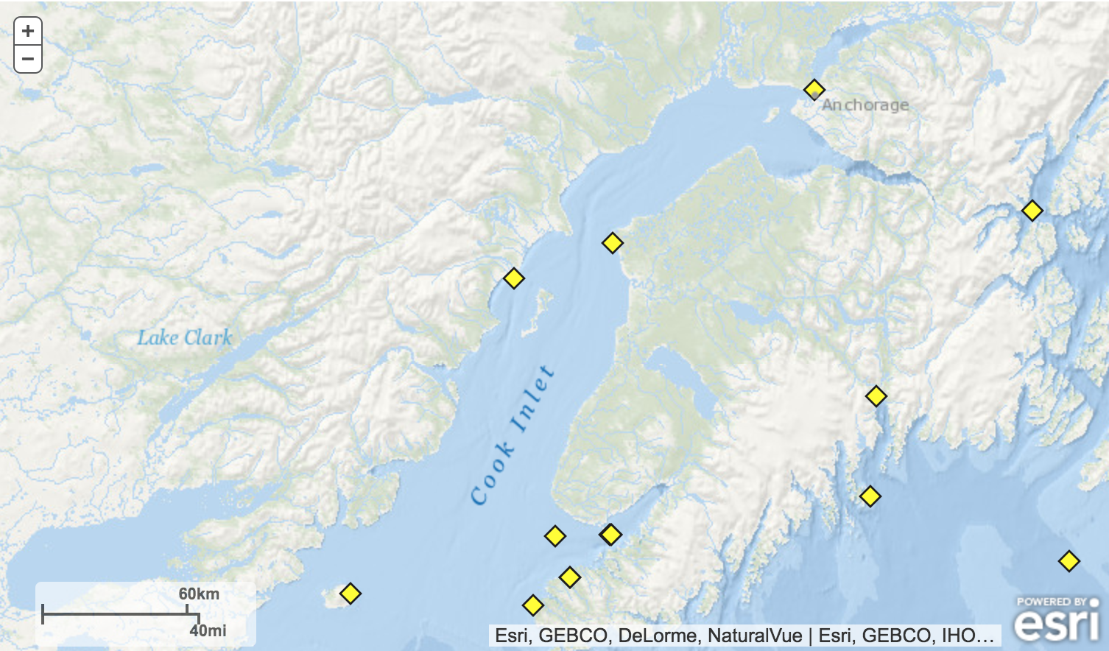
Cook Inlet Buoys
ANTA2
NKTA2
46108
FV3GFS is clearly colder than the GFS, RAP analysis, and buoy obs at ANTA2 and NKTA2

Slide 57
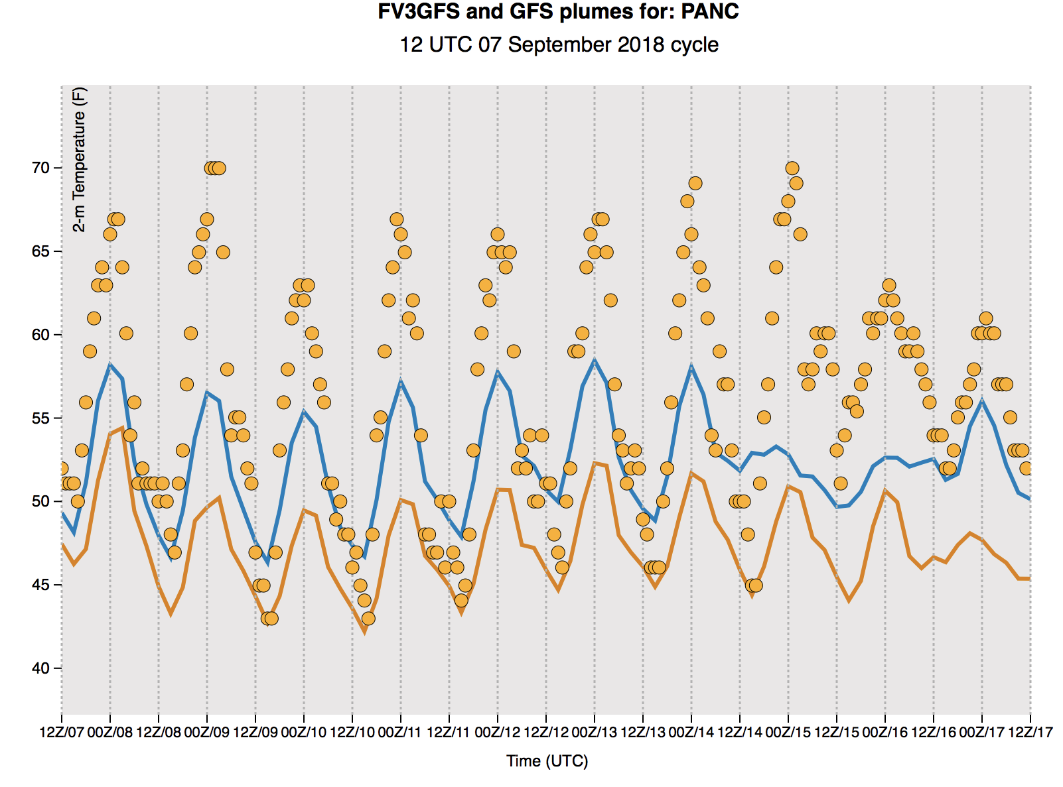
SAMPLE PLUMES of 2-mT at ANCHORAGE, AK
GFS
FV3GFS
OBS

Slide 58
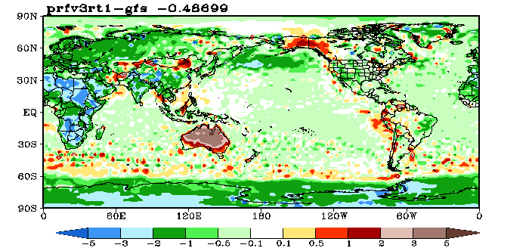
Diagnosing and Fixing the NSST Issue
In response to feedback on how well gulf stream was resolved, the background error correlation lengths were revised to be more consistent with those used in other operational SST analyses (50km).
After a number of months of pre-operational testing an SST anomaly of ~3K was noted in the northern Pacific. This was a symptom of a lack of observations in the area and the reduced influence of distant observations because of the reduction in length scales.
At the same time anomalies in lake temperatures were noted by the MEG team which was also traced to a lack of observations being assimilated.
Tref, 26 May – 18 September 2018
Both of these are solved by switching on a climatological update of the tref to the background SST field. This option is currently being tested along with an increase in background error length scales to 100km.
gcycle is now called hourly in GDAS forecast step
From: DA Team

Slide 59
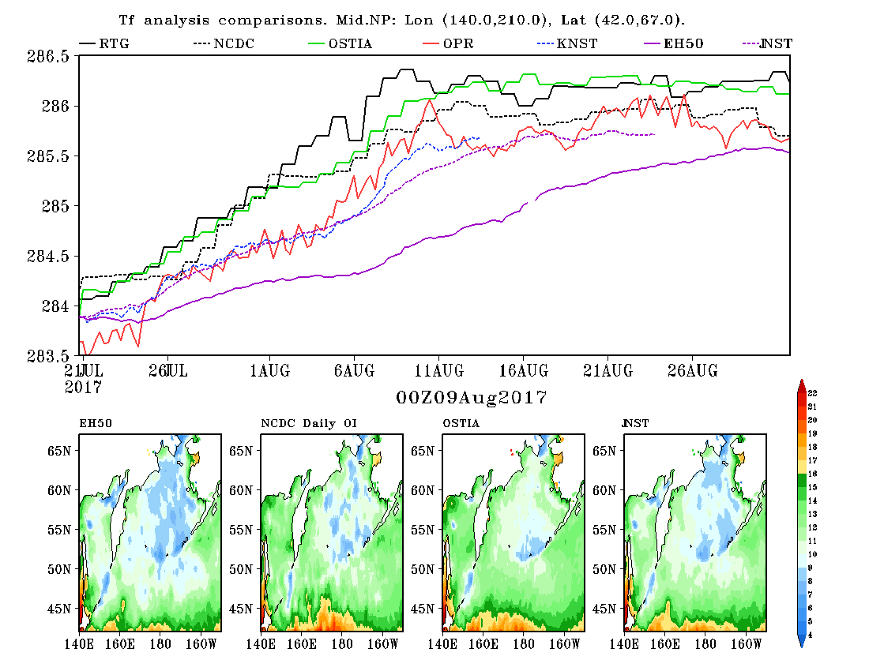
Fixing the N. Pacific Cold Bias
RTG Analysis
NCDC OI Analysis (dashed)
Ostia Analysis
Operational NSST
NSST 100km + clim. update.
NSST 50km + clim. update.
NSST 50km

Slide 60
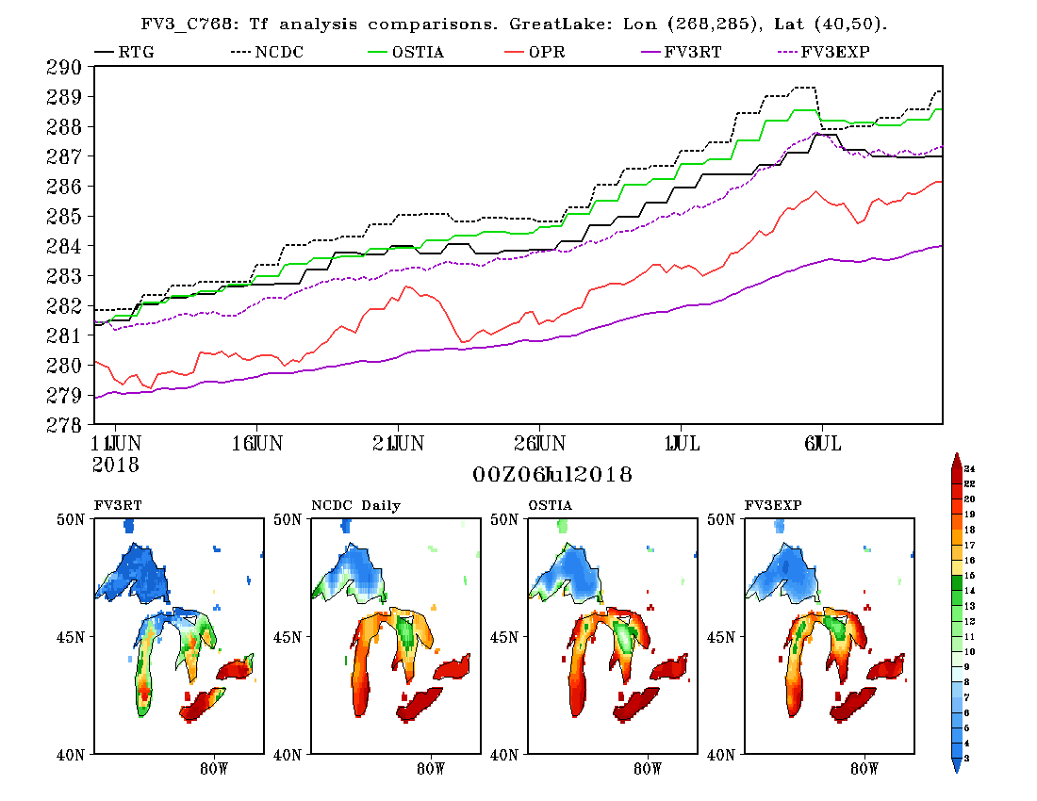
Fixing the Great Lakes Cold Bias
RTG Analysis
NCDC OI Analysis (dotted)
Ostia Analysis
Operational NSST
NSST: FV3 real time parallel
NSST: FV3 EXP with fixes (dashed)
Cold
warmer

Slide 61
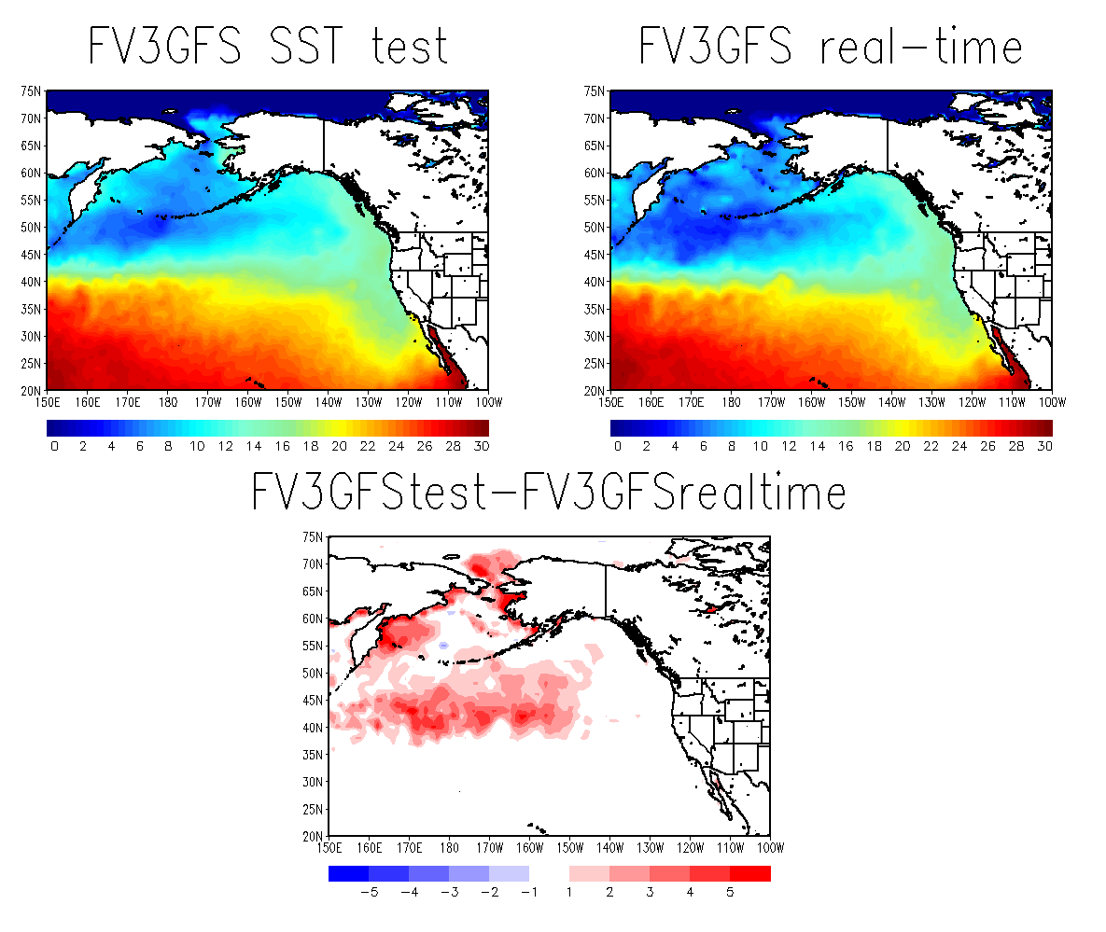
SSTs in Northern Pacific Ocean and Bering Sea
Are Several Degrees Warmer in Test Run
00Z 7/16/18 Cycle 12-h Forecast
Test run shows improvement in areas of most concern

Slide 62
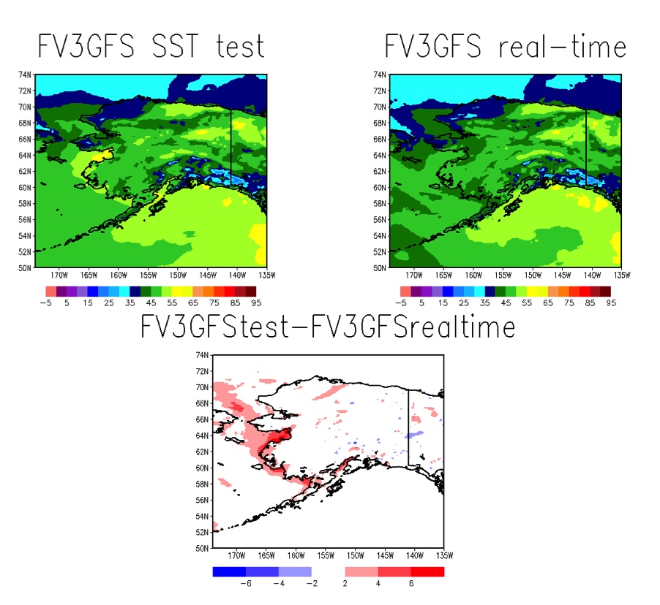
SSTs Are Warmer in Shallower Bays and Inlets Around Alaskan Coast
00Z 7/16/18 Cycle 12-h Forecast
Test run shows improvement in areas of most concern

Slide 63
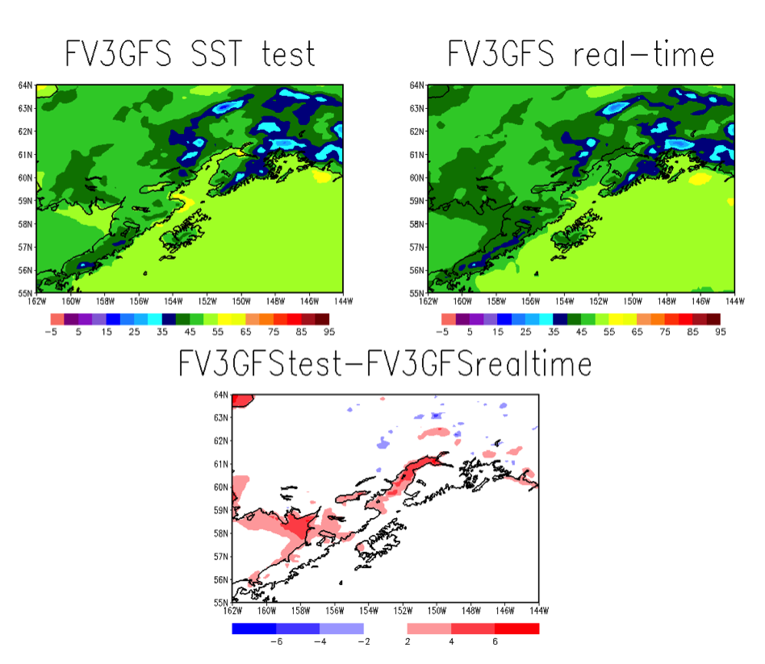
SSTs Are Warmer in Shallower Bays and Inlets Around Alaskan Coast
00Z 7/16/18 Cycle 12-h Forecast
Cook Inlet is much warmer

Slide 64
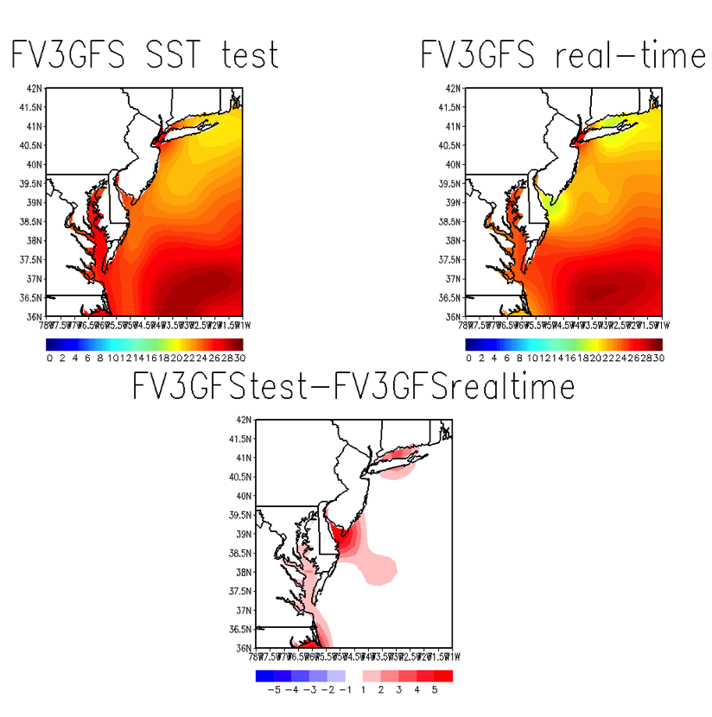
SSTs Are Warmer in Shallower Bays and Sounds along the Mid-Atlantic Coast
00Z 7/16/18 Cycle 12-h Forecast
Test run shows improvement in areas of most concern

Slide 65
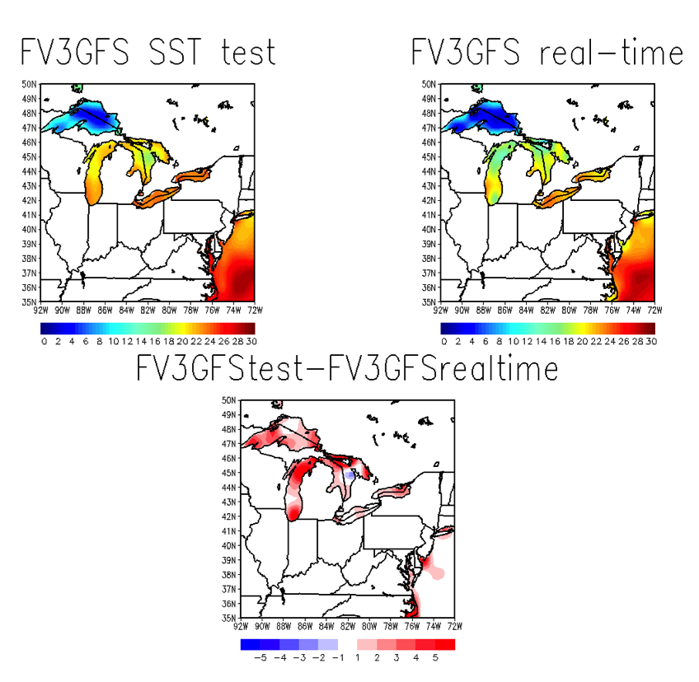
SSTs Are Generally Warmer in the Great Lakes
00Z 7/16/18 Cycle 12-h Forecast
Test run shows improvement in areas of most concern

Slide 66
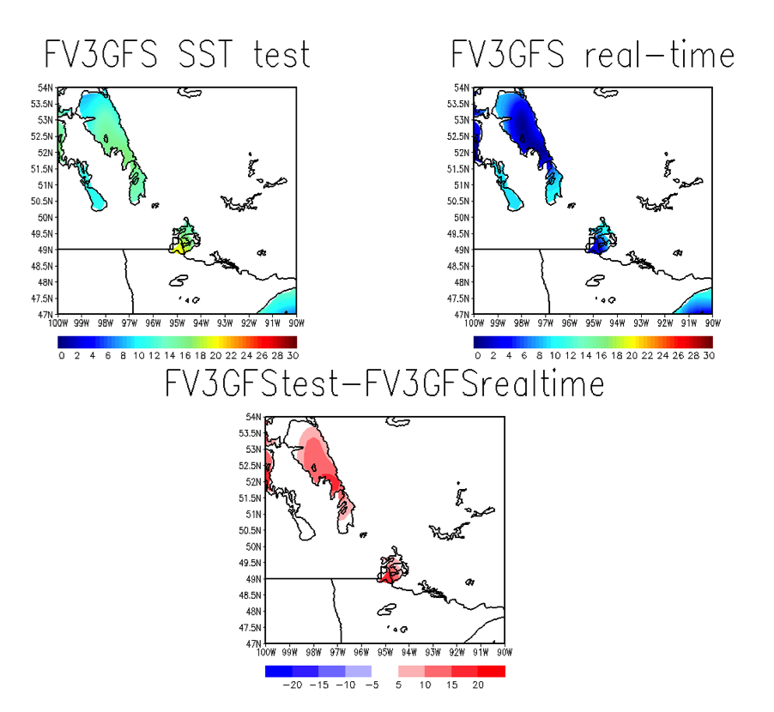
SSTs Are Much Warmer in Lake of the Woods and Lake Winnipeg
00Z 7/16/18 Cycle 12-h Forecast
Test run shows improvement in areas of most concern

Slide 67
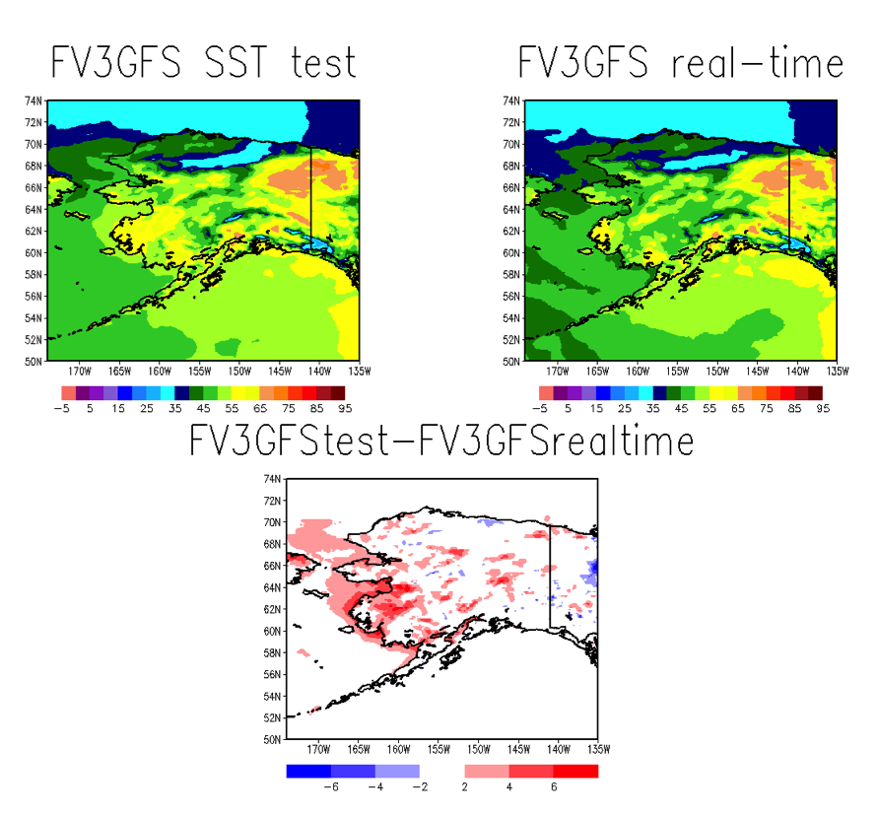
Most Importantly, Afternoon 2-m Temperatures Are Warmer
Across Much of Alaska
00Z 7/16/18 Cycle 24-h Forecast
Test run shows improvement in areas of most concern

Slide 68

Impact of SST Fix on 2-m Temps in Southern Alaska
SOUTH ALASKA
11 June – 15 July
OBS GFS FV3GFS FV3GFSTEST
FV3GFS test run better matches GFS for early morning low temps
  Still too cold relative to obs
Afternoon max temps from test run are warmer than FV3GFS, but notably colder than GFS and obs
  Too much cloud in Arctic may be playing a role here
SST fix will likely make it into the real-time parallel on Friday, 9/28

Slide 69
3. A Look at Problems With Days 6-7
FV3GFS Tropical Cyclone Tracks in the Atlantic Basin

Slide 70
Degradation of Track Forecast Skill on Days 6 & 7
Of special concern as NCEP centers
(NHC, OPC, WPC) look ahead to issuing
public Day 6-7 forecasts

Slide 71

2015-18 Atlantic TC Track Skill Relative to NEMSGFS
FV3GFS skill shown relative to the forecasts generated with the FY17 (current) GFS version
For all 2015-2018 Atlantic TCs, generally modest improvement in track forecasts through Day 5
Clear degradation by Day 6 with significant degradation at Day 7

Slide 72

2015-18 Atlantic Hurricane Track Skill Relative to NEMSGFS
For all 2015-2018 Atlantic hurricanes, track forecasts were degraded at all lead times (likely significant beyond Day 4)

Slide 73
Why are medium-range track forecasts so much worse?
Let’s look at the stats by season…

Slide 74
2015 Atlantic TC Track Errors
TC
TOTAL
DAY 6 EVENTS 27
DAY 7 EVENTS 16

Slide 75
2015 Problems Come Primarily from Two Cases
JOAQUIN
IDA
TOTAL IDA JOAQUIN
DAY 6 EVENTS 27 9 9
DAY 7 EVENTS 16 5 5
For Joaquin, FV3GFS shows degradation relative to the FY17 GFS,
but the FV3GFS is clearly better than what was operational in 2015

Slide 76

2016 Atlantic TC Track Errors
TC
TOTAL
DAY 6 EVENTS 71
DAY 7 EVENTS 60

Slide 77


2016 Problems Come Primarily from Two Cases
NICOLE
MATTHEW
TOTAL MATTHEW NICOLE
DAY 6 EVENTS 71 20 16
DAY 7 EVENTS 60 14 13

Slide 78

2017 Atlantic TC Track Errors
TC
Overall season stats are ok
Poor performance for Maria was balanced out by Harvey, Irma, and Ophelia
TOTAL
DAY 6 EVENTS 123
DAY 7 EVENTS 96

Slide 79


2018 Atlantic TC Track Errors
TC
FLORENCE
TOTAL FLORENCE
2018 stats have been dominated by Florence
DAY 6 EVENTS 62 40
DAY 7 EVENTS 50 36

Slide 80
Working theory from the MEG:
FV3GFS TCs that gain latitude too quickly are picked up by midlatitude troughs
Closer examination of Ida (2015) and Matthew (2016)

Slide 81
Notes of Clarification
FV3GFS track error statistics are compared to those from the current operational version of the GFS (noted as FY17)
  i.e., GFS forecasts of 2015 and 2016 TCs are retrospective runs
GFS forecasts for Ida (2015) and Matthew (2016) on the following slides are from what was operational at the time NOT reruns generated with the FY17 GFS
  These operational GFS forecast graphics are shown solely for a qualitative comparison

Slide 82


12Z 21 September 2016 Cycle Stands Out for Ida
12Z 9/21/15 Cycle 60-h Forecast
Errors
FV3GFS: 260 nm
FY17 GFS: 93.4 nm
FV3GFS had similar central pressure to NHC and ops GFS (different from FY17 GFS)
FV3GFS shows the vortex extending through 500 mb
GFS
FV3GFS
NHC:
1004 mb
1004 mb
1002 mb

Slide 83

12Z 21 September 2016 Cycle Stands Out for Ida
GFS
FV3GFS
Cross sections (by A. Bentley) show total wind speed in m/s
FV3GFS storm is of similar strength (MSLP), though radius of maximum wind is smaller than the GFS
FV3GFS has a taller storm. More susceptible to the mean steering flow?

Slide 84


12Z 21 September 2016 Cycle Stands Out for Ida
12Z 9/21/15 Cycle 120-h Forecast
Errors
FV3GFS: 287.6 nm
FY17 GFS: 20.4 nm
FV3GFS had similar central pressure to NHC
FV3GFS shows the vortex extending through 500 mb
Different 500 mb presentation than opsGFS ANL
GFS
FV3GFS
NHC:
1006 mb
1006 mb
1006 mb

Slide 85

12Z 21 September 2016 Cycle Stands Out for Ida
GFS
FV3GFS
FV3GFS storm is of similar strength (MSLP), but it’s still clearly taller than the GFS storm

Slide 86

FV3GFS Had Larger Errors When Ida Was Stronger and Gained Latitude Too Quickly
GFS
FV3GFS
12Z 9/21/15 Cycle 144-h Forecast
Errors
FV3GFS: 486.9 nm
FY17 GFS: 185.7 nm
Stronger FV3GFS storm gained latitude too quickly
Picked up by a midlatitude trough
NHC had a weakened low
NHC:
1007 mb
1008 mb
955 mb

Slide 87

FV3GFS Had Larger Errors When Ida Was Stronger and Gained Latitude Too Quickly
12Z 9/21/15 Cycle 144-h Forecast
Errors
FV3GFS: 486.9 nm
FY17 GFS: 185.7 nm
Stronger FV3GFS storm gained latitude too quickly
Picked up by a midlatitude trough
Trough interaction in FV3GFS forecast exacerbates problem caused by initial latitude gain

Slide 88


12Z 1 October 2016 Cycle Stands Out for Matthew
12Z 10/1/15 Cycle 24-h Forecast
Errors
FV3GFS: 58.8 nm
FY17 GFS: 37.7 nm
Matthew’s short-term forecasts were initially ok
Matthew consistently gained latitude too quickly in the FV3GFS
GFS
FV3GFS
NHC:
947 mb
980 mb
967 mb

Slide 89

12Z 1 October 2016 Cycle Stands Out for Matthew
GFS
FV3GFS
FV3GFS has a stronger (lower MSLP & stronger wind speeds) and taller storm
Was Matthew exposed to more of the mean steering flow in the FV3GFS?

Slide 90

12Z 1 October 2016 Cycle Stands Out for Matthew
12Z 10/1/15 Cycle 156-h Forecast
Errors
FV3GFS: 1084.1 nm
FY17 GFS: 28.5 nm
Matthew gaining latitude too quickly was the initial problem
Being picked up by a midlatitude trough caused significant track errors by Day 6

Slide 91
Closing Thoughts on Atlantic TC Track Errors
FV3GFS track errors appear largest when TCs gain latitude too quickly, which increases the likelihood of erroneous trough interactions that exacerbate initial track errors
FV3GFS may have a propensity toward simulating taller tropical cyclones
  Unsure if this is happens during the initialization, during the model integration, or during both
Taller TCs in the FV3GFS would be more exposed to the mean steering flow, but is this the (sole) reason for early latitude gain?
Would expect stronger storms to be taller, which might explain why forecast tracks are degraded throughout the model integration for hurricanes, but degradation only seen at Days 6-7 when including weaker named systems

Slide 92
Summary
Evaluations were generally positive given the expectation that this implementation simply match the performance of the operational GFS
Recommendations for implementation were mostly neutral with some additional ‘yes’ votes
Common concerns were issues (TC tracks, progressive upper troughs, cold SSTs, dry bias for mid-upper QPFs) that could significantly affect the forecast process
Significant Atlantic TC track errors appear to be caused by early latitude gain and subsequent trough interactions. More investigation is needed.
Change to address cold SSTs in the northern Pacific Ocean will likely go into the real-time parallel on Friday, 9/28
Strong signal from the field that EMC should prioritize issues like over-mixing within the PBL in the next implementation
Again, thanks to all the Regions, Centers, and labs
for submitting thoughtful evaluations.

Slide 93
Going Forward
NCEP Director Briefing scheduled for Monday, October 1st
Pending approval by the acting NCEP Director:
  10/1/18: Code handoff and public release of operational code
  12/20/18: Begin NCO 30-day IT test
  1/24/19: Operational implementation as GFSv15.0

