Slide 1
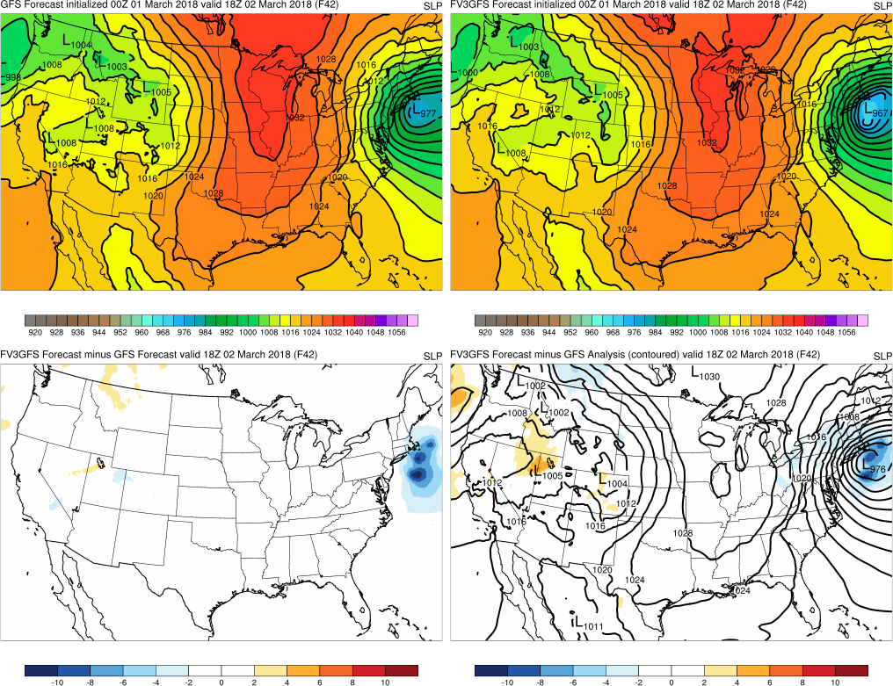
19 July 2018 MEG Briefing
Introduction to MEG Evaluation of FV3GFS Retrospectives
Logan Dawson, Alicia Bentley, Tracey Dorian, Geoff Manikin
EMC Model Evaluation Group

Slide 2
Topic
Introduction to MEG evaluation of FV3GFS retrospectives
Overview of retrospective period and specific cases
Overview of available forecast and validation fields
Overview of web interface for retrospective cases

Slide 3
FV3GFS Retrospective Runs
EMC’s FV3GFS real-time parallel officially began 25 May 2018 and will run until implementation in early 2019
To facilitate more robust evaluation of the FV3GFS model, EMC is also running retrospective forecasts over the period from May 2015 through May 2018
Three warm seasons: Summer/Fall 2017, Summer/Fall 2016, and Summer/Fall 2015
Three cool seasons: 2017-18 Winter/Spring, 2016-17 Winter/Spring, and 2015-16 Winter/Spring
Cool and warm season forecast data are being provided to MDL to allow for MOS calibration
Will allow us to 1) obtain a more robust set of statistics and 2) evaluate high-impact cases from recent years
Ultimately, we want to make sure there are no surprises before implementing

Slide 4
Layout of Real-Time Parallel and Retrospectives
 | Period | Machine | Comment
Real-Time Parallel (Stream 0) | 5/25/18 – 1/25/19 | WCOSS Prod Cray | Sample for MOS
2017-18 Winter/Spring (Stream 1) | 11/25/17 – 5/31/18 | WCOSS Dell | Cool season sample for MOS
2017 Summer/Fall (Streams 2a and 2b) | 5/25/17 – 8/31/17 8/2/17 – 11/30/17 | WCOSS Dev Cray WCOSS Dell | Warm season sample for MOS
2016-17 Winter/Spring (Stream 3) | 11/25/16 – 5/31/17 | WCOSS Dell
2016 Summer/Fall (Streams 4a and 4b) | 5/22/16 – 8/25/16 8/17/16 – 11/26/16 | WCOSS Dev Cray WCOSS Dell
2015-16 Winter/Spring (Stream 5) | 11/25/15 – 5/31/16 | WCOSS Dell
2015 Summer/Fall (Streams 6) | 5/3/15 – 11/28/15 | WCOSS Dell
Pace of completing runs has been highly variable, and we’re unable to populate cases until the forecasts have been run

Slide 5
Evaluation of FV3GFS Retrospectives
The VPPPG branch is generating statistics from retrospective forecasts
The Hurricane Group will be generating TC-related statistics
The MEG is examining high-impact cases from the retrospective period
Identified cases cover a selection of tropical cyclones (in multiple basins), winter storms, high wind events, extreme temperature events, heavy QPF events, and severe weather events
Generally focusing on synoptically-driven events
Will likely examine dropout cases identified once retros are completed and 500 mb anomaly correlations are available

Slide 6
MEG Evaluation of FV3GFS Retrospectives
In cases where the ops GFS did well, we’re hoping the FV3GFS can match that performance.
In cases where the ops GFS struggled, we want to see if the FV3GFS would have done better.
In general though, with most of the physics suite remaining unchanged, systematic significant improvements are unlikely

Slide 7
Current Selection of Retrospective Cases
Tropical Cyclones:
Atlantic storms: Joaquin, Matthew, Harvey, Irma, Maria, and Nate
Pacific storms: Soudelor, Noru, Winston, Amos, and Gita
Winter Storms:
January 2016 blizzard, March 2017 blizzard, December 2017 Deep South snowstorm, and January 2018 “bomb cyclone”
High Wind Events:
Aug 2015 and Oct 2016 Pac. NW windstorms and March 2018 windstorm/nor’easter
Extreme Temperature Events:
July 2017 interior California heat and Dec 2017/Jan 2018 CONUS cold air outbreak
Heavy QPF Events:
October 2015 South Carolina flooding, February 2017 West Coast AR, April/May 2017 Mississippi River Valley flooding, June 2017 flooding associated with ET of Tropical Storm Cindy, July 2017 “nor’easter,” and March 2018 West Coast AR event
Severe Weather Outbreaks:
26-27 April 2016 outbreak and 18-19 May 2017 outbreak

Slide 8
MEG Evaluation of FV3GFS Retrospectives
The MEG has begun generating graphics for cases
Retrospective graphics will be very similar to those displayed on the real-time FV3/GFS comparison page maintained by G. Manikin
Aiming to begin presenting on retrospectives by summarizing our evaluation of 2017 Atlantic hurricane cases in the coming weeks

Slide 9
Overview of Forecast and Validation Data

Slide 10
Overview of Forecast and Validation Data
Potential fields available:
SLP, 2-m temperature, 2-m dewpoint, 10-m winds, and surface wind gusts
250 mb winds, 500 mb heights and abs. vorticity, 850 mb temperature, 850 mb winds, PWAT, SBCAPE, and vertical wind shear
Total cloud cover and precipitation type
6-h, 24-h, and total QPF
6-h, 24-h, and total snowfall (SNOD and 10:1 WEASD)
Potential domains available:
North America, Alaska, CONUS, and 10 CONUS subdomains
Gulf of Mexico, Puerto Rico, Northwest Atlantic, East Pacific, West Pacific, and South Pacific*
Variables, domains, initializations, and forecast ranges made available will vary on a case-by-case basis
Notes:
*primarily for TCs, West Coast ARs, and East Coast ECs

Slide 11
Overview of Forecast and Validation Data
Because these are retrospective forecasts, we have (adequate) analysis data for most variables, which allows us to provide validation for the FV3GFS
Exceptions include cloud cover, precipitation type, and oCONUS QPF/snow
Building on the foundation of the FV3/GFS comparison page, graphics for all other variables will also include a fourth panel with validating information
Validation data include:
GFS upper air and SLP analyses
RAP and GFS analyses for sensible surface weather
Stage IV QPE analyses and NOHRSC snowfall analyses for CONUS domains
Validation will be provided in the form of contoured or color-shaded analyses as well as some color-shaded forecast–analysis difference fields

Slide 12
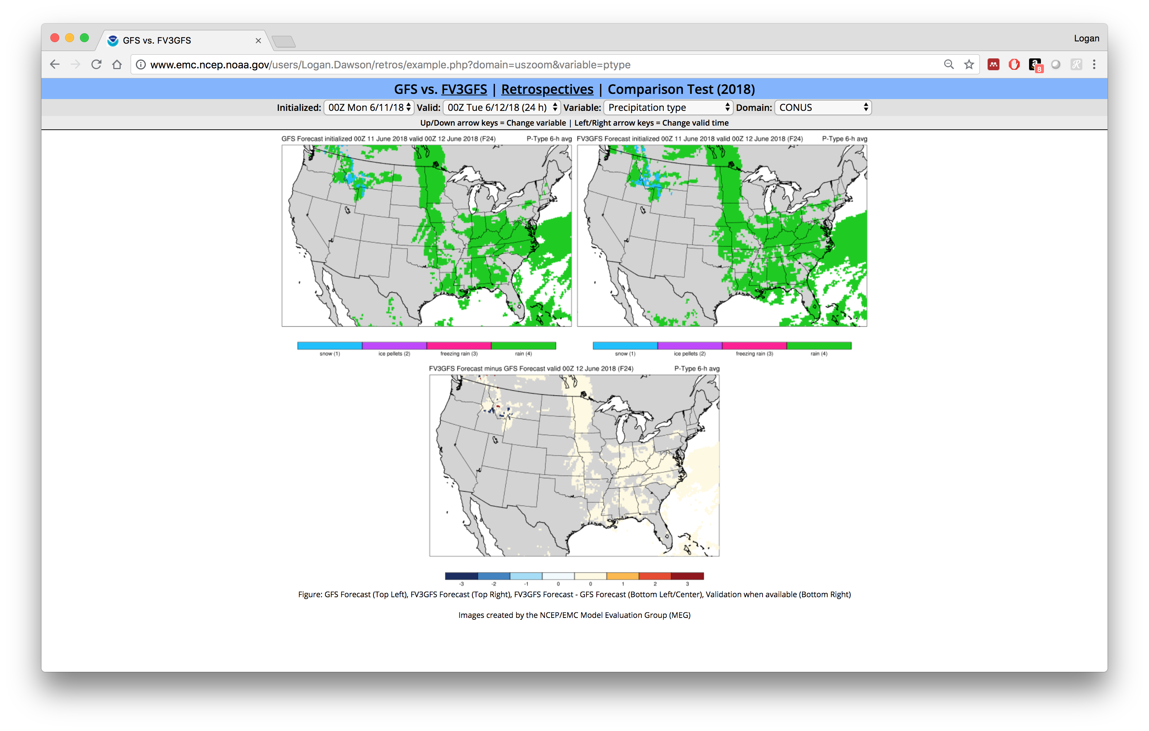
Examples of Retrospectives Graphics Interface
Upper Left:
GFS Forecast
Upper Right: FV3GFS Forecast
Lower Middle:
Forecast Difference
(FV3GFS – GFS)
Currently, layout for cloud cover and precipitation type graphics will mirror the real-time comparison page

Slide 13
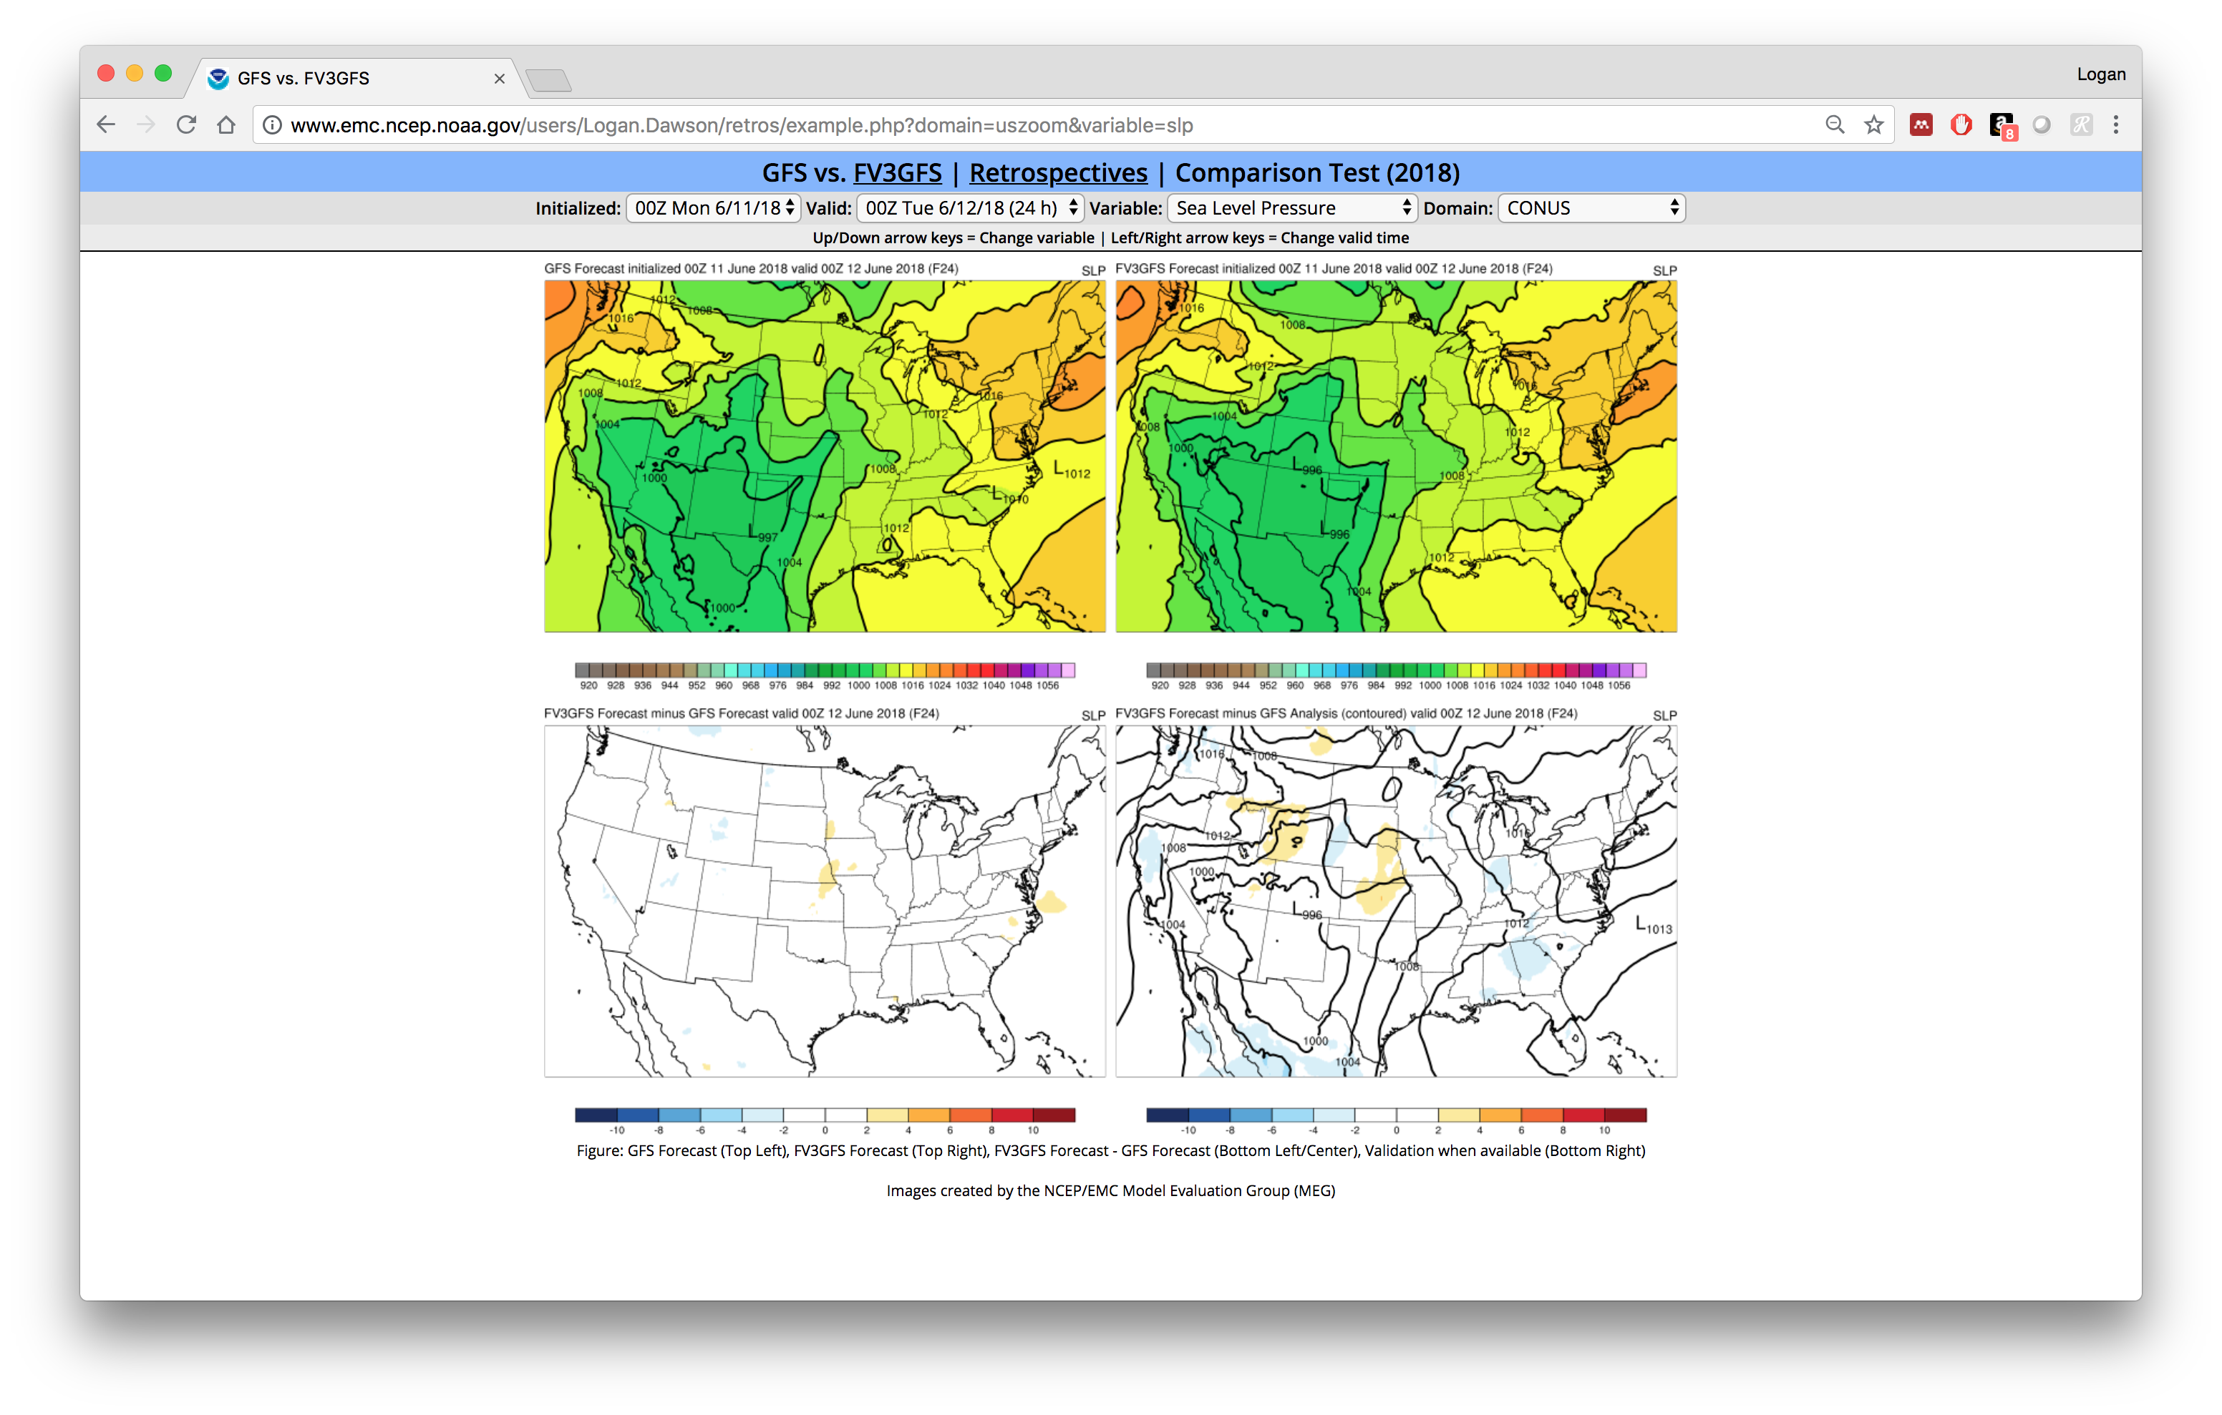
Examples of Retrospectives Graphics Interface
Upper Left:
GFS Forecast
Upper Right: FV3GFS Forecast
Lower Left:
Forecast Difference
(FV3GFS – GFS)
Lower Right:
Validating Information

Slide 14
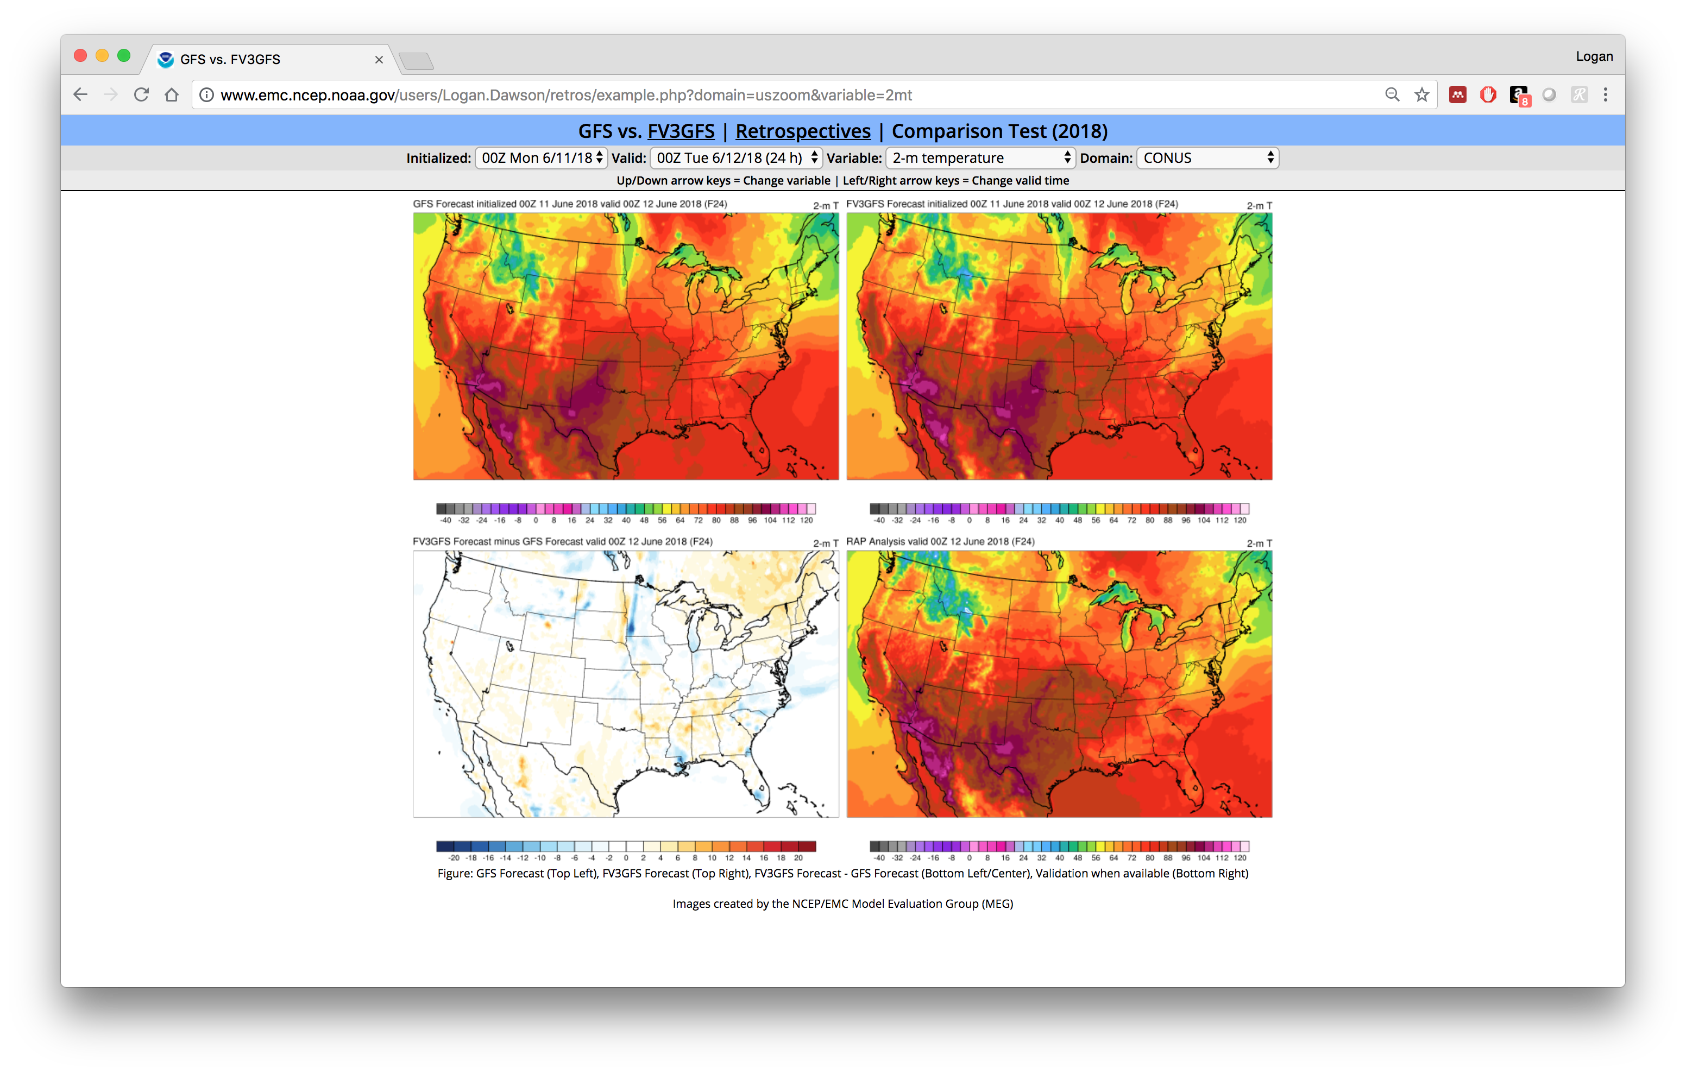
Examples of Retrospectives Graphics Interface
Upper Left:
GFS Forecast
Upper Right: FV3GFS Forecast
Lower Left:
Forecast Difference
(FV3GFS – GFS)
Lower Right:
Validating Information

Slide 15
Overview of Forecast and Validation Data
Demonstration at:
http://www.emc.ncep.noaa.gov/users/Logan.Dawson/retros/example.php

Slide 16
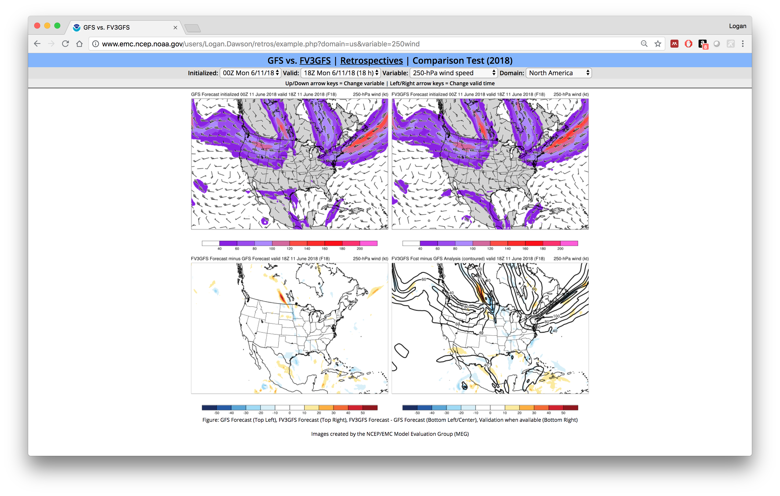
250 mb and 500 mb Maps Will Have Analysis+Difference Validation
Analyzed 250 mb jets will be contoured and the difference (FV3GFS forecast – GFS analysis) will be color shaded

Slide 17
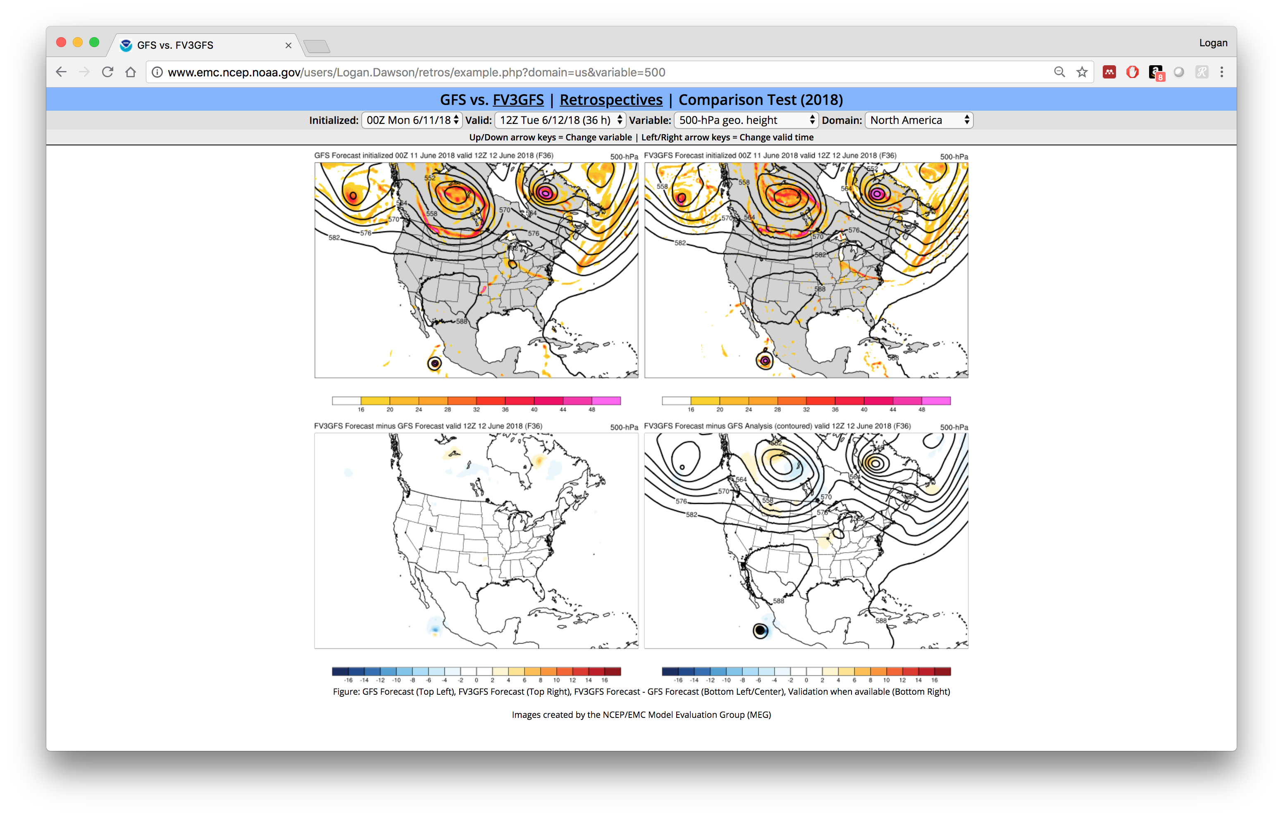
250 mb and 500 mb Maps Will Have Analysis+Difference Validation
Analyzed 500 mb heights will be contoured and the difference (FV3GFS forecast – GFS analysis) will be color shaded

Slide 18
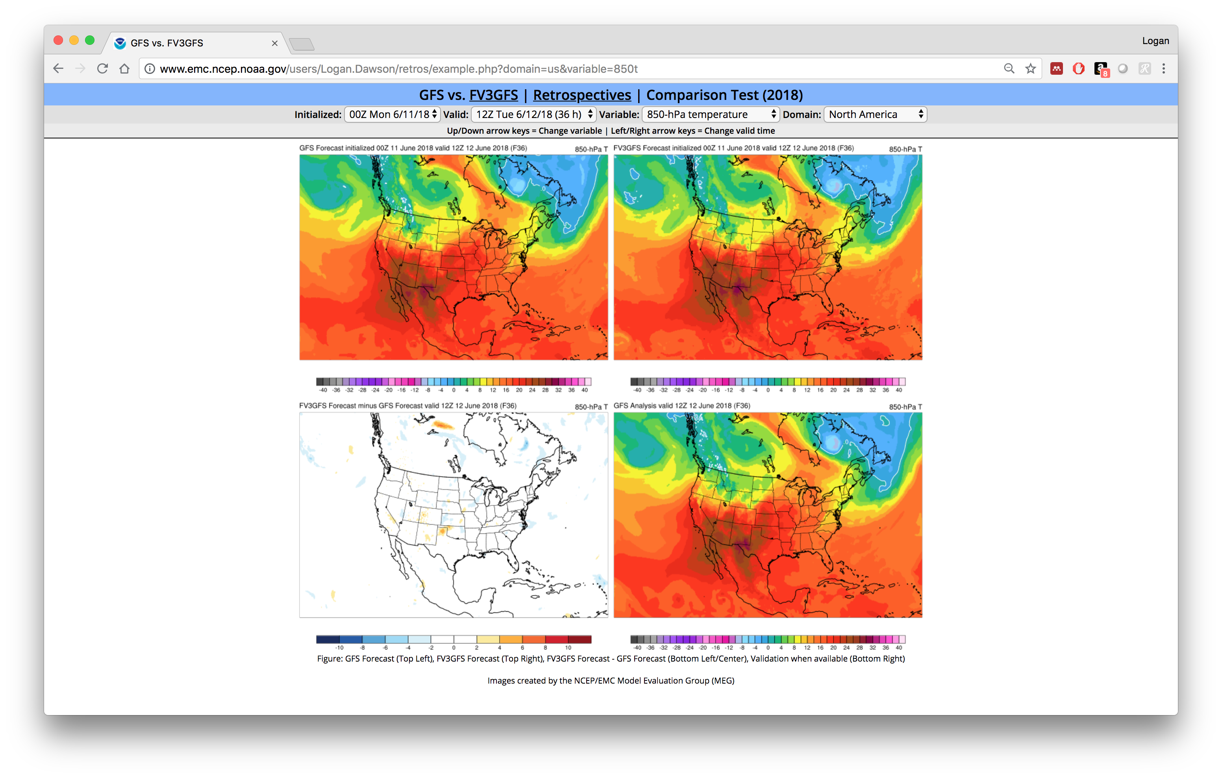
850 mb Maps Will Only Have a Validating Analysis
GFS analysis is color shaded as validation here

Slide 19
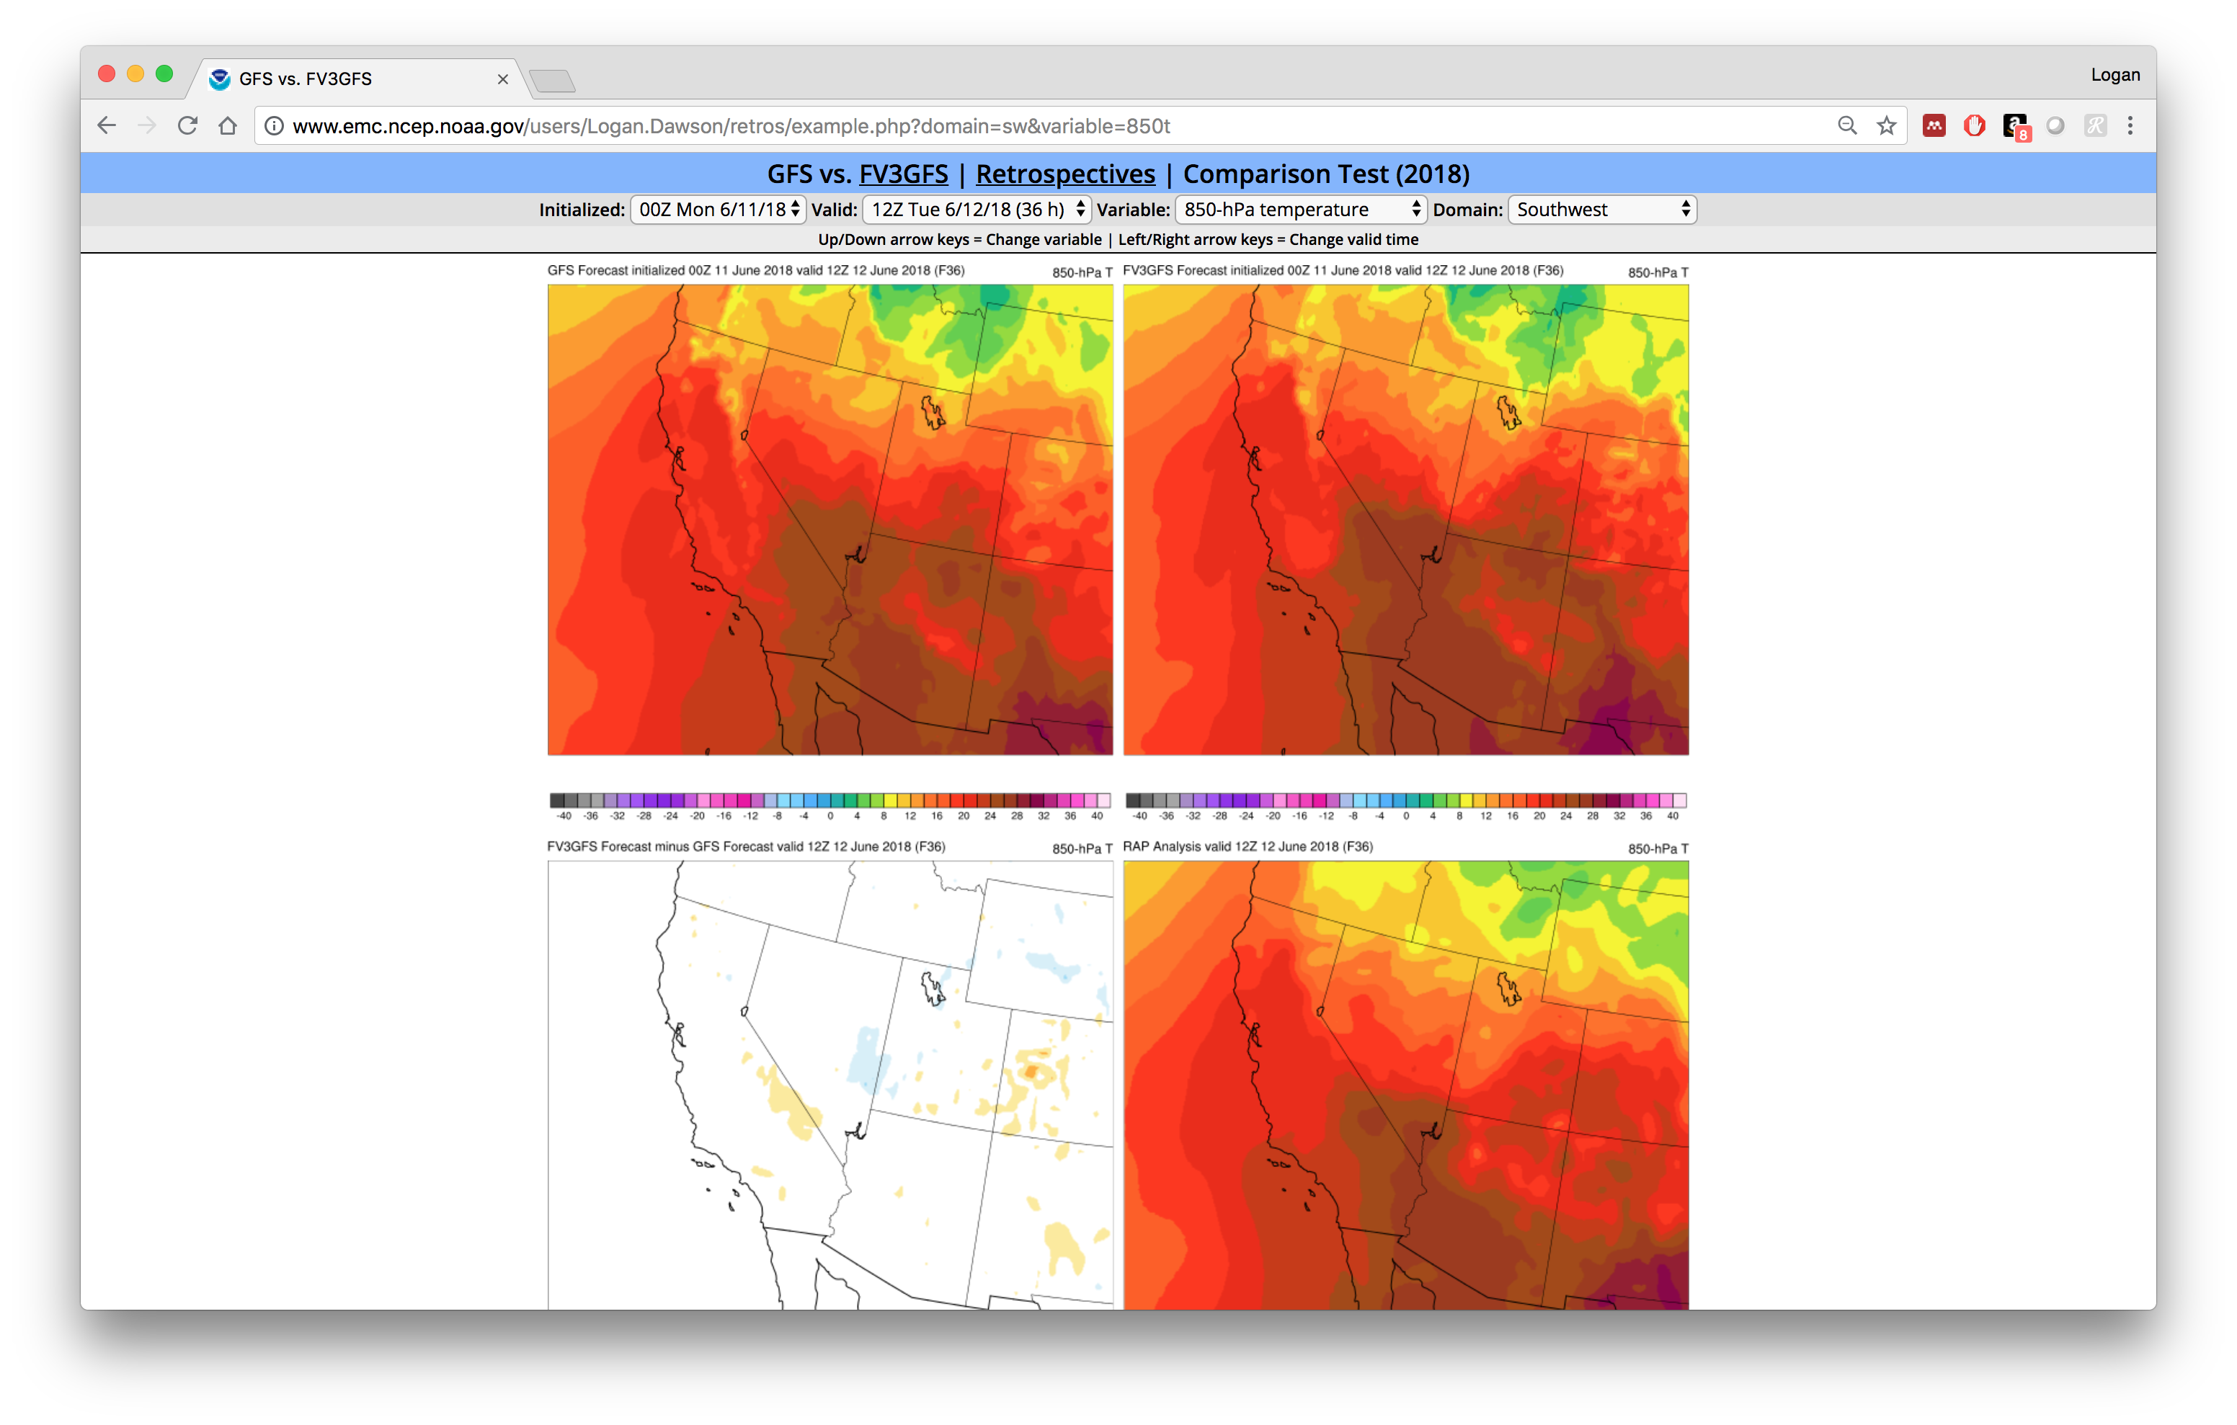
850 mb Maps Will Only Have a Validating Analysis
RAP analysis used as validation here. Not computing a difference field at this time, so only the analysis (RAP or GFS) will be shown for now.

Slide 20
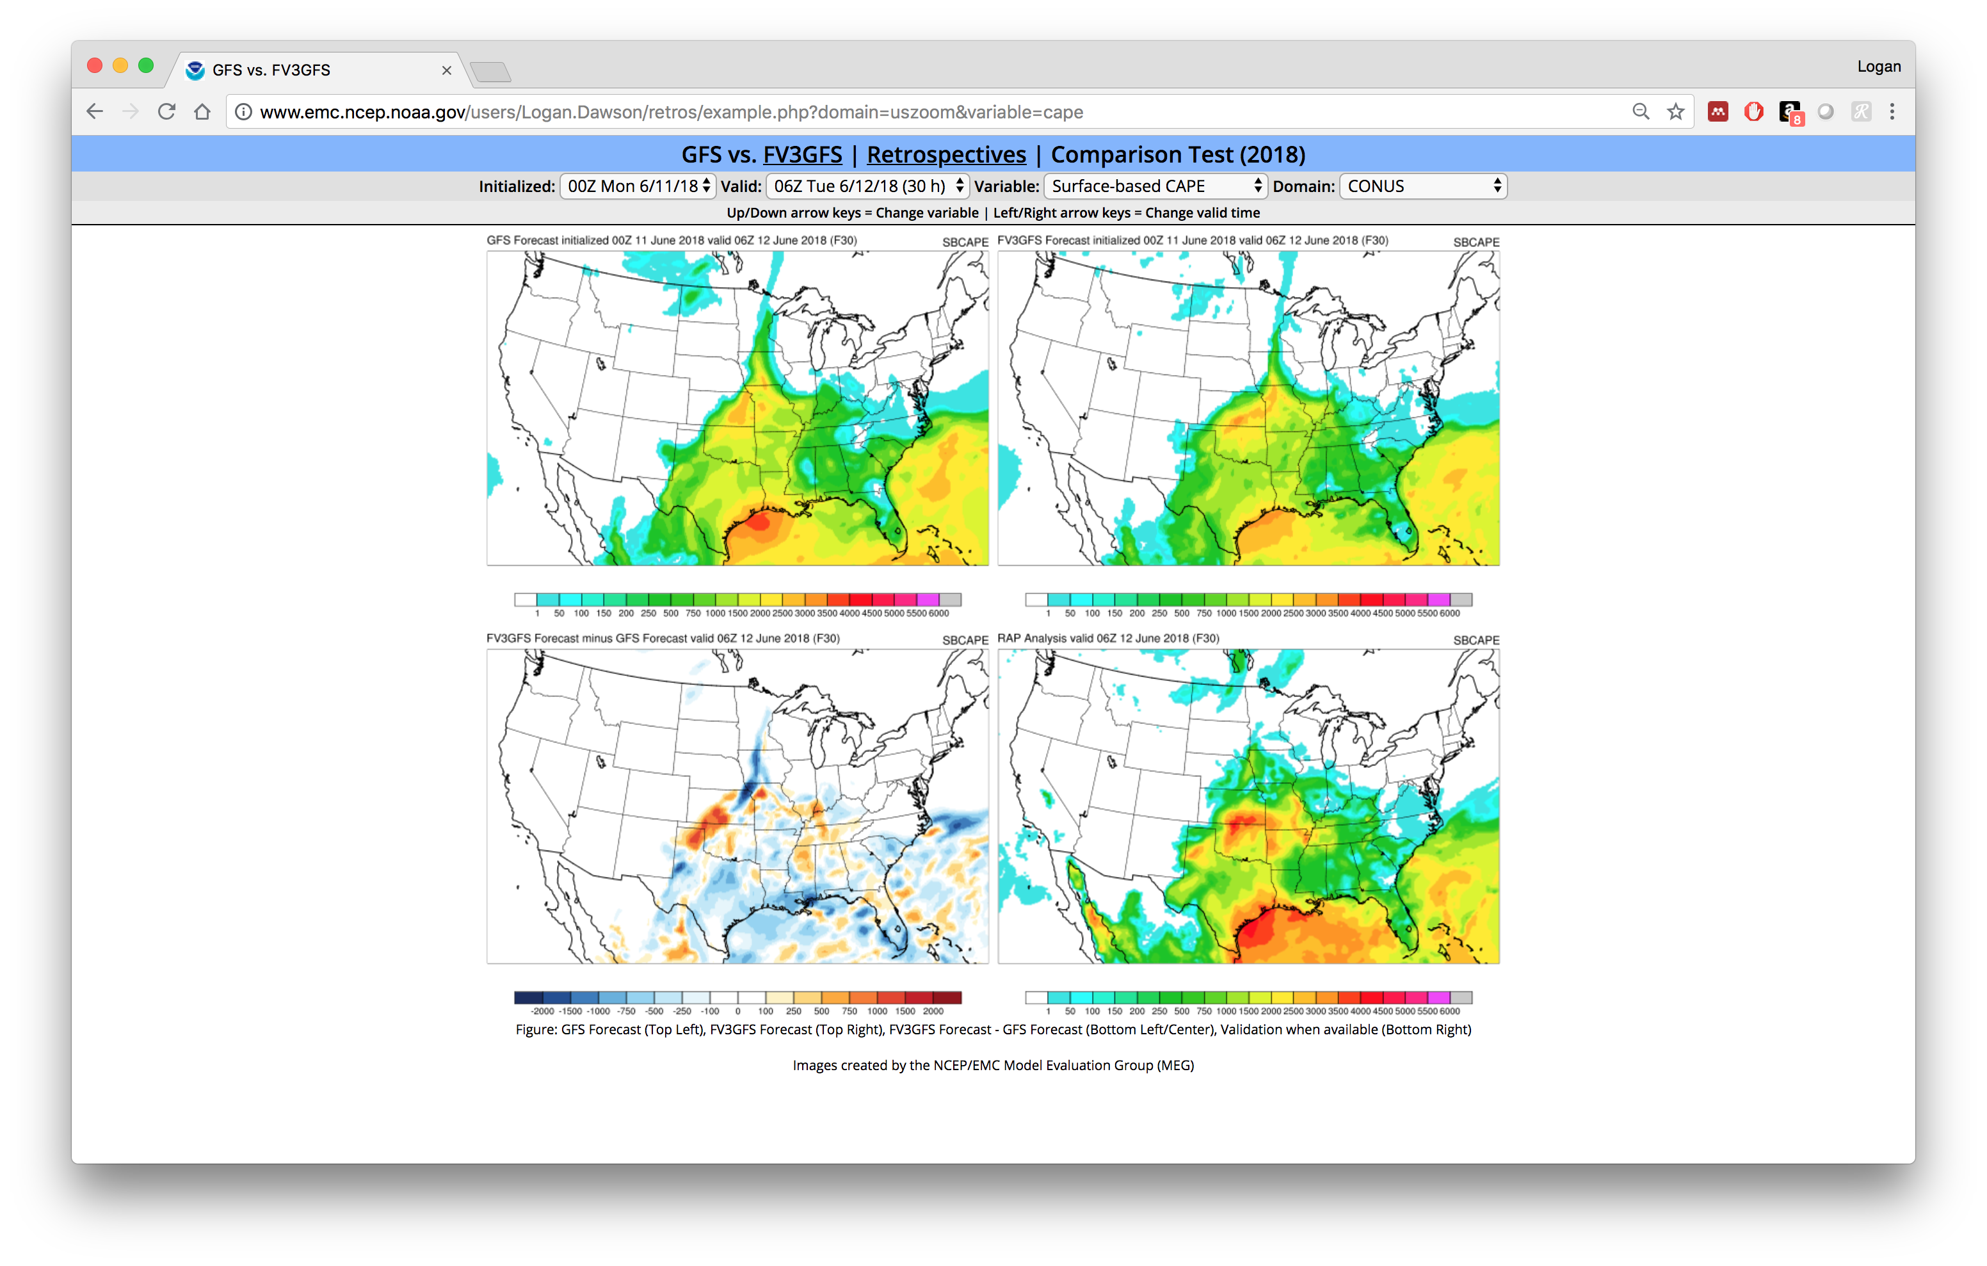
CAPE and Sensible Surface Fields Will Have RAP or GFS Analyses
Chose to use RAP analyses for SBCAPE, 2-m T, 2-m Td, and 10-m winds on CONUS domains because we believe RAP analyses are superior to GFS analyses for these fields

Slide 21
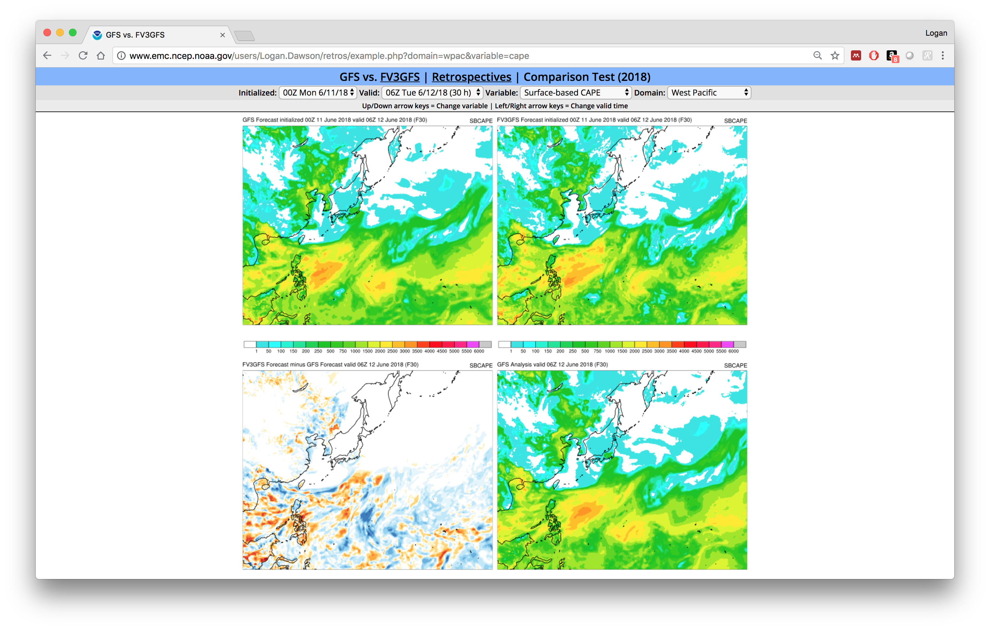
CAPE and Sensible Surface Fields Will Have RAP or GFS Analyses
Have to use GFS analyses for domains covering areas outside of RAP domain

Slide 22
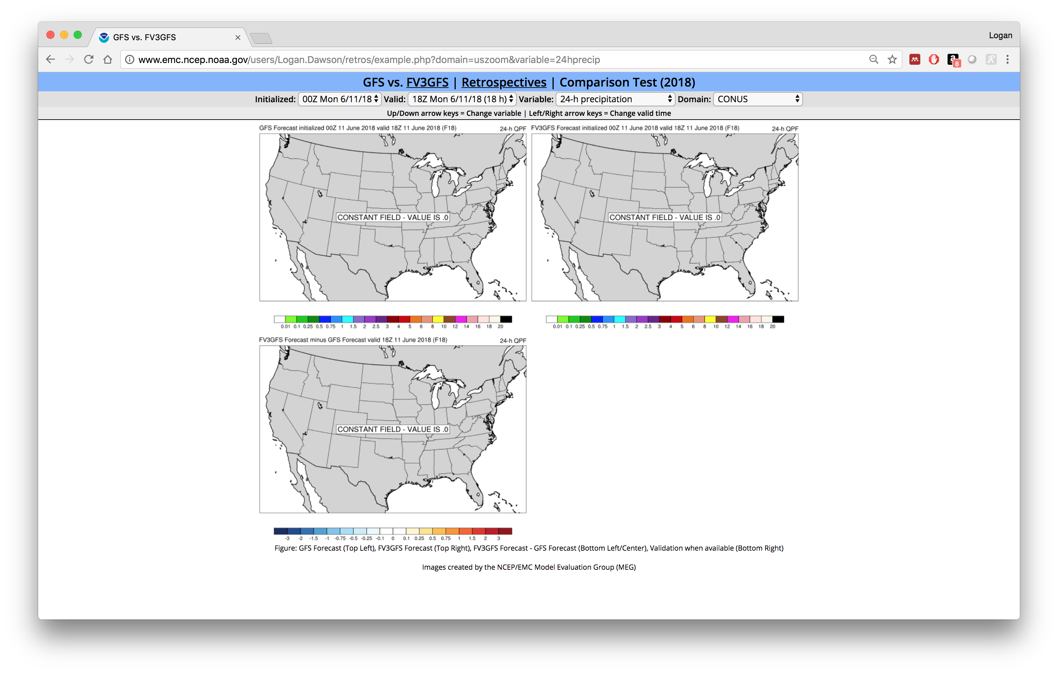
24-h Precipitation Will Not Be Plotted Until After F024
Avoid confusion with the total QPF graphics. 6-h QPF available at shorter forecast ranges.

Slide 23
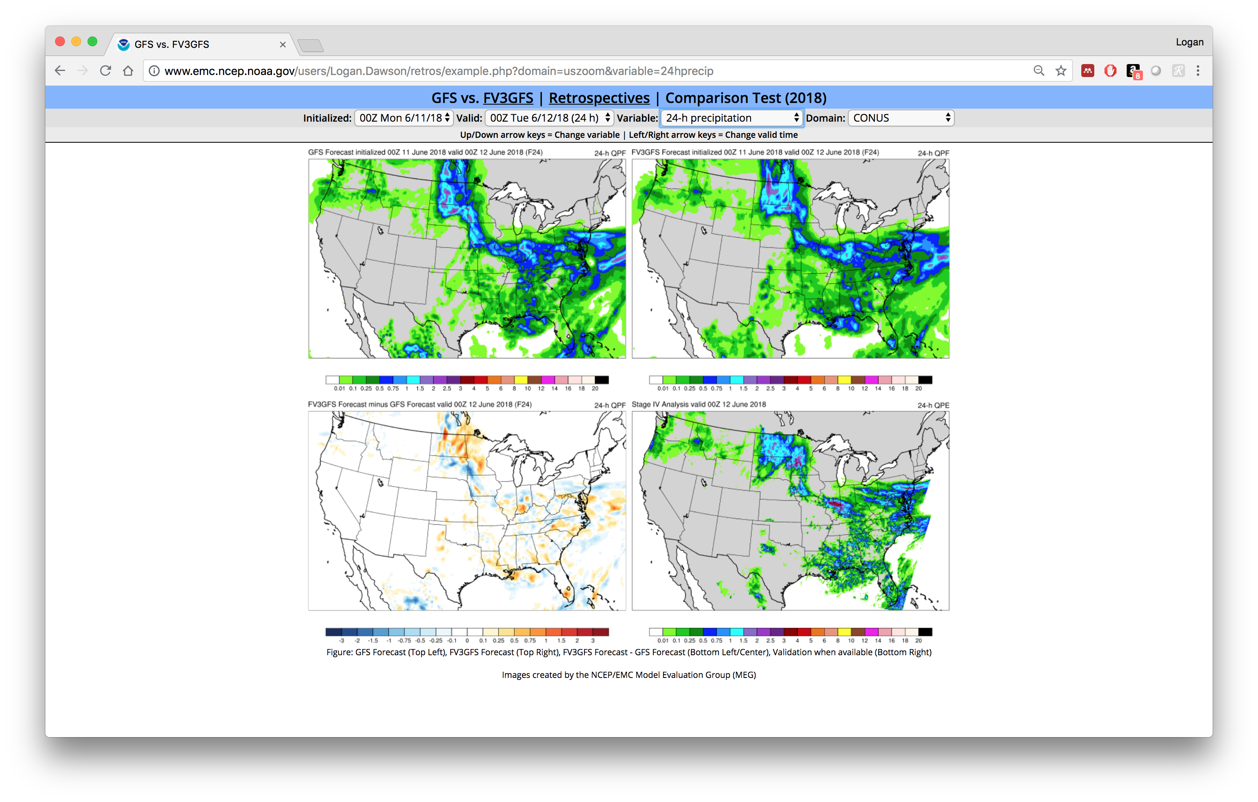
24-h Precipitation Will Not Be Plotted Until After F024
Avoid confusion with the total QPF graphics. 6-h QPF available at shorter forecast ranges.
Again, not computing forecast–analysis difference field at this time

Slide 24
Overview of Web Interface for Retrospective Cases

Slide 25
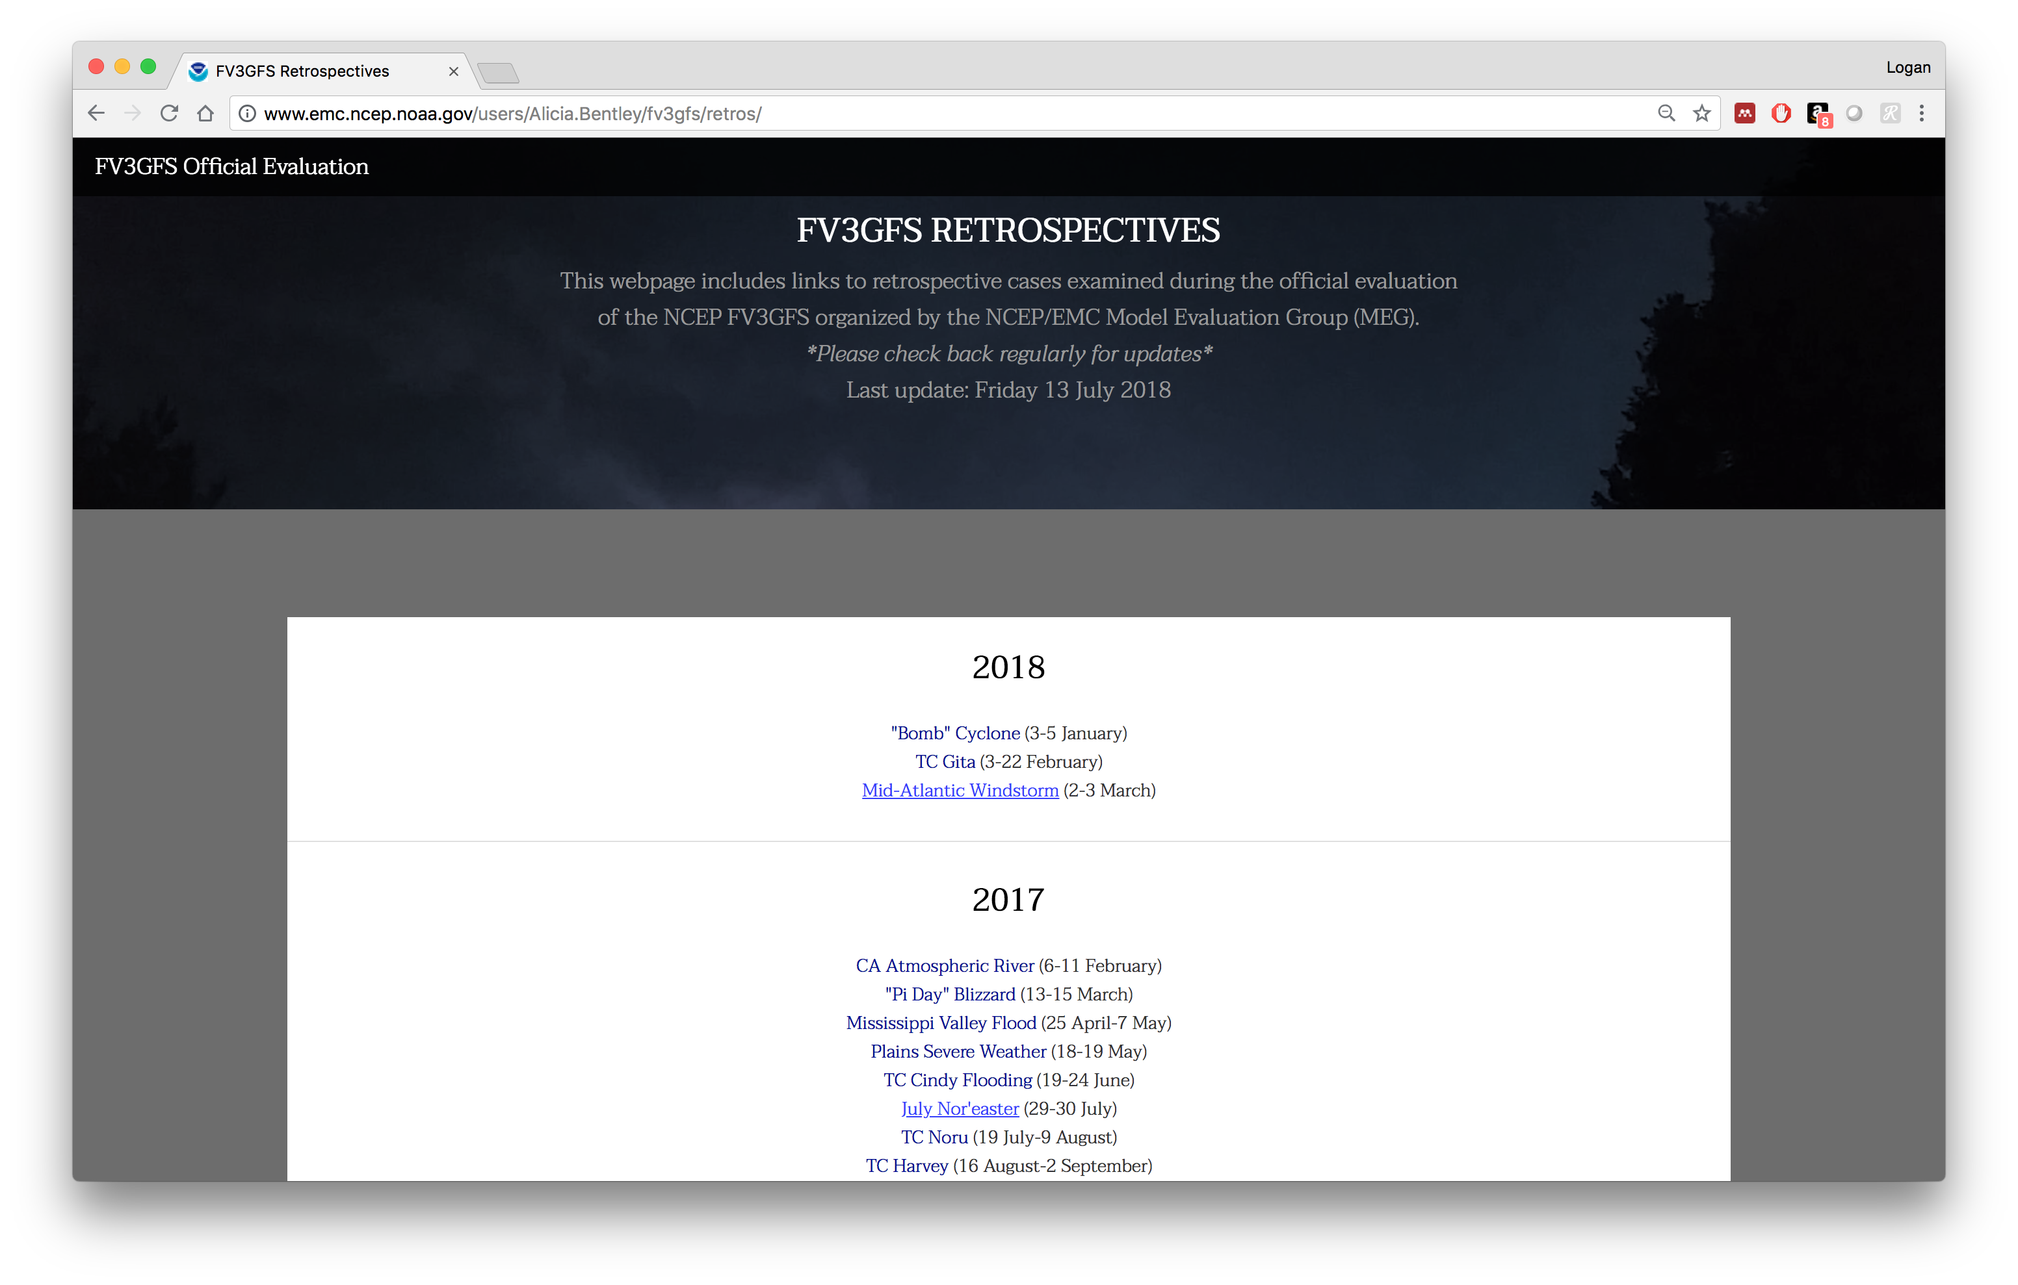
Webpage Listing Retrospective Cases
Links will become live as cases are completed. Check webpage regularly for updates between MEG meetings

Slide 26
Webpage Listing Retrospective Cases
Demonstration at:
http://www.emc.ncep.noaa.gov/users/Alicia.Bentley/fv3gfs/retros/

Slide 27
Summary
Retrospective FV3GFS forecasts are being run from May 2015 through May 2018 to allow for more robust evaluation of the FV3GFS
In the coming weeks, we will begin summarizing our evaluation selected cases
Field input for additional cases may be requested if time permits
Graphics for retrospective cases can be found at: http://www.emc.ncep.noaa.gov/users/Alicia.Bentley/fv3gfs/retros/
We welcome your comments on the results of the retrospective cases. Feel free to start a thread or contribute to discussion on the VLab forum if you see something of interest in the retros https://vlab.ncep.noaa.gov/web/emc-model-evaluation-group/discussions-forums-/-/message_boards/category/3251785

