Slide 1
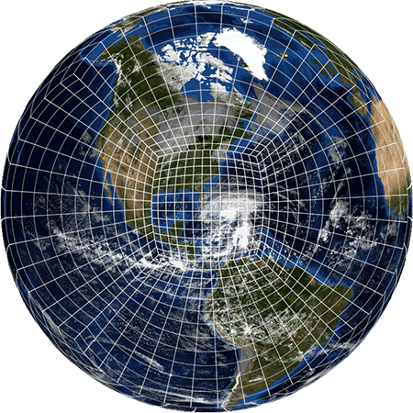
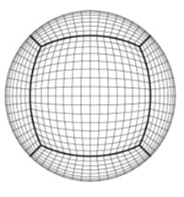
THE IMPLEMENTATION of GFSv15
Geoff Manikin, Alicia Bentley, Logan Dawson, Tracey Dorian
NCEP/EMC Model Evaluation Group
13 June 2019

Slide 2
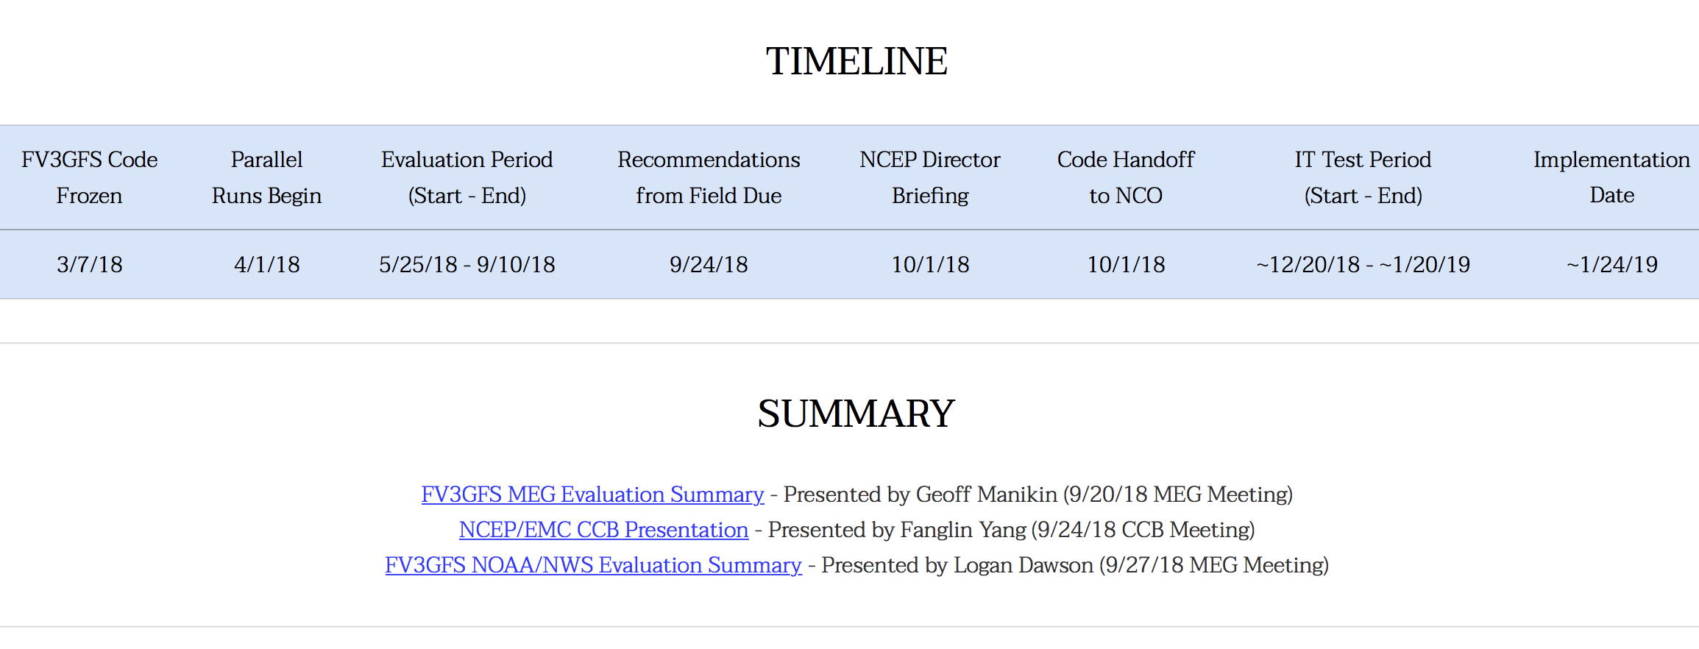
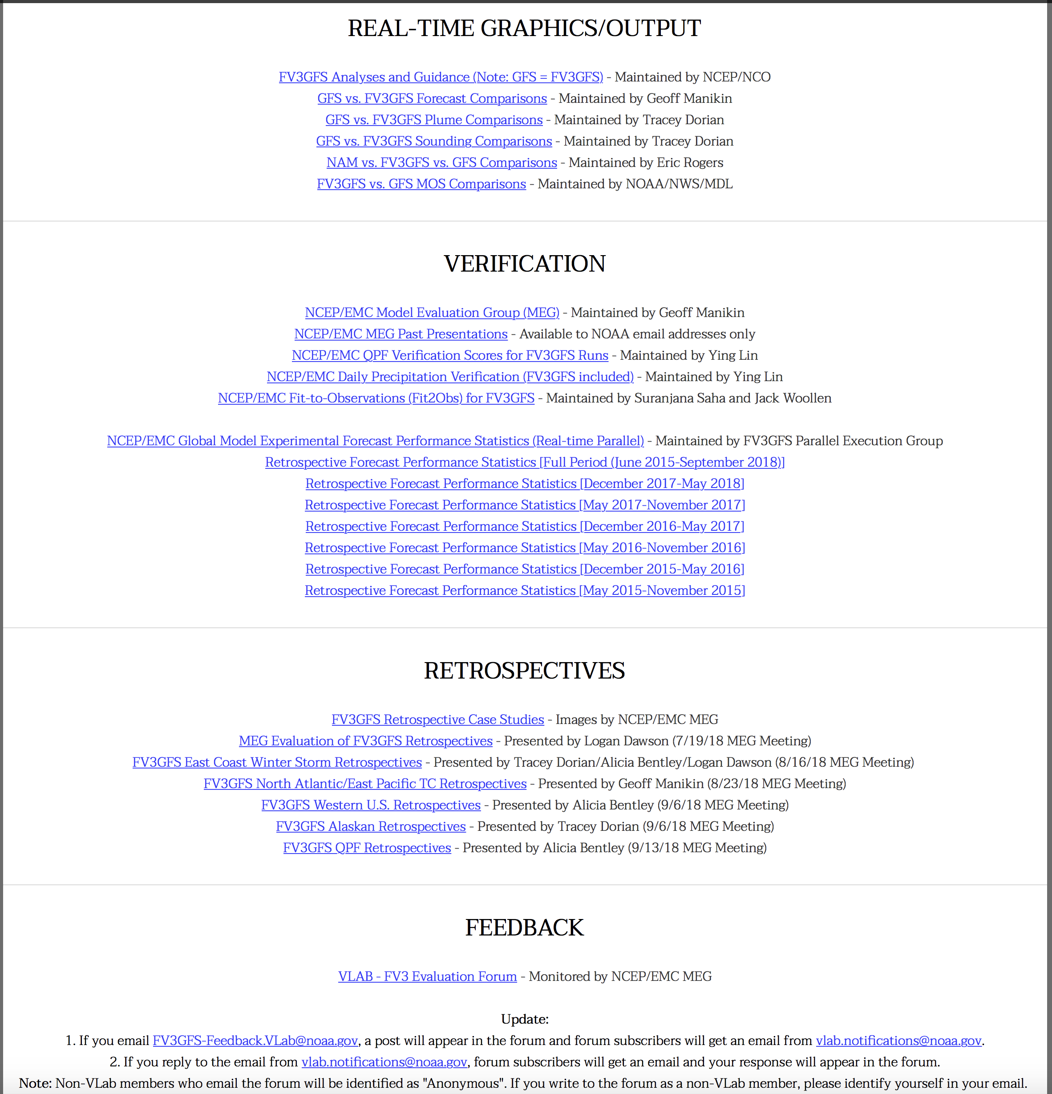
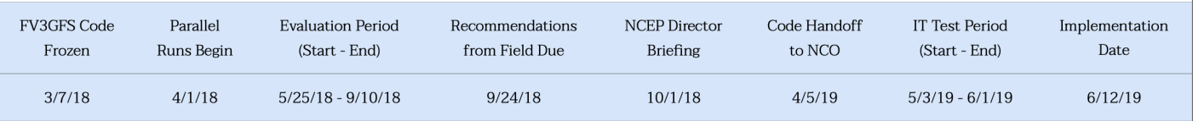
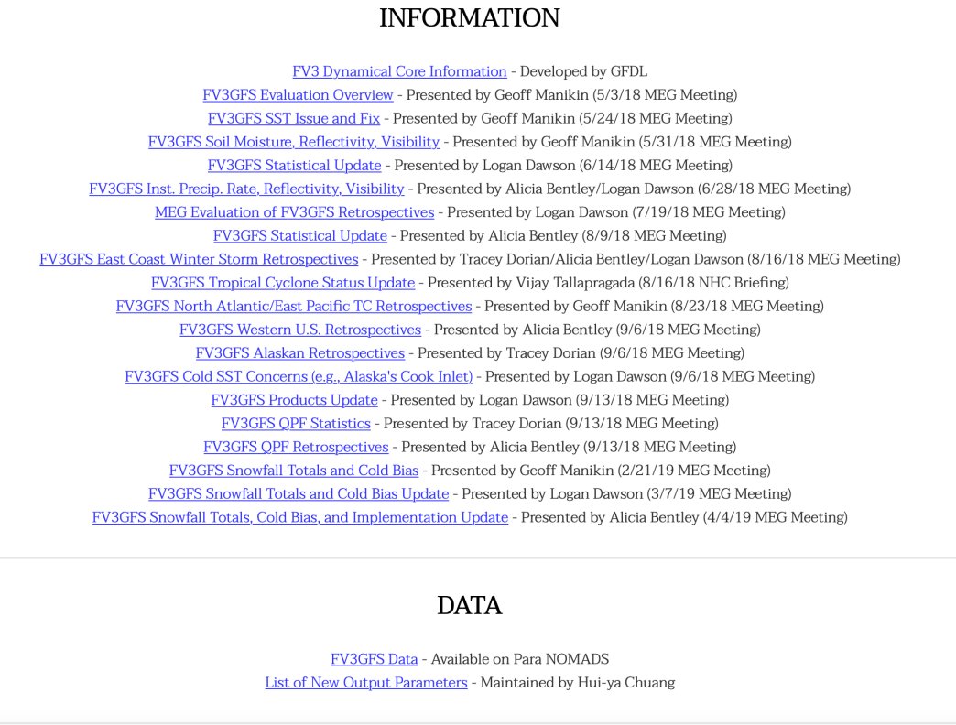
Official Evaluation Website
http://www.emc.ncep.noaa.gov/users/meg/fv3gfs

Slide 3
FV3GFS: Infrastructure and Physics Upgrades
Revised bare soil evaporation scheme
Stochastic physics in the data assimilation
Higher resolution in GDAS (now ~25 km)
other minor changes:
correction bugs related to the convective cloud water
radiation bug fix
slight modification in scale-aware mass-flux deep or shallow convection schemes
Integrated FV3 into NEMS
Replaced Zhao-Carr microphysics with the more advanced GFDL microphysics
Updated parameterization of ozone photochemistry with additional production and loss terms
New parameterization of middle atmospheric water vapor photochemistry
Remove tropical cyclone vortex relocation
Service Change Notice

Slide 4
A Few Key Product Changes
Non-hydrostatic vertical velocity (dz/dt in m/s) now available in addition to omega; Omega in gridded output (Pa/s) is now derived using the hydrostatic approximation; VV has now replaced omega in GFS station time series bufr output
New cloud hydrometeor fields, isobaric (3D cloud fractions), and simulated composite reflectivity now available
Total and convective accumulated precip now available in addition to 6-hr buckets (although not yet in AWIPS)
GFS directory structure on NCEP web services now breaks out daily directories by cycle
3hrly output now available beyond f240, but there is no decrease in resolution beyond f240 as in GFSv14, so delivery of grids beyond f240 is slower than in GFS v14; f384 delivery time now 20 minutes later than in GFSv14
GFSv14 still running, with products available in GFS “para” data flow

Slide 5
A Few Key Model Changes After the Initial Code Freeze

Slide 6
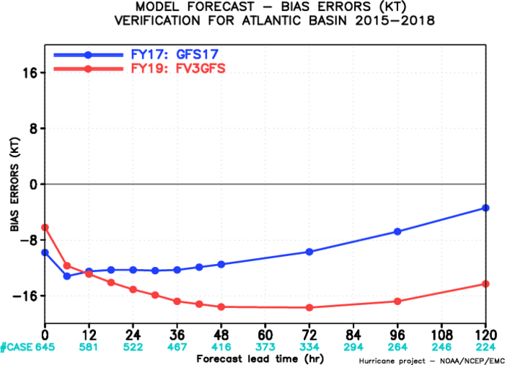
TROPICAL CYCLONES in the ORIGINAL VERSION of GFSv15 WERE
CONSISTENTLY CONSIDERABLY WEAKER THAN IN THE OPS GFS in ALL BASINS
GFSv14
HURRICANE HARVEY
GFSv15
GFSv14
TYPHOON NORU
GFSv15
927
958
938
966
ANL:929
NHC: 941
GFDL recommended changing the horizontal advection setting

Slide 7
JUSTFICATION FOR HORD=5 CHANGE
There was a clear improvement with regard to tropical cyclone intensity –
almost always yielded a stronger storm than HORD=6 run, and it was usually
in the right direction with its forecast of a stronger storm
Some concern about overdeepening of winter storms but overall impact
was far less than on tropical cyclones
Stats indicated little change on the synoptic scale with this change in any
time of year
NCEP Director Approved changing hord=6 to hord=5 starting with 18Z
on August 15, 2018 for real-time parallel

Slide 8
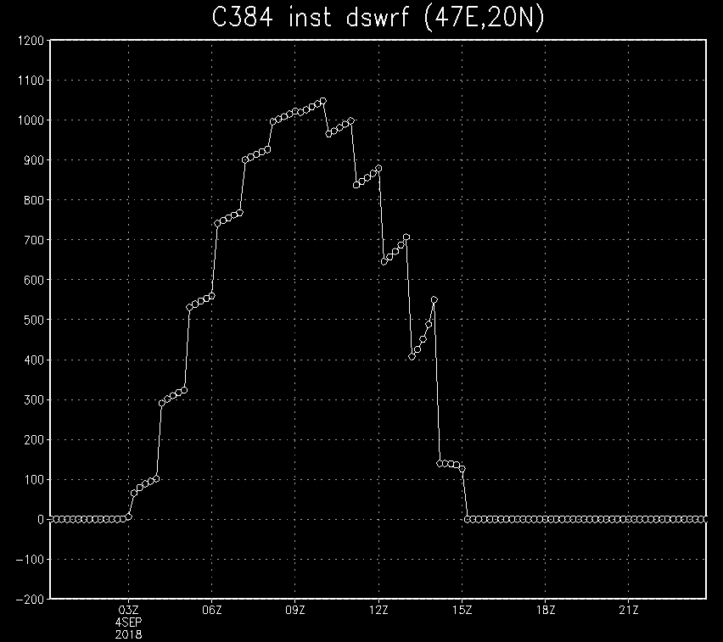
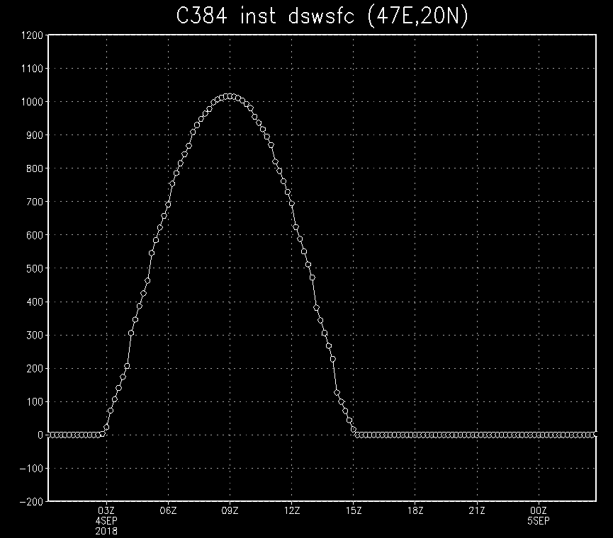
BUG w DOWNWARD SOLAR RADIATION
FOUND AND CORRECTED in FALL 2018
Old version of GFSv15
New version of GFSv15
EXAMPLE from 47E, 20N
MORE on THIS LATER!

Slide 9
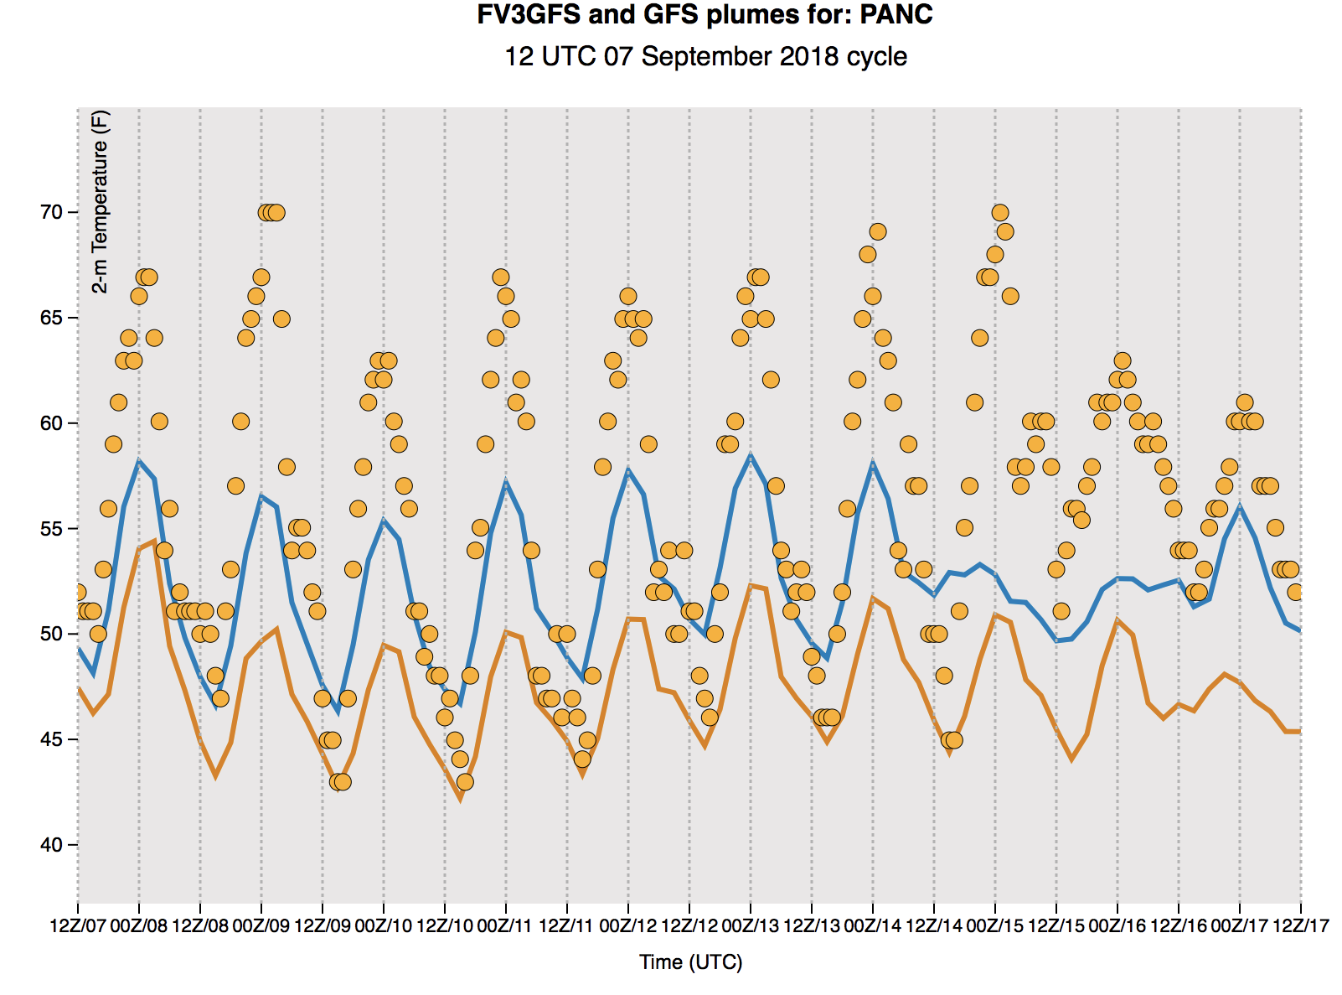
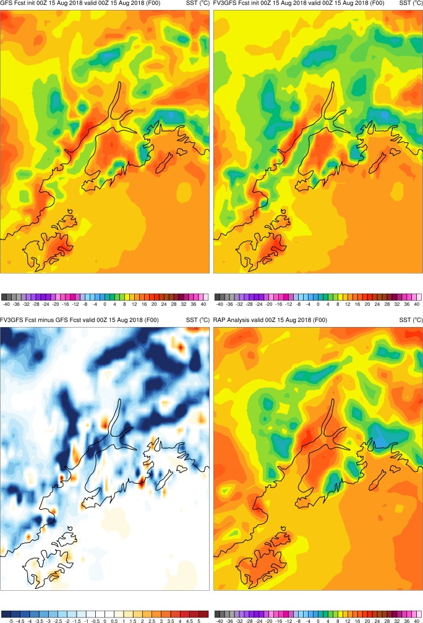
2m ALASKA TEMP STATS SHOWED A COLD BIAS in SUMMER 2018, and ANCHORAGE PLUMES CONFIRMED IT
GFSv14
GFSv15
OBS

Slide 10
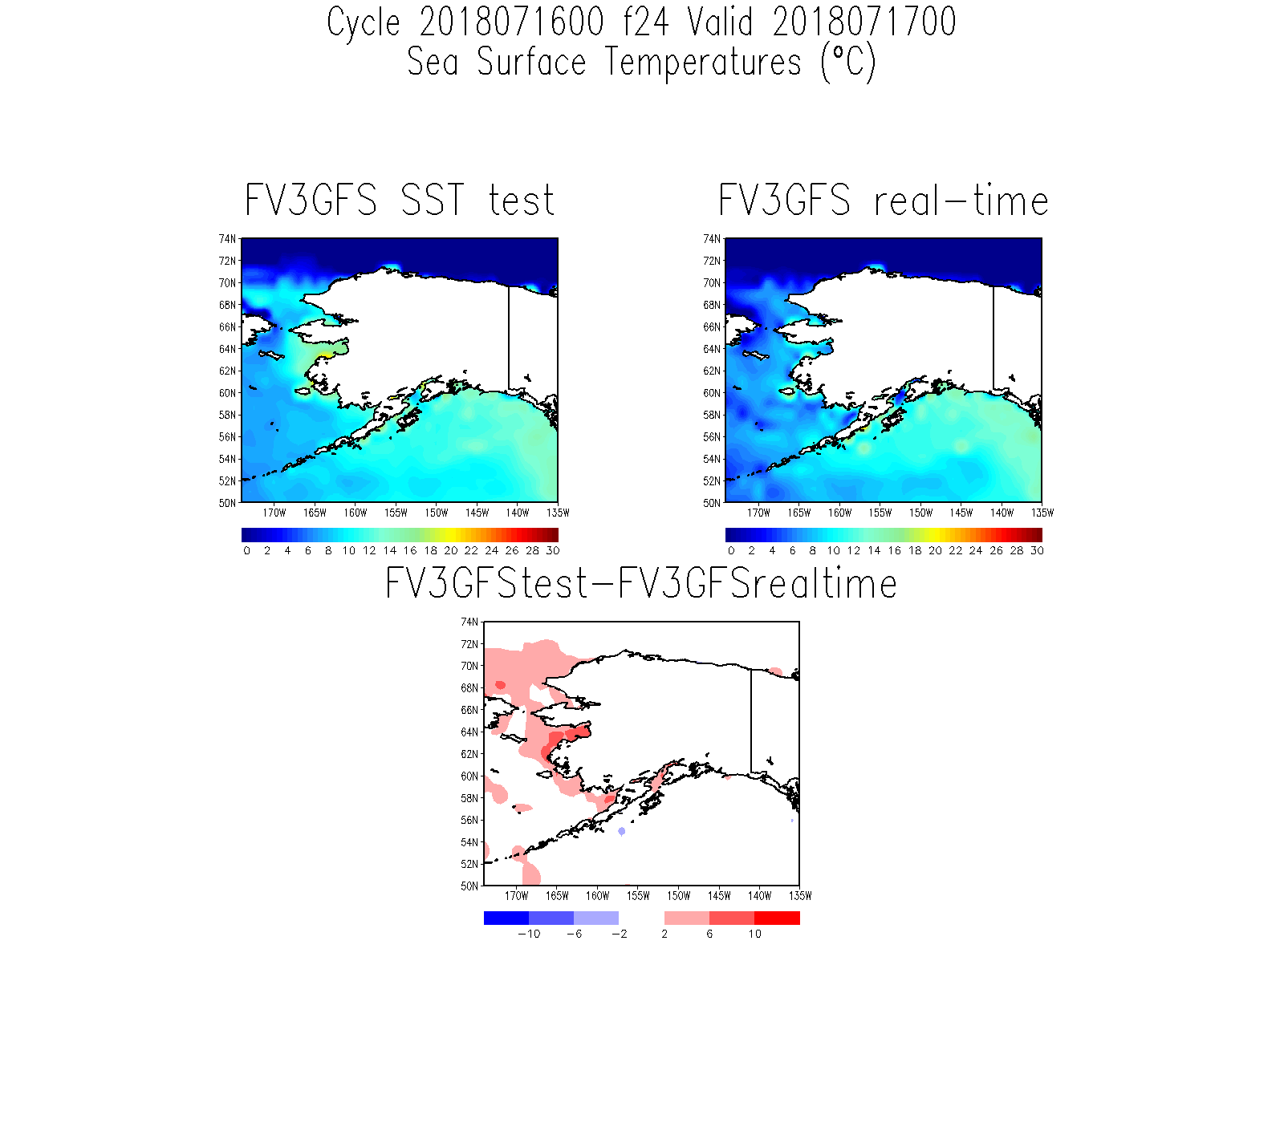
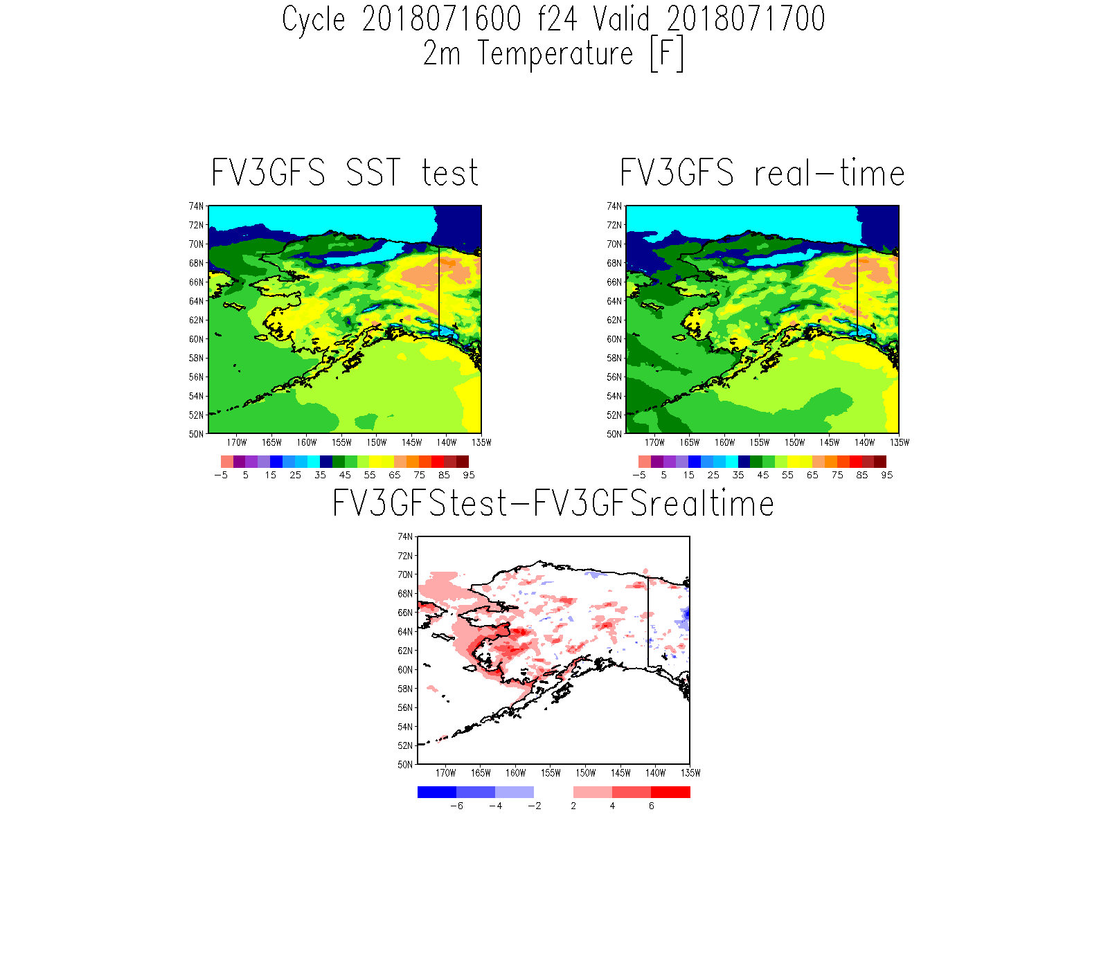
CHANGE MADE IN SEPTEMBER 2018 to SST
F24 valid 00Z
RED indicates where
run with new SST
is warmer
BETTER
GFSv14
GFSv15
GFSv15
TOO COLD
Mean SST in
North Pacific
GFSv14 vs v15

Slide 11
HIGHLIGHTS OF THE POSITIVES
500-MB AC SCORES ARE STATISTICALLY SIGNIFICANTLY BETTER IN GFSv15, AND OTHER SYNOPTIC STATS ARE TYPICALLY AS GOOD AS IN GFSv14, WITH SOME IMPROVEMENT IN DETAILS
IMPROVED WARM-SEASON DIURNAL CYCLE OF PRECIPITATION
3. INTENSE TROPICAL DEEPENING NOT SEEN IN GFSv15
4. DOUBLE-LOW CENTERS FOR SINGLE STORM NOT SEEN IN GFSv15 FCTS OR ANL
5. GFSv15 SEEMS TO BE ABLE TO GENERATE MODEST SFC CONVECTIVE COLD
POOLS, WITH CORRESPONDING IMPROVEMENT IN WARM SEASON QPF
6. NEW SIMULATED COMPOSITE REFLECTIVITY PARAMETER IS AVAILABLE

Slide 12
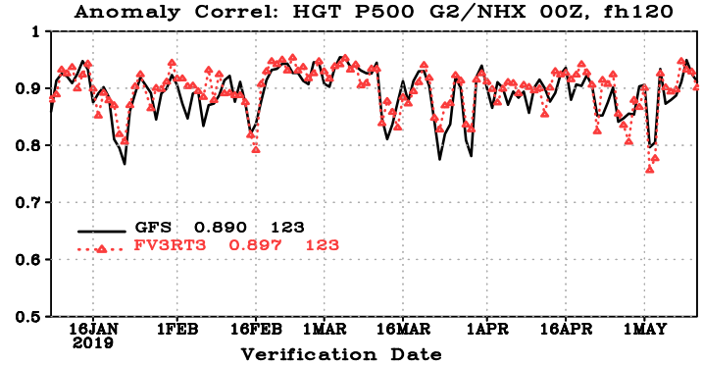
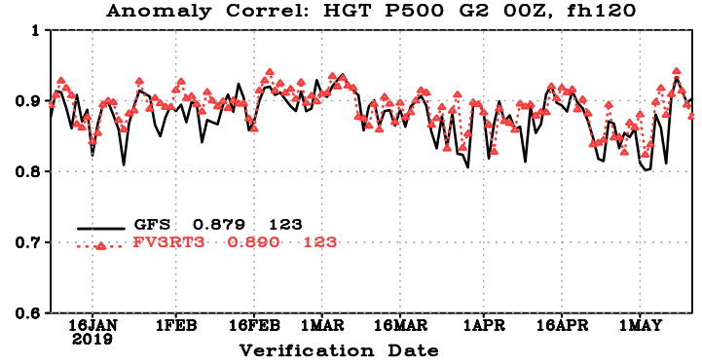
DAY 5: 500-mb AC SCORES FOR THIS PAST WINTER
NH
GLOBE
GFSv14: 0.890
GFSv15: 0.897
GFSv14: 0.879
GFSv15: 0.890

Slide 13
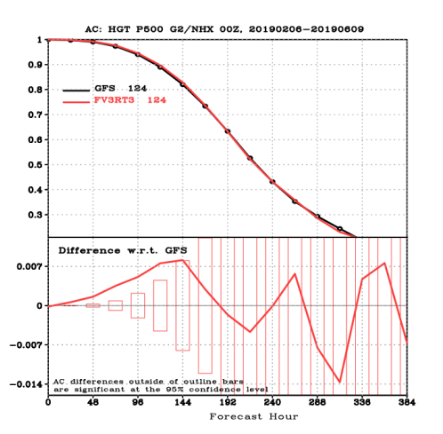
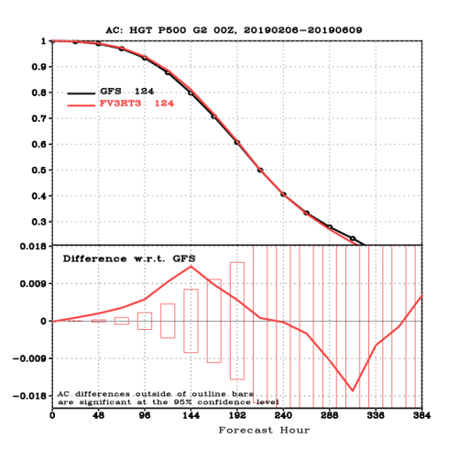
DIE-OFF : 500-mb AC SCORES FOR THIS SPRING
GFSv15 is SS better
through ~Day 6 &
better (not SS)
through Day 7
GFSv15 is SS better
through Day 6 &
better (not SS)
through Day 9
GFSv14
GFSv15
GFSv14
GFSv15
NH
GLOBE

Slide 14
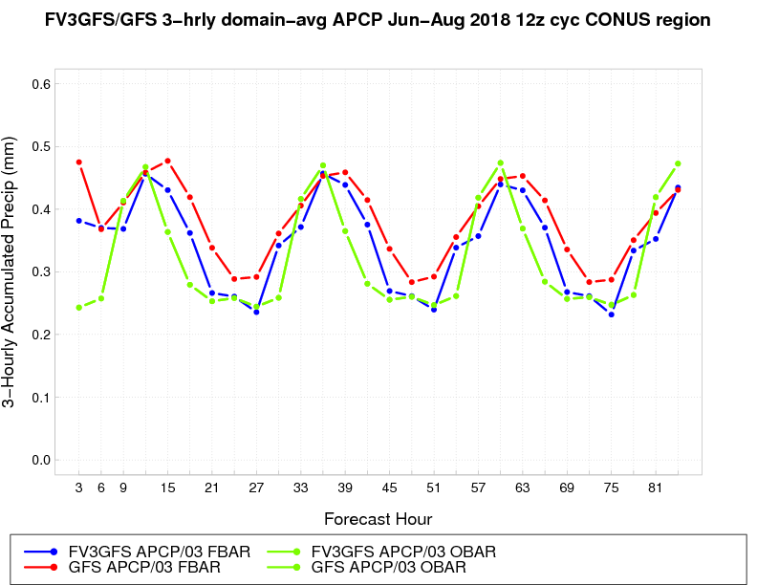
SUMMER 2018 CONUS DOMAIN-AVG PCP
Better timing
of late-day MAX
Considerable
improvement
in diurnal cycle
of warm season
precipitation
Improvement in
GFSv15 is the most
pronounced during
overnight hours
Better magnitude
of late-night MIN
GFSv15 GFSv14 OBS

Slide 15
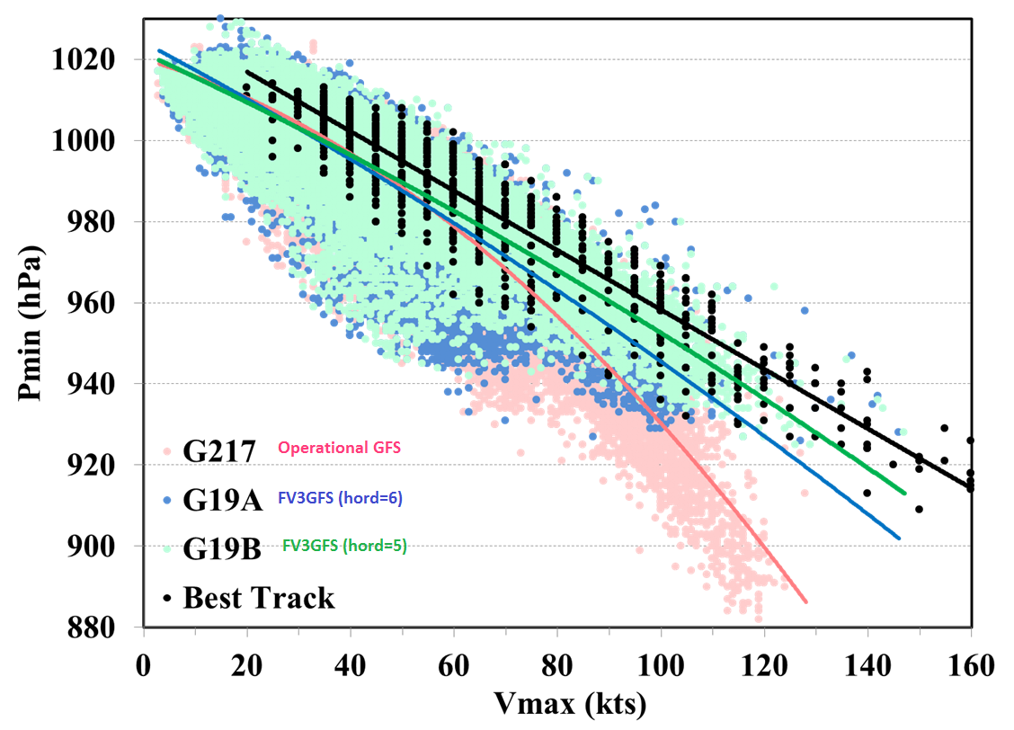
TROPICAL CYCLONE WIND-PRESSURE RELATIONSHIP
Extreme SLP deepening
not seen in GFSv15
GFSv14 has a poor
wind-pressure relationship,
with max wind speeds
inconsistent w/ extremely
low SLP values
Intensity scores, computed
with maximum wind speed,
are better in GFSv15
(not shown)
GFSv14
GFSv15 (hord=6)
Older version
GFSv15 (hord=5)
Final version

Slide 16
IRMA 00z 9/8/17 F54
GFSv14
GFSv15
NHC: 931 mb
899 mb
941 mb
- Higher SLP values in GFSv15 are more consistent w/
nature (wind-pres) & resolution of a global model
- Higher SLP does not mean a weaker tropical cyclone

Slide 17
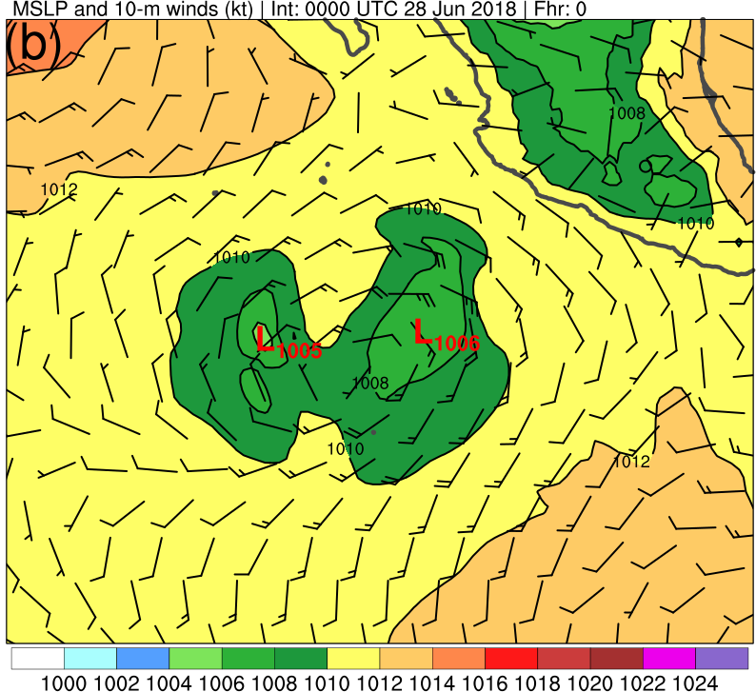
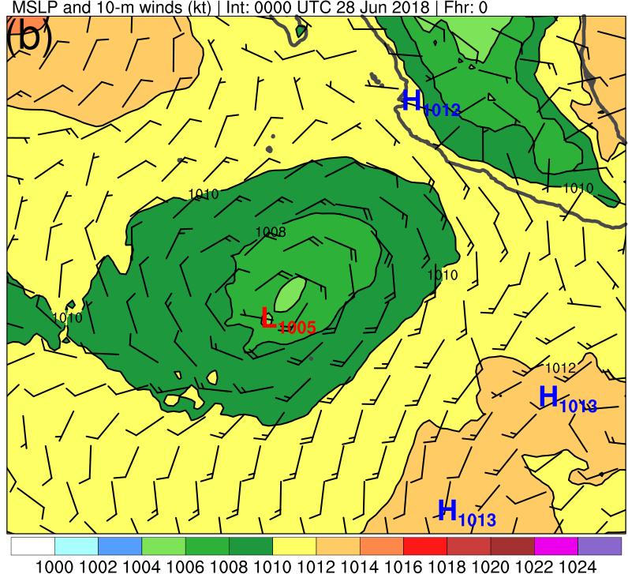
MULTIPLE TROPICAL CYCLONE CENTERS
FOR SINGLE STORM GENERATED BY GFSv14
NOT SEEN IN GFSv15 FORECASTS or ANALYSES
6/28/18 00z F00
GFSv14
GFSv15

Slide 18
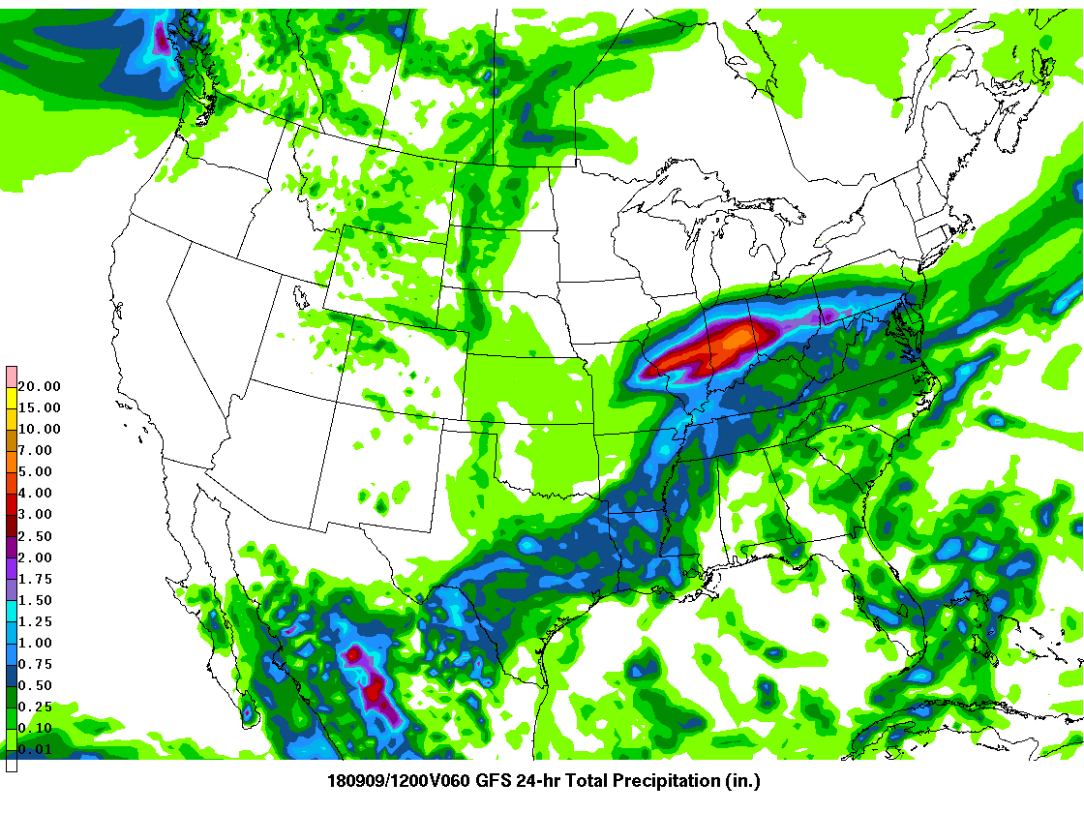
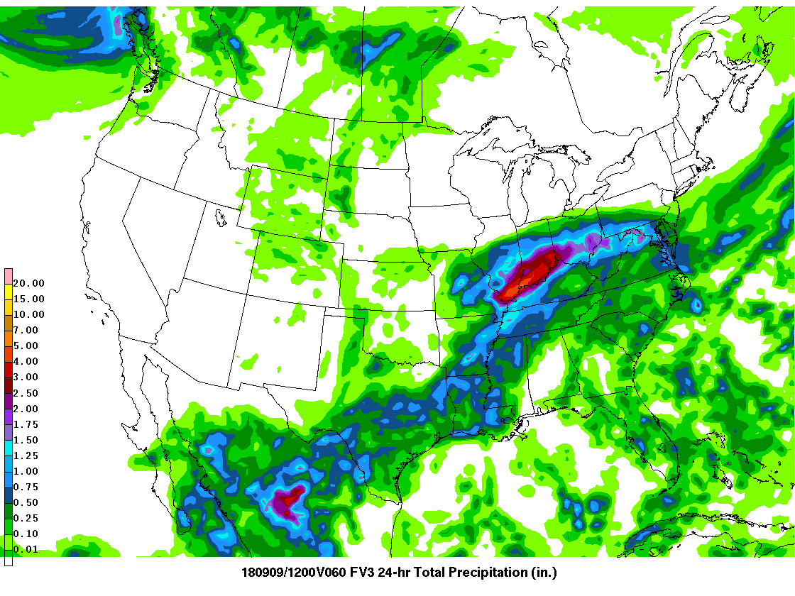
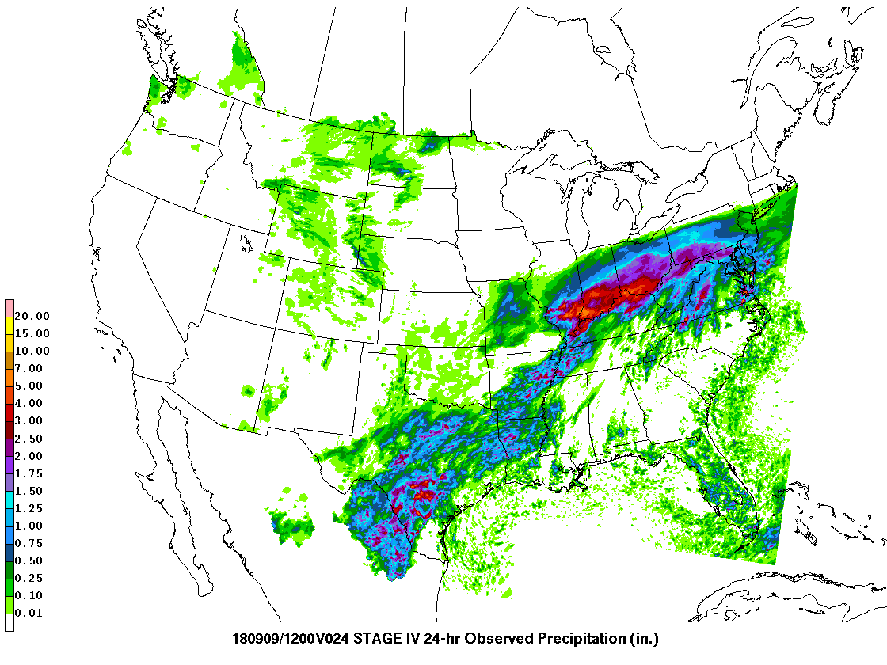
From the WPC GFSv15 Evaluation
GFSv14 24-h QPF F60
GFSv15 24-h QPF F60
SOME REDUCTION IN NORTHWARD QPF BIAS, POTENTIALLY ASSOCIATED
WITH ABILITY OF GFSv15 TO GENERATE MODEST COLD
POOLS FROM SIGNIFICANT CONVECTION
24-h Stage IV
QPE valid
12Z 9/9/2018

Slide 19
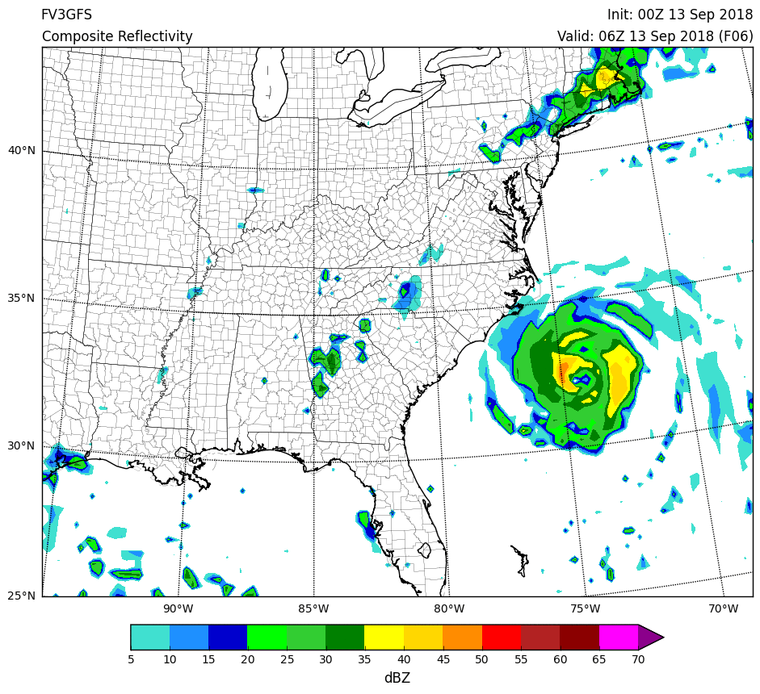
NEW GFDL MP ALLOWS FOR SIMULATED COMPOSITE REFLECTIVITY

Slide 20
SOME CONCERNS
LOW-LEVEL COLD BIAS IN THE COLD SEASON, POTENTIALLY LEADING TO EXCESSIVE SNOW FORECASTS
FV3GFS CAN BE TOO PROGRESSIVE CLOSED UPPER LOWS RE-ENTERING THE FLOW
3. WARM-SEASON DRY QPF BIAS FOR MID AND UPPER THRESHOLDS
CONCERNS WITH FORWARD SPEED OF POLEWARD-MOVING
TROPICAL CYCLONES

Slide 21
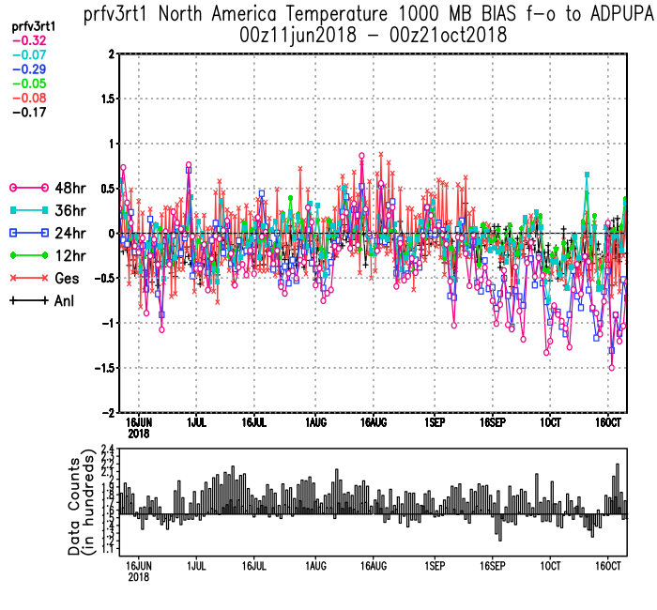
GFSv15 change @ 18z 9-17-18 to correct radiation error:
RADIATION DRIVER CORRECTION LED TO A SIGNIFICANT
INCREASE in the LOW-LEVEL
COLD BIAS

Slide 22
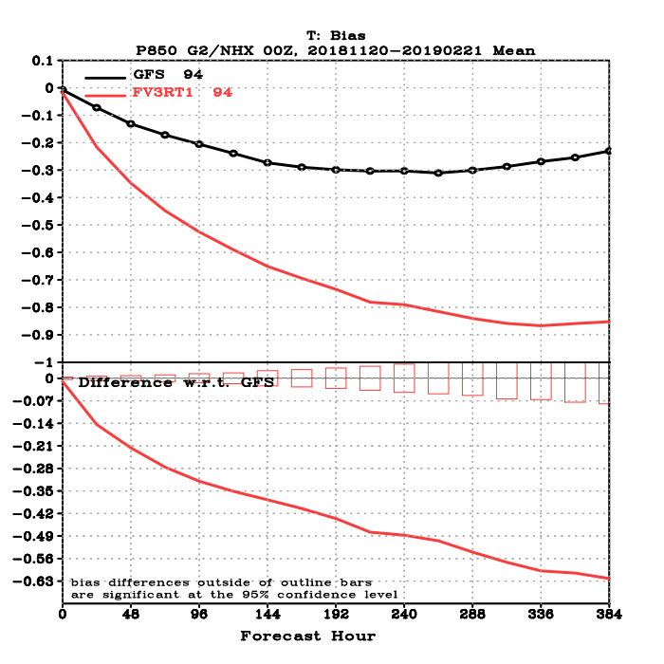
COLD BIAS WAS EVIDENT IN RETROSPECTIVE RUNS, BUT MAGNITUDE
INCREASED SIGNIFICANTLY THIS PAST WINTER
GFSv14
GFSv15
500 mb
Height Bias
850 mb
Temp Bias
Day-10 500-hPa winter geopotential height bias
(2015–2016) -4.5 m
(2016–2017) -5.0 m
(2017–2018) -3.2 m
(2018–2019) -14.4 m
Day-10 850-hPa winter temperature bias
(2015–2016) -0.27°C
(2016–2017) -0.35°C
(2017–2018) -0.23°C
(2018–2019) -0.77°C

Slide 23
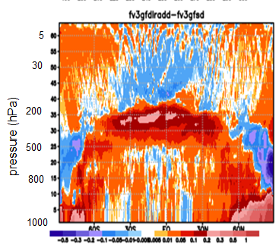
Mitigation of the cold bias (Late Winter 2019)
Zonal Mean Temperature Difference
Lat-HGT Cross Section, 24hr Forecast
Physics:
Adopting an improved cloud radiation interaction in the new configuration reduces long-wave cooling in the troposphere, and indirectly increases heating in the PBL and near-surface due to mixing, warming the troposphere.
Data Assimilation:
Adjustment to supersaturation constraint in the new configuration reduces the cold bias in the polar regions near surface.
Impact of improved cloud-radiation interactions: Warm the atmosphere (recovers some of the cold bias in the lower troposphere)
GFDL is acknowledged for their contribution to the implementation of the improved cloud-radiation interaction scheme in the new configuration.
23

Slide 24
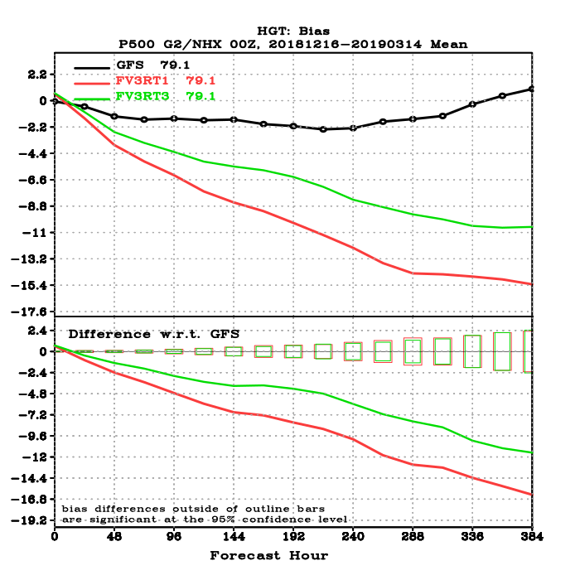
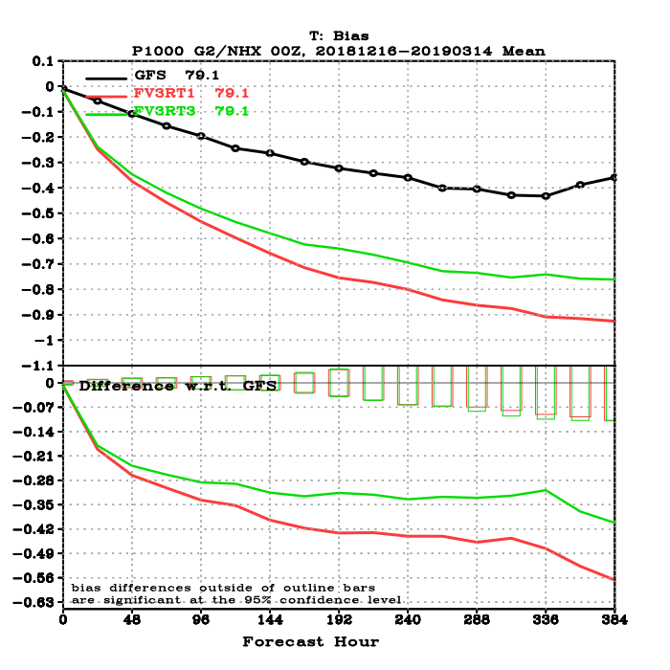
500 hPa Height Bias
1000 hPa Temp Bias
Ops GFS
New Configuration
Real-time Parallel

Slide 25
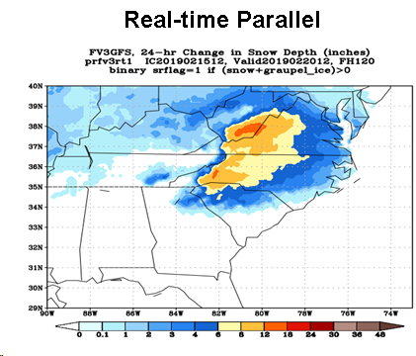
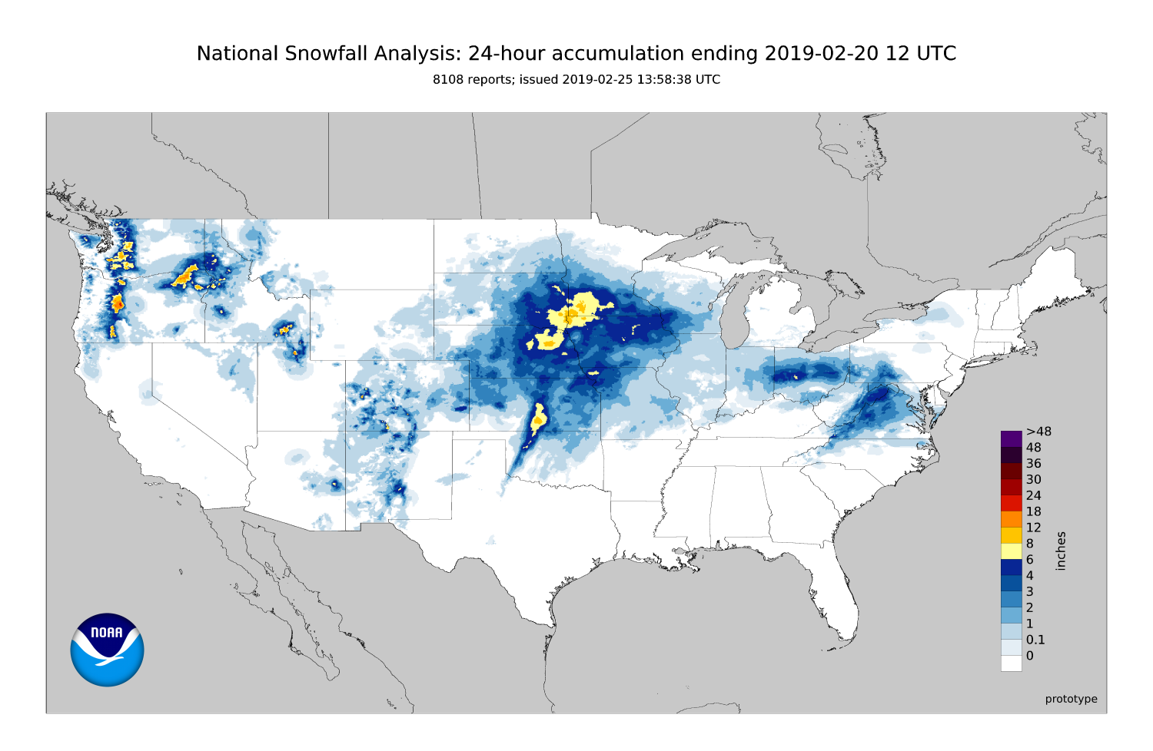
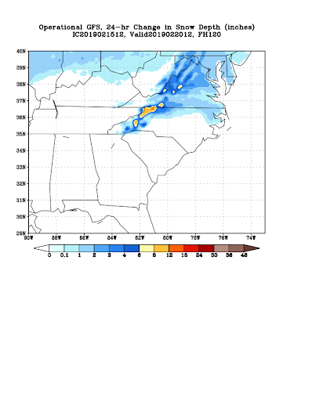
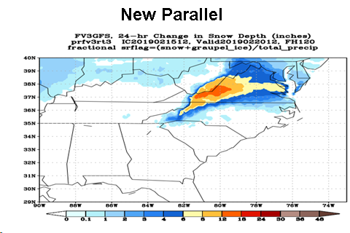
Excessive 24-h Snowfall Totals in Medium Range (Valid: 12Z 2/20/19)
NOHRSC Analysis
Previous GFSv15 Version
Final Configuration has correct
areal coverage of snowfall, and
coverage of higher amounts is
significantly reduced from the
real-time parallel run but are
still too high, potentially due to
the lingering low-level cold bias
Final GFSv15 Configuration
GFSv14
13

Slide 26
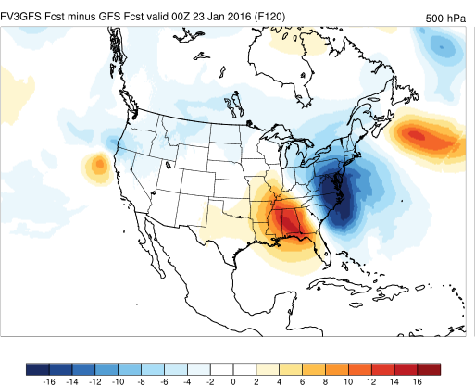
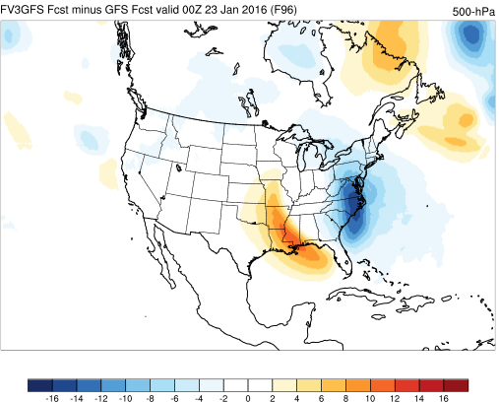
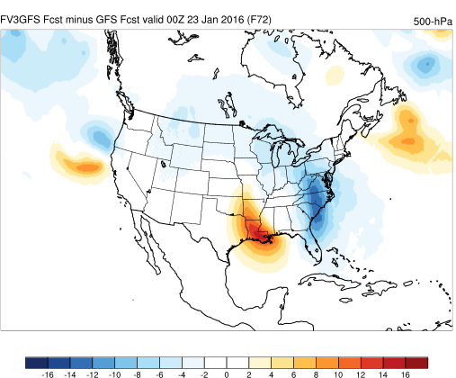
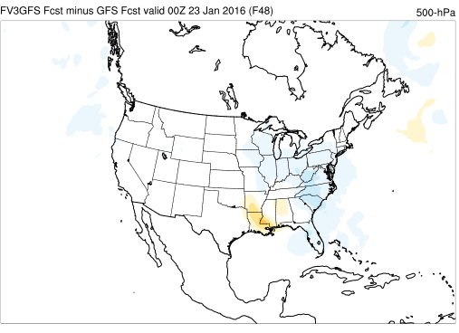
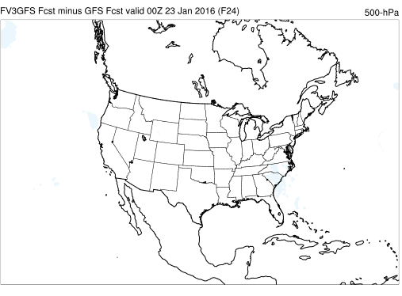
PROGRESSIVENESS
F120
F96
F72
GFSv15 – v14 500mb
BLIZZARD of 2016
CLEARLY TOO
PROGRESSIVE
in MEDIUM
RANGE; DIFFS
GET SMALLER
CLOSER to
VERIFYING TIME
Blue = GFSv15
has lower heights
Red = GFSv15
has higher heights
F48
F24

Slide 27
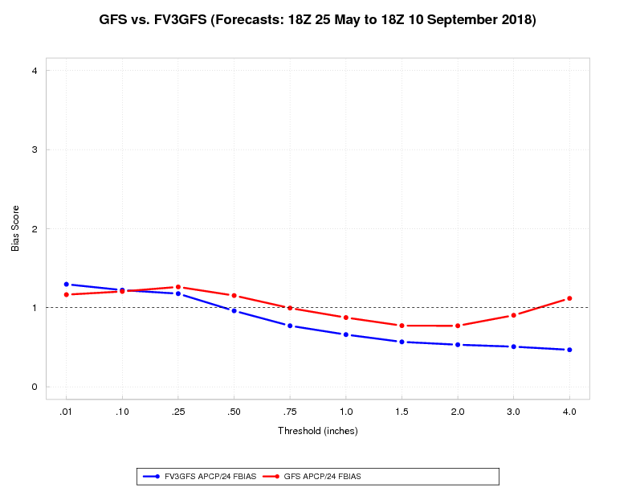
GFSv14
GFSv15
WARM SEASON DRY BIAS FOR MID AND UPPER-RANGE AMOUNTS

Slide 28

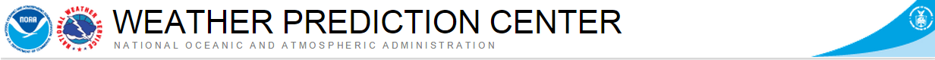
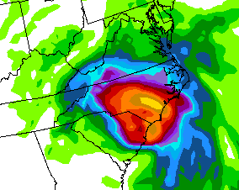
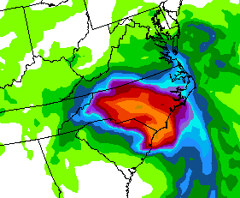
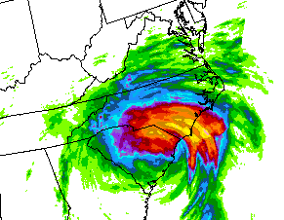
QPF Evaluation - Concerns
Low bias for higher QPF thresholds
24-hour QPF from the 00Z Sep 14 runs valid 12Z Sep 16 (F060)
GFSv14
GFSv15
Stage IV QPE

Slide 29
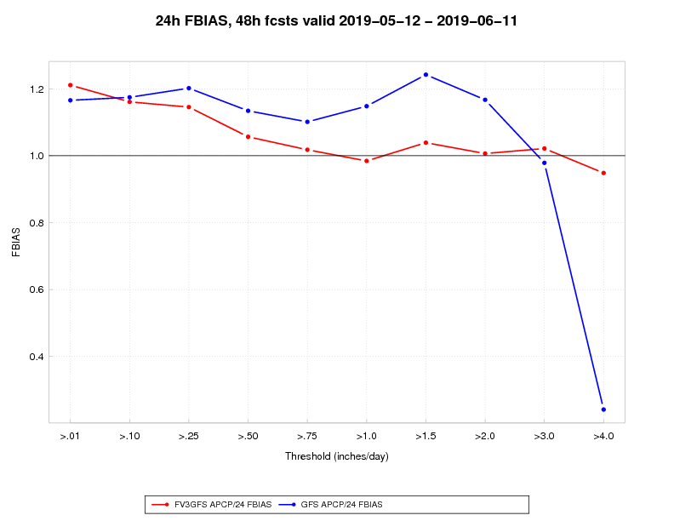
But some evidence this spring of better performance on wetter cases
STAGE IV OBS
GFSv14
GFSv15
Recent
Bias
Scores
GFSv14
GFSv15

Slide 30
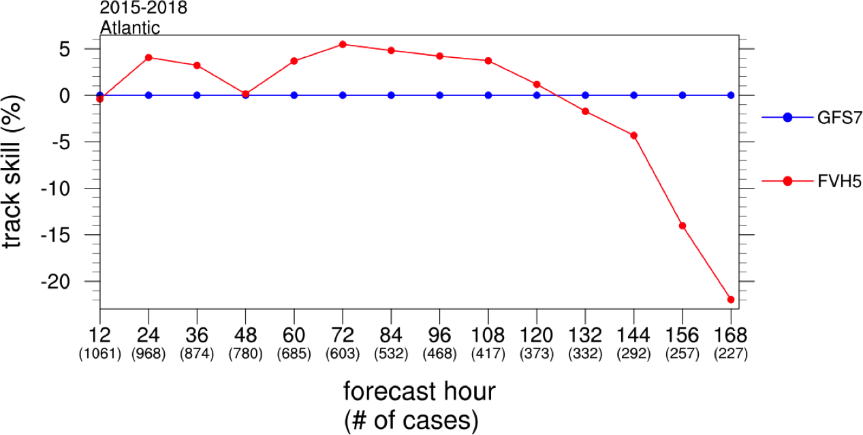
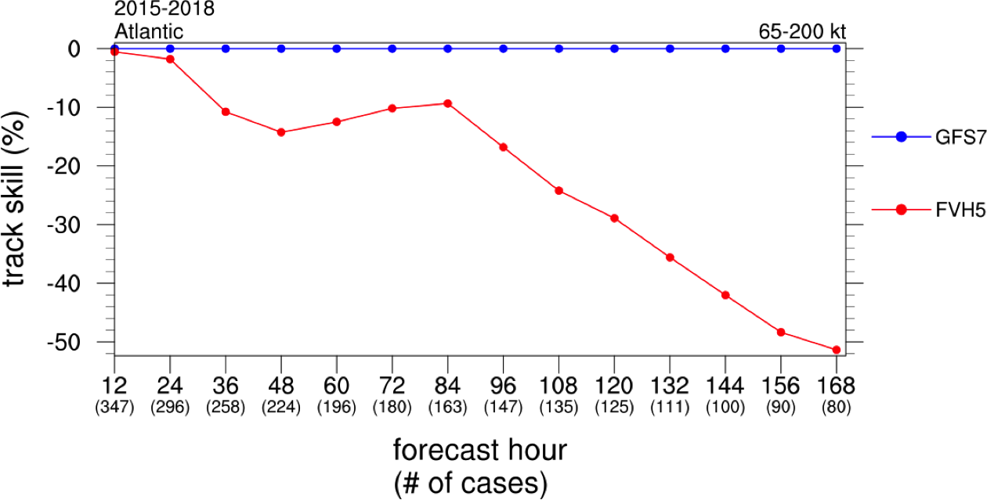
GFSv15 Track Skill Relative to Older GFS for 2015-18 Atlantic TCs and Hurricanes
From NHC Evaluation of GFSv15
TROPICAL
TRACKS
All TCs
Hurricanes
GFSv14
GFSv15
For all 2015-2018 Atlantic TCs (left), modest improvement in track forecasts through Day 5
Clear degradation by Day 6 with significant degradation at Day 7
For all 2015-2018 Atlantic hurricanes (right), track forecasts were degraded at all lead times –
worst cases seemed to be ones with poleward-moving storms

Slide 31
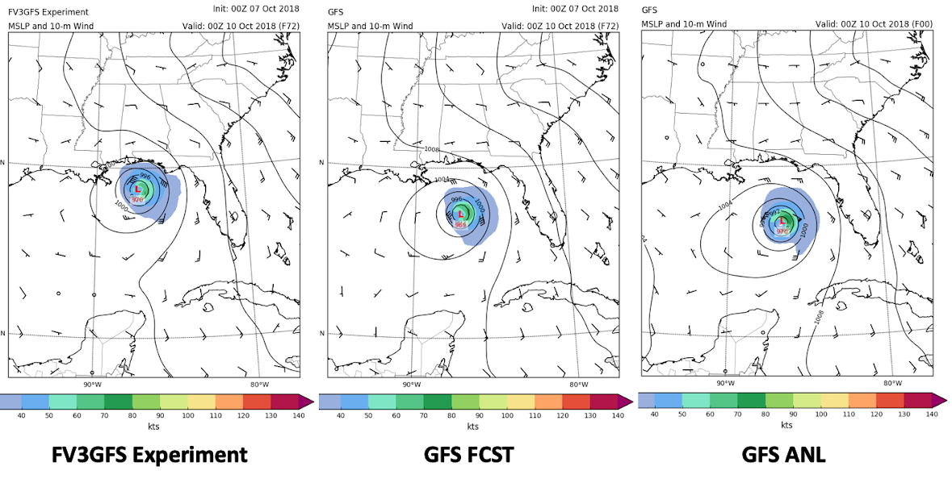
HURRICANE MATTHEW - 2016
9/30/16 12z F132
GFSv14
GFSV15
GFSv14
GFSv15
HURRICANE MICHAEL - 2018
10/7/18 00z F72
GFSv15
GFSv14

Slide 32
GOING FORWARD

Slide 33
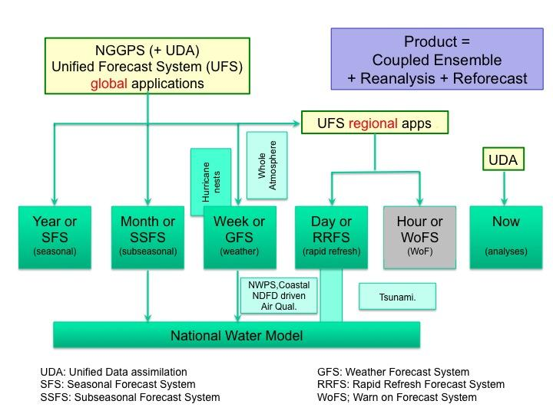
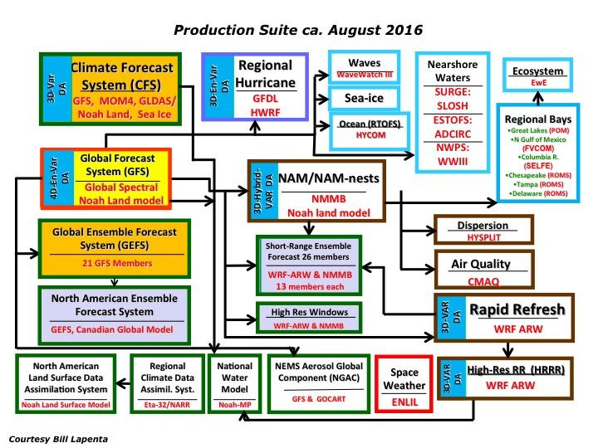
Target: Simplifying the NCEP Production Suite

Slide 34


CURRENT PLAN TO SIMPLIFY THE PRODUCTION SUITE
Move toward the Unified Forecast System
In 2016, the GFDL finite-volume cubed-sphere (FV3) dynamical core was selected to be the cornerstone of future NCEP modeling efforts
Allows NCEP to focus development on a single system
Initial work focused on developing the Next-Generation Global Prediction System (NGGPS)
FV3GFS (GFSv15), transition of the Global Forecast System to the FV3 dynamical core, is the first step toward implementing NGGPS

Slide 35

Sub-Seasonal Forecast System
The next step towards the UFS
Configuration
  C384L64 (~25km)
  31 members, 4 cycles/day
  Forecast extension to day 35 (1x/day)
Q2FY19: Start to produce 30 years (1989-2018) reforecast
Q4FY19: Start to produce retrospective runs (2-3 years)
Q2FY20: Official evaluation
Q4FY20: Implement FV3GEFS operational version (v12)
Global Ensemble Forecast System GEFS v12

Slide 36
Global Wave Ensemble (GWES) Coupled to GEFS v12
Coupling to GEFS v12: Provide initial framework for transition to unified, fully-coupled systems at NCEP,
New global grids: Improve overall model skill, and match requirements for inclusion of wave products to NAEFS,
Global core resolution increased from ½ degree to ¼ degree,
Inclusion of Arctic Polar grid with 18km resolution.
Objective Physics Retuning: Reduction of RMS error and bias, adjustment of wave model physics to FV3 forcing.

Slide 37
GFS V16: Major Upgrades to Deterministic Global Model
Model resolution:
  Increased vertical resolution from 64 to 127 vertical Levels and raise model top from 54 km to 80 km; Increased horizontal resolution from 13 km to 10 km (depending on operational resources)
Dynamics: New advection algorithms from GFDL
Advanced physics chosen from Physics Test Plan:
  PBL/turbulence: K-EDMF => sa-TKE-EDMF
  Land surface: Noah => Noah-MP
  Gravity Wave Drag: => unified gravity-wave-drag
  Radiation: updates to cloud-overlap assumptions,
  Microphysics: Improvements to GFDL MP
Coupling to WaveWatchIII
  Two-way interactive coupling of atmospheric model with Global Wave Model (GWM)
Data Assimilation Upgrades:
  Local Ensemble Kalman Filter (LETKF), including early cycle updates in support of GEFS
  4-Dimensional Incremental Analysis Update (4DIAU)
  Stochastic Kinetic Energy Backscatter (SKEBS) and land- surface perturbations
  Stratospheric humidity increments
  Improved Near Surface Sea Temperature (NSST) analysis
  Land Data Assimilation
  Shifting and Lagging Ensemble Members to expand ensemble size
  Improved cloud analysis
  Delz increments
Evaluation planned for Q3 FY20, with planned for implementation in Q2FY21

Slide 38

Potential Additional Components of GFSv16
work ongoing within physics group to understand and further mitigate the low-level cold bias
New PBL scheme shows promise in
slightly mitigating long-standing GFS
issues with being too weak with low-
level inversions – more testing ongoing
GFS
v15
GFSv15
+ new PBL

Slide 39
Thank You! Questions?

