Slide 1
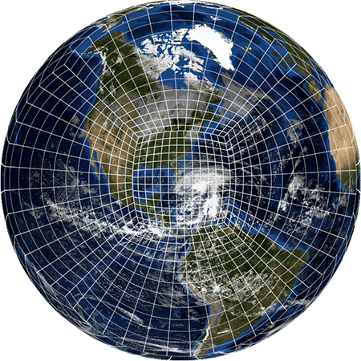
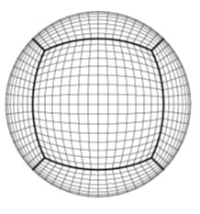
MEG FV3-GFS
Evaluation Overview
EMC MODEL EVALUATION GROUP
Geoff Manikin, Alicia Bentley, Logan Dawson, Tracey Dorian
Fanglin Yang and Vijay Tallapragada
3 MAY 2018
geoffrey.manikin@noaa.gov

Slide 2
Current Status
Original plan to implement FV3GFS with advanced physics and increased resolution early next year will not work
  It took longer than expected to build expertise on FV3GFS
  Not enough HPC resources to do the development (late availability of Dells)
  Can’t meet implementation milestone of Q2FY19
Backup plan to run the FV3GFS and GFS side-by-side for a year also will not work
  Lack of computing resources to maintain this parallel long-term
  May not need that long to validate the FV3GFS as a replacement
FV3GFS V1.0 with operational GFS configuration has the potential to replace the GFS in operations as early as Q1FY19
  Early results look promising
  Take advantage of additional HPC resources on Dell to conduct retrospective and real-time testing, and transition to operations in Q1FY19
  Minimum impact on FV3GEFS reanalysis, reforecasts and operational implementation of GEFS v12 (with extension to 35 days) in Q4FY19

Slide 3
Proposed Schedule for NGGPS/FV3GFS Version 1
(GFS v15.0) Implementation
3/7/18: code freeze of FV3GFS-V1 (GFS V15.0)
3/30/18: Public release of FV3GFS-V1 code
4/1 - 12/11/18: real-time EMC parallels
5/15 - 8/1/18:
  retrospectives and case studies (May 2015 – March 2018: 3 summers and three winters)
  develop and validate downstream products
  prepare downstream NPS models
  science evaluation
  NCEP Centers and Field engagement
* 8/1/18 Field Recommendations Due
8/16/18: Brief NCEP Director
8/17/18: code handoff and public release of operational code
11/1/18: commence NCO 30-day parallels
12/11/18: GFS V15.0 operational

Slide 4
Configuration for FV3GFS v1
FV3GFS C768 (~13km deterministic); FV3GDAS C384 (~25km, ensemble)
64 layer, top at 0.2 hPa
Real-time Parallel:
  4 times daily; Hourly output up to 120 hours, then 3 hourly up to 384 hours
  Uniform Resolution throughout the forecast period
Retrospectives:
  3 hourly up to 240 hours, then 6 hourly up to 384 hours.
  Uniform Resolution throughout the forecast period
Real-Time data made available through para-NOMADS

Slide 5
FV3GFS: Infrastructure and Physics Upgrades
Revised bare soil evaporation scheme
Stochastic physics in the data assimilation
Enable NSST
other minor changes:
correction bugs related to the convective cloud water
radiation bug fix
slight modification in scale-aware mass-flux deep or shallow convection schemes
Integrated FV3 into NEMS
Replaced Zhao-Carr microphysics with the more advanced GFDL microphysics
Updated parameterization of ozone photochemistry with additional production and loss terms
New parameterization of middle atmospheric water vapor photochemistry

Slide 6
Evaluation website maintained by Alicia Bentley
http://www.emc.ncep.noaa.gov/users/Alicia.Bentley/fv3gfs

Slide 7
MEG Evaluation of FV3GFS in Collaboration with Field
STI has initiated the “FV3 Evaluation and Dissemination group”
  Members include representatives from various centers and regions including OCONUS and Alaska region
  Identified fields and metrics important for evaluation
  Established FV3/GFS comparison site
  Established VLab Forum for active discussion
  Data from the EMC parallel is available on paranomads
  The MEG and the STI team have been validating preliminary FV3GFS forecasts throughout the winter, prior to the official evaluation period
Still need the NCEP Centers, NWS Regions, private sector and other interested parties to monitor forecasts
  Recommendations to NCEP Director will be a major part of the decision on whether to proceed

Slide 8
Layout of Real-Time and Retrospectives
 | Period | Machine | Comments
Real-time Parallel (Stream 0) | 04/01/2018 ~ | WCOSS Prod | Will switch to Dell when available
2017/18 Winter-Spring (Stream 1)* | 11/20/2017 ~ 03/31/2018 | WCOSS Prod | *MDL cool season sample data for MOS (Will switch to Dell when available)
2017 Summer-Fall (Stream 2)* | 05/20/2017 ~ 11/20/2017 | WCOSS Dev | *MDL warm season sample data for MOS (Will switch to Dell when available)
2016/17 Winter-Spring (Stream 3) | 11/20/2016 ~ 05/31/2017 | WCOSS Dev | Will switch to Dell when available
2016 Summer-Fall (Stream 4) | 5/20/2016 ~ 11/30/2016 | Dell
2015/16 Winter-Spring (Stream 5) | 11/20/2015 ~ 05/31/2016 | Dell
2015 Summer-Fall (Stream 6) | 5/01/2015 ~ 11/20/2015 | Dell

Slide 9
MEG PLANS FOR RETRO RUNS
Verification branch will generate stats from retro runs
MEG will examine high-impact cases during this period and compare FV3GFS runs to ops GFS runs
Tropical Systems
  Harvey, Irma, Maria, Nate, Matthew, Joaquin, Haima, Meranti
Winter Storms
  Blizzard of 2016 and March 2017 east coast storm
  December 2017 deep south snow
  Christmas 2016 northern plains blizzard
QPF
  February 2017 west coast AR event
  Ohio Valley flooding w Cindy extratropical transition
  2015 South Carolina flooding
Other
  Recent winter cold air outbreaks
  Dropout cases

Slide 10
SOME VERY PRELIMINARY STATS

Slide 11
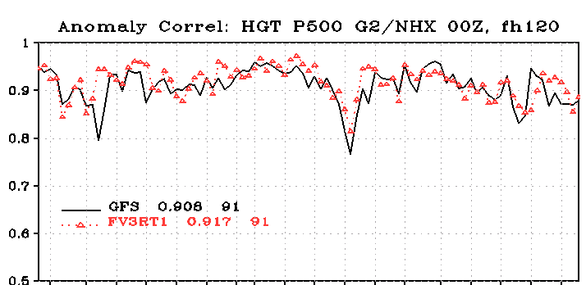
Real-time experiments with fully cycled FV3GFS+GFDL MP; 500-hPa HGT ACC
NH
NORTHERN HEMISPHERE
Jan 26 Mar 17 Apr 27

Slide 12
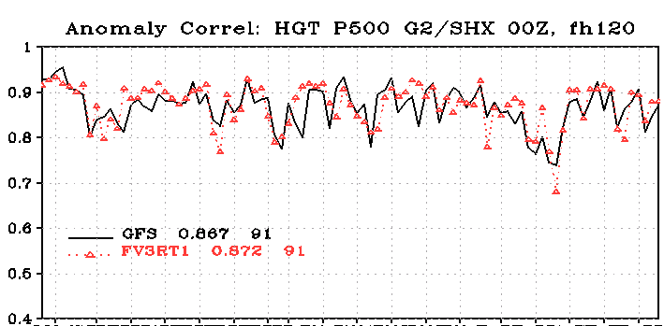
Real-time experiments with fully cycled FV3GFS+GFDL MP; 500-hPa HGT ACC
SOUTHERN HEMISPHERE
Jan 26 Mar 17 Apr 27

Slide 13
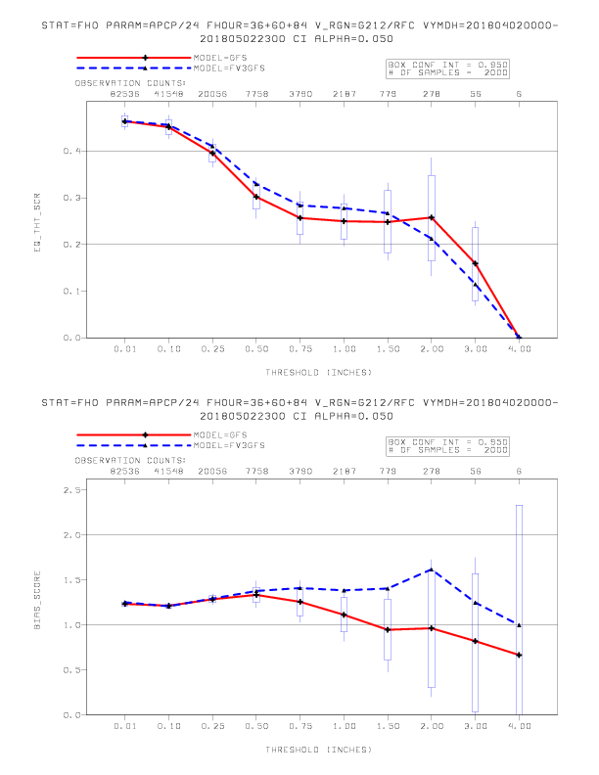
CONUS Precip ETS and Bias Scores

Slide 14
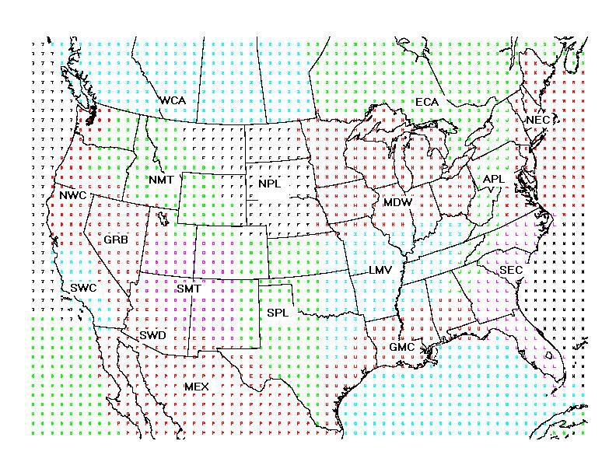
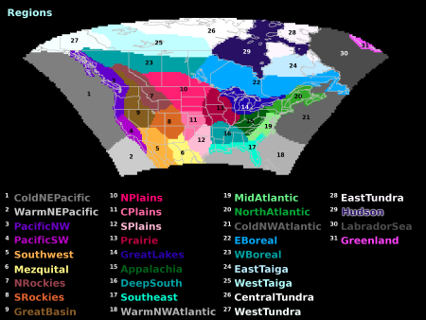
Hoping to change near-sfc verification away from outdated regional grouping

Slide 15
EXPECTATIONS
Since most of the physics are the same as currently being run in the GFS, we overall don’t expect large systematic differences
This primary goal of this evaluation is to make sure that there are no major problems with the FV3 and that it at least matches overall GFS performance
With validation of the FV3 core in the Global Forecast System, work can begin on NGGPSv1

Slide 16
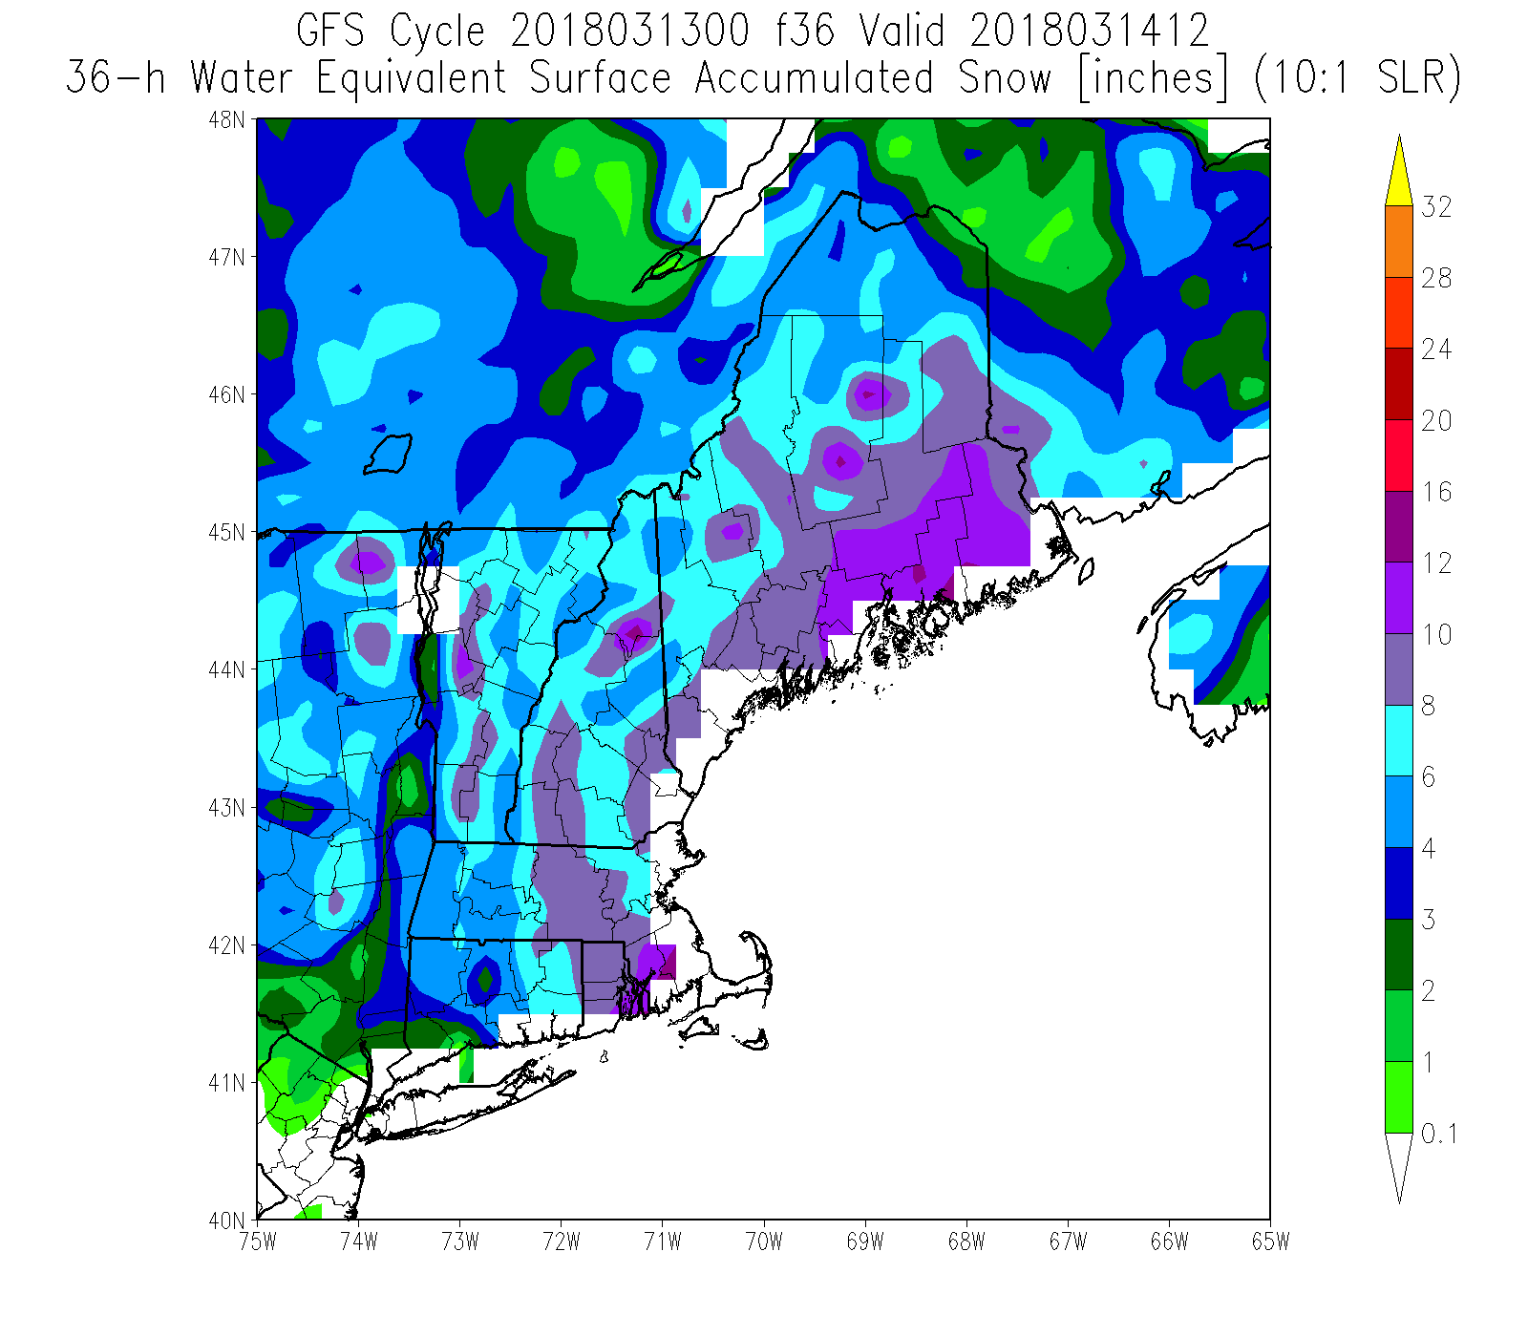
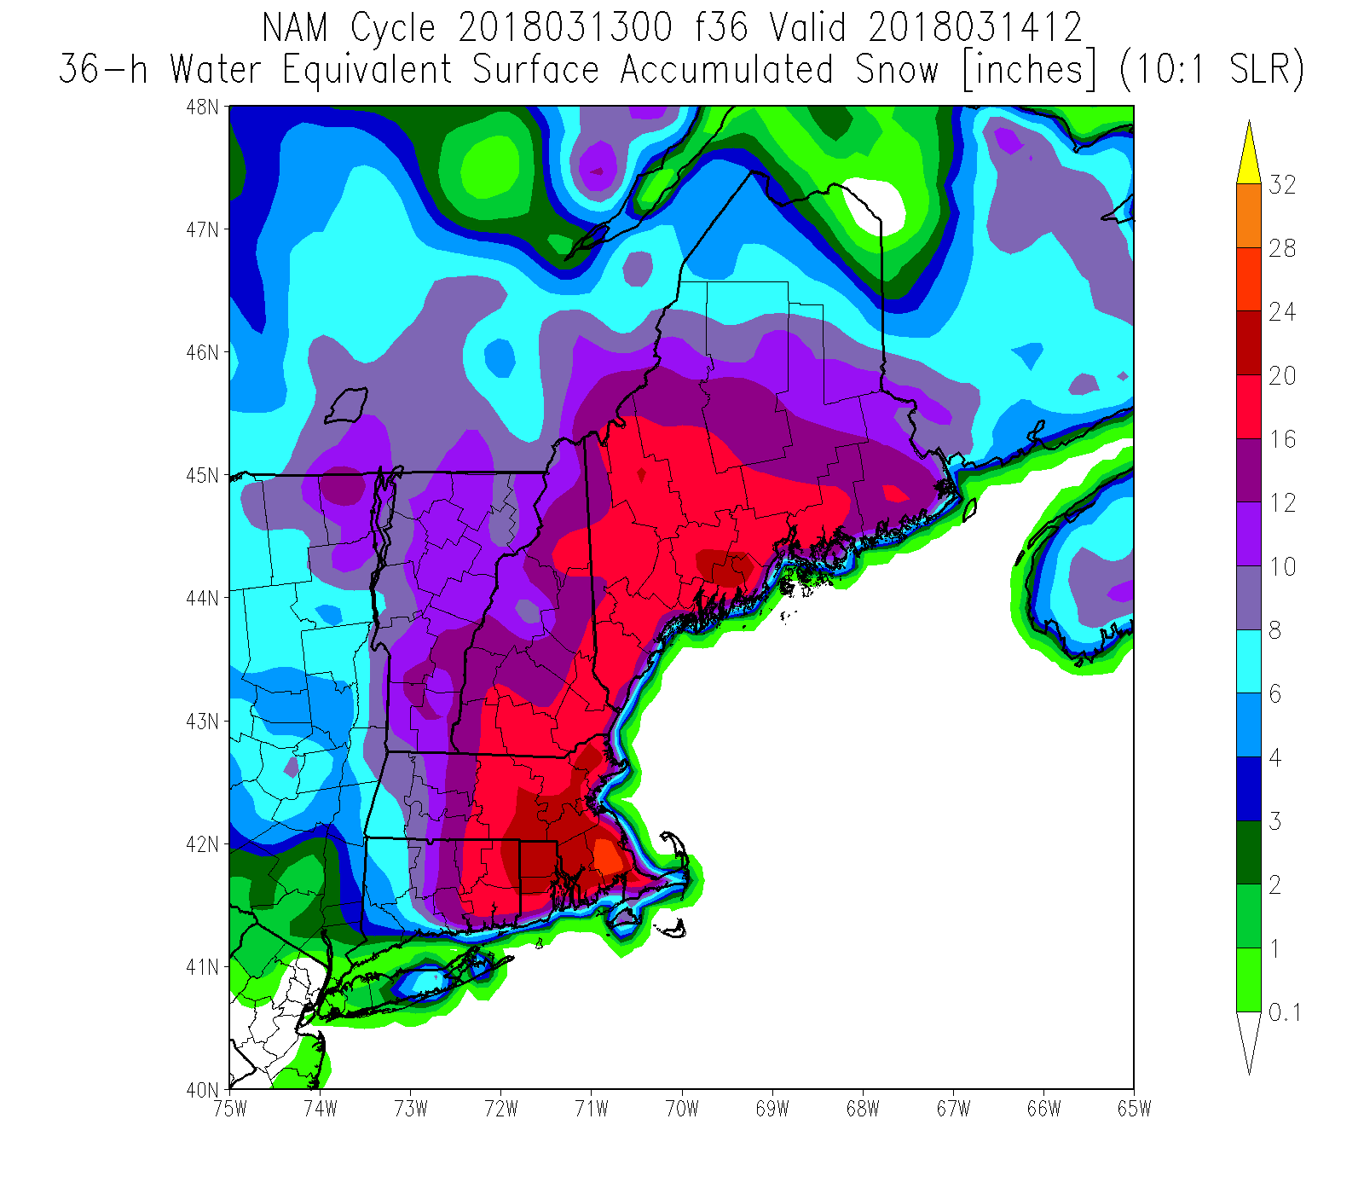
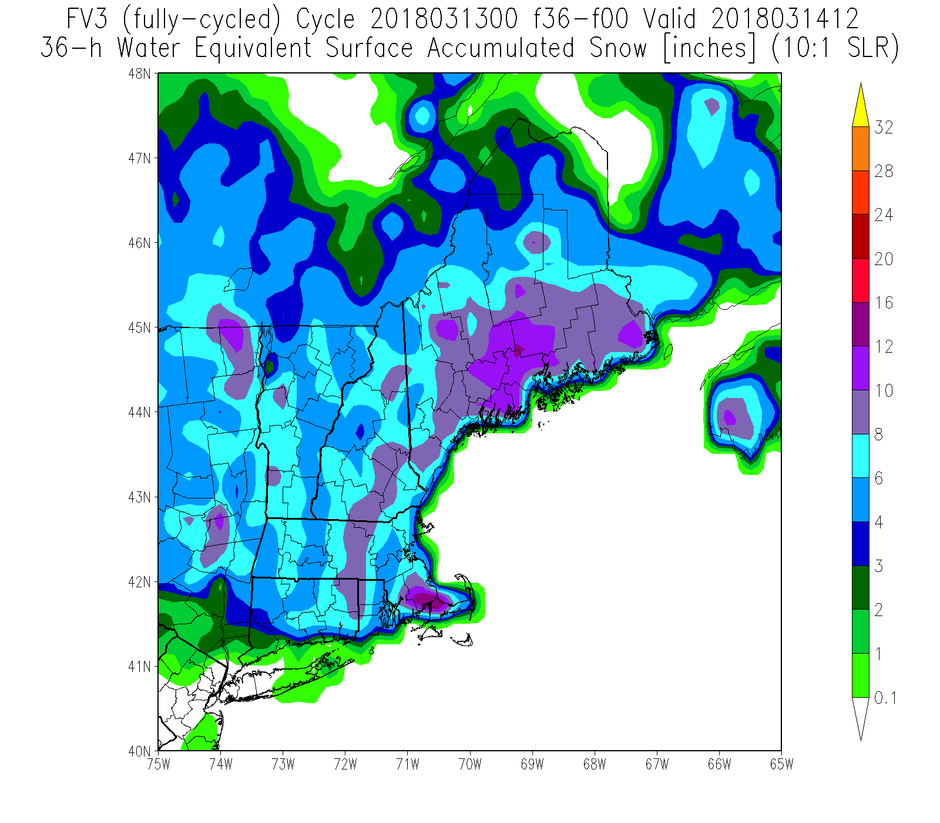
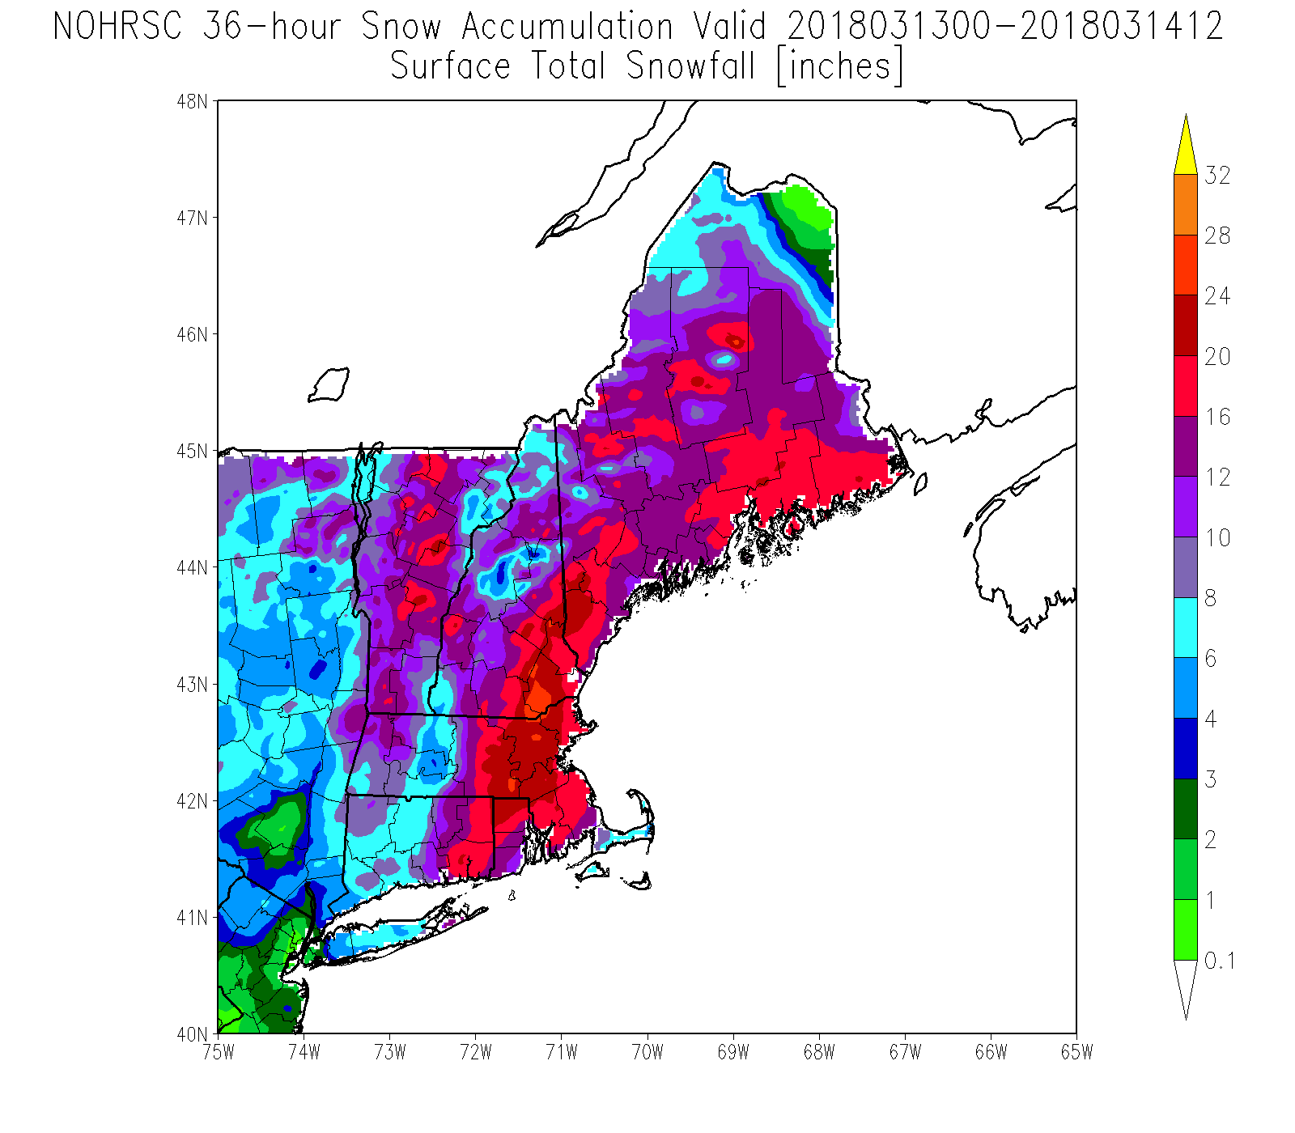
Water
Equiv
Snow
Depth
10:1
GFS
NAM
As expected, FV3
showed same GFS
bias this winter of
underdoing precip
on west side of east
coast storms
FV3
NOHRSC

Slide 17
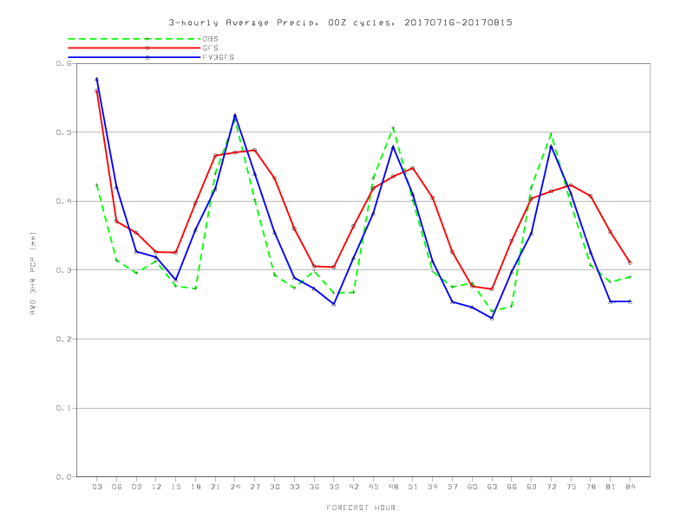
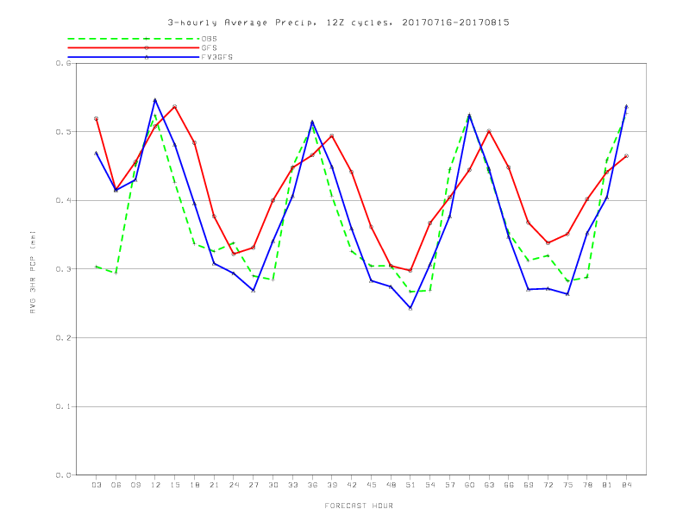
ConUS-avg’d 3hrly pcp vs. fcst hr,
16 Jul - 15 Aug GFS/FV3GFS/CCPA
00Z cycles
Surprisingly, though,FV3 much better agreement with CCPA on
diurnal cycle in preliminary warm season testing last year

Slide 18
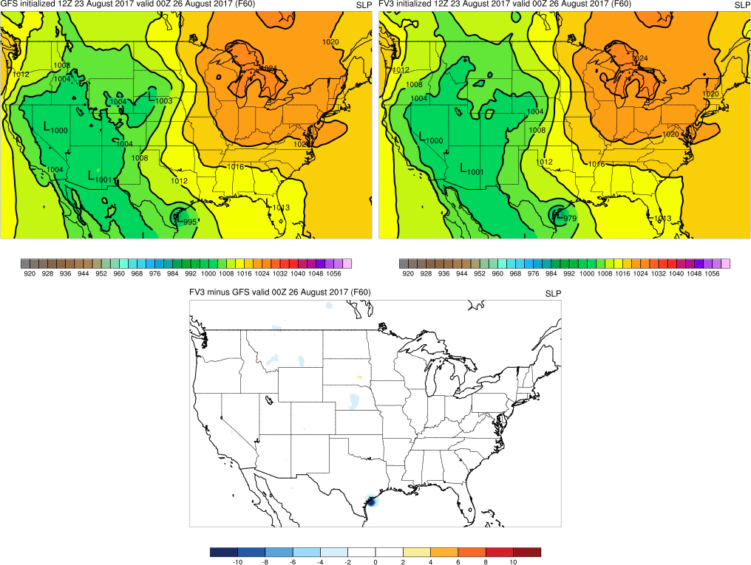
GFS / FV3 examples: Harvey
12Z 8/23 GFS
Central Pressure: 995 mb
12Z 8/23 FV3
Central Pressure: 979 mb
FV3 - GFS
MSLP forecasts and difference field valid at 00Z Saturday, 8/26 (F060)
During the first five days of each cycle, GFS and FV3 generally similar
Example above shows FV3 suggested rapid intensification and a deeper storm at landfall before the GFS (which caught on in later cycles)

Slide 19
HOW TO VIEW OUTPUT
http://para.nomads.ncep.noaa.gov/pub/data/nccf/com/gfs/para/
http://www.emc.ncep.noaa.gov/mmb/gmanikin/fv3gfs/fv3images.html
NWS WAVE viewer
tropicaltidbits.com
pivotalweather.com
FV3 plumes coming soon

Slide 20
GET IN TOUCH
https://vlab.ncep.noaa.gov/web/emc-model-evaluation-group/discussions-forums-/-/message_boards/category/3251785
(linked directly from FV3-GFS evaluation page)
contact the MEG: geoffrey.manikin@noaa.gov alicia.bentley@noaa.gov
logan.dawson@noaa.gov tracey.dorian@noaa.gov
we’d love to hear comments about systematic biases observed, oddities in the FV3GFS output, or successes
MEG will provide frequent briefings in the next 3 months covering updates on the timeline, stats, and retrospective cases

Slide 21
FV3 dycore and global models: GFS/GDAS
Near-term Milestones
Q3FY18: Conduct real-time parallels and 3-year retrospective experiments
Q1FY19: Implement FV3GFS (GFS v15) into operations
Q2FY19: Configure advanced physics; increased resolution and enhanced DA
Q3FY19: Finalize FY20 FV3GFS implementation configuration
Q4FY19: Conduct real-time parallels and 3-year retrospective experiments
Q1FY20: Complete 3 year retro & real time parallel and Evaluation
Q2FY20: Implement Advanced FV3GFS (GFS v16) into operations
Completed
Q3FY17: Implement FV3 into NEMS
Q4FY17: Couple FV3 to GFS Physics & complete forecast only exp.
Q4FY17: Adapt existing DA techniques for FV3
Q1FY18: Evaluate and prepare FV3 documentation
Q2FY18: Complete Pre/Post processing, verification, & downstream
Q2FY18: Public Release of FV3GFS v1.0 through Github.com

