Slide 1
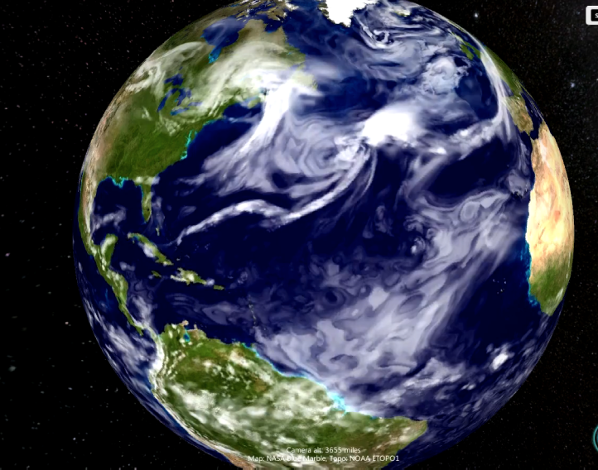
Subseasonal Forecasting with an Icosahedral, Vertically Quasi-Lagrangian Coupled Model: Systematic Errors and Deterministic/Probabilistic Forecast Skill
Shan Sun^{1,2}, Rainer Bleck^{1,2,3}, Stanley G. Benjamin¹, Benjamin W. Green^{1,2} & Georg Grell¹
¹NOAA Earth System Research Laboratory, Global Systems Division
²University of Colorado/CIRES, Boulder
³NASA Goddard Institute for Space Studies (GISS)
EMC
March 23, 2018
Clouds in FIM global model – 10km, 64 levels, 10-day forecast init 00z 21 Mar 2014

Slide 2
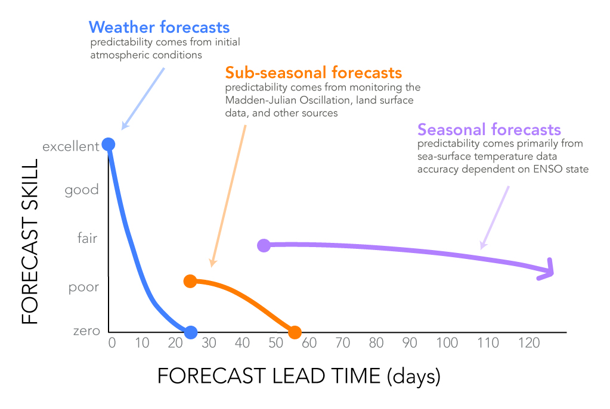
S2S
NWP
from http://iri.columbia.edu/news/qa-subseasonal-prediction-project/

Slide 3
Potential sources of predictability on sub-seasonal time scales
MJO
Blocking
Sudden stratospheric warming (SSW)
Soil moisture
Ice related processes
ENSO related processes
. . . . . .

Slide 4
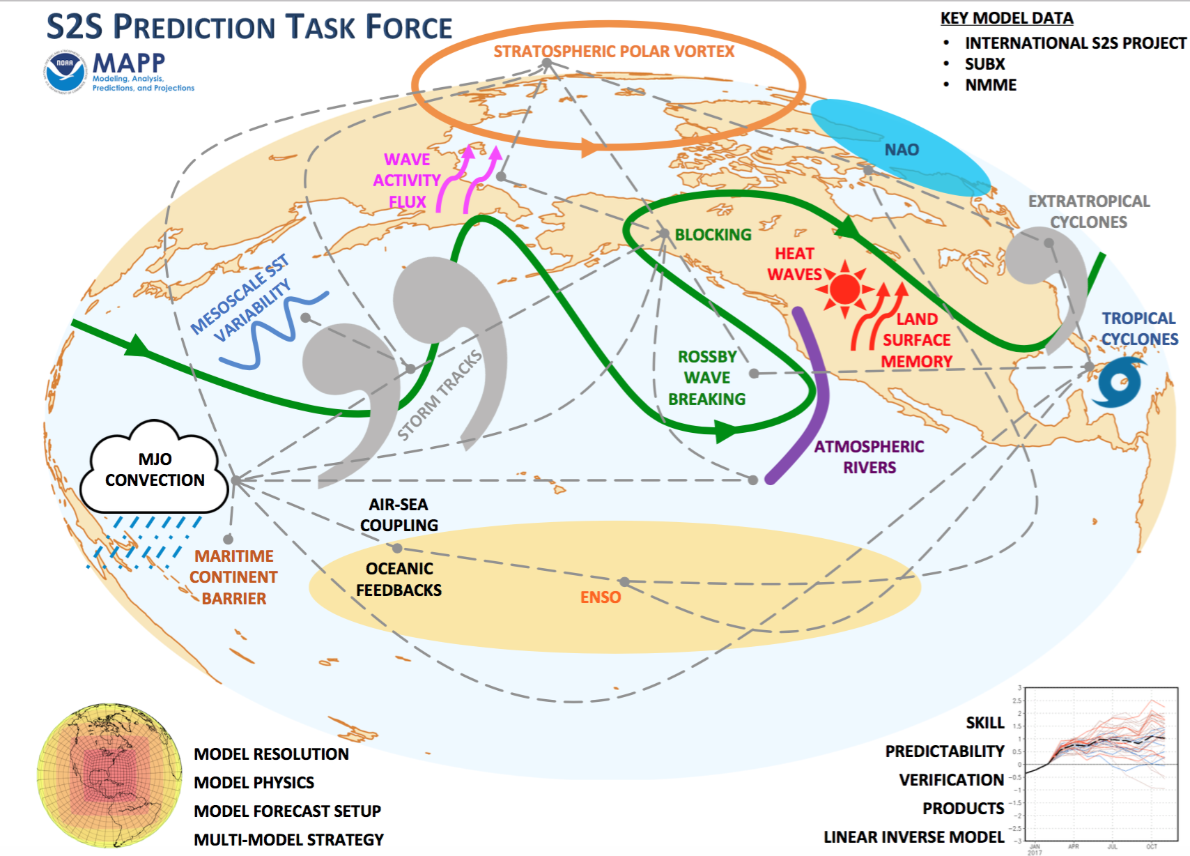
Courtesy MAPP S2STF

Slide 5
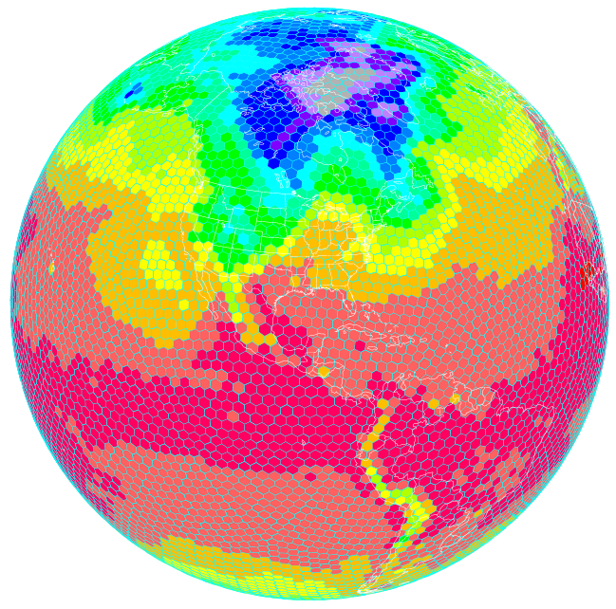
Coupled Atmospheric-Ocean Modeling on an Icosahedral Grid at NOAA/ESRL
Flow-following* finite volume
Icosahedral Model (FIM)
atmosphere
* flow-following = vertically quasi-Lagrangian

Slide 6
Coupled Atmospheric-Ocean Modeling on an Icosahedral Grid at NOAA/ESRL
Flow-following* finite volume
Icosahedral Model (FIM)
atmosphere
ocean
HYbrid Coordinate Ocean Model (HYCOM,
Bleck 2002)
iHYCOM => icosahedral HYCOM
* flow-following = vertically quasi-Lagrangian

Slide 7
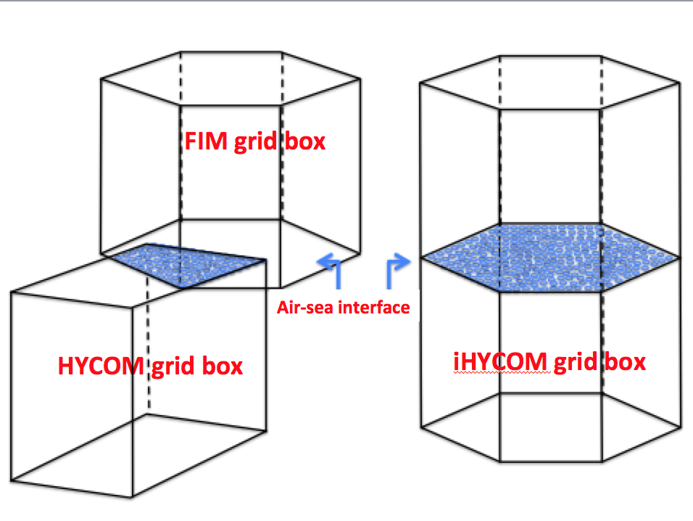
Coupled atmospheric model (FIM) with ocean model (iHYCOM)
atmosphere
ocean

Slide 8
Advantages of Uniform Horizontal Grid for
Atmosphere & Ocean
No need for flux coupler
Local and global conservation
No coastline discrepancies between atmosphere and ocean
  - especially bothersome in the presence of sea ice
  ……

Slide 9
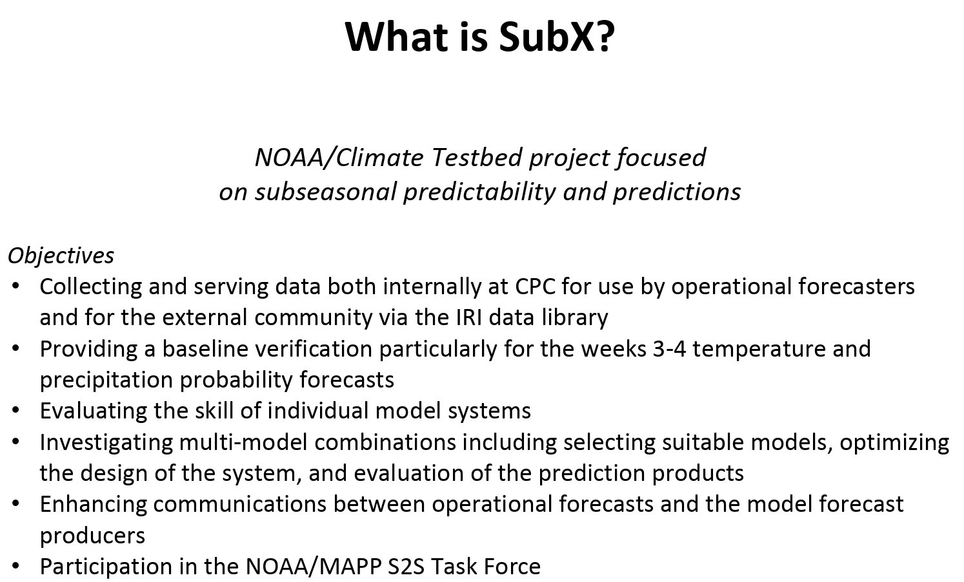
Courtesy Kathy Pegion

Slide 10
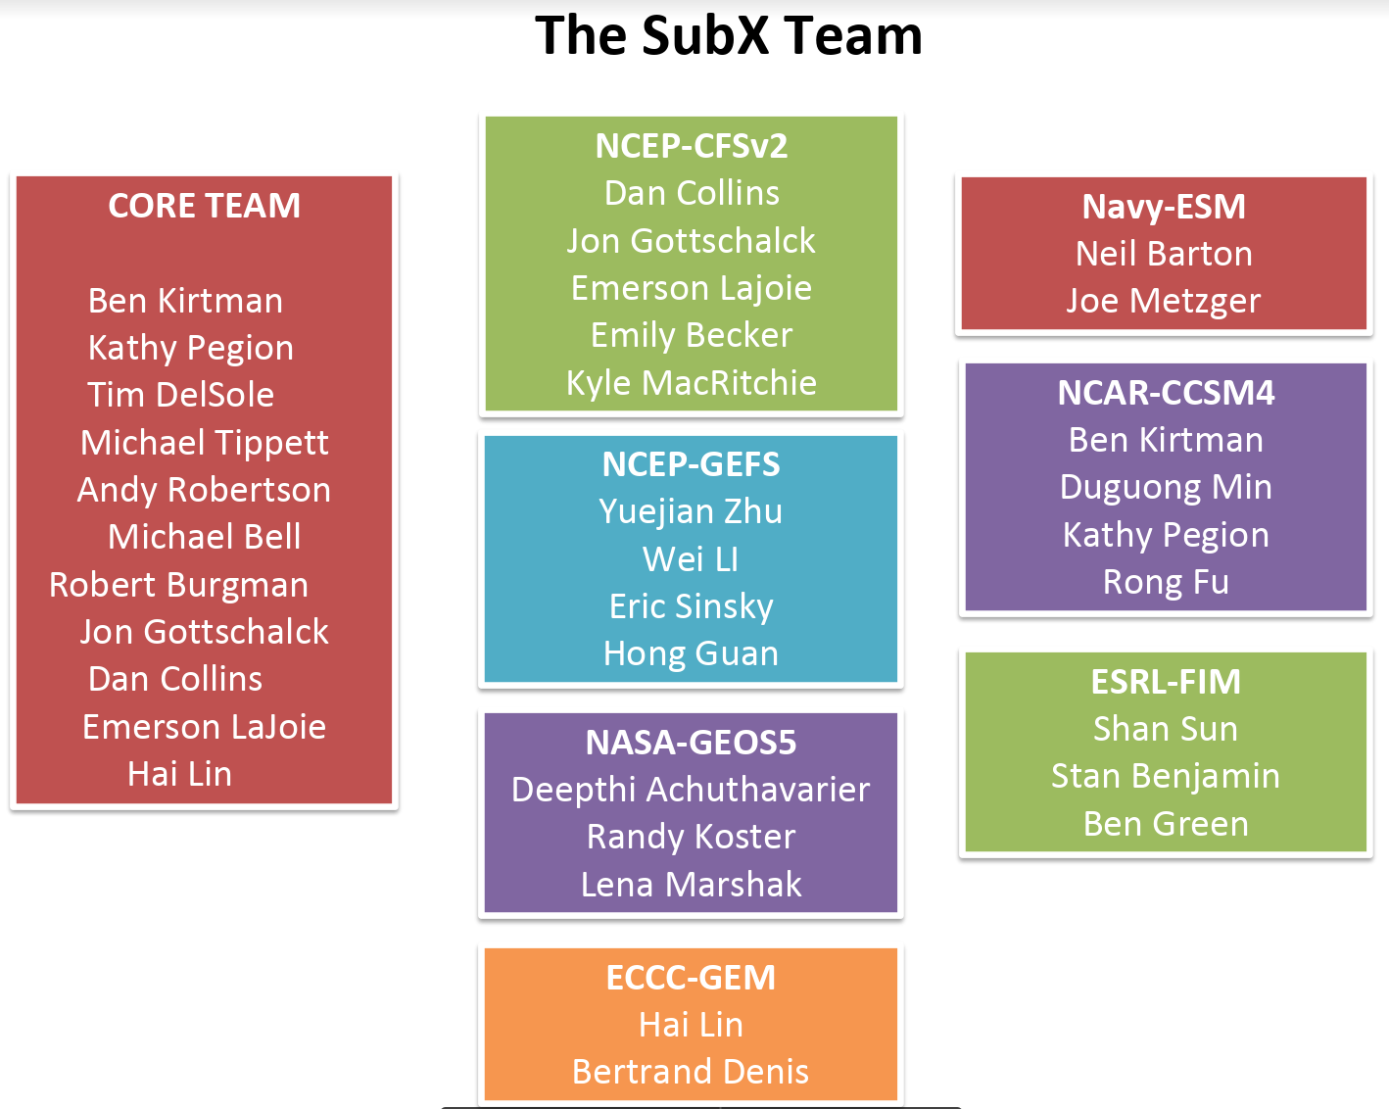
Courtesy Kathy Pegion

Slide 11
NOAA Subseasonal Experiment (SubX): hindcast & real-time w. FIM-iHYCOM
Hindcast period 1999-2014 (since extended through June 2017);
Weekly 32-day forecasts with 4 time-lagged members;
Initial conditions from CFSv2 for atmosphere, land, ocean and sea ice;
Cold starts from these ICs (no additional data assimilation);
No stochastic physics applied;
Real-time forecasts started in July 2017.

Slide 12
Model Configuration: CFSv2 and FIM-iHYCOM
 | CFSv2 | FIM-iHYCOM
Horizontal Resolution | T126 (~100km) atm; 0.25 – 0.5 deg ocean | 60km
Vertical Resolution | 64 layers | 64 layers
Initial Conditions | CFSR with data assimilation | CFSR with no extra data assimilation
Dynamical Core | Spectral, vertical - sigma | Finite volume, icosahedral; vertical – isentropic+sigma
Physics | Older version of GFS physics | GFS 2015 physics, with Grell-Freitas deep/shallow convection
Ocean Model | MOM4 | HYCOM on icosahedral grid
Land Surface Type | CFSR | MODIS

Slide 13
DJF T2m Biases vs. CFSR (K, 60S-60N)
FIM
CFSv2
wk1 bias
wk4 bias
drift (wk4 – wk1)

Slide 14
FIM
CFSv2
wk1 biases
wk4 biases
drift (wk4 – wk1)
Bias (mm/dy)

Slide 15
DJF Precip Biases vs. GPCP (mm/day, 60S-60N)
DJF | FIM | CFSv2 | GPCP
Week 1 | 2.94 | 3.05 | 2.65
Week 2 | 2.98 | 3.12 | 2.65
Week 3 | 3.01 | 3.18 | 2.65
Week 4 | 3.02 | 3.20 | 2.65
DJF Global avg
precip (mm/dy)

Slide 16
DJF Z500 Biases vs. CFSR (gpm, 20N-90N)
FIM
wk1
CFSv2
wk4

Slide 17
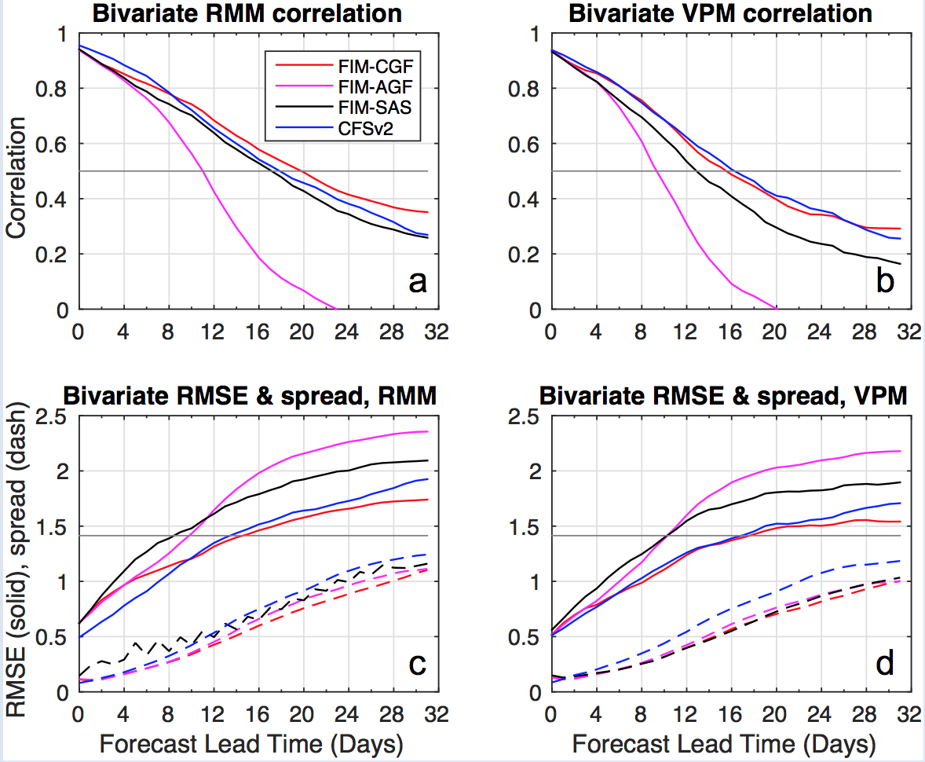
Prediction of MJO Indices (Green et al. 2017, MWR)
Top: Bivariate RMM/VPM correlation
Bottom: Bivariate root-mean-square error (solid) and 4-member ensemble spread (dashed).
FIM-CGF and CFSv2 have similar skill, RMSE and spread, and are better than FIM-SAS. The uncoupled AGF fares worst.
Fig.3: Model performance as a function of lead time for FIM-iHYCOM (GF7, AGF7, SAS7) and CFSv2 ensemble mean forecasts of the RMM index. Top: Bivariate RMM/VPM correlation; Bottom: Bivariate root-mean-square error (solid) and 4-member ensemble spread (dashed). GF7 and CFSv2 have similar skill, RSME and spread, and are better than SAS7. The uncoupled AGF7 fares worst.
 | Conv. Scheme | Ocean Model
FIM-iHYCOM CGF | GF | Yes
FIM-iHYCOM SAS | SAS | Yes
FIM w. obs SST AGF | GF | No
Fig.3: Model performance as a function of lead time for FIM-iHYCOM (GF7, AGF7, SAS7) and CFSv2 ensemble mean forecasts of the RMM index. Top: Bivariate RMM/VPM correlation; Bottom: Bivariate root-mean-square error (solid) and 4-member ensemble spread (dashed). GF7 and CFSv2 have similar skill, RSME and spread, and are better than SAS7. The uncoupled AGF7 fares worst.
Fig.3: Model performance as a function of lead time for FIM-iHYCOM (GF7, AGF7, SAS7) and CFSv2 ensemble mean forecasts of the RMM index. Top: Bivariate RMM/VPM correlation; Bottom: Bivariate root-mean-square error (solid) and 4-member ensemble spread (dashed). GF7 and CFSv2 have similar skill, RSME and spread, and are better than SAS7. The uncoupled AGF7 fares worst.
Fig.3: Model performance as a function of lead time for FIM-iHYCOM (GF7, AGF7, SAS7) and CFSv2 ensemble mean forecasts of the RMM index. Top: Bivariate RMM/VPM correlation; Bottom: Bivariate root-mean-square error (solid) and 4-member ensemble spread (dashed). GF7 and CFSv2 have similar skill, RSME and spread, and are better than SAS7. The uncoupled AGF7 fares worst.

Slide 18
Blocking Frequency (%): debiased (grey) raw (color) Tibaldi-Molteni (solid) vs. Pelly-Hoskins (dashed)
All Cases
FIM-iHYCOM
CFSv2
4-day Episodes

Slide 19
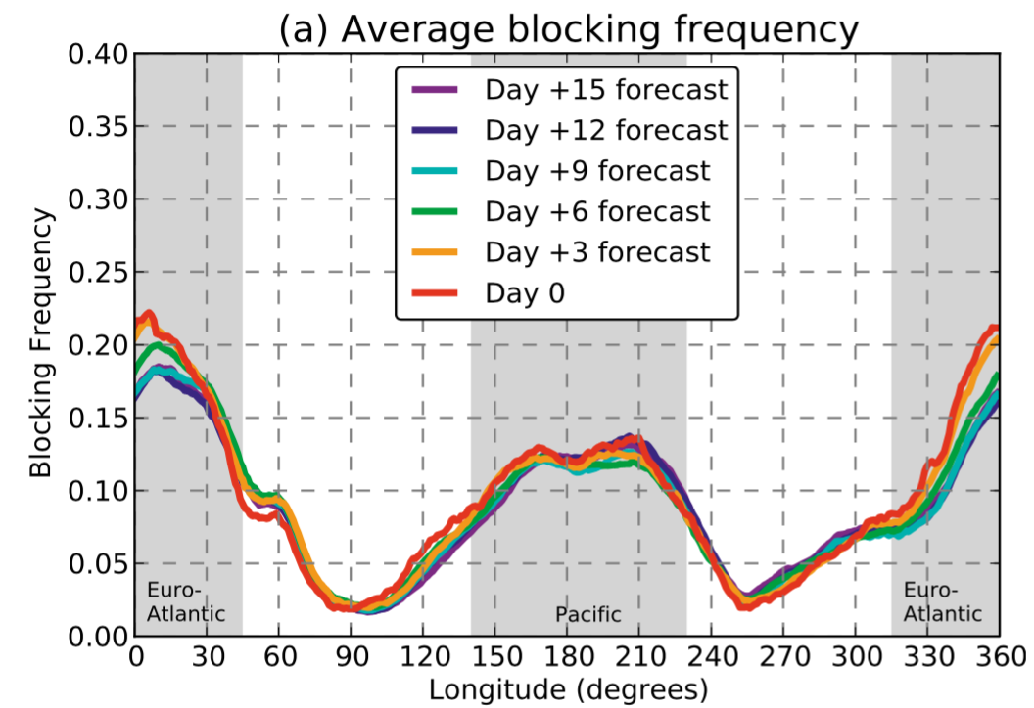
TM Blocking Frequency from GEFS
Hamill and Kiladis (2014)

Slide 20
Sudden Stratospheric Warming (tilted lines: equal verif.time)
max temp at 10hPa and > 60N
zonal mean westerlies at 10hPa and 60N

Slide 21
T2m ACC (1999-2014 DJF)
WK1 WK2 WK3 WK4
FIM
CFSv2
Notes:
W: 5.13; H: 2.04; L: 4.1; T: 2.76

Slide 22
Precipitation ACC (1999-2014 DJF)
WK1 WK2 WK3 WK4
FIM
CFSv2

Slide 23
H500 ACC (1999-2014 DJF)
WK1 WK2 WK3 WK4
FIM
CFSv2
Notes:
W: 5.12; H: 3.11; L: 4.1; T: 2.21

Slide 24
ACC
DJF
JJA
T2m
(NH land)
PRCP (NHX)
H500
(NHX)
Dashed: week 3+4 combined

Slide 25
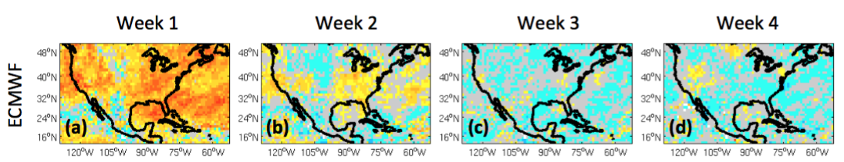

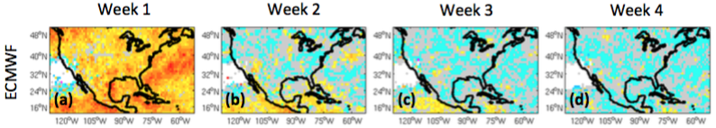

Ranked Probabilistic Skill Score for Precipitation
(1999-2010 Jan-Feb-Mar)
WK1 WK2 WK3 WK4
FIM
CFSv2
Vigaud et al. 2017

Slide 26
Ranked Probabilistic Skill Score for T2m
(1999-2010 Jan-Feb-Mar)
WK1 WK2 WK3 WK4
FIM
CFSv2

Slide 27
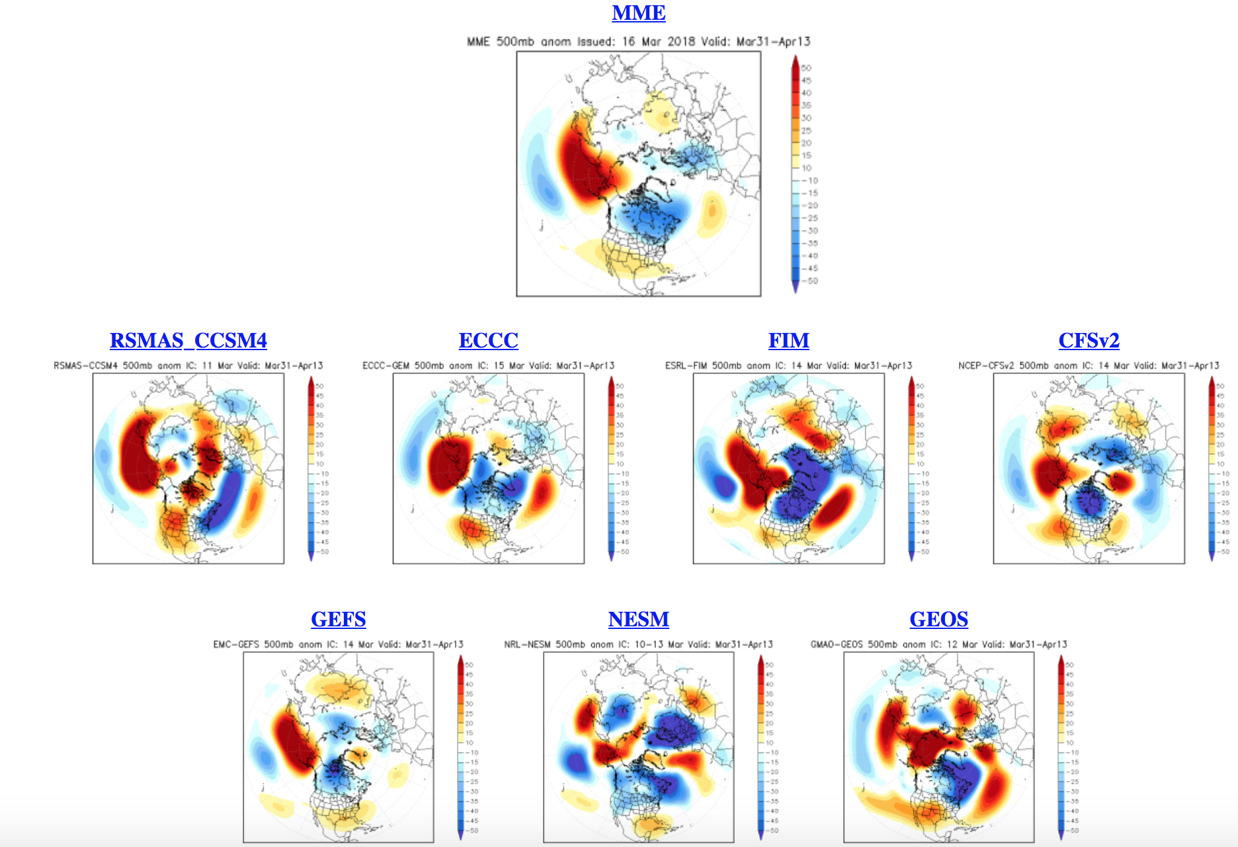
NOAA Subseasonal Experiment (SubX)
500 hPa Height Anomaly (m) Week 3 & 4 outlook
IC: Oct 25 2017
- Issued Mar 16 2018
Valid Mar 31 – Apr 13 2018
All bias-corrected from 1999-2016 retrospective runs
7-model SubX multi-model ensemble
Courtesy Dan Collins, NOAA/CPC

Slide 28
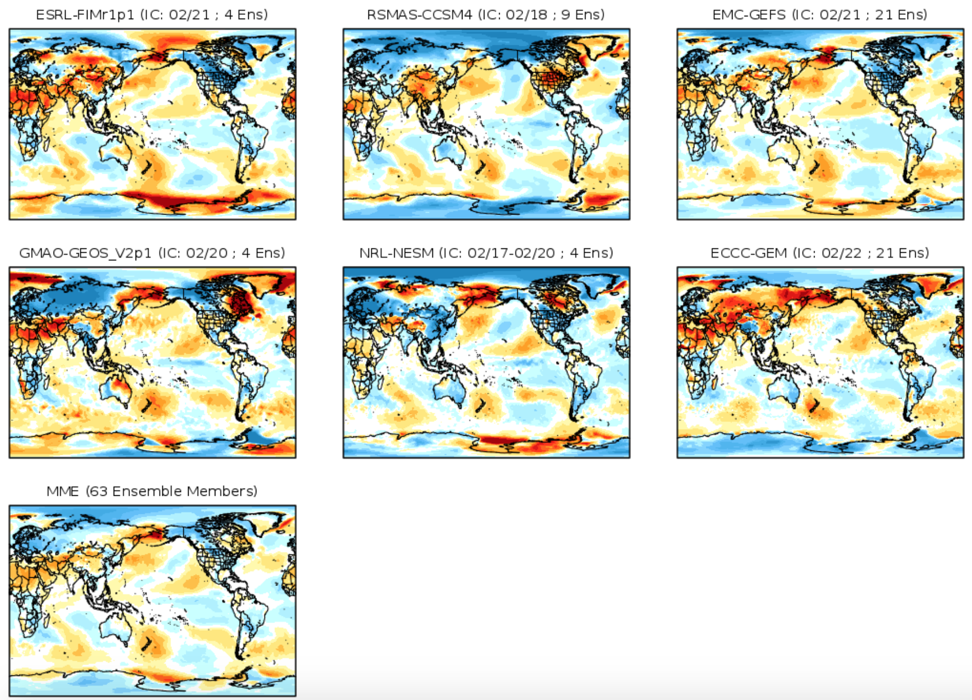
SubX wk3-4 T2m anomaly (ºC)
Issued: Feb. 23 2018
Valid: Mar. 10 – 23 2018
http://cola.gmu.edu/kpegion/subx/forecasts/forecasts.html

Slide 29
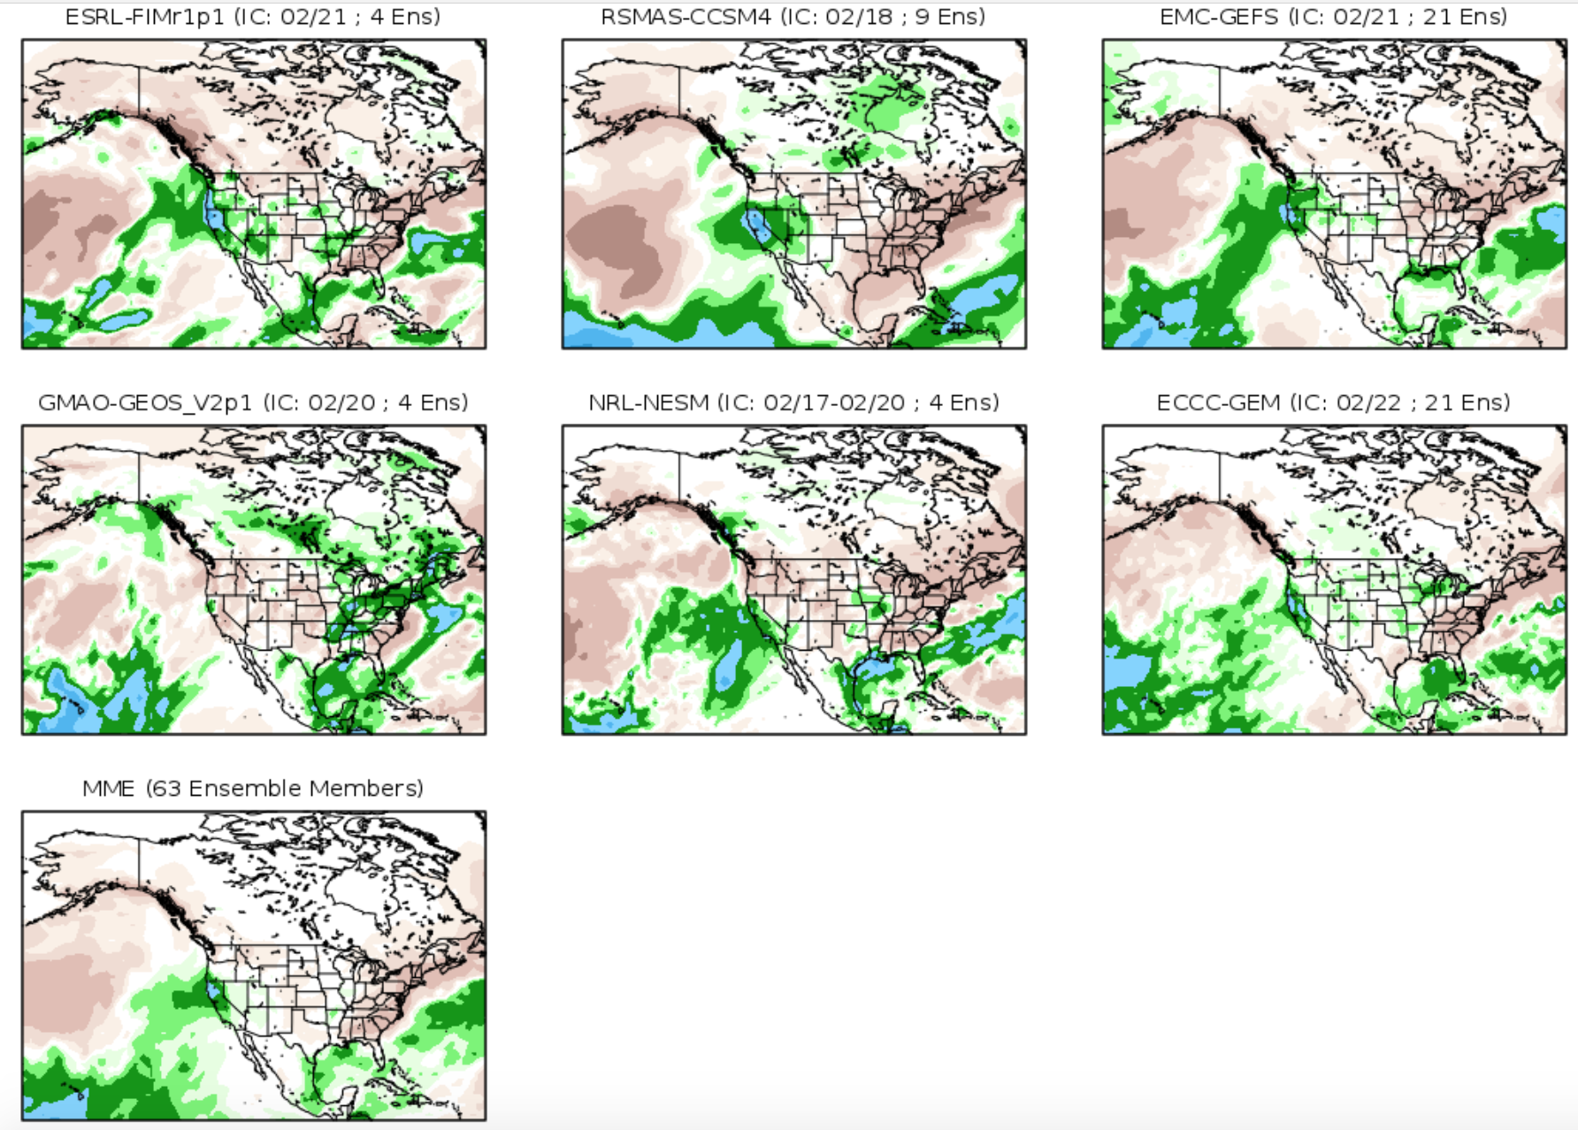
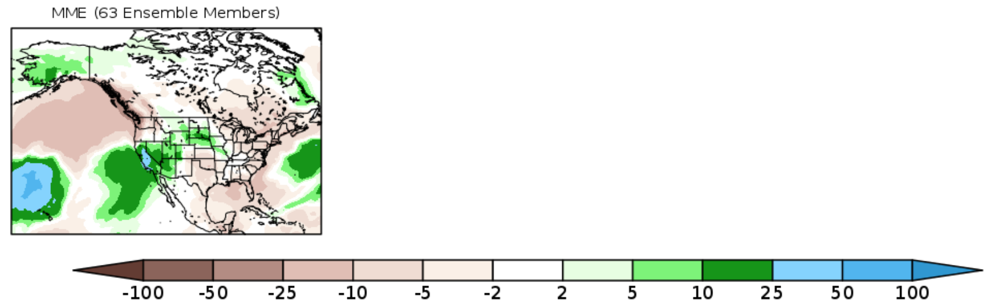
SubX Week 3 & 4 Outlook Precipitation Anomalies (mm)
Issued: Feb. 22 2018
Valid: Mar. 10 – 23 2018
http://cola.gmu.edu/kpegion/subx/forecasts/forecasts.html

Slide 30
grid A
Flux coupler details
“Pixel”
grid B
Pixels defined on grid A

Slide 31
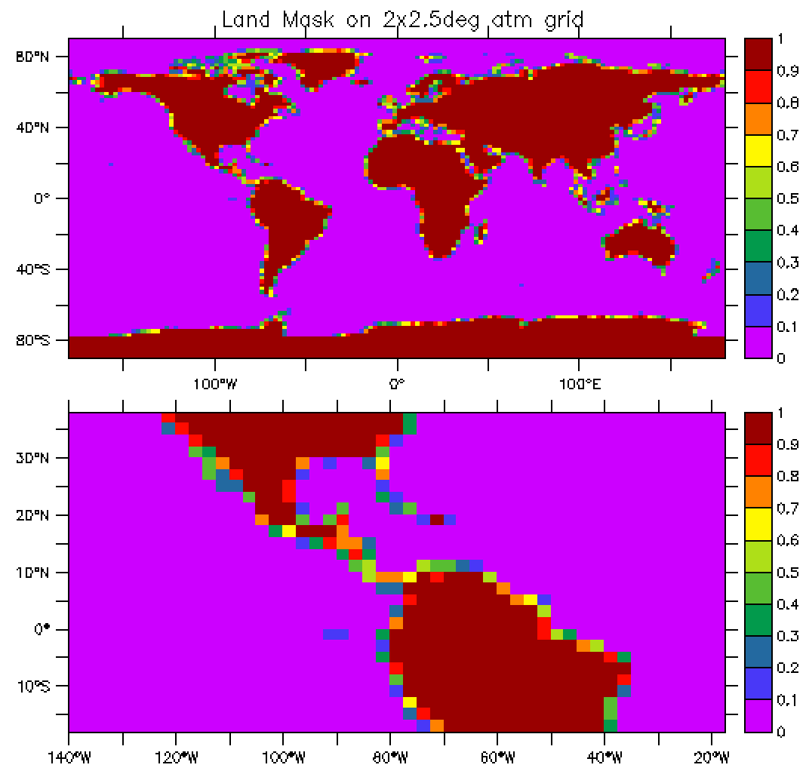
Fractional Land Mask Used in GISS ModelE
Ocean grid defines the location of coastline
Atmospheric land mask is given by the overlay of 2 grids
1st key: total surface ocean area on A & O grids is identical
2nd key: flux integral over surface ocean area on A & O grid is identical (land value=huge)

Slide 32
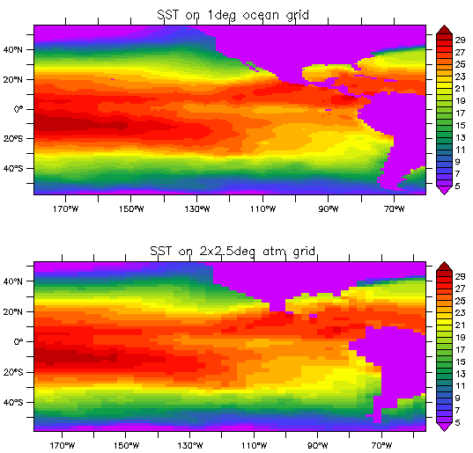
SST in GISS Coupled Model
1º ocean grid
2ºx2.5º atm grid

Slide 33
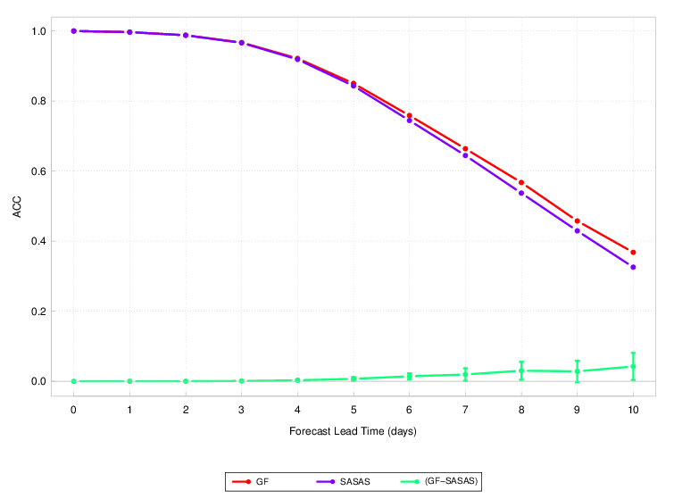
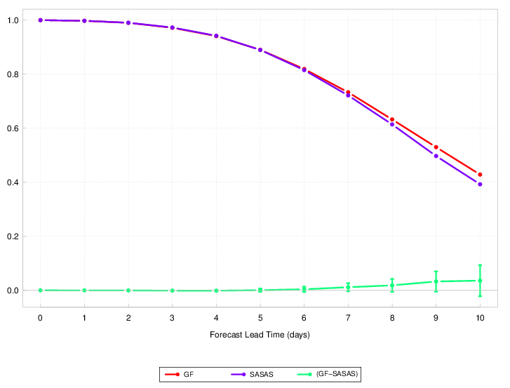
FV3 merge_update simulations
GFS physics with SASAS and latest Grell-Freitas convective parameterization
Resolution: C384
Integration: 240 hours
30 cases, initialized at 0Z, June1 – June 30, 2016
NHX
SHX
Courtesy Haiqin Li

Slide 34
FV3 merge_update simulations, Cont’d
Monthly averaged shortwave radiation vs. NASA’s Clouds and Earth's Radiant Energy System (CERES) W/m²
CERES ave=181
Global Mean Precipitation
SASAS ave=196
 | Total (mm/day) | Convective
SASAS | 3.33 | 2.07 (62.2%)
GF | 3.55 | 1.99 (56.1%)
GF ave=183
(still 25%-30% too high)
Courtesy Haiqin Li

Slide 35
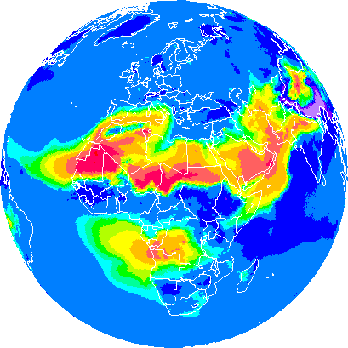
Development of Earth System Models for All Time-Scales
atmosphere
inline chemistry
ocean
Increased application of coupling from atmosphere to ocean/lake/hydro models and inline chemistry (/biology)
for seasonal NWP, but also potentially applicable to shorter time scales
for improved cloud/precipitation/air-quality forecasts for aviation, energy, transportation, air quality, and severe weather applications.

Slide 36
High Performance Computing at Global Systems Division ESRL
Making Forecasts Better (and faster)
Parallel Programming Tools:
  The Scalable Modeling System (SMS): directive-based code parallelization tool for distributed and shared memory computers (Govett et al. 2003)
  OpenMP
FIM-iHYCOM is equipped with both SMS and OpenMP
Close collaboration between scientists and software engineers has accelerated model development
Test suites for checking bitwise identity between serial and parallel and parallel with different numbers of processors
Well-documented code repository

Slide 37

NOAA Environmental Software Infrastructure and Interoperability (NESII) Group in Global Systems Division at Earth System Research Laboratory
Developing community software for model coupling and grid remapping
  The Earth System Modeling Framework (ESMF)
  National Unified Operational Prediction Capability (NUOPC) layer for model coupling
FV3-CHEM activity at GSD
  coupling ESRL version of NASA GOCART chemistry model to FV3 via NUOPC
  Testing in real-time

Slide 38
Summary
Subseasonal prediction is of great interest to many sectors of society. Finding potential sources of predictability is an issue at this time scale;
Candidate processes include Madden Julian Oscillation, atmospheric blocking, SST anomalies, snow cover, etc.;
Evaluation of FIM-iHYCOM retrospective sub-seasonal experiments suggests its subseasonal skill is comparable to NCEP-CFSv2;
Given that both FIM and iHYCOM are very different from the current North American Multi-Model Ensemble, they will add diversity to multi-model ensembles, and will likely improve the overall skill of subseasonal prediction.

Slide 39
Future Direction for NOAA/ESRL Modeling
ESRL Focus: Earth-system prediction for situation awareness (hourly) to medium-range NWP to subseasonal;
Modeling: Develop global and storm-scale regional models; demonstrate advanced earth system modeling/assimilation components for research and NOAA/NWS operations;
Storm-scale: Testing of FV3 for convective-storm simulation with other labs using advanced physics packages and storm-scale assimilation;
Collaboration on global FV3-based modeling
  NWP applications with advanced physics packages
  S2S applications with ocean, chemistry/fire/aerosols, process studies. Build off experience with FIM-iHYCOM-CHEM as well as the coupled climate model at NASA/GISS.

