Slide 1
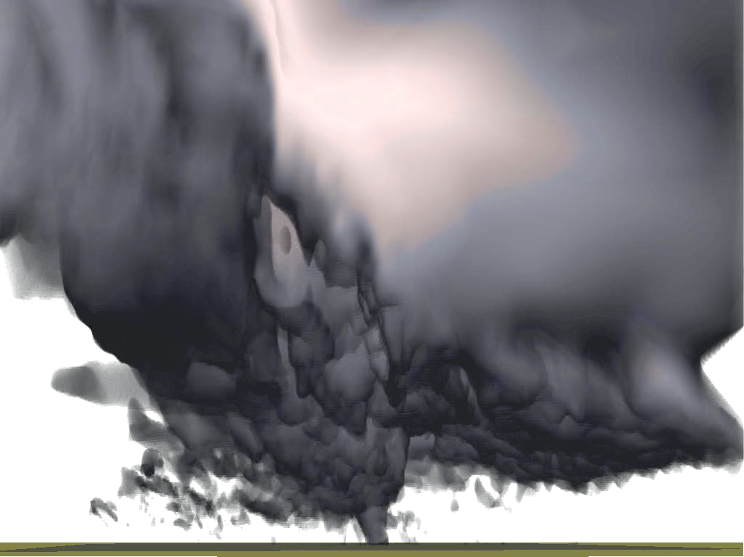

Testing of 3-km FV3 during 2017 HWT
& Development and Inter-comparisons of EnVar and Hybrid Methods for Radar DA
Ming Xue
Center for Analysis and Prediction of Storms
and School of Meteorology
University of Oklahoma
mxue@ou.edu
October, 2016
ARPS Simulated Tornado

Slide 2
Models run for the Hazadous Weather Testbed (HWT) organized by NSSL and SPC since 2007
6 Ensembles in 2015!
CAPS SSEF
51 in 2011
CAPS has been producing CAM ensemble forecasts to HWT since 2007, starting with ten 4-km forecasts in 2007
Assimilating radar data since 2008

Slide 3
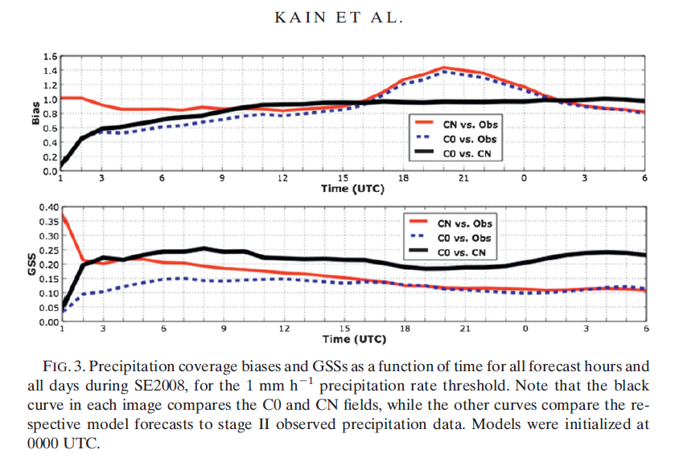
Hourly Precipitation Verifications of CAPS 2008 Forecasts with and without Radar
Kain, J. S., M. Xue, M. C. Coniglio, S. J. Weiss, F. Kong, T. L. Jensen, B. G. Brown, J. Gao, K. Brewster, K. W. Thomas, Y. Wang, C. S. Schwartz, and J. J. Levit, 2010: Assessing advances in the assimilation of radar data within a collaborative forecasting-research environment. Wea. Forecasting, 25, 1510-1521.

Slide 4


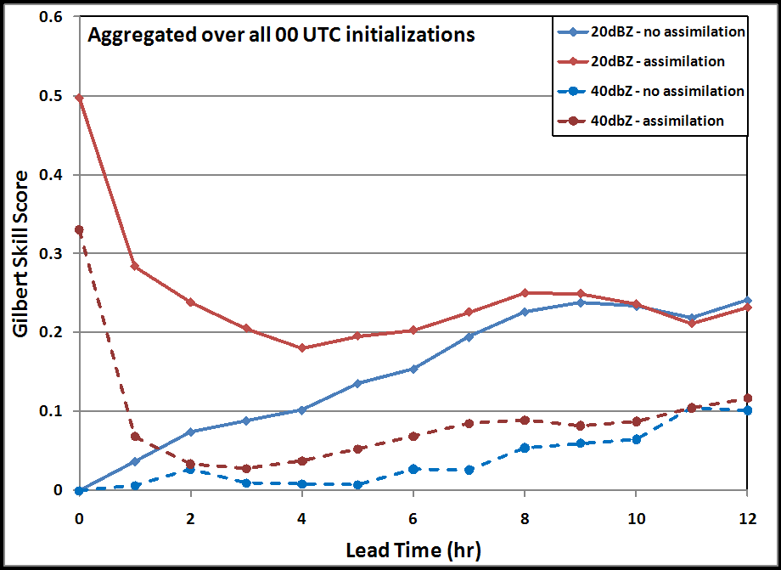
Gilbert Skill Scores as a Function of Time (20 dBZ and 40 dBZ reflectivity thresholds during SFE2009)
CN and C0 reflectivity forecasts from CAPS:
Impact of radar data greatest early in forecast period
CN scores falls rapidly within first few hours
Scores of CN & C0 similar by 9-12 hrs
With Radar Data
20 dBZ
Without Radar Data
40 dBZ
(Courtesy Tara Jensen of DTC)

Slide 5
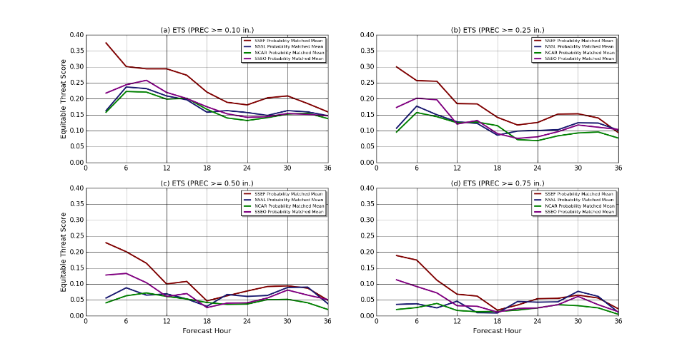
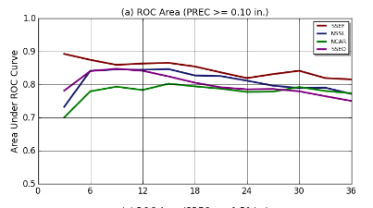
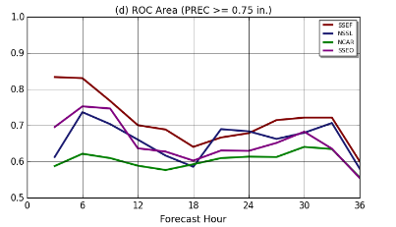
QPF Scores of 2015 Forecasts
ETS Scores (>0.10 in)
ROC Area (>0.10 in)
CAPS SSEF
ETS Scores (>0.75 in)
CAPS SSEF
ROC Area (>0.75 in)
SSEO
NSSL
NCAR
Forecast hour
Forecast hour
CAPS system assimilated radar data, and used multiple physics.
Still too many differences to tell exactly why?
From Adam Clark

Slide 6
Community Leveraged Unified Ensemble (CLUE)
- more controlled experiments in the HWT
GOAL: Design experiment to provide more controlled datasets that can be better utilized to inform design of near-future operational systems (i.e., evidence-based decision making).
2017 Contributors: CAPS (34), NCAR (10), NSSL (14), other OU group (10), and GSD (10), GFDL (1) – 79 Total CLUE Members

Slide 7
CLUE Experiments (2017)
(1) multi-core vs. single core – Two ensembles will be compared. One using 5 ARW and another using 5 NMMB members
(2) single physics vs. multi-physics– An ensemble with perturbed ICs/LBCs will test whether there is a noticeable advantage when using varied physics vs. common physics in all members
(3) single physics vs. single stochastic physics – Compare an ensemble with single physics and perturbed ICs/LBCs to one with single physics with stochastic perturbations but without IC/LBC perturbation
(4) 3DVAR vs. EnKF – Compare two methods for radar DA
(5) GSD radar vs. CAPS radar – Two members are configured identically, except one will use GSD’s method for radar DA and one uses CAPS method.
(6) Microphysics sensitivities – The impact from different microphysical parameterizations on the resulting convective storm forecasts will be examined.
(7) FV3 convection-allowing members- Two FV3 members with different microphysics will be compared to each other, and to currently well-known models (HRRR, 3-km NAM, …).

Slide 8
CAPS Contributions to CLUE 2017
34 Members (out of 79 total CLUE members)
    Storm-Scale Ensemble Forecast (SSEF) System using CAPS’s 3DVAR/cloud analysis DA
      10-member, 3-km WRF-ARW ensemble with 60-hr forecasts from 00Z
      Multi-physics, multi-IC/LBC conditions: add SREF perturbations to NAM ICs
      One member matches HRRR model configurations, but using CAPS 3DVAR/cloud analysis for radar DA
    SSEF using GSI EnKF DA plus CAPS EnKF for radar DA
      10-member, 3-km WRF-ARW ensemble with 60-hr forecasts from 00Z
      Multi-physics, 3-km 40-enemble 6-h cycled EnKF analysis ICs with radar DA
    FV3 convection-allowing forecasts
      ~3 km over CONUS, nested within global run
      Thompson microphysics (added by CAPS to compare with GFDL Lin MP run)
    Single physics SSEF members with radar
      9-member, 3-km with 60-hr forecast from 00Z
      Single physics, multi-IC/LBC conditions
    Mixed microphysics SSEF with radar
      4-member, 3-km with 60-hr forecast from 00Z
      Multiple microphysics, no IC/LBC perturbation (using NAM 12km for LBC)

Slide 9
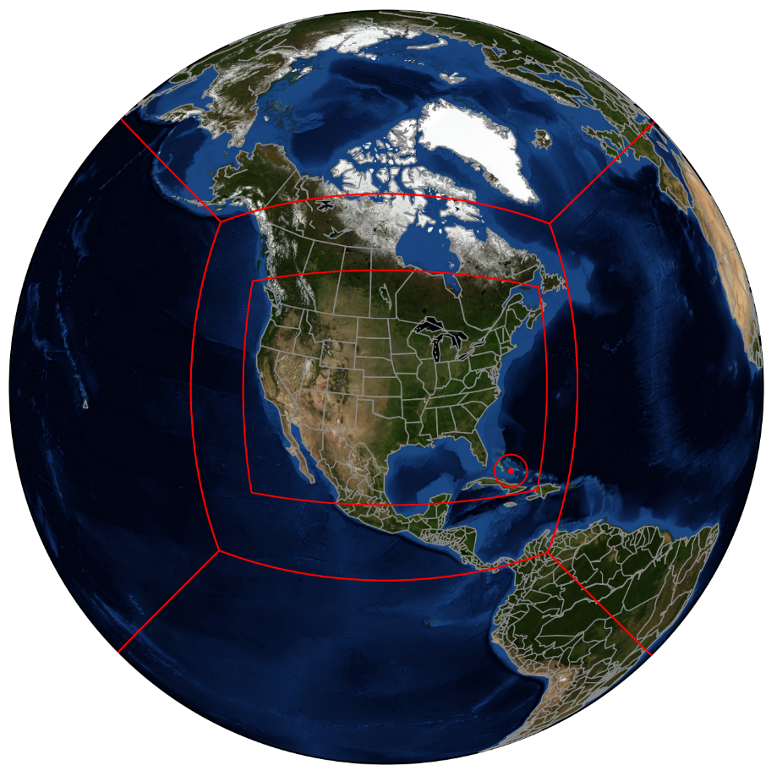
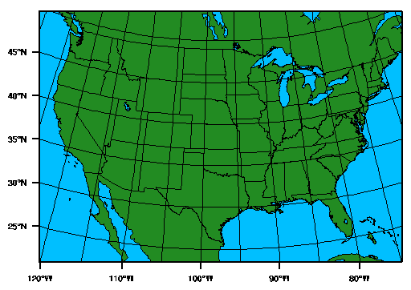
2017 CAPS 3km SSEF and FV3 Domains
3 km WRF Grid 1620x1120
Shared with other CLUE members
Nested FV3 Grid ~ 3 km over CONUS
~ 13 km average global grid
Coordinated with GFDL run
Notes:
Forecast domain for the 2016 HWT & HMT

Slide 10
Physics packages used
Microphysics
  CAPS: Thompson MP
  GFDL: GFDL MP (based on WSM-6)
Cumulus
  Scale-aware SAS (Global), None (Nest)
PBL
  MRF (GFS)
Radiation
  RRTM
Initial condition
  Cold-started from 00Z GFS T1534 analysis every day

Slide 11
Thompson MP Implementation
Implemented by CAPS
Taken from WRF v3.8.1 with very few modifications
  Graupel is the only rimed ice category
  Aerosol-aware code turned off
Not fully integrated with other parameterization schemes (because of time constraints - recent implementation does)
  Precipitation doesn’t make it into the LSM
  Radiation scheme interacts with hydrometeor masses, not effective radii computed by Thompson scheme

Slide 12
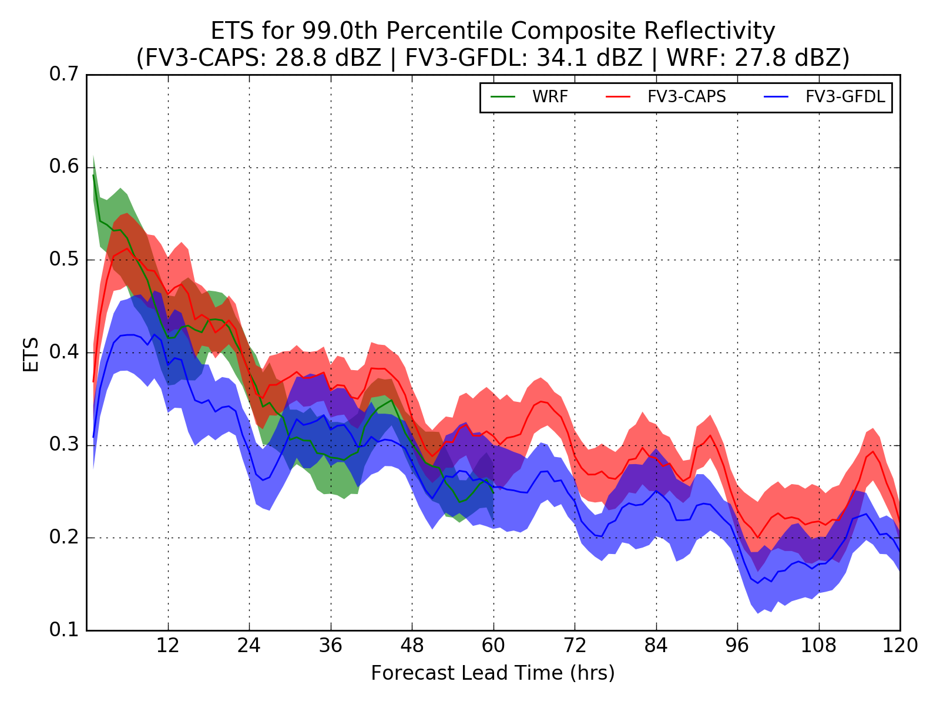
Neighborhood ETSs for 99th Percentile
Neighborhood size of 45 km
  Similar to SPC’s outlook
99th percentile values:
  FV3-CAPS: 28.8 dBZ
  FV3-GFDL: 34.1 dBZ
  WRF: 27.8 dBZ
WRF best before forecast hour 6
  Initialized with radar DA by CAPS for HWT Spring Experiment
  Also used Thompson MP
WRF and FV3-CAPS comparable for the remainder of Day 1
FV3-CAPS generally the best on days 2-3
For the 3-5 Day period, FV3-CAPS is usually better than FV3-GFDL
The shaded area is the 90% confidence interval on the bootstrap resampled set of forecasts (e.g. for 60 hours, I bootstrap resampled the set of 60-hour forecasts 10,000 times and computed the ETS for each sample)
Notes:
The reflectivities on the second line of the figure title refer to the 99th percentile of composite reflectivity for each model
The shaded area is the 90% confidence interval on the bootstrap resampled set of forecasts (e.g. for 60 hours, I bootstrap resampled the set of 60-hour forecasts 10,000 times and computed the ETS for each sample)

Slide 13
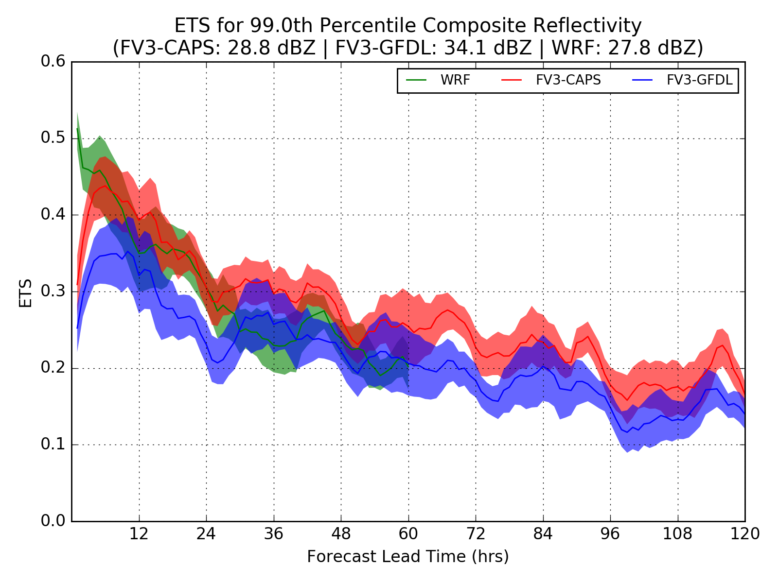
Neighborhood ETSs for 99th Percentile
Neighborhood size of 30 km
Similar behaviors observed
The shaded area is the 90% confidence interval on the bootstrap resampled set of forecasts (e.g. for 60 hours, I bootstrap resampled the set of 60-hour forecasts 10,000 times and computed the ETS for each sample)
Notes:
The reflectivities on the second line of the figure title refer to the 99th percentile of composite reflectivity for each model
The shaded area is the 90% confidence interval on the bootstrap resampled set of forecasts (e.g. for 60 hours, I bootstrap resampled the set of 60-hour forecasts 10,000 times and computed the ETS for each sample)

Slide 14
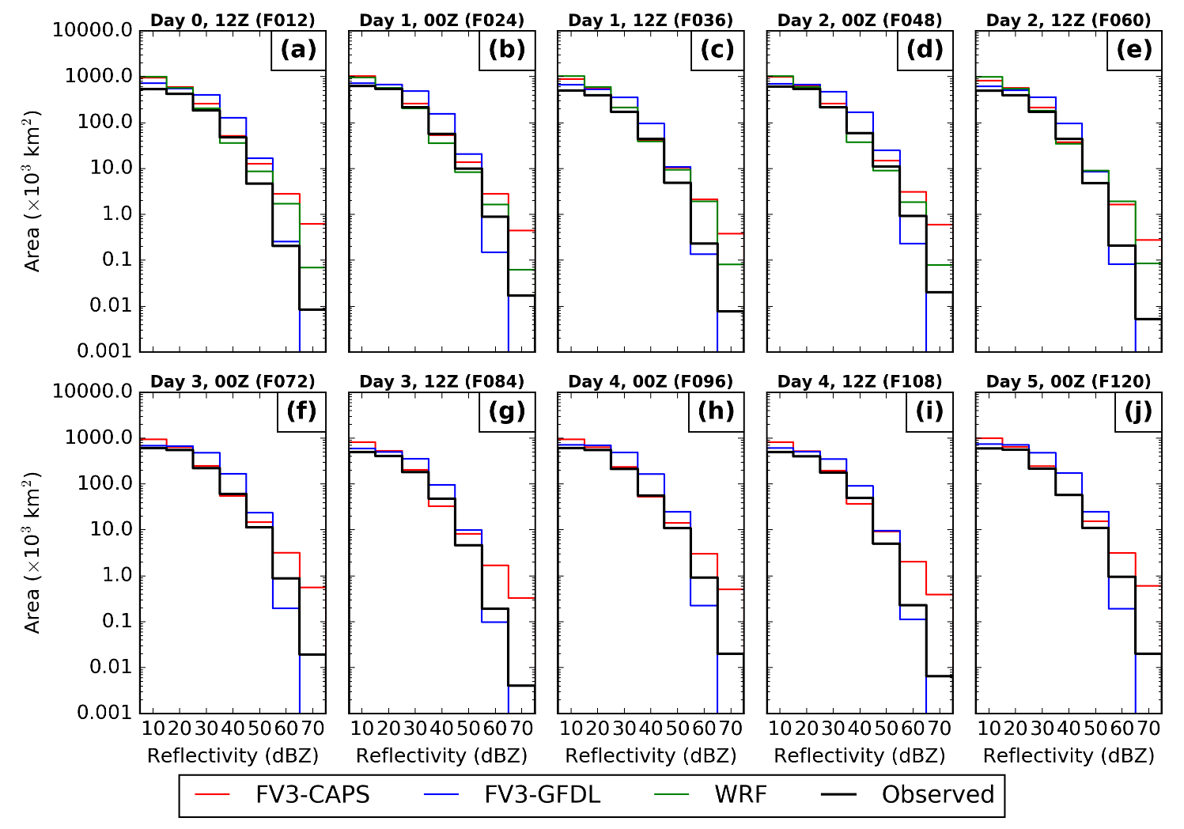
Histograms of Composite Reflectivity
Notes:
“Observed” is the MRMS composite reflectivity mosaic

Slide 15
Histograms of Composite Reflectivity
GFDL Microphysics has severe low bias in the 60-70 dBZ reflectivity bins and a slight high bias in the 30-50 dBZ bins
  Hydrometeor species in the GFDL microphysics are more diffusive
  Said to be linked to implicit treatment of hydrometeor sedimentation which is being changed.
Both WRF and FV3 Thompson microphysics have a high bias in the 60-70 dBZ reflectivity bins.
Notes:
“Observed” is the MRMS composite reflectivity mosaic

Slide 16
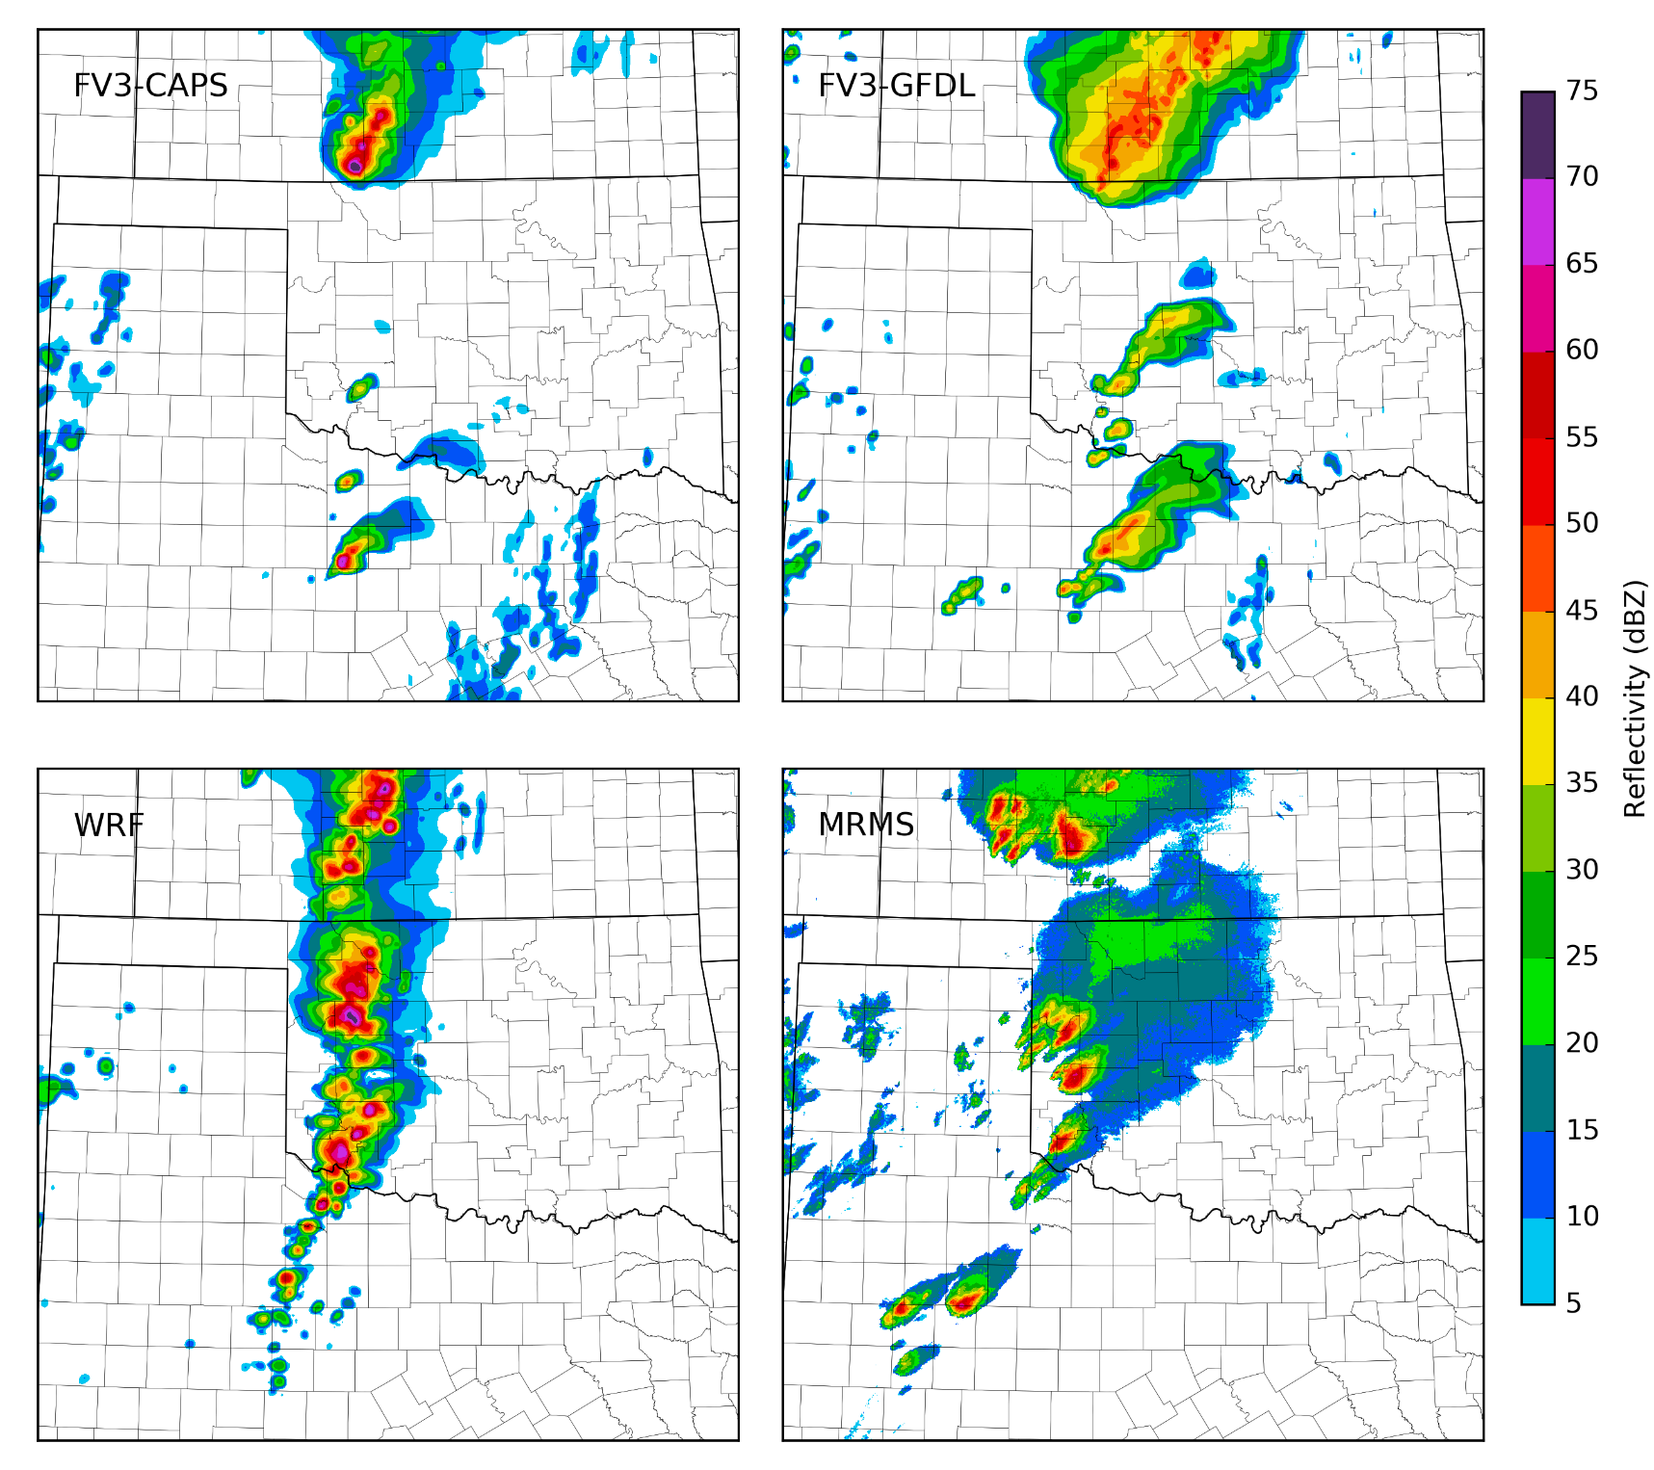
16 May 2017 Composite Reflectivity (00Z 17 May)
t = 24h
FV3-CAPS
FV3-GFDL
WRF-CAPS
MRMS

Slide 17
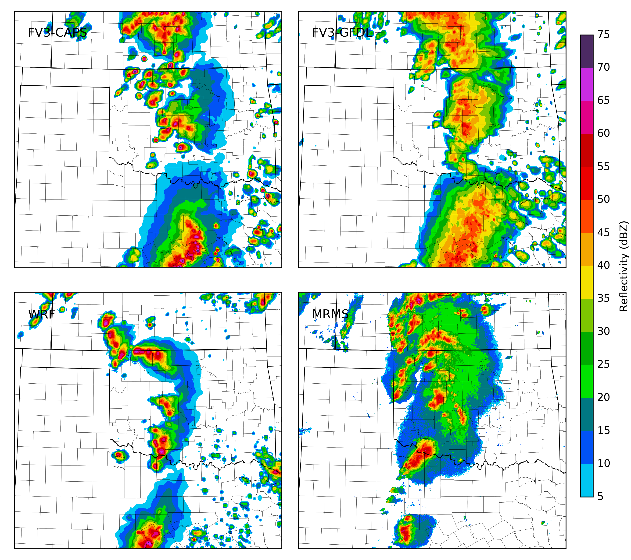
18 May 2017 Composite Reflectivity (22Z 18 May)
t = 22h
FV3-CAPS
FV3-GFDL
WRF-CAPS
MRMS

Slide 18
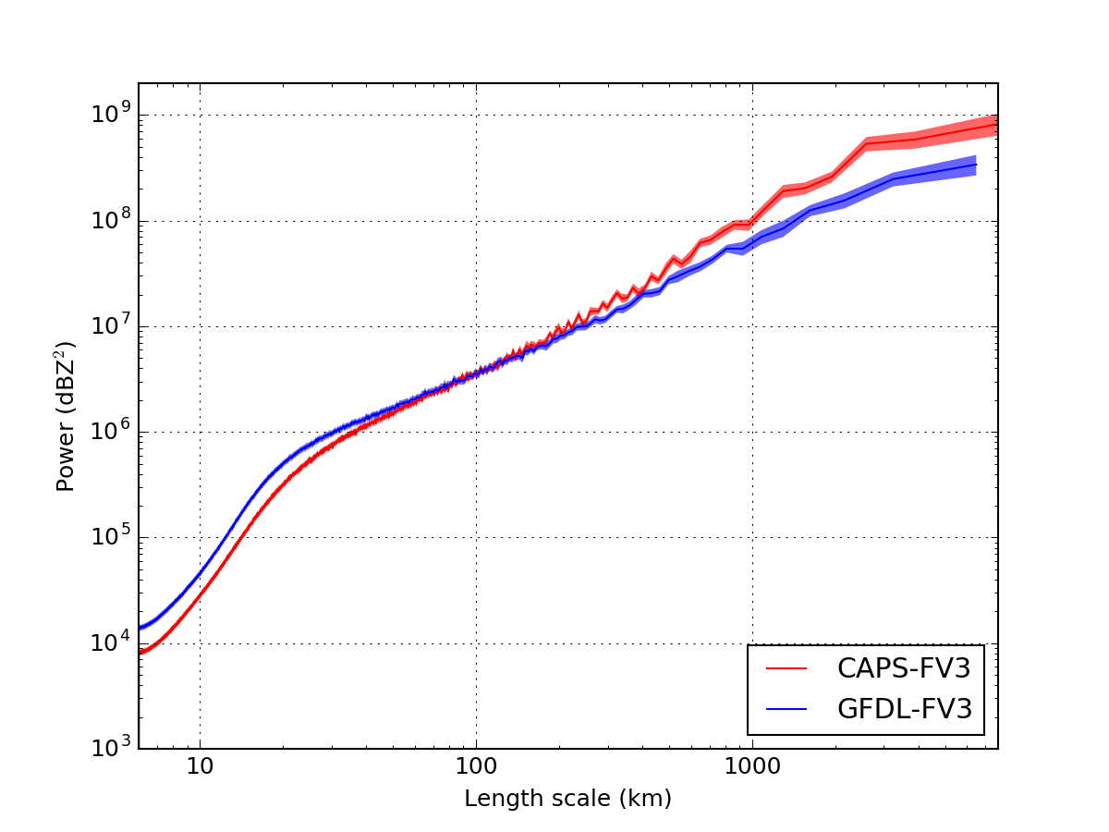
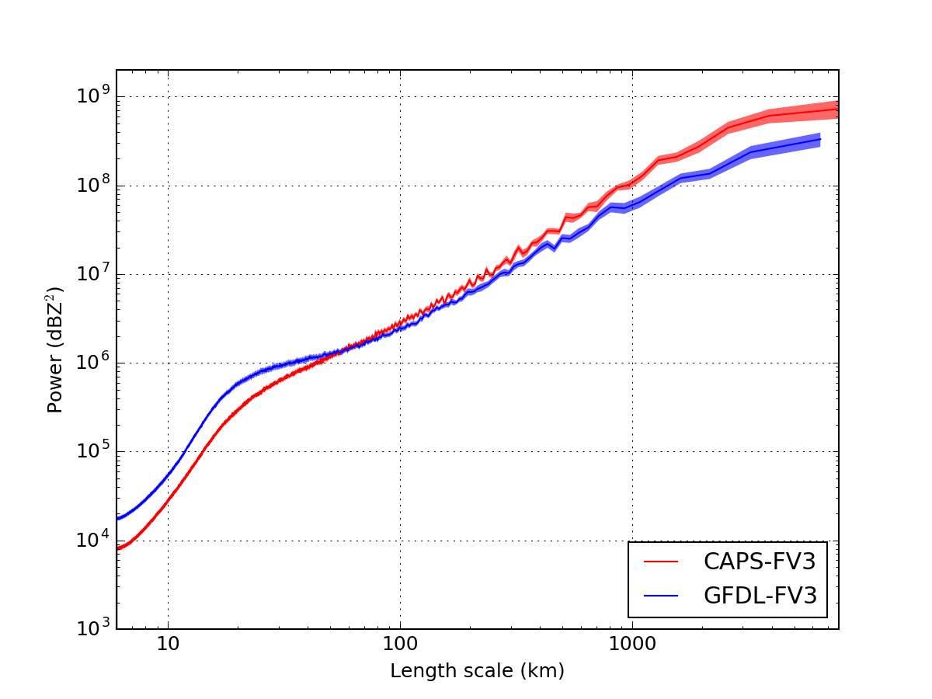
Power Spectra (Composite Reflectivity)
Discrete cosine transform method (as in Surcel et al. 2014)
FV3-GFDL has more power on scales less than ~30 km
More power on scales 30-100 km at 00Z than the following 12Z (decaying MCSs?)
24-hr forecasts (00Z)
36-hr forecasts (12Z)

Slide 19
Implementation and Testing of hybrid
3DEnVar/4DEnVar Algorithms Suitable
Direct Assimilation of Radar Data
Chengsi Liu, Ming Xue, and Rong Kong
Center for Analysis and Prediction of Storms
University of Oklahoma

Slide 20
Methods for Radar Data Assimilation
3DVAR plus Semi-empirical methods, e.g., complex cloud analysis has been shown to improve precipitation forecasts in the first 6-12 hours.
  3DVAR itself can’t effectively analyze reflectivity data
  Difficult to suppress spurious precipitation in continuous cycles
Ensemble Kalman filters (EnKF);
  Background error covariance may be unreliable
Ensemble-Variational hybrid (EnVar)
  Allows for inclusion of static BE and equation constraints
  Benefits for radar DA unproven

Slide 21
Hybrid 4DEnKF-4DEnVar
A Unified Framework (Liu and Xue MWR 2016)
Combine 4DEnVAR and 4DEnKF
  Can assimilate high-frequency data in 4D windows
  Carry ensemble covariance through assimilation cycles
  Does not require tangent linear or adjoint model
Hybrid 4DEnVar-NPC-FGAT:
Static covariance
Ensemble covariance
Liu and Xue (2016) – Placed Lorenc’s ECV and Liu et al’s En4DVAR formulations in
a unified framework – shown to be equivalent under certain approximations

Slide 22
4DEnKF-4DEnVar Hybrid
Obs
Obs
Obs
Obs
Obs
Obs
Obs
4DEnKF
4DEnVar
Obs
Obs
4D Assimilation Window – 1 cycle
t0
t1
Notes:
The EnKF is a 4-d data-assimilation method that uses a Monte-Carlo
ensemble of short-range forecasts to estimate the covariances of the forecast
error (Evensen,1994).

Slide 23
Vr and Z Observation Operators
(Assuming single-moment ice microphysics)
Radial velocity:
Reflectivity:
Z_{e} in mm⁶/m³
q_{r}, q_{s}, q_{h} in kg/kg

Slide 24
OSSES with 3DVar, EnKF and Pure and
Hybrid En3DVar
Del City supercell simulation;
Optimal B scale for 3DVar and localization scales
for EnKF and En3DVar found and used
experimentally;
Perfect model experiments
Imperfect model experiments, with microphysics scheme difference error (truth: Lin ice, DA: WSM6)

Slide 25
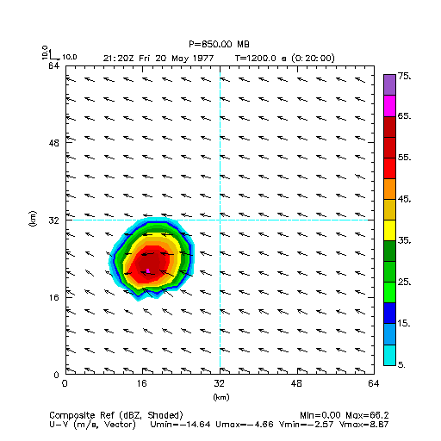
OSSES comparing 3DVar, EnKF,
Pure and Hybrid En3DVar
Del City supercell simulation;
Optimal B scale for 3DVar and
localization scales for EnKF and En3DVar found experimentally;
Perfect model experiments
Imperfect model experiments, with microphysics scheme
difference error
(truth: Lin ice, DA: WSM6)
Kong, Xue and Liu (MWR 2017 - conditionally accepted)

Slide 26
Perfect-model OSSEs
Compare hybrid En3DVar with 3DVar, EnKF, and pure En3DVar using own optimal configurations.

Slide 27
Optimal hybrid weights in hybrid En3DVar as a function of static B weight and ensemble size
Average RMSEs
3DVar
W_{B}=1.0(3DVar), W_{B}=0 (PEn3DVar)
At least 25 ensemble members are needed for the hybrid scheme to have benefit
On average, hybid En3DVar With 5%~10% weight of B performs slightly better than pure En3DVar, and both are much better than 3DVar.
PEn3DVar
Minimum averaged RMSE

Slide 28
Comparisons using own optimized
configurations (40 ensemble)
3DVar performs the worst!
EnKF and DfEnKF perform similarly and both are better than PEn3DVar and HEn3DVar5%B.

Slide 29
RMSEs for 3DVar, EnKF, pure En3DVar, and Hybrid En3DVar (50%)
3DVar worst
EnKF the best, especially for snow

Slide 30
Reflectivity analyses (through maximum vertical velocity of truth)

Slide 31
Major conclusions based on perfect-model OSSEs
When the algorithms are tuned optimally, hybrid En3DVar does not outperform EnKF and pure En3DVar in perfect-model OSSEs, though their analyses are all much better than 3DVar.
When ensemble background error covariance is a good estimation of the true error distribution, pure ensemble-based DA methods can do a good job, and the advantage of static B is not obvious in hybrid DA.

Slide 32
Imperfect Model OSSEs
Model errors are introduced by using different microphysical schemes in nature run (Lin scheme, Lin et al. 1983) and forecasts (WSM6 scheme, Hong and Lim 2006) within the DA window.
Optimal configurations for 3DVar, EnKF, pure and hybrid En3DVar algorithms are obtained before they are compared.
Kong, Xue and Liu (MWR 2017 - to be submitted)

Slide 33
Reflectivity analyses (through maximum vertical velocity of truth)
Reflectivity core and updraft from 3DVar are weaker, others are similar.

Slide 34
Analyzed reflectivity calculated based on hydrometeor mixing ratios (Z_{r}, Z_{s}, Z_{h})
Weaker!
Weaker!
Weaker!
Weaker!
missing!
missing!
missing!

Slide 35
Analyzed reflectivity calculated based on hydrometeor mixing ratios (Zr, Zs, Zh)
Ensemble spreads at low levels are too small through out the whole DA cycles!

Slide 36
Imperfect Model OSSE Conclusions
In imperfect-model OSSEs, model errors are introduced by using different microphysical schemes in the truth run and the forecasts.
Hybrid En3DVar then outperforms EnKF and pure En3DVar (3DVar) for better capturing the the hail analyses below the freezing level (intensity) of the storm in the analysis.
The advantage of hybrid En3DVar over pure ensemble-based methods is most obvious when ensemble background errors are better underestimated.
Kong, Xue and Liu (MWR 2017 - to be submitted)

Slide 37
Real case application
Compare performance of the analyses and forecasts from hybrid En3DVar with those from 3DVar, EnKF, and DfEnKF.

Slide 38
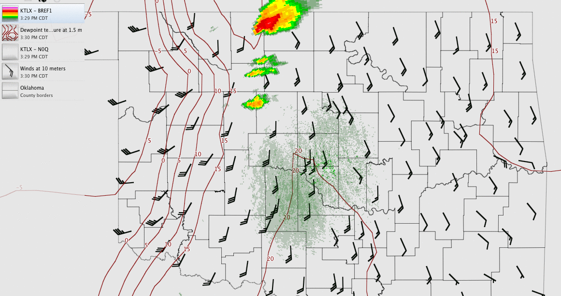
Case overview: dry line induced multi-cell (including tornadic supercell) storms on 10 May 2010
Generated using WeatherScope

Slide 39
Flow diagram of the experiments
The first analysis is conducted after 30-minute integration of the initial perturbations at 21:00 Z to allow spin up of initial perturbations.
Oklahoma Mesonet, radar radial velocity and reflectivity data from four S band WSR-88D radars (KTLX, KINX, KVNX, KFDR) available from 21:30 Z to 22:30 Z are assimilated very 5 min for an hour. One-hour following up forecasts are made as well.
Notes:
The first analysis is conducted after 30 minutes of integration of the initial ensemble at 21:00 Z to allow spin-up of initial perturbations.
Tornado: 22:56~23:35

Slide 40
Comparisons among CNTL, 3DVar, EnKF, DfEnKF, pure and hybrid En3DVar
The errors of velocity forecasts within the DA cycle increase quickly for most of the algorithms, except EnKF. In this case, the mean of the ensemble forecasts (for EnKF) is better than a single deterministic forecast (for DfEnKF).
EnKF and DfEnKF perform similarly and are poorer than the others for reflectivity analyses and forecasts within the DA cycles (except CNTL).
Notes:
Which means averaging the forecasts over different ensemble members could help to decrease the forecast errors in the velocity field.

Slide 41
45-minute reflectivity forecasts at 1km AGL
Too linear! Too weak!
Weak! Less organized! Best!

Slide 42
1-hr Forecasts of updraft intensity
w(m s⁻¹)
Too weak!
The forecast of updraft intensity from 3DVar is too weak!.

Slide 43
1-hr Forecasts of the low-level mesocyclone (0.5º tilt of KTLX)
Mesocyclone is more clearly captured in the 60-min radial velocity forecasts at the lowest elevation angle of KTLX radar by HEn3DVar than those from the others, suggesting stronger rotation and a larger tornado threat in the forecast.

Slide 44
Conclusions
For the real case, hybrid En3DVar outperforms 3DVar (EnKF) in better capturing the hook echo structure, rotating updraft (intensity) of the main tornadic supercell.
The low-level mesocyclone is better forecast when using hybrid En3DVar than other methods, leading to stronger rotation and a higher expectation for tornado.

Slide 45
Summary
In perfect-model OSSEs, EnKF performs the best, better than pure or hybrid En3DVar, especially for snow mixing ratio;
When microphysics error is included, hybrid analysis benefits from both ensemble and static background error covariances and can produce better storm analysis.

Slide 46
Direct Variational Assimilation of Radar Reflectivity (Z) and Radial Velocity (Vr) Data: Issues with Nonlinear Reflectivity Operator
When using q_{x} as the control variables (CV_q), the extremely large gradients in regions with weak background precipitation cause the assimilation of Z in storm regions and of Vr ineffective.
When using log(q_{x}) as control variables (CV_logq), the mixing ratio analysis increments may show strange spatial structures due to the nonlinear relationship.
Liu, Xue and Kong (2017, to be submitted)

Slide 47
Treatments for CV_q (using q as control variables)
A lower limit to the mixing ratios of the Z operator (qLim, Sun and Crook 1997)
Modification to equivalent reflectivity for small mixing ratios (ZeLim)
A separate analysis pass for Vr data (VrPass)

Slide 48
Optimal threshold for qLim

Slide 49
Z Innovation of OSSEs for a supercell storm case
In precipitation area, Z RMSI with ZeLim is better than with qLim, and similar to using logq as control variables.
Convergence with logq is much faster than with q

Slide 50
Vr RMSI of OSSEs for a supercell storm case
Vr data are difficult to assimilate when both Z and Vr data are assimilated using q as control
When assimilating Vr in a separate pass, Vr RMSI is similar to using logq as control variables

Slide 51
Single observation test for CV_logq
(a)
(b)
(c)
If the analysis increment is very large relative to the background value, the spread of the analysis increment becomes narrower (blue line in Fig. c)
When the background is spatially inhomogeneous (green line in Fig. a), the analysis increment in q space is apparently overestimated or underestimated (green line in Fig. c).

Slide 52
Treatments for CV_logq
Setting a lower limit (X_{b}Lim) and adding a smoothing function ( denoted f ) to background field when converting log(q) increment back to q increment

Slide 53
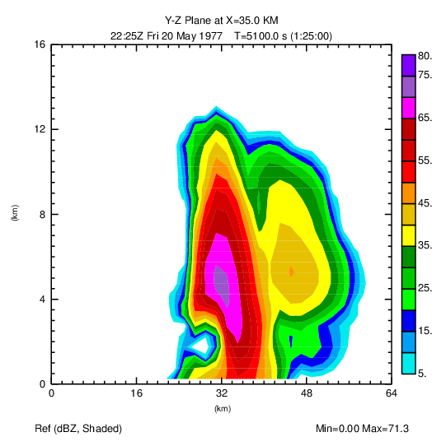
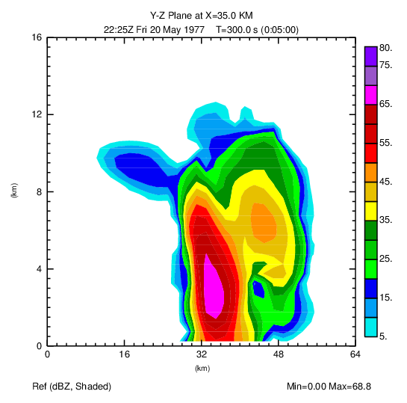
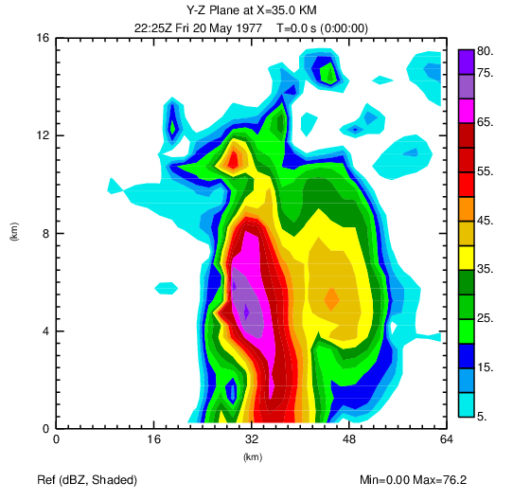
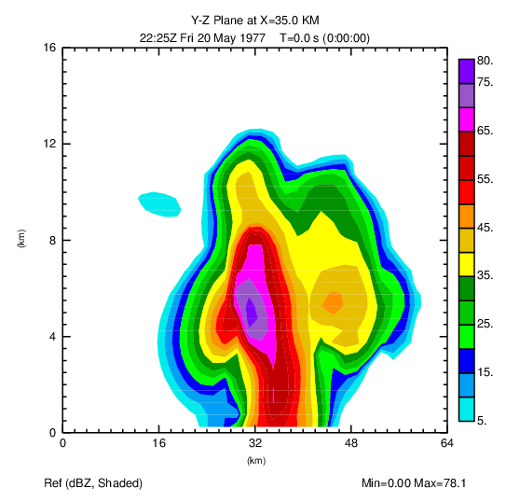
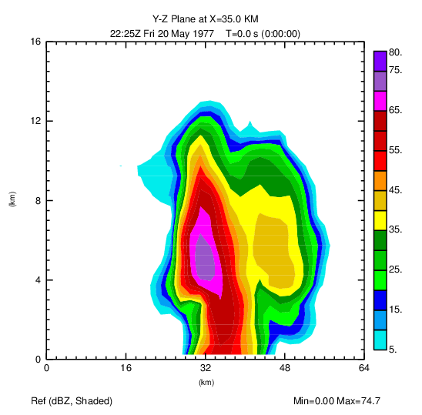
The Z cross-section through max w of the truth
obs
background
CV_logq
without treatment
CV_logq
with X_{b}_Lim
CV_logq
with X_{b}_Lim & smooth

Slide 54
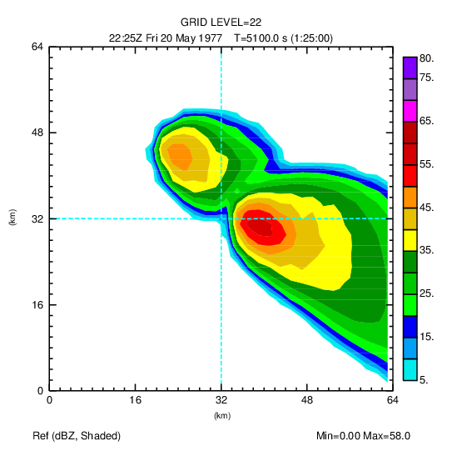
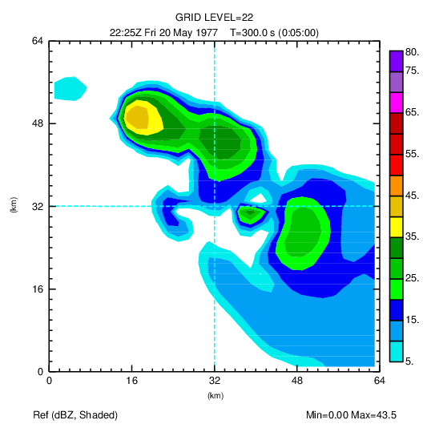
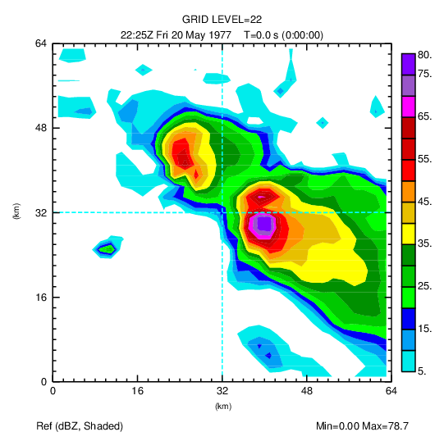
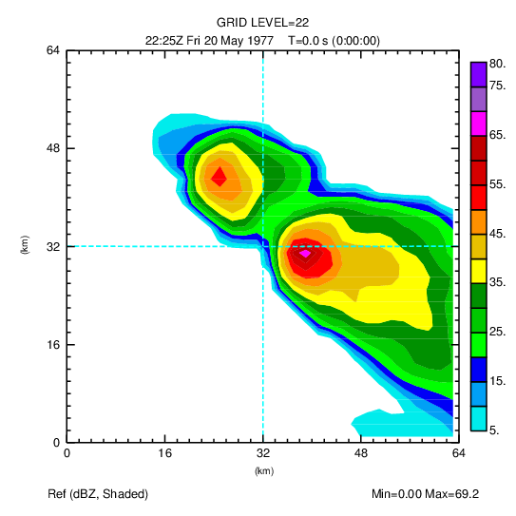
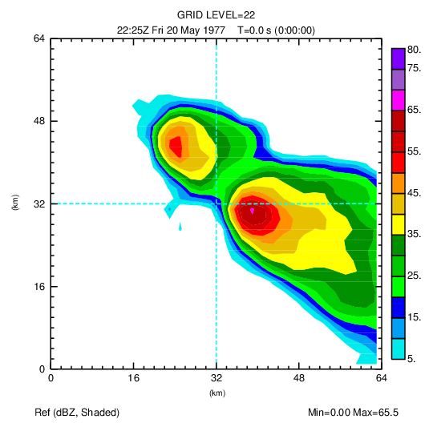
The Z of the 22nd level
(where the max spurious Z for CV_log without treatments)
obs
background
CV_logq
without treatment
CV_logq
with X_{b}_Lim
CV_logq
with X_{b}_Lim & smooth

Slide 55
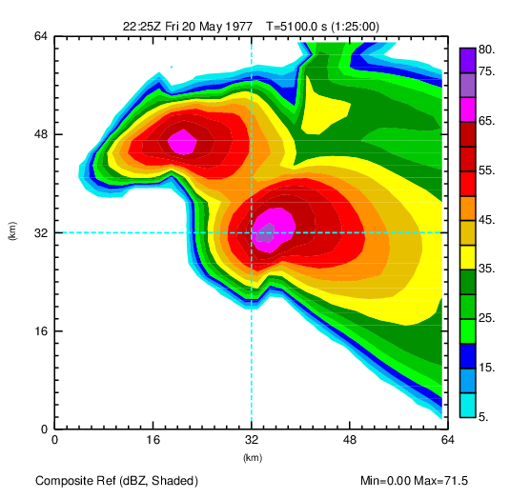
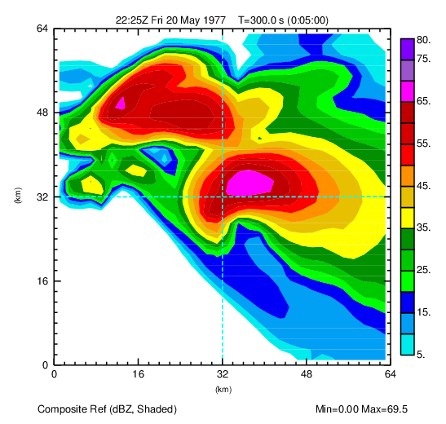
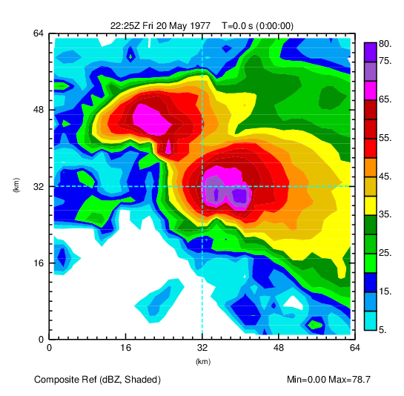
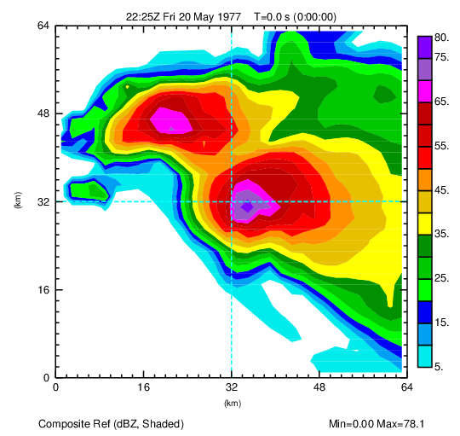
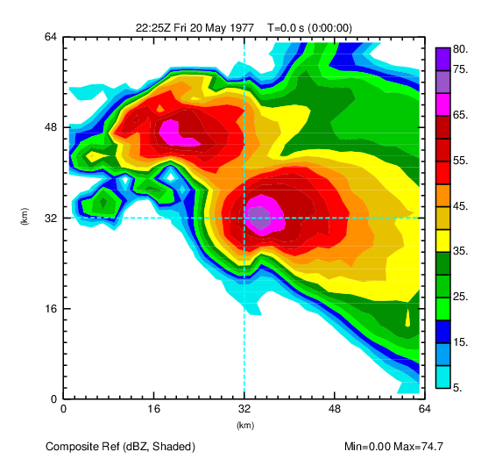
The horizontal Z composite
obs
background
CV_logq
without treatment
CV_logq
with X_{b}_Lim
CV_logq
with X_{b}_Lim & smooth

Slide 56
Variational Analysis of Reflectivity within GSI 3DVar and Hybrid 3DEnVar
Development of new capabilities
Will be tested via HWT

Slide 57
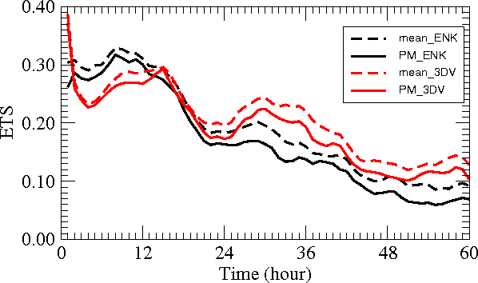
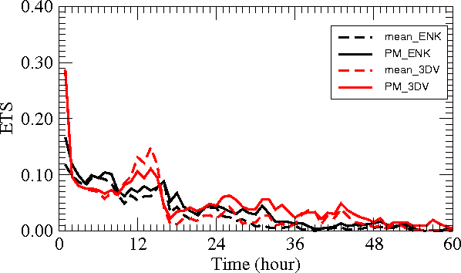
ETS of 1-h Accumulated Precipitation
EnKF vs 3DVAR (7-day)
(not apple to apple comparisons)
0.01”
0.25”
Are further tuning the EnKF System

Slide 58
GSI EnKF and Hybrid for Regional Rapid Refresh
Zhu, K., Y. Pan, M. Xue, X. Wang, J. S. Whitaker, S. G. Benjamin, S. S. Weygandt, and M. Hu, 2013: A regional GSI-based ensemble Kalman filter data assimilation system for the Rapid Refresh configuration: Testing at reduced resolution. Mon. Wea. Rev., 141, 4118-4139.
Pan, Y., K. Zhu, M. Xue, X. Wang, M. Hu, S. G. Benjamin, S. S. Weygandt, and J. S. Whitaker, 2014: A regional GSI-based EnKF-variational hybrid data assimilation system for the Rapid Refresh configuration: Results with a single, reduced resolution. Mon. Wea. Rev., 142, 3756-3780.
Pan, Y., M. Xue, K. Zhu, and M. Wang, 2017: A GSI-based dual-resolution coupled EnSRF-3DEnVar hybrid data assimilation system for the operational Rapid Refresh model. Adv. Atmos. Sci., Accepted.
Zhu, K., M. Xue, and Y. Pan, et al. 2017: Impacts of AMSU, AIRS and other polar orbiting satellite radiance data assimilation using GSI 3DVar and GSI-based ensemble Kalman filter for a Rapid Refresh configuration. J. Adv. Modeling Earth Systems, In review.

