Slide 1


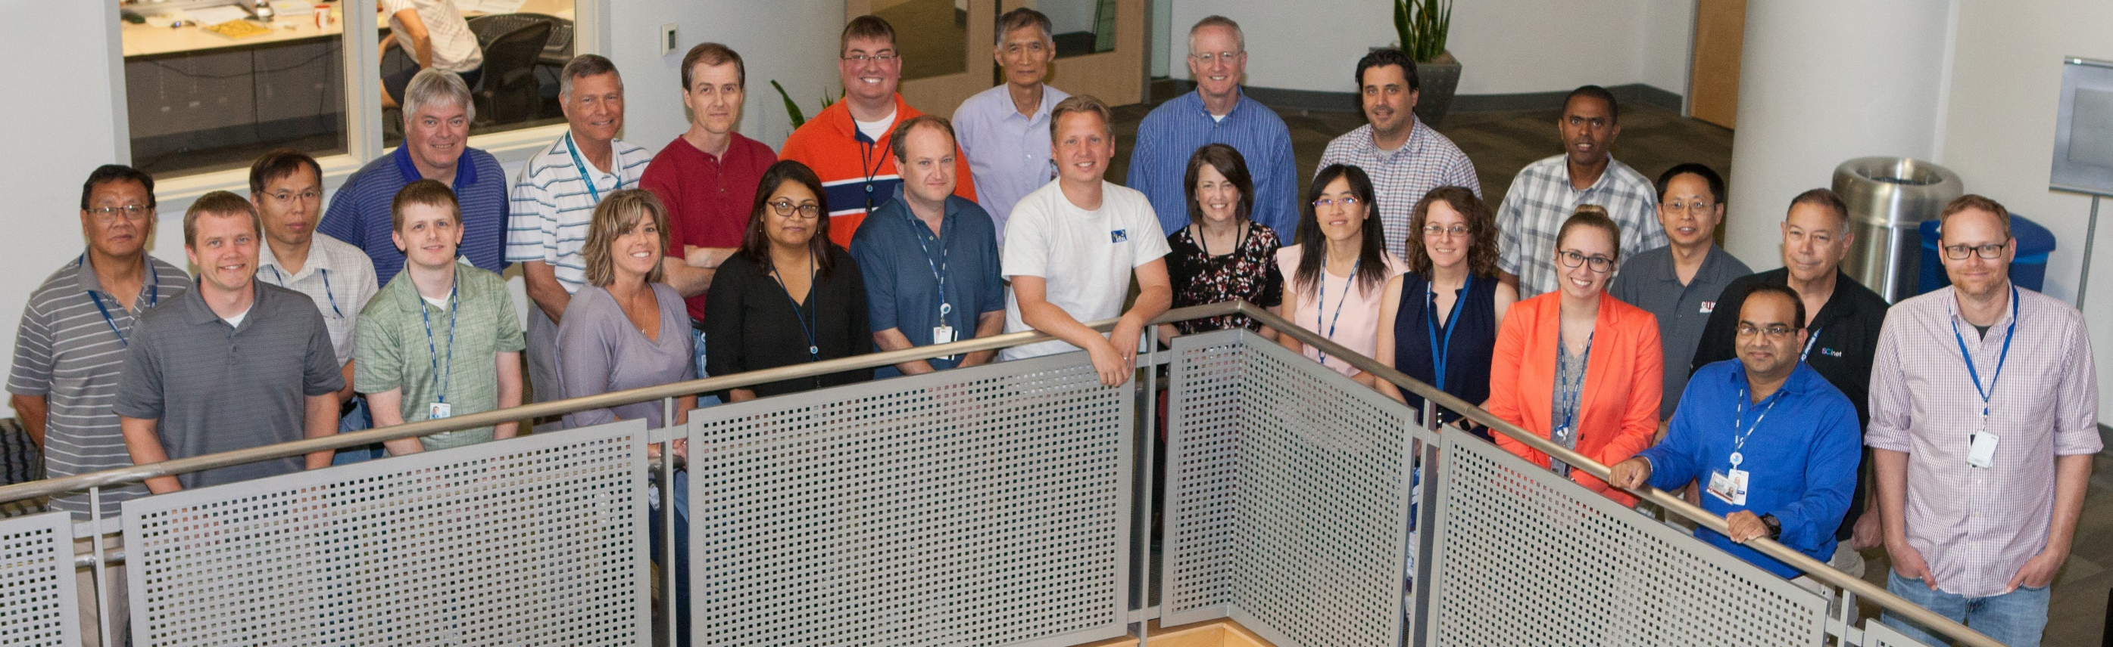
A vision for development and implementation of the Warn on Forecast concept
Pamela Heinselman,
Lou Wicker, & Pat Skinner
Acknowledgements: NSSL/FRDD WoF Team
I’m living the life at EMC!

Slide 2


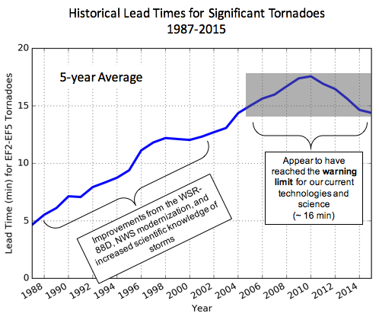
Warn-on-Forecast Motivation
Work
at home parents
Outdoor Events
Hospitals
Schools
Avg. 13-min tornado warning lead time
Deterministic Warning Polygons
Deterministic Watch boxes

Slide 3

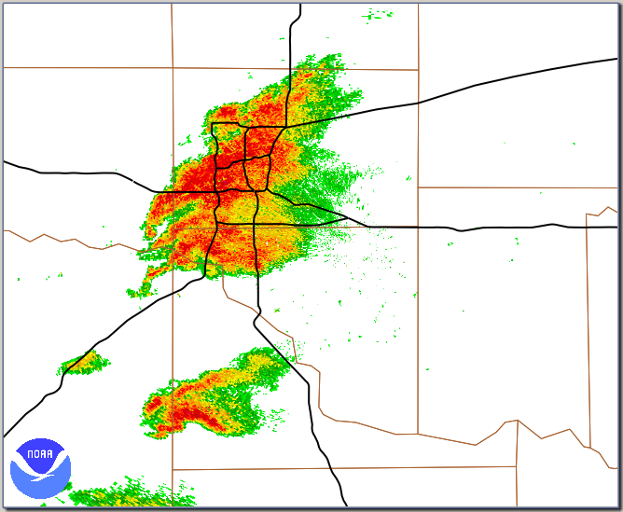
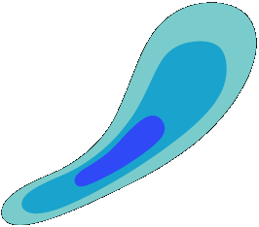
Future Warning Process: “Warn on Forecast”
“Probabilistic warnings enabled by combining observations with
rapidly-updating, high-resolution storm-scale models”
Warning will be more targeted (smaller area)
Threat information will have temporal and spatial distributions (moving away from binary warnings to probabilities)
Warning will be information rich with multiple threats described
Different users (schools, hospitals) will use information in different ways
New warnings will use social science research to maximize public response to warnings.
30%
70%
50%
T=2120 CST
T=2140
T=2150
T=2130
Notes:
Warnings are limited because the forecaster
Cannot quantitatively predict the evolution of the storm
Beyond 15 min…..WoF can help….

Slide 4
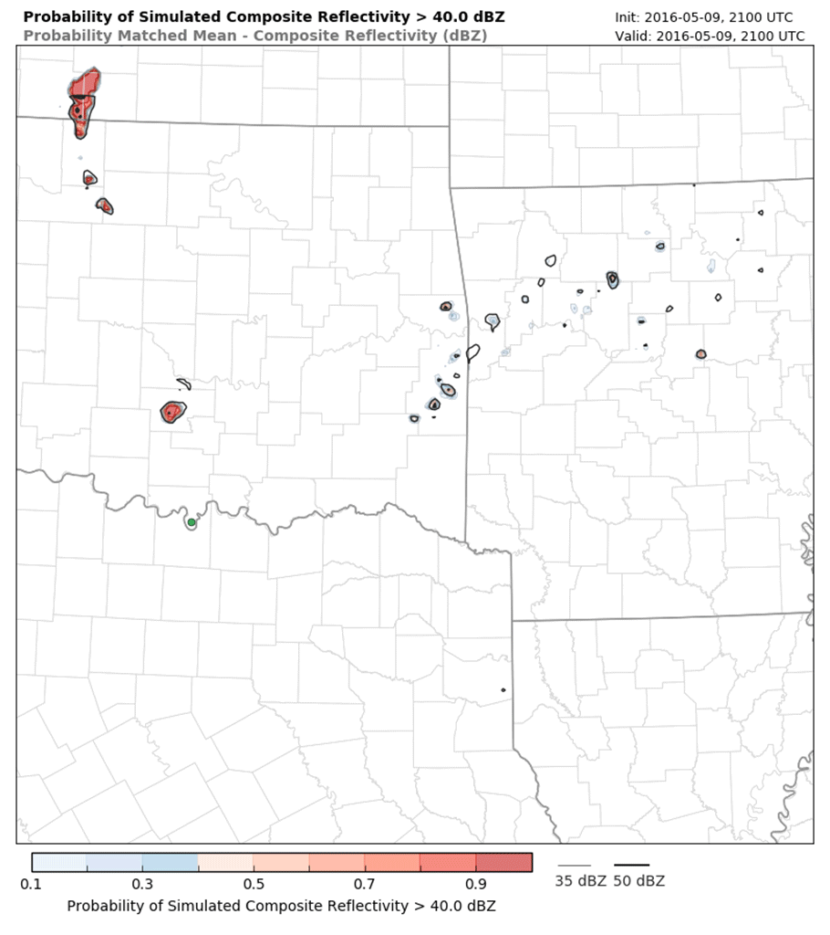
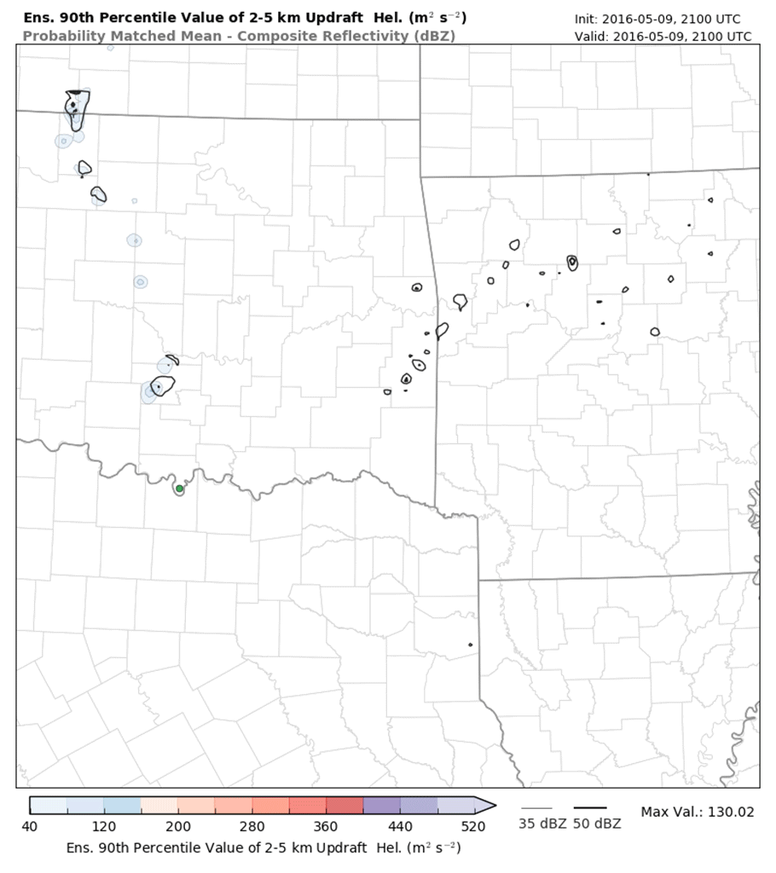
Operational Goal
Predicting likelihood of high-impact weather at specific locations during the next 0 to 3 hours.
Anticipate storm location, mode, & intensity
Composite Z > 40 dBZ
90th percentile 2-5 km UH
Notes:
5-min time steps

Slide 5

Also…
While the Storm Prediction Center and WFOs do an excellent job issuing timely Watches and Warnings, there is a gap in the guidance available to aid forecast continuity between the Watch to Warning time frame.
Watches are usually issued
~3 hours prior to severe weather occurrence
Warnings are usually issued up to 20 min prior to severe weather occurrence
Based on 18+hr Model Forecasts
Based primarily on radar detection + surface obs + spotter reports

Slide 6
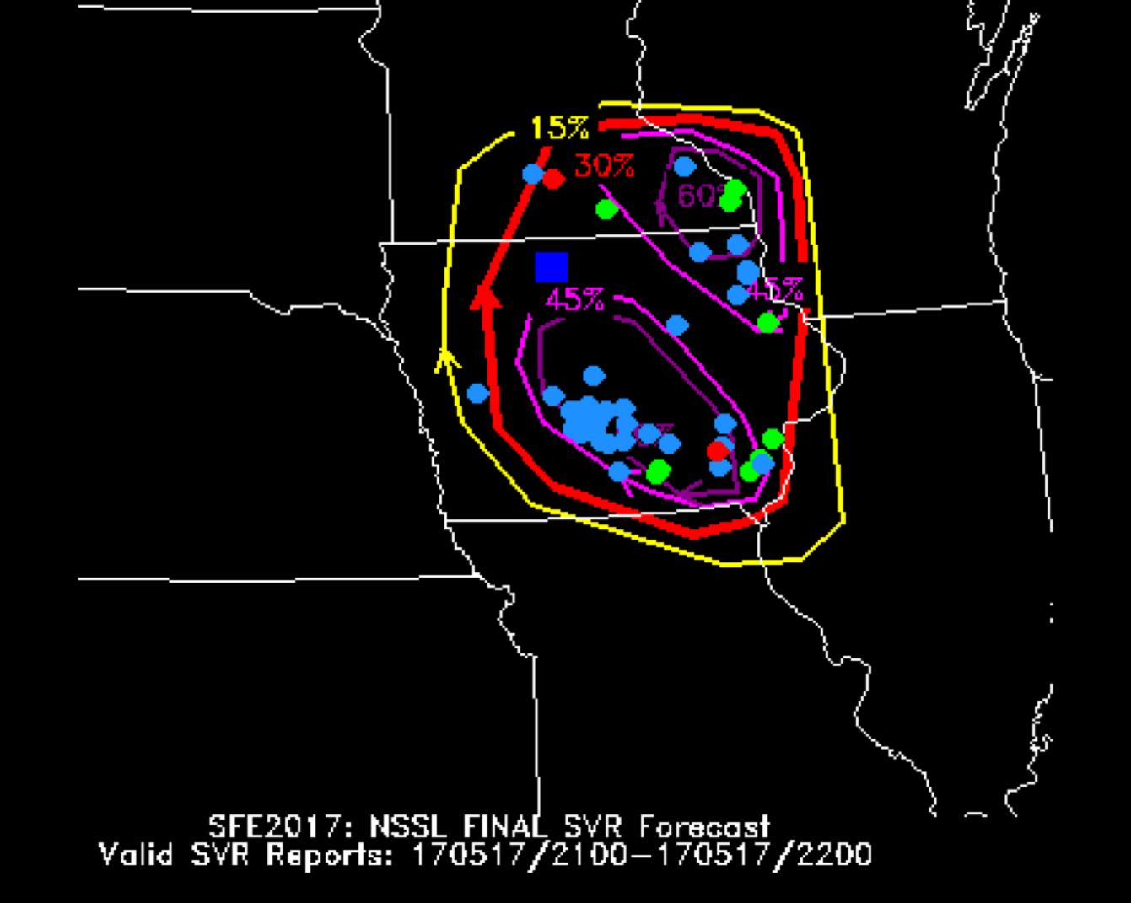
Goal: Fill spatial and temporal forecast gap
While the Storm Prediction Center and WFOs do an excellent job issuing timely Watches and Warnings, there is a gap in the guidance available to aid forecast continuity between the Watch to Warning time frame.
Experimental 1-hour Outlooks
Watches are usually issued
~3 hours prior to severe weather occurrence
2100-2200 UTC Outlook
issued from 2000 WoF Forecast
Warnings are usually issued up to 20 min prior to severe weather occurrence
Based on 18h+ Model Forecasts
Based primarily on radar detection + surface obs + spotter reports
WoF ~30 min– 3 h
probabilistic forecast guidance

Slide 7
Grand Challenge
Can scientific/technological advances permit the prediction individual severe storms reliably enough to extend warnings and fill the forecast gap between watches and warnings?

Slide 8
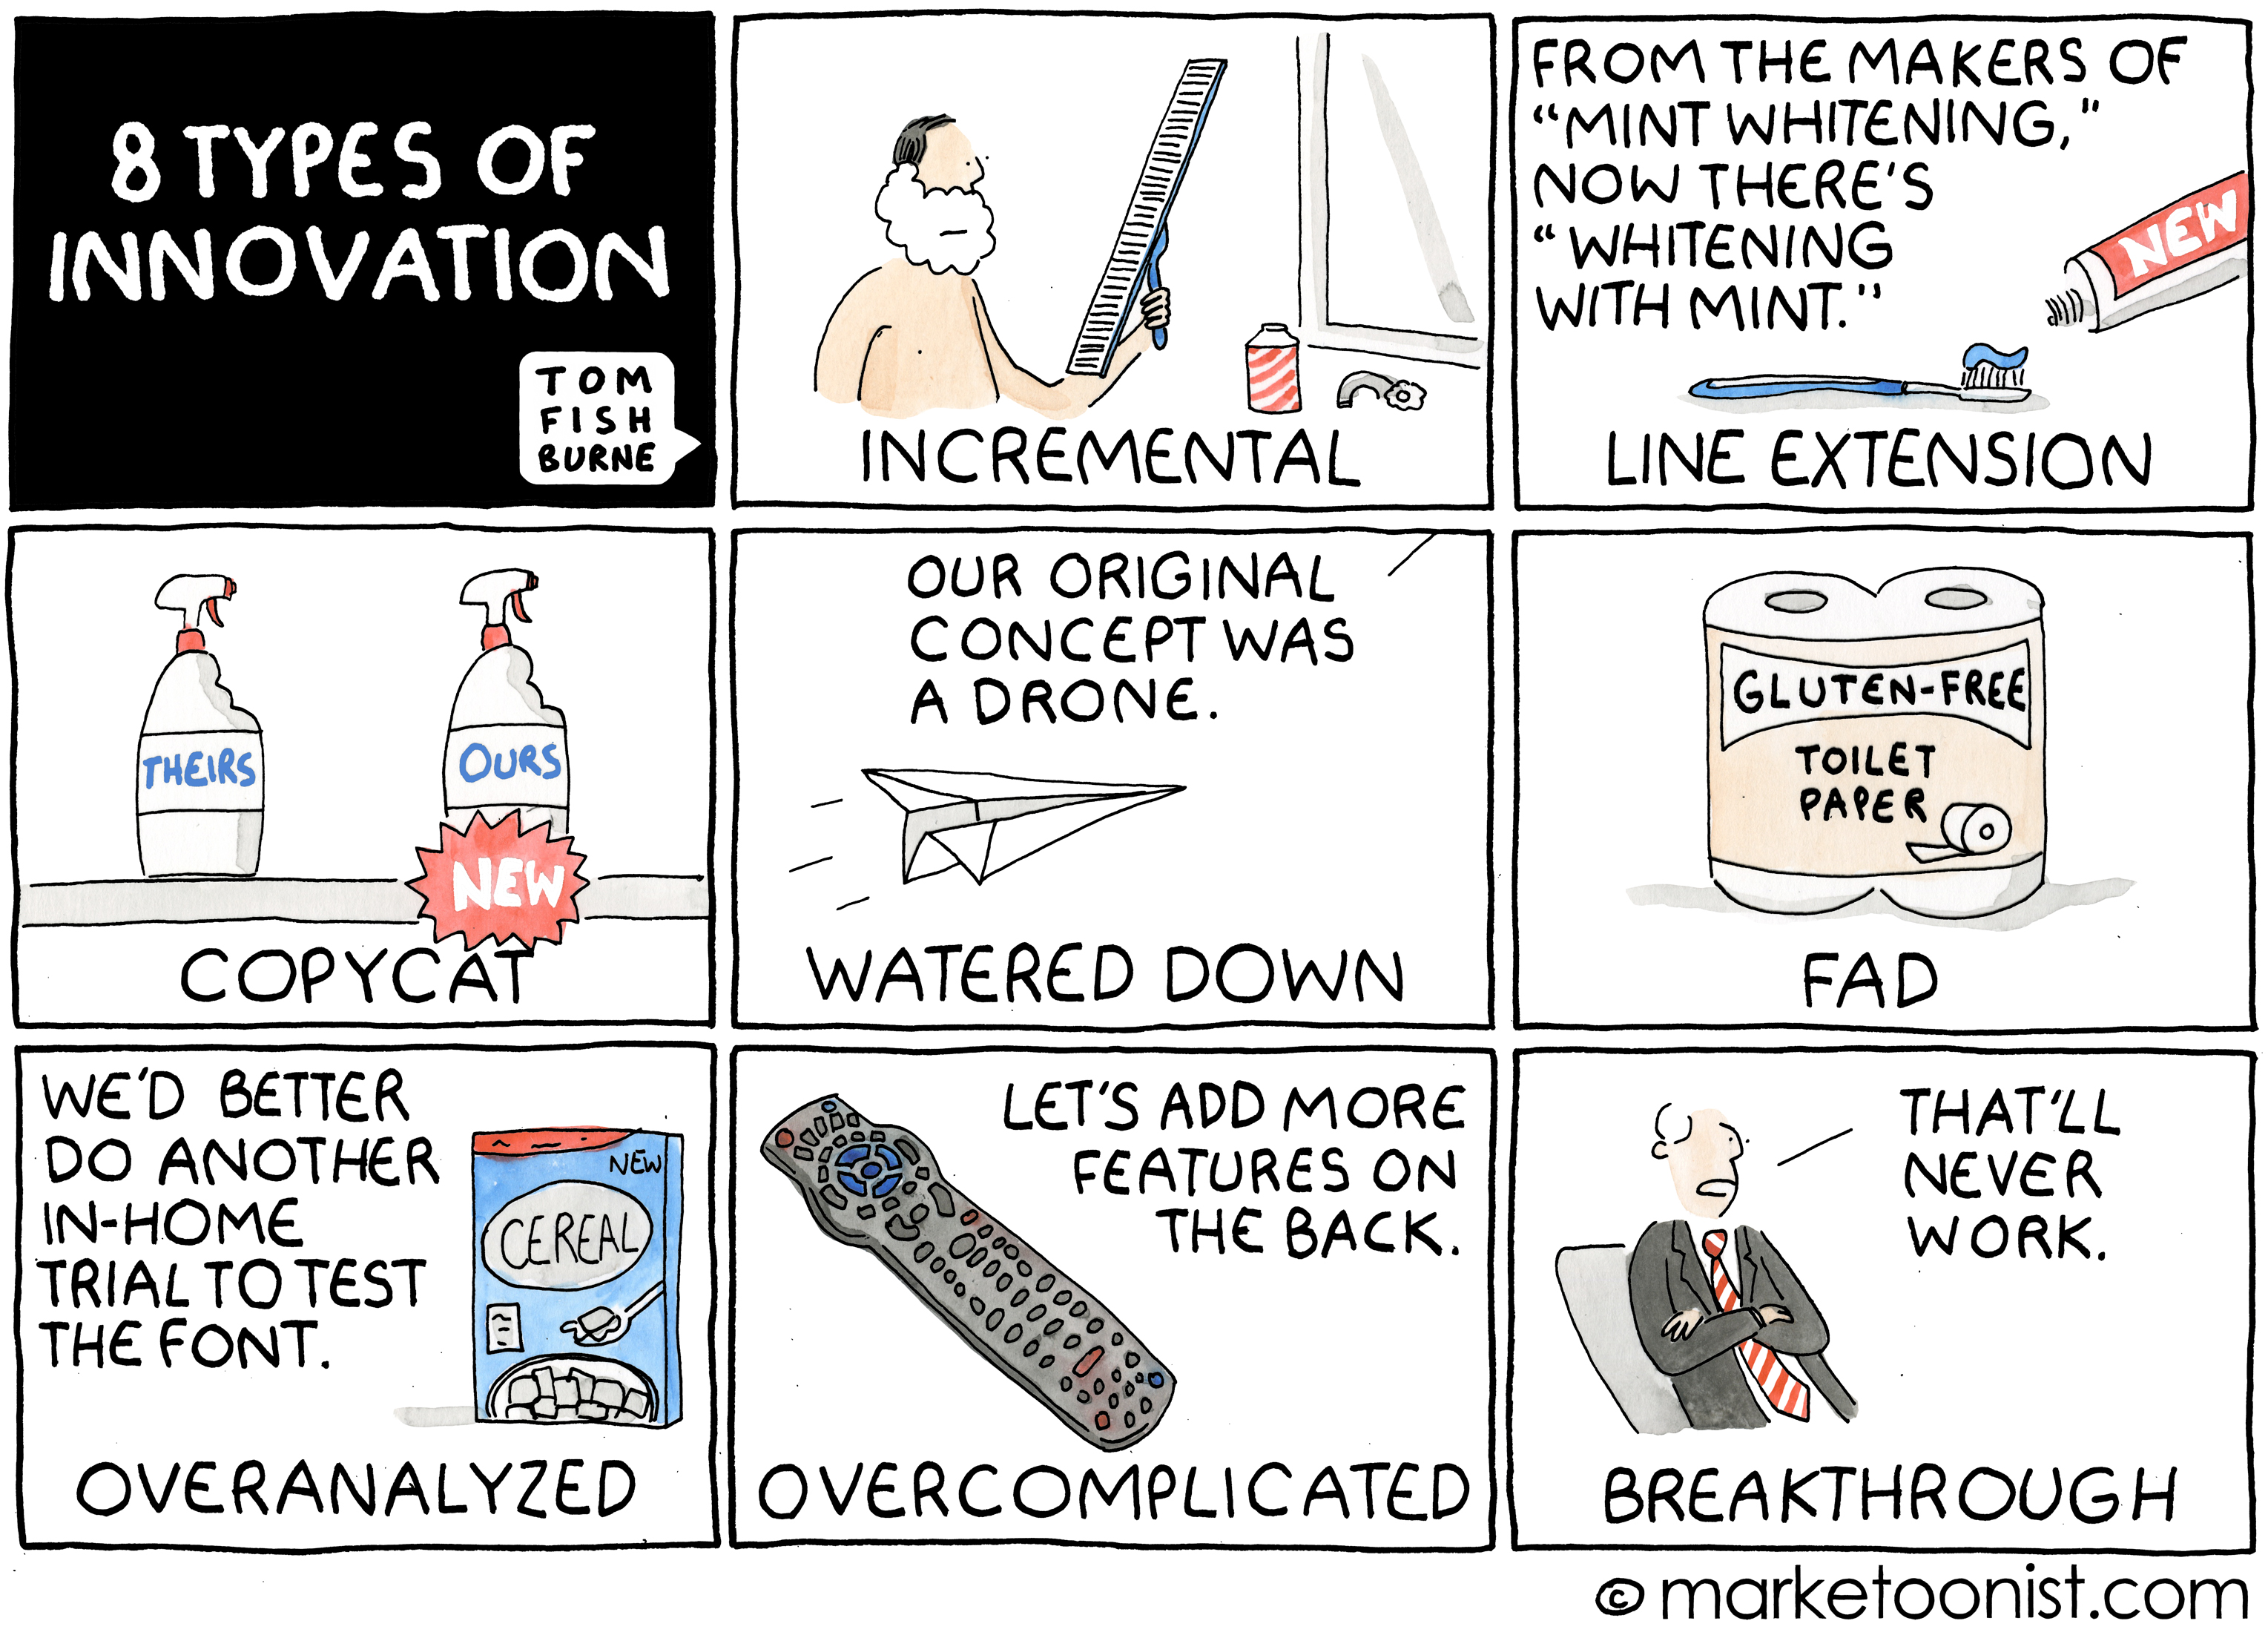
Motivation: Our current warning paradigm has probably run its course…

Slide 9
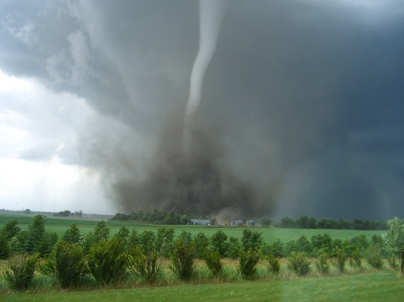
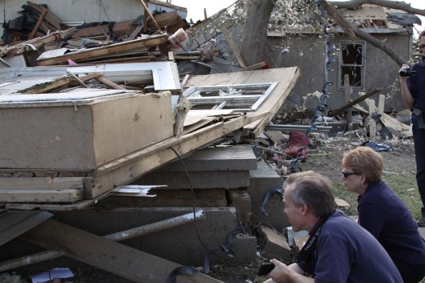
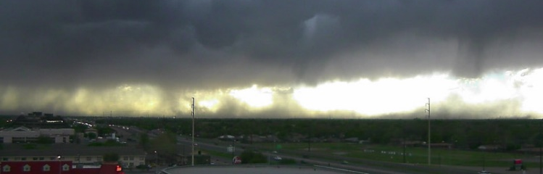
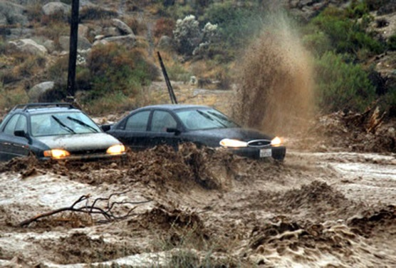
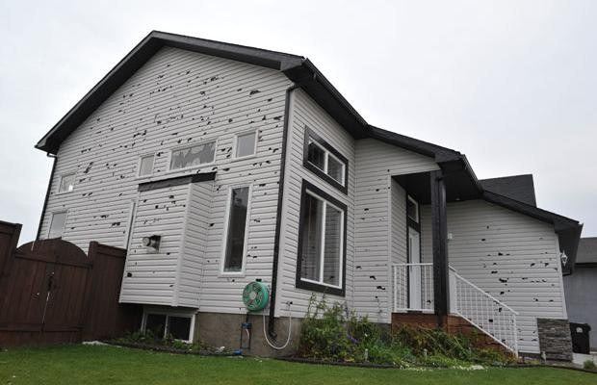
Prototype WoF System
NSSL Experimental WoF System for ensembles
(NEWS-e)
Weather adaptive, placeable, frequently updating convection-allowing ensemble prediction system
that supports high-impact forecast and warning operations for NOAA, other agencies, and industry.
Notes:
5-min time steps

Slide 10
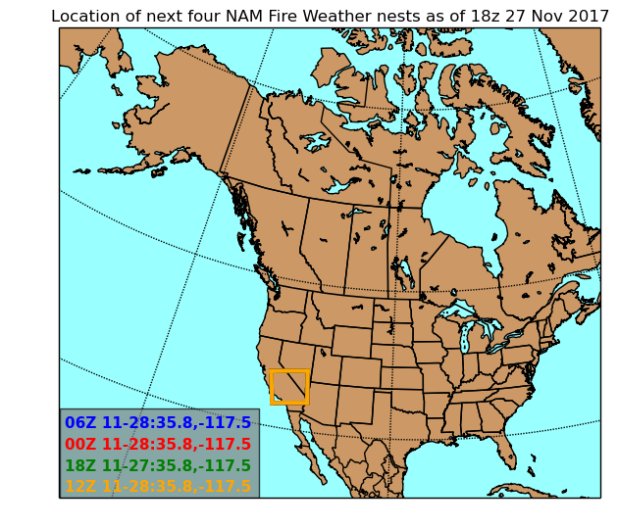
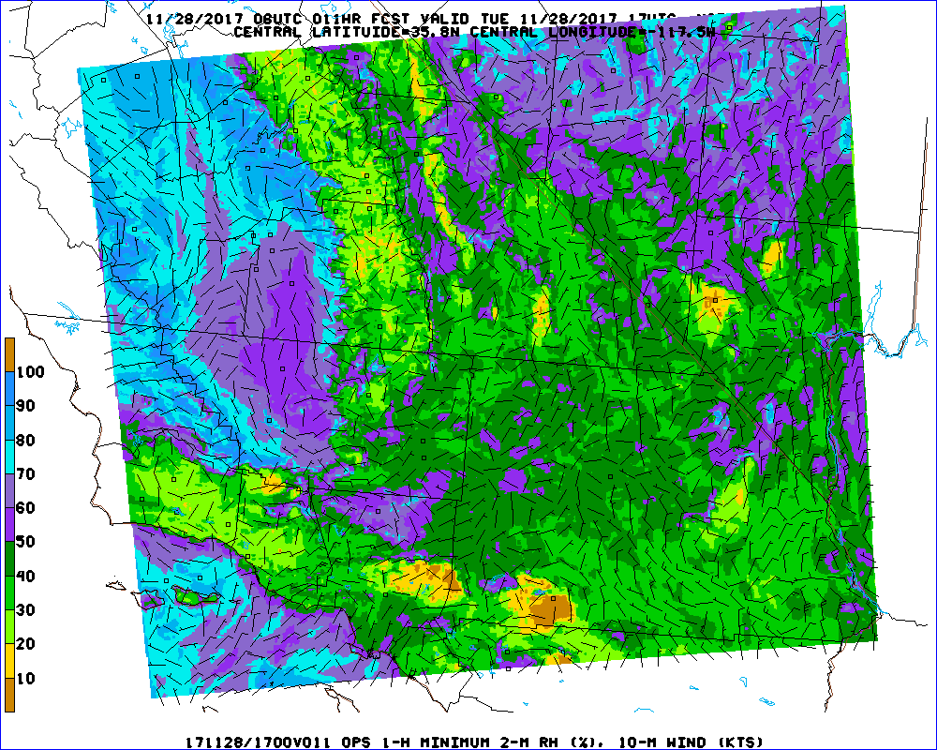
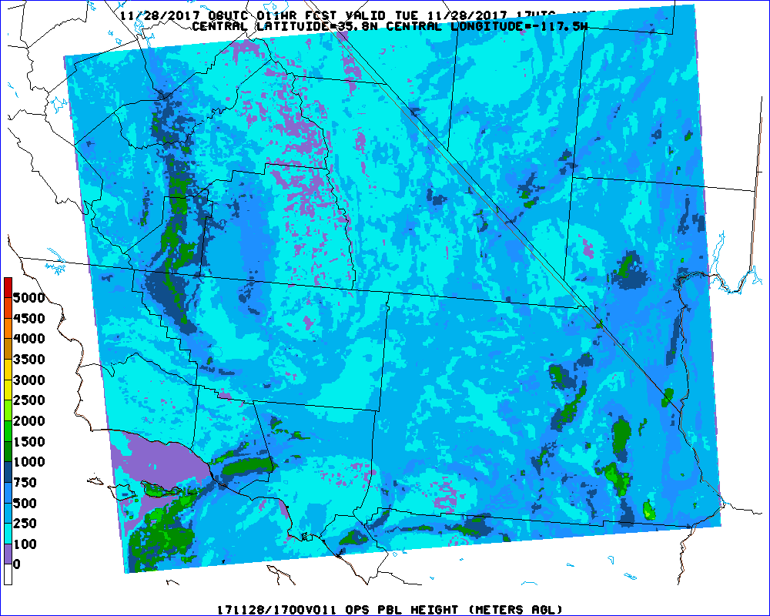
NAM Fire Weather High Resolution Nested Runs
Example domain 06Z 11/28/2017
2-m RH, 10-m Wind
PBL Height
36-h runs with 1.5-km horizontal spacing at 00z, 06z, 12z, and 18z within
NAM CONUS or Alaska nest
Adapted from: http://www.emc.ncep.noaa.gov/mmb/mmbpll/firewx/

Slide 11
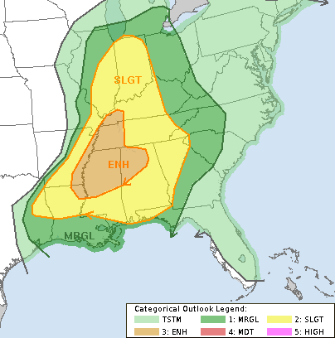
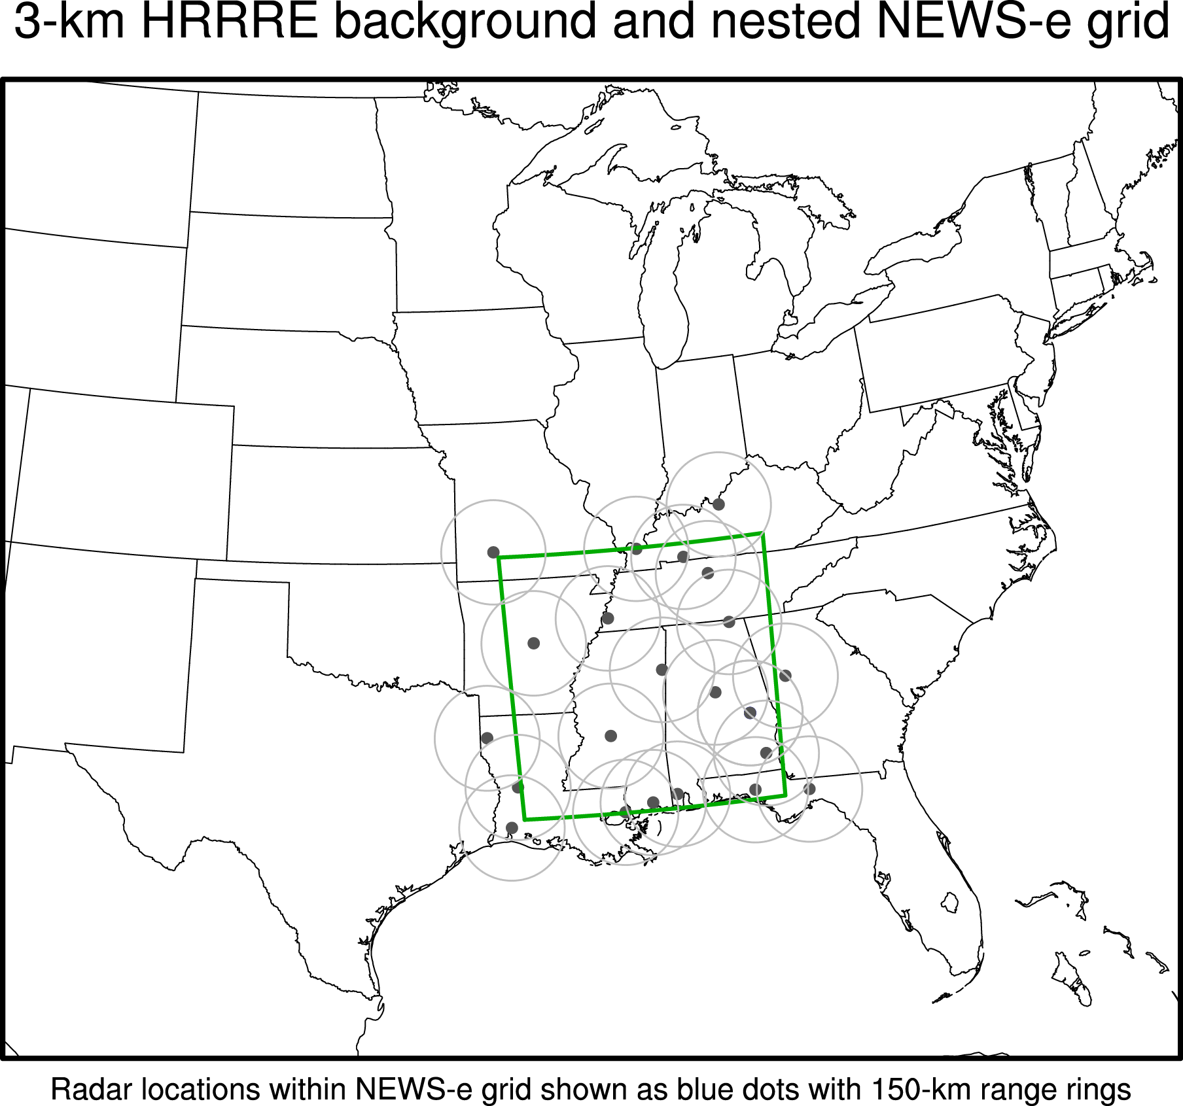
Weather-adaptive and Placeable
based on Storm Prediction Center Day-1 Outlook
SPC 1630 UTC Day 1 Convective Outlook
NSSL
An NSSL-SPC Collaboration
An NSSL-GSD Collaboration
Notes:
5-min time steps

Slide 12
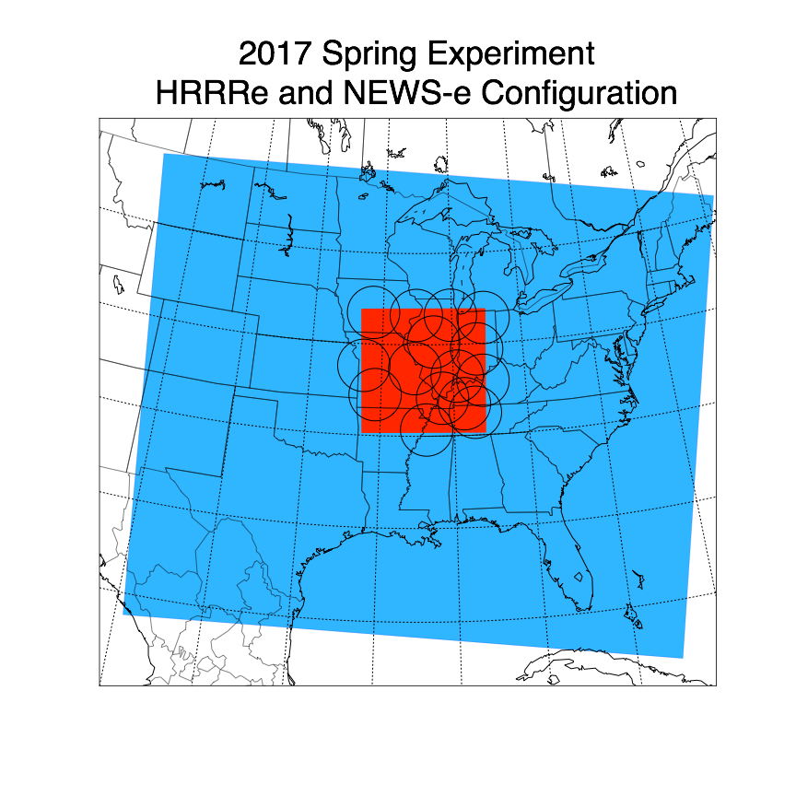
2017 Real-Time Configuration
Blue: Prototype High-Resolution Rapid Refresh Ensemble (“HRRRe”)
Hourly-updated 3-km 36-member ensemble
  assimilates reflectivity, surface, ACARS
18-hour 9-member forecasts every 6 hours
for 28 Feb 2017
NEWS-e
Domain
(circles are radars
to be assimilated)
Red: NSSL’s “NEWS-e” System
3-km storm-scale 36-member ensemble
15 min cycling analysis system
assimilates reflectivity and radial velocity,
ASOS, mesonet (TX/OK), GOES satellite
3-hour 18 member forecasts every 30 min
Movable event-dependent domain
HRRRe
Domain
Goals in 2017
Improve NEWS-e/HRRRe integration
Continue to examine what is current “state of the art” 0-3 h NWP
NEWS-e testing 2-moment microphysics (NSSL-ZVD) to improve DA

Slide 13
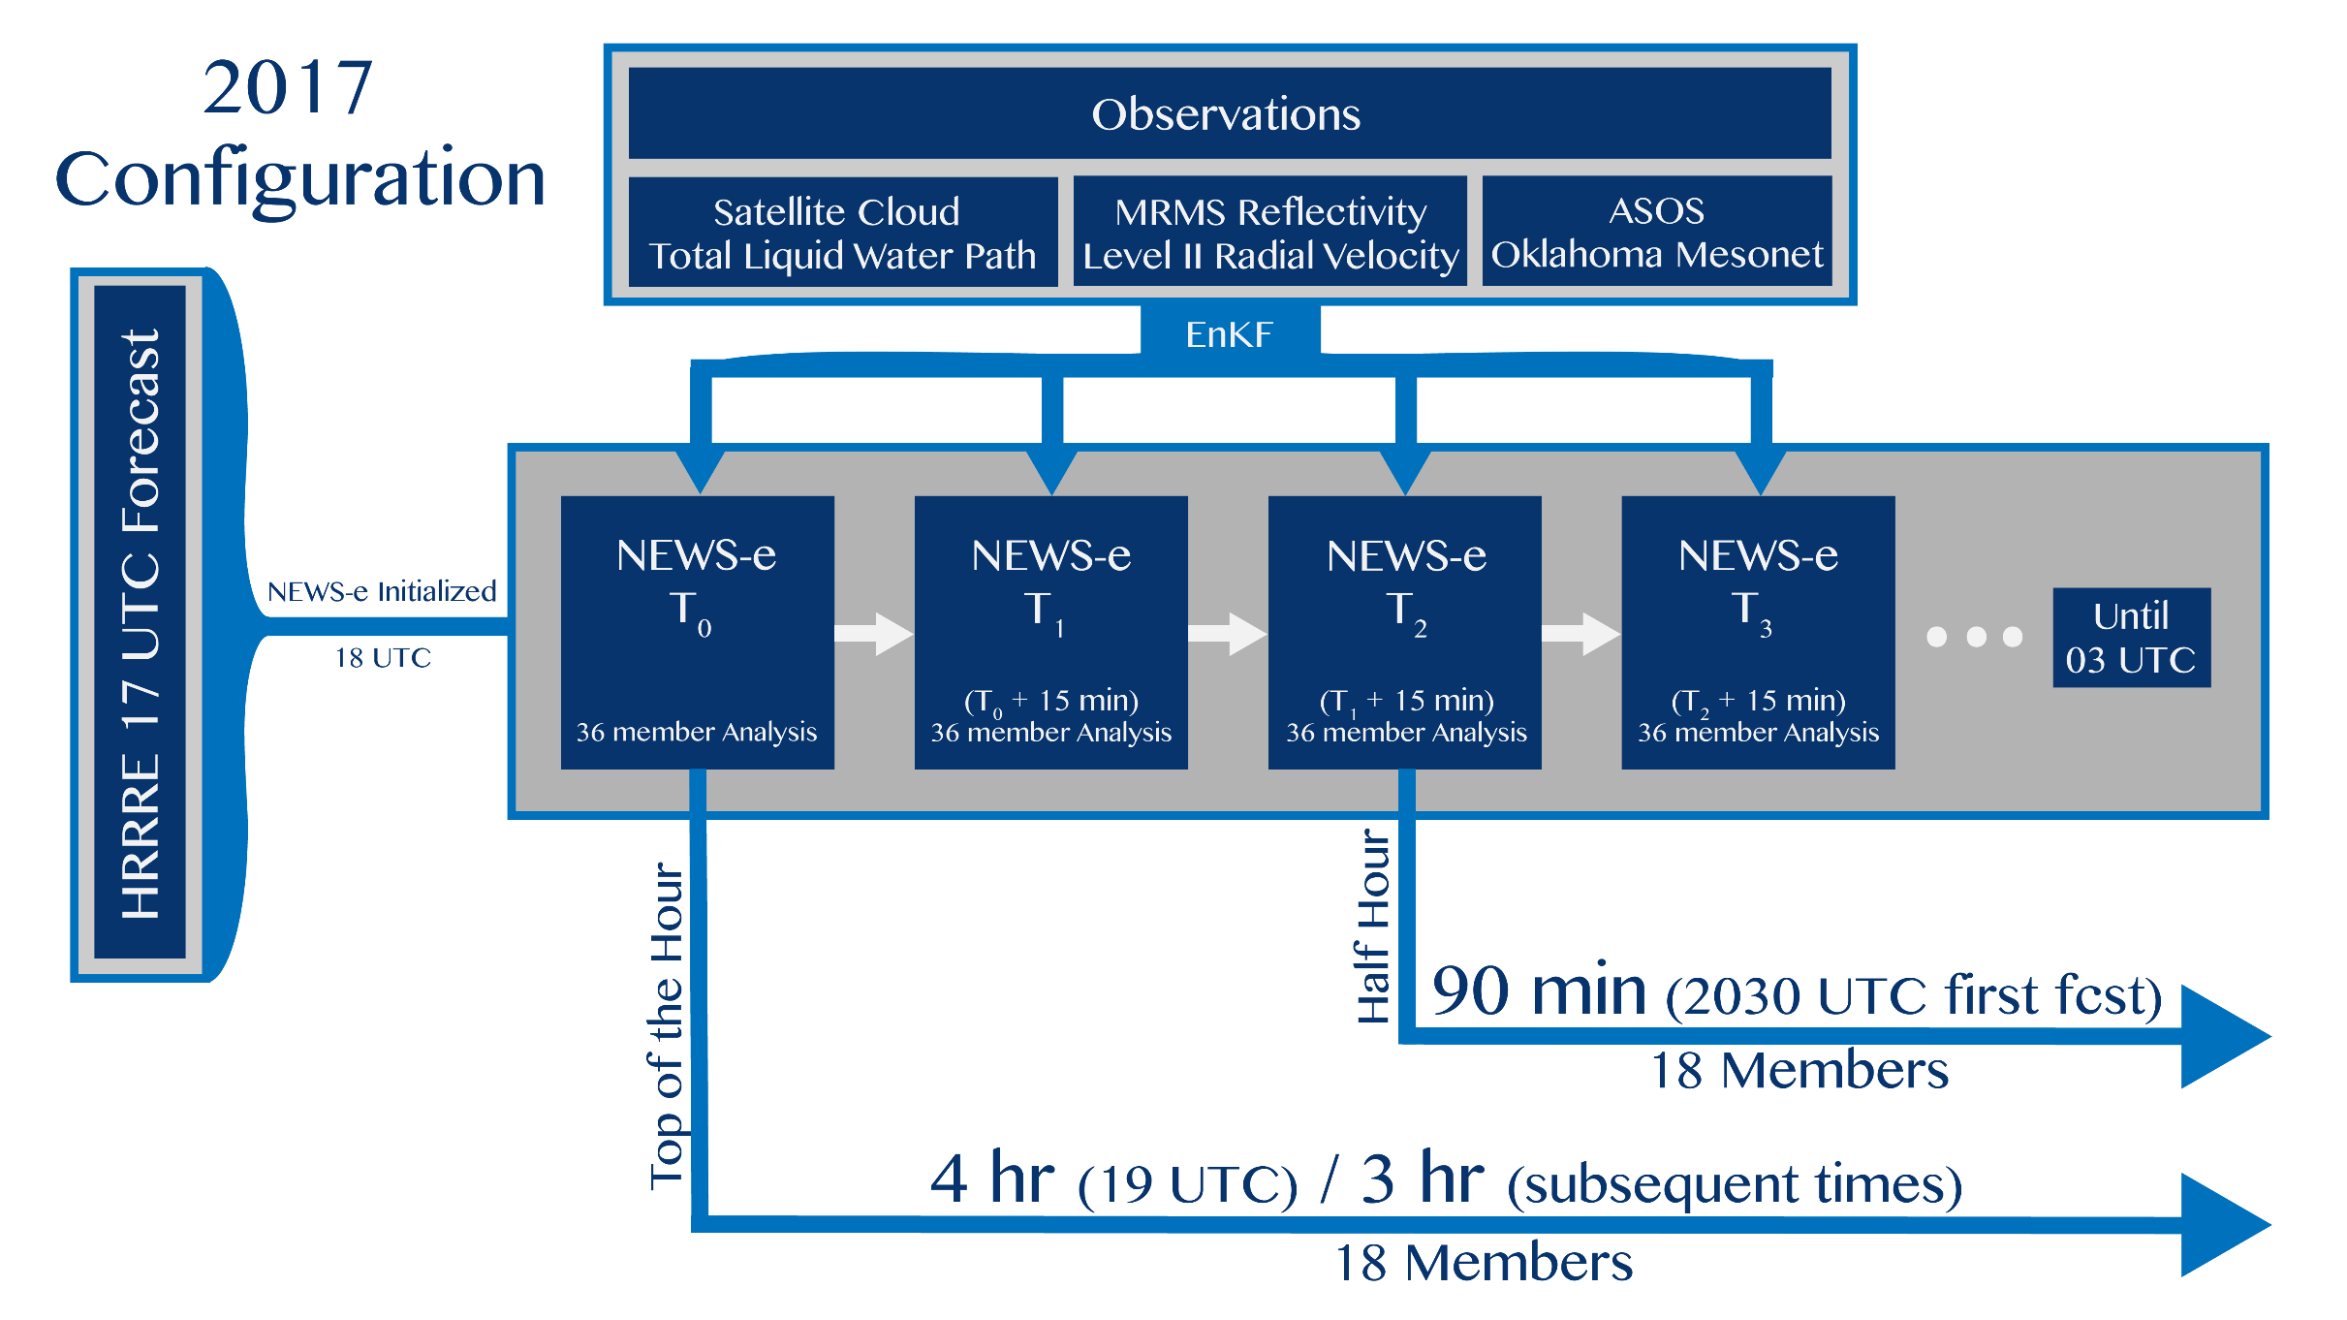
Frequently Updating Data Assimilation
NEWS-e

Slide 14
Emerging Applications

Slide 15
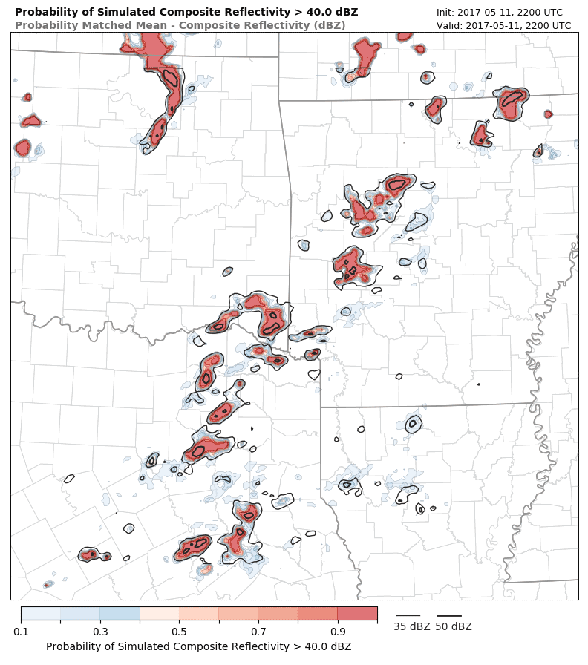

Situational Awareness
How is storm coverage / mode forecast to evolve?
3-hr NEWS-e forecast
22–01 UTC 11 May 2017
Probability of Simulated Composite Reflectivity > 40 dBZ
Probability Matched Mean (contour)
TUL

Slide 16
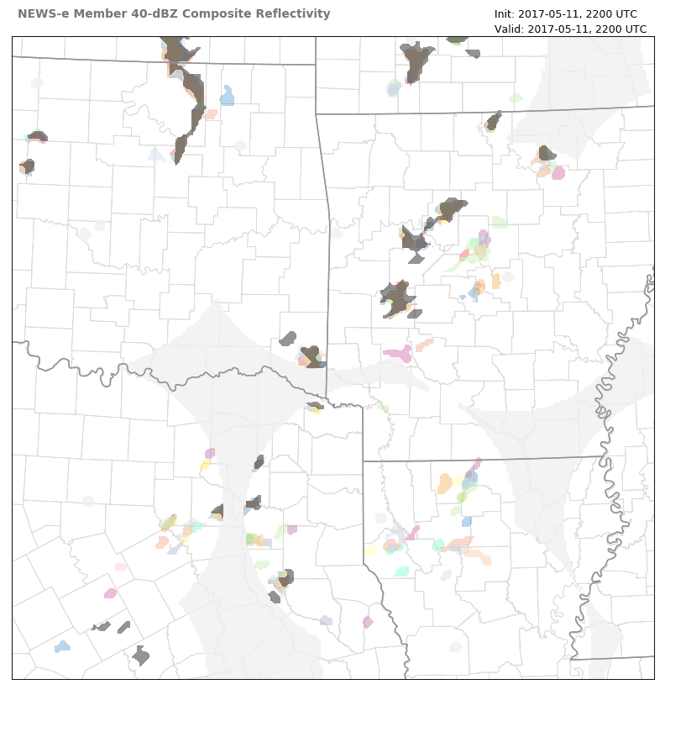
Situational Awareness
How is storm coverage / mode forecast to evolve?
Qualitative Verification
Each color represents 1 of 18 members with 40+ dBZ
composite reflectivity
Grey fill is the MRMS 40-dBZ composite reflectivity
TUL
FAY
OKC
LIT
DFW

Slide 17
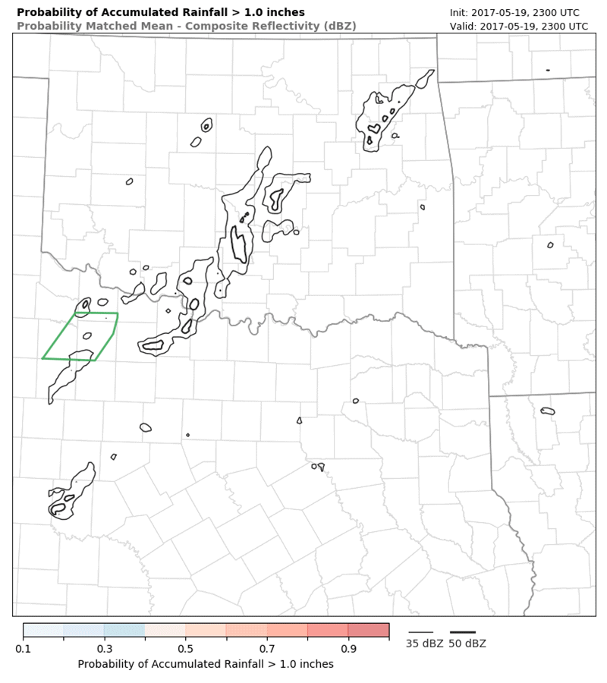
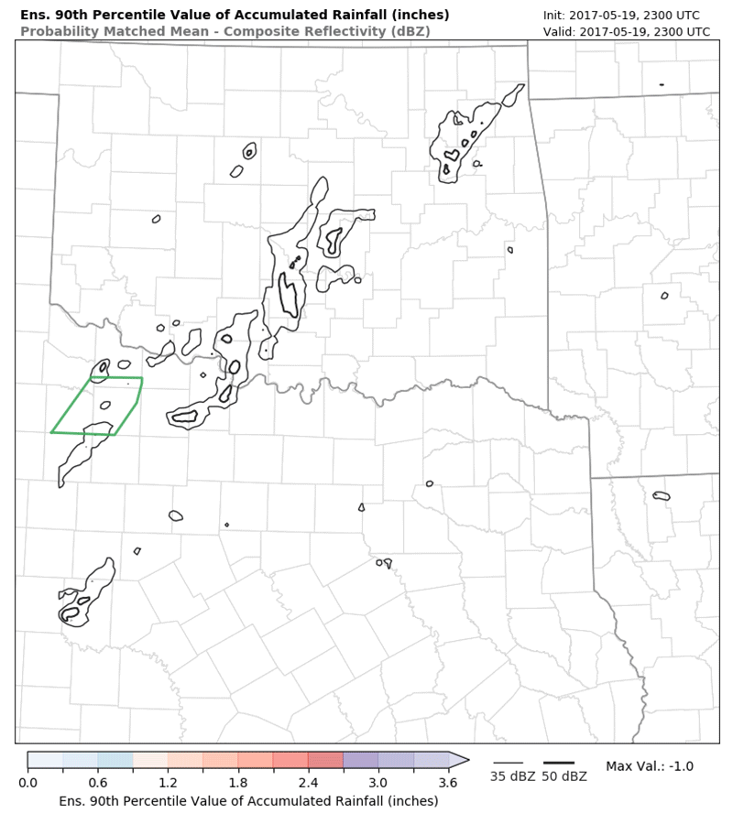
WoF QPF: Testing 0–6 forecasts
Prob. Accum. Rainfall > 1.0”
90th Percentile Accum. Rainfall

Slide 18
Ellicott City, Maryland, Flash Flood – 30 July 2016
Forecasts for Flash Flood-Producing
Extreme Convective Rainfall
Ellicott City
6-h NCEP Stage IV rainfall
Probability of 0-6 h rainfall forecast > 2 inches
Courtesy of Nusrat Yussouf
Notes:
The WoF ensemble system can also provide useful probabilistic forecasts of heavy rainfall in terms of location and amount out to ~3-6 hours in advance.
This is the flash flood event in Ellicott City, Maryland from last year. On that day, heavy rainfall occurred in and near Ellicott City causing severe flash flooding.
There were 2 fatalities and lots of property damages on that day.
On the left is the observed 6-h rainfall accumulation from NCEP’s stage IV analyses during the peak of the event. Some part of Ellicott city experienced over 5″ of rainfall.
On the right is the 6hr exceedance probability of rainfall forecasts greater than 2 inches from WoF. The thick black line overlaid is the observed 2 inches of rainfall contour.
The 6hr rainfall forecast from the WoF is able to associate higher probabilities and good areal coverage over the Ellicott City area.

Slide 19
South Central TX Flash Flood Event
23-24 May 2015
Probability of 0-6-h rainfall forecast
valid 0300 UTC 24 May, 2015
Rainfall > 1 inch
Rainfall > 2 inches
Rainfall > 3 inches
Rainfall > 4 inches
Observed Stage IV
Rainfall Contour
%
Courtesy of Nusrat Yussouf
Notes:
These are 6-hr exceedance probability of rainfall forecast from another heavy rainfall event in south central Texas that led to flash flood.
From the left to right, the thresholds are increased from 1 inches to 4 inches of rainfall during 6 hour accumulation period.
The WoF experiment compares reasonably well in term of areal coverage with the observed STAGE IV rainfall overlaid in black.
Correct location is essential for flash flood forecasting.
The WoF ensemble forecast can be utilized to drive the hydrology models.
The potential benefit is longer flash flood forecast lead-time and probabilistic rather than deterministic forecast.

Slide 20
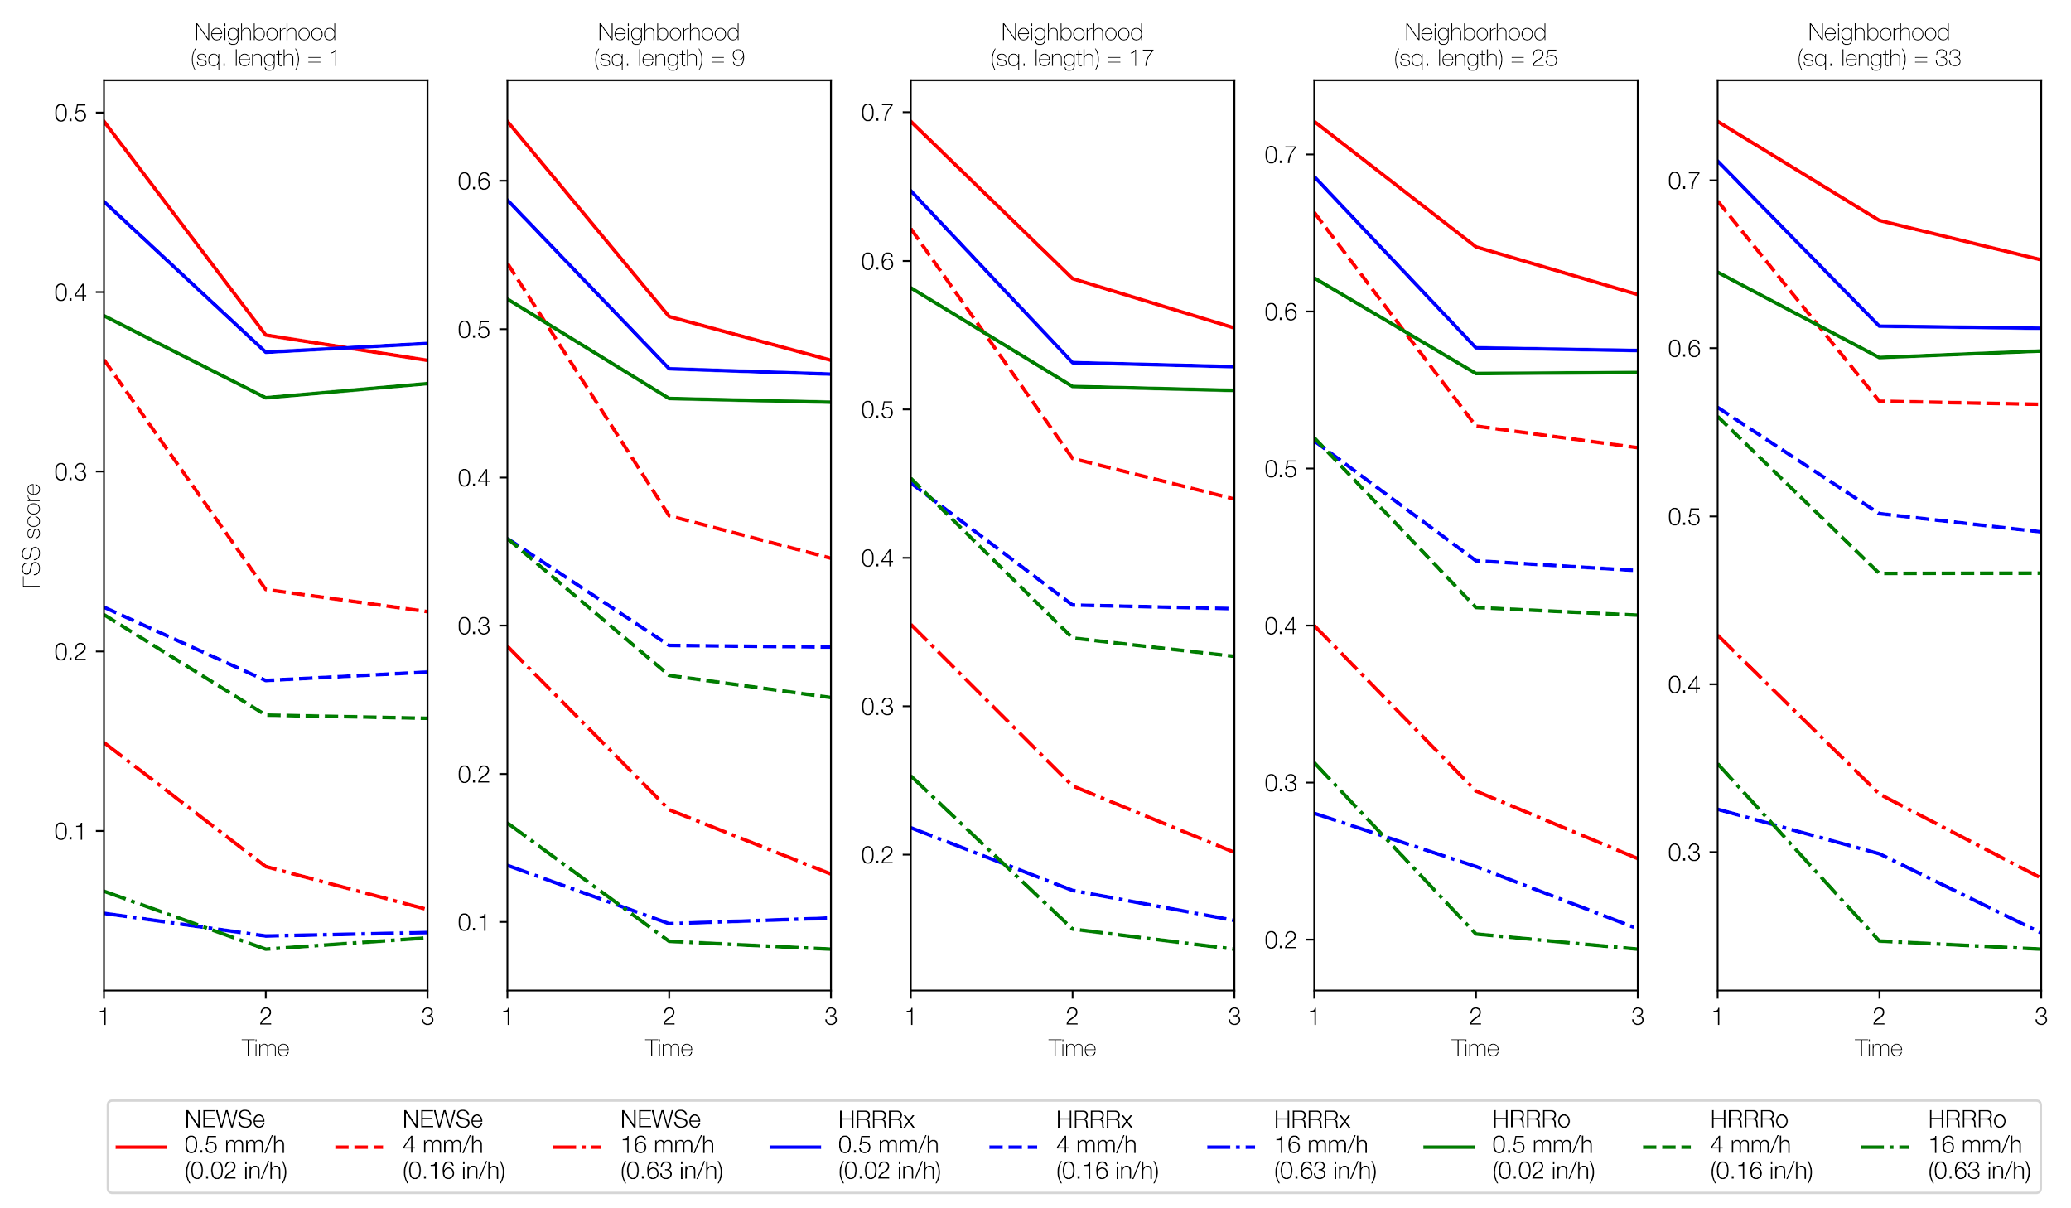
0-3 hr Rainfall Forecasts NEWSe vs. HRRR
Fractional Skill Score
NEWSe
HRRRo
HRRRx
0.5 mm/h
0-3 h WoF
rainfall forecast
performs better than
both operational and
experimental HRRR
(Lawson et al. 2017 under review)
4.0 mm/h
16 mm/h
Aggregated FSS score from 12 severe weather cases during 2016 HWT NEWSe runs. FSS was calculated over a range of thresholds and neighborhood sizes for all NEWSe members and both HRRR configurations.
Notes:
This is the aggregated FSS score from 12 severe weather cases during 2016 HWT NEWSe runs.
FSS was calculated over a range of thresholds and neighborhood sizes for all NEWSe members and both HRRR configurations.
We see that NEWSe offers higher skill at both large and small QPF thresholds than both operational and experimental HRRR though this advantage reduces with lead time.
This advantage for the NEWSe members likely stems from the more frequent, longer cycling EnKF radar-data assimilation.

Slide 21
WoF QPF: Next Steps…
Test NEWS-e probabilistic rainfall guidance during FY18 FFAiR, at the WPC Metwatch desk, and at the Norman, OK WFO.
Develop capability and test the use of NEWS-e probabilistic rainfall guidance to provide the forcing for hydrologic models
Provide forcing for FLASH as a part of the FY18 & F719 HMT Experiments in Norman, OK.

Slide 22
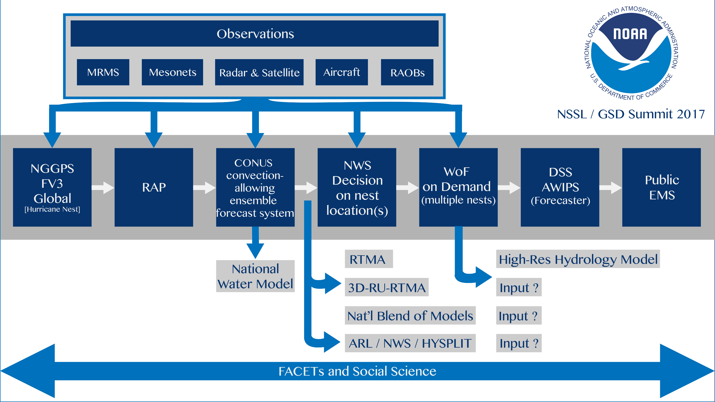
Potential Concept of Operations
Forecasting a Continuum of Environmental Threats (FACETS) and Social Science

Slide 23
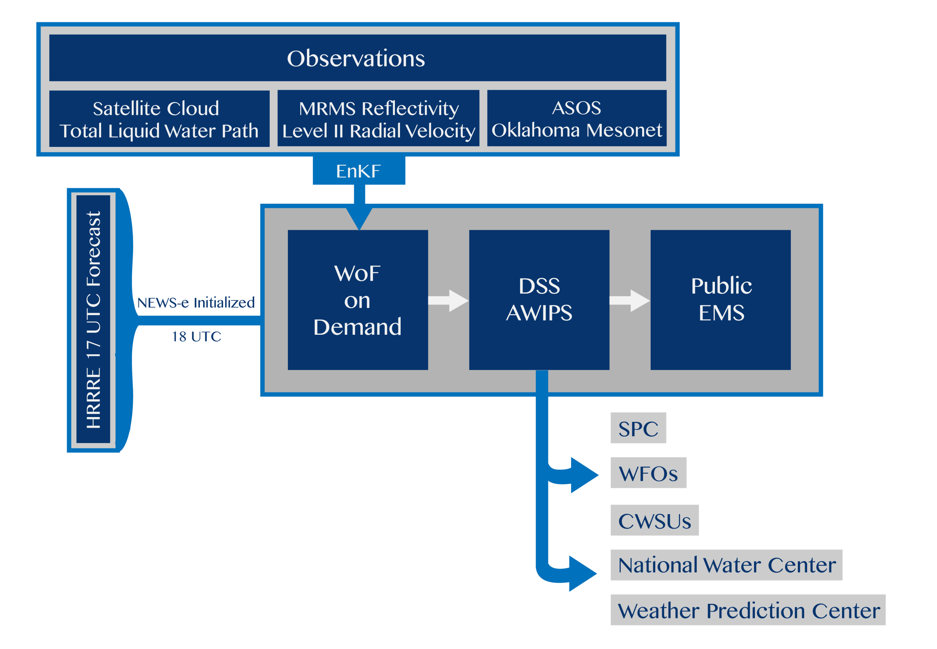
Potential Concept of Operations

Slide 24
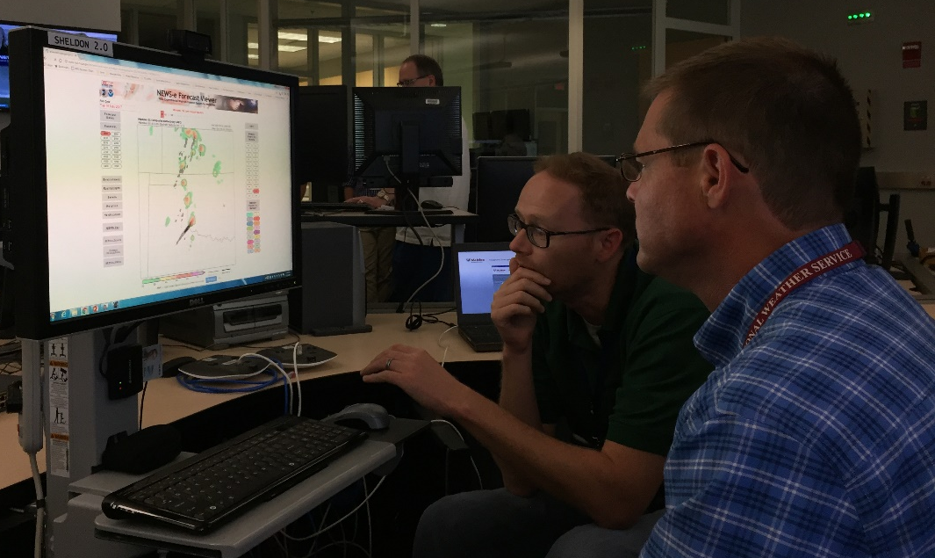
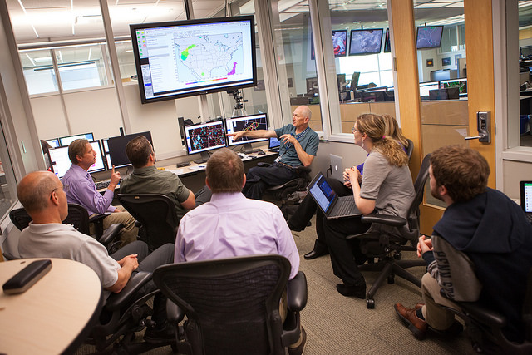

NEWS-e: 2017 Spring Forecast Experiment
Just beginning its evaluation and testing phases of development
1) Real-time Operational Testing
2) Pseudo-Operational Testing

Slide 25
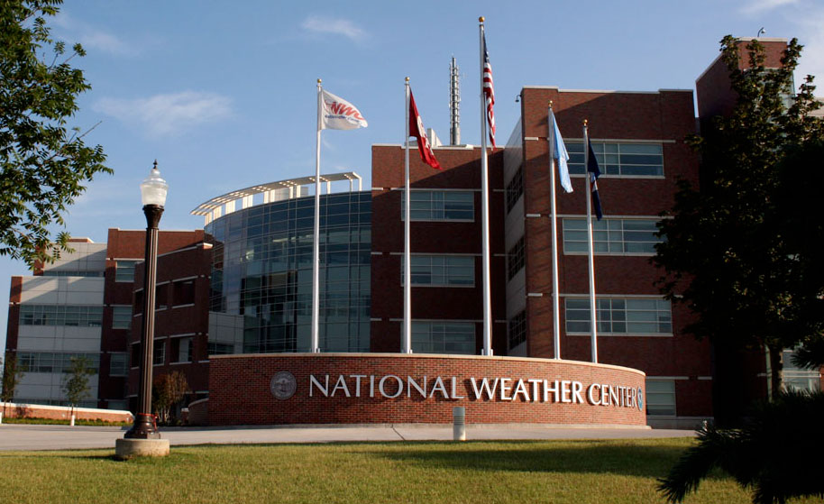
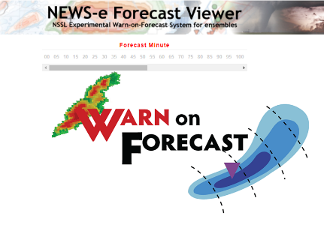
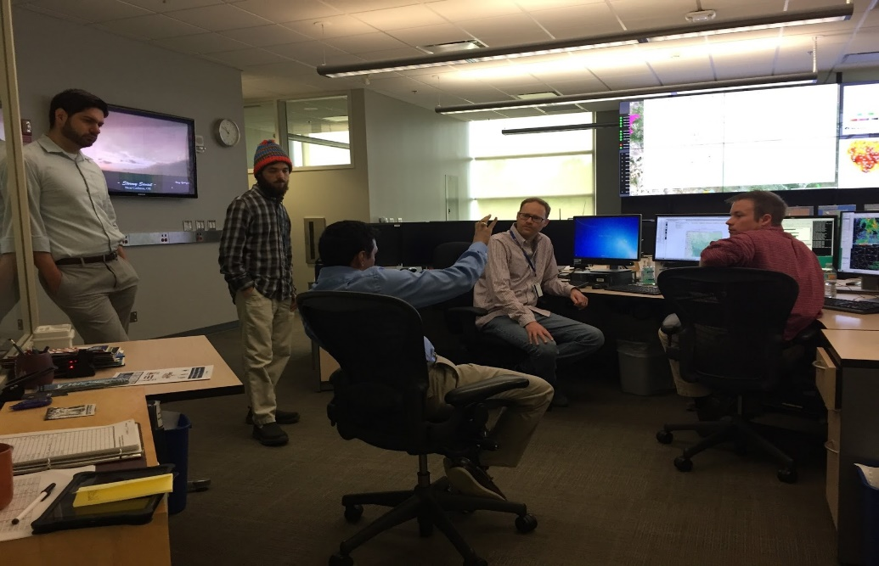
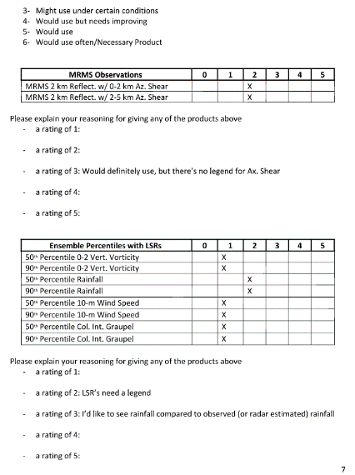
NSSL-WFO Collaboration
NWC is a unique R2O environment for collaboration
During WFO 2017 seasonal readiness, forecasters asked to review NEWS-e output for past case
Forecasters continued to regularly meet with OU CIMMS/NSSL developers to discuss NEWS-e modifications and performance
Forecasters were invested in NEWS-e, and supplement traditional mesoscale analysis
Courtesy T. Lindley and P. Skinner

Slide 26
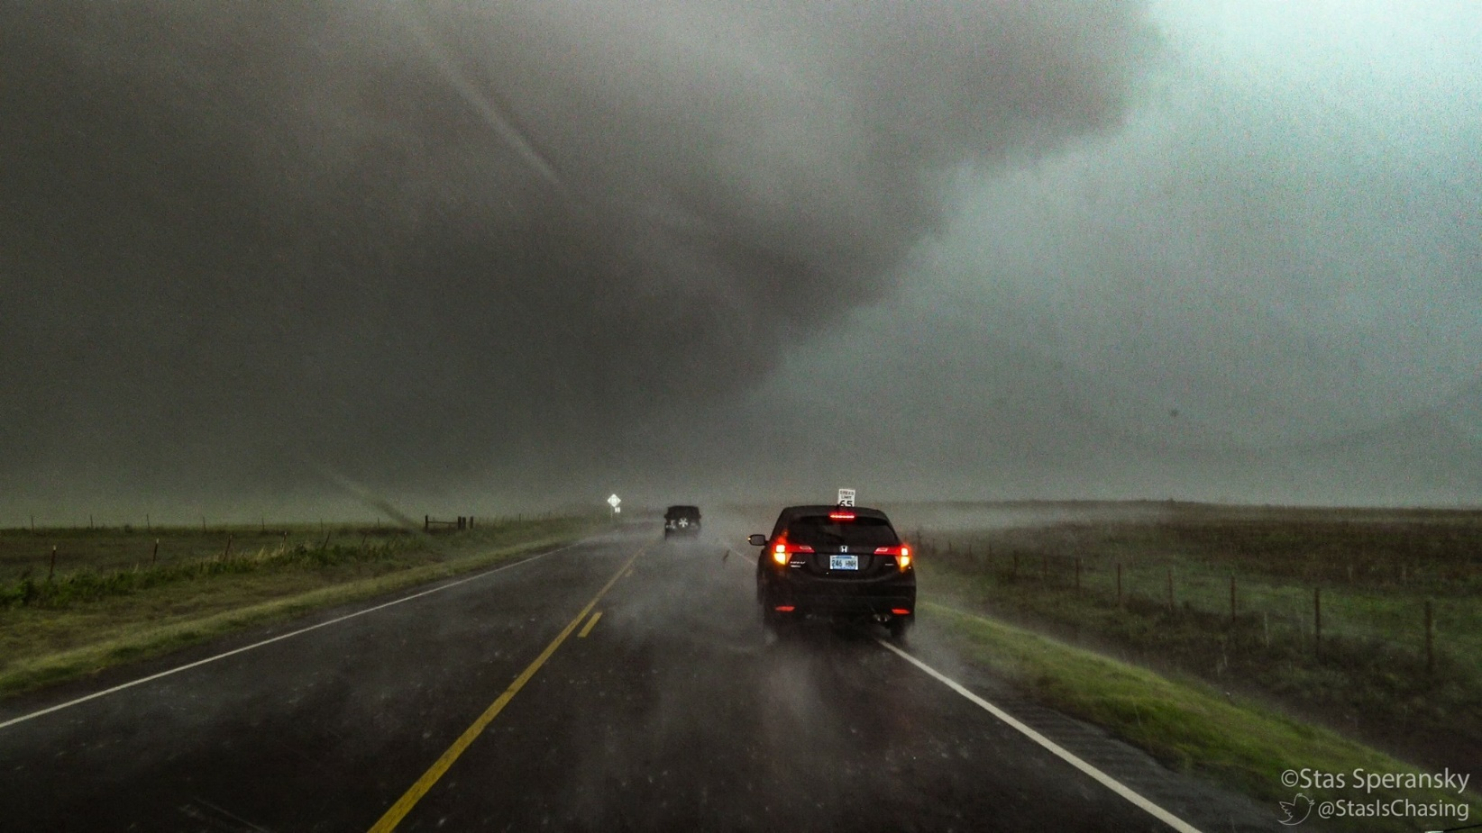
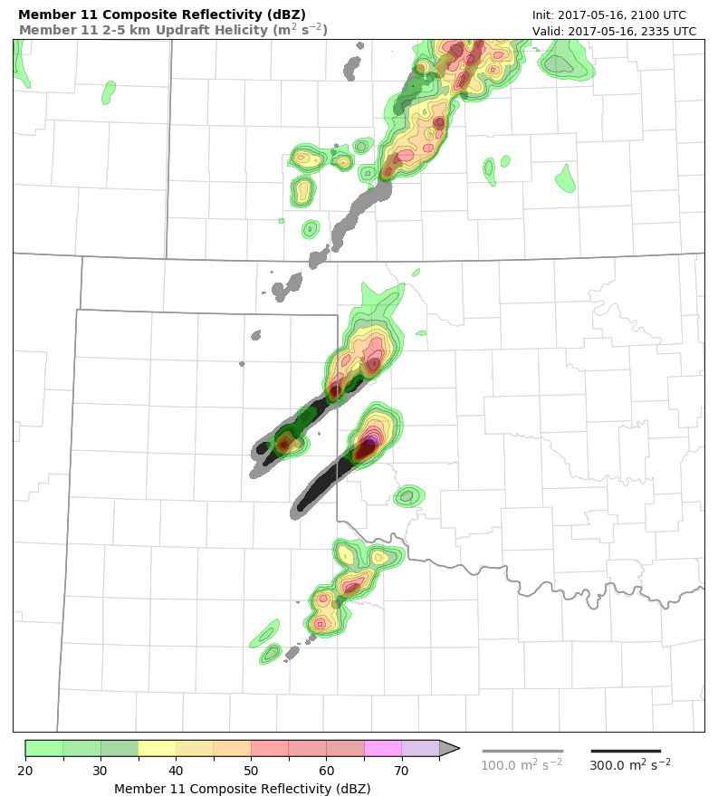
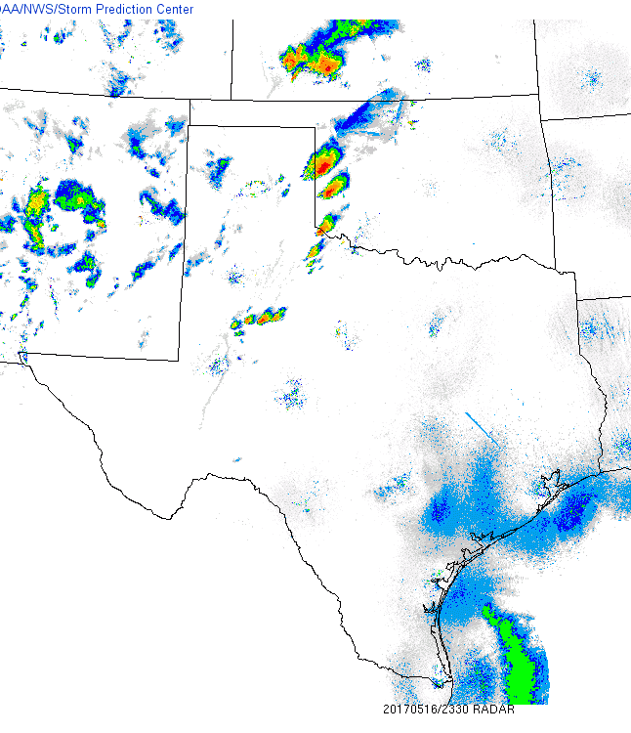



First Use of Warn-on-Forecast in Operations:
Prior to the 16 May 2017
Elk City, Oklahoma, Tornado
©Stas Speransky
Todd Lindley
Science & Operations Officer
WFO Norman, OK
Patrick Skinner
OU CIMMS
Norman, OK

Slide 27
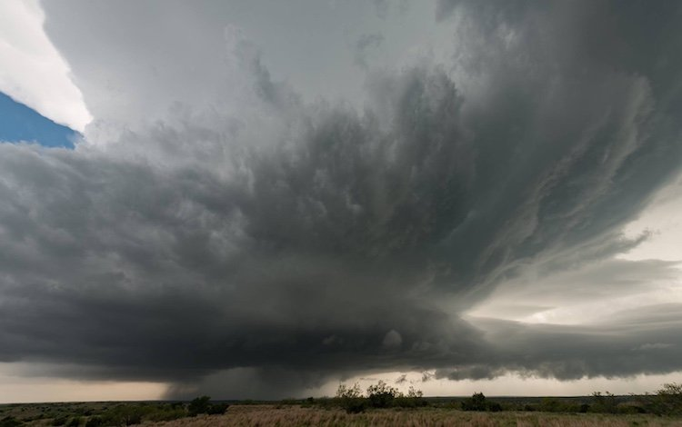
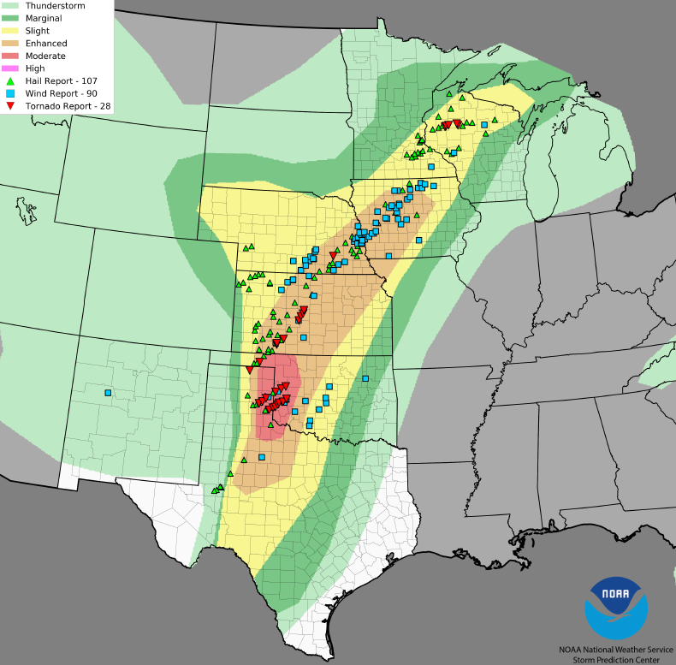
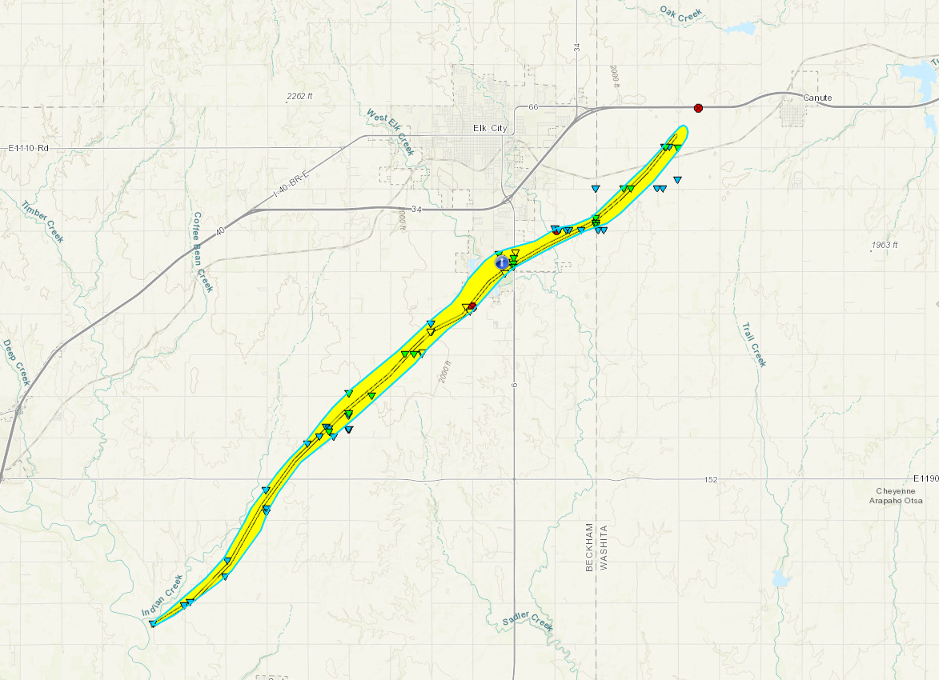
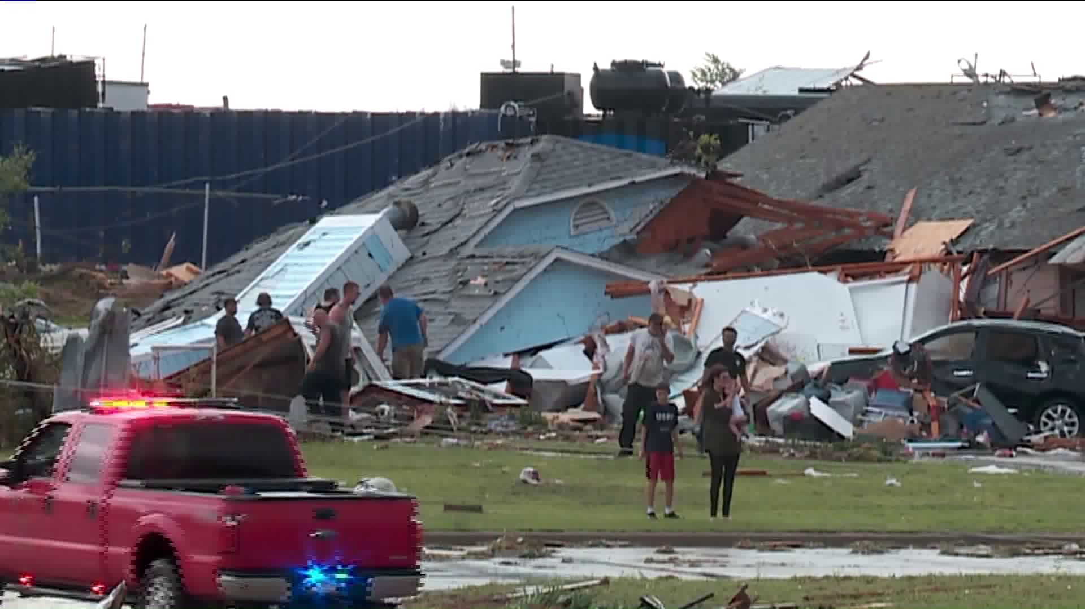
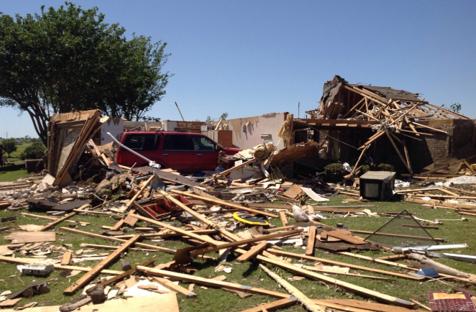

©Matt Crowther
Elk City Tornado – EF2
16 May 2017, 2346-0012 UTC
15 miles x 1000 yards
$25 Million, 1 dead, 10 injured

Slide 28
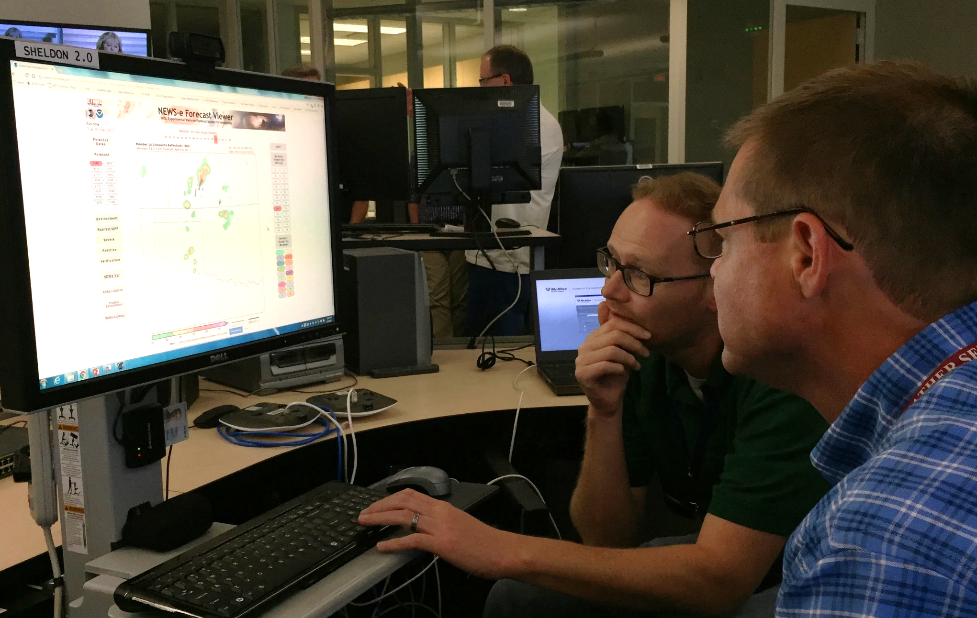
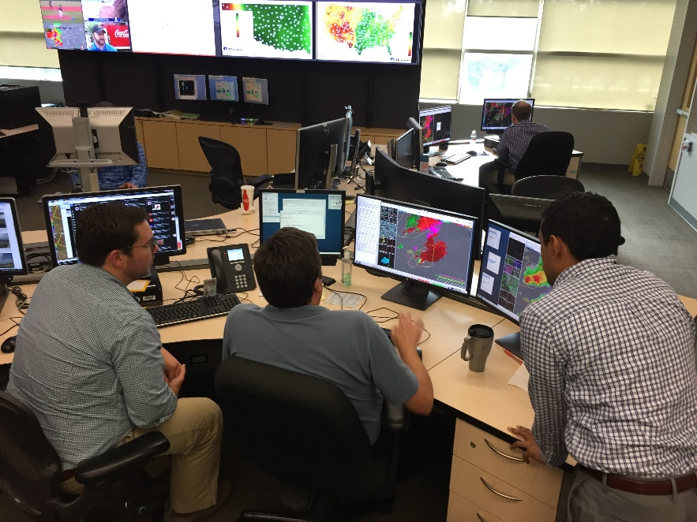
16 May 2017 OUN WFO Operations
Patrick Skinner (CIMMS) briefs WFO Norman on real-time NEWS-e output in operations
Warning forecasters coordinate on how to communicate increased confidence in tornadic storms impacting western Oklahoma… between the watch and warning timescales

Slide 29
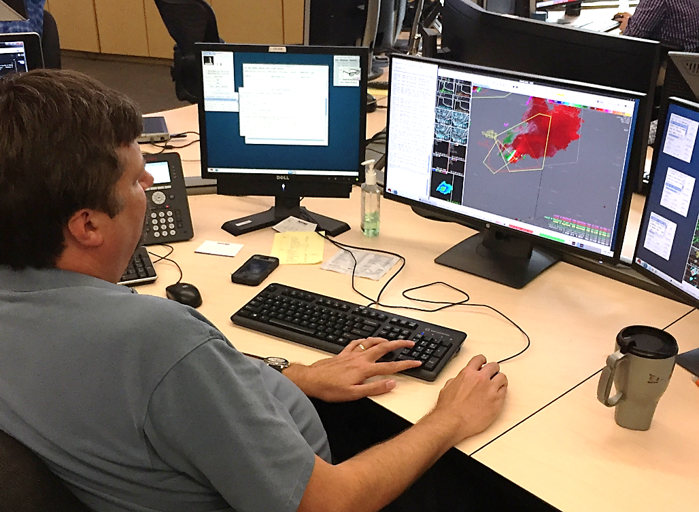
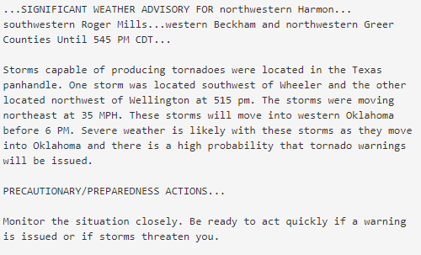
16 May 2017 Operations
Significant Weather Advisory was issued with modified wording to indicate “a high probability” of tornado warnings
Issuance of the advisory was not atypical.
Confidence applied to “forecasting a warning” was unusual.

Slide 30
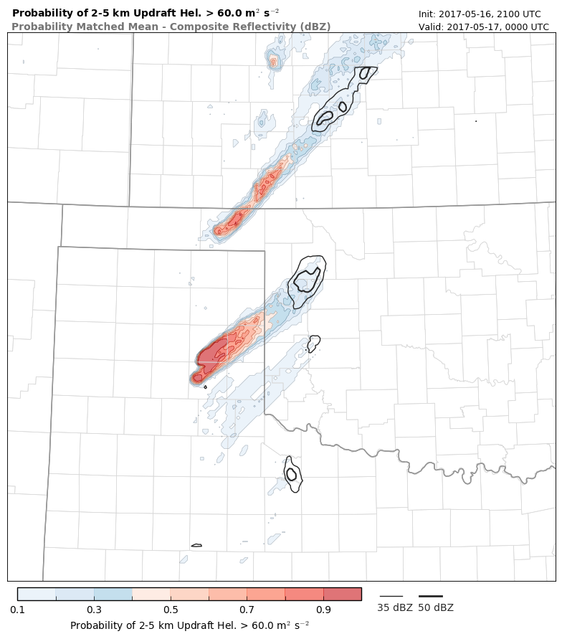
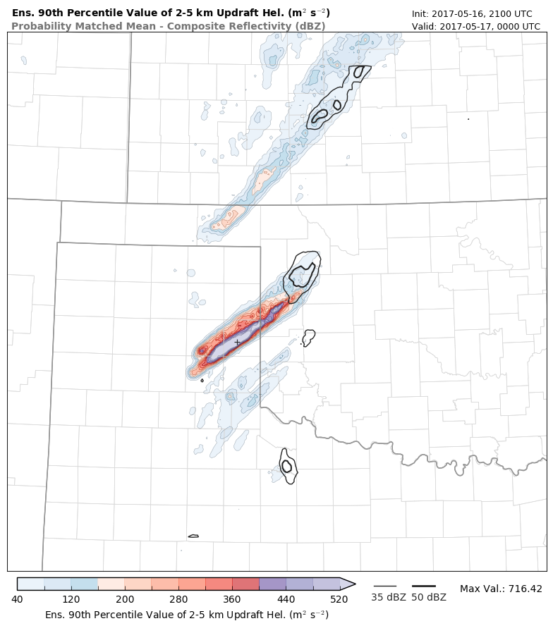
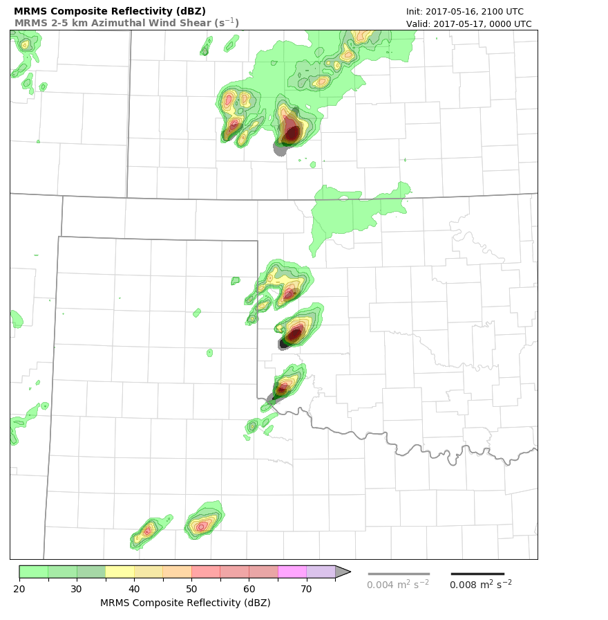
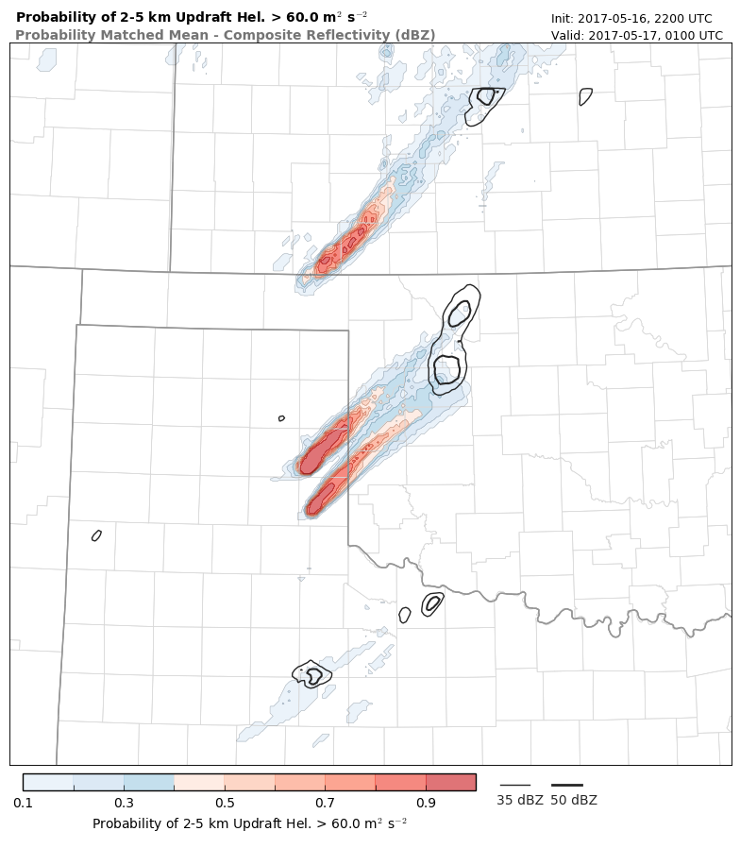
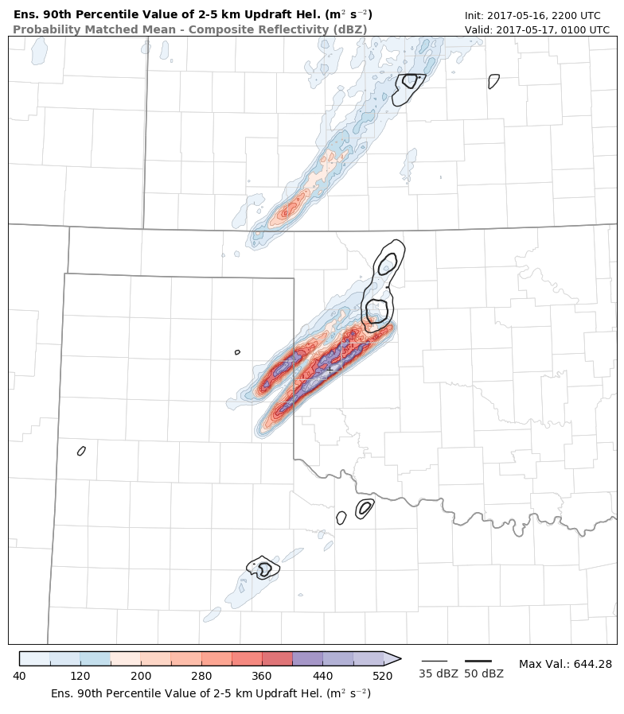

16 May 2017 NEWS-e Evolution
21 UTC
30-min after CI of eventual Elk City supercell
Storm not well initialized in ensemble
Indicates primary threat from northern supercell
22 UTC
4 Additional cycles of radar data assimilation
Elk City supercell well initialized
Accurate forecast of track and severity out to 3 hours

Slide 31


16 May 2017 NEWS-e Evolution
Example NEWS-e Forecast:
Probability of 2-5 km UH > 60 m² s⁻²
Measure of mesocyclone likelihood
Ensemble 90th percentile value of UH
‘Reasonable’ maximum mesocyclone intensity

Slide 32
















16 May 2017 Timeline
2313z
2346-0012z
1819z
2113z
2245z
1850z
2345z
0008z
“high probability of tornado warnings”
19z radar
21z radar
22z radar
23z radar
19z NEWS-e v23z
21z NEWS-e v23z
22z NEWS-e v23z
“We had a picture of the storms and their evolution before they became life-threatening. We used this model guidance to forecast with greater lead time and greater confidence”
-Todd Lindley NWS Norman
“Based on the information from the NWS, we were able to activate outdoor warning sirens about 30 minutes ahead of the tornado”
– Lonnie Risenhoover, Elk City EM

Slide 33


Summary
First use of NEWS-e to influence an operational advisory
Persistent signal for intense supercells impacting west-central Oklahoma (within 100 km corridor) evident 3 hours prior
Forecaster-researcher involvement in Seasonal Readiness vital to early success
Initial operational success is a stepping stone for future development

Slide 34


Pseudo-operational Testing, 2017 Spring Forecast Experiment
17 May 2017 Straight-line wind forecast
90th Percentile Value
Max 10 m Gust (m s⁻¹)
Good:
    Captures upscale growth
    of cellular convection in southeast NE
    Predicts developing straight line wind threat well before occurrence
Bad:
    Misses evolution of supercells southeast of developing MCS

Slide 35


Expert forecaster used NEWS-e and observations to issue 1-hour Severe Weather Outlooks
17 May 2017 Straight-line wind forecast
2100-2200 UTC Outlook
issued from 1900 WoF Forecast
2100-2200 UTC Outlook
issued from 2000 WoF Forecast
Practically perfect
hindcast

Slide 36

Survey: Interpretations of NEWS-e Products
Goal: To gain understanding of meteorologists’ interpretations of probability concepts used in WoF products, including ensemble probabilities and percentiles. Survey taken by 62 meteorologists during the FY17 Spring Forecast Experiment.
What would your expectations be based on this forecast guidance?
Prob. 2-5km UH > 60 m² s⁻²
Ensemble 90th Percentile value of
2-5km UH

Slide 37
Survey: Interpretations of NEWS-e Products
Goal: To gain understanding of meteorologists’ interpretations of probability concepts used in WoF products, including ensemble probabilities and percentiles. Survey taken by 62 meteorologists during the FY17 Spring Forecast Experiment.
What would your expectations be based on this forecast guidance?
Prob. 2-5km UH > 60 m² s⁻²
Ensemble 90th Percentile value of
2-5km UH

Slide 38

Demographic Information (60 of 62 Respondents)
Gender/ Age/ Education
Female, n=8
Male, n=52
18-29, n=20
30-49, n=34
50-64, n=6
College graduate, n=7
Post graduate, n=53

Slide 39

Examining understanding of percentile concepts
In an ensemble-based probabilistic forecast, what do you think the 70th percentile value of accumulated rainfall represents?

Slide 40
In an ensemble-based probabilistic forecast, what do you think the 70th percentile value of accumulated rainfall represents?
N=60 respondents
Of these participants, 55% (n=33) demonstrated a clear understanding
70% of members have a value less than this/ 70th percentile (n=29) | 30% (or, at least a minority) of members have a value more than this (n=10) | High-end possibility/showing something akin to the max (n=8) | Probability distribution function concept (n=12)
“It means that 70% of ensemble members have this much precipitation or less over the accumulated time period.”
“70% of the ensemble members have less than the amount shown / 30% of the members have more.”
“… Getting towards a “maximum reasonable” precipitation estimate from the raw ensemble distribution.”
“If there are 10 ensemble members, the QPF from the 7th-highest member at any given point.”
Notes:
Note- often time, respondents’ answers would fit multiple code categories.
First code→ majority of the 33 “correct” respondents included this code
Second code→ of these 10 respondents, 8 also chose the first code, and therefore references both 70 and 30 in the answers.
Third code→ Of these 8 participants, 4 had also picked the first category. 2 of the participants’ answers only fit this single code.
Fourth code→ 11 of the 12 participants picked at least one of the other three codes in addition to discussing the PDF concept. (Backgrounds varied with this response- students, forecasters, professor, research scientists)
Note– respondents’ answers heavily favored the first code. It is possible that the phrasing of the question influenced forecasters’ greater fixation on 70 vs. 30.

Slide 41
In an ensemble-based probabilistic forecast, what do you think the 70th percentile value of accumulated rainfall represents?
N=60 respondents
Of these participants, 45% (n=27) demonstrated misunderstanding or ambiguity
“The accumulated rainfall amount that 70% of the members are producing.”
“Accumulated rainfall that at least 70% of the members agree on.”
“The regions shaded represent the union of at least 70% of ensemble members.”
Quick demographic analysis (26 of 27 of the respondents)
  N=16, Research scientist/professor (experience ranging 0.8–37 years)
  N=4, Forecaster (experience ranging 4–15 years)
  N=6, Graduate student (experience ranging 1–4.5 years)
This lack of understanding spread across academic, research, and operational participants with varied experience
Notes:
Quick analysis of demographics for respondents that did not demonstrate a clear understanding… very mixed! 26 responded that they were:
N=17, Research scientist/professor (exp. ranging 0.8–37 years)
N=3, Weather forecaster (exp. ranging 4–15 years)
N=6, Graduate Student (exp. ranging 1–4.5 years)

Slide 42
NEWS-e Verification

Slide 43





NEWS-e Composite Reflectivity Verification
Improved reflectivity forecasts largely attributable to switch to NSSL 2-moment
microphysical parameterization in 2017
Improvement in 2017 forecast is apparent
from ~20 to 120 minutes of forecast time
Improvement in 2017 forecasts largely
result of improved FAR

Slide 44




NEWS-e Rotation Track (2-5 km UH) Verification
May be partially attributable to differences
between cases from 2016 to 2017; tests
using re-runs of 2017 cases with
Thompson microphysics in progress
Similar, but less pronounced
Improvement from 2016 to 2017

Slide 45

Warn-on-Forecast System Transition Concepts

Slide 46
Background / Design assumptions
Using SIP FY18-20 and CAM FY18-22 planning documents from EMC
Starting with SIP and CAM plans: How we see our system evolving and dovetailing into EMC current plans (which will change of course!)
Presenting an evolutionary scenario for WoF implementation ~ 2022-28
Fundamental assumptions about a Warn on Forecast system:
  Existence of an operational CAM 3-km ensemble (~40 members) for OCONUS
    Hourly DA / 3-hourly forecasts for 18 h for a subset of the membership (~10 members)
  WoF is an on demand system guidance by the NCEP centers (SPC, WPC)
  WoF only runs in a limited domain – weather adaptive
  The system must provide probabilistic information
  During svr wx, WFO’s now provide 1-3 hour impact forecasts on regular basis
  The application space is broader than originally proposed: “Next-Watch/Warning”

Slide 47

WoF Starter (V1)
FY22
SPC OUTLOOK
WoF
grid
ICs from hourly DA operational 3-km CAM ensemble/ BC’s from subset of 3-hr FCSTs
Run NEWS-e 1-way nested ensemble!
Placeable WoF domain within OCONUS
Same grid resolution as parent OCONUS
  Rapidly update DA (10-15 min cycling)
  O(40) members analysis cycle
  O(20) member forecasts every 30 min
Time-scale is for ”watch-to-warning” guidance
Only requires <2K cores!
THIS is what runs today at NSSL!
WoF
grid
CAM ENSEMBLE

Slide 48
WoF Advanced (V2)
FY25
SPC OUTLOOK
WoF
grid
ICs from hourly DA operational 3 km CAM ensemble/ BC’s from subset of 3 hr FCSTs
NEWS-e one-way nested ensemble!
  Placeable WoF domain within OCONUS
  Add dual-resolution hybrid/ens DA system
  O(10) members run at high resolution
  Rapidly updating DA (15 min cycling)
  O(40) members analysis cycle
  O(20) member mixed-res fcsts every 30 min
Time-scale is for ”watch-to-warning” guidance
Only requires ~10K cores!
WoF
grid
CAM ENSEMBLE

Slide 49
WoF “mad-MAX”
(V3) FY28
SPC OUTLOOK
WoF
“MAX”
grid
Use 3-hourly operational CAM ensemble as background/BC’s
~1 km grid, > 60 levels
Placeable WoF domain within OCONUS
40 member ensemble / 20 member forecast
Rapid DA cycling (~10 min cycling)
Include specific WoF obs (dual-pol, lightning)
Forecasts @ 20 min interval with T+20 min latency for forecast and post-processing
Configured for specific applications?
  Severe versus winter weather
  QPF
  Hurricane landfall
~50K cores or 2015 CPU eqv needed
WoF
“MAX”
grid
CAM ENSEMBLE

Slide 50
WoF Challenges
Making WoF applicable for severe weather that can occur over OCONUS
  Cool season and climatologically infrequent areas
  QPF for flash flood events
  Winter weather applications, e.g., Lake Effect snow squalls
Hurricane tornadoes at landfall
Ultimately, demonstrate the cost benefit $$$
Work with economists, social scientists, etc.

