Slide 1
Optimising wave hindcasts with the Cylc workflow engine
Richard Gorman, Jose-Henrique Alves, Hilary Oliver
NCEP, 30 November 2017

Slide 2
Model Optimisation
What is model optimisation?
How can this be automated?
Task scheduling in complex workflows - Cylc
A Cylc optimisation suite: Cyclops V1.0
Application to wave hindcasts
Potential applications and future developments

Slide 3
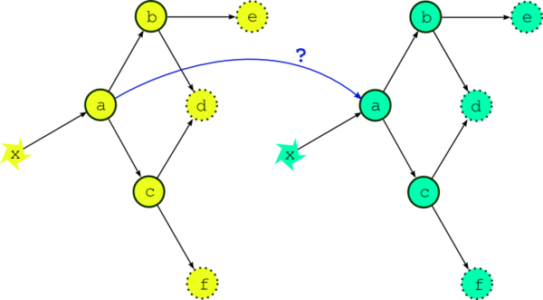
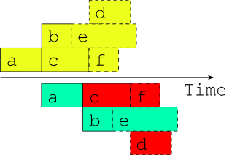
The Cylc workflow engine
Developed by Hilary Oliver (NIWA) and collaborators (NIWA, UKMO,…)
Handles the scheduling of inter-dependent computing tasks repeated over multiple cycles (e.g. in an operational forecast system)
Configures task scheduling via dependency graphs
Allows for tasks from multiple cycles to run simultaneously while respecting inter-cycle dependencies
Used at:
NIWA (NZ)
UK Met Office
NRL Marine Meteorology Division (USA)
Max Planck Institute for Meteorology (Germany)
Bureau of Meteorology (Australia)
GFDL (NOAA/Princeton University, USA)
…

Slide 4
Application to a wave hindcast
Wavewatch v4.18 with either Tolman & Chalikov (1996) or Ardhuin et al (2010) source term parameterisation
Global domain at 1° × 1° spatial resolution
Input wind and sea ice concentration fields from the ERA-Interim Reanalysis (1979-2016)
Error metric: normalised RMSE of significant wave height compared with collocated altimeter data (from the IFREMER database), spatially averaged (between 61°S and 61°N)

Slide 5
Cylc dependency graph example: wave hindcast suite
Initial tasks
Monthly tasks
Prepare model control file
Process wind & ice inputs
Process satellite inputs
Get restart file from previous run
Run Wavewatch
Compute & accumulate error statistics
Process model outputs

Slide 6
Error statistics from the full hindcast – normalised RMS error in Hs

Slide 7
Model parameter tuning
A numerical model will generally have parameters that can be adjusted, and which affect the model outputs
If the model has M adjustable parameters $(x_{1},x_{2 }$, $x_{3 },…,x_{M })$, each time we run the model we can evaluate some error metric f that gives a single “score” for the model.
For example
The aim is to find a set of parameters that makes that error metric f$(x_{1},x_{2 }$, $x_{3 },…,x_{M })$ as small as possible
$$f=RMSE=\sqrt{\frac{1}{N}\sum_{i=1}^{N}{{\left(y_{i}^{model} −y_{i}^{measured}\right)}^{2}}}$$

Slide 8
The objective function
2 parameter example
How does f vary with $x_{1}$and $x_{2}$?
How can we find the optimal $x_{1}$and $x_{2}$ as efficiently as possible?
$$f$$
$$x_{2}$$
$$x_{1}$$

Slide 9
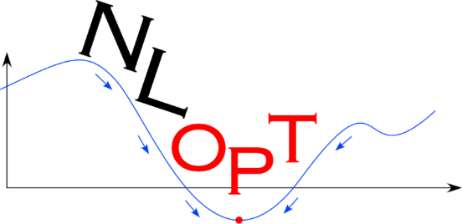
Algorithms for nonlinear optimisation
Global:
DIRECT: Dividing RECTangles (Jones et al., 1993)
DIRECT-L: Dividing RECTangles, locally optimised (Gablonsky and Kelley, 2001)
DIRECT-L-RAND: a slightly randomised variant of DIRECT-L (Johnson, 2014)
CRS: Controlled Random Search (Hendrix et al., 2001)
CRS2: Controlled Random Search (Price, 1983)
CRS2-LM: Controlled Random Search with Local Mutation (Kaelo and Ali, 2006)
MLSL: Multi-Level Single-Linkage (Rinnooy Kan and G. T. Timmer, 1987)
ISRES: Improved Stochastic Ranking Evolution Strategy (Runarsson and Yao, 2005)
ESCH: Evolutionary algorithm (da Silva Santos et al., 2010)
Local:
COBYLA: Constrained Optimization BY Linear Approximations (Powell, 1994)
BOBYQA: Bounded Optimization BY Quadratic Approximation (Powell, 2009)
NEWUOA: Unconstrained Optimization (Powell, 2004)
NEWUOA-BOUND: a bounded variant of NEWUOA (Johnson, 2014)
PRAXIS: Principal Axis (Brent, 1972)
Nelder-Mead Simplex (Nelder and Mead, 1965)
Sbplx: Nelder-Mead applied on a sequence of subspaces (Rowan, 1990)
Nlopt nonlinear optimisation toolbox (Johnson, 2014)
http://ab-initio.mit.edu/nlopt
Versions in C, python
Implements many algorithms
We want derivative-free, bounded optimisation
Requires the user to write a subroutine to evaluate the objective function

Slide 10
Schematic of an optimisation algorithm
User supplied starting value of x
objective function subroutine:
Call the user-supplied objective function to compute f(x)
Run the model system with parameter set x
Return the resulting f(x)
Do some computation on all the x and f values sampled so far
Have we met our convergence criteria?
NO
YES
Select a new sample point x
Optimal x, f(x)

Slide 11
Schematic of an optimisation algorithm – with generic objective function
User supplied starting value of x
objective function subroutine:
Call the user-supplied objective function to compute f(x)
Is x is in a lookup table of previous results?
Do some computation on all the x and f values sampled so far
YES: return
tabulated f(x)
NO: Write the parameter set x to a model input file
Have we met our convergence criteria?
Stop the optimisation algorithm
NO
YES
Select a new sample point x
Optimal x, f(x)
Model system :
Run the whole model system with parameter set x
Add x, f(x) to the lookup table
REPEAT UNTIL THE OPTIMISATION CODE COMPLETES

Slide 12
The new optimisation method
The optimisation program no longer has the computation of the real objective function built in
Instead, the optimisation programme simply takes the set of previous results, and either decides that the process has converged, or returns the next set of parameter values to try (according to a chosen algorithm)
A separate modelling system takes a set of parameters, and returns an error score
Parameters
Optimisation
Program
Model
Suite
Error score

Slide 13
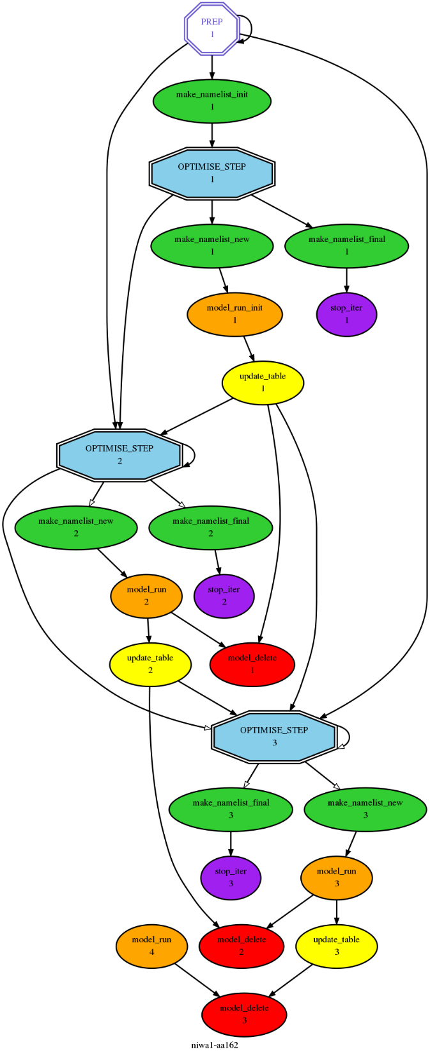
A Cylc optimisation suite
iteration 1
Instead of cycling on time, use integer cycling, on iteration number
Run the optimisation algorithm to pick the next parameter set
iteration 2
Create a model input file with the requested parameter set
Start a new copy of the model suite
Or write some final outputs and stop
Update the lookup table with the result
iteration 3

Slide 14
Evolution of the optimisation (ST4 – 1 year)
ST4 Ardhuin et al (2010) parameterisation
19 adjustable parameters:
8 from wind input term (including swell)
8 from dissipation terms
1 for DIA nonlinear interaction strength
2 sea ice concentration thresholds
Calibration run from Jan-Dec 1997
Stopping criteria: < 0.1% change in f or x
Error metric reduced from:
0.1436 (initialised with Ardhuin et al (2010) defaults (TEST441), to
0.1431 (after 89 iterations)

Slide 15
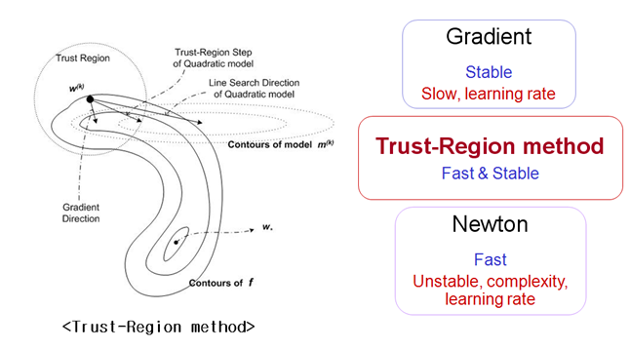
Algorithm: BOBYQA (Bounded Optimisation By Quadratic Approximation) A LOCAL trust-region method (Powell 2009)
A trust-region method finds a direction and a step size in an efficient and reliable manner with the help of a quadratic model of the objective function.

Slide 16
Parallel model simulations
In the first part of the BOBYQA algorithm, a fixed sequence of parameter values is used, varying one dimension at a time, to form a quadratic model
In that case, the next x value chosen does not depend on the values of f previously determined
Hence we could run several model simulations in parallel
This capability has been implemented in the Cylc optimisation suite.

Slide 17
Error statistics from the full hindcast – normalised RMS error in Hs

Slide 18
Error statistics from the full hindcast – bias in Hs

Slide 19
Application of Cyclops to NCEP’s Global Wave Model
Why worry?
Physics parameterizations are very sensitive to forcing fields,
We’ve taken physics parameterization by its face value:
Trusting tuning made by collaborators overseas, or
Little changes to those, usually focusing on single parameter (typically growth rate, eg BETAMAX),
Absence of objective tuning framework: global wave models not accounted for upgrades to NCEP atmospheric NWPs,
Always lingering question: is current config really the best?
At least one red flag: not up to date with changes to GFS,
New motivation: FV3 and coupled paradigm will change things so much → wave model require extensive tuning to ensure robust results.

Slide 20
Application to NCEP’s Global Wave Model
Wavewatch v6.03 (quasi-current dev version),
Ardhuin et al (2010) source terms (operational),
Global domain at 1° × 1° spatial resolution.
Input wind and sea ice concentration fields from
NCEP CFSR reanalysis,
NCEP GFS DA cycle (GDAS).
Error metric: normalised RMSE of Hs vs collocated IFREMER altimeter data (61S:61N).
Several adaptations of Cyclops required to run on NCEP R&D machines, with NCEP forcing fields.

Slide 21
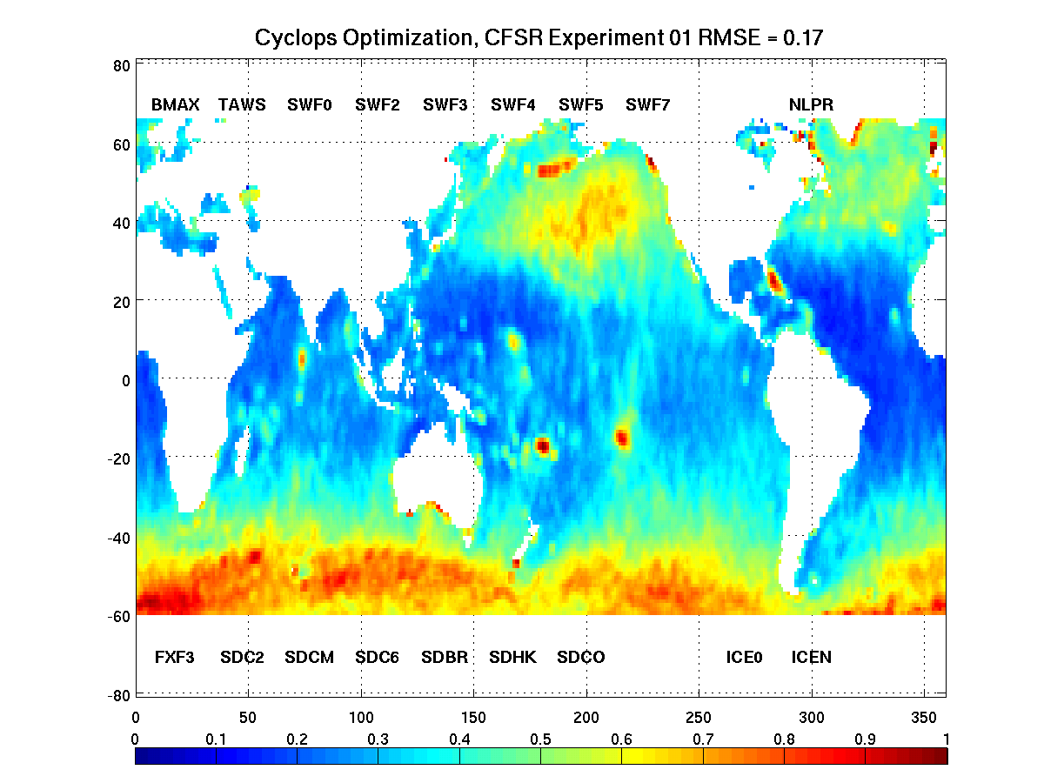
NCEP’s Global Wave Model: Optimized Physics Parms
Sin
Snl
Sds
Ice

Slide 22
NCEP, CFSR: Optimization’s Mind (full cycle)

Slide 23
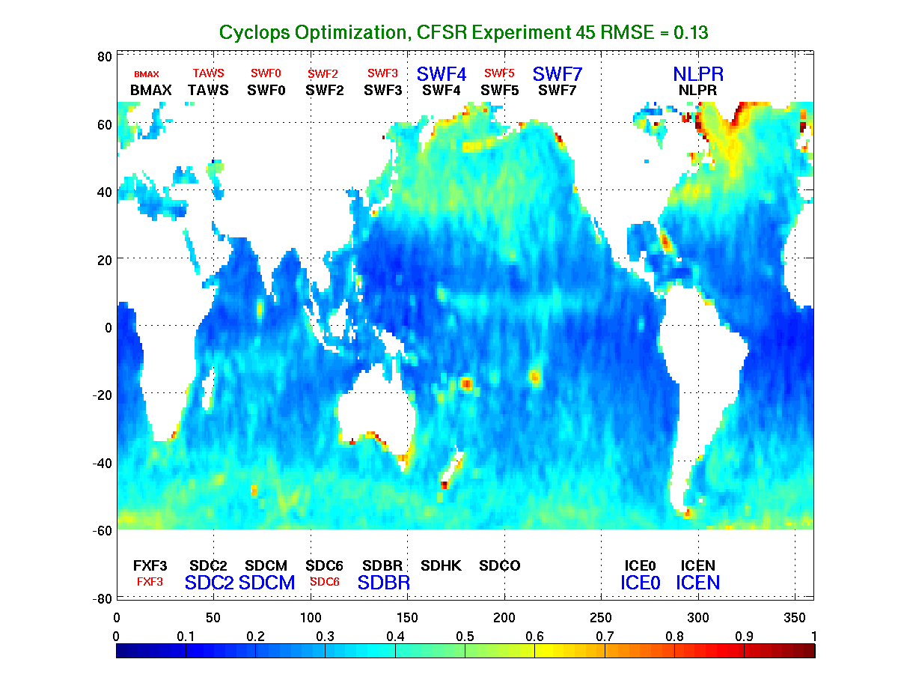
NCEP’s Global Wave Model, CFSR: Hs RMSE

Slide 24
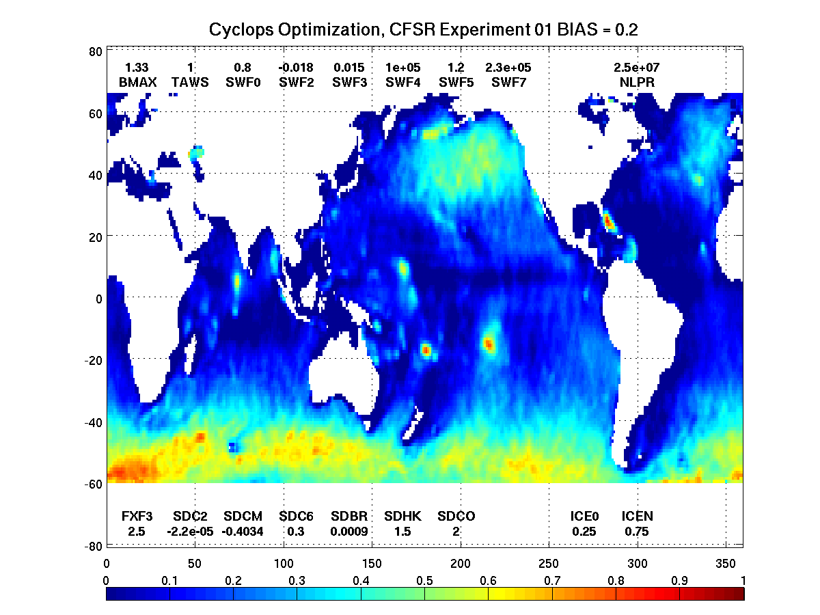
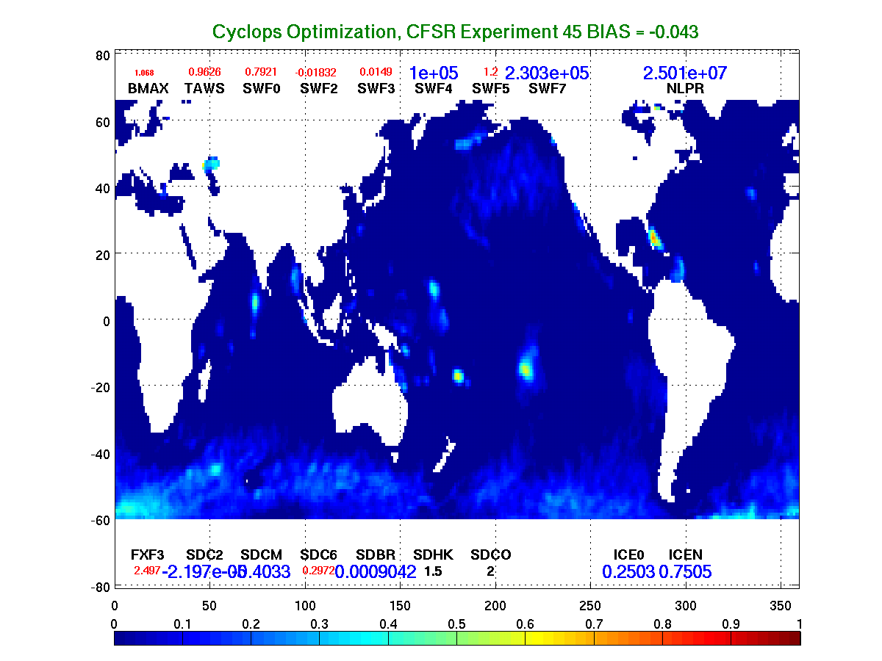
NCEP’s Global Wave Model, CFSR: Hs Bias

Slide 25
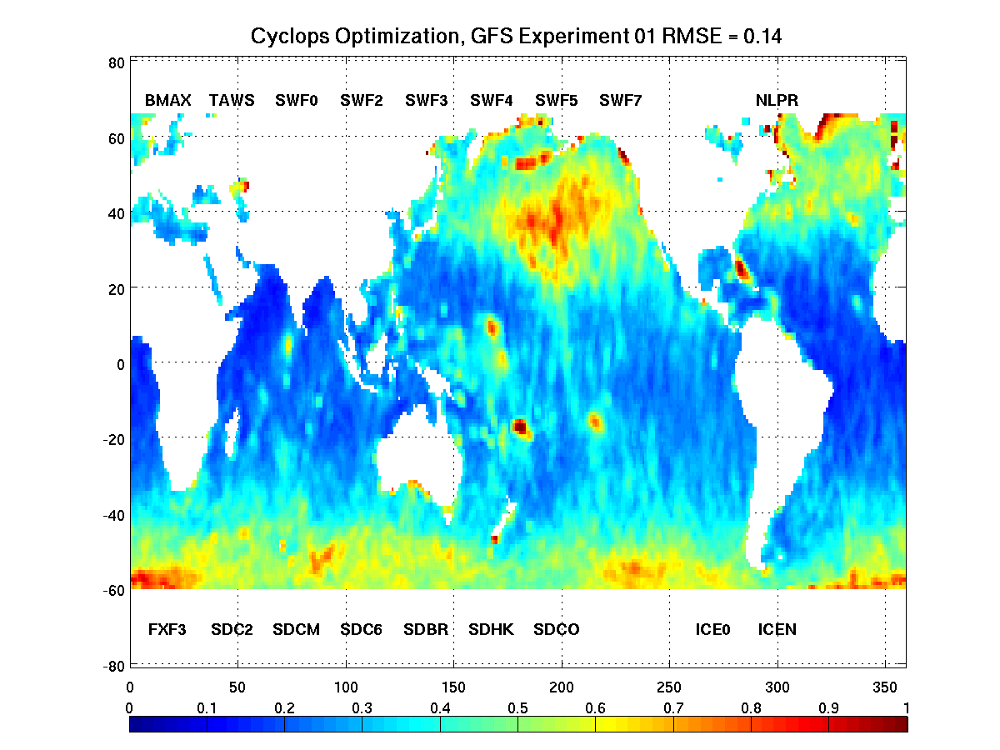
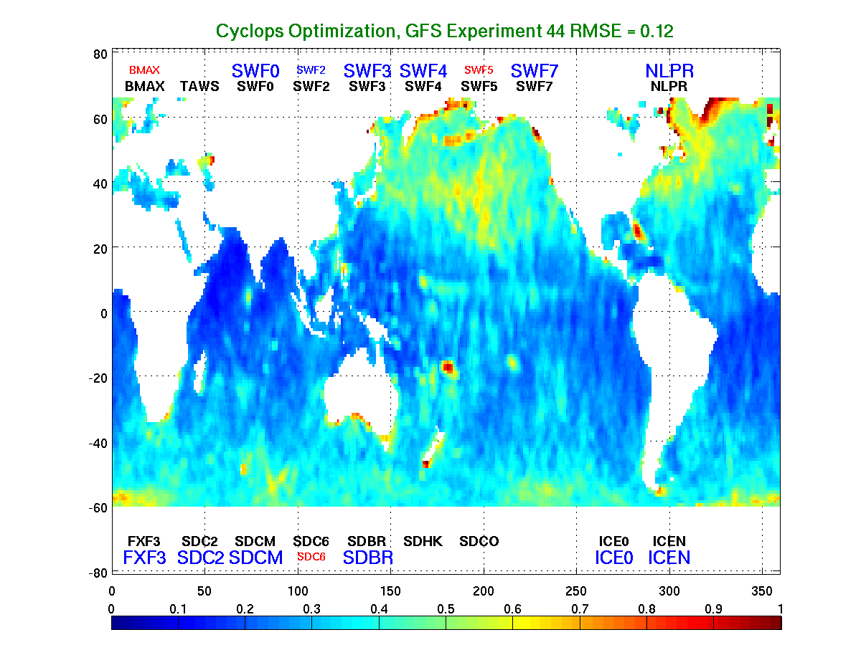
NCEP’s Global Wave Model, GFS: Hs RMSE

Slide 26
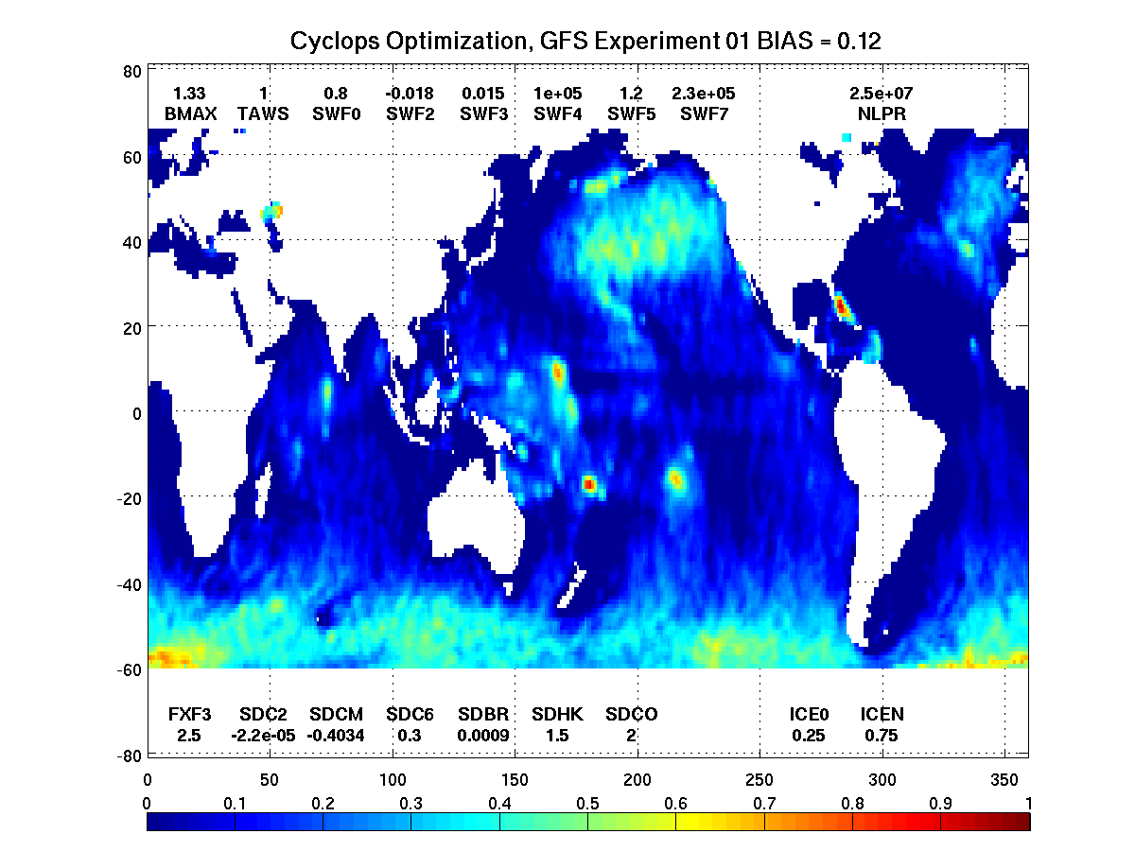
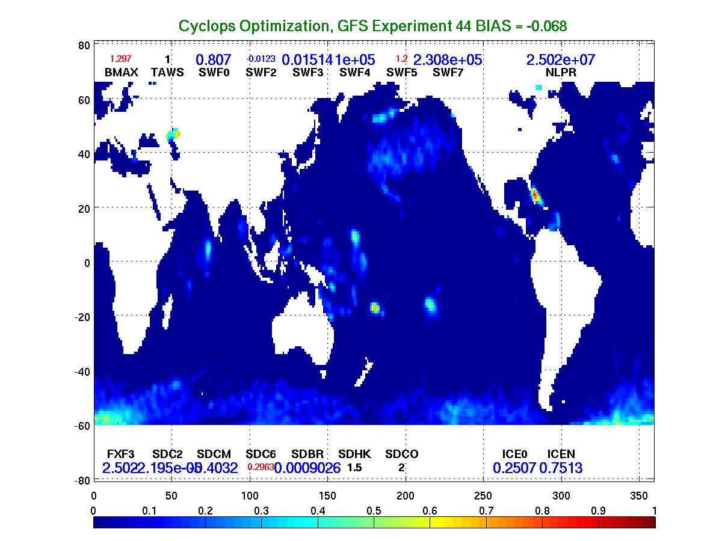
NCEP’s Global Wave Model, GFS: Hs Bias

Slide 27
NCEP Summary
NCEP wave model physics parameterizations tuning drastically improve wave-height error metrics,
Previous configurations have not been the best for wave models using NCEP’s operational forcing fields (winds),
A systematic calibration phase added to wave model upgrade workflow would be advisable, reflecting both changes in atmospheric and wave model systems,
Objective tuning approach based on Cyclops provides attractive framework that can bring immediate benefits to NCEP wave guidance products quality,
Objective tuning would certainly benefit quality of products in forthcoming NEMS coupled system.

Slide 28
Summary
NWPs can be tuned by solving a nonlinear optimisation problem,
There are many algorithms for this: some are good for “local” optimisation, some are good for a “global” solution.
Require user to supply subroutine to evaluate objective function.
We have developed an optimisation tool based on the Cylc workflow engine, that uses a simple, generic objective function subroutine
Hence it can be readily applied to optimise any model system that has been implemented as a Cylc suite, that accepts parameter values on startup, and returns an error metric on completion
This has been applied to optimise wave model hindcasts against altimeter measurements.
Published through zenodo (Cyclops-v1.0: https://doi.org/10.5281/zenodo.837907).

Slide 29
Questions?

Slide 30
Parameters for 12 month ST4 optimisation (SIN4, SNL1, MISC)
Parameter | Code variable | Initial | Lower bound | Upper bound | Final | Delta | n
 | SIN4:
$$z_{u}$$ | ZWND | 10.0
$$α_{0}$$ | ALPHA0 | 0.0095
$$β_{max}$$ | BETAMAX | 1.52 | 1.0 | 2.0 | 1.5194 | 0.02498 | 1
$$p_{in}$$ | SINTHP | 2.0
$$z_{α}$$ | ZALP | 0.006
$$s_{u}$$ | TAUWSHELTER | 1.0 | 0.0 | 1.5 | 0.9339 | 0.2706 | 2
$$s_{0}$$ | SWELLFPAR | 1
$$s_{2}$$ | SWELLF | 0.8 | 0.5 | 1.2 | 0.8224 | 0.0206 | 3
$$s_{1}$$ | SWELLF2 | -0.018 | -0.03 | -0.01 | -0.01721 | 0.00064 | 4
$$s_{3}$$ | SWELLF3 | 0.015 | 0.01 | 0.02 | 0.01526 | 0.00042 | 5
$${Re}_{c}$$ | SWELLF4 | 1.0×10⁵ | 0.8×10⁵ | 1.5×10⁵ | 0.9888×10⁵ | 0.2328×10⁵ | 6
$$s_{5}$$ | SWELLF5 | 1.2 | 0.8 | 1.6 | 0.9360 | 0.3974 | 7
$$s_{6}$$ | SWELLF6 | 0.0
$$s_{7}$$ | SWELLF7 | 2.3×10⁵ | 0.0 | 4.0×10⁵ | 2.2433×10⁵ | 0.7911×10⁵ | 8
$$z_{r}$$ | Z0RAT | 0.04
$$z_{0.max}$$ | Z0MAX | 0.0
 | SINBR | 0.0
 | SNL1:
$$C$$ | NLPROP | 2.5×10⁷ | 2.4×10⁷ | 2.8×10⁷ | 2.5181×10⁷ | 0.1191×10⁷ | 17
 | MISC:
$$ε_{c,0}$$ | CICE0 | 0.25 | 0.15 | 0.45 | 0.2413 | 0.1285 | 18
$$ε_{c,n}$$ | CICEN | 0.75 | 0.55 | 0.85 | 0.7521 | 0.2358 | 19
 | FLAGTR | 4

Slide 31
Parameters for 12 month ST4 optimisation (SDS4)
Parameter | Code variable | Initial | Lower bound | Upper bound | Final | Delta | n
 | SDS4:
 | SDSC1 | 0.0
$$p$$ | WNMEANP | 0.5
 | FXPM3 | 4.0
$$f_{FM}$$ | FXFM3 | 9.9
$$C_{ds}^{sat}$$ | SDSC2 | -2.2×10⁻⁵ | -2.5×10⁻⁵ | 0.0 | -2.1433×10⁻⁵ | 0.0087×10⁻⁵ | 9
$$C_{cu}$$ | SDSCUM | -0.40344 | -0.5 | 0.0 | -0.40194 | 0.02145 | 10
$$B_{0}$$ | SDSC4 | 1.0
$$C_{turb}$$ | SDSC5 | 0.0 | 0.0 | 1.2 | 0.0 | - | 11
$$δ_{d}$$ | SDSC6 | 0.3 | 0.0 | 1.0 | 0.2736 | 0.0928 | 12
$$B_{r}$$ | SDSBR | 9.0×10⁻⁴ | 8.0×10⁻⁴ | 10.0×10⁻⁴ | 8.9788×10⁻⁴ | 0.0951 ×10⁻⁴ | 13
 | SDSBR2 | 0.8
$$p^{sat}$$ | SDSP | 2.0
 | SDSISO | 2
$$C_{ds}^{BCK}$$ | SDSBCK | 0.0 | 0.0 | 0.2 | 0.0 | - | 14
 | SDSABK | 1.5
 | SDSPBK | 4.0
 | SDSBINT | 0.3
$$C_{ds}^{HCK}$$ | SDSHCK | 0.0 | 0.0 | 2.0 | 0.0 | - | 15
$$Δ_{θ}$$ | SDSDTH | 80.0
$$s_{B}$$ | SDSCOS | 2.0 | 0.0 | 2.0 | 2.0 | 0.0757 | 16
 | SDSBRF1 | 0.5
 | SDSBRFDF | 0
 | SDSBM0 | 1.0
 | SDSBM1 | 0.0
 | SDSBM2 | 0.0
 | SDSBM3 | 0.0
 | SDSBM4 | 0.0
 | WHITECAPWIDTH | 0.3

Slide 32
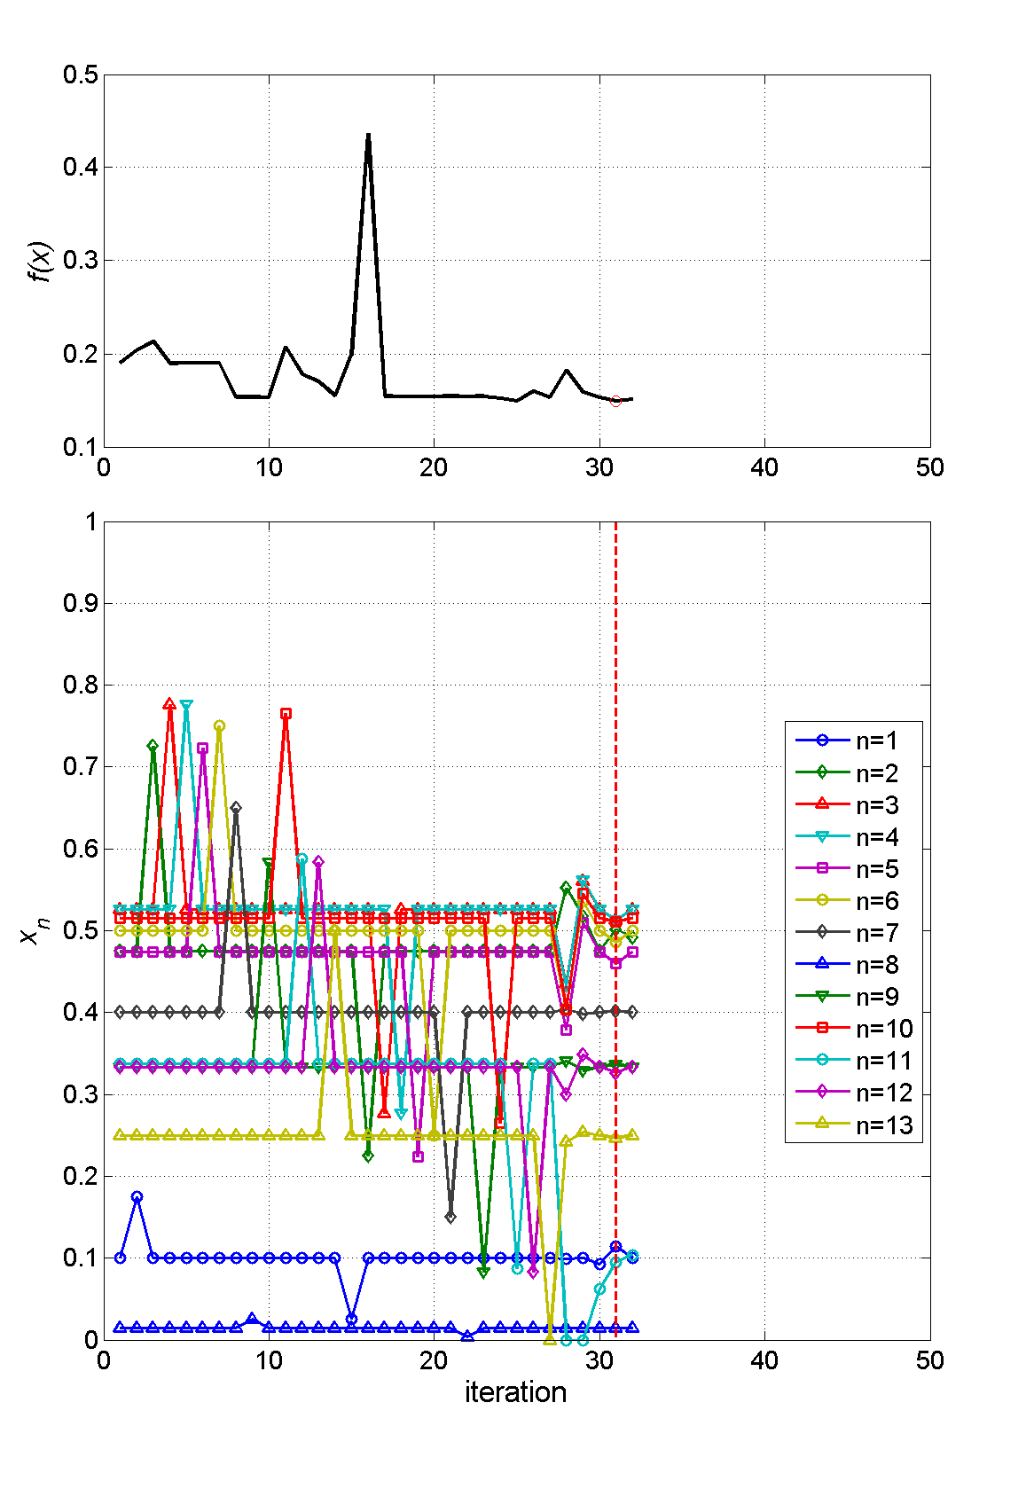
Evolution of the optimisation (ST2, 3 months)
ST2 Tolman & Chalikov (1996) parameterisation
13 adjustable parameters:
6 from the wind input term
6 from the dissipation terms
1 for DIA nonlinear interaction strength
Calibration run from Feb-Apr 1997
Stopping criteria: < 2% change in f or x
Error metric reduced from:
0.1901 (initialised with Tolman & Chalikov defaults), to
0.1495 (after 33 iterations)

Slide 33
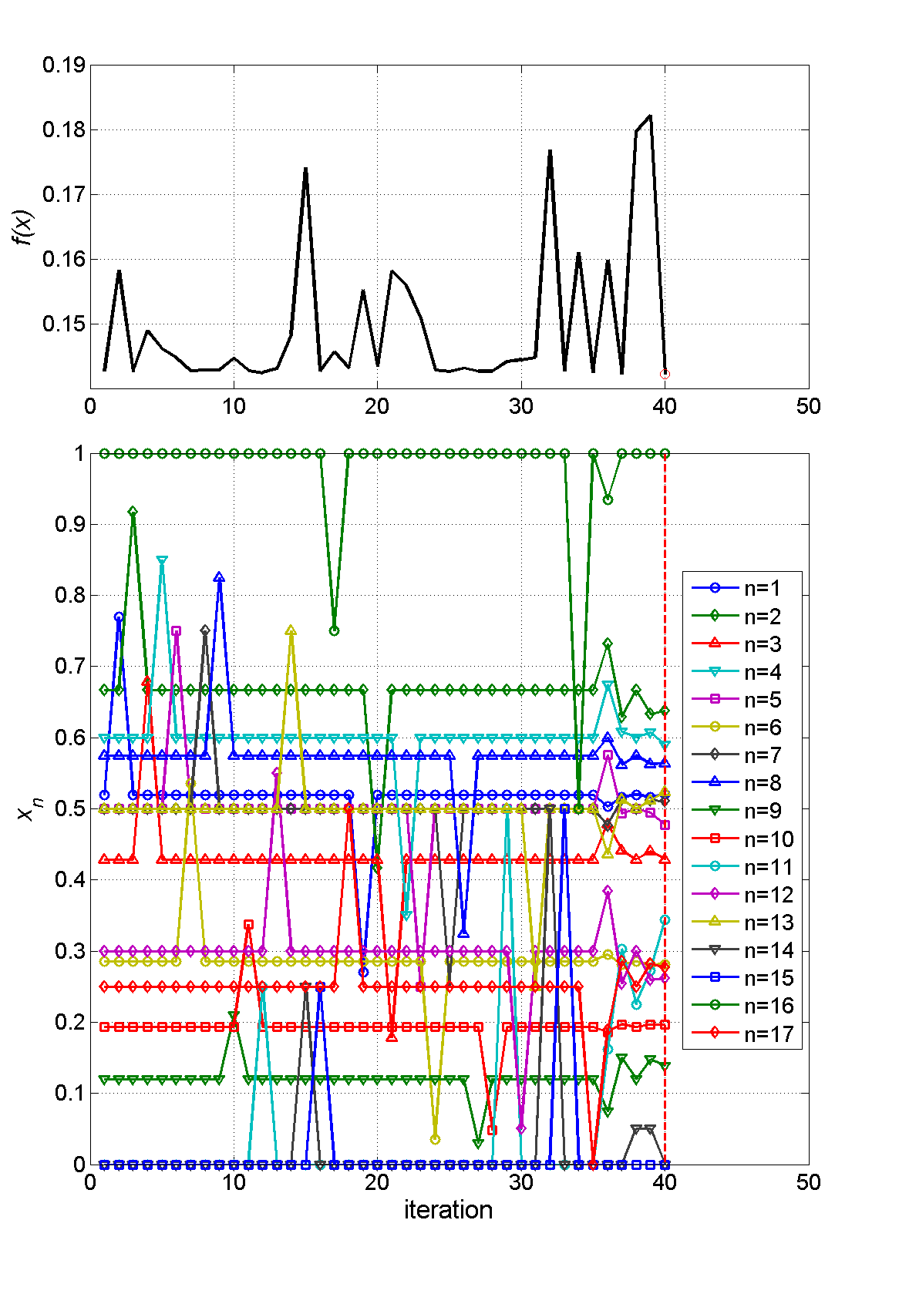
Evolution of the optimisation (ST4, 3 months)
ST4 Ardhuin et al (2010) parameterisation
17 adjustable parameters:
8 from the wind input term (including swell)
8 from dissipation terms
1 for DIA nonlinear interaction strength
Calibration run from Feb-Apr 1997
Stopping criteria: < 2% change in f or x
Error metric reduced from:
0.1427 (initialised with Ardhuin et al (2010) defaults (TEST441), to
0.1422 (after 40 iterations)

