Slide 1

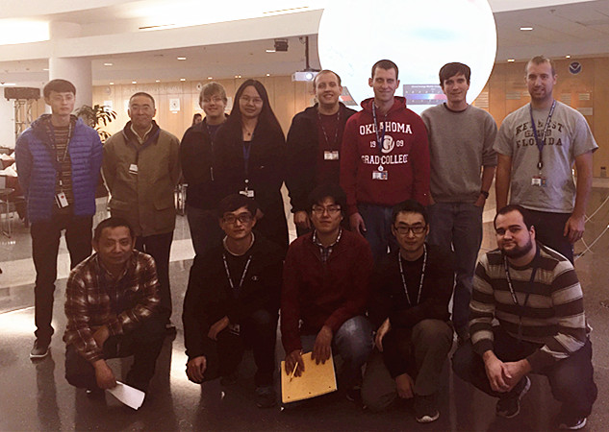
GSI-based Hybrid Ensemble-Variational Data Assimilation for Global, Hurricane and Storm Scale Numerical Weather Prediction
Xuguang Wang
Mutliscale data Assimilation and Predictability (MAP) Lab
School of Meteorology
University of Oklahoma, Norman, OK, USA
xuguang.wang@ou.edu
http://weather.ou.edu/~map
D
In collaboration with
EMC: Jacob Carley, Geoff Demingo, Mingjing Tong, Vijay Tallapragada, Rahul Mahajan, John Derber, Yuejian Zhu
ESRL/PSD: Lili Lei, Jeff Whitaker
NSSL: Lou Wicker
ESRL/GSD: David Dowell, Stan Benjamin
UMD: Daryl Kleist
EMC Seminar, College Park, China
Aug. 8, 2016

Slide 2

GSI-based Var/EnKF/EnVar/Hybrid for global and convection resolving regional modeling systems
GSI-based Var/EnKF/3/4DEnVar/ Hybrid
GFS
WRF-ARW
WRF NMMB
Hurricane-WRF (HWRF)
Efforts have been made to further develop the GSI based Var/EnKF/EnVar for convective resolving NWP.
Highly relevant to NGGPS planning as NGGPS will be a convection resolving global prediction system.
Efforts are also being made to further improve GSI 4DEnVar for GFS.

Slide 3
R&D of GSI-based Var/EnKF/EnVar/Hybrid for convective scale NWP over CONUS
GSI-based Var/EnKF/3/4DEnVar/ Hybrid
GFS
WRF ARW
WRF NMMB
Hurricane-WRF (HWRF)

Slide 4
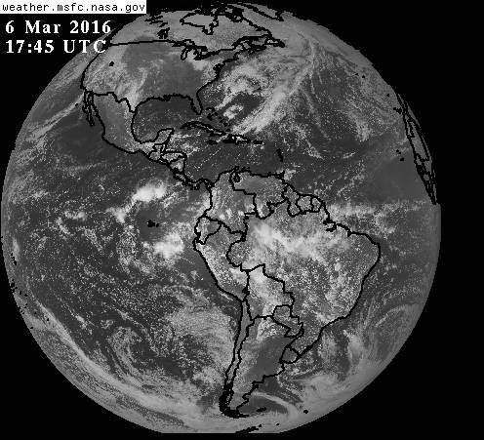
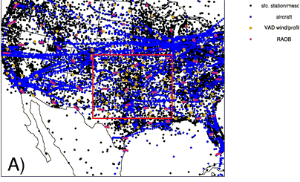
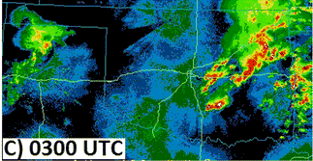
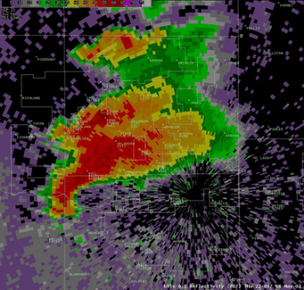
Why further development is needed for convective scales?

Slide 5
Why further development is needed for convective scales?
Convective scale analysis and forecasting is a multi-scale problem, requiring an accurate estimate of both the synoptic/mesoscale environment and the convective scale details.
Convective scale observations (i.e., radar, cloudy radiances) require unique observation operators that are often complex and nonlinear.
Inclusion of additional state variables (e.g., hydrometeors, W) are required.
Accurate cross-variable covariance is especially important.
Comparison study among Var, EnKF, 3DEnVar, 4DEnVar and Hybrid for convective scales is still limited.

Slide 6
Development so far for convective scales
GSI-based Var, EnKF, 3DEnVar, 4DEnVar and Hybrid are extended to work with convection-resolving models such as WRF ARW (Johnson et al. 2015; Wang and Wang 2016) and NMMB.
Vertical velocity and hydrometeor state variables are added.
For assimilating radar data, radar radial velocity and reflectivity observation operators are implemented.
  Capability to use storm scale perturbations to treat model errors is added.
  GSI-based EnVar without tangent linear (TL) and adjoint of the nonlinear observation operator is derived and implemented for direct assimilation of reflectivity observations (Wang and Wang. 2016).

Slide 7
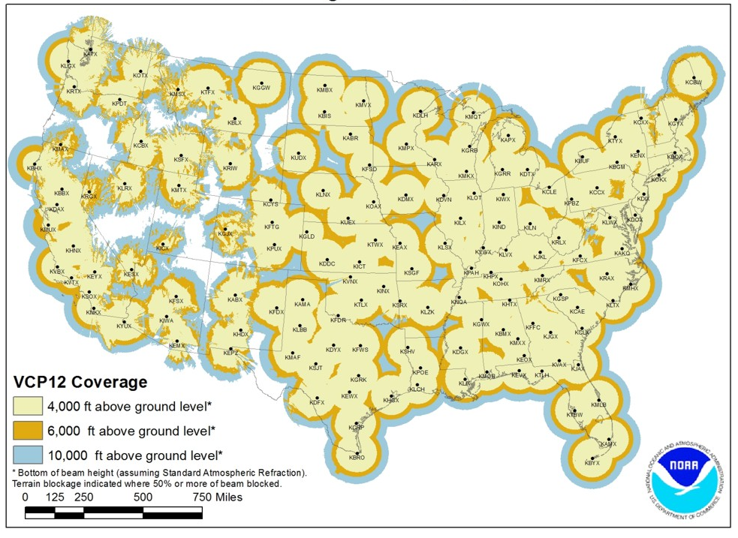
Issue with TL of nonlinear reflectivity operator in EnVar
Wang and Wang 2016
GSI-based EnVar cost function (Wang 2010)
Nonlinear radar reflectivity operator
H(q_{r}, q_{s}, q_{g}) = Z_{dB} = 10logZ_{e}
Z_{e} = Z_{r} + Z_{s} + Z_{g}

Slide 8
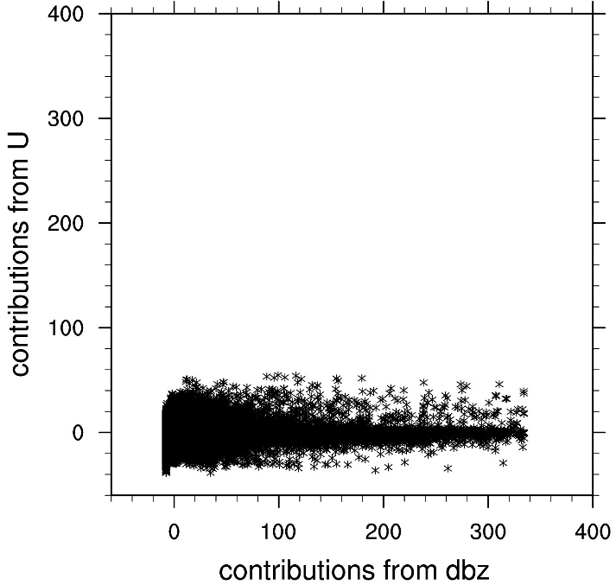
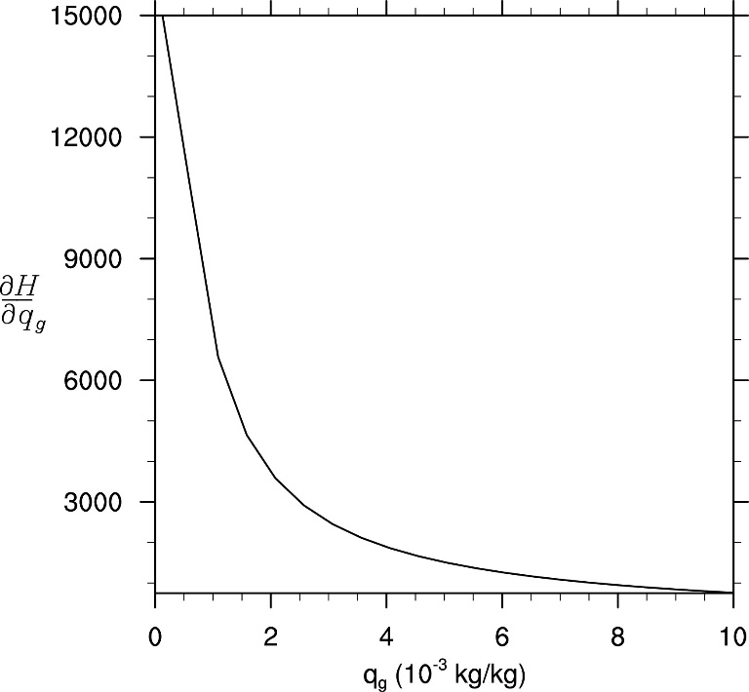
Issue with TL of nonlinear reflectivity operator in EnVar
Wang and Wang 2016
Use hydrometeor mixing ratio as state variable

Slide 9
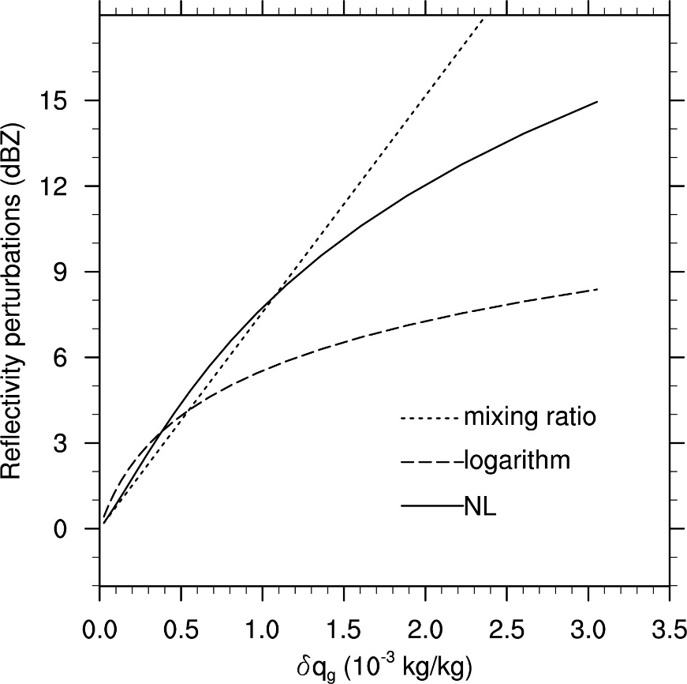
Issue with TL of nonlinear reflectivity operator in EnVar
Wang and Wang 2016
Use hydrometeor mixing ratio as state variable

Slide 10
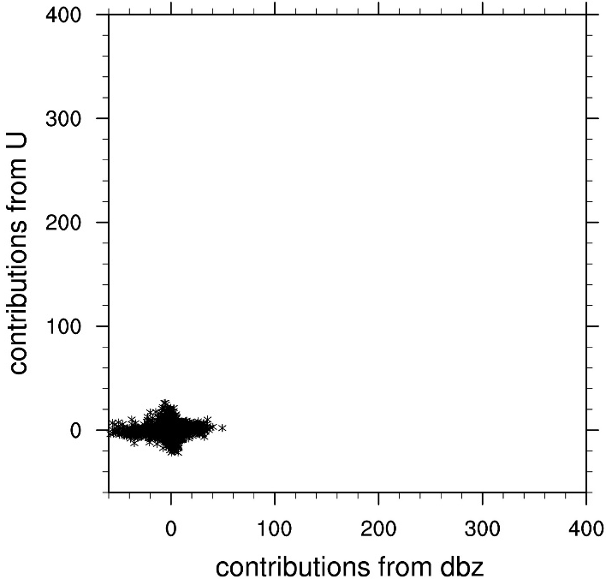
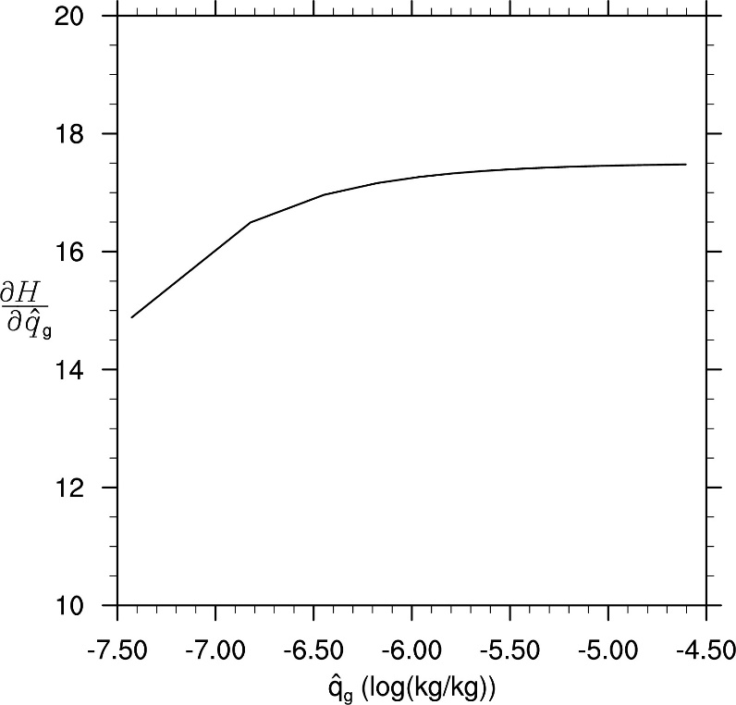
Issue with TL of nonlinear reflectivity operator in EnVar
Wang and Wang 2016
Use logarithm of hydrometeor mixing ratio as state variable

Slide 11
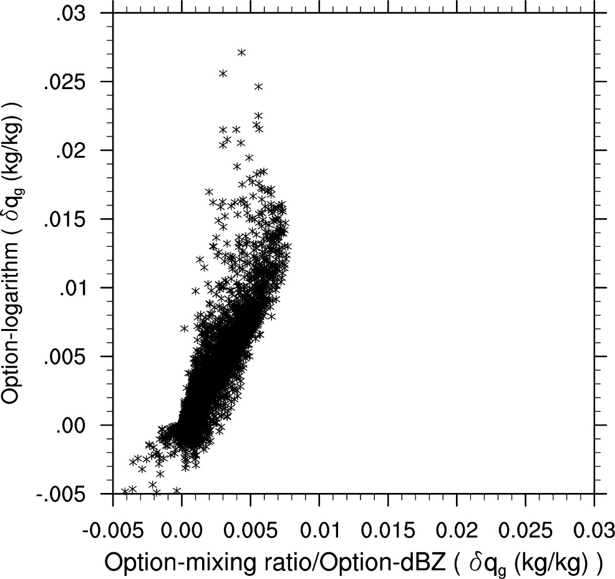
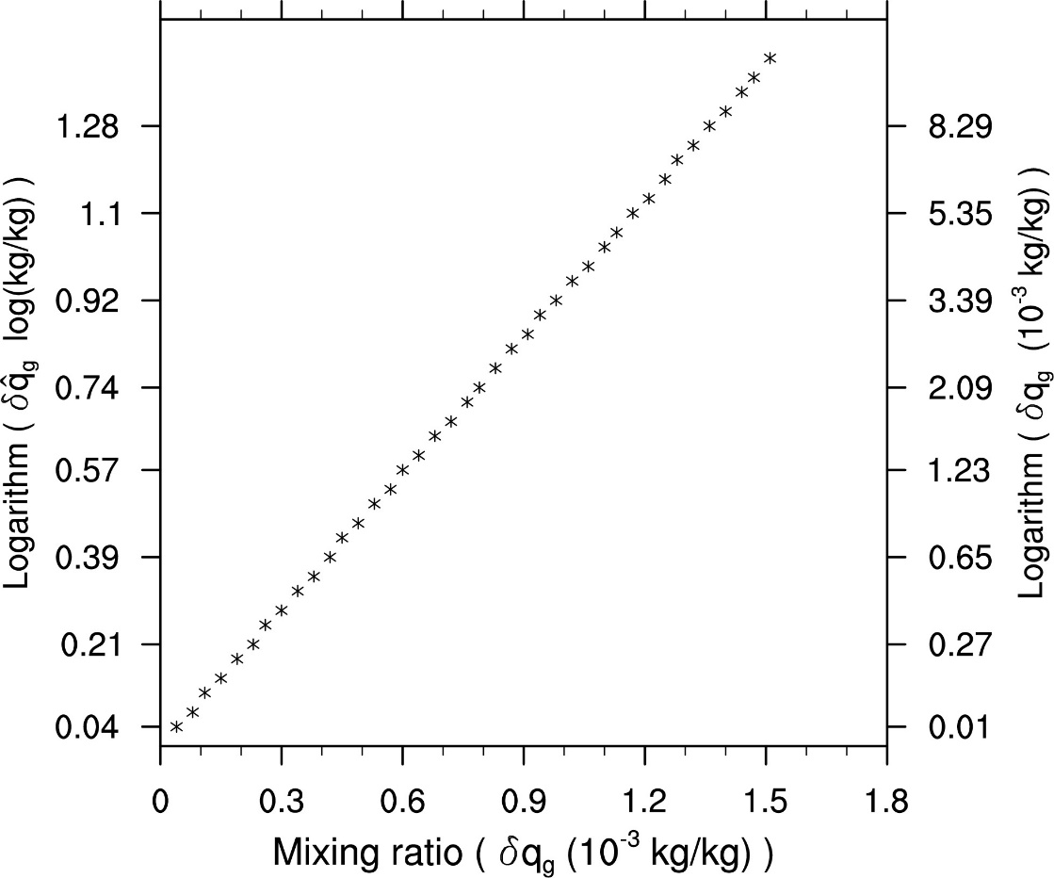
Issue with TL of nonlinear reflectivity operator in EnVar
Wang and Wang 2016
Use logarithm of hydrometeor mixing ratio as state variable
Anomalously large increment

Slide 12
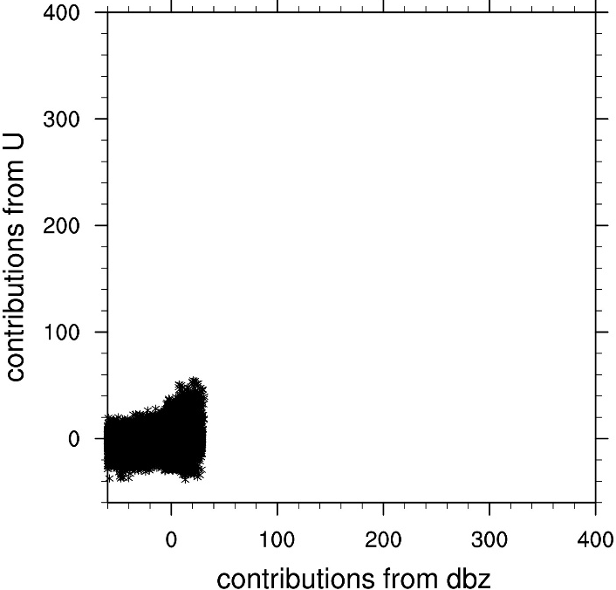
GSI-based EnVar without tangent linear (TL) and adjoint of the nonlinear reflectivity operator
Wang and Wang 2016
Use reflectivity as state variable
New: Ref.

Slide 13
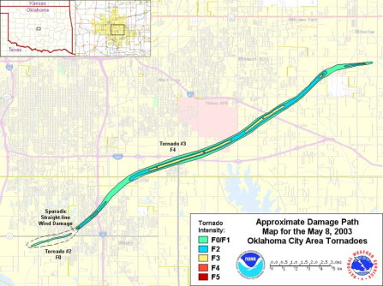
May 8th 2003 OKC Tornadic Supercell
Path of the May 8, 2003 Moore-South OKC Area Tornado
22:00 UTC 08 May
http://www.srh.noaa.gov
An isolated supercell case that produced F-4 intensity tornadoes in Moore and Oklahoma City (OKC) during about 2210—2240 UTC.
Supercell maintained well beyond 2300 until about 0000 UTC.

Slide 14
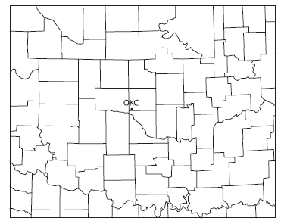
Experiment design
Wang and Wang 2016
Model: WRF-ARW 2km
Observation: radar radial wind and reflectivity from KTLX
IC and LBC ensemble: A 45-member ensemble downscaled from a mesoscale ensemble at 2100 UTC.
5 min
1 hour forecast
21:00
22:00
23:00

Slide 15
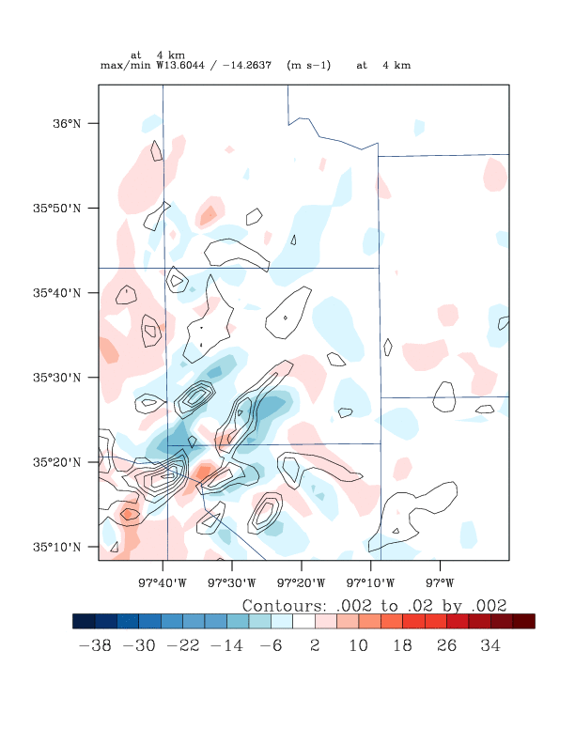

GSI based 3DVar: analysis and 1h forecast from 2200UTC
Ref and vorticity at 1 km
W at 4 km

Slide 16
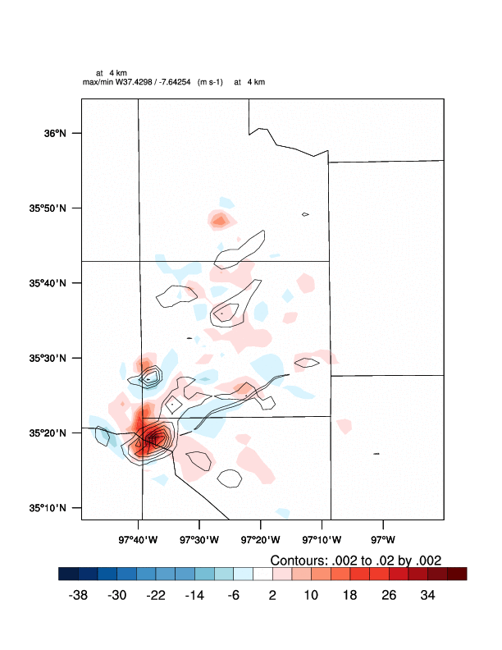
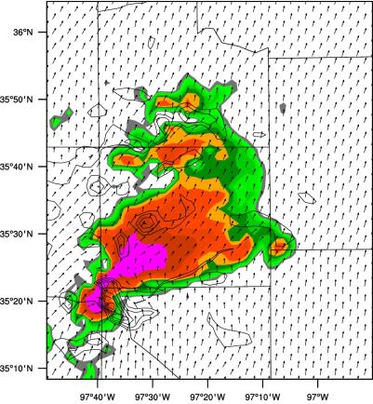
GSI based EnVar: analysis and 1h forecast from 2200UTC
Ref and vorticity at 1 km
W at 4 km
Notes:
Replace with best EnKF results

Slide 17
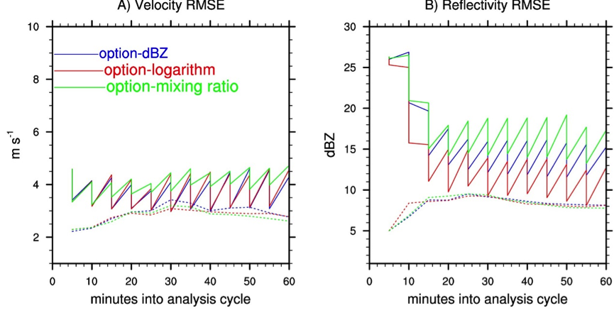
RMS fit to radar observation
New:Ref.
Log
q

Slide 18
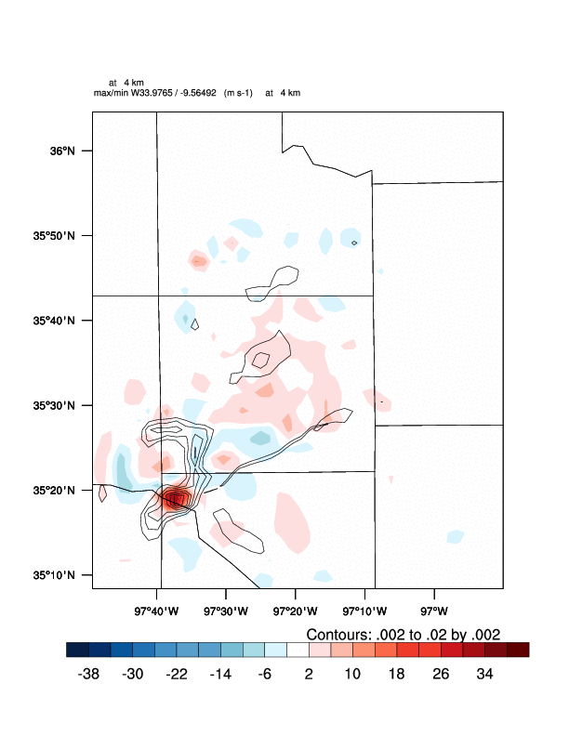
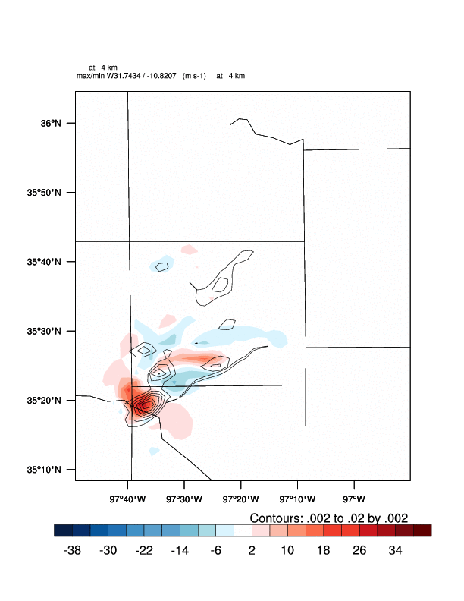
1 hour forecast: w and vorticity at 4km
New:Ref.
Log
q
m/s
m/s
m/s

Slide 19
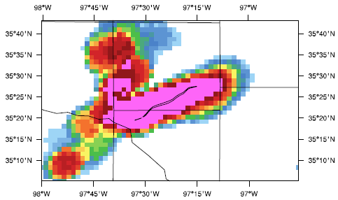
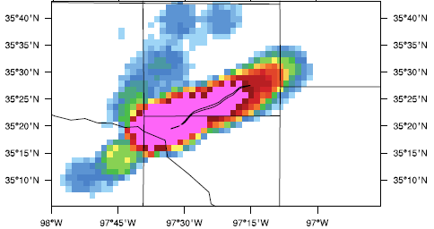
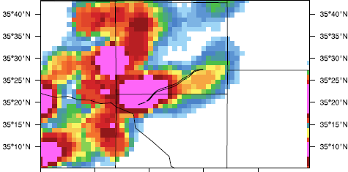

1 hour forecast: Neighborhood ensemble probability (%) of vorticity at 150 m AGL
New:Ref.
Log
q

Slide 20
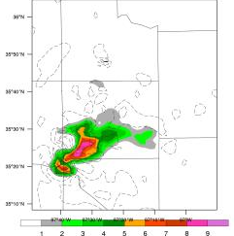
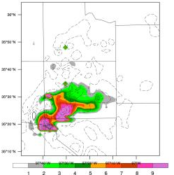
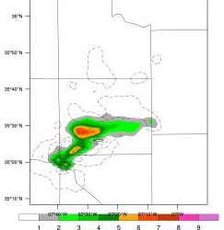
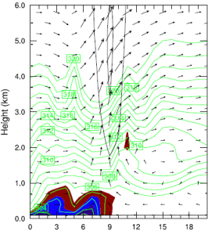
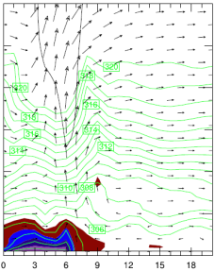
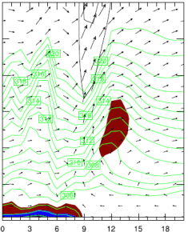
Graupel (q_{g}) analysis and dynamical factors that impact storm evolution
New:Ref.
Log
q
(g/kg)

Slide 21
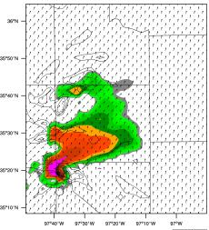
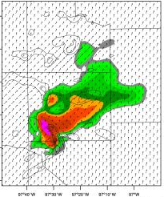
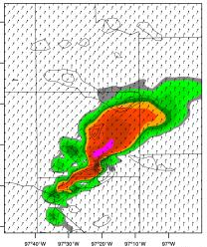
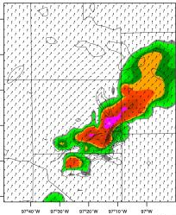
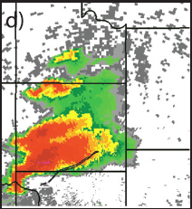
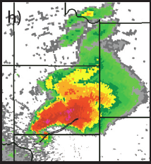
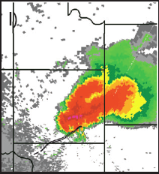
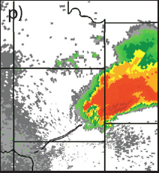
1 hour forecast: Reflectivity
Thompson microphysics scheme
2200 UTC
2215 UTC
2230 UTC
2245 UTC
Thompson
Observation

Slide 22
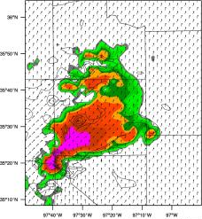
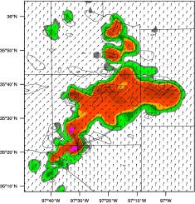
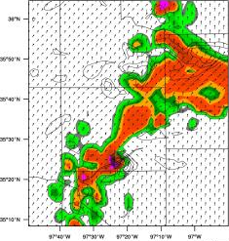
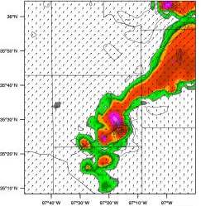
1 hour forecast: Reflectivity
WSM6 microphysics scheme
2200 UTC
2215 UTC
2230 UTC
2245 UTC
WSM6
Observation

Slide 23
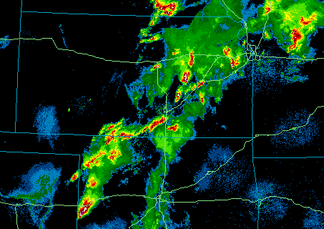
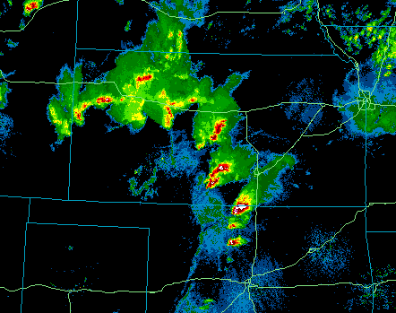
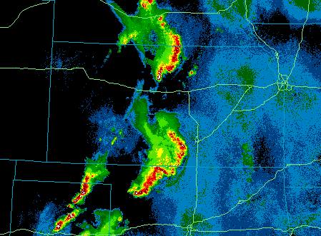
Multiscale DA for convective scale forecast:
Experiences with GSI-EnKF
Diverse cases from May 2010 are used to provide robust systematic results
  Different scales of convective organization and forcing mechanisms
  Forecasts initialized at 0000 UTC on May 11, 13, 15, 17, 18, 19, 20, 21, 25 and 26 (days with most active convection)
Scattered cellular convection
Supercells
Mesoscale Convective Systems
www.mmm.locust.ucar.edu
Johnson et al. 2015, MWR

Slide 24
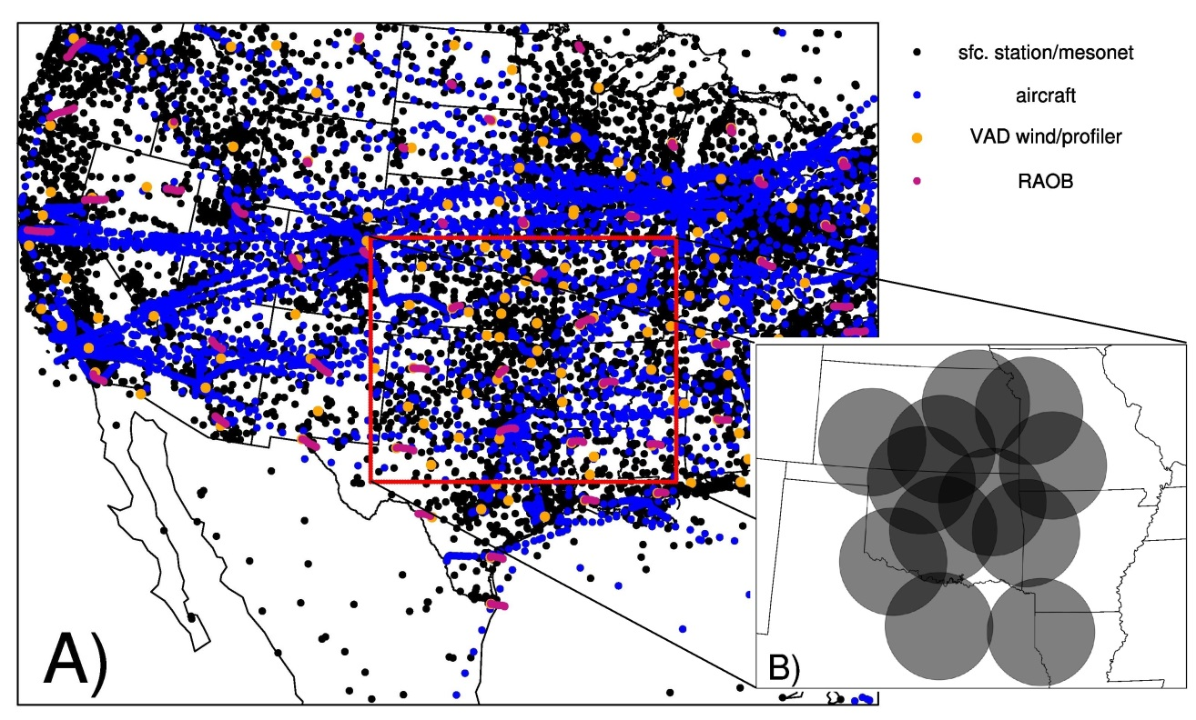
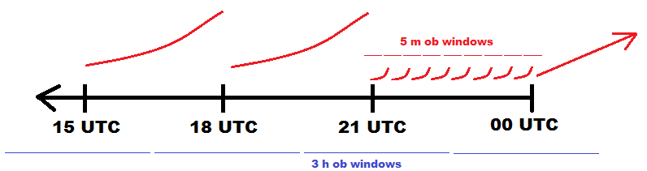
Multi-scale DA experiment design
Outer Domain (12km)
  Assimilate operational conventional surface and mesonet observations, RAOB, wind profiler, ACARS, and satellite derived winds every 3 hours to define synoptic/mesoscale environment
Inner Domain (4km)
  Assimilate velocity and reflectivity from NEXRAD radar network every 5 min during last 3hr cycle
Notes:
Squeeze aaron by 5 siles

Slide 25
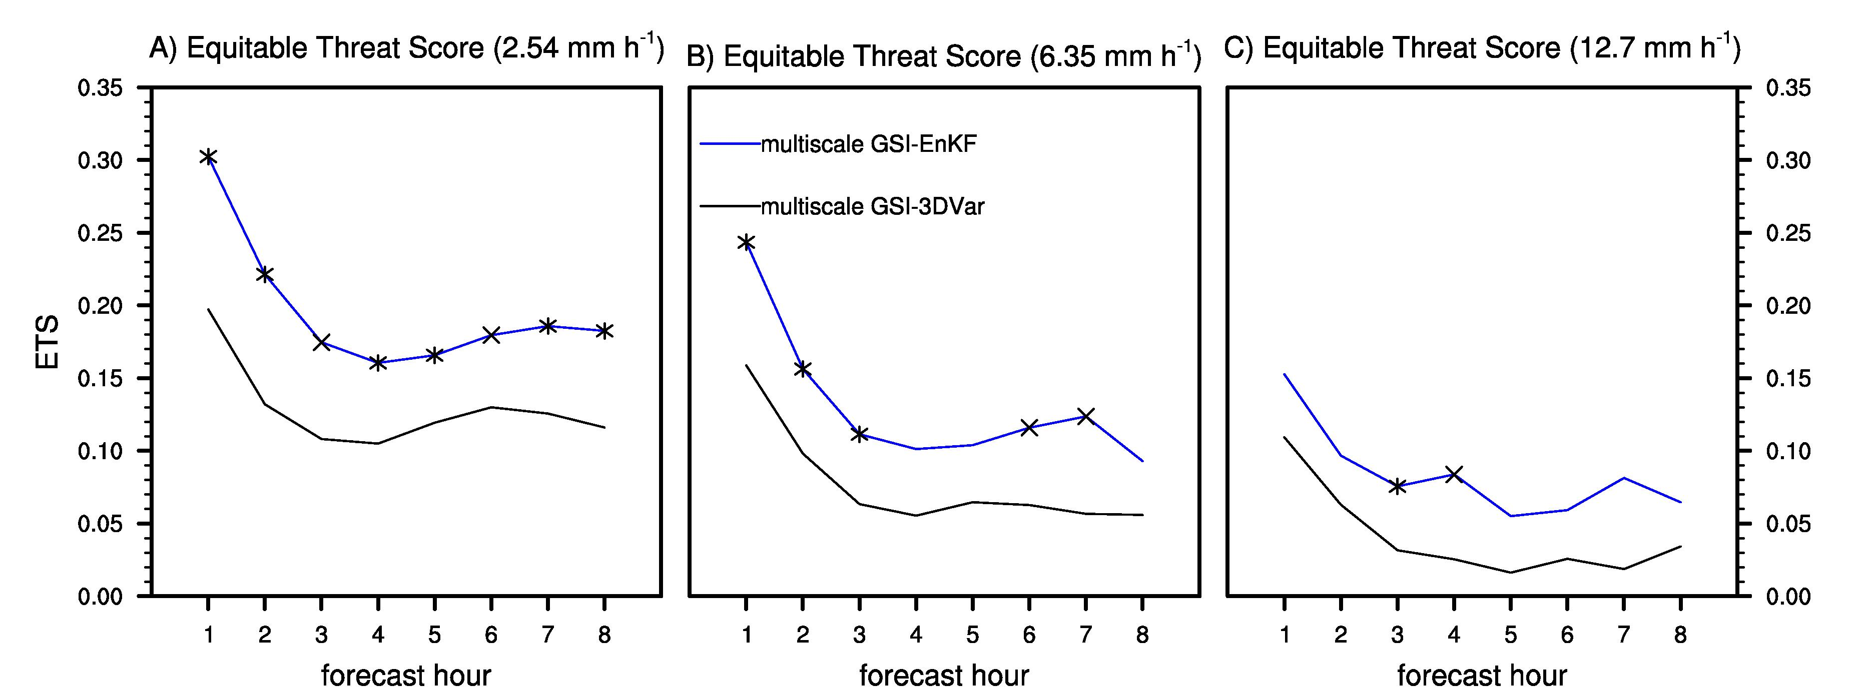
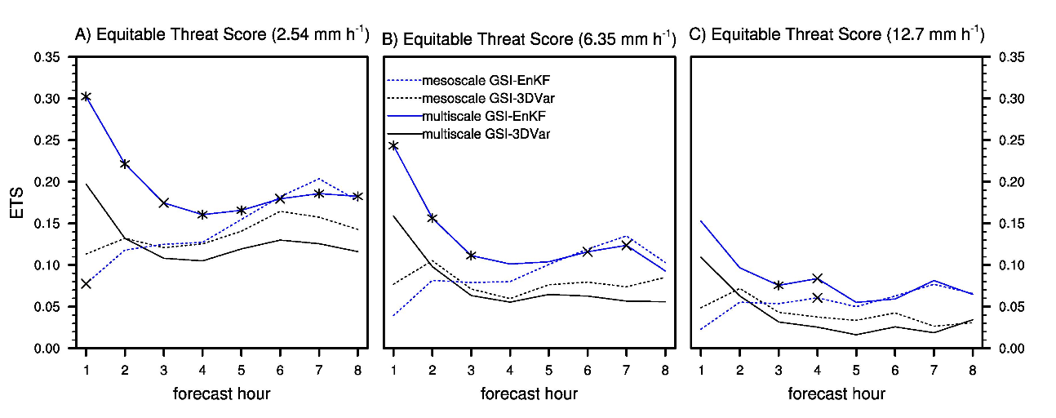
Systematic results: QPF
Johnson et al. 2015, MWR
Forecasts initialized from multi-scale analyses are more skillful for EnKF than 3DVar. Diagnostics show that all scales of motion contributing to the convective evolution are better analyzed with GSI-based EnKF.
Radar data assimilation improves forecast skill for 4-5h for EnKF but only 1h for 3DVar.
Precipitation forecasts initialized from mesoscale and multiscale analyses

Slide 26


Real-time GSI-EnKF Multi-scale Ensemble DA and Forecasting in support of the PECAN field campaign
One primary goal of PECAN is to improve prediction of nocturnal CI, nocturnal MCSs, bores, and LLJs with a particular focus on the next generation convective-permitting models and advanced assimilation techniques.

Slide 27

June 4th 2015 MCS
The ensemble successfully predicts the presence of multiple smaller MCSs as well as high uncertainty about storm location, although the mean location is displaced slightly south of where the storms are observed
Johnson and Wang 2016, Johnson et al. 2016, WAF

Slide 28

June 24 2015 CI
The ensemble forecast successfully identifies the occurrence of this CI as well as the orientation of northwest to southeast bands of cells, although with a mean location error
Johnson and Wang 2016, Johnson et al. 2016, WAF

Slide 29

July 11 2015 Bore
The 1km grid forecast was successfully able to resolve bore like features, although the predictability of specific bores was limited largely by the predictability of antecedent convection leading to density currents
Johnson and Wang 2016, Johnson et al. 2016, WAF

Slide 30







R&D of GSI-based Var/EnKF/EnVar for convection resolving NMMB
Multiscale event in southern US Dec. 26, 2015
dBZ
90-min 0130 UTC
2-hr fcst 0200 UTC
2.5-hr fcst 0230 UTC

Slide 31
Summary and future work
GSI-based Var/EnKF/EnVar/Hybrid data assimilation system is further developed for convective scale radar data assimilation.
Experiments for complex mesoscale system and isolated supercell both show improved analysis and forecast by EnKF (Johnson et al. 2015) and EnVar(Wang and Wang 2016) compared to 3DVar.
A method that avoids the tangent linear (TL) and adjoint of the nonlinear observation operator is developed for GSI EnVar (Wang and Wang 2016). So now 4DEnVar is not only TLA free for forecast model, but also TLA free for nonlinear obs. operator and therefore does not need outloops.
Plan to extend the R&D to cloudy radiance (e.g., GOES-R) assimilation.
Continue testing and experiment under HRRR, NAMRR and WoF contexts in collaboration with GSD, EMC and NSSL.

Slide 32
R&D of GSI-based Var/EnKF/EnVar/Hybrid for convection permitting hurricane prediction
GSI-based Var/EnKF/3/4DEnVar/ Hybrid
GFS
WRF ARW
WRF NMMB
Hurricane-WRF (HWRF)

Slide 33
GSI hybrid for HWRF: impact of error covariances for airborne radar DA
Lu, Wang et al. 2016, QJRMS

Slide 34
Difference of error covariances
Sandy 2012

Slide 35

Comparison with HRD radar wind analysis
Sandy 2012

Slide 36
Correlation between HRD radar wind analysis and analyses from various error covariances

Slide 37

Continuously cycled, Dual-resolution, Self-consistent HWRF hybrid DA system(Lu and Wang 2016a MWR)
GFS initial Ensemble
120 h 27/9/3 ensemble forecast
120 h 27/9/3
ensemble forecast
Mem 01
Mem 02
…
…
Mem 40
Fcst 01
Fcst 02
…
…
Fcst 40
Relo 01
Relo 02
…
…
Relo 40
EnKF a01
EnKF a02
…
…
EnKF a40
Fcst 01
Fcst 02
…
…
Fcst 40
Relo 01
Relo 02
…
…
Relo 40
EnKF a01
EnKF a02
…
…
EnKF a40
HWRF
Spin-up
27/9
Relocation
9km EnKF
HWRF
27/9
Relocation
9km EnKF
…
9km
Ens
pert
9km
Ens
pert
9km Recenter
9km Recenter
GFS initial
Relocation/
Initialization
Relocation/
Initialization
Control
HWRF
Spin-up
27/9/3
Fcs for Hybrid
Relo Hybrid
Hybrid
3 ingest 9
9 ingest 9
Hybrid anl
HWRF
27/9/3
Fcs for Hybrid
Relo Hybrid
Hybrid
3 ingest 9
9 ingest 9
Hybrid anl
…
120 h forecast
d01 from GFS analysis
d02/03 from Hybrid analysis
120 h forecast
d01 from GFS analysis
d02/03 from Hybrid analysis

Slide 38

Directed moving nest strategy: move ensemble of domains to a same location
Storm-following moving nests will lead to non-overlapped domains for ensemble members. Current GSI-based EnVar/EnKF code can not handle this.
Move ensemble of nests to prescribed locations during DA cycling to solve this issue without changing GSI code.
d01:
member 1 with domain
moving fixed
d02:
member 2 with domain
moving fixed
d03:
member 3 with domain
moving fixed
d01-old:
member 1 with domain
moving
d02-old:
member 2 with domain
moving
d03-old:
member 3 with domain
moving

Slide 39

Example of 6-hourly cycling using directed moving nest strategy (Edouard 2014)
This strategy has capability to move and stop as needed to apply e.g., 4DEnVar, FGAT
Straightforward to apply to e.g. basin scale HWRF with multiple moving nests
Simple to implement. No GSI DA code changes needed.
Analysis and forecast domains are the same (i.e., avoid requesting analysis domain larger than forecast domain like the current HWRF).
Flexibility to select directed locations.
.

Slide 40
Experiments for Edouard 2014
Lu and Wang 2016, MWR
Experiment name | Description
Hybrid | 6-hourly continuous end to end cycling
 | 3DEnVar hybrid with FGAT
 | Dual-resolution hybrid (3km control ingests 9km ensemble);
 | New directed moving nest strategy adopted; domains move for first 3 hour integration and stay for the next 6-hour integration.
 | Control background: vortex relocation and initialization for the control background when no TDR; vortex relocation only when TDR.
 | Ensemble backgrounds: vortex relocation
Hybrid-279 | Same as “Hybrid” except it is not dual-resolution hybrid. Both hybrid control and ensemble are done at 9km resolution.
Hybrid-norelo | Same as “Hybrid” except it does not do any vortex initialization or relocation on control and ensemble backgrounds.
Hybrid-noensrelo | Same as “Hybrid” except it does not do relocation for ensemble backgrounds.
Hybrid-4DTDR | Same as “Hybrid” except it uses 4DEnVar in the TDR-involved cycles.
Hybrid-HrlyTDR | Same as “Hybrid” except it uses Hourly assimilation in the TDR-involved cycles.

Slide 41
Experiments for Edouard 2014
Observations assimilated:
3km domain:
Conventional in-situ data in prepbufr, satellite wind, TDR and tcvital
9km domain:
Conventional in-situ data in prepbufr, satellite wind, TDR and tcvital
Satellite radiances

Slide 42






Impacts of Dual Resolution Hybrid
analyzed Edouard structure @2014091518
The horizontal wind pattern generated by Hybrid (dual resolution) fit the HRD wind analysis better than Hybrid-279 (single coarse resolution).

Slide 43








Impacts of vortex initialization and ensemble relocation
analyzed Edouard structure @2014091518
There was a large location and structure error if no initialization and relocation.
Relocation of ensemble is also important for storm structure.

Slide 44



Motivation of 4DEnVar/Hourly for vortex scale observation assimilation
Spuriously large wind maximum analyses in Hybrid with 3DEnVar were found in the last two TDR-involved cycles.
Edouard was going through complicated rapid-changing eyewall replacement process.
TDR coverage was very brief and unevenly distributed over the 6-hour window (e.g. TDR covers 12:58~14:17 for cycle 24 valid at 12Z).
Methods considering rapid error evolution during the 6 hr window (rather than 3DEnVar over 6-hr window) is needed based on our previous results (Wang and Lei, 2014 MWR; Lu et al 2016 QJRMS)
Flight Track
12:58
14:17
TDR
09
12
15
201409171200

Slide 45








Impacts of 4DEnVar/Hrly for vortex scale observation assimilation
analyzed Edouard structure @2014091712
W
E
Using 4DEnVar or Hrly, the spurious wind maximum was reduced and the wind pattern was more consistent with HRD radar composite as compared to 3DEnVar

Slide 46





Alleviation of the “spin-down” issue relative to operational HWRF
MSLP
Hybrid-4DTDR improved MSLP and Vmax forecast relative to operational HWRF during the intensification of Edouard until it reached the maximum intensity.
The improvement is largely due to the alleviation of spin down issue.
Vmax
hr
hr
Notes:
Legend font too small

Slide 47






Why new hybrid system alleviate the “spin-down” issue ?
Compared to operational HWRF, Hybrid analysis has a stronger inertial stability, smaller RMW, stronger tangential wind and shallower inflow layer.
Stronger inertial stability -> stronger resistance to radial inflow-> stronger updraft-> stronger secondary circulation -> intensification
(Holland and Merrill, 1984)
This explains why hybrid analysis help alleviate the “spin-down” issue
Average azimuth mean Inertial Stability (Shaded), Radial wind (Grey contour) and Tangential wind (Black contour) during Intensifying Stage ( Vmax change > 10kt/12h )
00h
Hybrid
06h
Hybrid
12h
Hybrid
00h
Operational HWRF
06h
Operational HWRF
12h
Operational HWRF

Slide 48




2015 near real-time experiment results
(Hurricane Patricia)
Track
MSLP
Vmax
2015 near real time experiments showed better MSLP & Vmax forecasts during the RI of Patricia in comparison with the operational HWRF.
Notes:
Gopal: Size verification
Pu: overestimation of peak intensity. Why?

Slide 49





Impact of anomalous size correction from vortex initialization (VI) on DA
Lu and Wang 2016b)
Back @ 10m 18Z22
All+SFMR @ 10m 18Z22
Patricia 2015 during RI
VI produces too large vortex.
DA can help improve the size & structure analysis.
Vmax and MSLP adjustment “seemingly” inconsistent.
Spin-down issue.
Vmax
MSLP

Slide 50





Impact of anomalous size adjustment from vortex initialization on DA
Corrections made during DA:
Wind maximum increase
Size contraction
The pressure and wind increments during DA are consistent
Back dP/dr @ Surface
All+SFMR dP/dr @ Surface
dP/dr increment

Slide 51

Impact of anomalous size adjustment from vortex initialization on DA
The less intense MSLP after DA is consistent with the pressure gradient adjustment during size contraction.
Therefore the “seemingly” inconsistent Vmax and MSLP adjustment during DA is due to dramatic size correction to fix the anomalously large size produced by VI.

Slide 52








Better wind and pressure relationship in DA than VI
All+SFMR @ 500m uv
Back-VI @ 500m leq
All+SFMR @ 500m leq
HRD @ 500m leq
Back-VI @ 500m req
All+SFMR @ 500m req
VI breaks the gradient wind balance. DA is more consistent with gradient wind balance.

Slide 53


DA is more reasonable, then where is the spin down coming from?
Vmax
MSLP
Although VI analysis is not consistent, spin down is less apparent.
Although DA produces more consistent analysis, spin down is more apparent. Why?

Slide 54












DA is more reasonable, then where is the spin down coming from?
Back-VI @ surface
-3.4m/s
-1.6m/s
+0.5m/s
……
+0.4m/s
+5m/s
00 min
02 min
04 min
06 min
48 min
50 min
All+SFMR @ surface
-2.4m/s
-4.8m/s
-1.6m/s
……
+0.1m/s
-7.3m/s
00 min
02 min
04 min
06 min
48 min
50 min
DA can produce a better wind and pressure relationship at the analysis time, but the model can not handle the relationship built from DA analysis because HWRF is tuned to adapt to VI.

Slide 55







DA is more reasonable, then where is the spin down coming from?
24h forecast initialized from DA
surface
1km
3km
Although wind above surface and at surface all corrected toward obs. by DA, HWRF can not maintain the large Vmax from DA due to HWRF model bias.
Consistent with HWRF bias diagnostic by Sippel et al.
Sippel et al.

Slide 56
Summary and ongoing work
GSI-based, continuously cycled, dual resolution, self consistent 3D/4DEnVar DA system with new directed moving nest strategy, assimilating all operational observations for HWRF is developed.
The new hybrid system improved MSLP and Vmax forecasts especially during intensification period through alleviation of spin down issue.
The spin-down issue is alleviated by better analyzed storm structures consistent with the characteristics of an intensifying storm.
Although vortex initialization integrated with DA is helpful, diagnostics suggest VI produces too large vortex, and wind & pressure relationship from VI is not consistent.
DA can alleviate the spin down issue. To further eliminate the spin down, HWRF model needs to retune to adapt to the analysis from DA rather than VI, and surface low bias also needs to be corrected.
We plan to optimize the usage of and explore the impact of other airborne and spaceborne observations (P3, GIV radar, dropsonde, flight level, SFMR, HIRAD, AMV, cloudy radiances, etc.) using the new system.
Implementation and conducting research on 4DIAU for HWRF hybrid DA.
Integrate with operational HWRF and transition to operational implementation with HWRF team

Slide 57
Further R&D to improve GSI-based Var/EnKF/EnVar/Hybrid for GFS
GSI-based Var/EnKF/3/4DEnVar/ Hybrid
GFS
WRF ARW
WRF NMMB
Hurricane-WRF (HWRF)
Improving Global and Hurricane Predictions by Using Minimum-Cost Large Ensembles in GFS 4DEnVar Hybrid Data Assimilation System

Slide 58

Sampling Error
Covariance localization vs increasing ensemble size
Increase
ensemble size
Covariance
localization
Miyoshi et al, 2014
Large-sized ensemble reveals long-range error covariance at the continental scales, while localization will remove this signal.
Extremely expensive computations are required for large-sized ensemble.

Slide 59
Impact of Increasing Ensemble Size
in GFS Hybrid EnVar System
Hybrid 3DEnVar in GFS was further improved by directly increasing the original 80 members to 320 members (Lei and Wang, 2016). Similar is found for 4DEnVar (Lei and Whitaker talk, EnKF workshop, 2016).
NH
SH
TR

Slide 60
Objectives
Aside from increasing ensemble members directly, is there a cheaper way to increase the ensemble size while still improving the analysis and forecast?
To what extent would such method help? Why is it helpful?
What is the best way of using such cheaply generated ensemble?
What is the best way of using ensemble resolving different range of scales?

Slide 61
Valid Time Lagging method (VTL)
Shift the the ensemble perturbations at m hours before and after t_{i} to t_{i} . E.g., m=3, then ensemble size will be tripled in current GFS 4DEnVar.
t_{i} -2m t_{i} -m t_{i} t_{i} +m t_{i} +2m
VTL
t_{i} -2m t_{i} -m t_{i}
t_{i} -2m t_{i} -m t_{i} t_{i} +m t_{i} +2m
t_{i} t_{i} +m t_{i} +2m

Slide 62
Why would VTL help?
May more completely represent the forecasts errors related to the location, structure and orientation so that truth acts like one of the ensemble members.
ENS80
VTL240M80
80-mem 6h fcst
80-mem 3h perturbations plus 6h ensemble mean
Ensemble mean from 80-mem 6h fcst
80-mem 9h perturbations plus 6h ensemble mean
EC analysis
Hurricane Henriette (2013)

Slide 63




Why would VTL help ?
VTL by design has smoothing effect.
03Z
06Z
09Z
06Z after VTL

Slide 64
Initial Time Lagging method (ITL)
Increasing ensemble size by collecting ensemble perturbations valid at t_{i} but initialized at different times prior to t_{i-1.}
t_{i}
Ens fcst from t_{i-1}
Ens fcst from t_{i-2}
Ens fcst from t_{i-3}
Ens fcst from t_{i-4}
…...
May better represent the model error due to the use of forecasts with different leading times.
Forecasts with different leading times may need to be assigned with different weights.

Slide 65


Experiment Design
GSI-4DEnVar for GFS
GSI-4DEnVar: Naturally extended from and unified with GSI-based 3DEnVar hybrid formula. Conveniently avoid TLA.
Add time dimension in 4DEnVar
Wang and Lei 2014, MWR
True increment
4DEnVar (hrly)
4DEnVar (2hrly)
3DEnVar
Hurricane Daniel 2010
Hurricane Daniel 2010
*
time
-3h 0 3h

Slide 66
Experiment Design
Experiment Settings for Baseline Experiment (ENS80)
4DEnVar using 80 member ensemble.
T670/T254 GFS model.
6-hourly assimilation of all operational conventional and satellite data.
12.5% weight on the static background error covariance and 87.5% weight on the ensemble covariance.
Three-hourly ensemble perturbations.
Level-dependent localization length scales.
Multiplicative inflation with a relaxation coefficient 0.85 and stochastic parameterizations for the spread issue.
Four-dimensional incremental analysis update (4DIAU) and tangent linear normal mode constraint (TLNMC) to alleviate the imbalance issue.
Cycling experiment for Aug. 2013 and verify both global forecast and hurricane track forecast.

Slide 67
Experiment Design
Lagged Ensemble Experiment Design and Estimated Cost
Huang et al. 2016
Exps. | Total ensemble perts for 4DEnVar at t_{i} | Total mem for EnKF at t_{i} | Ensemble Fcsts at t_{i} | Cost estimate (rel. to ENS80) | Required storage (rel. to ENS80)
ENS80 | 80-mem perts from fcsts valid at t_{i} but initialized from t_{i-1} | 80 | 80-mem 9-hour fcsts | 1 | 1
ENS240 | 240-mem perts from fcsts valid at t_{i} but initialized from t_{i-1} | 240 | 240-mem 9-hour fcsts | 3 | 3
ENS320 | 320-mem perts from fcsts valid at t_{i} but initialized from t_{i-1} | 320 | 320-mem 9-hour fcsts | 4 | 4
VTL240M80 | 240-mem perts by shifting the 80-member perts. at the time 3-hour before and after t_{i} to t_{i} | 80 | 80-mem 12-hour fcsts | 1.1 | 1.3
ITL320M80 | 320-mem perts by adding additional 3 groups of 80-mem perts from fcsts valid at t_{i} but initialized from the analysis at t_{i-2}, t_{i-3} and t_{i-4} | 80 | 80-mem 27-hour fcsts | 2.05 | 2.5

Slide 68



VTL method
Self-correlation evaluation (TT at 700hpa)
ENS240
ENS80
VTL240M80
VTL240M80 is qualitatively closer to ENS240 than ENS80.
Scattering plots show that both the small ([0, 0.1], red) and large((0.1 1.0]) correlations of VTL240M80 are improved over ENS80.

Slide 69



VTL method
Cross-correlation evaluation (TU at 700hPa)
ENS240
ENS80
VTL240M80
VTL240M80 is qualitatively closer to ENS240 than ENS80.
Scattering plots show that both the small ([0, 0.1], red) and large((0.1 1.0]) correlations of VTL240M80 are improved over ENS80.

Slide 70
VTL method
Systematic evaluation of ENS80 correlation errors
Relative correlation errors (RCE) of ENS80 was defined by comparing with ENS240.
TT & TU
RCE was systematically evaluated for the small ([0 0.1), red) and large ([0.1 1.0],blue) absolute correlations and self-correlation (no green edge) and cross-correlations (with green edge)
Errors for small correlations (red) are larger than large correlations (blue) for both the self- and cross-correlations.
Errors for cross-correlations (with green edge) are larger than self-correlations (no green edge) for both the small and large correlations.
UU & UT
Notes:
Samples were collected at three model levels (200hPa, 500hPa and 850hPa) over the one-week cycles (the middle of the cycling). Each model level will cover equally-spaced 165 correlation boxes with side length of 20 °.

Slide 71
VTL method
Improvement of VTL correlation relative to ENS80
Percentage correlation errors reduction (PCER) was defined by
TT & TU
PCER was systematically evaluated for the small ([0 0.1), red) and large ([0.1 1.0],blue) absolute correlations, and the self-correlation (no green edge) and cross-correlations (with green edge).
VTL240M80 improves the correlation estimate compared to ENS80 for both the small/large and the self-/cross-correlation.
VTL240M80 generally has a larger improvement for the small correlations than the large correlations.
VTL240M80 has a larger improvement for the cross-correlation when correlation is small; it has a larger improvement for the self-correlation when the correlation is large.
UU & UT

Slide 72
VTL method
6-hour forecast verification against rawinsondes
Both ENS240 and VTL240M80 show a closer fit than ENS80, especially for the wind field. In most levels the difference VTL240M80 and ENS80 is significant at the 95% confident level.
Improvement of VTL240M80 is more than half of the improvement of ENS240.

Slide 73
VTL results
5-day forecast verification against rawinsonde
ENS80
ENS240 – ENS80
VTL240M80 – ENS80
Temp
UV
VTL240M80 in general improves forecast during the 5-day period. Spatial pattern of improvement resembles that of ENS240.
Degradation may be caused by the small samples (3-weeks). More DA cycling is ongoing.

Slide 74
VTL Method
Hurricane track verification
WPC
Three weeks
ATL
One month
EPC
VTL240M80 has a better track forecast compared with ENS80.
VTL240M80 vs ENS240 is mixed (more sample is needed).

Slide 75
ITL method
Improvement of ITL correlation relative to ENS80
TT & TU
ITL320M80 can only improve small correlation errors at certain levels, but degrade large correlation errors.
UU & UT

Slide 76
ITL method
6-hour forecast verification against rawinsondes
12.5%
4.7%
One-month experiments show that
Both ENS320 and ITL320M80 show a closer fit than ENS80, especially for the wind field;
Improvement of ITL320M80 is much smaller than ENS320.

Slide 77
Summary and ongoing work
  Among all tested methods of increasing ensemble size, our results indicate VTL is the most cost-effective method.
  VTL is easy to implement. Cost increase is during background forecast, not much on DA. So can fit NCEP production suite.
  Plan to study the sensitivity of VTL240MA80 to the shifting period ( m =1 or 2 hour(s) instead of 3 hours. Combination of VTL and ITL.
  Explore the benefit of VTL w/o IAU, TLMNC.
  Implement multi-resolution lagged ensemble in GSI 4DEnVar
  Implement and explore scale-dependent weighting on multi-resolution lagged ensemble in 4DEnVar

Slide 78
Challenges for ensemble DA and implication for NGGPS
Assimilating observations in a system that resolves multiple scales.
Effective methods to sample model error in ensemble background.
Assimilating advanced/new observations (e.g. cloudy radiances, dual pol radar data)
Methods to treat or take into account nonlinearity and non-Gaussianity
Given GFS becoming non-hydrostatic and convection resolving, global DA now is a multiscale problem. DA development and experiences gained from global NWP as well as from regional, convection resolving NWP under the unified GSI should be leveraged to form foundation for further R&D.

Slide 79
References cited
Wang, X., T. M. Hamill, J. S. Whitaker and C. H. Bishop, 2007a: A comparison of hybrid ensemble transform Kalman filter-OI and ensemble square-root filter analysis schemes. Mon. Wea. Rev., 135, 1055-1076.
Wang, X., C. Snyder, and T. M. Hamill, 2007b: On the theoretical equivalence of differently proposed ensemble/3D-Var hybrid analysis schemes. Mon. Wea. Rev., 135, 222-227.
Wang, X., D. Barker, C. Snyder, T. M. Hamill, 2008a: A hybrid ETKF-3DVAR data assimilation scheme for the WRF model. Part I: observing system simulation experiment. Mon. Wea. Rev., 136, 5116-5131.
Wang, X., D. Barker, C. Snyder, T. M. Hamill, 2008b: A hybrid ETKF-3DVAR data assimilation scheme for the WRF model. Part II: real observation experiments. Mon. Wea. Rev., 136, 5132-5147.
Wang, X., T. M. Hamill, J. S. Whitaker, C. H. Bishop, 2009: A comparison of the hybrid and EnSRF analysis schemes in the presence of model error due to unresolved scales. Mon. Wea. Rev., 137,3219-3232.
Wang, X., 2010: Incorporating ensemble covariance in the Gridpoint Statistical Interpolation (GSI) variational minimization: a mathematical framework. Mon. Wea. Rev., 138, 2990-2995.
Johnson, A., X. Wang, J. Carely, L. Wicker and C. Karstens, 2015: A Comparison of Multi-scale GSI-based EnKF and 3DVar Data Assimilation using Radar and Conventional Observations for Mid-latitude Convective-scale Precipitation Forecasts. Mon. Wea. Rev. , 143, 3087-3108.
Wang, X. 2011: Application of the WRF hybrid ETKF-3DVAR data assimilation system for hurricane track forecasts. Wea. Forecasting, 26, 868-884.
Wang, X., D. Parrish, D. Kleist and J. S. Whitaker, 2013: GSI 3DVar-based Ensemble-Variational Hybrid Data Assimilation for NCEP Global Forecast System: Single Resolution Experiments. Mon. Wea. Rev., 141, 4098-4117.
Wang, X. and T. Lei, 2014: GSI-based four dimensional ensemble-variational (4DEnsVar) data assimilation: formulation and single resolution experiments with real data for NCEP Global Forecast System. Mon. Wea. Rev., 142, 3303-3325.
Li, Y., X. Wang and M. Xue, 2012: Assimilation of radar radial velocity data with the WRF ensemble-3DVAR hybrid system for the prediction of hurricane Ike (2008) . Mon. Wea. Rev. , 140, 3507-3524.
Lu, X., X. Wang, Y. Li, M. Tong, and X. Ma, 2016:GSI-based ensemble-variational hybrid data assimilation for HWRF for hurricane initialization and prediction: Experiments with airborne radar observations. Q. J. R. Meteo. Soc., in review
Lu, X. and X. Wang 2016: GSI-based, continuously cycled, dual resolution, ensemble-variational hybrid data assimilation for HWRF: system description and experiments with Edouard (2014). Mon. Wea. Rev., To be submitted.
Wang, Y. and X. Wang, 2016: Direct Assimilation of Radar Reflectivity without Tangent Linear and Adjoint of the Nonlinear Observation Operator in GSI-Based EnVar System: Methodology and Experiment with the 8 May 2003 Oklahoma City Tornadic Supercell, Mon. Wea. Rev., in review.
Johnson, A. and X. Wang, 2016: Design and implementation of a GSI-based convection-allowing ensemble data assimilation and forecast system for the PECAN field experiment. Part 1: Optimal configurations for nocturnal convection prediction using retrospective cases", Weather and Forecasting, in review.

