Slide 1
The overview of JMA activity: numerical prediction division, RSMC Tokyo, and Meteorological Research Institute
Masahiro Sawada (Dr)
EMC (visiting scientist from MRI/JMA)
Thanks to colleagues at NPD, Tokyo Typhoon center, and MRI of JMA, and JAMSTEC
EMC seminar 27 September 2016
@ NCWCP, College Park, US

Slide 2
contents
Operational NWP system at JMA
Overview of RSMC Tokyo
Recent activity of MRI/JMA

Slide 3
Operational NWP system at JMA
Recent achievement of numerical prediction division.
Following slides are kindly provided by colleagues at NPD.

Slide 4
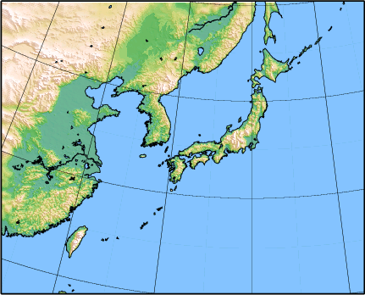
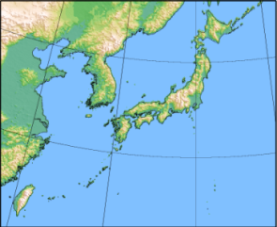
Current NWP models of NPD/JMA
 | Global Spectral Model GSM | Meso-Scale Model MSM | Local Forecast Model LFM | One-week Ensemble WEPS | Typhoon Ensemble TEPS
Objectives | Short- and Medium-range forecast | Disaster reduction Aviation forecast | Aviation forecast Disaster reduction | One-week forecast | Typhoon forecast
Forecast domain | Global | Japan and its surroundings (4080km x 3300km) | Japan and its surroundings (3160km x 2600km) | Global
Horizontal resolution | TL959(0.1875 deg) | 5km | 2km | TL479(0.375 deg)
Vertical levels / Top | 100 0.01 hPa | 48 21.8km | 58 20.2km | 60 0.1 hPa
Forecast Length (Initial time) | 84 hours (00, 06, 18 UTC) 264 hours (12 UTC) | 39 hours (00, 03, 06, 09, 12, 15, 18, 21 UTC) | 9 hours (00-23 UTC hourly) | 264 hours (00, 12 UTC) 27 members | 132 hours (00, 06, 12, 18 UTC) 25 members
Initial Condition | Global Analysis (4D-Var) | Meso-scale Analysis (4D-Var) | Local Analysis (3D-Var) | Global Analysis with ensemble perturbations (SV)
Numerical Prediction Division, JMA
Notes:
This table shows specifications of the models.

Slide 5
Global model

Slide 6
Objectives of Global Model (GSM)
basic information for a short- and medium-range and one week forecasts
basic information for typhoon track and intensity forecasts
basic information to assist aviation and ship routing forecasts
boundary condition for Meso-Scale Model
forcing data for ocean wave model
forcing data for ocean data assimilation
wind information which drives chemical transport model
Numerical Prediction Division, JMA
Notes:
An elapse time of 20 minutes for 84 hour forecast

Slide 7
Numerical/Dynamical Properties (1)
Horizontal representation
Spectral (spherical harmonic basis functions) with transformation to a reduced Gaussian grid for calculation of nonlinear quantities and most of the physics.
Horizontal resolution
Spectral triangular TL959.
Vertical representation
Finite differences in sigma-pressure hybrid coordinates.
Vertical domain
Surface to 0.01 hPa.
Vertical resolution
There are 100 unevenly spaced hybrid levels.
Numerical Prediction Division, JMA

Slide 8
Numerical/Dynamical Properties (2)
Time integration scheme
A two-time level semi-implicit semi-Lagrangian scheme is used for the time integration.
A constant time step length 400 sec. is used.
Governing Equations
Primitive equations for dynamics in a spectral semi-Lagrangian framework formulated using wind components, temperature, specific humidity, cloud water and surface pressure as prognostic variables.
Diffusion
A linear fourth-order horizontal diffusion is applied on the hybrid sigma-pressure surfaces in spectral space.
A linear second-order horizontal diffusion is applied in the divergence equation as a sponge layer around the model top region.
Numerical Prediction Division, JMA

Slide 9
Recent update of physics-1 (2016.3)
- Cumulus convection (Arakawa-Schubert) by A. Shimokobe, H. Sato, M. Ujiie
1. Revising budget equation of moist static energy
→ Improving energy conservation
2. Revising estimation of static energy at cloud base
Entrainment rate based on Jakob and Siebesma (2003), adding static energy perturbation at cloud base
→ Improving convective heating profile
3. Revising snow melting process
→ Improving convective heating profile
4. Introducing fallout of precipitation between cloud base and cloud top Iterative calculation to estimate entrainment rate
→ Improving convective heating profile
- Cloud (PDF-based parameterization (Smith 1990)) by K. Saitou, M. Ujiie
1. Removing increase of PDF width by cumulus effect
→ Reducing dry bias in the middle troposphere
2. Revising cloud ice falling process
→ Reducing time step dependency
Numerical Prediction Division, JMA
Notes:
積雲 A. Shimokobe, H. Sato, M. Ujiie
雲 K. Saitou, M. Ujiie
陸面 T. Tokuhiro, D. Hotta, M. Hirai, M. Ohizumi
海面 H. Yonehara, M. Higaki
放射 R. Nagasawa, R. Sekiguchi

Slide 10
Recent update of physics-2 (2016.3)
- Land surface (iSiB) by T. Tokuhiro, D. Hotta, M. Hirai, M. Ohizumi
1. Increasing number of soil layer
2. Refining snow model
3. Refining treatment of canopy and soil processes
4. Improving flux exchange
5. Renewal of vegetation parameters and related parameters
6. Renewal of climatology for initial condition of soil moisture
→ reducing low temperature bias at lowest level in winter season
- Sea surface by H. Yonehara, M. Higaki
1. Introduction of 4 layers sea-ice model
2. Renewal of surface boundary layer scheme
3. Introduction of sea-ice and open-water mixed grid
→ reducing excessive latent heat flux at ocean bias and low temperature bias at polar region
Numerical Prediction Division, JMA

Slide 11
Recent update of physics-3 (2016.3)
- Radiation scheme by R. Nagasawa, R. Sekiguchi
1. Introduction of maximum-random overlap by Practical Independent Column Approximation for short-wave radiation
→ decrease cloud optical thickness in tropics ~ extratopics
2. Revising optical properties of water clouds parameterization
→ decrease overestimation of effective radius of water cloud
3. Renewal of climatology of GHGs
→ physically reasonable change
There are other several modifications of dynamics/physics to reduce the elapse time.
This update was the biggest changes of JMA-GSM in recent years!
Numerical Prediction Division, JMA

Slide 12
Operational Global Objective Analysis
Cut-off time | 2h20m for early run analyses at 00, 06, 12 and 18 UTC, 11h50m for cycle run analyses at 00 and 12 UTC, 7h50m for cycle run analyses at 06 and 18 UTC
Initial Guess | 6-hour forecast by GSM
Grid form, Horizontal resolution | Reduced Gaussian grid, approximately 20km for outer model Reduced Gaussian grid, approximately 55km for inner model
Vertical resolution | 100 forecast model levels up to 0.01 hPa + surface
Analysis variables | Surface pressure, temperature, winds and specific humidity
Methodology | Four-dimensional variational (4D-Var) scheme on model levels
Data Used | SYNOP, SHIP, BUOY, TEMP, PILOT, wind profiler, Aircraft, MW sounders, MW imagers, hyperspectral IR sounders, sea surface wind data from scatterometer on the Metop, AMV and CSR from geostationary satellites, MODIS wind data from Terra and Aqua, bending angle from GPS radio occultation observation, GNSS-ZTD(Zenith Total Delay) data; Typhoon bogussing applied for analysis
Initialization | Non-linear normal mode initialization and a vertical mode initialization for inner model
Early Analysis:
Analysis for weather forecast. The data cut off time is very short.
Cycle Analysis:
Analysis for keeping quality of global data assimilation system. This analysis is done after much observation data are received.
Numerical Prediction Division, JMA

Slide 13
Typhoon Bogus Technique
Bogus are made up of Psea (2 points) and vertical profile of the wind around TC (4 profiles).
Step1. Symmetric bogus profiles are generated based on TC central position, central pressure and the radius of 30kt wind, which are analyzed by forecasters at JMA only over WNP basin.
Step2. Asymmetric component are retrieved from the first guess fields and added to the symmetric bogus profile.
Step3. The resulting bogus are assimilated in the 4DVAR assuming that they are observation data.
Analyzed TC center
TC center on the first guess
Numerical Prediction Division, JMA
Notes:
TC central position, central pressure and the radius of 30kt wind analyzed by forecasters at JMA are reflected into the initial state of GSM and MSM.

Slide 14
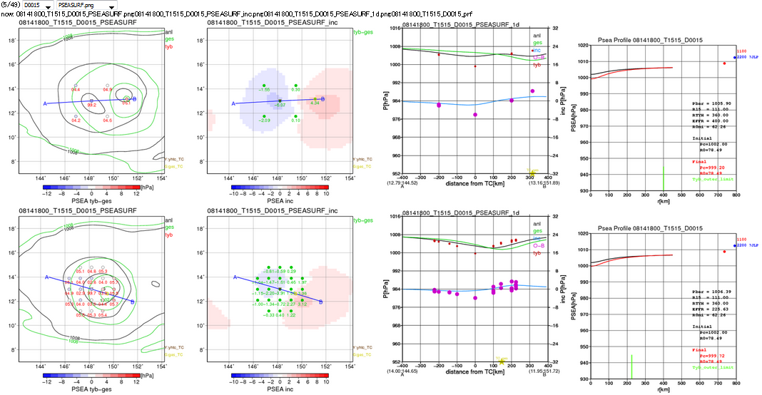
Problem 1: locally large increment at sea level
Guess
Analysis
Cntl
Test
In Cntl, there are two TC centers; one is the center of first guess, which should be removed by typhoon bogus, and the other is generated from bogus with locally large increment. This deteriorates track forecast in this case.
=> May solve it by changing obs. error and density of bogus points.
Numerical Prediction Division, JMA
Notes:
Psea面で局所的に急激なインクリメント 性能評価試験の事例1で紹介した15号。業務化試験でのCntl、Testの結果を表示。この試験でもCntlで台風中心が二つになっている。ges台風中心が残ったままであり、予報時間が進むとgesの台風中心が発達する。中心位置の補正が全くできなかったということ。

Slide 15
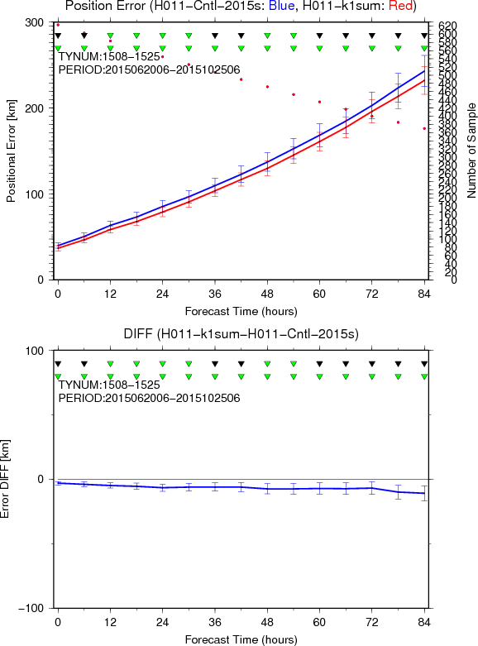
TC Track error
Case: 2015062006-2015102506
Blue: Cntl
Red: Test
By adjusting density of typhoon bogus, observation error, and gross error check procedure, TC track error reduced with statistically significance.
Test-Cntl
Numerical Prediction Division, JMA

Slide 16
Meso scale model

Slide 17
Objectives of Meso-scale NWP System
Disaster Prevention
Prediction of severe weather (heavy rainfall etc.) is important to reduce loss of life and property.
Input to very short-range precipitation forecast system
Input to storm surge model
Boundary condition for Local Forecast Model
Aviation Weather Forecast
Enhanced weather information for aviation safety
Terminal Aerodrome Forecast (TAF) Guidance and so on.
Numerical Prediction Division, JMA

Slide 18
Overview of MSM based on JMA-NHM:“JMA-NonHydrostatic Model”
Fully compressible equations with map factors
Hybrid terrain-following vertical coordinate
Sound and gravity waves
Split explicit scheme
Advection terms
Horizontal : fourth order , Vertical : second order
Cloud microphysics
Bulk method：qc,qr,qci,qs,qg,nci
Cumulus parameterization
Kain-Fritsch scheme
Surface processes
computation of bulk coefficients : Beljaars and Holtslag
Boundary layer process
Improved Mellor-Yamada (MYNN) Level 2.5 scheme
Radiation
Short-wave and long-wave radiations are calculated every 15 minutes
Model of MSM will be upgraded to ASUCA from JMA-NHM very soon!
Numerical Prediction Division, JMA

Slide 19
Development of a New NWP System – asuca, Physics Library, asuca-Var –

Slide 20
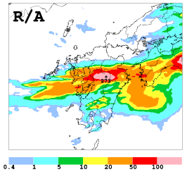
Development of a New NWP System
NPD/JMA has been developing a new Forecast/DA system “ASUCA”, for the next-generation operational Meso-scale and Local NWP Systems.
ASUCA: new dynamical core
(Asuca is a System based on a Unified Concept for Atmosphere)
Physics Library: repository of highly-portable physical process routines
ASUCA
Physics Library
ASUCA-Var: Variational data assimilation system based on “ASUCA”
ASUCA-Var (3D/4D-Var core, Obs. Operator)
“ASUCA”-based Local NWP has been in operation since Jan. 2015.
Development to incorporate ASUCA and ASUCA-Var into the Meso-scale NWP System is in progress.
ASUCA-based Local NWP
Observation
3h accumulated precipitation valid at 11 Jul. 2012, 21UTC
6h forecast
Numerical Prediction Division, JMA

Slide 21
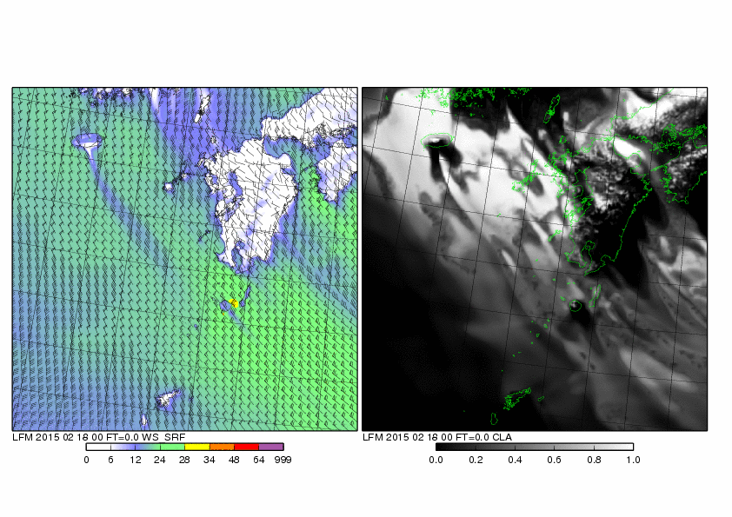
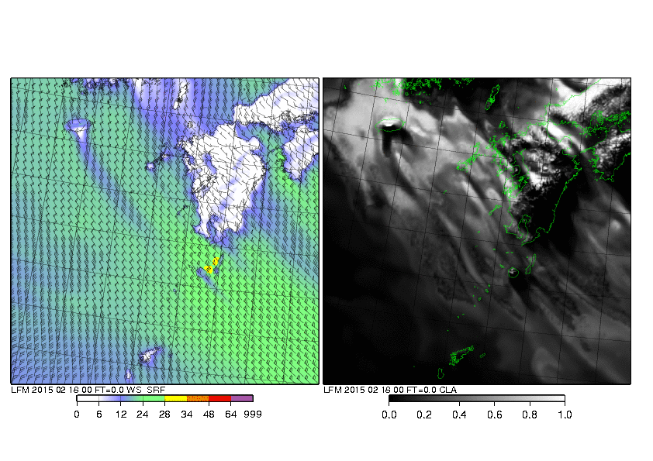
Karman Vortex Streets
Initial time at 2015/02/18/00UTC (T+0 to T+9)
Karman vortex streets on the leeside of Jeju island are well reproduced by the ASUCA-based new 2km-LFM.
Observation at 2015/02/18/04UTC
ASUCA-based new 2km-LFM
Previous 2km-LFM
Numerical Prediction Division, JMA

Slide 22
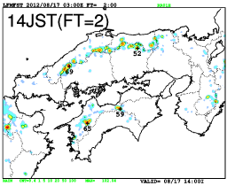
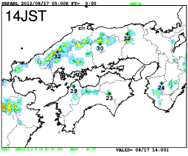
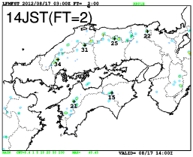
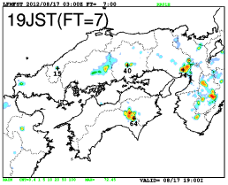
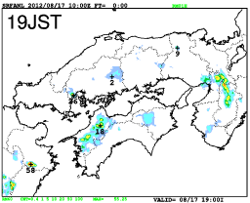
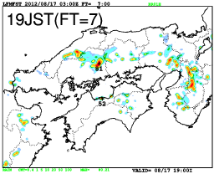
“ASUCA”-based Local NWP System
Effect from the parameterization of convective-initiation newly introduced in ASUCA
1h accumulated precipitation 17 Aug. 2012
Small scale convections initiated under an unstably stratified condition formed from daytime heating of the surface in summer.
Initiation stage
05UTC (14:00 local time)
Operational ASUCA-based System
Observation
Previous JMA-NHM based System
termination stage
10UTC (19:00
Local time)
Operational ASUCA-based System
Observation
Previous JMA-NHM based System
Phases of convection (initiation, development and termination) are improved in the ASUCA forecast.
Numerical Prediction Division, JMA

Slide 23
Future plan

Slide 24
FY2015
FY2016
FY2017
FY2018
FY2019--
Current Supercomputer
Next supercomputer
DX=13km, L128
Hybrid data assimilation
GSM
Upgrade of physics / dynamics
DX=20km, L100
Upgrade of physics/dynamics
Upgrade of data assimilation
Start/upgrade of observation data assimilation
Weekly EPS
Unification
of system
DX=27km, L128
51 members
DX=40km, L60
27 members
DX=40km, L100, 27 members
Unification of 2week and 1month EPS
Start of reforecast
Upgrade of EPS
Typhoon EPS
DX=40km, L60
25 members
Upgrade of EPS
Super computer system upgrade
Numerical Prediction Division, JMA

Slide 25
FY2015
FY2016
FY2017
FY2018
FY2019--
Current Supercomputer
Next supercomputer
Meso EPS
Test operation
DX=5km, L76, 11 members
DX=5km, L76,
21 members
DX=5km, L96
21 members
DX=5km, L48, 11 members
Introduction of ASUCA
Upgrade EPS
DX=5km, L96
Hybrid data assimilation
MSM
Upgrade of vertical resolution
Introduction of ASUCA 4D-Var
DX=5km, L48
DX=5km, L76
Introduction of ASUCA
Upgrade of physics/dynamics
Upgrade of data assimilation
Start/upgrade of observation data assimilation
LFM
DX=2km, L76
Upgrade of analysis cycle
DX=2km, L58
Upgrade of physics/dynamics
Upgrade of data assimilation
Start /upgrade of observation data assimilation
Super computer system upgrade
Numerical Prediction Division, JMA

Slide 26
Activities of the RSMC Tokyo – Typhoon Center Following slides are kindly provided by colleagues at RSMC Tokyo and Office of Marine Prediction
Early Dvorak analysis
NWP-TCEFP
Storm-surge model

Slide 27
Early Dvorak Analysis
T0.0, T0.5, or T1.0 is assigned to a TC meeting 3 or less, 4, or 5 conditions.
T1.5 or T2.0 are assigned when a TCs with T1.0 is further developed.
convective clouds
cyclonic cloud circulation
[1] System has persisted for 12 hours or more.
[4] A dense (-31 ºC or colder) overcast exists within 2.0º lat. from the CSC.
[2] CSC is defined within an area of 2.5º lat. or less in diameter.
[5] The above overcast size is more than 1.5º lat. in diameter.
[3] CSC has persisted for 6 hours or more.
CSC: cloud system center
Notes:
CSC: cloud system center

Slide 28
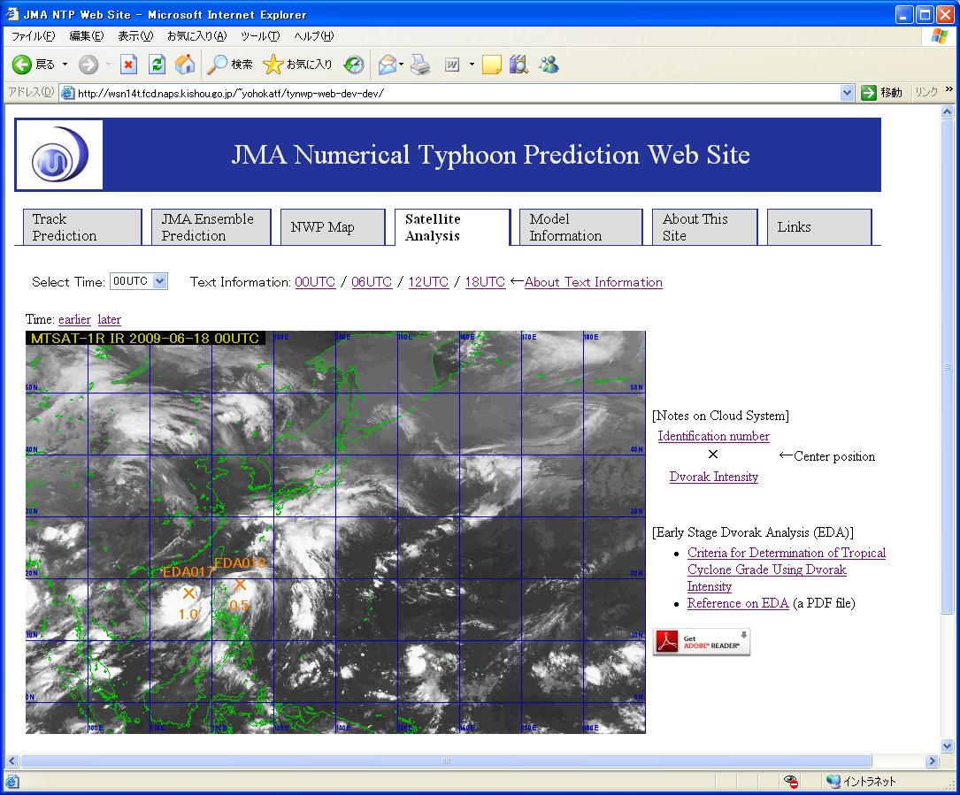
TC genesis probability based on EDA
About 26 % of tropical disturbances analyzed with T-Number of 0.5 reach a tropical storm intensity within 48 hours

Slide 29
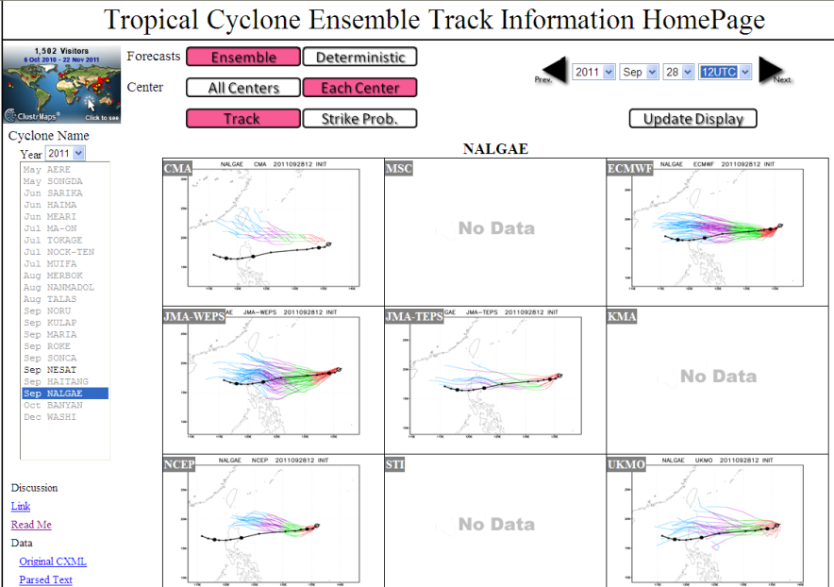
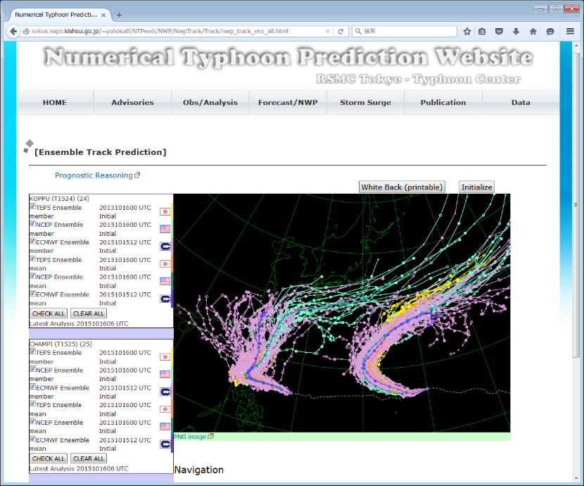
What is WMO North Western Pacific Tropical Cyclone Ensemble Forecast Project (NWP-TCEFP)?
NWP-TCEFP is the initiative by RSMC Tokyo to promote operational use of TC ensemble products in NWP.
NWP-TCEFP website provides TC ensemble products using TIGGE data in a near real-time basis. The effectiveness of such products were confirmed by the WMO questionnaires in 2011 and 2012.
In 2014, RSMC Tokyo requested ECMWF, UKMO, and NWS to send their ensemble NWP data in a real-time basis.
NCEP, UKMO, and ECMWF ensemble track guidance have been provided through the Numerical Typhoon Prediction website.

Slide 30
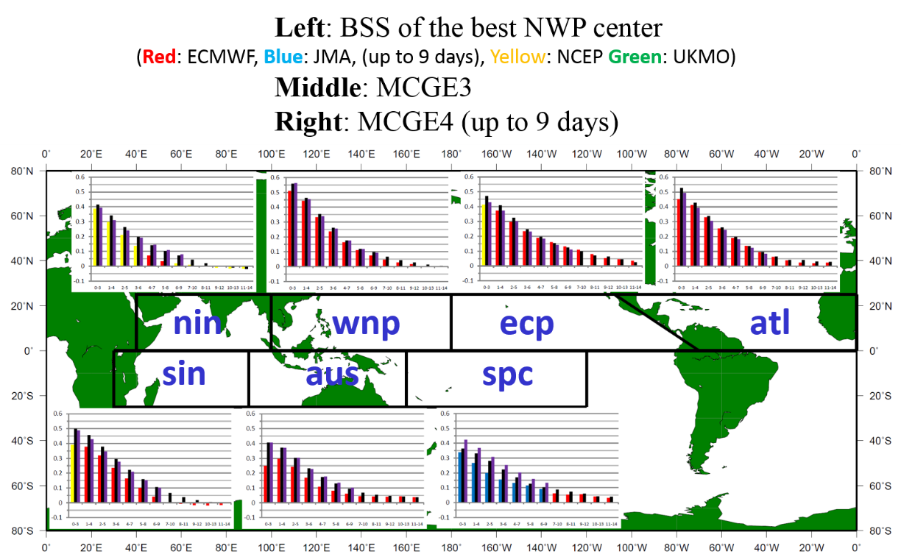
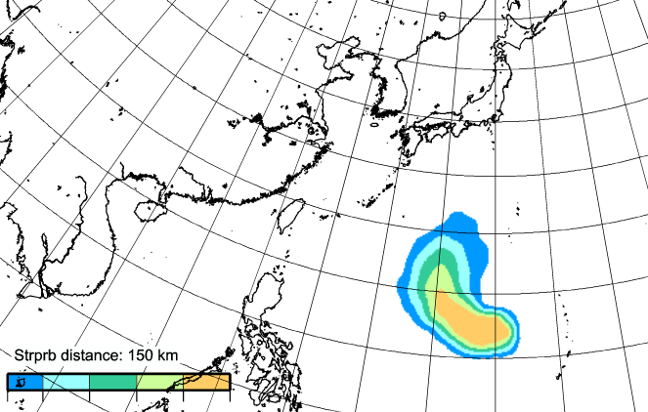
TC activity forecast on NWP-TCEFP
SAMPLE
In most of these basins, these operational global medium-range ensembles are capable of providing skillful guidance of TC activity forecasts with a forecast lead time extending into week 2.
The MCGEs have more skill (larger BSS) than the best single-model ensemble, which is generally the ECMWF ensemble for most time windows and in most TC basins.
Yamaguchi et al. (2015, WAF) http://journals.ametsoc.org/doi/abs/10.1175/WAF-D-14-00136.1

Slide 31
TC activity prediction based on EPS
Grand Ensemble
ECMWF
NCEP
UKMET
RSMC Tokyo strongly desires NCEP provides TC tracking data!!! (This background image is dummy)

Slide 32
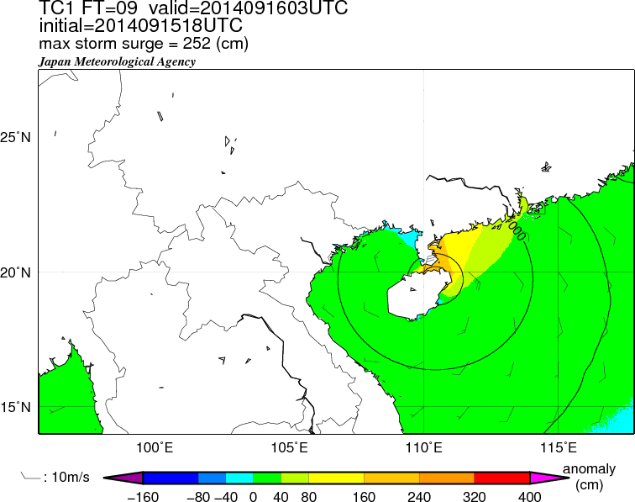
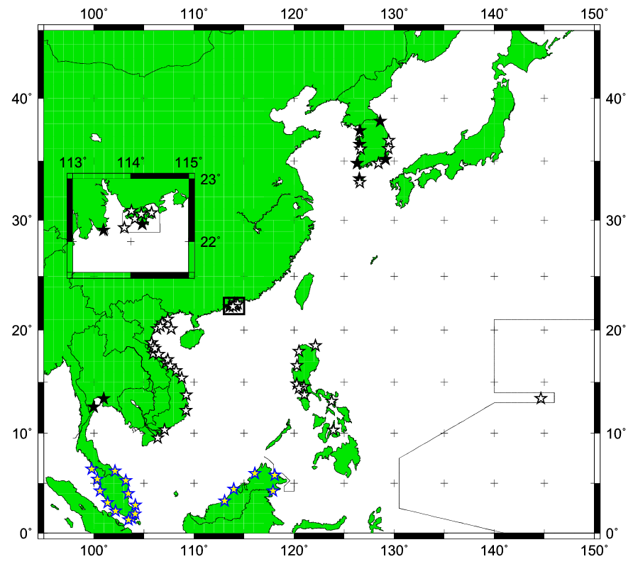
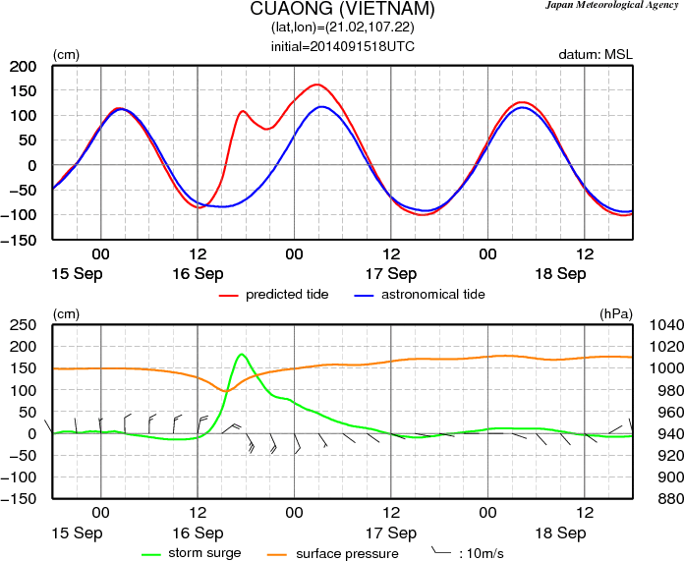
Regional Storm Surge Prediction
RSMC Tokyo has provided storm surge prediction in WNP to the Typhoon Committee Members since 2011.
Storm surge distribution maps
Time series prediction charts
68 stations
↑ enlarged map image
The maximum surge height in the domain is added since 24 September.
★：~2013
☆：added in 2014
☆：added in Jan. 2016
32

Slide 33
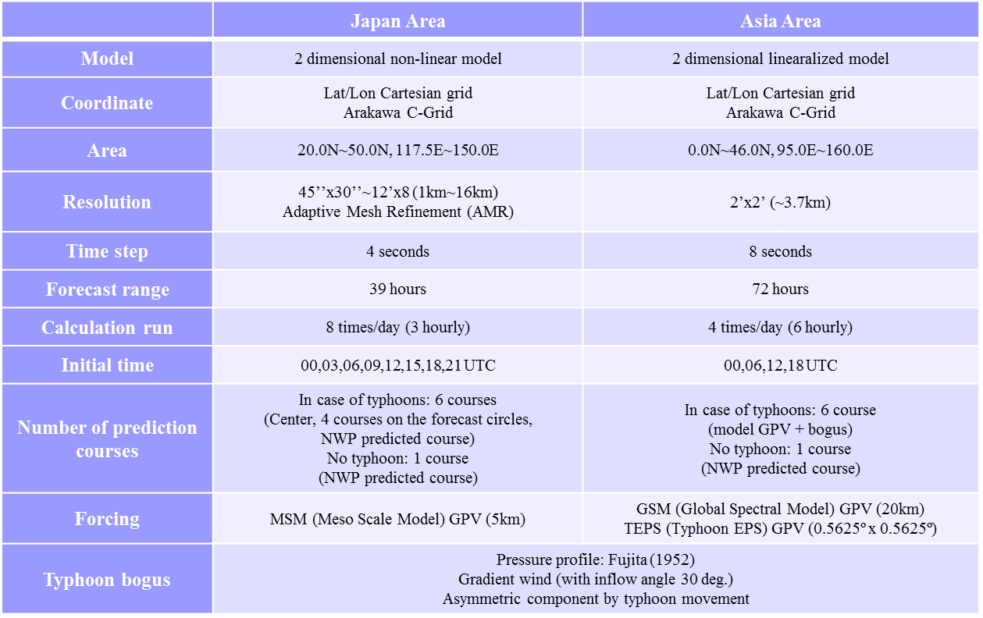
Specification of Storm Surge model
Notes:
Table 1 shows the outline of the specifications of the SSWS storm surge model. The horizontal grid
resolution is 2 minutes, corresponding to a distance of about 3.7 km. The model covers almost all coastal
areas in the RSMC Tokyo area of responsibility (Figure 4). It runs four times a day (every 6 hours) on the
JMA supercomputer system, and calculates storm surge predictions up to 72 hours ahead.
Each calculation takes about 10 minutes, and storm surge distribution maps are created using the
results. When no typhoon is expected during the forecast time, the model calculates data only for the next
run, and no distribution maps are produced.

Slide 34
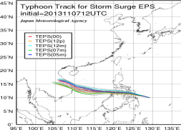
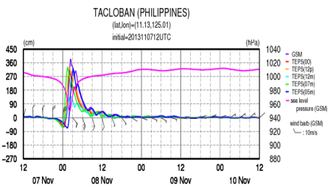
Multi-scenario Storm Surge Prediction
Additional five storm surge predictions based on five TC track scenarios derived from the cluster analysis (k-mean clustering) from 25 members of JMA’s Typhoon Ensemble Prediction System (TC intensity scenarios are based on TC advisory).
TEPS (25 members ⇒ five typhoon tracks)
TC intensity of these scenarios is based on those in TC advisory

Slide 35
Future Challenges & Directions
TC Genesis
Need NWP based objective guidance for issuance of quantitative TC genesis prediction
Potential for 5 Day TC genesis forecasts
TC Track Forecast
Potential for further improvement in TC track accuracy (7 Day track forecast ?)
Better use of ensemble forecasts to represent track forecast uncertainty
TC Intensity Forecast
Need objective guidance to issue 5 Day TC intensity forecasts
Potential of regional NWP models for use of TC intensity guidance
TC Analysis
Better use of satellite microwave data for TC intensity estimates
Utilization of Himawari-8 for TC analysis/forecast
TC Forecast Competency & Forecast Training
Establishment of TC forecaster competency & better forecaster training

Slide 36
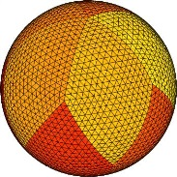
Global 7-km mesh nonhydrostatic Model Intercomparison Project for improving TYphoon forecast (TYMIP-G7)
DFS
(MRI)
Double Fourie Series model
NICAM
(JAMSTEC/AORI/AICS)
Icosahydral grid
MSSG
(JAMSTEC)
Yin-Yang grid
Nakano, M., Wada, A., Sawada, M., Yoshimura, H., Onishi, R., Kawahara, S., Sasaki, W., Nasuno, T., Yamaguchi, M., Iriguchi, T., Sugi, M., and Takeuchi, Y.: Global 7-km mesh nonhydrostatic Model Intercomparison Project for improving TYphoon forecast (TYMIP-G7): Experimental design and preliminary results, Geosci. Model Dev. Discuss., doi:10.5194/gmd-2016-184, in review, 2016
This project was conducted as “The Earth Simulator Strategic Project with Special Support” of JAMSTEC. All numerical experiments were run on the Earth Simulator (NEC SX-ACE).

Slide 37
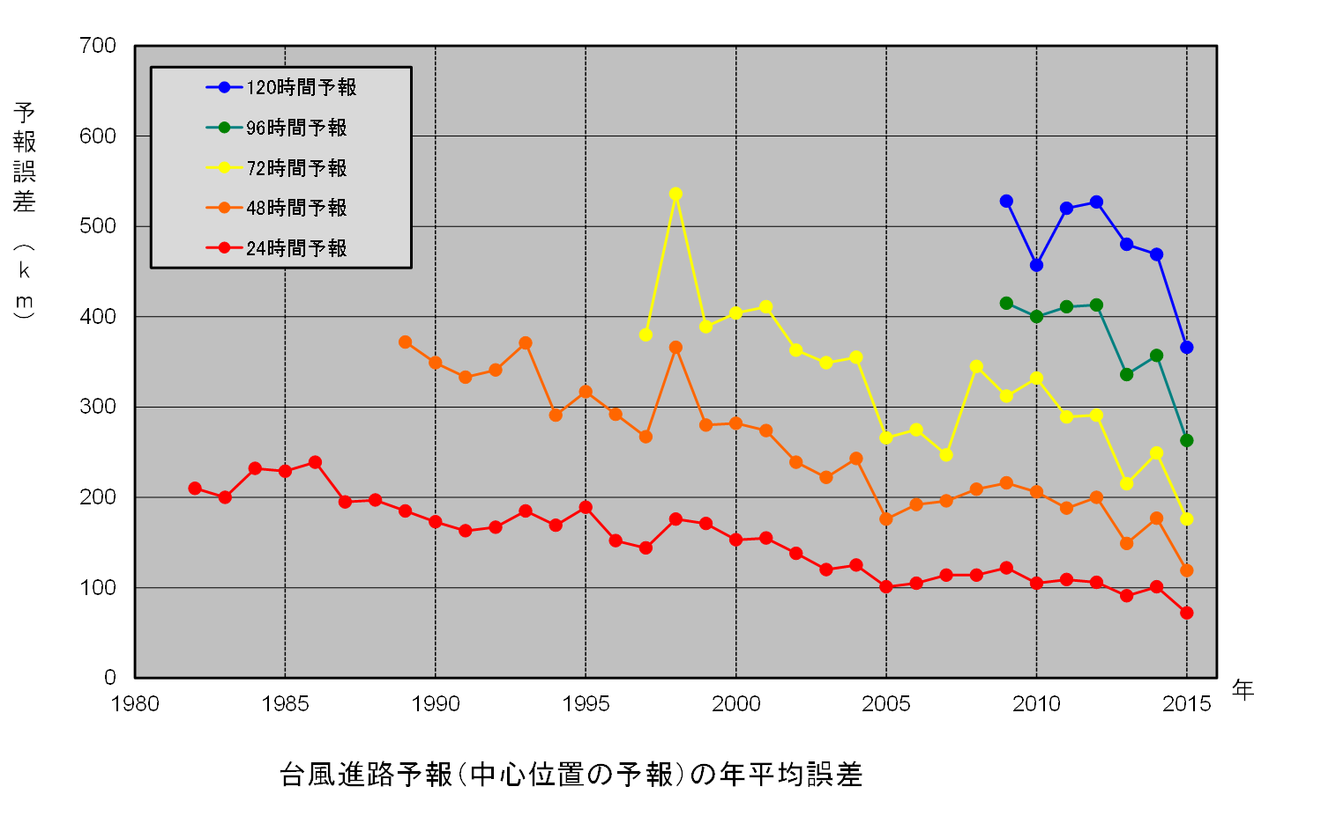
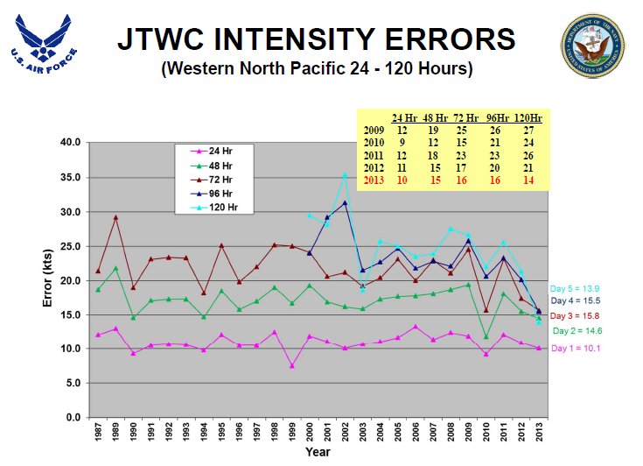
Background of this project
Social needs for TC prediction and advancement in high-performance computer
Further improvement of TC track prediction
Improvement by sophisticate TC intensity prediction
(From JTWC website)

Slide 38
Aim of project & expected outcome
Quantify the advantage of high resolution nonhydrostatic global atmospheric models
Verify benefit of multi-model ensemble
Gain knowledge of physical schemes suitable for high-resolution models
Develop efficient handling method for big-data
Sharing the knowledge obtained in this project among research and operational communities would facilitate R2O

Slide 39
Outline of Model and experiments
First stage: 2013/9-10, most activate TC season since 1951. 9 TCs in 52 runs.
Second stage: a lifecycle of a TC such as genesis, rapid intensification, recurvature, extratropical transition. 13 TCs in 85 runs.
 | GSM | DFSM | MSSG | NICAM
Horizontal grid configuration | Reduced linear Gaussian grid | Reduced linear equally spaced latitude grid | Yin-yang grid | Icosahedral grid
Dynamical core | Hydrostatic spectral model using spherical harmonics | Nonhydrostatic spectral model using double fourier series | Nonhydrostatic grid model using finite difference method | Nonhydrostatic grid model using finite volume method
Cloud physics | Smith(1990) | Smith(1990) | Onishi&Takahashi (2012) | Tomita (2008)
Cumulus convection | Randall&Pan (1993) | Randall&Pan (1993) | Not used | Not used
PBL | MY2 (Mellor&Yamada,1974,1982) | MY2 (Mellor&Yamada, 1974,1982) | MYNN2.5 (Nakanishi&Niino, 2009) | MYNN2 (Nakanishi&Niino,2004; Noda et al. 2010)
Radiation | Yabu(2013) | Yabu (2013) | MSTRN-X (Sekiguchi&Nakajima, 2008) | MSTRN-X (Sekiguchi&Nakajima, 2008)
Land/Sea surface | SiB(JMA,2013) | SiB (JMA,2013) | Bucket (option: 3D ocean model) | MATSIRO (Takata et al. 2003) Slab ocean model

Slide 40
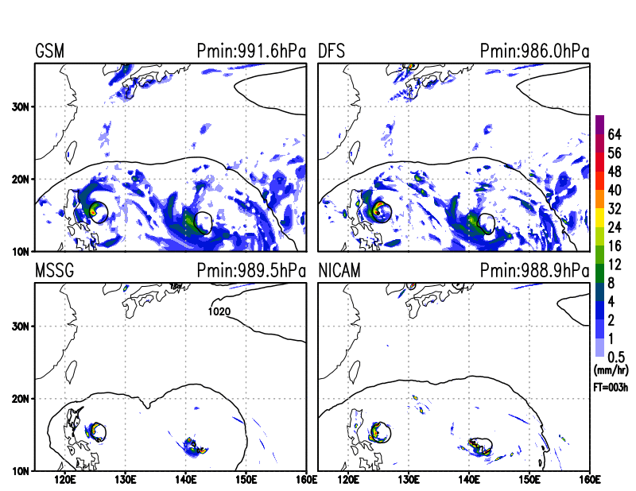
SLP and rainfall distribution -animantion-

Slide 41
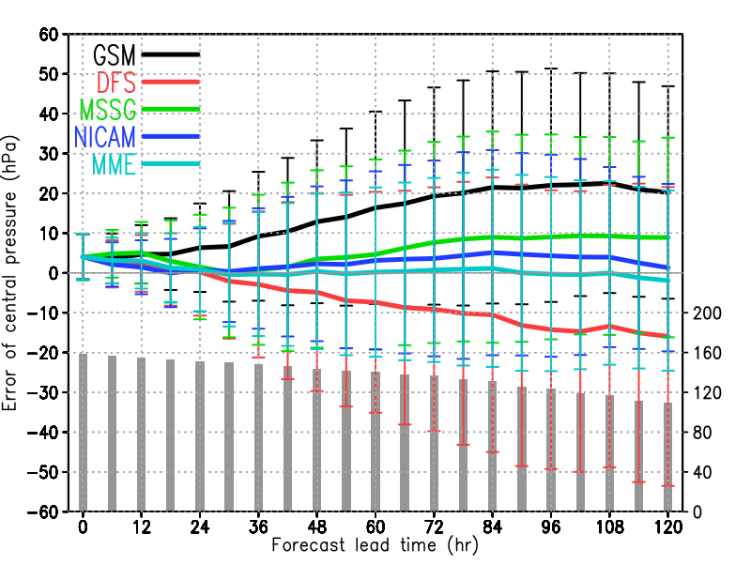
Bias of TC Intensity
The 7-km models reduces systematic intensity forecast bias compared with the 20-km model.

Slide 42
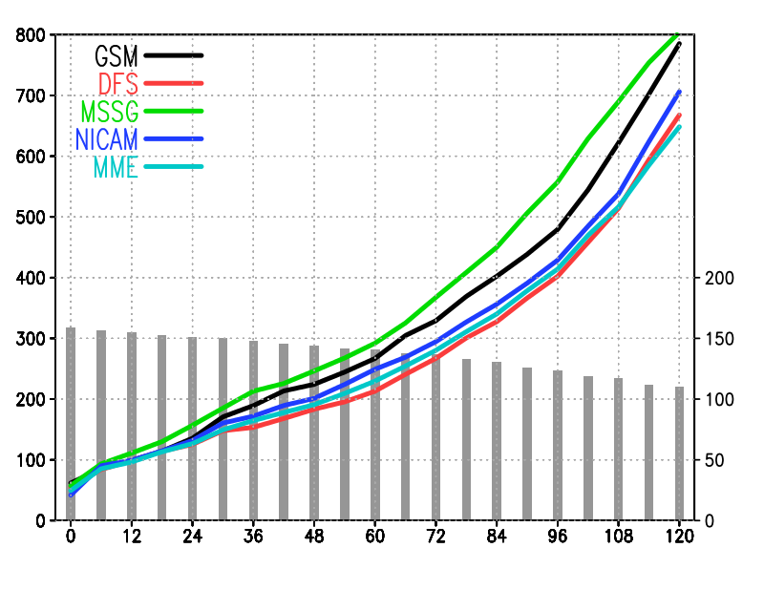
TC track error-1
DFS and NICAM show better track forecast compared with the 20-km model. MSSG seems to be the worst of them all but the track error has been reduced by modifying physics.

Slide 43
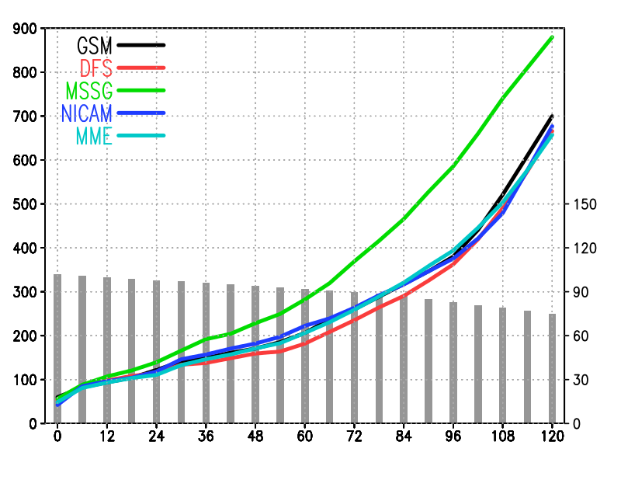
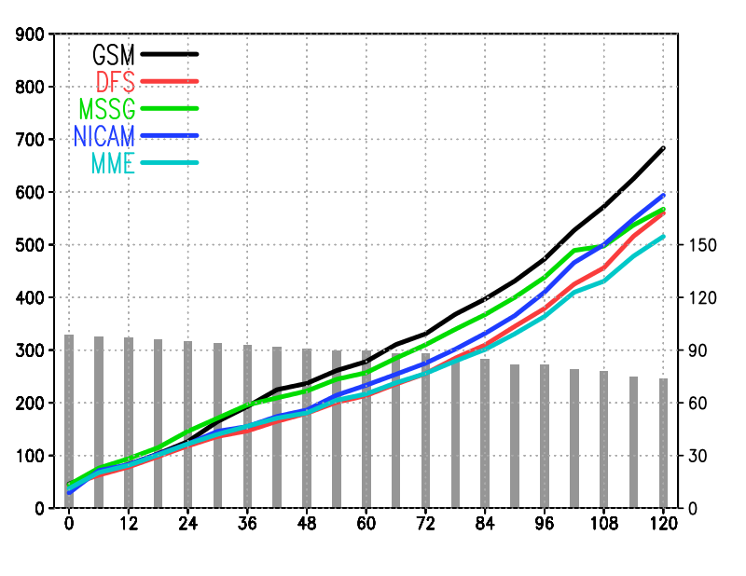
TC track error-2
First stage
Second stage
First stage of the project, MSSG shows the largest track error. In second stage, track error of MSSG is smaller than that of GSM for the forecast lead time longer than 48 hours.

Slide 44
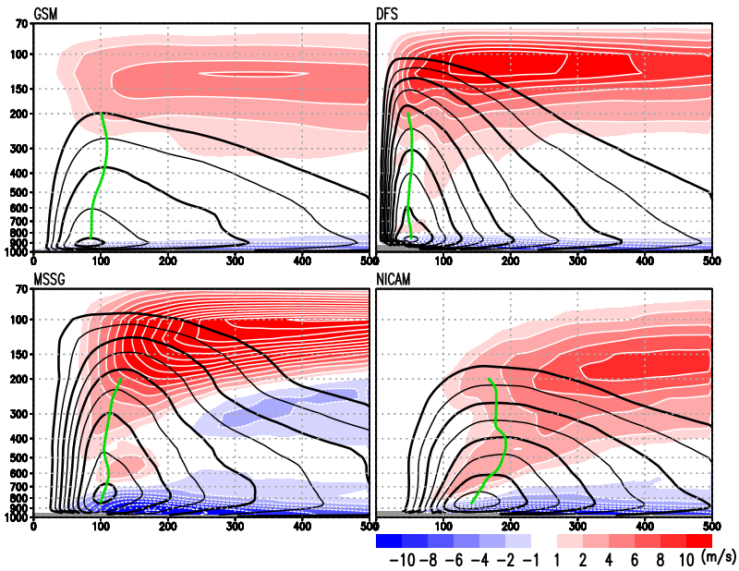
Vertical structure of Vt & Vr
Composite for One typhoon case using 15 experiments.
Color: radial wind
Cotour: tangential wind （>15m/s, 5m/s interval）
Green line：RMW
_{DFSM: smallest RMW}
_{MSSG: thickest inflow layer}
_{NICAM: shallower TC vortex}

Slide 45
Summary and future work on TYMIP-G7
The 7-km models statistically improve both TC intensity and track predictions, whereas improvement of individual TC track depended on the case.
The MME is a promising approach to further enhancement of TC intensity and track predictions.
Predicting rapid intensification is still challenging for 7-km mesh global atmospheric models.
Predicted TC structure differs greatly among the three models, even though they have the same horizontal resolution.
Why are the TC predictions improved by high-resolution models?
What causes the differences in simulated TC structure among the three 7-km mesh atmospheric global models?

