Slide 1
Coupled Atmospheric Chemistry Schemes for Modeling Regional and Global Atmospheric Chemistry
Emily M. Saunders & William R. Stockwell
Howard University, NCAS (NOAA Center for Atmospheric Sciences)
Date: July 27, 2016

Slide 2
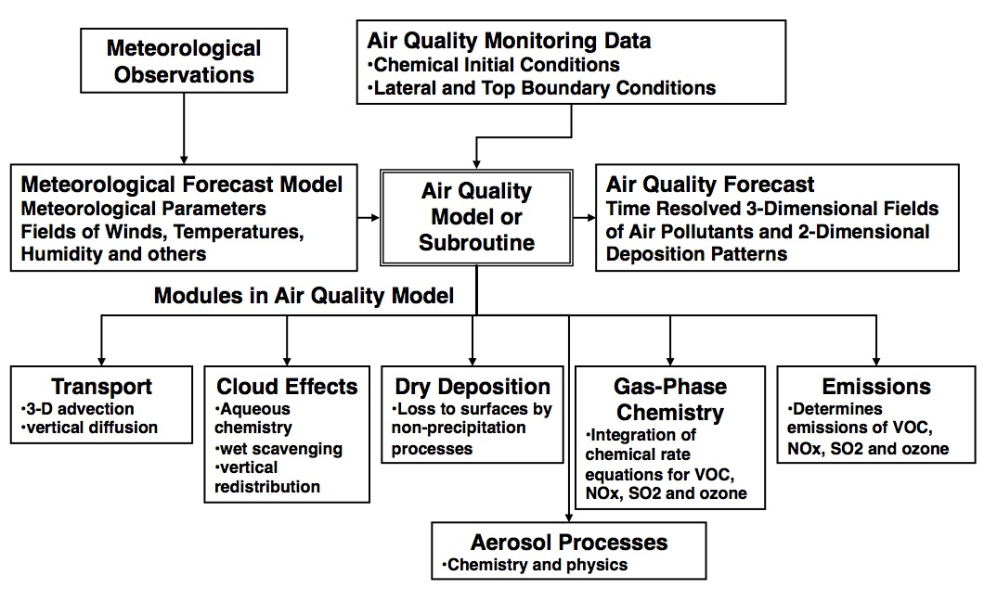
Air Quality Models
Stockwell, et. al., 2002
Notes:
Air quality models use mathematical and numerical techniques to simulate the physical and chemical processes that affect air pollutants as they disperse and react in the atmosphere. Based on inputs of meteorological data and source information like emission rates and stack height, these models are designed to characterize primary pollutants that are emitted directly into the atmosphere and, in some cases, secondary pollutants that are formed as a result of complex chemical reactions within the atmosphere. These models are important to our air quality management system because they are widely used by agencies tasked with controlling air pollution to both identify source contributions to air quality problems and assist in the design of effective strategies to reduce harmful air pollutants. For example, air quality models can be used during the permitting process to verify that a new source will not exceed ambient air quality standards or, if necessary, determine appropriate additional control requirements. In addition, air quality models can also be used to predict future pollutant concentrations from multiple sources after the implementation of a new regulatory program, in order to estimate the effectiveness of the program in reducing harmful exposures to humans and the environment.

Slide 3
Regional Atmospheric Chemistry Mechanism (RACM2)
Gas phase mechanisms play a vital role in air quality models because the mechanisms are incorporated into the modules that are use to calculate the concentrations of chemical sources, sinks of ozone, and the precursors of particulates.
The Regional Atmospheric Chemistry Mechanism (RACM2) is a gas-phase chemical mechanism that is widely used for the modeling of regional atmospheric chemistry (Stockwell, et. al., 2013).
Notes:
It includes 17 stable inorganic species, 4 inorganic intermediates, 55 stable organic species (3 of these are primarily of biogenic origin) and 43 organic intermediates includes 363 reactions. The gas phase chemistry of the polluted atmosphere helps determine the effect of emissions on the production of ozone and other air pollutants produced within the lower atmosphere. These chemical mechanisms consist of chemical species, reactions, rate constants and photochemical data (used to calculate the photolysis frequencies). Aggregated species are placed in the mechanism to represent a group of organic species within the atmosphere.

Slide 4
Global Atmospheric Chemistry Mechanism (GACM)
The global atmospheric chemistry mechanism will be the global version of RACM2 to run simulations around the globe and produce output of species within the atmosphere in regional and global communities.
GACM includes additional chemistry for marine environments while reducing its treatment of the chemistry needed for highly polluted urban regions. The overall reduction in GACM’s size will allow it to be used efficiently in global models.
Notes:
GACM’s chemistry of volatile organic compounds (VOC) is highly compatible with the VOC chemistry in RACM2. This compatibility in VOC should reduce error when a model with GACM is used to provide boundary conditions for a model with RACM2. The global gas-phase chemical mechanism will help predict the atmospheric oxidants produced within the atmosphere in both a local and global regions. The GACM-RACM2 system of mechanisms will hopefully yield more accurate forecasts over the ocean and land. The implementation of GACM initial conditions into a current regional air quality models will show how global gas phase chemical mechanisms can help produce better air quality model forecasts for the regional scale.
Chemistry was removed because the globe covers a much wider area (lower resolution and larger grid slice). The mechanism should have a more simple mechanism, not as detailed as regional model. Added species the were more marine chemistry friendly because RACM2 was created for the highly polluted continental United States.

Slide 5
Boundary Conditions
Lateral and top boundary conditions (BCs) are a major uncertain factor in regional air quality prediction.
In principle, regional chemical transport/air quality model should also import boundary conditions from corresponding global models in order to consider the external forcings.
However, additional uncertainties are introduced in this importing process because of the uncertainties in the global models, and because of differences in resolution between the global and regional models, and differences in model formations, such as chemical mechanisms (Tang, Y, et. al., 2007).
Notes:
These results have important implication for air quality modeling, as the treatment of BCs is recognizes as a large source of uncertainty. In the past air quality predictions have had to rely on the use of climatological, and often fixed, BCs. As global model predictions have become available, regional air quality models are beginning to use BCs from the global models.
The most important advantage of using global model BCs is that these BCs can bring time-varied external signals to the regional domain, and reflect certain event information, such as biomass burning, stratospheric intrusion, and Asian air mass inflow.These results suggest that the use of global model BCs can improve regional air quality predictions. These results also point out that further improvement in regional model predictions will require efforts to reduce the uncertainty in the global model BCs.

Slide 6
GACM-RACM2 System
GACM
GACM Boundary Conditions
RACM2
Air Quality Forecast (Regional/Global)
GACM is intended for use in global scale atmospheric chemistry models to provide chemical boundary conditions for regional scale simulations by models such as CMAQ.
GACM includes additional chemistry for marine environments while reducing its treatment of the chemistry needed for highly polluted urban regions. This keeps GACM’s size small enough to allow it to be used efficiently in global models.
GACM’s chemistry of volatile organic compounds (VOC) is highly compatible with the VOC chemistry in RACM2 allowing a global model with GACM to provide VOC boundary conditions to a regional scale model with RACM2 with reduced error.
The GACM-RACM2 system of mechanisms should yield more accurate forecasts by regional air quality models such as CMAQ.

Slide 7
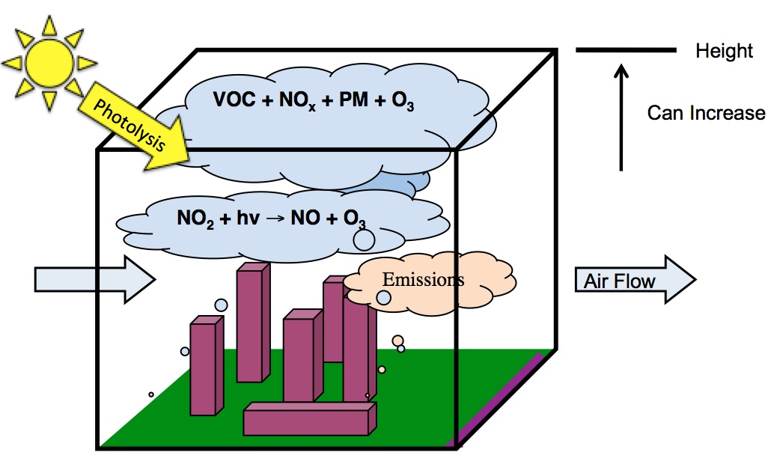
The S-BOX Model
Stockwell, et. al., 2002
Notes:
S – Box Model: The box model used to run simulations with the regional atmospheric chemistry mechanism is based on the concept behind the Eulerian box model. The Eulerian box encloses on a region in the atmosphere, which is assumed to have a height equal to the mixing layer height. The mixing layer height can vary at times to simulate the atmospheric condition state. The model is based upon the mass conservation of a species inside the Eulerian box of volume. Measures/calculates chemistry at a particular point.
Box Model w/ RACM2: The chemical compiler reads the rate constants from the reactions and sets up the differential equations and reads them into Fortran code or any other mathematical language that can read the data output. Basically it creates the subroutines that are called has a numerical solver.

Slide 8
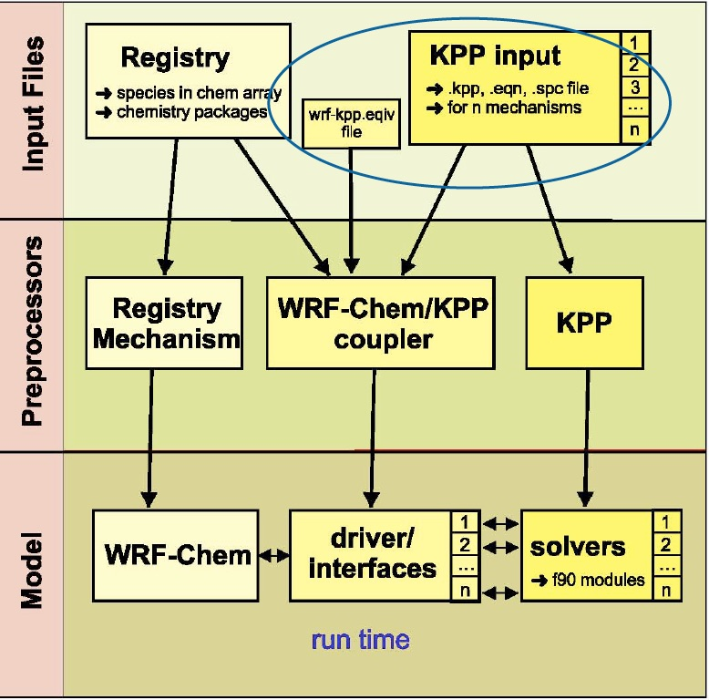
Weather Research & Forecasting Model (WRF-Chem)
NCAR (National Center for Atmospheric Research), 2015
Notes:
WRF-Chem- is a numerical weather prediction (NWP) system designed to serve both atmospheric research and operational forecasting needs. NWP refers to the simulation and prediction of the atmosphere with a computer model, and WRF is a set of software for this.
KPP software tool used to read the chemical reactions and rate constants from the mechanism (ASCII) input files and automatically generates code for chemistry integration using the Rosenbrok solver (more efficient, less time consuming, less errors, numerically efficient, and flexibility in updating the mechanism with additional species and equations).
WRF-Chem/KPP Coupler writes the f90 interfaces between WRF-Chem and KPP generated code, minimum modifications to WRF-Chem, almost everything in one directory and also minimum changes in KPP, script to automatically compile/run KPP during WRF compile time
Add changes to the registry and KPP input (adding new reactions with rate constants to .eqn file, add new species to the .spc, add new defined functions to the .def file). After add all new species to the registry.chem file (if not already there). Compile new WRF-Chem source code. Update subroutines (i.e. chem_driver.F is adding new emissions. Be sure to add new emissions and chemical to emission and chem. package.

Slide 9
EPA BenMAP-CE Program
The BenMAP-CE program estimates the human health impacts and economic value of air quality changes.
First, BenMAP-CE determines the change in ambient air pollution using user-specified air quality data.
Next, BenMAP-CE applies the relationship between the pollution and certain health effects.
BenMAP-CE applies that relationship to the exposed population to calculate health impacts (EPA, 2015).
Notes:
This relationship is often referred to as the health impact function or the concentration-response (C-R) function, which is derived from epidemiology studies as shown in Figure 1-1.

Slide 10
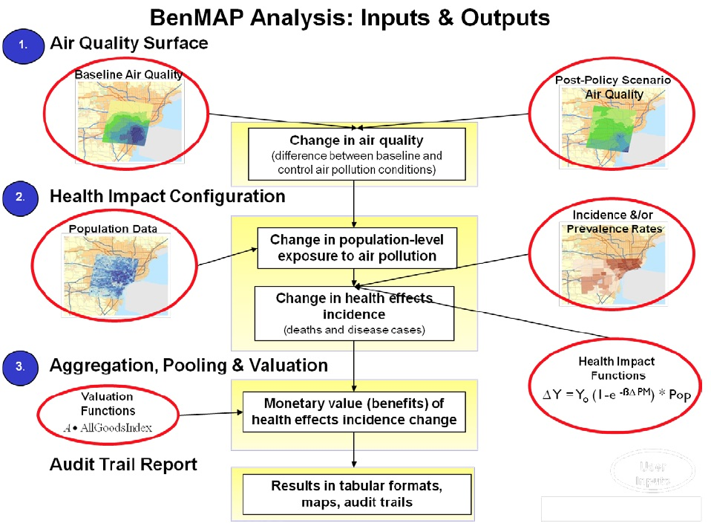
BenMAP Analysis
EPA BenMAP-CE, 2015
Notes:
Analysts can use BenMAP-CE to:
Create maps illustrating the population/community level ambient pollution levels;
Compare benefits associated with various regulatory programs;
Characterize the distribution of health impacts among population sub-groups;
Estimate health impacts and economic values of existing air pollution concentrations;
Estimate the health benefits of alternative ambient air quality standards; and
Perform sensitivity analyses of health or valuation functions, or of other inputs.
C-R function Y_{o}-Baseline Incidence, B-Health effect estimate, PM-Air quality change, Pop-exposed population
Health Effect = Air Quality Change * Health Effect Estimate * Exposed Population * Health Baseline Incidence
Air Quality Change. The air quality change is the difference between the starting air pollution level (i.e., the baseline) and the air pollution level after some change, such as a new regulation (i.e., the control).
Health Effect Estimate. The health effect estimate is an estimate of the percentage change in the risk of an adverse health effect due to a one unit change in ambient air pollution.
Exposed Population. The exposed population is the number of people affected by the air pollution reduction. The government Census office is a good source for this information.
Health Baseline Incidence. The health incidence rate is an estimate of the average number of people who die (or suffer from some adverse health effect) in a given population over a given period of time.
BenMAP-CE also calculates the economic value of avoided health effects. After calculating the health changes, you can estimate the economic value by multiplying the reduction of the health effect by an estimate of the economic value per case:
Economic Value = Health Effect * Value of Health Effect

Slide 11
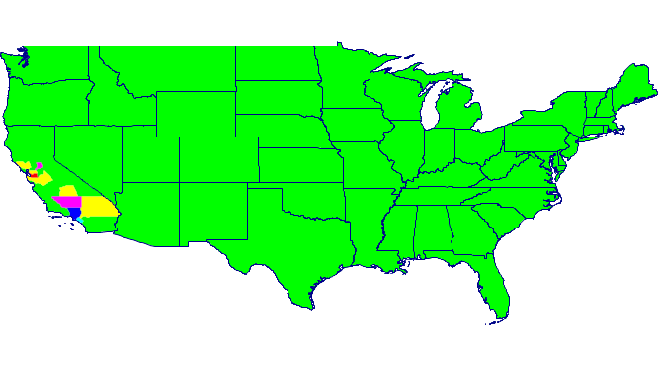
BenMAP Results – USA Map
Map of USA which shows the health impacts due to poor air quality, particularly in the Southern California Region.

Slide 12
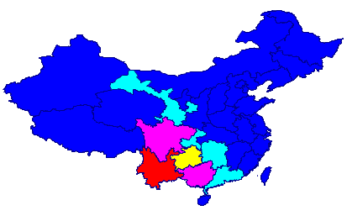
BenMAP Results – China Map
Map of China which shows the health impacts due to poor air quality.

Slide 13
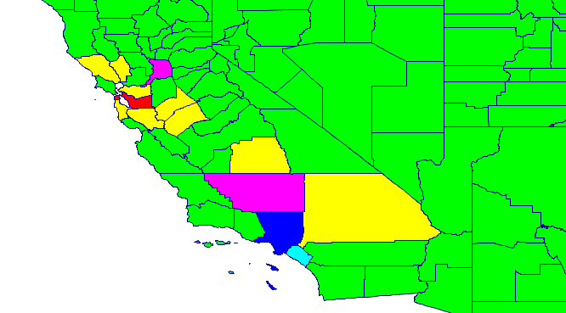
BenMAP Results – L.A. County Map
Map of the counties in the California, which shows the health impacts due to poor air quality.

Slide 14
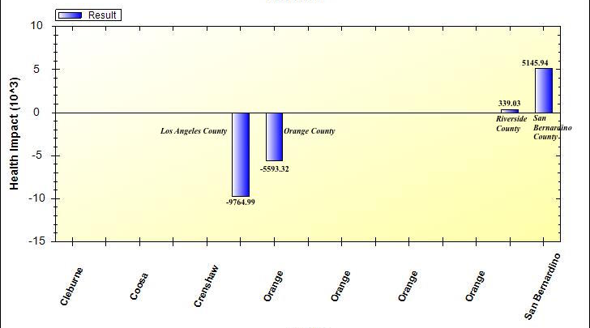
BenMAP Results - Chart
Chance in acute respiratory symptoms incidences* by selected counties from BenMAP-CE calculations.
*The incidence rate is the number of health outcomes (e.g., number of hospital visits) per person, per unit of time (generally a day or a year)—from air pollution as well as all other causes.*

Slide 15
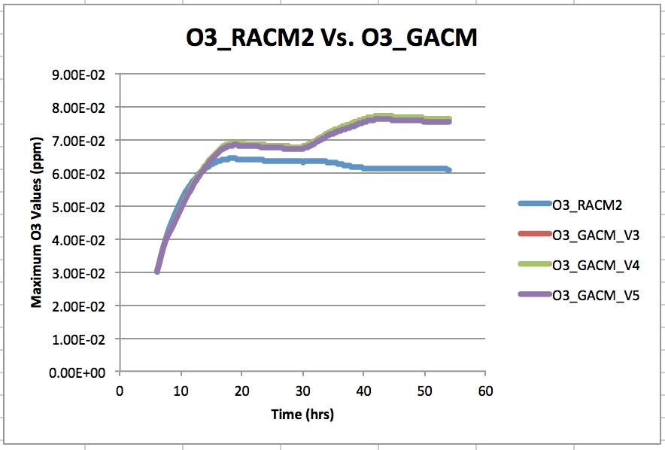
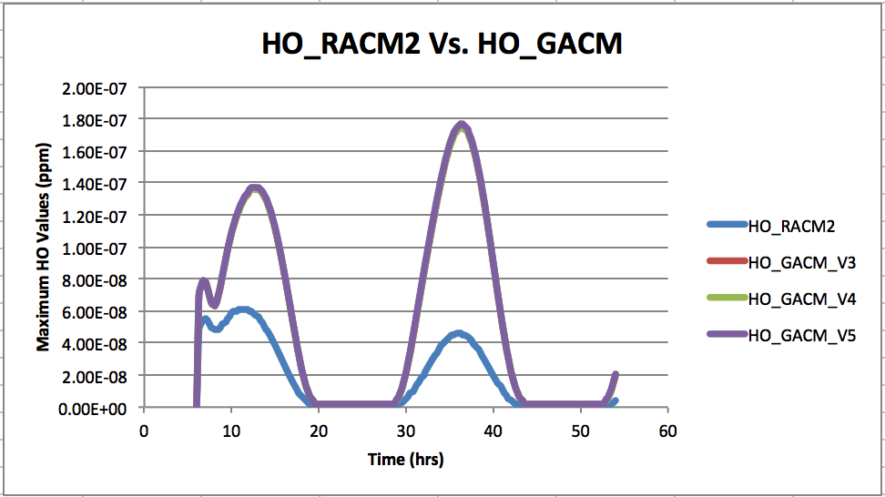
GACM Expected Results – Box Model Runs
Time Series of Ozone shows that GACM predicts more ozone (O₃) and hydroxyl radical (HO)production
GACM V3 – Initial input concentrations does not include halogen or DMS, GACM: modified RACM2
GACM V4 – Initial input concentrations does include halogen (Br & Cl) and DMS, GACM: modified RACM2
GACM V5 – Initial input concentrations does not include halogen (Br, Cl & I) or DMS, GACM: modified RACM2. Iodine reacted with O₃ to produce IO and Iodine oxide reacted with HO₂, ClO, & NO to produce HOI & I.

Slide 16
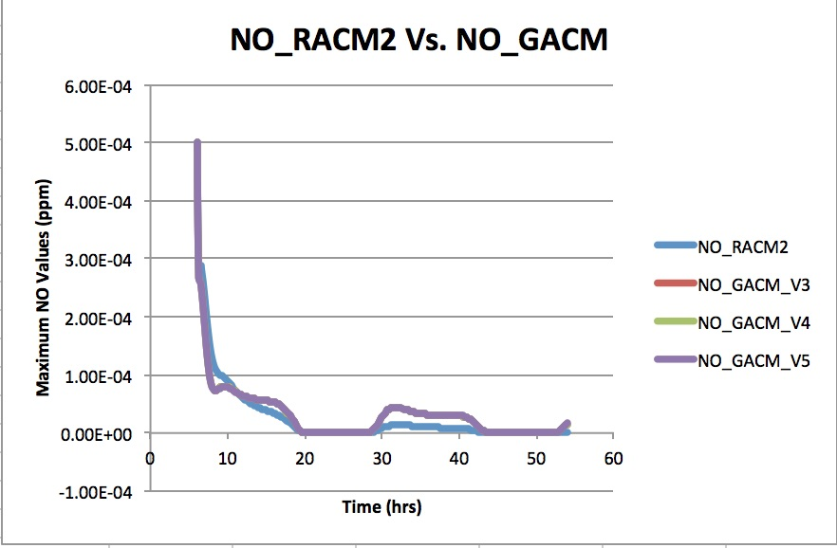
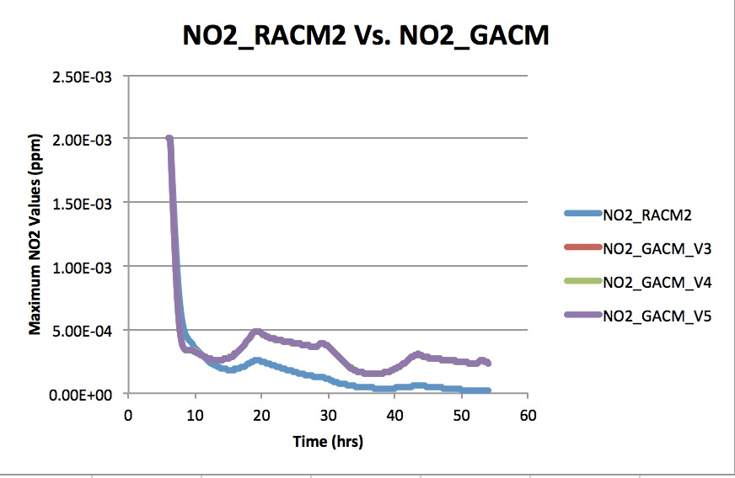
GACM Expected Results – Box Model Runs (Cont’d)
Time Series of NO and NO₂ shows that GACM produces slightly more NOx throughout the day.
GACM V3 – Initial input concentrations does not include halogen or DMS, GACM: modified RACM2
GACM V4 – Initial input concentrations does include halogen (Br & Cl) and DMS, GACM: modified RACM2
GACM V5 – Initial input concentrations does not include halogen (Br, Cl & I) or DMS, GACM: modified RACM2. Iodine reacted with O₃ to produce IO and Iodine oxide reacted with HO₂, ClO, & NO to produce HOI & I.

Slide 17
GACM Expected Results –Toluene Chamber Data Analysis Runs
Time series of O₃ and NO RACM2 Toluene chamber data against GACM shows that GACM produces more of both species throughout the day
RACM2_Chamber – RACM2 ec340 (Toluene) chamber data from collaborator Wendy Goliff
GACM_ec340 – GACM mechanism with added wall reactions for ec340 chamber data, run with ec340 input and ec340 photolysis file
GACM_ec340(DCB Increase) – Same as GACM_ec340, but increased the rate constant of DCB (dicarbonyls)
Notes:
The real test of the system is the overall performance of the GACM-RACM2 coupled modeling. But its good to use chamber data as a “bench mark” at least. Given that we are trying to use a more simplified aromatic scheme, optimizing DCB yields (we have only one DCB species in GACM) to improve its performance against chamber and against RACM2 simulations does not seem out of the question.

Slide 18
GACM Expected Results –Toluene Chamber Data Analysis Runs (Cont’d)
Time series of TOL RACM2 Toluene chamber data against GACM shows a slight difference and NO₂ shows that GACM produces more NO₂ throughout the day.
RACM2_Chamber – RACM2 ec340 (Toluene) chamber data from collaborator Wendy Goliff
GACM_ec340 – GACM mechanism with added wall reactions for ec340 chamber data, run with ec340 input and ec340 photolysis file
GACM_ec340(DCB Increase) – Same as GACM_ec340, but increased the rate constant of DCB (dicarbonyls)

Slide 19
GACM Expected Results –Xylene Chamber Data Analysis Runs
Time series of O₃ and NO RACM2 Toluene chamber data against GACM shows a major difference from the chamber data, but that is expected since GACM does not include many aromatics except for toluene.
RACM2_Chamber – RACM2 ec344 (Xylene) chamber data from collaborator Wendy Goliff
GACM_ec344 – GACM mechanism with added wall reactions for ec344 chamber data, run with ec344 input and ec344 photolysis file
GACM_ec344(DCB Increase) – Same as GACM_ec344, but increased the rate constant of DCB (dicarbonyls)

Slide 20
GACM Expected Results –Xylene Chamber Data Analysis Runs (Cont’d)
Time series of O₃ and NO RACM2 Toluene chamber data against GACM shows a major difference from the chamber data, but that is expected since GACM does not include many aromatics except for toluene.
*Rate constant weighting was calculated between GACM TOL and RACM2 Chamber XYL to graph the results, this was done by taking the ratio of the rate constants between xylene and toluene. Equation: k_{xyll+ho}/k_{tol+ho}*

Slide 21
Conclusion
Air Quality Models
Atmospheric Chemistry Mechanisms
Global Models & Boundary Conditions
GACM-RACM2 Coupled System

Slide 22
References
Tang, Y., et al. (2007), Influence of lateral and top boundary conditions on regional air quality prediction: A multiscale study coupling regional and global chemical transport models, J. Geophys. Res., 112, D10S18, doi:10.1029/2006JD007515.
Gollif, W., Stockwell, W. R., & Lawson, C. V.. (2013). The Regional Atmospheric Chemistry Mechanism, Version 2, Science Direct, Volume 68, Pages 174-185.
E.P.A. (2015). Environmental Benefits Mapping and Analysis Program-Community Edition: User’s Manual. Research Triangle Park, NC: Author.

Slide 23

Thank You!!!!

Slide 24

Questions ?????

