Slide 1
Forecast Evaluation: Statistical Techniques for Decision Support
Betsy Weatherhead
U. Colorado at Boulder
September 17, 2015

Slide 2
Many metrics exist - for evaluating a variety of parameters
Examples of metrics:
  Bias (too high, too low)
  Absolute Bias (doesn’t matter if it’s too high or too low)
  500 mb anomaly correlations
  RMSE (typical forecasting error, sign irrelevant)
  BCRMSE (typical forecast error, after forecast has been corrected for typical bias)
  Distance from location of landfall
  Storm intensity errors
Many more metrics are being developed for ensemble forecasting, and extreme events.
Some metrics are more valuable to the end user than others. How a final product will be used can dictate to how the analysis should take place.

Slide 3

With multiple approaches, we’d very much like a report card
The model with the best score is declared the best model.
BUT
  Identifying differences is one task
  Assuring that observed differences are likely to represent future behavior is harder.
  The need for statistical significance
We need an honest report card

Slide 4
Likely results: Models’ performance will look nearly identical.
Possible Report Card for Relative Humidity
Forecast Model | RMSE | St. Err.
Model A | 1.467 | .263
Model B | 1.385 | .259
It is hard to have confidence that one model will perform better than the other in the long run.
Very hard to have confidence in the amount of improvement.

Slide 5
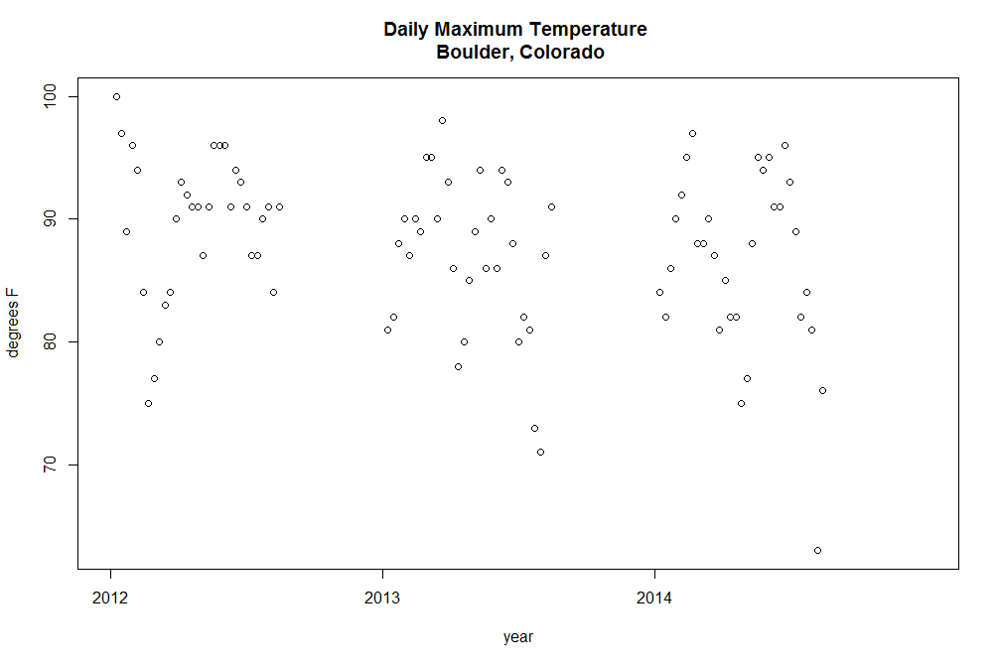
Small sidebar:
Standard Deviation and Standard Error
Two separate questions: what is the average spread, and what is our level of certainty on the mean.
These are daily maximum values (ºF) in July

Slide 6
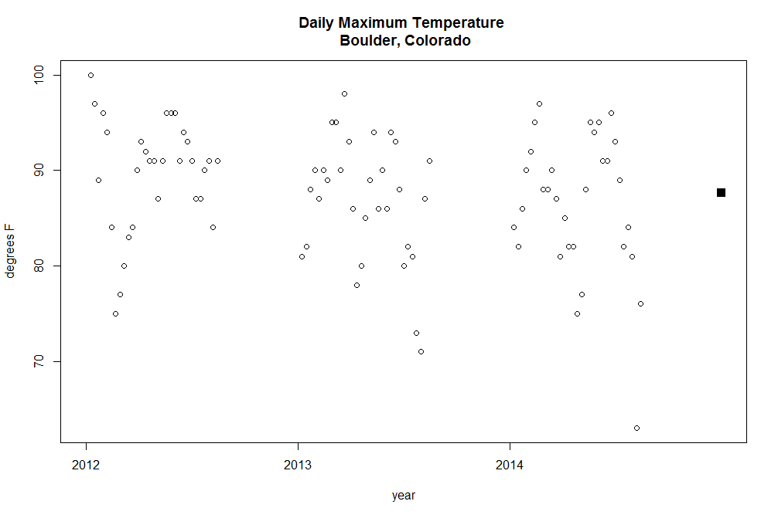
Small sidebar:
Standard Deviation and Standard Error
Two separate questions: what is the average spread, and what is our level of certainty on the mean.

Slide 7
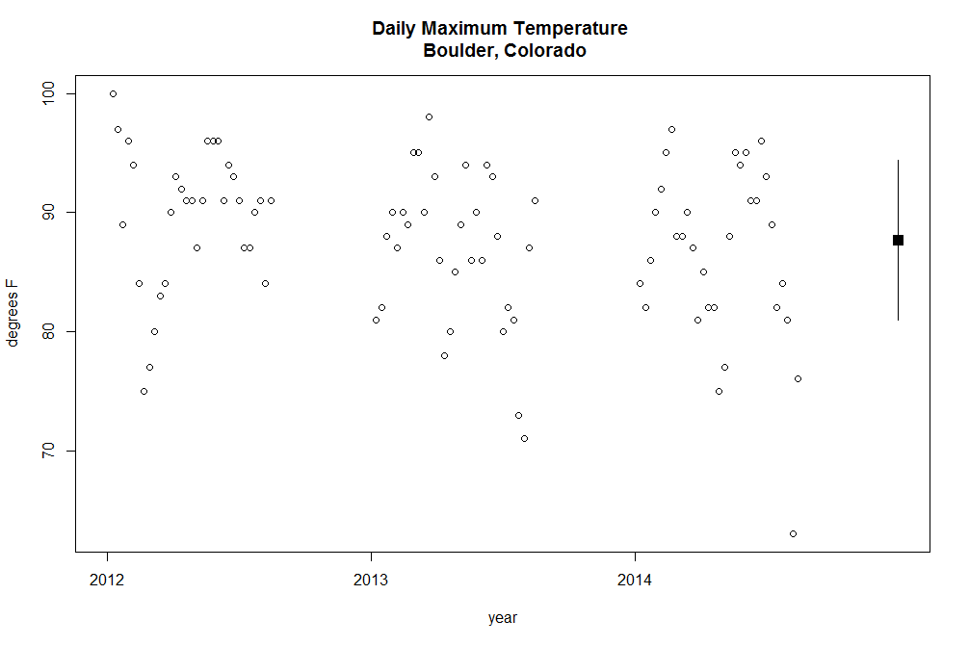
Small sidebar:
Standard Deviation and Standard Error
Two separate questions: what is the average spread, and what is our level of certainty on the mean.
Standard deviation
Gives us an indication of the spread.
Bars are ± σ

Slide 8

Small sidebar:
Standard Deviation and Standard Error
Two separate questions: what is the average spread, and what is our level of certainty on the mean.
Standard Error gives us an unerstanding of how confident we are in the mean.
Classically:
~ ˡ / √n-1

Slide 9
Did something go wrong?
Classical Statistics makes some assumptions that may not be appropriate here:
  Each sample is independent;
  Data are identically distributed;
  Data are normally distributed.
When these assumptions are violated, results are often inappropriate.

Slide 10
days
days
days
days

Slide 11
days
days
days
days
Notes:
When we have high autocorrelation, a small sample size will give us over confidence that we understand what is going on.

Slide 12
The field of Time series analysis addresses situations where data are not independent from one another.
Mathematics
Statistics
Time Series Analysis
Spectral Analysis
Theoretical
Applied
Temporal Analysis
Theoretical
Applied
The other boring stuff
The other boring stuff
Many tools have been developed to address these “auto-correlated” situations.
Stock Market analyses have advanced this field considerably.

Slide 13
Small sidebar:
Standard Deviation and Standard Error
Two separate questions: what is the average spread, and what is our level of certainty on the mean.
Standard Error gives us an understanding of how confident we are in the mean. Classically:
~ ˡ / √n-1

Slide 14
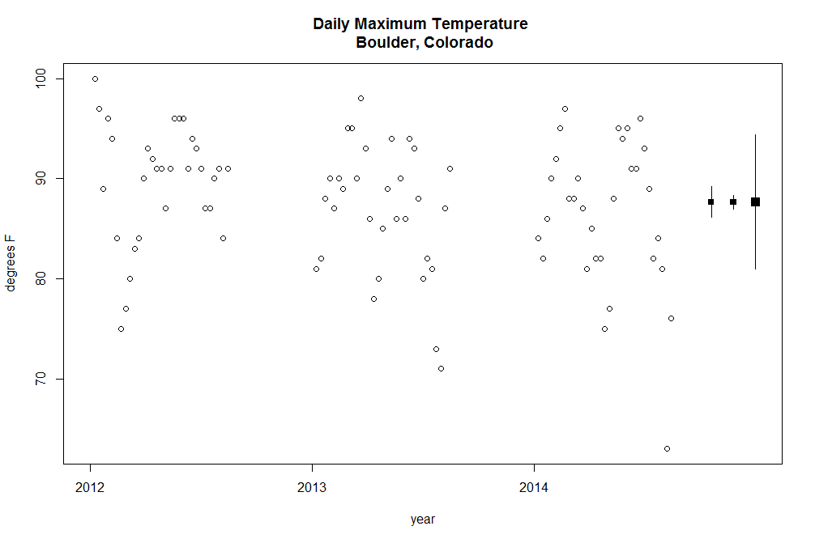
Small sidebar:
Standard Deviation and Standard Error
Two separate questions: what is the average spread, and what is our level of certainty on the mean.

Slide 15
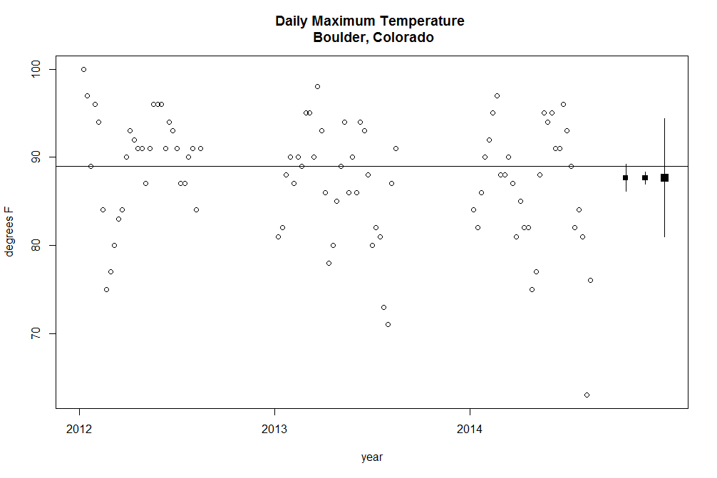
Small sidebar:
Standard Deviation and Standard Error
Two separate questions: what is the average spread, and what is our level of certainty on the mean.
Added line:
Mean from 1999-2014

Slide 16

Small sidebar:
Standard Deviation and Standard Error
Two separate questions: what is the average spread, and what is our level of certainty on the mean.
Two lines:
Mean from 1999-2014
Mean from 1950-2014

Slide 17

Small sidebar:
Standard Deviation and Standard Error
Two separate questions: what is the average spread, and what is our level of certainty on the mean.
Three lines:
Mean from 1999-2014
Mean from 1950-2014
Mean from 1900-2014

Slide 18
Quick Recap – Descriptive Statistics
We’d like to identify improvements in forecasting capabilities
  Perhaps even a report card with multiple metrics
  Creating an honest, fair, robust report card means we need to respect the characteristics of weather data
Standard Deviation:
  Expresses how much variability can be expected from each measurement
  Doesn’t change much with more data
Standard Error:
  Expresses how much uncertainty there is in the estimate of the mean
  Gets smaller with more data
Temporal and geographic autocorrelation means we have fewer pieces of information than datapoints.
Statistical tools exist to address this autocorrelation—ignore the autocorrelation, and false conclusions are likely.
We likely want to focus on the standard error for any report card

Slide 19
Comparing two means
(e.g. bias or rmse)
 | Sample 1 | Sample 2
Mean | 0.42 | 1.52
Standard Deviation | 5.20 | 5.29
Standard Error | 0.47 | 0.48
The difference between the
Two datasets becomes more
Apparent with additionally
Data.

Slide 20
Classic Overlapping Error Bars

Slide 21
A more statistically powerful test

Slide 22
A more statistically powerful test

Slide 24
Once we have a methodology for comparison, we can look at how the differences in models compare for different forecast lead times, across seasons or for different types of situations (day/night, low/high pressure, etc.)

Slide 25
Quick Recap – Decision Support
If we have a clear decision in mind (e.g. which forecasting approach is better?), we can often develop statistical techniques that can address those decisions.
For many metrics, we can run the same forecasting approach on the same set of challenges, and perform pairwise statistics, accounting for autocorrelation and distributions of variability.
Small differences can be clearly identified and statistically quantified.
Other possible decisions could be envisioned: e.g. at what stage does human decision add value?

Slide 26
A few possible applications
How much difference does it make to temperature forecasts to include this one set of observations?
Does this physics package improve the precipitation forecasts for all seasons and locations?
Does the use of computer platform make any systematic difference for 500 mb heights?
Is windfarm power forecasting significantly improved with additional radar observations?

Slide 27
Can we detect incredibly small differences?

Slide 28
How much does difference does a computer platform make?

Slide 30
Decision Support testing - Proactively designing the test to detect differences.
Testing of weather forecasting can be expensive.
We can design tests to assure that we can identify changes of a particular magnitude.

Slide 31
A few caveats that make these methods difficult to apply
CONUS Temperature rmse – Six Pressure Levels
Change in St. Dev. for 24 hour (00Z) predictions using every other day
blue is every day
0.4
red is every other day
0.2
Most statistical models assume:
  Data are independent;
  Data are identically distributed;
  Data are normally distributed.
Estimates of RMSE Differences
0.0
-0.2
-0.4
annual
winter
spring
summer
autumn
P150,P200,P250,P300,P400,P500,P700,P850

Slide 32
How universal are conclusions from one study applied to other geographic areas
Physics dominates weather
Daily persistence exists everywhere
Natural variability in weather exists everywhere
Assumptions about persistence and variability always need to be tested.

Slide 33
How Universal are autocorrelation and variability estimates?
days
days
days
days

Slide 36
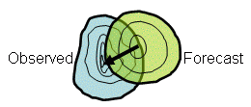
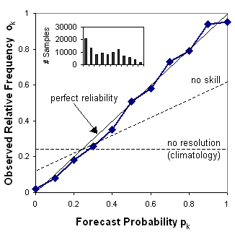
Probabilistic and ensemble forecast verification – descriptive statistics
Probabilistic, ensemble forecasting and extreme event forecasting require special techniques.
Evaluation depends strongly on distributions—often non-Gaussian distributions.
Reliability, resolution, uncertainty.
False positives and false negatives are weighed differently.
Decision support is starting to focus on weighting of different approaches.

Slide 37
Current Efforts
Variety of groups with ongoing efforts on verification…
For NGGPS, GSD is working with EMC and DTC to build a unified verification system focused on model development and improvement.
FIQAS works on third party verification of impact results, often in stages before products going operational.

Slide 38
Future
Multiple groups working on verification—all with different foci.
NGGPS/GSD –Bonny Strong
FIQAS – Missy Petty
DTC – Tara Jensen
Verification efforts in the future will focus on:
Impacts
Probabilistic forecasting
High resolution issues
Supporting changes
Community building for better forecasts in the future.
Evidence Based Decision Making.
Published papers
Common forum for discussions?

Slide 39
Conclusions
Daily autocorrelation means we have less information than datapoints.
Descriptive statistical tools can give a report card, but are inefficient at supporting decisions.
Various statistical tests exist or can be developed to support decisions.
Pairwise testing makes maximal use of the design structure and is highly sensitive to small, systematic differences.
Four complications can be addressed:
  Lack of independence (increases error bars)
  Non-Gaussian nature of the data (makes error bars lopsided)
  Irregular verification statistics. (small alteration)
  Unusual points can have strong influence on results (decision needed)
Physical understanding of the situation usually trumps all.
Statistical tests must respect the characteristics of the data.
Scientific judgment must be used in both designing tests and interpreting results.

