Slide 1
HDF at NASA, NOAA and Met Office
and people behind it
Elena Pourmal
epourmal@hdfgroup.org
The HDF Group

Slide 2
Outline
The HDF Group company
  Mission and vision
  Products and services
  What do we do for NASA, NOAA and Met Office
Overview of HDF5
  Portability
  Extensibility
  Parallel HDF5
  Internal compression

Slide 3
The HDF Group company

Slide 4
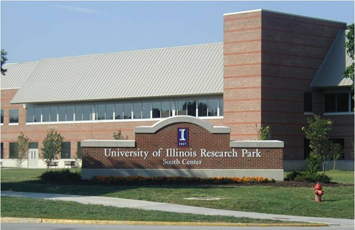
Champaign, Illinois, USA

Slide 5
The HDF Group
www.hdfgroup.org
Not-for-profit company (since 2006), ex-NCSA at University of Illinois
  Offices in 5 states
About 40 employees (more than 50% growth in the past 9 years)
  Core software developers
  Domain specialists
  Documentation team
  Technical support
Mission-driven

Slide 6
The HDF Group Mission
To ensure long-term accessibility of HDF data through sustainable development and support of HDF technologies.

Slide 7
Data challenges addressed by HDF

Slide 8
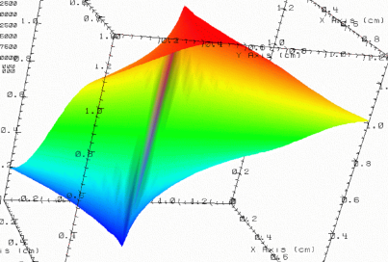


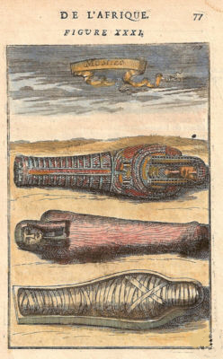
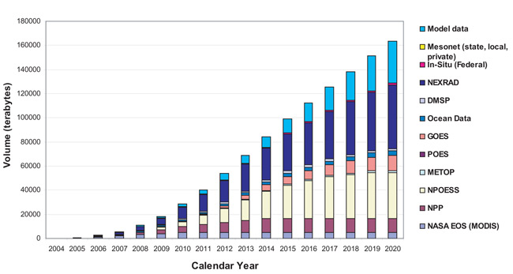
Data Organization and Preservation
Need to organize complex collections of data
lat | lon | temp
----|-----|-----
12 | 23 | 3.1
15 | 24 | 4.2
17 | 21 | 3.6
Experiment Notes:
Serial Number: 99378920
Date: 3/13/09
Configuration: Standard 3
Long term data preservation
Efficient, scalable storage and access

Slide 9
Success stories
Petabytes of NASA remote sensing data in HDF4 and HDF5 file formats
  New NASA/JPSS missions chose HDF5 format for data archiving

Slide 10
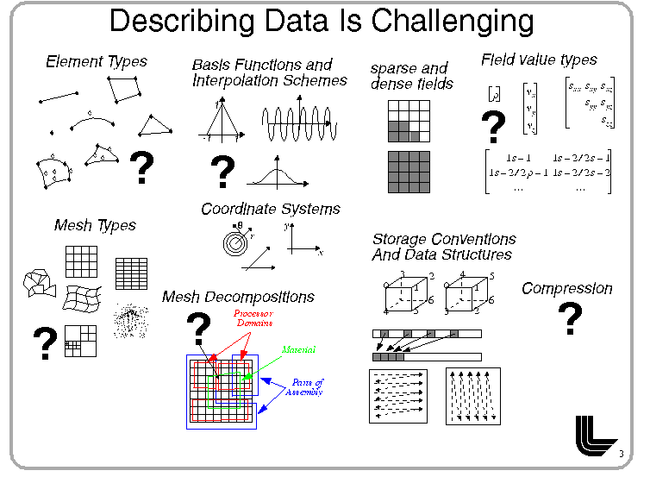
Data Variety and Complexity
LCI Tutorial
Thanks to Mark Miller, LLNL
10

Slide 11
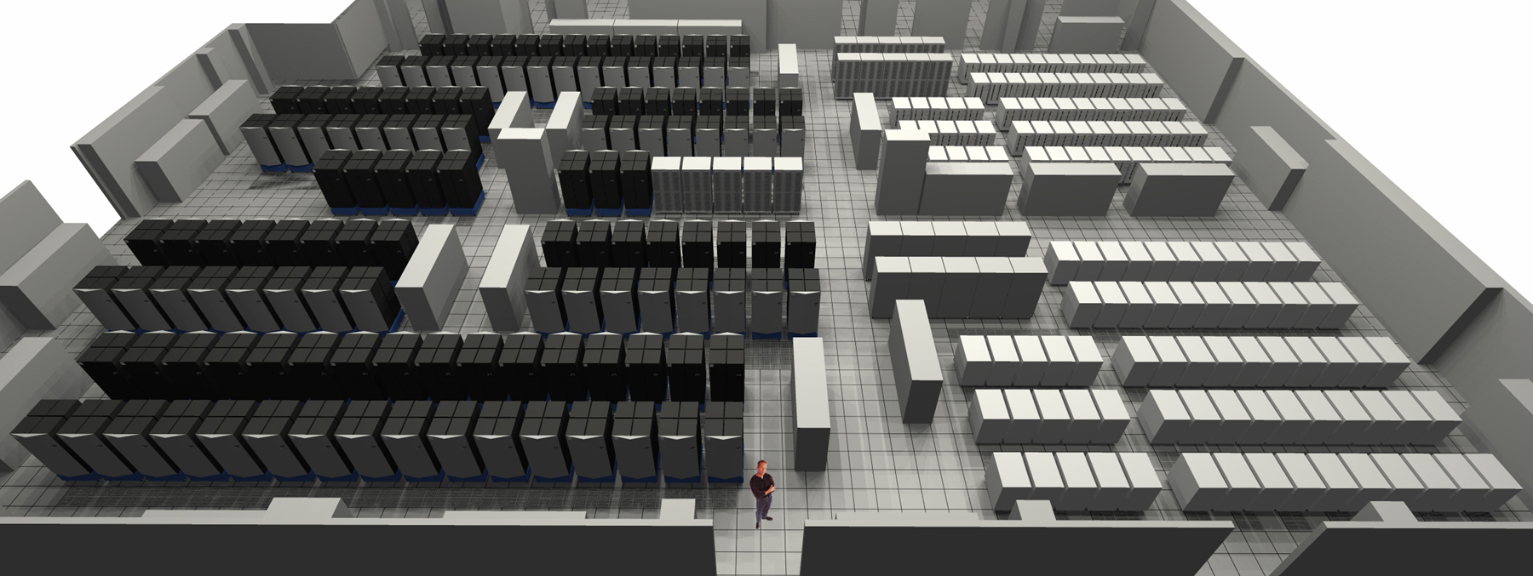


Data Access on Big Computers
… and small computers …
and it has to be FAST
11

Slide 12
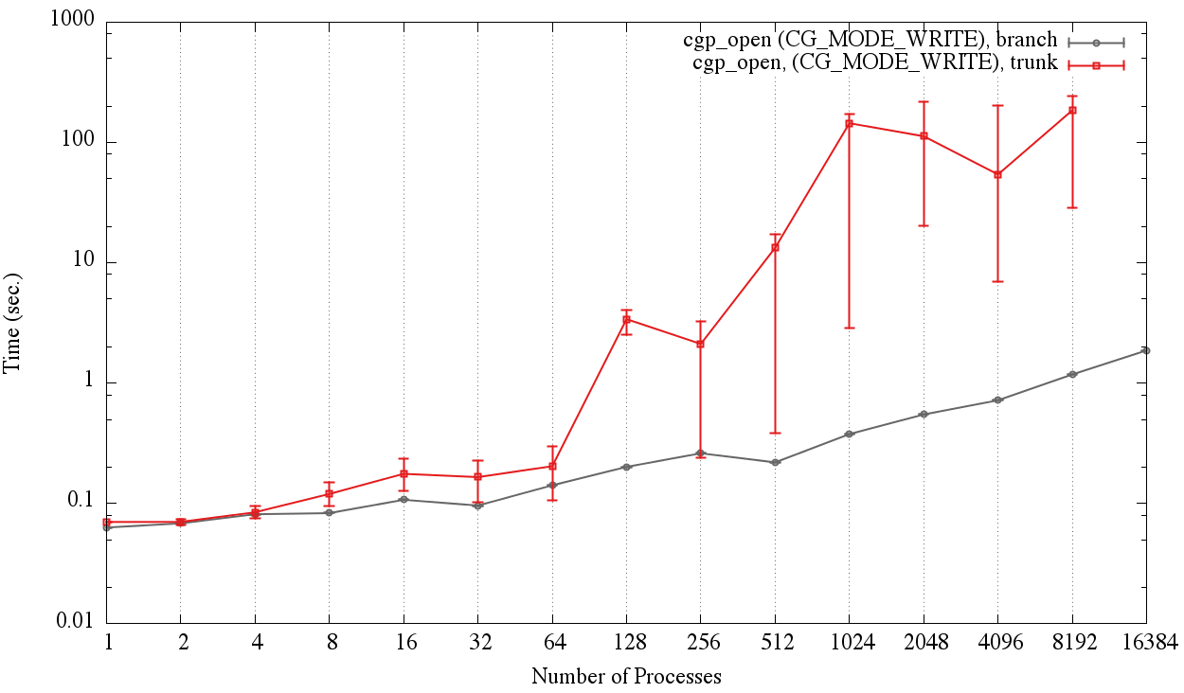
Success story: CGNS for HPC
CGNS – CFD standard
The HDF Group helped to tune CGNS to solve large scale problems
Computational mesh size
  ~33 million elements
  ~200 million nodes
Efficiently handles
large I/O from
Exascale CFD simulations
Thanks to Scot Breitenfeld, THG
Before Improvements

Slide 13
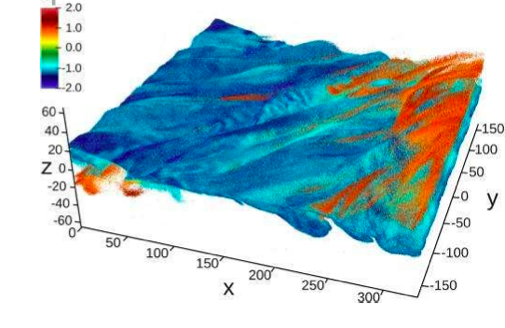
Success story: Trillion Particle Simulation
Physics plasma simulation at NERSC Cray XE6
Simulation ran on 120,000 cores using
    80% of computing resources
    90% of available memory
    50% of Lustre scratch system and writing
    10 one-trillion particle dumps of
    30-42 TBs in HDF5 files;
    sustained ~ 27 GB/sec;
    total 350 TBs in HDF5

Slide 14
The HDF Group philosophy
Committed to Open Source
  HDF software is free
  BSD type of license
  Community involvement
    Testing
    Patches
    New features (e.g., CMake support)
Serving diverse user base
  Remote sensing, HPC, non-destructive testing, medical records, scientific modeling, etc.

Slide 15





Brief History of HDF
1987 At NCSA (University of Illinois), a task force formed to create an architecture-independent format and library:
    AEHOO (All Encompassing Hierarchical Object Oriented format)
    Became HDF
Early NASA adopted HDF for Earth Observing System project
1990’s
1996 DOE’s ASC (Advanced Simulation and Computing) Project began collaborating with the HDF group (NCSA) to create “Big HDF” (Increase in computing power of DOE systems at LLNL, LANL and Sandia National labs, required bigger, more complex data files).
“Big HDF” became HDF5
1998 HDF5 was released with support from National Labs, NASA, NCSA
2006 The HDF Group spun off from University of Illinois as non-profit corporation

Slide 16
















Members of the HDF community
Notes:
NASA – EOS
NOAA/NASA/Riverside Tech – NPOESS/JPSS
A leading U.S. aerospace company
DOE projects
Sandia National Laboratory
Lawrence Berkeley National Lab
Argonne
ITER – international project to build an experimental fusion reactor based on the tokamak concept
Paul Scherrer Institute – variety of projects
Projects in oil and gas industry, finance, others
“In kind” support

Slide 17
Revenues by source

Slide 18
Products and services

Slide 19
The HDF Group products
Main product: HDF Technology Suite
  For managing high volume complex, heterogeneous data
  Flagship: HDF5 data store
    Flexible and efficient storage and I/O
    Portable
    Highly customizable
    Misc. tools
  Specialized software and tools (e.g., JPSS)

Slide 20
HDF5 Technology Platform
HDF5 Abstract Data Model
  Defines the “building blocks” for data organization and specification
  Files, Groups, Links, Datasets, Attributes, Datatypes, Dataspaces
HDF5 Software
  Tools
  Language Interfaces (C, Fortran, C++, Java)
  HDF5 Library
HDF5 Binary File Format
  Bit-level organization of HDF5 file
  Defined by HDF5 File Format Specification

Slide 21
HDF5 API and Applications
Applications
Climate
Model
myApp
YourBioApp
MATLAB©
Domain Data
Objects
EOS
library
netCDF4
library
Sony Pict
Field3d
BioHDF
library
…
HDF5 API
HDF5 Library
HDF5 Data Model Objects
Groups, Datasets, Attributes, …
Language
Interfaces
Tunable Properties
Creation, Access, Transfer, ..
Internals
Dataspace Selection
Datatype Conversion
Filters
Chunked Storage
Version Compatibility
and so on…
Virtual File Layer
POSIX
I/O
Split
Files
MPI I/O
Custom
…
Storage
Notes:
Language interfaces in C, C++, FORTRAN
Virtual File Layer is like I/O drivers

Slide 22
HDF5 Software
HDF5 runs on all flavors of Linux, Mac OS X, Windows, AIX, Solaris, FreeBDS, Cray, etc.
GNU, Intel, PGI compilers
Platforms and configurations tested for each release are listed at
  https://www.hdfgroup.org/HDF5/release/platforms5.html
Talk to us if you need help to port HDF5 to unsupported platform!

Slide 23
The HDF Group services
Helpdesk and mailing lists
  help@hdfgroup.org
  hdf-forum@hdfgroup.org
  Open to all users of HDF
HDF5 Documentation
https://www.hdfgroup.org/HDF5/doc/index.html
HDF Examples (C, Fortran, C++, Java, Python, MATLAB)
https://www.hdfgroup.org/HDF5/examples/

Slide 24
The HDF Group services
Standard support
  Assistance in general areas of HDF usage
Premium support
  Access to our consulting and training resources
  Limited consulting hours are included
Enterprise support
  Help with developing common strategies for managing HDF data within organization
  Organization shares consulting/troubleshooting services
Training
Consulting, custom development and support
Notes:
Standard Support: (package pricing TBD)
Standard Support is offered for organizations that need a modest level of high quality, high priority assistance in general areas of HDF usage.
Priority issue acknowledgment within one business day
Assistance with software installation, API usage, and documentation questions
Access to feature/bug tracking database
Patch releases
Eligibility to register for user workshops
Premium Support: (package pricing TBD)
Premium Support options are available for organizations that desire high quality, high priority assistance plus enhanced access to our consulting and training resources. This level of support includes all benefits of Standard Support plus:
12 hours of consulting services
Discount on daily training rates
Monthly 30-minute teleconferences
Reduced registration fee for user workshops
Enterprise Support: Contact us for pricing
Enterprise Support options are for organizations making a substantial, organization-wide commitment to HDF, and these relationships can be customized to focus on specific needs. In addition to providing all benefits of Premium Support, Enterprise Support allows businesses to:
Coordinate HDF activities across departments
Share consulting/troubleshooting options
Combine training and development resources
Develop common strategies for managing HDF data
Share HDF-based applications and tools
Assure continuing support for HDF in your organization
Training: Contact us for course development and pricing
Training courses may be conducted at The HDF Group headquarters, at a site of your choosing, or remotely. Courses can be customized to your needs and may include topics ranging from an introduction to HDF to advanced topics such as advanced software development using HDF, tuning your application to improve performance, and using HDF effectively on parallel systems. Training may include tutorials and hands-on practical experience. All travel costs for instructors are in addition to the training costs.
Consulting and Custom Development: Contact us for project planning and pricing
The HDF Group encourages you to contact us to discuss specific consulting needs or project specifications. We offer a number of options for creating individualized relationships and agreements with our customers. Consulting and special projects cover topics such as:
Adapting your applications to HDF
Adding new features to the HDF libraries and tools
Support for new programming languages
Implementing new tools
Performance tuning
Porting HDF to a specific platform
Regular teleconferences and onsite work
Special projects are priced individually, depending on staffing requirements, equipment, travel, and other factors.
Is this a private area for just their bugs, or access to the general issue tracking in Jira? I think our plan has been to make the general bugs publicly visible (like most other open source packages)…

Slide 25
HDF @nASA
Sustaining mission critical software

Slide 26
Support for NASA
Goal: Sustain mission-critical software technology
“The HDF Group conducts evolutionary development program to improve the reliability, availability, functionality, operability, and performance of the HDF Subsystem within the EOSDIS while reducing operational and maintenance costs.”

Slide 27
Support for NASA
Sustaining Engineering
  Maintenance releases of HDF software and tools
    HDF4 and HDF5 libraries
    Java tools
    OPeNDAP HDF servers
  Technical support to HDF software developers
    HDF-EOS2(5)
    netCDF-4
  Vendors support (MATLAB, IDL)
  Community support (h5py, PyTables)
  User support
Special projects (e.g., h4mapping)

Slide 28
Support for NASA
Other projects
  BEDI
    Provide technical leadership and oversight for the Metadata Guidance for Earth Observation Data
  ISO Standard extension
    Support the adoption of ISO TC211 and other standards and conventions in EOSDIS data and metadata systems.
    Support the entire data life-cycle including mission planning, data system implementation, data formatting/access (i.e., HDF and netCDF), granule, inventory, and collection metadata.

Slide 29
HDF @NOAA JPSS
HDF5 Risk-reduction Support

Slide 30
Support for NOAA JPSS
Goal: Provide HDF5 risk-reduction support for the distribution of JPSS VIIRS, OMPS and other sensor and environmental data product
Maintain HDF5 and JPSS specific software and features developed by The HDF Group
Provide user and technical support
Perform special maintenance tasks
Perform special research projects as requested

Slide 31
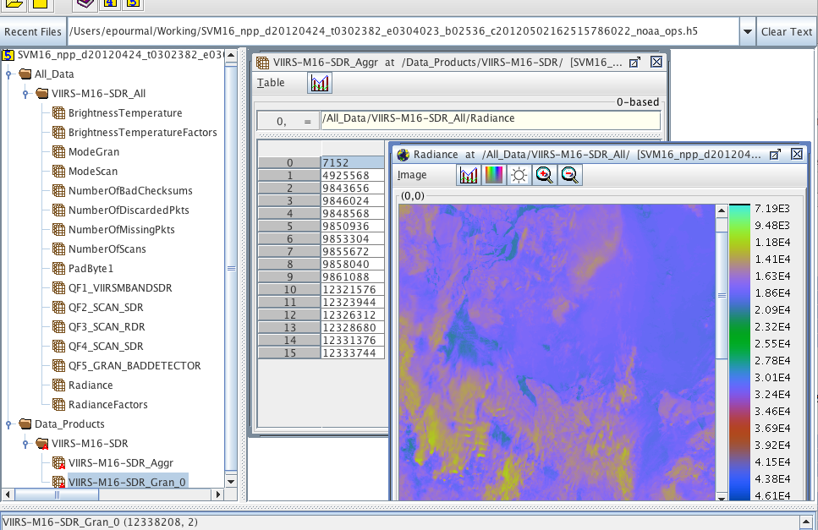
JPSS Products in HDFView

Slide 32
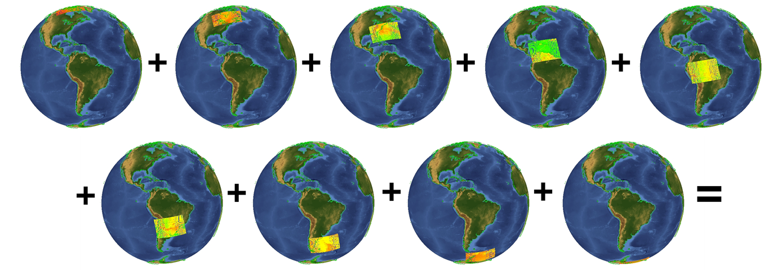
nagg – aggregation and packaging tool
9 input files – 4 granules each in GMODO-SVM07… files
Visualization with IDV

Slide 33
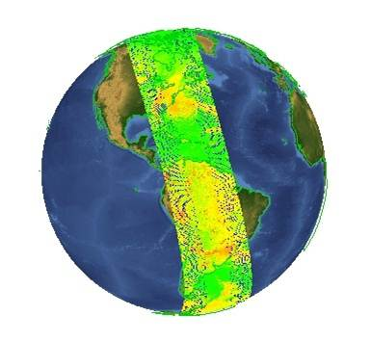
nagg – aggregation and packaging tool
1 output file –36 granules in GMODO-SVM07… file
Visualization with IDV

Slide 34
HDF @Met Office
Making HDF5 work on Met’s HPC systems

Slide 35
Support for Met Office
Goal: Help with porting HDF5 and netCDF-4 to systems at the Met Office
OSs and Compilers not supported by THG
  Cross-compiling
  Testing troubleshooting
  Performance tuning

Slide 36
Exploring new directions
Examples

Slide 37
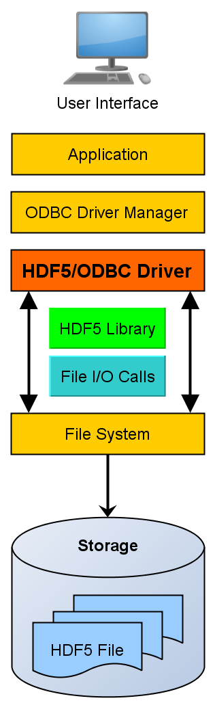

HDF5 ODBC Driver
Open DataBase Connectivity (ODBC)
Industry standard middleware API for accessing database management sys.
All analytics apps. have an ODBC client
HiFive – ODBC driver for HDF5
  Windows, [Linux, MacOS X]
  Client & Client/Serve
  Accessing HDF5 files from Excel & R
Thanks to Gerd Heber, THG

Slide 38
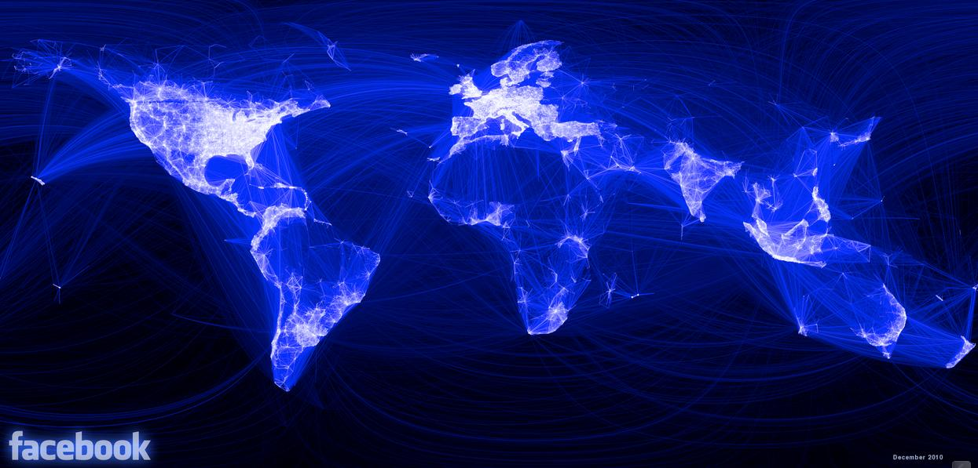

HDF5 for the Web
Can I access HDF5 files remotely?
API? My (mobile) client speaks HTTP!
What is a file system? Who uses files anymore?
Cloud computing w/ HDF5
Thanks to John Readey, THG

Slide 39
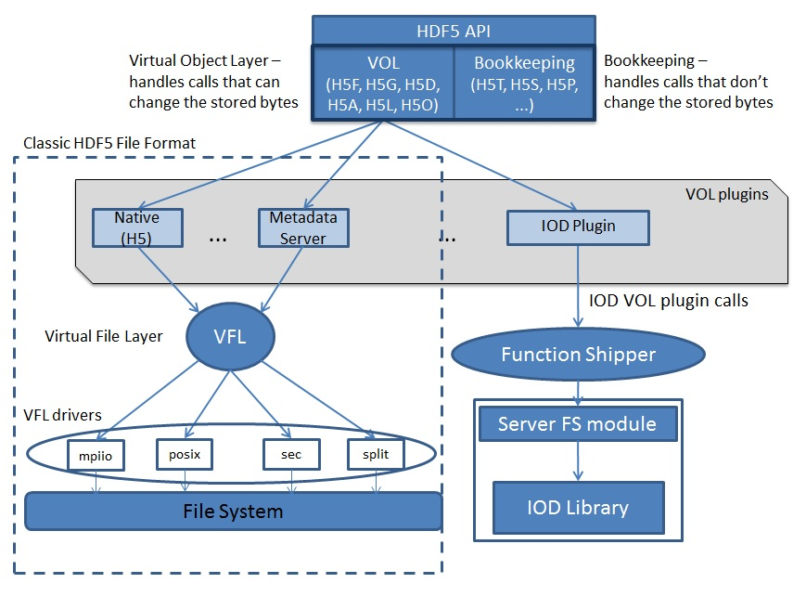
HDF5 as an interface to non-HDF5 storage

Slide 40
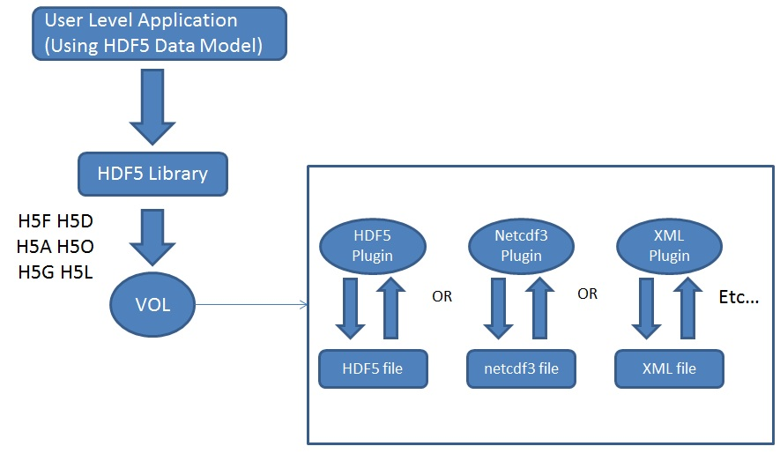
HDF5 as an interface to non-HDF5 storage
Different File Formats plugins:

Slide 41
HDF5
Powerful features

Slide 42

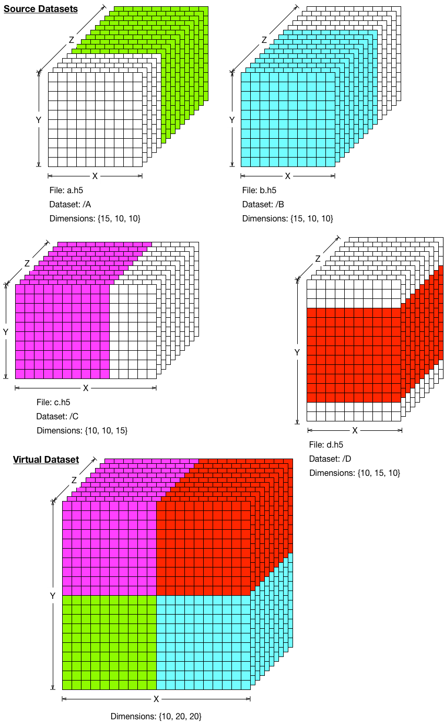


HDF5 Features - Portability
HDF5 file is a container
  Data can be moved between different systems
    Self-describing datatypes and arrays
HDF5 file is a “smart” container
  Data is organized within the file
    Group and link objects; reference datatypes
  Data is organized within a collection of files
    External links
    Virtual datasets
lat | lon | temp
----|-----|-----
12 | 23 | 3.1
15 | 24 | 4.2
17 | 21 | 3.6

Slide 43
HDF5 Features - Extensibility
Data can be added to the existing arrays
  Extensible along each dimension
File structure can be modified by adding new groups and datasets (arrays)
No limit on file size and number of objects stored in the file
KBs
TBs

Slide 44
Powerful I/O
Fast
Partial I/O
  I/O on subsets of arrays including compressed arrays
Customized I/O (Virtual File Drivers); writing/reading to/from
  Memory
  Sockets
  Split files, family of files
Parallel I/O

Slide 45
PHDF5 Implementation Layers
Application
PHDF5 built on top of standard MPI-IO API
Parallel computing system (Linux cluster)
Compute
node
Compute
node
Compute
node
Compute
node
I/O library (HDF5)
Parallel I/O library (MPI-I/O)
Parallel file system (GPFS)
Switch network/I/O servers
Disk architecture & layout of data on disk

Slide 46
Concurrent Access to Data
New data elements…
Writer
Reader
HDF5 File
…which can be read by a reader…
with no IPC necessary.
… are added to a dataset in the file…

Slide 47

Internal Compression
HDF5 comes with several compression methods and data transformations
  GZIP, SZIP, nbit, scale+offset, checksum
HDF5 can use custom compression and other filters
  Loaded at application run time
  Works with the HDF5 off-shelf
  tools (e.g., MATLAB)
Application
HDF5 Library
Data
Filter(s)
VFD
HDF5 File
DLL or so library

Slide 48
netCDF-4
Data Model
  Variable (HDF5 dataset)
  Dimension Scale (HDF5 Dim. Scales)
  Attributes (HDF5 attribute)
  Group (HDF5 group)
Library
  Implements the model in many formats (netCDF 3.*, HDF4, CDM, including HDF5
  Takes advantage of HDF5 chunking storage, compression, data organization, and parallel access
Notes:
GRID: Usage - Data which is organized
by regular geographic spacing,
specified by projection parameters.
Structure
Any number of 2-D to 8-D data arrays per structure, one per data type (e.g. temperature)
Geolocation information contained in projection formula, coupled by structural metadata.
SWATH: Data which is organized by time, or other track parameter.
Spacing can be irregular.
Structure
Geolocation information stored explicitly in Geolocation Field (2-D array)
Data stored in 2-D or 3-D arrays
Time stored in 1-D or 2-D array, TAI is standard.
Geolocation/science data connected by structural metadata
POINT: Data is specified temporally and/or spatially, but with no particular organization
Structure
Tables used to store science data at a particular Lat/Long/Height
Up to eight levels of data allowed. Structural metadata specifies relationship between levels.

Slide 49
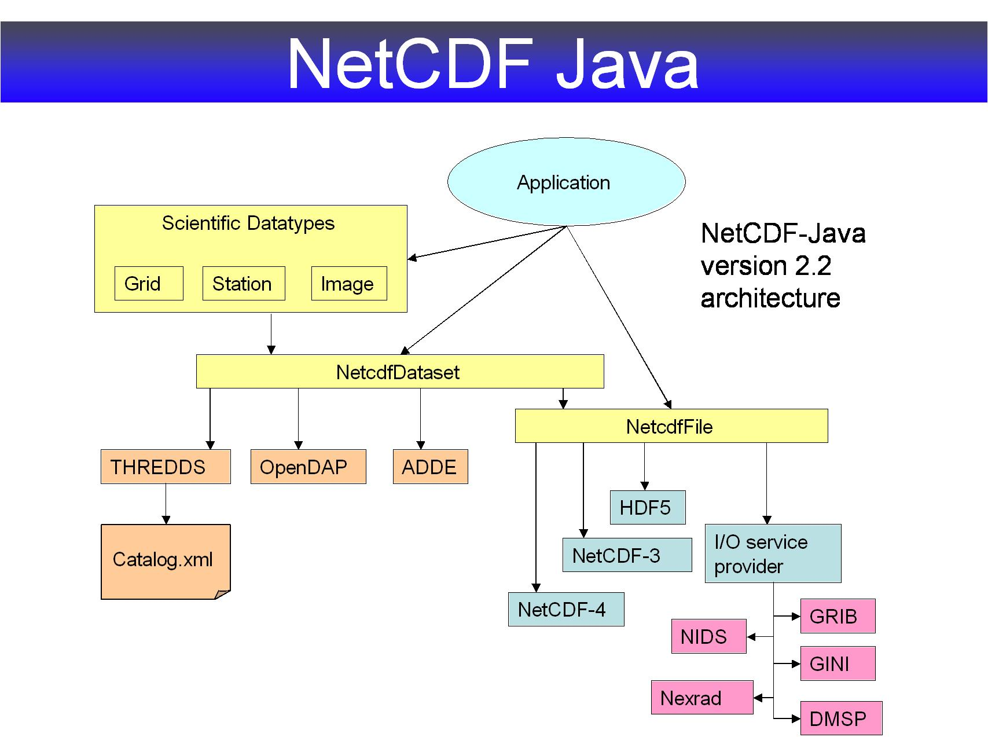

Slide 50
Thank You!
Questions?

