Slide 1
Recent development of all-sky radiance assimilation at JMA
Kozo Okamoto, Masahiro Kazumori
Japan Meteorological Agency (JMA)
The 3rd Joint JCSDA-ECMWF Workshop, 1-3 Dec. 2015, NCWCP, College Park, US

Slide 2
Content
1. All-sky radiance assimilation for MW imagers
2. All-sky radiances assimilation for IR sounders/imagers
Preliminary study for IASI in ECMWF global system
Preliminary study for Himwari-8/AHI in JMA regional system
Ref: Assimilation of overcast, opaque radiances of MTSAT IR window ch
Based on simple cloud approach
Small positive impacts on temperature and wind forecast In global data assimilation experiments
Okamoto (2013), QJRMS

Slide 3
1. All-sky MW imager radiance assimilation
Super-ob : averaging observations in 80-km grid box
Symmetric cloud parameter (Geer and Bauer 2011, QJRMS)
Determine thresholds of gross error QC ( |OB-FG|>2.5 )
RTTOV-10 : rttov_scatt
Cloud water, cloud ice, cloud fraction, rain, snow from moist physics in linearized inner model
Observations assimilated
AMSR2, SSMIS(F16,17,18), TMI, GMI
19V, 23V and 37V
Test is underway to
Assign observation errors as a function of C₃₇
Remove biased situations with large C₃₇
Symmetric cloud parameter
AMSR2 37V BIAS
BIAS and STD of FG departure as function of
AMSR2 37V STD
Current JMA global model has biases in CLW, i.e. insufficient CLW in cloudy situation.
OB-FG mean (K)
OB-FG SD (K)
Reject
Reject
C₃₇, C₃₇º, C₃₇^{b}
C₃₇, C₃₇º, C₃₇^{b}
Notes:
OB-FG mean/SD is computed from data w/o BC (in passive monitor data set)

Slide 4
PDF of OB,FG and OB-FG before/after QC+BC
OB & FG (all)
OB-FG (before QC+BC)
OB-FG (after QC+BC)
19V
Red: OB-FG
Grey: Gaussian
Red: OB-FG
Grey: Gaussian
Red: OB
Blue: FG
Tb (K)
OB-FG (K)
OB-FG (K)
37V
Tb (K)
OB-FG (K)
OB-FG (K)
Notes:
Period:10 June – 11 Sep. 2014
AMSR2 80km grid averaging

Slide 5
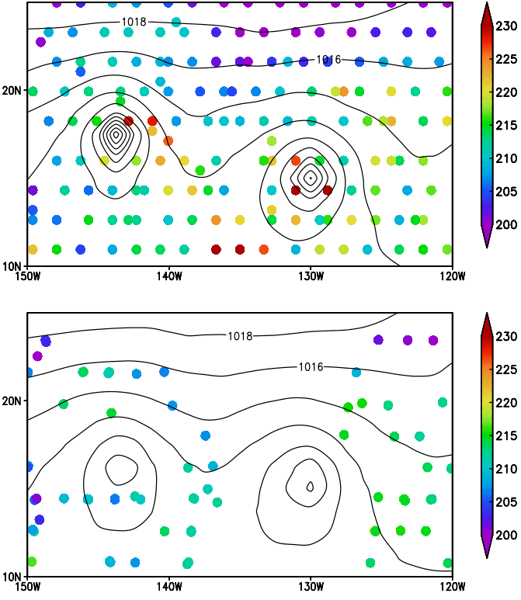
Results of assimilating all-sky MWI rad
Distribution of assimilated MWI rad (19V)
Analyzed SLP and TCWV
All-sky assimilation
All-sky assimilation
12UTC 06 August 2014
Clear-sky assimilation
12UTC 06 August 2014
Clear-sky assimilation
GOES-W IR Obs.
Large TCWV difference in cloudy area
TC(Iselle)
TC(Julio)
All-sky assimilation improves TC analyses
SLP : Sea Level Pressure
TCWV : Total Column Water Vapor
12UTC 06 August 2014

Slide 6
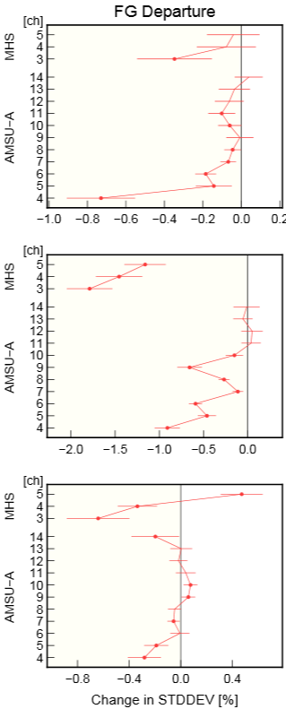
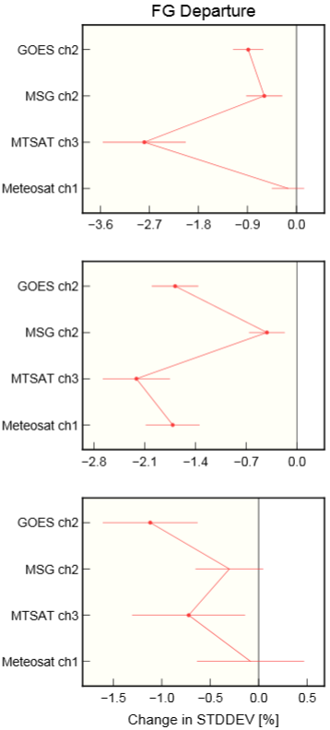
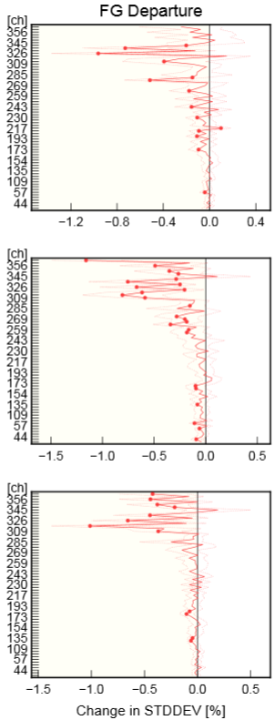
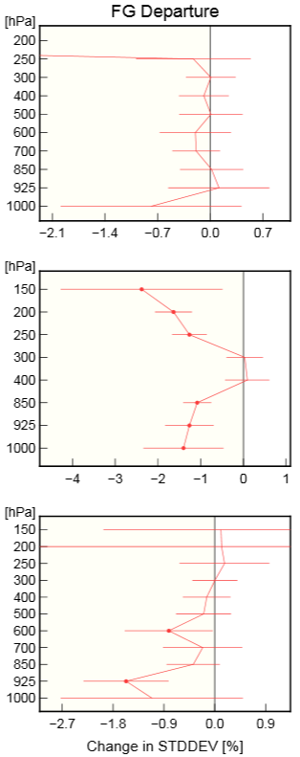
Results: FG fitting to observations
Changes in FG departure from Clear-sky exp.
NH
MW Sounder
IR Imager (Geo)
IR Sounder (IASI)
AMV Vector Wind
AMSU-A MHS
TR
AMSU-A MHS
SH
AMSU-A MHS
Large positive impacts on temperature, humidity, and wind field in the Tropics!
Degradation in low level humidity in the S.H.
Negative value indicates improvements

Slide 7
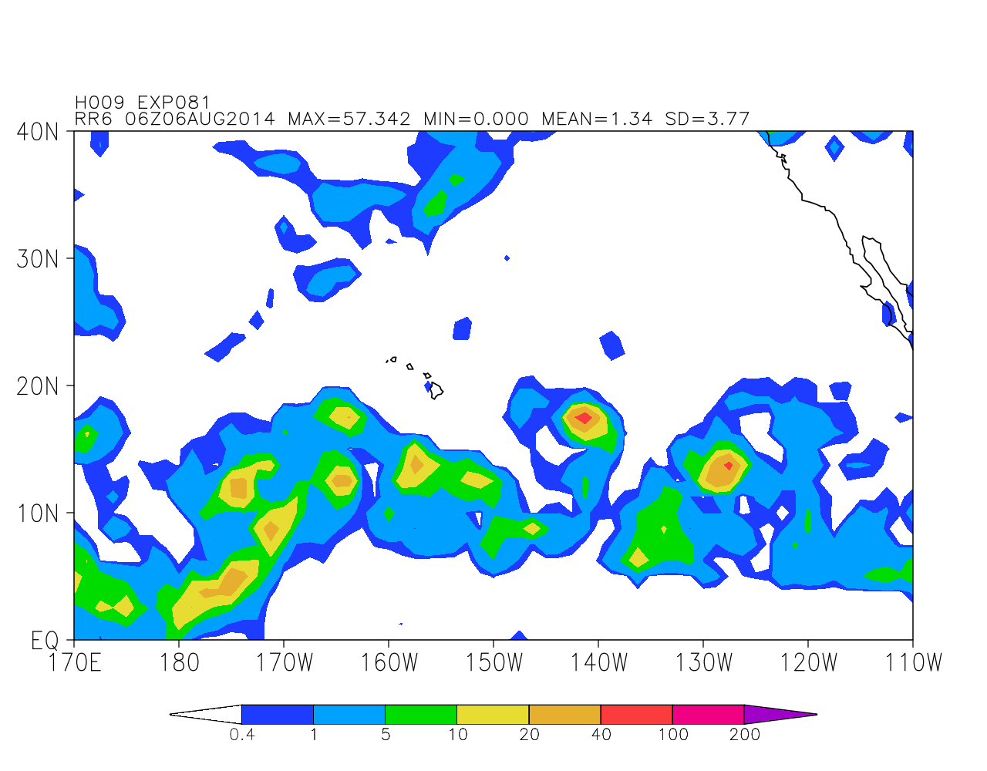
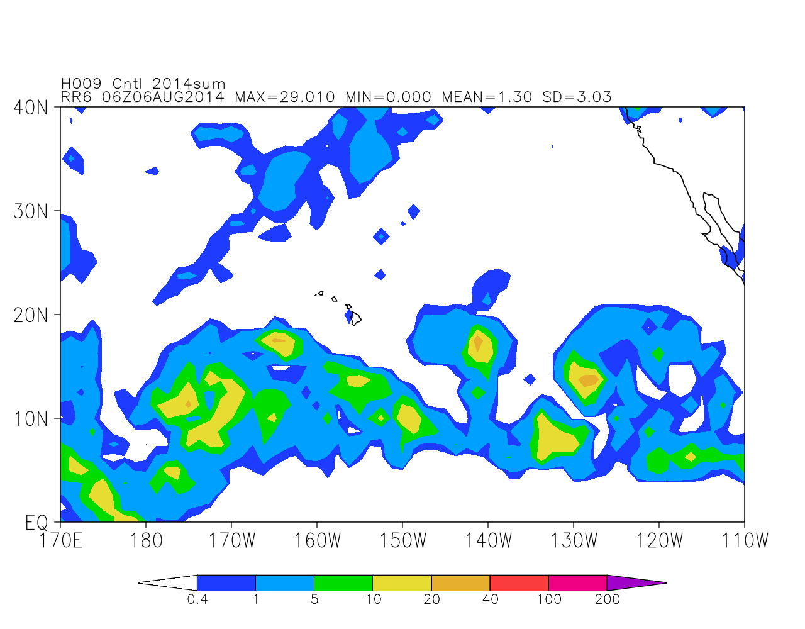
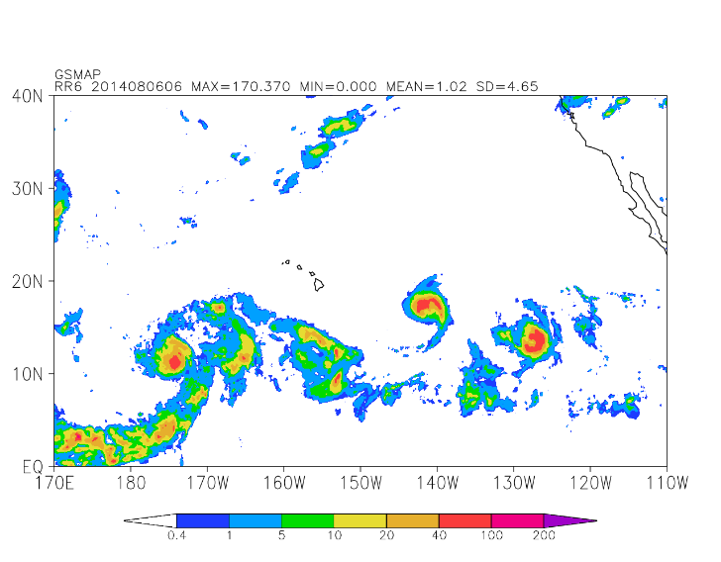
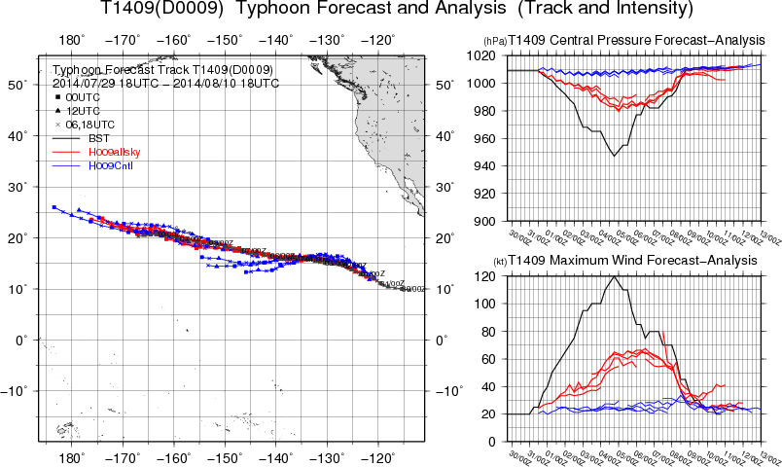
Results: Impacts on precipitation and TC forecast
Forecast of 6-h accumulated precipitation
All-sky assimilation
Clear-sky assimilation
Central Pressure
GSMaP (analyzed rain by JAXA)
Genevieve
Iselle
Julio
Max. Wind
Forecast of track and intensity for Tropical Cyclone (TC) Iselle
Central Pressure
All-sky assimilation Improves forecasts for
Precipitation around TC
Both TC track and intensity
Iselle (2014)
Max. Wind
Red: All-sky, Blue: Clear-sky
Black: Best track

Slide 8
Summary of all-sky MW imager rad assimilation
Preliminary cycle experiments in global DA system
Apply cloud parameter for cloud-dependent gross error QC
Improve analysis and FG of T, H, W in the troposphere, and TC analysis and prediction
Negative impacts : Magnify negative bias in T850 and TCWV
Associated with model biases of low T850 and excessively broad weak-precipitation area
T850 diff: All-sky – Clear-sky
TCWV diff: All-sky – Clear-sky
Notes:
TCWV: 全球解析の可降水量の場は他のMWイメージャのプロダクトや、ECMWF解析値と比べ て過小であることが知られています（100層化で更に顕著になったようです）。 それを更に減少させることは、現実から離れていくことになると考えています。

Slide 9
2. All-sky IR radiance assimilation
Apply similar MW-approach
Develop a symmetric cloud parameter for IR rad
CA_{i} = (|OB_{i}-FG_{clr,i}|+|FG_{i}-FG_{clr,i}|)/2 FG_{clr}: clear-sky FG, i: channel
Test the usability of the parameter for
IASI in global system (ECMWF-IFS)
T511L91 (~40km)
RTTOV10.2, Cloud water/ice/fraction from moist physics model
1~15 Aug. 2011, over the sea
AHI in regional cloud resolving system (JMA-NHM)
5km, L50
RTTOV11.2, Cloud water/ice from cloud microphysics
Cloud fraction = 1.0
Super-ob : Averaging 2x2pixels
Remove cases with |OB-FG|>30K or 50K
03~09 UTC on 7~11 Sep. 2015, over the sea

Slide 10
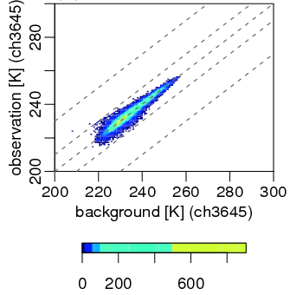
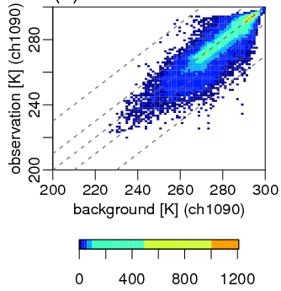
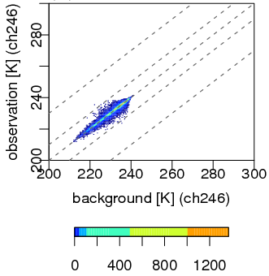
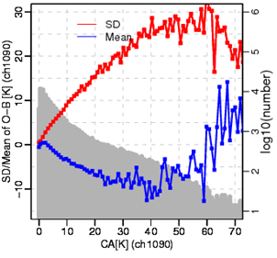
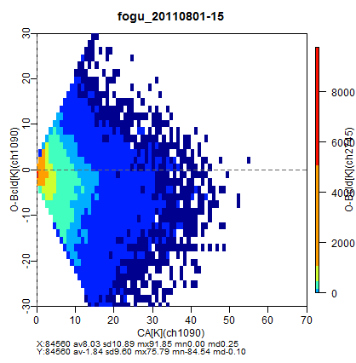
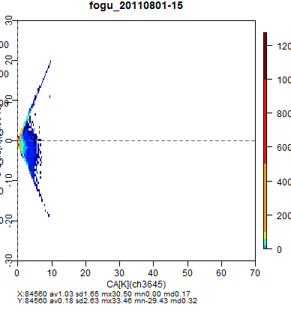
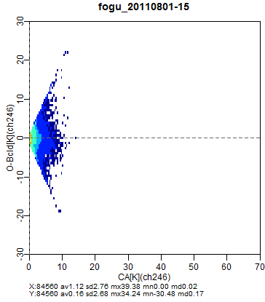
IASI comparison in ECMWF global system
humidity ch
window ch
UT Temperature ch
OB (K)
85% satisfies |OB-FG|<10K
FG (K)
FG (K)
FG (K)
CA vs OB-FG SD & OB-FG mean
num
OB-FG SD
OB-FG SD & mean (K)
OB-FG (K)
OB-FG mean
CA (K)
CA (K)
CA (K)
CA (K)
Notes:
85%(69%) satisfies |O-B|<10K(5K)

Slide 11
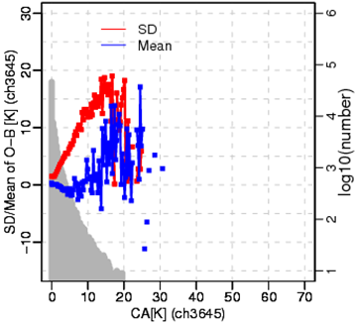
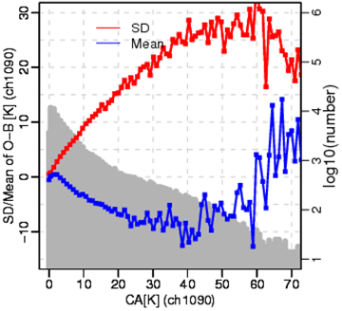
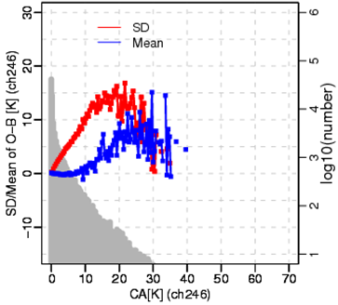
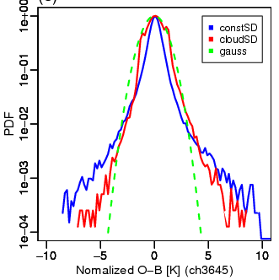
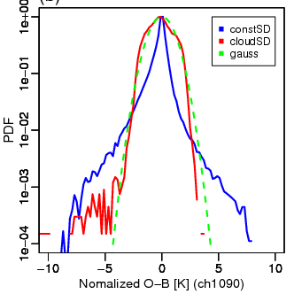
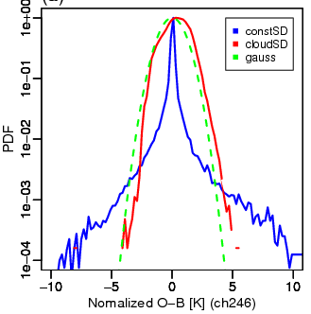
Dependency of the symmetric cloud parameter (CA)
humidity ch
window ch
UT Temperature ch
num
OB-FG SD
OB-FG SD & mean
OB-FG mean
CA (K)
CA (K)
CA (K)
constSD
cloudSD
Gauss
constSD
cloudSD
Gauss
constSD
cloudSD
Gauss
PDF of Normalized OB-FG
(OB-FG)/SD
(OB-FG)/SD
(OB-FG)/SD

Slide 12
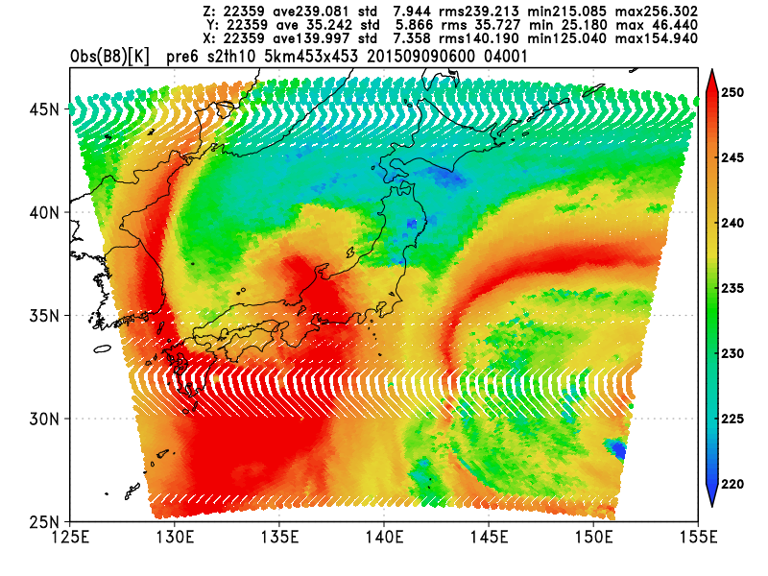
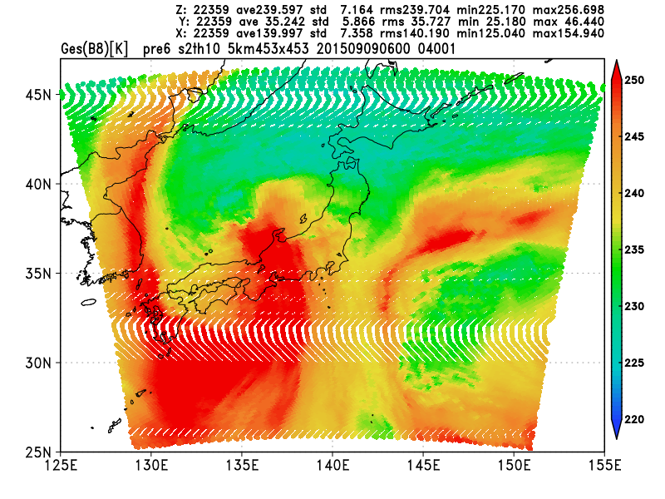
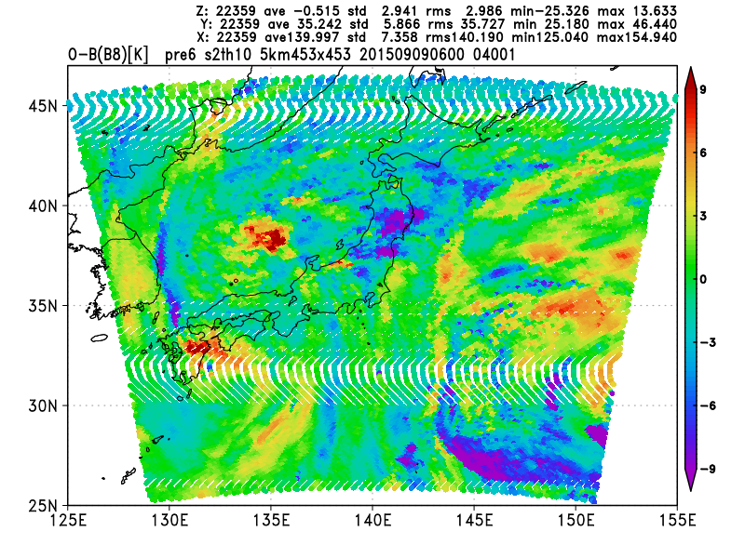
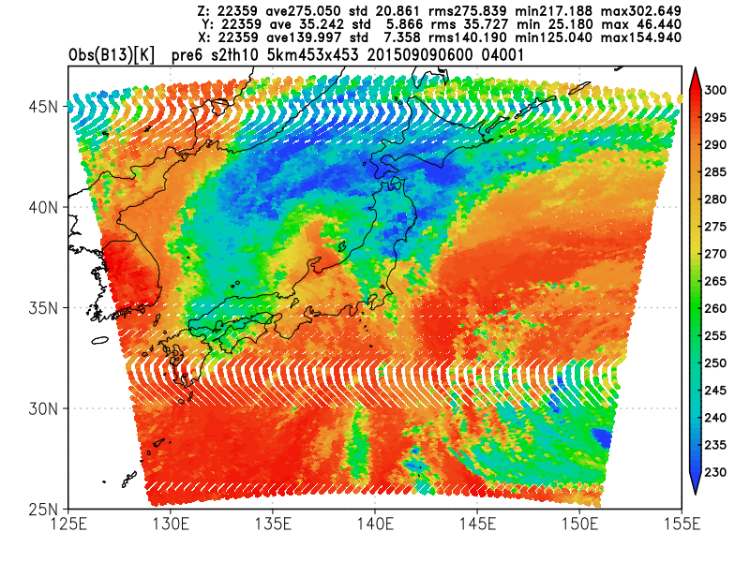
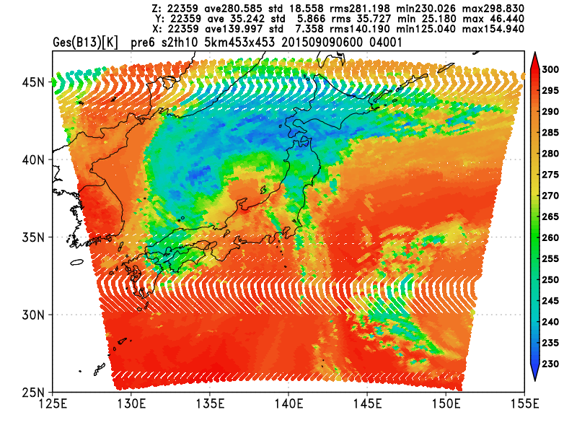
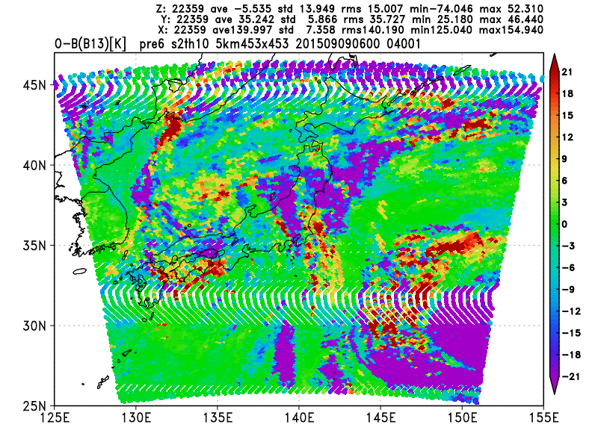
Himawari8/AHI comparison in JMA regional system
JMA-NHM (Non-hydrostatic cloud resolving model) with 5km resolution
AHI 2km res → super-ob 2x2 pixels
03~09 UTC on 7~11 Sep. 2015, over the sea
Example at 06 UTC on 20150909
OB
FG
OB-FG
B8 (6.2μm)
B13 (10.4μm)

Slide 13
AHI comparison in JMA regional system
B8 (6.2μm)
B10 (7.3μm)
B13 (10.4μm)
OB
FG (K)
FG (K)
FG (K)
OB-FG
CA (K)
CA (K)
CA (K)
log(num)
log(num)
log(num)

Slide 14
Dependency of the symmetric cloud parameter (CA)
B8 (6.2μm)
B13 (7.3μm)
B13 (10.4μm)
num
OB-FG SD
OB-FG SD & mean
OB-FB mean
CA (K)
CA (K)
CA (K)
constSD
cloudSD
Gauss
constSD
cloudSD
Gauss
constSD
cloudSD
Gauss
PDF of normalized OB-FG
(OB-FG)/SD
(OB-FG)/SD
(OB-FG)/SD

Slide 15
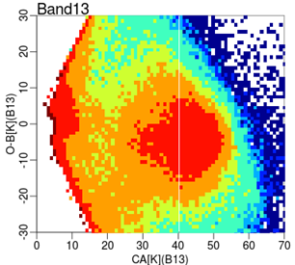
Problems with OB-FG of regional AHI
Large OB-FG variability
Larger uncertainty of cloud prediction in higher res. system
Mislocation of predicted clouds
Inhomogeneous clouds increase representativity inconsistence
FG underestimates clouds
Model bias, no subgrid clouds in RTTOV input, insufficient cloud effect in RTTOV
AHI in JMA regional system
OB~FGclr and FG<FGclr
FG overestimates clouds
(The boundary indicates FG clouds in OB clear-sky areas)
OB-FG (K)
FG~FGclr and OB<FG
→FG significantly underestimates clouds. (The boundary indicates FG clear-sky in OB cloudy areas)
IASI in ECMWF global system
CA (K)
30
log(num)
OB-FG = (FGclr-FG) - (FGclr-OB) = A-B 2CA ~ (FGclr-FG) + (FGclr-OB) = A+B
-30
0
70

Slide 16
Summary and discussion of all-sky rad assimilation at JMA
All-sky MW imagers
Developed super-ob and gross error QC using the cloud parameter
Preliminary results of cycle assimilation experiments show positive impacts in T/H/W and TC forecasts
Model biases probably cause degradation in T850 and TCWV
All-sky IR sounders/imagers
Developed an cloud parameter that well predicts OB-FG variability
Exception is window bands of AHI in high-res system
Plan to start assimilating all-sky AHI rad at only humidity bands
Final remarks : All-sky rad assimilation
Highly relies on model performance of clouds/precip prediction
Requires careful QC (and BC) that handle (remove) situations where NWP and RT models do not accurately reproduce observations
How to handle convective clouds, highly inhomogeneous clouds, mislocation error, inconsistent representativeness, negative bias (insufficient cloud),,, ?

Slide 18
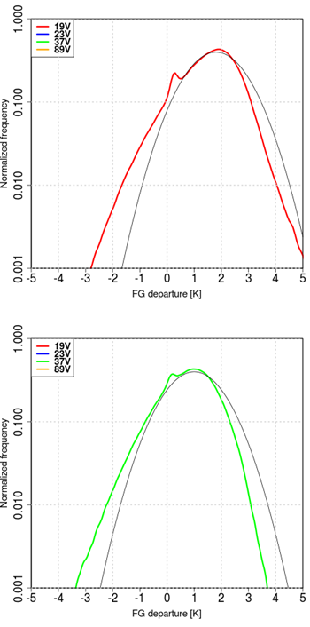
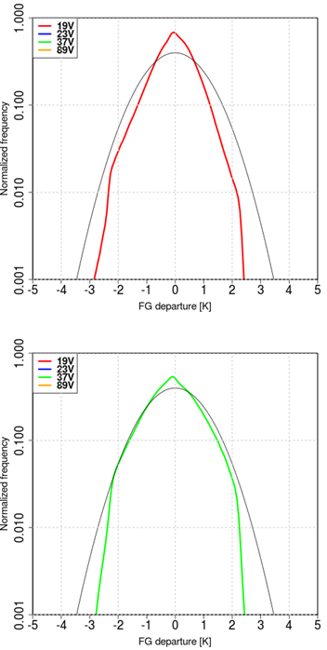
Normalized OB-FG before/after QC
Before QC+BC
After QC+BC
Red: OBS
Blue: GES
Red: OB-FG
Grey: Gaussian
19V
(OB-FG)/SD
(OB-FG)/SD
37V
(OB-FG)/SD
(OB-FG)/SD
Notes:
Period:10 June – 11 Sep. 2014
AMSR2 80km grid averaging

Slide 19
All-sky IR rad : AHI & JMA-NHM
Himawari-8/AHI
10 IR bands with 2.0 km resolution
JMA-NHM
Cloud-resolving, Non-Hydrostatic Model, used for operational meso-scale system
5 hydrometeors
5km-res, 50 layers,
RTTOV11.2
Input clouds from micro-physical process (grid-scale cloud)
Cloud fraction is set to one
Pre-processings
Super-ob : Averaging 2x2pixels
Remove data with |OB-FG|>30K or 50K
Case : 03~09 UTC on 7~11 Sep 2015
~220,000 samples
Himawari-8,9/AHI
Band | Wavelength [μm] | Spatial Resolution
1 | 0.43 - 0.48 | 1km
2 | 0.50 - 0.52 | 1km
3 | 0.63 - 0.66 | 0.5km
4 | 0.85 - 0.87 | 1km
5 | 1.60 - 1.62 | 2km
6 | 2.25 - 2.27 | 2km
7 | 3.74 - 3.96 | 2km
8 | 6.06 - 6.43 | 2km
9 | 6.89 - 7.01 | 2km
10 | 7.26 - 7.43 | 2km
11 | 8.44 - 8.76 | 2km
12 | 9.54 - 9.72 | 2km
13 | 10.3 - 10.6 | 2km
14 | 11.1- 11.3 | 2km
15 | 12.2 - 12.5 | 2km
16 | 13.2 - 13.4 | 2km

