Slide 1

The Grell-Freitas scale- and aerosol aware stochastic convective parameterization: development as well as global and regional applications
Georg A. Grell
With slides from: Saulo R. Freitas, Joseph Olson, Jian-Wen Bao, E. Grell, I. Jankov, P. Marrapu, B. Skamarock, L. Fowler, Steven E. Peckham

Slide 2
Structure of talk
Basic details of Grell-Freitas convection scheme (as of 2014)
Scale-awareness (RAP, WRF-Hurricane simulations, fresh from the press HWRF simulation)
Scale-awareness global (MPAS)
New implementations for HIWPP (as of May 2015)
Stochasticism
More improvements when using within GFS physics: Using a few more SAS “features” (as of last week)
Next
Aerosol-awareness experiments (WGNE working group)

Slide 3
Motivation
NWP and Air Quality modeling on better and better resolutions: need for scale and aerosol aware convective parameterization
  Use stochastic parameterization
  Including transport of chemical compounds,
  Including aerosol interactions
Improve predictive skill
  Convection permitting
    Hurricane track and intensity forecasts
    Short range weather forecasting
  Range of scales (hydrostatic to convection permitting
    Medium range NWP
    Seasonal predictions
Special additional intention for talk here at EMC: possibly get some ideas on further development and applications especially with respect on how GF schemes interacts with other physics in GFS physics package

Slide 4

Grell-Freitas Convective Param
Scale-aware/Aerosol-aware (Grell and Freitas, 2014, ACP)
  Stochastic approach adapted from the Grell-Devenyi schem
    Originally many parameters could be perturbed
    In 2014 version only 2 were kept (closures and capping inversion threholds)
  Scale awareness through Arakawa approach (2011) or spreading of subsidence
  Aerosol awareness is implemented with empirical assumptions based on a paper by Jiang and Feingold
  Separate shallow scheme also exists with modifications by Joe Olson

Slide 5
The scale awareness: Our adaptation of Arakawa’s approach
Define fractional coverage (σ) = area covered by active updraft and downdraft plume
Define very simple relationship between σ and entrainment rate (which is related to radius of plume) – but any other approach may easily be used
Initial entrainment rate determines when σ is becoming important (when scale awareness kicks in),
  Maximum allowable fractional coverage determines when scheme transforms itself to a shallow convection parameterization
  This effect can be turned off

Slide 6
Aerosol awareness
Change 1: Change constant autoconversion rate to aerosol (CCN) dependent Berry conversion
Change 2: Modified evaporation of raindrops (Jiang and Feingold) based on empirical relationship
Change 2 introduces a proportionality between precipitation efficiency (PE) and total normalized condensate (I₁), requiring determination of the proportionality constant C_{pr}

Slide 7

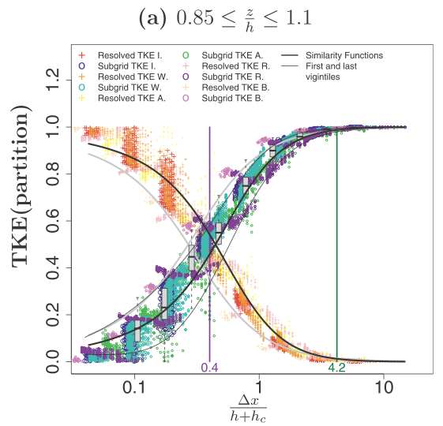
Tapering of Shallow-Cu Scheme
Based off of Honnert et al. (2011, JAS):
  TKE partition in the entrainment layer
Other methods are/will be tested (i.e., Shin and Hong 2013, JAS).
Figure 5
RAP/HRRR Grey Zone Testing

Slide 8

Aerosol awareness
How do we get CCN?
Most sophisticated approach:
  directly from complex model results (WRF-Chem)
Simplest approach:
  from observed Aerosol Optical Thickness (AOT) at 550 nm (global or regional analysis), following Rosenfeld et al. (2008) and Andreae et al (2008), using
Or anywhere in between – depending on complexity of model setup
The dependency introduced through precipitation efficiency
can have a strong effect on downdrafts, but is
limited by other environmental conditions (e.g., if the precipitation efficiency is already very low, it cannot get much lower, and vice versa)

Slide 9
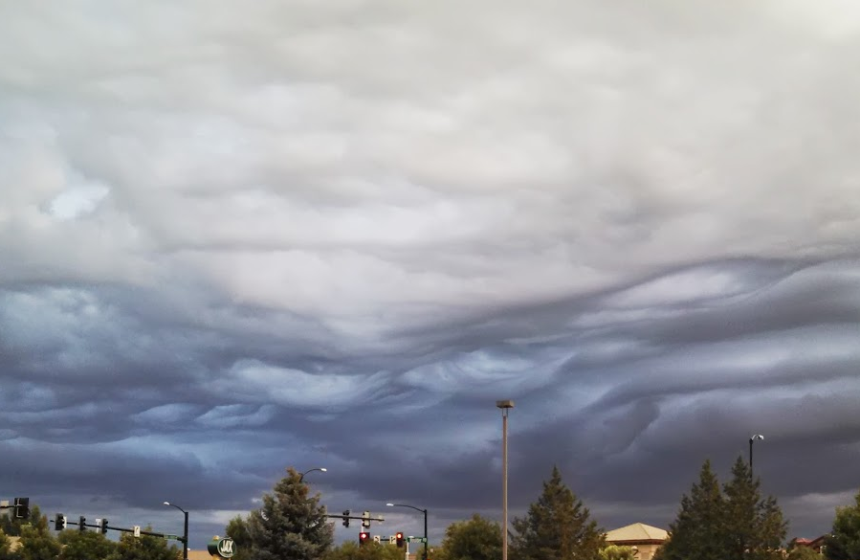



Improving WRF Physics to Better Perform Across a Wide Range of Spatial Scales
Joseph Olson and Georg Grell
Test Case: Grey Zone Project
  Organized by the U.K. Met Office with many participants from around the world.
  Cold-air outbreak case over N. Atlantic.
  Primarily shallow-cumulus regime with very little deep convection.

Slide 10
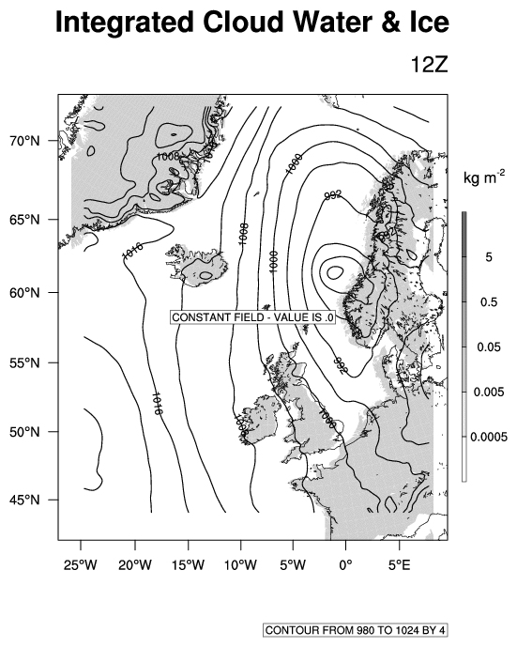
Grey Zone Project to test scale awareness
The Grey Zone Project (headed by UK Met Office) aims to systematically explore convective transport and cloud processes in NWP models at resolutions ranging from 1 to 16 km.
For each set of the LAM simulations (at grid spacings of 1, 2, 4, 8, 16 km), two permutations were run:
  GF deep-cu scheme OFF GF shallow-cu scheme OFF.
  GF deep-cu scheme ON GF shallow-cu scheme ON.
36 hour simulations are done using ECMWF analyses beginning at 12 UTC 30 Jan 2010, and used every 6h to generate LBCs for the coarsest domains.
Two set of 1-way nested domains are used:
  16-4-1 km grids
  8-2 km grids
Integrated Cloud Water & Ice
16 km
8 km
4 km
2 km
1 km

Slide 11
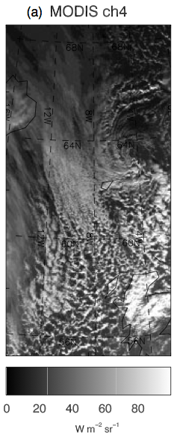
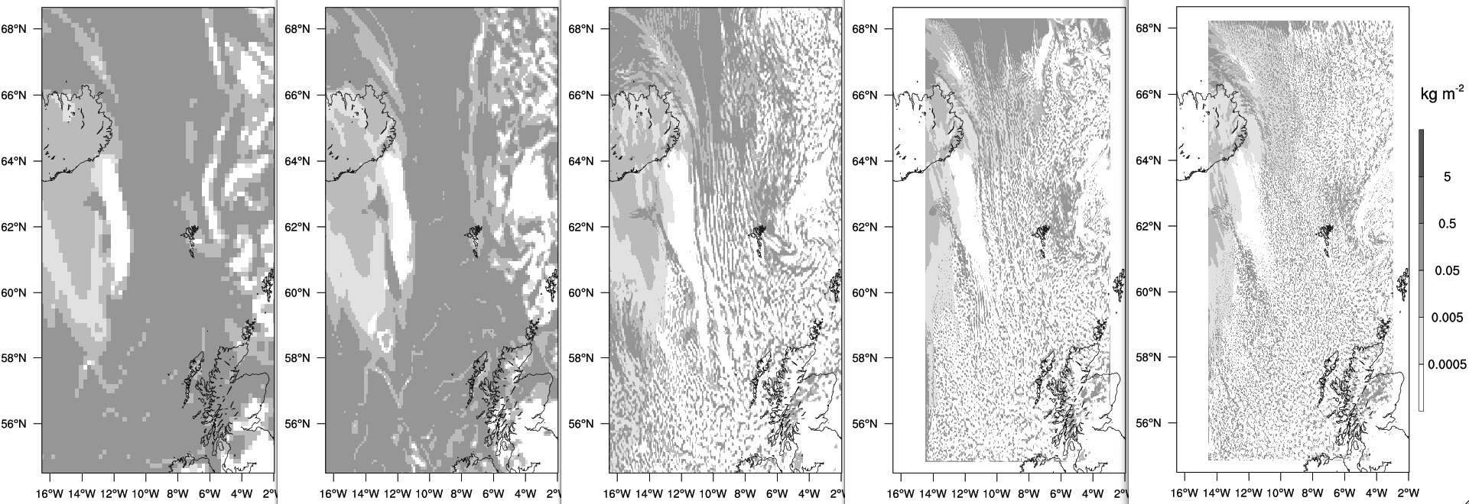
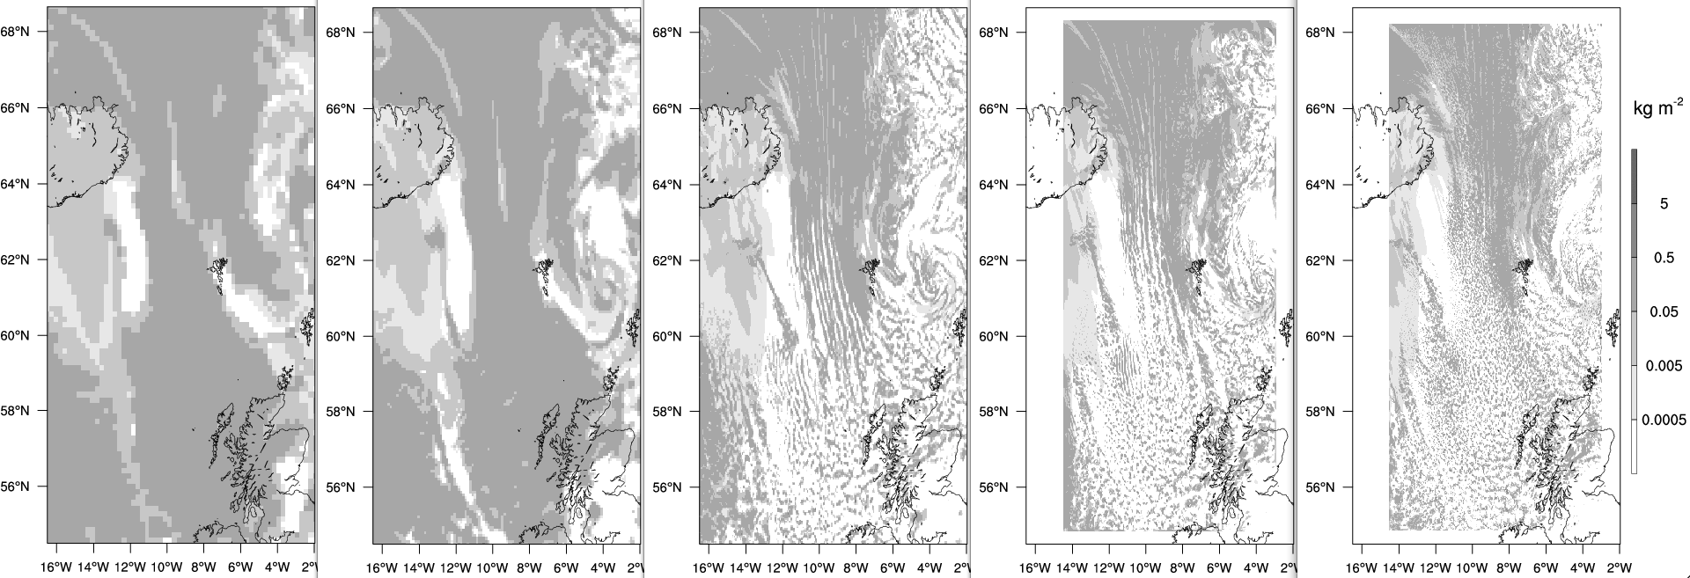
Final results after some improvements in the PBL (MYNN-Olson) scheme
Δx = 16 km
Δx = 8 km
Δx = 4 km
Δx = 2 km
Δx = 1 km
Cu off, ShCu off, 51 levels (Control)
Cu on, ShCu on, 63 levels, with PBL mods
Above figure taken from Field et al (2013).

Slide 12

Variable Resolution Tests
using the Grell-Freitas Convection Scheme
(Laura Fowler, Bill Skamarock, GF group)
MPAS mesh:
50 – 3 km variable resolution.
CONUS is the 3 km region.
Very smooth transition to the 50 km region.
MPAS Physics:
WSM6 cloud microphysics
Grell-Freitas convection scheme
Monin-Obukhov surface layer
YSU PBL
Noah land-surface
RRTMG lw and sw.

Slide 13
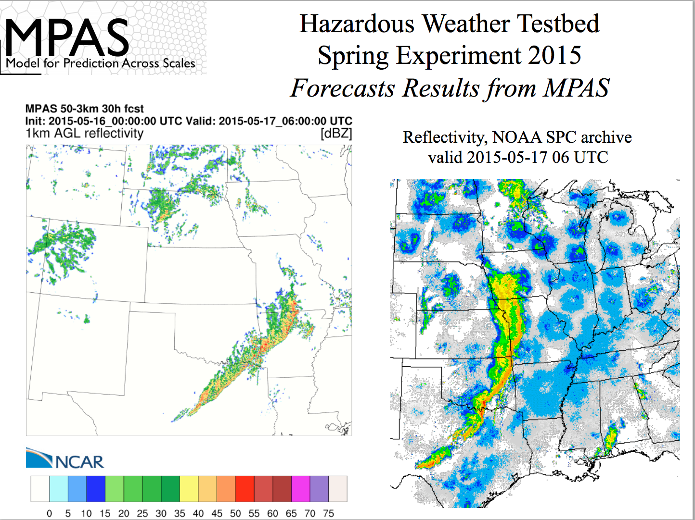

Slide 14
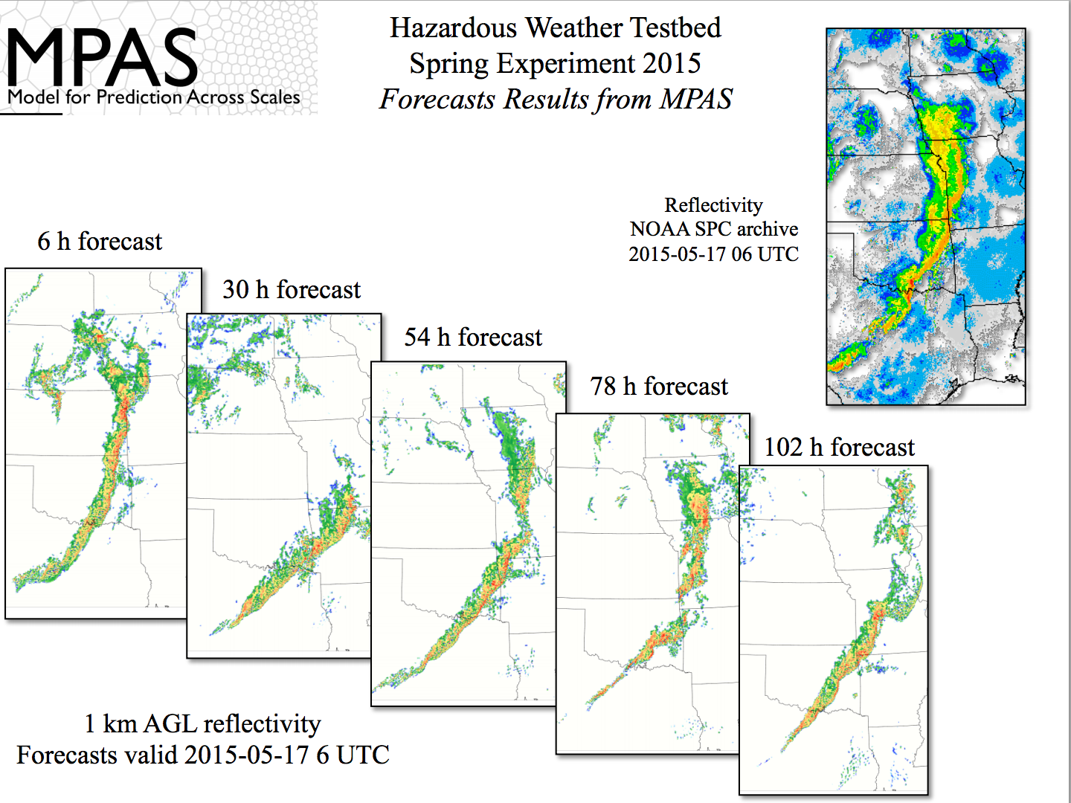

Slide 15
MPAS results for South America runs

Slide 17
Tropical Cyclone scale awareness fully 3d simulations
Model setup for full 3d idealized tests
A prescribed weak axisymmetric vortex:
— maximum surface tangential wind: 15 ms⁻¹
— radius of surface maximum wind: 90 km
initial mass and wind fields associated with the weak vortex disturbance are obtained by solving the nonlinear balance equation for the given wind distributions of the initial vortex (Wang 1995, MWR)
Idealized environment thermally corresponding
to the Jordan sounding with a constant sea
surface temperature of 29ºC (favorable for hurricane development)
f-plane located at 12.5ºN
4 different resolutions are used, 27-9-3-1km. There is no 2-way interaction. 43 vertical levels
All experiments use a Monin-Obukhov surface layer, the unified Noah land-surface model, modified 3dTKE mixing
Model Setup
WRF-ARW is initialized with a weak axisymmetric vortex disturbance in an idealized tropical environment that is favorable for the vortex disturbance to develop into a hurricane. The initial mass and wind fields associated with the weak vortex disturbance are obtained by solving the nonlinear balance equation for the given wind distributions of the initial vortex (Wang 1995, MWR), and the prescribed background thermal sounding and winds.
f-plane located at 12.5ºN
A prescribed axisymmetric vortex:
— maximum surface tangential wind: 15 ms⁻¹
— radius of surface maximum wind: 90 km
Quiescent environment thermally corresponding
to the Jordan sounding with a constant sea
surface temperature of 29ºC
The models are run with 2 domains, a 9 km
outer domain with a vortex-following 3-km nest and 43
vertical levels
All experiments use a Monin-Obukhov surface layer, the unified Noah land-surface model, 3dTKE mixing and no cumulus parameterization on the 3 km grid.
The control configuration for radiation is the RRTM scheme for longwave and Dudhia scheme for shortwave radiative forcing.

Slide 18
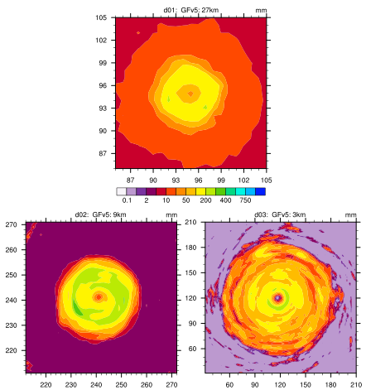
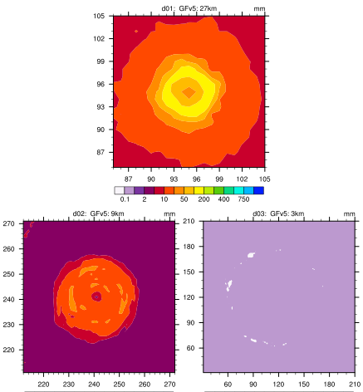
total precipitation
convective precipitation
27km
27km
9km
3km
9km
3km
Early stage of storm development

Slide 19
Heating and drying tendencies at 36hr ( deg/day) – averaged inner part of 3km domain
Cloud tops at ~7km
Height (km)
Heating tendencies
Drying tendencies

Slide 20
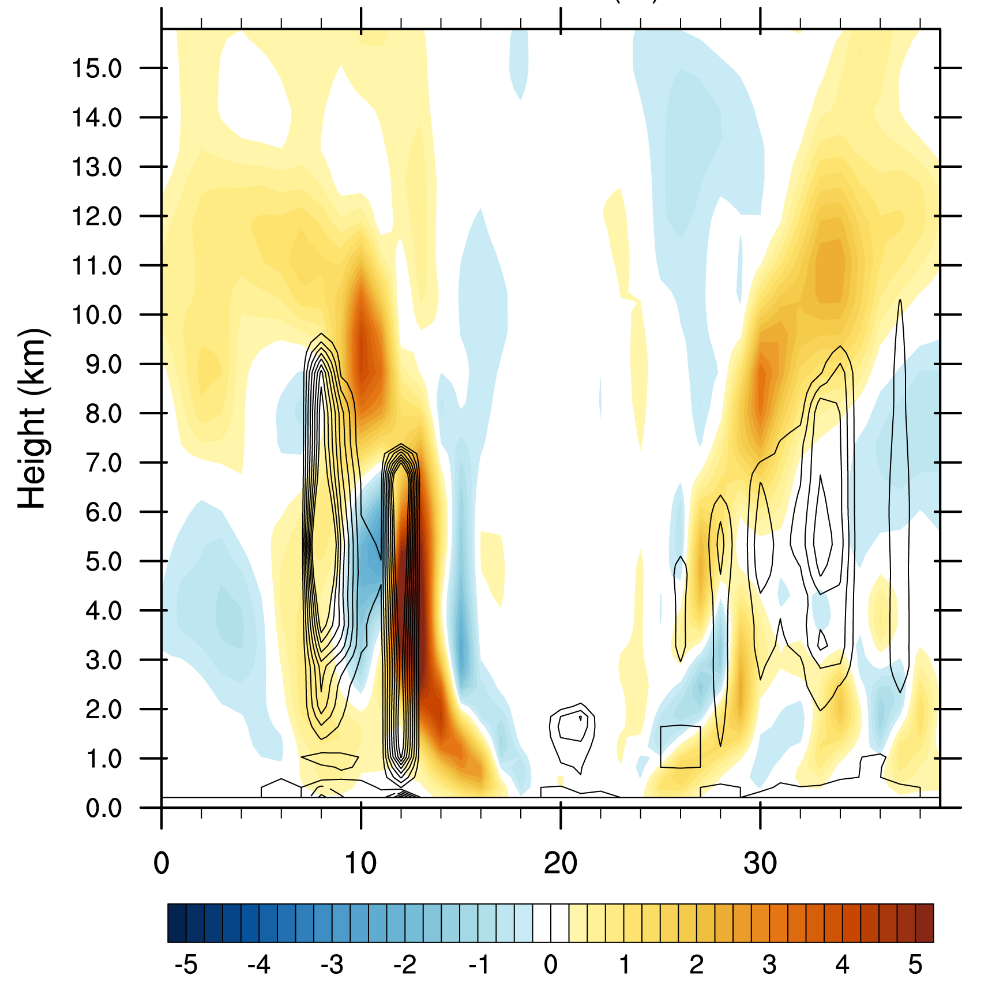
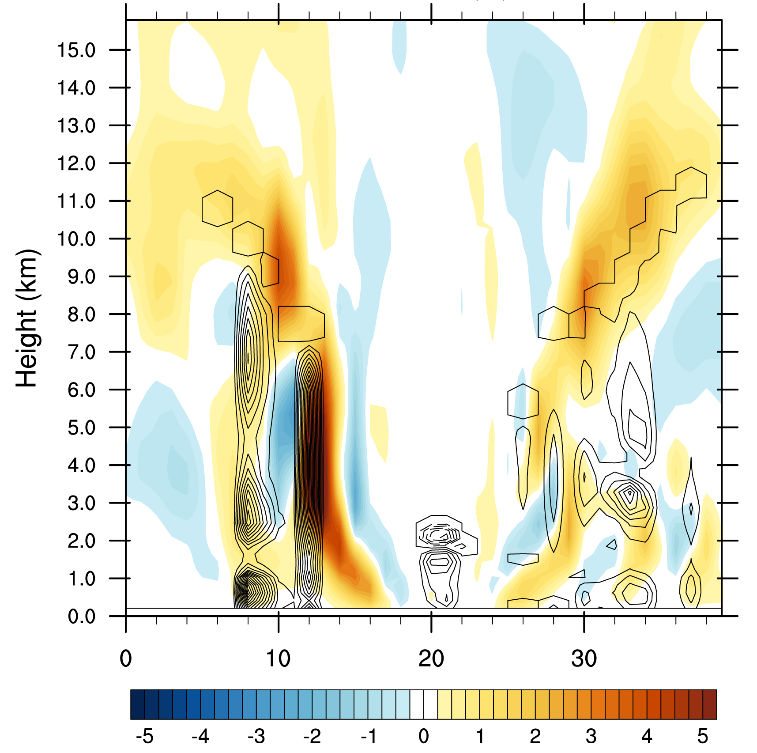
Crossection through center of storm, dx=3km, vertical velocity in color (m/s)
Heating tendencies (contours)
Drying tendencies (contours)
Parameterization can not handle tilt, could be a significant problem if tendencies would not be so miniscule

Slide 21
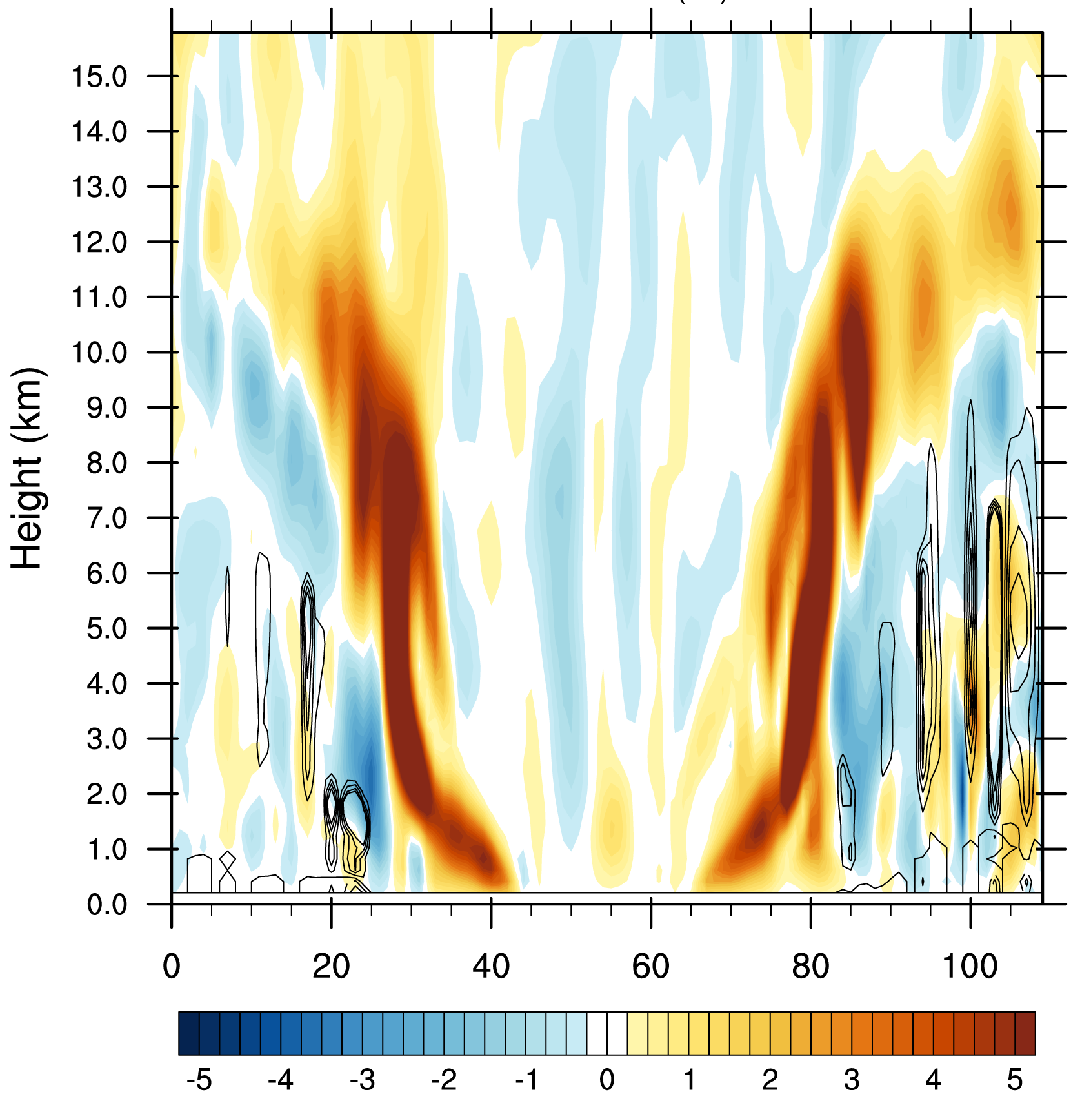
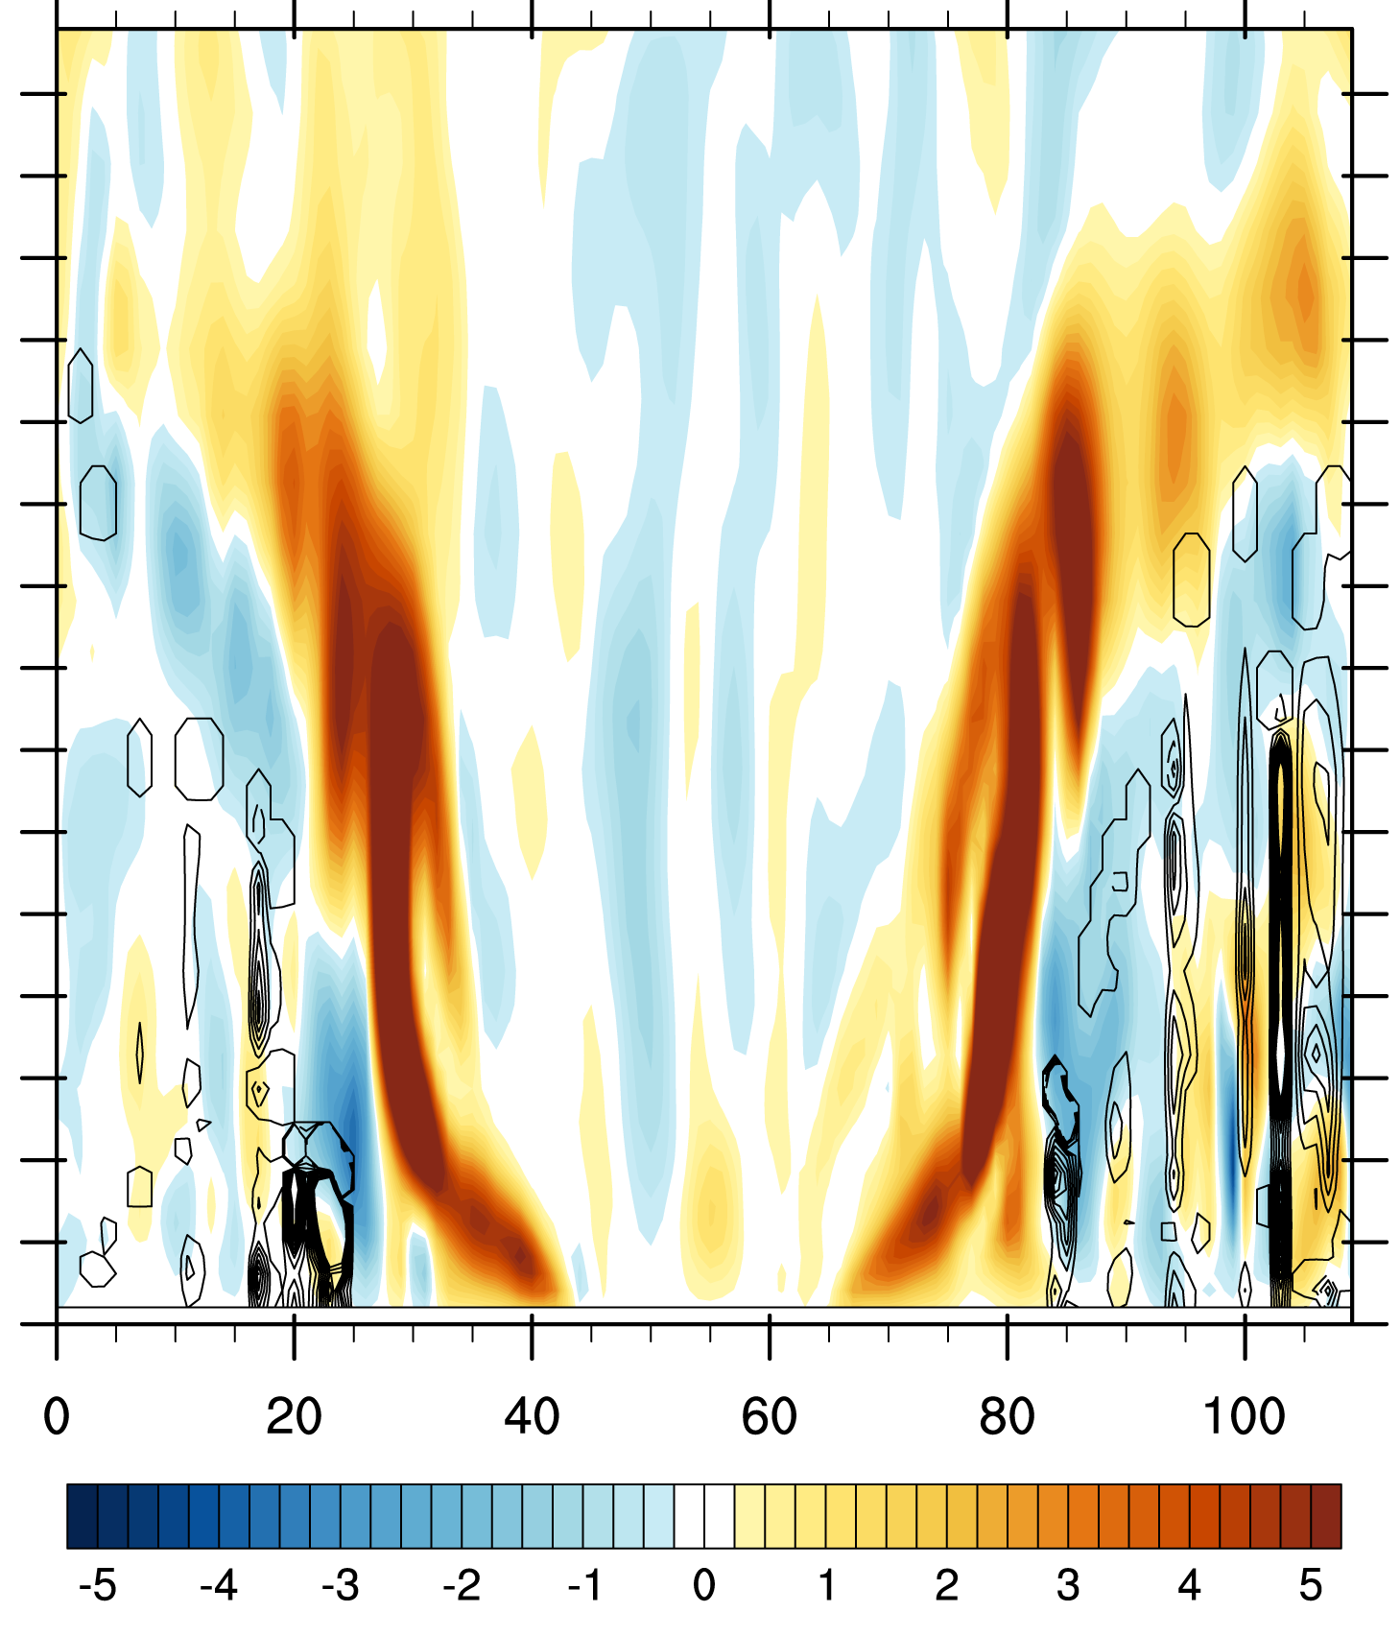
Adding a 1km resolution simulation
Cross-section through center of storm, dx=1km, vertical velocity in color (m/s)
Heating tendencies (contours)
W (m/s) in color
Drying tendencies (contours)
W (m/s) in color
Actually looks better on dx=1km!

Slide 22
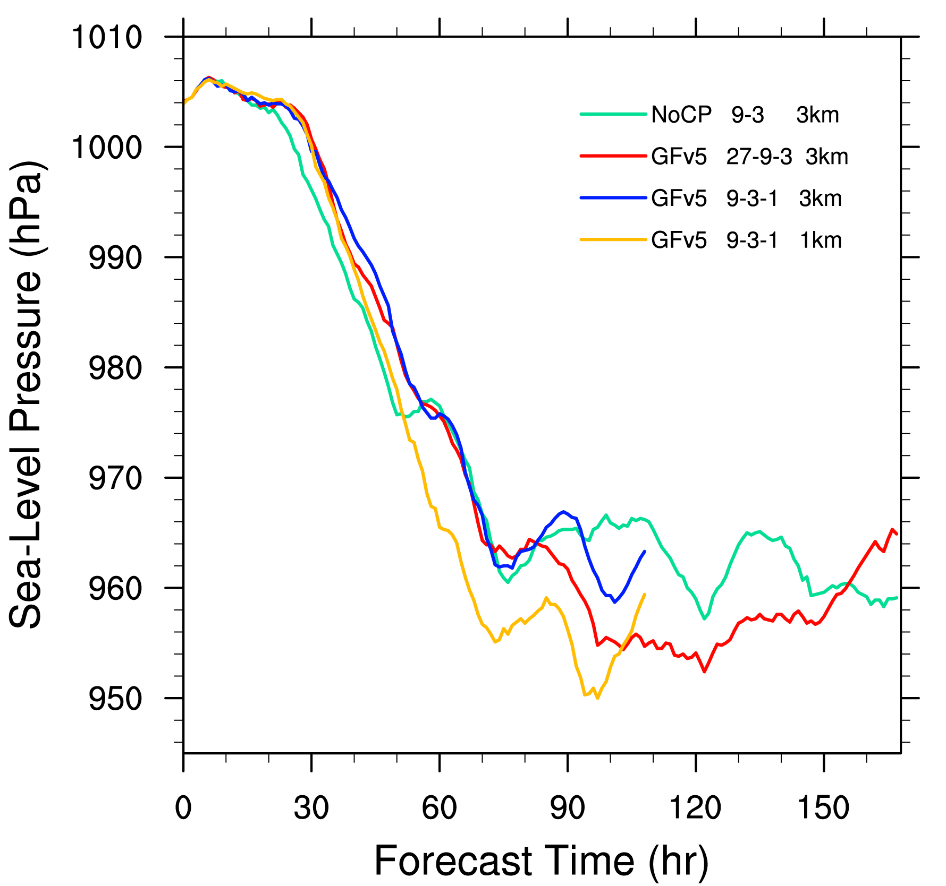
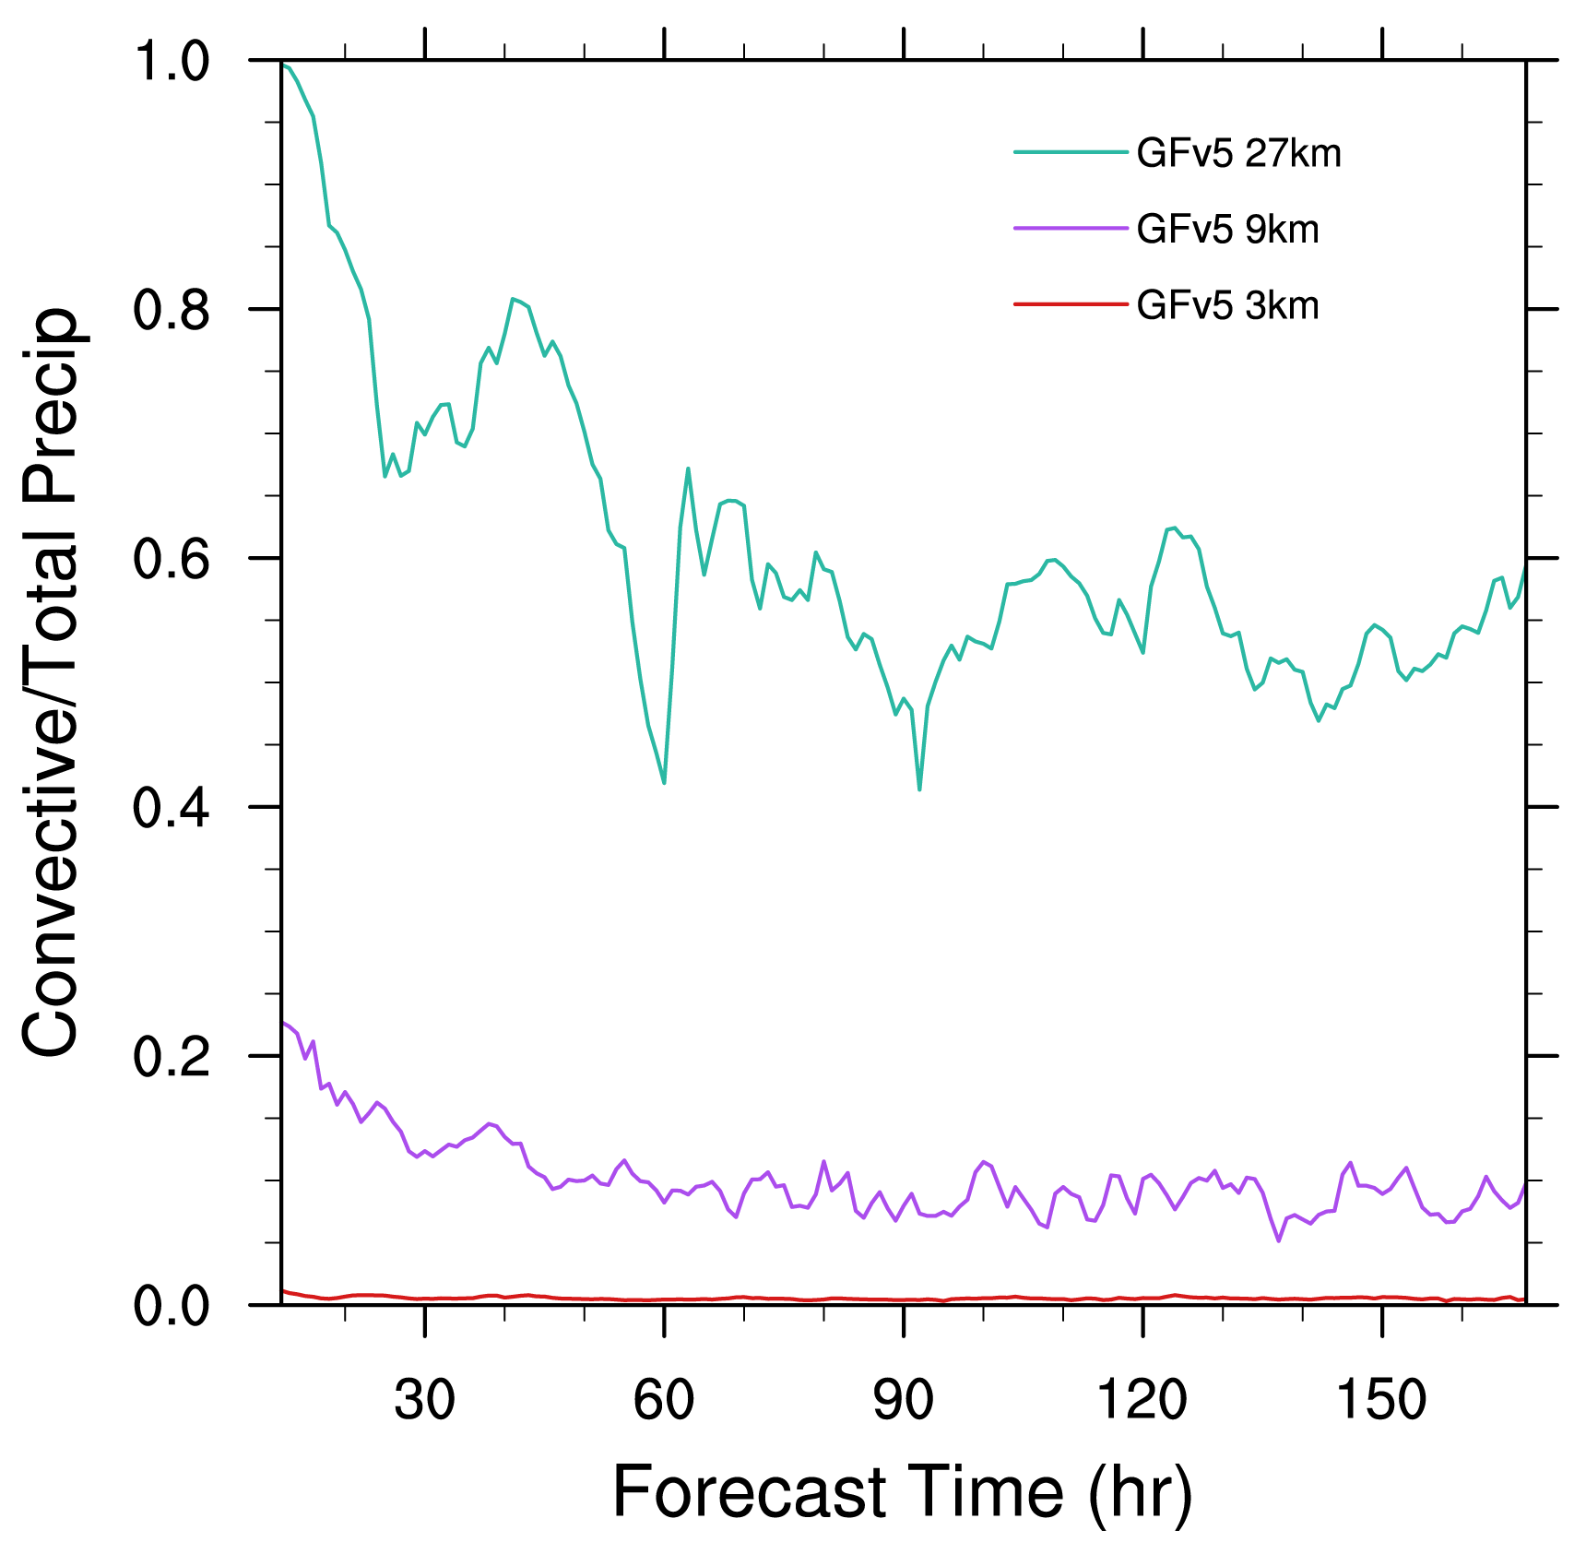
Domain averaged (3km resolution domain) precipitation rate (mm/h) and fraction of convective to total rain

Slide 23
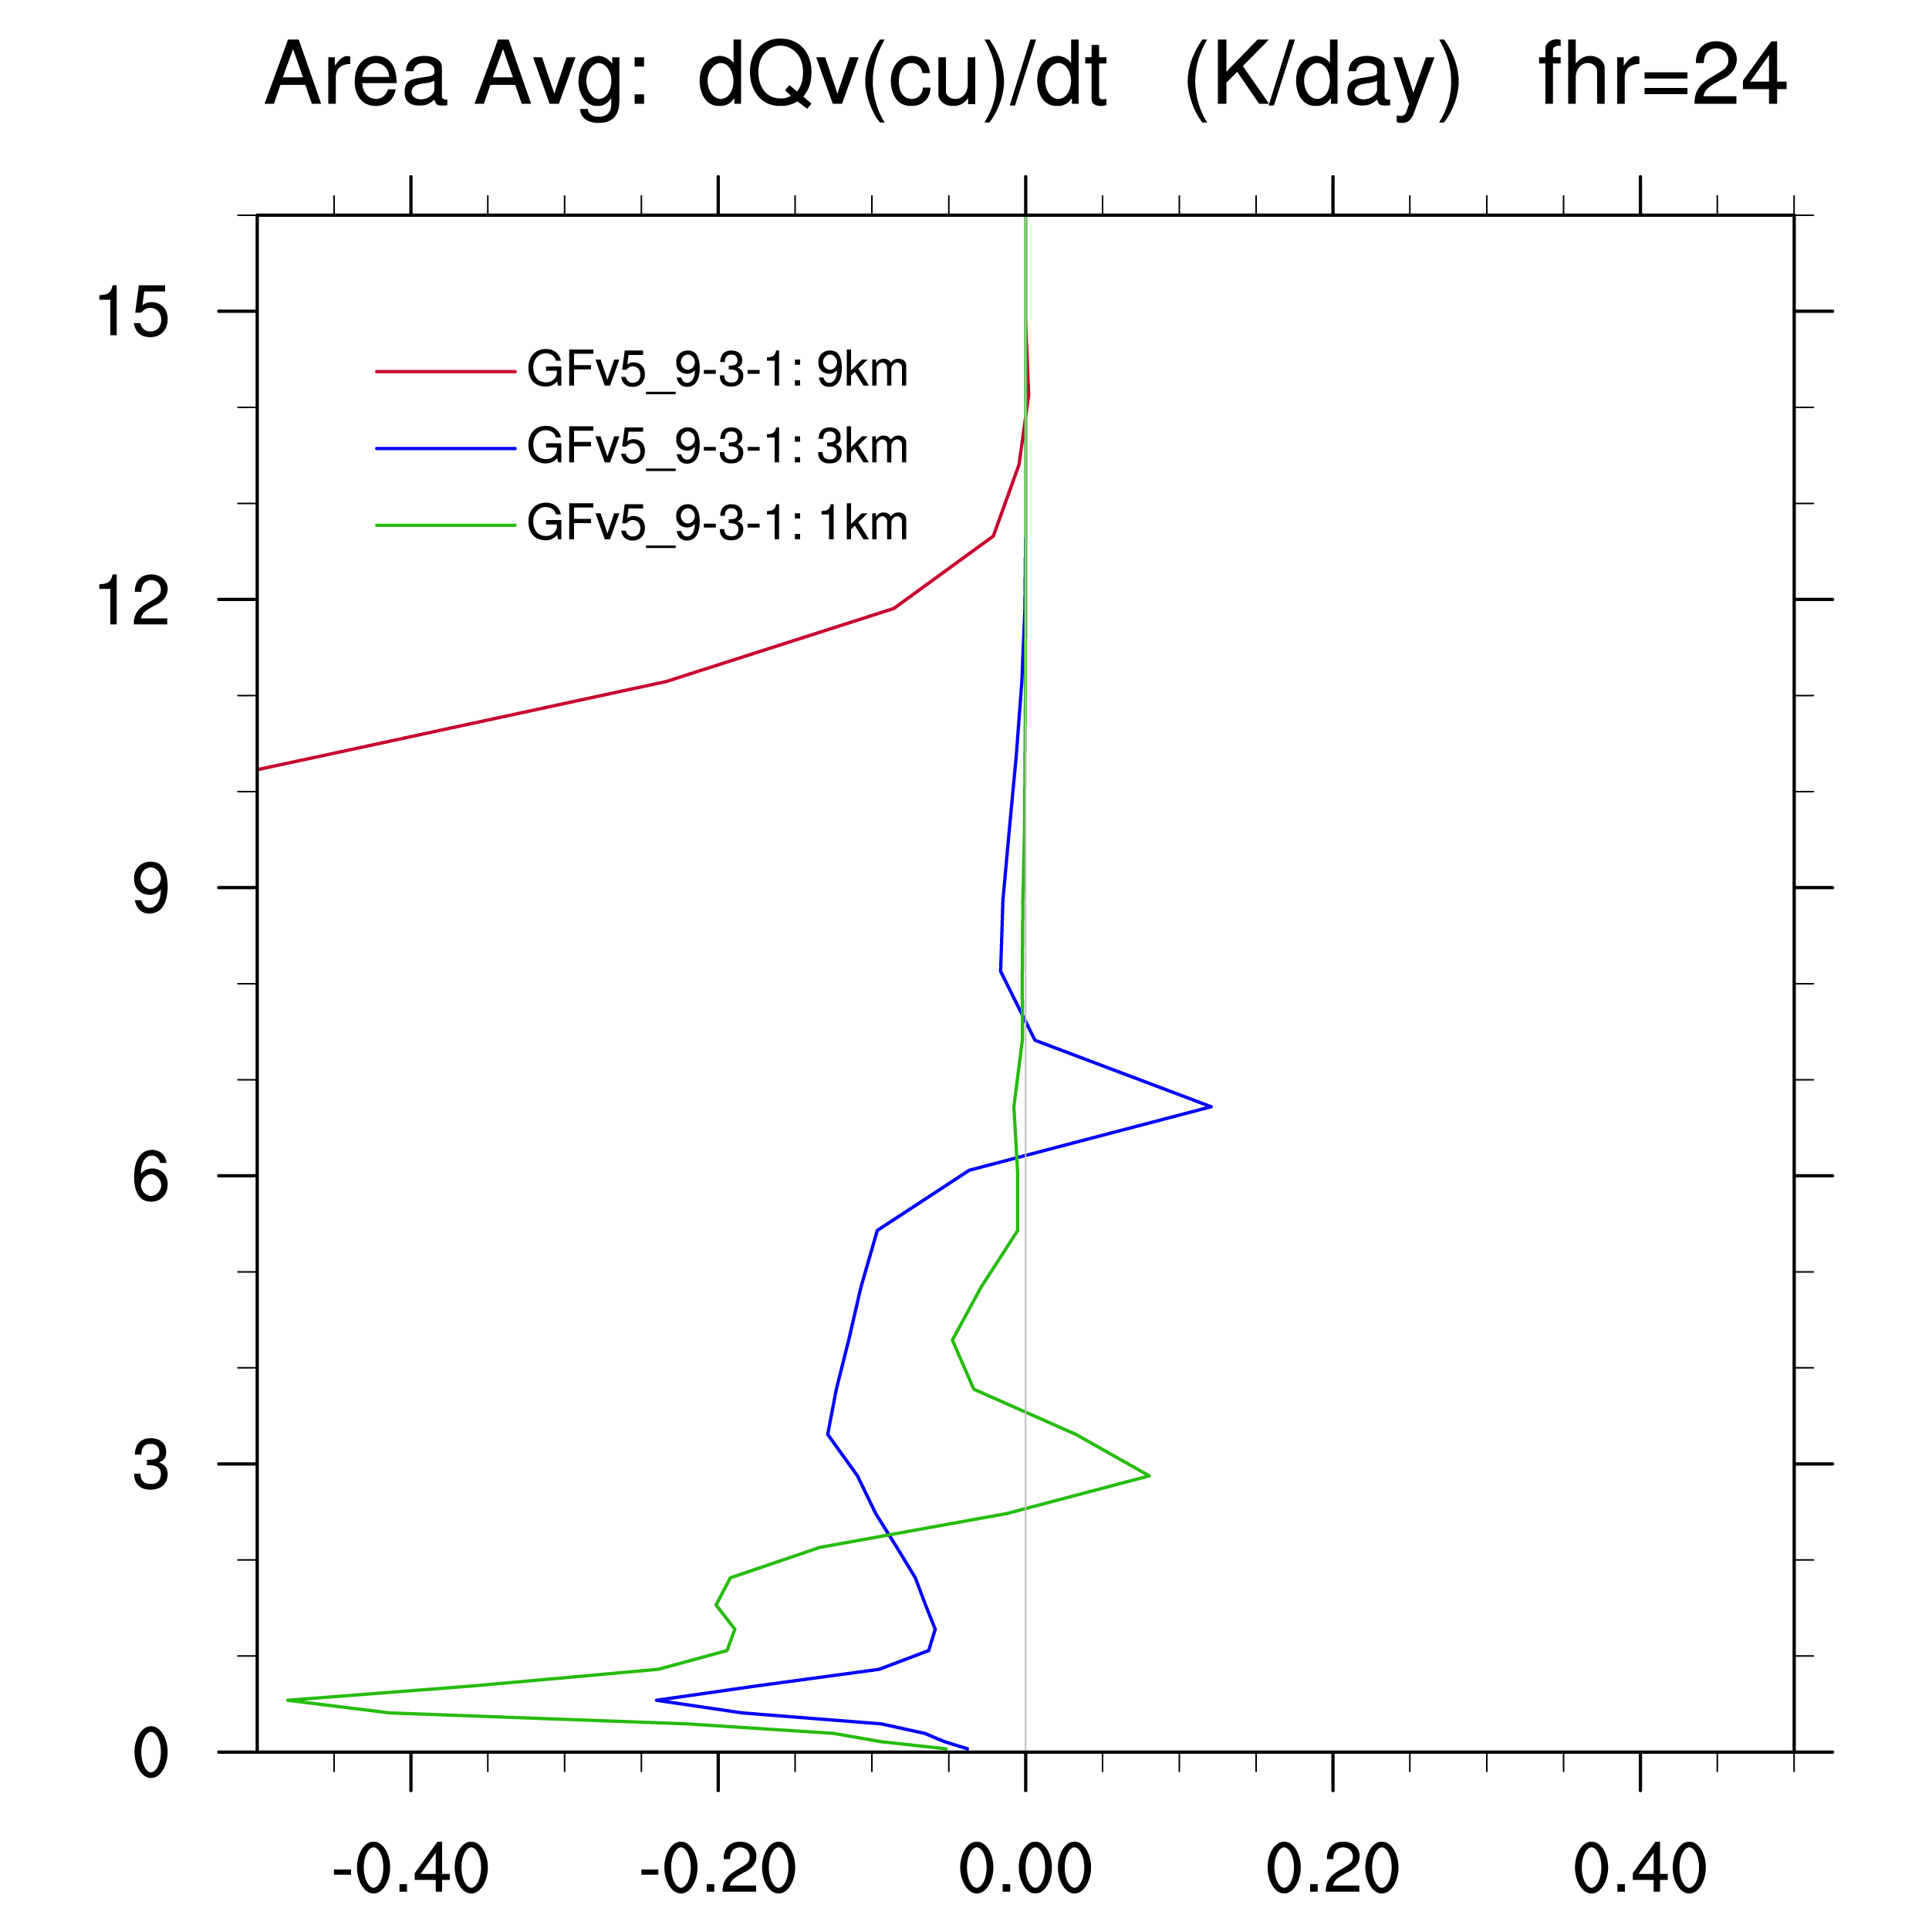
Idealized 3d tropical cyclone simulation
Heating profiles from convective parameterization for idealized tropical cyclone simulations at 27km, 9km, and 3km
Average cloud top at 7km
Drying profiles from convective parameterization for idealized tropical cyclone simulations at 3km and 1km (!) resolution
Average cloud top at 3km

Slide 24
Scale-awareness seems to work fine with the very simple Arakawa (2011) approach, as well as other very simple assumptions to estimate a fractional coverage.

Slide 25
  Recent new “HIWPP” implementations
    Momentum transport (as in SAS or ECMWF)
    Additional closure for deep convection: Diurnal cycle effect (Bechtold )
    Mass conserving transport completed for shallow scheme
    Mass conserving transport for deep currently being tested
    Additional closures for shallow convection (including the SAS shallow convection closure, and one from Renno and Ingersoll, JAS 1996)
    PDF approach for normalized mass flux profiles was implemented (fitting LES modeling for shallow convection and allows easy application of stochastic perturbation of vertical heating and moistening profiles)
    GF scheme was fully immersed into GFS 2012 and 2015 physics (replacing the call to SAS deep and/or shallow schemes)
    Rain evaporation (by parameter choice) after tendency calculations

Slide 26
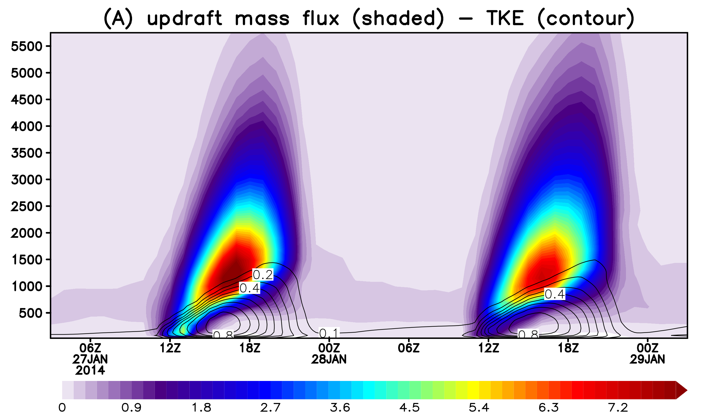
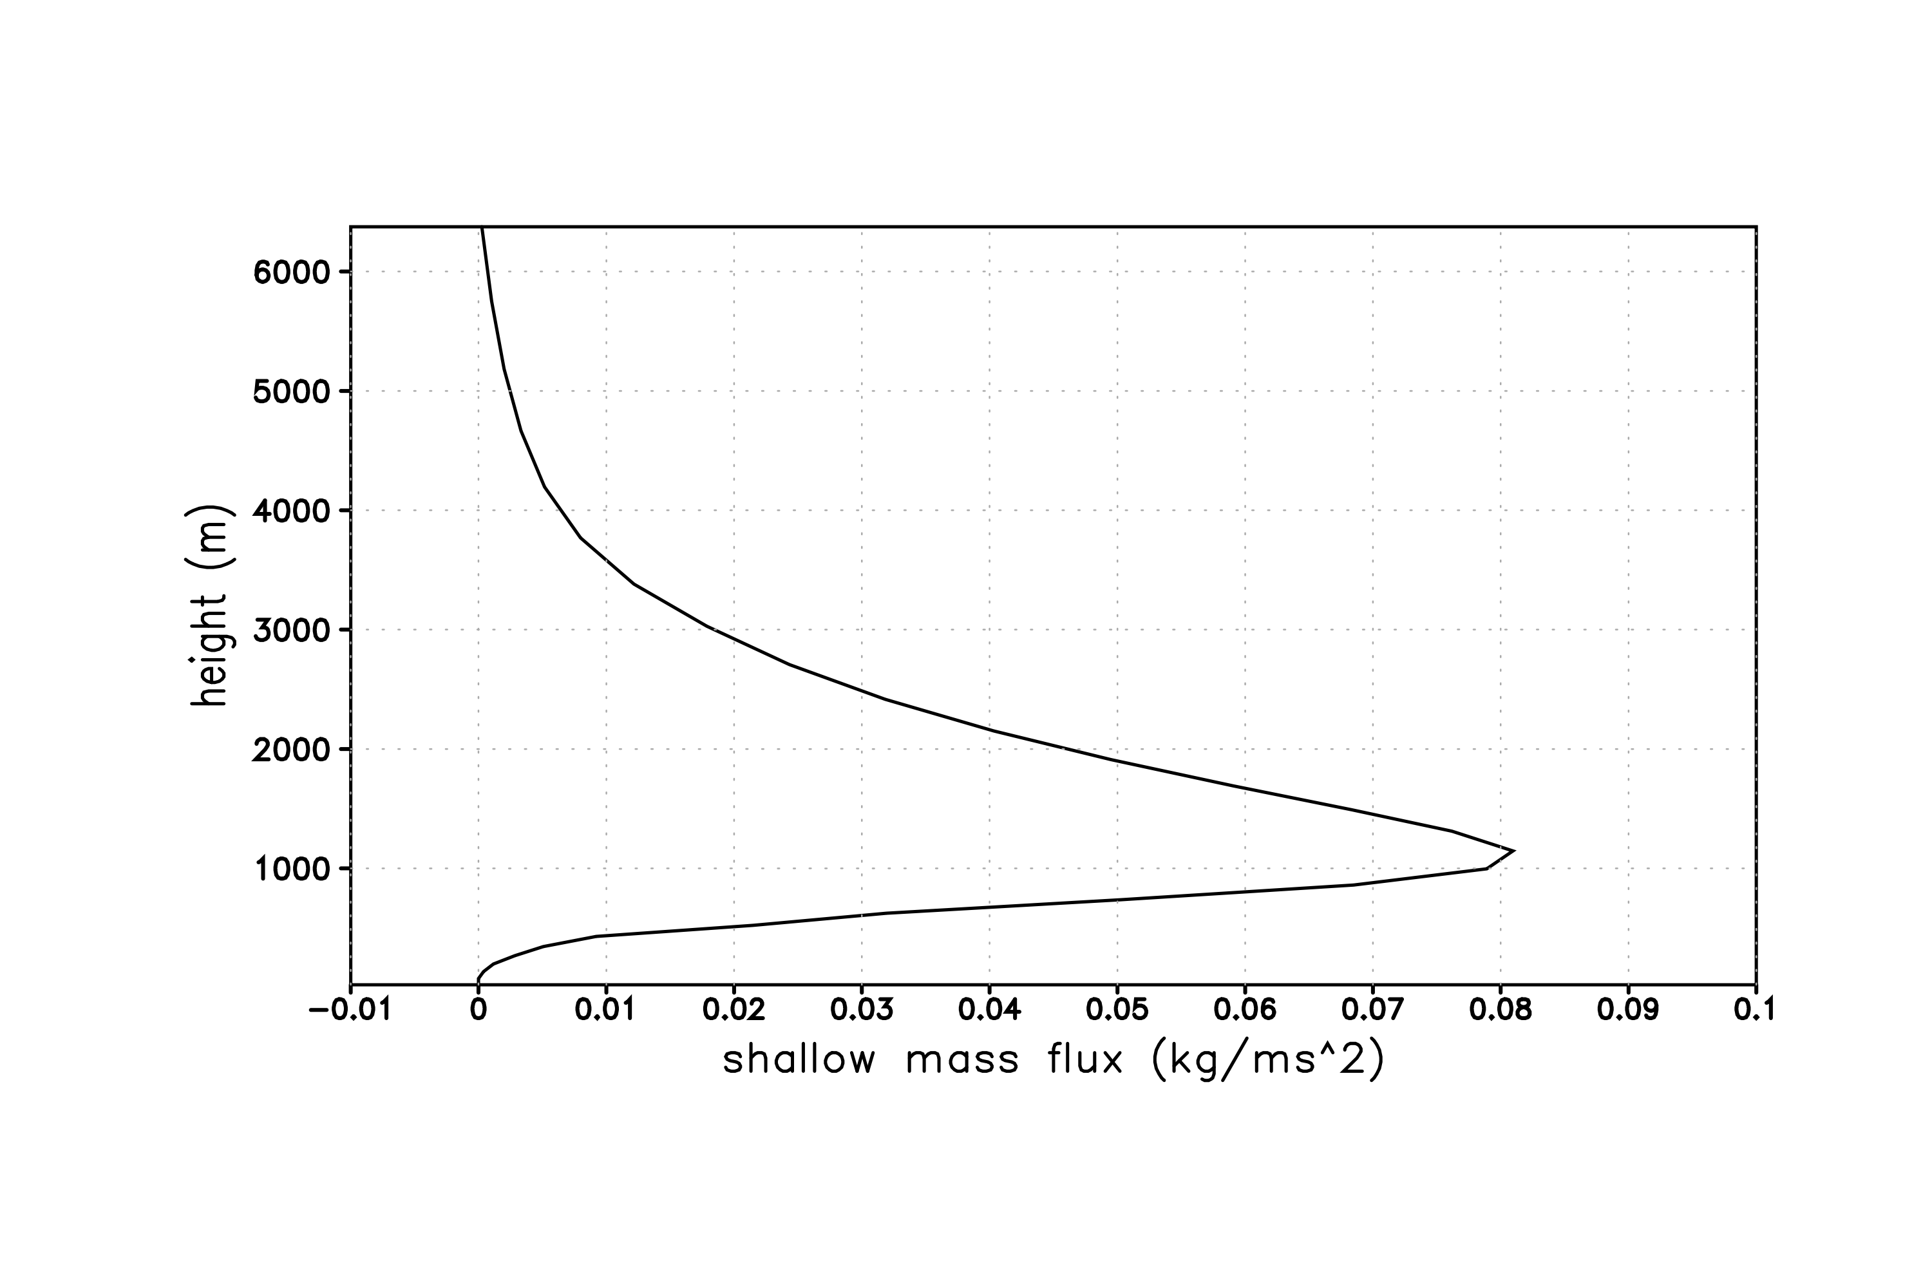
Shallow Convection Scheme
Non-precipitating
Transport of moisture, heat and tracers
Mass flux profile given by a Beta PDF
Three closures – BLQE (Raymond, 1995), W*(Grant, 2001) and convection as natural heat engine (Rennó and Ingersoll, 1996).
Diurnal cycle of shallow convection and diffusion in PBL
Mass flux Profile
Height (m)
Siebesma et al 2003
Similar with LES
Sharp increase, peaking just above boundary layer
Smooth decrease above
updraft mass flux: shaded
TKE: contour

Slide 27
So, with all those changes, where are we now for the global model?

Slide 28
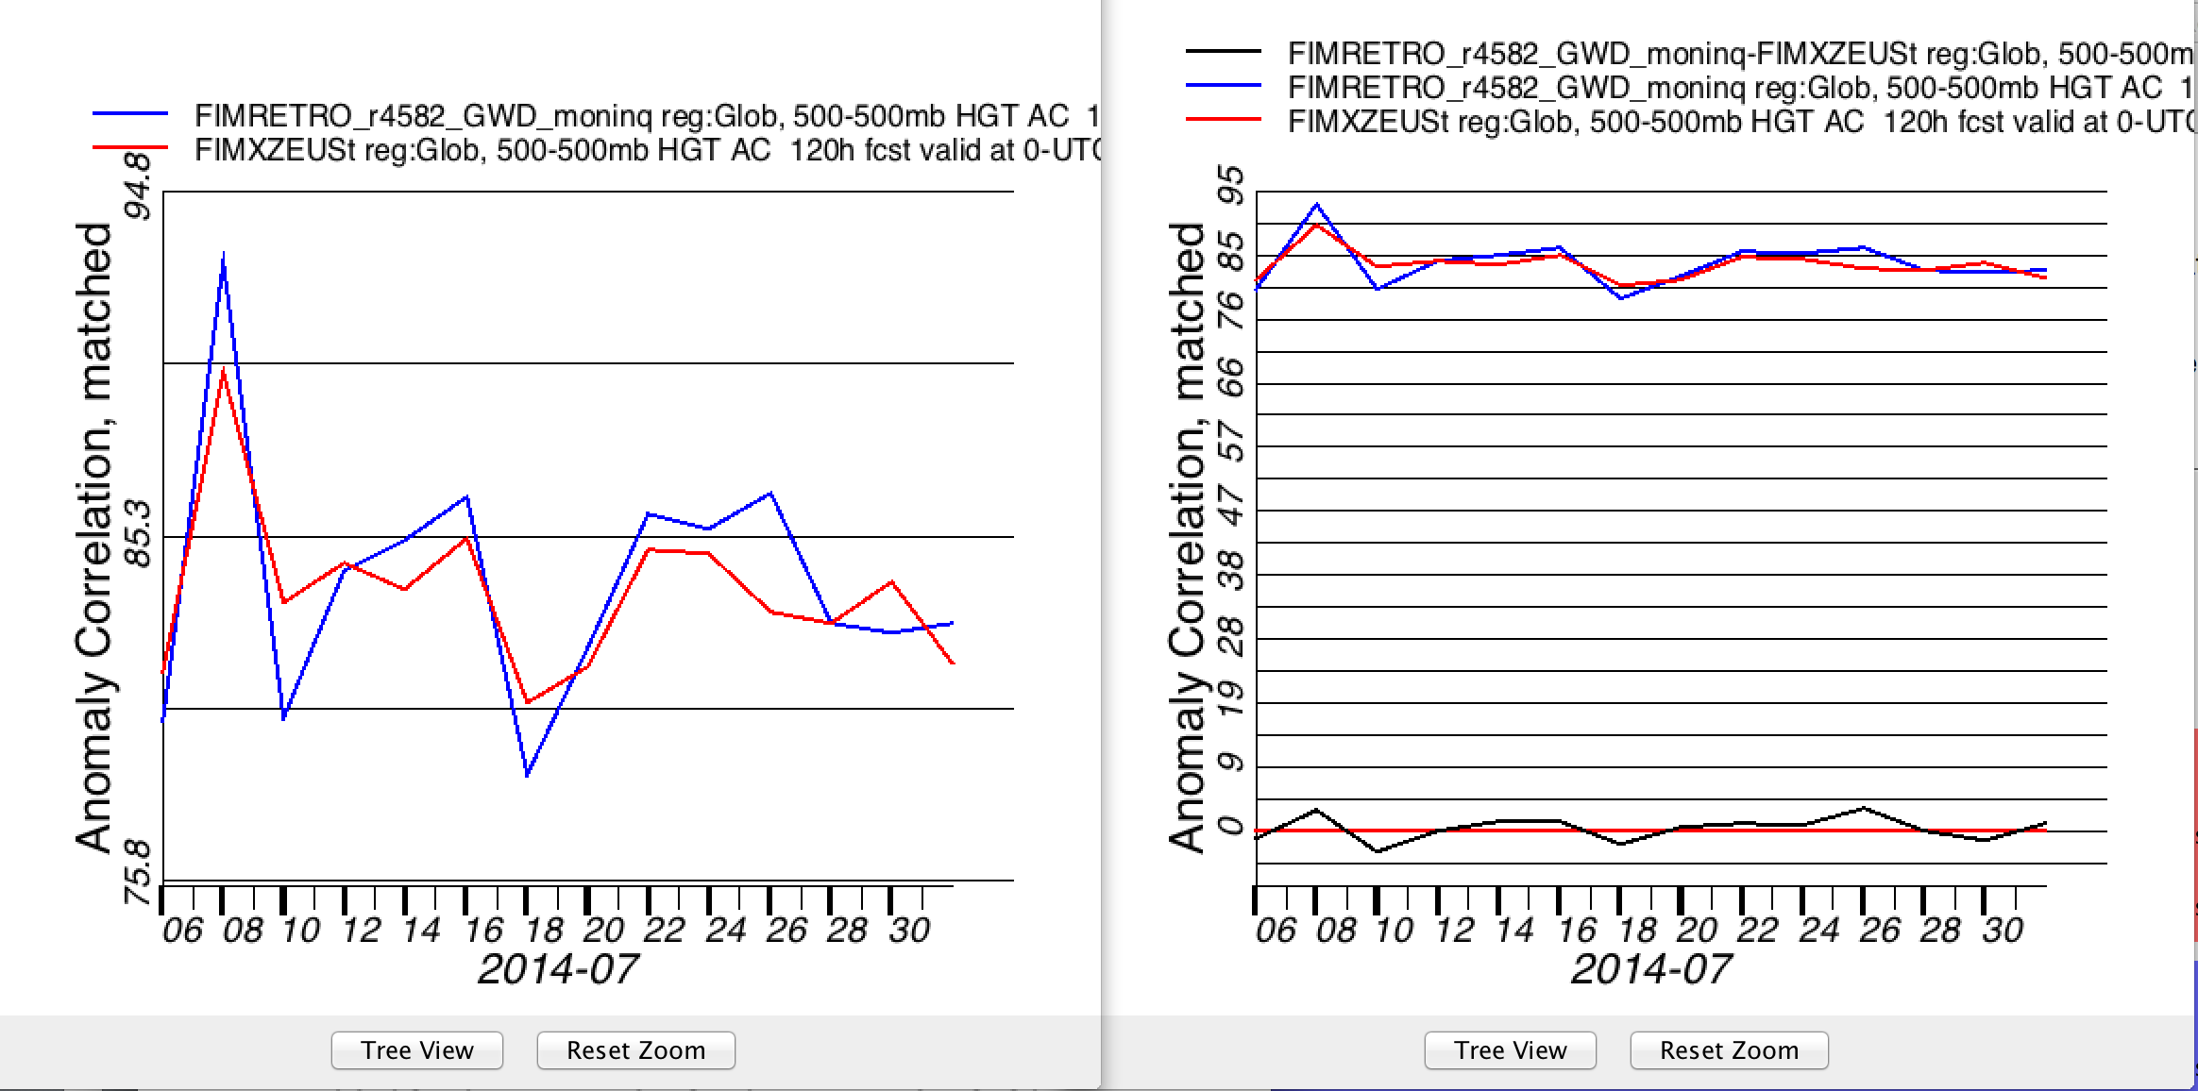
120hr height anomaly correlations as of latest HIWPP meeting (May 2015) - close

Slide 29
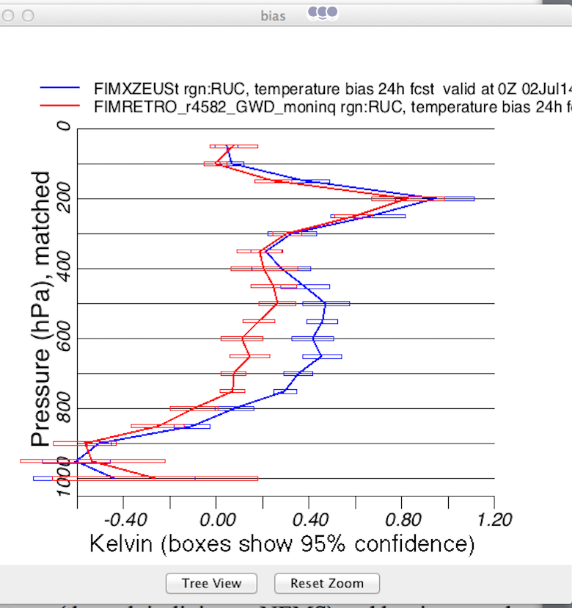
Remaining problem to solve
What is responsible for positive temperature bias?
  This was the reason for implementing SAS rain evaporation
  Take a detailed look at momentum transport

Slide 30
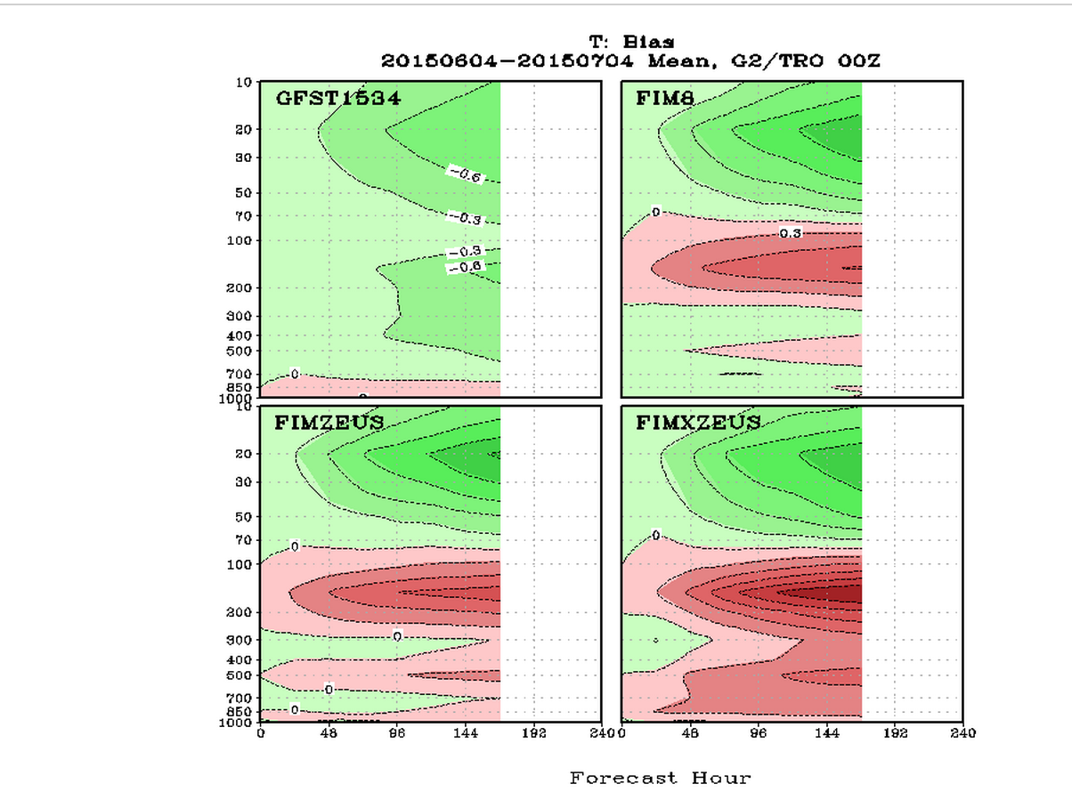
In tropics: temperature bias in both GFS physics versions, but worse when using GF – yet heating tendencies are actually smaller in GF!
T-Bias
First look at upper level T-bias: overshooting tops (is also used in SAS) as an option?
Next slides are from FIM simulations at about 30km resolution, using GFS 2015 physics and T1534 GFS initial conditions

Slide 31
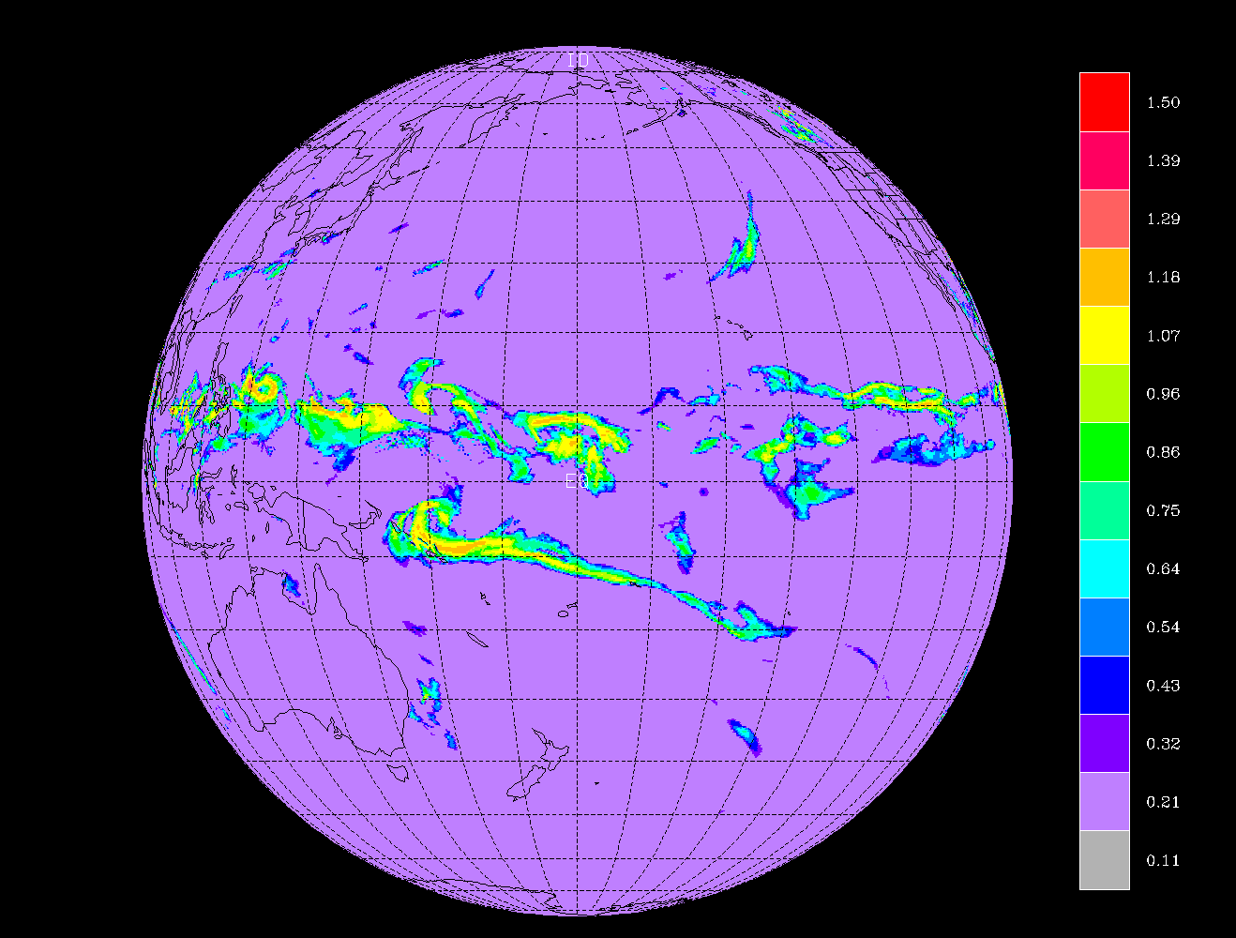
Vertical profiles of physics tendencies over 10x10 degree average, 24hr into the forecast

Slide 32
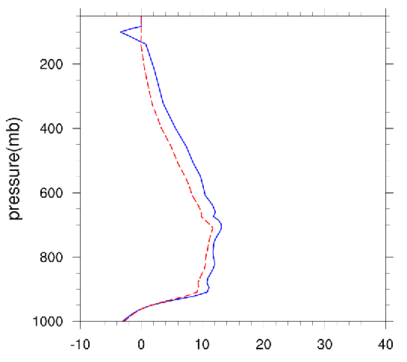
Vertical profiles of temperature tendencies from GF scheme allowing significant overshooting to see impact clearly!
GF with over shooting
GF no over shooting
Cooling, but initial version higher than wanted – easy to modify

Slide 33
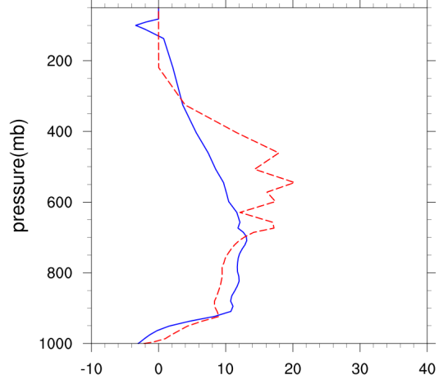
Vertical profiles of temperature tendencies from GF and SAS scheme over 10x10 degree average, 24hr into the forecast
GF with over shooting
SAS
Lower cloud tops when using SAS
Moving on to lower levels heating bias : differences must be caused by interaction with microphysics or radiation

Slide 34
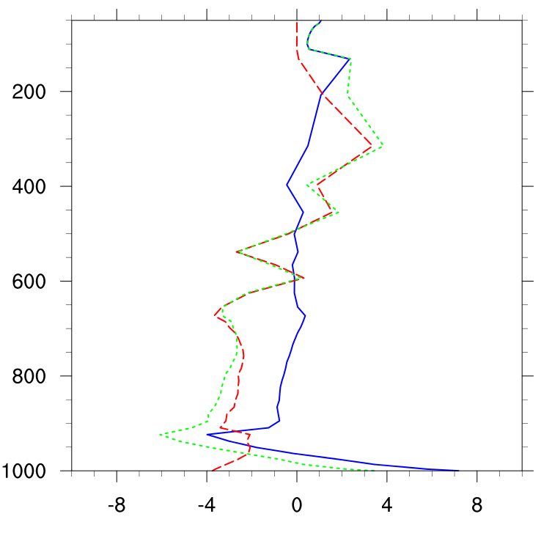
Vertical profiles of temperature tendencies from GFS physics over 10x10 degree average, 24hr into the forecast
SW radiation
Microphysics tendencies
Significant heating from microphysics and SW radiation !
Significant cooling from microphysics !

Slide 35
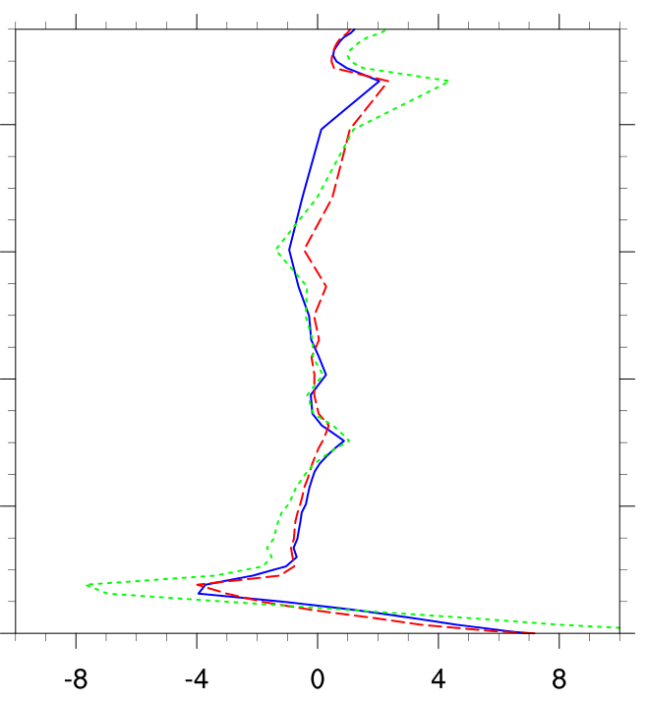
Vertical profiles of microphysics nd SW radiation temperature tendencies when using SAS (left) and GF (right) over 10x10 degree average, 24hr into the forecast
SW radiation
Microphysics tendencies
GF
SAS

Slide 36
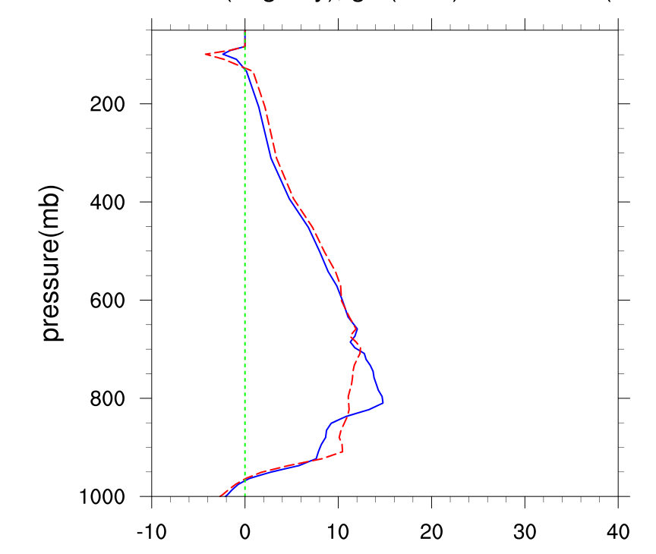
Vertical profiles of temperature tendencies from GF scheme over 10x10 degree average, 24hr into the forecast with different formulation of clw detrainment.
In SAS: detrainment is formulated similar to what is done with the autoconversion parameter, making this much more tunable and independent of mass detrainment.
GF with over shooting
GF with different clw detrainment and overshooting
For tendencies coming from GF, not very large differences..

Slide 37
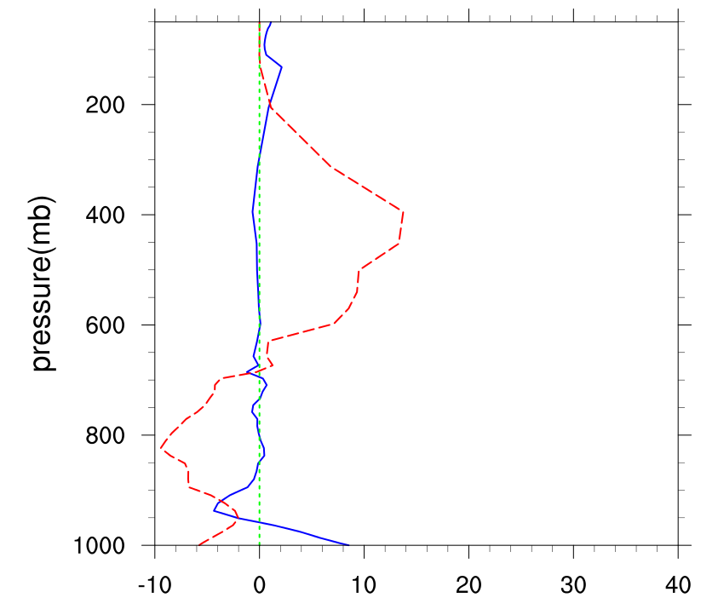
Microphysics and SW radiation tendencies when using arbitrary clw detrainment (similar what is done in SAS
SW
MP physics
Next we will
Redo retro-runs with 2015 GFS physics, GF and T1534 resolution
Compare to MP tendencies from different microphysics scheme (started looking at Greg Thompson’s aerosol aware scheme within the GFS physics)
Take a detailed look at momentum transport

Slide 38
Stochastic Parameter Perturbation in GF Scheme
  For stochasticism
    Starting to work with Judith Berner’s approach (Stochastic Kinetic Energy Backscatter scheme (SKEBS) but currently restricted to WRF) – Isidora Jankov
      Apply directly to closure assumptions – for location and strength of convection)
      Apply to skewness of vertical mass flux PDF’s (an easy way to significantly alter vertical heating and drying profiles
    Plan is to try for forecast improvements or ensemble data assimilation

Slide 39
Comparison of performance between mixed physic and stochastically perturbed parameters ensembles
Experiment design
Regional RAP model simulations
Can be transferred to FIM, GFS, MPAS, HWRF, or other NGGPS core for testing on global domains
14 day period 15-31 May, 2013, 24 hr simulations
Focus on convective Grell-Freitas parameterization
Analysis of simulated precipitation was performed against Stage IV data, and for other standard variables (tmp., height, wind) against NDAS analysis
All verifications performed over CONUS
The control run, expensive mixed physics ensemble includes two versions of Arakawa-Schubert (AS) scheme, Betts-Miller-Janjic (BMJ) and Grell Freitas (GF) convective parameterizations - ctrl
Stochastically perturbed parameter ensemble experiments (using only one run!):
  Stochastically perturbed closures-V3
  SKEBS scheme was added to closure perturbations – V3_skeb
  In addition to the closure perturbations entrainment rate was perturbed – V3_exp
  Stochastically perturbed max capping inversion –V3_exp3
Performance of the mixed physics ensemble, V3, V3_exp and Ve_exp3 in terms of simulated precipitations was evaluated

Slide 40
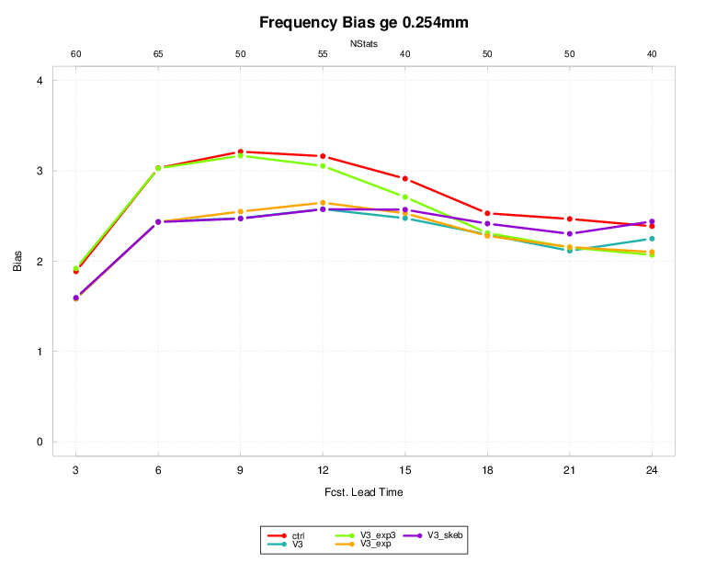
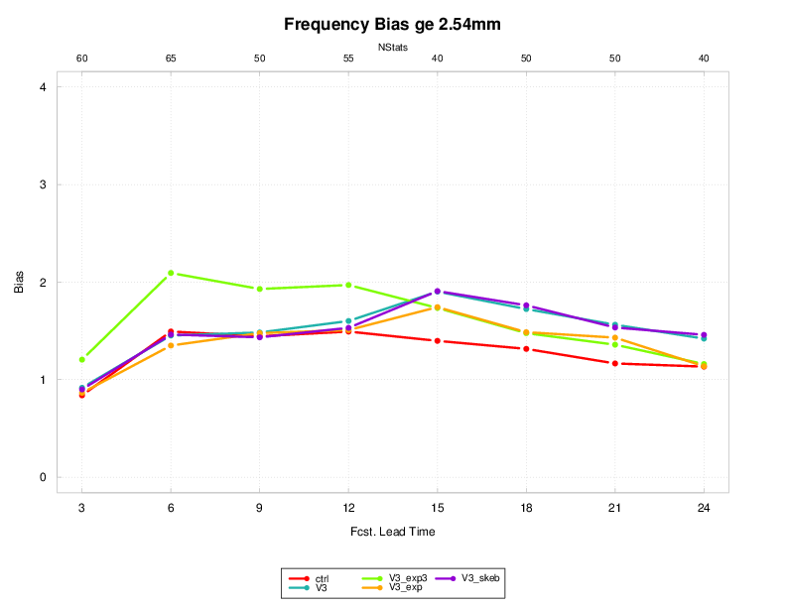
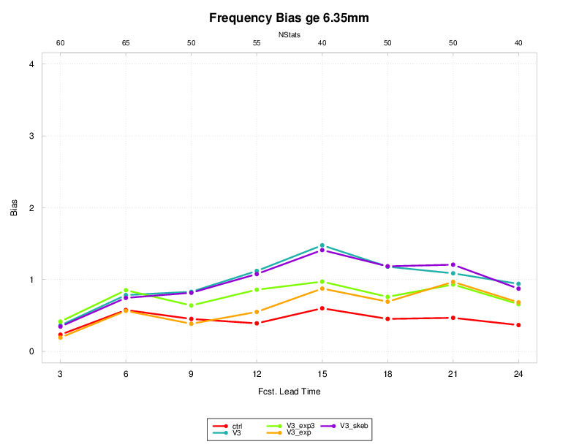
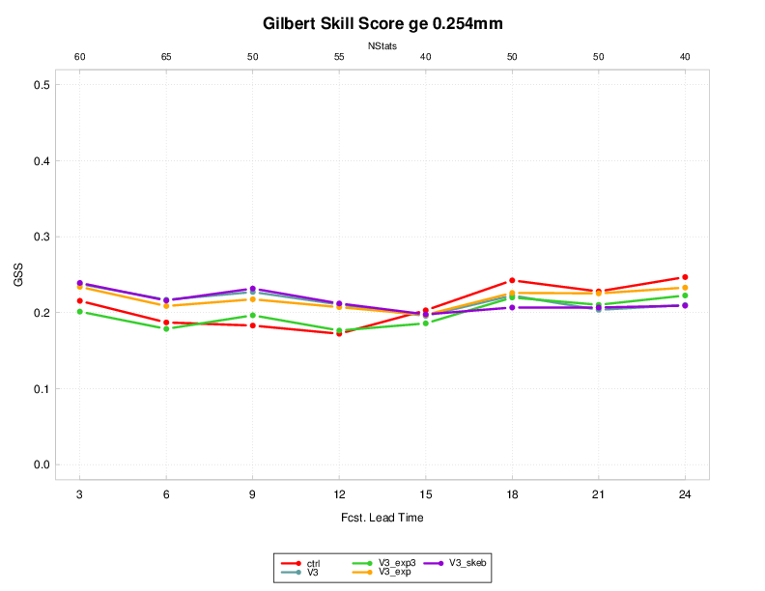
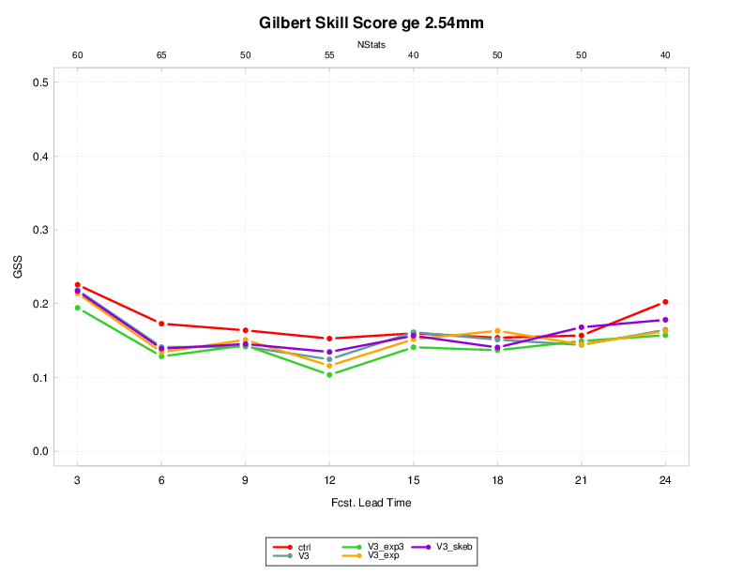
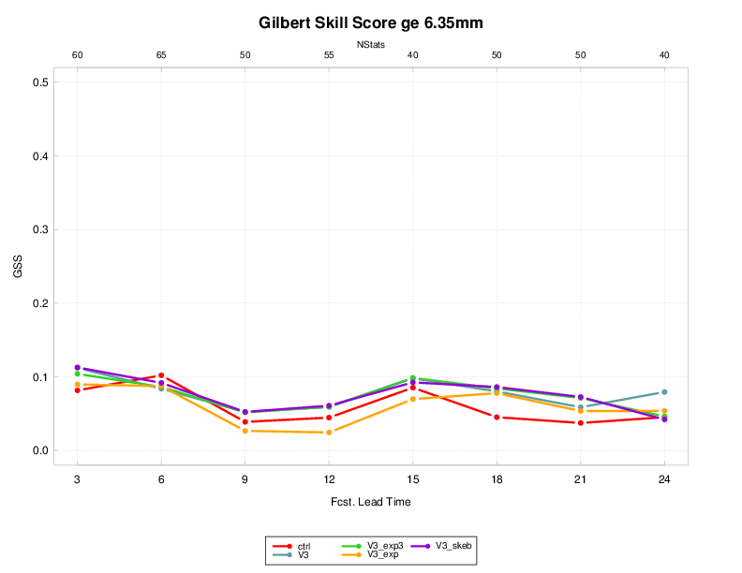
Ensemble Mean Frequency Bias and Gilbert Skill Score
Legend:
Ctrl – mixed physics ensemble
V3 – perturbed closures
V3_exp3 – perturbed max inversion capping
V3_exp – +perturbed closures + entrainment rate
V3_skeb - perturbed closures +skeb

Slide 41
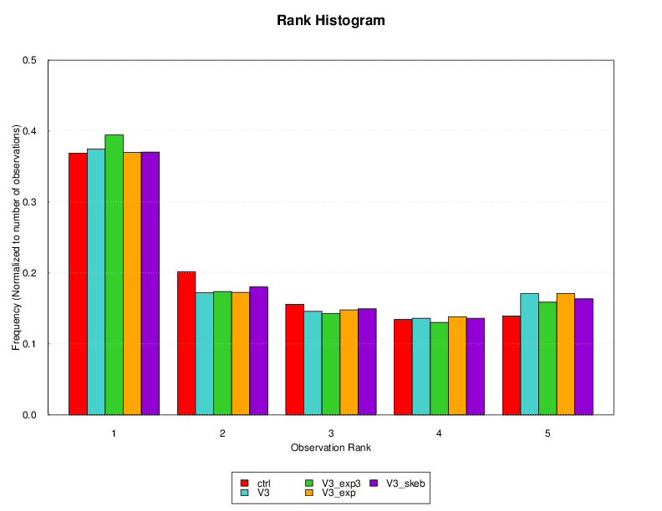
Ensemble Statistics

Slide 42
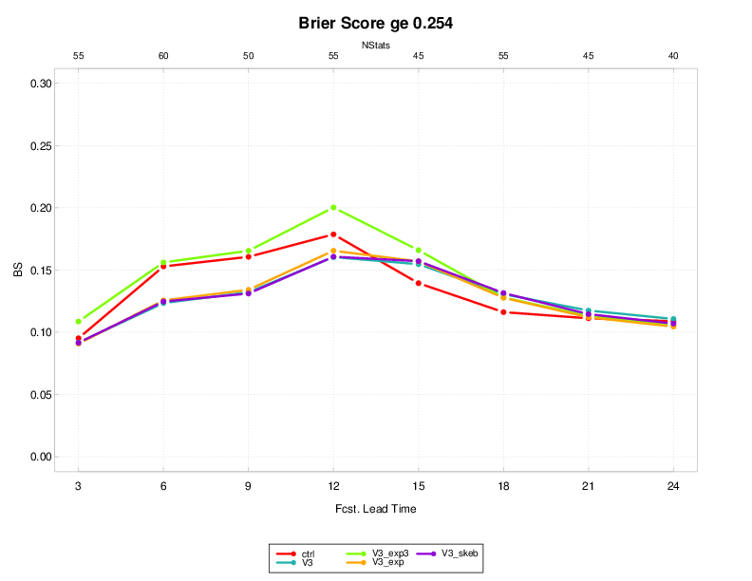
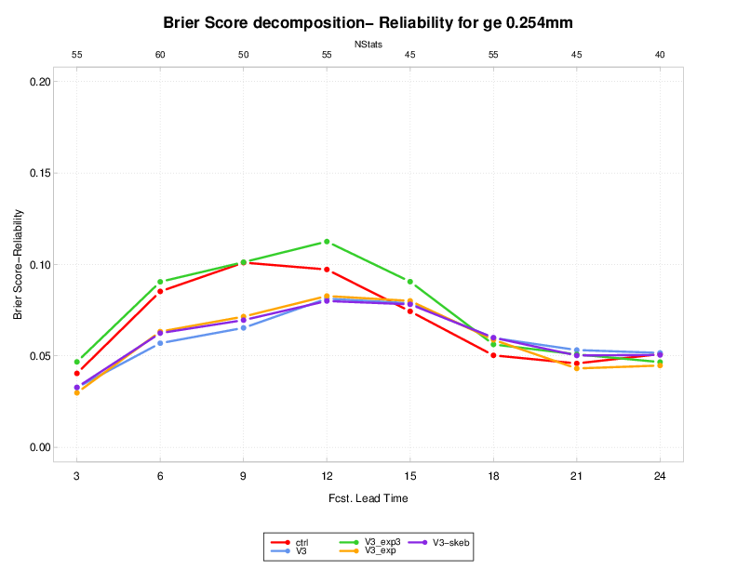
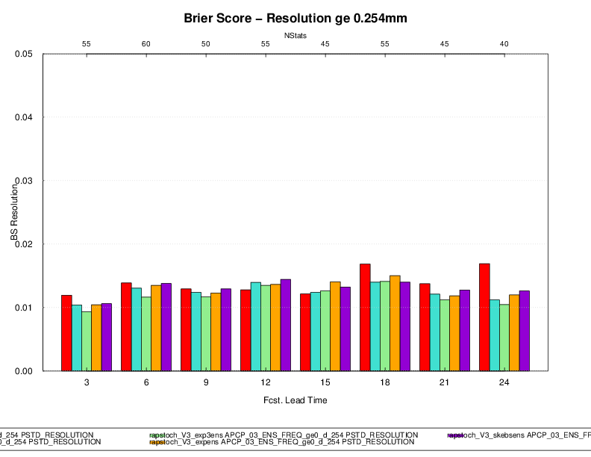
Brier Skill and its decomposition to Reliability and Resolution
Brier Score (smaller better)
Resolution part of BS (larger better)
Reliability part of BS (smaller better)

Slide 43
Combination of stochastic physics and SKEB impact on standard variables

Slide 44
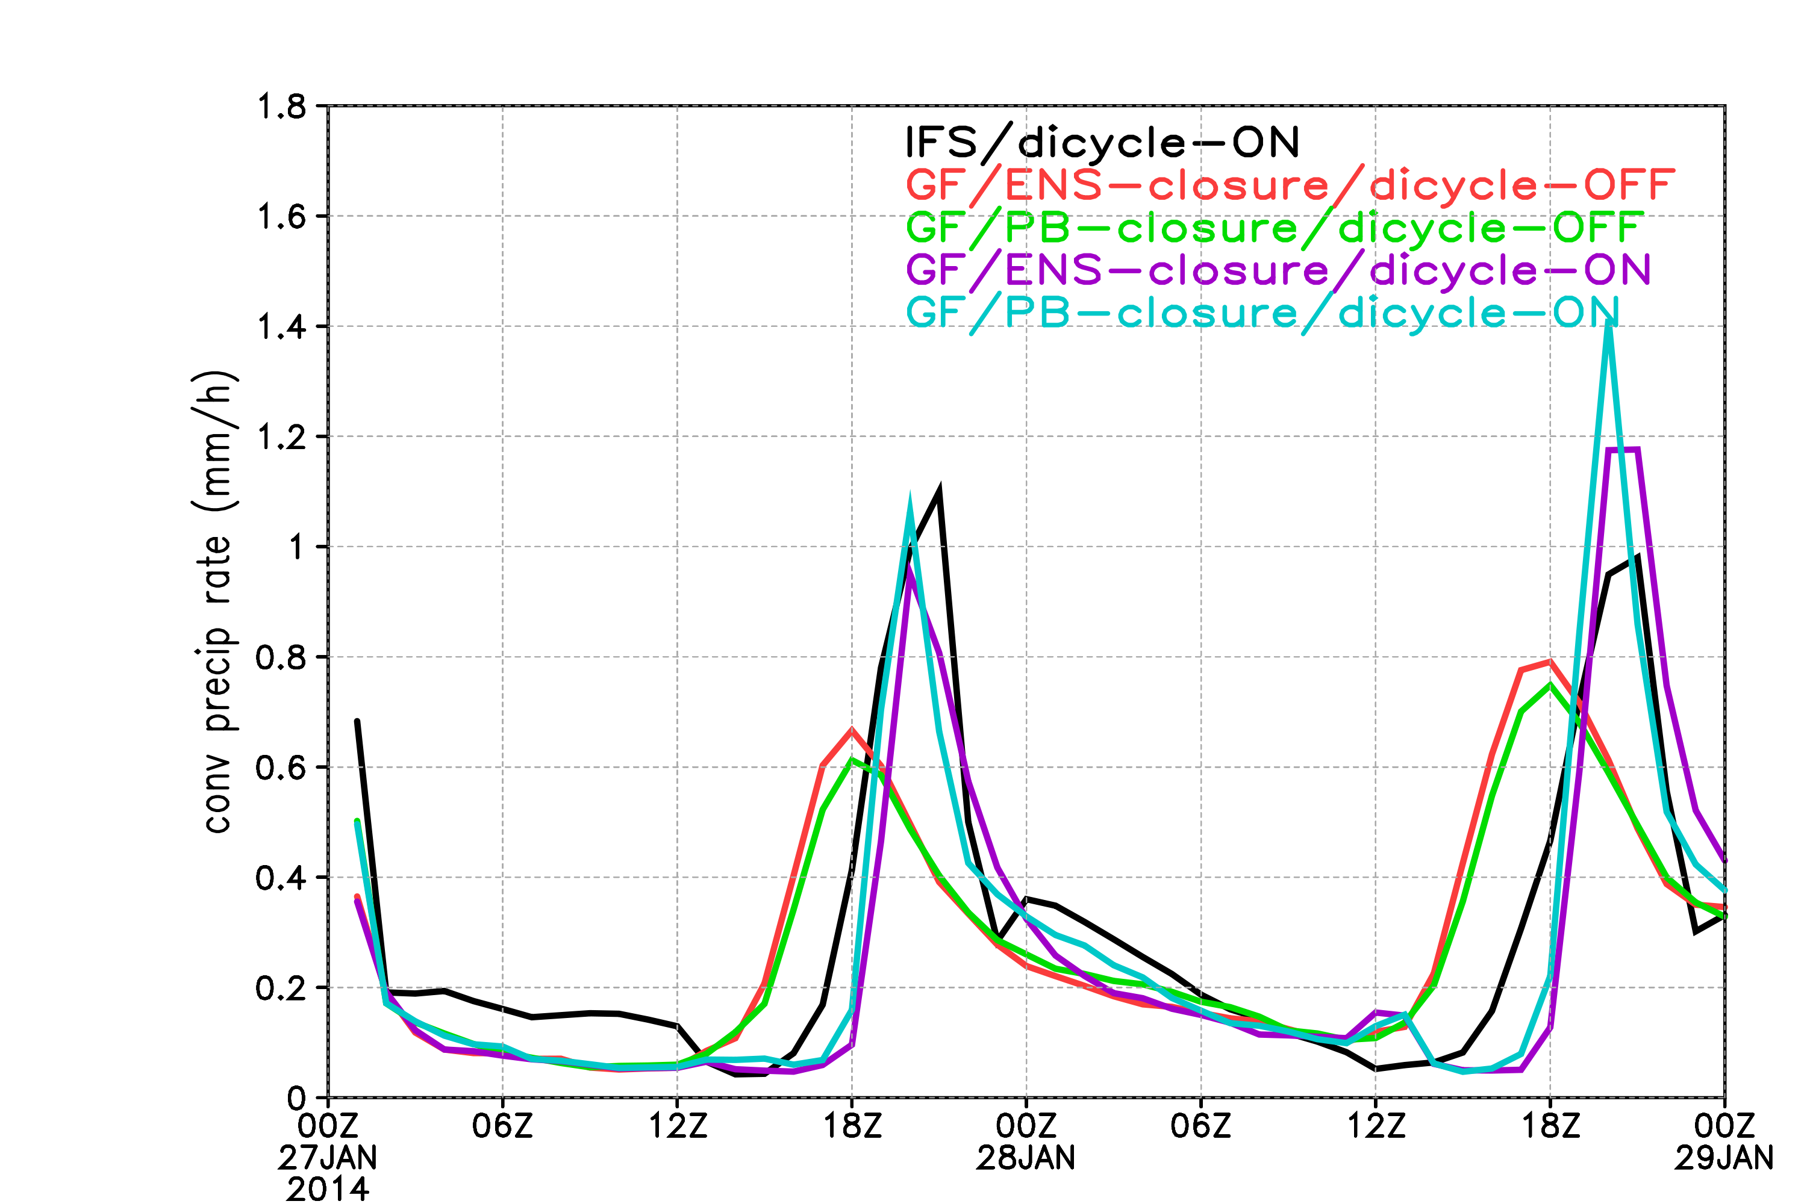
Conv prec rate (mm/h) from cumulus parameterization
(area average over Amazonia domain)
Ongoing experiments: (1) Evaluate impact of diurnal cycle inclusion on HAC’s (FIM) and precip scores (RAP)
21Z

Slide 45
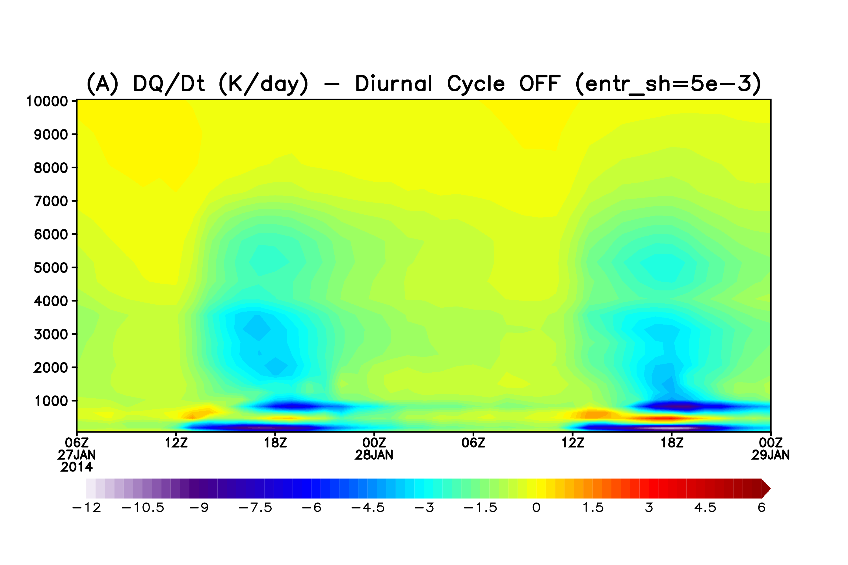
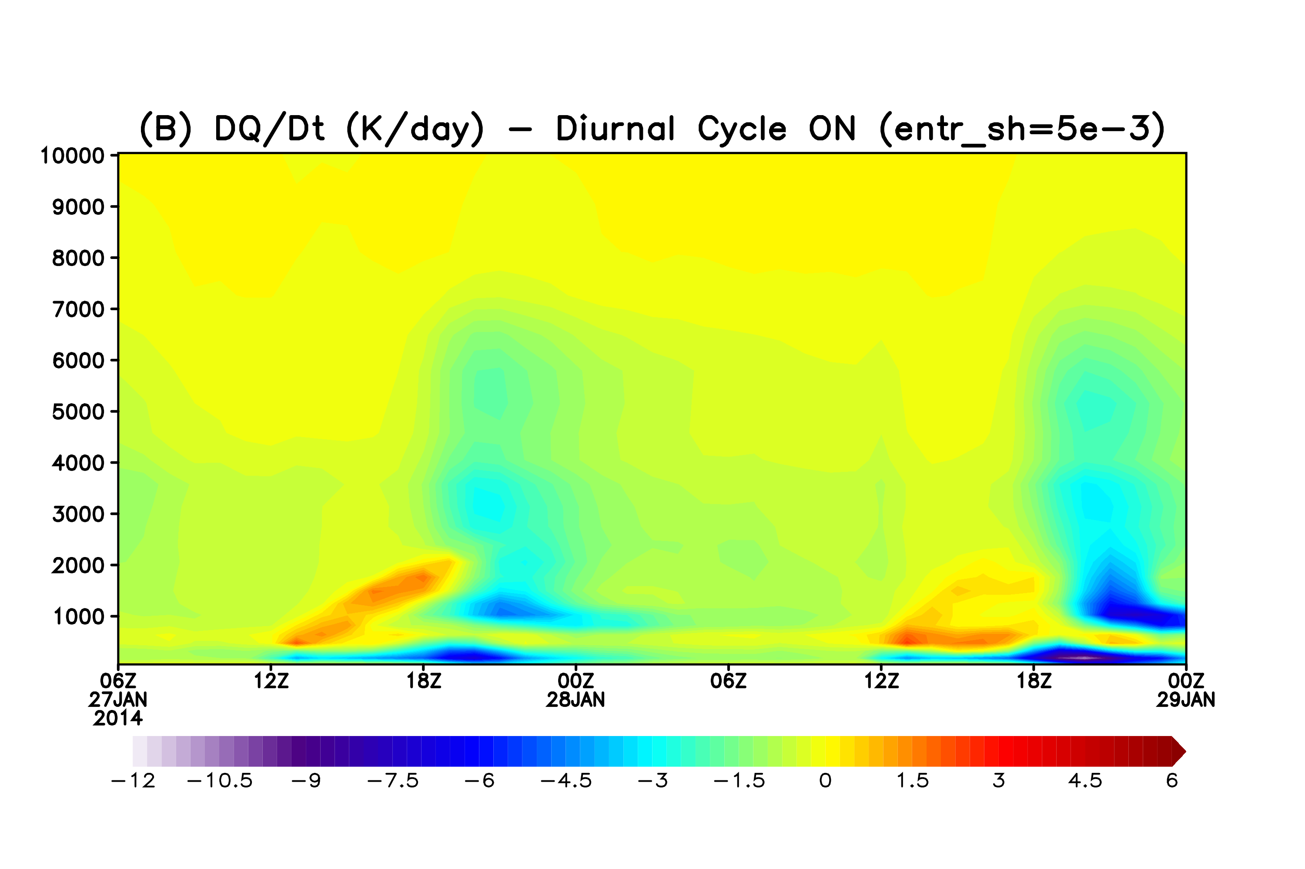
Ongoing experiments: (1) Evaluate impact of diurnal cycle inclusion on HAC’s

Slide 46
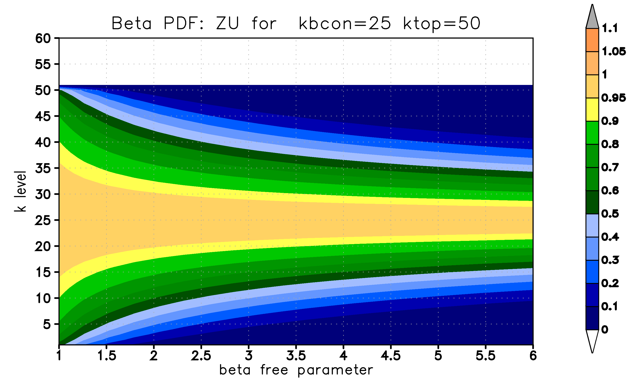
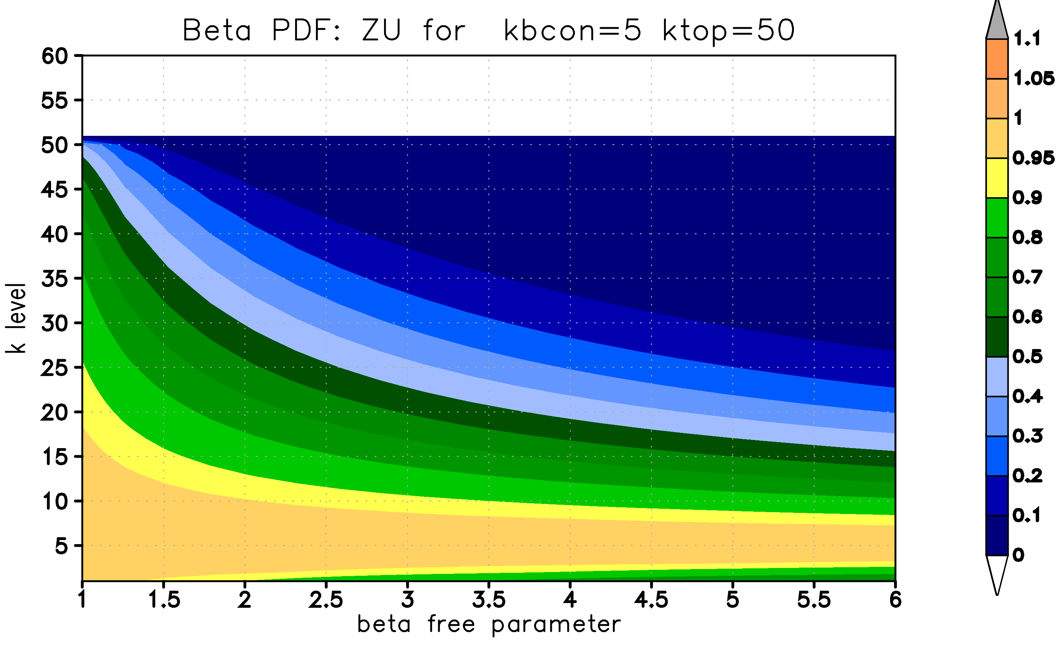
(2) Evaluate impact of stochastically perturbing vertical mass flux PDF’s

Slide 47
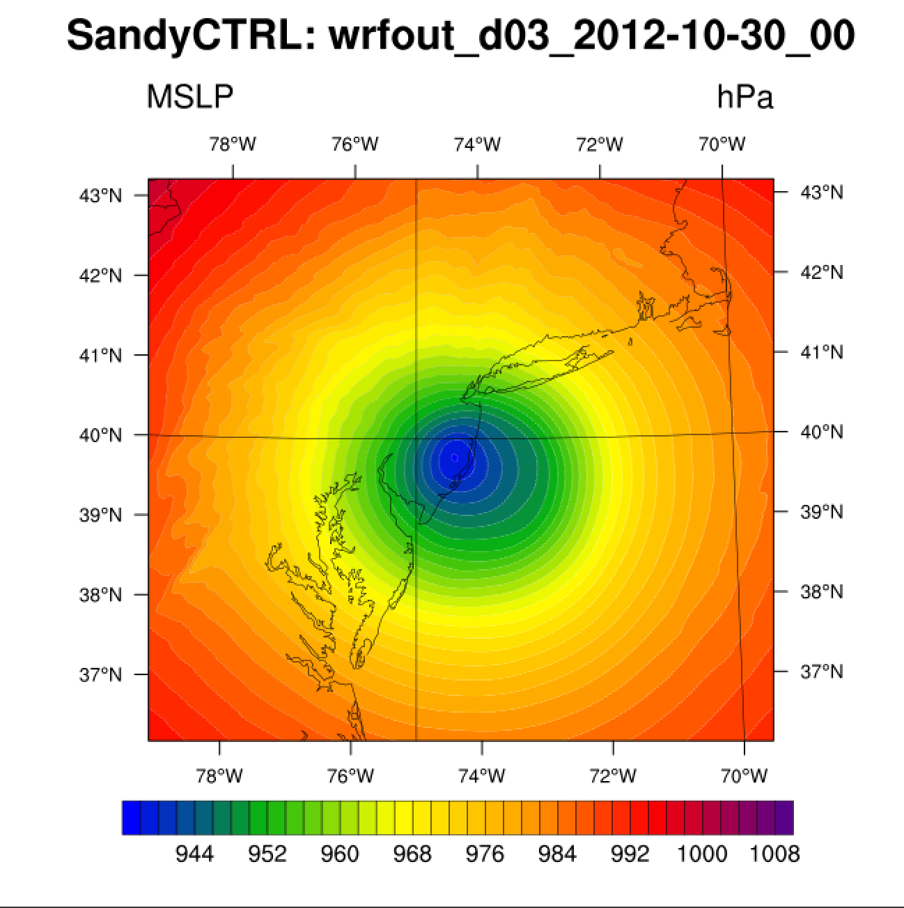
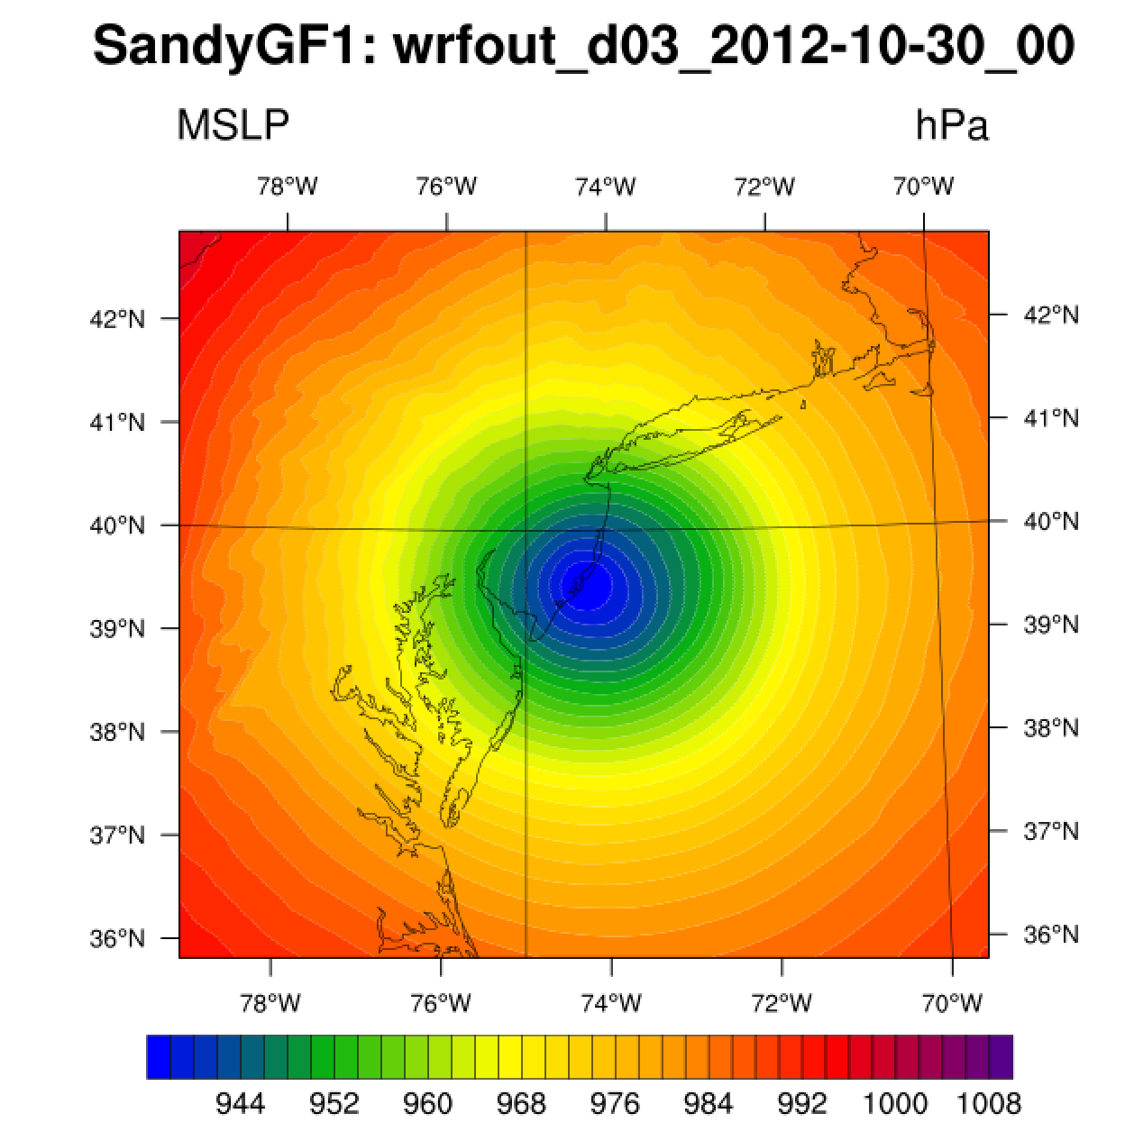
Currently under way: Initial tests within HWRF, 27-9-3km resolution simulations of Hurricane Sandy

Slide 48
Currently receiving much attention at operational NWP centers: Aerosols
Interaction with radiation (direct and semi-direct effect), clouds (indirect effect), and impact on data assimilation
Result: Working Group for Numerical Experimentation (WGNE) for aerosol impacts on numerical weather prediction

Slide 49
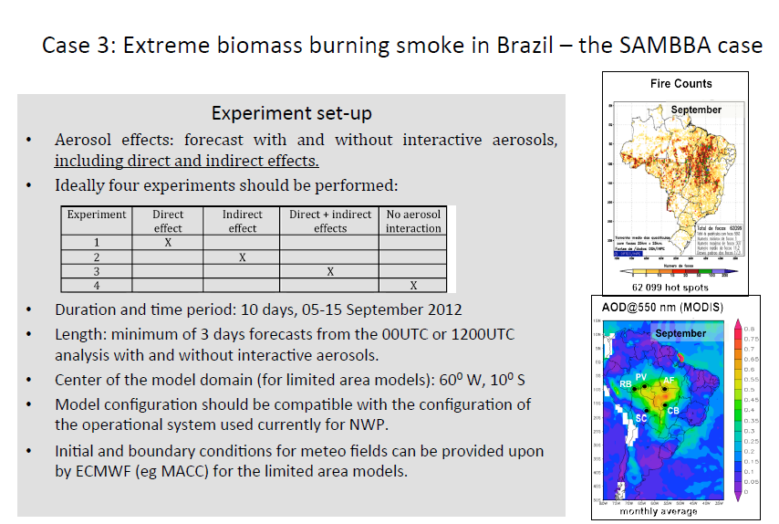
Second and third test case selected to evaluate aerosol impact on NWP (WRF-Chem, but also global modeling systems)

Slide 50
Our planned Methodology for WGNE testcases
Aerosol impacts on NWP: Use more sophisticated cloud resolving simulations, then decrease complexity and resolution to what is used in operational systems
How different are simple, lower resolution simulations from complex simulations? Observations?
Many studies of indirect effect use resolutions that require convective parameterizations. Unless the CP includes aerosol interactions, conclusions are at best suspect.
Conclusions are also suspect with a CP that includes aerosol interactions – unless we can show agreement with cloud resolving simulations
Can we even believe in cloud resolving simulations? – Hopefully strong signals will tell us something..

Slide 51
RMSE: 2-m Temperature
ECMWF
NASA
RMSE(AER-NOAER) > - 0.2 K
RMSE(AER-NOAER) > - 0.3 K
NO AER -----
AER ….…
JMA
NCEP
4.12 – no interaction
3.94 – indirect only
3.83 – direct only
3.79 – IND + DIR
ECMWF, NASA, JMA: Consistent and significative RMSE reduction
NCEP : negligible change
JMA : RMSE reduction increases with the aerosol treatment complexity
JMA
NCEP

Slide 52
BIAS: 2m Temperature
Comparing to no direct effect: Consistent bias reduction
Comparing to no aerosols: bias decreases during the day, but increases* at night
ECMWF
NASA
JMA
NCEP
Consistent bias reduction with increasing aerosol treatment complexity during the day, with a slight increase* during the night.
(*) Absolute value
Slight decrease of bias during 12-18 UTC

Slide 53
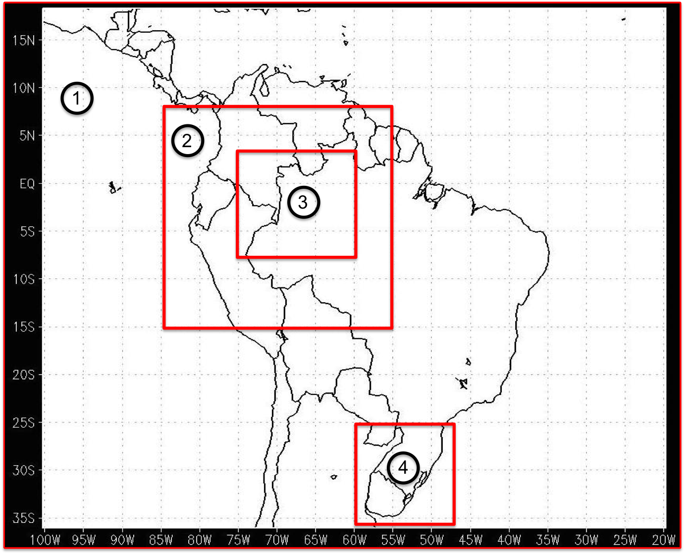
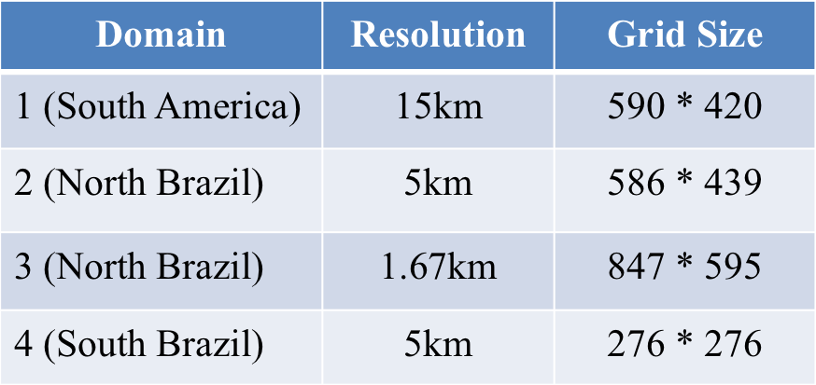
WRF-Chem domains

Slide 54
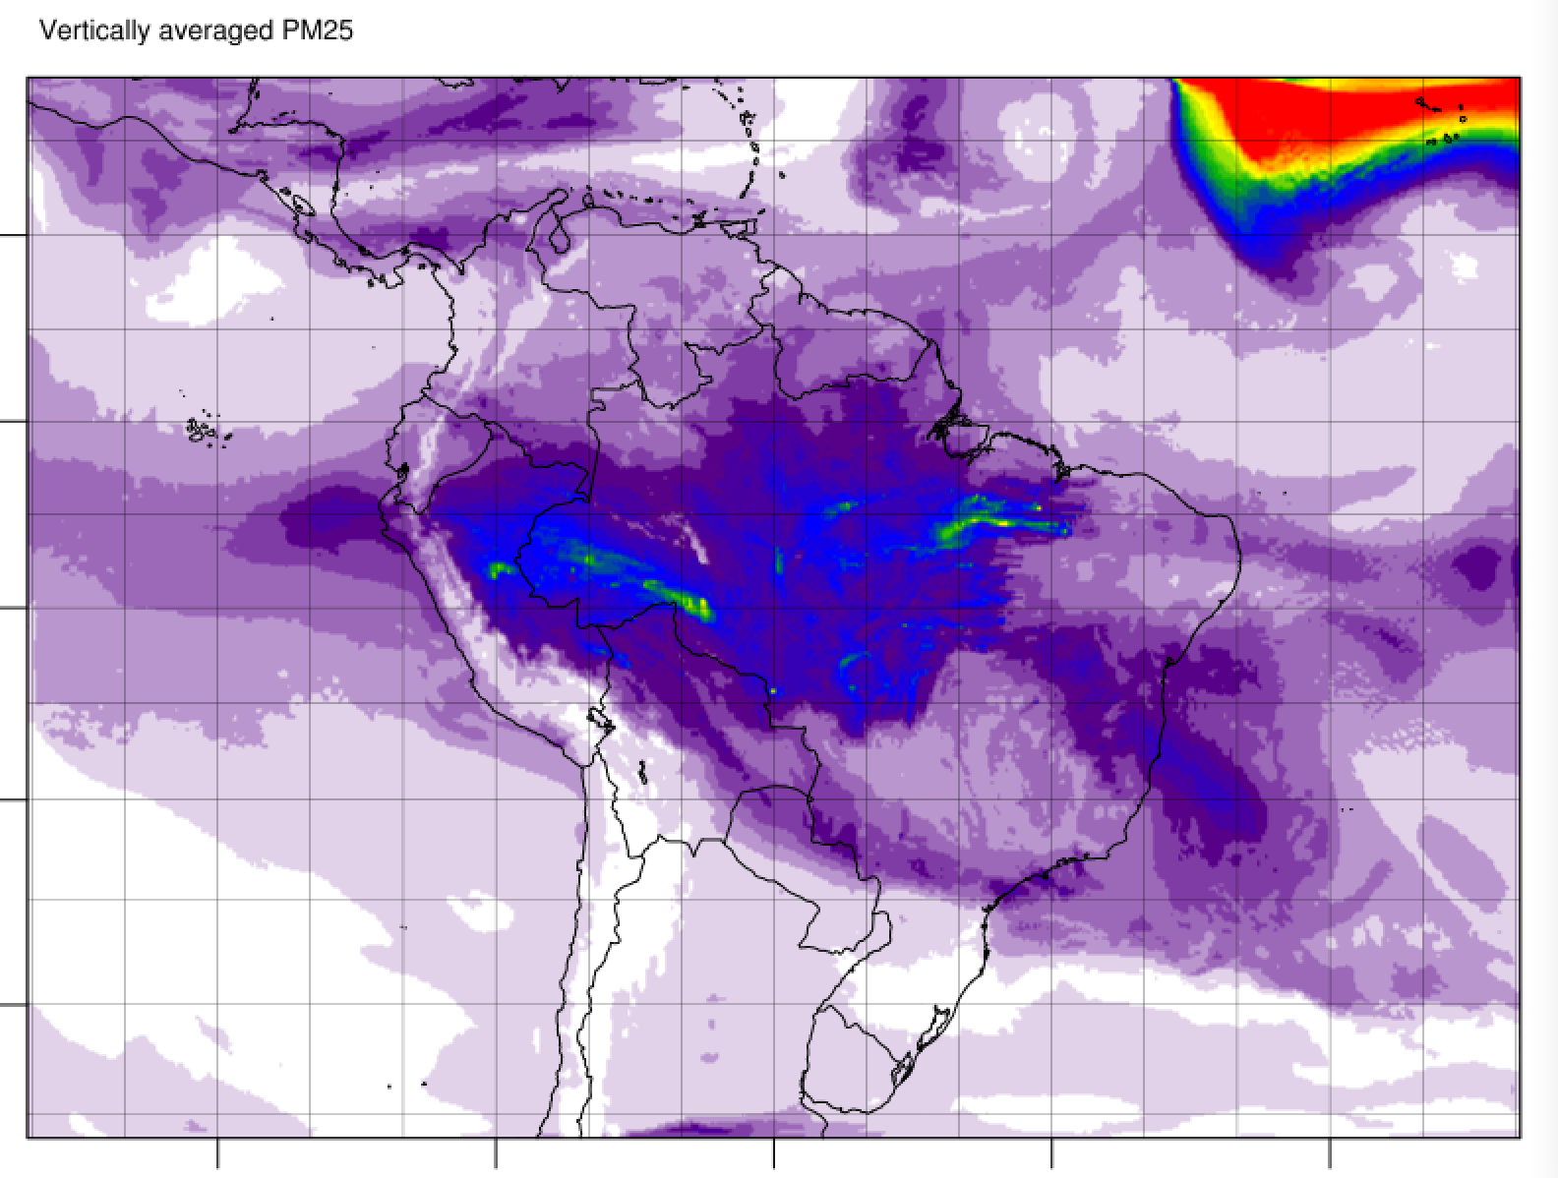

Typical vertically averaged PM25 distribution

Slide 55


Systematic and random SW differences (Chem – Met) (almost every run, 20 runs, 3-day forecasts)
Apparently random changes, interesting because of high aerosol concentrations, usually less SW radiation reaching the ground
Random changes, caused by different location of clouds, not interesting at this point
Systematic changes, in almost every run

Slide 56



Differences in integrated cloud water and ice concentrations, 36 hour simulations starting Sep 9, 12Z. DX=5km, displayed is Sep 10, 12Z
MET - Chem
More cloudwater in the met run! But only in the lowest levels!
g/kg

Slide 57

Results from 5km resolution simulation, T2m differences, CHEM - MET
Sep 10, 12Z
Next: 1.7km resolution, convection: WRF-Chem simulation over 30hr period, initialized at 18Z, Sep 9

Slide 58



T2M differences, Chem-Met, 12Z, Sep 10
Hourly precipitation difference
Low level clouds in NE corner do not exist in run with indirect effect included…

Slide 59




Averaging in areas with significant convection
PM2.5 (μg/m³)
1.E6*kg/kg
T2M, 18Z, Sep 10
RNW+SNOW at different locations
RNW unpredictable: Convection has different strength
PM2.5 (μg/m³)
PM2.5 (μg/m³)
Box averaged vertical profile of CLW+ICE
CLW and ICE appear to have a signal
Lat = -4.5 to -6.5
Lon -68 to -72
1.E6*kg/kg
1.E6*kg/kg

Slide 60

So what if you try this with aerosol-awareness turned on in the GF convective parameterization
Polluted (AOD=1.)
clean (AOD=.01)
Previous 1-d tests
much more detrainment of cloud water and ice at cloud top
less suspended hydrometeors, especially in lower part of parameterized clouds
stronger downdrafts. Leading to less drying in and just above the boundary layer, but stronger cooling in lowest levels

Slide 61


T2M difference fields, September 10, 1200UTC- mid-morning. Positive (red) is warmer compared to MET – simulation with convective parameterization
Using convective parameterization with and without aerosol awareness
Why should this be related to convective parameterization?
Direct effect only
DIR +IND
DX=5km
DX=1.7km
Convection permitting simulations

Slide 62
Aerosol tests – initial conclusions
Tropical environments may be the most likely to see an impact – signal strength also very important (very low or very high AOD)
Strength of convection at this point, and with our model setup, may be difficult to correlate to aerosols
Initial results for aerosol aware convective parameterization indicate more tests needed
  Shallow convection
  Use CCN from model
3d impacts will depend on environmental conditions
  Because of the dependence of precipitation efficiency on wind shear and subcloud humidity in addition to CCN, impacts in middle latitudes may be much more mixed

Slide 63
Aerosol tests – ongoing and future work
More simulations are currently being done with dx=1.7km, also over the mid latitude domain in southern Brazil
We will also test simpler chemistry modules and microphysics schemes with a focus on:
  Thompson aerosol aware microphysics would be much less expensive approach and will be used operationally at NCEP on regional scales
  GF scheme can run with observed AOD (no chemistry at all necessary)
  How simple can we go and still compare well to the complex simulations
We are planning on testing the impact on NWP within a global modeling system (FIM, http://fim.noaa.gov ), also for seasonal predictions using FIM-iHYCOM-Chem
Experiments with stochasticism (J. Berner)

