Slide 1
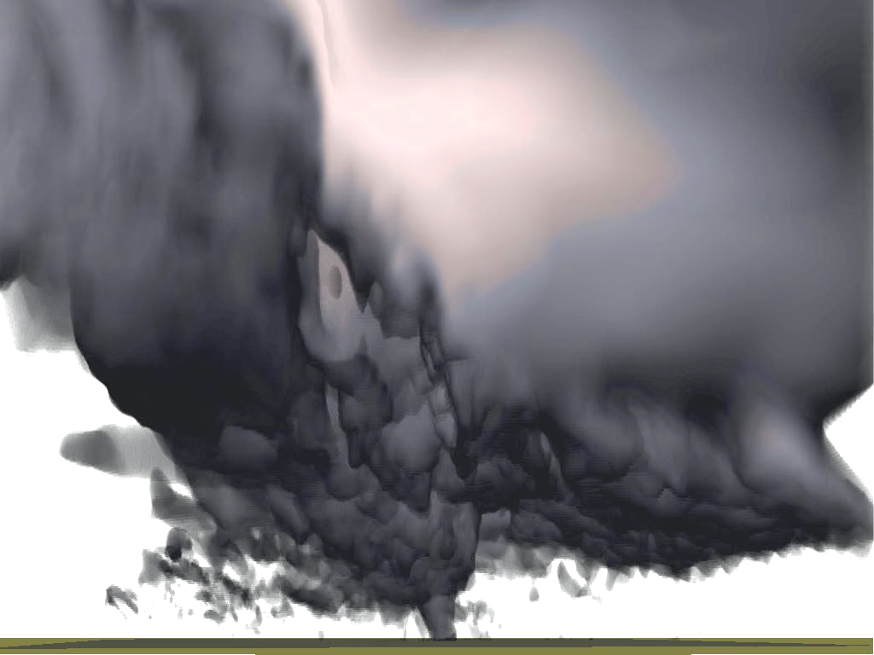


Ensemble and Variational Data Assimilation for the Storm Scale and with GSI for Rapid Refresh
Ming Xue
Center for Analysis and Prediction of Storms (CAPS)
and School of Meteorology
University of Oklahoma
mxue@ou.edu
October 2014
Given at the EMC/NCEP
ARPS Simulated Tornado

Slide 2
Convective-Scale DA and Prediction
Here “Convective Scale” mainly refers to moist convection/storms, that require ~1 km grid spacing to resolve;
Need comparable-resolution observations to observe the convection itself, and other high-resolution observations to sample the storm environment;
Radar is the most important observation platform for the convective storms;

Slide 3
Specific Challenges with Convective-Scale Data Assimilation
Radar observes very few parameters (Vr and Z), no coverage in clear air region;
Model constraint essential to ‘retrieve’ unobserved variables but model and state errors tend to be large;
Analysis very sensitive to model errors, especially for un-observed/retrieved parameters;
Need quality storm environment to support storm prediction – a multiscale/multi-data source problem;

Slide 4
Specific Challenges with Convective-Scale Data Assimilation - continued
Much higher degree of freedom – more difficult for typical small-ensemble DA system to adequately sample essential directions to fit observations and retrieve unobserved quantities;
Strongly nonlinear physics a serious obstacle for adjoint-based 4DVAR methods; Single-moment microphysics may not be enough;
Ensemble system design/ensemble perturbation maintenance less well understood than larger-scale DA system;
Much larger computational challenges;

Slide 5
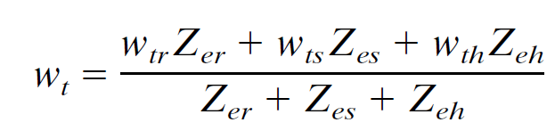
Radial Velocity (Vr) Data
Most times, only single-Doppler radial velocity coverage is available;
Radial velocity observation operator:
Sometimes V_{r} is further weighted by reflectivity factors, making it microphysics dependent and more nonlinear.

Slide 6
Reflectivity for Precipitating Hydrometeors
Assuming exponential DSD,
Equivalent reflectivity factor:
where is DSD slope
Z_{e} in mm⁶/m³
q_{r}, q_{s}, q_{h} in kg/kg
Total reflectivity in dBZ:
Nonlinear!
Smith, Meyer and Orville (1975), Tong and Xue (2005), Dowell et al. (2011)

Slide 7
Within Convective Storms
From Vr and Z, we need to determine ≥16 state variables (when predicting two MP moments):
u, v, w, T, p, q_{c}, q_{i}, q_{v}, q_{r}, q_{s}, q_{h/g}, N_{Tc}, N_{Ti,} N_{Tr}, N_{Ts}, N_{Th/g}, etc.
where N_{T} is total number concentration.
The problem is severely under-determined!
3DVar by itself is incapable to analyzing so many variables - Need help from physical constraints, e.g., a numerical model.

Slide 8
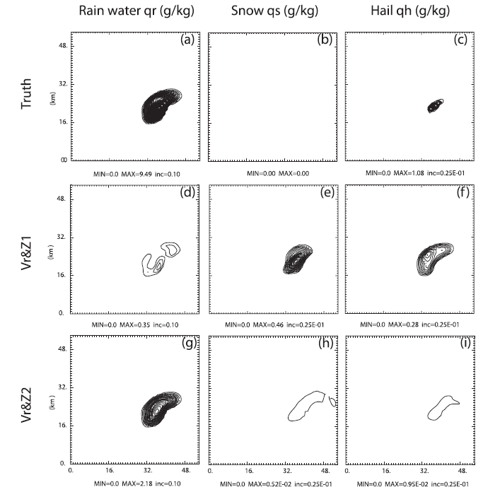
3DVar Analysis of Hydrometeors at Surface from Z
Truth
Original Z operator
T-dependent operator
Gao and Stensrud (2012)

Slide 9
Solutions
4DVar uses model equations as a strong constraint, and multi-time level data (e.g., VDRAS – warm rain only);
EnKF (EnSRF/EAKF/LETKF etc) uses model constraints in a statistical representation, and accumulates info in time;
3DVar for Vr and complex cloud analysis for Z (e.g., ARPS and RUC/RAP 3DVar systems with cloud analysis);
Methods that combine the above (EnVar, hyrid)
Polarimetric radar measurements may provide additional MP information.

Slide 10
Solutions
4DVar uses model equations as a strong constraint, and multi-time level data (e.g., VDRAS – warm rain only);
EnKF (EnSRF/EAKF/LETKF etc) uses model constraints in a statistical representation, and accumulates info in time;
3DVar for Vr and complex cloud analysis for Z (e.g., ARPS and RUC/RAP 3DVar systems with cloud analysis);
Methods that combine the above (EnVar, hyrid)
Polarimetric radar measurements may provide additional MP information.

Slide 11
        ARPS Complex Cloud Analysis
Construct 3D cloud fields using radar reflectivity data, surface cloud observations, satellite data, and the background from previous forecast by semi-empirical rules.
Retrieve hydrometeors and adjusts in-cloud temperature and moisture.
The increments can be applied as a single time or gradually through IAU (Incremental Analysis Update)

Slide 12
ARPS Cloud Analysis
GOES Satellite Data
Vis: Cloud fraction
IR: Cloud top temperature
Radar Data
Reflectivity to precipitation hydrometeors
Surface Observations
Cloudbase height
Originated from the LAPS cloud analysis, with adaptation and updates by Jian Zhang and Keith Brewster, et al.
(also Xue et al. 2003 MAP, Hu et al. 2006 MWR)

Slide 13
Estimating the Cloud Water
Use parcel theory to find saturation dq_{vsat}/dz
and increment cloud water
Water is carried with parcel - less a mixing/dilution factor (Warner curve)
Ice created when colder than –10 C
Cloud water/ice reduced in later step if precipitating hydrometeors are prescribed
(presumed converted by coalescence or aggregation)

Slide 14
In-cloud temperature adjustment (Diabatic Heating)
Original:
Updated:
  Moist-adiabatic temperature profile
  Warner entrainment curve
  Heating applied only in updraft regions

Slide 15
Moisture adjustment
Adjusted to saturation within cloudy regions.
May be optionally applied to the first analysis cycle only.
Analysis increments may be applied incrementally via Incremental Analysis Update (IAU) to reduce shock.
Cloud analysis is typically combined with ADAS or 3DVAR (including Vr data)

Slide 16








CAPS Realtime Storm-Scale Ensemble Forecasting for NOAA Hazardous Weather Testbed Spring Experiments
Realtime 4-km ensemble and 1-km deterministic forecasts over entire CONUS
Assimilating Level-2 Vr and Z data from all WSR-88D radars using ARPS 3DVAR/Cloud analysis since 2008
Initialize ARW-ARW, WRF-NMM and ARPS models.

Slide 17
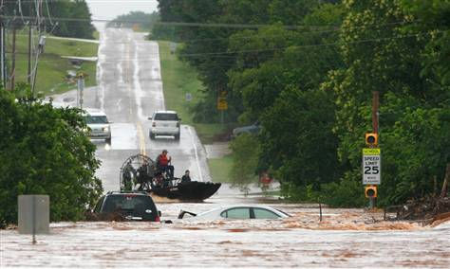
June 14, 2010 – Oklahoma City Flooding
~ 10 inch rain fell in part of OKC

Slide 18
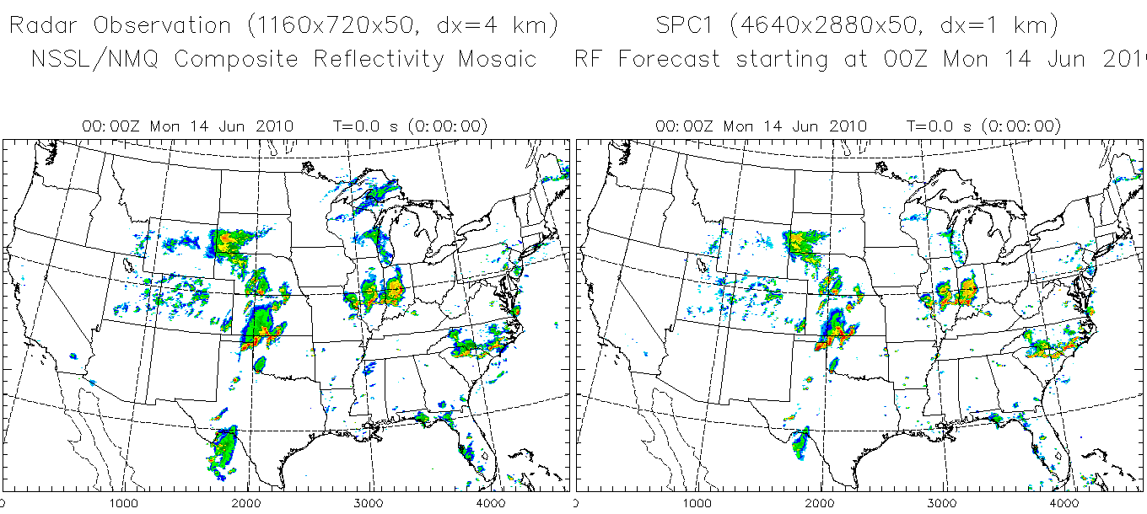
June 14, 2010 – Oklahoma City Flooding Case
Radar reflectivity observation 1 km CAPS realtime forecast using WRF
4640x2880x50 grid
Movie

Slide 19
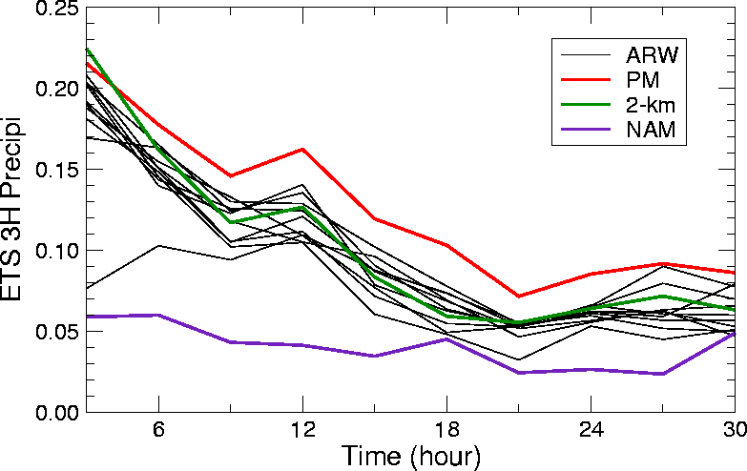
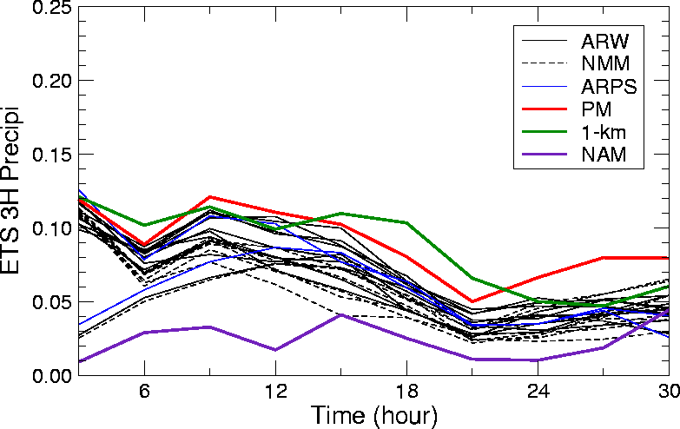
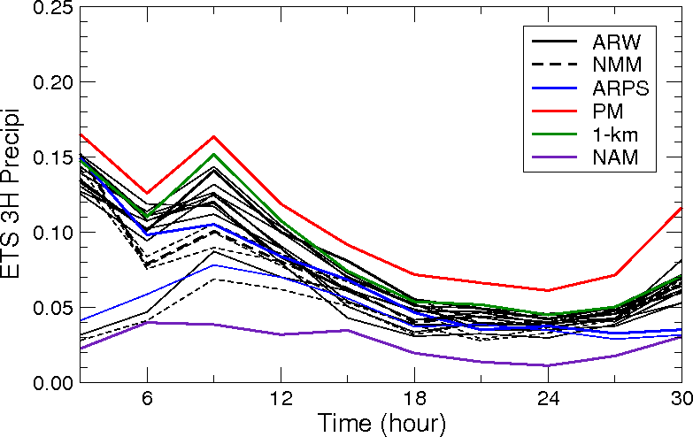
Equitable Threat Scores for 3-hourly Precip. ≥ 0.5 in
2008 (32-day)
2009 (26-day)
With radar
With radar
no radar
no radar
12 km NAM
12 km NAM
2010 (36-day)
Radar data impact lasts up to in 12 hours
All high-res models outperform 12km NAM
Probability-matched score generally better than any ensemble member
2 km score no-better than the best 4-km ensemble member – may be due to physics
1-km score better than any 4-km member and than the 4 km PM score in 2009.
With radar
no radar
12 km NAM
Notes:
Probability-matched score generally better than any ensemble member
2 km score no-better than the best 4-km ensemble member – may be due to physics
1-km score better than any 4-km member and than the 4 km PM score.

Slide 20
Limitations of 3DVAR/Cloud Analysis
Unobserved cross-beam wind components tend to be poor;
Microphysics and thermodynamic fields don’t fit model well → fast error growth;
General lack of balance among state variables;
Difficult to suppress spurious storms, more problematic with continuous cycling.

Slide 21
Solutions
4DVar uses model equations as a strong constraint, and multi-time level data (e.g., VDRAS – warm rain only);
EnKF (EnSRF/EAKF/LETKF etc) uses model constraints in a statistical representation, and accumulates info in time;
3DVar for Vr and complex cloud analysis for Z (e.g., ARPS and RUC/RAP 3DVar systems with cloud analysis);
Methods that combine the above (EnVar, hyrid)
Polarimetric radar measurements may provide additional MP information.

Slide 22
EnKF Assimilation of Vr and Z with Multi-Phase Microphysics (Tong and Xue 2005 MWR)
Radar data:
V_{r} only (Z>10dBZ)
V_{r} (Z>10dBZ) & Z
K is the Kalman Gain, a function
of background and obs error covariances
Tong, M. and M. Xue, 2005: Ensemble Kalman filter assimilation of Doppler radar data with a compressible nonhydrostatic model: OSS Experiments. Mon. Wea. Rev., 133, 1789-1807.

Slide 23
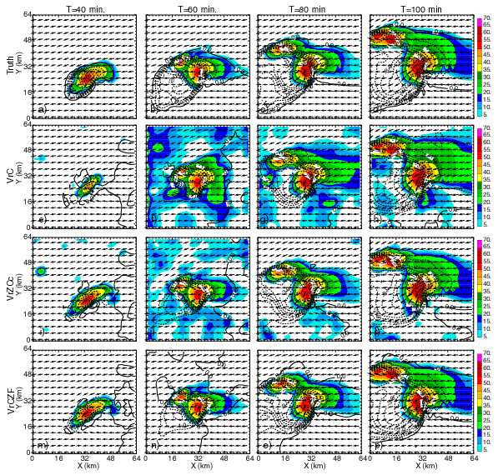
Analyses of Low level cold pool and reflectivity v.s. Truth
Truth
Vr only
Vr + Z

Slide 24
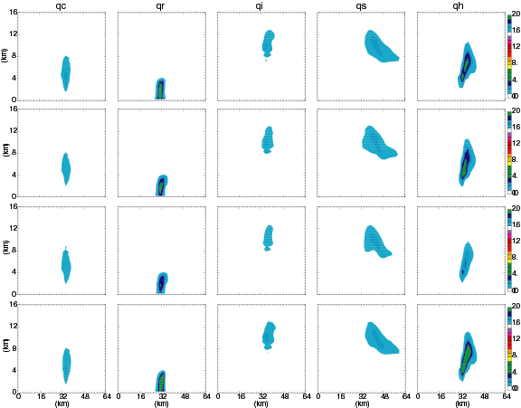
Analysis of Microphysical Fields
q_{c}
q_{r}
q_{i}
q_{s}
q_{h}
Truth
Vr only
Vr + Z
Notes:
q_{c}, q_{r}, q_{i}, q_{s}, q_{h} at T=65 min

Slide 25
Correlation coefficients between Z and model states at t=80min
Experiment assimilating Z (>10dBZ) only
u
w
q’
P’
q_{c}
q_{r}
q_{s}
q_{h}

Slide 26
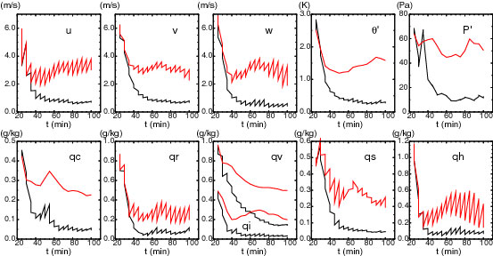
Cross-covariances Critical
RMS ensemble mean forecast and analysis errors
Red: Only update variables directly involved in obs operators when assimilating Vr and Z

Slide 27
Analysis and ensemble forecasting of a tornadic mesoscale convective system (MCS) based on EnKF assimilation of CASA X-band and WSR-88D radar data
Snook, Xue and Jung (MWR 2011, 2012)
Putnam et al. (2014)
Snook, N., M. Xue, and J. Jung, 2011: Analysis of a tornadic meoscale convective vortex based on ensemble Kalman filter assimilation of CASA X-band and WSR-88D radar data. Mon. Wea. Rev., 139, 3446-3468.
Snook, N., M. Xue, and Y. Jung, 2012: Ensemble probabilistic forecasts of a tornadic mesoscale convective system from ensemble Kalman filter analyses using WSR-88D and CASA radar data. Mon. Wea. Rev., 140, 2126-2146.
Putnam, B. J., M. Xue, Y. Jung, N. A. Snook, and G. Zhang, 2014: The analysis and prediction of microphysical states and polarimetric variables in a mesoscale convective system using double-moment microphysics, multi-network radar data, and the ensemble Kalman filter. Mon. Wea. Rev, 142, 141-162.

Slide 28
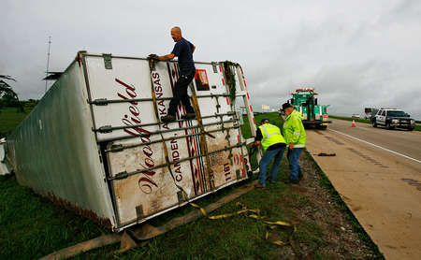
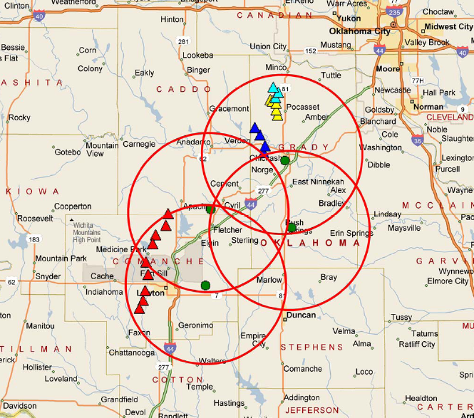
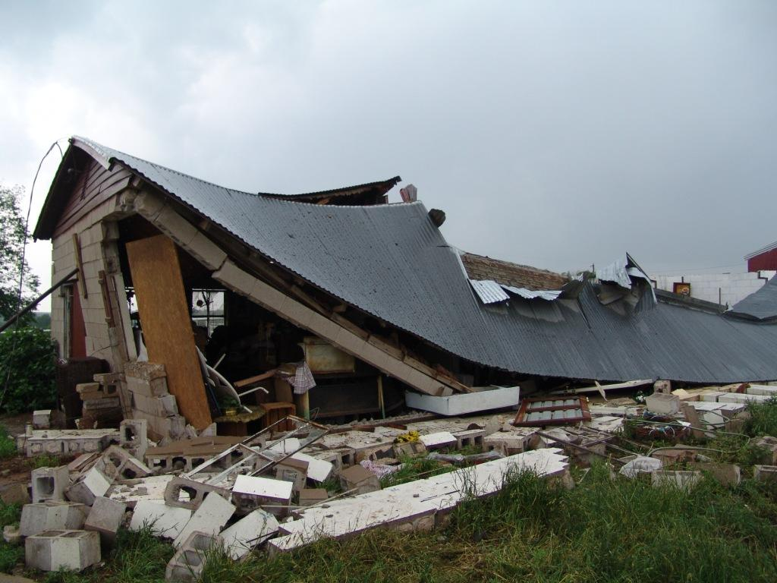
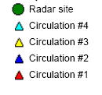
Tornadoes of 8-9 May 2007
El Reno tornado
Union City tornado
© Patrick Marsh
Minco Tornado 10:54pm (0354Z)
CASA X-band Radar Network – 30 km range
7:21pm (0021Z)
Lawton Tornado
Lawton tornado

Slide 29
EnKF analysis and ensemble forecasts for May 8-9 2007 tornadic mesoscale convective system (MCS)
Ensemble forecast
1 hr. spin-up period
Assimilation period
Reported tornadoes →
Deterministic forecast
0:00Z
0:30Z
1:00Z
1:30Z
2:00Z
2:30Z
3:00Z
3:30Z
4:00Z
4:30Z
5:00Z
dx=2 km
Used multiple microphysics in ensemble
(Snook, Jung and Xue 2011; 2012, Putnam et al. 2014 MWR)
Notes:
Experiment contained 40 Ensemble members. Reflectivity and radial velocity observations from 5 WSR-88D radars as well as the 4 CASA radars were assimilated every 5 minutes over a 1 hour window.
Analysis and probabilistic ensemble forecasts were generated for three experiments to test effect of assimilated CASA data and use of a mixed-microphysics ensemble using three single moment ice microphysics schemes.
2-moment (DM) of Milbrandt and Yau (2005) were used in both simulation and analysis and compared with the results using a 1-moment (mixed NEM, Lin, and WSM-6).The final analyses were used to initialize 1-moment and 2-moment 2 hour forecasts, respectively. This work is an extension of previous work by Snook et al. (2011) and Jung et al. (2010)

Slide 30
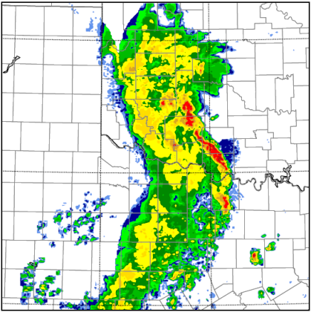
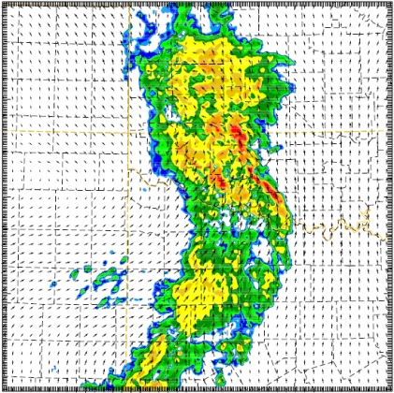
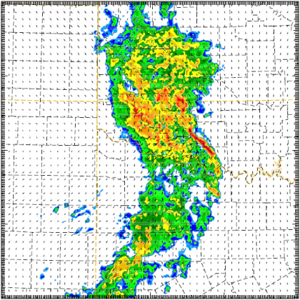
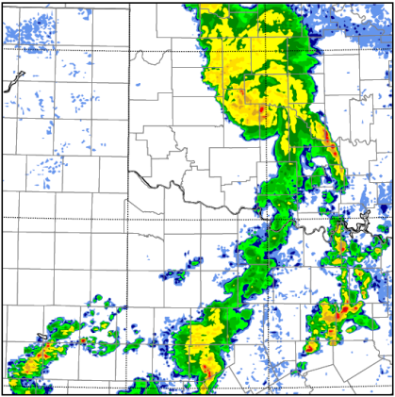
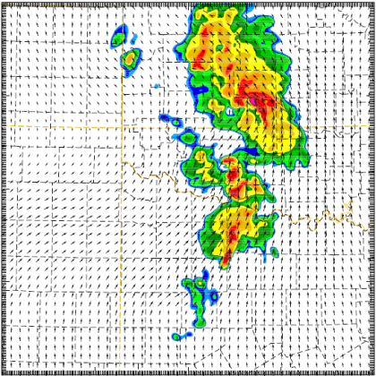
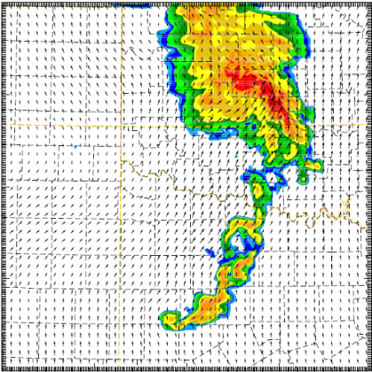
Single- and Dual-Moment Microphysical State Estimation with EnKF
Direct Comparison with Radar Reflectivity
Final analysis (0200 UTC ) Reflectivity
OBS
SM
MY DM
Two-hour forecast (0400 UTC)
(Putnam, et al. 2014 MWR)
Notes:
The analyzed reflectivity fields in both 1-moment and 2-moment experiments compare well with radar observations (shown at top).
However, 2-moment forecast show significant improvement over the 1-moment experiment (shown at bottom).
The structure and evolution of the forecast MCS, LEV and leading and trailing convective lines is remarkably better with a 2-moment scheme throughout the forecast period than with a 1-moment scheme.
Putnam, B. J., M. Xue, Y. Jung, N. A. Snook, and G. Zhang, 2013: The analysis and prediction of microphysical states and polarimetric variables in a mesoscale convective system using double-moment microphysics, multi-network radar data, and the ensemble Kalman filter. Mon. Wea. Rev., In press.

Slide 31
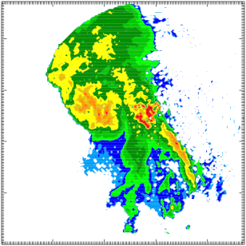
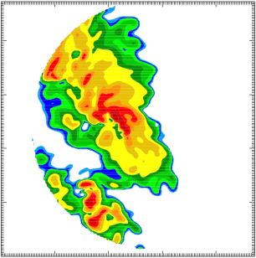
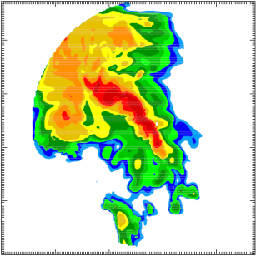
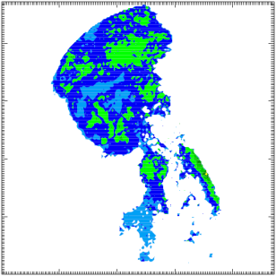
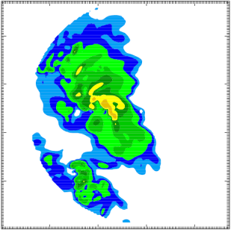
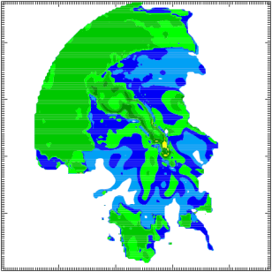
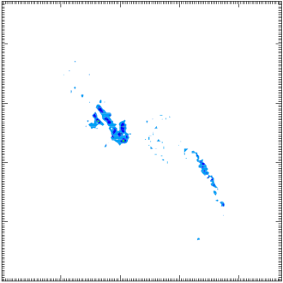
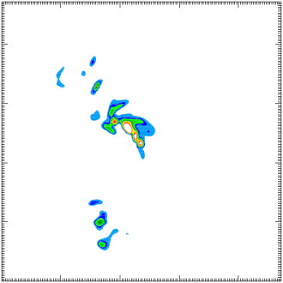
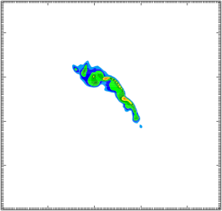
Two hour Forecast (0400 UTC)
KOUN OBS
1-moment
2-moment
Z
Same
pattern
as Z –
No unique
info
Effects of
size sorting
Z_{DR}
K_{DP}
Too high
Notes:
Polarimetric variables on .5 tilt as seen by KOUN using polarimetric radar data simulator (Jung et al. 2010)
Size sorting of hydrometeors on the leading edge of the system indicated by increased Z_{DR}. The reduction of Z_{DR} in the center of the line in 2-moment experiment is due to hail while observations show no sign of hail.
K_{DP} is unrealistically high in the 1-moment scheme (maximum ~ 11 deg/km), suggesting an excess of rain drops. As with Z_{DR} , the 2-moment scheme values are also higher than observed, but the results are in a closer agreement with observations.

Slide 32
4D Ensemble Kalman Filter (4DEnKF/4DEnSRF)
Phased array radars can provide fast volume scans
Wang, Xue and Min (2012 QJ)
Obs
Obs
Obs
Obs
Obs
Obs
Obs
State updating
One assimilation cycle
t0
t1
Notes:
The EnKF is a 4-d data-assimilation method that uses a Monte-Carlo
ensemble of short-range forecasts to estimate the covariances of the forecast
error (Evensen,1994).

Slide 33
4D Asynchronous EnSRF (4DEnSRF)
Motivation
  High-frequency EnKF DA is costly, given that data I/O can cost >80% overall (reading and writing of ensembles).
  4D extension of EnKF requires fewer cycles while still using obs at their correct times
  Implemented based on the serial EnSRF algorithm in the ARPS EnKF framework – 4DEnSRF
  Forecast model used was WRF-ARW.
Wang, Xue and Min (QJRMS 2012)

Slide 34
4DEnKF vs. Regular EnKF
EnKF: Observation are assumed to be taken at the assimilation time, like 3DVAR.
y_{o1}
y_{o2}
y_{o3}
y_{o4}
Existing 4D ensemble algorithms include 4D-LETKF, En4DVAR.
4D EnSRF algorithm requires special treatment due to its serial nature.
4DEnSRF computes and update observation priors at the observations times.
4DEnSRF has been tested with simulated radar data for both WRF and ARPS, and with real data and ARPS.
t_{o1}
t_{o2}
t_{a1}
t_{o3}
t_{o4}
t_{a2}
Δt
t_{a}: time of analysis, Δt: analysis time interval, t_{o}: time of observation
4DEnKF: Observation can be assimilated at the times they are taken – no timing error, like 4DVAR
H(x)_{o1}
H(x)_{o2}
H(x)_{o3}
H(x)_{o4}
y_{o1}
y_{o2}
y_{o3}
y_{o4}
t_{o1}
t_{o2}
t_{a1}
t_{o3}
t_{o4}
t_{a2}
time
H(x) can be calculated within the numerical model – added to ARPS.

Slide 35
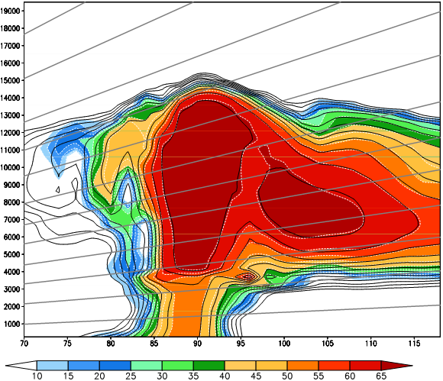
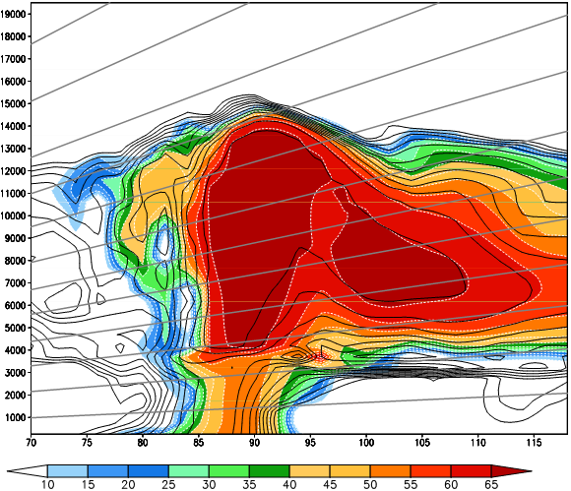
4DEnSRF v.s. EnSRF with 5 min data batches
Reflectivity
4DEnSRF
EnSRF
Color shade: Truth Black contours: Analysis
Analyzed reflectivity with EnSRF exhibits larger errors due to timing error

Slide 36
EnSRF and 4DEnSRF Analysis and Forecast Errors:
OSSEs for a Supercell with WRF
Blue: EnSRF Red: 4DEnSRF
during analysis
during forecast
5 min data batch
10 min data batch
The RMS errors of 4DEnSRF are lower than those of EnSRF.
The advantage of 4DEnSRF is more when analysis interval is longer (10 min or longer).
Forecast error with 4DEnSRF grow faster for 10 min data batches than the 5 min case, while the growth rates for EnSRF are fast in both cases.
(Wang et al. 2012 QJRMS)

Slide 37
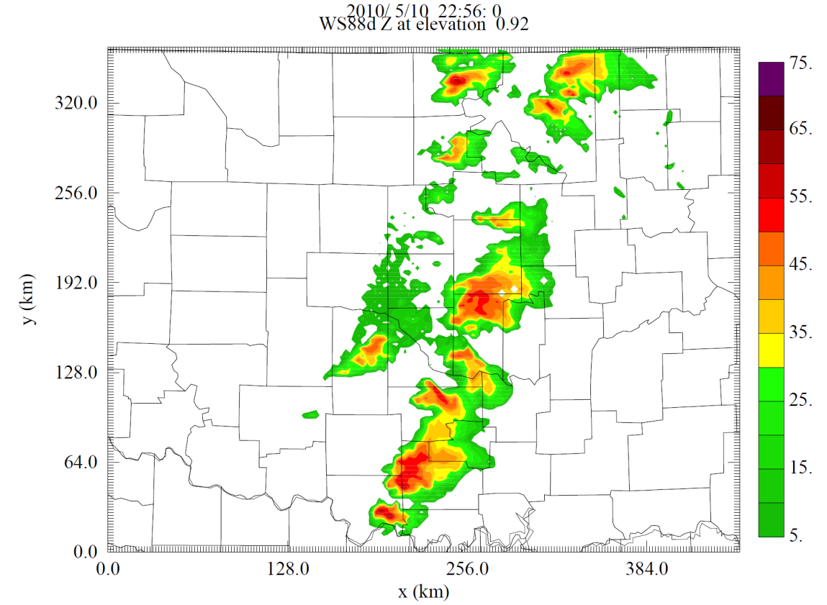
Analysis of a tornadic supercell on May 10, 2010
EnSRF v.s. 4DEnSRF
dx=1.5 km
KTLX
A tornadic
Supercell
Storm
dx=0.5 km
Wang, Xue and Min (2014 To be submitted)

Slide 38
Analyzed T' (shaded), Pressure (contours) and Wind Vectors
at 1.5 km AGL
4DEnSRF EnSRF
Much better organization of low-level mesocyclone with 4DEnSRF
Better dynamical consistency between wind, pressure and temperature fields

Slide 39
Z obs at 23:27Z
Vr obs at 23:27Z
OBS
at 0.52°
Elevation
AE5M at 23:26z
Z, wind, w
analyses
at 1 km
4DEnSRF at 23:26Z
EnSRF at 23:26Z

Slide 40
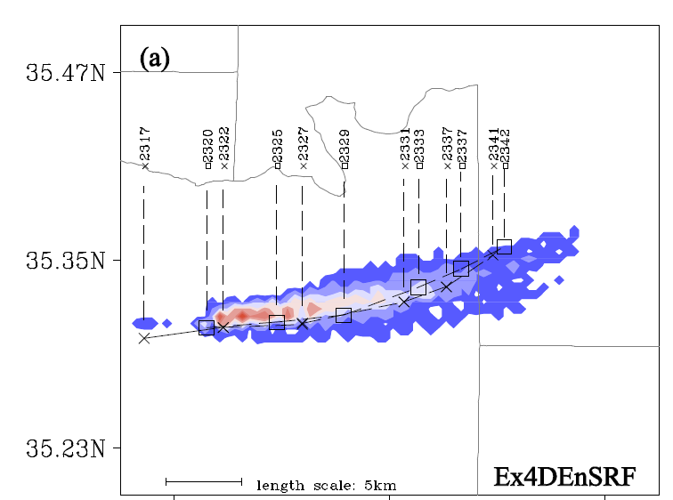
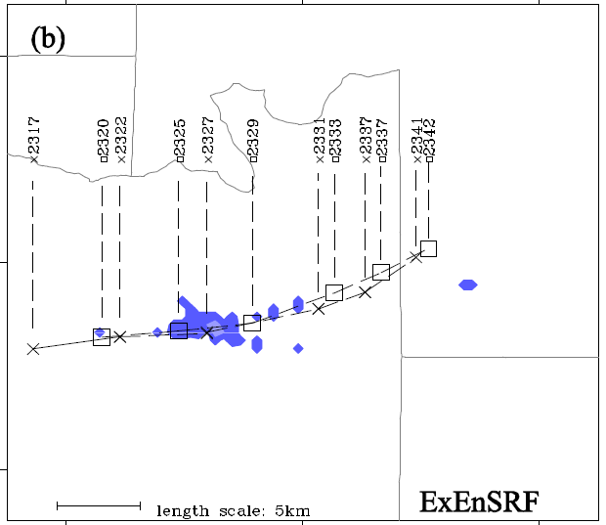

Probability of sfc vorticity exceeding a threshold
4DEnSRF
EnSRF

Slide 41
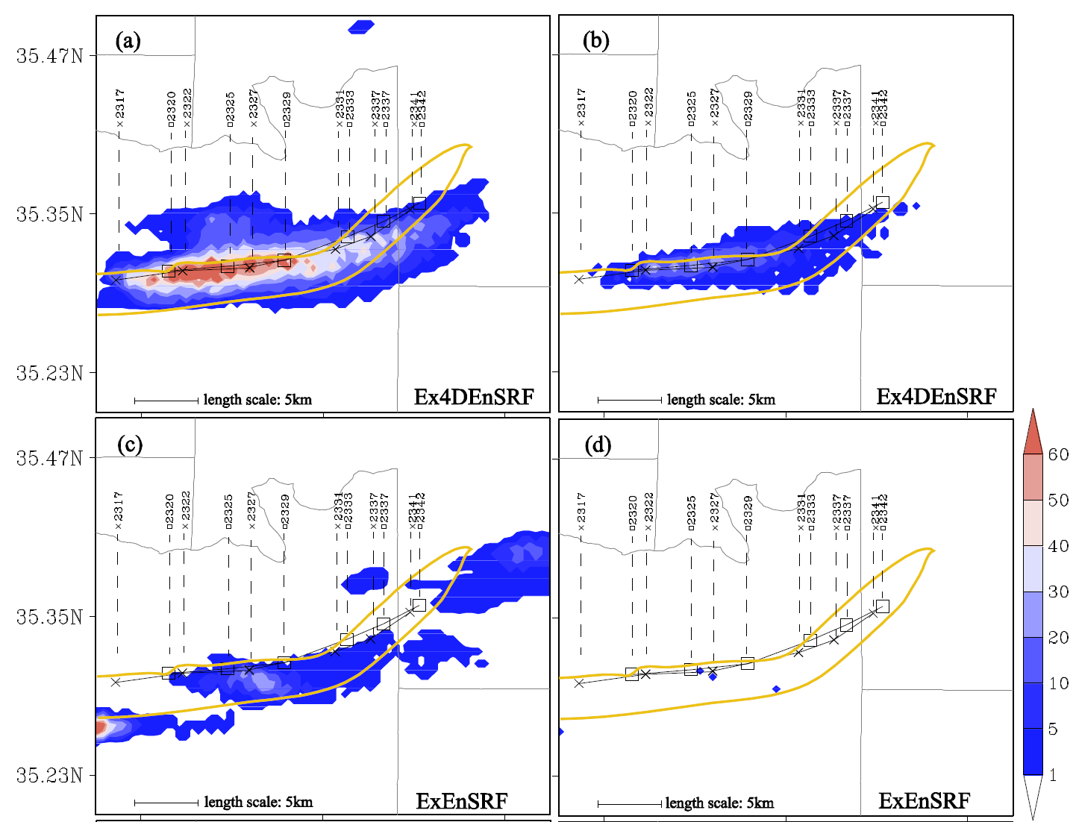
Probabilities of sfc wind speed exceeding 29 ms⁻¹ (EF0) and 38 ms⁻¹ (EF1)
EF0
EF1
4DEnSRF
EnSRF

Slide 42
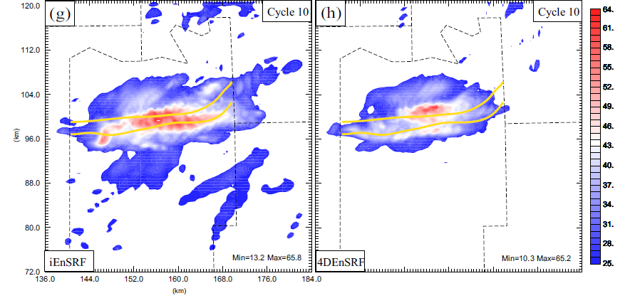
Iterative 4DEnSRF (10 May 2010 case)
i4DEnSRF
4DEnSRF
The 10 m maximum wind speed from all ensemble forecasts from 2320 through 2340 for i4DEnSRF and 4DEnSRF, after 10 cycles.
The yellow thick lines mark the reported damage path of tornado J4 in Seminole county.
Further Improvement with iEnSRF
(Wang et al. 2014b)

Slide 43
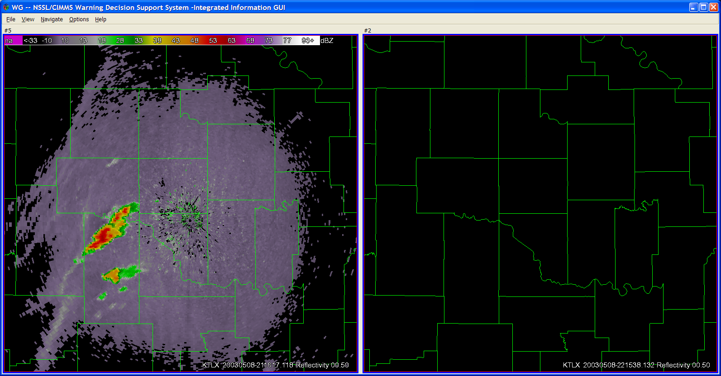
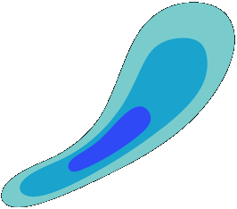
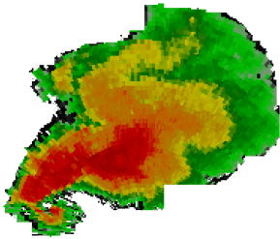
Vision: Warn-on-Forecast
Radar and Initial Forecast at 2100 CST
Radar at 2130 CST: Accurate Forecast
An ensemble of storm-scale NWP models predict the path of a potentially
tornadic storm. A Warning is Issued!
The warning issued based on the computer model forecast(s) includes detailed information on the expected event
Most
Likely
Tornado
Path
Most
Likely
Tornado
Path
Developing
Thunderstorm
30%
30%
50%
50%
70%
70%
T=2200 CST
T=2200 CST
T=2150
T=2150
T=2140
T=2140
T=2120 CST
T=2130
T=2120 CST
T=2130
More than triple current Tornado Warning lead times
Improved warnings allow enhanced community response
NSSL Warn on Forecast Briefing March 5, 2007
(Stensrud, Xue and others 2009)

Slide 44


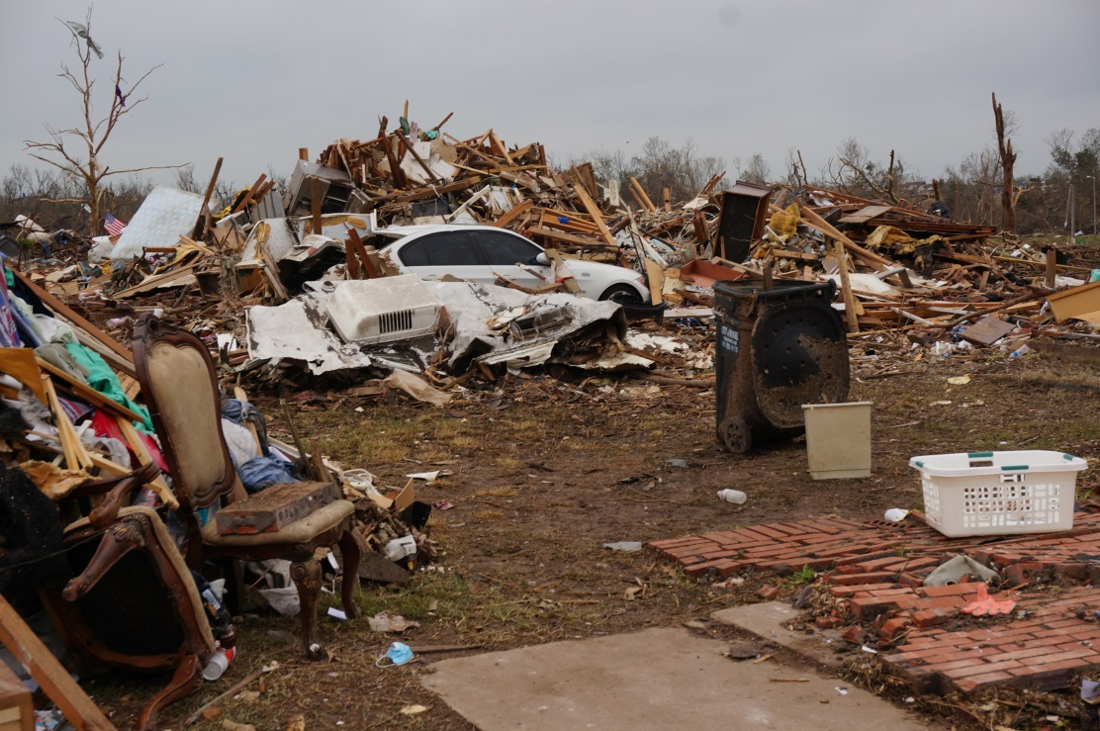
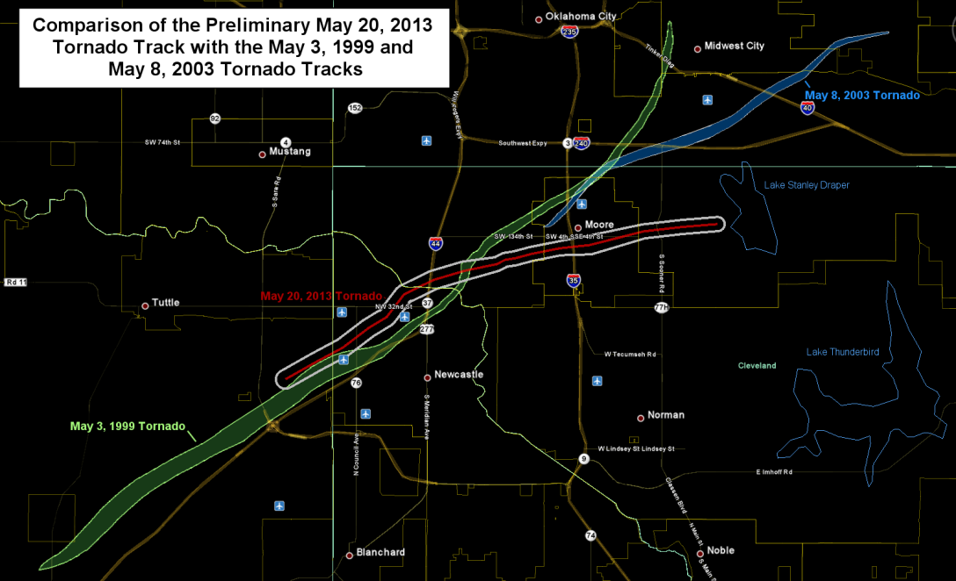
5/20/2013 Moore, Oklahoma Tornado

Slide 45
Moore, Oklahoma Tornado of May 20, 2013 – 10 km north of Norman
EF5 intensity
Occurred ~3pm
24 people killed
Several thousands of houses destroyed
Warning issued ~15 min before tornado touchdown
Forecast of high tornado potential issued 1 days ahead of time.

Slide 46
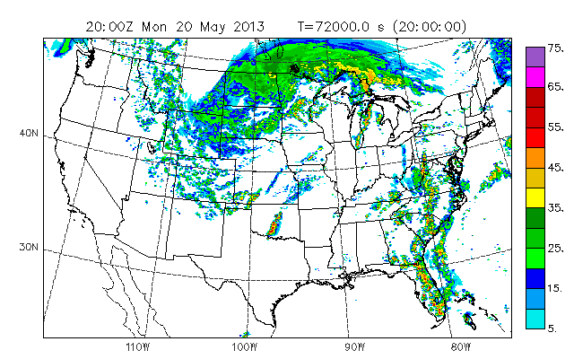
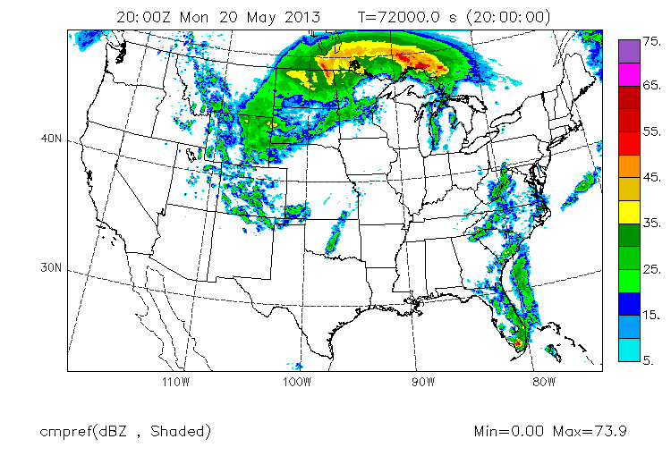
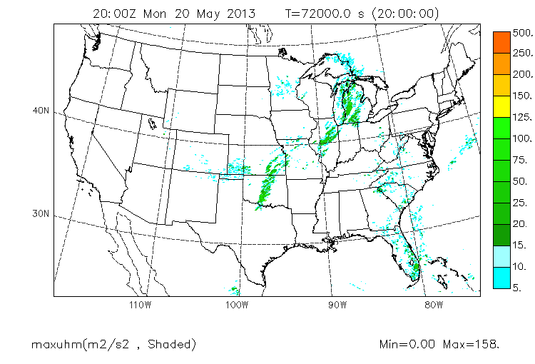
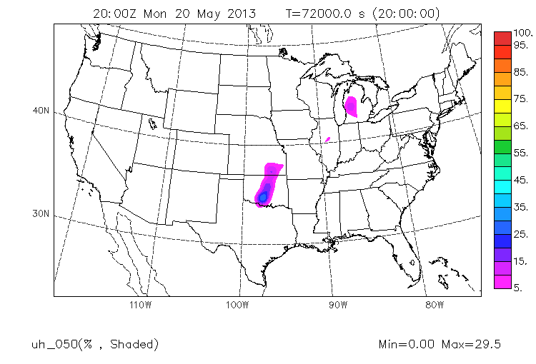
Reflectivity from Control Member
Probability Matching Mean of Composite Reflectivity
20 hour forecast valid at 20 UTC, 20 May 2013, time of Moore Tornado
by CAPS Storm-Scale Ensemble Forecasting System
Ensemble Maximum of
Hourly-max Updraft Helicity
Neighborhood Probability of
Hourly-max UH ≥ 50

Slide 47
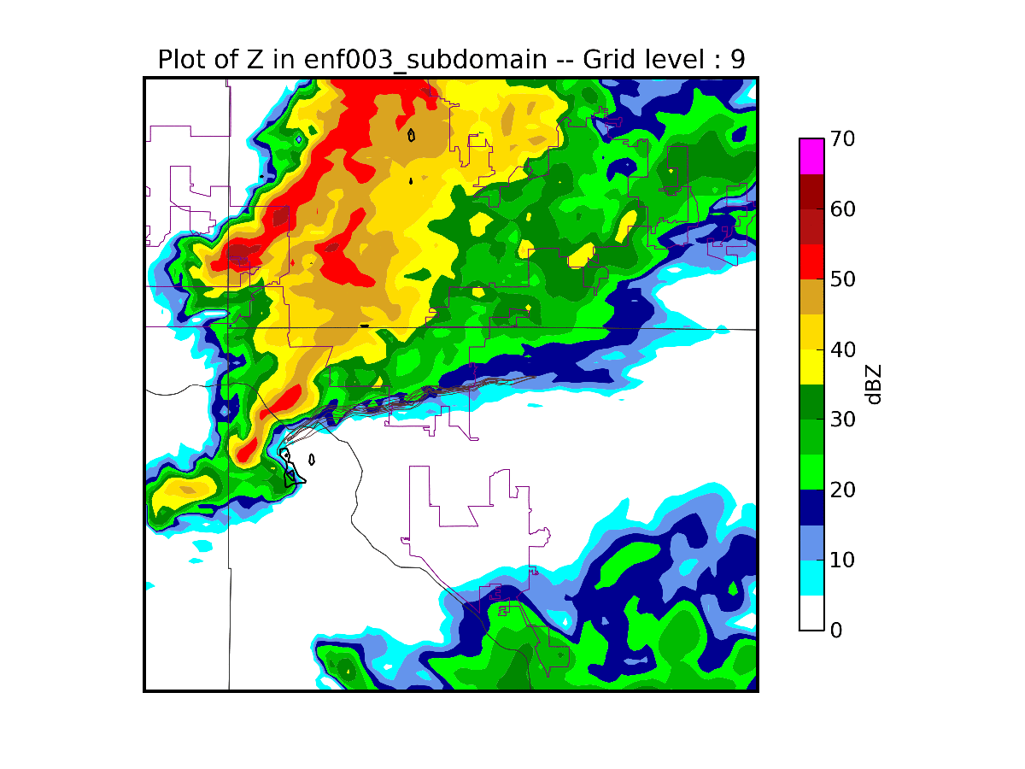
Prediction of Moore Tornadic Storm
@5 min intervals @0.5km spacing
t = 10 minutes
(1840 UTC)
Storm initialized
with EnKF
assimilation
of radar etc data
ARPS model
Prediction
dx=500 m

Slide 48
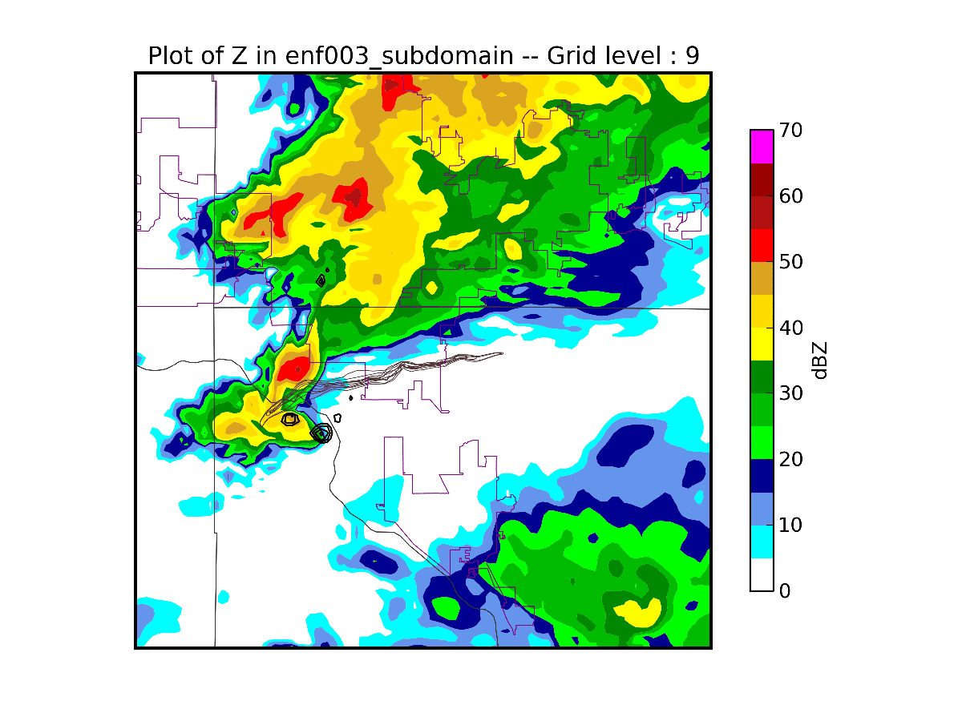
Prediction of Moore Tornadic Storm
@5 min intervals @0.5km spacing
t = 15 minutes
(1845 UTC)
Storm initialized
with EnKF
assimilation
of radar etc data
ARPS model
Prediction
dx=500 m

Slide 49
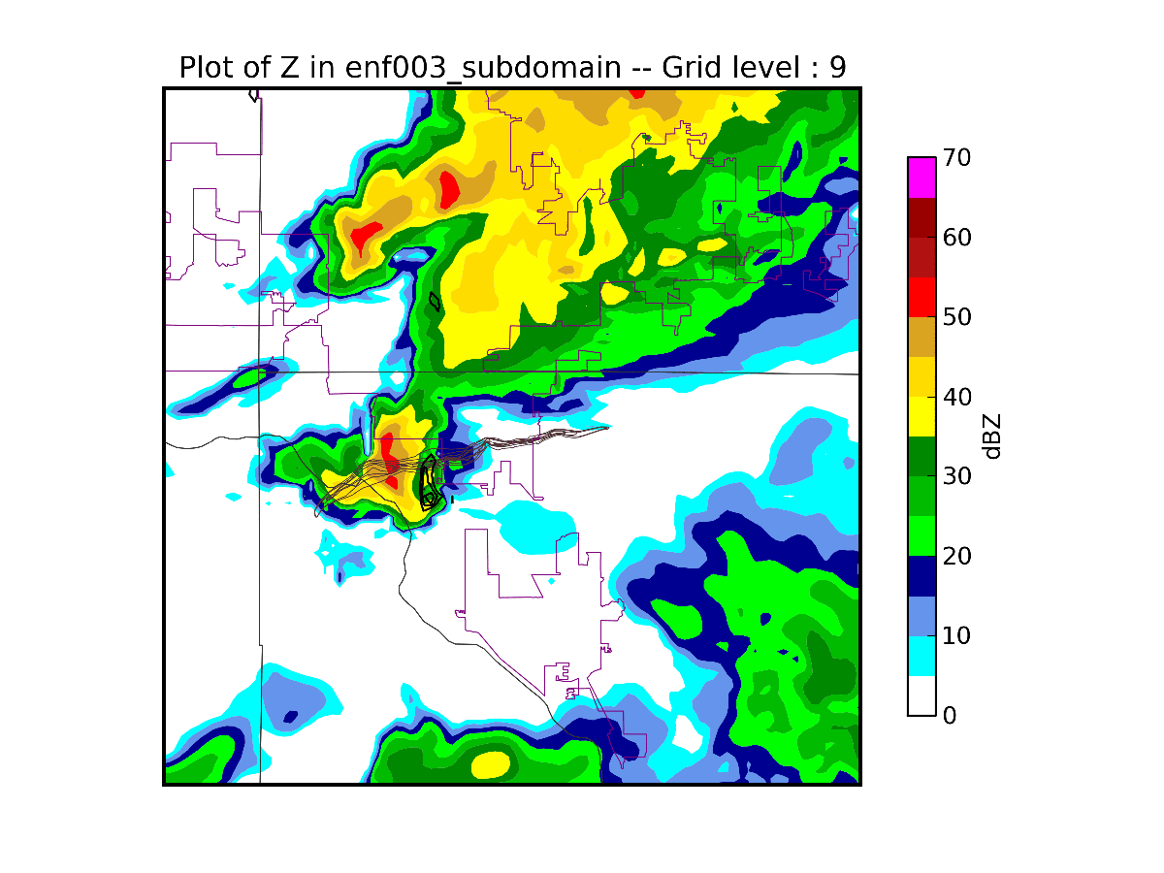
Prediction of Moore Tornadic Storm
@5 min intervals @0.5km spacing
t = 20 minutes
(1850 UTC)
Storm initialized
with EnKF
assimilation
of radar etc data
ARPS model
Prediction
dx=500 m

Slide 50
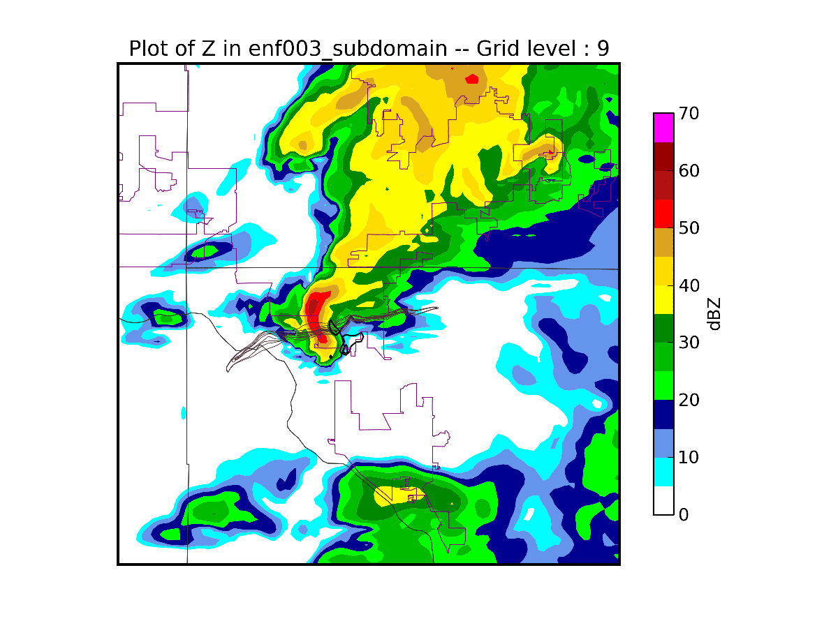
Prediction of Moore Tornadic Storm
@5 min intervals @0.5km spacing
t = 25 minutes
(1855 UTC)
Storm initialized
with EnKF
assimilation
of radar etc data
ARPS model
Prediction
dx=500 m

Slide 51

Prediction of Moore Tornadic Storm
@5 min intervals @0.5km spacing
t = 30 minutes
(1900 UTC)

Slide 52

Prediction of Moore Tornadic Storm
@5 min intervals @0.5km spacing
t = 35 minutes
(1905 UTC)
Storm initialized
with EnKF
assimilation
of radar etc data
ARPS model
Prediction
dx=500 m

Slide 53

Prediction of Moore Tornadic Storm
@5 min intervals @0.5km spacing
t = 40 minutes
(1910 UTC)
Storm initialized
with EnKF
assimilation
of radar etc data
ARPS model
Prediction
dx=500 m

Slide 54

Prediction of Moore Tornadic Storm
@5 min intervals @0.5km spacing
t = 45 minutes
(1915 UTC)
Storm initialized
with EnKF
assimilation
of radar etc data
ARPS model
Prediction
dx=500 m

Slide 55
CAPS’s Multi-scale Parallel EnKF system
Hybrid OpenMP/MPI parallelization
Multiple data types, especially high-density radar data
4D asynchronous filter (4DEnSRF), and iterative procedure (iEnSRF) for faster convergence/spin up
Interface with both ARPS and WRF
Support for 2-moment microphysics, perturbed physics and multi-physics ensemble, build-in attenuation correction
Microphysical parameter estimation
Polarimetric radar data assimilation
Adaptive covariance inflation, successive spatial localization
EnKF-3DVAR hybrid (testing) and LETKF algorithms
En4DVAR (being implemented)
Observation operators build into ARPS (for 4DEnKF).

Slide 56
Parallel EnSRF algorithm suitable for dense data from large radar networks via domain decomposition
Supports hybrid OpenMPI/MPI parallelization
(Wang, Jung, Supinie and Xue 2013 JTech)
Notes:
R is maximum localization radius
Grid is decomposed into sub-domains, each domain is assigned to a shared-memory node
Each sub-domain is further divided into S1-S4 sub-patches
Sub-patches with the same label must be at least 2R apart so that obs within them don’t affect common grid points and can be processed simultaneous
Loop through S1-S4 to complete obs assimilation

Slide 57
Realtime EnKF Radar DA Experiment for CONUS Domain

Slide 58
First time ever
Realtime EnKF Radar DA Experiment for Convective Storms in spring 2013 over ¼ CONUS at dx=4 km
40-member CONUS 6-h ensemble forecasts fed the EnKF analyses for WRF at 00 UTC

Slide 59

20 hour forecast using EnKF I.C.
May 20, 2013 Moore Tornado Time

Slide 60


Reflectivity ETS Scores for 14 forecasts from May-June 2013 (EnKF v.s. 3DVar)
20dBZ threshold
40dBZ threshold
Notes:
EnKF cases: 5/19, 5/20, 5/21, 5/22, 5/23, 5/24, 5/27, 5/30, 5/31, 6/3, 6/4, 6/5, 6/6, 6/7
3DVAR cases: 5/20, 5/21, 5/22, 5/23, 5/27, 5/30, 5/31, 6/3, 6/4, 6/5, 6/6, 6/7

Slide 61

CAPS CONUS Domain 4-km Cycled EnKF DA and Ensemble Forecast Experiment
(Setup for Spring 2014)

Slide 62
CONUS Domain 4-km Cycled EnKF DA and Ensemble Forecast Experiment (Setup for Spring 2014)
Forecast model: WRF-ARW
Physical domain: CONUS (1200x768x50)
40 member ensemble
DA: 2300, 2315, 2330, 2345, 0000 UTC
Observations: sounding, profiler, surface, radar (Z, V_{r})
Microphysics scheme: WSM6 with perturbed N0r, N0g, ρ_{g}
Multi-PBL schemes: MYJ, YSU, ACM2, MYNN, QNSE
DA scheme: ARPS parallel EnSRF

Slide 63
Configurations for 12-member ensemble forecasts
Member | IC | BC | Microphysics | LSM | PBL
enkf_m1 | enk_m1a | arw_cn | Thompson(8) | Noah | MYJ(2)
enkf_m2 | enk_m2a | arw_m3 | MY2(9) | Noah | MYJ(2)
enkf_m3 | enk_m3a | arw_m4 | Morrison(10) | Noah | MYJ(2)
enkf_m6 | enk_m6a | arw_m5 | Thompson(8) | Noah | MYNN(5)
enkf_m7 | enk_m7a | arw_m6 | MY2(9) | Noah | YSU(1)
enkf_m8 | enk_m8a | arw_m7 | Morrison(10) | Noah | YSU(1)
enkf_m9 | enk_m9a | arw_m8 | Thompson(8) | Noah | QNSE(4)
enkf_m10 | enk_m10a | arw_m9 | MY2(9) | Noah | MYNN(5)
enkf_m11 | enk_m11a | arw_m10 | Thompson(8) | Noah | YSU(1)
enkf_m12 | enk_m12a | arw_m11 | WDM6(16) | Noah | YSU(1)
enkf_m15 | enk_m15a | arw_m12 | Morrison(10) | Noah | MYNN(5)
enkf_m16 | enk_m16a | arw_m13 | WDM6(16) | Noah | MYJ(2)

Slide 64

Spring 2014 15-min Cycled 4-km CONUS Grid EnKF and 3DVAR DA and SSEF
(See Youngsun Jung’s Presentation Thursday)

Slide 65
2014 Cycled 4-km EnKF DA
WRF ARW model with multiple physics;
Observations: sounding, profiler, surface, radar (Z, V_{r})
Microphysics scheme: WSM6 with perturbed N0r, N0g, ρ_{g}
Multi-PBL schemes: MYJ, YSU, ACM2, MYNN, QNSE
DA scheme: ARPS parallel EnSRF
NAM initial background + SREF perturbations
15-min cycles at 2300, 2315, 2330, 2345, 0000 UTC
24-h deterministic and ensemble forecasts
Assimilation of all radar data within CONUS domain: 7 min/cycle!

Slide 66
13 April 2014 Squall Line Test
Member | IC | BC | Radar | Micro | LSM | PBL
S4CN | 00Z ARPSa | 00Z NAMf | yes | Thompson | Noah | MYJ
3DVAR | 00Z cycled ARPSa | 00Z NAMf | yes | Thompson | Noah | MYJ
Thom | 00Z EnKFa | 00Z NAMf | yes | Thompson | Noah | MYJ
WSM6 | 00Z EnKFa | 00Z NAMf | yes | WSM6 | Noah | MYJ
3DVAR (Vr)+Cloud Analysis(Z)
EnKF(Vr, Z)
Notes:
S4CN is the HWT control member.

Slide 67




Analyzed composite reflectivity (0 hour)
Cycled EnKF
Non-cycled 3DVAR/cloud anx
Cycled 3DVAR/Cloud anx
OBS
Notes:
EnKF and s4cn show good match with observations. Cycled 3DVAR overestimates intensity (maybe some over-adjustment is going on? Need to check). Because of the lack of radar observations over the sea (upper left and lower right corners), spurious echoes were left unsuppressed in 3DVAR experiment. Echoes in the north of the great lakes could be real.

Slide 68





1 hr forecast
Valid at 0100 UTC
13 May 2014
EnKF_Thom
EnKF_WSM6
OBS
Cycled 3DVAR
Non-cycled 3DVAR
Top: EnKF
Bottom: 3DVAR+Cloud analysis
Notes:
The shape and location of the rain band in the eastern Texas is better predicted by the EnKF forecast up to 5 hour into the forecast. However, echoes in Wisconsin are too weak and dissipates too early in the EnKF forecast. On the other hand, echoes near the Great Lake are over-predicted in s4cn (HWT control member). The northern part of precipitation system start to weaken at 0600 UTC but dissipation is much delayed in S4CN. Cycled 3DAR show better prediction of the structure and location of the middle part of the line during the medium range (7-16 hr) forecast. From 9 hr forecast, Thom and S4CN forecast become very similar for the southern part of the system (enclosed by pink dashed circles) suggesting the microphysics scheme is taking over the evolution of the system.

Slide 69





2 hr forecast
Valid at 0200 UTC
13 May 2014
EnKF_Thom
EnKF_WSM6
OBS
Cycled 3DVAR
Non-cycled 3DVAR
Top: EnKF
Bottom: 3DVAR+Cloud analysis

Slide 70





3 hr forecast
Valid at 0300 UTC
13 May 2014
EnKF_Thom
EnKF_WSM6
OBS
Cycled 3DVAR
Non-cycled 3DVAR
Top: EnKF
Bottom: 3DVAR+Cloud analysis

Slide 71





4 hr forecast
Valid at 0400 UTC
13 May 2014
EnKF_Thom
EnKF_WSM6
OBS
Cycled 3DVAR
Non-cycled 3DVAR
Top: EnKF
Bottom: 3DVAR+Cloud analysis

Slide 72





5 hr forecast
Valid at 0500 UTC
13 May 2014
EnKF_Thom
EnKF_WSM6
OBS
Cycled 3DVAR
Non-cycled 3DVAR
Top: EnKF
Bottom: 3DVAR+Cloud analysis

Slide 73





6 hr forecast
Valid at 0600 UTC
13 May 2014
EnKF_Thom
EnKF_WSM6
OBS
Cycled 3DVAR
Non-cycled 3DVAR
Top: EnKF
Bottom: 3DVAR+Cloud analysis

Slide 74





7 hr forecast
Valid at 0700 UTC
13 May 2014
EnKF_Thom
EnKF_WSM6
OBS
Cycled 3DVAR
Non-cycled 3DVAR
Top: EnKF
Bottom: 3DVAR+Cloud analysis

Slide 75





8 hr forecast
Valid at 0800 UTC
13 May 2014
EnKF_Thom
EnKF_WSM6
OBS
Cycled 3DVAR
Non-cycled 3DVAR
Top: EnKF
Bottom: 3DVAR+Cloud analysis

Slide 76





9 hr forecast
Valid at 0900 UTC
13 May 2014
EnKF_Thom
EnKF_WSM6
OBS
Cycled 3DVAR
Non-cycled 3DVAR
Top: EnKF
Bottom: 3DVAR+Cloud analysis

Slide 77





10 hr forecast
Valid at 1000 UTC
13 May 2014
EnKF_Thom
EnKF_WSM6
OBS
Cycled 3DVAR
Non-cycled 3DVAR
Top: EnKF
Bottom: 3DVAR+Cloud analysis

Slide 78





11 hr forecast
Valid at 1100 UTC
13 May 2014
EnKF_Thom
EnKF_WSM6
OBS
Cycled 3DVAR
Non-cycled 3DVAR
Top: EnKF
Bottom: 3DVAR+Cloud analysis

Slide 79





12 hr forecast
Valid at 1200 UTC
13 May 2014
EnKF_Thom
EnKF_WSM6
OBS
Cycled 3DVAR
Non-cycled 3DVAR
Top: EnKF
Bottom: 3DVAR+Cloud analysis

Slide 80





13 hr forecast
Valid at 1300 UTC
13 May 2014
EnKF_Thom
EnKF_WSM6
OBS
Cycled 3DVAR
Non-cycled 3DVAR
Top: EnKF
Bottom: 3DVAR+Cloud analysis

Slide 81





14 hr forecast
Valid at 1400 UTC
13 May 2014
EnKF_Thom
EnKF_WSM6
OBS
Cycled 3DVAR
Non-cycled 3DVAR
Top: EnKF
Bottom: 3DVAR+Cloud analysis

Slide 82





15 hr forecast
Valid at 1500 UTC
13 May 2014
EnKF_Thom
EnKF_WSM6
OBS
Cycled 3DVAR
Non-cycled 3DVAR
Top: EnKF
Bottom: 3DVAR+Cloud analysis

Slide 83





16 hr forecast
Valid at 1600 UTC
13 May 2014
EnKF_Thom
EnKF_WSM6
OBS
Cycled 3DVAR
Non-cycled 3DVAR
Top: EnKF
Bottom: 3DVAR+Cloud analysis

Slide 84





17 hr forecast
Valid at 1700 UTC
13 May 2014
EnKF_Thom
EnKF_WSM6
OBS
Cycled 3DVAR
Non-cycled 3DVAR
Top: EnKF
Bottom: 3DVAR+Cloud analysis

Slide 85





18 hr forecast
Valid at 1800 UTC
13 May 2014
EnKF_Thom
EnKF_WSM6
OBS
Cycled 3DVAR
Non-cycled 3DVAR
Top: EnKF
Bottom: 3DVAR+Cloud analysis

Slide 86





19 hr forecast
Valid at 1900 UTC
13 May 2014
EnKF_Thom
EnKF_WSM6
OBS
Cycled 3DVAR
Non-cycled 3DVAR
Top: EnKF
Bottom: 3DVAR+Cloud analysis

Slide 87





20 hr forecast
Valid at 2000 UTC
13 May 2014
EnKF_Thom
EnKF_WSM6
OBS
Cycled 3DVAR
Non-cycled 3DVAR
Top: EnKF
Bottom: 3DVAR+Cloud analysis

Slide 88





21 hr forecast
Valid at 2100 UTC
13 May 2014
EnKF_Thom
EnKF_WSM6
OBS
Cycled 3DVAR
Non-cycled 3DVAR
Top: EnKF
Bottom: 3DVAR+Cloud analysis

Slide 89





22 hr forecast
Valid at 2200 UTC
13 May 2014
EnKF_Thom
EnKF_WSM6
OBS
Cycled 3DVAR
Non-cycled 3DVAR
Top: EnKF
Bottom: 3DVAR+Cloud analysis

Slide 90





23 hr forecast
Valid at 2300 UTC
13 May 2014
EnKF_Thom
EnKF_WSM6
OBS
Cycled 3DVAR
Non-cycled 3DVAR
Top: EnKF
Bottom: 3DVAR+Cloud analysis

Slide 91





24 hr forecast
Valid at 0000 UTC
14 May 2014
EnKF_Thom
EnKF_WSM6
OBS
Cycled 3DVAR
Non-cycled 3DVAR
Top: EnKF
Bottom: 3DVAR+Cloud analysis

Slide 92





Hourly Precipitation ETS Scores
0.01
0.10
0.25
0.50
Notes:
Cycled 3DVAR forecast show higher ETS score for the surface precipitation than the EnKF Thompson forecast before 6 hr forecast as stratiform rain area and the northern part of system is under-predicted (broken) in the EnKF forecasts.

Slide 93
A comparison between EnSRF and LETKF algorithms for convective-scale radar data assimilation: OSSEs and
Effects of nonlinear observation operator
(Zhao and Xue 2014)

Slide 94
Outline
Background and motivations;
ARPS-LETKF DA system and OSSE setup;
Comparison of EnSRF and LETKF analyses with radar observations;
Effects of nonlinear reflectivity observation operator;
Summary and conclusions.

Slide 95
Background
The Ensemble-Square-Root Kalman filter (EnSRF) algorithm (Whitaker and Hamill 2002) (or very similar Ensemble Adjustment Kalman Filter – EAKF) had been used almost exclusively for radar DA at the convective scale;
  A serial algorithm – assimilating one observation at a time
  Easy to implement
  Promising results with radar DA at convective scale
Local Ensemble Transform Kalman Filter (LETKF, Hunt et al. 2007) algorithm is grid-point or state-space based – it updates the state variables using observations within specified influence radii simultaneously.

Slide 96
Background
The state-space LETKF is easier to parallelize on distributed-memory processors but the algorithm itself is more expensive;
With the observation-space EnSRF algorithm, observations affecting common grid points cannot be analyzed simultaneously - they have to be processed in separate batches (e.g., in parallel algorithm of ARPS EnSRF - Wang et al. 2013);
Because observations are processed independently in EnSRF, localization can be set differently for different observations, offering additional flexibility.

Slide 97
Background: Previous Studies
Greybush et al. (2011) and Holland and Wang (2013) compared EnSRF and LETKF algorithms using OSSEs
  Both studies used idealized large-scale models with linear observation operators;
  B-localization vs R-localization for covariances;
  Serial vs simultaneous observation processing;
  Some differences were found with the sequential and serial versions of these algorithms, and with B versus R-based localization;
  R-localization and simultaneous processing tend to produce more balanced analyses although differences tend to be relatively small.

Slide 98
LETKF Algorithm and Implementation
LETKF has been applied successfully to global, regional, and mesoscale NWP models (Szunyogh et al. 2008; Seko et al. 2011; Miyoshi and Kunii 2012);
LETKF has not been applied to the radar DA problem until very recently;
We implemented LETKF within the ARPS ensemble DA framework (Tong and Xue 2005; Xue et al 2006) and compare LETKF and EnSRF in OSSEs for a supercell storm

Slide 99

Localization Schemes in Ensemble Filters
To suppress the impact of observations from distant regions upon an analysis caused by spurious correlation in $P^{f}$ due to sampling error
B-localization applied to Kalman gain K, in EnSRF
R-localization applied to Kalman gain K, in LETKF
Regulated R-localization (Nerger and Janjic 2012)
$ρ$ is the localization weight function, which is distance-dependent function. In this work, it is 5th-order correlation function introduced in Gaspari and Cohn (1999)
Notes:
To suppress the impact of observations from distant regions upon an analysis caused by spurious correlation due to sampling error
Also increase the rank
First step is to select the observations only from a region surrounding the location of the analysis grid. Actually this step is intrinsically contained in LETKF at the step 3 of LETKF algorithm. The data selection method is used in Houtekamer and Mitchell (1998). LEKF and LETKF are named with “Local” just for this local analysis approach. In addition to providing better results, this localization approach allows the LETKF analysis to be done more efficiently as a parallel computation (Hunt, Kostelich et al. (2007)). However, in this way, the weighting function of the localization is the Heaviside function that weights 1 inside and 0 outside the domain (Miyoshi and Yamane (2007)), then abrupt localization cutoff can result in a noisy analysis (Greybush, Kalnay et al. (2011)). So Hunt et al. (2007) proposed a “smoothed localization”, called R localization, also called “observation localization” in Nerger and Janjic (2012), by multiplying the observational error variance (which is the element of diagonal matrix R) by the inverse of a localization weighting function. This weight function, also called localization function, decays smoothly from one to zero as the distance of the observations from the analysis grid point increases.

Slide 100

Radar Data OSSEs with a Supercell Storm
20 May 1977 in Del City supercell storm simulation using ARPS model (Tong and Xue 2005);
Model variables: $u,v,w,θ,p,q_{v},$ $q_{c},$ $q_{r},$ $q_{s},$ $q_{i},q_{h}$
Lin ice microphysics and 1.5-order TKE SGS turbulence;
64 × 64 × 16 km³ domain, dx=dy=2km, dz=500m;
Del City sounding, storm triggered by a thermal bubble;
Vr and Z data simulated on 14 elevation levels of a single S-band 88D radar;
40 members; 12% inflation, ~6 km localization radius by EnSRF
DA every 5 min from 25 min through 100 min
Truth simulation
start time
25min(1st anx)
60min(8th anx)
100min(16th anx)
0
anx cycle
ending time
20min
(ensemble initialization)

Slide 101

Simulation of Radar Data
Observation operators
$V_{r}$ is linear without considering the effect of hydrometeor sedimentation, Z has strong nonlinearity.

Slide 102
LETKF and EnSRF Experiments
1st determine optimal localization radii for EnSRF and LETKF
Inter-compare LETKF and EnSRF analyses and forecast errors in DA window
  Both Vr and Z
  Only Vr
  Only Z
  Only Z but thinned or in separate batches

Slide 103

RMSEs of LETKF and EnSRF with Vr+Z Data
U V W PT P
qc qr qv, qi qs qh
Optimal radius for R-localization (3500m) is shorter than B-localization (6000m); But regulated R-localization has a similar optimal localization radius of 6000 m
In the initial spin-up stage, EnSRF outperforms LETKF
LETKF and EnSRF perform similarly after the initial spin-up period

Slide 104






Wind Reflectivity
t=25min
Truth
wind field and radar reflectivity in X-Z cross-section
EnSRF
After first analysis, EnSRF analysis is closer to truth.
LETKF

Slide 105
EnSRF vs. LETKF with Vr data only
U V W PT P
qc qr qv, qi qs qh
Similar performances in final stable stages
LETKF is slightly better than EnSRF in the early stage
Simultaneous LETKF analysis might have helped to produce more balanced analyses

Slide 106
EnSRF vs. LETKF with Z data only
U V W PT P
qc qr qv, qi qs qh
Similar performances in final stable stages
In spin-up stage, EnSRF outperforms LETKF at analysis step (esp. for the Z-related variables, qr, qs and qh);

Slide 107
RMS Difference to radar observation: EnSRF vs. LETKF with only Z used
Similar performances in final stable stages
In spin-up stage, EnSRF outperforms LETKF at analysis step obviously, esp. for Z reflectivity;
At forecast step, RMSD of EnSRF jumps back at forecast step;

Slide 108
Effects of Nonlinear Observation Operator
Implicit linearization of nonlinear operator in EnKF
(1)
(2)
(3)
The linearization is implicit in Eqs. (1) ~(2) although full nonlinear operators are used (Lorenc 2003);
This implicit linearization is around ensemble mean state of possibly different quality, from different stages of the analysis cycle.

Slide 109
Effects of Nonlinear Z Observation Operator
In EnSRF, effective linearization of Z operator for subsequent observation is made around the newly updated, intermediate ensemble during the serial processing;
Updated ensemble is better than the prior ensemble, especially during the early cycles when ensemble state is poor;
The improved intermediate ensemble helps EnSRF outperform LETKF;
Differences become small when state estimation becomes good – when analysis increments are small.
Notes:
Why Different linearization leads to different analysis, and linearization about better state helps EnSRF outperform LETKF

Slide 110
Effects of Nonlinear Observation Operator
In LETKF, linearization is made about the entire prior ensemble since all the observations are processed simultaneously;
In EnSRF, linearization for subsequent observation is made around the newly updated, intermediate ensemble during the serial processing;
Updated ensemble is better than the prior ensemble, especially during the early cycles when ensemble state is poor;
The improved intermediate ensemble helps EnSRF outperform LETKF (our hypothesis);
Differences become small when state estimation becomes good – when analysis increments are small.
Notes:
Why Different linearization leads to different analysis, and linearization about better state helps EnSRF outperform LETKF

Slide 111
Experiments to Test the Hypothesis
Experiments are designed to deliberately remove the differences of linearization or sequential v.s. simultaneous processing of EnSRF and LETKF
  Experiment 1: Thinned Z data
  Experiment 2: LETKF analysis with 2 batches of Z observations

Slide 112
Experiment 1: Thinned Z Observations
Z observations are thinned (red dots) to have spacing larger than cut-off radius in horizontal;
Observations analyzed earlier have no influence on the state used by later observation operators hence not affecting linearization in EnSRF;

Slide 113
EnSRF vs LETKF with Thinned Z Observations
Differences between ENSRF and LETKF are mostly gone in early cycles
Notes:
In the final stage,
some difference in the RMSD of wind components, which might be related to the effect of localization on balance; less imbalance in LETKF analysis
for difference in the RMSD of reflectivity, it is because the observations are only thinned in horizontal, so there is still effect of nonlinear observation through vertical direction.

Slide 114
Exp. 2: LETKF analysis with 2 batches of Z observations
Z observations are split into 2 batches:
  batch 1 includes thinned data used in Exp.1;
  batch 2 includes the remaining data;
LETKF effectively runs in a partially sequential processing mode;
By providing better prior ensemble for the 2nd batch LETKF analysis, effects of linearization are reduced.

Slide 115
LETKF with 2 Batches of Z Observations
2 batches
LETKF with 2 batches is much closer to EnSRF than LETKF with 1 batch.
Can be seen more clearly from RMSD of Vr and Z (not shown)
Notes:
the original reflectivity dataset is split into 2 smaller datasets. Then LETKF processes the 2 smaller datasets in 2 analysis batches sequentially. In each analysis batch, the observations in the smaller dataset are still processed simultaneously.
black curve is for EnSRF;
red curve is for LETKF with all the observation in 1 batch;
blue curve is for LETKF with 2 batches of observation.

Slide 116
Summary and Conclusions
LETKF can effectively assimilate radar observations and produce similar analyses as EnSRF after a few DA cycles.
The optimal cut-off radius for R-localization in LETKF is shorter, but that for regulated R-localization is similar to that of B-localization in EnSRF;
Simultaneous processing in LETKF appears to produce slightly more balanced analyses than serial EnSRF when assimilating linear Vr data;
EnSRF outperforms LETKF noticeably when assimilating nonlinear Z data during the initial cycles when state estimation is poor;
The differences are demonstrated to be due to different degrees of effective linearization of the nonlinear Z operator, essentially due to sequential v.s. serial data processing.

Slide 117
EnKF for Storm-Scale DA - Summary
Capable of dealing with complex ice and multi-moment microphysics, which reduce model error;
Effective in assimilating reflectivity data;
Can assimilate polarimetric radar data directly;
Can assimilate attenuated reflectivity directly (not shown)
Does not require adjoint model;
Algorithm more parallelization-friendly than 4DVAR;
Can produce much more balanced analyses than 3DVar;
Can update and provide ensemble perturbations for EnVar hybrid;
4DEnKF outperforms 3DEnKF;
iEnKF helps during initial cycles;
EnKF and LETKF very similar, more difference found with NL obs operator;
Can retrieve MP DSD parameters;
We are at the stage of performing realtime testing.

Slide 118
Important Questions
3D/4DEnVar v.s. 3D/4DEnKF
  Any value of static B at all at convective scale?
  Equation constraint and state space localization?
  Multi-scale issue? How to deal with localization for very different spatial characteristics (radar/satellite versus rawinsondes)?
  Spatially adaptive localization (convective v.s. clear air regions)?
  Adjoint-based 4DVar difficult – how to properly localize for fast moving storms in 4DEnVar/4DEnKF when flow-following localization is important?
  Running-in-Place/iterative EnKF – how useful and when to use?
  EnSRF v.s. LETKF?
  How to deal with large model errors?
At CAPS, a hybrid 4DEnKF/4DEnVar systems has been developed base on ARPS 3DVAR and ARPS EnKF in a consistent framework, allowing us to answer some of these questions through carefully designed experiments.

Slide 119
4DEnKF-En4DVar Hybrid
Obs
Obs
Obs
Obs
Obs
Obs
Obs
4DEnKF
En4DVar
Obs
Obs
4D Assimilation Window – 1 cycle
t0
t1
Notes:
The EnKF is a 4-d data-assimilation method that uses a Monte-Carlo
ensemble of short-range forecasts to estimate the covariances of the forecast
error (Evensen,1994).

Slide 120
4DEnKF-En4DVar Hybrid
Combine benefits of 4DVAR and EnKF
  Can assimilate high-frequency data in 4D windows
  Carry ensemble covariance through assimilation cycles
  Does not require tangent linear or adjoint model
En4DVar-NPC-FGAT:
Static covariance
Ensemble covariance
Liu, C., and M. Xue, 2014: A unified framework for four-dimensional ensemble-variational hybrid data assimilation. Quart. J. Roy. Met. Soc. Submitted

Slide 121
Development of a
Coupled EnKF-En3DVar/En4DVar Hybrid DA System suitable for Radar DA
Integrated recent, new developments into an updated 3DVAR package
    To be able to analyze reflectivity directly for mixed phase microphysics;
    Diagnostic pressure equation constraint;
    Radar data on elevation levels and using of beam pattern weighting (as in EnKF)
Developed a unified theoretical framework for En3DVar/En4DVar ;
    Efficient 4DEnVar formulation without requiring adjoint
Implemented 3DEnVar and 4DEnVar, coupling it with CAPS EnKF;
    Testing it with OSSE radar data;
    To compare with 3DVar, 3DEnSRF, 4DEnSRF, 3DLETKF, 4DLETKF
To directly support WRF model also;

Slide 122

Development and Testing of GSI-Based EnKF and EnKF/3DVAR Hybrid Data Assimilation Systems for the Operational Rapid Refresh System
(Supported by FAA Aviation Weather Research Program
- Very limited funding)
Zhu, K., Y. Pan, M. Xue, X. Wang, J. S. Whitaker, S. G. Benjamin, S. S. Weygandt, and M. Hu, 2013: A regional GSI-based EnKF system for the Rapid Refresh configuration: Results with a single, reduced resolution. Mon. Wea. Rev., 141, 4118-4139.
Pan, Y., K. Zhu, M. Xue, X. Wang, M. Hu, S. G. Benjamin, S. S. Weygandt, and J. S. Whitaker, 2014: A regional GSI-based EnKF-variational hybrid data assimilation system for the Rapid Refresh configuration: Results with a single, reduced resolution. Mon. Wea. Rev., 142, 3756-3780.
(Zhu et al. MWR 2013; Pan et al. MWR 2014)

Slide 123
Ensemble and Ensemble-Variational DA
The benefit of flow-dependent B for DA is well recognized.
Ensemble-derived B can be used directly in EnKF or via variational formulations, either alone or in combination with static B (with hybrid B)
Hybrid En3DVar coupled with EnKF has been implemented at NCEP for the global GFS since 2012.
NCEP regional models (NAM, RR and HRRR) still use GSI 3DVAR.
This talk reports on the development and testing of regional EnKF and EnKF/En3DVAR hybrid for the Rapid Refresh (RR) system.
Both regional and global hybrid DA share the same framework and code base, and are based on the operational GSI 3DVAR.

Slide 124
First, EnKF and GSI Results at Reduced 40 km Resolution
40 km reduced resolution grid (for lower costs)
40 ensemble members, adaptive inflation
Nine-day-long period with 3-hourly assimilation cycles during spring 2010
All data used by operational RR system, initially without satellite data
Single set of physics v.s. multiple-physics ensemble
Best results obtained with observation-type and height-dependent localization radii
Comparison with similarly configured GSI

Slide 125

Rapid Refresh（RR）System
RR
RUC
~13km, hourly DA cycles, WRF-ARW dynamic core, currently using GSI 3DVAR
Developed at GSD/ESRL and run operationally at NCEP
Replaced original RUC (Rapid Update Cycles) in 2012

Slide 126












Observation Distribution Valid at 2010051412
SFCSHP
ADPSFC
AIRCAR
SATWND
ADPSFC
ADPSFC
PROFLR
AIRCFT
ADPUPA
VADWND
SATWND
AIRCFT

Slide 127
EnKF v.s. GSI
Zhu et al. (2013 MWR)

Slide 128




Sounding and profiler
Surface data from land stations and ships
Horizontal distribution of selected observation kinds
Satellite retrieval winds
Aircraft
GPS PW and Sat
radiance data
not included

Slide 129

List of EnKF Experiments
Inflation

Slide 130

Physics options used
in multi-physics
Ensemble
(radiation, sfc layer,
PBL and cumulus)

Slide 131





Verification against upper air soundings – Forecast RMSES
RH
T
Average Fcst RMSEs
U
V
Notes:
The first row is the 3 hour forecast RMSE in the vertical distribution. The second is the domain and time averaged RMSE (3 to 18 hours).

Slide 132





Surface variable forecast verification - against surface stations
Surface pressure
2m RH
2m T
When multiple-physics is employed, EnKF consistently outperforms GSI in surface variable verification
Height-dependent localization radii are used.
10m U
10m V
Notes:
Slide 5-7 is for the outer domain forecast (40km horizontal resolution)

Slide 133




3h forecast RMSE profiles against soundings
RH
T
Multi-physics
Improves
results
GSI errors
larger at
all levels
U
V
RH
Temperature
Notes:
The first row is the 3 hour forecast RMSE in the vertical distribution. The second is the domain and time averaged RMSE (3 to 18 hours).

Slide 134

Stage IV hourly
precipitation
EnKF 13km 11 h forecast
from 2010051012
GFS 13km 11 h forecast
from 2010051012
A
A
A
Notes:
Slide 8-11 is for the inner domain precipitation forecast (13 km horizontal resolution)
The first case is the May 10th OK tornado outbreak. The first row is 9 hours forecast start from 12 UTC May 10 2010; The second row is 11 hours forecast. Since the model resolution is of 13km, we didn’t expect the forecast to describe the detail of storm structure. For both EnKF and GSI, the predicted storms are relatively weaker than observation. But EnKF is better than GSI in the prediction of storm position and intensity. It could be seen the EnKF predicted rainband is very close to the observation with several scatted storms along the dry line. Moreover, it describes largest storm A which suited in the south boundary of Kansas pretty well. However, the GSI predicted rainband is moving slowly and about half degree west to the observation. It almost failed to describe the storms within the Oklahoma state.

Slide 135



13-km hourly Precipitation Forecast ETS Scores from EnKF_Multi5 and GSI_Ctr
EnKF is consistently better than GSI for the precipitation forecasts
Positive impacts of AMSU and AIRS radiance data also obtained with EnKF better performing than GSI (not shown)
Notes:
The time averaged GSS scores of above slide. It could be seen that EnKF consistently outperforms GSI. As a further examination, we also calculated GSS scores using higher threshold: 1.25mm/h and 2.5 mm/h. The conclusion is the same as the smaller threshold that EnKF is consistently better than GSI. In all, the verification scores indicate the EnKF improve the precipitation forecast.

Slide 136
En3DVAR Hybrid v.s.
EnKF and GSI
40km Single-Resolution Results
Pan et al. (2014 MWR)

Slide 137
Ensemble-Variational (EnVar) Hybrid DA
Use of ensemble-derived B in variational DA framework
  Allows flow-dependent B
  Take advantage of existing variational DA infrastructures
  More robust for small ensembles
  Allows inclusion of equation constraints
  Allows model space localization – needed for non-local observations (radiance, GPS RC, etc)
  Allows for 4DVAR hybrid
EnVar systems still requires the update of ensemble perturbations (using EnKF or ensemble of Var)

Slide 138
GSI-Hybrid: Method
Extended alpha control variable method (Lorenc 2003)
Extra term associated with extended control variable
Extra increment associated with ensemble

Slide 139

Flowchart of Coupled EnKF-En3DVar Hybrid System
EnKF
Two-way feedback
En3DVAR

Slide 140

Localization and Inflation Configurations
Experiments | Horizontal localization (KM) | Vertical localization ( ln(p) ) | Fix inflation | Adaptive inflation
EnKF | 1000 (height-dependent) | 1.1/1.6 (height- and observation-type- dependent) | 0.1 | 0.9
Hybrid1W_Ctl/ Hybrid2W_Ctl | ~1000 (constant) | ~1.1 (constant) | / | /
Hybrid_HD | The same localization used for EnKF | The same as localization for U&V used in EnKF | / | /
Horizontal radius vertical radii
RH & T
Localization radii for EnKF
U&V
Notes:
The cut-off radii used in the well-tuned EnSRF control experiment of Z13 (EnKF_CtrHDL in their paper) are height- and observation-type dependent based on the vertical position of the observations. The horizontal cut-off radius at the model top is 1.5 times the value at the surface for all state variables; as shown in Fig. 3a, increases from 700 km at the surface to 1050 km at the model top. The vertical cut-off radius is not only height dependent, but also observation-type dependent. For RH and T observations (solid line in Fig. 3b), the vertical cut-off radii at the model top and surface are set to a quarter of 1.1 and half of 1.1, respectively. For wind observations (dash line in Fig. 3b), is twice as large as that for RH and T observations. For surface pressure observations and GPS PW data (which are most strongly linked to low-level moisture), their vertical localization radii are set to a constant value of 1.6. These settings were used in the control experiment of Z13, and their choices were guided by the correlation scales found in the NMC-method-derived error statistics used by GSI 3DVar and were further tuned based on sensitivity experiments.

Slide 141




3-18 h forecast RMSEs against soundings
GSI 3dvar
EnKF
In 3D RMSES, hybrid better than EnKF in T, U, V fcst, slightly worse for RH
Hybrid 1way
RH
Hybrid 2way
T
U
V
Now includes
GPS PW data

Slide 142





3-18 hour Surface variable forecast verifications
GSI 3dvar
Hybrid 1way
EnKF
Hybrid 2way
Psfc
RH
EnKF better here
T
3h
18h
EnKF:
Horizontal localization: 1000km
Vertical localization: 1.1 (lnp)
Fix Inflation: 0.1
Adaptive Inflation: 0.9
Hybrid:
Horizontal localization:1000km
Vertical localization: 1.1 (lnp)
Weight of static covariance: 0.5
U
V
Hybrid
improves Psfc, RH
degrades T, U, V

Slide 143




Verification of 3-h forecasts against soundings
3 h fcsts
3 h fcsts
Obs-type dependent
Localization in EnKF
Key for the difference
Hybrid 1way
EnKF
Hybrid 2way
3h fcst
RMSE
Profiles
3h RH
GSI 3dvar
T
U
V

Slide 144




3-h forecast RMSEs verified against soundings through cycles
GSI
GSI
RH
T
GSI
U
GSI
V
08/12
12/12
16/00 (day/hour)
8 days
Notes:
After May 10th, the differences among experiments turns stable indicates the ensemble has been spined up

Slide 145



GSS/ETS scores for Precipitation Forecasts on 13 km Grid
Positive Impact of Hybrid somewhat less than Pure EnKF

Slide 146
Dual-Resolution RR Hybrid System
40 km
EnKF
En3DVAR
13 km

Slide 147



Precipitation ETS Scores
Sensitivity Experiments | Weight to ensemble covariance
GSI13C | 0.0
HybridD05 | 0.5
HybridD09 | 0.9
HybirdD10 | 1.0
Hybrid1W13 | /
>0.1mm/h
>1.25mm/h
DR-hybrid
HR-GSI
LR-hybrid
HR-GSI
Hybrid1W13 is the 13 km forecasts launched from the interpolated fields from 40 km Hybrid1W_Ctl analyses.
GSI13C is the pure 13 km GSI 3DVAR experiment
>2.5mm/h
Dual-resolution improves precipitation skills for long time forecast at low threshold, and high thresholds.
Different from single-resolution 40 km hybrid experiments, dual-resolution using full ensemble covariance slightly outperforms those using half ensemble covariance.
DR-hybrid
HR GSI
LR = 40 km
HR = 13 km

Slide 148
Hourly Precipitation Forecast ETS Scores
LR = 40 km
HR = 13 km
>1.25mm/h
>0.1mm/h
DR-hybrid
HR-GSI
LR-hybrid
HR-GSI
>2.5mm/h
Dual-resolution improves precipitation skills for long time forecast at low threshold, and high thresholds.
Different from 40 km hybrid experiments, dual-resolution using full ensemble covariance slightly outperforms those using half ensemble covariance.
DR-hybrid
HR GSI

Slide 149
Summary
The GSI-based EnKF, and EnKF-En3DVAR hybrid DA systems are established for the Rapid Refresh system
EnKF running at reduced 40-km resolution out-performs similarly configured GSI for both conventional state variables and for precipitation forecasts produced on 13 km grid.
The use of multiple physics further improves the EnKF results, especially at the lower levels.
The use of height- and observation-type-dependent localization radii improves EnKF results.
Coupled with single-physics EnKF, the single-resolution hybrid further improves the pure EnKF for conventional variable, but not for precipitation.
High-resolution analyses on the 13 km grid, either with dual-resolution hybrid, or 13-km GSI, improve precipitation forecasts, but do not necessarily improve sounding verification.

Slide 150
Future Work with Regional GSI System
Test and operationalize regional EnKF and EnVar hybrid for RR (and possibly NAM – collaborative effort with ESRL and EMC)
Establish and test 13/3km configurations for HRRR.
Adding radar reflectivity and radial velocity assimilation capabilities into GSI-ARW system (coding mostly completed), initially using CAPS’s parallel EnKF as the second step to GSI-based EnKF for handling radar data.
Reflectivity observation operators consistent with model microphysics (Thompson for RR and HRRR).
Lots of tuning and testing.
A proposal submitted to Round 1 of Research to Operation Initiative to accelerate this effort (as well as to provided needed support for Storm Scale Ensemble Prediction efforts to HWT)

