Slide 1
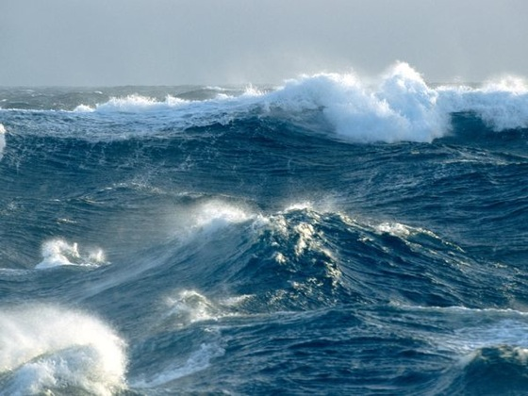
The impact of wave to the water level, sediment and water quality dynamics
Meng Xia
University of Maryland Eastern Shore
www.surfholidays.com

Slide 2
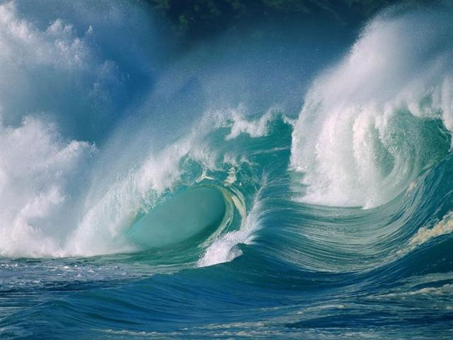
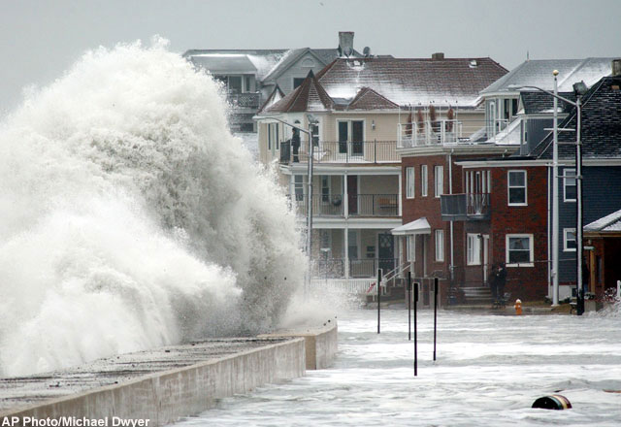
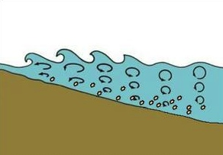
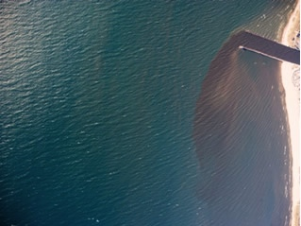
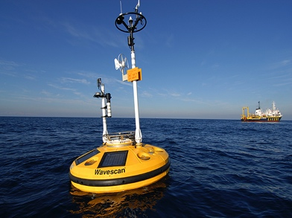
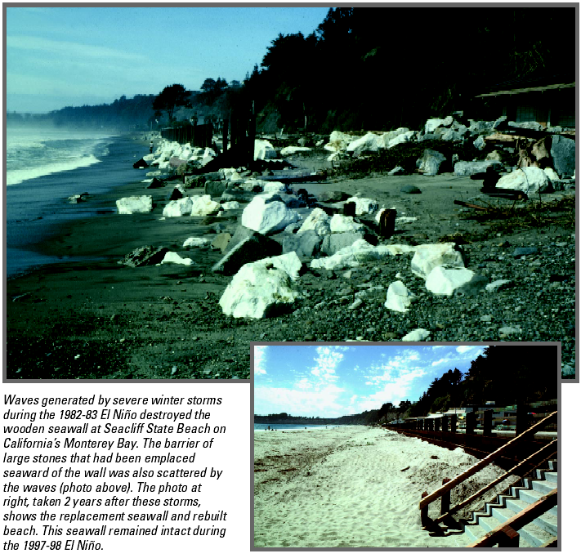
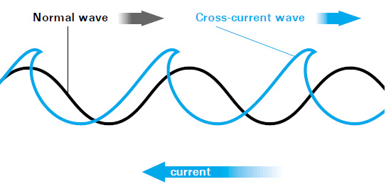
1. Introduction
Waves generated by storm are relatively large and can easily reach 10-20 meters or even larger in sufficiently deep open ocean waters
Waves generated by severe winter storms destroyed the wooden Seawall at Seacliff State beach on California’s Monterey Bay during the 1982-83 El Nino.
www.glerl.noaa.gov
www.wikipedia.com
www.offshoretechnology.com
www.ec.gc.ca

Slide 3
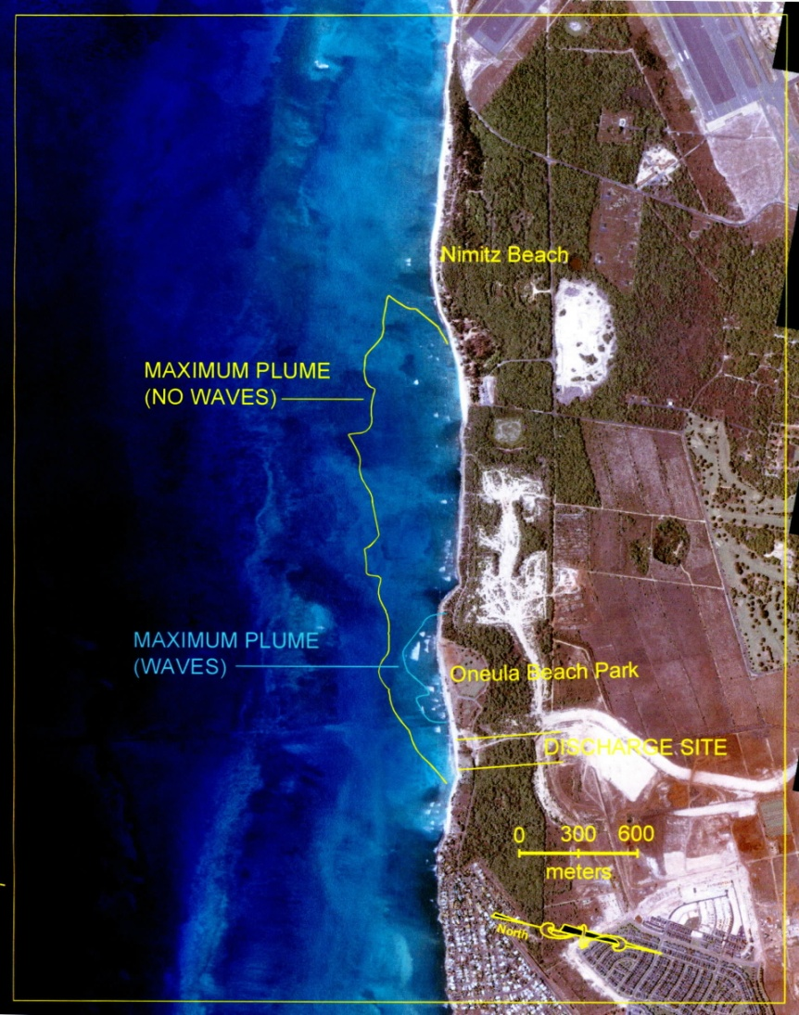
1. Introduction
As waves move into nearshore regions, the energy gradients created cause nearshore circulation. The currents resulting from this circulation many times control the transport of parameters of interest to water quality.
The interplay of the non-linear processes involved require the use of numerical modeling to understand the nearshore energy distribution and describe the transport processes accurately.
www.glerl.noaa.gov
www.wikipedia.com
www.offshoretechnology.com
www.ec.gc.ca

Slide 4
1. Introduction
Wind waves significantly impact the sediment resuspension, plume dynamics, and the regional ecosystem
Proper prediction of wind wave patterns and wave current interaction (WCI) are critical to recognize these remarkable effects
How wave and WCI influence water elevation, circulation pattern, sediment dynamics and water quality is receiving increasing attention
www.glerl.noaa.gov
www.wikipedia.com
www.offshoretechnology.com
www.ec.gc.ca

Slide 5
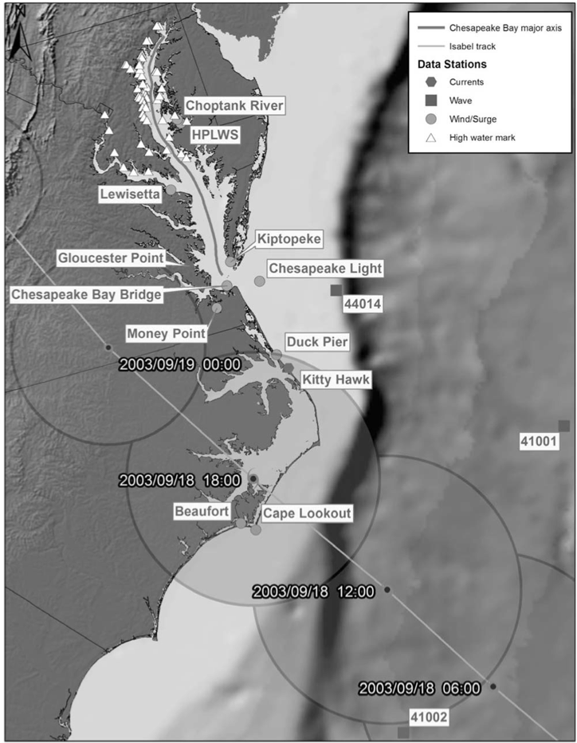
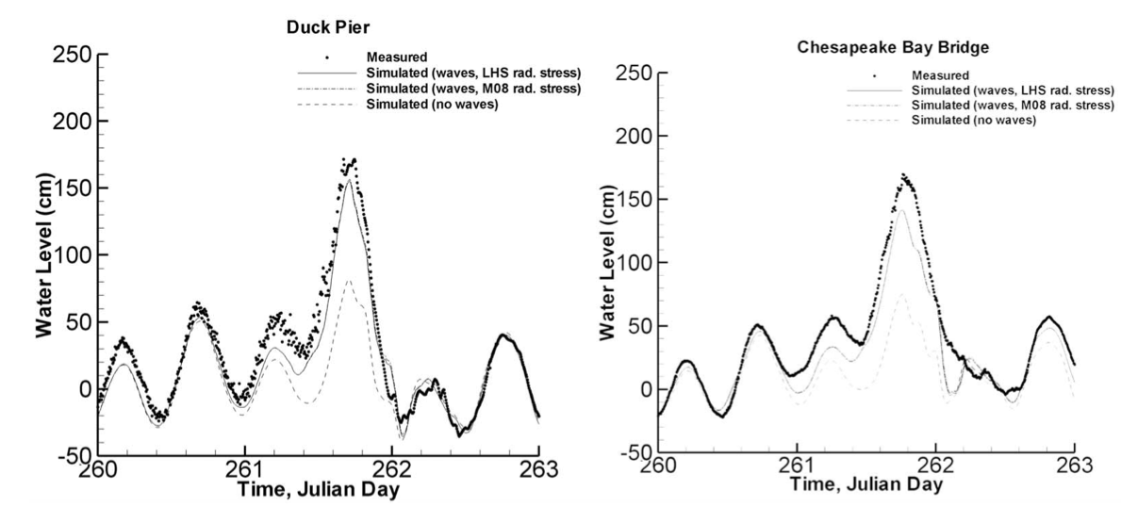
1. Introduction
Previous studies in large bays
(Chesapeake Bay)
（Sheng and Liu, 2011)
Isabel track showing locations of measured data and definition of Chesapeake Bay major axis (left panel).
Measured and simulated water levels at Duck Pier and Chesapeake Bay Bridge
The wave effects contribute significantly for the surge level. Without considering the wave effects, the surge level was highly underestimated.

Slide 6
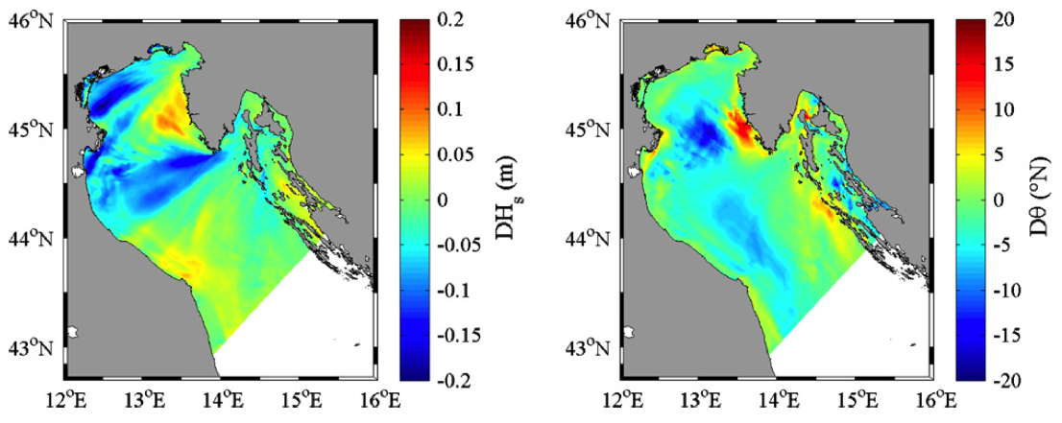
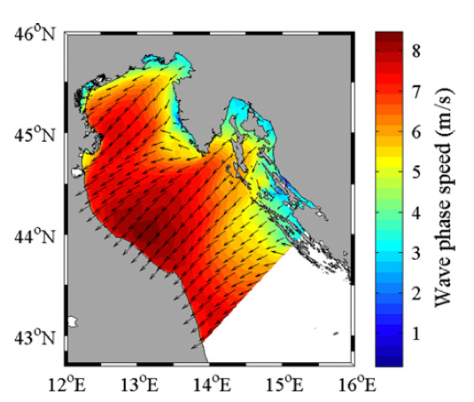
1. Introduction
Previous studies in an semi-enclosed gulf (Adriatic Sea)
（Benetazzo et al., 2013)
Difference of significant wave height (Hs) (left), and mean direction of propagation (θ) (middle) fully coupled and uncoupled WCI models (ROMS-SWAN) in Adriatic Sea, and the mean wave phase speed (right). (2011 January, 27 18:00 UTC – 2011 January, 29 12:00 UTC)
The ocean–wave interactions are strongly dependent on the wind forcing direction.
When applied to intense storms, the effect of coupling on waves results in variations of significant wave height up to 0.6 m, with some areas experiencing significant increase/decrease of wave spectral energy for opposite/following currents respectively.

Slide 7
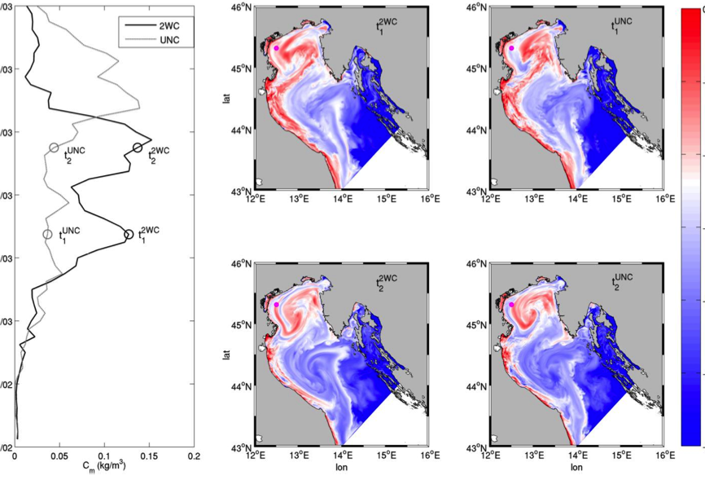
1. Introduction
Previous studies in an semi-enclosed gulf (Adriatic Sea)
(Benetazzo et al., 2013)
Adriatic Sea suspended sediment concentration (log10 kg/m3) patterns with WCI coupling (left panels) and without WCI coupling (right panels) runs during the Bora storm. Top: conditions at 2nd March, 2011 (09:00).
Bottom: conditions at 3rd March, 2011 (18:00).
Pink dots: the position of the Acqua Alta (AA) tower.
The depth-averaged sediment concentration (kg/m3) at AA is shown on the left hand of the Figure, where circles show the time (t1 and t2) of sediment conditions depicted.
WCI has a twofold influence on sediment transport: the presence of a flow field modifies the geometric features of waves; the wave contribution to the water column momentum can generate relevant modifications in the local circulation features.
Both bottom stress and advective flow fields are affected by WCI, in turn affecting both sediment resuspension and transport.

Slide 8
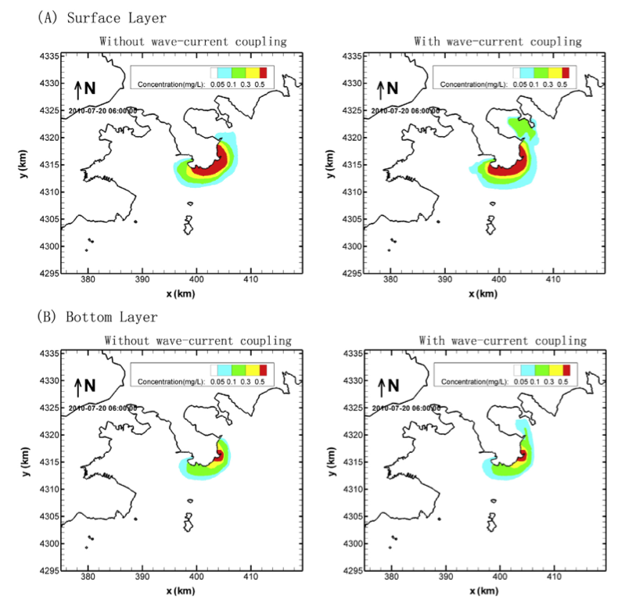
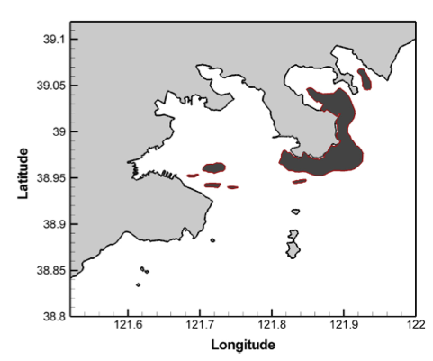
1. Introduction
Previous studies in coastal areas
(Coastal Area near Dalian, China)
(Guo et al., 2014)
The developed model taking into account wave-current coupling administers to giving better conformity than the one without WCI.
3D radiation stress impacts the spill dynamics drastically near the sea surface and along the coastline, while having less impact in deeper water.
The distribution of oil slick observed on the water surface by the satellite (06:01 20 July, 2010).
Concentration distribution of oil in the water column near Dalian, China (06:00 20 July, 2010)

Slide 9
1. Introduction
Limitations of previous studies
Previous studies of wave dynamics and WCI processes are mainly based on structured grid models, which would not be able to resolve wave dynamics in the nearshore regions.
Most of the wave simulation in previous studies are conducted through the application of SWAN, which is a state-of-the-art finite-difference 3rd generation spectral wave model. It’s performance has never been compared with finite-volume wave models.
The implementations of unstructured models regarding wave and WCI in the Great Lakes areas and Maryland Coastal Bays remain unknown.

Slide 10
1. Introduction
Wave case studies in Lake Michigan, Lake Erie, and Maryland Coastal Bays (MCBs)
The study of wave dynamics in Lake Michigan by using unstructured grid wave-current coupled model FVCOM
The impacts of wave on the hydrodynamics (e.g., velocity, temperature), river plumes (e.g., sediment plume), and water quality in Lake Erie by using unstructured FVCOM
The influences of wave on the hydrodynamics (e.g., water elevation and velocity) in Maryland Coastal Bays (MCBs) by using unstructured FVCOM

Slide 11
2. Model Description
FVCOM
Three-dimensional ocean circulation model
Unstructured horizontal grids
Eleven vertical layers (sigma-coordinate)
Vertical mixing: modified Mellow and Yamada 2.5
Horizontal mixing: Smagorinsky
FVCOM-SWAVE
Unstructured grid, finite-volume surface wave model
Based on SWAN (Simulating WAves Nearshore)
FVCOM-SED
Three-dimensional sediment transport model
Developed based on CSTM (Community Sediment Transport Model)
The general form of the source and sink terms can be written as:
where ω_{s,m} is the vertical-settling velocity (positive upwards), C_{m} is the suspended sediment concentration, E_{s,m} is the erosion source, and m is the number of sediment classes.
Coupling between FVCOM circulation module, wave module, sediment module, and the bottom boundary layer model. (from Wu et al., 2011)
Model coupling:
The model coupling is conducted for every time step.
The wave-current interaction (WCI) is through incorporating three-dimensional radiation stress.

Slide 12
2. Model Description
Wave spectral action balance equation for unstructured SWAN and FVCOM-SWAVE models
∂N/∂t+∂C_{g,x}N/∂x+∂C_{g,y}N/∂y+∂C_{g,σ}N/∂σ+∂C_{g,θ}N/∂θ=S_{tot}/σ
Local variation of wave action spectral density
Change in geographical space
Change in wave spectral space
Wave energy source and sink
S_{tot}=S_{in}+S_{n3}+S_{n4}+S_{ds,w}+S_{ds,b}+S_{ds,br}
Six energy source terms are wind forcing, nonlinear triad and quadruplet interactions, whitecapping dissipation, bottom friction, and depth-induced wave breaking, respectively.

Slide 13
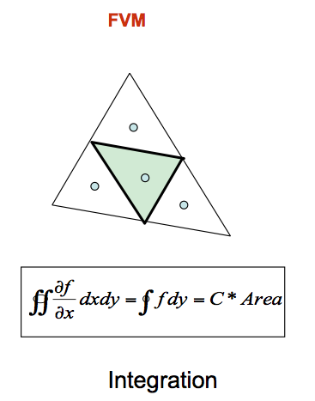
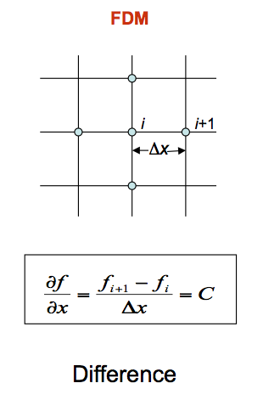
2. Model Description
FVCOM-SWAVE
Finite volume method (FVM)
Explicit/implicit second order upwind scheme in geographic space
Flux-Corrected Transport (FCT) algorithm in frequency space
Implicit Crank-Nicolson method in directional space
SWAN
Finite difference method (FDM)
First order, backward space, and backward time (BSBT) scheme in geographical space and time
Hybrid central or upwind scheme in wave spectral space

Slide 14
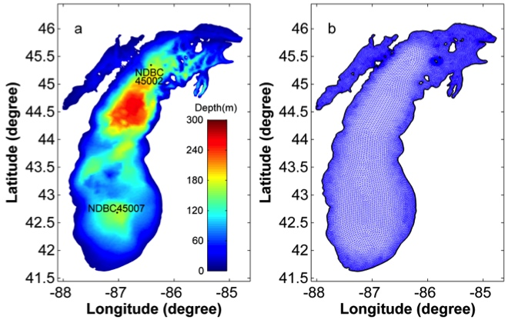
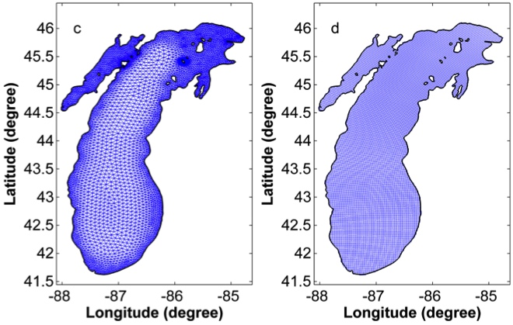
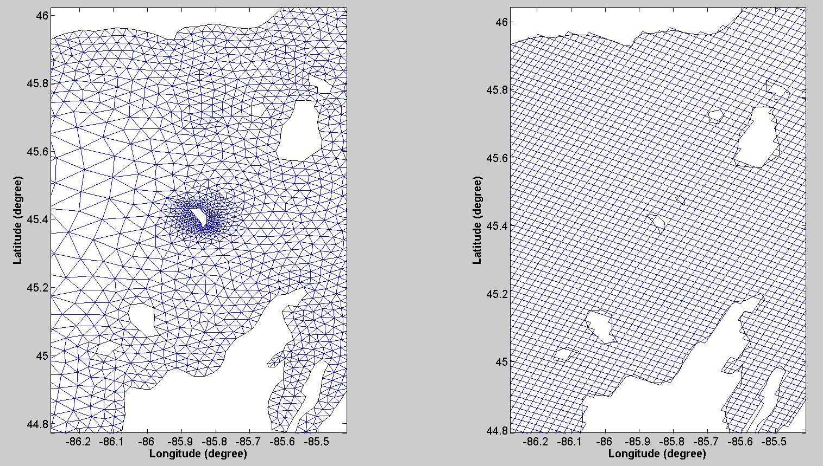
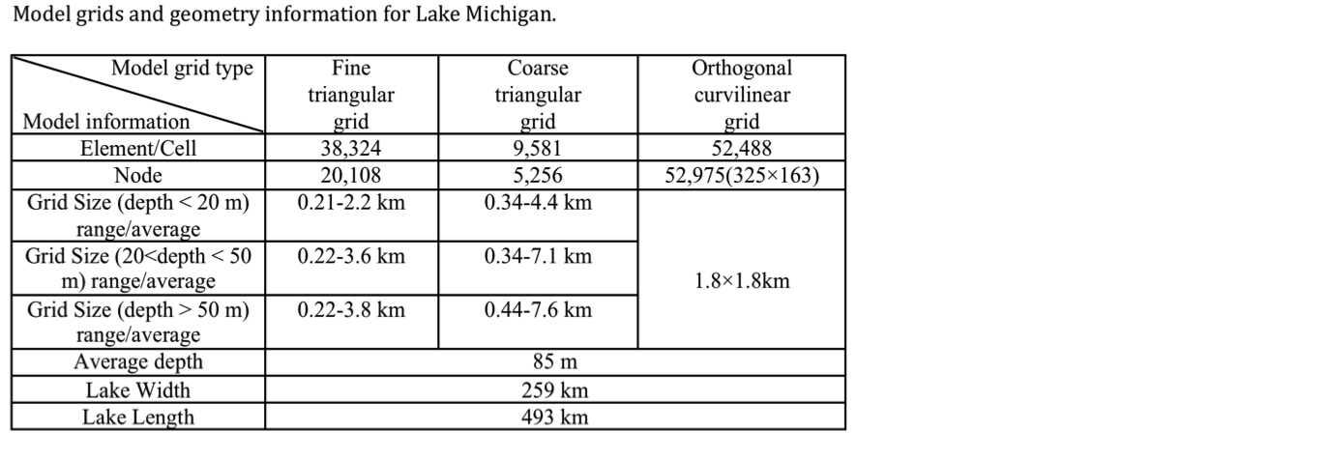
3. Wave Simulation (Lake Michigan)
(a) Bathymetry and the locations of NDBC buoy stations, distributions of (b) unstructured triangular fine, (c) coarse, and (d) orthogonal curvilinear grids for Lake Michigan. The black lines in (b-d) are the coast and island lines.

Slide 15
3. Wave Simulation (Lake Michigan)
Temporal evolutions of (a) SWH at NDBC45002, (b) 45007, (c) PWP at NDBC45002, and (d) 45007 in July 2008. The wave simulation results from unstructured fine, coarse, and orthogonal curvilinear grids of SWAN; the observation data are from NDBC45002 and 45007.

Slide 16
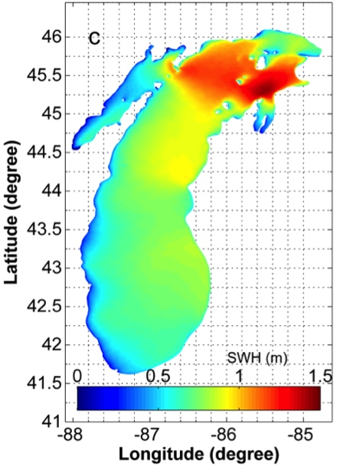
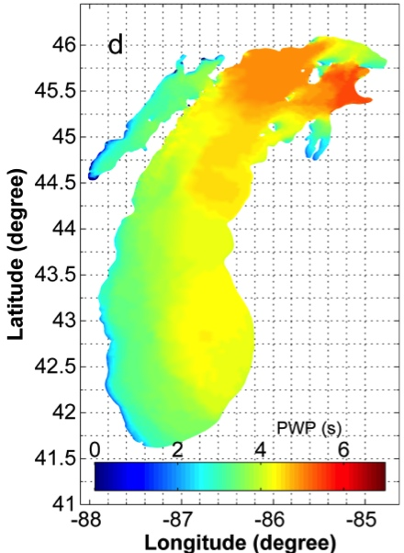
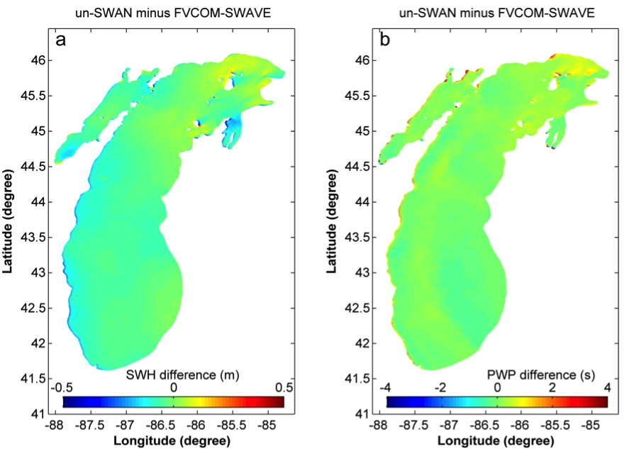
3. Wave Simulation (Lake Michigan)
The simulation results (SWH and PWP) by coarse unstructured SWAN in July 12th 2008.
The biases between un-SWAN and FVCOM-SWAVE resulted from different numerical schemes, where un-SWAN adopted Finite-Difference method while FVCOM-SWAVE utilizes Finite-Volume method.

Slide 17
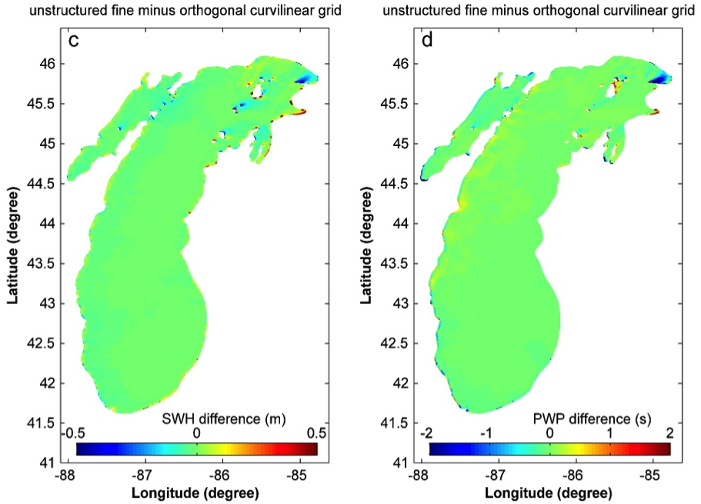
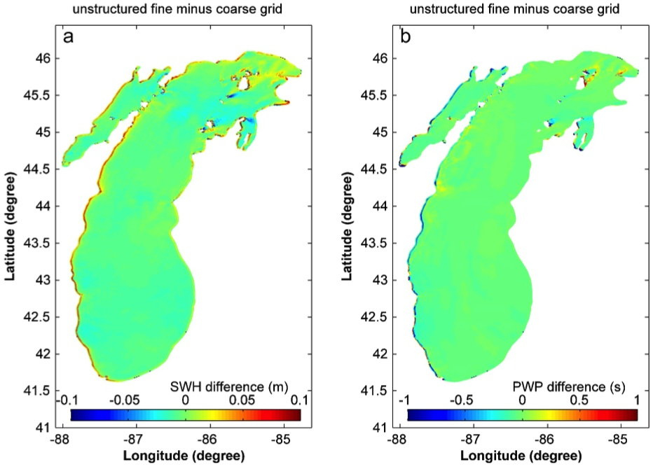
3. Wave Simulation (Lake Michigan)
The grid resolution and type dominated the wave dynamics only in nearshore regions, where the differences of SWH and PWP induced from different grid resolutions are approximately 5-10cm, and 0.5-1s, respectively.
Comparatively speaking, the variations for SWH and PWP are 10-50cm and 1-2s due to different grid types (e.g., unstructured fine triangular mesh and orthogonal curvilinear grids) in nearshore region.

Slide 18
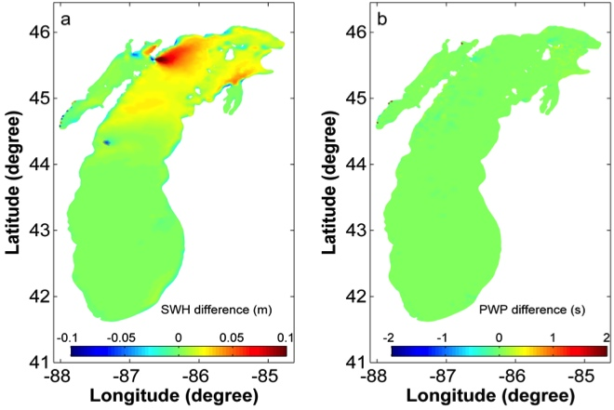
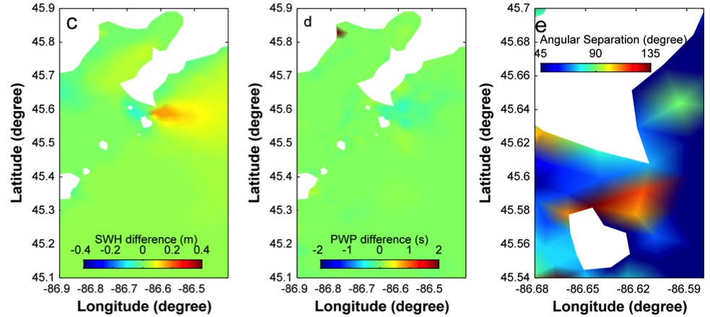
3. Wave Simulation (Lake Michigan)
WCI significantly impacts the wave dynamics when large SWH and strong current coexist. Generally, the SWH decreases/increases when the wave and current are in the same/opposite direction. The changes of SWH are about 3-4cm in the western coasts near the Chippewa Basin, 5-10cm near Beaver Island, and 15-20cm in the northern shallow channel near the Green Bay part. A PWP difference of about 1s occurred in the northern shallow channel near the Green Bay.
The residuals for (a) SWH and (b) PWP with and without WCI, their local view (c) and (d) in the northern channel near Green Bay part, and (e) the angular separation between MWD and current direction near the channel.

Slide 19
3. Wave Simulation (Maryland Coastal Bays)
1 station for wave parameters calibration
9 tidal stations for water level calibration

Slide 20
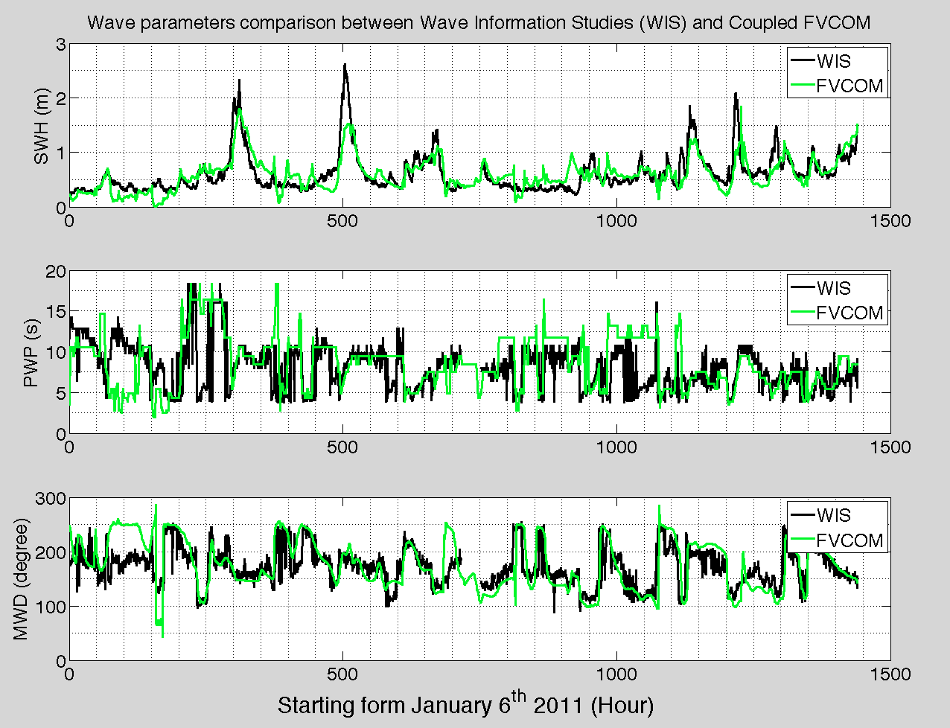
3. Wave Simulation (Maryland Coastal Bays)
Significant wave height (SWH), peak wave period (PWP), and mean wave direction (MWD) were well reproduced by FVCOM-SWAVE compared with WIS station near OCI.
The wave conditions near OCI was 0.1-1m, 5-10s, and 180 degree for SWH, PWP, and MWD, respectively.

Slide 21
3. Wave Simulation (Lake Erie)
Wave dynamics in Lake Erie could be well reproduced with FVCOM-SWAVE. Simulated SWH reasonably consisted with the observational data, with mean RMSE of 0.16 m and R of 85 % with field data at four observational stations.
Models with different horizontal grid resolution have similar performance in reproducing surface gravity waves in the open lake.
There is consistent bias in simulated SWH with different horizontal grids within 2 km offshore. These differences were at the order of 0.1 m, and could also be depicted in the open lake (about 40 km offshore) during episodic storm events.
Location of stations in Lake Erie for wave calibration.
Influence of Horizontal Grid Resolution
Spatial averaged wind speed anomaly (a) and bias between simulation with Grid_V1 and Grid_V2 on Hs in the western Lake Erie (b).
Modeled versus observed (red) significant wave height at stations S02 (a), S06 (b), S07 (c) and S13 (d), with Grid_V1 (green), Grid_V2 (black), and the bias (blue) of result between Grid_V1 and Grid_V2, 2005.
Horizontal grid applied in Lake Erie.
Grid_V1
Grid_V2

Slide 22
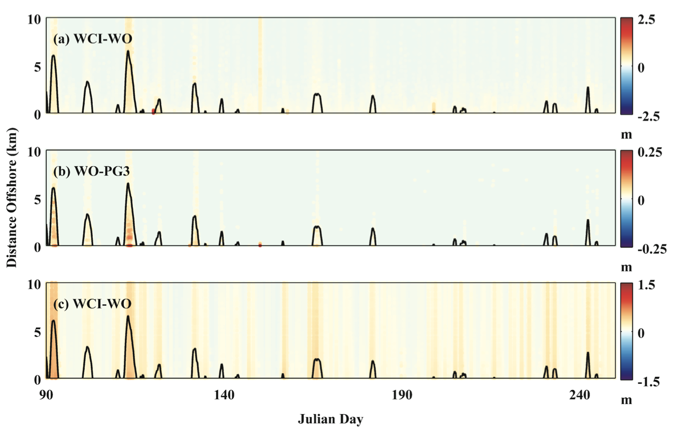
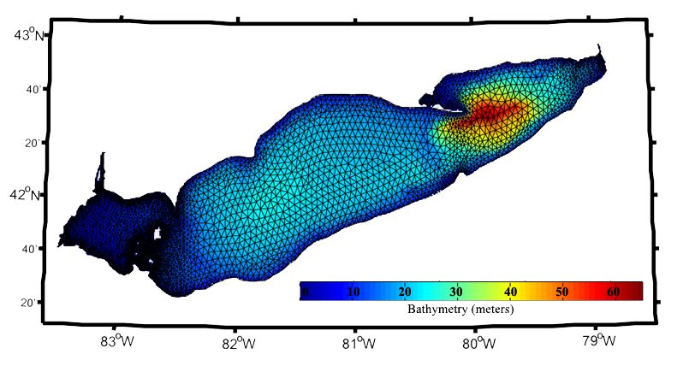
4. Impact on Water Elevation (Lake Erie)
WCI-WO: Water elevation
WO-NW: Water elevation
WCI-WO: Significant wave height
Model grid and bathymetry in Lake Erie.
When considering the effect of WCI, SWH were magnified during storms. These differences have a mean value of 0.02 m within 1 km offshore, and of 0.003 m in the open lake.
The differences in the simulated SWH induced by WCI could reach to 2 m within the CBL (~ day 125), and could move into the open lake during episodic events.
Compared to the influence of wave on the water elevation, that induced by WCI was more significant, with mean values of 0.08 m in the CBL and of 0.04 m in the open lake.
Bias in simulated water elevation and significant wave height under different wave conditions. Black lines denotes spatial averaged wind speed anomaly in unit m/s.
Case Name | Wave Dynamics | WCI Processes
NW | No | No
WO | Yes | No
WCI | Yes | Yes

Slide 23
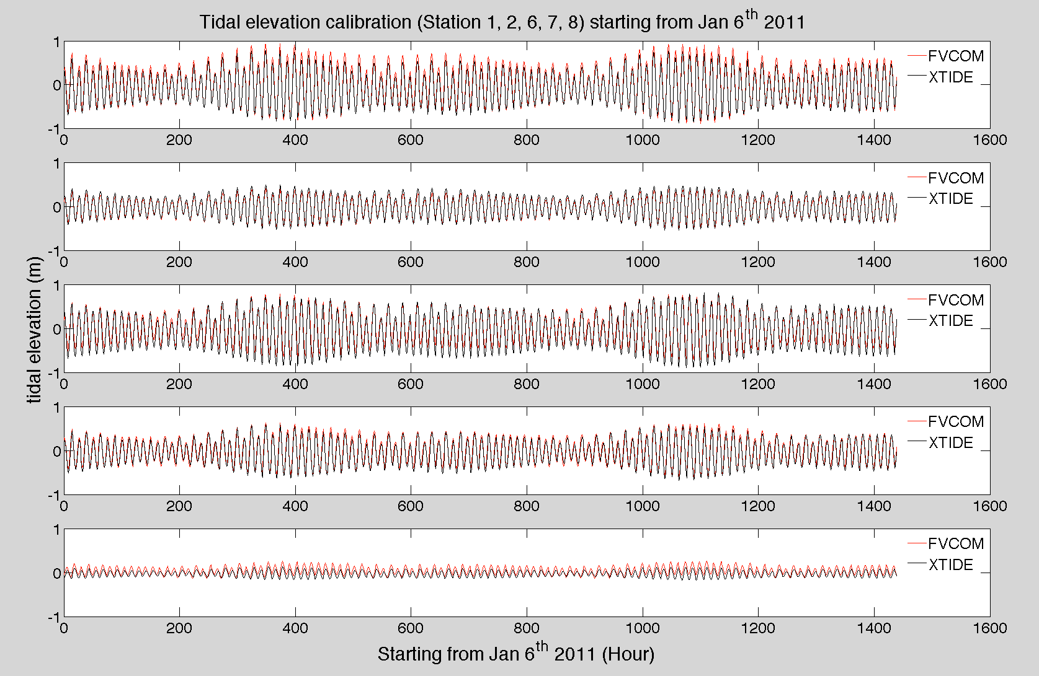
4. Impact on Water Elevation and Wave Dynamics of WCI (MCB)
The simulated water elevation by FVCOM matched the XTIDE predictions reasonably well in MCBs. The range of water elevation decreased from 1m (station 1) to about 0.5m (station 2) when the water passed through Ocean City Inlet (OCI), but no significant reduction of water elevation was found near Chincoteague Inlet (CI) (station 6 and 7). Compared with CI, OCI was relatively smaller and shallower, which could enhance the bottom friction effect. The reduction of water level amplitude from SCI (station 6) to major part of Chincoteague Bay (station 8) resulted from the bottom friction with shallow bay bathymetry.

Slide 24
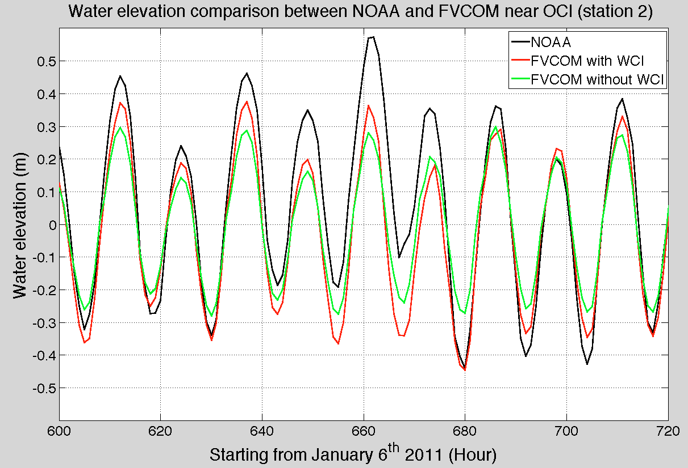
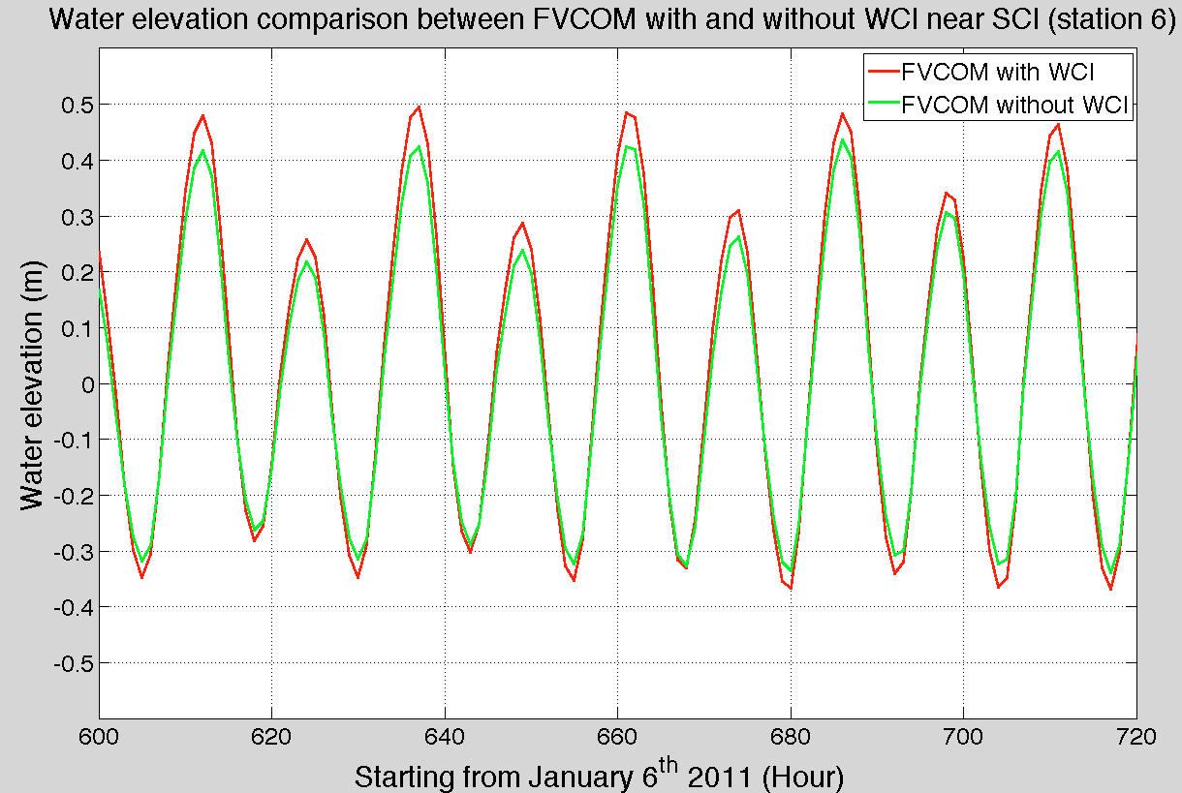
4. Impact on Water Elevation and Wave Dynamics of WCI (MCB)
The effect of WCI near OCI was found important during flooding and ebbing. Both FVCOM with and without WCI underestimated the variations of waver elevation near OCI. However, the maximum model-data discrepancy was significant reduced when the WCI was taken into consideration.
The effect of WCI near CI was not as strong as in OCI. Though the water elevation differed during flooding, it was almost overlapped during ebbing near CI.

Slide 25
4. Impact on circulation of WCI (MCB)
During flooding, WCI is apparent within northern part of OCI resulting in about 70 cm/s maximum velocity difference. This was due to complex shallow geometry with WCI.

Slide 26
4. Impact on circulation of WCI (MCB)
During ebbing, strong WCI occurred within and near OCI leading to about 40 cm/s velocity difference. Therefore, the WCI is more significant during flooding than ebb, and OCI than SCI.

Slide 27
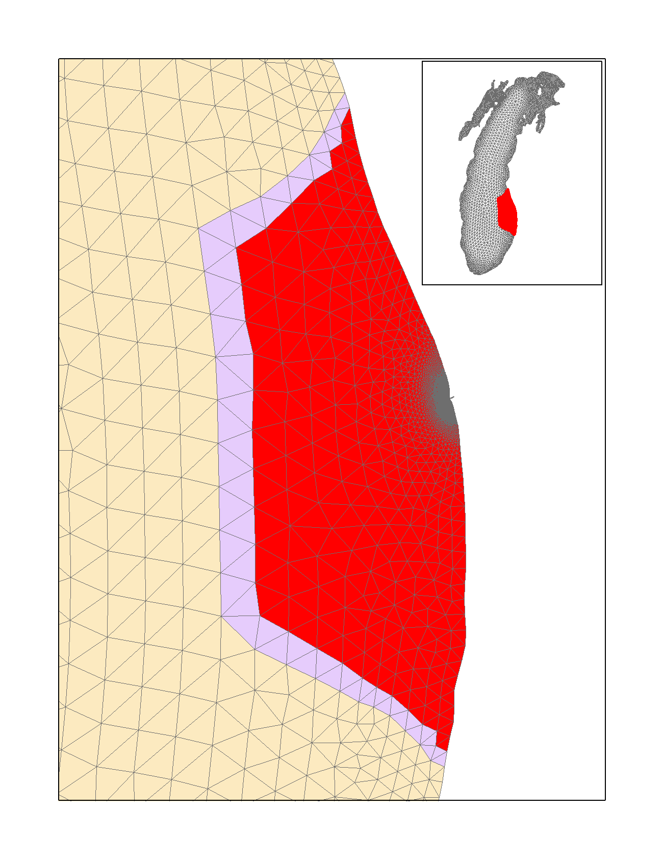
4. Impact on circulation of WCI (Grand Haven)
Study Site: Grand Haven in Lake Michigan
The Grand River is the largest tributary entering Lake Michigan. The combination of a major river, relatively simple shoreline geometry, and low-slope, regular bathymetry makes this an ideal site for developing, testing, and refining a wave-current based hydrodynamic-ecological model. There are also several highly utilized and often contaminated beaches in this area.
In coastal applications, involving the nearshore, wide-scale modeling of coastal circulation and transport must represent tidal, surface wave, and other possible forcing simultaneously. So the Great Lakes should be the premier place to explore this coupled modeling system compared to the tidal dominated coastal ocean.

Slide 28
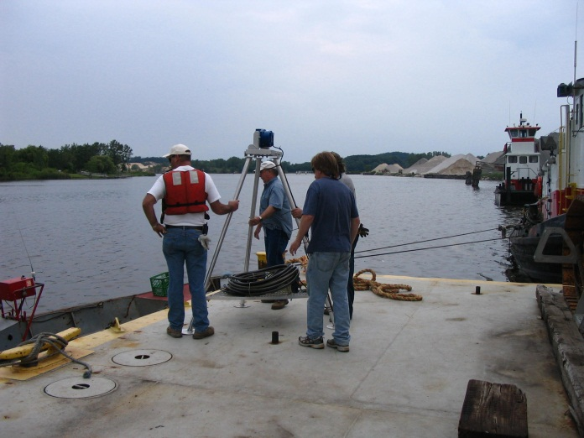
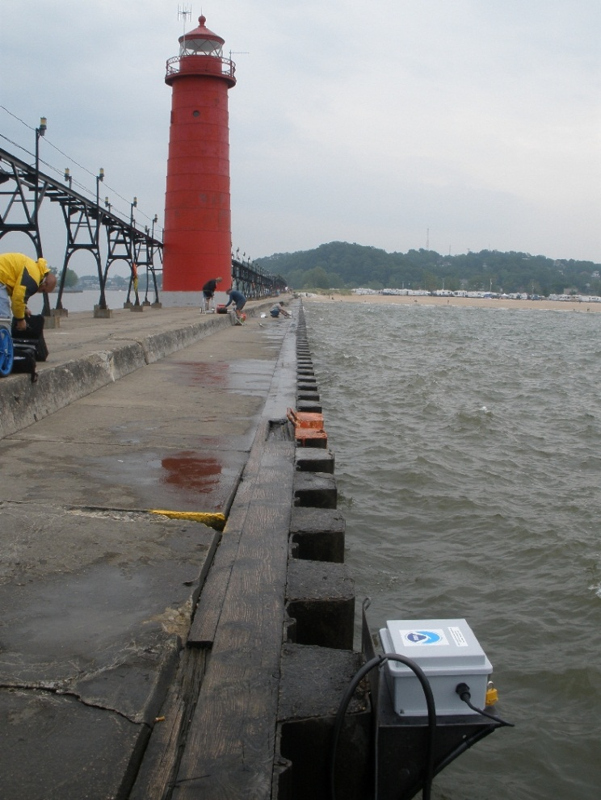
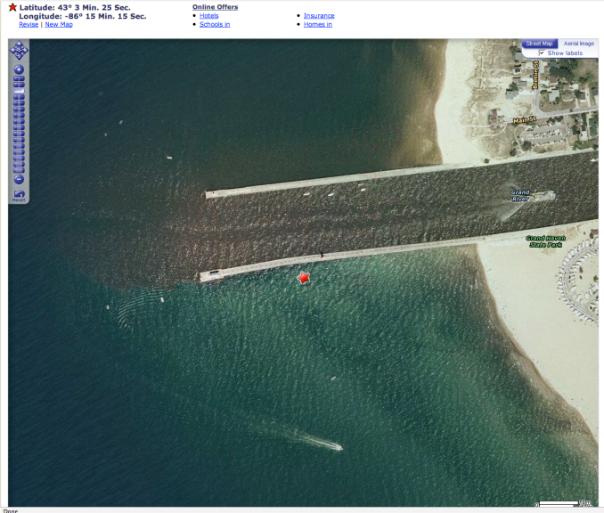
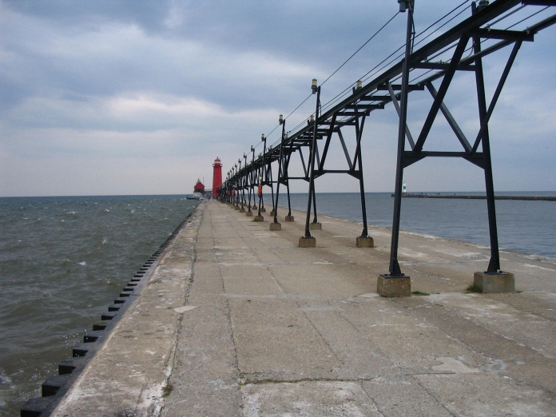
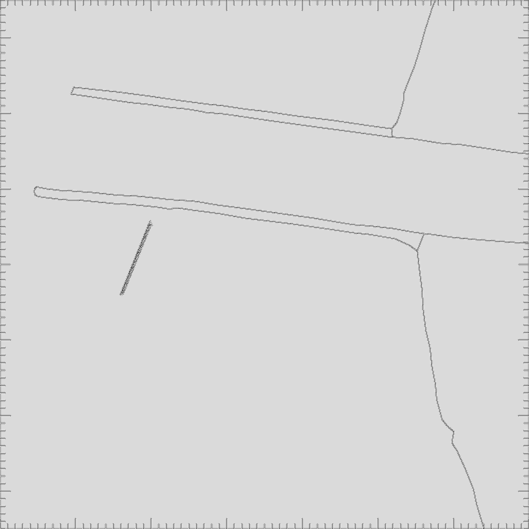
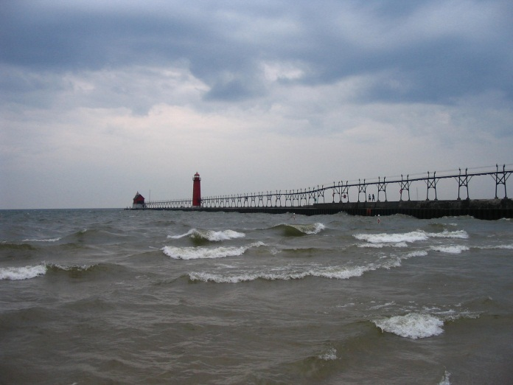

Grand Haven HADCP Deployment 2008

Slide 29
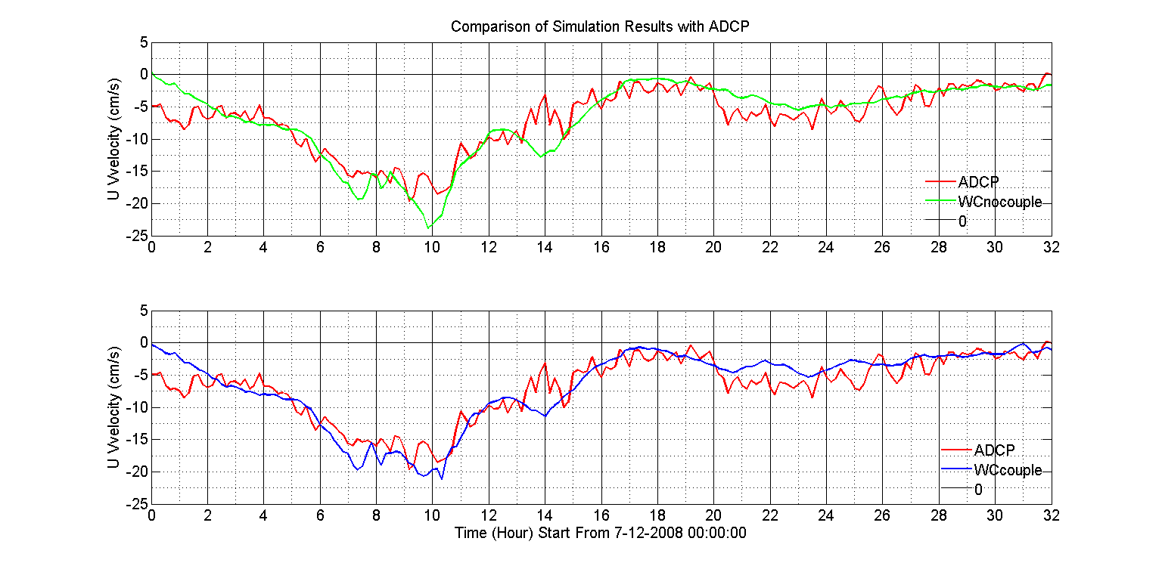
4. Impact on circulation of WCI (Grand Haven)

Slide 30
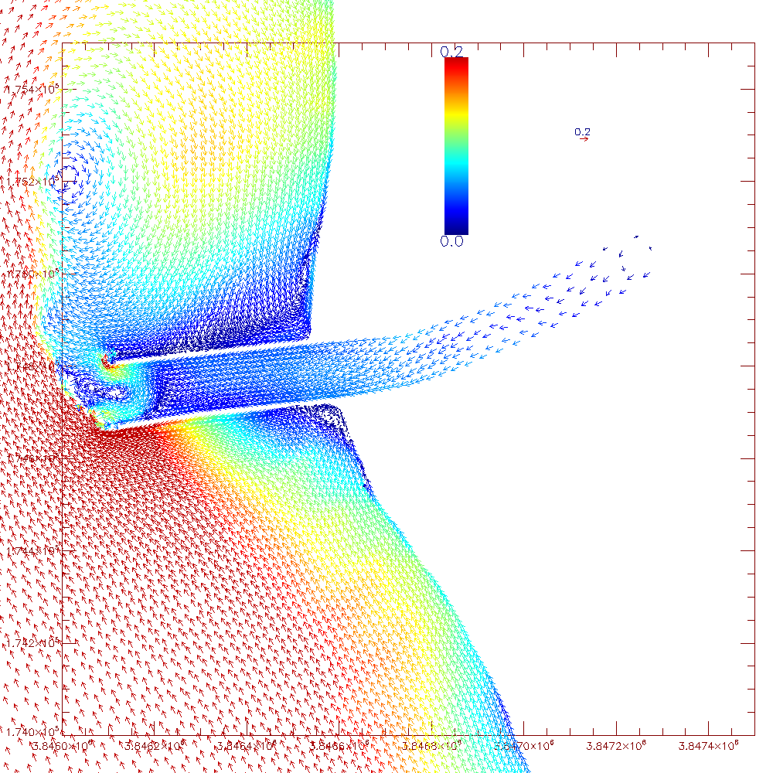
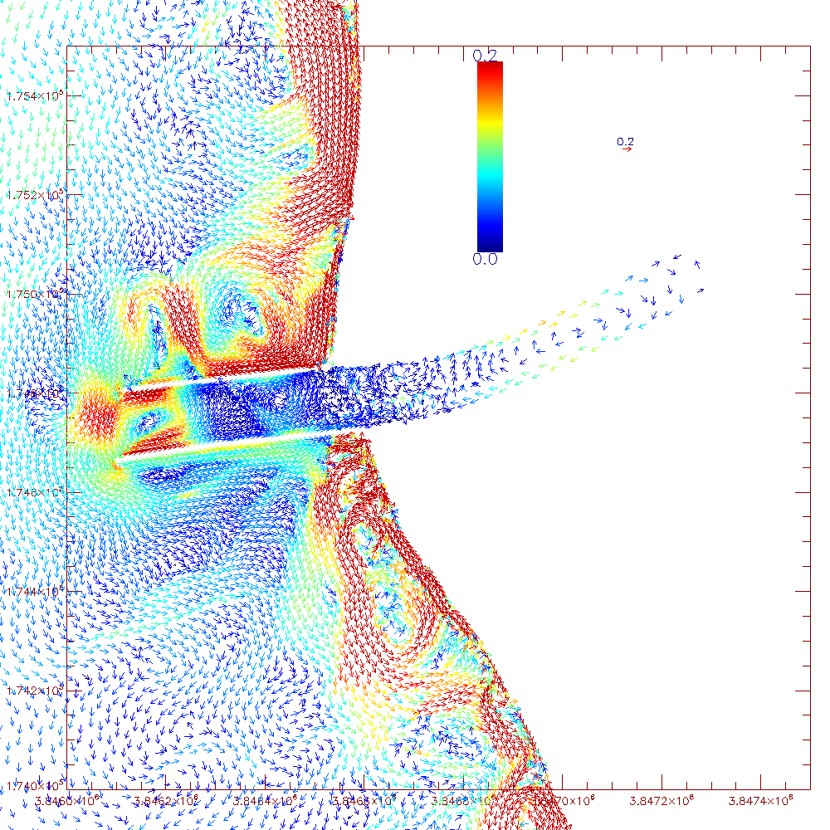
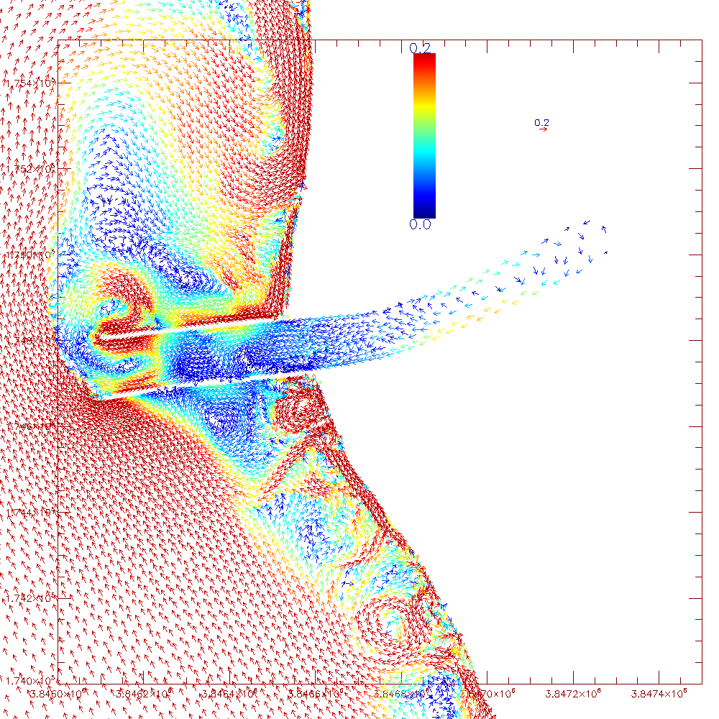
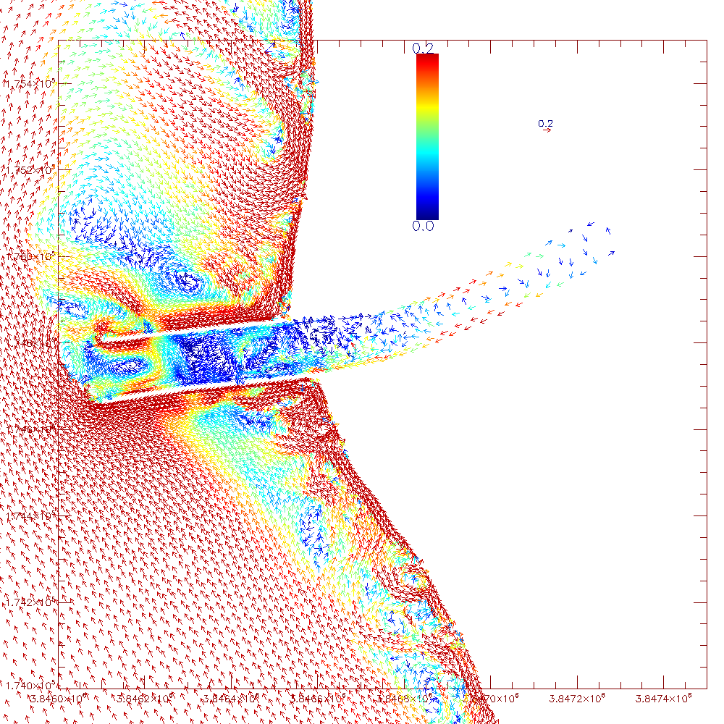
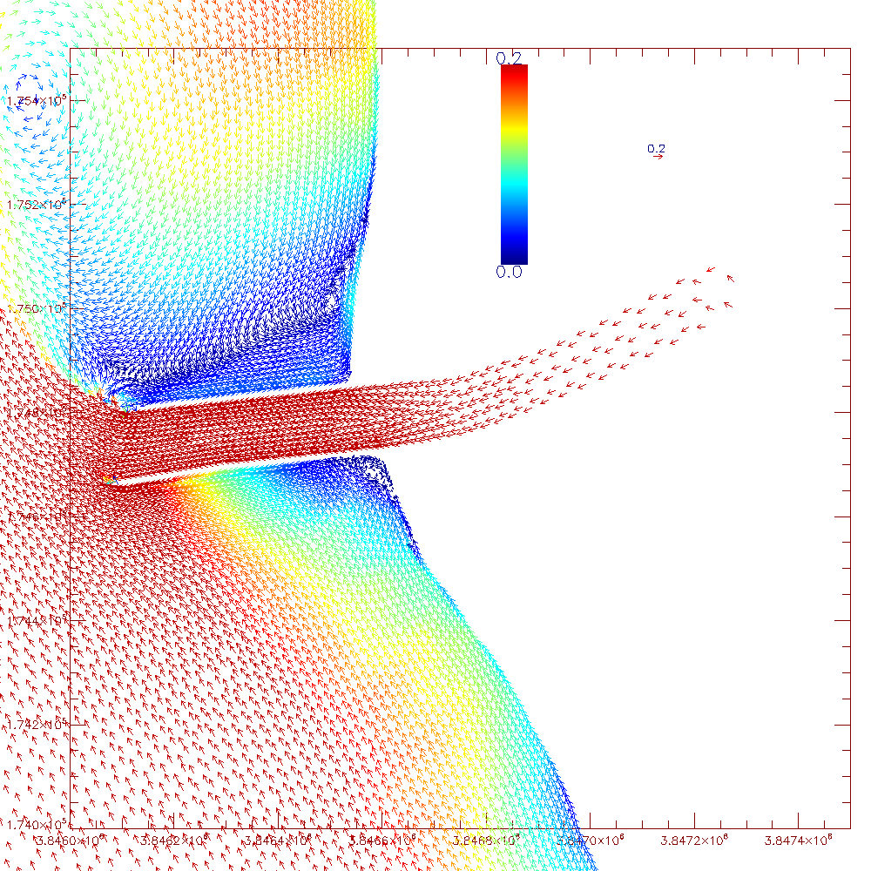
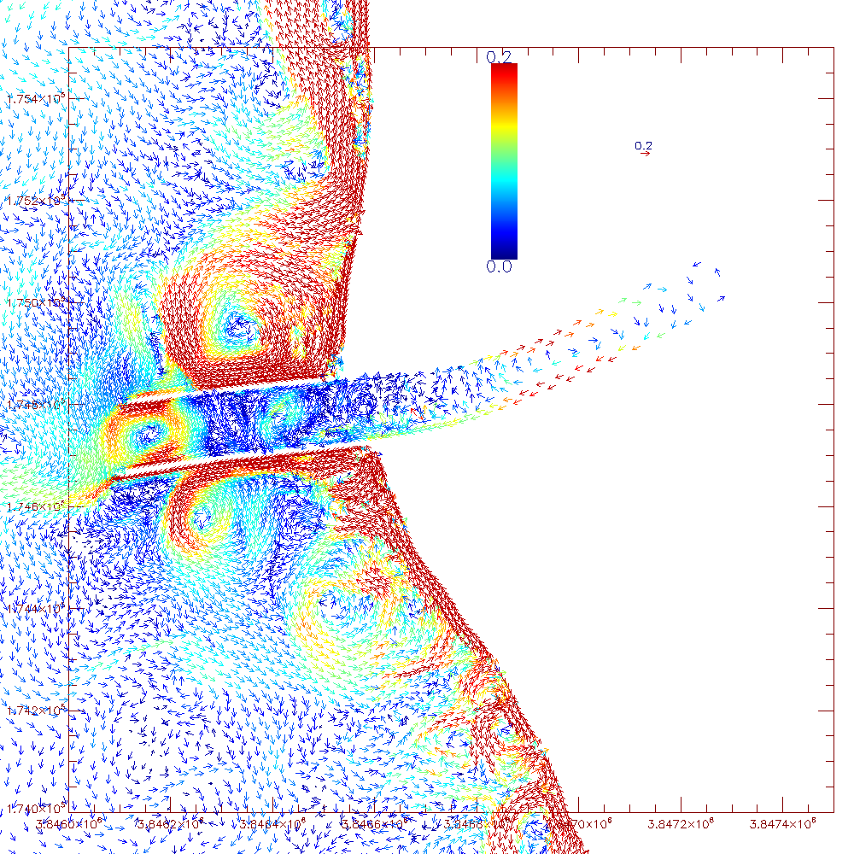
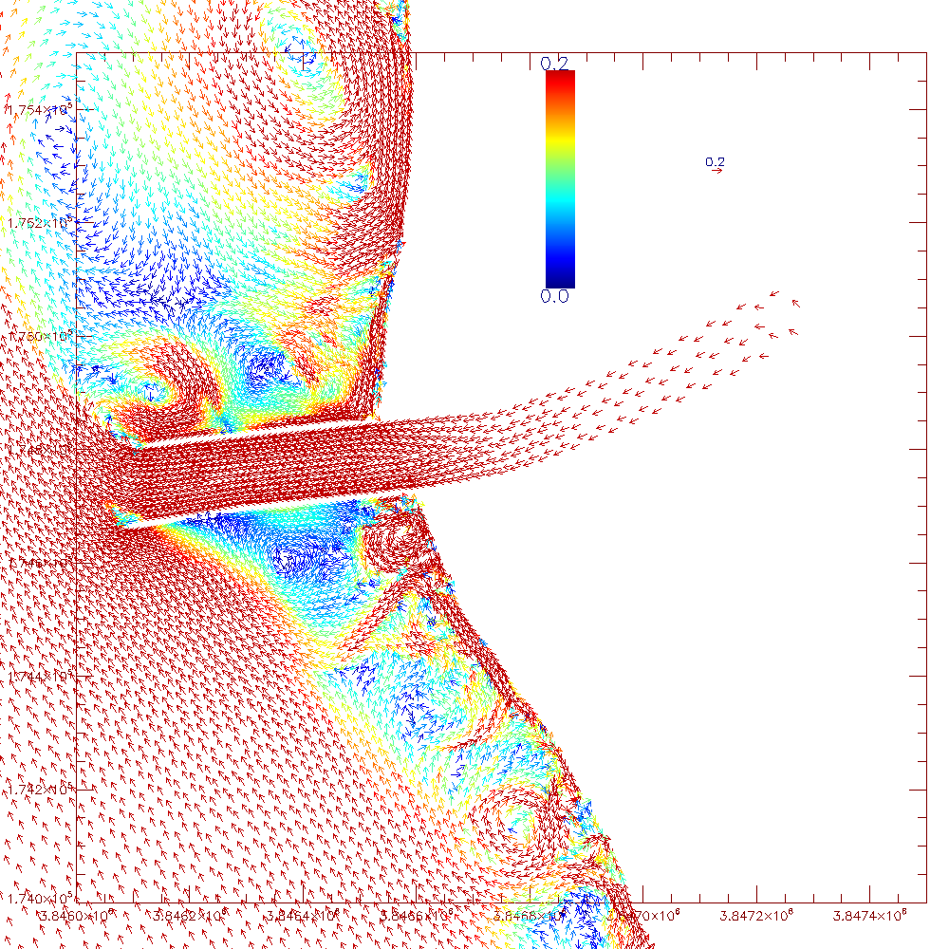

Ideal Numerical Simulation of WC
4. Impact on circulation of WCI (Grand Haven)
A
W
A&W
A,W&WCI
0.2m/s
0.2m/s
0.2m/s
0.2m/s
A&R
W&WCI
R,A,W
R,A,W&WCI
0.2m/s
0.2m/s
0.2m/s
0.2m/s
R | River |  | WCI | Wave-Current Interaction
W | Wave |  | A | Ambient Flow

Slide 31

4. Impact on circulation of WCI (Lake Erie)
NW: Monthly mean surface circulation
WCI-NW: Monthly mean surface circulation
Left: Surface circulation of Apr (a) and Aug (c), 2005, simulated with PG3
Right: Bias of Surface circulation of Apr (b) and Aug (d), 2005, between cases WCI and NW.
Additional momentum forcing is contributed from breaking waves within the surf zone, areas adjacent to river mouth.
During stratification, profound bias of circulation exists on the intersection of the central and eastern basins, where the Long Point Ridge locates and bathymetry rises rapidly.
It should be noted that albeit the bias is only 0.01 m/s on a monthly mean scale, it could reach to 0.2m/s during episodic events.

Slide 32


4. Impact on thermal structures of WCI (Lake Erie)
NW: Water temperature on ECB
WCI-NW: Water temperature on ECB
Surface gravity waves modified the lake’s thermal structure through its contribution to upper-lake mixing, mainly during stratification.
In the central basin, when WCI was incorporated, more heat was retained in epilimnion, and less was transported to the bottom.
Incorporation of wave dynamics enhanced the strength of thermocline. This alleviated the diffusion problem in simulating thermocline with sigma-coordinate numerical models.
Location of transect
Right: Water temperature on transect ECB, 2005.
Left: Bias of water temperature between cases WCI and NW on transect ECB, 2005.

Slide 33














Significant Wave Height
4. Impact on sediment plume of WCI (Lake Erie)
Sediment plumes from Detroit River, Maumee River, and resuspension events during May, 2003.
Depth-averaged Circulation
Detroit River Plume
Maumee River Plume
Resuspended Sediment
Physical Conditions in western Lake Erie during May, 2003
Extremely high discharge from Maumee River (1013 cms)
Constant inflow from Detroit River (4806 cms)
Relatively strong surface wind (5.59 m/s) and intense wave condition (Hs=0.25 m)
When strong surface gravity wave dynamics was included:
Stronger nearshore currents were captured.
Surface gravity waves have limited influence on Detroit and Maumee plumes
Resuspended sediment was greatly increased.
Surface gravity waves have little impact on sediment plumes from rivers, but they greatly influence the sediment resuspension processes.

Slide 34


4. Impact on water quality (Lake Erie)
Study Site: western Lake Erie
Western basin is the shallowest, most turbid and most productive basin of Lake Erie. Detroit River: 90% river discharge, 50% P loading. Maumee River: 5% river discharge, 50% P loading
Photo Courtesy: www.noaa.gov
Model: FVCOM-ICM
Surface wave and other hydrodynamics processes are simulated in FVCOM, biogeochemical calculations are conducted using CE-QUAL-ICM kinetics over the same finite volume mesh.
Kim and Khangaonkar (2011)

Slide 35




The influences of wind-induced wave on circulation and plankton are not significant on the seasonal scale.
4. Impact on water quality (Lake Erie)
Seasonal velocity difference caused by wave is less than 0.01 m/s
Mean surface circulation from Mar. 15 to Jul. 31, 1996
Mean surface circulation difference (with wave - without wave)
Seasonal differences of phytoplankton and zooplankton biomass are not prominent between with-wave and without-wave
Mean surface phytoplankton difference (with wave - without wave)
Mean surface zooplankton difference (with wave - without wave)

Slide 36










4. Impact on water quality (Lake Erie)
Time series of NH₄, NO₃, PO₄, diatom, green algae, micro-zooplankton and meso-zooplankton
NH₄
NO₃
The water quality parameters and plankton biomass show little difference between wave ON and OFF on the long term
Biogeochemical regulation induced by wave is mainly episodic (red boxes) associated with wind events
PO₄
Diatom biomass
Green algae biomass
Microzooplankton biomass
Mesozooplankton biomass

Slide 37




4. Impact on water quality (Lake Erie)
Strong episodic waves could result in redistribution of nutrient, phytoplankton and zooplankton
Significant wave height and wave direction on May 25, 1996
Mean surface PO4 difference on May 25, 1996 (with wave - without wave)
Mean surface phyto. difference on May 25, 1996 (with wave - without wave)
Mean surface zoo. difference on May 25, 1996 (with wave - without wave)

Slide 38




4. Impact on water quality (Lake Erie)
Episodic wave direction shift could result in redistribution of nutrient, phytoplankton and zooplankton
Significant wave height and wave direction on Jun. 29, 1996
Mean surface PO4 difference on Jun. 29, 1996 (with wave - without wave)
Mean surface phyto. difference on Jun. 29, 1996 (with wave - without wave)
Mean surface zoo. difference on Jun. 29, 1996 (with wave - without wave)

Slide 39
5. Conclusions
By including WCI processes in the model simulation, both Hs and water elevation was magnified, especially for those in the coastal boundary layer.
Gird type, numerical scheme, and WCI are important for the wave dynamics in shallow regions near coast and islands of Lake Michigan.
Model with inclusion of WCI reduced the discrepancy between simulated and observed water elevation near OCI. The water elevation and velocity biases are the synthetical influences of WCI and topography. Shallow and narrow geometry in OCI contributed significantly to the magnitude of WCI on water elevation and velocity redistribution.
The magnitude and regions of WCI near OCI are different between flooding and ebbing. The magnitude of WCI is stronger during flooding than ebbing, and the interaction region is in the northern part with OCI when flooding while it is located outside OCI when ebbing.
OCI has an obvious ebbing dominant pattern, but there is no significant features of flooding or ebbing dominated type in SCI.

Slide 40
5. Conclusions
6. Stronger nearshore currents were captured during storm events, and sharper thermoclines were depicted during stratification when WCI processes were incorporated.
7. Horizontal grid resolution has little impact on reproducing dynamics, including both waves and circulation, in the open lake, while stronger currents were depicted during episodic events in the nearshore areas, and areas adjacent river mouths and aits.
8. Surface gravity waves are of great implication for sediment resuspension.
9. Wind-induced surface wave could result in non-negligible redistribution of phytoplankton and zooplankton on relatively small time scales, especially during episodes of high wind/wave energy and wind/wave direction shift.

Slide 41
Thank you

