Slide 1
Recent R&D on regional ensemble ALADIN-LAEF
Regional Cooperation for
Limited Area Modeling in Central Europe
Yong Wang, M. Bellus, T. Gorgas, M. Szucs, S. Tascu, F. Weidle

Slide 2
Outline
RC LACE
Overview of ALADIN-LAEF
Land surface uncertainties: initial and physical
Initial uncertainties: LBC
Resolution and ensemble size
Convection permitting ensemble and coupling
1

Slide 3
RC LACE
Regional Cooperation for Limited Area Modelling in Central Europe
A Central European collaborative programme pursues extensive scientific and technical collaboration in the field of very high resolution operational NWP for weather research, forecast and application.
Austria, Croatia, Czech, Hungary, Romania, Slovakia, Slovenia.
Starting from 1990
www.rclace.eu
2
2

Slide 4
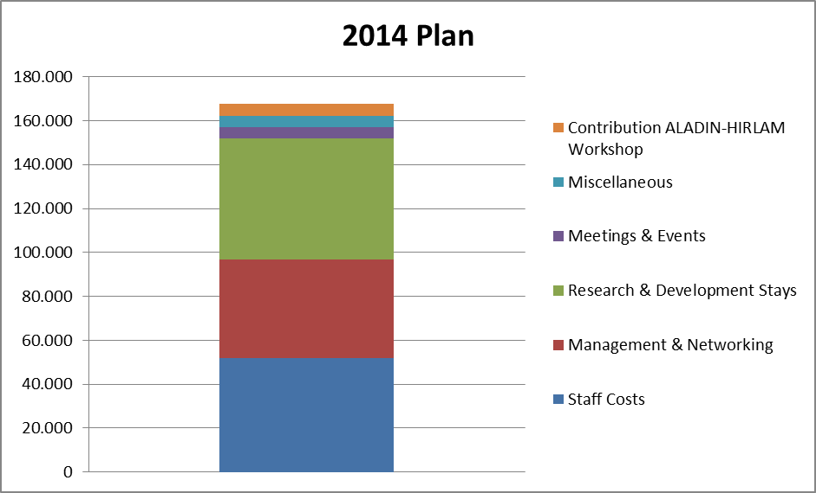
RC LACE
Council
(Directors General)
Programme manager
Area Leaders (DYN, DA, PHY, EPS), Data Manager, System Coordinator, Climate coordinator, secretary for administration and finance
Steering committee
Personal: ca. 50 FTE
Annual Budget Management: 165k €
3

Slide 5
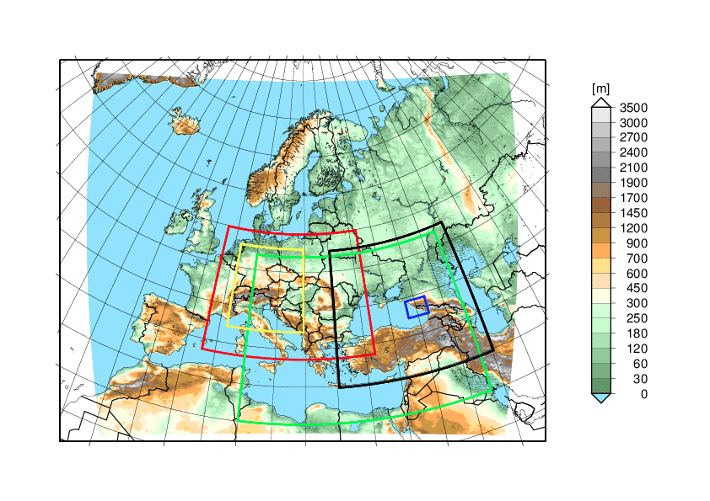
ALADIN-LAEF
Ensemble size | 16+1
Horizontal resolution | 11km
Vertical resolution | 45
Runs/day | 2
Forecasts range | 72h
Coupling | ECMWF
IC perturbation: Belnding cycling of
ECMWF EDA + ALADIN Breeding
IC surface perturbation: ensemble
surface assimilation
Multi-physics scheme

Slide 6
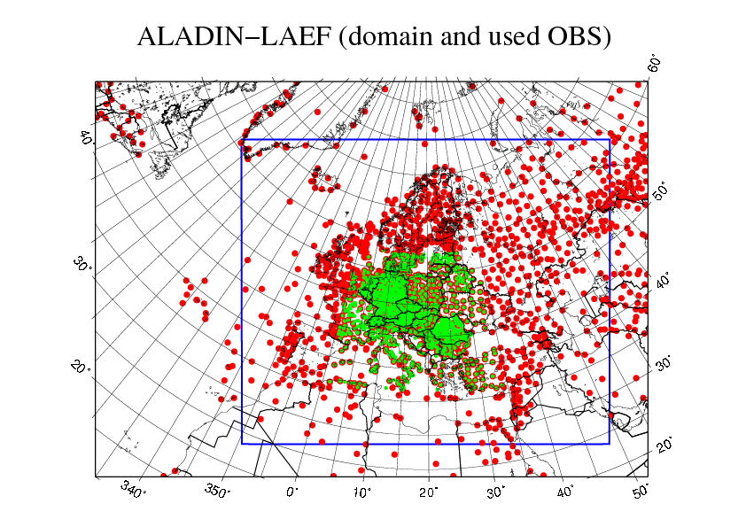
Surface IC perturbation
NCSB: surface IC perturbation obtained by 12h ALADIN-LAEF integration drivien by perturbed ECMWF atmosphere.
CANA: Ensemble land surface data assimilation cycle.
Random perturbation of screen level observations
ALADIN-LAEF 12h forecasts as background
SYNOP obs. (red dots) used + “local” AT SYNOP observations (green dots)
5

Slide 7
Non-Cycling Surface Breeding
Perturbed surface fields for initial time t
NO cycling!!
Cycling causes drift in surface (away from climatology)
t-12h
t
t
12h FC using perturbed BCs
M 01
EPS FC
Perturbed IC(t-12)
Atmo. fields
IC(t)
ARPEGE surface
perturbed surface
perturbed surface
M 16
Perturbed IC(t-12)
Athm. fields
IC(t)
ARPEGE surface
perturbed surface
perturbed surface
6
6

Slide 8
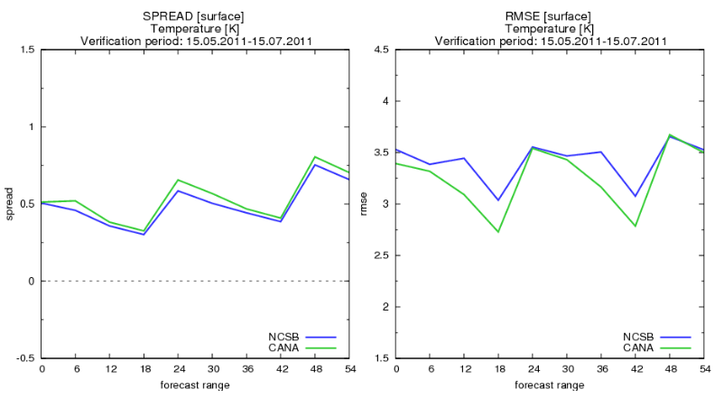
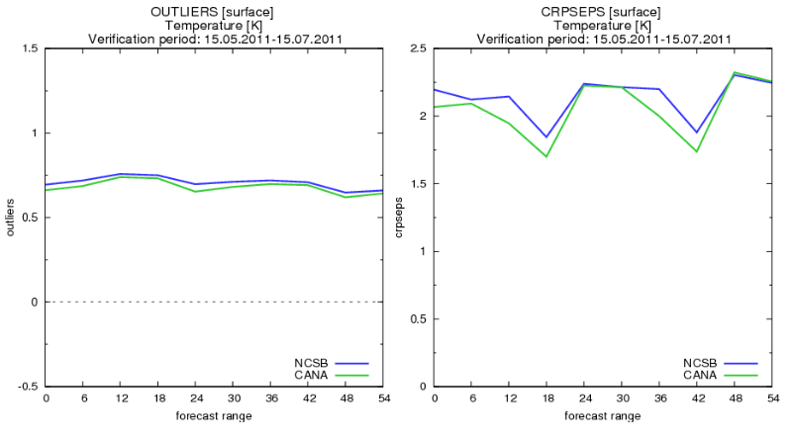
Ens. Surf. DA vs. NCSB

Slide 9
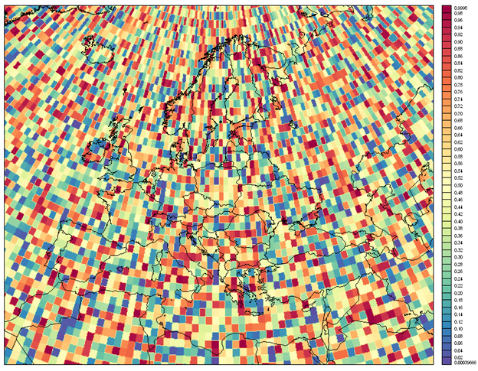
Stochastic soil physics
Stochastic perturbation of tendencies in the ISBA soil scheme:
Surface temperature
Total contents of soil water, snow, snow-water
Surface content water/ice
Trapped surface water (e.g. in leaves)
Snow density
Snow albedo
Perturbations induced every 20 time steps separately for each surface parameter
Generation of random numbers:
X_{P} = (1+r_{x})X_{c}
with r_{x} between -0.5 and 0.5
Example of random numbers:
1° x 1° boxes
8

Slide 10
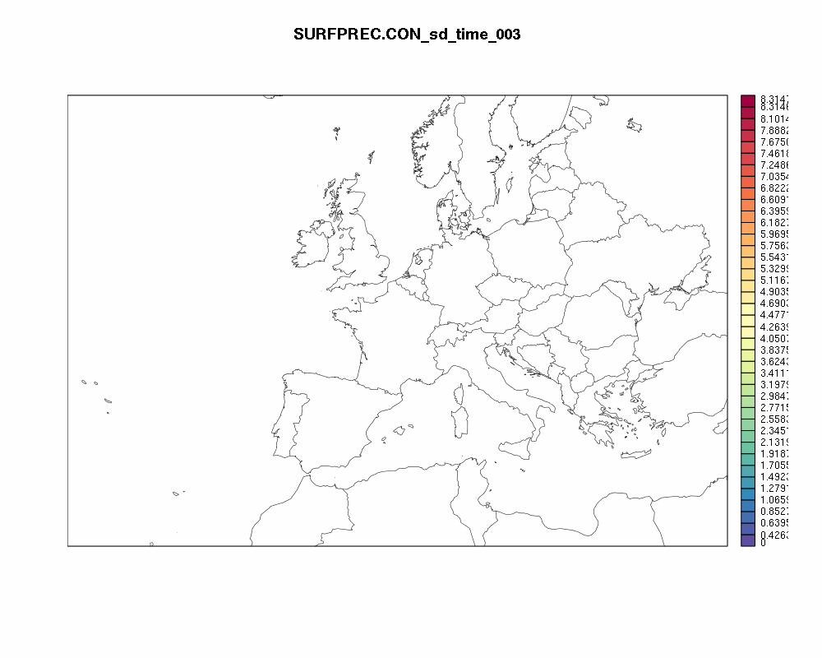
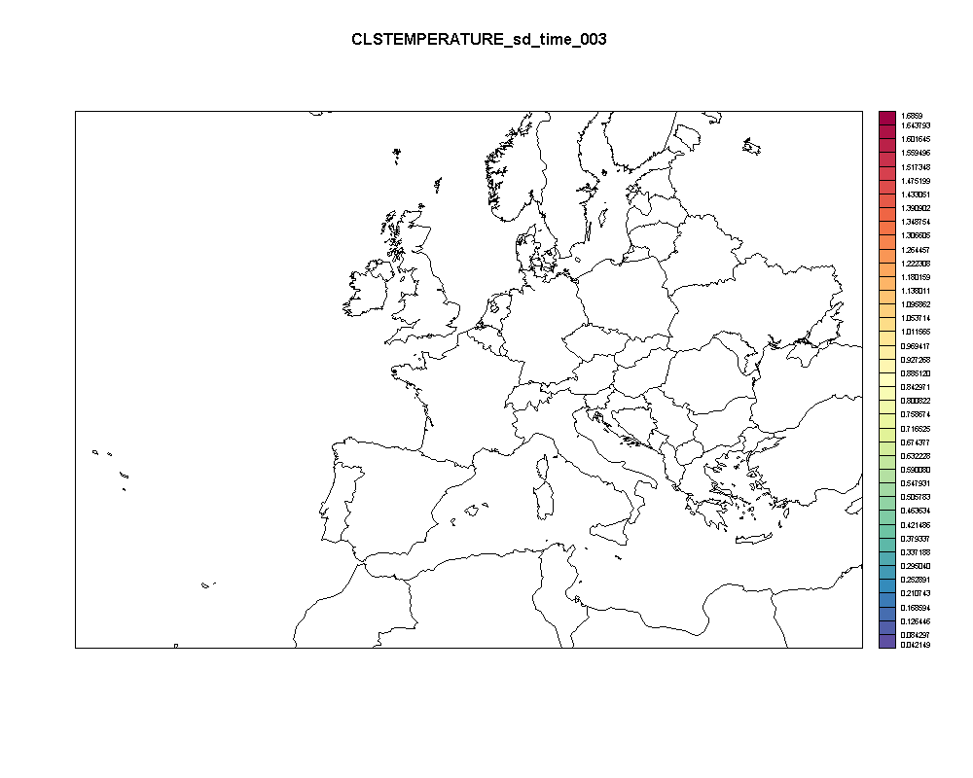
Atmospheric response to surface perturbation
Convective rainfall
Surface temperature
9
9

Slide 11
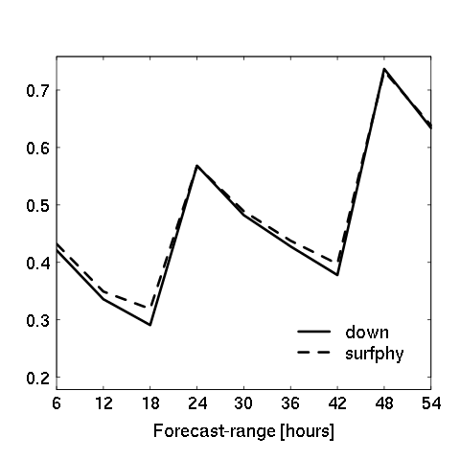
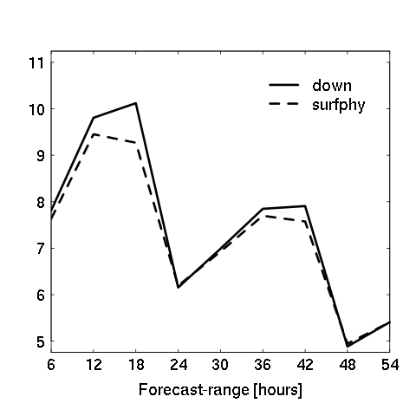
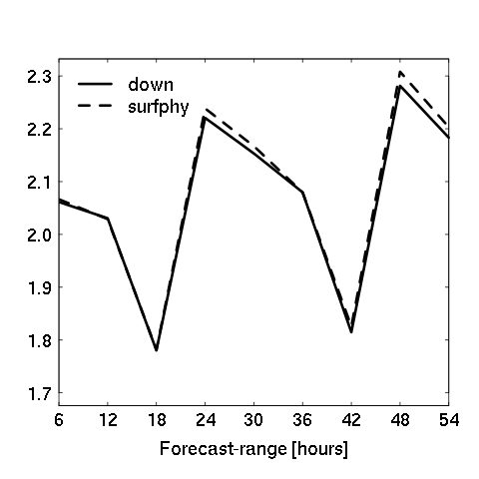
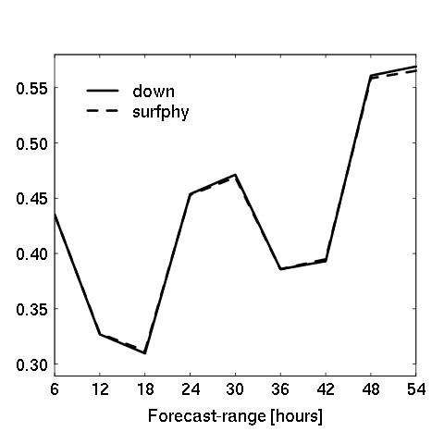
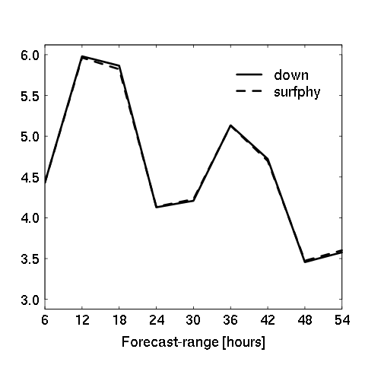
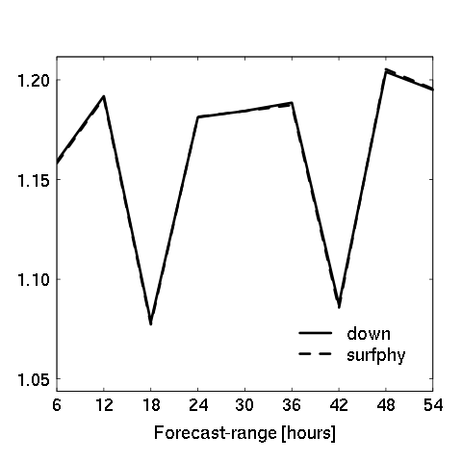
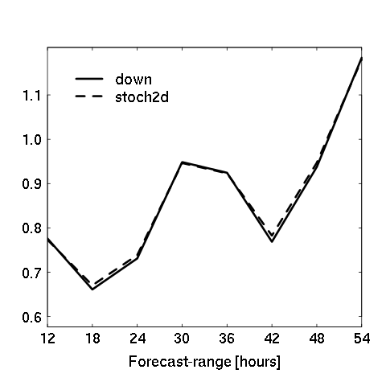
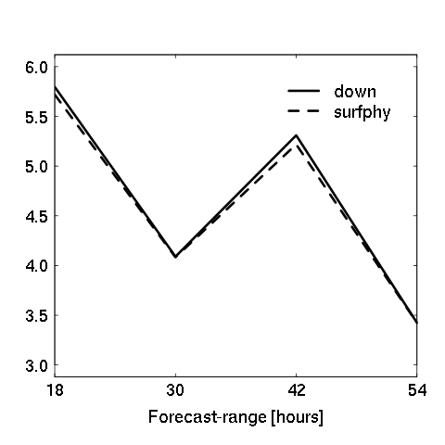
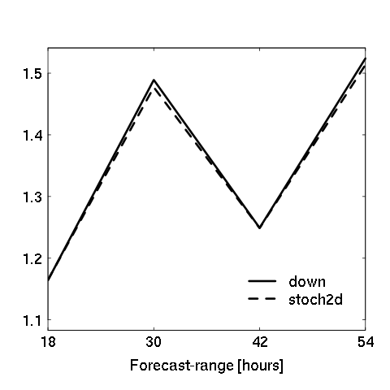
Stochastic soil physics - results
2m Temperature
10m Wind Speed
12h Precipitation
Spread RMSE/Spread CRPS
10
10
10
10
10

Slide 12
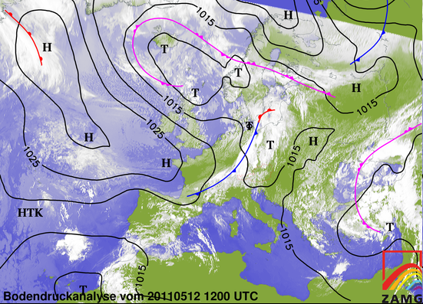
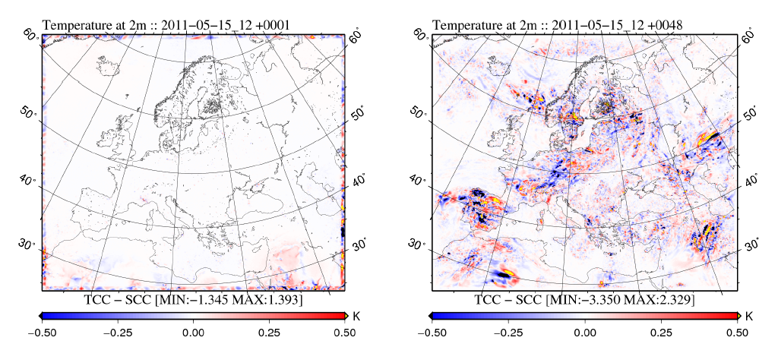
Initial LBC uncertaities
TCC - Time consistent: First LBC file from driving model
SCC - Space consistent: First LBC equal to INIT
Impact on case with frontal zone
11
11
11
11
11
11

Slide 13
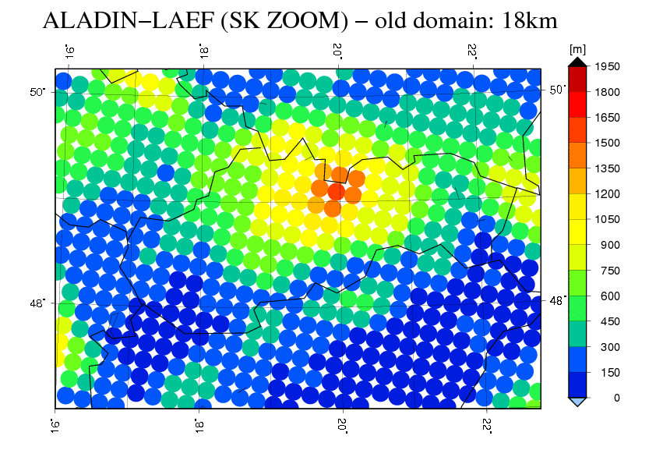
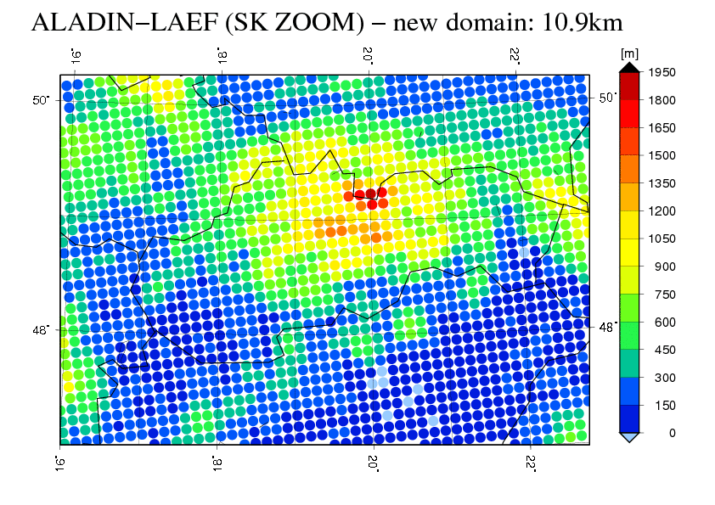
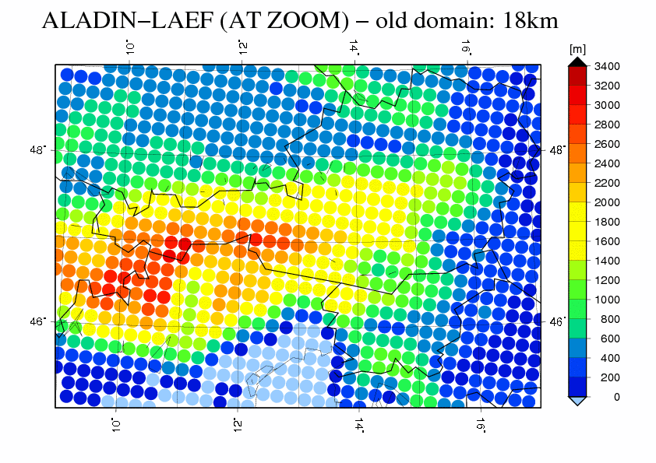
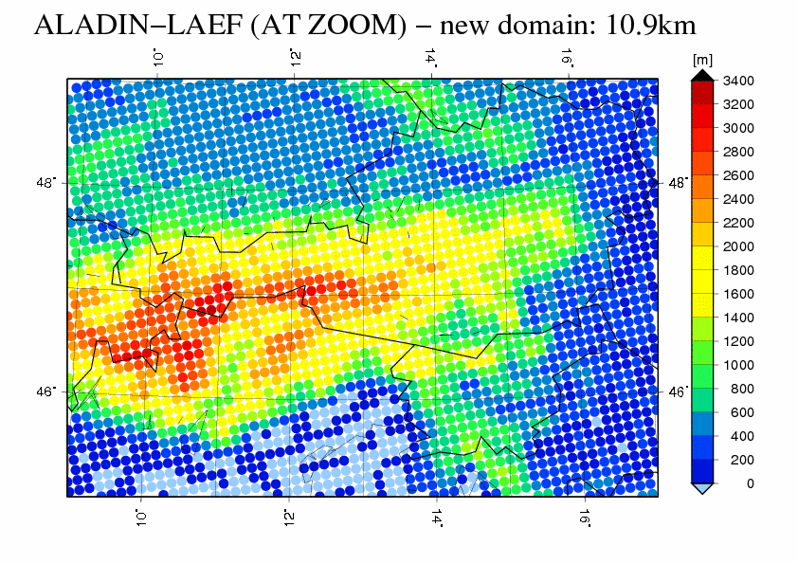
Higher resolution
18km vs. 11km
12

Slide 14
Higher resolution
LAEF 37L vs. LAEF 45L
More levels in the lower atmosphere
13
13

Slide 15
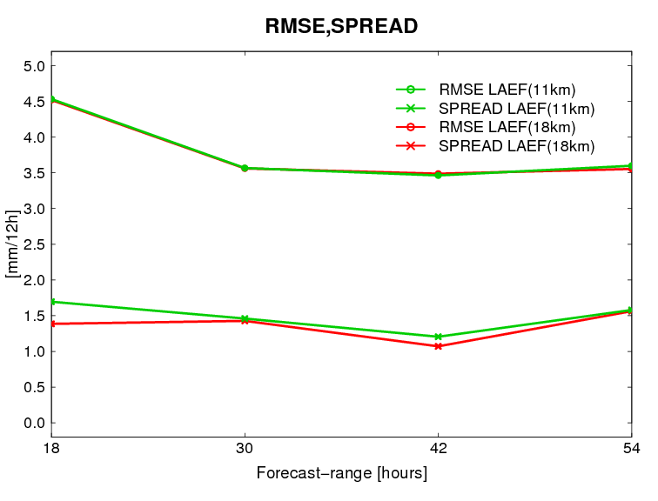
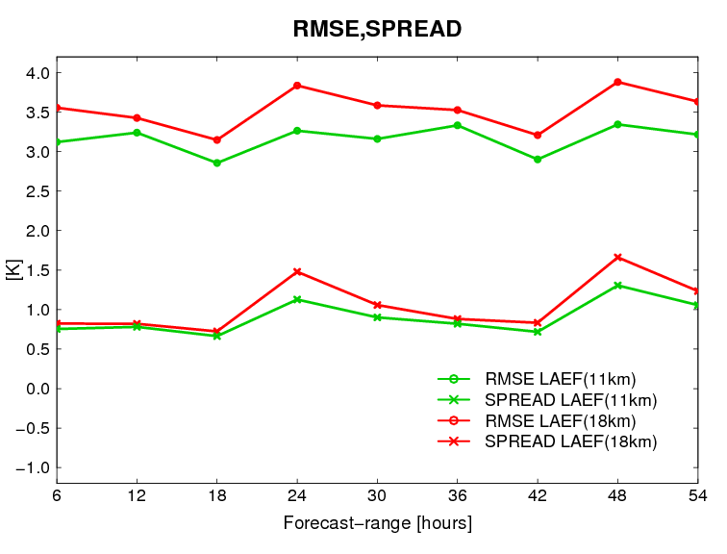
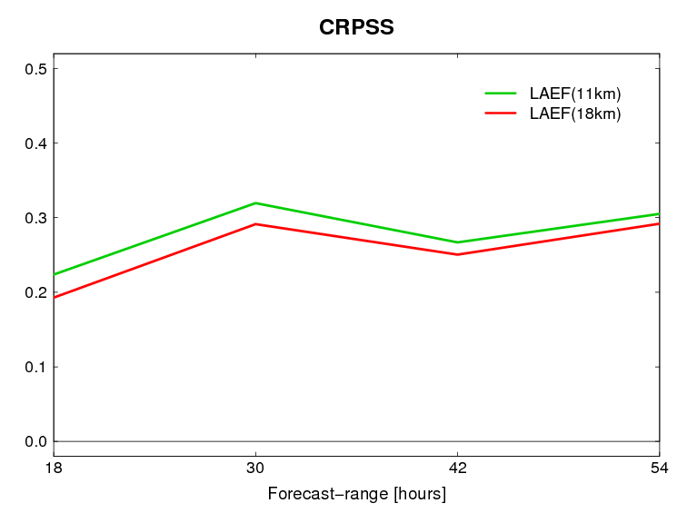
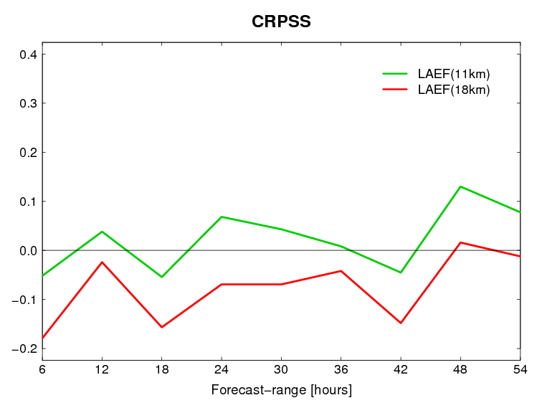
Impact of resolution:
Precipitation
2m temperature
14
14
14
14
14
14

Slide 16
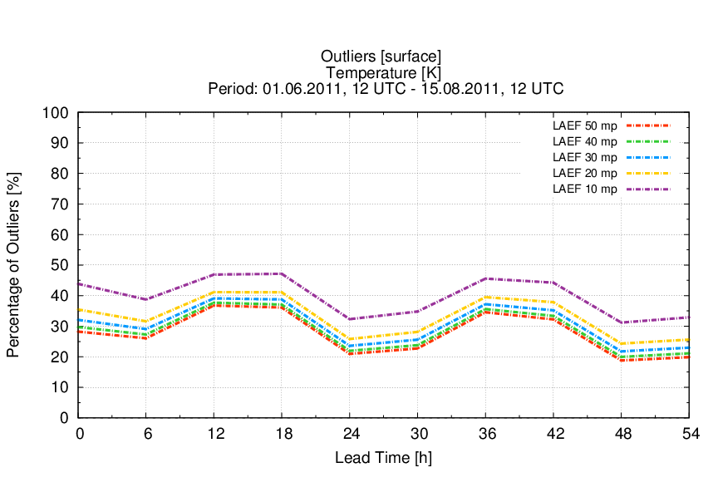
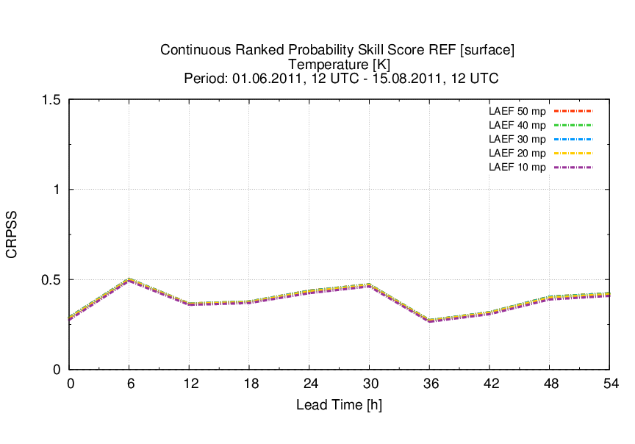
Impact of ensemble size
Experiments with 50 ensemble members:
Coupled with 50 ECMWF global EPS members
Verification for subsets of 10, 20, 30, 40, 50 members
Two experiments:
without multiphysics, but: with blending and ens. land surface assimilation
with multiphysics: 10 selected configurations, repeated 5x for 50 members
Outliers T2m
CRPSS
T2m
15
15
15
15
15
15
15

Slide 17
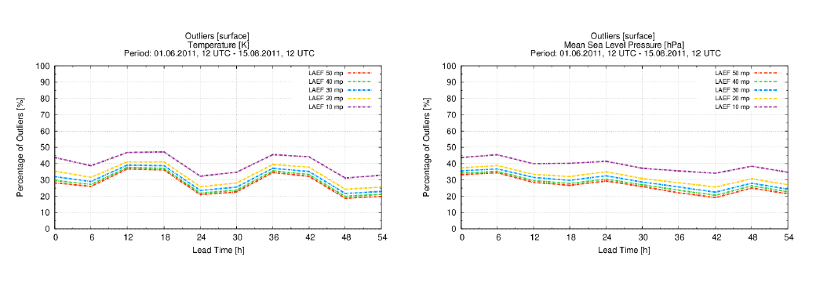
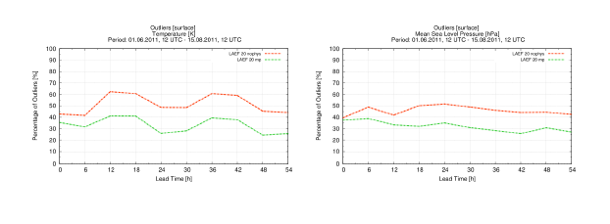
Impact of ensemble size
16
16
16
16
16
16
16

Slide 18
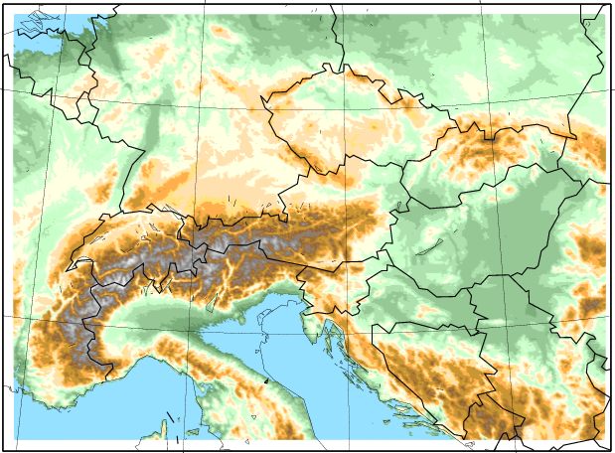
AROME-LAEF
Ensemble size | 16+1
Horizontal resolution | 2.5 km
Vertical resolution | 60
Runs/day | 4
Forecasts range | 30h
Coupling | ALADIN-LAEF
Downscaling of ALADIN-LAEF
17
17
17
17
17
17
17
17

Slide 19
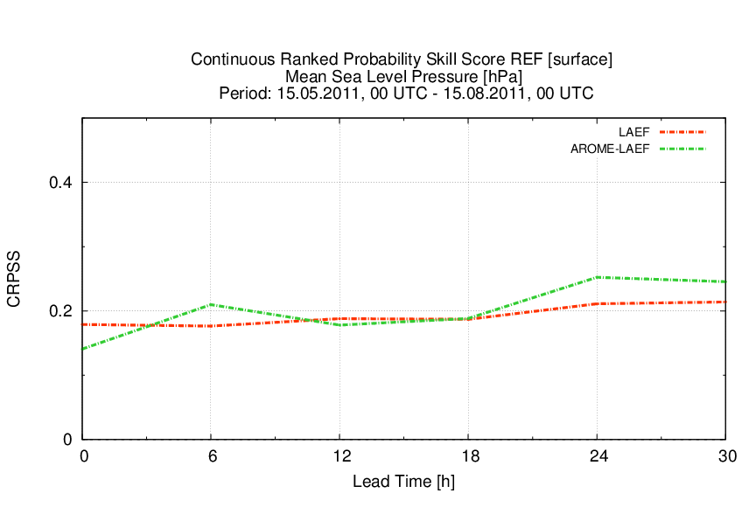
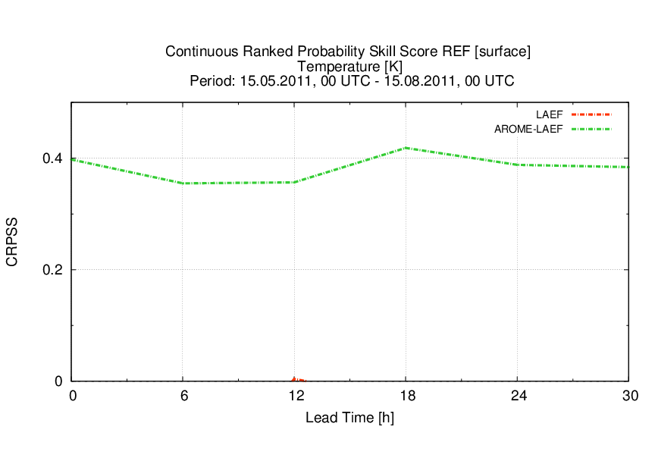
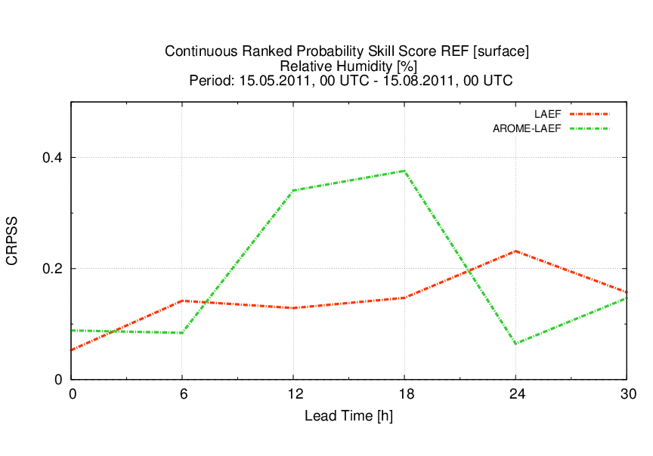
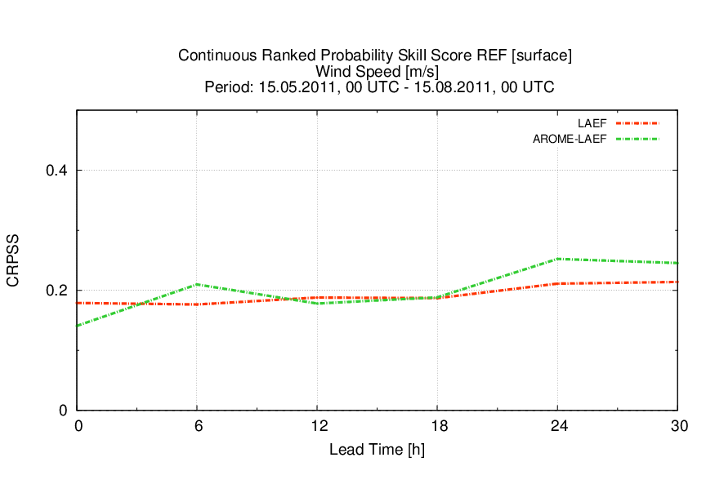
LAEF: AROME vs. ALADIN
18
18
18
18
18
18
18
18

Slide 20
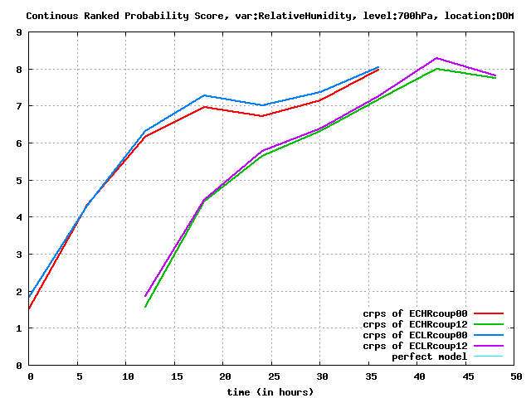
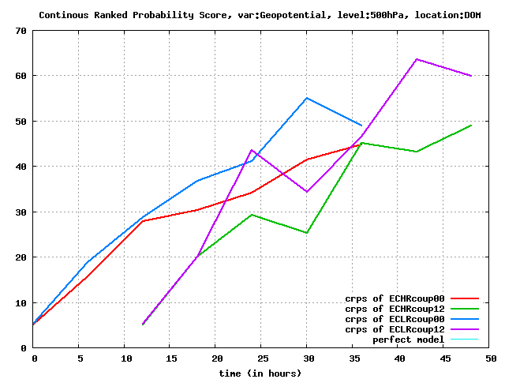
AROME-LAEF + H/L res. ECMWF EPS coupling
LBCs – T1279, 20 members provided by ECMWF to EPS community for 3 periods.
Winter period ( 26.12.2011 – 8.1.2012) was evaluated
Downscaling compared for HR-LBCs versus LR-LBCs (T639)
Positive impact is bigger for upper levels and smaller for lower levels and near surface
Presented at LAM-EPS BC meeting at ECMWF in December 2013
CRPS
RH 700hPa
CRPS
Geopot. 500hPa
19
19
19
19
19
19
19
19

Slide 21
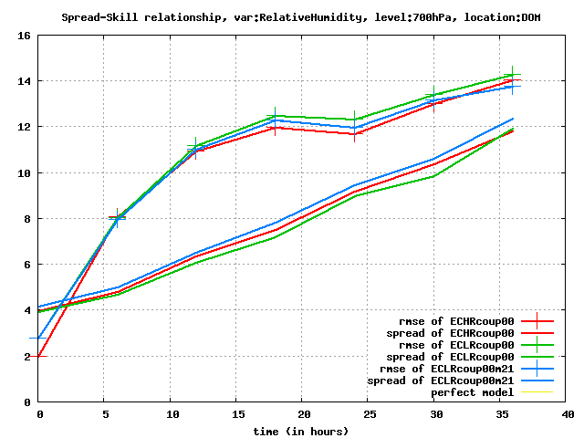
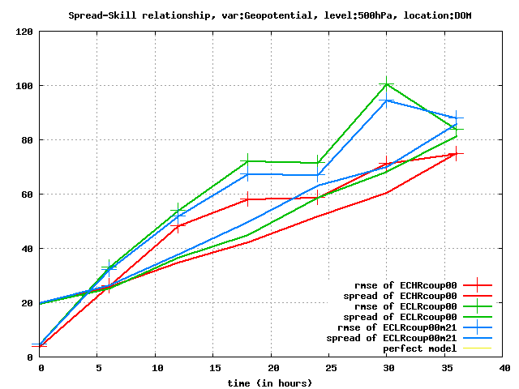
AROME-LAEF + H/L res. ECMWF EPS coupling
Spread-Skill
RH 700hPa
Spread-Skill
Geopot. 500hPa
Impact of HR-LBCs is comparable to impact of ensemble size of LR-LBCs
20
20
20
20
20
20
20
20
20

Slide 22
For the next future 2-3 years
Efforts mainly on resolution, DA and model physics
Higher resolution: 5km, 60 levels
Ensemble DA, considering the LS forcing
and LBC/IC consistency, Blend+ensVAR
Stochastic physics, atmosphere and land surface
21

