Slide 1


Meaningful Evaluation Strategies for Numerical Model Forecasts using MET
Tara Jensen
NCAR/RAL/JNTP
and
Developmental Testbed Center (DTC)
Presentation at NCWCP – 29 July 2014

Slide 2





Support for MET is provided by
AFWA, NOAA and NCAR
through the Developmental Testbed Center (DTC)

Slide 3
MET Package
MET is community code supported by DTC that is free to download (registration required)
  Approximately 2500 registered users
  124 countries
  Universities, Government, Private Companies, Non-Profits
Download MET release and compile locally.
  Register and download: www.dtcenter.org/met/users
Language:
  Primarily in C++ with calls to some Fortran libraries
Supported Platforms and Compilers:
  Linux with GNU compilers
  Linux with Portland Group (PGI) compilers
  Linux with Intel compilers
In-person tutorials given yearly

Slide 4
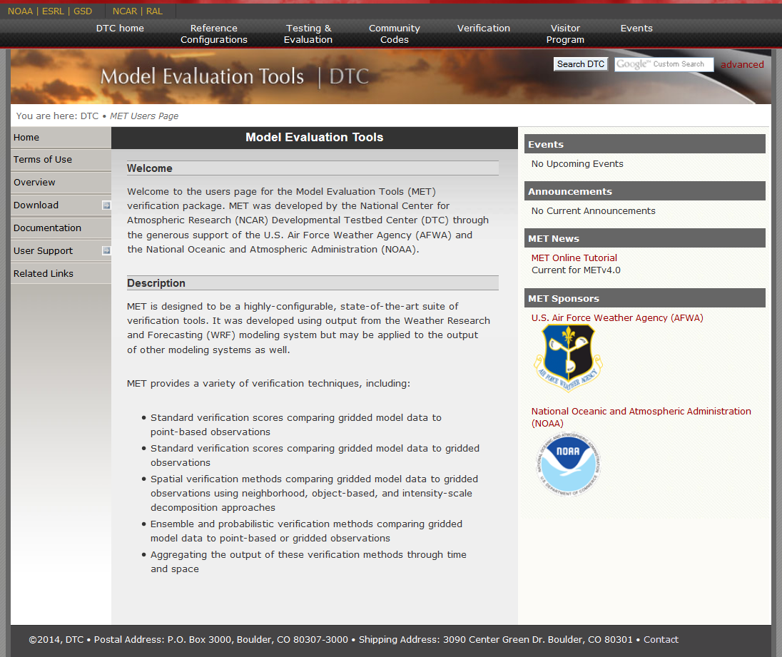
www.dtcenter.org/met/users

Slide 5
MET v5.0 Tools (Release: August 2014)
Input
Reformat
Plot
Statistics
Analysis
MET-TC
Gridded
Model
Forecasts
and
Observation
Analyses
Gen
Poly
Mask
NetCDF
Mask
File
Land
Data
File
MODE
ASCII
NetCDF
PS
MODE
Analysis
PCP
Combine
Plot
Data
Plane
Wavelet
Stat
STAT
ASCII
NetCDF
PS
NetCDF
DLand
TC
DLAND
MODIS
Data
MODIS
Regrid
Gridded
NetCDF
ASCII
Grid
Stat
STAT
ASCII
NetCDF
TC
PAIRS
ATCF
Track
Data
WWMCA
Data
WWMCA
Regrid
WWMCA
Plot
Series
Analysis
NetCDF
Stat
Analysis
TCST
Pairs
ASCII
Point Obs
ASCII2NC
Plot
Point
Obs
Ensemble
Stat
STAT
ASCII
NetCDF
TC
STAT
PrepBufr
Point Obs
PB2NC
NetCDF
Point
Obs
Point
Stat
STAT
ASCII
PS
ASCII
MADIS
Point Obs
MADIS2NC
Notes:
5

Slide 6
Data | MET Tool
Gridded Forecasts Gridded Observations | Grid Stat (traditional or neighborhood) Ensemble Stat Wavelet Stat MODE Series Analysis
Gridded Forecasts Point Observations | Point Stat Ensemble Stat Series Analysis
Point Forecasts Point Observations | TC Pairs TC Stat

Slide 7
Typical MET Verification Process
Determine Gridded Forecast Source
  MET reads GRIB1, GRIB2 and some versions of netCDF format
Determine Observation Source
  Point: Run through MET pre-processing to put into MET netCDF
  Gridded: Put on same grid as forecast
Set up config file for Statistical Tool
  Typically tell software what:
    Variable (based on GRIB ID and Level or Accumulation Interval)
    Thresholds
    What type of output you’d like – Categorical, Continuous, Probabilistic
Run Statistical Tool
Run Analysis Tool to filter data and aggregate then plot –OR –
Run METViewer to view filter, aggregate and plot thru user interface
Analyze
10%
15%
25%
50%

Slide 8
Goal of this presentation…
To get you thinking about how MET might help you
Full Suite of Standard Statistics
Non-Traditional Statistics added regularly
Great for diagnostic studies
Designed for systematic evaluations
Used internationally
Database and Display system for aggregating and plotting data
Provides a standardized evaluation platform for
cross-institution comparisons

Slide 9
Traditional Statistics (Deterministic Forecasts)
Point Stat and Grid Stat

Slide 10
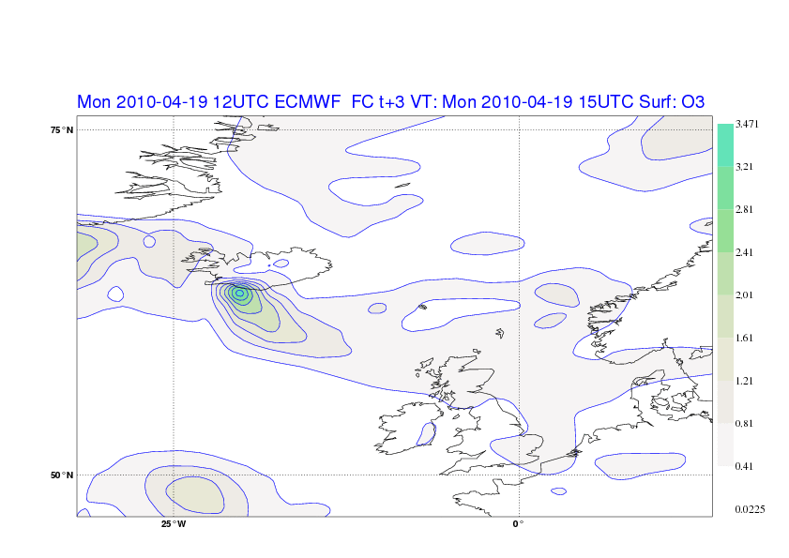
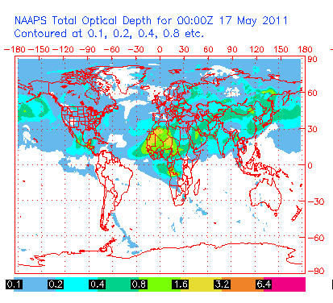
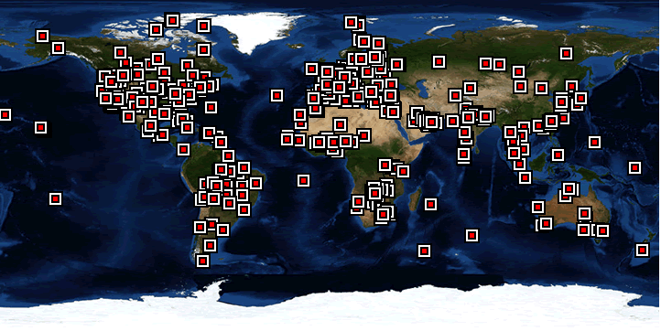
Point Stat: Overview
Verification methods:
  Continuous statistics for raw fields.
  Single and Multi-Category counts and statistics for thresholded fields.
  Parametric and non-parametric confidence intervals for statistics.
  Compute partial sums for raw fields and/or the raw matched pair values.
  Methods for probabilistic forecasts.
Image Courtesy of NAAPS website
Compare gridded forecasts to point observations.
Accumulate matched pairs over a defined area at a single point in time.
Verify one or more variables/levels.
Analysis tool provided to aggregate through time.
Aeronet Sites – Image Courtesy of Aeronet website

Slide 11
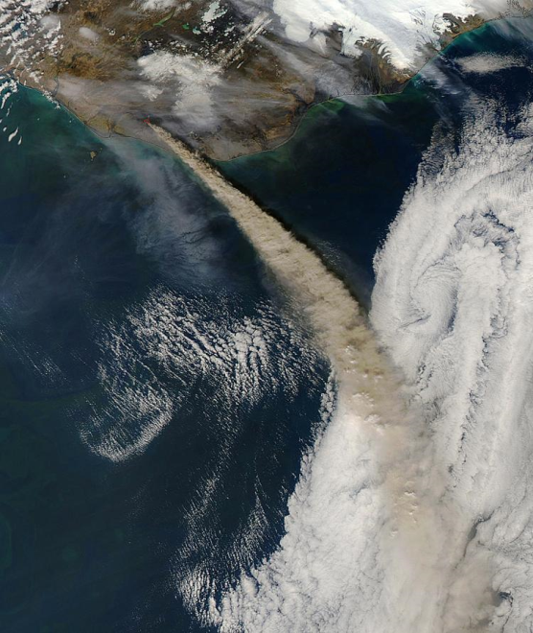
Grid Stat: Overview
Verification methods:
  Continuous statistics for raw fields.
  Single and Multi-Category counts and statistics for thresholded fields.
  Parametric and non-parametric confidence intervals for statistics.
  Compute partial sums for raw fields.
  Methods for probabilistic forecasts.
  Continuous
  statistics and
  categorical
  counts/
  statistics
  using
  neighborhood
  verification
  method.
ECMWF Forecast courtesy of Angela Benedetti
Compare gridded forecasts to gridded observations on the same grid.
Accumulate matched pairs over a defined area at a single point in time.
Verify one or more variables/levels.
Analysis tool provided to aggregate through time.
Aqua (NASA MODIS/AFP/Getty Images)
2010 May 8

Slide 12
Details on Categorical and Continuous Statistics
Continuous | Categorical / Multi-Categorical
Forecast Mean Forecast Standard Deviation Observation Mean Observation Standard Deviation Pearson Correlation Coefficient (aka Correlation) Spearman’s Rank Correlation Kendall’s Tau statistic Number of ranks used in Kendall’s tau Number of tied forecasts in Kendall’s tau Number of tied observations in Kendall’s tau Mean error Standard Deviation of error 10th, 25th, 50th, 75th, 90th Percentile of Error Inner Quartile Range Multiplicative Bias (aka Bias) Mean Absolute Error Mean Square Error Bias-corrected Mean Square Error Root Mean Square Error Mean Absolute Deviation | Total number of matched pairs Contingency Table Counts Forecast rate Hit rate Observation rate Base rate Forecast mean Accuracy Frequency Bias Probability of Detection – Yes Probability of Detection – No Probability of False Detection (aka False Alarm Rate) False Alarm Ratio Critical Success Score (aka Threat Score) Gilbert Skill Score (aka Equitable Threat Score) Bias-Adjusted Gilbert Skill Score Odds Ratio Log-Odds Ratio Odds-Ratio Skill Score Hanssen-Kuipers Discriminant Heidke Skill Score Extreme Dependency Score Symmetric Extreme Dependency Score Extreme Dependency Index Symmetric Extreme Dependency Index
25 Statistics
24 Statistics

Slide 13
Details on Categorical and Continuous Statistics
Continuous | Categorical / Multi-Categorical
Forecast Mean Forecast Standard Deviation Observation Mean Observation Standard Deviation Pearson Correlation Coefficient (aka Correlation) Spearman’s Rank Correlation Kendall’s Tau statistic Number of ranks used in Kendall’s tau Number of tied forecasts in Kendall’s tau Number of tied observations in Kendall’s tau Mean error Standard Deviation of error 10th, 25th, 50th, 75th, 90th Percentile of Error Inner Quartile Range Multiplicative Bias (aka Bias) Mean Absolute Error Mean Square Error Bias-corrected Mean Square Error Root Mean Square Error Mean Absolute Deviation | Total number of matched pairs Contingency Table Counts Forecast rate Hit rate Observation rate Base rate Forecast mean Accuracy Frequency Bias Probability of Detection – Yes Probability of Detection – No Probability of False Detection (aka False Alarm Rate) False Alarm Ratio Critical Success Score (aka Threat Score) Gilbert Skill Score (aka Equitable Threat Score) Bias-Adjusted Gilbert Skill Score Odds Ratio Log-Odds Ratio Odds-Ratio Skill Score Hanssen-Kuipers Discriminant Heidke Skill Score Extreme Dependency Score Symmetric Extreme Dependency Score Extreme Dependency Index Symmetric Extreme Dependency Index
25 Statistics
New in
MET v5.0
24 Statistics

Slide 14
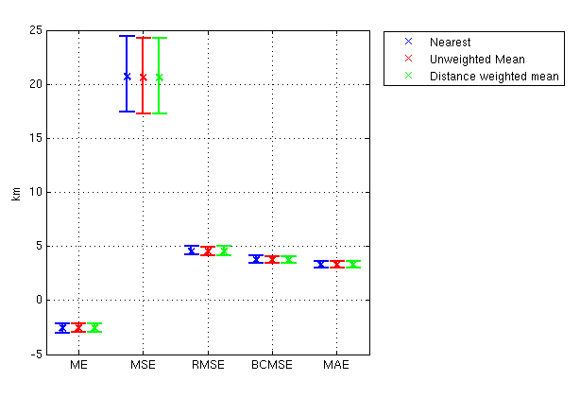
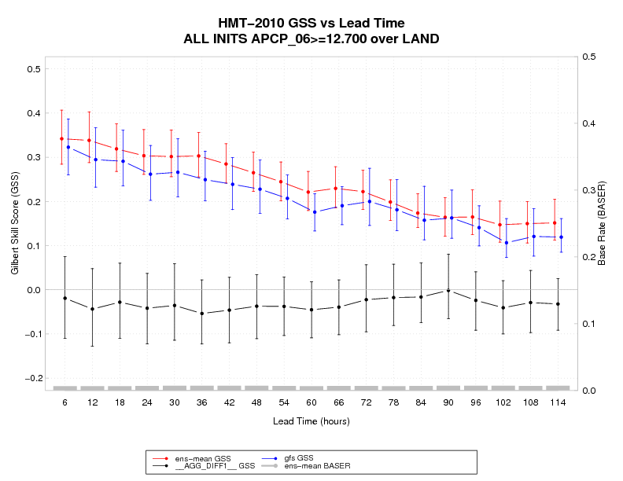
Confidence Intervals and Interpolation in MET
Normal Approximation CI
  Calculated for all statistics for which this is appropriate
Bootstrapped CI
  Can be turned on in config file
  Number of repetitions are user defined
Interpolation for Point Data – Nearest Neighbor, Unweighted Mean, Distance Weighted Mean, Bilinear Interpolation

Slide 15
Analysis Tools
Its not just what you compute… it’s how you aggregate it!!
Stat Analysis
Series Analysis
METViewer

Slide 16
Stat Analysis Tool for flexible aggregation
MET output - Contingency Table Counts
 | OBS
FCST |  | Y | N
 | Y | 32 | 43 | 75
 | N | 32 | 827 | 859
 |  | 64 | 870 | 934
V4.1 WRF 360000 20070331_120000 20070331_120000 000000 20070331_103000 20070331_133000 UGRD Z10 UGRD Z10 ADPSFC DTC165 DW_MEAN 9 >=5.000 >=5.000 NA NA CTC 934 32 43 32 827
V4.1 WRF 360000 20070331_120000 20070331_120000 000000 20070331_103000 20070331_133000 UGRD Z10 UGRD Z10 ADPSFC DTC166 DW_MEAN 9 >=5.000 >=5.000 NA NA CTC 2955 24 104 72 2755
(NOTE: header modified to show only pertinent info)
 | OBS
FCST |  | Y | N
 | Y | 24 | 104 | 128
 | N | 72 | 2755 | 2827
 |  | 96 | 2859 | 2955

Slide 17
Stat Analysis Tool for flexible aggregation
Stat Analysis Output
 | OBS
FCST |  | Y | N
 | Y | 56 | 147 | 251
 | N | 104 | 3582 | 317
 |  | 241 | 327 | 3889
JOB_LIST: -job aggregate
-fcst_var UGRD -vx_mask DTC165 -vx_mask DTC166 -interp_mthd DW_MEAN -line_type CTC -dump_row out/aggregate2.stat
COL_NAME: TOTAL FY_OY FY_ON FN_OY FN_ON
CTC: 3889 56 147 104 3582
Provides ability to aggregate statistics diurnally, seasonally, regionally, or station by station with independent calls
MET v5.0 will include the ability to exclude one or more stations
(e.g. if one or a few are known to be bad)

Slide 18
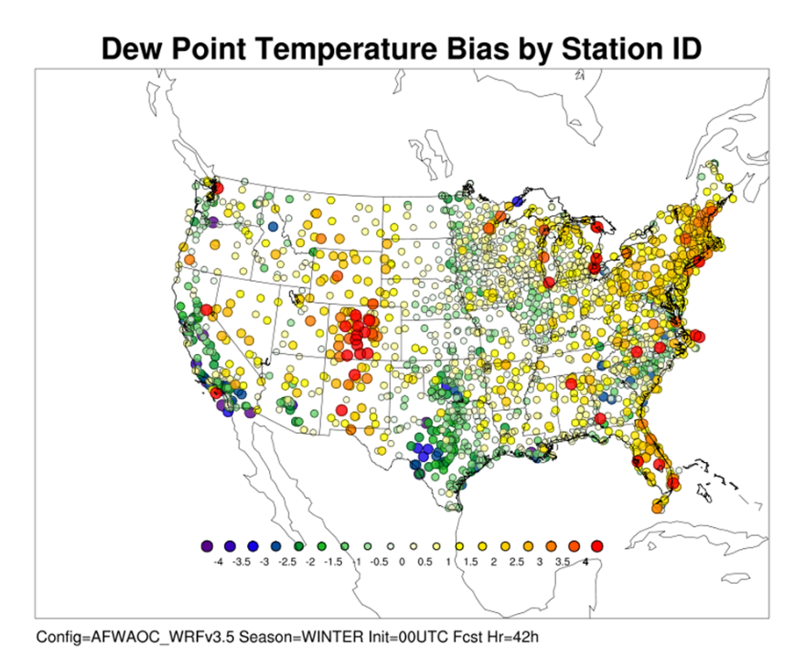
Series Analysis tool for geographic representation of scores
Accumulates statistics separately for each grid location over a series
  Time
  Height
  Other series
Accumulate over
  Stations
  Grids

Slide 19
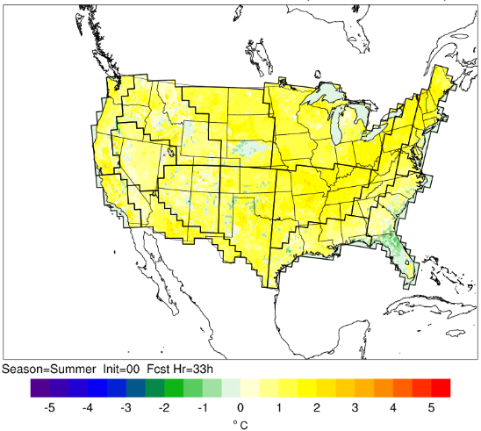
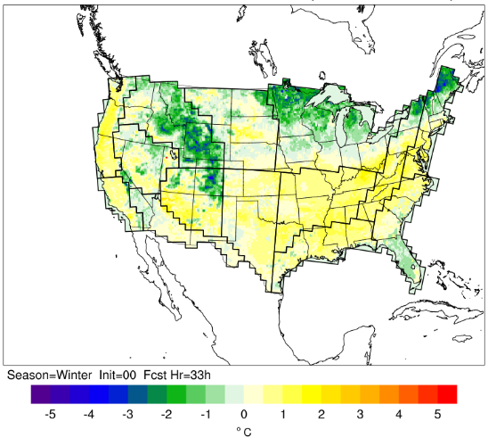
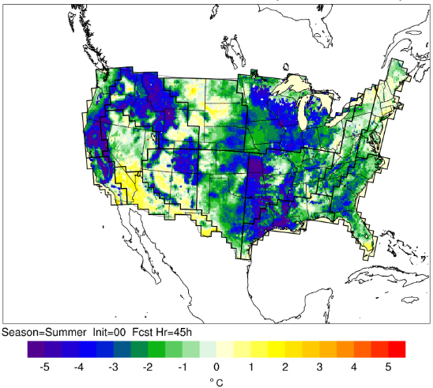
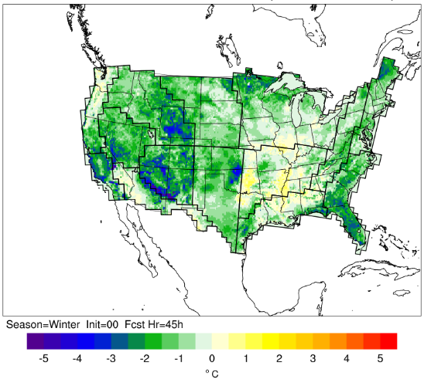
Series Analysis tool for Gridded Data
Soil Temperature (0–10 cm)
Summer
Winter
AFWAOC – Noah-MP
Diff > 0 → AFWAOC has larger values
Diff < 0 → NoahMP has larger values
33 h forecast
Differences in snow-covered versus snow-free areas
Snow-covered areas experience little diurnal signal, with Noah-MP typically warmer than AFWAOC
Snow-free areas behave similarly to 2 m temperature, with Noah-MP typically having higher temperatures during the afternoon and AFWAOC having warmer temperatures in the overnight hours
45 h forecast

Slide 20
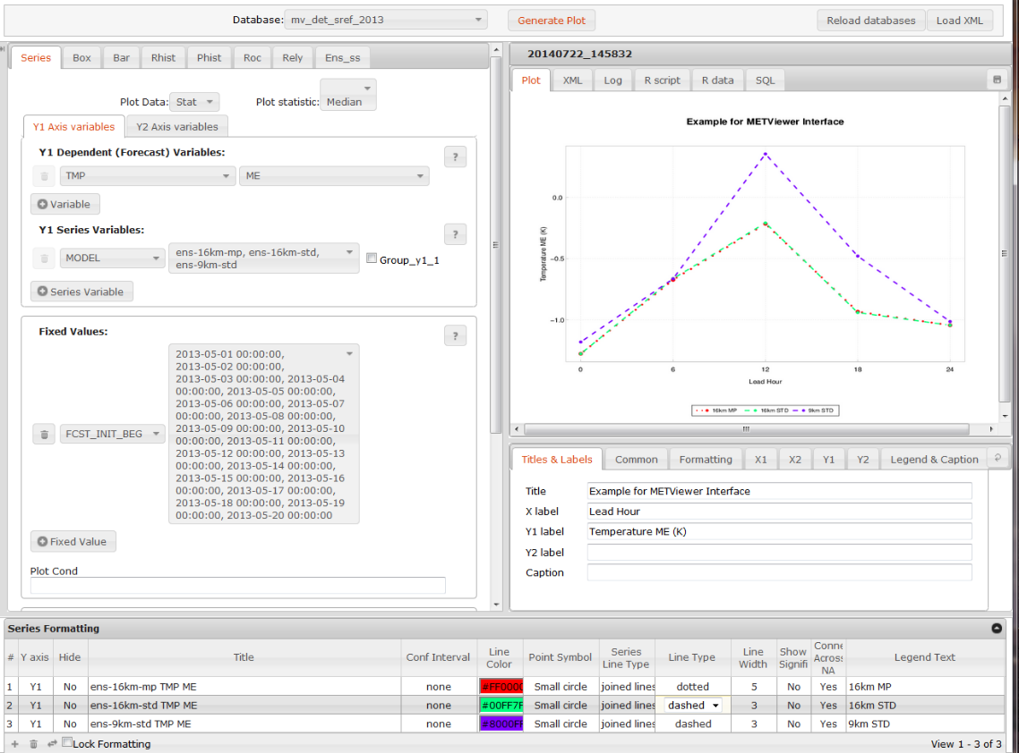
METViewer 1.0 – database and display system

Slide 21
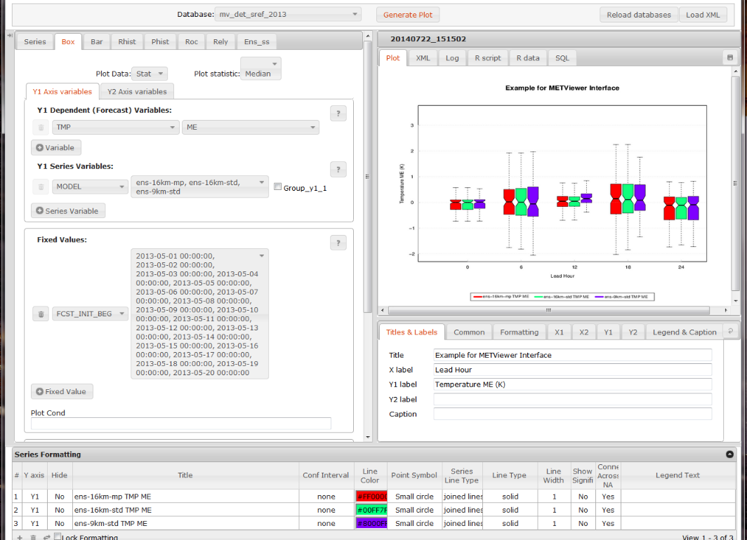
METViewer 1.0
Many plot options
Time Series
Box Plots
Bar
Histograms
Rank Histograms
ROC
Reliability
Ensemble Spread Skill
Configure plot area

Slide 22
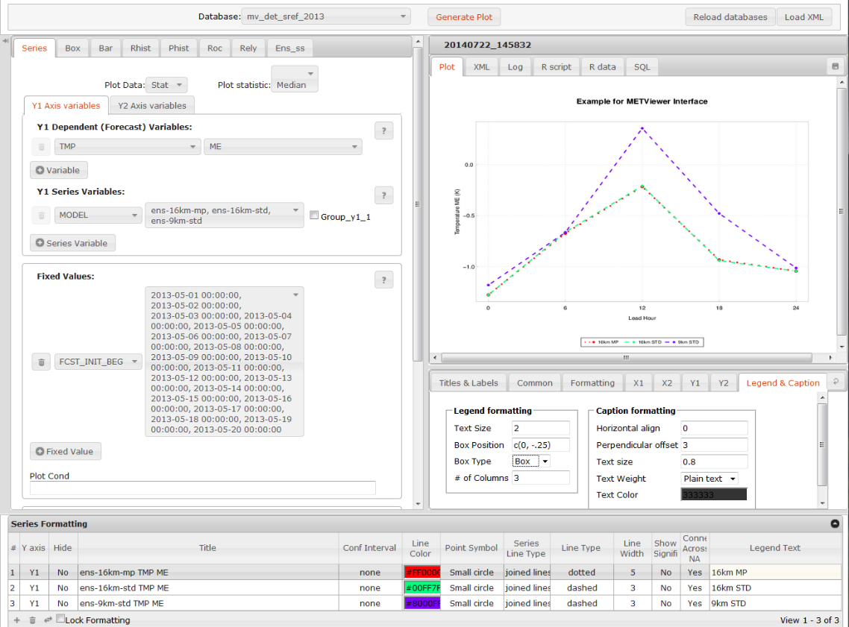
METViewer 1.0
Configure plot area

Slide 23
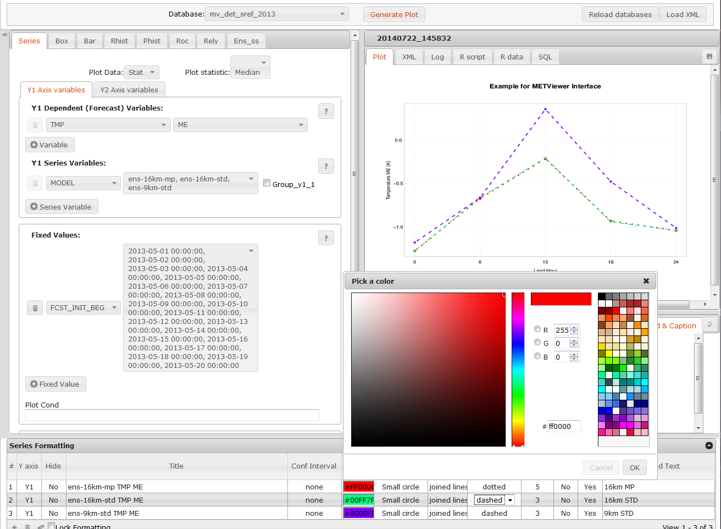
METViewer 1.0
Easy to change line color

Slide 24
METViewer 1.0
User interface for custom plots and developing templates
for Batch engine which is used for systematic use
Code base: Java / MySQL / R-statistics
Currently used in-house at DTC and NCAR/JNT
Prototype transitioned to Aviation Weather Center
Used by staff at NOAA GSD and NOAA PSD
DTC is interested in opening METViewer to others
  Beta release
  Upload data to our database and use remotely

Slide 25
Object Based Evaluation
Method for Object Based Diagnostic Evaluation (MODE)

Slide 26
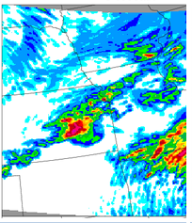
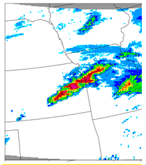
Typical situation
6hr accumulated precip
Forecast
Observation
Object verification is more like what human brain does.
It recognizes the spatial relationship between points.

Slide 27
Simple example
Observed
Forecast
Shifted
Totally wrong

Slide 28
Comparing objects can tell you things about your forecast like . . .
This: | Instead of this:
30% Too Big (area ratio=1.3) | POD = 0.35
Shifted west 1 km (centroid distance = 1km) | FAR = 0.7235
Rotated 15° (angle diff = 15%) | CSI = 0.1587
Peak Rain 1/2” too much (diff in 90th percentile of intensities = 0.5)

Slide 29
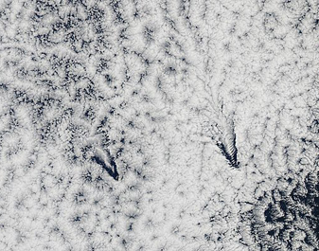
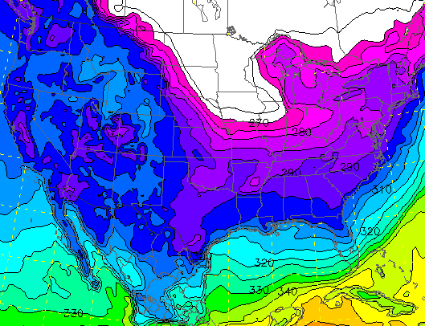
Verifying with objects doesn’t always make sense . . .
NASA/MODIS - May 9, 2011 - Ship-wave-shape wave clouds induced by Juan Fernandez Islands, off Chile

Slide 30
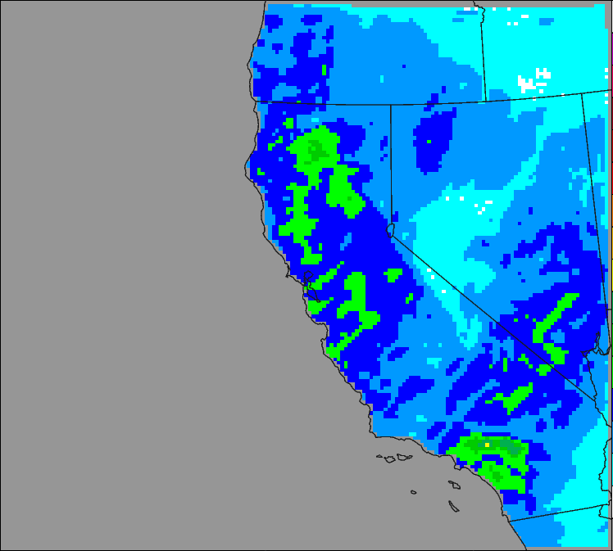
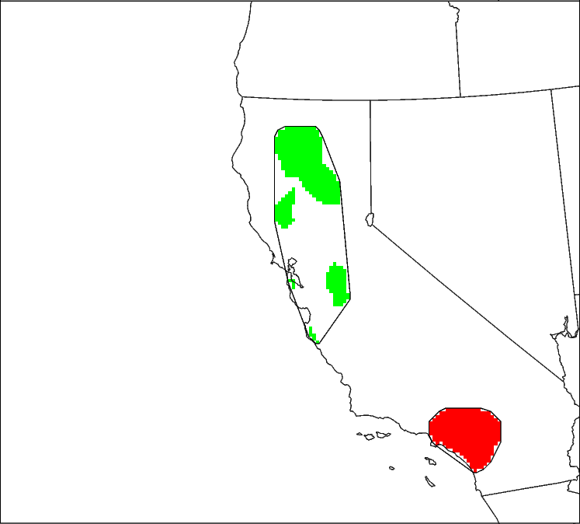
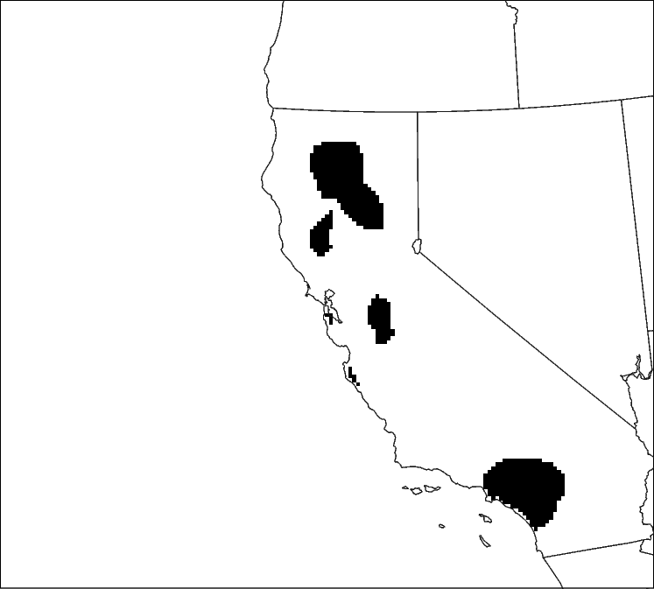
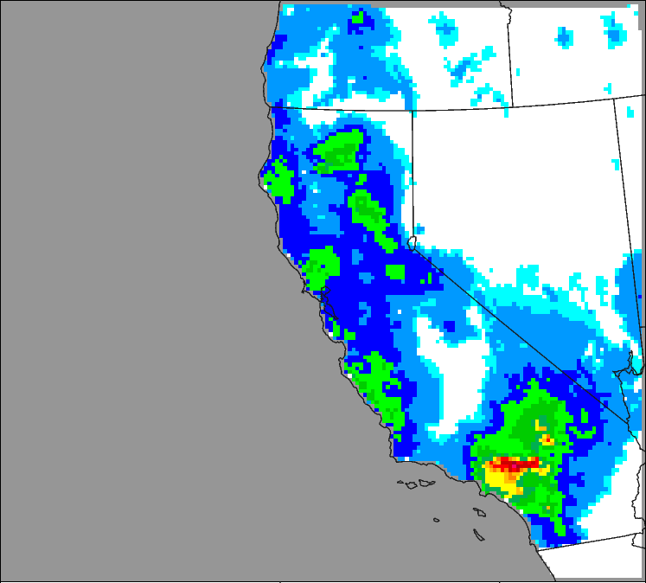
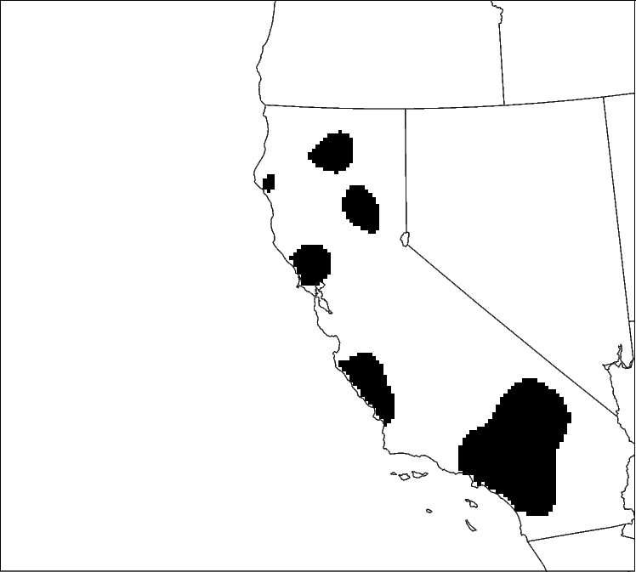
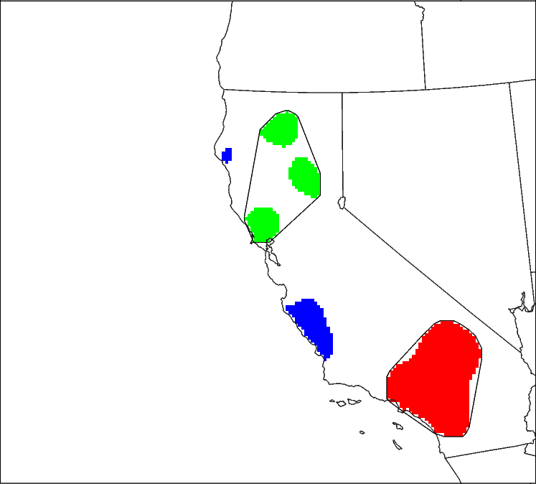
Method for Object-based Diagnostic Evaluation (MODE)
How it works
  Matched Object 1
  Matched Object 2
  Unmatched Object
ENS FCST
OBS
Radius=5
ObjectThresh
>6.35 mm
MergingThresh
>5.7 mm
Radius=5
ObjectThresh
>6.35 mm
MergingThresh
> 5.7 mm
Merging
Merging
No false alarms
Misses
Matching
Notes:
Precipitation fields are smoothed using a user specified radius.
The smoothed fields are then thresh-holded to form objects.
MODE then acts on the individual fields to merge objects into clusters, which in this case is done by using a second lower threshold – the rubber band and coloring indicate the merged clusters.
MODE then compares the objects and clusters between fields and calculates an interest value and matches based on these.
MODE compares gridded model data to gridded observations and can be used as a basis for development of diagnostic verification metrics that can provide quantitative measures of uncertainty.

Slide 31
Use of Attributes of Objects defined by MODE
Forecast
Field
Observed
Field
Centroid Distance: Provides
a quantitative sense of spatial
Displacement.
Small is good
Axis Angle: Provides an objective measure of how well the objects are aligned. Small is good
Obs
Area
Area Ratio: Provides an
objective measure of whether
there is an over- or under-
prediction of areal extent.
Close to 1 is good
Area Ratio =
Fcst Area
Obs Area
Fcst
Area

Slide 32
Use of Attributes of Objects defined by MODE
Symmetric Difference:
Non-Intersecting Area
Forecast
Field
Obs IWV*10
P50 = 26.6
P90 = 31.5
Observed
Field
Fcst PWT
P50 = 29.0
P90 = 33.4
P50/P90 Int: Provides objective measures of Median (50th percentile) and near-Peak (90th percentile) intensities found in objects.
Ratio close To 1 is good
Symmetric Diff: May be a good summary statistic for how well Forecast and Observed objects match. Small is good
Total Interest: Summary statistic derived from
fuzzy logic engine with user-defined Interest
Maps for all these attributes plus some others.
Close to 1 is good
Total Interest
0.90
Total Interest
0.75

Slide 33
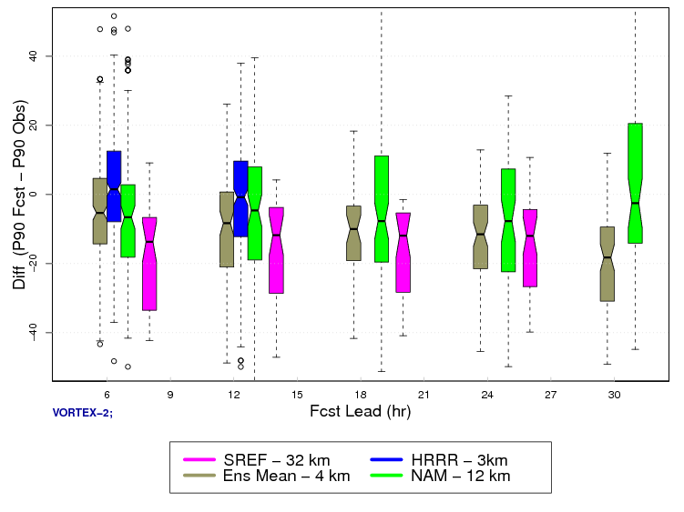
6hr Accumulated Precipitation Near Peak (90th%)
Intensity Difference (Fcst – Obs)
Overforecast
High Resolution
Deterministic
Does Fairly Well
Difference(P90 Fcst – P90 Obs)
High Resolution
Ensemble Mean
Underpredicts
Mesoscale
Deterministic
Underpredicts
Mesoscale
Ensemble
Underpredicts
the most
Underforecast

Slide 34
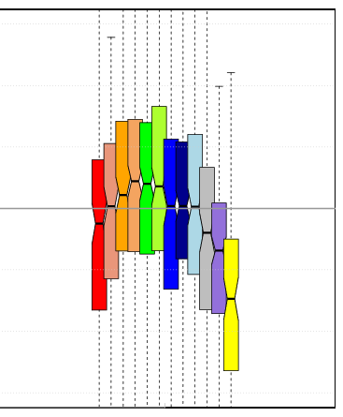

Impact of Core & Microphysics
NMM
ARW
Using Attributes from MODE Objects
90% Intensity shows over- forecast of precipitation for ARW-Fer and ARW-MY members especially at higher thresholds – which means when it rains it pours in these members
Difference (Fcst-Obs) in Near Peak
Intensity in MODE Obj (mm)
HMT
NAM
GFS
Optimal
Color groups
Different
Microphysics
Ferrier
Milbrant-Yau
Thompson
> 25.4mm
Intense Cores
Object Threshold (mm)
Notes:
Convolution Radius = 5 gs; Convolution Threshold = 25.4 mm; Default Interest Map and Weighting

Slide 35
MODE has been used to evaluate
Precipitation
  Standard Accumulation Intervals
  Probability Fields
Reflectivity
  Composite
  Radar Echo Top
Precipitable Water / IWV
Cloud free areas
A-Train 2-D vertical curtain of satellite fields
World-Wide Merged Cloud Analysis (WWMCA)

Slide 36
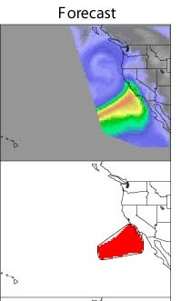
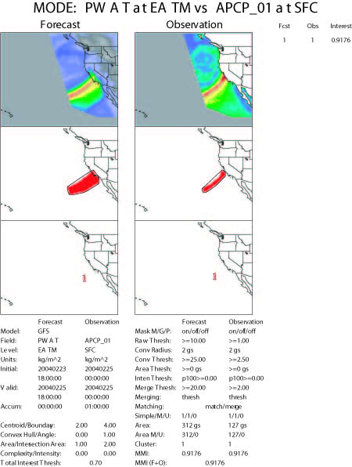
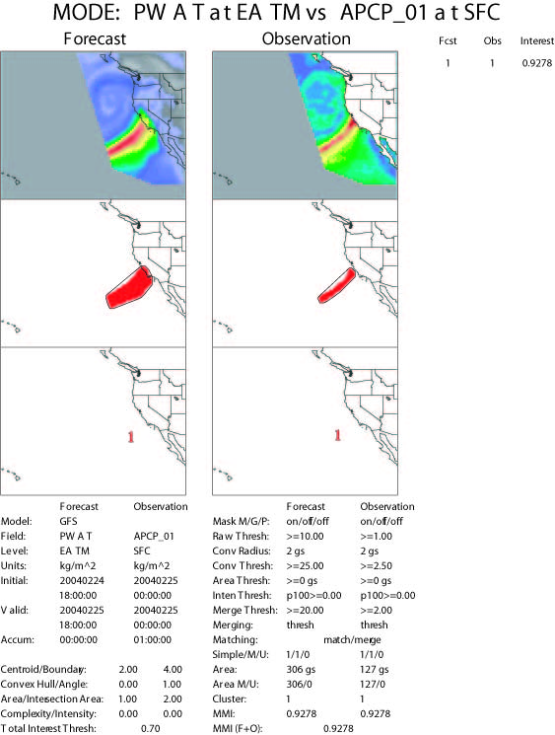
Example: PWAT / IWV
SSMI Integrated
Water Vapor
GFS Precipitable Water
Area=369
Area=312
Area=306
Area=127
72 hr
48 hr
24 hr

Slide 37
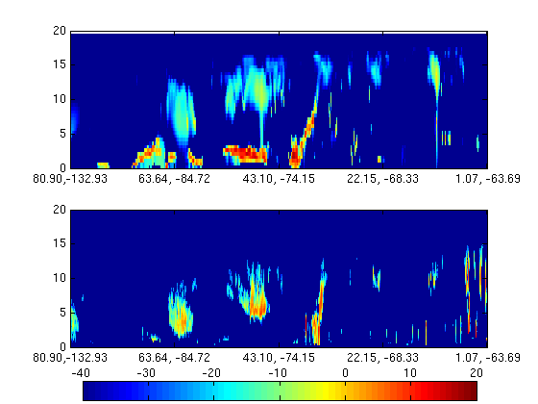
CloudSat/NWP Comparison: Object Based: Reflectivity
Model
CloudSat

Slide 38
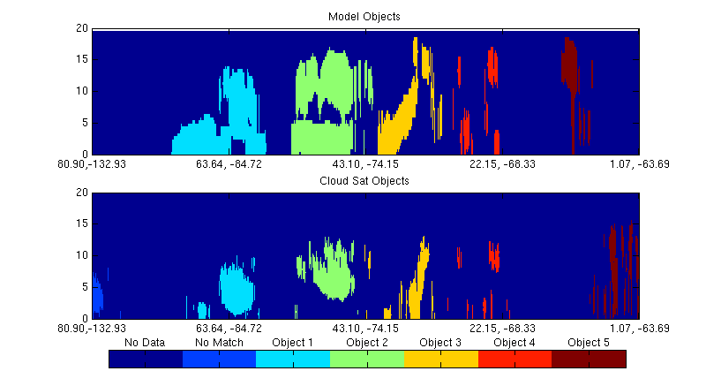
CloudSat/NWP Comparison: Object Based: Objects
Model
CloudSat

Slide 39
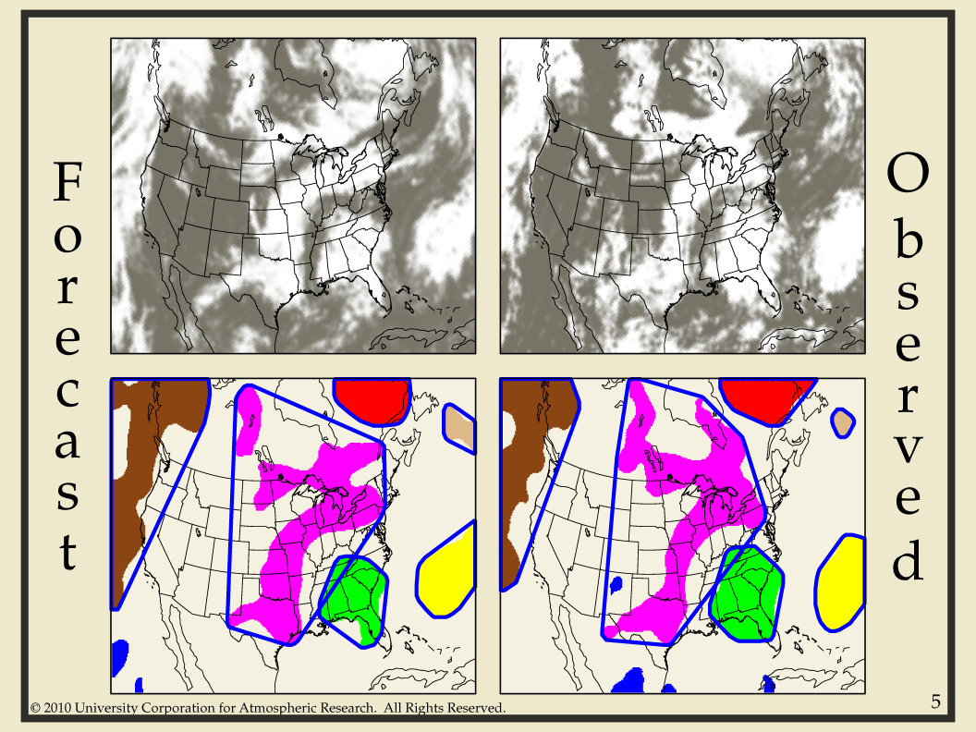

Slide 40
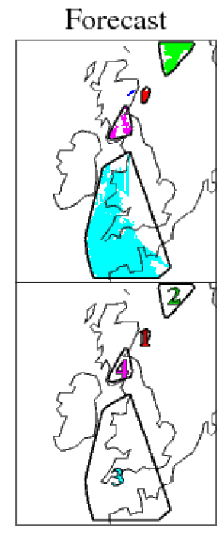
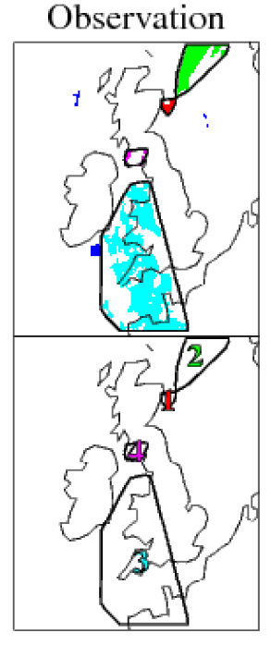
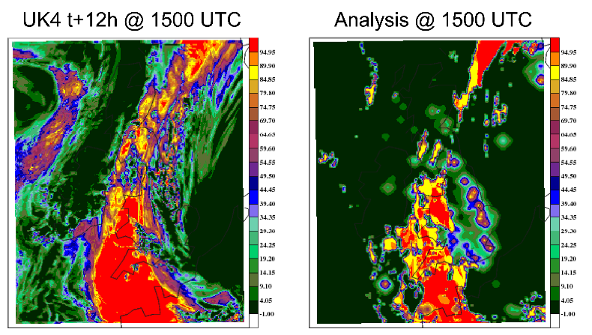
MODE Used on Non-Cloudy Areas
Clouds
Clear Sky
Cloud forecast objects would have taken up most of domain so non-cloudy areas were identified
Slide provided by M. Mittermaier, 2012

Slide 41
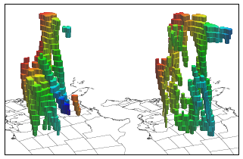
MODE Time DOMAIN
X, Y, Time
Great tool for high temporal resolution to look at forecast consistency and evolution
Planning to include in next release

Slide 42
Scale Decomposition
Grid Stat and Wavelet Stat

Slide 43
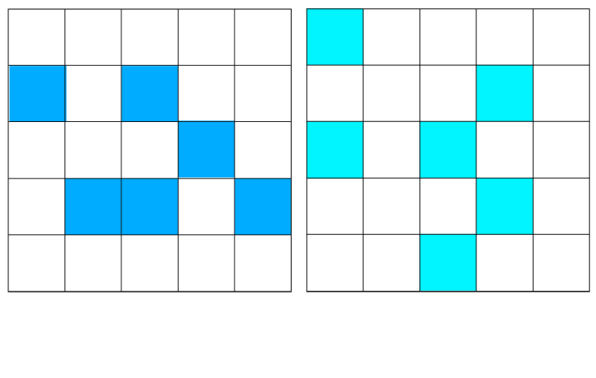
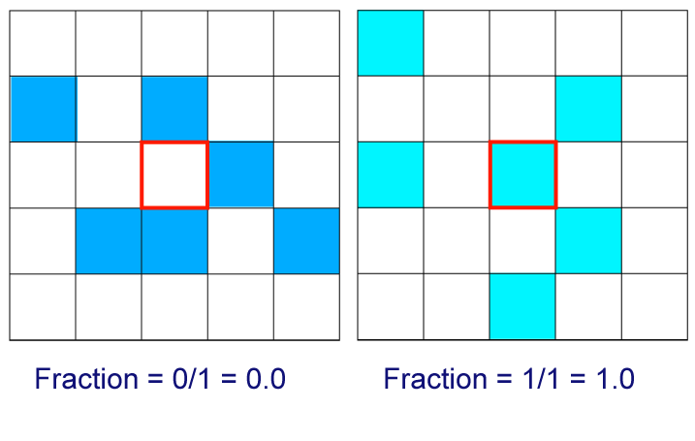

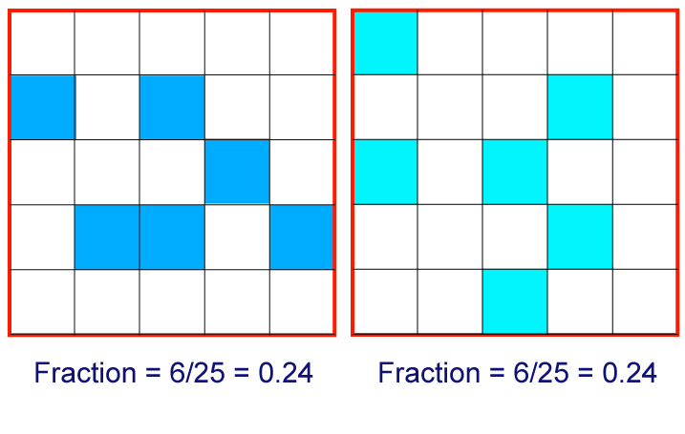
Neighborhood Methods:
Fractional coverage of events
Intensity threshold exceeded where squares are blue
observed
forecast
P is the fractional event frequency
within the neighborhood.
This is calculated for all n grid points in the domain
slide from Mittermaier

Slide 44
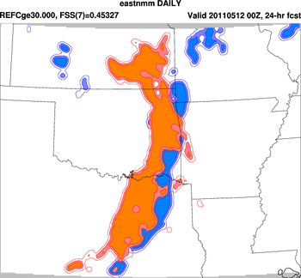
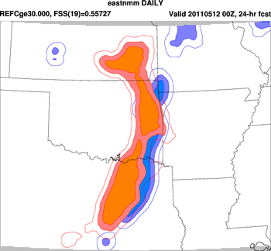
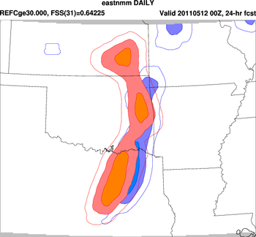
Example – REFC > 30 dBZ
Neighborhood
Size
FSS = 0.45
FSS = 0.56
Increase in FSS with increasing neighborhood
size is a characteristic of method and can be
attributed to the smoothing that occurs
FSS = 0.64

Slide 45
Ensembles
Ensemble Stat, Point Stat, Grid Stat and MODE

Slide 46
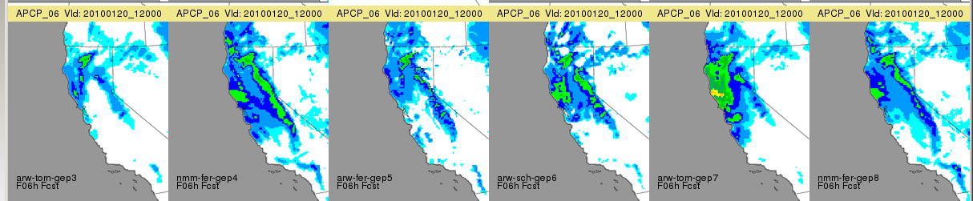
Ensemble Stat: Overview
Ensemble Stat primarily a pre-processing tool
  Mean, Spread, Mean + 1 STDev, Min, Max, Range, Number of valid members
Calculates rank histograms and outputs:
  Bins and Counts
  Matched Pair ranks

Slide 47
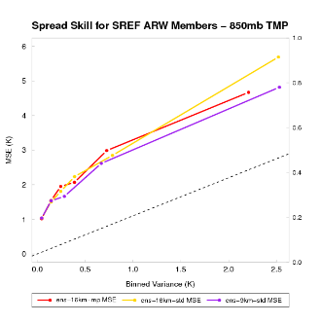
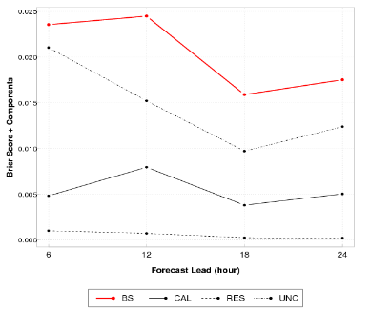
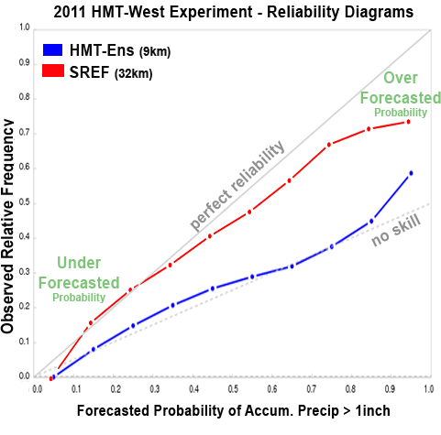
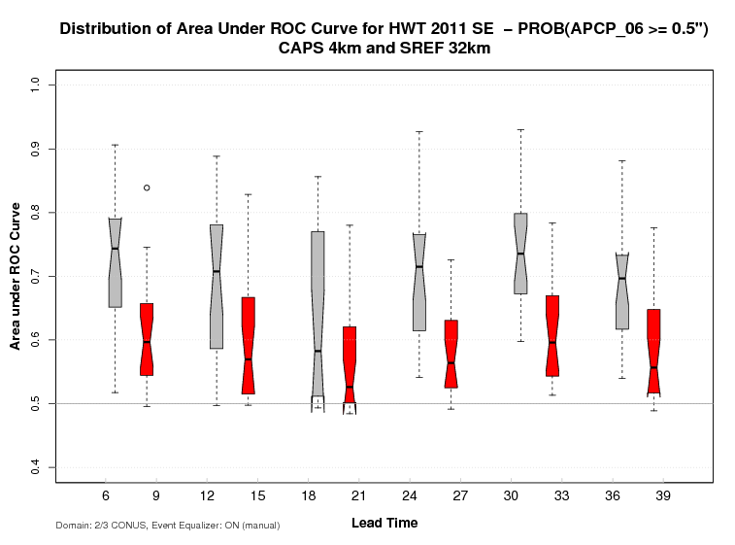
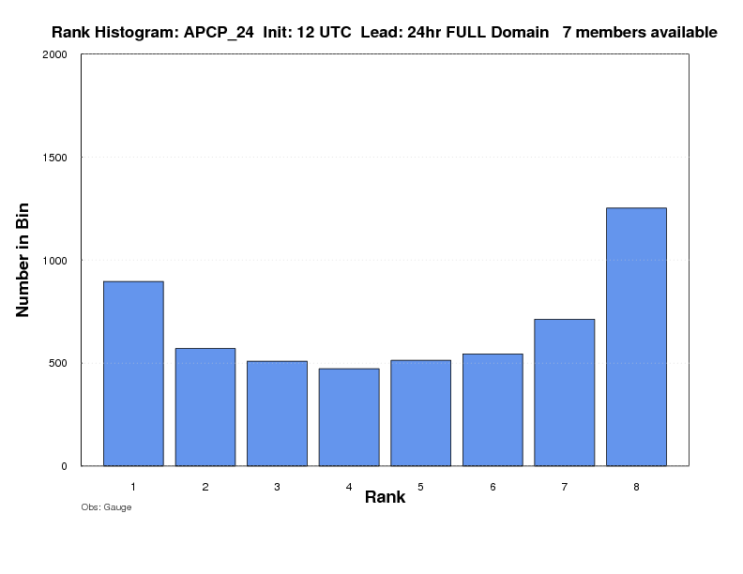
MET Ensemble and Probability Evaluation
Ensemble Characteristics (Ensemble Stat)
Probability Measures
(Grid and Point stat)
Rank Histogram
PIT
CRPS
Ignorance Score
Spread-Skill
Brier Score + Decomposition
Brier Skill Score
ROC and Area Under ROC
Reliability
MET v5.0 – PIT histograms
for comparison of
ensembles of different sizes

Slide 48
MET - TC
Verification for Tropical Cyclones

Slide 49
MET-TC components
Dark circles represent MET-TC modules
Light boxes represent input/output
Primary functions of the code are:
  Compute pair statistics from ATCF input files
  Filter pair statistics based on user specifications
  Compute summary statistics

Slide 50

TC_DLAND
Aids in quickly parsing data for filter jobs:
  Only verify over water
  Threshold verification based on distance to land
  Exclusion/inclusion of forecasts within a specified window of landfall
Input: ASCII file containing Lon/Lat coordinates of all coastlines/islands considered to be a significant landmass. (aland.dat)
Output: gridded field representing distance to nearest coastline/island in NetCDF format
MET v5.0 release will be able to process global datasets (e.g. aland.dat, sh.dat, wland.dat)

Slide 51
TC_PAIRS
Produces pair statistics on independent model input or user-specified consensus forecasts
Matches forecast with reference TC dataset (most commonly Best Track Analysis)
Pair generation can be subset based on user-defined filtering criteria
ASCII pair output allows for new or additional analyses to be completed without performing full verification process

Slide 52
TC_STAT
Provides summary statistics and filtering jobs on TCST output
Filter job:
  Stratifies pair output by various conditions and thresholds
Summary job:
  Produces summary statistics on specific column of interest
Input: TCST output from tc_pairs
Output: TCST output file for either filter or summary job
MET v5.0 release will have more flexible definition of Rapid Intensification and Rapid Weakening events for diagnostic studies

Slide 53




Graphics tools-examples
MET-TC: Introduction | Getting Started | TC-dland | TC-pairs | TC-stat | Graphics

Slide 54
Different uses of MET
Researchers
  Compile statistics for thesis and dissertation
  Diagnostic case studies
  Input of neural network applications
  Evaluation of climate models (in development)
  Tracking evolution of systems
Operational Centers
  WPC uses MODE systematically
  Saudi Arabian Presidential Ministry of Environment – part of their real-time NWP system
  The Met Office – diagnostic studies
  Indian Met Department and National Center for Medium Range Weather Forecasts – systematic evaluation of components and diagnostic case studies

Slide 55




Thank Yous and Further Information
DTC would like to thank you for your interest and the assistance of all of our collaborators…
JNT: http://www.ral.ucar.edu/jnt
DTC: http://www.dtcenter.org
MET: http://www.dtcenter.org/met/users
Email: jensen@ucar.edu
met-help@ucar.edu
Support for the Developmental Testbed Center (DTC),
is provided by
NOAA, AFWA
NCAR and NSF

