Slide 1
20 years of ensemble prediction at ECMWF
Roberto Buizza
European Centre for Medium-range Weather Forecasts
Acknowledgement: everyone at ECMWF,
in particular people in the Research Department
and the Predictability Division.

Slide 2

1975 > 1992 > 2012: from 10d-single to 13m-ensemble fcs
1975-1990
1990-2010
2030
F(x,t)
0 10 100 1000
Forecast day
0 10 100 1000
Forecast day
0 10 100 1000
Forecast day
Notes:
Forecasting have been evolving and improving:
1980: single forecast, up to 10d, at synoptic scale, of atmosphere and land
2005: probabilistic forecasts, up to 6 months, at convective scale, of atmosphere, land and ocean
2030: probabilistic forecasts, up to ~ 2 years, at 10 km, of the atmosphere with chemistry, land, rivers, oceans

Slide 3
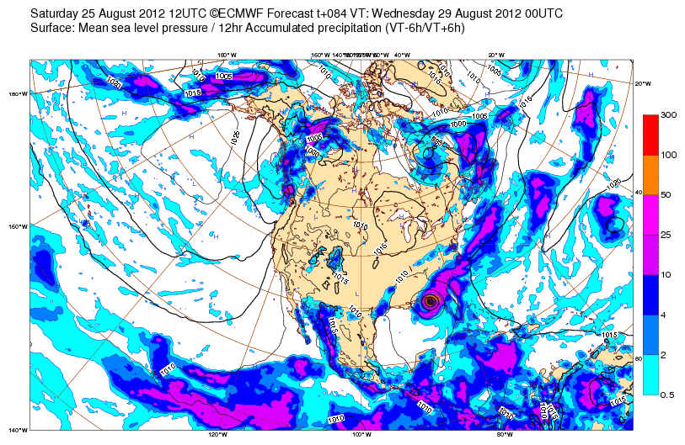
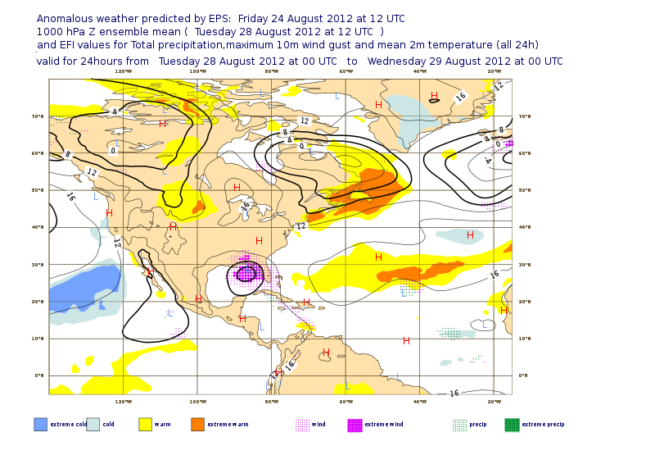
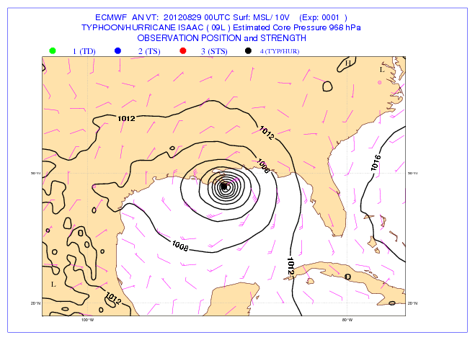
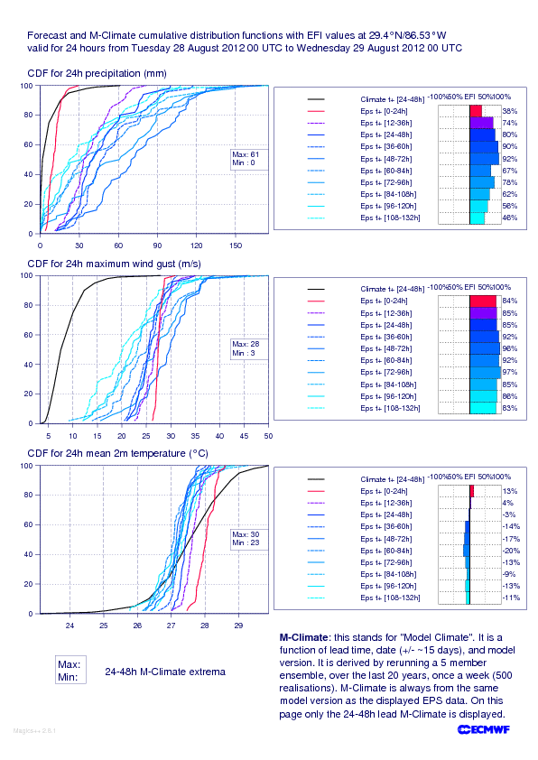
1975 to 2012: from single to probabilistic forecasting
Isaac, 29 Nov 2012
Notes:
Before 1992 we were issuing only single forecasts. Only statistics of past events could have been used to estimate the potential skill of a forecast (flow independent estimation based only of past cases: new cases, and flow dependent aspects were not considered). Today, forecasts include a whole range of possibilities, PDF of forecasts, and forecasts products based on the comparison of current and climate PDFs.

Slide 4
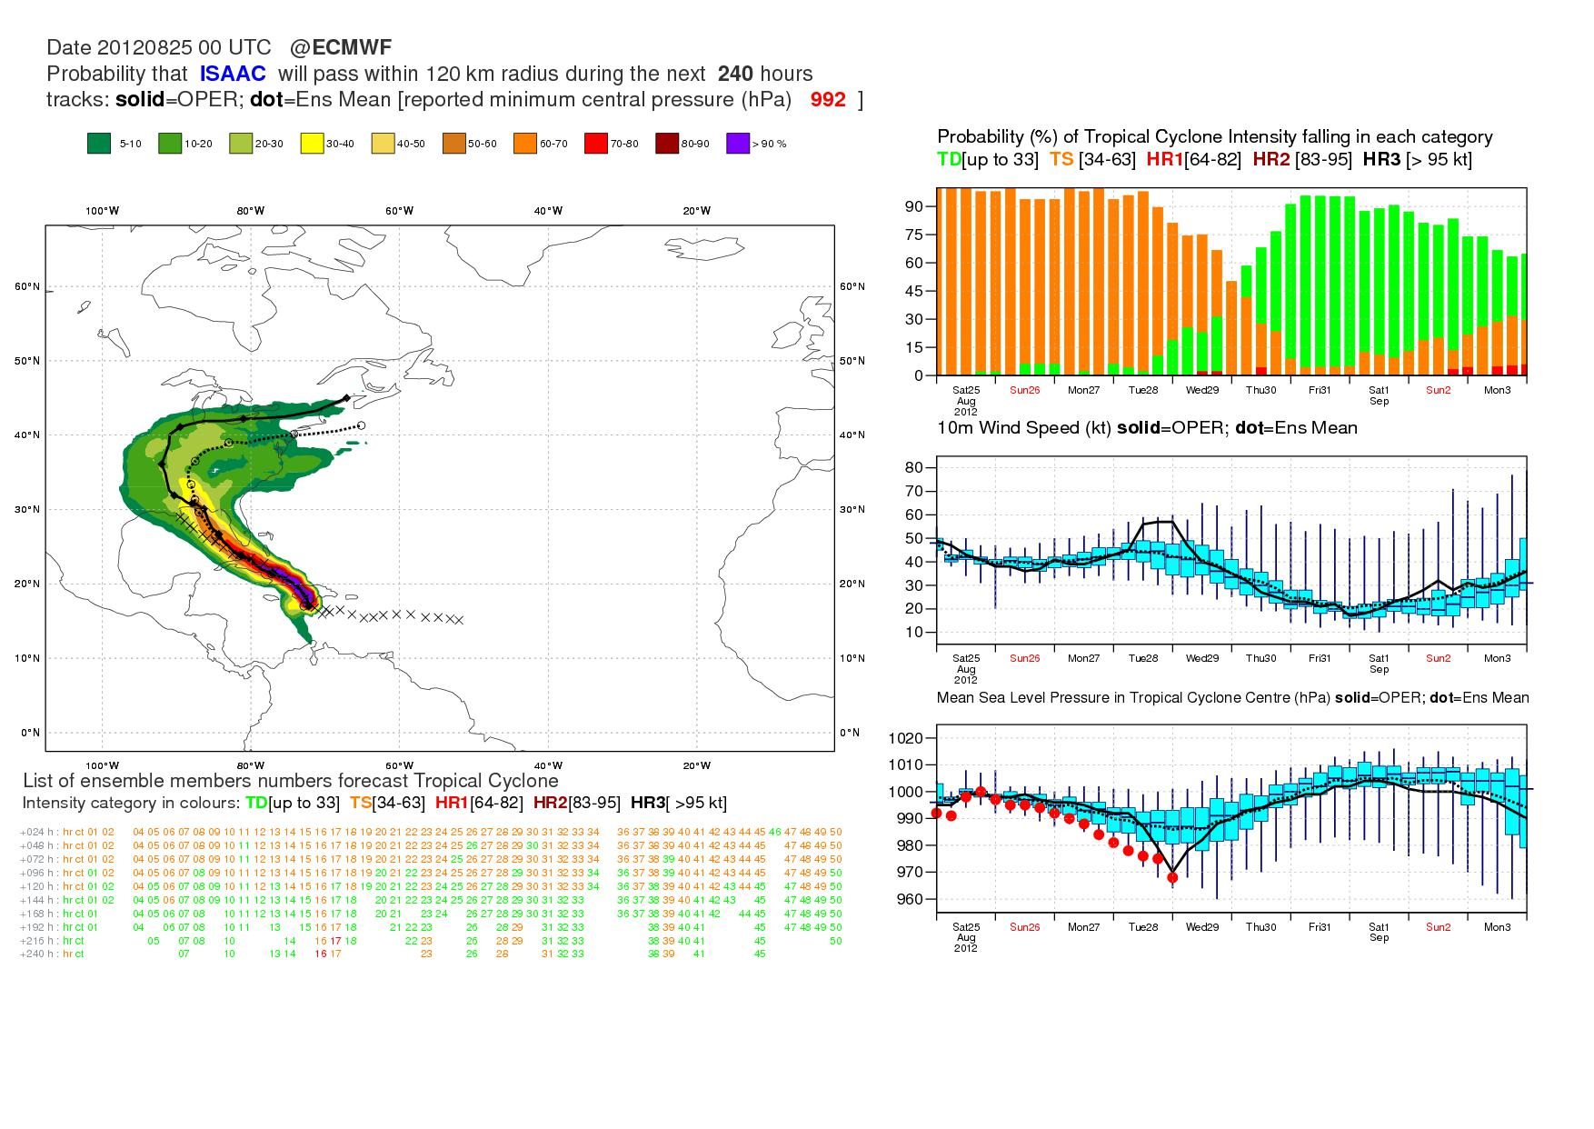
1975 to 2012: from single to probabilistic forecasting
TC Isaac
19 Aug 2012 + 240h
(from F Prates)
Notes:
Isaac TC, 29 August 2012, New Orleans. 10 day strike probability, and forecast distribution of intensity, 10m wind speed and MSLP. The observed MSLP is inside the range spanned by the EPS.

Slide 5
Ensembles: why?
To predict the most likely scenario and its uncertainty
To predict the time evolution of the probability density function of forecast states
To estimate the forecast confidence
This has to be applied also at initial time.
Temperature
Temperature
fc_{j}
fc₀
PDF(t)
reality
PDF(0)
Forecast time
Notes:
Single forecasts fail due to a combination of initial and model uncertainties, and that the problem is made extremely complex by the chaotic nature of the atmosphere. Does it make sense to issue single forecasts? Can something better be done? More generally, what is the aim of weather forecasting? Should it aim to predict only ‘the most likely scenario’, or shall it try also to predict its uncertainty, i.e. the probability that different weather conditions can occur? A complete description of weather prediction can be stated in terms of an appropriate probability density function (PDF). Ensemble prediction based on a finite number of deterministic integration appears to be the only feasible method to predict the PDF beyond the range of linear growth. Products should all be probabilistic: analysis and forecasts PDFs.

Slide 6
Ensembles: how do we do them at ECMWF?
PDF(0) << 4DV+EDA²⁵+ORAS4⁵
PDF(0) << ERA-I+ORAS4⁵ (refc suite)
PDF(T) << HRES+ENS⁵¹/S4⁵¹
EDA²⁵
ERA-I
ENS⁵¹
S4⁵¹
HRES
4DV
ORAS4⁵
System components simulate the effect of:
Observation uncertainties
Model uncertainties (2 stochastic schemes)
Notes:
At ECMWF, systems are designed to provide users with the whole PDF of initial condition and forecast states. 4DV+EDA+ORAS4 provide the best estimate of the ICs of the atmosphere and the ocean plus their uncertainty. ERA+ORAS4 provide the IC estimate and uncertainty for the past (30y). HRES+EPS provide an estimate of the PDF of forecast states (i.e. not just the most likely scenario but also probabilities of any event).

Slide 7

Ensembles: how do we do them at ECMWF?
EDA²⁵
T_{L}399L137
HRES
T_{L}1279L137 (d0-10)
EPS⁵¹
T_{L}639L91 (d0-10)
T_{L}319L91 (d10-15/32)
Seasonal S4⁵¹
T_{L}255L91 (m0-7/12)
Atmospheric model
Atmospheric model
Wave model
Wave model
Ocean model
ORTAS4 Real Time Ocean Analysis ~8 hours
ORAS4 Delayed Ocean Analysis ~12 days
Notes:
Ocean data assimilation with 10-day window every 10 days. Forcing from ocean to atmosphere through SST+ocean currents (wave model), vice versa through P-E, wind stress, heat flux.

Slide 8
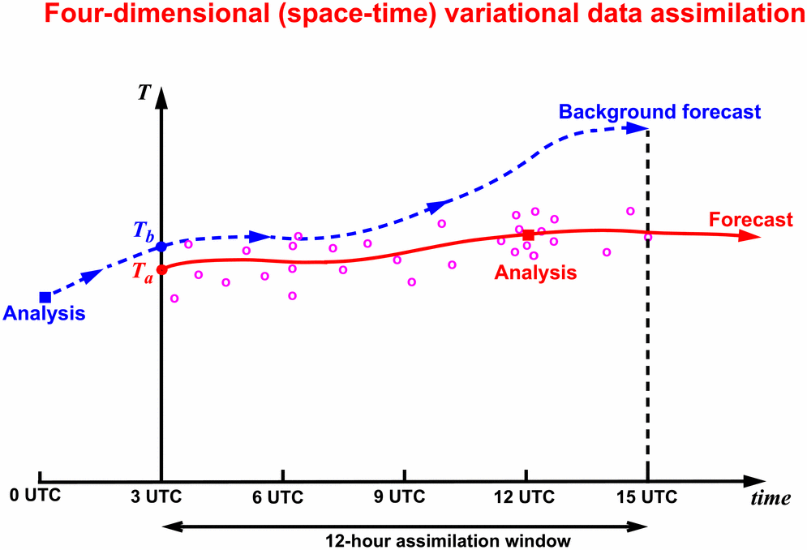
The ECMWF Ensemble of Data Assimilations (EDA)
Each observation has an error (instrument, representativeness) and also each model trajectory should take model error into account.
A way to simulate both these effects is to follow an ensemble approach.
Notes:
Each observation has an error (instrument, representativeness) and also each model trajectory should take model error into account.
A way to simulate both these effects is to follow an ensemble approach, whereby an ensemblf of 4D-Var assimilations are run, with each obs perturbed and each model trajectory computed with a stochastic model error scheme.
Results presented later are based on data-assimilation experiments run with the following version of the ECMWF data-assimilation/forecasting system:
12-hour 4-dimentional Variational Data Assimilation System (4D-VAR)
Resolution:
Outer loops at T_{L}511L60
Inner loops at T_{L}159L60 resolution (50 iter) and T_{L}95L60 (70 iter, reduced phys)
Same set-up as ECMWF early-delivery suite used in operation
From each analysis, 10-day T_{L}511L60 forecasts have been run.

Slide 9
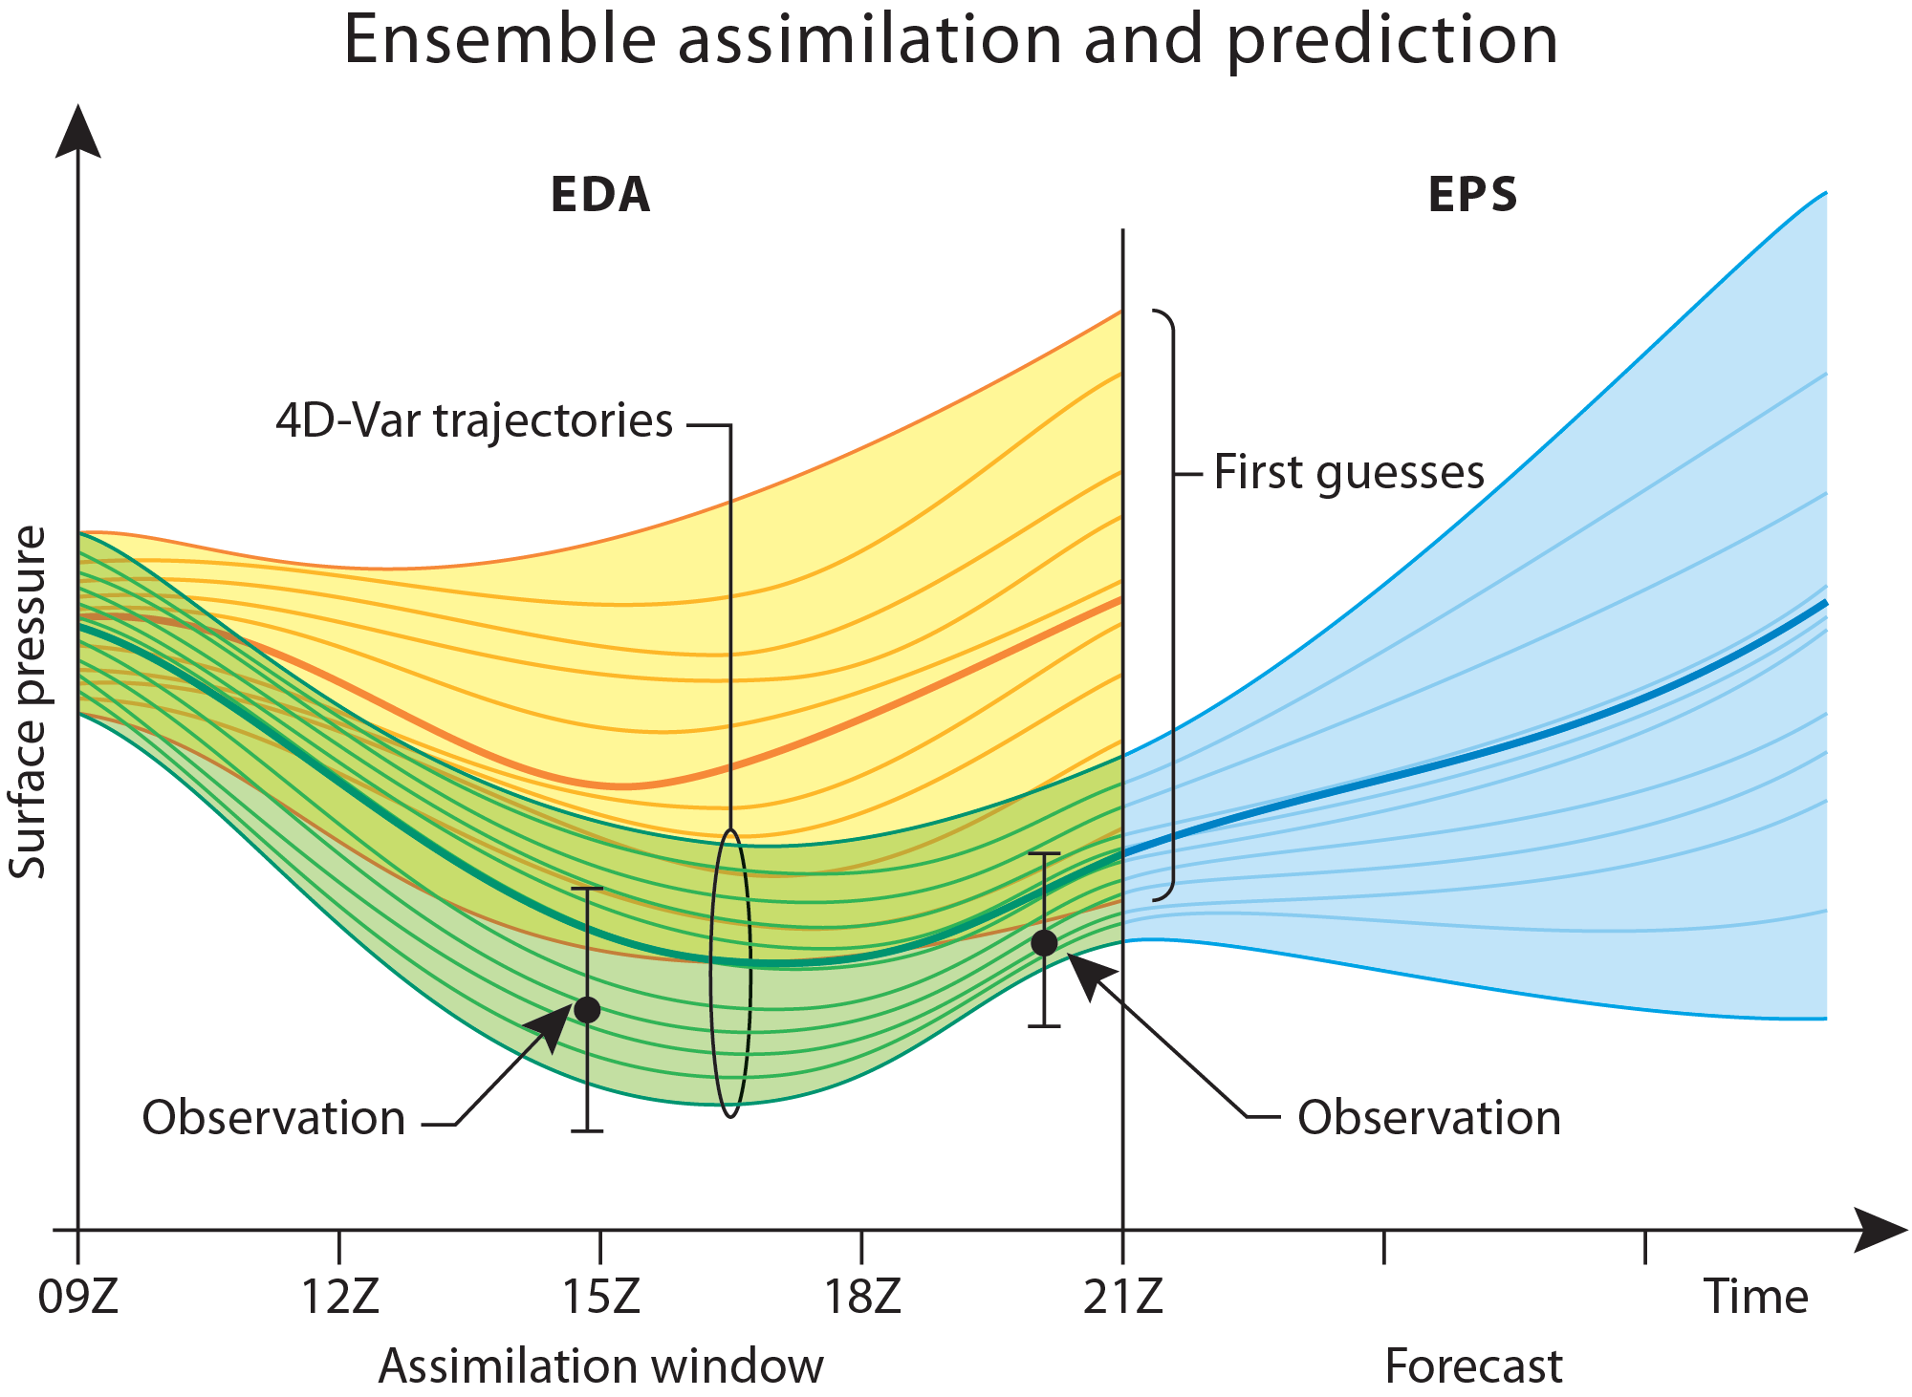
EDA+ENS to provide uncertainty estimates at all times
Ensemble Data Assimilation
(EDA)
Ensemble Forecasts
ENS

Slide 10
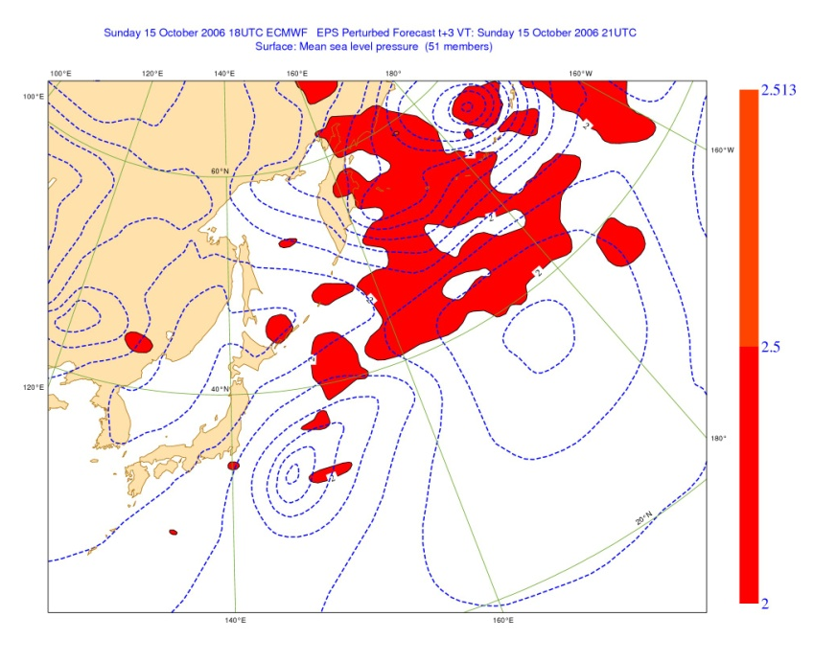
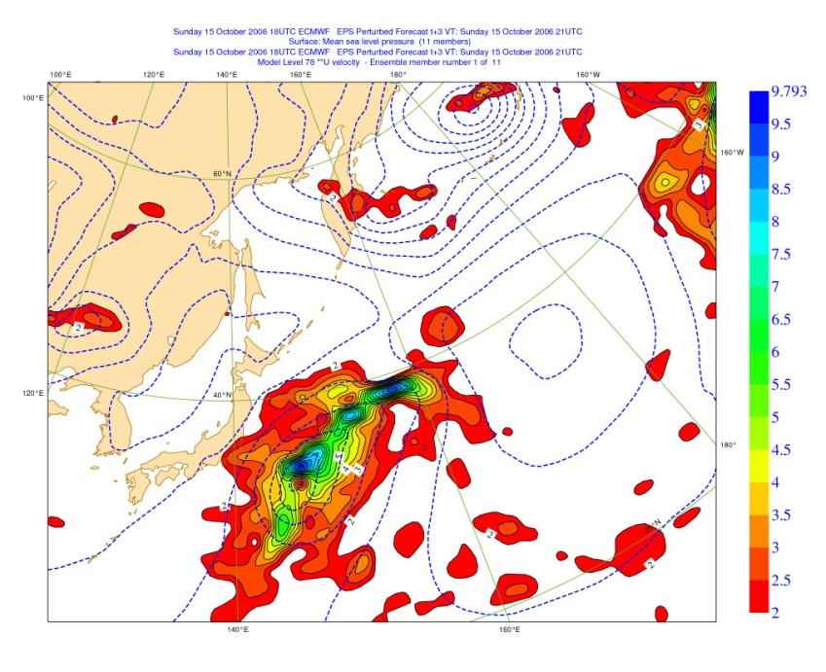
EDA to provide flow-dependent analysis error var/covar
At initial time, the EDA captures the flow-dependent analysis uncertainty due to observation and model uncertainty.
U850 background error standard deviation
Randomization method (left) – EDA (from cy36r4, right)
(from M Bonavita)

Slide 11
ENS to predict the probability of severe weather
By comparing the model climate CDF^{MCLI} and the forecast CDFs (coloured lines), we can define the Extreme Forecast Index (EFI) and predict extremes as seen by the model.
The EFI is the average difference between the CDF^{MCLI} and the fc CDF:
For example in figure:
MCLI=N(3.0,1.5)
FC_{A}=N(4.0,1.0) >> EFI_{A}=+40%
FC_{B}=N(5.0,0.5) >> EFI_{B}=+59%
M_{CLI}
FC_{A}
M_{CLI}
FC_{B}

Slide 12
The ENS re-forecast suite to estimate the M-climate
…28 6 13 20 27 March …
Following Thomas Hamill work, a re-fc suite is part of all ECMWF ensemble systems. Each day, the M-climate is estimated using 500 EPS re-forecasts:
20 years (1994 – 2013)
5 ICs (-14d,-7d,0,+7d, +14d)
5 members
Some of the ENS products (e.g. the Extreme Forecast Indices) are bias corrected and/or calibrated using the model climate.
51
T639
L91
51
T319
L91
2014
5
5
2013
5
5
5
5
5
5
5
5
5
5
2012
5
5
20y
5
5
5
5
5
5
5
5
2011
5
5
5
5
5
5
5
5
…..
5
5
1994
5
5
5
5
5
5
5
5

Slide 13
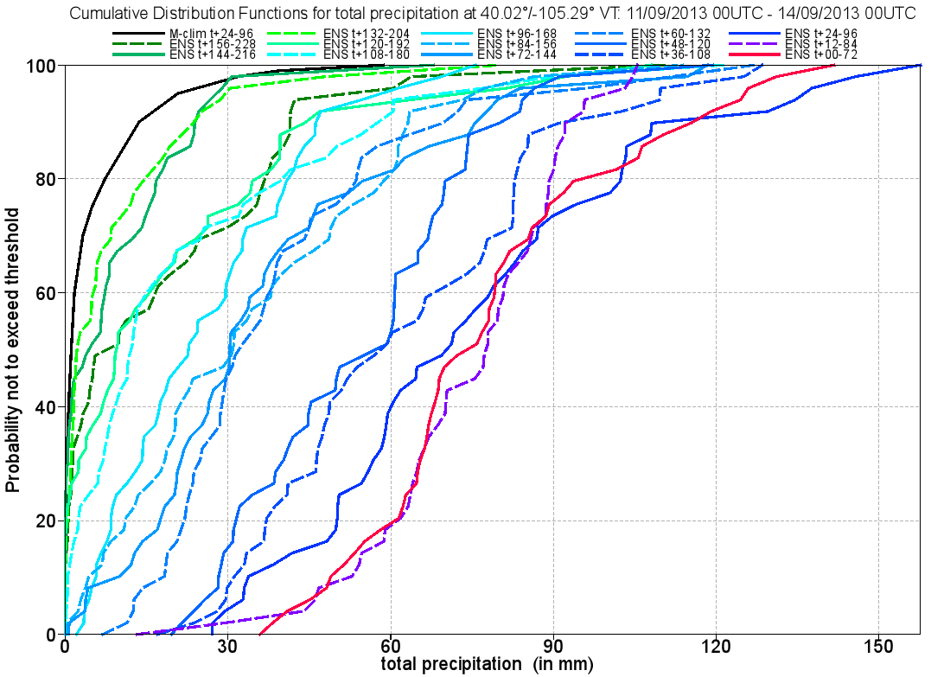
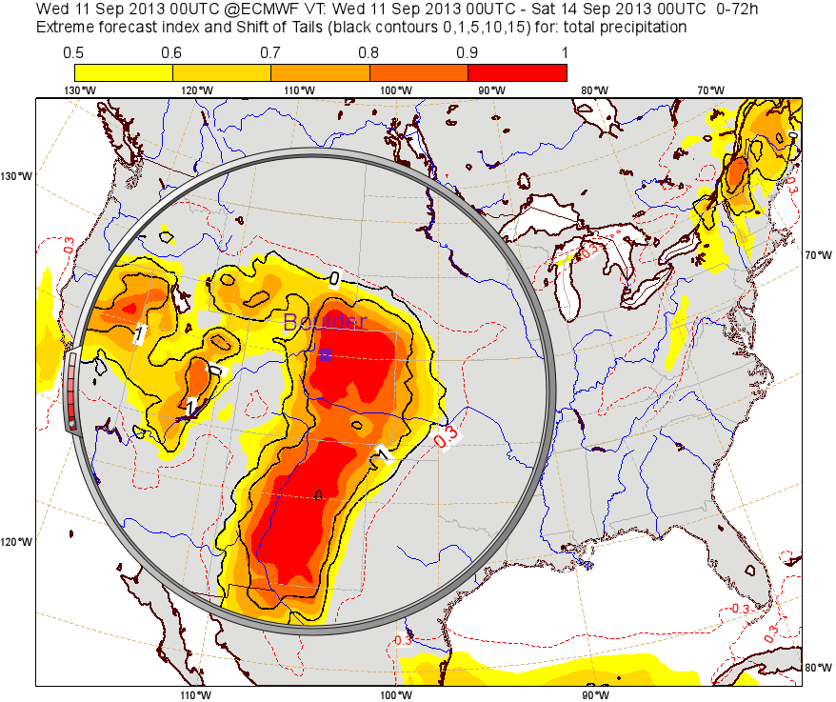
Boulder, ENS EFI for TP72 fcs vt 11@00UTC-14@00UTC
ENS t+0-72h Extreme Forecast Index
M_{CLI}
t+0-72h
t+96-168h
TP72 CDFs for Boulder
M_{CLI} max
The EFI reached high values (approaching 1) in the last few forecasts preceding the onset of the event, with ~10% of the ENS members predicting rainfall beyond the climate extreme (99th percentile of the model climate).
(From Ivan Tsonevski)
Notes:
The EFI reached high values (approaching 1) in the last few forecasts preceding the onset of the event. In earlier runs of ENS there was a certain proportion of ensemble members giving exceptional rain, exceeding the climate maximum, except in 2 runs at the beginning. Positive SOT shows that at least 10% of the ENS members are beyond the climate extreme (99th percentile of the model climate); the bigger the SOT values the more extreme event these members forecast.

Slide 14
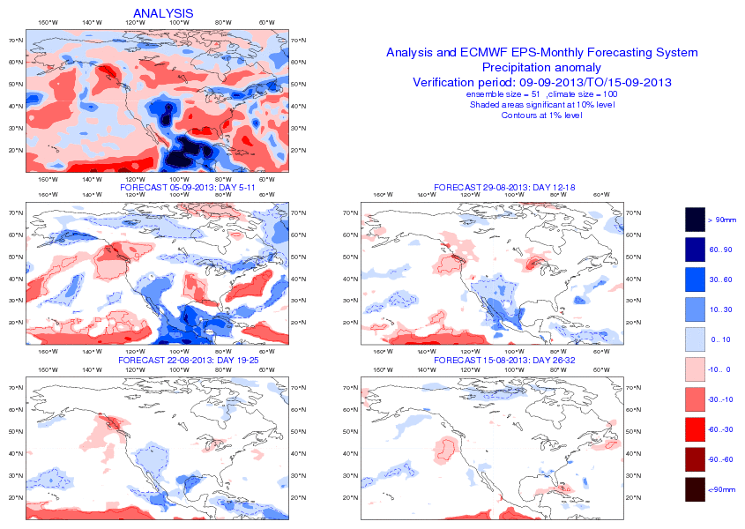
NA: ENS monthly fc of weekly-ave. precipitation anomaly
TP7d’
+w1 TP7d’
+w2 TP7d’
+w3 TP7d’
+w4 TP7d’
(From Fernando Prates)

Slide 15
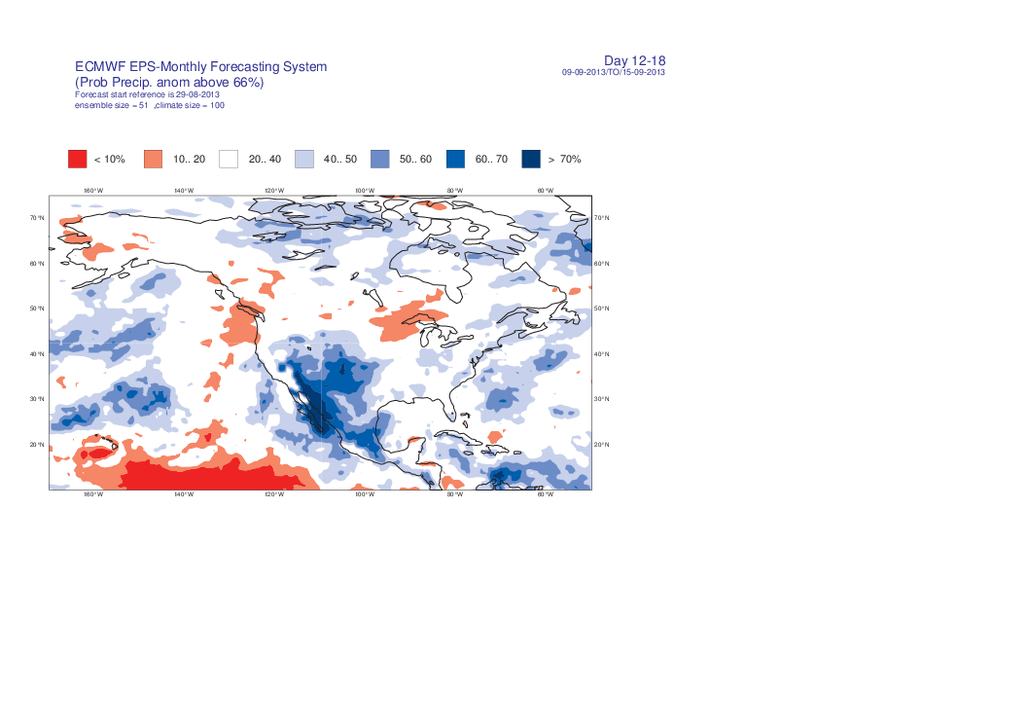
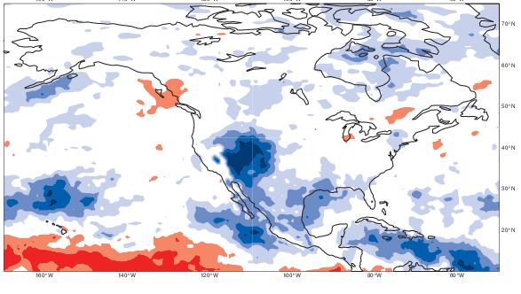
NA: ENS monthly fc of weekly-ave. precipitation anomaly
TP7d’
+w2 PR(TP7d’>66th)
+w2 TP7d’
+w3 PR(TP7d’>66th)
+w3 TP7d’
(From Fernando Prates)

Slide 16
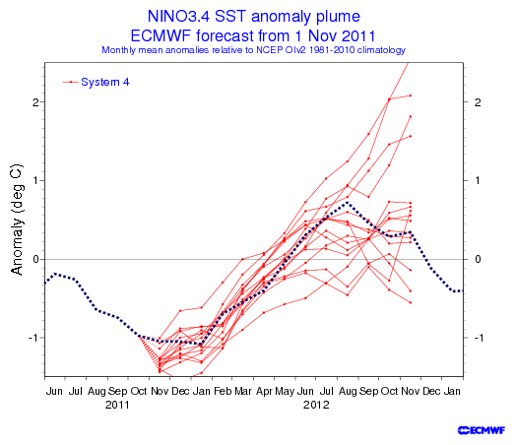
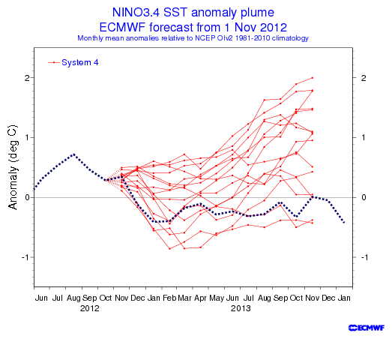
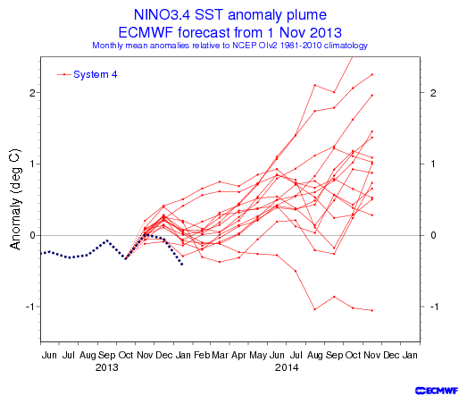
Seasonal system provides probabilities up to 1y
The tropics remain the area where seasonal prediction has the highest skill, as indicated e.g. by the accuracy of 1-year forecasts of SST anomaly in the Nino3.4 area.
1 Nov ‘11 > Nov ‘12
1 Nov ‘12 > Nov ‘13
1 Nov ‘13 > Nov ‘14
Notes:
The tropics is the area where seasonal predictability is higher, controlled mainly by ENSO, a coupled ocean-atmosphere phenomenon centred over the tropical Pacific. The ECMWF S3 13m integrations (generated every quarter, based on an 11-member ensemble) gave very good predictions of the most recent transitions:
2007>2008: from cold (la nina) to neutral anomalies;
2008>2009: from neutral to warm (el nino) anomalies;
2009>2010: from warm (el nino) to neutral anomalies.

Slide 17
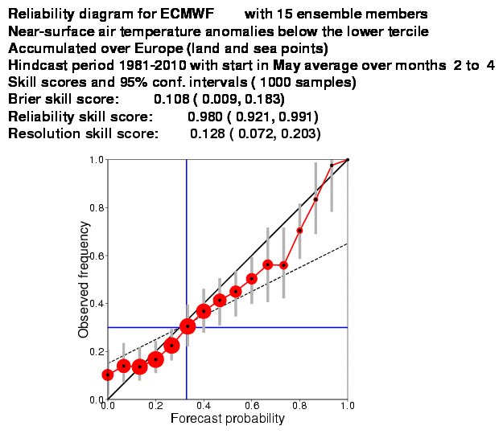
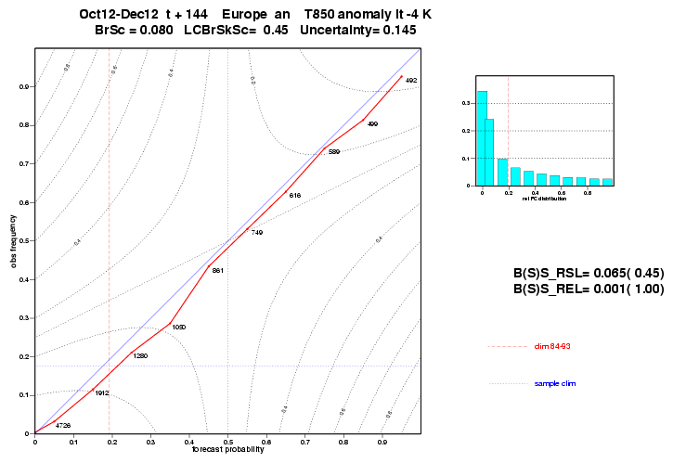
How do our ensembles perform? They must be reliable
Reliability is a key property that probabilistic forecasts must have.
Reliability: ENS T850 +6d fcs over Europe
Reliability: S4 2mT 1May +2m for JJA anomaly fcs

Slide 18
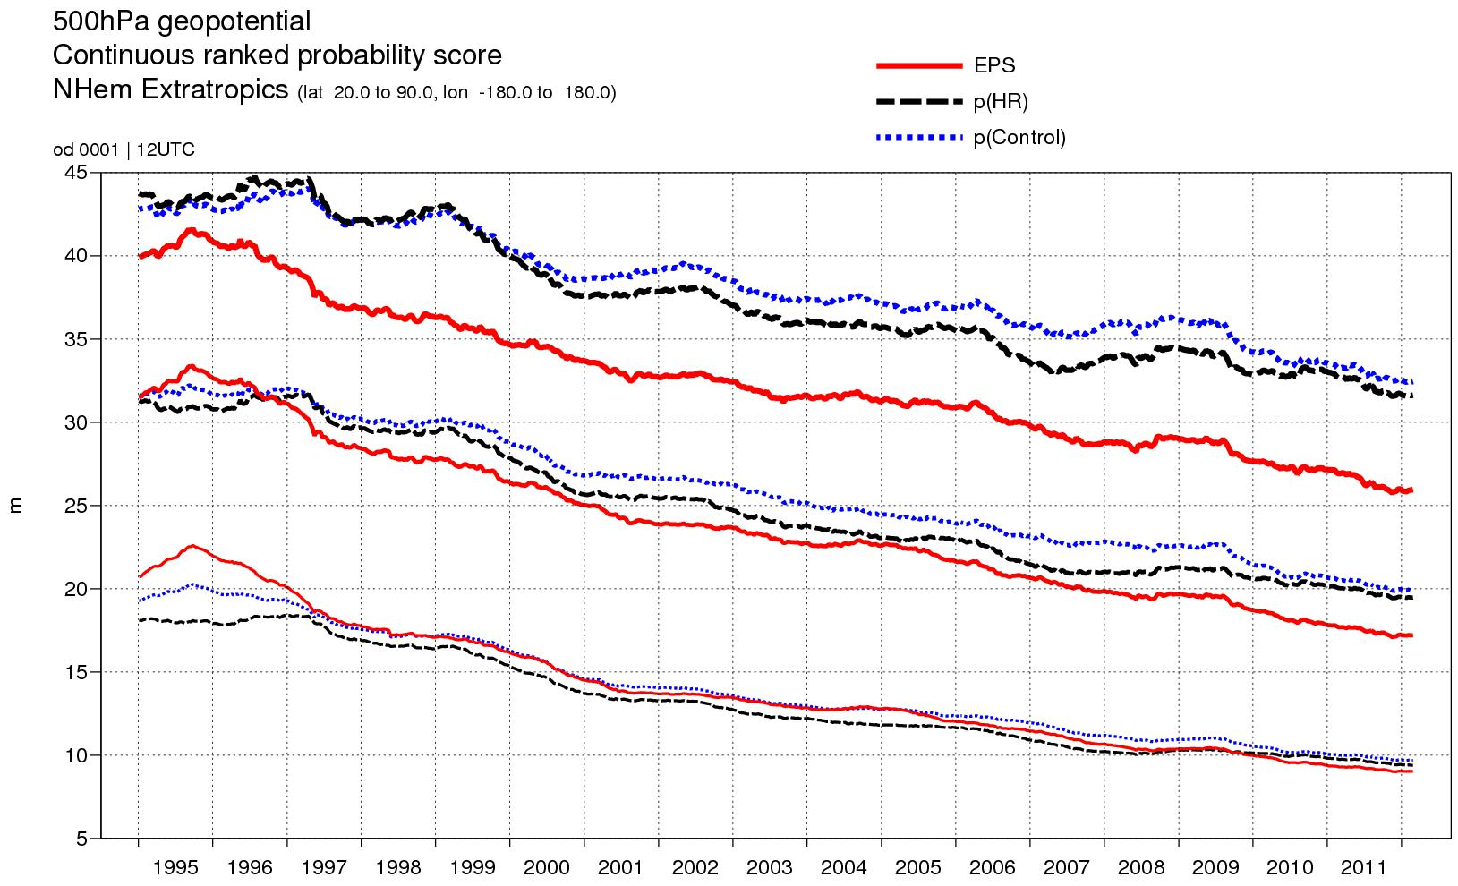
How do our ensembles perform? ENS v benchmark
+7d
+5d
+3d
N(CON,<e²>)
N(HRES,<e²>)
EPS
(from M Leutbecher)
Notes:
PFS - Extend Simmons and Hollingsworth (2002) to more years, include EPS, and relate skill of EPS and single forecasts.
Evaluate single forecast (e.g. the EPS control) and the EPS with the same score: EPS →CRPS; single fc→MAE
Convert single forecast into probabilistic forecast: fc → N(fc,<mse>)
<mse> from past 30 days verifying prior to initial time of forecast
Apply to EPS control, High-res. and ERA-Interim forecasts
Difference in skill between the EPS and the probabilistic version of the control forecast measures impact of changes affecting the EPS perturbations.

Slide 19
How do our ensembles perform? ENS MJO & NAO
NH – NAO (11d)
TR – MJO (26d)
The skill of monthly forecasts have been continuously improving both in the tropics for the MJO (top left) and the extra-tropics for the NAO (top right).
Improvements in the physics have led to better teleconnection between tropics and extra-tropics (bottom).
(From F Vitart)
Notes:
PFS -

Slide 20
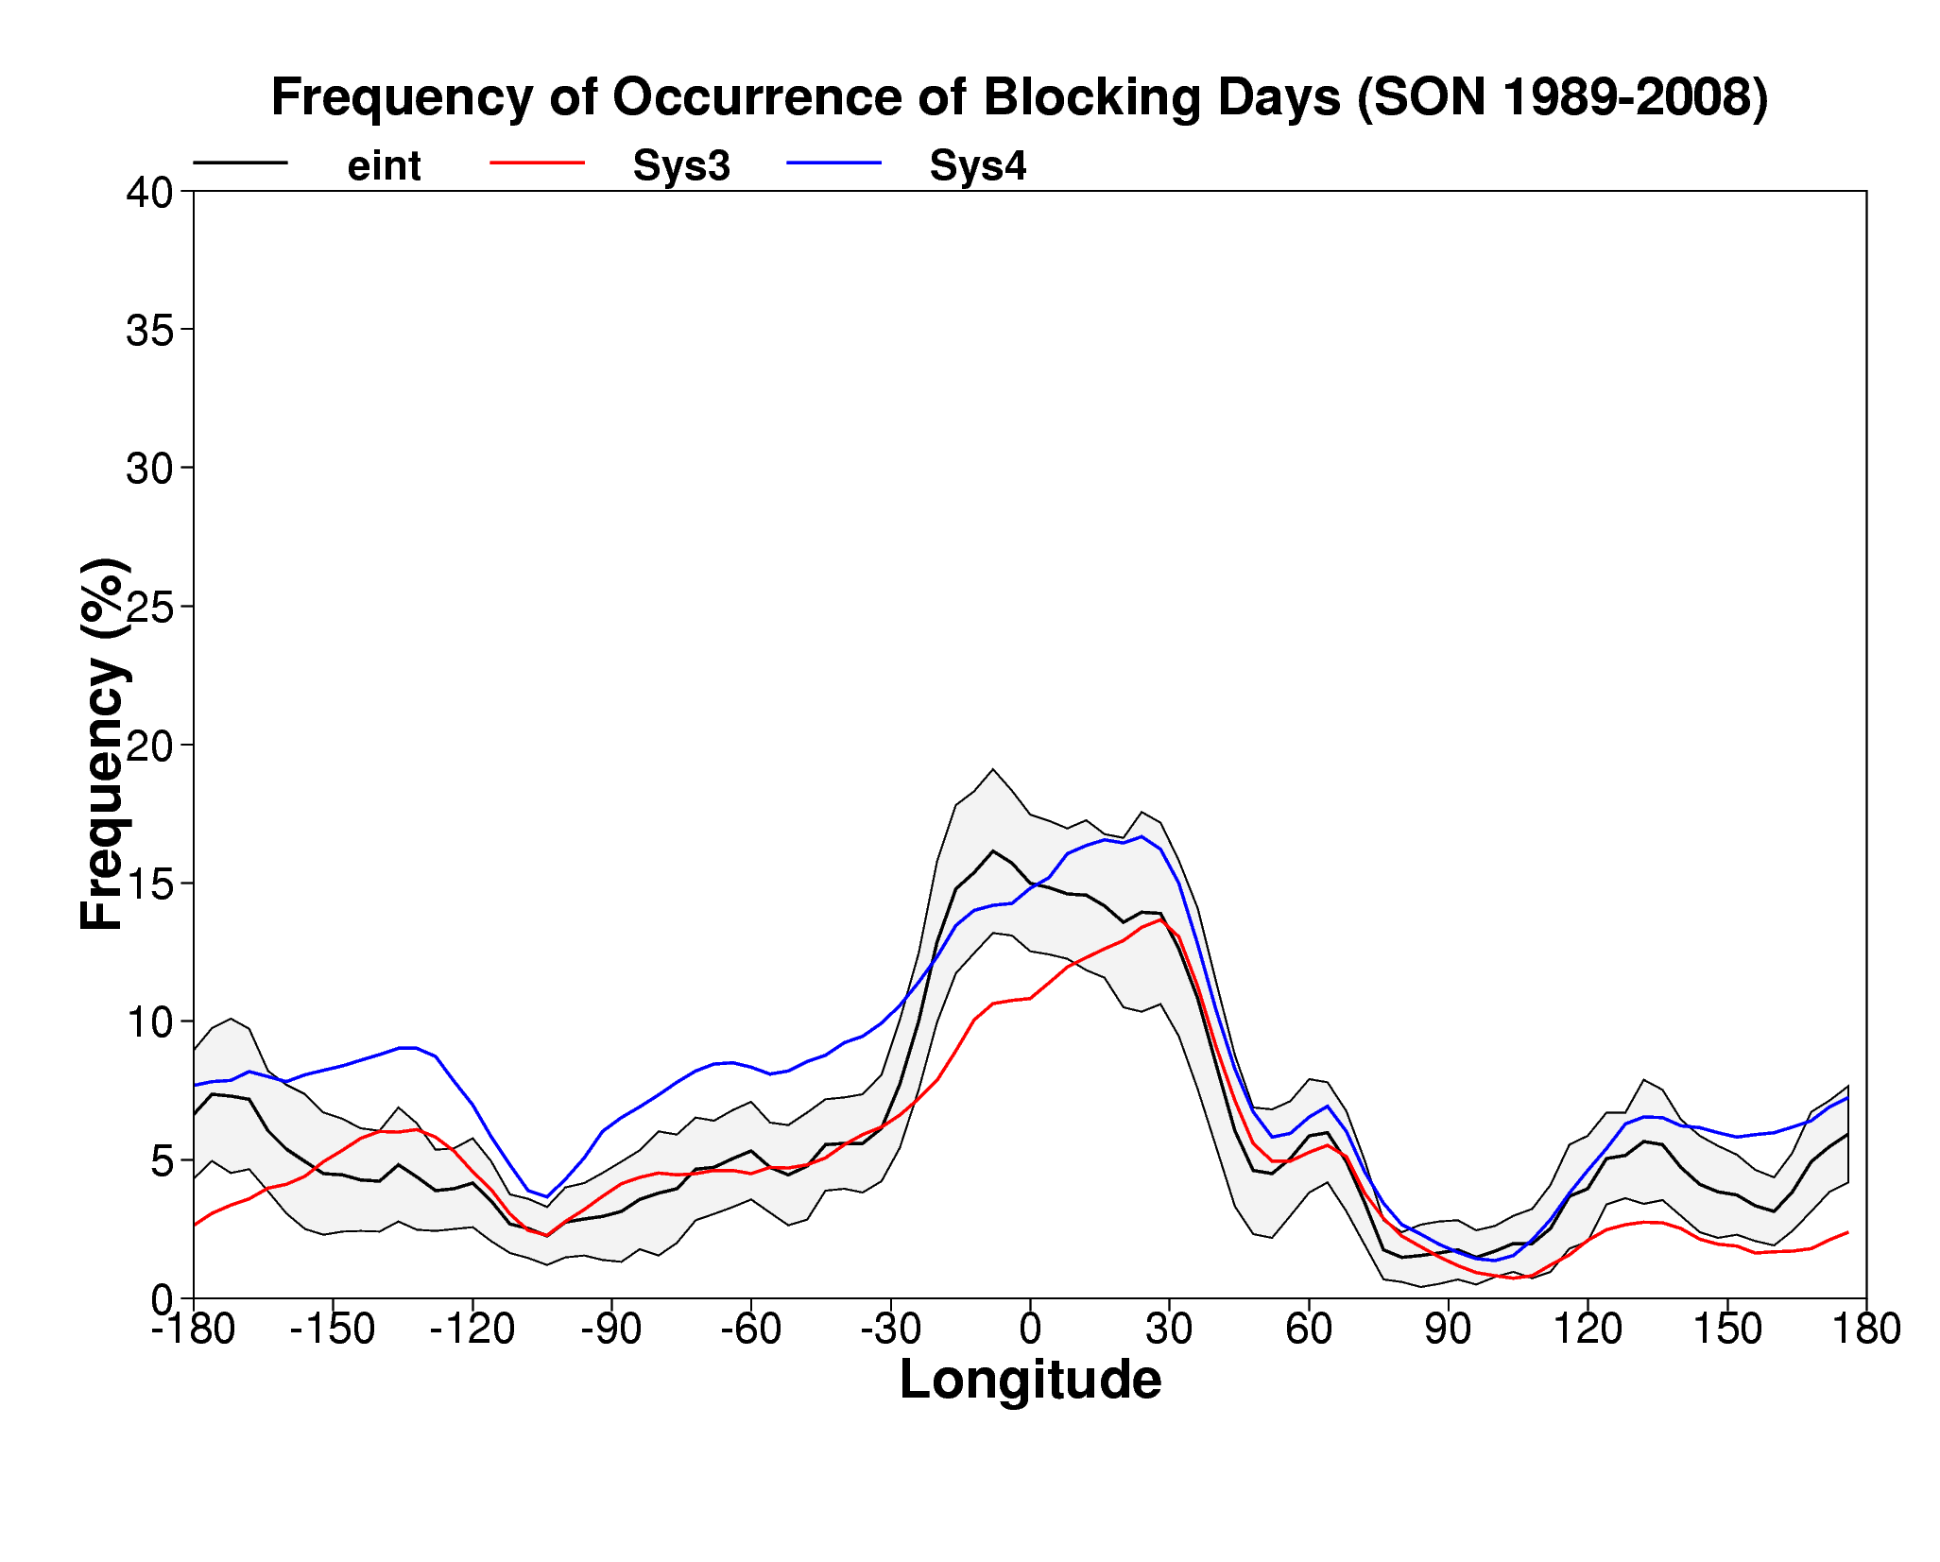
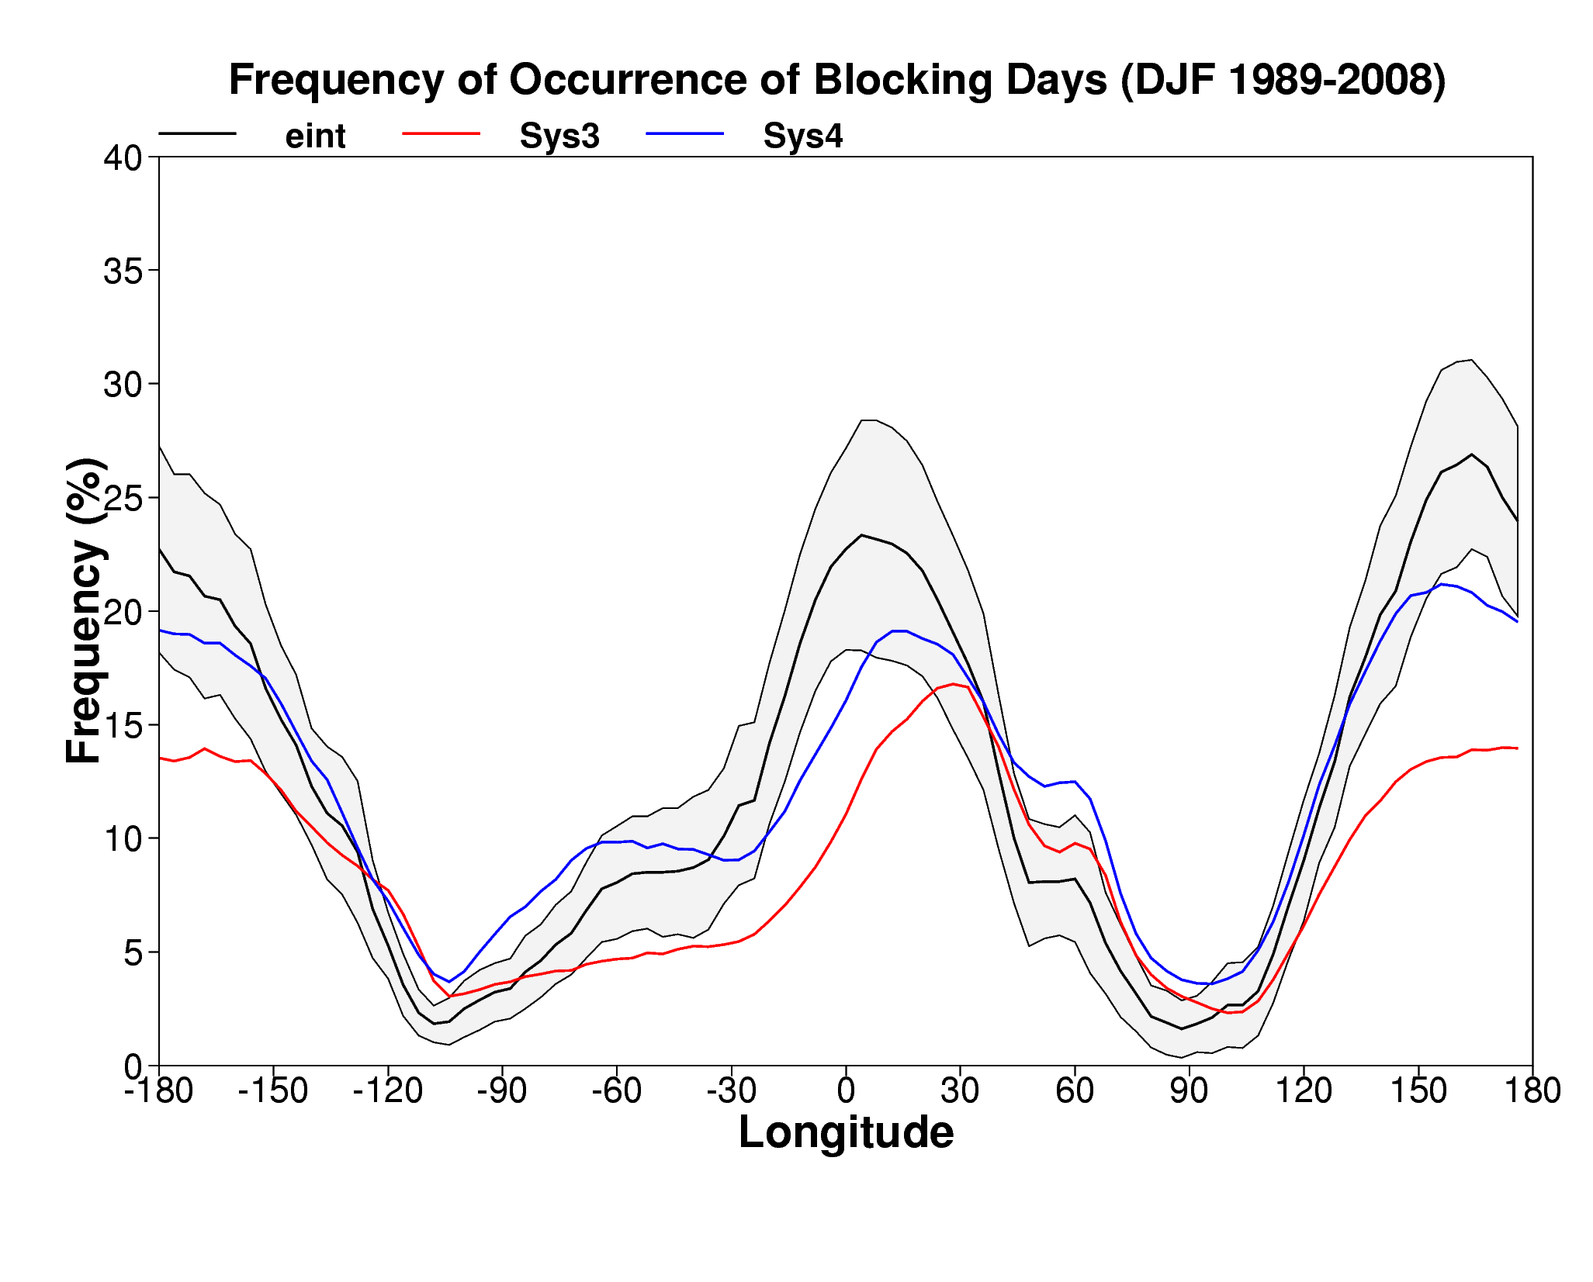
How do the ensemble perform? S3 & S4 blocking statistics
S4 (blue lines) shows in general better blocking statistics than S3 (red lines) over both the Euro-Atlantic and the Pacific sectors.
SON
ERA-Interim
System-4 (S4)
System 3 (S3)
DJF
Notes:
MAS/PFS – S4 blocking statistics are closer to the ERA-Interim than S3, confirming the improvements between S3 and S4:
- S3: cycle 31r1 (operational in 2007), HOPE ocean model, HOPE-OI initialization, T159L40 resolution, TOA at 5hPa, 41-member forecasts, 11-member x 25y hindcasts (1981-2005)
- S4: cycle 36r4 (operational in 2011), NEMO ocean model, NEMOVAR initialization, T255L91 resolution, TOA 0.01hPa, 51-member forecasts, 15-member x 30y hindcasts (1981-2010)

Slide 21
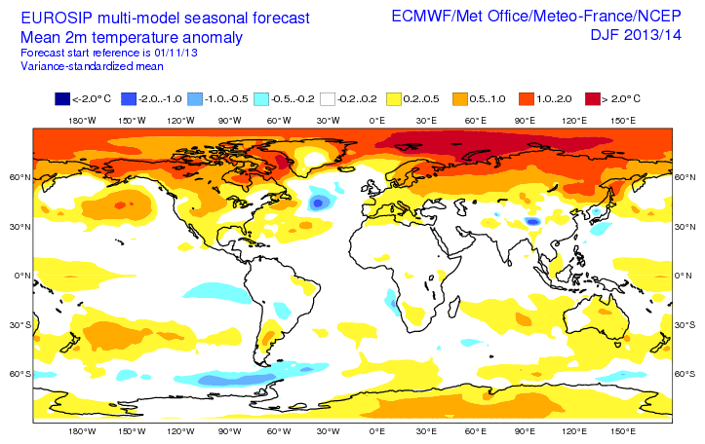
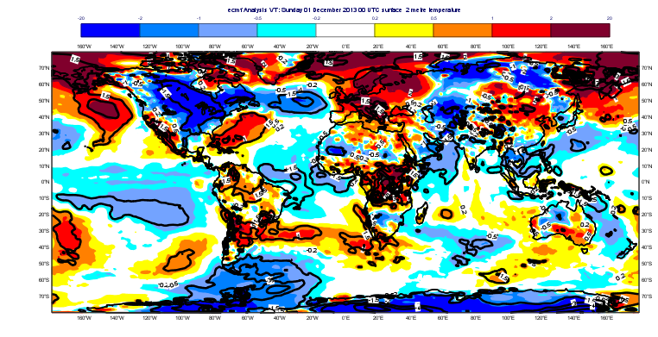
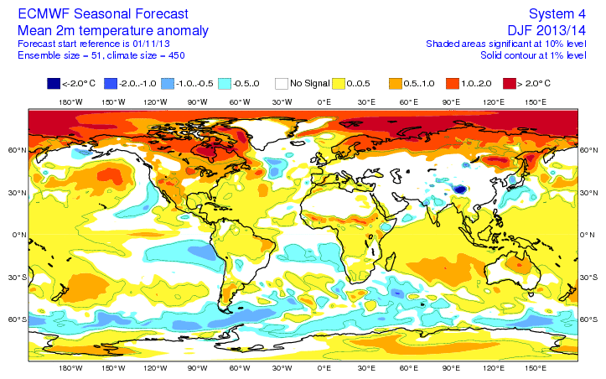
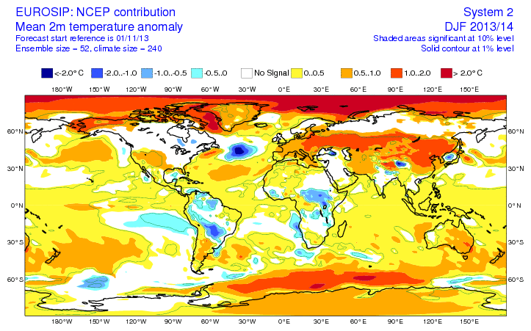
How do the ensemble perform? EUROSIP, D13JF14
(from Laura Ferranti)

Slide 22
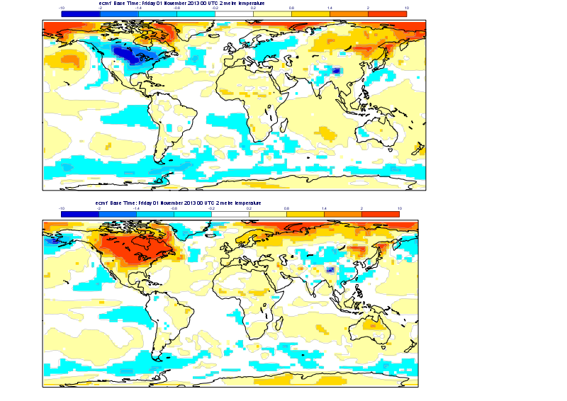
How do the ensemble perform? S4, D13JF14
2m temp anomalies composite
for members with 2mt over North America below/above -/+ 1 σ
(from Laura Ferranti)

Slide 23
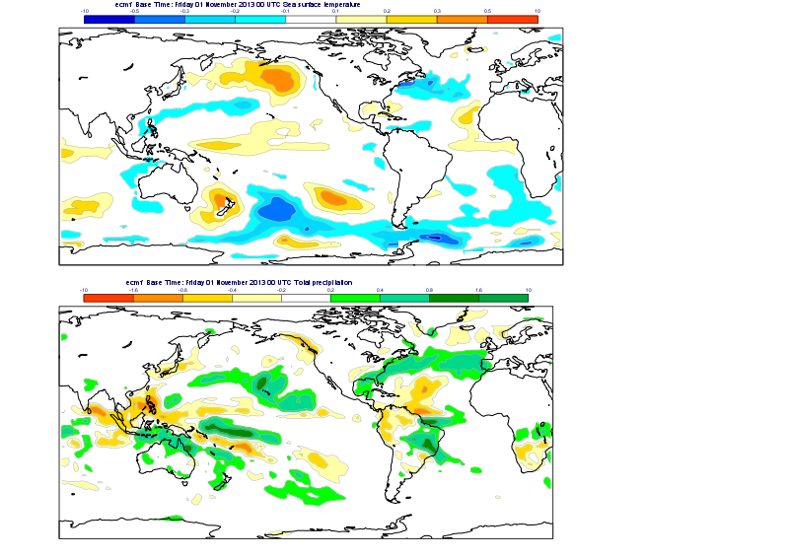
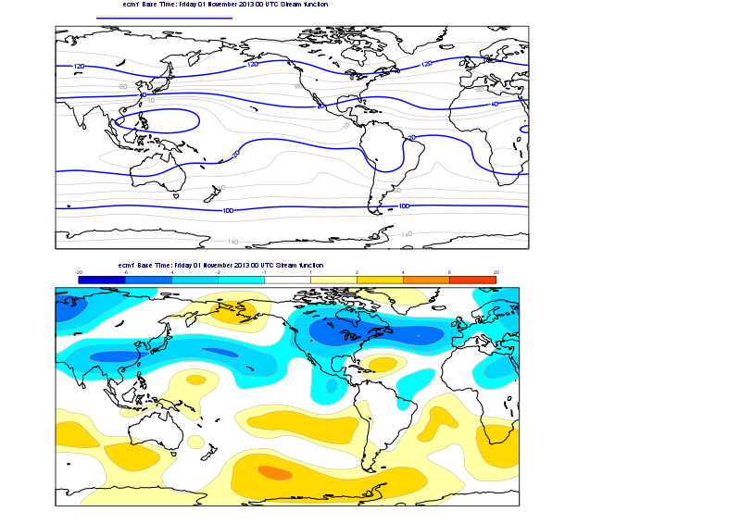
How do the ensemble perform? S4, D13JF14
Precip. and stream-function composite anomalies
for members with cold 2mt anomalies over North America below/above -/+ 1 σ
(from Laura Ferranti)
Notes:
10**6 m**2*s-1

Slide 24
How can we keep improving the system?
Work is progressing in several areas to further improve the forecast reliability:
Improvements in the estimation of the initial conditions and in the simulation of the initial uncertainties
Model improvements (e.g. moist processes, radiation, land-surface, stratosphere, ocean, ..) that include more physically-based simulation of model uncertainties
System configurations (resolution, membership, update frequency, ..)

Slide 25
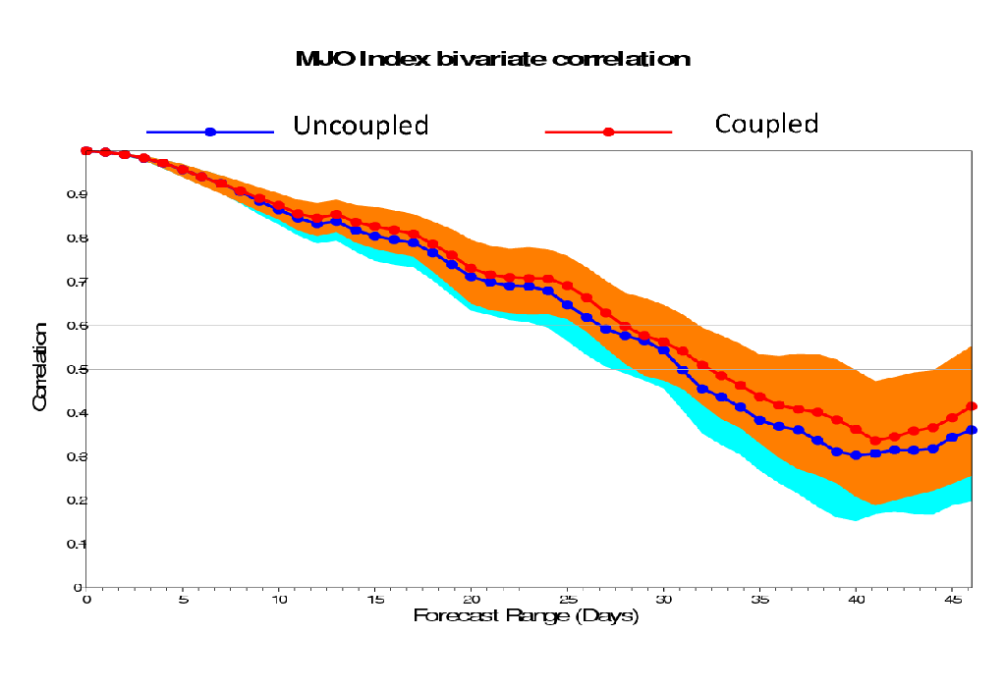
Nov 2013: ENS coupling from d0 to a better marine model …
Nov 2013: coupling from initial-time to a new version of the ocean model (NEMO), with 1-way wave-currents coupling, improved skill, especially in the monthly time-range.
Work is progressing to introduce a better, unified wave-currents-sea-ice model (LIM). The new model based on NEMO is under testing at higher resolution, ORCA_025_Z75.
In 2014 we will complete a ¼ degree NEMOVAR re-analysis, and we will then implement the ¼ model first in ENS, and then in the seasonal system (S5, planned for 2016/17).
(From F Vitart)
Notes:
Coupling to NEMO from initial time leads to improvements in MJO scores (not shown). It has also an impact on SST in the trail of a TS. Preliminary results shown here indicate a positive impact of coupling at d0 on SST (see fig. in the case of TC Nadine).

Slide 26
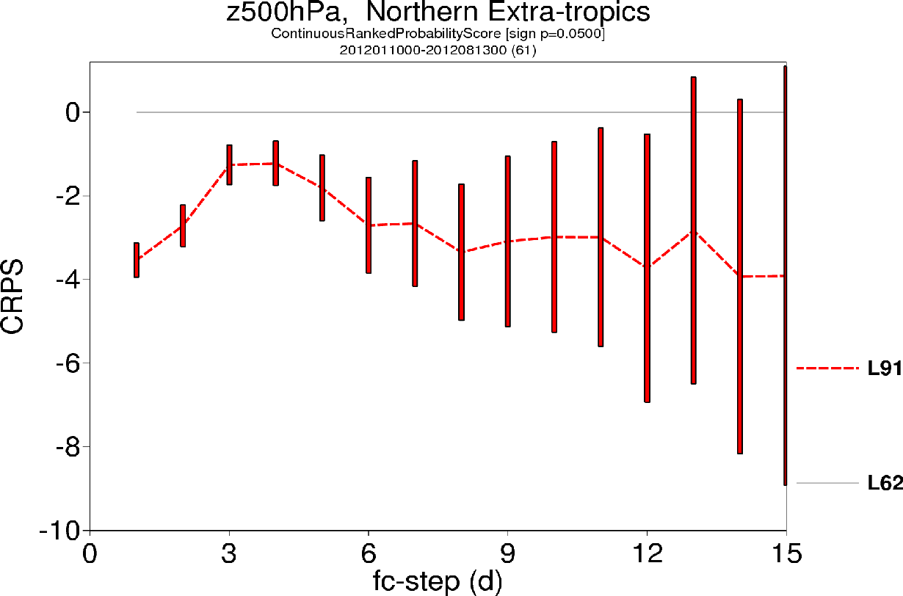
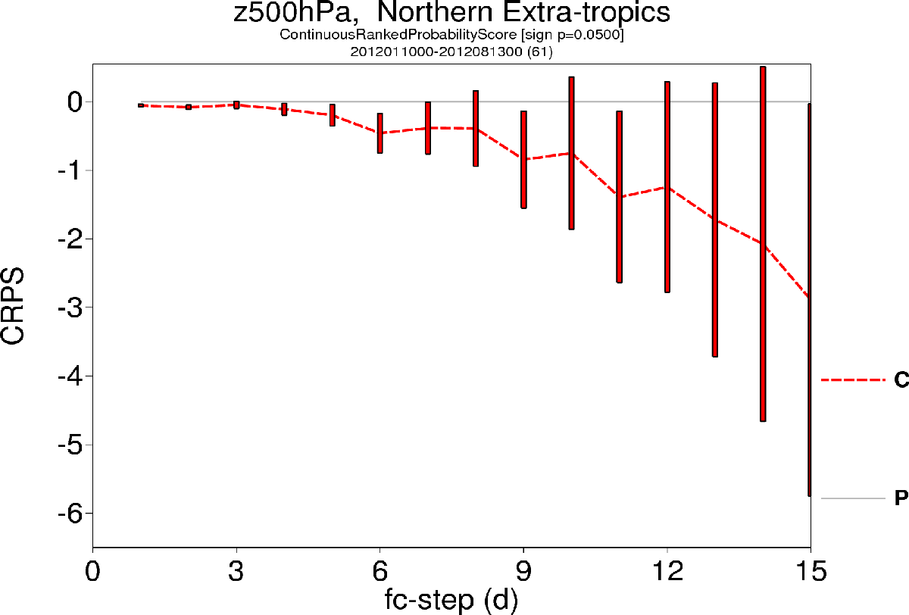
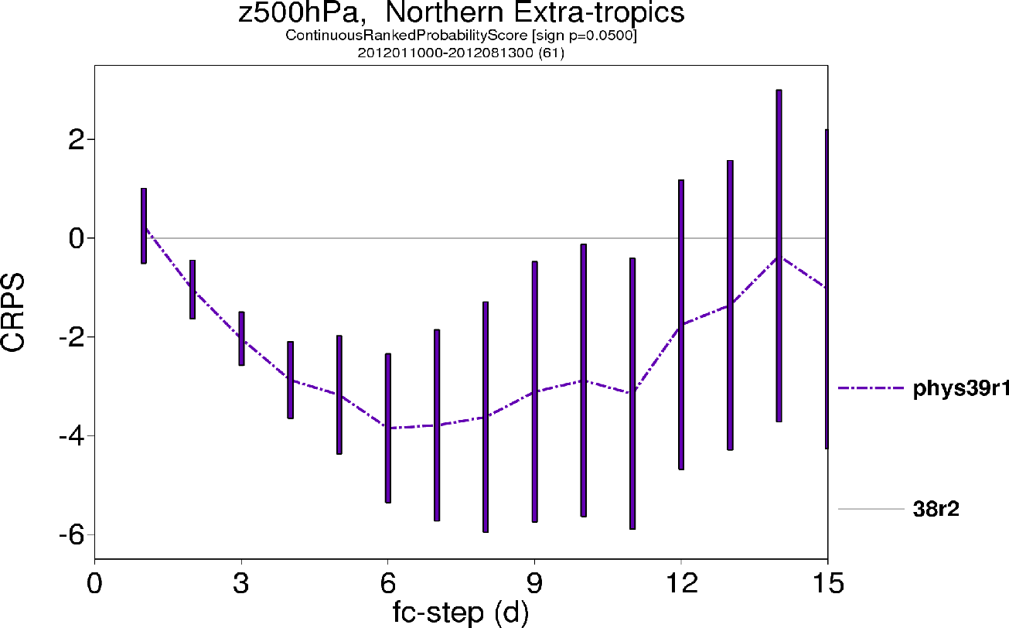
Nov 2013: ENS coupling d0, L62>L91, new physics+SKEB
Nov 2013: the new model cycle included 3 key changes to ENS:
Increased vertical resolution: 62 to 91 levels with TOA from 5 to 0.01 hPa
Coupling to NEMO (1 deg, z42) from d0
New physics and re-tuned back-scatter scheme
a) L62(5hPa) to L91 (0.1hPa)
c) 39r1 physics+RBR
b) coupling from t=0
(From M Leutbecher)

Slide 27
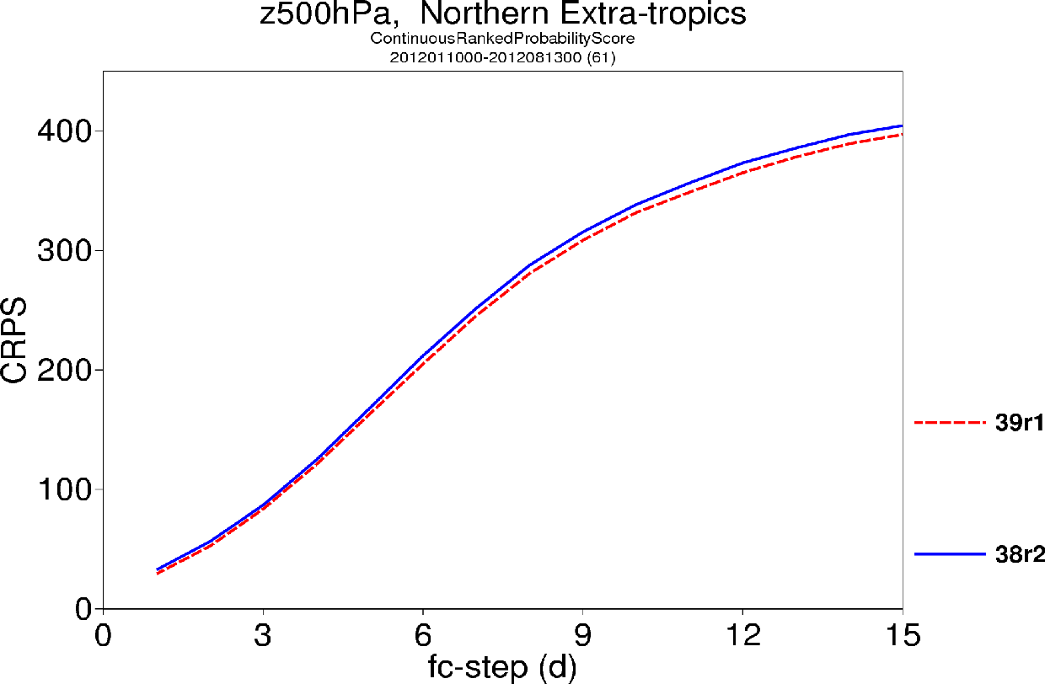
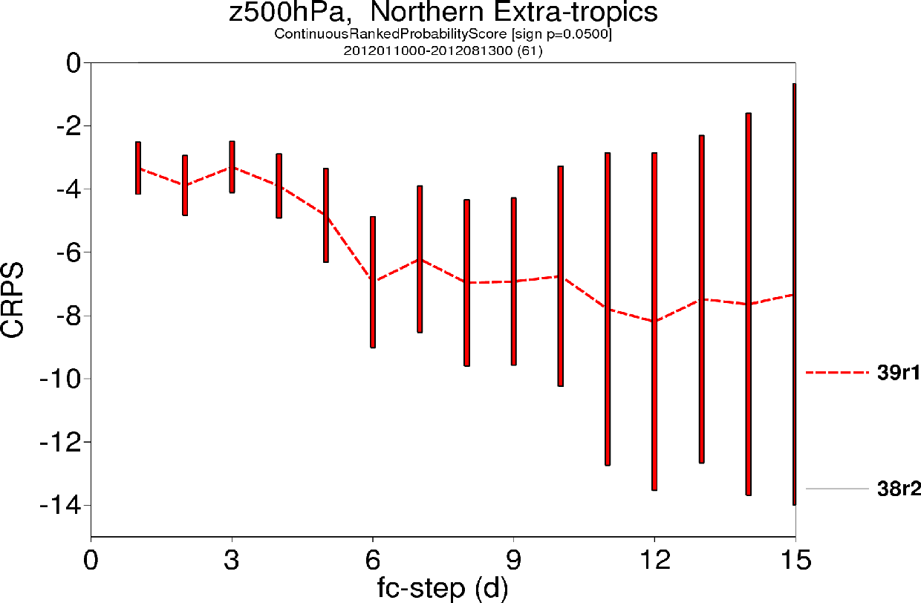
Nov 2013: ENS coupling d0, L62>L91, new physics+SKEB
Results based on 61 cases (JFM12, JJA12); 38r2 analyses and EDA perturbations.
(From M Leutbecher)

Slide 28
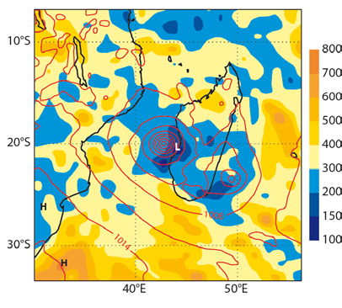
Nov 2013: EDA flow dependent co-variances
Nov 2013: the EDA size increased from 10 to 25 members, to provide 4DV-HRES also with flow dependent background error co-variances (EDA-based perturbations from the past 12 days will be used; sample size=600).
Background error correlation length scale for long(p_{msl}) and p_{msl}
km
4DV₀₀
Un-pert obs
EDA var/co-var
EDA₀₀
Static Jb
Model err
4DV₁₂
Un-pert obs
EDA var/co-var
Perturbed obs
(From M Bonavita)
Notes:
DA - An important milestone has been the successful operational introduction of flow-dependent, filtered variances sampled from the ensemble of data assimilations (EDA) as background error estimates for the deterministic 4D-Var analysis. This has first been implemented in cycle 37r2 (Nov 2011). The use of EDA variances in the deterministic 4D-Var has shown a clear positive impact on the skill of the deterministic IFS forecasts and marks the first step towards the implementation of a fully flow-dependent model for the background error covariances. Research is ongoing to improve the EDA’s ability to represent analysis and background error uncertainty.

Slide 29
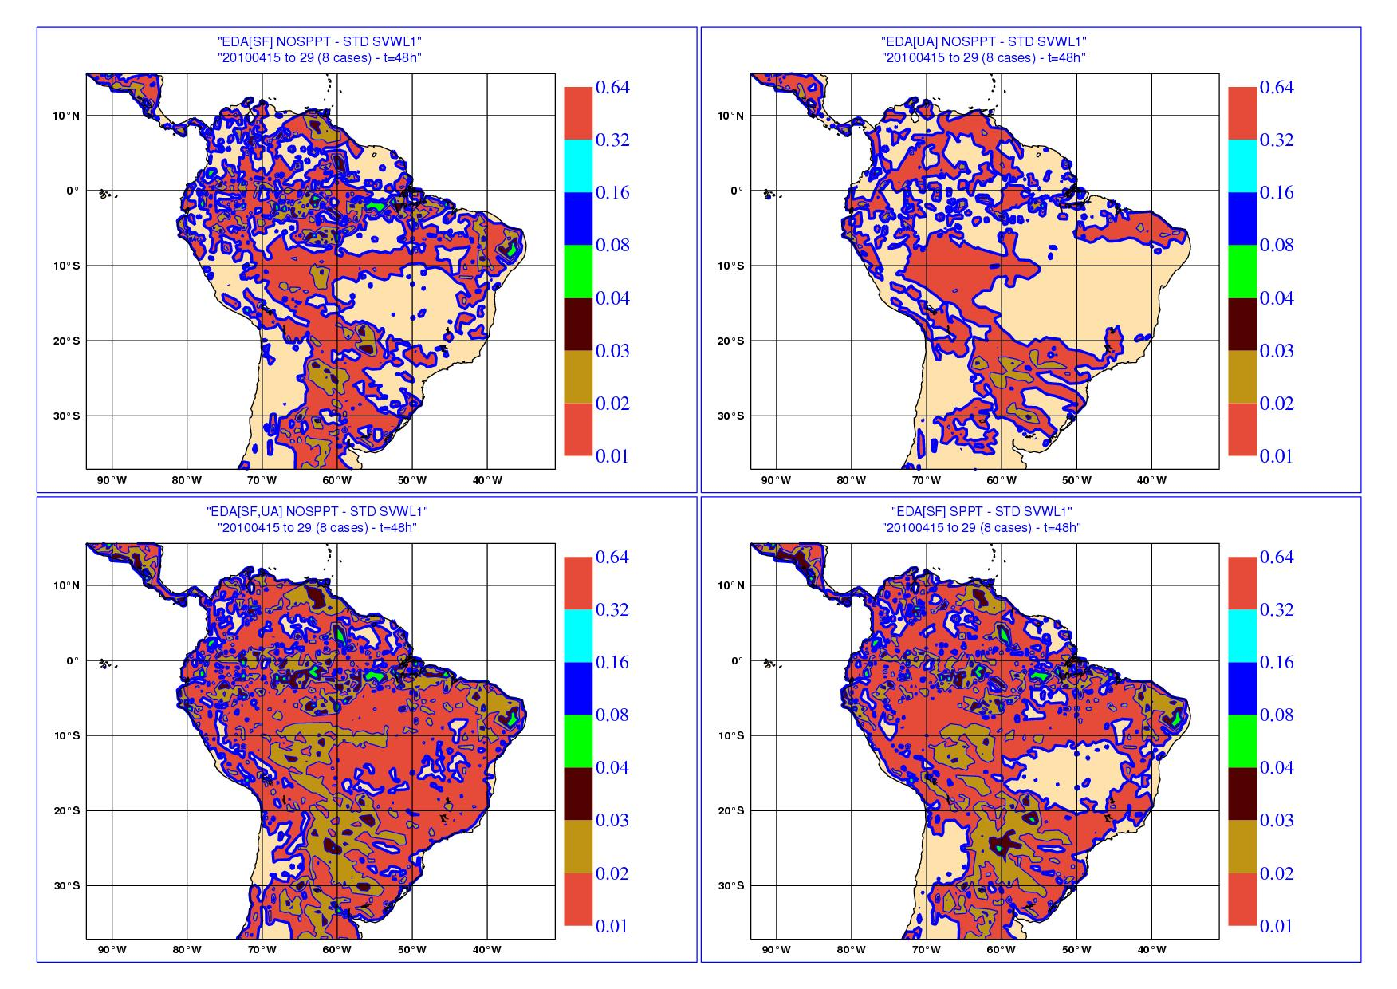
Nov 2013: EDA-based land-surface pert. in ENS ICs
Initial perturbations improved by coupling more the ensemble of analyses and forecasts.
SWVL1 – std(t=48h)
Nov 2013: EDA-based surface initial perturbations introduced in ENS.
Preliminary results indicate increased reliability in the short forecast range, due to small spread improvements.
EDA[sf]
NOSPPT
EDA[ua]
NOSPPT
EDA[sf,ua]
NOSPPT
EDA[sf]
Notes:
The plan is to include EDA-based surface initial perturbations. Preliminary results (obtained with GP Balsamo) indicate that for SWVL1, after 48 hours, the spread induced by the land-surface and the upper-air perturbations has a similar amplitude. SPPT also induces some extra divergence.

Slide 30
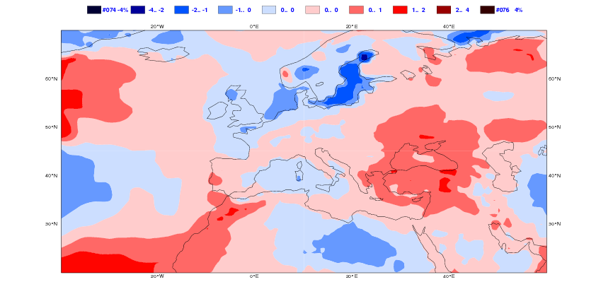
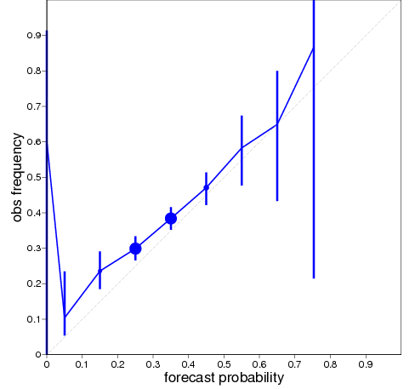
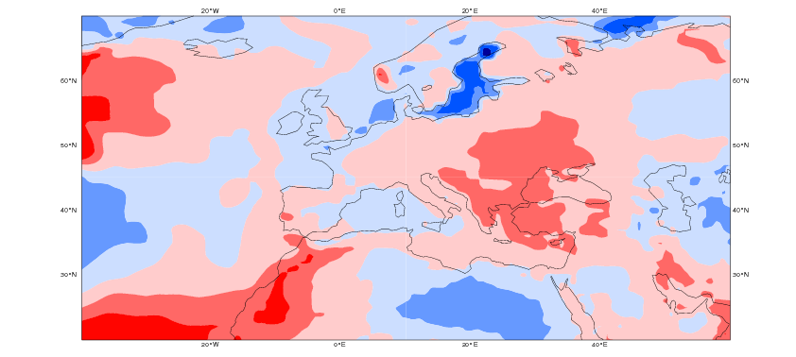
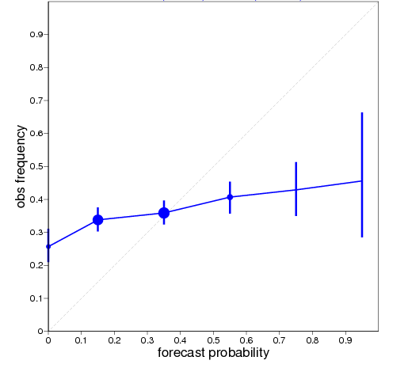
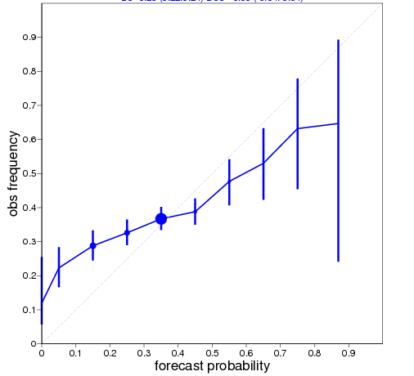
2014: enlarge the re-fc ensemble size (to 2*11m pw)
Impact on calibration
2mtm anomalies – Day 26-32
Impact on verification
T850- Upper terciles – Week 4
51 m
5 m
15 m
5 m
15 m

Slide 31
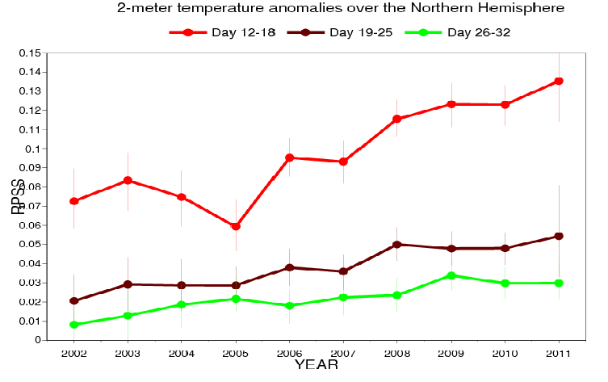
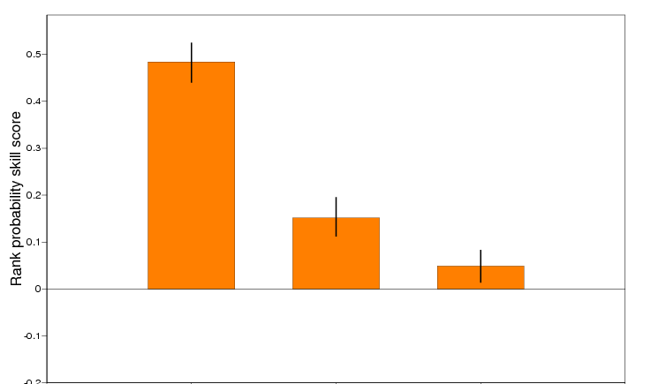
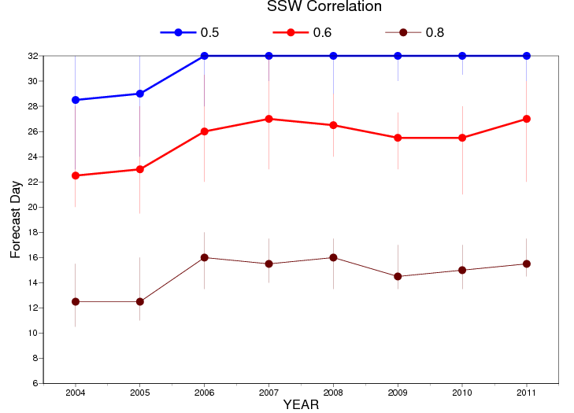
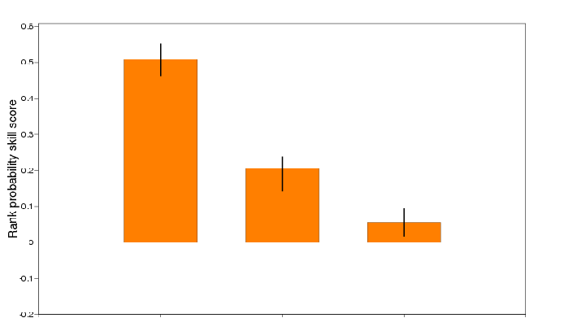
2014/15: extend ENS to 45d/60d to exploit increased skill
2mT - NH
T850 - Europe
1-15 16-30 31-45
+32d
Z500 - NH
SSW

Slide 32
2014/15: build a more complete model
  IFS today
  The future
Atmosphere
Atmosphere
Numerics
Numerics
Physics
Physics
Chemistry
Ocean
Land surface
Ocean
Land surface
Waves
Vegetation
Waves
Vegetation
Snow/ice
Dynamics
Snow/ice
Ocean
Cryosphere
Rivers
Dynamics
Notes:
Opportunities to improve and address the existing challenges exist, and rely on building more complete, coupled models that include more (and today missing) processes. For example, today the ECMWF IFS includes only few two-way interactions. Tomorrow, a future IESM should include the missing components and simulate all the two-way interactions.

Slide 33
Future: move towards a more integrated approach
Today
The future
EDA²⁵
ERA
ENS⁵¹
S4⁵¹
HRES
4DV
Ensemble^{N}
coupled analysis
and re-analysis
Ensemble^{N}
coupled
forecasts
ORAS4⁵
PDF(0) << 4DV+EDA+ORAS4
PDF(0) << ERA+ORAS4 (refc)
PDF(T) << HRES+ENS/S4
PDF(0) << coupled analysis and
re-analysis (refc) stream
PDF(T) << medium/long range stream
Notes:
Today: 6 IFS-based components are used to estimate PDF(0) and PDF(T). In the future only 2 ensemble and coupled components will be needed.

Slide 34
Conclusions
20 years ago ECMWF was issuing one forecast only up to 10 days.
Today, ensemble methods are used in analysis and forecast mode, and ECMWF issues probabilistic forecasts up to 13-month, and ensemble-based analysis error estimates.
In 2014/15 we will upgrade the medium-range/monthly ensemble: improve the marine component (coupling waves <> currents <> sea-ice), increase the resolution (to ~ 25 km in atmosphere and ocean)
In 2016/17 we will upgrade the seasonal ensemble
The future will see ECMWF providing more accurate estimates of the most likely scenario and its uncertainty at analysis and forecast time for all variables (atmospheric, land, ocean, chemical and composition, …).

Slide 35
… extra slides

Slide 36
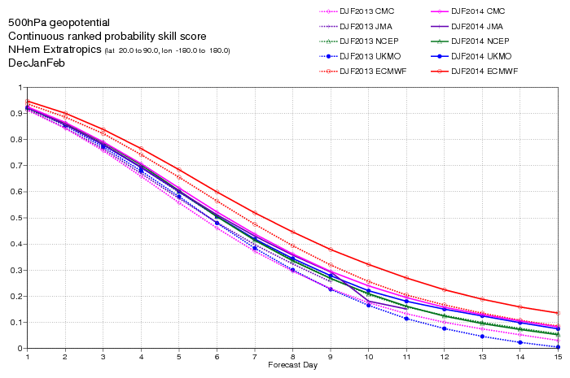
How do the ensembles perform? ENS in the medium-range

Slide 37
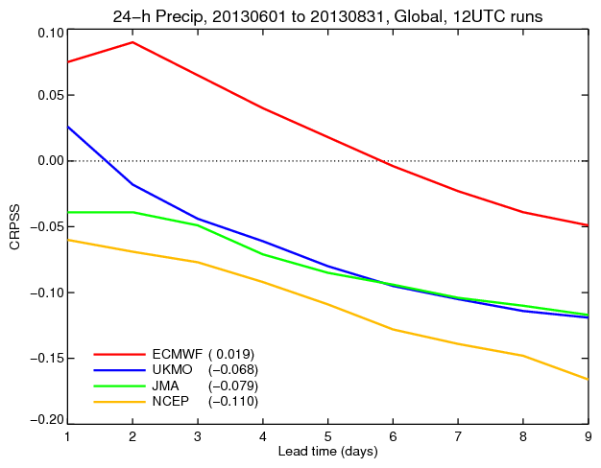
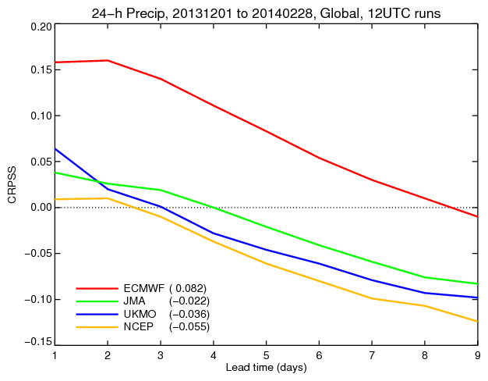
How do the ensembles perform? ENS in the medium-range

Slide 38
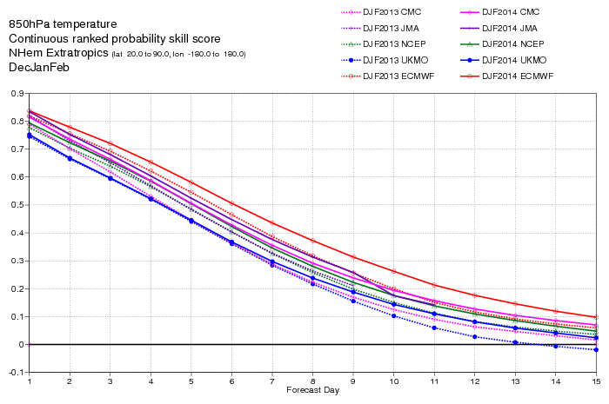
How do the ensembles perform? ENS in the medium-range

Slide 39

How do the ensembles perform? ENS in the medium-range

Slide 40

How do the ensembles perform? ENS in the medium-range

Slide 41

How do the ensembles perform? ENS in the medium-range

Slide 42

How do the ensembles perform? ENS in the medium-range
CRPSS for total precipitation, verified against observations.
Notes:
The performance of the EPS has been improving continuously for upper level fields, as seen by looking at the CRPSS for the t+72h, t+120h and t+168h probabilistic prediction of Z500 over NH (verified against analyses). Results indicate a predictability gain of ~ 1.5-2.0 days/decade.

Slide 43

Scores’ trends: CRPSS Z500 NH
Scores’ trends can be used to monitor progress.
This plot shows that for upper-level fields over the NH extra-tropics , performance has been improving continuously.
Results indicate predictability gains of 1.5-2.0 days per decade.
Notes:
The performance of the EPS has been improving continuously for upper level fields, as seen by looking at the CRPSS for the t+72h, t+120h and t+168h probabilistic prediction of Z500 over NH (verified against analyses). Results indicate a predictability gain of ~ 1.5-2.0 days/decade.

Slide 44

Scores’ trends: CRPSS T850 EU
This plot shows that also for probabilistic prediction of T850 over Europe performance has been improving, with a 2.5 day gain between 1998 and 2012.
The plot shows the forecast lead time with CRPSS crosses a reference value (25% in this case).

Slide 45

Scores’ trends: CRPSS TP24 EU
Similar, although smaller in size, improvements can be seen by looking at 24h total precipitation, with skill gains of about 1.75 days between 2001 and 2012.
The plot shows the forecast lead time when CRPSS crosses a 10% value.

Slide 46




How do they perform? ENS TCs forecasts
Verification Areas
4 TIGGE ENS: ECMWF JMA NCEP UKMO
TIGGE-based results for Jul-Oct 2012. TC tracking data have been created with the ECMWF vortex tracker (Vitart et al. 1997, JC). Verified TCs are storms with a ‘Tropical Storm’ intensity or stronger (>35 knots).
BSS
10 deg. X 10 deg.
BSS
20 deg. X 10 deg.
(From M Yamaguchi)
Notes:
The examples shown earlier should be corroborated by a more complete, statistical evaluation. The quality of the S4 probabilistic forecasts have been assessed considering 30-years (1981-2010) 15-member forecasts. One key measure of the quality of probabilistic forecasts is their reliability, as indicated by reliability diagrams and corresponding Brier score and skill scores. Reliability diagrams and BSS indicate that for 2mT, even 4-6m forecasts are skilful.

Slide 47
How do our ensembles perform? ENS MJO predictions
The ECMWF ensemble predicts the MJO up to about 25 days.
ECMWF
ECMWF
(From B Wang and J-Y Lee)
Notes:
Recent results have indicated that the 32d EPS has an improved description of the MJO and is capable to capture at least part of the tropical/extra-tropical interaction due to the MJO. ECMWF forecasts for the MJO are top of the range. In the EPS (which has higher resolution than the seasonal system), forecasts are skilful up to 3-4 weeks.

Slide 48

How do the ensemble perform? S3 SST seasonal fcs
ECMWF seasonal prediction system-3 provided top quality Enso predictions (IRI source: Barnston et al 2011, BAMS, in press).
S4 will further strengthen ECMWF leadership position .
ECMWF
(From T Barnston)
Notes:
MAS/PFS – S3 NINO3.4 SST anomaly correlation scores (3-month running means) indicate that ECMWF seasonal system-3 outperforms the others (from: Barnston et al. 2011: Skill of Real-time Seasonal ENSO Model Predictions during 2002-2011—Is Our Capability Increasing? BAMS, in press). S3 was implemented in 2007 and will be replaced by S4 in Nov 2011. Solid lines refer to dynamical systems, dashed lines to statistical models. Note that since S3 is released only on the 15th of each month, the ECMWF forecasts are 1-month older than the others (i.e. the 0-lead point refers to the average skill of the m1-3 for everyone but ECMWF, for which it refers to the m2-4 forecast and so on).

Slide 49

ENS to provide probabilities of weather scenarii

