Slide 1
NWP Information Technology Environment (NITE) A model launcher, experiment database, and more
Ligia Bernardet
Ligia.Bernardet@noaa.gov; NOAA/ESRL/GSD, Boulder, CO
Laurie Carson
carson@ucar.edu; NCAR, Boulder CO
Acknowledgements
DTC Science Advisory Board
NCEP/EMC

Slide 2
Community Interactions at EMC/NCEP
Several Community Reviews of NCEP/EMC (by UCAR 2009, 2013, 2014) have recommended an increase in interaction with the research community
Why? To improve the infusion of new research findings in operational models (R2O) and improve NWP systems
The NCEP partnership with the Developmental Testbed Center helps the connection with the research community
NCEP’s mission is not to support and engage the NWP community but to to produce operational forecasts!

Slide 3
2013 Annual Report of the UCAR Advisory Committee for NCEP
http://www.ncep.noaa.gov/director/ucar_reports/UCACN_Report_Oct2012_Mar2013.pdf
NOAA should (…) ensure that NCEP will welcome and attract the support of the Earth system modeling community in designing and implementing the next generation models.
(…) we recommend EMC seek community’s participation and support for the evaluation of EMC modeling systems.
We strongly encourage EMC to continue close collaboration with NOAA laboratories and the broader research community on the development of next-generation operational modeling and data assimilation systems.
Engaging the community in the evaluation, diagnosis and testing of operational models will strengthen R2O and bring significant benefits to EMC.

Slide 4
2014 Annual Report of the UCAR Advisory Committee for NCEP - I
Interface with research community: Partnerships are necessary since NCEP can’t do it all. NCEP needs internal infrastructure to serve visitors well, but needs resources to do this.
For example, NCEP needs to set up a system such that outsiders, not just visitors, can use and test NCEP models. (This is already partially done at the DTC, but not for all NCEP models).

Slide 5
2014 Annual Report of the UCAR Advisory Committee for NCEP - II
Key to NCEP’s ability to make significant progress:
Develop IT infrastructure to support collaboration with research community
To encourage (…) R2O in NWP, it is important to make NCEP modeling systems and data sets easily accessible to the research community.
EMC should develop an IT infrastructure that can support a research modeler (or a visiting scientist) to conduct model experiments, with alternative physics or modeling components, using the operational systems.
Such an NWP IT environment would foster close collaboration between research modelers and EMC staff, leading to accelerated model improvement.

Slide 6
Challenges/Opportunities
EMC finds working closely with external partners challenging, because such collaboration represents additional unfunded burden that exacerbates the mismatch between resources and mission scope. (From UCAN 2013 report)
DTC has a Science Advisory Board (SAB) with representatives from EMC, NOAA OAR laboratories, academic community, and private companies to advise on community interactions
NCEP
DTC
Community

Slide 7
Recommendations from “R”
Quotes from the 2013 DTC Science Advisory Board report
Need for a software infrastructure for running and inter-comparing cycled DA and forecast
Inspired by the PrepIFS/ODB system used at ECMWF
Crucial to fulfill DTC’s mission of improving R2O transitions
Such a system must also be used at the operational centers in order to be effective at enhancing R2O. Therefore, the operational centers will have to be intimately involved in the development of the software

Slide 8
NWP Information Technology Environment (NITE)
Funding allocated by DTC Management Board (at the time, B. Lapenta, F. Toepfer, +OAR, +NCAR + AFWA)
Scope: Investigate current capabilities & consider options for building & expanding capabilities to easily prepare & run research experiments using NCEP’s models.
Requirements analysis to identify
User community (skills, needs)
System components adaptable to these needs
Hardware, software, data needs and resources
Documentation and training needs
Deliverable: Preliminary system design by March 2015

Slide 9
NITE: Work done so far
Discussions with EMC (Hendrik, Geoff, Dewitt, Colón, etc.)
NITE should be build in a general way (portable, expandable) with a first instantiation for NAM
NITE must be used both at NCEP and by external collaborators
Review of some existing model launchers and experiment databases (ECMWF prepIFS, NEMS launcher etc.)
Surveyed potential users about requirements
Goal: To collect ideas and requirements from a broad range of users.
Audience: EMC, OAR (ESRL, AOML), academic users, DTC staff, visitors and SAB members – 100 distributed; 40 completed

Slide 10
Survey Results
Users expressed great enthusiasm with NITE
A user friendly system is an important key to encourage more researchers use [NCEP operational models]
Thanks to the DTC for undertaking this project
I am very excited about NITE. Please make sure to include developers from all major modeling groups, this will help unify the groups faster

Slide 11
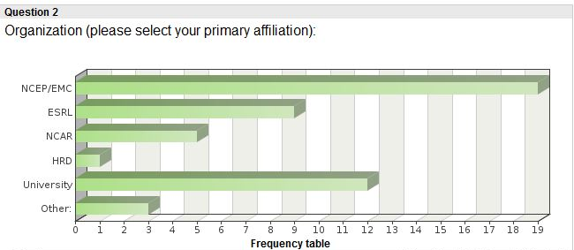
User Background
Most (> 90%) have used some NWP system in the past
Most common: NAM, HWRF, GFS
Most used for research, development, testing (vs teaching or operational implementation)

Slide 12
Difficulties faced by users
Faced IT limitations
… found the process of modifying and implementing the code somewhat difficult because of number of concurrent changes to the code coming from different people.
Source code managmt
Computer resources
Launch & monitor jobs
Namelists
*
Hardcoded parameters
*
Ultimately this slows down R2O and progress in operational NWP!
Changing source code
*
Retrieve input data
*
Manage large outputs
Interact with other researchers

Slide 13
What could NITE do to help?
Input data management
Everything!
Higher priority
Source code management
Input data management
Experiment metadata management
Launch and monitor jobs
Verification
Lower priority
archiving
local downloads
visualization
Experiment database with source code manag
*
Input data staging
Output archival managmt
Launch/monitor jobs
Local data downloads
*
Data visualization
*
Verification

Slide 14
Changes in an experiment
*
Higher priorities
Namelists
Source code changes
Workflow Changes
Lower priorities
Ensembles
Alternate inputs
New components
Namelists
*
Source code changes
Add new component (ocean, hydro etc)
*
Workflow changes (useful in DA and cycling)
Ensembles
Alternate inputs

Slide 15
Platforms
*
Zeus (NOAA R&D)
Jet (HFIP)
WCOSS (NOAA operations)
Yellowstone (NCAR/Univ)
Any generic platform
Priority is zeus (jet, yellowstone, wcoss lower priority)
Flexibility in compiler options ranked high
Downloading data to local machine ranked relatively low
Note that some launchers, such as ECMWF prepIFS, only work in a single platform – not a good solution for NOAA

Slide 16
NITE’s role in the development cycle
Initial development of idea
Early prototype
*
Case studies to test hypothesis
*
Large # of cases to test mature idea
End-to-end test with cycling
*
*
Finished work ready for pre-implementation testing
It seems that the NITE would be useful in ALL cases - if a researcher used it the entire time, then there would be no issues later in the process of R2O.

Slide 17
Operational system: how current?
Bimodal responses
Relevancy to operational implementation (R2O)
Must be near-current with the operational version
Should also have previous version and one used in past year
Relevancy to research and academic use
Should support repeating experiments of 5-10 years ago for research/thesis

Slide 18
Input datasets: how current?
Realtime
Few case studies
*
Four months (1 per season)
One-year retrospectives
Multi-year retrospectives
May need to keep older cases for repeating research cases
Significant demand for realtime feed

Slide 19
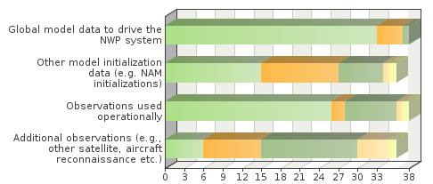
Types of input datasets
*
Global model and obs are higher priority
Additional obs also important
Global model for input
Other model (e.g., NAM)
*
Operational obs
Additional obs
Are non-operational datasets required (additional obs, reforecasts etc.?)
Essential 1
Priority is operational data (vs additional obs or other model initializations or parallel run results)
Some non-operational data maybe relevant
2
3
4
Not needed 5

Slide 20
Visualization and Verification
1 = less impt
5 = more impt
Visualization
Verification
Not needed
1
2
2
3
3
4
4
5
5
Essential
Users find both visualization and verification important
Basic visual/verif should be included
Users can create additional customized products
Verification was considered a higher priority
Some users rated visual/verif low because they consider visualization and verification important but secondary to other NITE capabilities (code management, experiment database etc.)

Slide 21
Challenges with provenance
We have no record of experiment configuration
Origin of source code, scripts, input datasets
It is currently difficult
To reproduce an operational run or pre-implementation test
Researchers do not have easy access to baseline
To reproduce one’s own experiments
To understand how our colleagues setup their experiments
To assess if a research experiment is relevant to operations
Did researcher use the latest code? The right namelist options?
Ultimately this slows down R2O and progress in operational NWP!

Slide 22
Experiment Database
1 = less impt
5 = more impt
Name & Institution
Saving information about source code and namelists is critical
Source code info
Script info
Platform info
Compilation info
Namelists
Describing comments
Searchable keywords
How important is it to see other people’s experiments in the database?
Very important!
1
2
3
4
5

Slide 23
Support for NITE and NWP system
Needed both for NITE and for the NWP system itself
Development will be more efficient if
NWP system is modular
Modifying/adding code is facilitated
Strong preference for online documentation and tutorials
In-person tutorials a lower priority

Slide 24
Summary of possible NITE capabilities
Facilitate configuring NWP system
Connect with mass store for obs, easy retrieval inputs/outputs
Launch and monitor jobs
Create visualization and verification
Create record of experiment
Source code and scripts version control
Experiment database
Allow scientists to inspect and reproduce others’ experiments
Expedite EMC’s understanding of research experiments leading to acceptance of results
Ultimately, speed the transition of tested capabilities to operations

Slide 25
NITE is for EMC and collaborators
It is fundamental for NITE to be adopted at EMC
Very important for EMC to be involved in design
Internal/external experiments setup identically = confidence
If all development is already done within NITE, when implementation occurs there is no delay in making capability available in NITE
Balance
Needs to fit with EMC/NCO framework
May require some changes in current systems

Slide 26
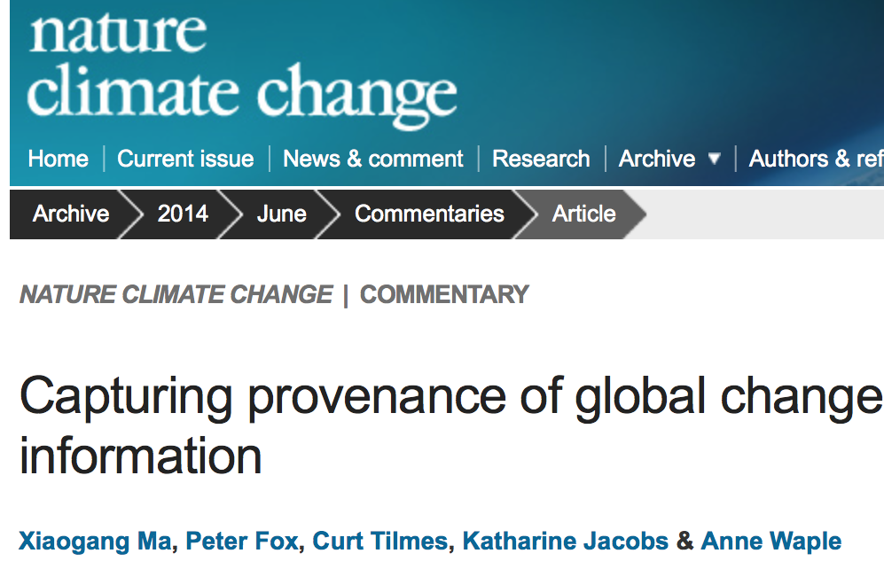
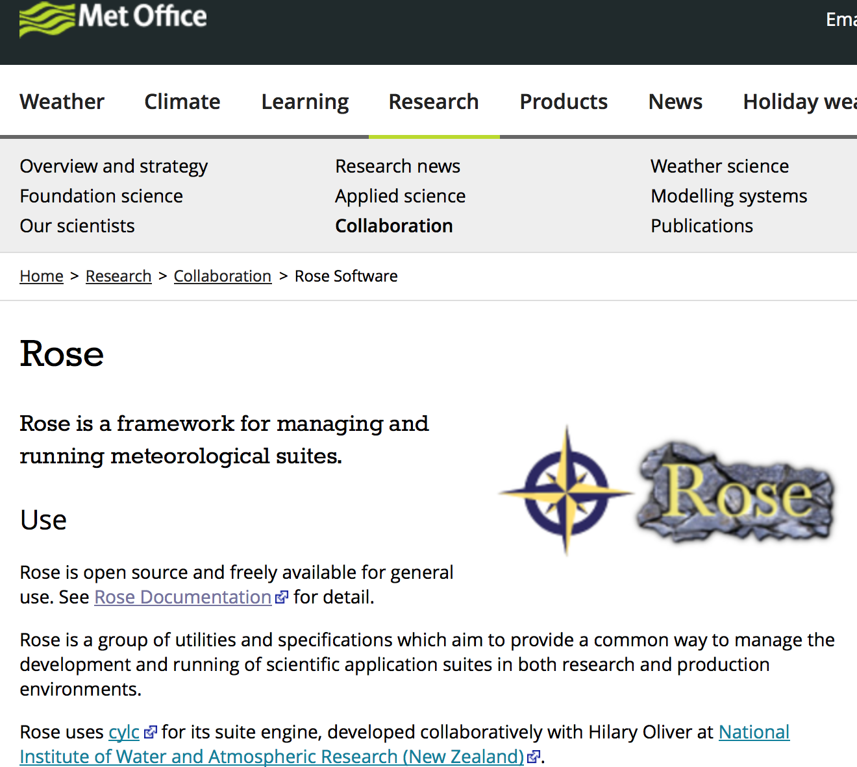
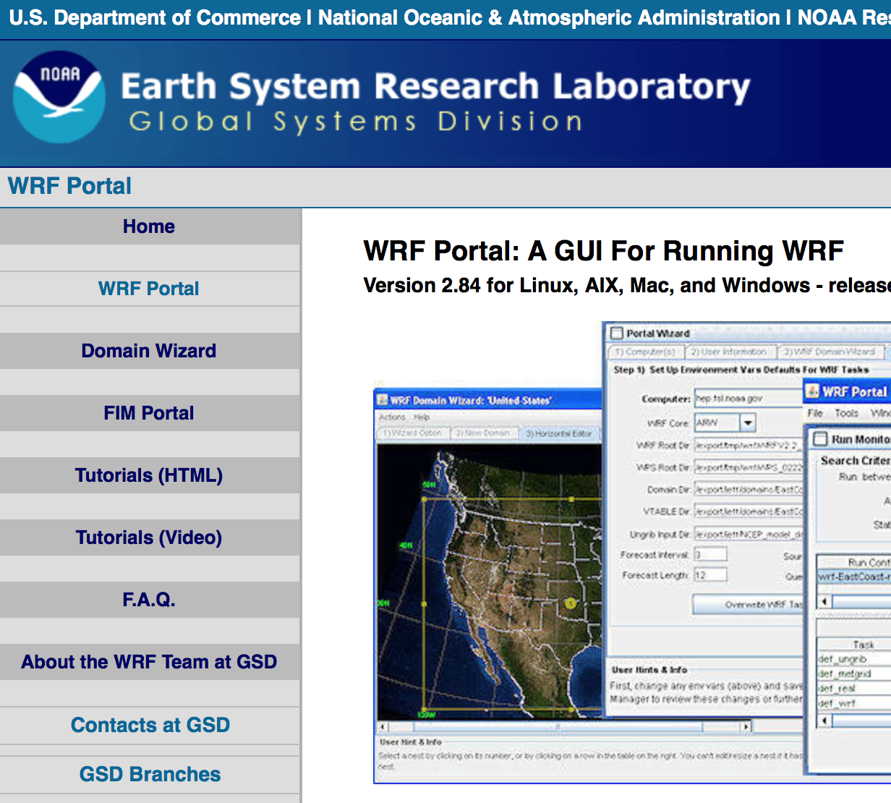
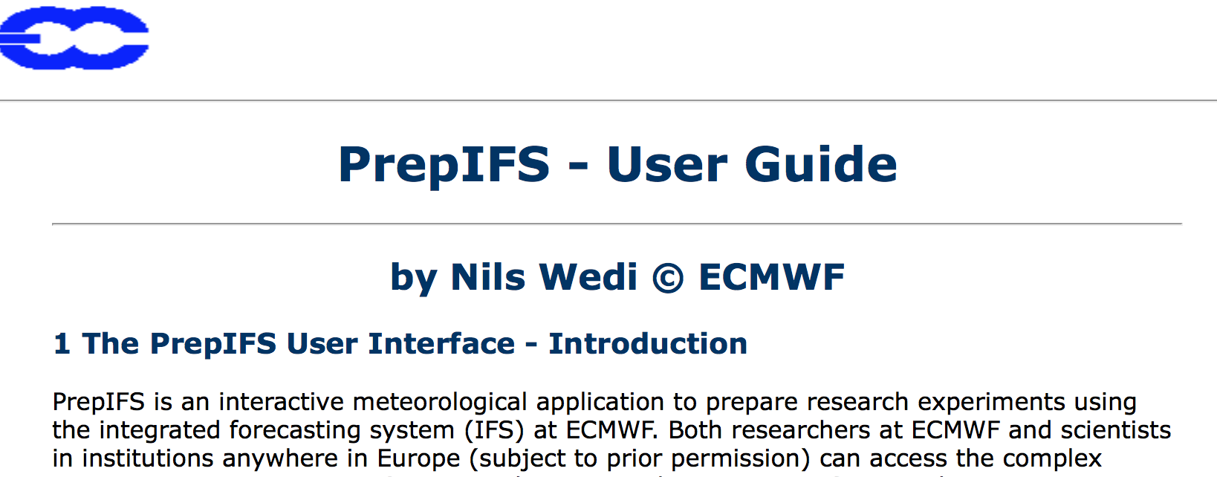
We are not alone
Need to carefully study what we can leverage and invest wisely for long-term

Slide 27
Review of existing systems
 | NEMS launcher | WRF Portal | PrepIFS | Rose
Creator | NCEP | GSD | ECMWF | UKMO
Models | NEMS NMM-B | WRF | ECMWF | UKMO or any
Current dev | Small | Partial | Small | Large
Workflow management | Kick_scripts | Rocoto | SMS/EcFlow | Cycl (New Zealand)
Portability Expandability | Low/Medium | High | Low | High
Code mgmt | No | No | Yes | Yes
Database of configuration | No | Yes | Yes | Yes
Currently HWRF, RAP, HRRR can be run with Rocoto

Slide 28
One of NOAA NGGPS’ goals
To improve software architecture and systems engineering
Build a high-performance, flexible software infrastructure to increase ease of use, performance, and interoperability
Investigate effective use of emerging HPC technologies; simplification of software structure; and a community-based model infrastructure which will streamline the incorporation of proven research advances into operations
NGGPS: NOAA Next-Generation Global Prediction System (R2O)

Slide 29
NITE: modular, expandable, portable
Can run any model
Retrieves and builds code
Creates configuration file to drive scripts
Runs workflow, keeps track of progress
Library of functions
Modular scripts
Configuration file
Configuration file
Model A
Model B
Pre-process
Forecast
Pre-process
Data Assimil
Work dir
Data retrieval
Run executable
Check output

Slide 30
Requirements for modularity (examples)
No hardcodes, use configuration files instead
Composition
NWP system is divided in smallest possible components
Scripts/Functions carry out execution of one component
Higher level scripts may aggregate lower level functions
Automation
Is completely separate from scripts (scripts do not call scripts)
Automation figures out dependencies and launches jobs
Scripts can run with various automation systems

Slide 31
Many outstanding questions
Adequacy of NAM for first deployment
Some survey responder indicate preference for other models
Balance between pre-operational and research needs
Support for current vs legacy systems (last year’s model)
Support for realtime vs older datasets
Flexibility and documentation of NWP system
Source of funding for NITE development
Ongoing maintenance, expansion, and training (incl. EMC)
Tool need to be good enough to meet requirements
but must fit within NOAA resources

Slide 32
Goals for this visit to NCEP
Present the perspective of the research community (from outside EMC) on NITE
Answer any questions you may have
Gather your input on NITE requirements, priorities, constraints, and technical solutions
This will be done now and in a few technical discussions that will take place today and tomorrow
Please let us or Ed Colón know if you would like to participate
Also, you can send feedback to
Ligia Bernardet: Ligia.Bernardet@noaa.gov
Laurie Carson: carson@ucar.edu

