Slide 1
Why do
ensemble prediction systems
so often possess an
apparent
under-dispersiveness ?
Åke Johansson
SMHI, Sweden

Slide 2
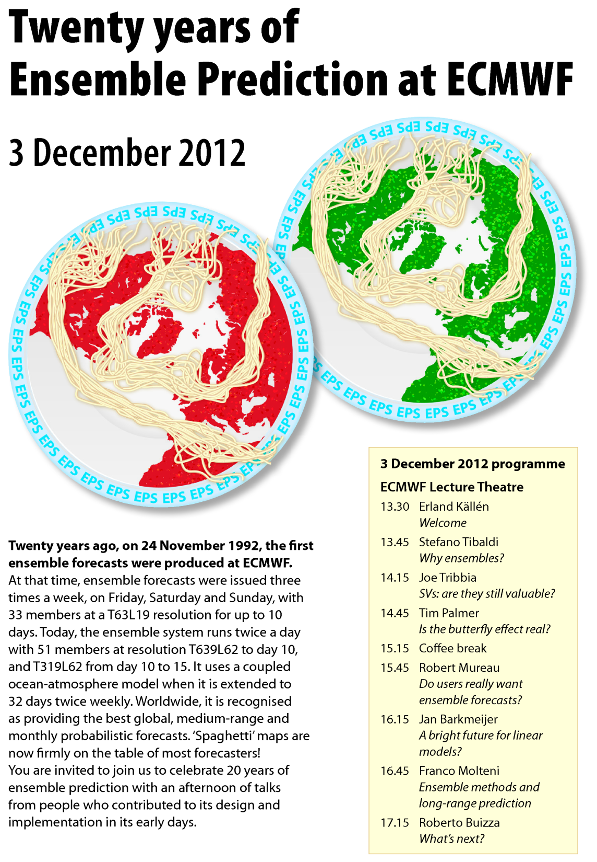

Slide 3
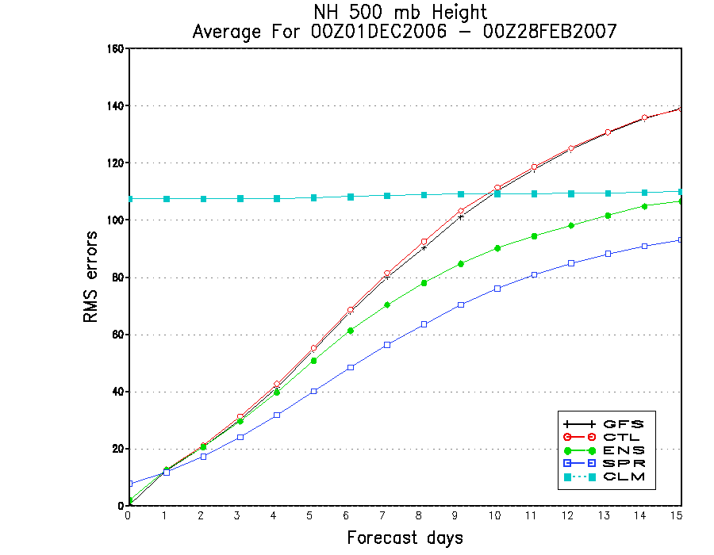

Slide 4
COMMONLY USED
SKILL – SPREAD CONDITION

Slide 8
Moore’s Law

Slide 9
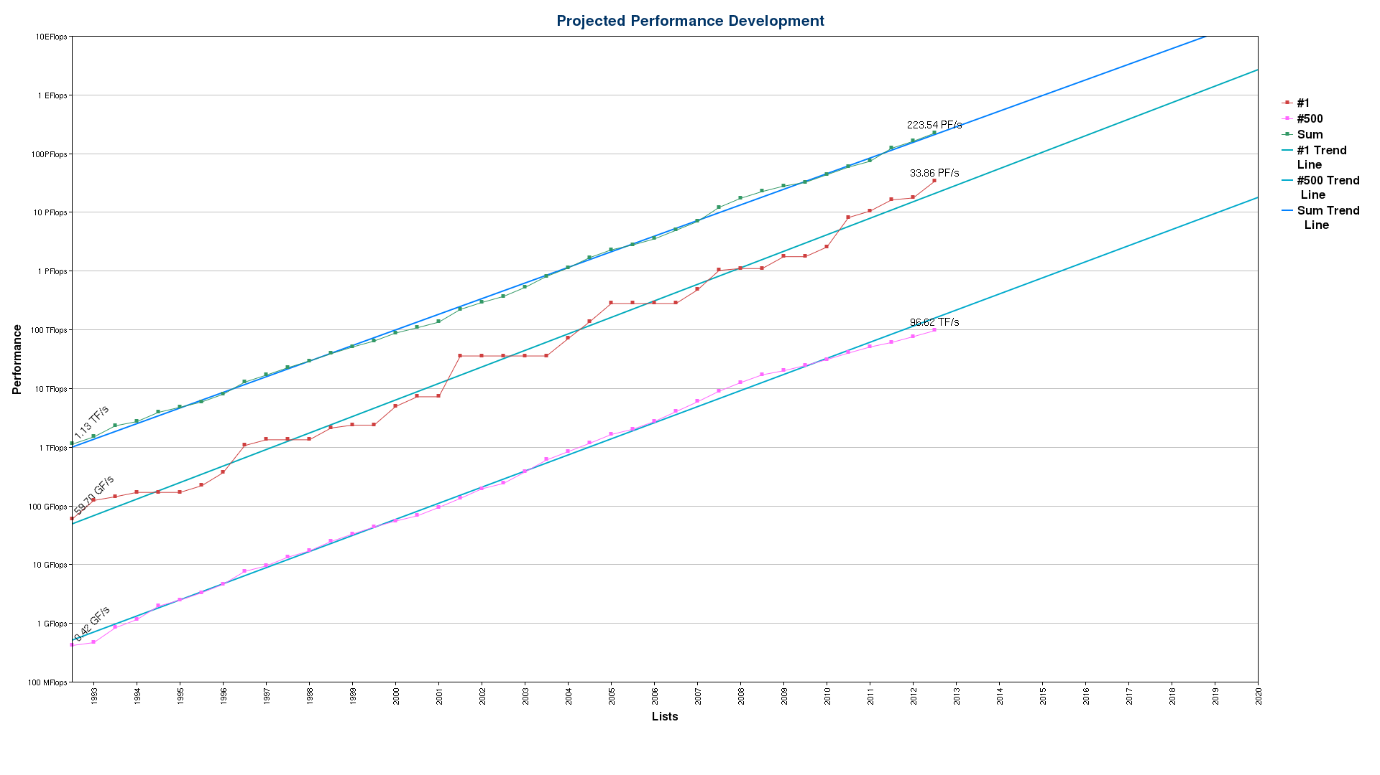

Slide 10
10⁵
1992
2012

Slide 11
km
1000
100
10
1

Slide 12
km
1000
100
10
1
1992
2012

Slide 13
dx * dy * dz * dt * dp * nmbr
10 * 10 * 10 * 10 * 10 * 50
10⁵

Slide 14
dx * dy * dz * dt * dp * nmbr
5 * 5 * 5 * 5 * 5 * 50
10⁵

Slide 15
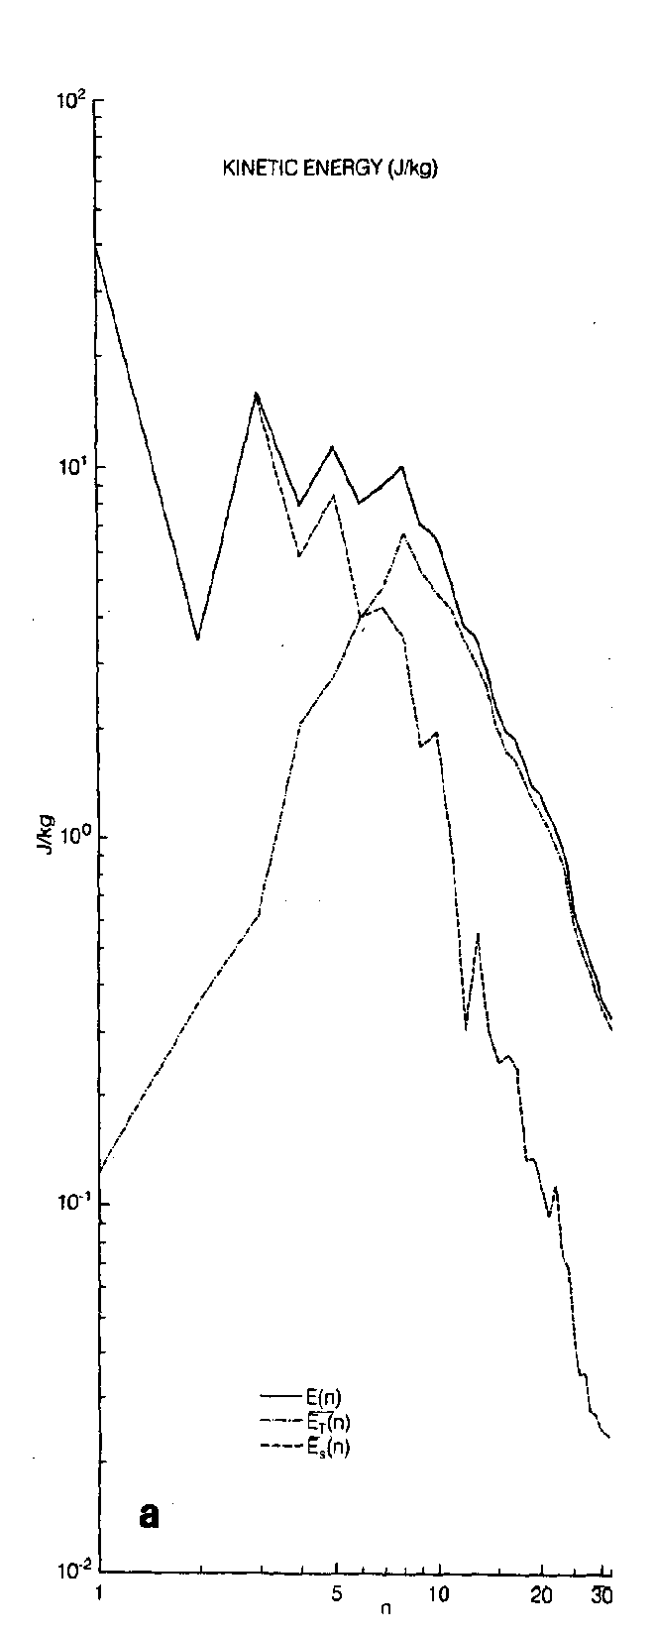

Slide 16
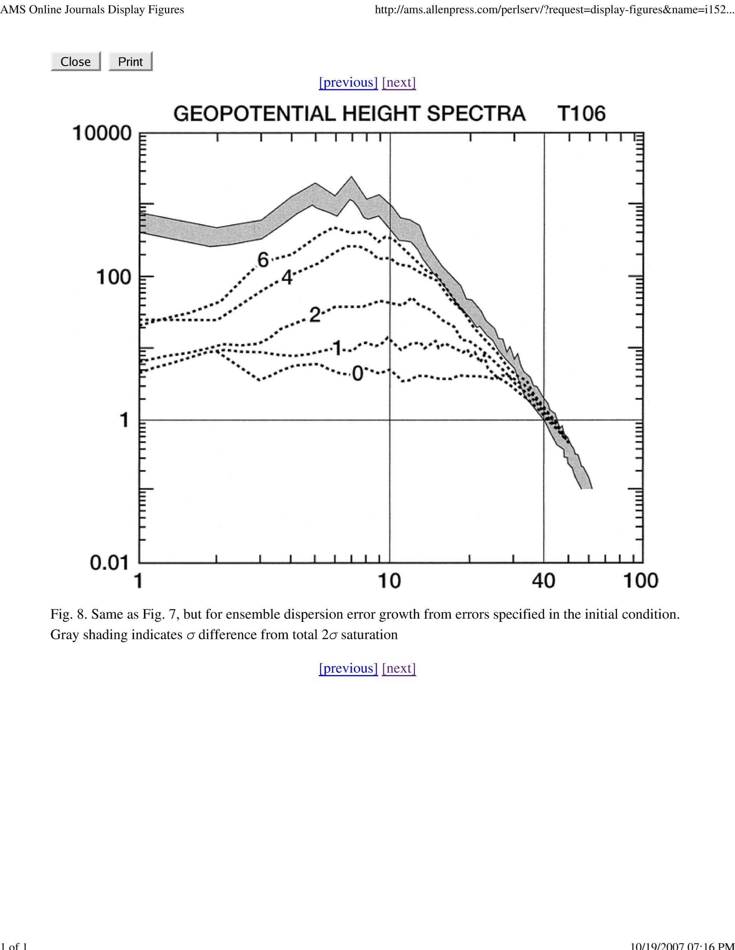
Tribbia and Baumhefner 2004

Slide 17
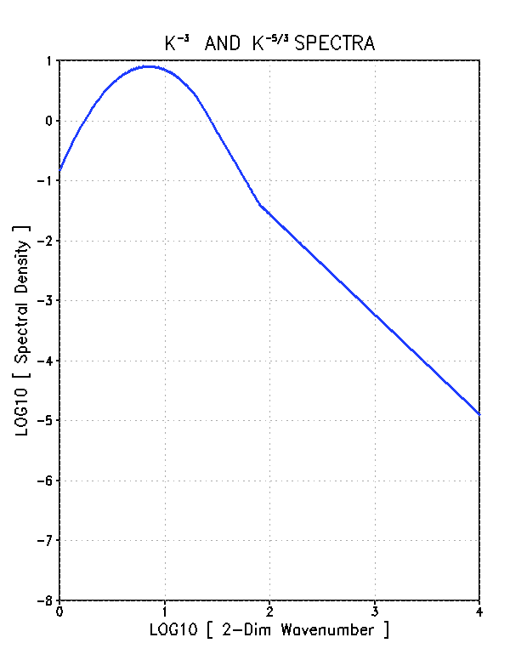
40000 4000 400 40 4 km

Slide 18
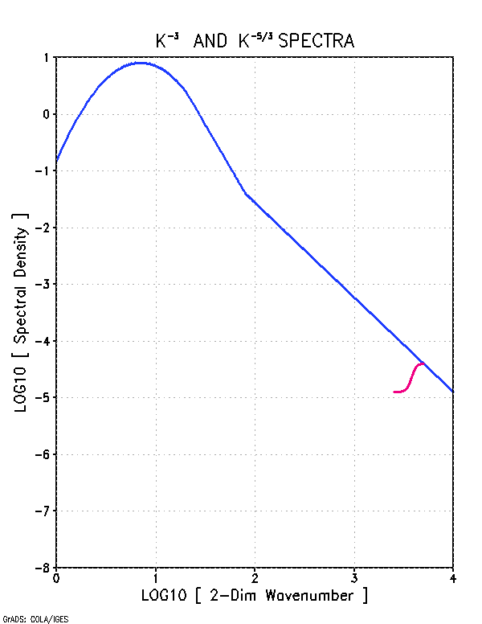
8
4
2
1
1/2
1/4
40000 4000 400 40 4 km

Slide 19
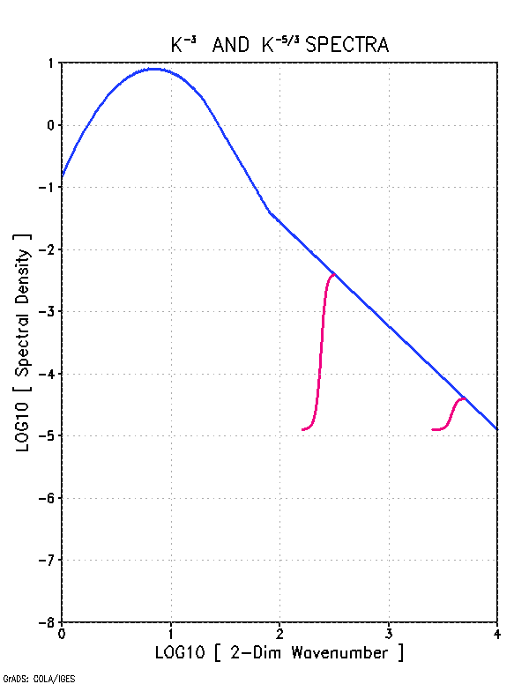
8
4
2
1
1/2
1/4
40000 4000 400 40 4 km

Slide 20
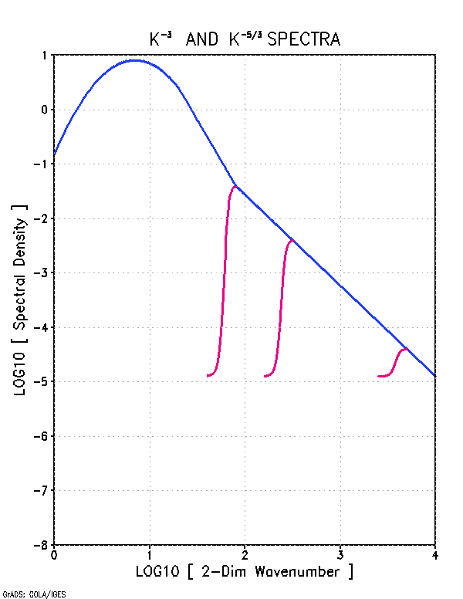
8
4
2
1
1/2
1/4
40000 4000 400 40 4 km

Slide 21
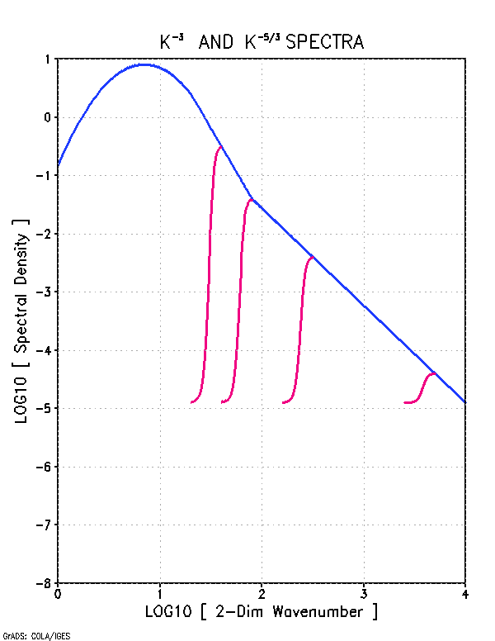
8
4
2
1
1/2
1/4
40000 4000 400 40 4 km

Slide 22
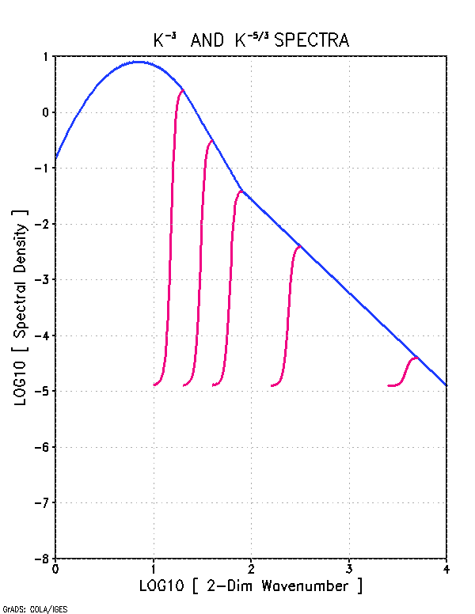
8
4
2
1
1/2
1/4
40000 4000 400 40 4 km

Slide 23
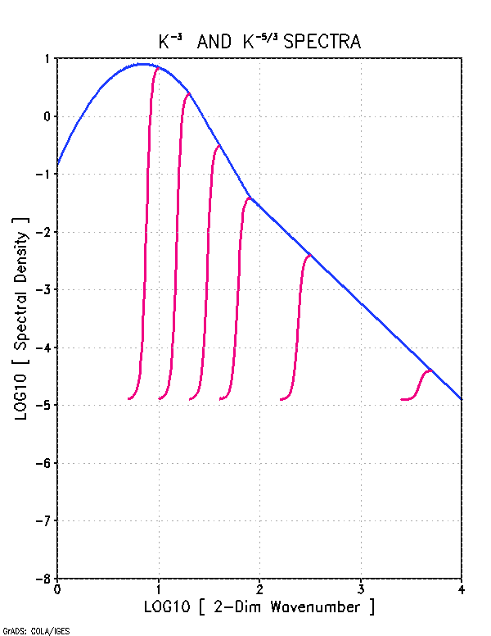
8
4
2
1
1/2
1/4
40000 4000 400 40 4 km

Slide 24
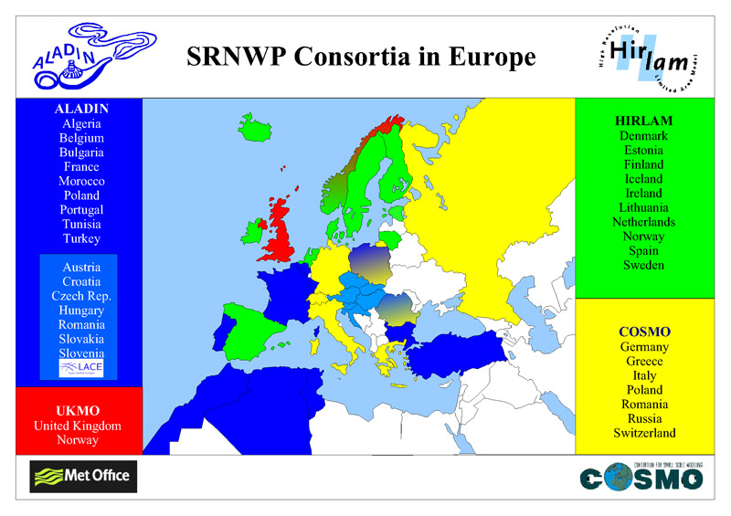

Slide 26
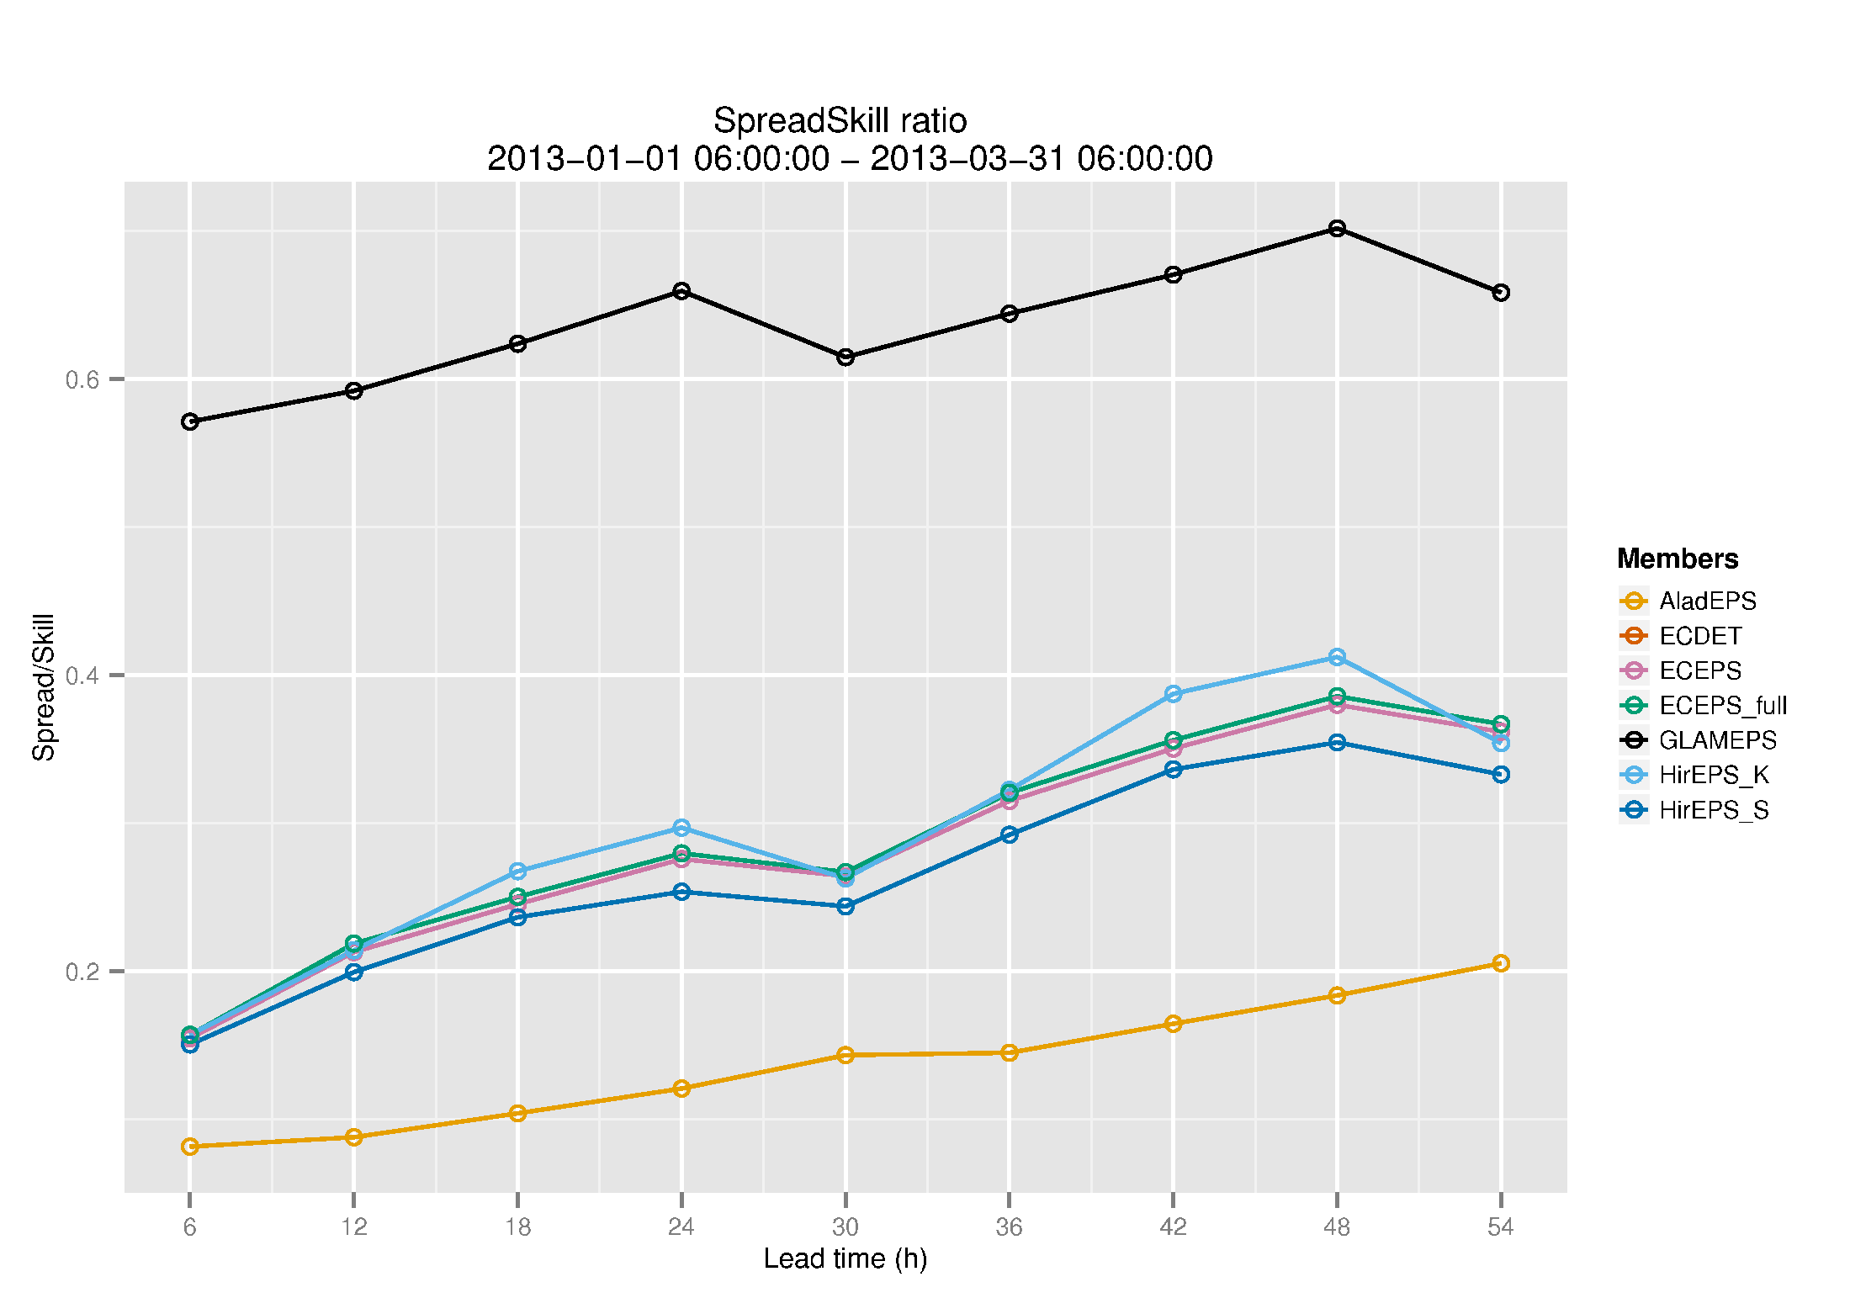

Slide 27
Notation

Slide 28
Notation

Slide 29
Averaging

Slide 30
Averaging

Slide 31
Averaging

Slide 32
Skill Measures

Slide 33
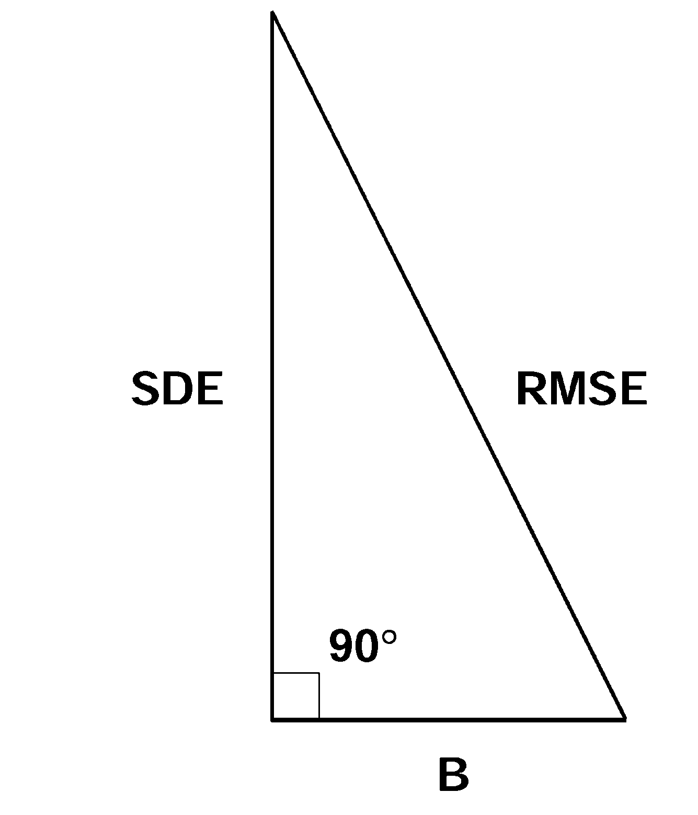

Slide 34
Skill of Control Member

Slide 35
Skill of Perturbed Member

Slide 36
Ensemble Mean

Slide 37
Skill of Ensemble Mean

Slide 38
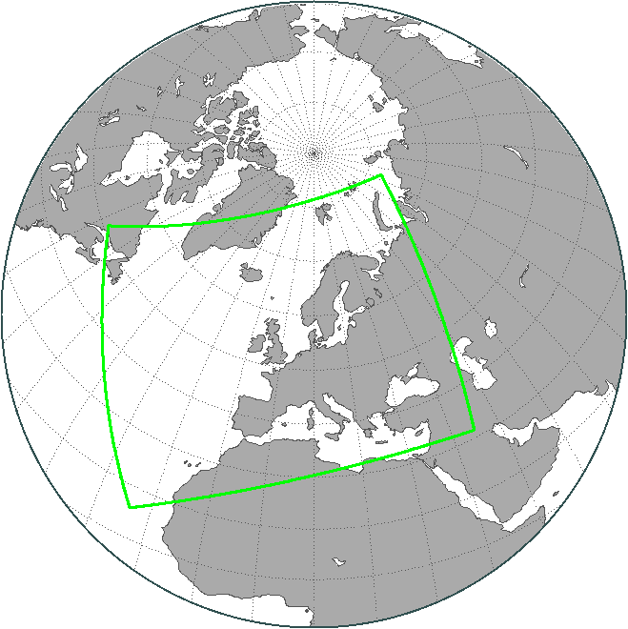
Experiment
HIRLAM 11 X 11 km L40
DA : Hybrid 3D-Ens-VAR (CNTR)
Ensemble method : ETKF
Ensemble members : 1 + 12
Spherical simplex transform
BC : ECEPS - 6 hr old
32 km
Pairing
Time Period : JUL-AUG 2010
Cycle : 06 UTC

Slide 39
5 Reasons for the
APPARENT Under-Dispersiveness
No Bias-correction
Use of inhomogeneous ensemble members
Use of incorrect Spread-Skill Condition
Use of Centering practice
Overestimation of observation error

Slide 40
5 Reasons for the
APPARENT Under-Dispersiveness
No Bias-correction
Use of inhomogeneous ensemble members
Use of incorrect Spread-Skill Condition
Use of Centering practice
Overestimation of observation error

Slide 41
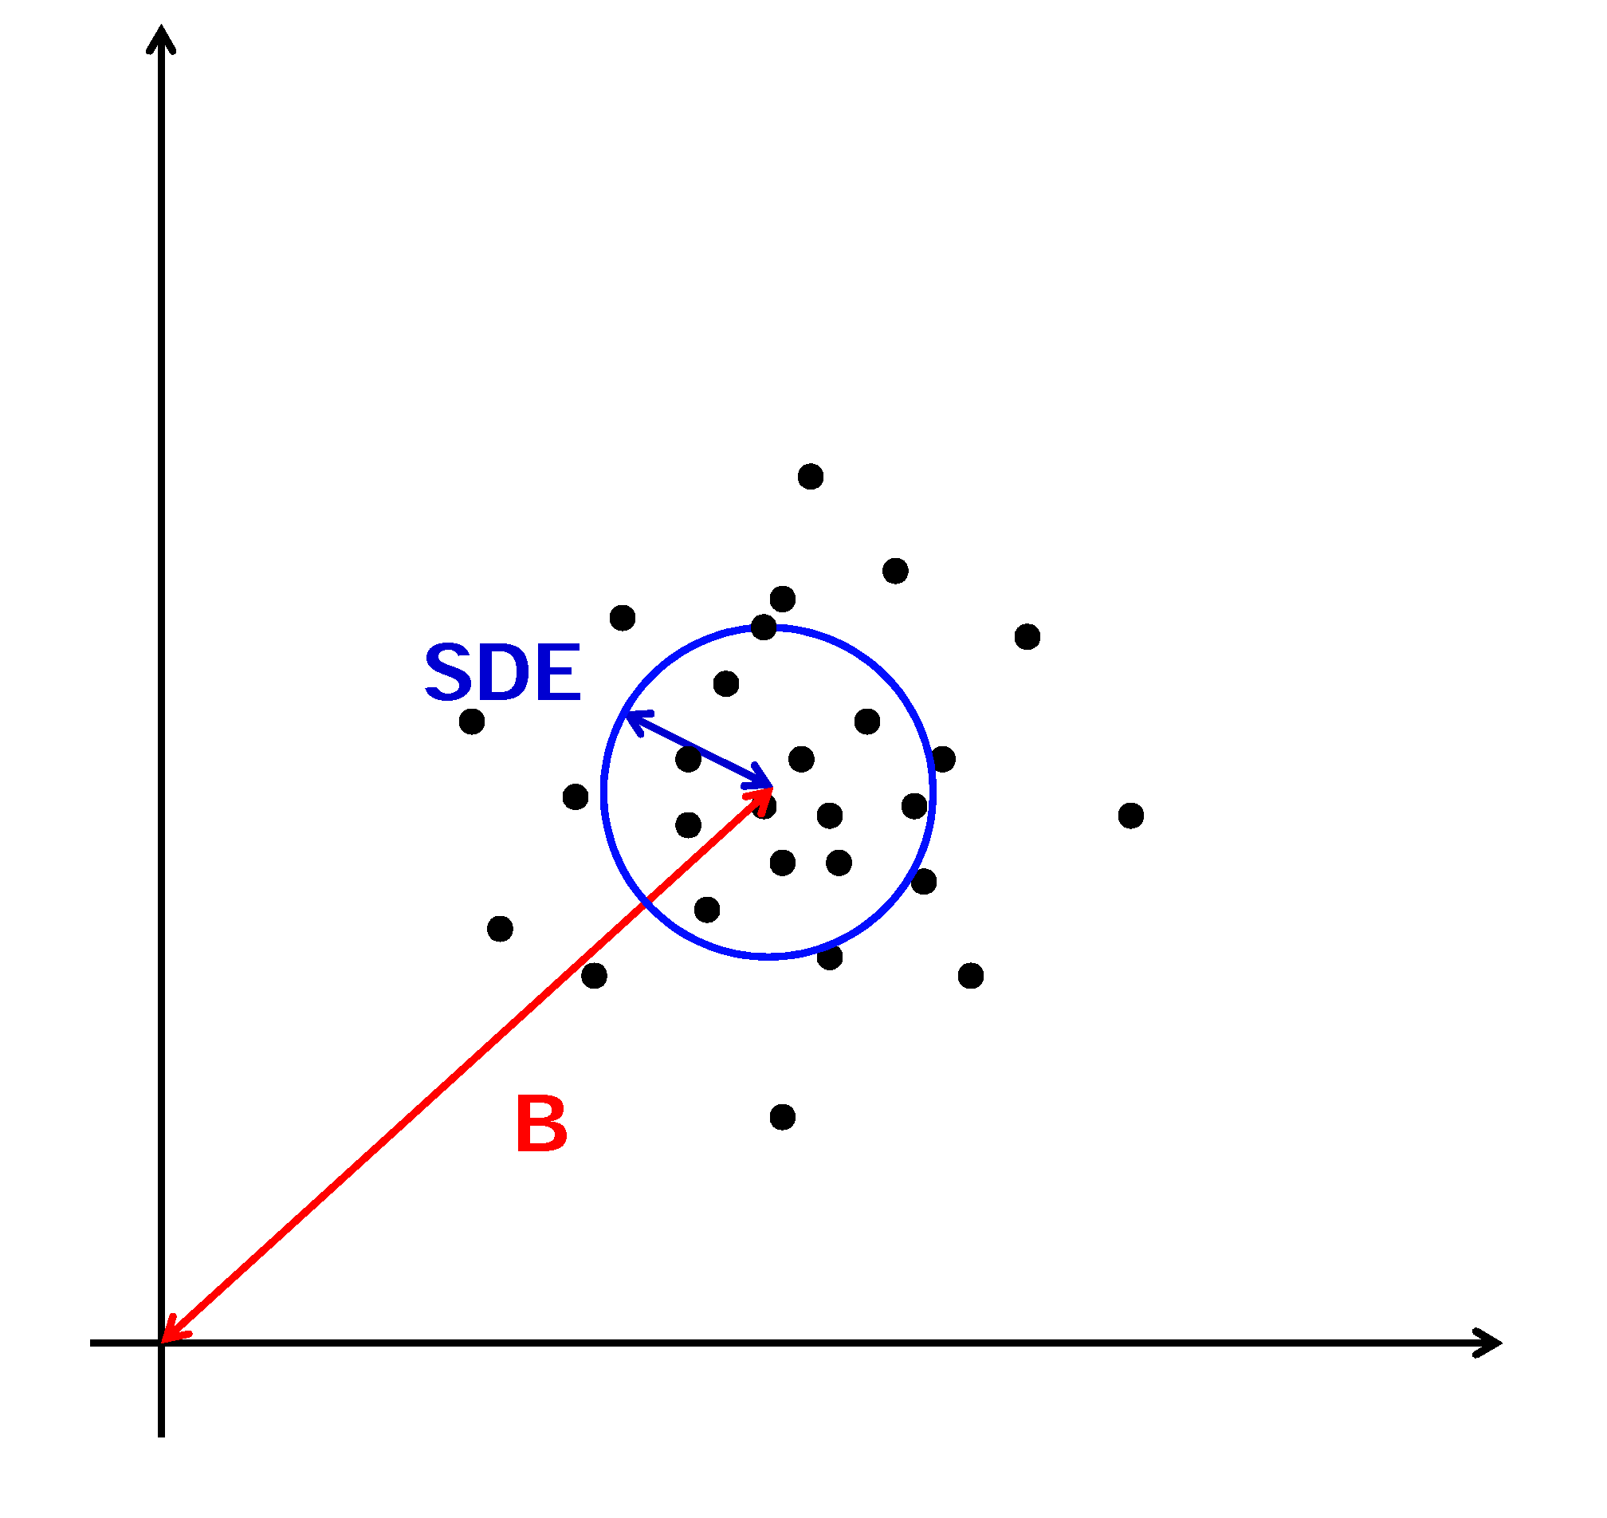

Slide 42
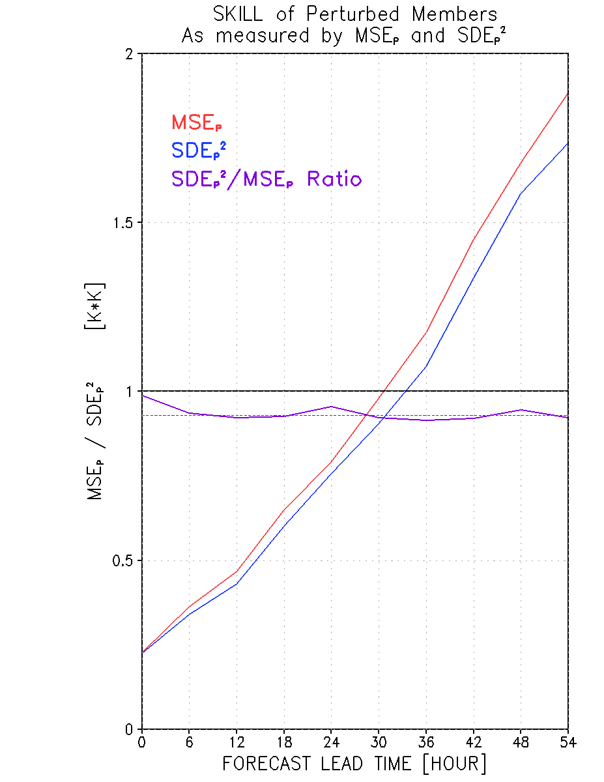

Slide 43
96
100
26

Slide 44
5 Reasons for the
APPARENT Under-Dispersiveness
No Bias-correction
Use of inhomogeneous ensemble members
Use of incorrect Spread-Skill Condition
Use of Centering practice
Overestimation of observation error

Slide 45
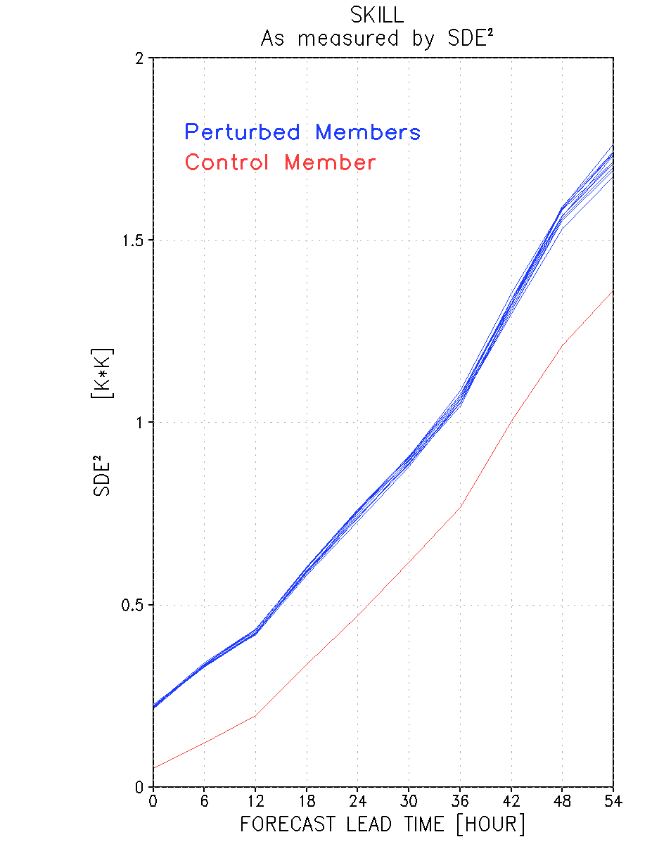

Slide 46
5 Reasons for the
APPARENT Under-Dispersiveness
No Bias-correction
Use of inhomogeneous ensemble members
Use of incorrect Spread-Skill Condition
Use of Centering practice
Overestimation of observation error
e.c.c. and i.i.d.

Slide 47
5 Reasons for the
APPARENT Under-Dispersiveness
No Bias-correction
Use of inhomogeneous ensemble members
Use of incorrect Spread-Skill Condition
Use of Centering practice
Overestimation of observation error

Slide 48
COMMONLY USED
SKILL – SPREAD CONDITION

Slide 49
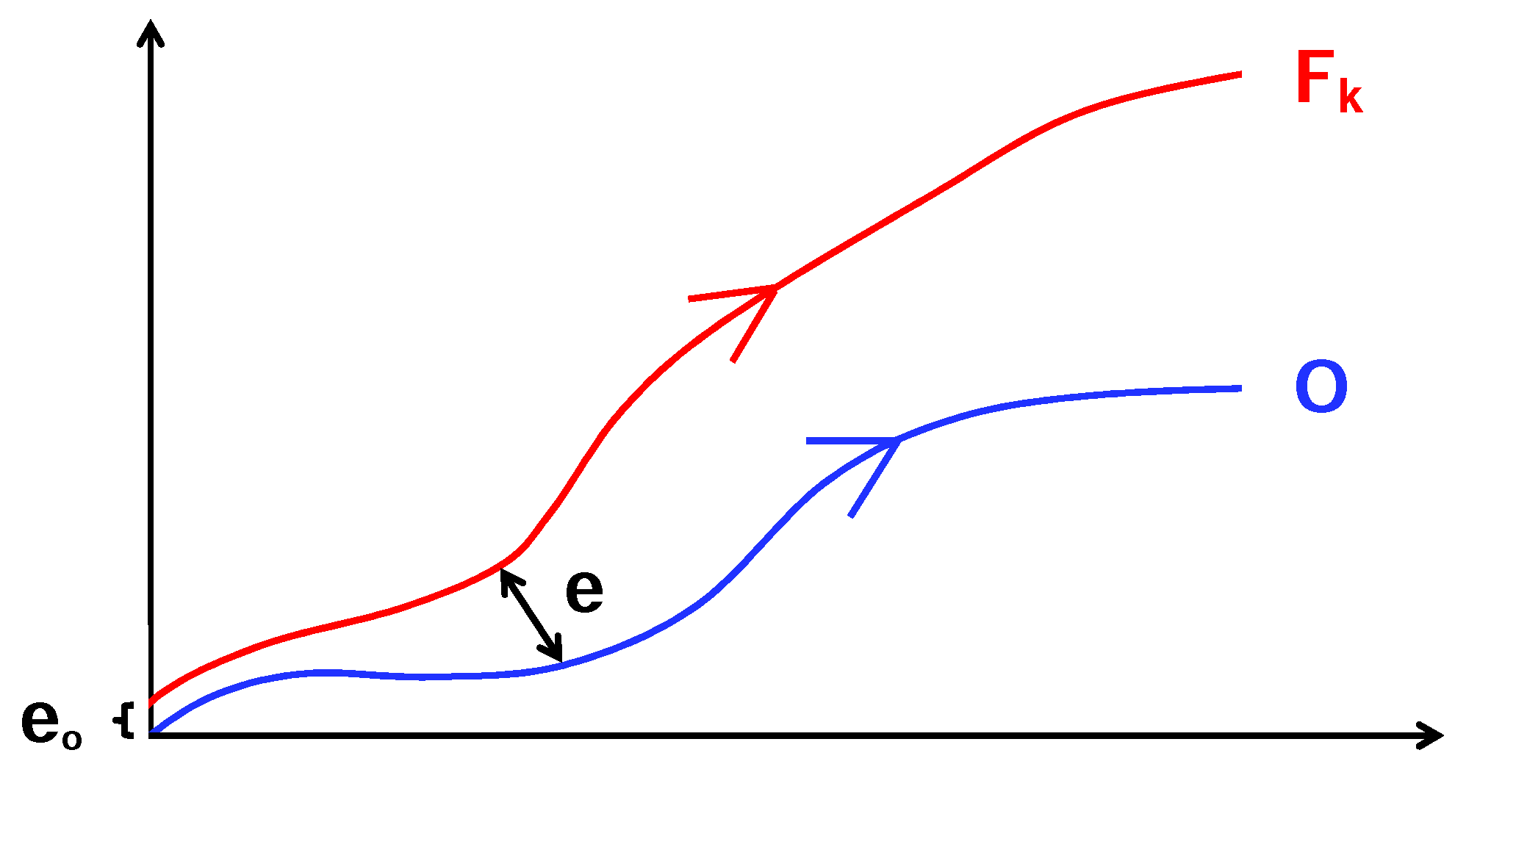
SKILL

Slide 50
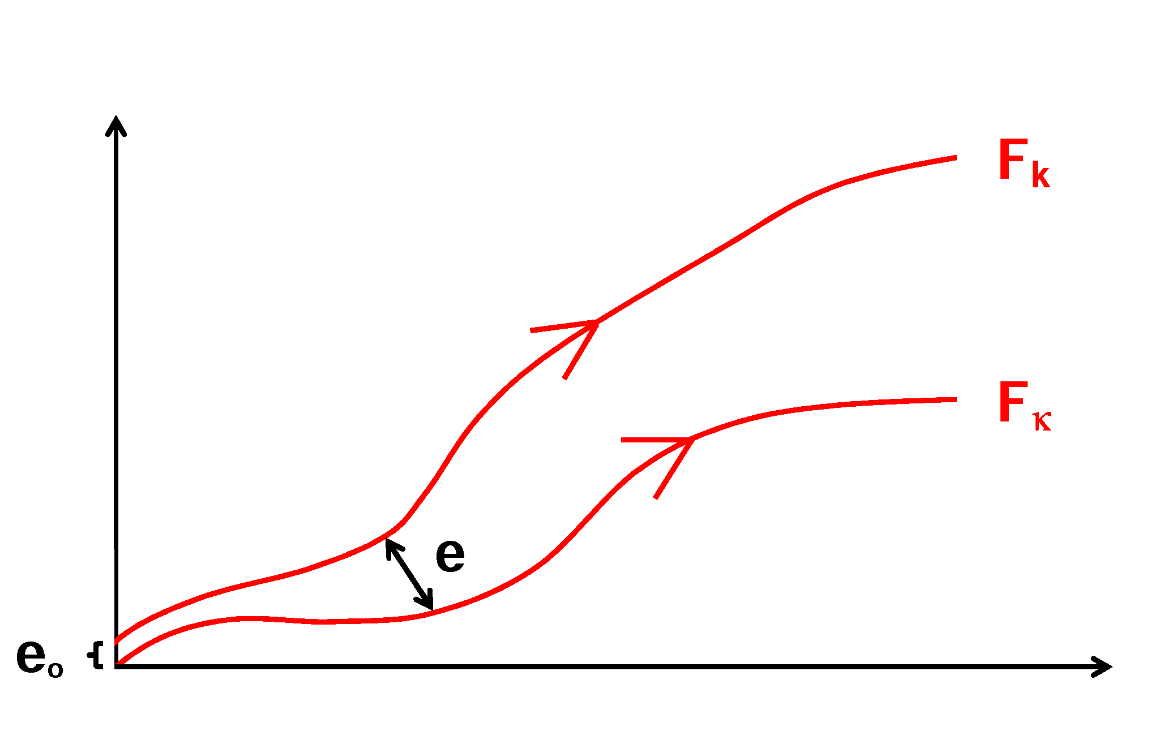
SPREAD

Slide 51
SPREAD

Slide 52
SPREAD
U-statistic
A U-statistic is defined as the average –
across all combinatorial selections of the given size from the full set of observations –
of the basic estimator applied to the sub-samples.
U-statistics, where the letter U stands for unbiased, arise naturally in producing minimum-variance unbiased estimators.

Slide 53
SPREAD
U-statistic
A U-statistic is defined as the average –
across all combinatorial selections of the given size from the full set of observations –
of the basic estimator applied to the sub-samples.
U-statistics, where the letter U stands for unbiased, arise naturally in producing minimum-variance unbiased estimators.

Slide 54
SPREAD

Slide 55
SKILL
U-statistic

Slide 56
U2I SKILL – SPREAD CONDITION

Slide 57
U2I SKILL – SPREAD CONDITION

Slide 58
SKILL – SPREAD CONDITIONS

Slide 59
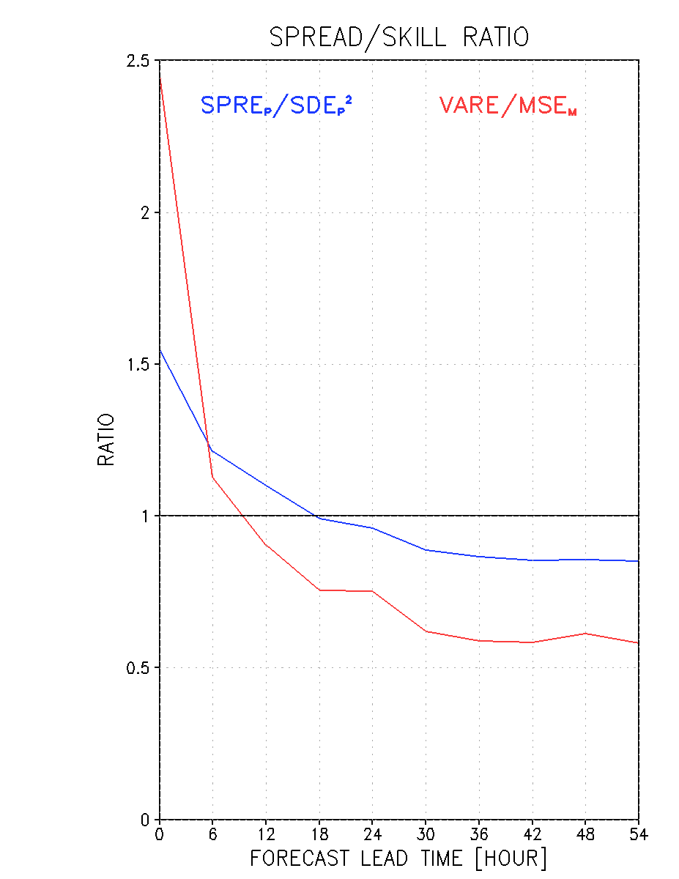
85 %
58 %

Slide 60
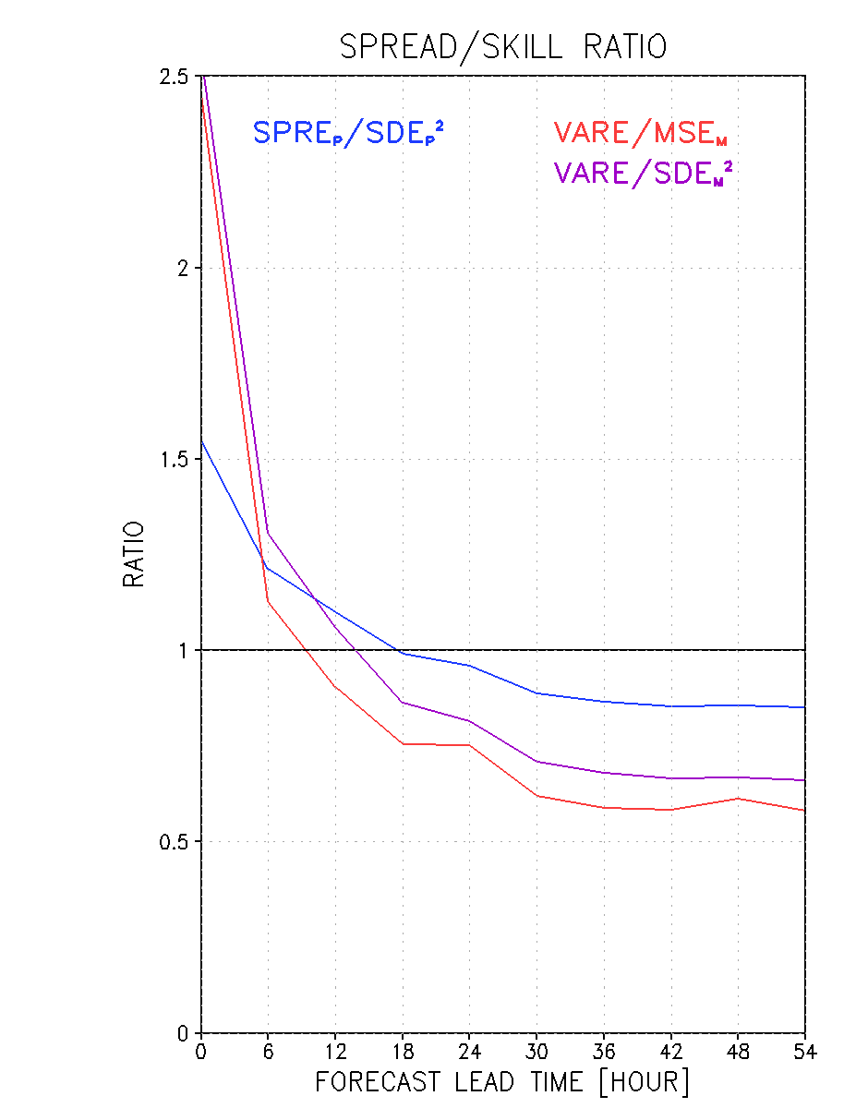
U₁

Slide 61
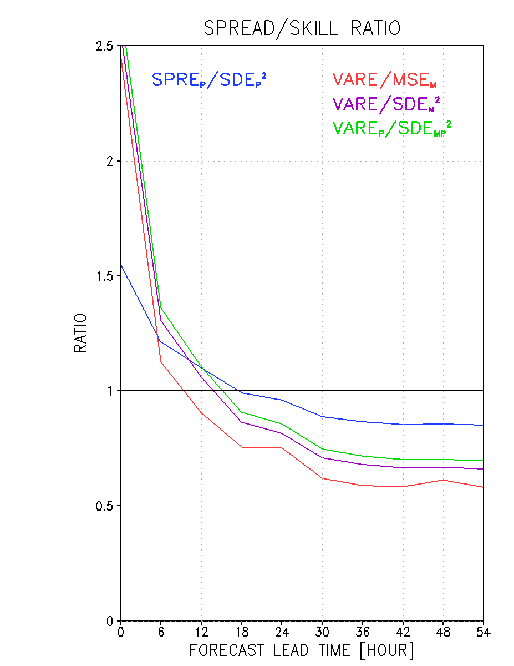
I
U₁

Slide 62
U₂
I
U₁

Slide 63
5 Reasons for the
APPARENT Under-Dispersiveness
No Bias-correction
Use of inhomogeneous ensemble members
Use of incorrect Spread-Skill Condition
Use of Centering practice
Overestimation of observation error

Slide 64
5 Reasons for the
APPARENT Under-Dispersiveness
No Bias-correction
Use of inhomogeneous ensemble members
Use of incorrect Spread-Skill Condition
Use of Centering practice
Overestimation of observation error

Slide 65
Implications
of
Centering

Slide 66
U2I SKILL – SPREAD CONDITION

Slide 67
U2I SKILL – SPREAD CONDITION

Slide 68
U2I SKILL – SPREAD CONDITION

Slide 70
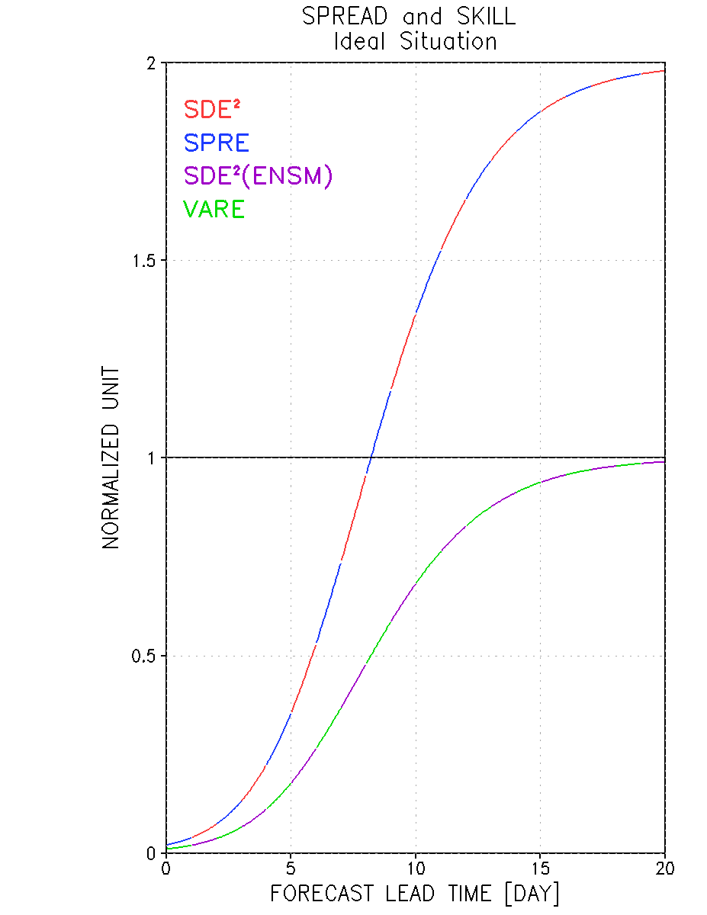

Slide 72
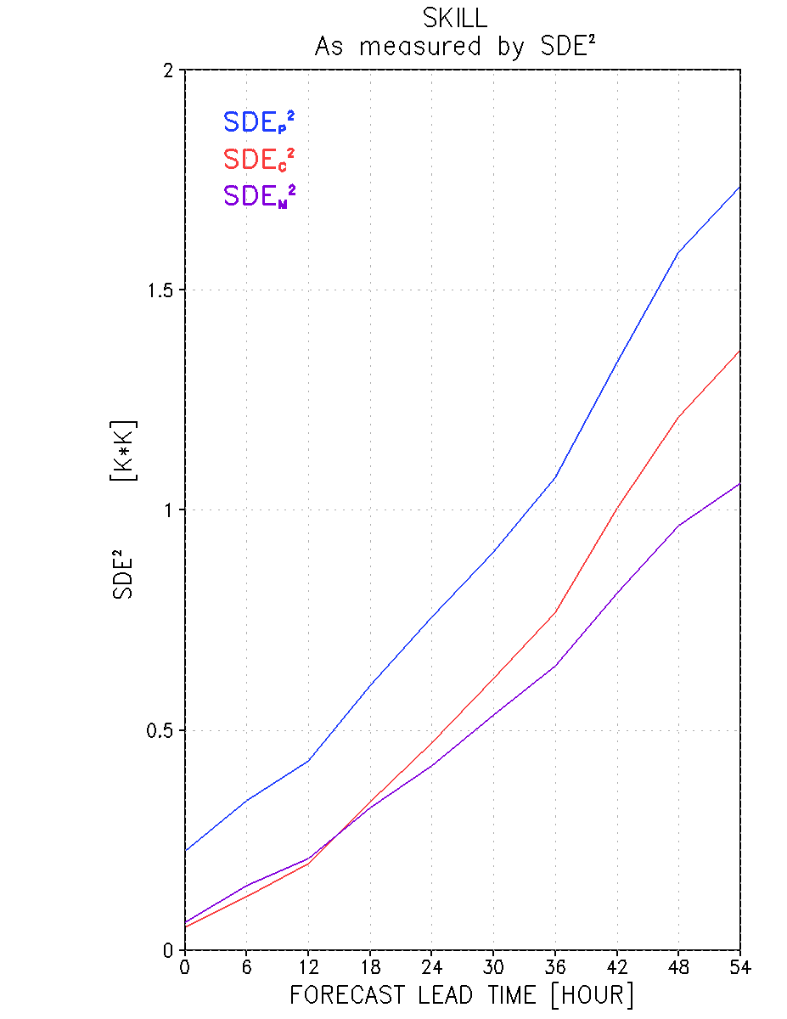

Slide 73
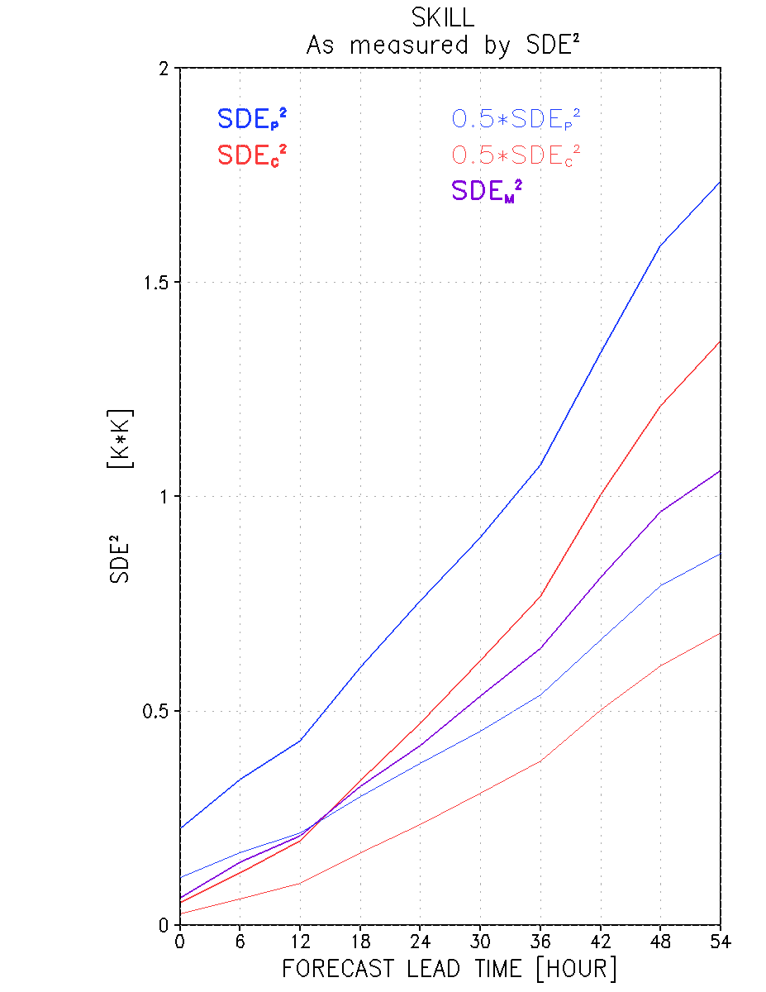

Slide 75
Ideal Ensemble
Infinite number of ensemble members
All are equally likely to be the truth
All members are bias-free and iid
Valid at all lead times, including IC

Slide 76
Ideal Ensemble
Infinite number of ensemble members
All are equally likely to be the truth
All members are bias-free and iid
Valid at all lead times, including IC

Slide 77
Ideal Ensemble
Infinite number of ensemble members
All are equally likely to be the truth
All members are bias-free and iid
Valid at all lead times, including IC

Slide 78
Ideal Ensemble
Infinite number of ensemble members
All are equally likely to be the truth
All members are bias-free and i.i.d.
Valid at all lead times, including IC

Slide 79
Ideal Ensemble
Infinite number of ensemble members
All are equally likely to be the truth
All members are bias-free and i.i.d.
Valid at all lead times, including IC

Slide 80
Quantity and Quality of available data
M << N
Observations have Errors
IC not Unique
Many – presumably infinitely many –
Equally Likely IC

Slide 81
Quantity and Quality of available data
M << N
Observations have Errors
IC not Unique
Many – presumably infinitely many –
Equally Likely IC

Slide 82
Quantity and Quality of available data
M << N
Observations have Errors
IC not Unique
Many – presumably infinitely many –
Equally Likely IC

Slide 83
Quantity and Quality of available data
M << N
Observations have Errors
IC not Unique
Many – presumably infinitely many –
Equally Likely IC

Slide 84
Quantity and Quality of available data
M << N
Observations have Errors
IC not Unique
Many – presumably infinitely many –
Equally Likely IC

Slide 85
Quantity and Quality of available data
M << N
Observations have Errors
IC not Unique
Many – presumably infinitely many –
Equally Likely IC

Slide 86
Quantity and Quality of available data
M << N
Observations have Errors
IC not Unique
Many – presumably infinitely many –
Equally Likely IC

Slide 87
Quantity and Quality of available data
M << N
Observations have Errors
IC not Unique
Many – presumably infinitely many –
Equally Likely IC Multimodal PDF

Slide 88
Representation of data

Slide 89
Representation of data

Slide 90
Representation of data

Slide 91
Representation of data

Slide 92
Partitioning of variables

Slide 93
Partitioning of variables

Slide 94
Partitioning of variables

Slide 95
Partitioning of variables
P_{k}
v
M
A_{k}

Slide 96
Partitioning of variables
v

Slide 97
Partitioning of variables
v

Slide 98
Ensemble members are i.i.d. →
PDF of P_{k} e^{iθ}k is a product of two factors
Unimodal with mode at

Slide 99
Ensemble members are i.i.d. →
PDF of P_{k} e^{iθ}k is a product of two factors
Unimodal with mode at

Slide 100
Ensemble members are i.i.d. →
PDF of P_{k} e^{iθ}k is a product of two factors
Unimodal with mode at

Slide 101
Ensemble members are i.i.d. →
PDF of P_{k} e^{iθ}k is a product of two factors
Unimodal with mode at

Slide 102
Possible form of f(P_{k} )
OR

Slide 103
Possible form of f(P_{k} )

Slide 104
Possible form of f(P_{k} )

Slide 105
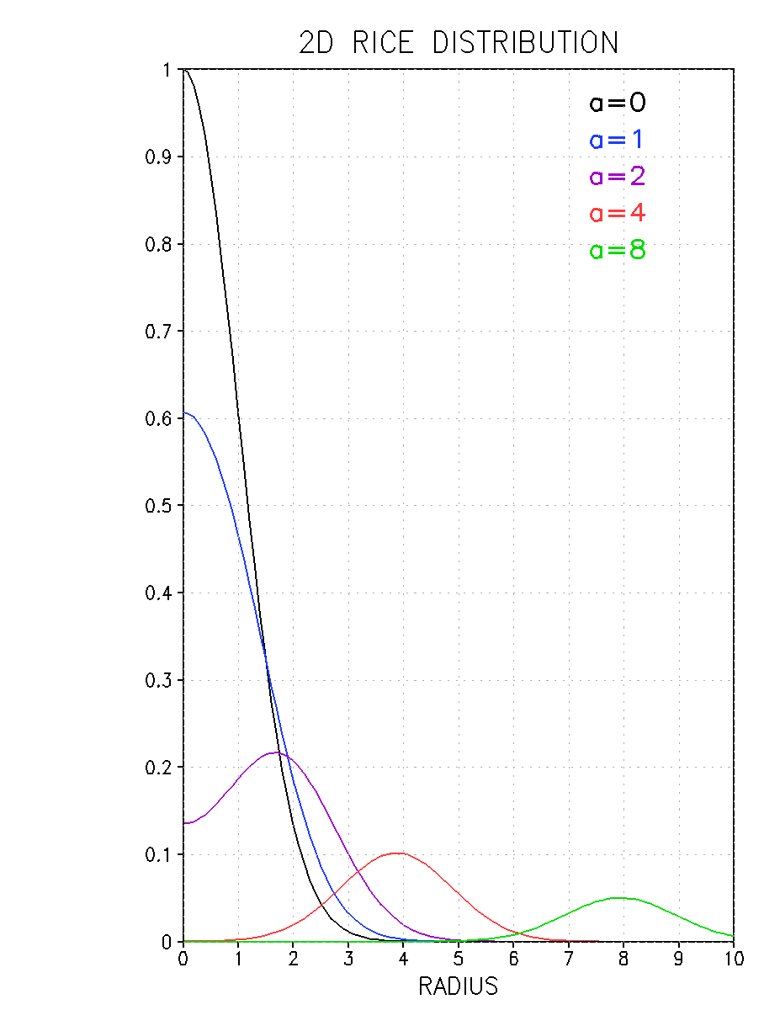

Slide 106
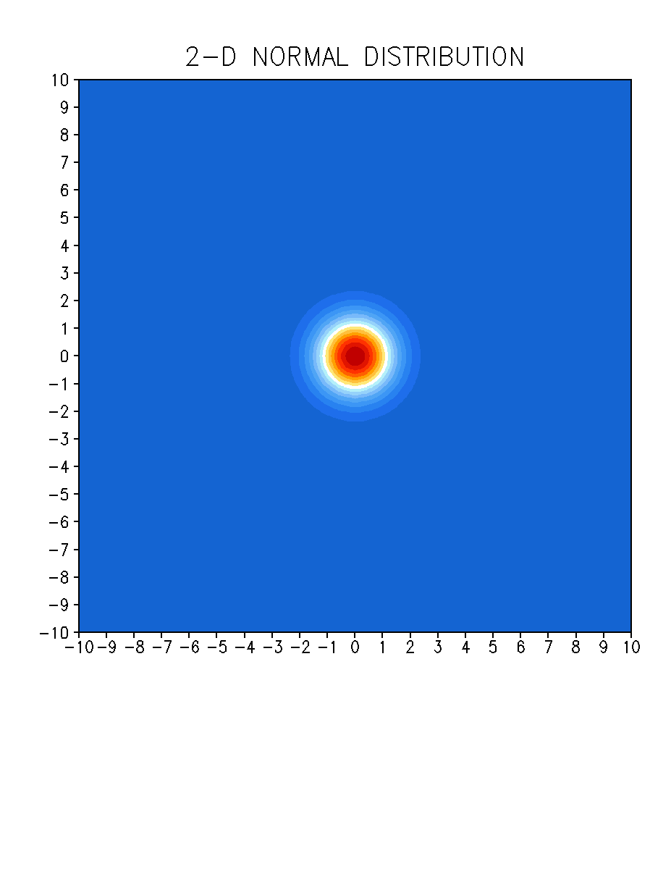

Slide 107
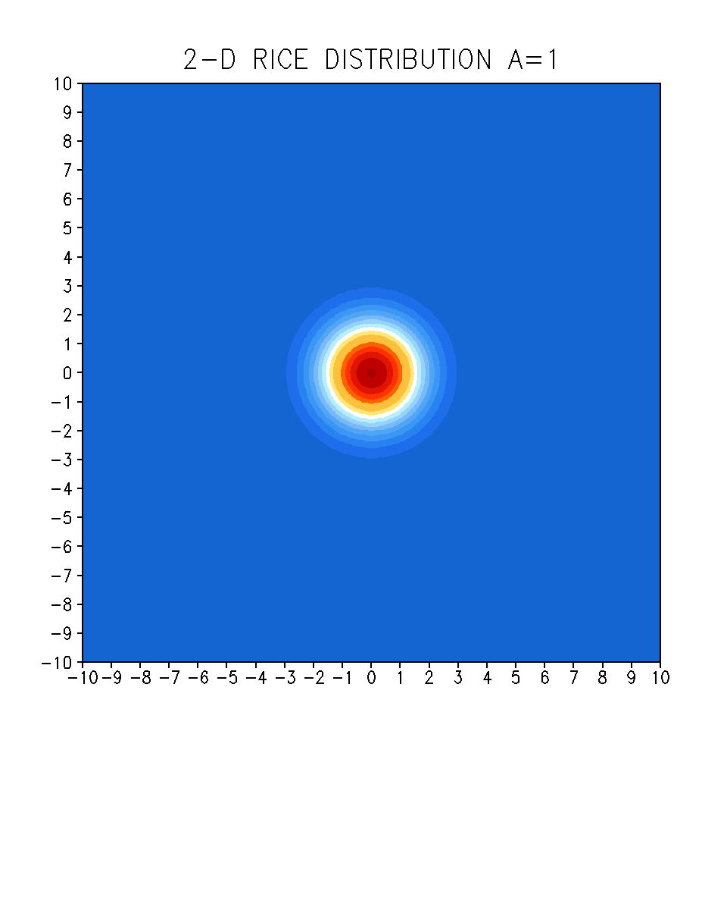

Slide 108
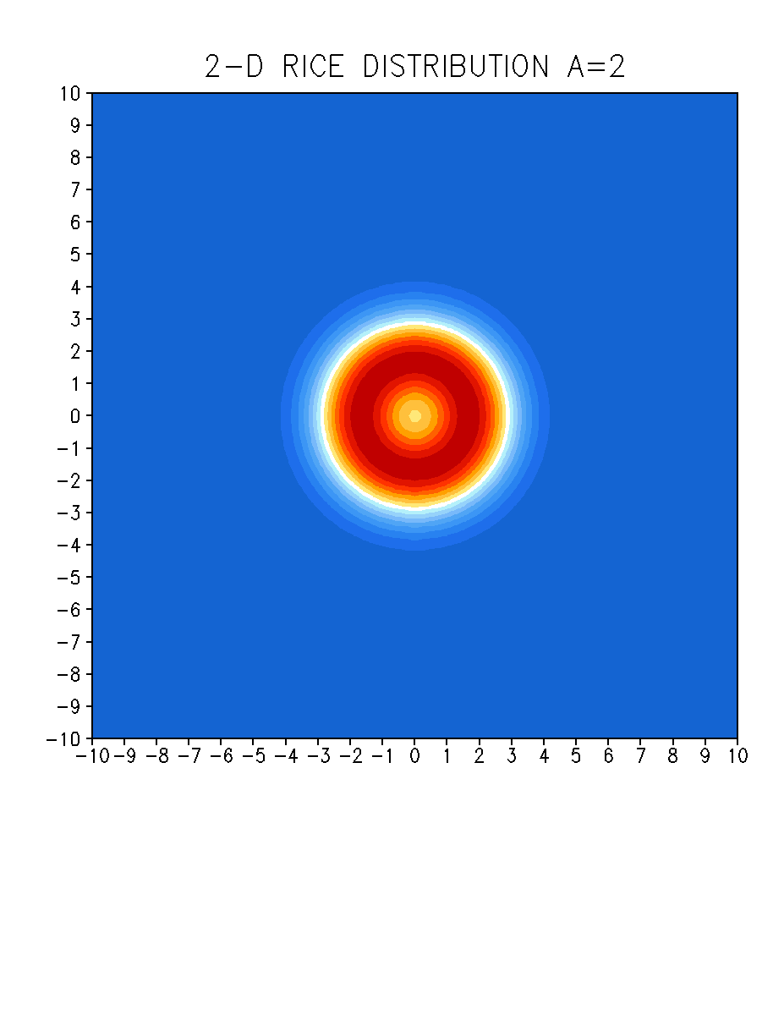

Slide 109
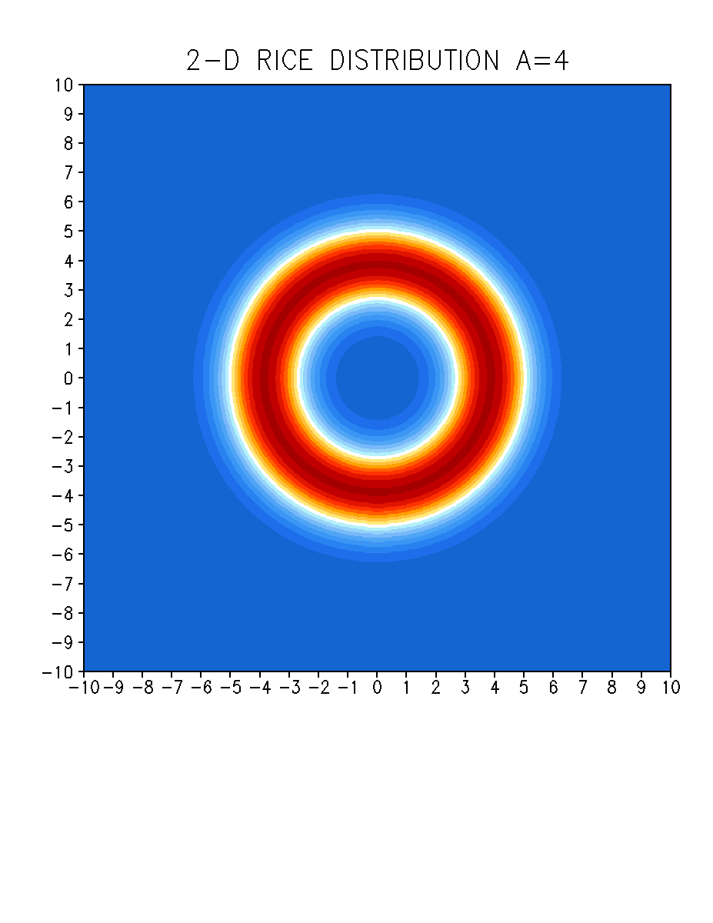

Slide 110
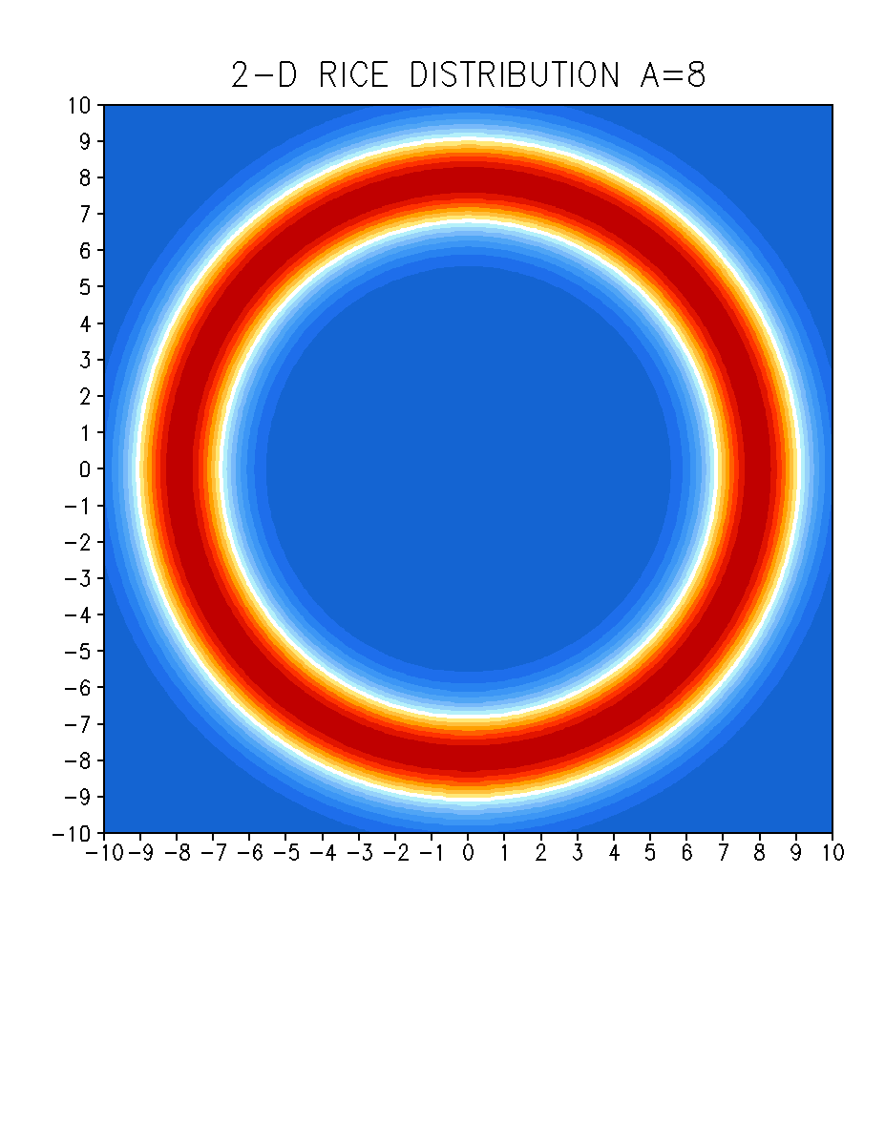

Slide 116
Realistic
Error Spectrum

Slide 117
Tribbia and Baumhefner 2004

Slide 118
Large Scales

Slide 119
Small Scales

Slide 120
Ideal Ensemble
v
v
v
v
v
v
v
v
v
v
v
v
v
v
v

Slide 121
Ideal Ensemble
v
v
v
v
v
v
v
v
v
v
v
v
v
v
v

Slide 126
Ideal Ensemble
v
v
v
v
v
v
v
v
v
v
v
v
v
v
v

Slide 132
Ideal Case
v
v
v
v
v
v
v
v
v
v
v
v
v
v
v

Slide 133
Ideal Case
v
v
v
v
v
v
v
v
v
v
v
v
v
v
v

Slide 134
Ideal Case
v
v
v
v
v
v
v
v
v
v
v
v
v
v
v

Slide 135
v
v
v
v
v
v
v
v
v
v
v
v
v
v
v
v
v
v
v
v
v
v
v
v
v
v
v
v
v
v
v

Slide 136
v
v
v
v
v
v
v
v
v
v
v
v
v
v
v
v
v
v
v
v
v
v
v
v
v
v
v
v
v
v
v

Slide 137
v
v
v
v
v
v
v
v
v
v
v
v
v
v
v
v
v
v
v
v
v
v
v
v
v
v
v
v
v
v
v

Slide 138
0.850
0.703

Slide 139
Centering is a
larger problem
for short-range EPS
compared to medium-range EPS

Slide 140
5 Reasons for the
APPARENT Under-Dispersiveness
No Bias-correction
Use of inhomogeneous ensemble members
Use of incorrect Spread-Skill Condition
Use of Centering practice
Overestimation of observation error

Slide 141
Verification
versus the truth

Slide 142
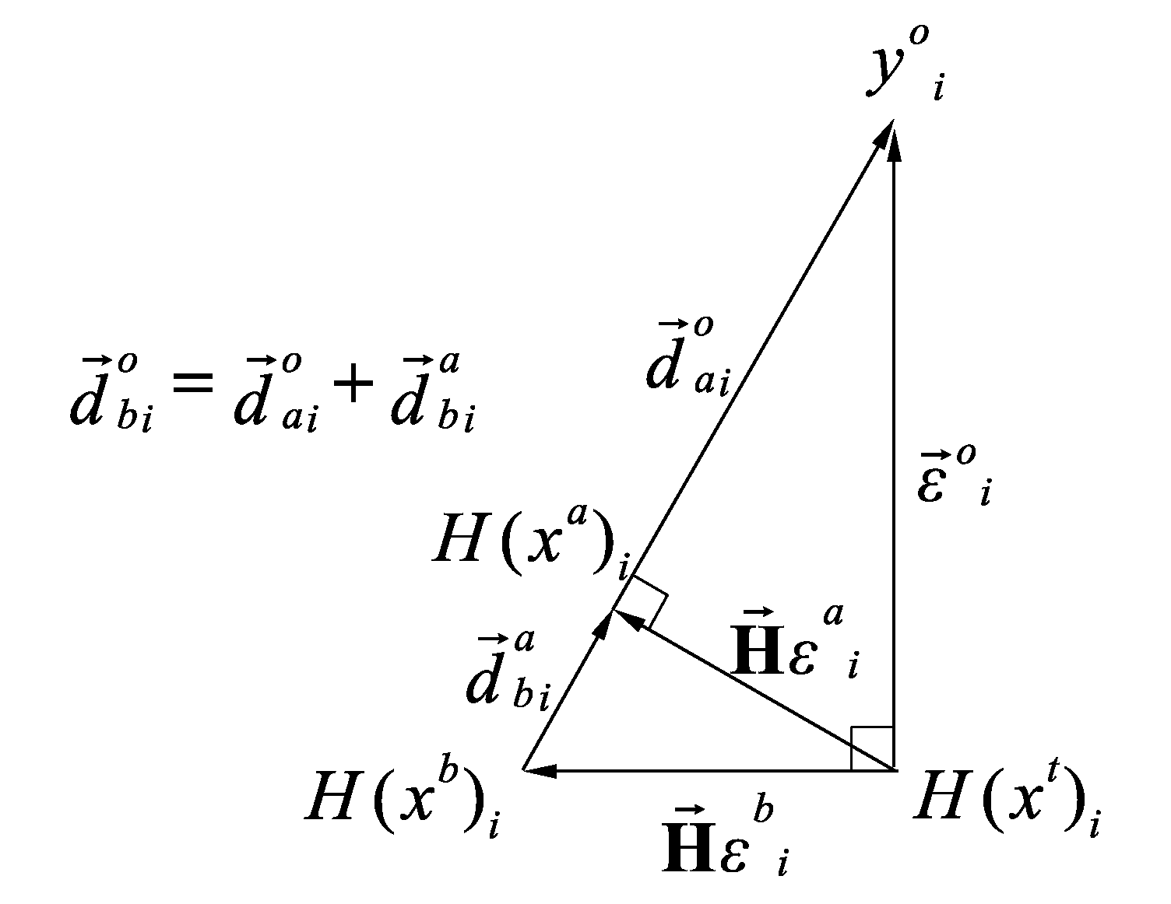

Slide 143
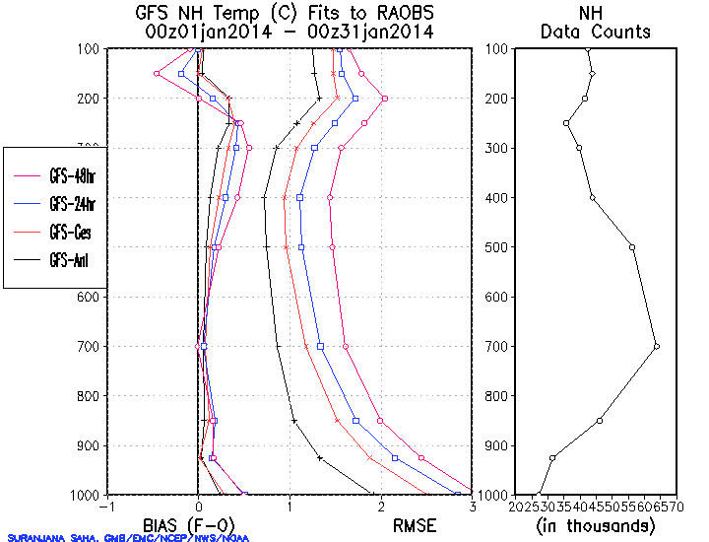

Slide 144
CONCLUSIONS
The U2I Spread-Skill Condition gives a more realistic assessment of the Spread-Skill relationship for a real EPS compared to the traditional Spread-Skill Condition
Centering should be avoided – Create equally likely ensemble members with same quality as control
Verification against the perceived ”truth” – Not against observations or analysis – Desroziers triangles

Slide 145
CONCLUSIONS
The U2I Spread-Skill Condition gives a more realistic assessment of the Spread-Skill relationship for a real EPS compared to the traditional Spread-Skill Condition
Centering should be avoided – Create equally likely ensemble members with same quality as control
Verification against the perceived ”truth” – Not against observations or analysis – Desroziers triangles

Slide 146
CONCLUSIONS
The U2I Spread-Skill Condition gives a more realistic assessment of the Spread-Skill relationship for a real EPS compared to the traditional Spread-Skill Condition
Centering should be avoided – Create equally likely ensemble members with same quality as control
Verification against the perceived ”truth” – Not against observations or analysis – Desroziers triangles

