Slide 1
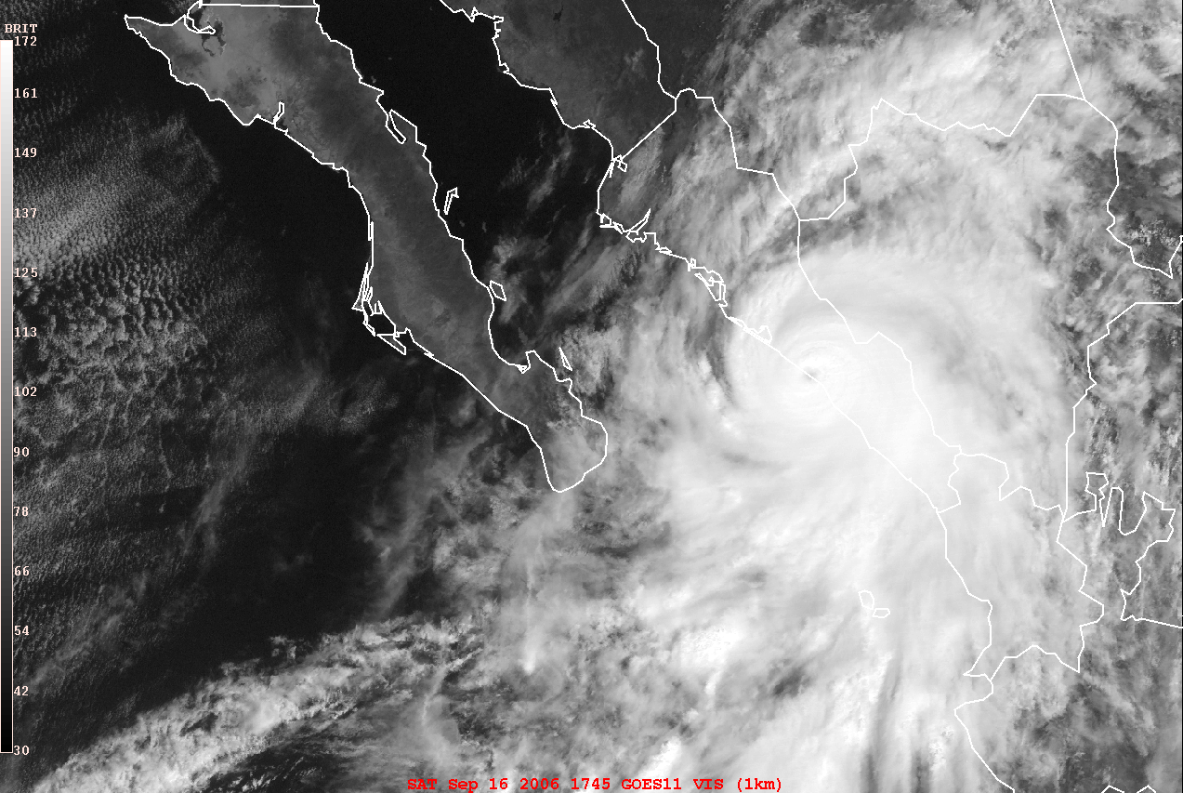
Application of the WRF and HWRF models for tropical cyclone development
L.M. Farfán, CICESE, Unidad La Paz, Baja California Sur, Mexico
Lane (2006), category-3 (205 km/h) hurricane at landfall
3rd strongest hurricane in west coast since 1969
Impact: 4 people killed and 240,700 affected

Slide 2
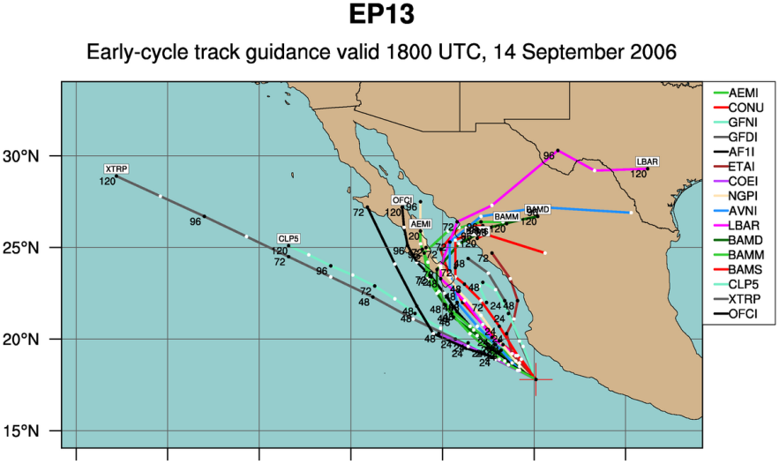
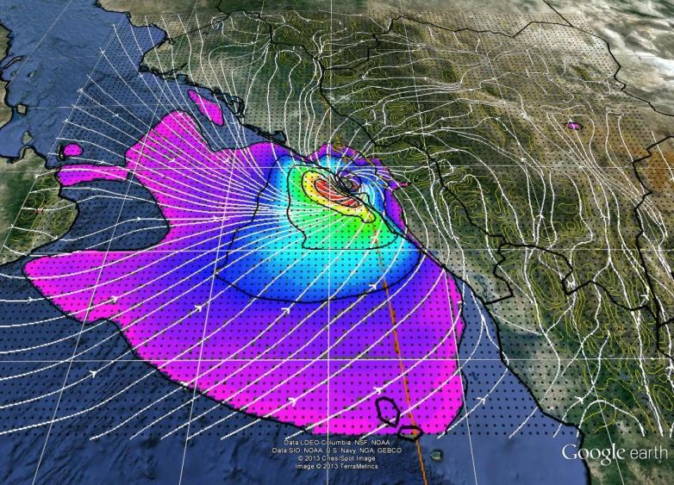
Application of the WRF and HWRF models for tropical cyclone development
L.M. Farfán, CICESE, Unidad La Paz, Baja California Sur, Mexico
Forecasts 48-h prior to Lane’s landfall, most → Los Cabos area
Courtesy, Jonathan Vigh (NCAR/tropical cyclone guidance project)
10-m winds from HWRF simulation performed at CICESE

Slide 3
My goal is to provide an overview of work oriented to understand
tropical cyclone predictions in the eastern Pacific, off Mexico,
and use a couple of models for research/practical applications.
1) Some of the material to be presented is observational from:
• geostationary (GOES) satellites
• rain-gauge network (SMN)
2) There are results from the application of numerical models:
• WRF provided by NCAR
• HWRF provided by DTC
Both are run at CICESE’s computing facility in Ensenada
3) Tropical cyclones are either from:
• previous seasons, 2006-2010, with emphasis on landfall events
• the current season, 2014, taking Odile as a case study
4) Some of the observational and model products are:
• available to the public in web sites hosted by CICESE
• used before authorities during the approach of “real” systems.

Slide 4
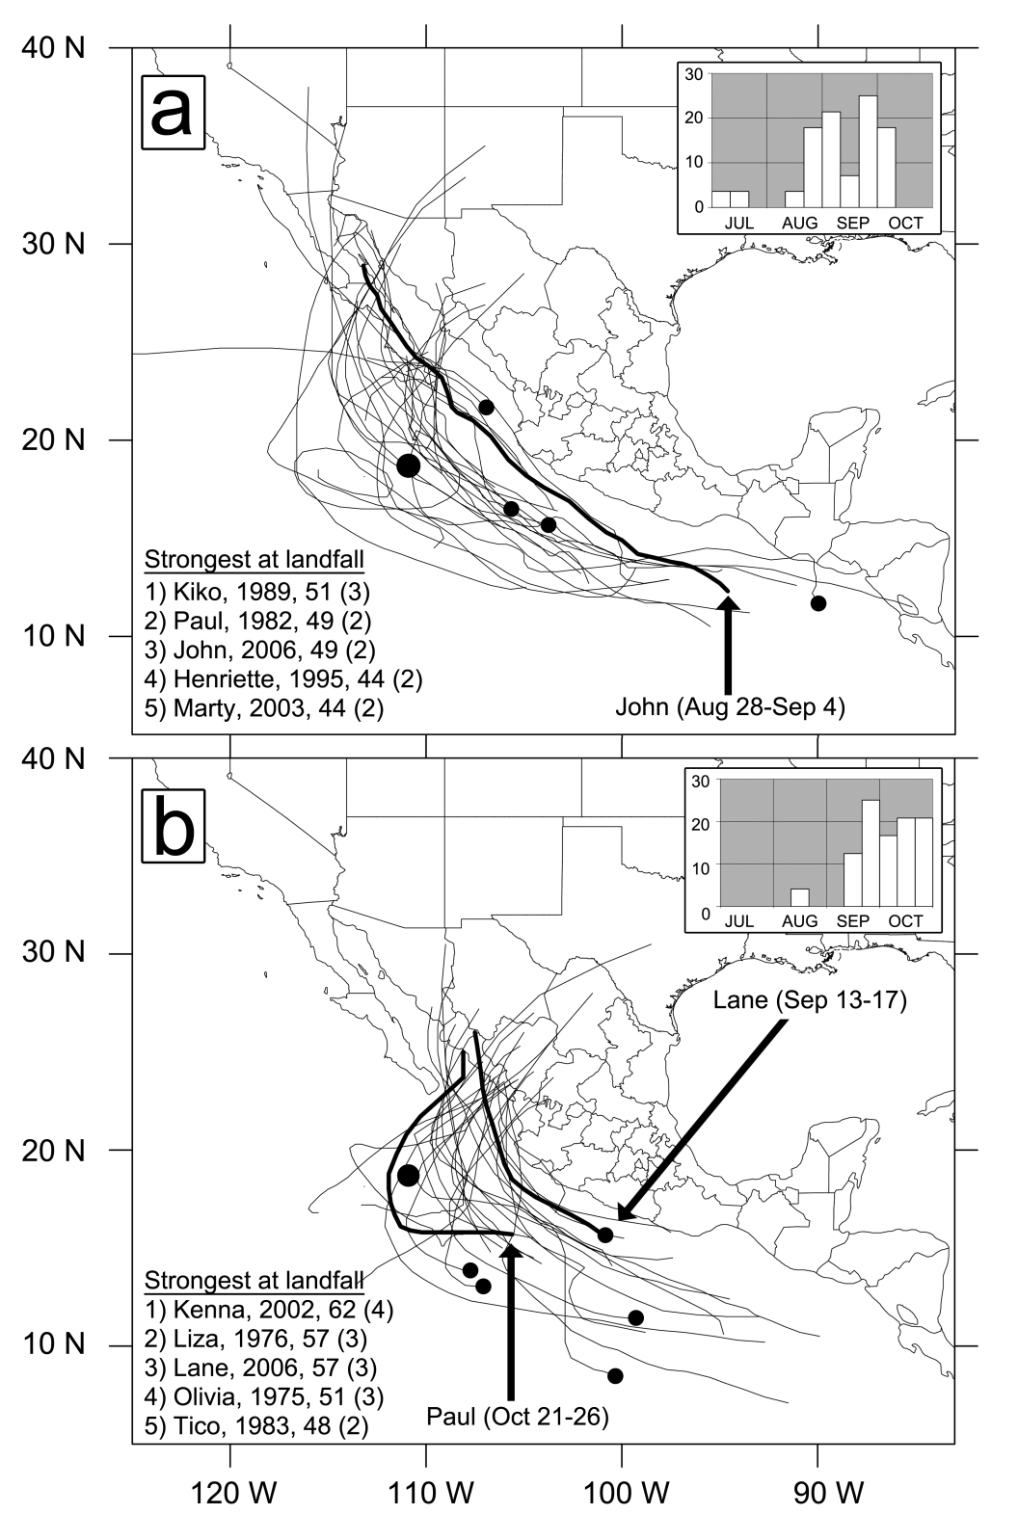
Tracks of tropical cyclones that made landfall over northwestern Mexico
Farfán et al., 2012. Weather and Forecasting
• Tracks are derived from the 1969–2005 seasons, thick lines are tropical cyclones from 2006.
• The majority of landfalls were along the coasts of Baja California Sur and Sinaloa
• Temporal frequency (percentage) of landfall strikes is shown in upper-right inserts, 90% of the peninsular events occurred from August-October
• Lower-left lists provide five strongest hurricanes at landfall: name, year, and maximum winds (m/ s), (Saffir–Simpson scale category)
• Only one (Kiko 1989) of 10 hurricanes crossed the peninsula with category-3 strength
• Some of the official forecasts had a westward bias 2-3 days prior to landfall!

Slide 5
3-day rainfall accumulations from TCs approaching/making landfall in Baja California
• Data from regional the network of SMN stations
Farfán et al., 2013. Atmósfera.

Slide 6
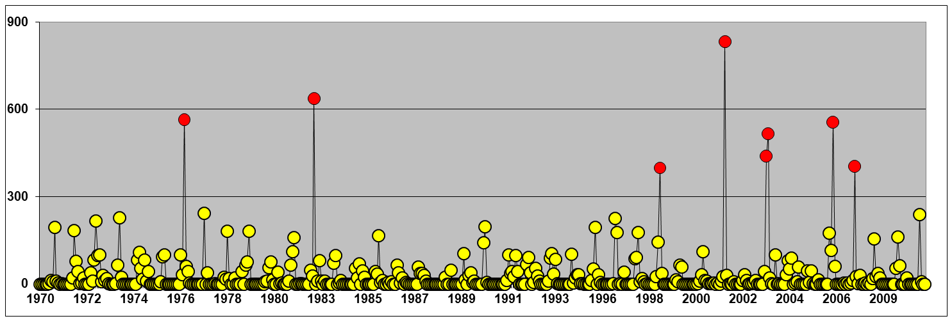
3-day rainfall accumulations from TCs approaching/making landfall in Baja California
• Data from regional the network of SMN stations
Farfán et al., 2013. Atmósfera.
Time series of monthly rainfall from 1970-2010: San Bartolo, Baja California Sur
Liza (1976)
Paul (1982)
Juliette (2001)
John (2006)
Isis (1998)
Ignacio, Marty (2003)
Henriette (2007)
• 833 mm in September 2001 associated with TC Juliette, 820 mm in 3 days, 392 mm in a single day
TCs John (449 mm), Liza (425 mm) and Paul (305) had daily records in a single day

Slide 7
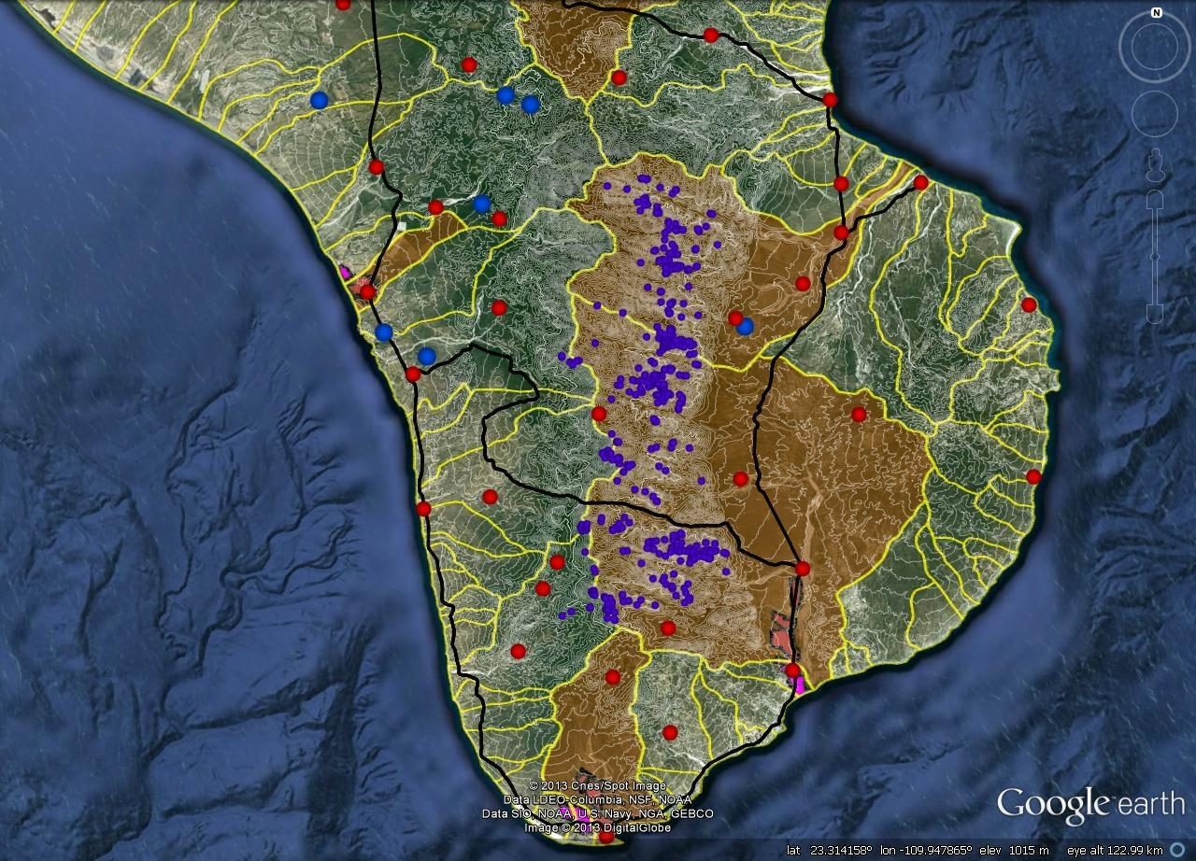
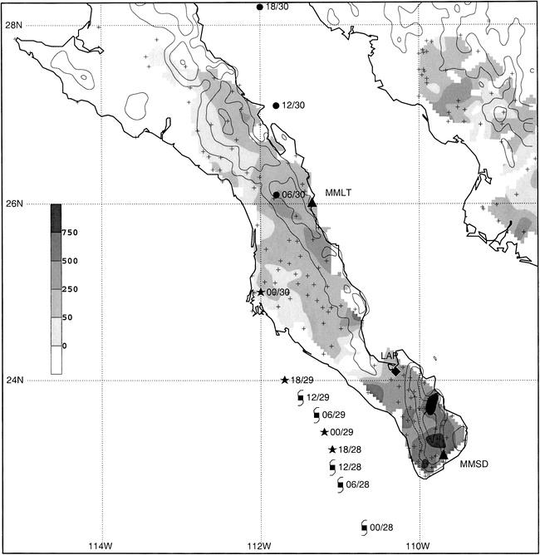
Spatial distribution of 419 landslides (•) associated with TC Juliette (2001)
Antinao and Farfán, 2013. Atmósfera.
Watersheds (yellow)
Weather stations (SMN)
Red=active, blue=inactive
Relatively large, populated areas (pink)
Terrain elevations (50m, white)
Juliette’s best track
Rain accumulations (mm)

Slide 8
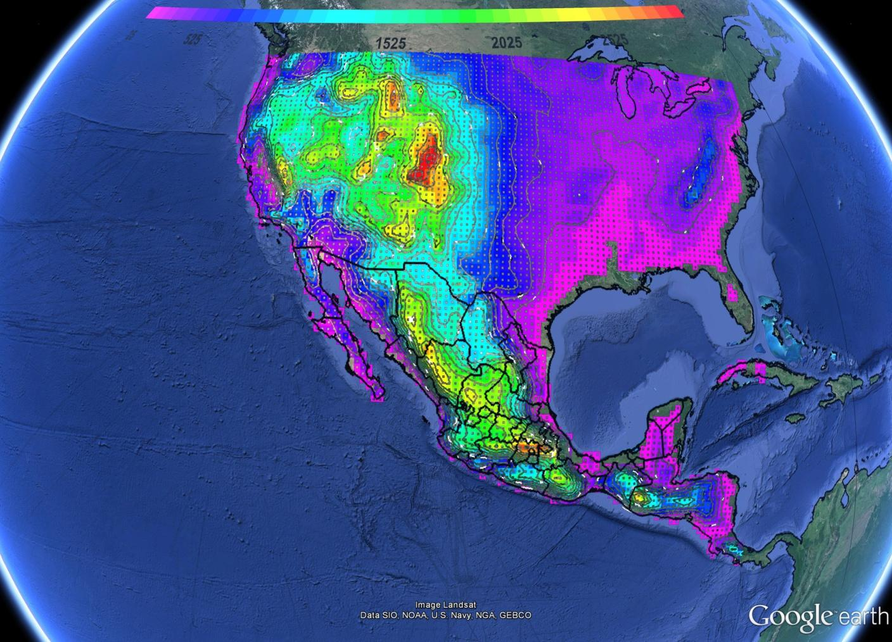
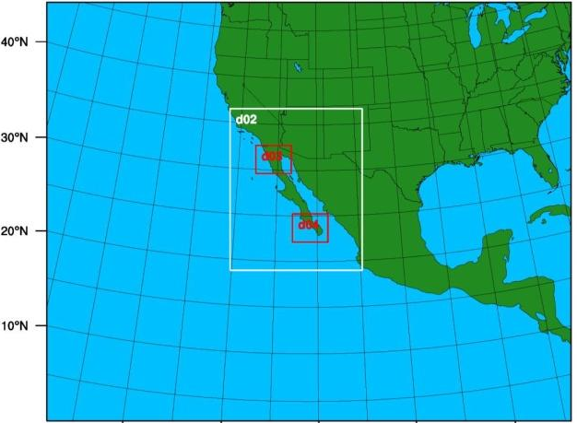
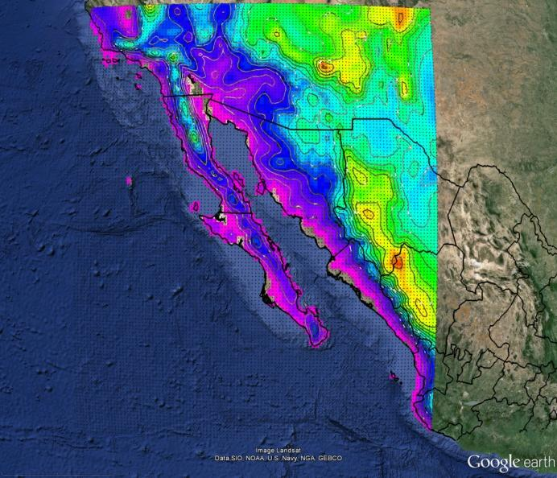
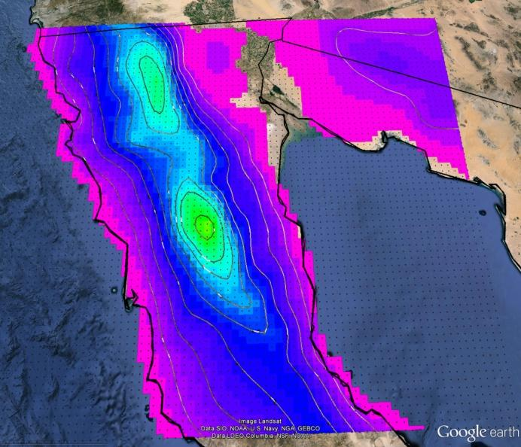
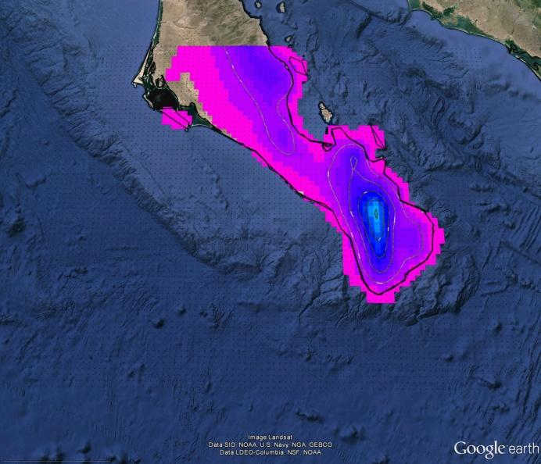
WRF, 4-grid configuration
ARW, version 3.5
16-core computer
Daily, 72-hour forecasts since November 2013
High resolution around Ensenada and La Paz
D01
45 km
144x115
D02
15 km
109x133
D03
5 km
88x70
D04
5 km
88x70

Slide 9
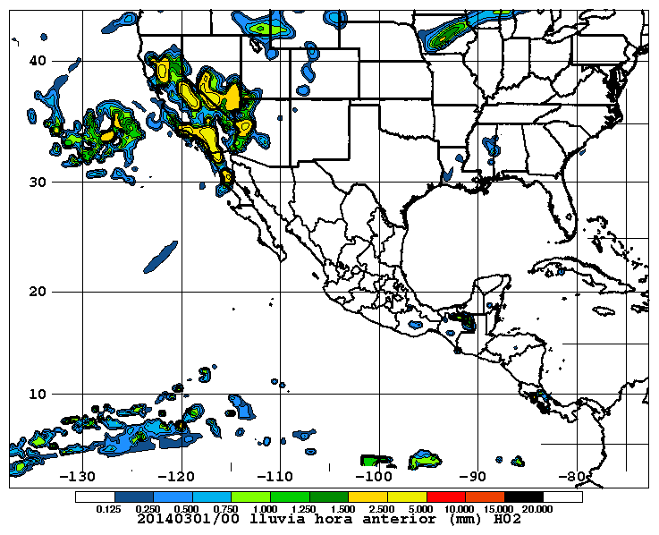
Start 21:00 PDT (04:00 UTC) ❶
406 megabytes, 4 minutes
GFS model datasets for initial and boundary conditions
Resolution 1 degree/3 hours
WRF prepares data for actual forecast ❷
Time integrations up to 72 hours
Intermediate format is generated: grib2
7.3 gigabytes as output datafiles
Time series for selected sites (14)
22:30 PDT (05:30 UTC) WRF completion
Graphical component (GEMPAK) ❸
More than 1,000 images (gif) generated
Some text datafiles
End 00:30 PDT (07:30 UTC) → 3.5 hours in total
Built a web site (http://met-wrf.cicese.mx) that allows to display some of the results:
Time series for locations along the peninsula
Accumulated (hourly and total) maps
Observations from GOES and NWS radars
(LDM feed from Unidata in Boulder, Colorado)

Slide 10
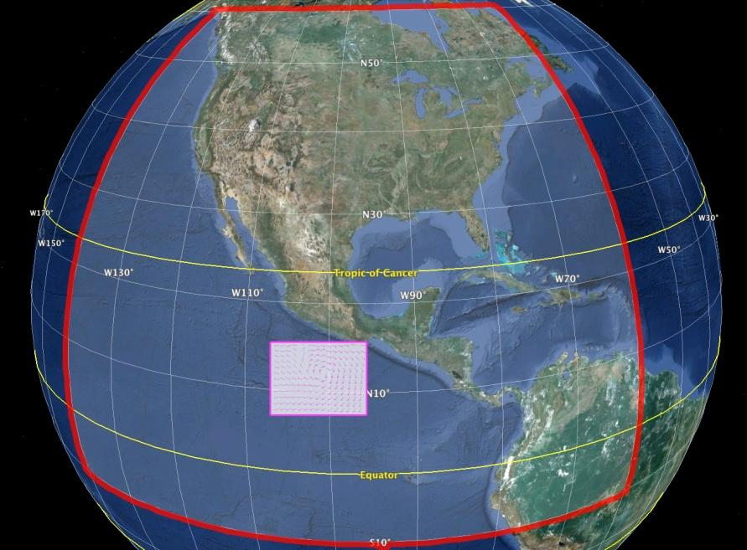
Summer/fall of 2012, HWRF installed
First, version 3.3a and, then, version 3.4a
Grid #1, 27 km
215x431 points
http://www.dtcenter.org/HurrWRF
Grid #2, 09 km
59x99 points

Slide 11
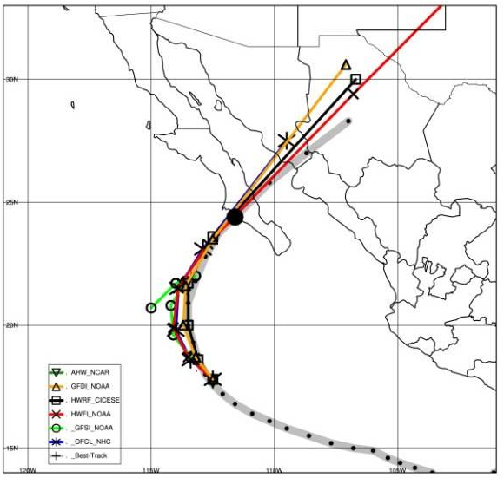
Summer/fall of 2012, HWRF installed
First, version 3.3a and, then, version 3.4a
Grid #1, 27 km
215x431 points
http://www.dtcenter.org/HurrWRF
Grid #2, 09 km
59x99 points
Hurricane (category-3) Norbert forecasts
12 UTC 9 October, 2008, 55 hours prior to actual landfall
Track errors (km)
Norbert
2008
 | OFCL | GFSI | HWFI | CLP5
F00 | 22.2 | 22.2 | 22.2 | X
F12 | 31.7* | 33.6 | 43.5 | 24.6
F24 | 56.8* | 76.9 | 63.6 | 88.3
F36 | 79.6 | 151.9 | 79.5* | 232.1
F48 | 90.6 | 249.6 | 60.3* | 430.9
F72 | 261.1 | 937.5 | 124.* | 1190.
F96 | X | X | X | X
F120 | X | X | X | X
HWRF seemed to be as good, and sometimes better, as the GFS and official forecasts. Also, something similar happened with the intensity predictions.
* Lowest errors at given times (F00, F12, etc)

Slide 12
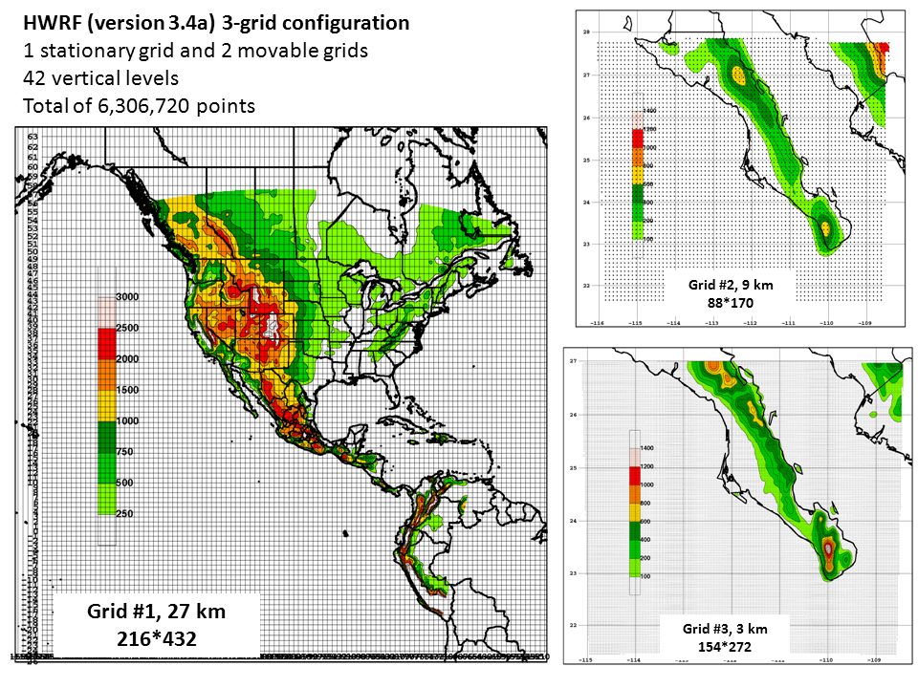

Slide 13
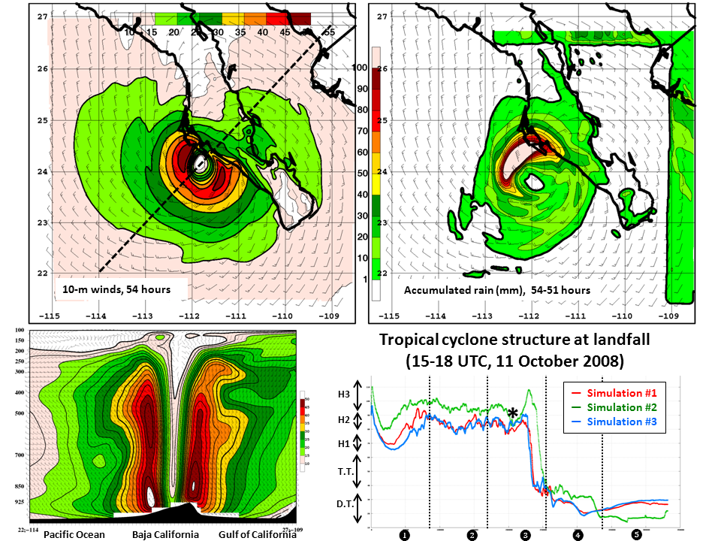

Slide 14
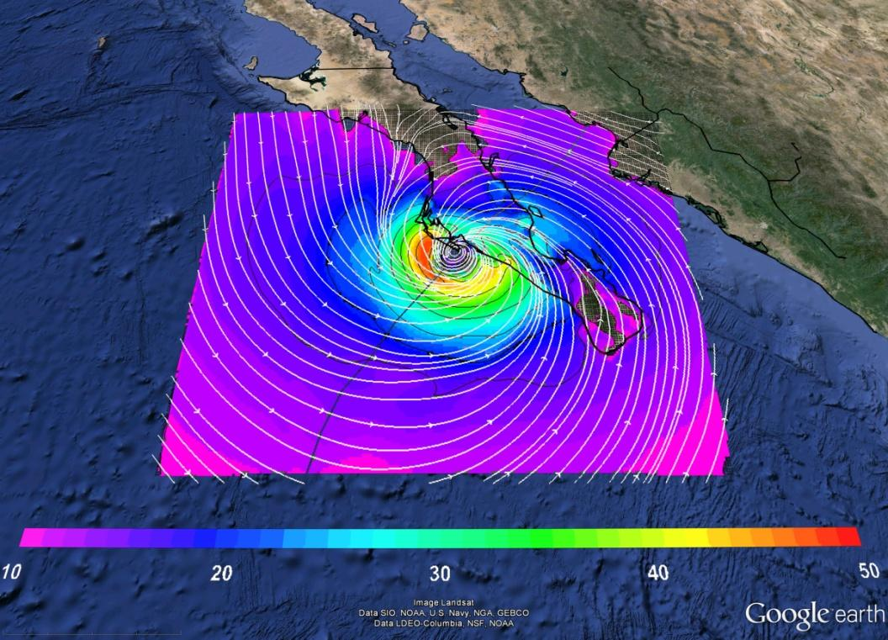
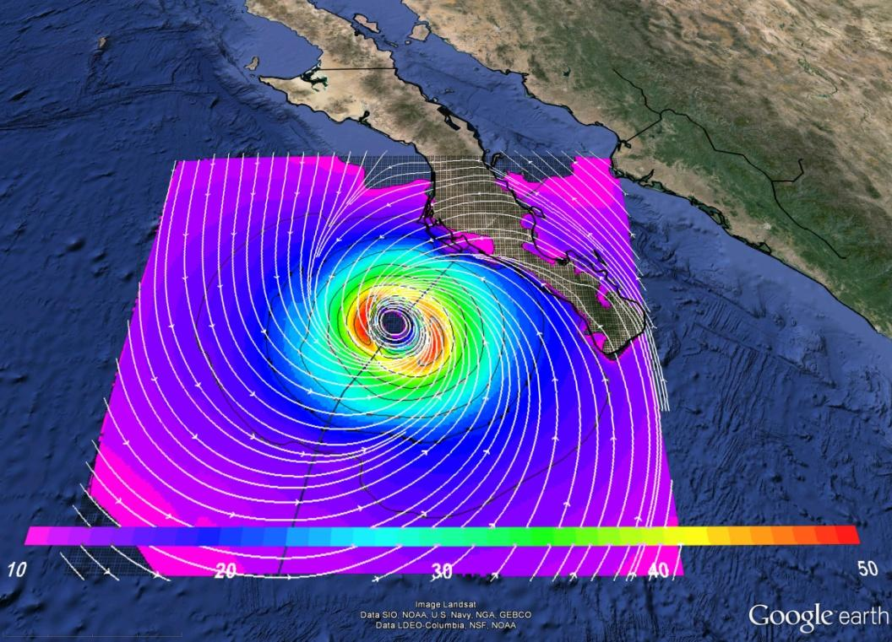
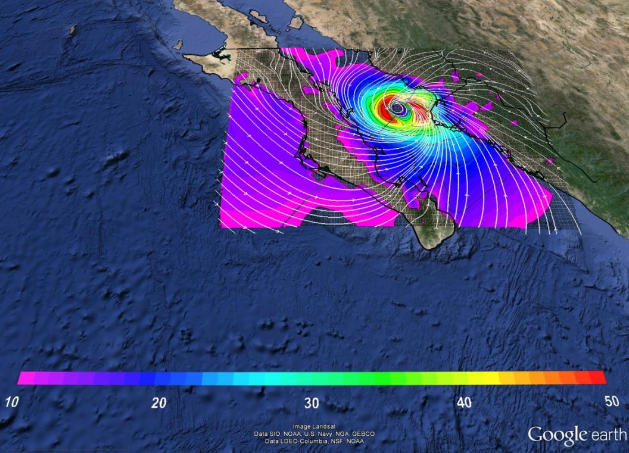
Hurricane Norbert (2008)
The HWRF model (version 3.4a) is applied in research mode initialized at 12 UTC, 9 October
Vortex approaches peninsula, makes landfall, and emerges over the Gulf of California
Weakening at landfall and (re)intensification over the gulf
White represents streamlines and shading are isotachs (m/s) at the model lowest level (10 meters).
Dark line is the vortex track during the forecast.
+ 54 hours
+ 48 hours
+ 63 hours

Slide 15
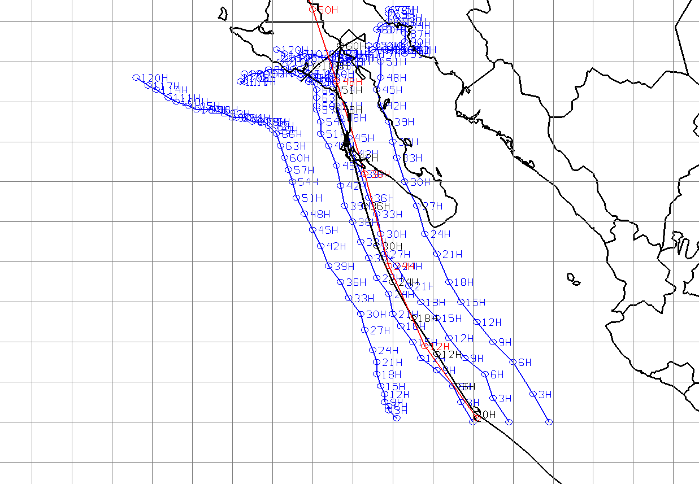
HWRF model and NHC best track for Jimena (2009)
Blue circles are (3-hourly) model positions with changes in the longitude of the initial vortex
Red line is the HWRF (NOAA/NCEP) operational version
Black line is the best track from NHC
SIM_05 is the first simulation with real-time data (tcvitals) available at 00 UTC 1 September, 2009
SIM_07 has initial vortex at 1⁰ to the east and results in a similas tracks as in SIM_05
SIM_08 is similar to SIM_07 but 2⁰ to the east
SIM_09 has the initial vortex 2⁰ to the west
In summary, the changes make different model tracks and impact areas along the southern peninsula.
18⁰N
SIM_09
SIM_05
SIM_07
SIM_08
111⁰W
109⁰W
108⁰W
107⁰W

Slide 16
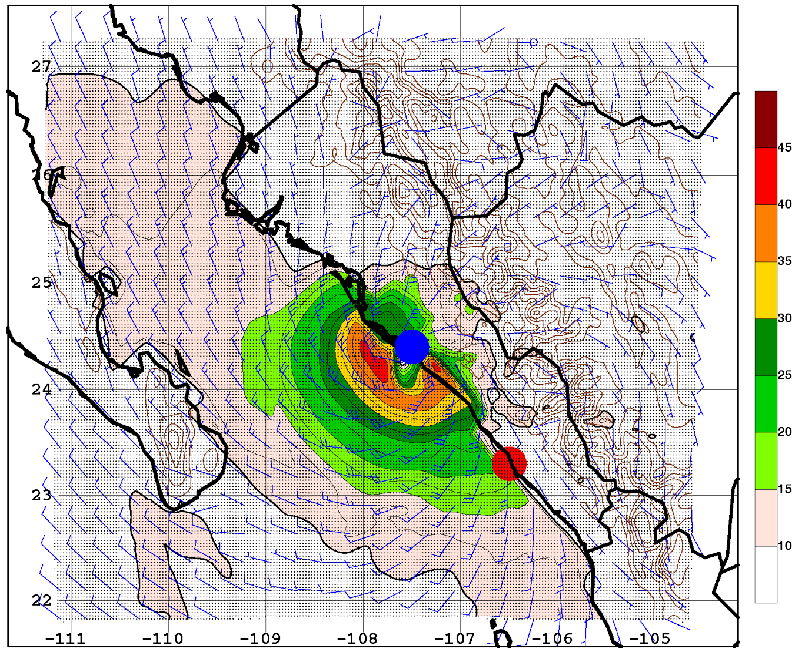
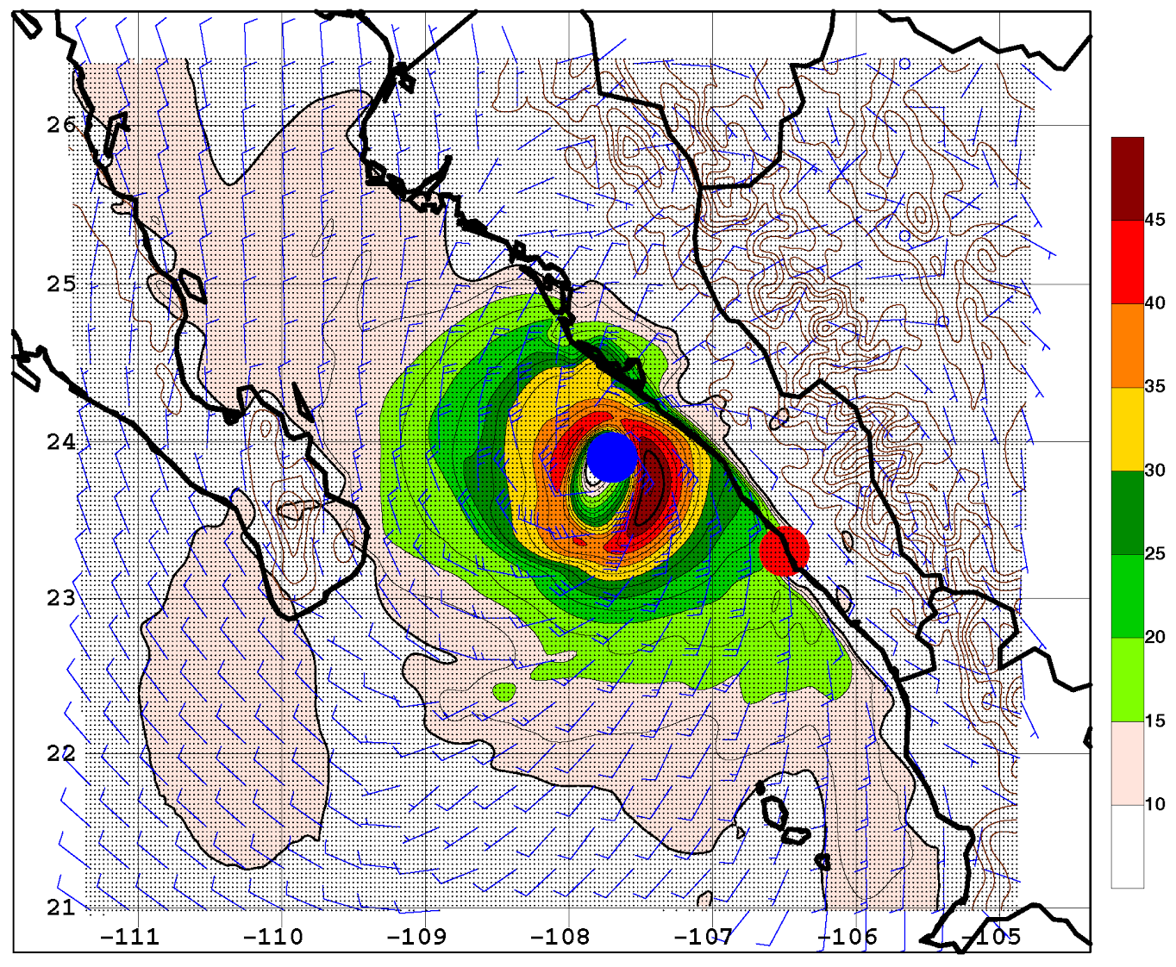
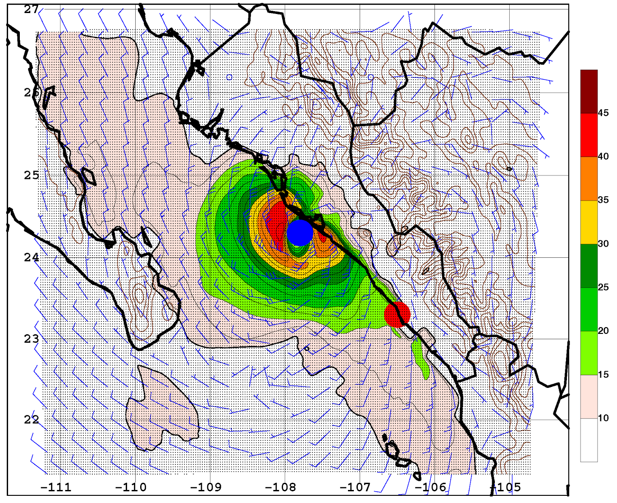
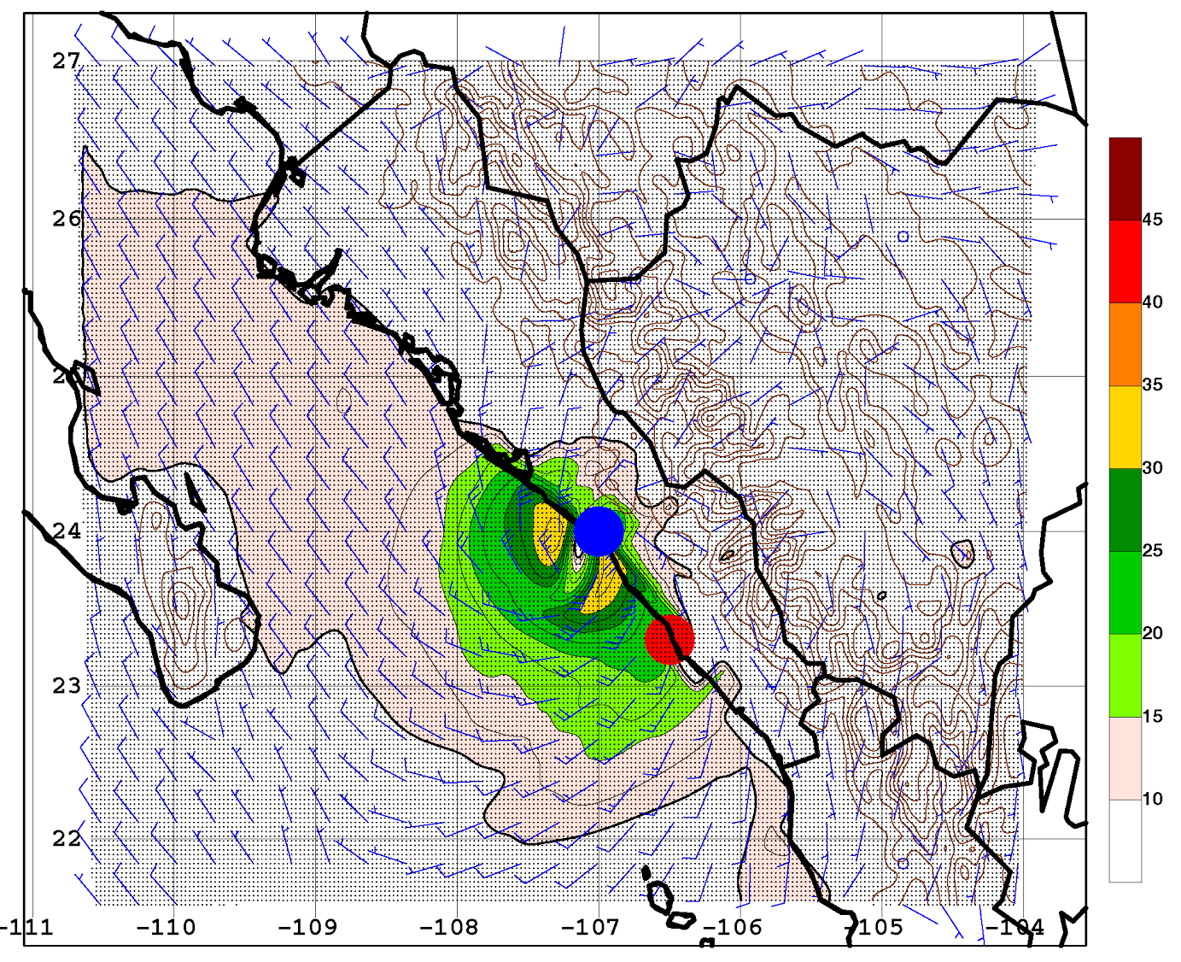
HWRF08, default TC vitals dataset
HWRF09, best-track position and intensity
Model landfall
Actual landfall
Observed (recurving) track
Hurricane Rick (2009)
10-m winds (m/s)
HWRF10, HWRF09 modified to aircraft intensity
HWRF11, HWRF09 modified to aircraft intensity and position

Slide 17
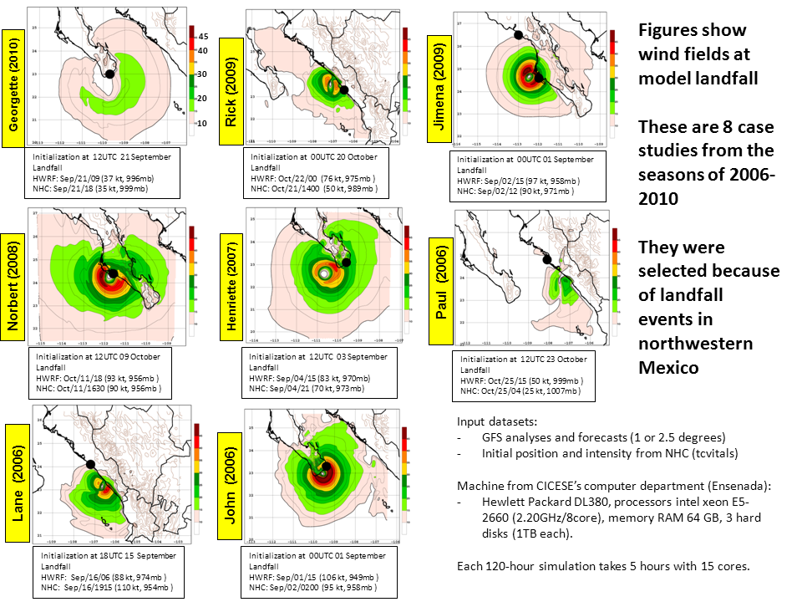

Slide 18
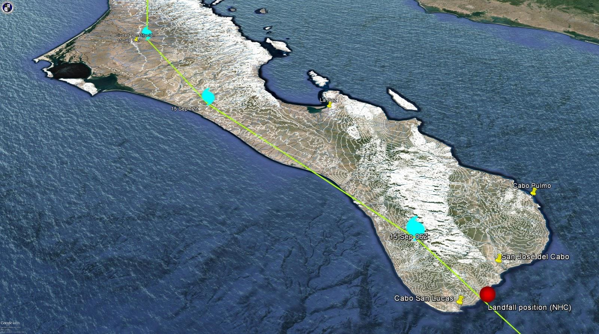
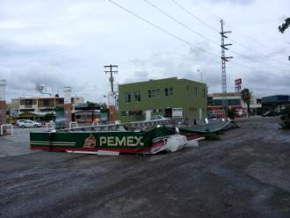
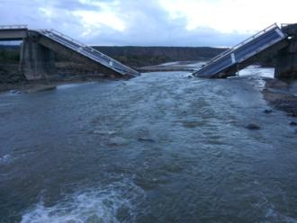
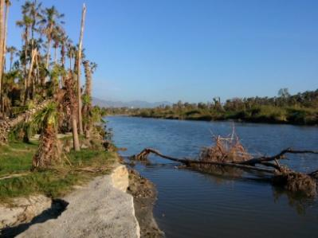
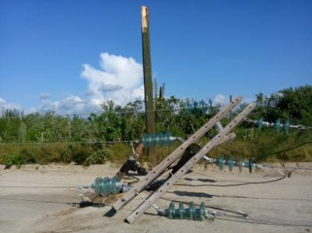
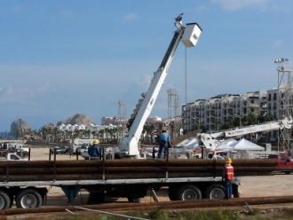
Observed Odile’s track, from ATCF/NRL database
Terrain elevations (white) at 50-m contour interval
(41,000)
6%
(215,000)
30%
Sierra de Laguna
(1-2 km heights)
(70,900)
10%
(68,500)
10%
(68,500)
• Damage to many structures from relatively strong winds (up to 200 km/h) for several hours
• Limited amounts of total rainfal, in the range of 100-250 mm, for periods of 1-2 days

Slide 19
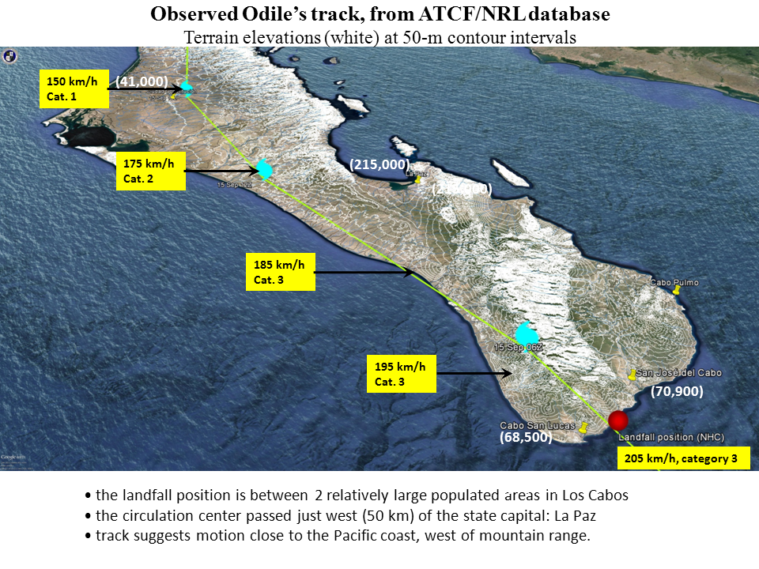
Sierra de Laguna
(1-2 km heights)

Slide 20
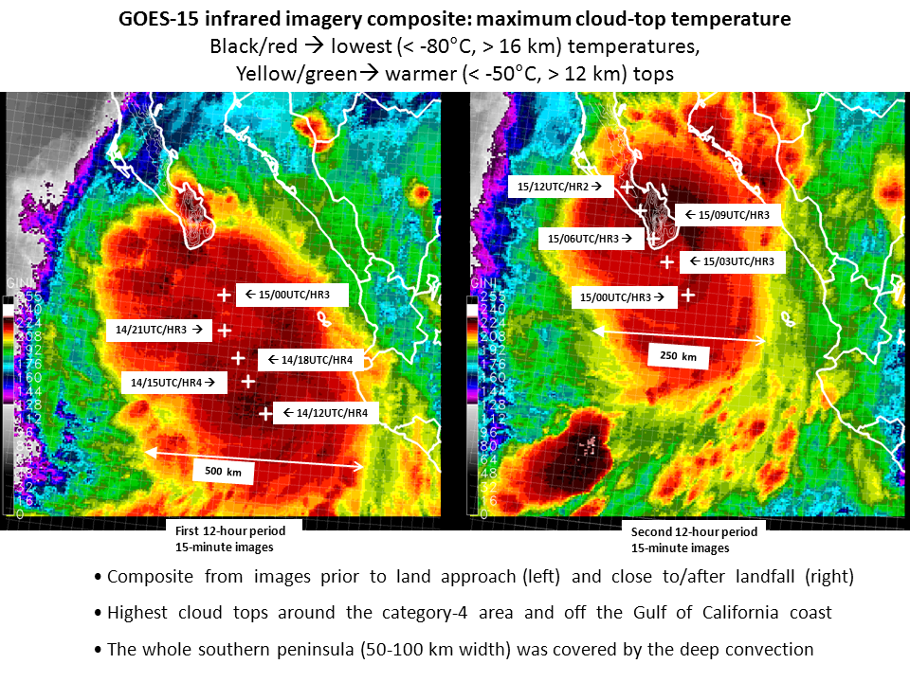

Slide 21
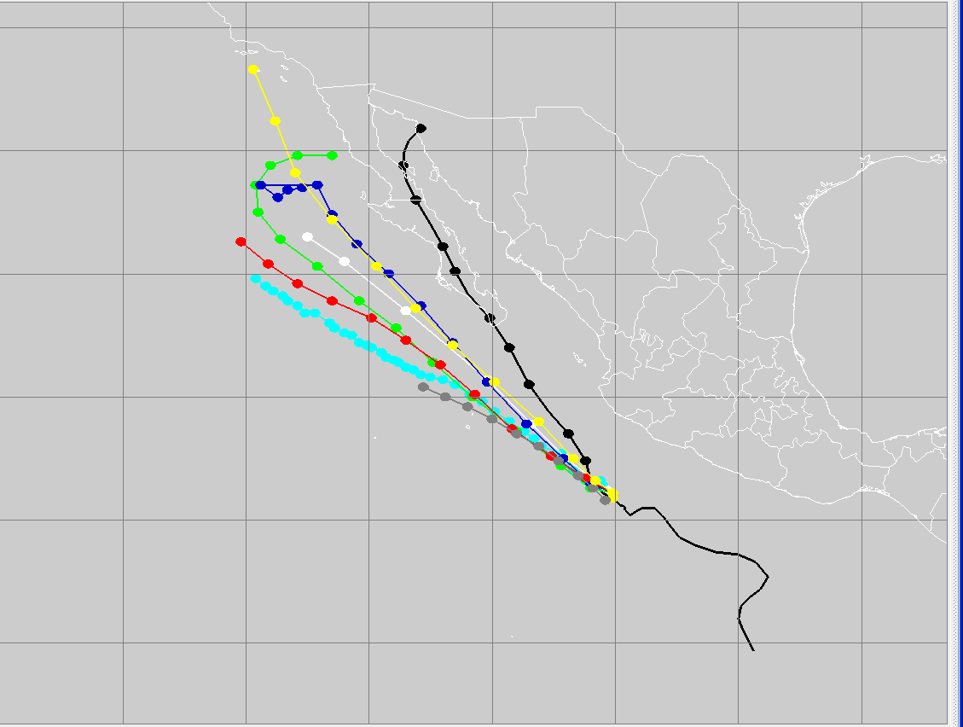
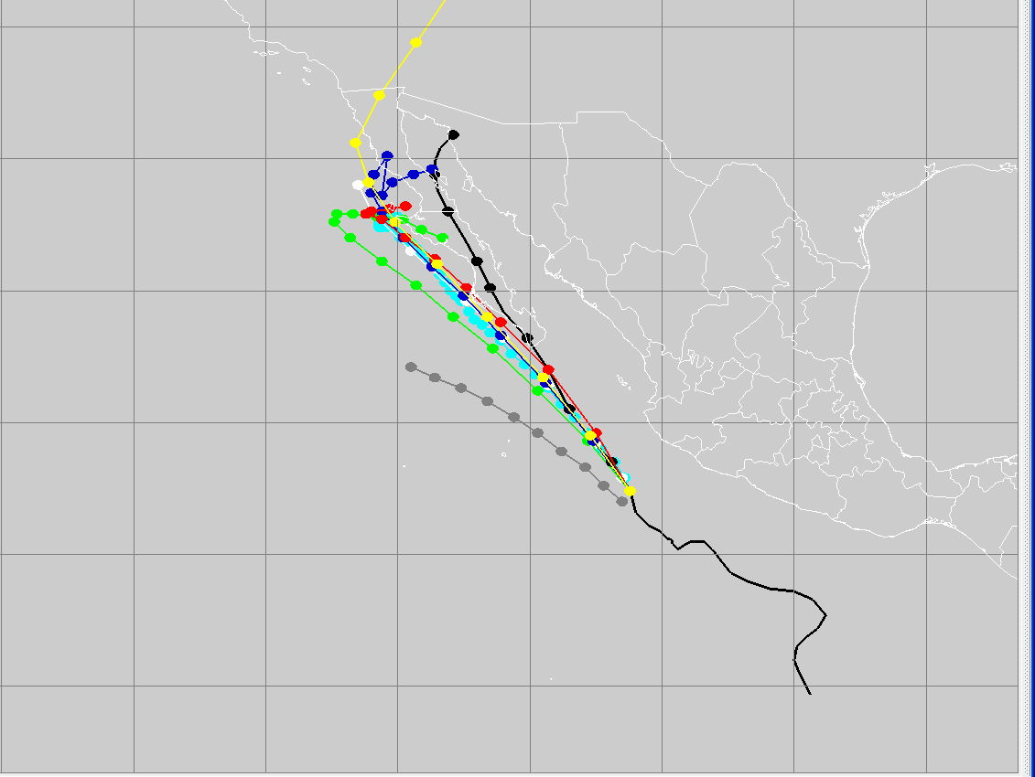
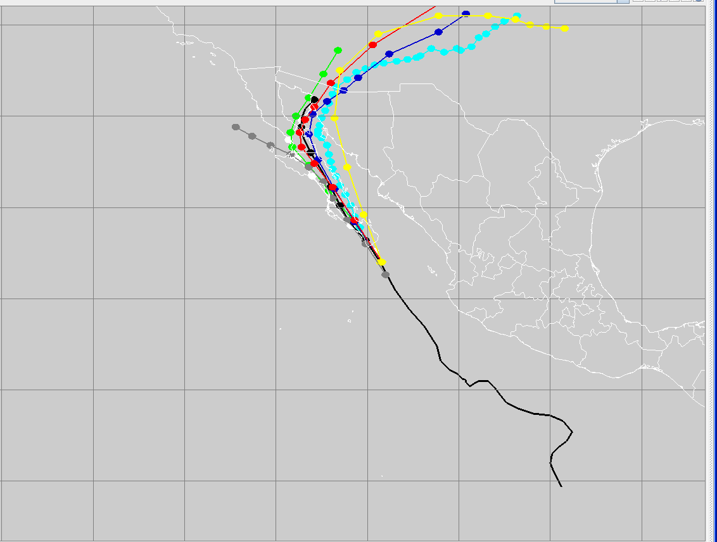
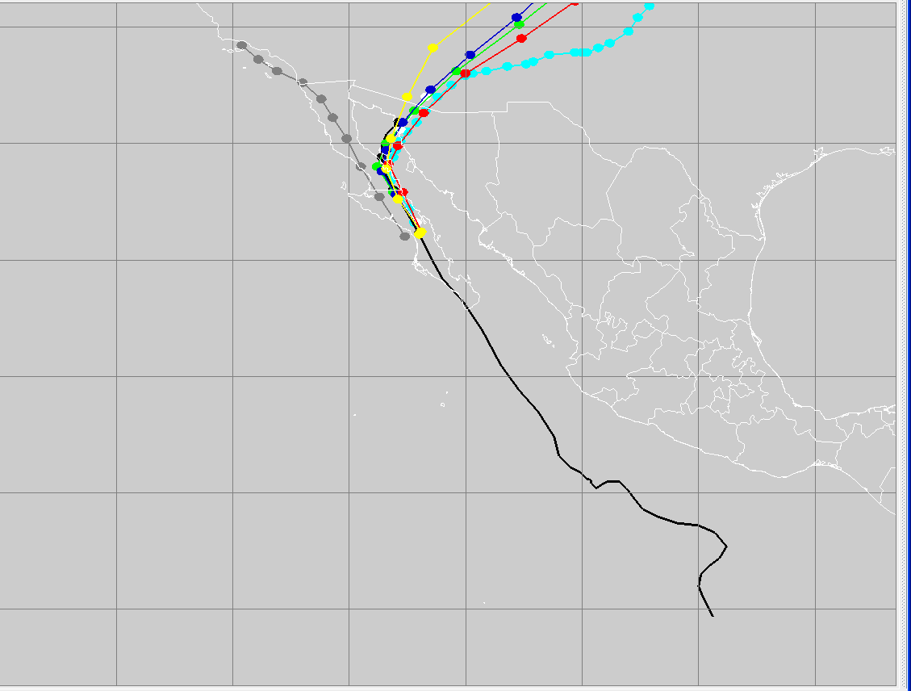
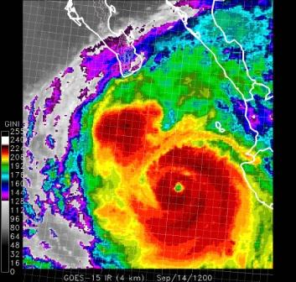
Tracks the ATCF database: GFS, Cliper, GFDL, HWRF, Official and TVCE
00 UTC, Sep/13/2014
53 hours to landfall
b) 00 UTC, Sep/14/2014
29 hours to landfall
Light blue= HWRF at CICESE
Light blue= HWRF at CICESE
c) 00 UTC, Sep/15/2014
5 hours to landfall
d) 00 UTC, Sep/16/2014
19 hours after landfall

Slide 22
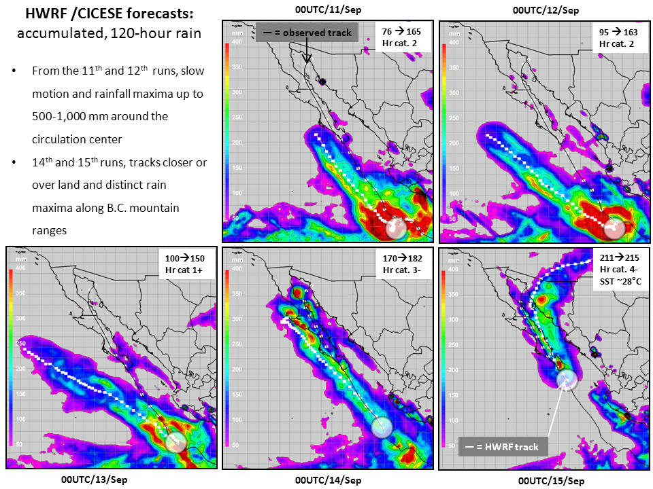

Slide 23
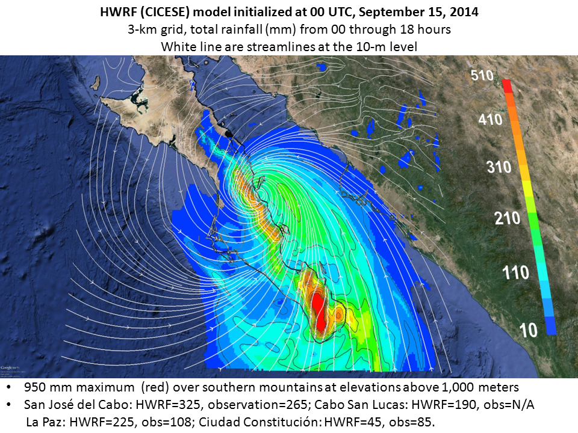

Slide 24
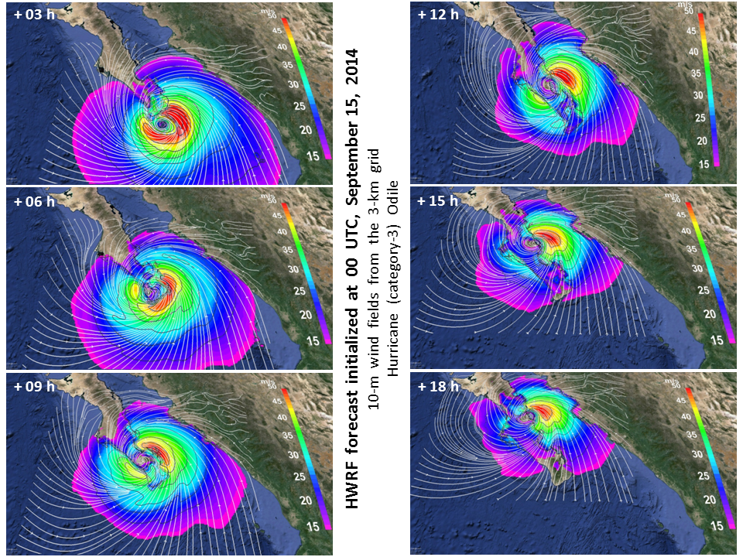
160 km/h →
Cat. 2 hurricane
110 km/h →
Cat. 1 hurricane

Slide 25
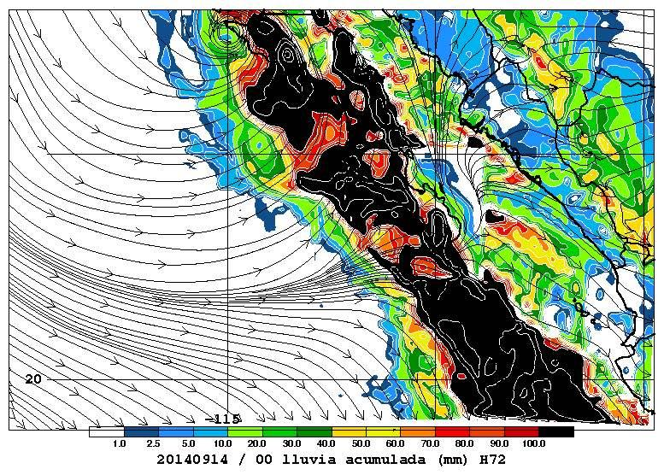
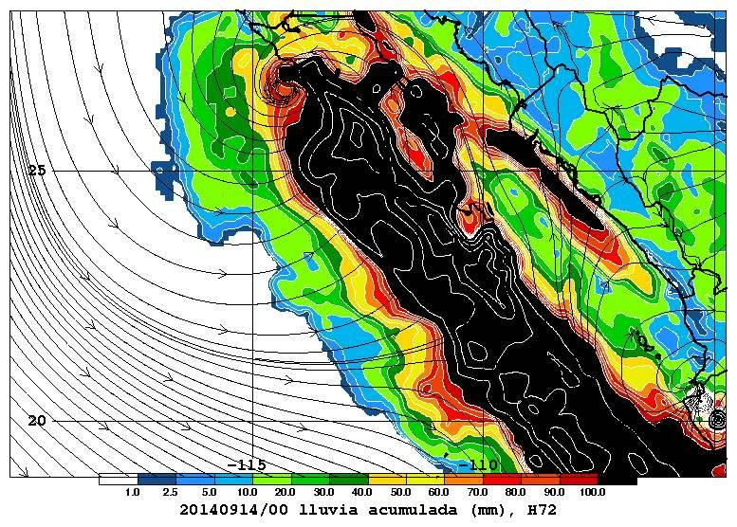
Distribution of accumulated rainfall
from 00 UTC initializations
• These are displays of the same geographical area
covering southern Baja California and adjacent
mainland
• Rainfall (mm) is shown at 72 hours (from both models) as static images and animations.
• The WRF-related animation has hourly intervals and goes up to 72 hours; while the HWRF animation follows 3-hourly output for 120 hours.
• Available since 08 UTC (WRF) and 13 UTC (HWRF).
WRF
(15 km)
HWRF
(27 km)
streamlines at 10-m

Slide 26
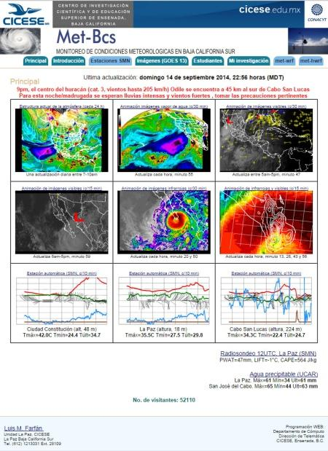
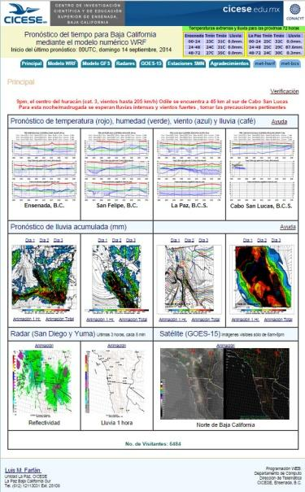
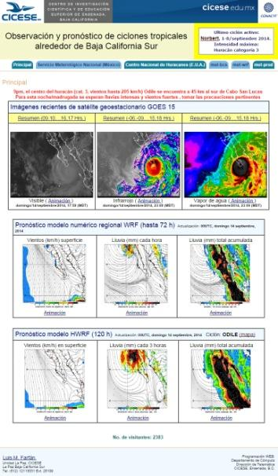
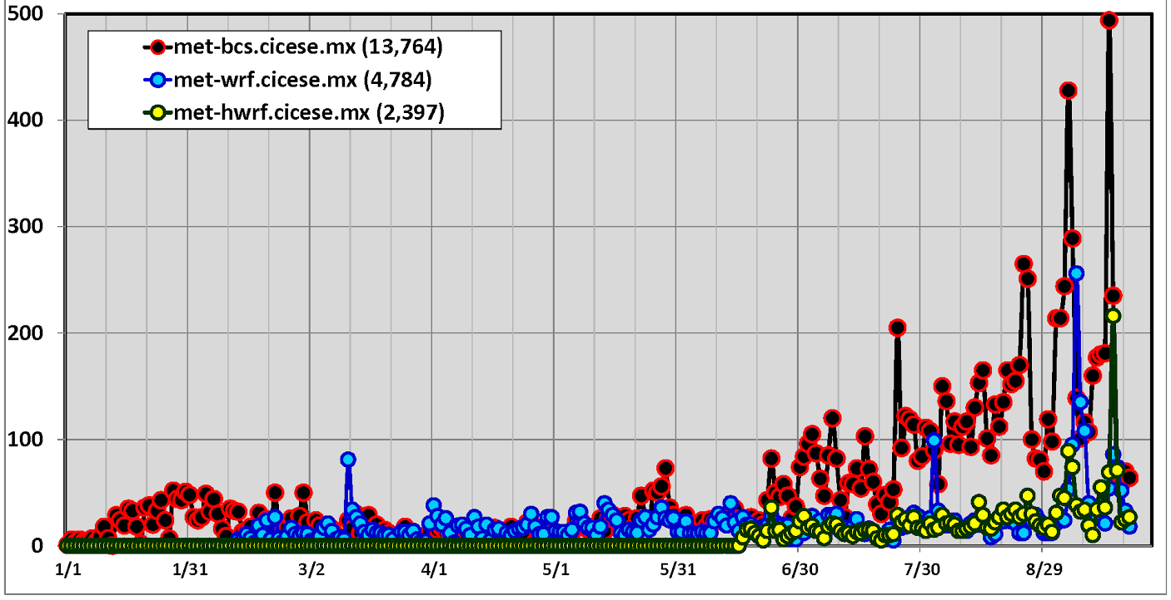
met-bcs →
regional observations from GOES and SMN surface/upper air stations.
← met-hwrf
- GOES imagery and WRF/HWRF forecasts for 10-m winds and hourly/total accumulated rainfall.
- WRF fields, 0-72 hrs, 15-km grid
- HWRF fields, 0-120 hrs, 27-km grid.
#494, Sep/14, category-4 hurricane Odile →
#428, Sep/4, category-1 hurricane Norbert →
Number of hits per day
#265, 24/Aug, category-5 hurricane Marie →
#205, 24/Jul, nocturnal mesoscale convective system across Gulf de California →
Days since January 1 through September 19, 2014

Slide 27
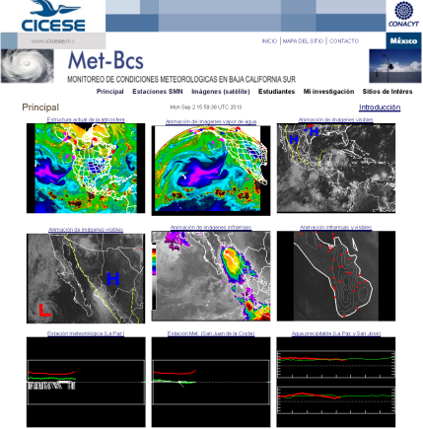
Number of visits during the season of 2013 (May/15 – November/15)
8,916 hits, 70% from August-October
http://met-bcs.cicese.mx/
Juliette (383) →
Lorena (304)
↓
↓ Manuel (291)
Ivo (199) →
← Octave (206)
← Erick (126)
Cosme (76) →
Visits increase during TC approach and this is inversely proportional to the storm distance
Same pattern in 2009, 2010, 2011 and 2012
TC tracks (yellow dots) and official forecasts (red) issued during lifecycles. In parenthesis, total number of these forecasts →

Slide 28
Future plans and activities
• Install and test HWRF version 3.6a (released September 8, 2014)
Consider selected case studies from 2006-2010 as well as from 2014 (Odile)
May want to try Manuel (2013) which made first landfall in southern Mexico
• Look for improvements in the acquisition of input datasets from the GFS model
It was taking a long time (5 hours) to have them in our end, now only 15 minutes
However, each HWRF (v3.5a) run takes 8-8.5 hours in a cluster with 64 cores
Bring additional (GDAS, GEFS, GFS spectral, etc ) data and improve assimilation
Get more storage space and well as number of available cores!
• Provide more and better graphical products in all of our web sites
Change WRF grids to a 27-09-03 km configuration to be comparable with HWRF
Attempt to make an additional WRF and HWRF forecast cycle, starting at 12 UTC
Use the “vortex tracker” tool to have ATCF-format tracks from WRF
• During the season of 2015, share results with federal and regional agencies
National Meteorological Service (SMN)
Emergency Managers (Protección Civil)
Baja California Sur, state government.

Slide 29
Application of the WRF and HWRF models for tropical cyclone development
L.M. Farfán, CICESE Unidad La Paz, farfan@cicese.mx
Acknowledgments
• Technical support,
Julián Delgado and Ismael Villanueva from CICESE’s main campus
They spent many hours, day and night to build our WRF and HWRF modeling systems
• Funding agencies
CONACYT (SEMARNAT program)
IAI (PI Graciela Raga, UNAM)
REDESCLIM (PI Tereza Cavazos, CICESE)
• CICESE
Dirección de telemática provided additional computer equipment
Unidad La Paz, support for communications and travel expenses.
Emergency Managers Meeting, Hurricane Norbert, September 5 2014

