Slide 1
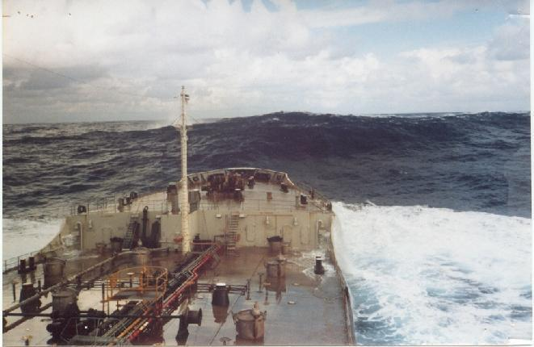
EXTREME WAVES: THEIR OBSERVATION AND THEIR GENERATION
Frédéric DIAS, University College Dublin
John Dudley, Claudio Viotti, Roxana Tiron, Sarah Gallagher and others

Slide 2
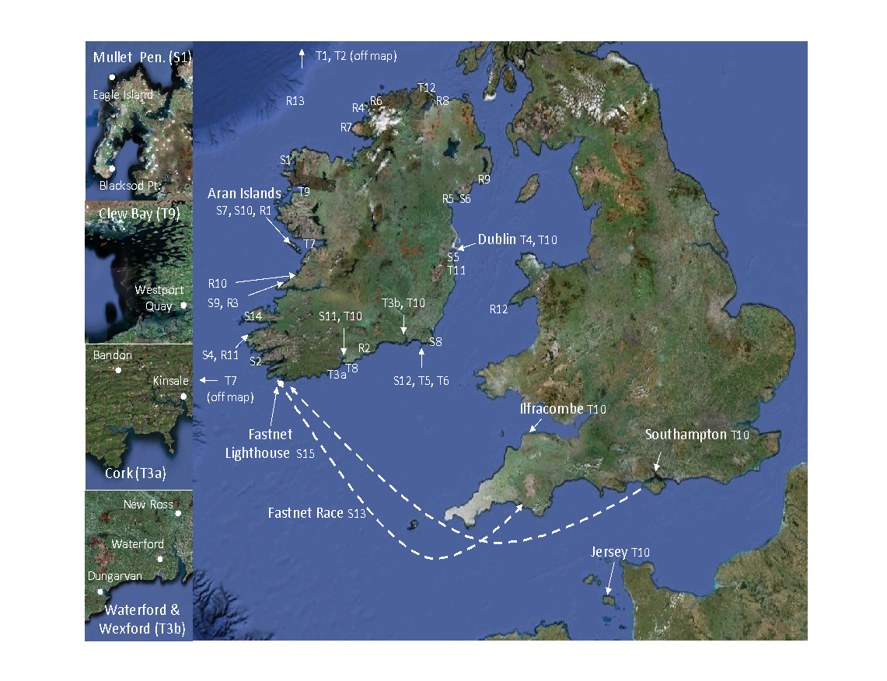
The Extreme Waves Map of Ireland
Ireland is battered by waves from all sides and has suffered many extreme oceanic events. From one of the largest known underwater landslides in the world at Storegga to the tragedy of the Fastnet Yacht race; from tsunamis in Kinsale to the navy vessel Róisín battered by rogue waves, it is clear that Ireland has experienced a wide variety of ocean extremes. This map presents the first catalogue of such events, dating as far back as the turn of the last ice age. Detailed studies of this kind are important both to understand the science of the ocean wave environment of Ireland, and also for applications such as improving the safety of shipping and coastal structures, and generating renewable energy from the sea. They can also provide new insights into myths and legends, and the origin of many unexplained features of our natural environment.
Legend
Storm Waves
S1 1837, 1861, 1894, 1935, 1987, 1988 and 1989
The Mullet Peninsula, Co. Mayo
S2 1869 and 1881: Calf Rock, Co. Cork
S4 1864: Valentia, Co. Kerry
S5 1877: Railway Lines, Co. Dublin and Co. Wicklow
S6 1899: Greenore, Carlingford Lough, Co. Louth
S7 1941: Inisheer Lighthouse, the Aran Islands
S8 1945: Rosslare, Co. Wexford
S9 1951: Kilkee, Co. Clare
S10 1953: the Aran Islands
S11 1962: Co. Cork
S12 1974: Kilmore, Co. Wexford
S13 1979: Fastnet Race
S14 1982: Ventry, Co. Kerry
S15 1985: Fastnet Rock Lighthouse
Tsunamis
T1 14,680 BP: the Barra Fan, Peach Slide
T2 8200 BP: Storegga slide
T3 1755, 1761, 1941 and 1975:
The Lisbon, Portugal tsunamis
T4 1767: The River Liffey, Dublin
T5 1841: Kilmore, Co. Wexford
T6 1854: Kilmore, Co. Wexford
T7 1894: Galway Bay and The Atlantic
(Festina Lente and Manhattan)
T8 1922: Ballycotton, Co. Cork
T9 1909: Westport Quay, Co. Mayo
T10 1910: Cork, Waterford, Southampton, Jersey, Dublin and Ilfracombe
T11 1912: Bray, Co. Wicklow
T12 1932: Inishowen, Co. Donegal
Rogue Waves
R1 1852: Inis Mór, The Aran Islands
R2 1883: Youghal , Co. Cork
R3 1899: Kilkee, Co. Clare
R4 1914: Iniskeeragh, off Donegal
R5 1936: Dundalk, Co. Louth
R6 1972: Mullaghderg, Donegal
R7 2004: L.E. Róisín, off Donegal coast
R8 2006: off Portrush, Co. Antrim
R9 2006: Ardglass, Co. Down
R10 2007: Doonbeg, Co. Clare
R11 2007: Valentia Island, Co. Kerry
R12 2011: Swanland, off Bardsey Island, Irish Sea
R13 2011: Largest wave recorded in Ireland
MULTIWAVE PROJECT
© Map Layout copyright L. O’Brien, J. M. Dudley, F. Dias
Extreme wave events in Ireland: 14680 BP–2012
L. O’Brien, J. M. Dudley and F. Dias. Nat. Hazards Earth Syst. Sci., 13, 1-24, 2013

Slide 3
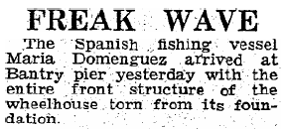
The Extreme Waves Map of Ireland
1962 !

Slide 4
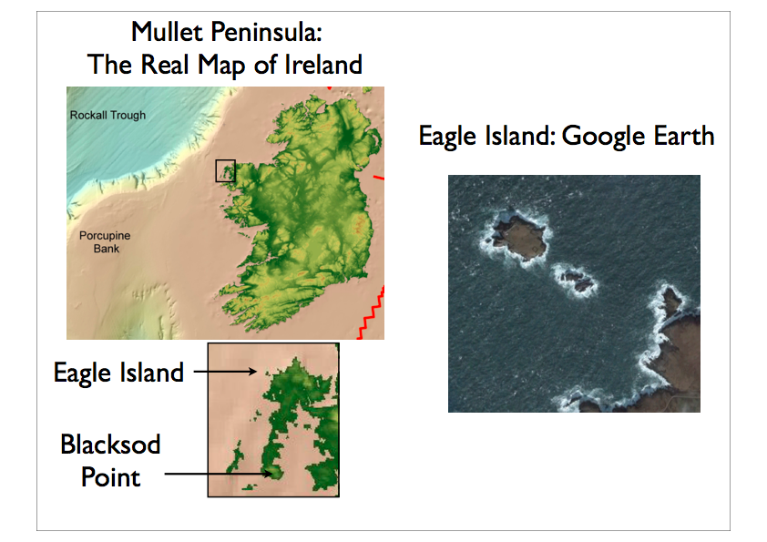
SOME EXAMPLES : MULLET PENINSULA
Notes:
Rather than giving another general talk on wave energy, I concentrate on one example.

Slide 5
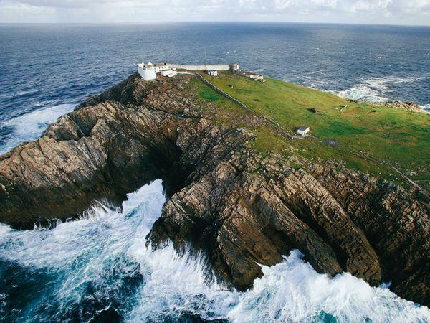
MULLET PENINSULA
Eagle Island Lighthouse
67 m above sea level
Tower height = 11 m
Close to the continental shelf
Originally : two towers, only one left today
Notes:
Rather than giving another general talk on wave energy, I concentrate on one example.

Slide 6
MULLET PENINSULA
During the construction of the west tower a great sea swept the partly built tower and much of the building materials into the sea. The towers were then completed with a massive storm wall on the sea side of the towers.
1837 – Wave swept over island and took off the roofs of the dwelling homes “there being no hurricane at the time”. The sea “must have risen 350 feet” (~106m) (The Irish Times)
11 March 1861 – A monster wave broke over the east light shattering 23 panes, damaging reflectors and flooding the tower. Rock thrown up by a severe storm ?
29 December 1894 – A storm damaged the dwellings and the east light beyond repair, broke the lantern glass, put out the light and damaged the protecting wall
January 1987 and February 1988 – Substantial damage done by storm
Notes:
Rather than giving another general talk on wave energy, I concentrate on one example.

Slide 7
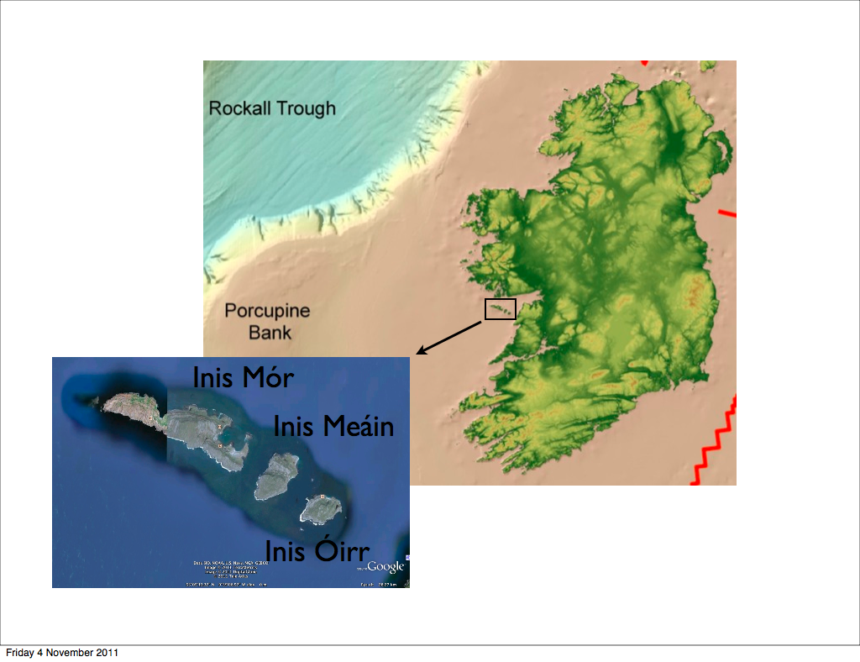
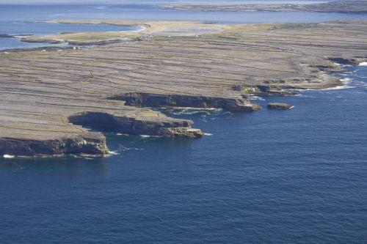
SOME EXAMPLES : THE ARAN ISLANDS
Notes:
Rather than giving another general talk on wave energy, I concentrate on one example.

Slide 8
THE ARAN ISLANDS
1839 – 1852 – 1914 - 1953
1839 – Boulders thrown up during the Night of the Big Wind
1852 – Story that 15 people were swept to their deaths by a wave on Inis Mór
Williams and Hall (2004) Cliff-top megaclast deposits of Ireland, a record of extreme waves in the North Atlantic — storms or tsunamis? Evidence of megaclast deposits on the top of vertical cliffs up to 50m above sea level weighing 2.9 tonnes (117 tonnes at 12m, 250 tonnes at sea level)
Notes:
Rather than giving another general talk on wave energy, I concentrate on one example.

Slide 9
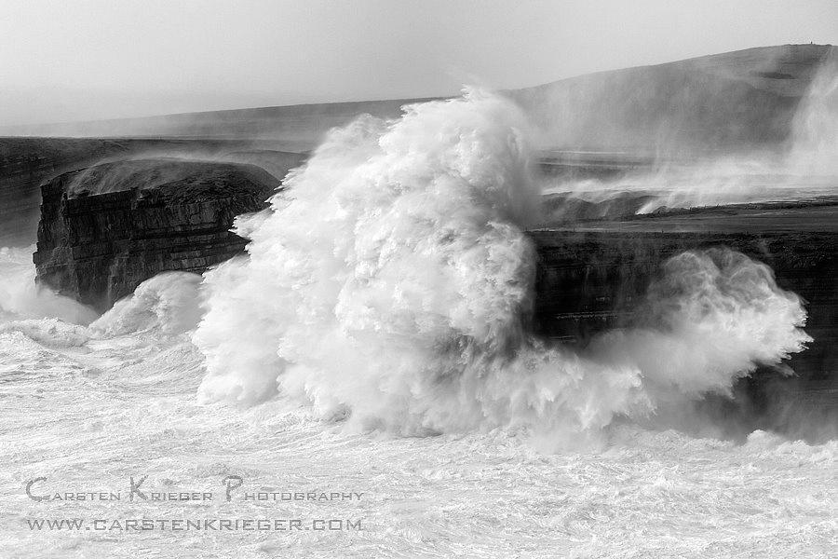
2013 – 2014 WINTER IN IRELAND
Loop Head, Ireland
This cliff is about 30 m high
01 February 2014
Notes:
Rather than giving another general talk on wave energy, I concentrate on one example.

Slide 10
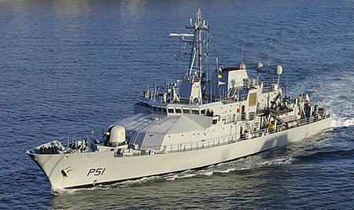
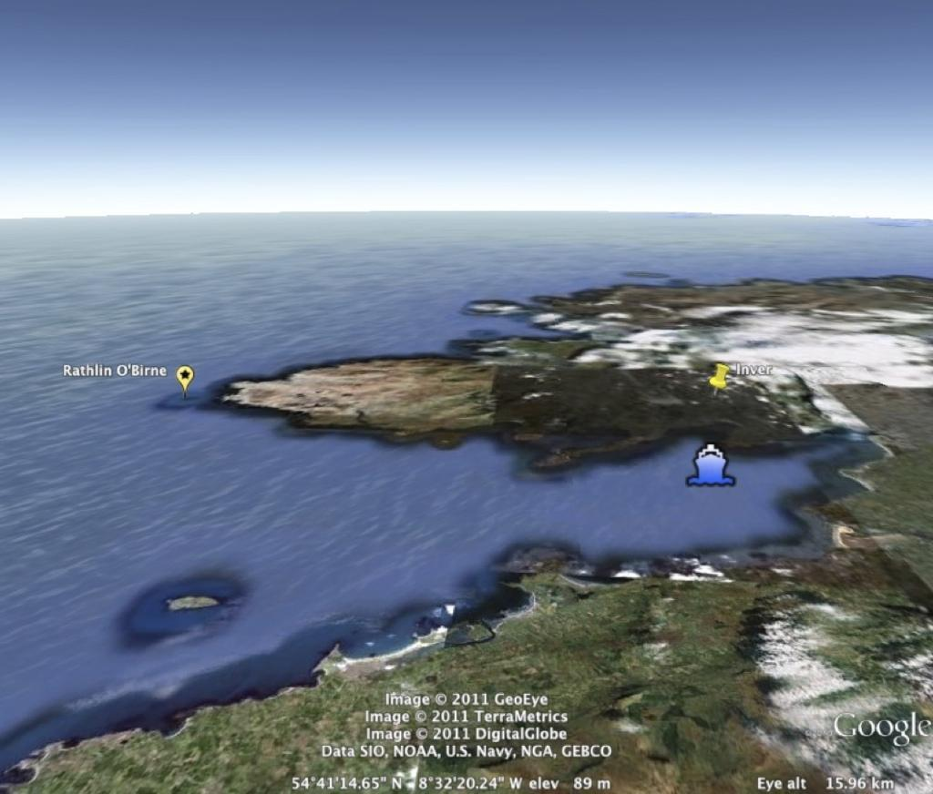
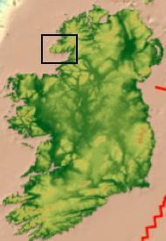
SOME EXAMPLES : IRISH NAVAL SHIP
05 October 2004
On Canadian submarine, HMS Chicoutimi, a fire broke out onboard after a significant ingress of water during repairs
LE Róisín had taken shelter in Donegal Bay due to bad weather when it responded to a pan-pan broadcast
Strong gale, heavy swell with waves approximately 3 – 4 m
Sustained damage just off Rathlin O’Birne island by two unusually large waves
Notes:
Rather than giving another general talk on wave energy, I concentrate on one example.

Slide 11
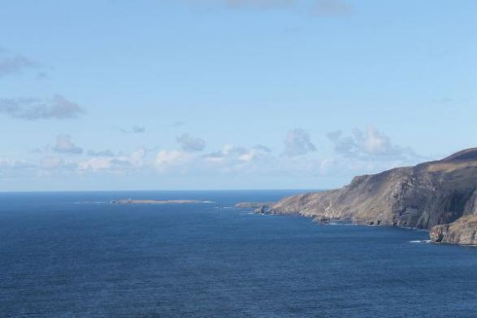
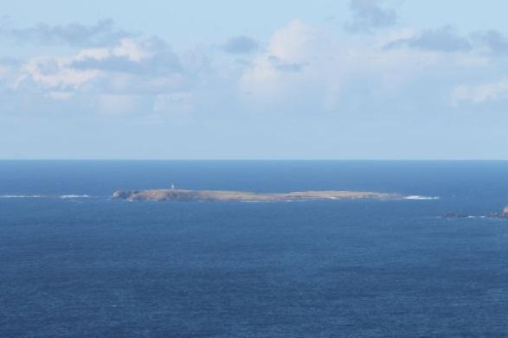
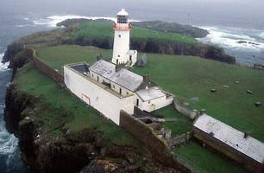
IRISH NAVAL SHIP 2004
Captain Lt Cdr. Terry Ward, eyewitness account
2 very large waves ~10-12 m with short period
The ship pivoted on the crest of the first wave and fell down the other side.
The bow plunged into a second large wave, about one third of the ship was submerged
The front of the ship filled with water until the buoyancy of the ship pushed it back up through the wave
On the port side of the forecastle the flare cracked and a piece (~A4 size) of the deck broke away and water was getting in.
The window wipers were all removed
The flare was moving and could have peeled back if the ship was to continue
Notes:
Rather than giving another general talk on wave energy, I concentrate on one example.

Slide 12
OCEAN WAVE MEASUREMENT TECHNIQUES
Current ocean wave measurement uses spectral approaches developed in the 1950s
Surface waves are recorded with a fixed length time series (usually around 20 minutes) from which are derived nominal wave spectra
Measurements are made at a single point
Many of the most dangerous wave classes on the ocean (wave breaking, rogue waves, etc) either cannot be measured at all or are inaccurately recorded because of sampling deficiencies
Sensor cost precludes wide area deployment and inhibits measurement of full spatio-temporal wave evolution dynamics

Slide 13
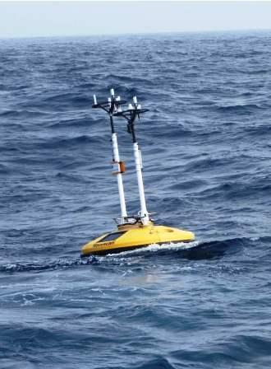
ALTERNATIVE OCEAN WAVE MEASUREMENT TECHNIQUES
 | Remote sensing | In situ | Optical methods
Spatial coverage | Extensive | Limited | Limited
Sea surface representation | Limited | High quality | High quality/ Problems in rough sea states
Accessibility | Available | High costs | High costs/ platforms required
Advantages (in green) and drawbacks (in red)
Irish M4 Weather Buoy

Slide 14
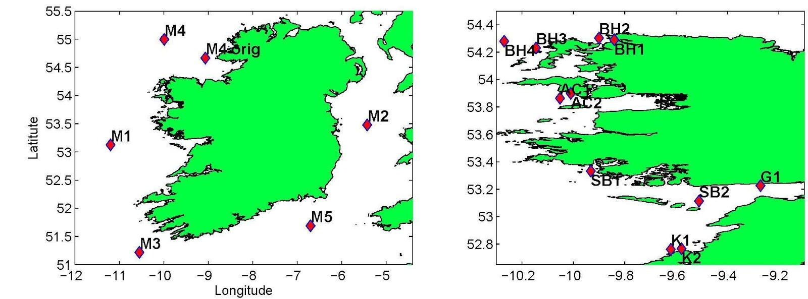
LOCATION OF THE M-BUOYS FROM THE IRISH MARINE WEATHER BUOY NETWORK AND THE NEARSHORE BUOYS
Today (16 July 2014), only the M3 and M4 wave buoys operate normally unfortunately !
The nearshore buoys have been deployed only during the recent years and for a limited amount of time.

Slide 15
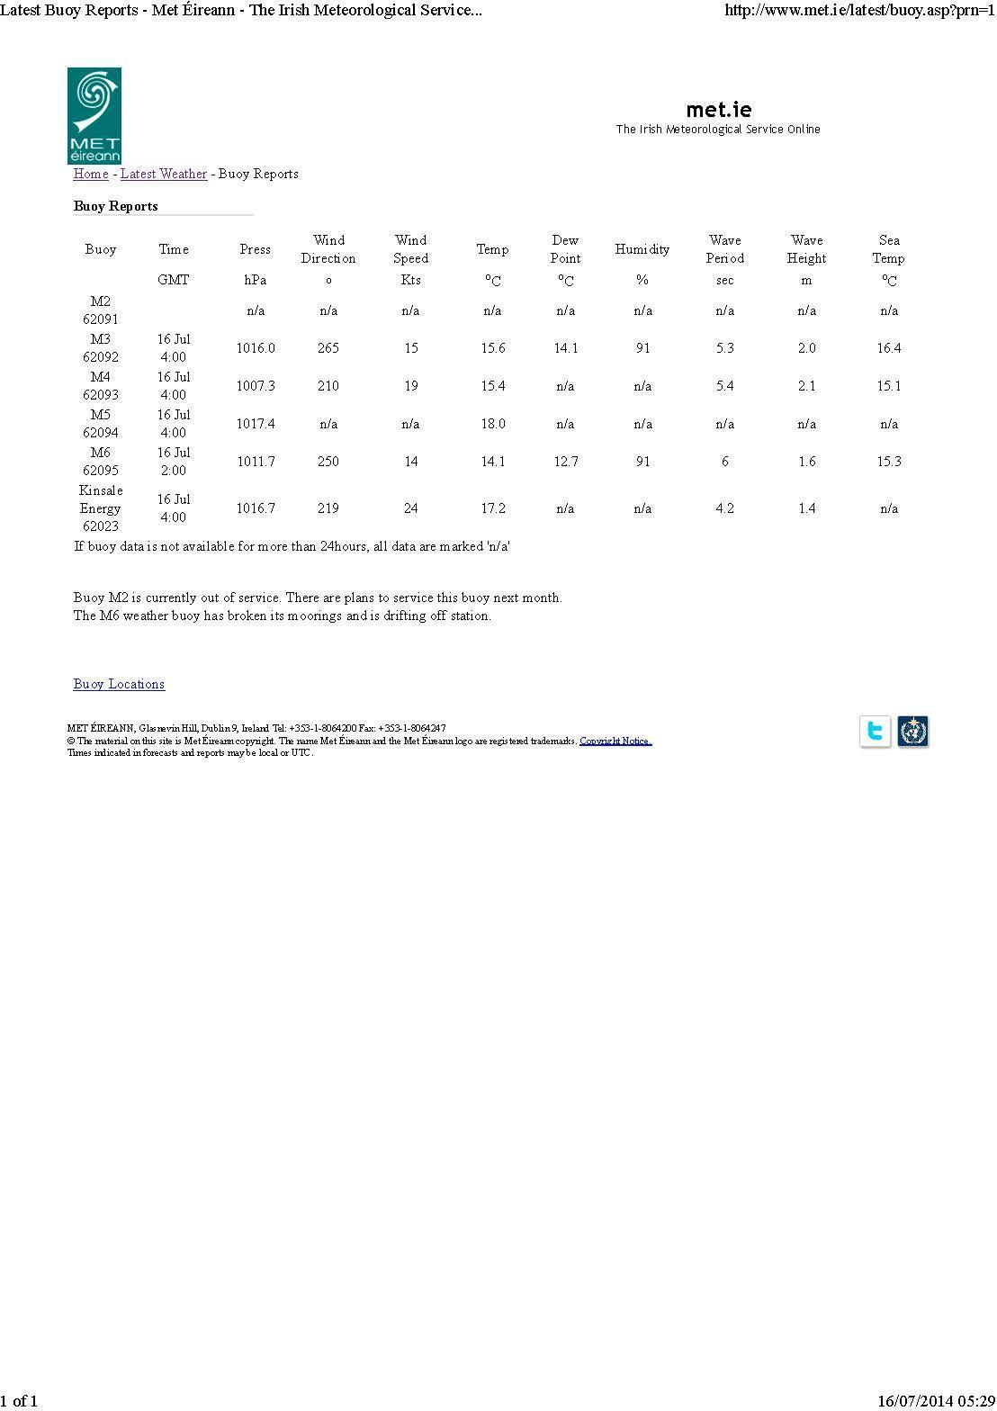
THE IRISH MARINE WEATHER BUOY NETWORK

Slide 16
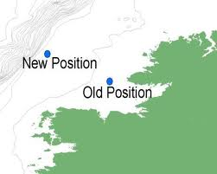
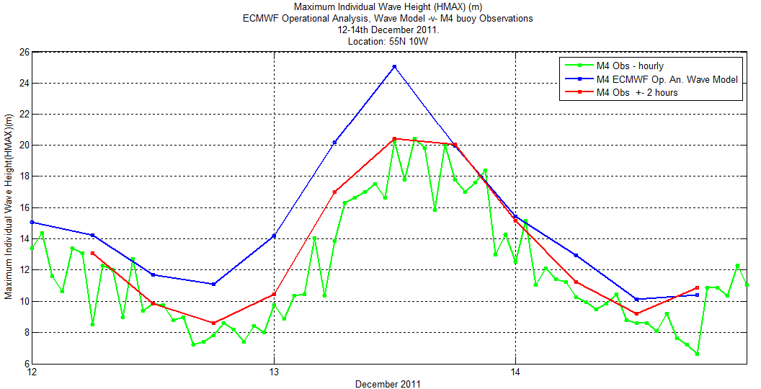
Irish M4 Buoy 12 – 14 December 2011
Several 20 m waves
(Sarah Gallagher, PhD student)
HMAX
12 Dec 2011
13 Dec 2011
14 Dec 2011
Notes:
Rather than giving another general talk on wave energy, I concentrate on one example.

Slide 17
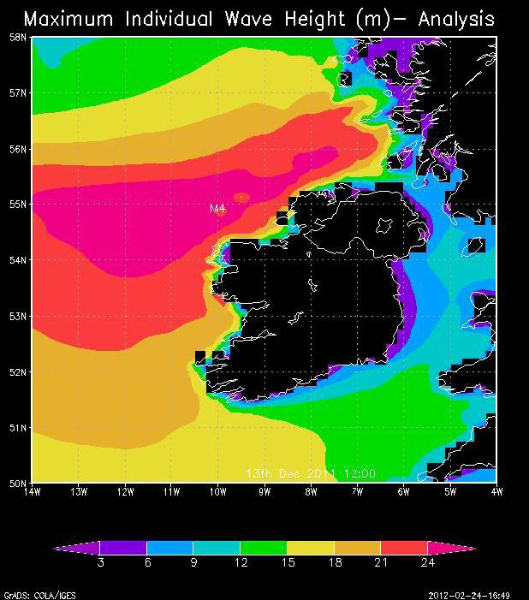
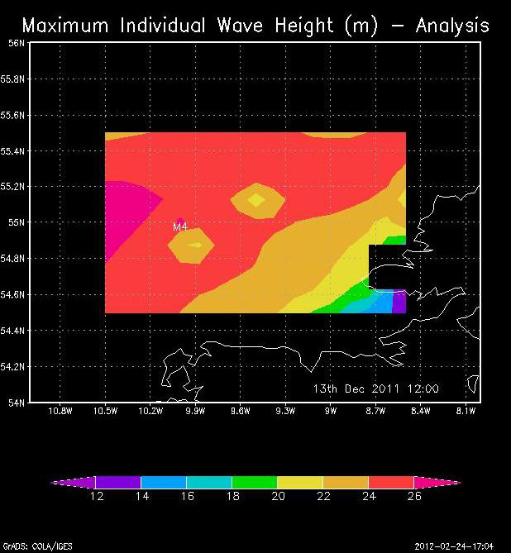
IRELAND 13 December 2011 at 12:00
Some even larger waves away from the buoy
Scale goes to more than 26 metres
Notes:
Rather than giving another general talk on wave energy, I concentrate on one example.

Slide 18
IRELAND Winter 2013/2014
Wave height of 23.4 m recorded at M4 wave buoy on 26 JAN 2014
Wave height of 25 metres recorded at Kinsale Energy Gas Platform on 12 FEB 2014
Notes:
Rather than giving another general talk on wave energy, I concentrate on one example.

Slide 19
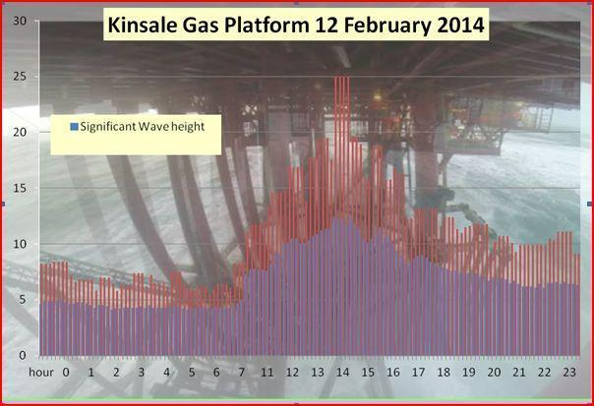
Wave height of 25 metres recorded at Kinsale Energy Gas Platform on 12 FEB 2014

Slide 20
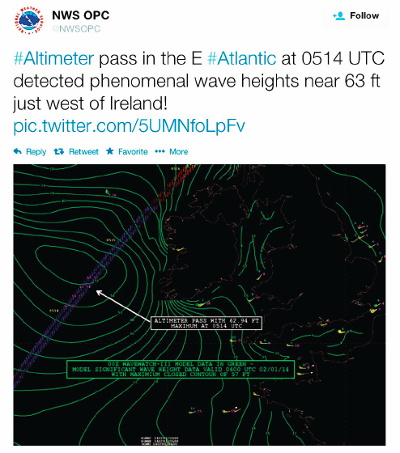
IRELAND Winter 2013/2014
Thank you
Joe Sienkiewicz, Laury Miller and Sinead Farrell
Notes:
Rather than giving another general talk on wave energy, I concentrate on one example.

Slide 21
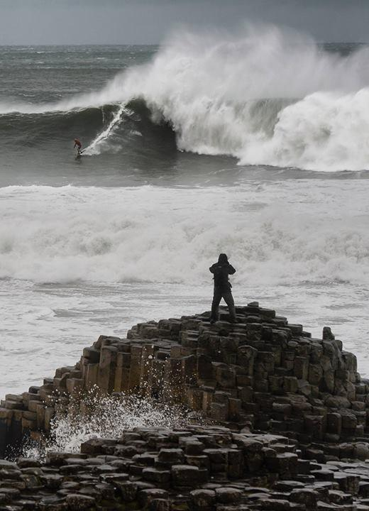
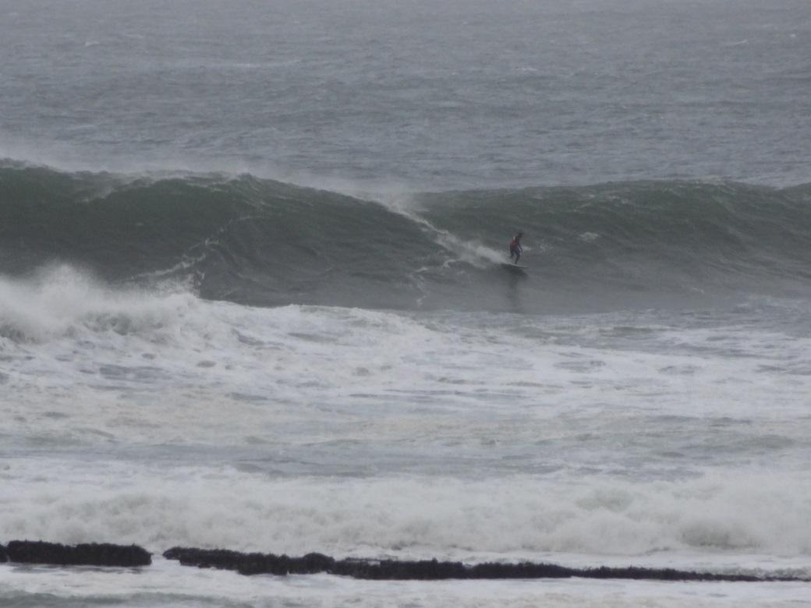
EXTREME OCEAN WAVES GENERATED BY THE BATHYMETRY
Giants Causeway, Northern Ireland – 01 February 2014
Mullaghmore, Ireland – 06 January 2014

Slide 22
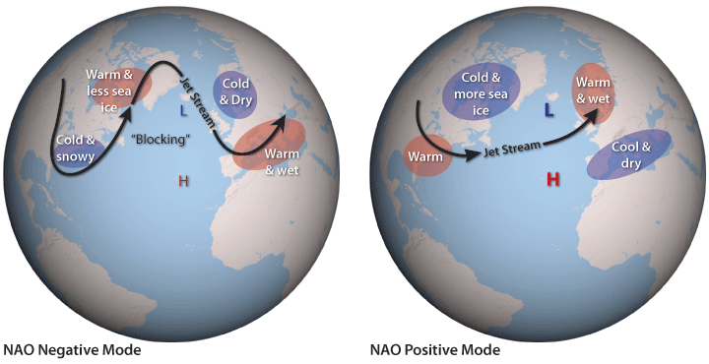
THE NORTH ATLANTIC OSCILLATION
NAO index: Difference in sea level pressure between Iceland and the Azores
Positive mode generates strong westerly winds at mid-latitude, and mild and wet winters in Ireland
Negative mode generates weaker winds, and cold winters (such as 2010/2011)
Notes:
http://www.youtube.com/watch?v=SvobKxEn_yA

Slide 23
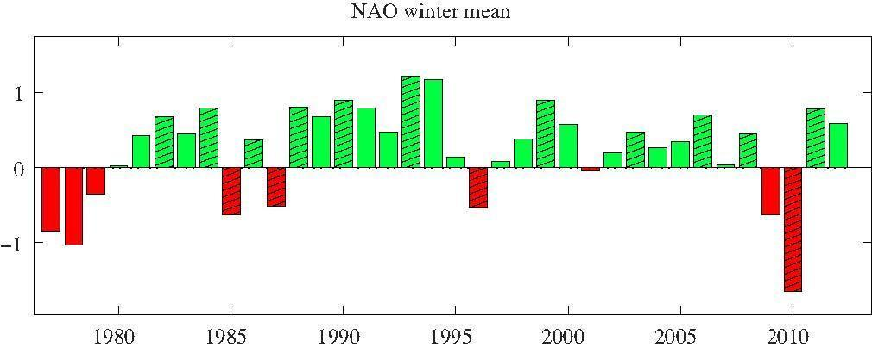
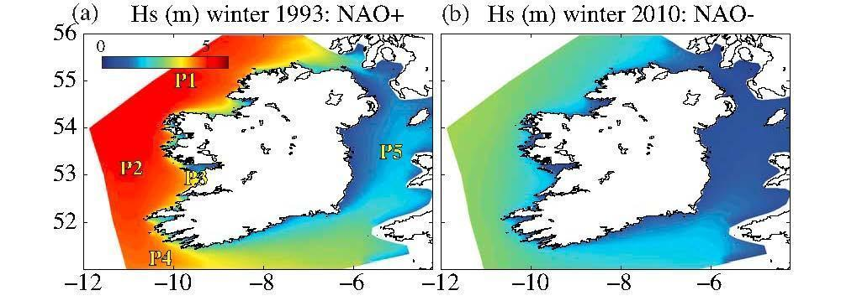
A CLEAR INFLUENCE OF THE NORTH ATLANTIC OSCILLATION
Averaged winter (December, January, February) NAO index
Very strong contrast between for example 1993 and 2010
Notes:
http://www.youtube.com/watch?v=SvobKxEn_yA

