Slide 1

MJO Structure Associated with the
Higher-Order CEOF Modes
Ping Liu
School of Marine and Atmospheric Sciences (SoMAS)
State University of New York at Stony Brook
In press to Climate Dynamics
[Acknowledgment to the anonymous reviewers]

Slide 2
Outline
. Review of MJO indices especially the RMM
. Why higher-order CEOF modes?
. How to derive and justify the modes?
. What improvement to the RMM framework?

Slide 3
Review of MJO indices
. MJO (Madden and Julian 1971)
30-100 days in period, 1-5 waves in eastward (Wheeler and Kiladis 1999)
Consensus of the bands remains elusive (Straub 2013)
Closely coupled mode of convection and zonal winds
at intraseasonal time scales and planetary zonal wave-
numbers
Straub (2013) grouped the indices into 3 types:
. 1) Cloudiness-based index (Rui and Wang 1990)
. 2) Dynamical- or circulation-based index
Slingo 1996: 200-hPa zonal mean zonal wind
Maloney and Hartmann: 850-hPa zonal wind

Slide 4
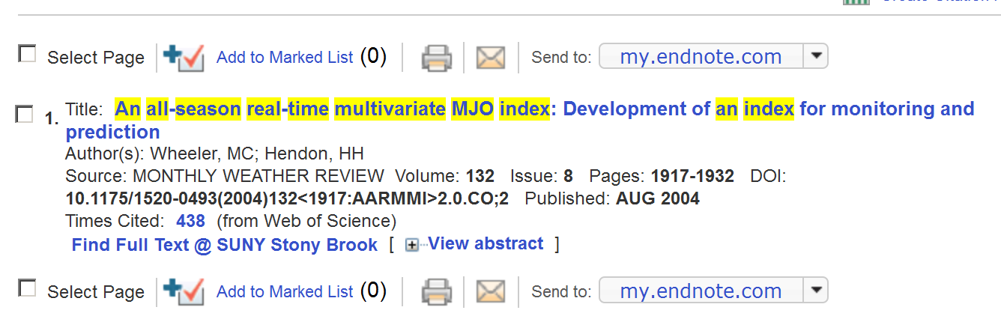
Review MJO indices
. 3) Combined index (Real-time Multivariate MJO; RMM)
Wheeler and Hendon (2004): Combined EOF (CEOF)
of daily anomalous 850-hPa u, 200-hPa u, and OLR,
based on the first two CEOF modes

Slide 5
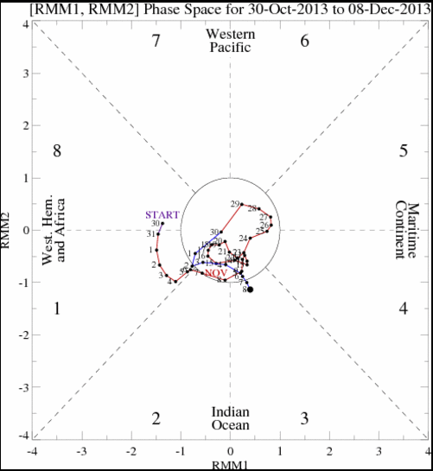
RMM Framework - diagram
http://www.cpc.ncep.noaa.gov/products/precip/CWlink/MJO/whindex.shtml
An MJO phase is
outside the circle

Slide 6
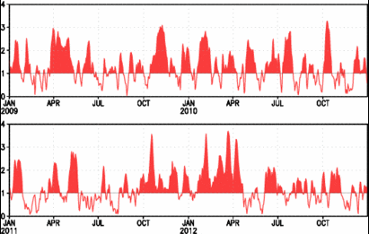

RMM Framework - amplitude
http://www.cpc.ncep.noaa.gov/products/precip/CWlink/MJO/whindex.shtml
$$\sqrt{{RMM1}^{2}+{RMM2}^{2}}$$

Slide 7
Why higher-order CEOF modes?
Spectral leakage at 2-5: OLR 1979-2012

Slide 8
Why higher-order CEOF modes?
Two events during TOGA-COARE, Hovmoller Diagram
OLR; underestimated amplitude and structure in the Western Pacific

Slide 9
Why higher-order CEOF modes?
Two events during TOGA-COARE, Hovmoller Diagram MJO
OLR, U850; also directly underestimated the MJO component

Slide 10
How to derive and justify the modes?
. Dedicated steps of WH04 for the daily anomalous data
Data: NOAA OLR, NCEP/NCAR U850 and U200, 2.5x2.5
1979-2012
Climatology: mean and first 3 harmonics of annual cycle
1979-2001
Interannual variance: REOF1 of SSTA in the Pacific
by regression; HadISST
Trend and frequency lower than interannual
Retrospective 120-day
High-frequency:
15ºS-15ºN mean
. CEOF: standardized by global STD; co-variance matrix
. 432 modes to analyze

Slide 12
How to justify the number of modes?
. Explained variance: 1st two CEOFs, 26%; 3-10, 27%

Slide 13
How to justify the number of modes?
. Explained variance: 1st two CEOFs, 26%; 3-10, 27%
Table 1 Accumulated variance in percentage by the EOF modes to the raw daily anomalous data and the MJO components of the modes to the total MJO
 | EOF1-2 |  | EOF1-6 |  | EOF1-10
 | RAW | MJO | RAW | MJO | RAW | MJO
OLR | 11.6 | 47.5 | 23.8 | 68.8 | 31.9 | 75.9
U850 | 35.1 | 84.3 | 52.9 | 99.3 | 60.9 | 97.1
U200 | 31.0 | 66.8 | 53.2 | 78.8 | 64.4 | 89.5

Slide 14
How to justify the number of modes?
STD of OLR in longitude
105ºE
90ºE
155ºE

Slide 15
How to justify the number of modes?
STD to total in % of OLR in longitude

Slide 16
How to justify …?
Structures of EOF 3-10
Wave 2-5 @WP
Zonal mean: U200

Slide 17
How to justify … modes?
Difference in PWR (10EOFs – 2EOFs)

Slide 18
What improvement to the RMM?
Hovmoller diagram of OLR during TOGA-COARE 1992-1993

Slide 19
What improvement to the RMM?
Hovmoller diagram of MJO during TOGA-COARE

Slide 20
DYNAMO 2012

Slide 21
DYNAMO 2012
Equatorial Rossby waves
6-50days,
1-10 westward
Kelvin waves
2.5-30 days
1-14 eastward

Slide 22
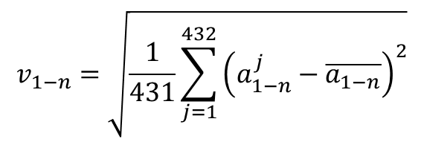
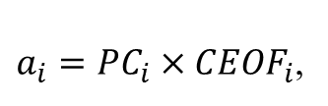
RMM-like Amplitude and Longitudinal STD
RMM amplitude was used without much explanation of its physical meaning.
It can be associated with the longitudinal STD of the reconstructed component
in the following.
A reconstructed component
Longitudinal STD of the first 1~n modes
$a_{i}={PC}_{i}×{CEOF}_{i}$,
$$v_{1−n}=\sqrt{\frac{1}{431}\sum_{j=1}^{432}{{\left(a_{1−n}^{j}−\overline{a_{1−n}}\right)}^{2}}}$$

Slide 23

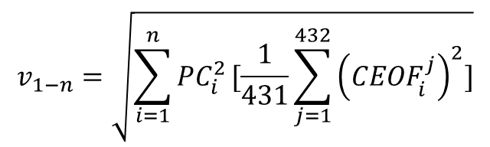
RMM-like Amplitude and Longitudinal STD
If
If $\overline{a_{1−n}}=0$,
$$v_{1−n}=\sqrt{\sum_{i=1}^{n}{{PC}_{i}^{2}}[\frac{1}{431}\sum_{j=1}^{432}{{\left({CEOF}_{i}^{j}\right)}^{2}}]}$$
and the second summation under the radical sign is constant, would the RMM
amplitude scaled to the longitudinal STD. Computations indicated that both
Conditions are rarely satisfied such that noise is accumulated as n becomes larger.

Slide 24
RMM-like Amplitude and Longitudinal STD
During TOGA-COARE
10EOFs

Slide 25
What improvement to the RMM framework?
Summary
. The CEOF modes 3-10 are necessary and sufficient in
restoring the power spectra at zonal wavenumbers
2-5 and MJO structure in the western Pacific
. Both the Hovmoller diagram and longitudinal STD
can be included to improve the MJO monitoring
. The 2-dimensional RMM diagram could not be revised
satisfactorily and needs to be retained
. Similar results were obtained by using slightly different
MJO bands and conventionally band-pass filtered
daily data at 20-80 or 30-80 days

Slide 26
Thanks !

