Slide 1
Development of a Lagrangian cloud model (LCM) and its application to the parameterization of cloud microphysics
(Riechelmann et al. NJP 2011, Noh et al. JAS submitted)
Yign Noh
Yonsei Univ. (Korea)
*In collaboration with
S. Raasch, T. Riechelmann (Univ. Hannover, Germany),
J. H. Lee (Yonsei Univ., Korea),
L. P. Wang (Univ. Delaware, U.S.A.)

Slide 2
Production of SST using the NWP-ocean mixed layer coupled model with satellite data assimilation
Improvement of the PBL parameterization (YSU model)

Slide 3
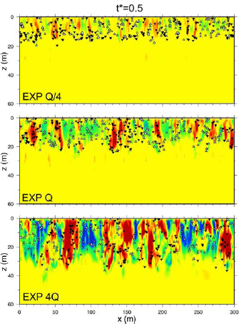

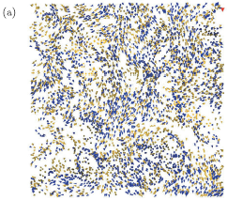
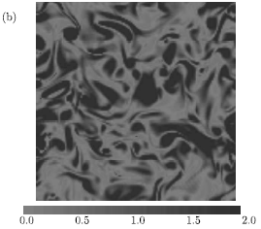
LES and DNS are widely used to simulate the Lagrangian motion of suspended particles in turbulent flows in fluid dynamics community.
Distribution of droplets and enstrophy
in isotropic turbulence (Wang et al., 2009)
Distribution of particles and vertical velocity
in the ocean mixed layer (Noh & Nakada, 2010)
A cloud is still simulated by the Eulerian model (bulk model, spectral bin model).

Slide 4
Lagrangian cloud model (LCM) is more natural to represent particle-laden turbulence than Eulerain model.
Dynamics and microphysics of a cloud is directly related to the physical process of individual droplets (cf. kinetic theory of gas)
Cloud microphysical process is more naturally simulated by LCM.
Initiation of rain by the motion of droplets settling gravitationally in turbulent flows.
Transport of droplets by the motion of individual droplets (no eddy diffusivity)
Condensational growth of a droplet that passes through a droplet an inhomogeneous turbulent environment
Activation of CCN
Collection of cloud water by rain water
Time history of droplets
Interaction between droplets and turbulence

Slide 5
Spectral Bin Model
- Eulerian Model
- K_{m} are different depending on particle sizes.
- Particle velocity is not the same as fluid velocity u_{i} - w_{s} because of particle inertia.
- Artificial spectral broadening occurs, if the number of bins are not sufficient.
- For sufficiently large number of bins, computational cost is extremely high.

Slide 6
However, the Lagrangian LES cloud model must resolve the following challenging problems.
1. How to deal with an extremely large number of droplets,
while conserving water content ?
2. How to deal with droplet collision?
*Only DNS can simulate droplet collision directly.

Slide 7
A New Lagrangian Cloud Model
Fluid Model
• Equations for the filtered variables in LES (PALM)
with
: potential temperature
: virtual potential temperature
: perturbation pressure

Slide 8
with
: Exner function with
: latent heat of evaporation
: specific humidity
: condensational source term

Slide 9
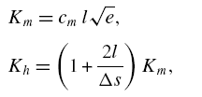
• The SGS Parameterization of LES (Deardorff 1980)

Slide 11
Largrangian Particle Model
• Super-droplet
A_{p} = Weighting factor
= mass of real droplets per unit volume
mass of simulated droplet per unit volume
- representing a large number of real droplets of the same size

* N_{p} = total number of superdroplets within a grid

Slide 12
• Advection of Droplets
*
with

Slide 13
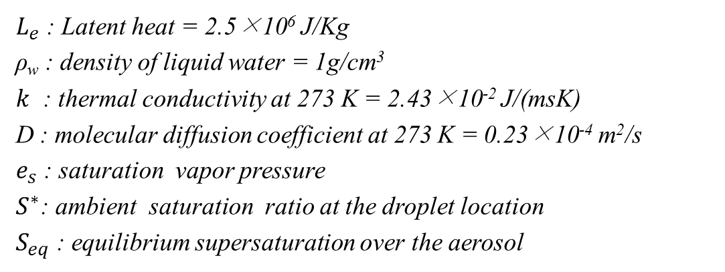
Microphysics
• Condensation/Evaporation
with


Slide 14
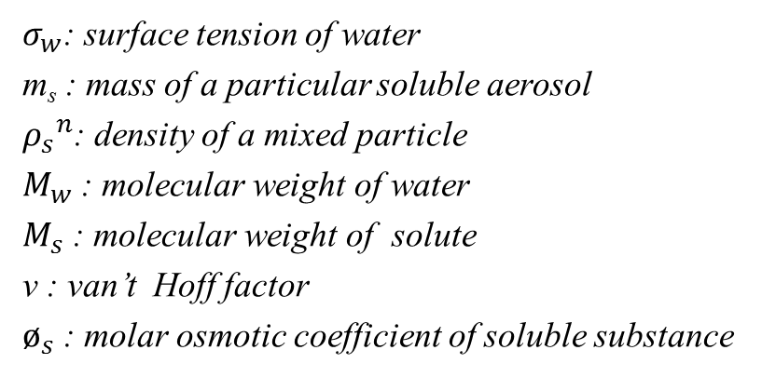
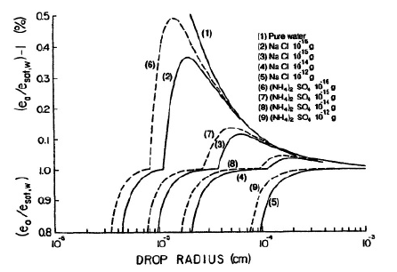
Calculation of S_{eq}
Pruppacher and Klett (1978)
→ With activation process
only a soluble aerosol
Mason (1971)
Without activation process
ignore solution-curvature effect
By Haanel(1976)

Slide 15
Previous Works on LCM
Shima et al., 'The super-droplet method for the numerical simulation of clouds and precipitation: A particle-based and probabilistic microphysics model coupled with a non-hydrostatic model', Q. J. R. Meteorol. Soc., 135, 1307-1320 (2009).
Andrejczuk et al., 'Cloud aerosol interactions for boundary layer stratocumulus in the Lagrangian cloud model', J. Geophys. Res., 115 (D2214) (2010).
*Both use the concept of a super-droplet, but calculate droplet collision in a fundamentally different way.

Slide 16
How to deal with droplet collision?
Shima et al. (2009)
• Monte Carlo scheme
- random sampling of non-overlapping pairs
 examine only N/2 pairs instead of N(N-1)/2 pairs
* Uniform distribution within a grid is assumed.

Slide 17
Andrejczuk et al. (2010)
1. subdivide a grid box into 8 smaller volumes ('collisional grid boxes')
 # of collision: N(N-1)/2  N(N/8-1)/2
2. assign droplets to 30 spectral bins
3. Collision during the time interval Δt between two super-droplets i and j
result in a creation of N_{ij} = K_{ij}n_{i}n_{j}Δt/V with radius (r_{i}³ + r_{j}³)^{1/3}.
 A new super-droplet with radius (r_{i}³ + r_{j}³)^{1/3} is created.
(cf., stochastic collection equation)
* In order to avoid the unlimited increase of N
- A new super-droplet is created only if its number is larger than n_{T}.
- N is limited by merging the ones with similar sizes.
*Uniform distribution within a grid is assumed.

Slide 18
• Collision/Coalescence
Basic Concepts
• We regard the collision/coalescence of two super-droplets, (R, A_{R}) and (r, A_{r}),
as "the growth of a larger droplet and the disappearance of a smaller droplet".
 the increase of R and the decrease of A_{r}
*Total number of super-droplets are not changed.
• We consider the statistical growth of droplets, instead of individual collision
event, based on the background droplet spectrum and dissipation rate.


Slide 19
In the real cloud,
In the simulation,
R_{3 ,} A₃
R₃” , A₃“
R₁“, A₁”
R₁ ,A₁
R₂ , A₂
R₂” , A₂“
- Particle collision is parameterized in terms of the modification of r_{i} and A_{i}.
Notes:
19
19

Slide 20
 Algorithm
1. collector droplet (R)
 increase of R with A_{R} fixed.

2. collected droplet (r_{i})
 decrease of A_{r} with r_{i} fixed


Slide 21
3. conservation of LWC during collision

* Super-droplets are sorted according to the size
 Repeat the process 1 - 3 with the collector droplet with decreasing r.
,

,
:

,

Slide 22
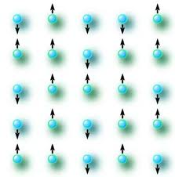
Mean Field Theory
(e.g., F. Reif, 'Statistical and Thermal Physics')
- The n-body system is replaced by a one-body system with a chosen
good external field that replaces the interaction of all the particles
with an arbitrary particle
ex) Ising model (on an N-dimensional cube lattice) in statistical physics

* H = Hamiltonian
s_{i} = spin
h = the external field
mJz = the effective mean field induced by the neighboring spins

Slide 23
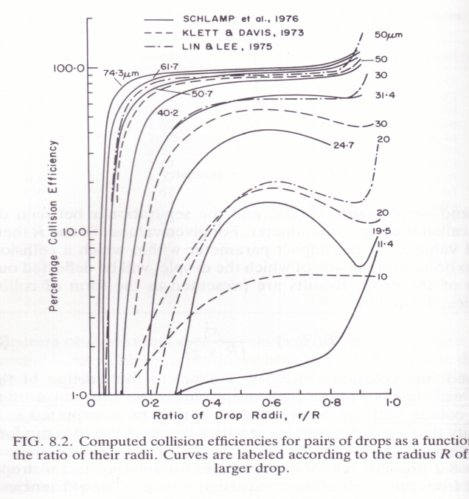
Classical Theory of Droplet Growth by Gravitational Collision
(Hall Kernel)
: collision kernel
: collision efficiency


Slide 24
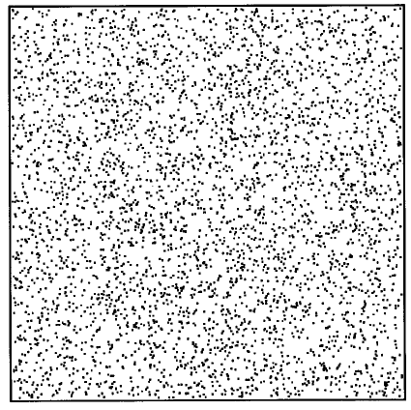
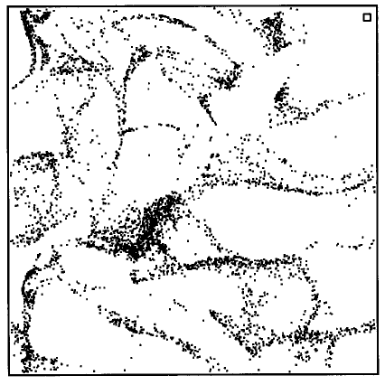
Effects of Turbulence on Collection Kernel
• the enhanced relative motion due to differential acceleration and shear effects
• the enhanced average pair density due to preferential concentration
• the enhanced collision efficiency
Preferential Concentration
(Shaw et al., 1997)

Slide 25
Ayalla & Wang Scheme (2008)
•
: geometrical collision

, if ε = 0 (no turbulence)
•
: enhancement of E by turbulence
•
: collision efficiency without turbulence
•
: enhancement of Γ by turbulence
 enhanced relative motion
 preferential concentration

Slide 26
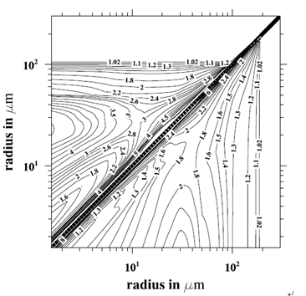
The ration of a typical turbulent collection kernel to the Hall kernel
(ε = 400 cm²s⁻³) (Wang & Grabowski, 2009)

Slide 27
The rate of change in droplet spectrums: Hall kernel (left) and a new kernel
with the effect of turbulence (right) (Wang and Grabowski, 2009)

Slide 28
Model Structure
Fluid Motion
SGS Turbulence
Thermodynamics
Microphysics
Particle Motion

Slide 29
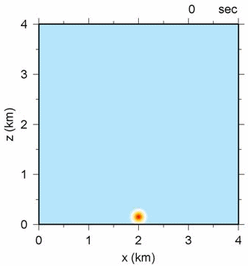
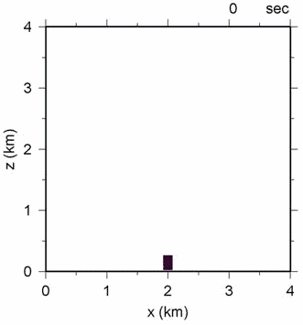
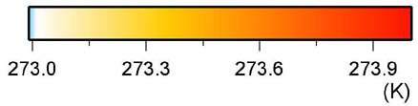
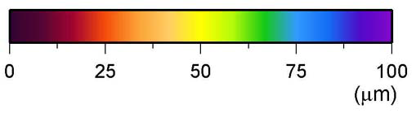
Evolutions of (a) potential temperature and (b) droplets position with radius
Simulation of an Idealized Single Cloud
(a)
(b)

Slide 30
Simulations
1. BOMEX
- nonprecipitating
• an idealized single cloud
• shallow cumulus convection
2. RICO
- precipitating
• an idealized single cloud
⎯ : BOMEX, ⎯ : RICO

Slide 31
An Idealized Single Cloud Experiment (BOMEX)
MODEL : Large Eddy Simulation Model ( PALM )
  Domain size : 1.28 km x 3.84 km x 3.84 km
  Time step: 0.1 s
  Resolution: 20 m
  Collision kernel: Hall kernel, Ayalla-Wang (AW) kernel
Particles information
  Particles are released every 4.5 m in whole domain
  Initial particles size: 1 µm (no CCN activation process)
  Initial weighting factor: 9·10⁹
  Total number of particles: ~ 1.5 x 10⁸ (~ 87 per grid box)
  Particle concentration: 100 cm⁻³
  Bubble size : 1280 m x 150 m x 200 m, ΔT = 0.4 K

Slide 32
Bulk Model
• one moment bulk model
• prognostic equations for potential temperature and total water content
- Ogura (1963), Orville (1965)
• condensation scheme
- all-or-nothing method (Cuijpers & Duynkerke, 1993)

Slide 33
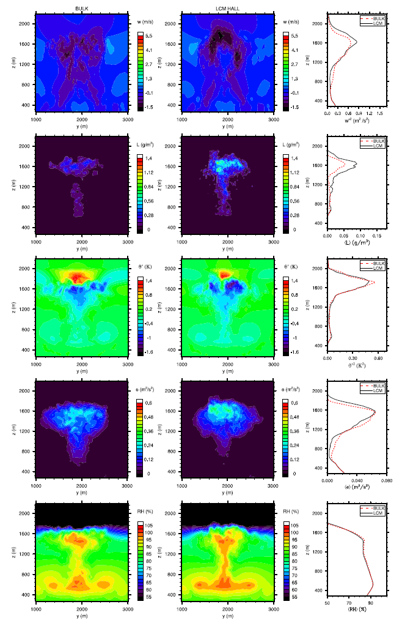
(a)
(b)
(a)
(b)
w
LWC
Δθ
TKE
RH
(a) bulk model, (b) LCM
(t = 1200 s)
(a) bulk model, (b) LCM (t = 1200 1600 s)

Slide 34
(a)
(b)
w
LWC
Δθ
TKE
At a horizontal cross section
( z = 1400 m, t = 1600 s)
(a) bulk model, (b) LCM
RH

Slide 35
Distribution of the droplet size (left: Hall kernel, right: AW kernel):
((a), (c): t = 1200 s, (b), (d): t = 1600 s)

Slide 36
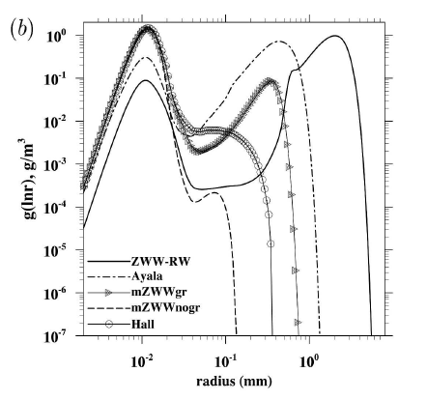
Evolution of the mass density function with the cloud: (a) Hall kernel, (b) AW kernel
Mass density function at t = 1800 s
(Xue et al. 2008)

Slide 37
Sensitivity tests: (a) Δt = 0.05 (blue), 0.1 (black), 1.0 (red) s,
(b) N_{p} = 4.5 x 10⁷ (green), 1.3 x 10⁸ (red), 1.5 x 10⁸ (black), 3.2 x 10⁸ (blue)
Δt = 0.1 s and N_{p} = 80 are necessary for the convergence of solutions

Slide 38
Shallow Convection Experiment (BOMEX)
MODEL : LES ( PALM )
  Domain size : 6.4 km x 6.4 km x 3 km
  Initial TKE profile: 1 - z/3000 m2s-2
  Constant surface sensible heat flux: 8 x 10-3 Kms-1
  Constant surface latent heat flux: 5.2 x 10-5 ms-1
  Total momentum flux: u* = 0.28 ms-1
  Large-scale forcing terms: subsidence, radiative cooling, low-level drying
  (Siebesma et al, 1995)
Particles information
  Particles are released every 4.5 m in whole domain
  Initial particles size: 1 µm
  Initial weighting factor: 10¹⁰
  Total number of particles: ~ 1.7 x 10⁹ (~ 125 per grid box)
  Particle concentration: 100 cm⁻³

Slide 39
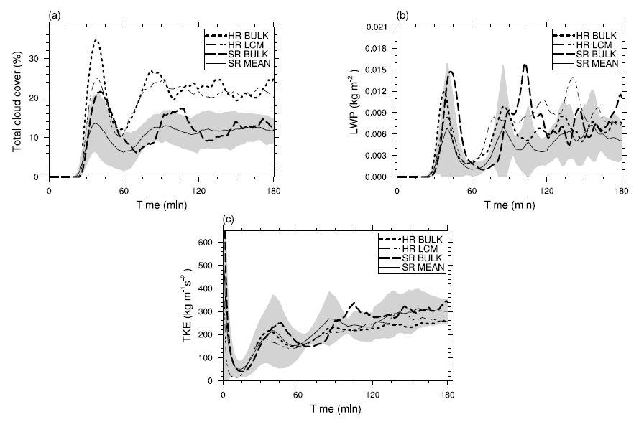
Comparison with Other LES Results for the BOMEX Case
Time series of (a) total cloud cover, (b) the vertically integrated LWP and (c) the vertically integrated TKE. The black solid lines indicate the mean over all the model results of Siebesma et al (2003).

Slide 40
Mean profiles averaged over 1 h (hours 2–3) of (a) the potential temperature, (b) the specific humidity and (c) the LWC. The black solid lines indicate the mean over all model results of Siebesma et al (2003).

Slide 41
An Idealized Single Cloud Experiment (RICO)
MODEL : LES ( PALM )
  Domain size : 1.28 km x 3.84 km x 3.84 km
  Time step: 0.1 s
  Resolution: 20 m
  Collision kernel: Hall kernel, Ayalla-Wang (AW) kernel
Particles information
  Particles are released every 4.5 m in whole domain
  Initial particles size: 1 µm
  Initial weighting factor: 9·10⁹
  Total number of particles: ~ 1.5 x 10⁸ (~ 87 per grid box)
  Particle concentration: 100 cm⁻³
  Bubble size : 1280 m x 150 m x 200 m, ΔT = 0.4 K

Slide 42
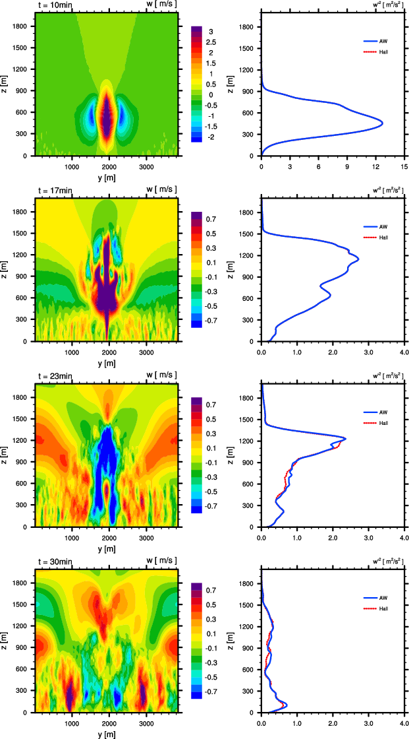
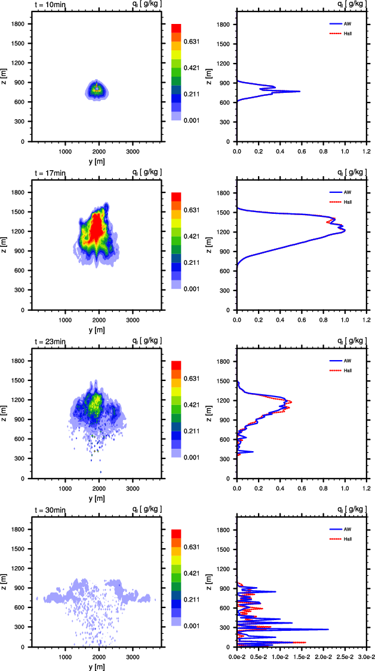
Cross-sections of fluid vertical velocity (w) and liquid water mixing ration (q_{l}) with vertical profiles (Hall: red, AW: blue)

Slide 43
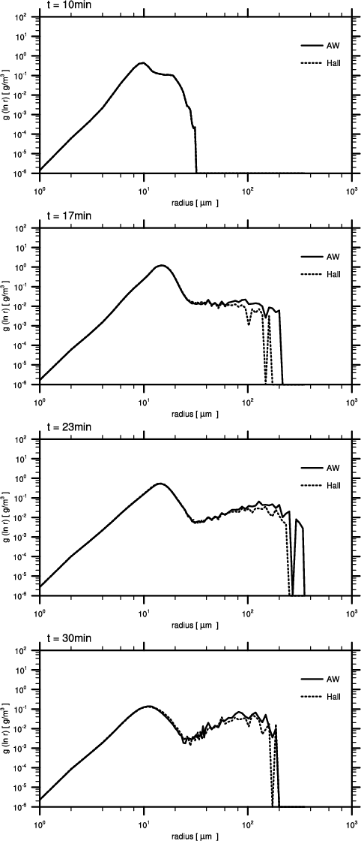
Evolution of mass density distribution of droplets at t = 10, 17, 23, 30 min (Hall: dashed; AW: solid).

Slide 44
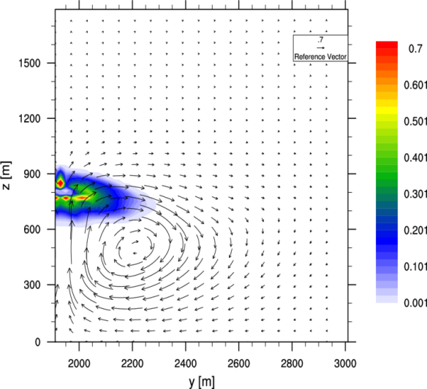
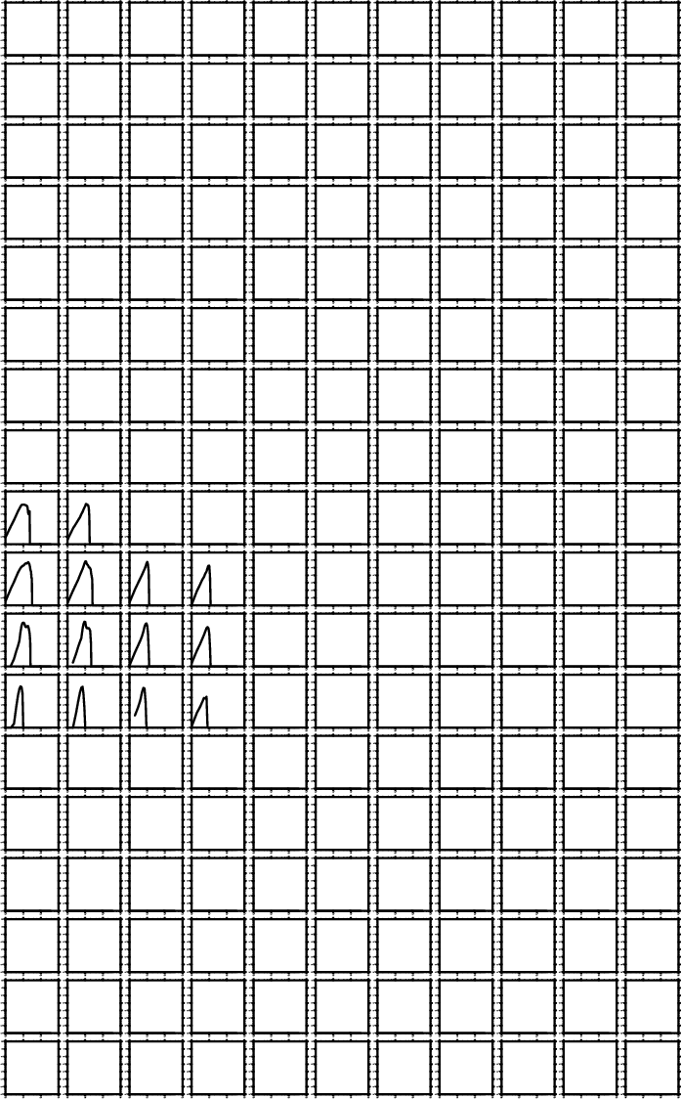
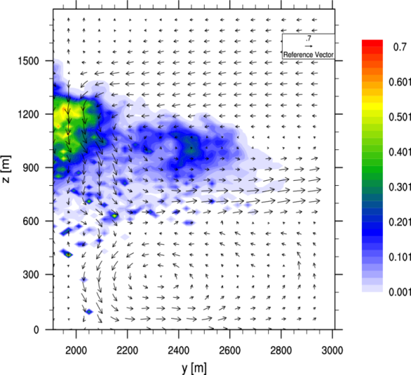
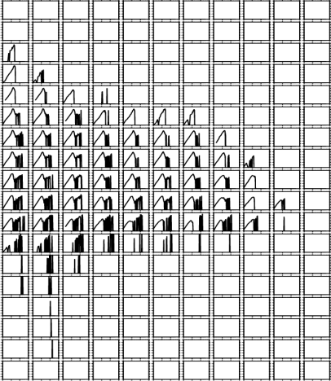
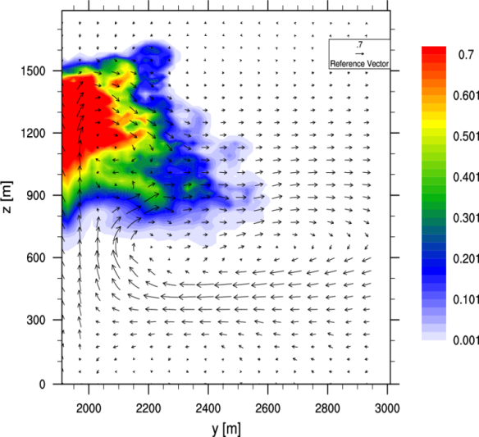
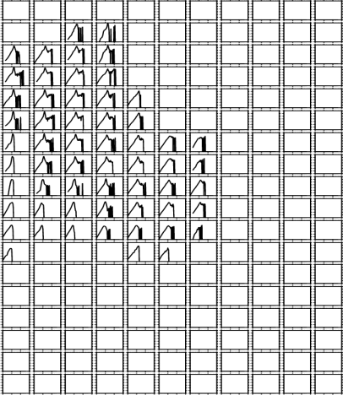
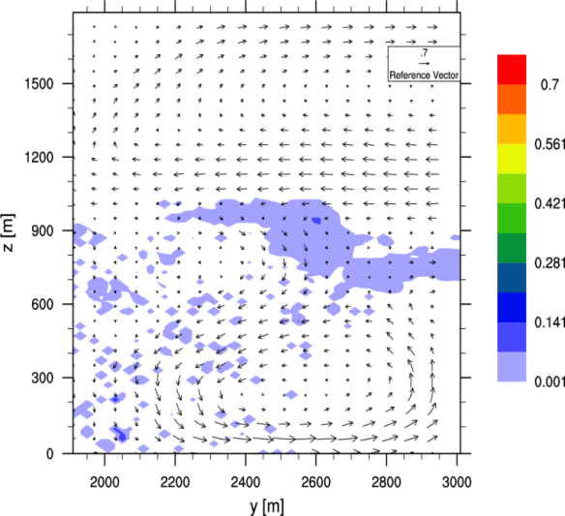
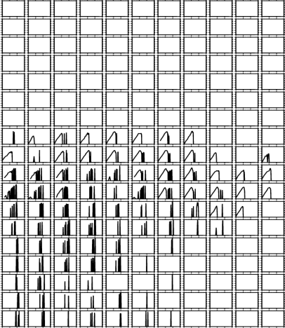
Distributions of (a) the liquid water mixing ratio overlapped with the fluid velocity vector and (b) the mass density distributions of droplets (t = 10, 17, 23, 30 min)

Slide 45
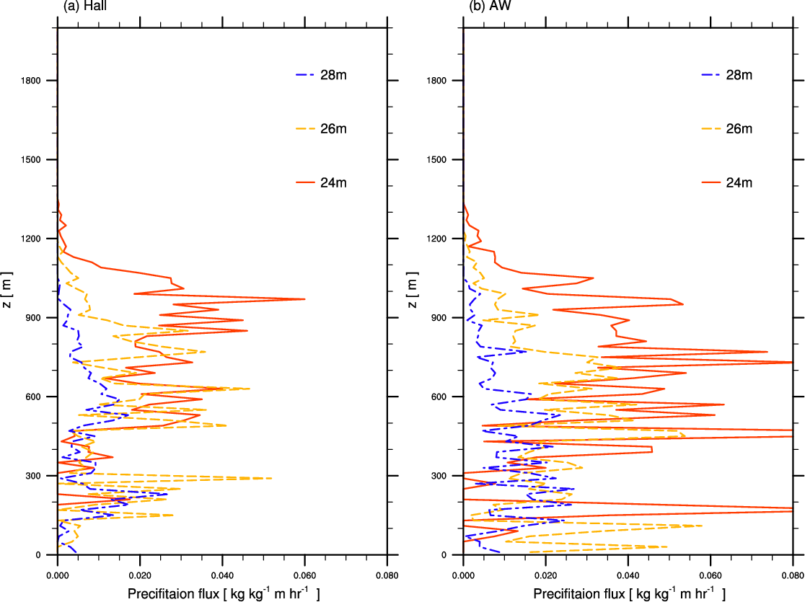
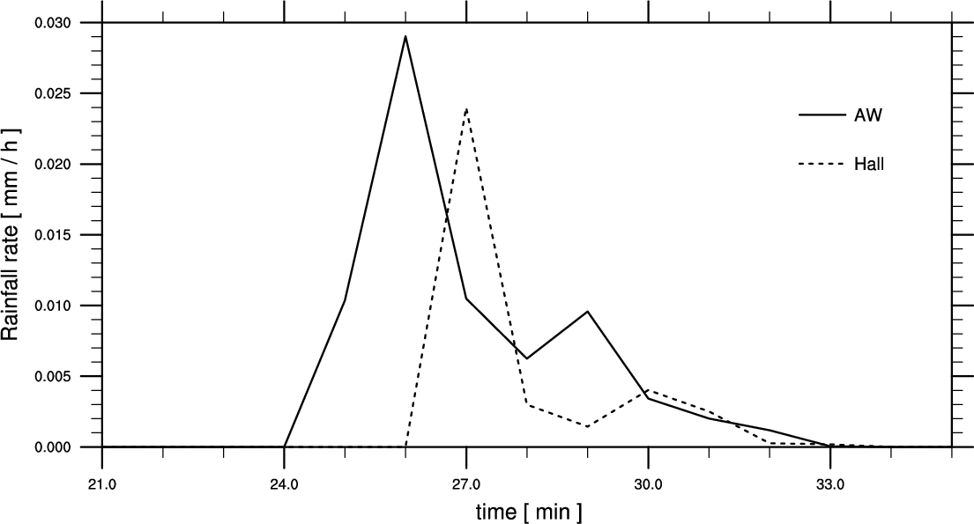
Time series of the precipitation rate
(dashed: Hall kernel, solid: AW kernel).
* precipitation flux
Evolution of the precipitation flux profiles: (a) Hall kernel (left), (b) AW kernel (right) at t = 24, 26, 28 min.
*Seifert et al. (2010)
- The inclusion of turbulence effects on cloud microphysics leads not only to the speed-up of
rain formation but also to the increase of precipitation intensity.

Slide 46
Bulk Models
They are based on several assumptions
bimodal distribution of droplets into cloud droplets and raindrops
- cloud droplet: following the fluid velocity
- raindrop: settling (e.g., W = w – w_{s})
- r_{c} ~ 40 – 100 μm
• rain size distribution
: Marshall-Palmer distribution
*W = particle velocity
w = fluid velocity
w_{s} = terminal velocity

Slide 47
• Kessler (1969)
q_{C} (q_{R}) = mixing ratio of cloud water (rainwater) ( )
A = autoconversion
C = collection of cloud water by rainwater
E = evaporation
D_{C} (D_{R}) = turbulent diffusion of cloud water (rainwater)
→ LCM can provide information for the parameterization of terms in RHS

Slide 48
Questions
1. How does the vertical velocity of a droplet vary with r?
2. How is the raindrop size is distributed?
3. How accurately does the precipitation flux using w_{s} predict the real one ?

Slide 49
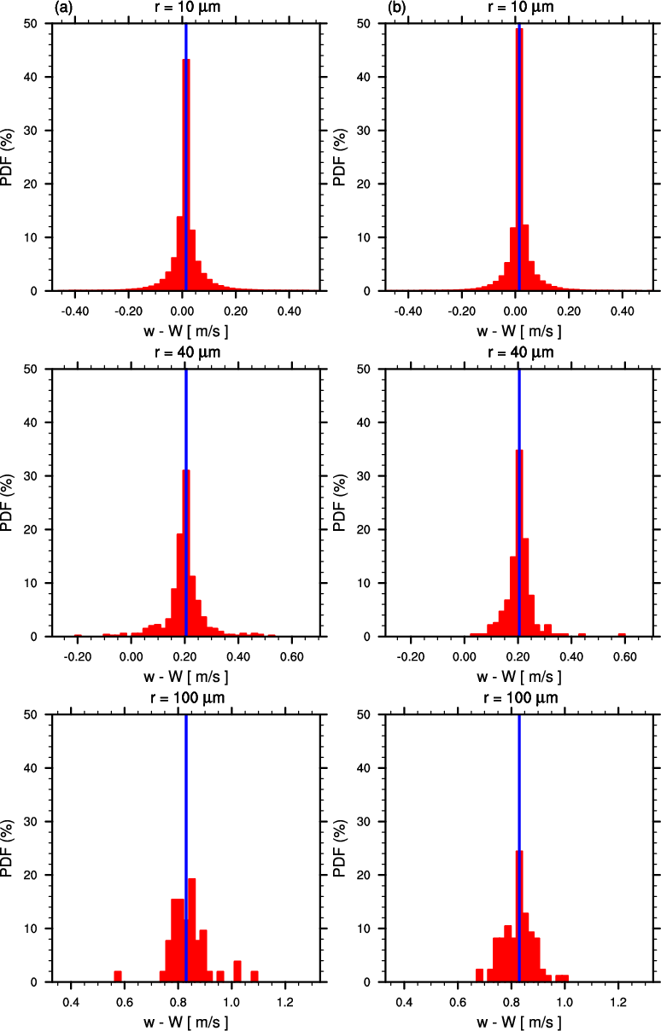
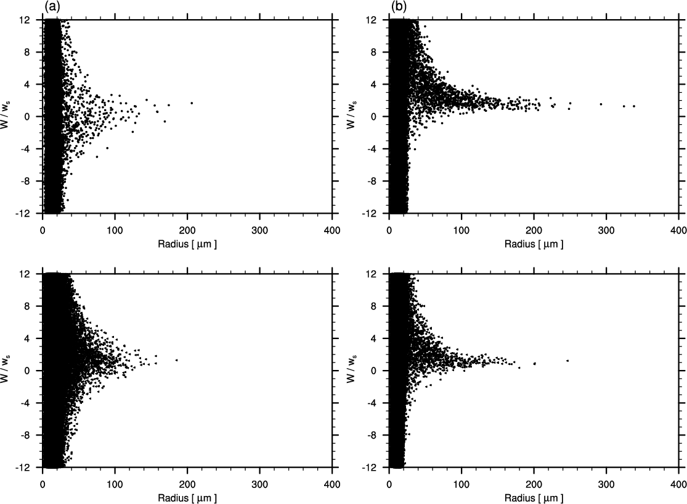
Scatter plots of W/ws in the inner (left) and outer (right) region: (a) t = 17 min, (b) t = 23 min.
⇒ r < 20 μm – cloud droplet
r > 100 μm − raindrop
PDF of ΔW (= w- W) (red) with ws (blue): (a) t = 17 min, (b) t = 23 min

Slide 50
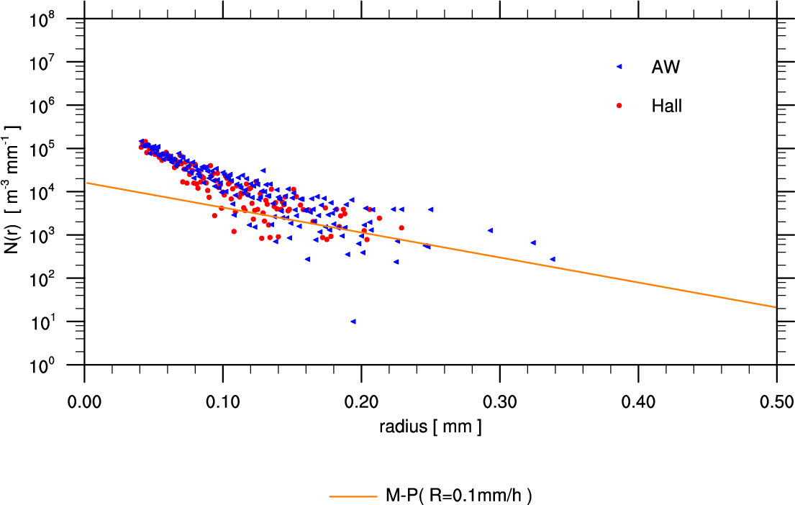
The general pattern of the raindrop size distribution is consistent with the Marshall-Palmer distribution.

Slide 51
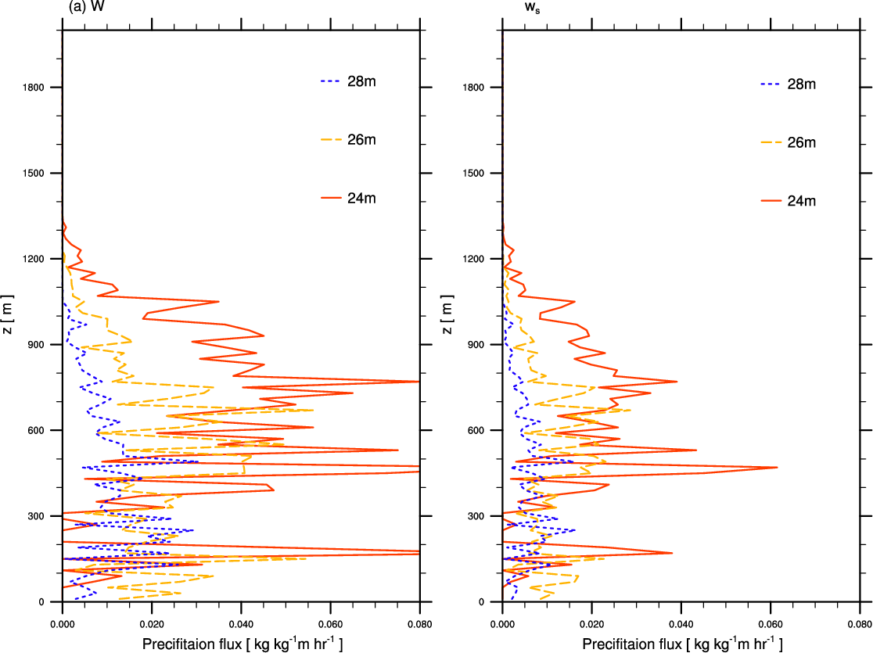
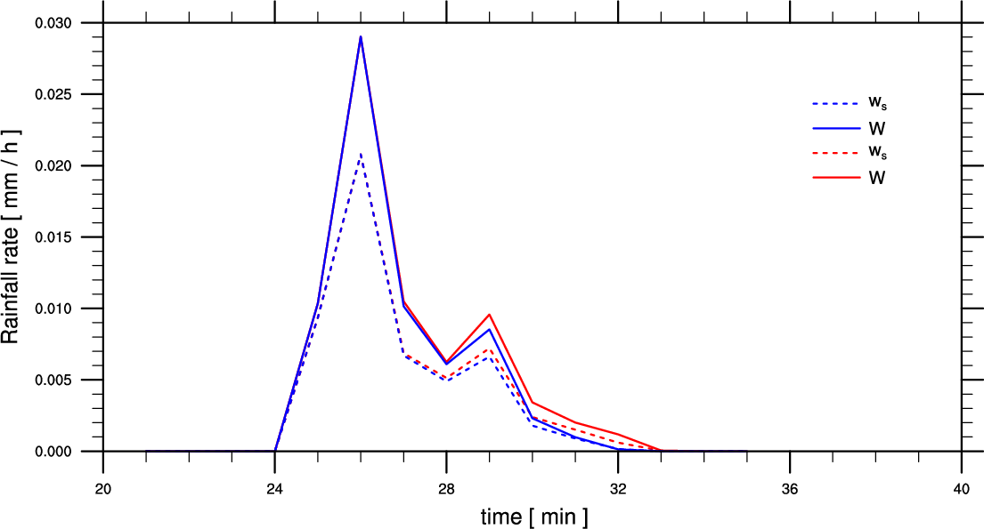
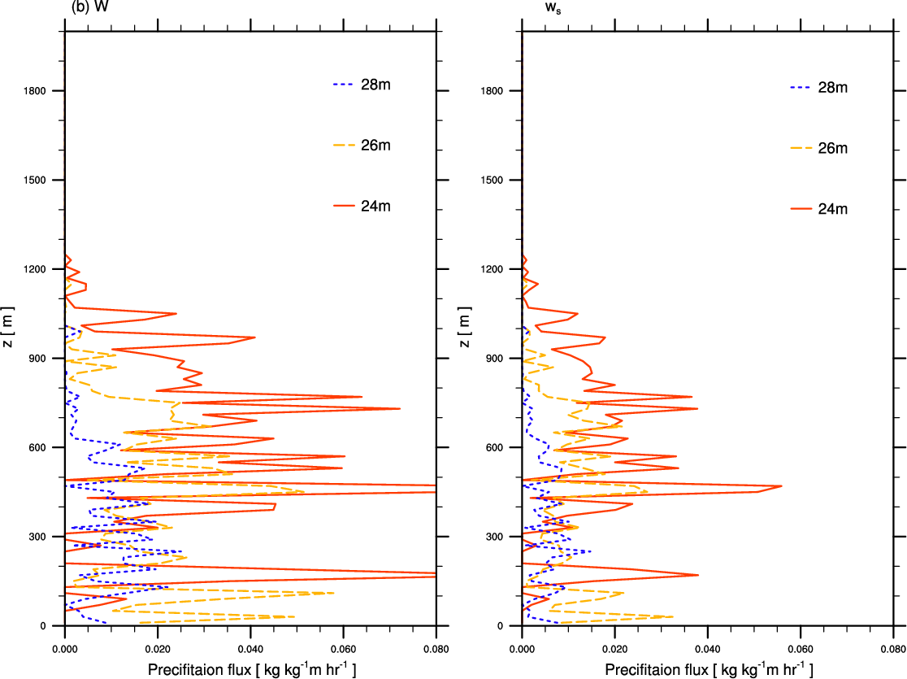
Time series of precipitation rate using (r_{c} = 40 μm, red; r_{c} = 100 μm, blue)
Precipitation flux profiles using W (left) and ws (right): (a) r_{c} = 40 μm, (b) r_{c} = 100 μm
Precipitation flux can be underestimated, if w_{s} is used instead of W, but it is not sensitive to r_{c}.

Slide 52
Conclusion
• The Lagrangian cloud model (LCM) is developed.
• The model results show good agreement with previous simulation results using bulk or spectral bin models.
• The sensitivity tests of LCM for the time step and the number of super-droplets are carried out to investigate the convergence of the solution.
• The effect of turbulence on the collision kernel leads to earlier and stronger precipitation.
• The parameterization of cloud microphysics is investigated by analyzing the LCM results (vertical velocity of droplets, raindrop size distribution, precipitation flux).
• Further improvement is necessary, including the collision process.

Slide 53
2. Production of SST using the NWP-ocean mixed layer coupled model with satellite data assimilation
(Noh et al. JGR 2011, Lee et al. JAOT submitted)

Slide 54
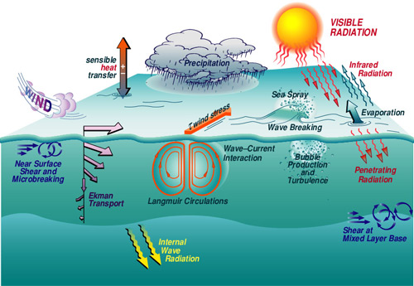
Ocean Mixed Layer

Slide 55
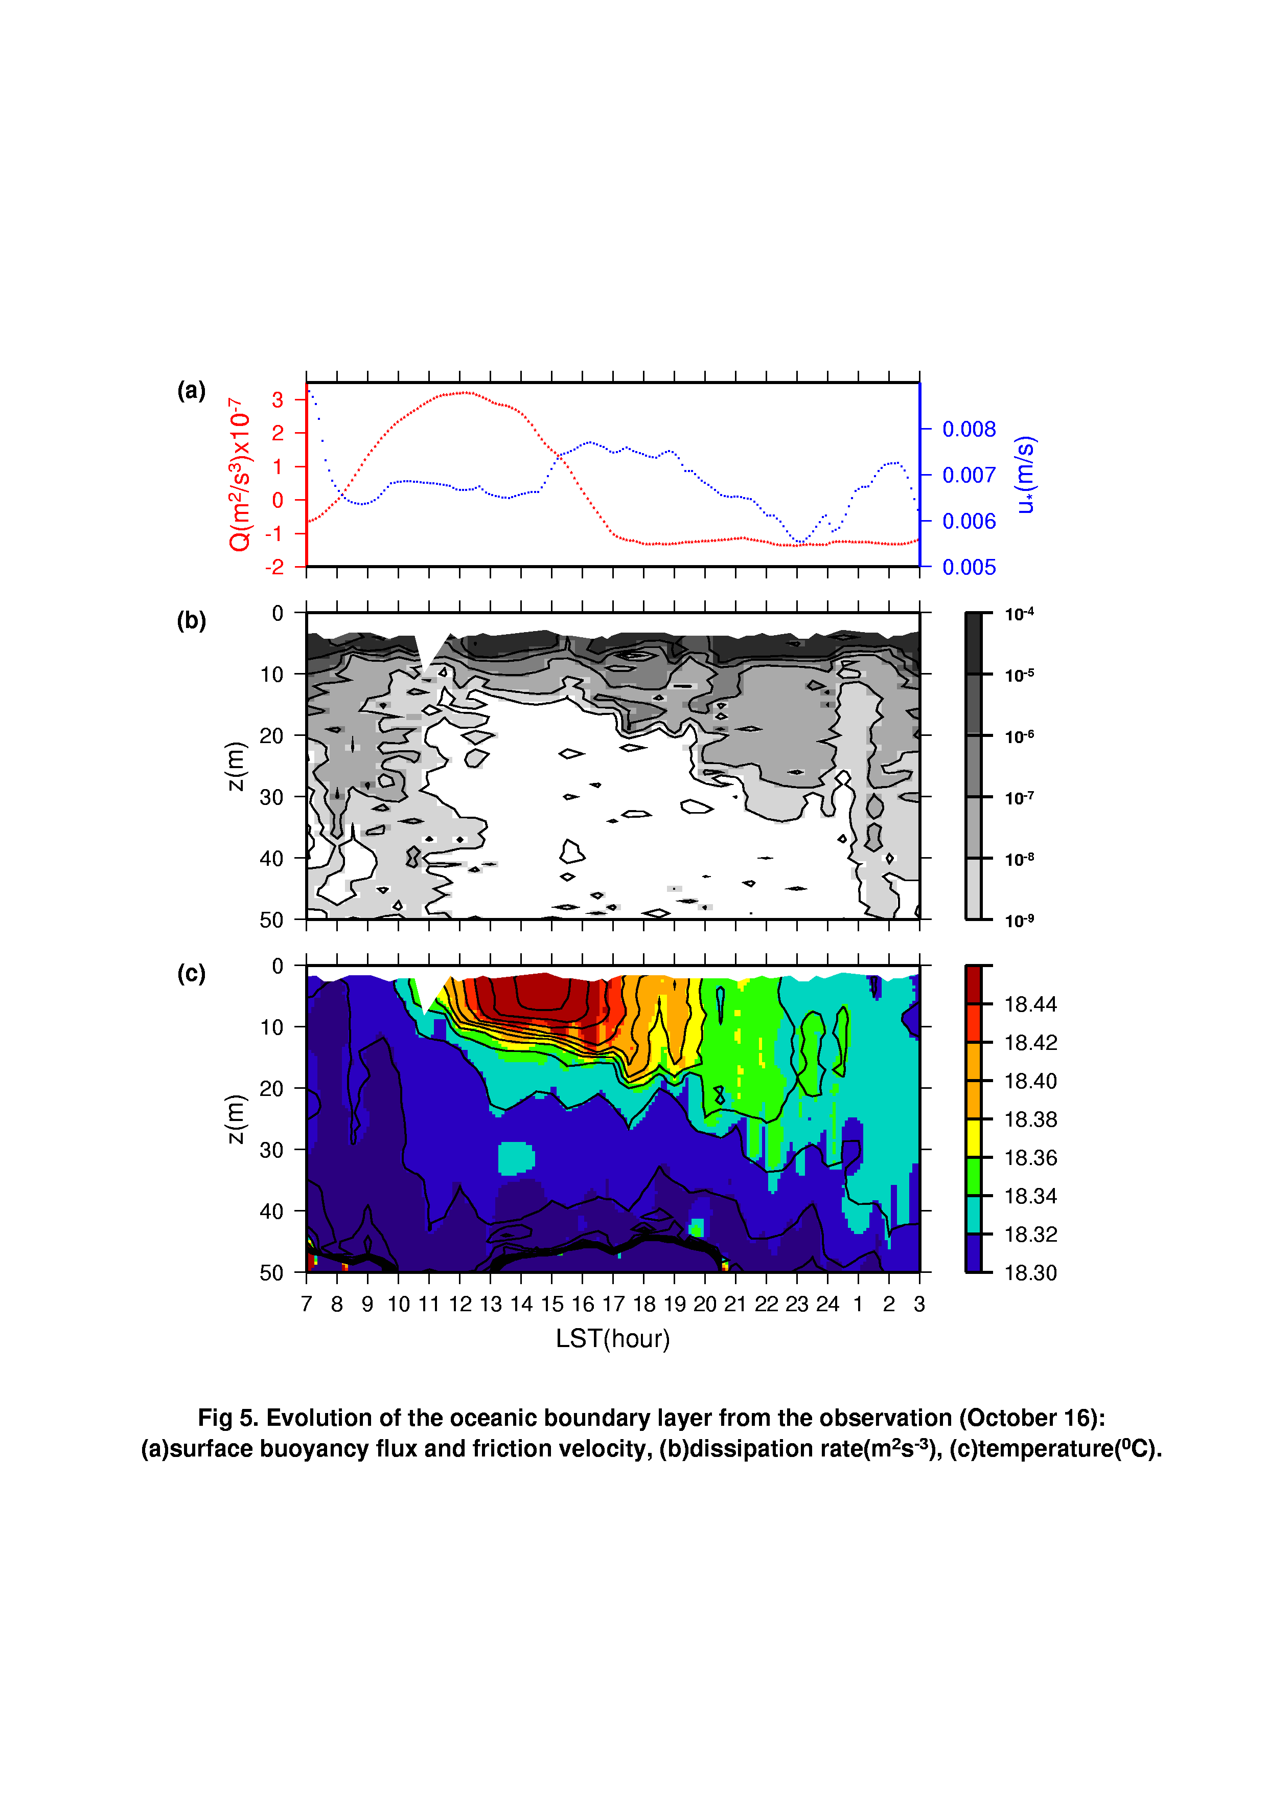
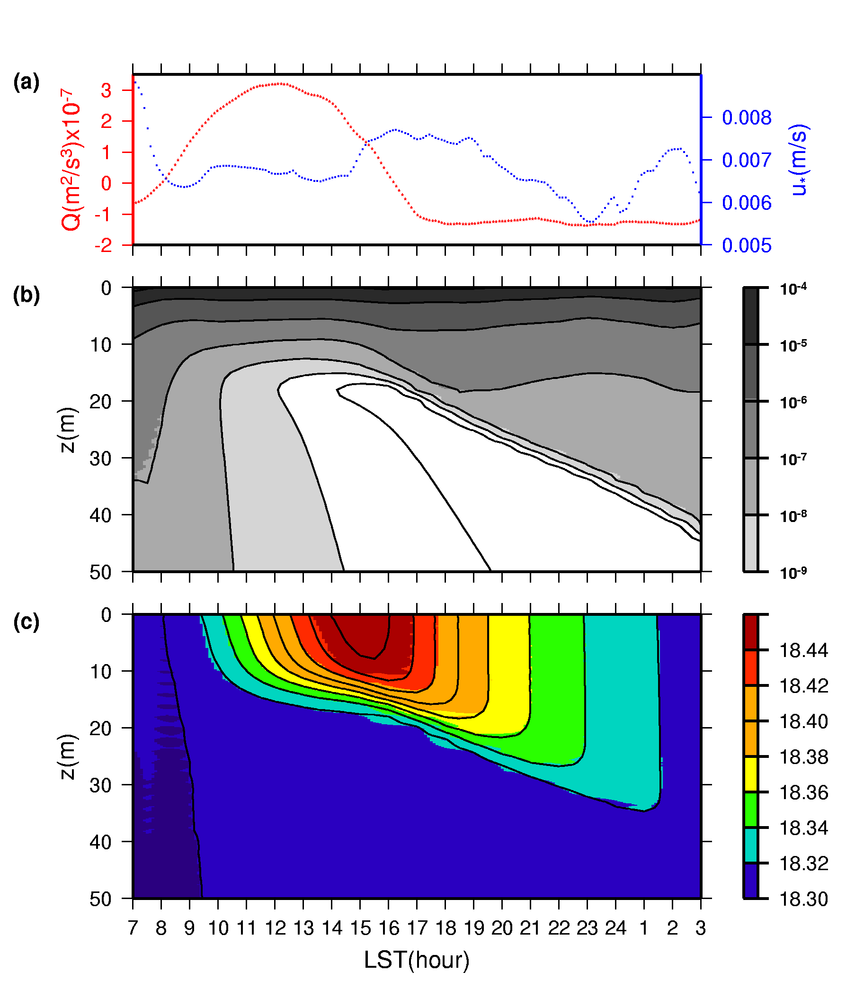
Noh Mixed Layer Model
( Noh et al., JGR 1999, 2011, JPO 2002, GRL 2004, 2005)
Evolution of the OML from the observation (PATCHEX) (left) and simulation (right): (a) surface forcing, (b) dissipation rate (m² s⁻³) and (c) temperature (⁰C)

Slide 56
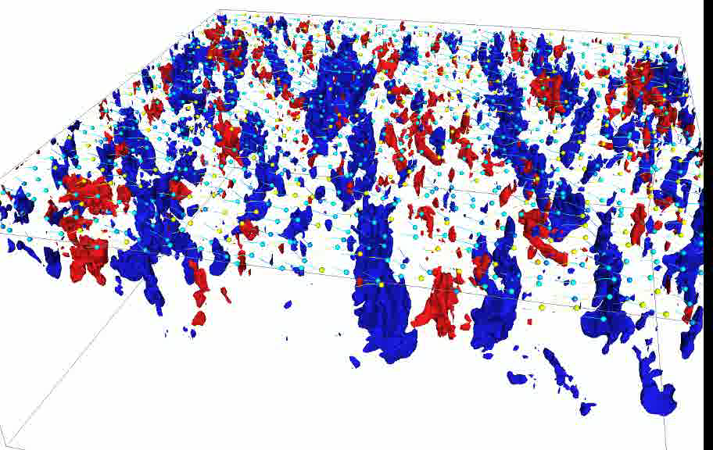
3D View of the Ocean Mixed Layer Simulated by LES
(Noh et al., JPO 2004, 2009, 2010, 2011, PF 2006; JGR 2010, 2011).

Slide 57
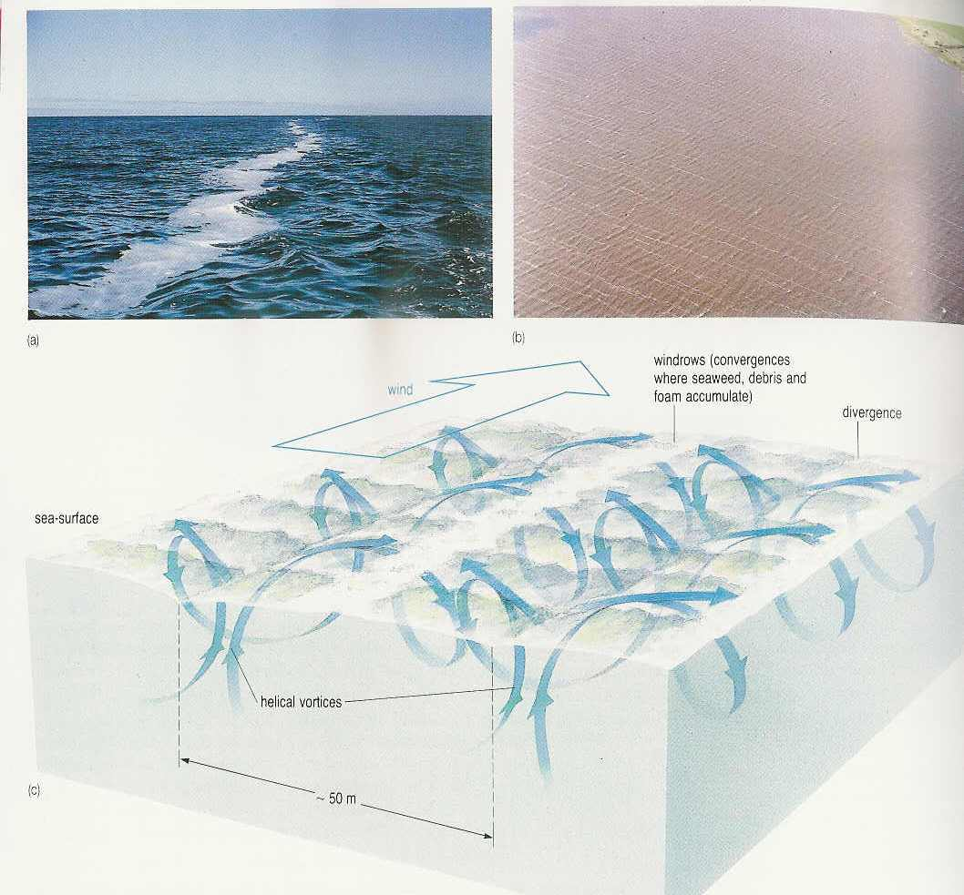
Effect of Langmuir Circulation on Vertical Mixing
.
Scatterplots in the logarithmic scale for l/l₀ vs. Rt. (blue: La= ∞ , green: La = 0.64, red: La = 0.32).

Slide 58
NWP – OML coupled model
(Noh et al., JGR 2011)
NWP (WRF)
OMLM(Noh)
Total heat flux :
Surface wind stress:
 | OML model | WRF model
Domain | East Asian region [100 - 150°E, 11 – 61°N]
Horizontal grid | 25 km
Vertical grid | 100 layers (∆z = 1m) | 31 layers
I.C, B.C | NCEP Final Analysis (1° resolution, every 6 hours), Climatological temperature profile.
Notes:
58
우선 두 모형의 효과적인 접합을 위하여 해양혼합층모형의 모든 변수를 WRF 모형에 등록시켜 두 모형의 정보가 서로 교환되도록 하였습니다. 다음 과정으로 그림과 같이 해양혼합층모형과 수치예보모형사이에 120초 간격으로 다음과 같이 정의된 열 속과 바람응력을 WRF 모형에서 제공받아 해양혼합층모형에서 해수면 온도를 계산하여 다시 WRF 모형에 제공하는 방식을 반복하여 서로의 정보를 교환하도록 하였습니다. 본 실험에서 수평격자는 50 km이고, 해양혼합층모형은 2 m의 연직격자를 100 m까지 설정하였습니다. WRF 모형의 영역은 동아시아 전 해역을 포함하고 있으며 연직으로 31층을 가다. 초기조건과 경계조건으로는 NCEP Final Analysis를 사용하였고, 온도의 연직분포 등 해양혼합층의 초기장은 기후평균치를 사용하였습니다. 위와 같이 개발된 접합 모형의 수행 결과로 해수면에서의 바람응력, 열 속 등의 조건아래서 해수면 온도의 변동을 예측하는 해양혼합층모형은 보다 수치예보모델의 예측성을 향상시켜줄 뿐만 아니라, 위성관측 해수면 온도 자료를 보완하여, 전 해역에 대한 해수면 온도의 일변화의 예측을 가능하게 해줄 것으로 예상됩니다.
58

Slide 59
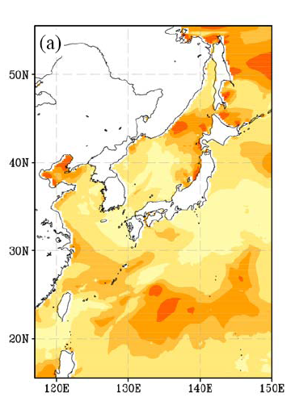
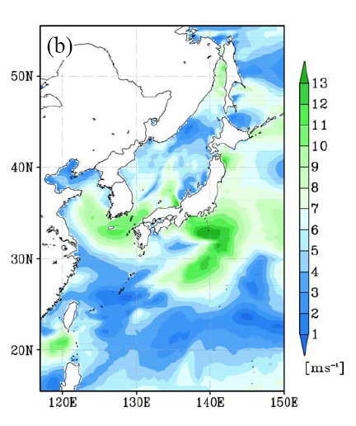
(June 5, 2008)
Distributions of ΔSST from the coupled model :
(a) bulk ΔSST,
(b) skin ΔSST
Distributions of atmospheric forcing from the coupled model:
(a) peak solar radiation,
(b) daily mean wind speed at z = 10 m (U).
*ΔSST = amplitude of diurnal variation of SST

Slide 60
Variations of ΔSST during the period June 4 - 14, 2008 from model output (red) and satellite data (blue): (I) 135-140E, 16-21N, (II) 142.5-147.5E, 20-25N.
Time series of SST from model output (red) and satellite data (blue) (June 8, 2008): (A) 20N, 130E, (B) 25N, 146E, (D) 46N, 145E
Comparison of SST diurnal variation with satellite data

Slide 61
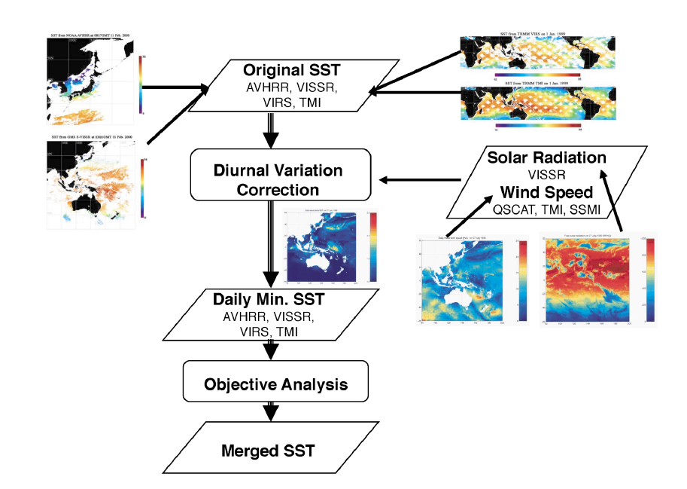
Application of the NWP-OML Coupled Model + Satellite SST
Data Assimilation to the SST Production for NWP
► NWP-OMLM coupled model
+ data assimilation

Slide 62
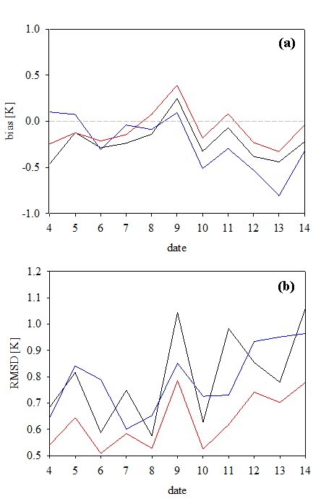
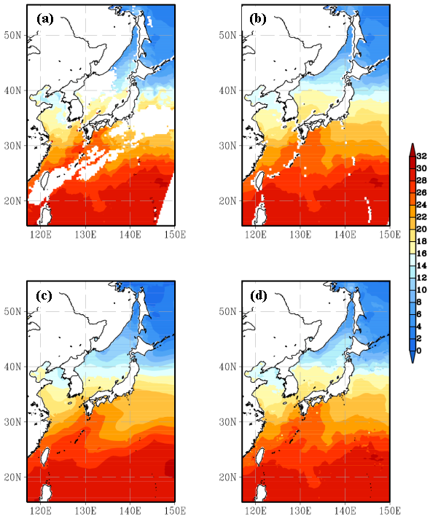
Variation of the domain average of (a) bias and (b) RMSD with respect to AMSR-E during the period (June 4 – 14th, 2008). MTSAT (black line), CTL (blue line) and DA-2 (red line).
Distributions of daily mean SST. (a) MTSAT-1R, (b) MTSAT-1R after Gaussian interpolation, (c) CTL and (d) DA-2 (June 5th, 2008).

Slide 63
Improvement of the PBL parameterization (YSU model)
(Noh et al. BLM 2003, Hong et al. MWR 2006)

Slide 64
Troen & Mahrt (BLM, 1986)
by matching
at z < εh (surface layer). (ε=0.1)
⇒ no non-local mixing for momentum
with z = εh
* If stable,
*Monin-Obukhov length scale
If unstable,

Slide 65
The growth of h is calculated by assuming that Ri_{b} = const at z = h.

Process
1.
with

θ (z)
2.

h
3.

Slide 66
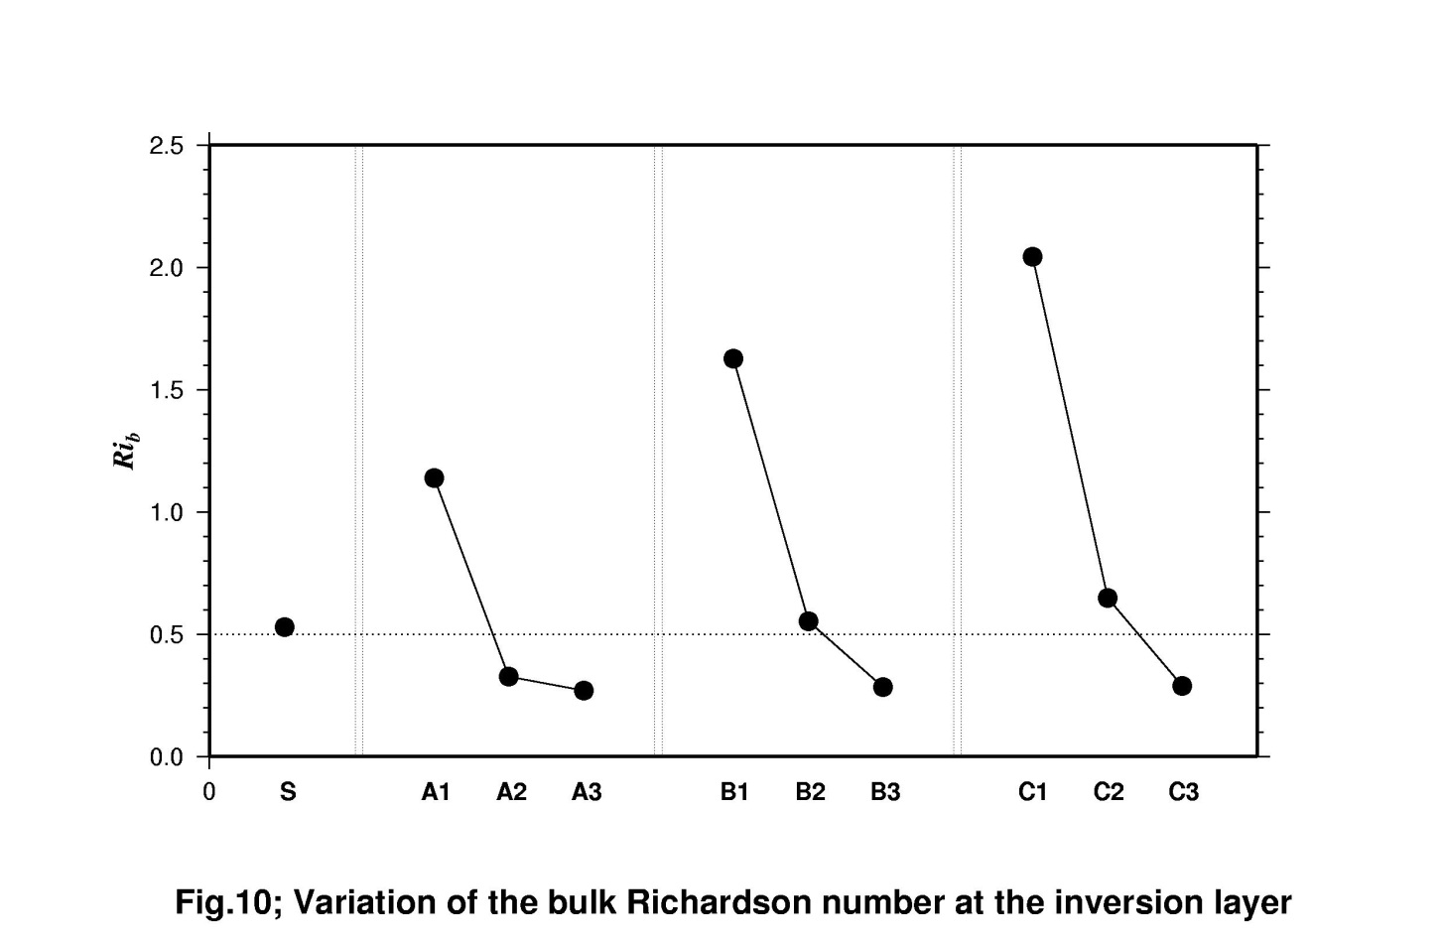
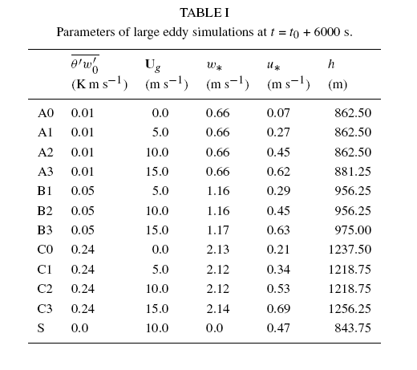
Ri_{b} varies depending on the PBL condition!

Slide 67
Profiles of heat flux (thin: LES, thick: YSU, dashed: TM): (a) shear-dominant
(b) shear + convection, (c) convection dominant

Slide 68

Comparison of a new PBL scheme and Troen-Mahrt scheme
with LES results (Noh et al., BLM 2003).

Slide 69

observation
YSU PBL
MRF PBL
Maximum Reflectibity (Hong et al., MWR 2006)

Slide 70


Slide 71
Consider the case
i) (r₁, A₁ = 4), (r₂, A₂ = 3), and (r₃, A₃ = 3) before collision (r₃ > r₂ > r₁)
ii) 3 collisions: (r₁, r₂), (r₁, r₃), and (r₂, r₃).
In the real cloud,
- 3 new droplets:
,
,
- A₁  2, A₂  1, A₃  1
In the simulation,
- increase r_{i} of a larger droplet, and decrease A_{i} of a smaller droplet.
• step 1:
• step 2:

Slide 72
ex) r₁ = 1, r₂ = 2 , r₃ = 4
A₁ = 4, A₂ = 3, A₃ = 3
before collision | real | model
4 4 4 | 4.16 4.02 4.0 | 4.06 4.06 4.06
2 2 2 | 2.08 2.0 | 2.04 2.04
1 1 1 1 | 1.0 1.0 | 1.0 1.0
It is assumed that the probability density of super-droplets becomes equivalent to that of real droplets as N  ∞, i.e.,

Slide 73
Problems of Ayalla & Wang Scheme
(Khain et al., 2007; Woittiez et al., 2009)
• The AW scheme is obtained by analyzing DNS results, but the condition of
DNS is different from the real cloud
- too small Re
- too high concentration
 The applicability of DNS results to the real cloud is in doubt.
• The parameterization of preferential concentration in the AW scheme is
obtained from the analysis of particle without sedimentation
- Sedimentation modifies preferential concentration seriously.

Slide 74
Further Improvement of the Collision/Coalescence Scheme
1. The present scheme ignores the generation of variance of the droplet size
of a collector droplet.
ex) i) the random perturbation after the calculation of a collector droplet size
ii) tuning of droplet statistics within a grid to the ideal double peak droplet
mass density distribution
2. Super-droplets are assumed to collide with any other super-droplets within
the same grid with the consideration of inter-droplet distance.
3. The relative velocity between two droplets are not considered for
the calculation of the collision kernel including turbulence effects.
4. Breakup of droplets is not considered.

Slide 75


Cross-sections of relative humidity and dissipation rate (ε) with vertical profiles (Hall: red, AW: blue)

Slide 76
Fluid Dynamical Issues
1. The total number of droplets cannot be neglected.
• Where there is no interaction between particle-fluid interaction and interparticle
interaction, it is fine to work with much smaller number of particles
(e.g., particle settling, particle diffusion)
• However, in clouds, there exist
- particle-fluid interaction (LWC affects cloud dynamics.)
- interparticle interaction (droplet collision).
2. Direct simulation of particle collision in turbulent flows is not appropriate in LES!
• Small-scale eddies are important  DNS is essential.
(ex, intermittency, supersaturation fluctuation, preferential concentration)
• Number of total suspended particles is too large (> 10²⁰ in clouds).
• Finite size of a particle affects collision efficiency.
 It is necessary to parameterize the collision coefficient in LES.

