Slide 1
EMC seminar 3/26/2013
Observation impact estimation and TC relocation
- Developments on the global EnKF -
Yoichiro Ota (NCEP/EMC visiting from JMA)
Acknowledgement
Daryl Kleist, Russ Treadon, John Derber (EMC), Jeff Whitaker (ESRL)
Eugenia Kalnay (UMD), Takemasa Miyoshi (RIKEN), Ricardo Todling (NASA/GMAO)
Xiaqiong Zhou, Dingchen Hou, Jiayi Peng, Yuejian Zhu (EMC)

Slide 2
Outline
During my visit in the EMC, I have
Implemented the LETKF as an option to run instead of the original EnKF.
Developed observation impact estimation capability using the EnKF
Investigated the representation of the TC in the EnKF ensembles.

Slide 3
LETKF (Local Ensemble Transform Kalman Filter, Hunt et al. 2007)
Observation
Analysis grid
EnSRF (Whitaker and Hamill, 2002)
LETKF
Pros:
Total computation is small
Cons:
Communication cost on parallel computing
Pros:
Completely parallelized
Cons:
Required memory is larger

Slide 4
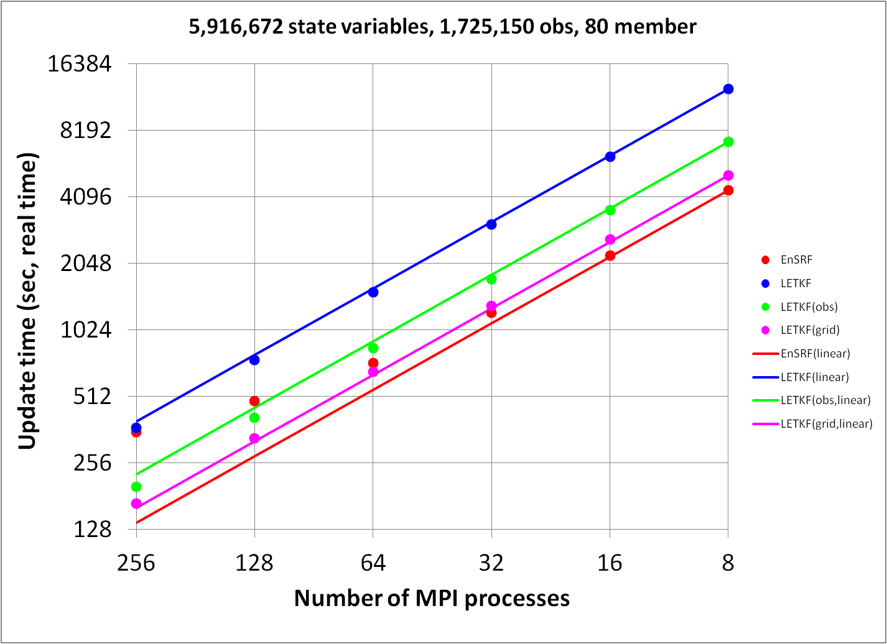
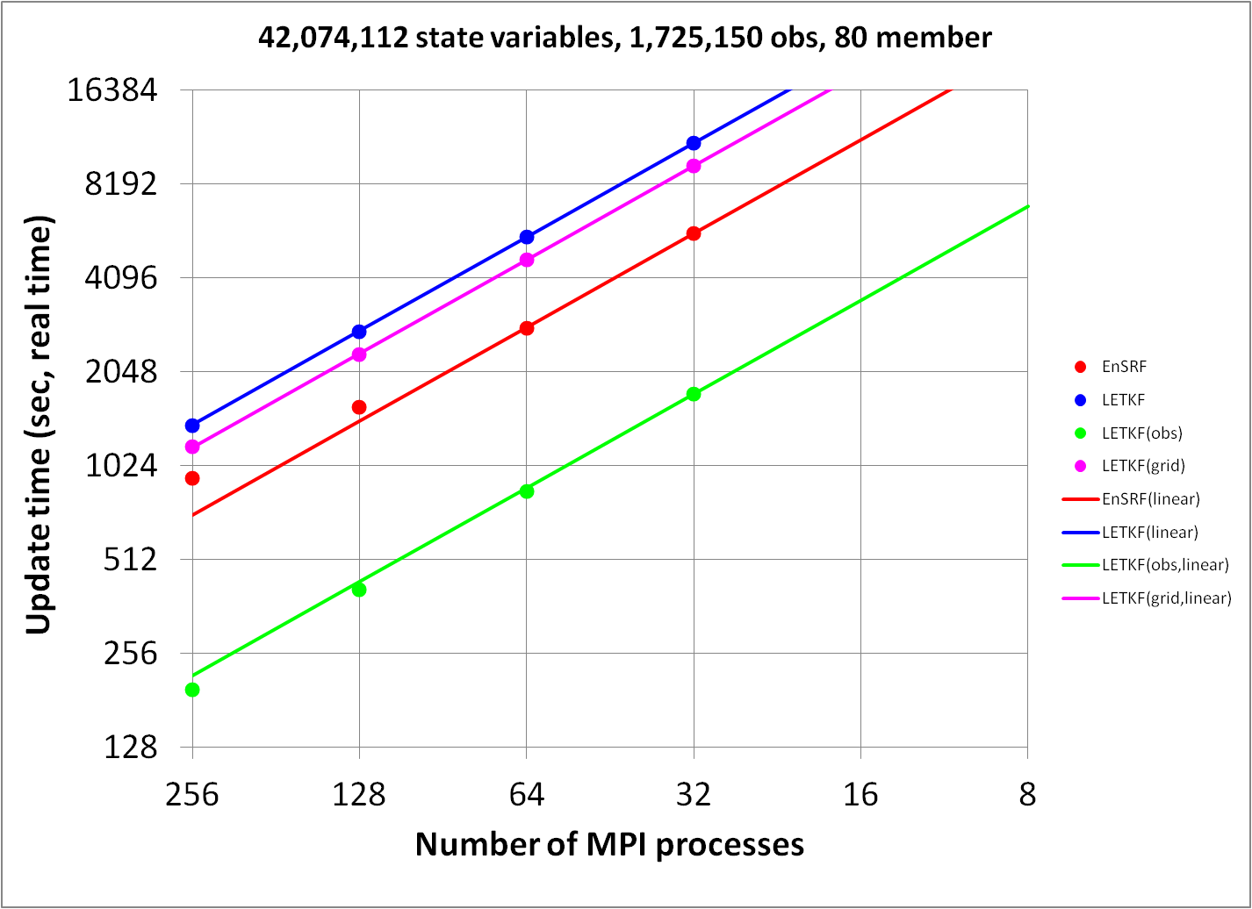
Computational time
T62
T254
Red: EnSRF
Blue: LETKF (total cost, obs+grid)
Green: LETKF (only update obs space)
Magenta: LETKF (only update grid space)
EnSRF has an advantage when
Number of observation is small compared to the number of analysis grid
Using a few MPI processes
LETKF has an advantage when
- Using massively parallel computing

Slide 5
Outline
During my visit in the EMC, I have
Implemented the LETKF as an option to run instead of the original EnKF.
Developed observation impact estimation capability using the EnKF
Investigated the representation of the TC in the EnKF ensembles.

Slide 6
Observation impact estimation
Estimating the impact of observation in NWP
Observing System Experiment (OSE)
  can give non-linear impact of observations with various metric,
  but is too expensive to get the impacts of each observation.
Linear estimation
  gives linear impact of each observation with simple verification metric,
  and is useful for short-range forecast.
  Adjoint-based method (Langland and Baker, 2004)
  Ensemble-based method

Slide 7
Ensemble-based impact estimation
(Kalnay et al 2012)
Forecast error reduction is defined as
Forecast error difference
C: norm operator, e_{t}^{f}, e_{t}^{g}: forecast error at t from analysis and first guess, M: tangent linear model, K: Kalman gain, δy_{o}: innovations, K: number of ensemble member, R: observation error convariance, X₀ª: analysis ensemble perturbations, X_{t}^{f}: forecast perturbations at t, H: linealized observation operator.
M
Analysis increment
Forecast error
-6hr
0
t
Use ensemble perturbations instead of an adjoint model.
Estimates provide the relative impacts of each observations on the short-range forecast accuracy.
Any EnKF (not just LETKF) can be used for the estimations.

Slide 8
Experimental settings
T254L64 80 member ensembles, 6 hourly cycle
Serial EnSRF (Whitaker and Hamill 2002)
NCEP/GFS (operational as of May 2012)
24 hour forecast error with moist total energy in global domain
Period: 1/8/2012 ~ 2/7/2012 (after one week spinup)
All observation types (operationally assimilated as of May 2012) except precipitation rate from TRMM/TMI are assimilated (~3.3 million obs per 1 analysis)
Localization function for the impact estimate is moved with the horizontal wind (0.75 times)

Slide 9
Effect of localization
Localization
function
Increment
Observation impact
FT=0
FT=t
Grid
Grid
Impact of observation is “moving away” from the observation point through the forecast.
Using fixed localization function is harmful when the forecast time is long.
Using advected localization, estimate become more consistent with true forecast error reduction than using fixed localization.
Figure: Total 24 hour forecast error reduction measured with moist total energy over global domain

Slide 10
List of assimilated observation types
Type of data | Description | Number (x1000)
Radiosonde | Radiosonde observations (u, v, T, q and Ps) | 55
Marine-Surface | Surface u, v, T, q and Ps observations from the buoys and ships | 23
Land-Surface | Ps observations from land surface stations | 54
Aircraft | u, v, and T observations from the aircrafts | 173
Profiler_Wind | u and v observations from the wind profilers | 12
NEXRAD_Wind | u and v observations from the NEXRAD (radar) | 14
ASCAT_Wind | u and v observations from ASCAT scatterometer over ocean | 17
TCVital | Pseudo surface pressure observations at tropical cyclone storm center | 0.0006
Satellite_Wind | Atmospheric Motion Vectors (u and v) from geostationary satellites | 96
Dropsonde | Flight-level reconnaissance and dropsonde (u, v, T and q) | 0.2
PIBAL | u and v observations from pilot balloons | 1.9
MODIS_Wind | Atmospheric Motion Vectors (u and v) from MODIS | 36
WINDSAT_Wind | u and v observations from ASCAT scatterometer over ocean (super observation) | 0.8
GPSRO | GPS radio occultation | 95
Ozone | Ozone retrievals from satellite radiances | 14
Aqua_AIRS | Satellite infrared hyper spectral sounder radiances | 630
AMSUA | Satellite microwave sounder radiances (from 5 satellites) | 586
HIRS | Satellite infrared radiances (from 2 satellites) | 119
IASI | Satellite infrared hyper spectral sounder radiances | 1143
MHS | Satellite microwave sounder radiances (from 3 satellites) | 67
GOES | GOES infrared sounder radiances (GOES13 and 15) | 40
ATMS | Satellite microwave sounder radiances (from Suomi-NPP) | 150
SEVIRI | SEVIRI clear sky radiances | 6.1

Slide 11
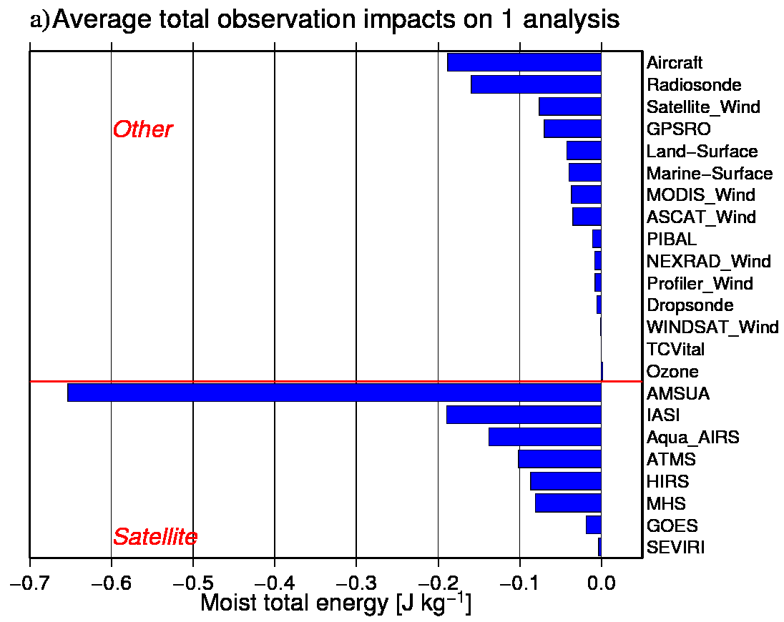
Total impacts (global)
1) AMSUA
2) IASI
3) Aircraft
4) Radiosonde
5) AIRS
All observation types have “positive” impacts except ozone retrievals.
Positive impact

Slide 12
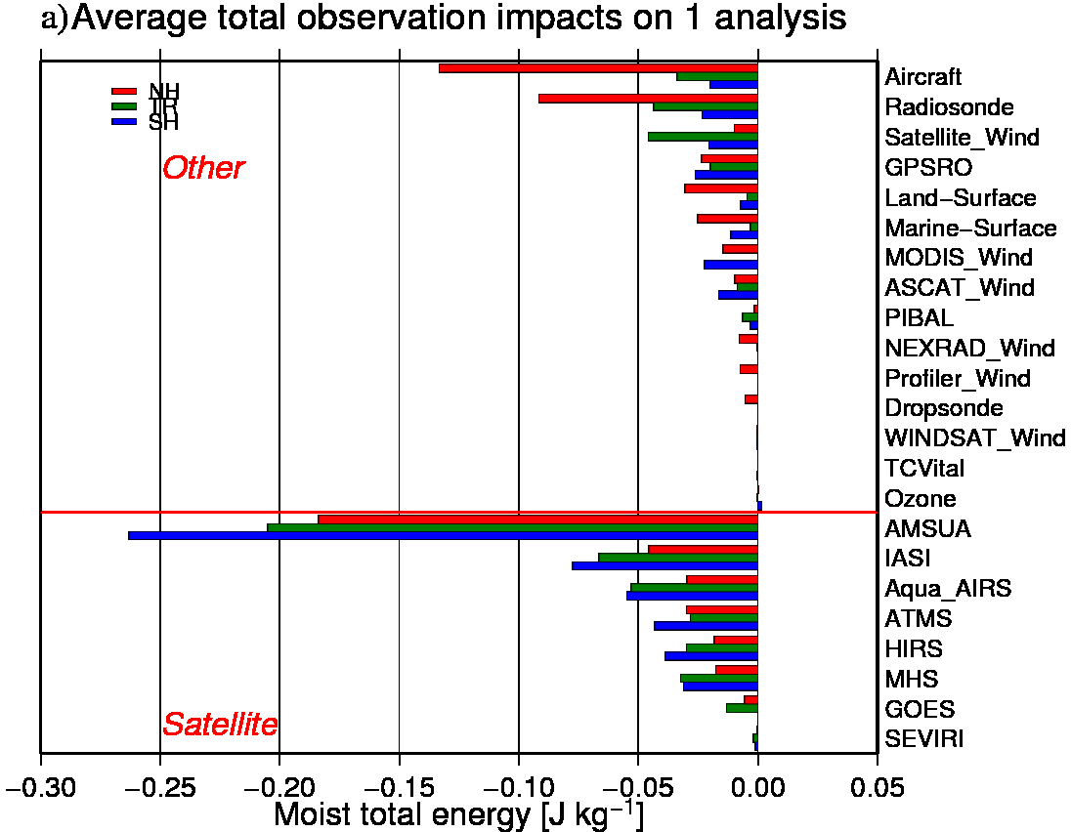
Total impacts (NH, TR, SH)
Red: NH (20N~90N)
Green: TR (20S~20N)
Blue: SH (90S~20S)
Positive impact

Slide 13
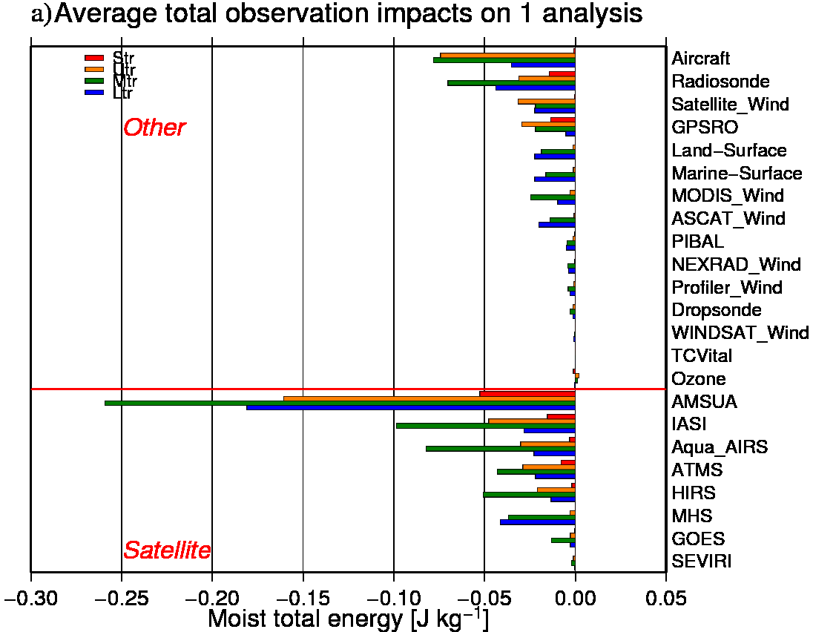
Total impacts (vertical layer)
Red: Stratosphere
Yellow: Upper troposphere
Green: Mid troposphere
Blue: Lower troposphere
Positive impact

Slide 14
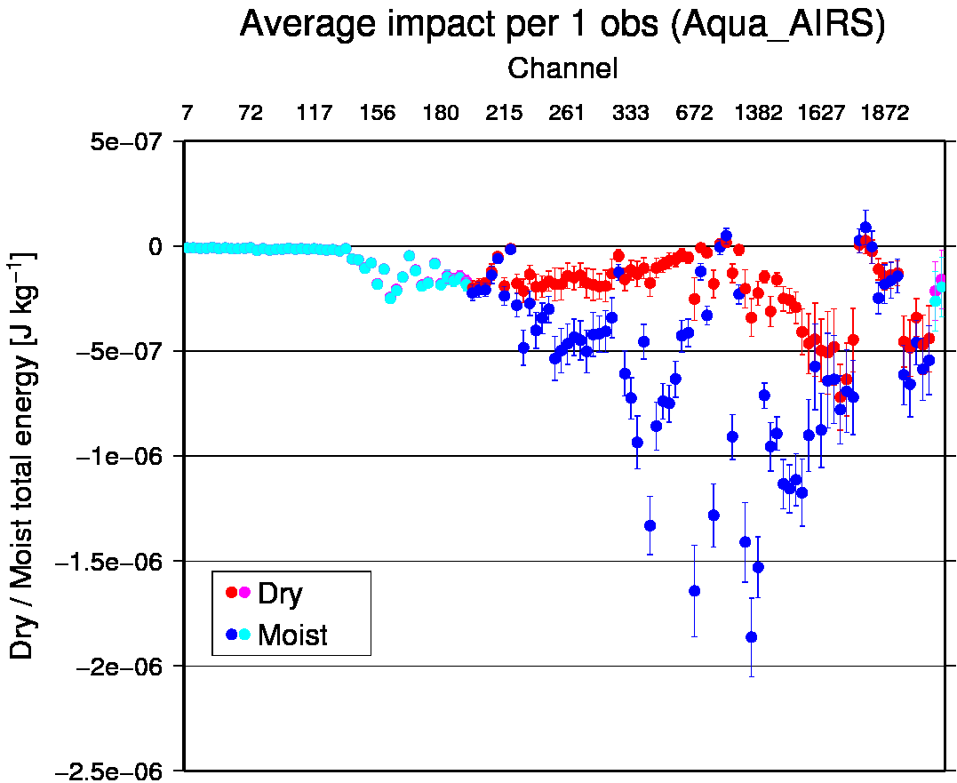
Impacts of each AIRS channels
Negative impacts
Positive impact
Dry
Moist
Moist
Dry
Sensitive on less than 300 hPa

Slide 15
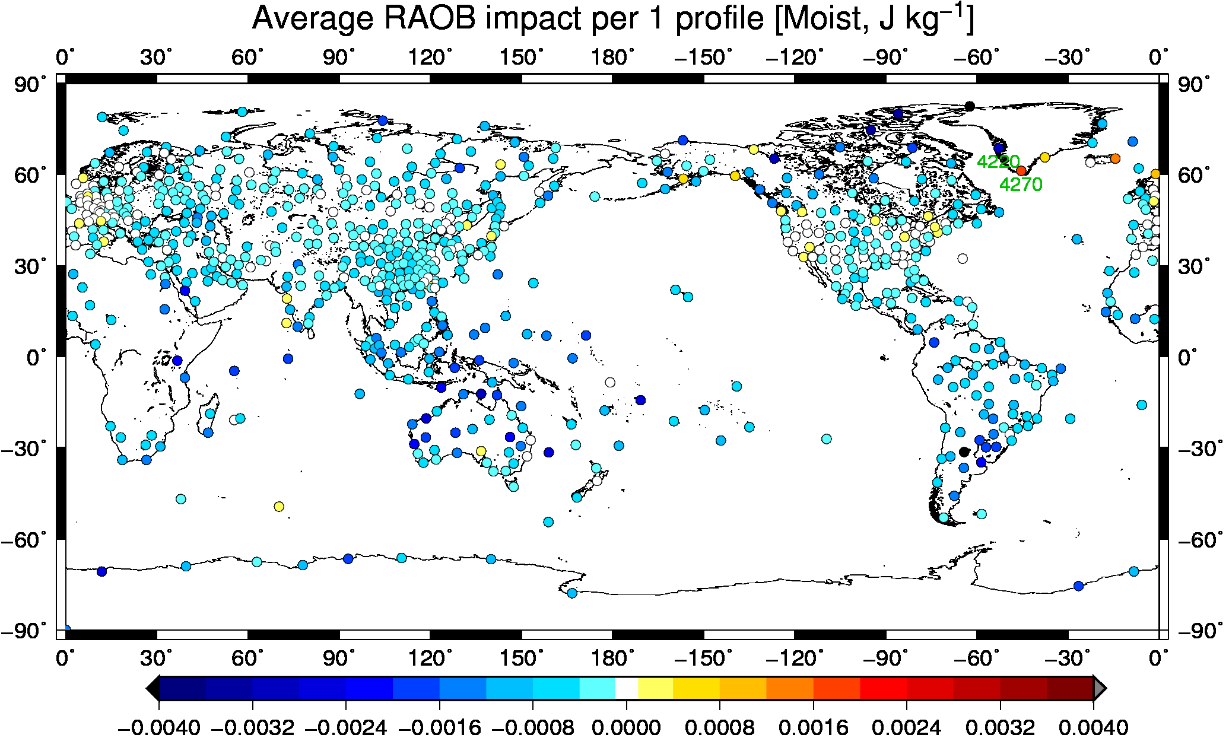
Impact of radiosonde per 1 profile
Large impacts on Tropics, Southern Hemisphere and Northern Canada
Relatively small impacts over Europe, CONUS and East Asia

Slide 16
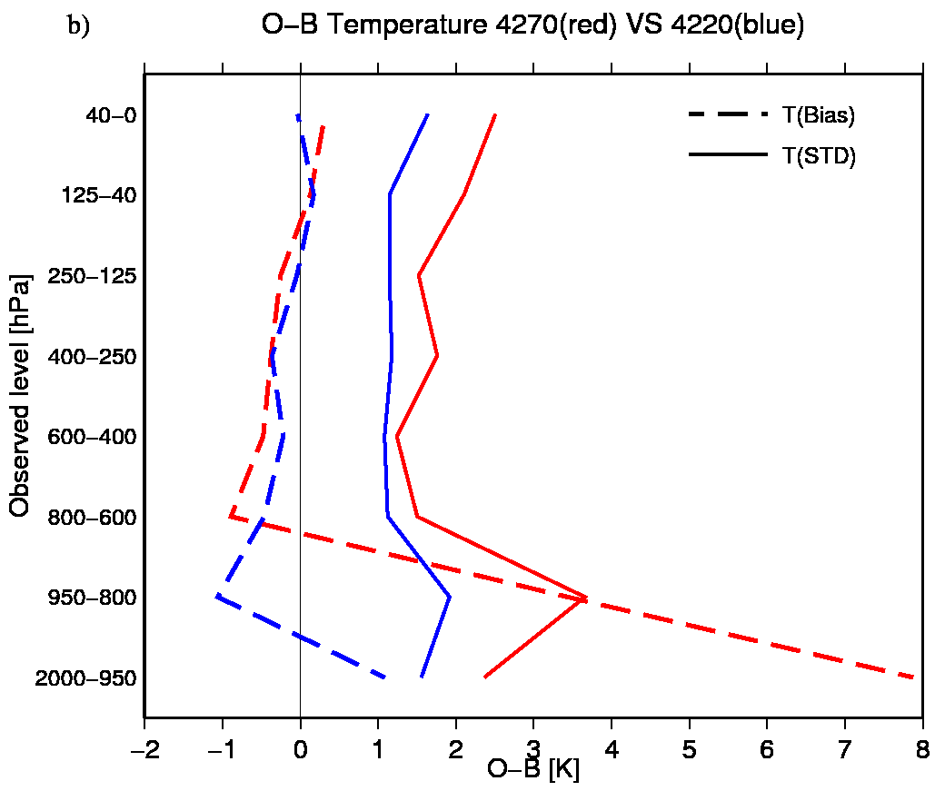
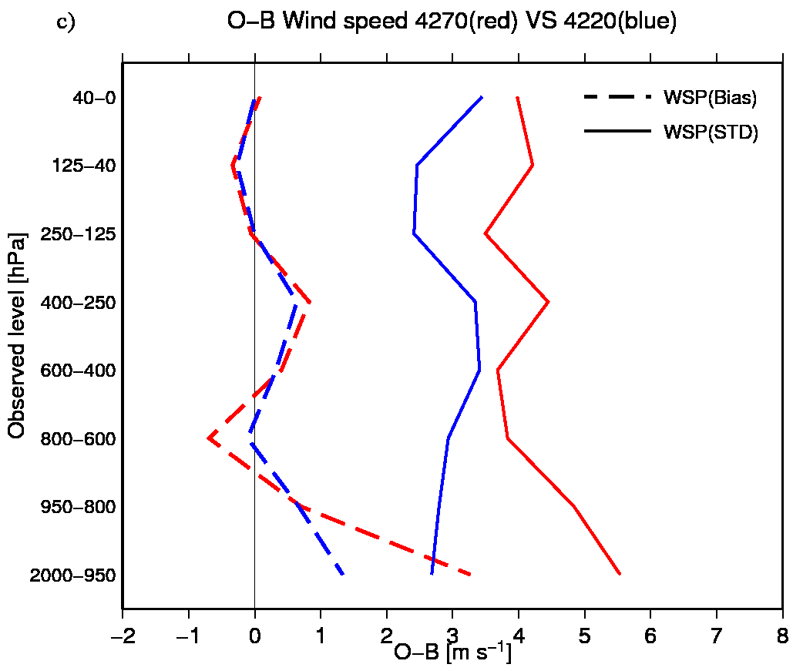
“Good” station VS “Bad” station
O-B for Temperature
O-B for Wind speed
O-B statistics for station 4270 (red) and 4220 (blue).
Dashed line is bias and solid line is standard deviation.
Observations from 4270 seems not good as those from 4220.

Slide 17
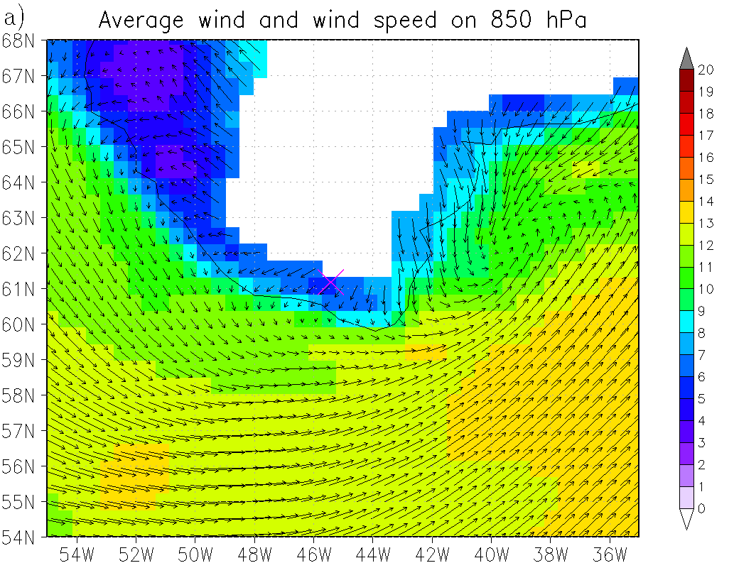
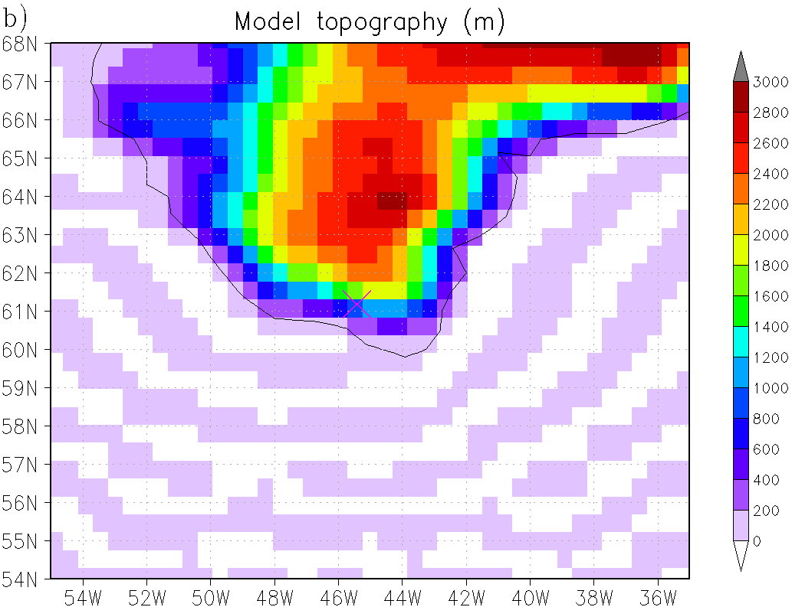
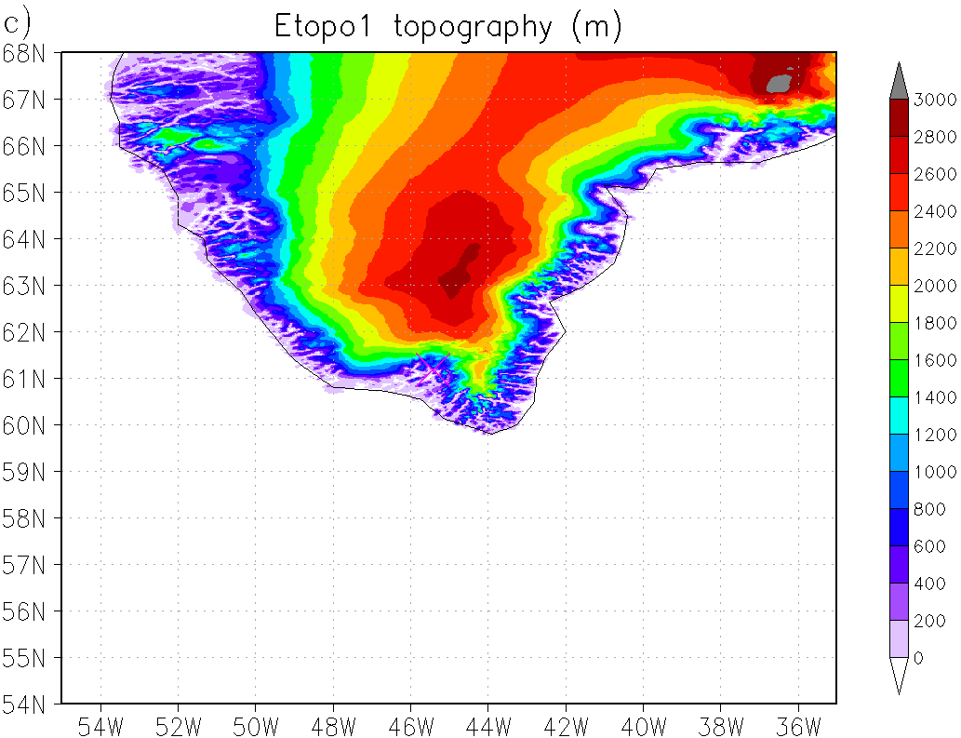
Southern Greenland
Katabatic flow
Westerly wind
Average wind and wind speed on 850hPa
Topography
Model surface height on nearest grid point is over 800 m.
Real observatory height is 4 m (according to the station dictionary).

Slide 18
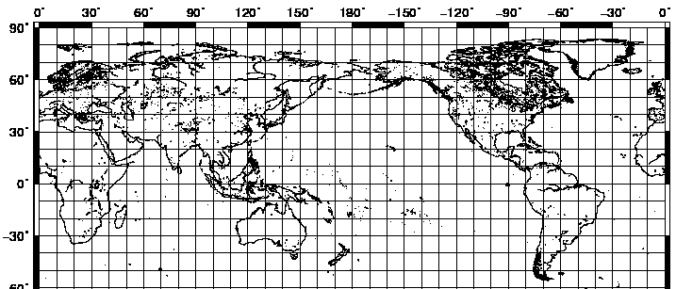
Case study with the local forecast failure
Select the local forecast failure cases based on:
1) 24 hour forecast error is larger than 1.7 times of its time average, and
2) 24 hour forecast error is larger than 1.2 times of the error of 30 hour forecast from the previous analysis.
Compute observation impacts in local area and remove bad observations.

Slide 19
Local forecast failures
Initial | Area | Size | Rate | N | Denied observation (denied number / total number) | Change (Estimate)
06 UTC JAN 12 | 50N~80N 145E~175W | 1.99 | 1.36 | 5 | AMSUA ch4, 5, 6 (2735 / 125063) | -8.7% (-19.5%)
00 UTC JAN 16 | 30N~60N 20W~0 | 2.71 | 1.35 | 6 | GPSRO 600~950 hPa (50 / 4918) | -0.6% (-4.3%)
18 UTC JAN 27 | 30S~0 105E~120E | 2.40 | 1.21 | 1 | AIRS (19908 / 670041) | -0.2% (-6.0%)
00 UTC JAN 30 | 70S~40S 165E~165W | 2.00 | 1.25 | 6 | AMSUA ch1, 3, 4, 5, 15 (3822 / 164934) | -4.7% (-12.8%)
06 UTC FEB 2 | 50N~80N 150W~110W | 3.01 | 1.22 | 5 | GPSRO 250~400 hPa, 600~850 hPa (407 / 13092) | -11.7% (-8.7%)
06 UTC FEB 4 | 30N~60N 150W~130W | 1.81 | 1.26 | 3 | IASI (57950 / 1177256), HIRS ch3, 4, 9, 11, 12, 14, 15 (785 / 73419), Aircraft 950 hPa~, 125~600 hPa (5794 / 100896) | -25.5% (-81.6%)
18 UTC FEB 6 | 60N~90N 40E~100E | 1.71 | 1.38 | 2 | MODIS_Wind (10970 / 43452) | -28.4% (-47.7%)
Forecast error has been reduced for all 7 cases, denying specified observations.
Estimate tends to be larger than the actual impact, suggesting the nonlinear compensational effect.

Slide 20
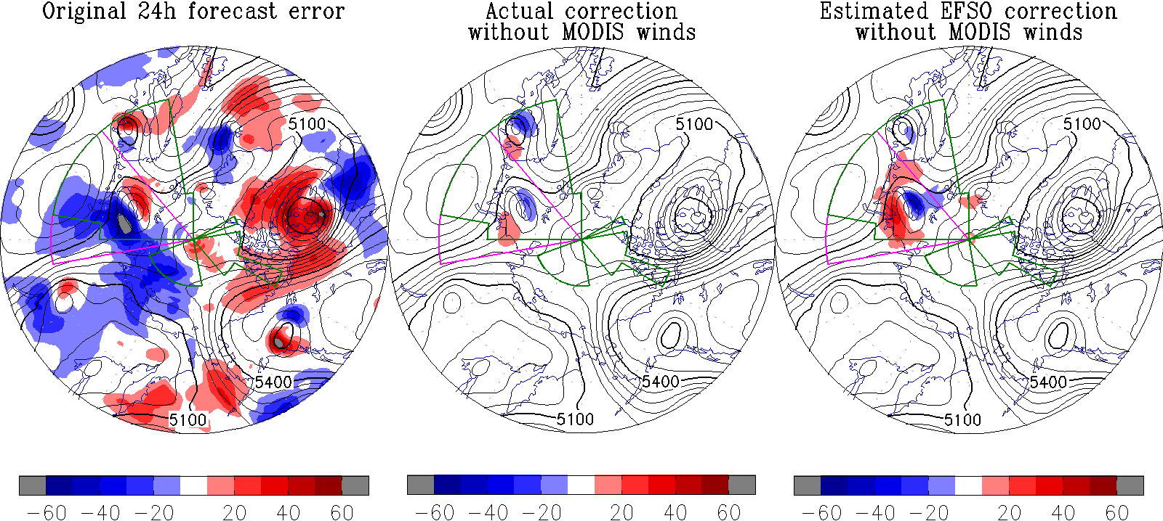
Observation denial experiment
Z500 error
Denial of MODIS winds reduced the forecast error of the trough.
Estimated forecast change from ensemble-based method gives a good estimate.

Slide 21
Summary and suggestions
Observation impact estimation using EnKF can give
  relative impacts of each observing system,
  diagnosis of data assimilation system,
  monitoring of observation quality, and
  help for investigation of short-range forecast dropout case.
There are possible applications including
  advanced QC tool using impact estimates,
  impact verified against observations, and
  application to the hybrid Var/EnKF system

Slide 22
Verification in observation space
Analysis is used as a verifying truth
We may use observations for verifications
where
and
C_{y} is appropriate weight in observation space. If we use R⁻¹ as C_{y}, this is much like an observation term in the cost function.

Slide 23
Outline
During my visit in the EMC, I have
Implemented the LETKF as an option to run instead of the original EnKF.
Developed observation impact estimation capability using the EnKF
Investigated the representation of the TC in the EnKF ensembles.

Slide 24
EnKF performance for TC initialization
TC ensemble track in siganl and sfg_fh06 of EnKF is verified.
Period: from 12UTC May 22 to 18UTC October 31, 2012
Tracker runs at 1 degree resolution converted from sigma files.
  No smoothed sea-level pressure is used.
Verified against gdas TCvitals.

Slide 25
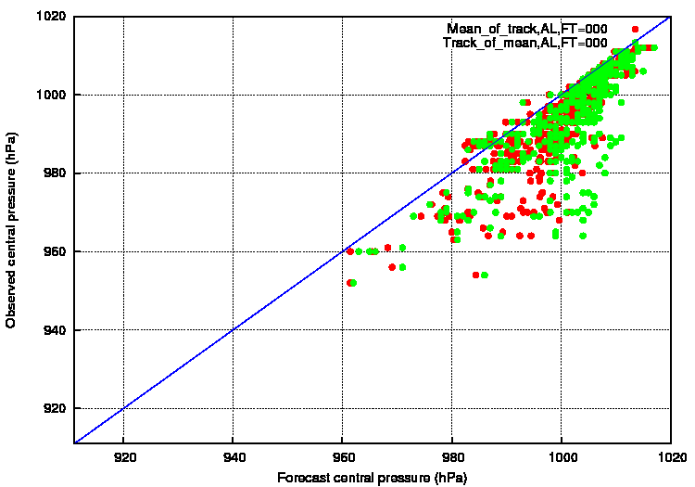
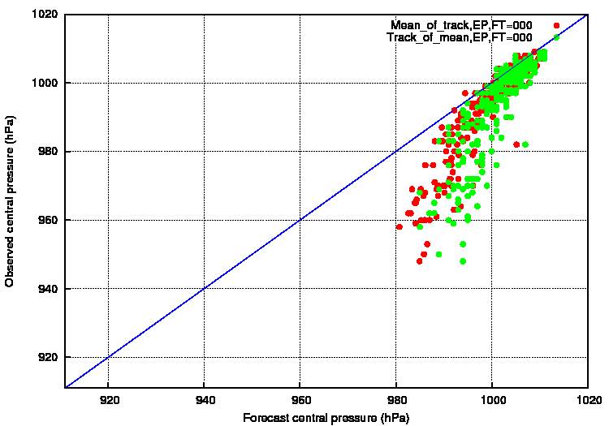
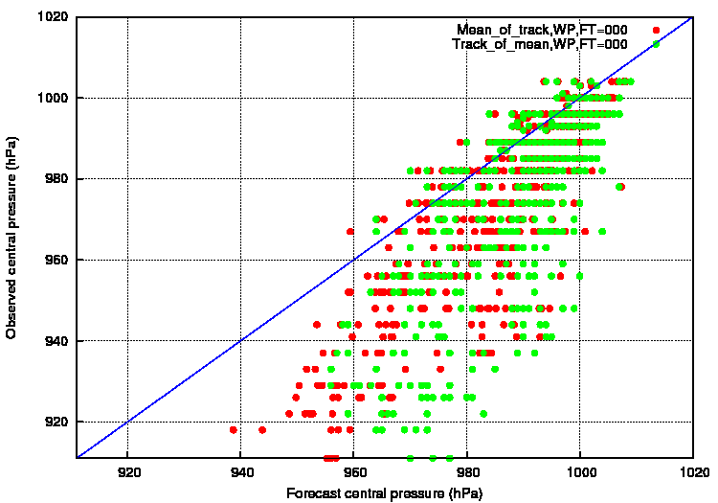
Track of ensemble mean VS Mean of tracks
Atlantic
East Pacific
Stronger than observed
Weaker than observed
Horizontal axis: forecast central pressure
Vertical axis: Central pressure in TCvitals
Red: Mean of ensemble tracks
Green: Track of ensemble mean
West Pacific
FT=0

Slide 26
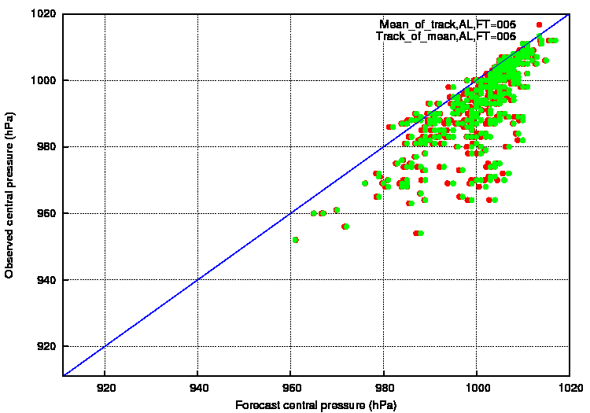
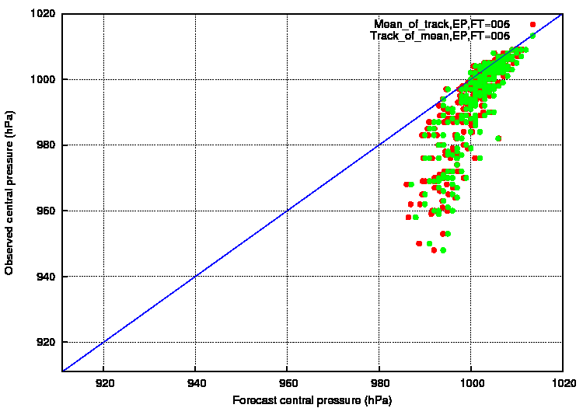
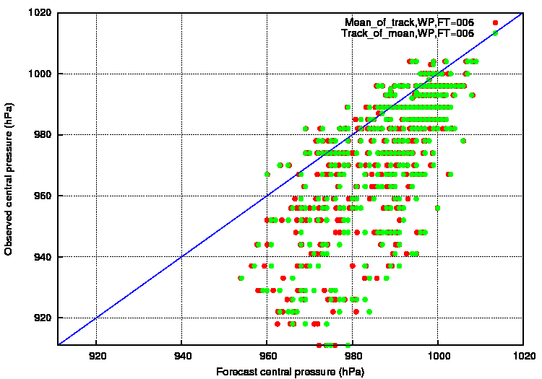
Track of ensemble mean VS Mean of tracks
Atlantic
East Pacific
Stronger than observed
Weaker than observed
Horizontal axis: forecast central pressure
Vertical axis: Central pressure in TCvitals
Red: Mean of ensemble tracks
Green: Track of ensemble mean
West Pacific
FT=6

Slide 27
Track of ensemble mean VS Mean of tracks
Central pressure is weaker than TCvitals in general especially for strong TCs and East Pacific.
  It is T254 and tracked on 1 degree sea-level pressure field
Mean of central pressures is lower than central pressure of ensemble mean on FT=0, but no large difference on FT=6.
TC of FT=6 is weaker than that of FT=0. There is a spin down in the ensemble forecast.

Slide 28
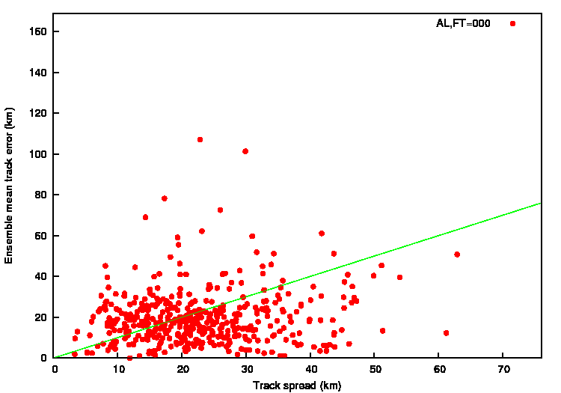
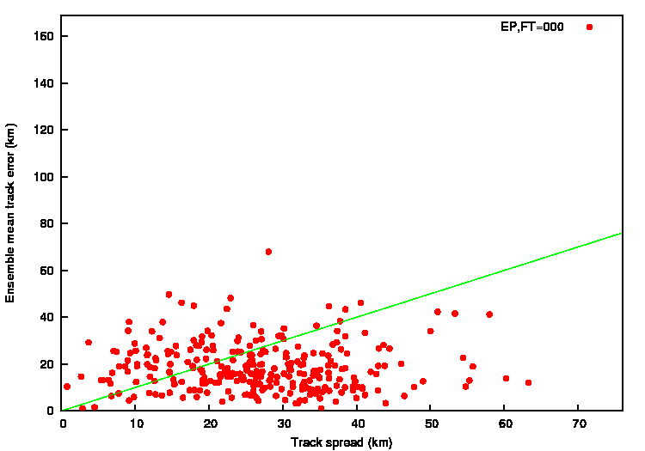
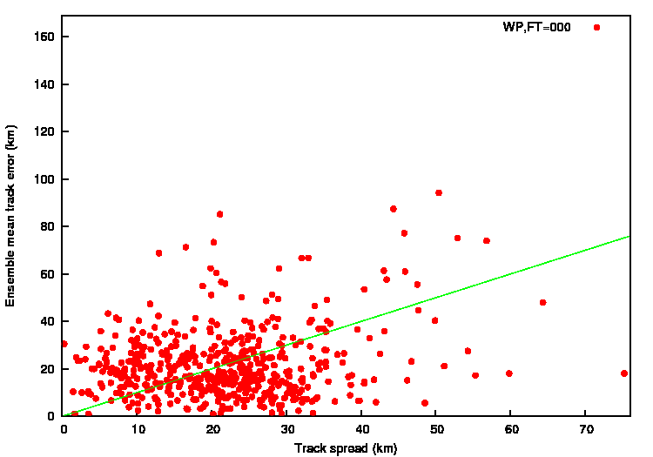
TC position error/spread in EnKF analysis
Atlantic
East Pacific
Horizontal axis: Track spread
Vertical axis: Ensemble mean track error
West Pacific
FT=0

Slide 29
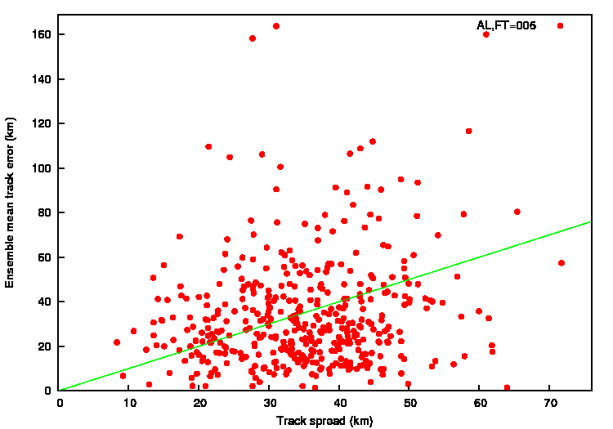
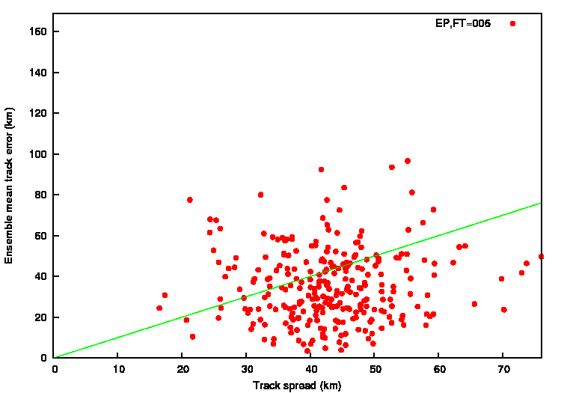
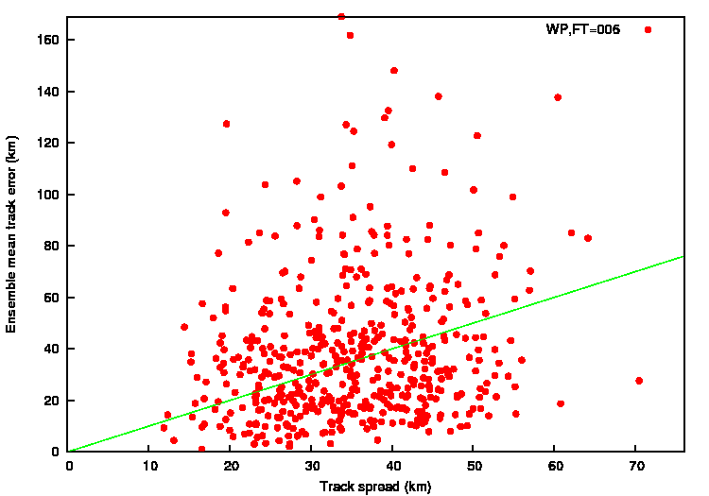
TC position error/spread in EnKF analysis
Atlantic
East Pacific
Horizontal axis: Track spread
Vertical axis: Ensemble mean track error
West Pacific
FT=6

Slide 30
TC position error/spread in EnKF analysis
For most TCs, track spread is less than 40km on FT=0 (less than 50km on FT=6).
Stronger storm tends to have smaller spread.
Mean track error and spread are relatively in good agreement (slightly over dispersive).
 | Error (Spread) on FT=0 | Error (Spread) on FT=6
Atlantic | 19.7km (22.7km) | 34.0km (35.0km)
East Pacific | 18.5km (26.4km) | 35.2km (43.1km)
West Pacific | 21.5km (21.8km) | 38.7km (35.1km)
All basins | 20.1km (23.0km) | 36.6km (36.9km)

Slide 31
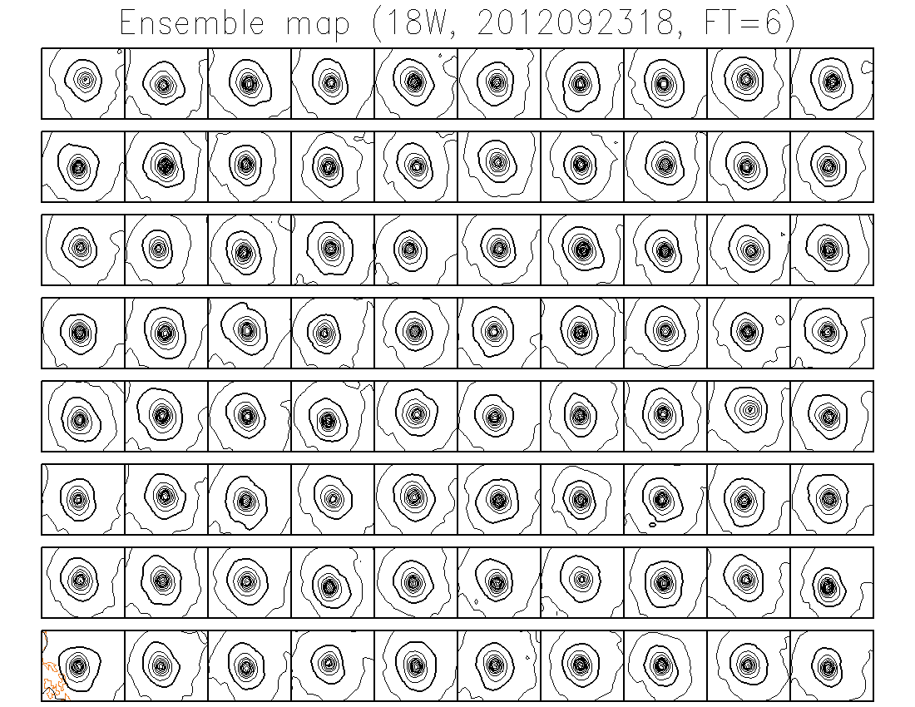
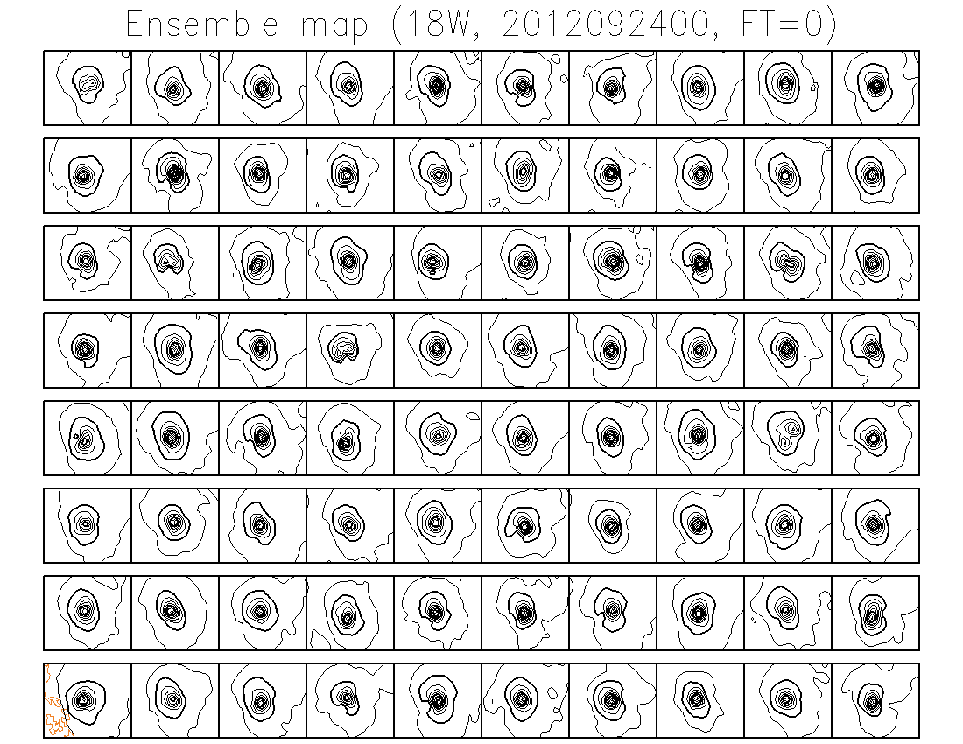
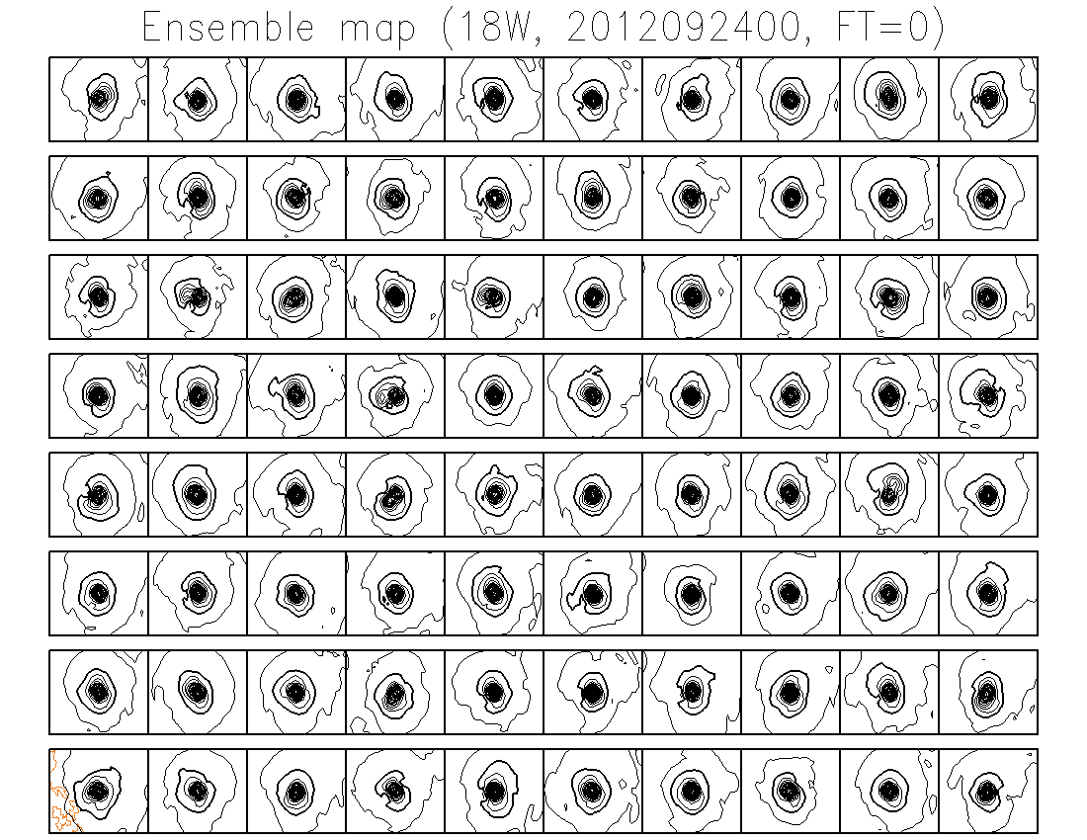
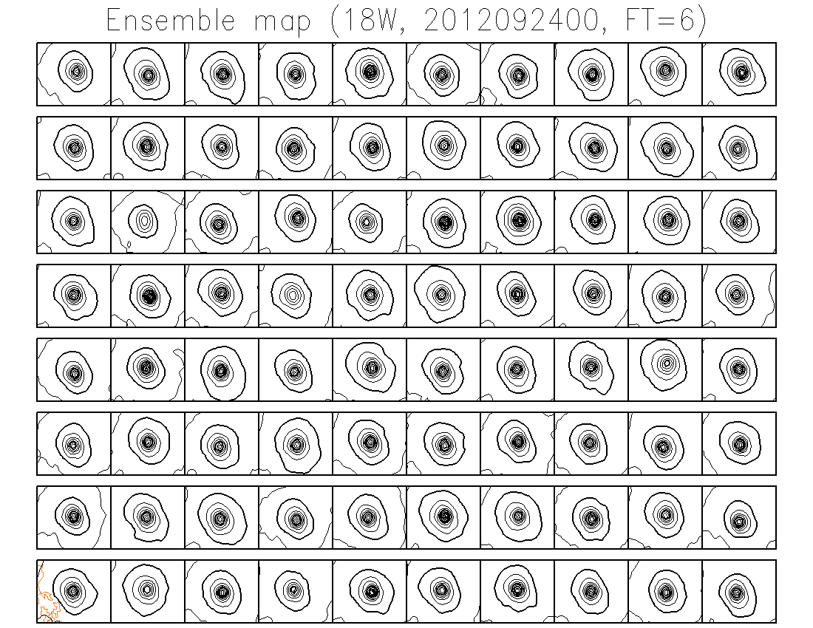
Why do we care about TC relocation?

Slide 32
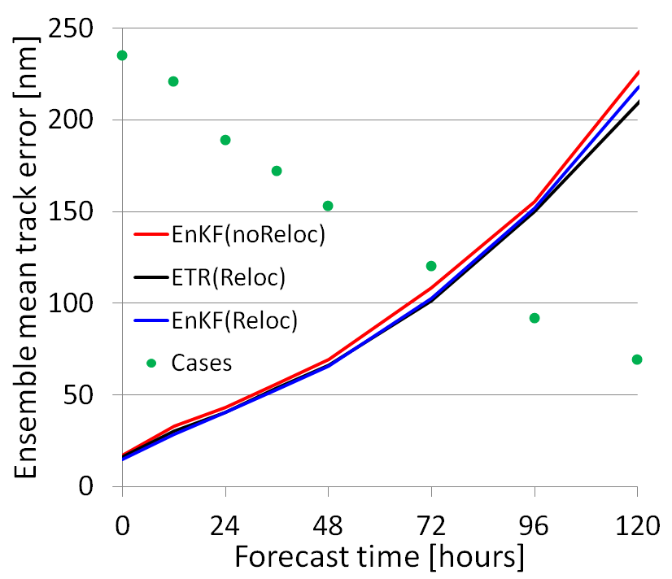
Why do we care about TC relocation?
7/1/2011 ~ 10/25/2011 00Z cycle
GEFS ensemble mean TC track error for all basins.
Black: ETR with relocation
Red: EnKF (6hr) without relocation
Blue: EnKF (6hr) with relocation
Verification has been done by Jiayi Peng

Slide 33
TC relocation in the operational GEFS
80 member ensemble forecasts (FT=6 of previous cycle)
TC track files
Separate (012)
TC structures
Environmental fields
5% of TC intensity Adjusted center position
Control member from GDAS
ETR (013)
Environmental fields
+ TC structure of control member
Combine (014)
80+1 member initial ensembles (FT=0)
Keys:
1) We need 6 hour TC track files from the previous cycle.
2) ETR process (013) includes the recentering around the control member which is a pert of the TC relocation process.

Slide 34
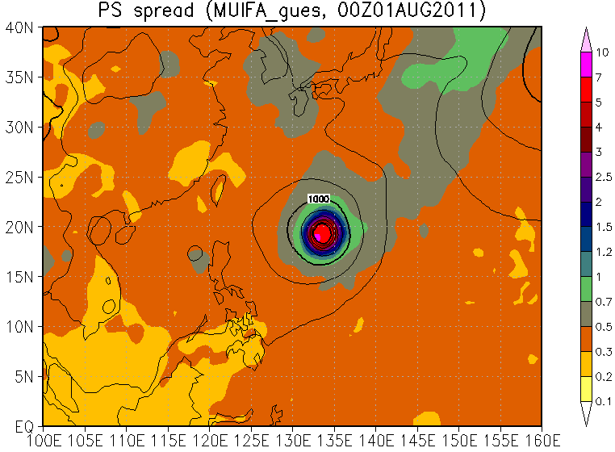
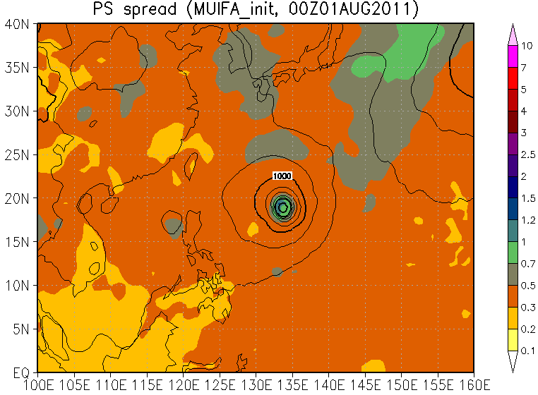
How does this perform?
Before relocation
After relocation
Ensemble mean SLP and surface pressure spread (hPa)

Slide 35
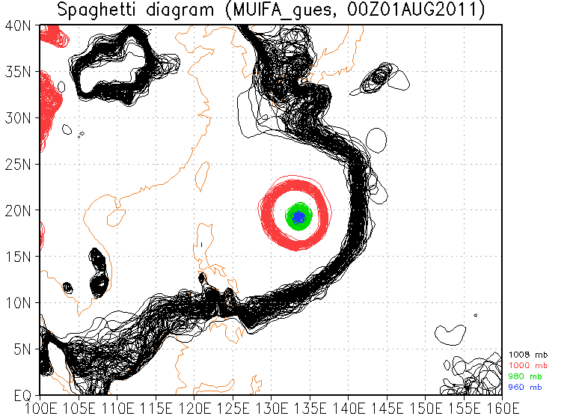
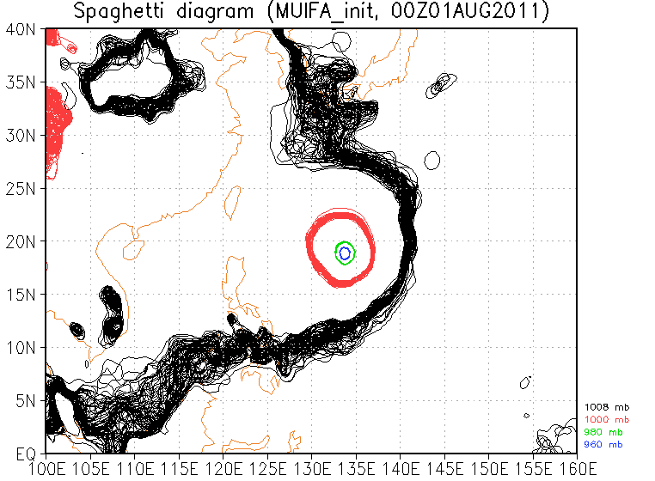
How does this perform?
Before relocation
After relocation
Spaghetti diagram of SLP

Slide 36
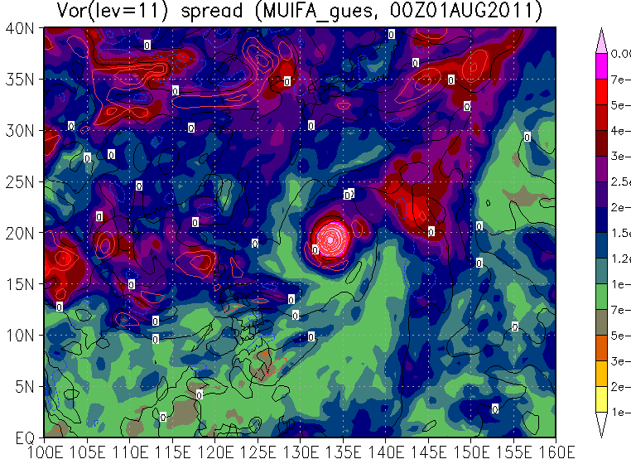
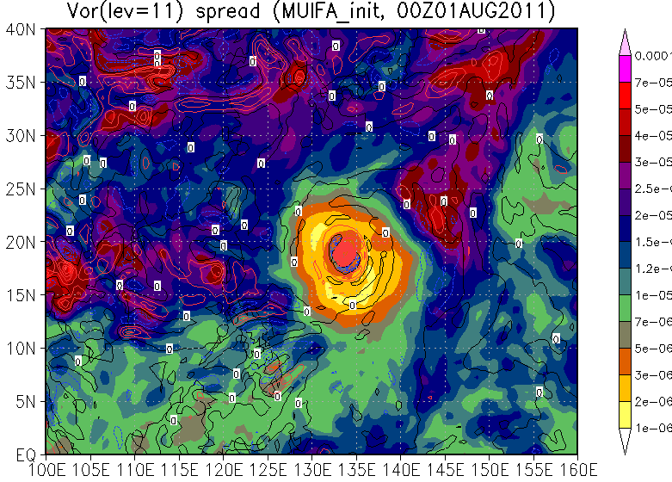
How does this perform?
Before relocation
After relocation
Ensemble mean and spread of relative vorticity on level 11 (~850hPa)

Slide 37
TC relocation in the operational GEFS
Current operational TC relocation scheme can improve the GEFS TC track forecast.
Central position of TC is moved to one position. -> Need position uncertainty
Magnitude of perturbation is fixed to 5%. -> Tunable parameter. It may be too small and the magnitude should be changed with case-by-case.
We should consider different method especially for the data assimilation (EnKF).

Slide 38
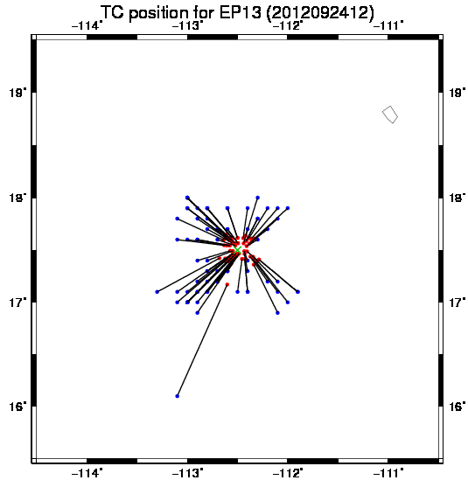
TC relocation to the EnKF ensembles
Apply TC relocation used in deterministic analysis to each ensemble member, but allowing TC structure perturbations and some TC position spread.
Update TC center position (latitude and longitude) by the EnKF
Use updated positions as inputs to the TC relocation
Apply this procedure before the EnKF analysis and GDAS analysis
The idea is to separate linear problem (TC location space) and nonlinear problem (actual relocation of fields).
Blue: first guess position
Red: Updated position
Green: TC vital position

Slide 39
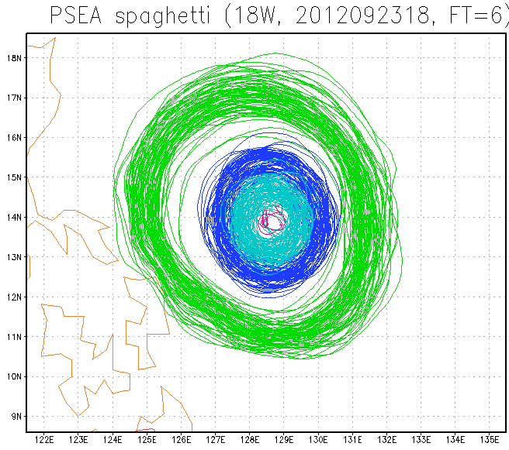
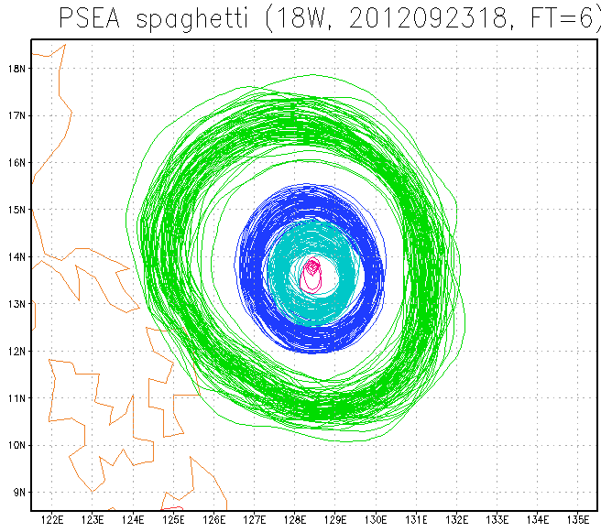
Example: spaghetti diagram
Before relocation
After relocation
TC relocation of this method can reduce the uncertainty on the TC position, maintaining the TC structure perturbations and some of the position uncertainty.

Slide 40
18W: 00UTC Sep. 24 EnKF analysis (no relocation)
sanl

Slide 41
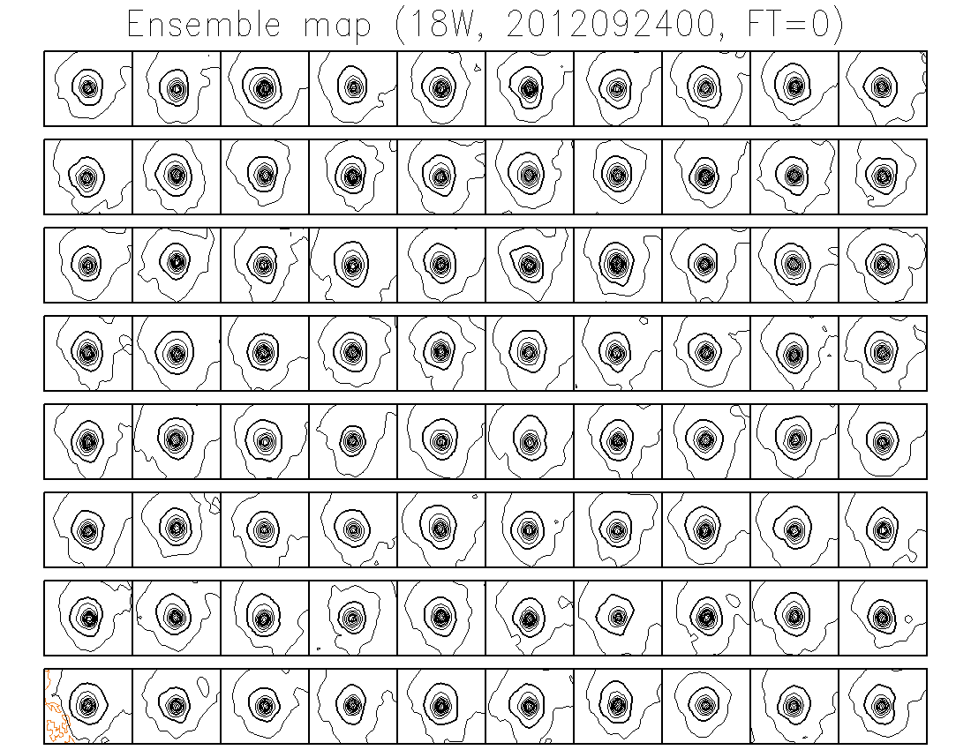
18W: 00UTC Sep. 24 EnKF analysis (with relocation)
sanl

Slide 42
18W: 00UTC Sep. 24 EnKF analysis (no relocation)
siganl

Slide 43
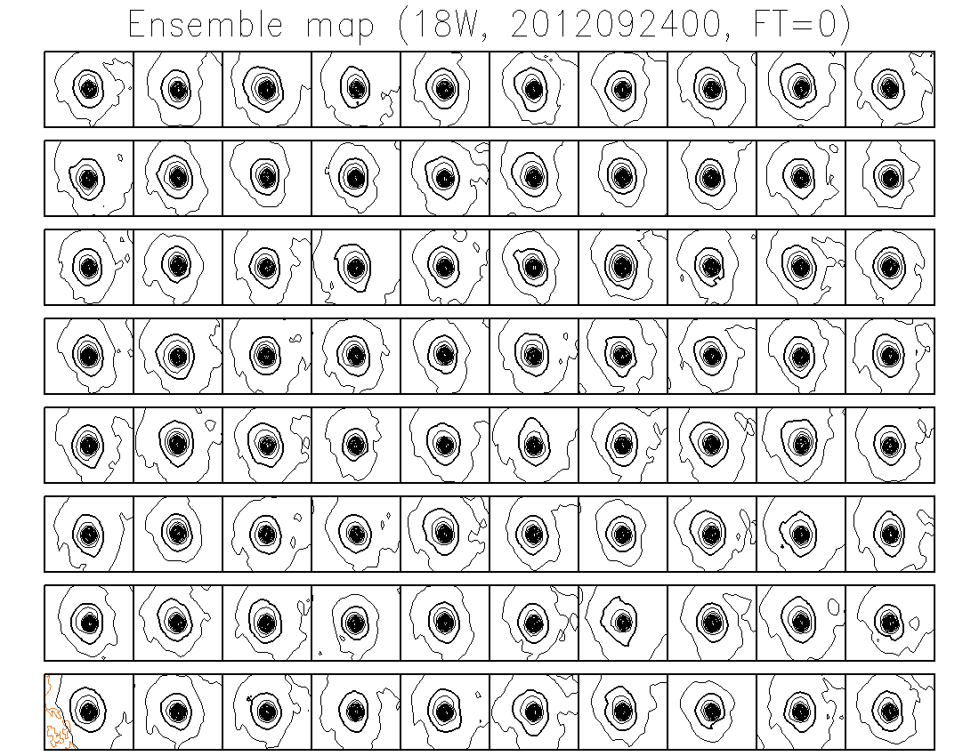
18W: 00UTC Sep. 24 EnKF analysis (with relocation)
siganl

Slide 44
18W: 00UTC Sep. 24 EnKF 6hr fcst (no relocation)
sf6

Slide 45
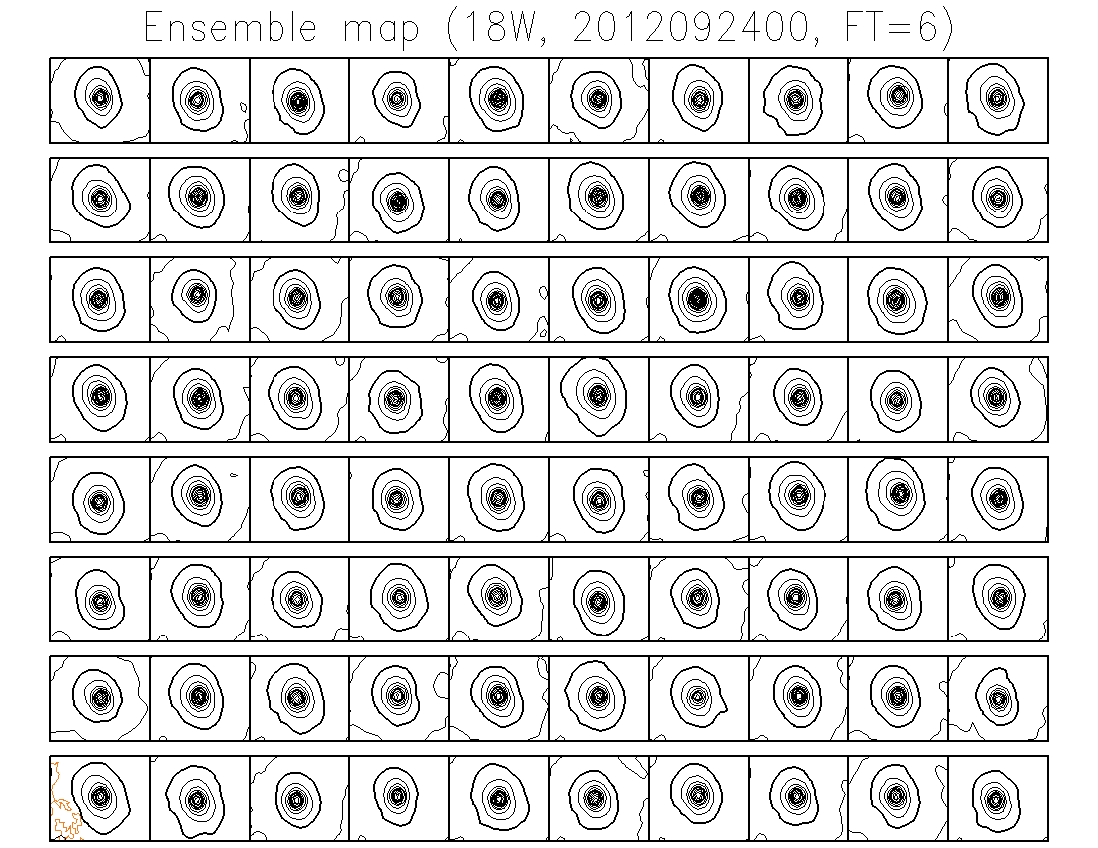
18W: 00UTC Sep. 24 EnKF 6hr fcst (with relocation)
sf6

Slide 46
TC position spread in EnKF
TC relocation can prevent unnatural distortion of TC structure.
How about the TC position spread?
 | FT=0 (after additive inflation) | FT=6 (before relocation)
No relocation | 30.8 km | 50.3 km
TC position assimilation | 24.0 km | 44.6 km
TC relocation | 16.9 km | 38.7 km
GFS track error for TC relocation experiment | 10.6 km | 35.8 km

Slide 47
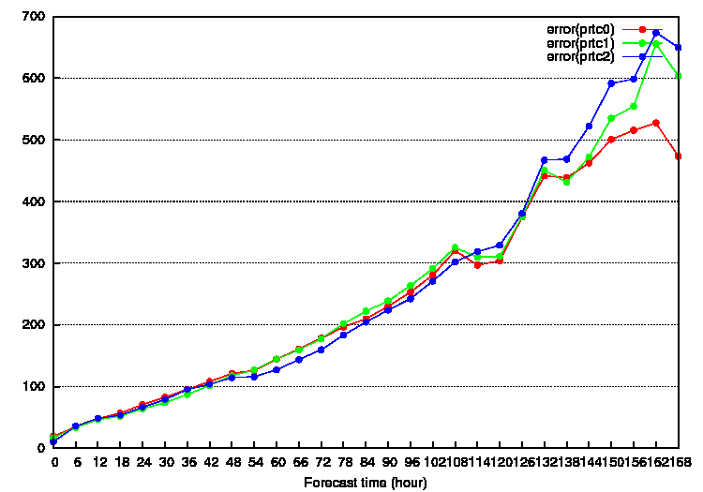
GFS TC track forecast accuracy
Red: No relocation
Green: TC position assimilation
Blue: TC relocation
Note: experimental period is only 4 days (all 4 cycles in all basins). Sample size is around 50 (FT=0~96).

Slide 48
Summary
A combination of EnKF and TC relocation has been tested for the EnKF analysis.
Results from preliminary experiment shows
  improvement on “double lows” problem,
  reduction of TC position spread at FT=0 and 6, and
  reduction of GFS TC track forecast error (?)
Longer experiment is needed to evaluate the impact on GFS TC track forecast
This method also may be applicable to the GEFS

Slide 49

Thank you very much !!
JMA’s mascot “Harerun”

