Slide 1
Assessing the Quality and Impact of Surface Observations
John Horel, Dan Tyndall¹, Xia Dong, Matt Lammers
University of Utah
¹ NRC Postdoctoral Research Associate United States Naval Research Laboratory
John.horel@utah.edu
MesoWest: Chris Galli, Alex Jacques, Nola Lucke, Judy Pechmann, Maggie Schoonover, Yan Zheng
Support from NWS CSTAR (Advancing Analysis, Forecast and Warning Capabilities for High Impact Weather Events) and NWS National Mesonet Expansion Project

Slide 2
National Academy of Science (2009) recommendation to build national network of networks from existing and future mesonets
Agencies under pressure to reduce costs: BLM may cut 20% of their fire weather stations
“What is the Appropriate RAWS Network?” (Brown et al. 2011)

Slide 3
Improving the Utilization of Infrastructure
Already in Place
Why do people & organizations install weather stations?
Diverse needs and objectives
Operating a network is like raising a child; it requires constant attention, and the kid never leaves home (Kelly Redmond. WRCC DRI)
Why not require single standard for all observations?
There are many standards developed within subdisciplines (aviation, fire weather, air quality, climate)
What makes an observation valuable?
Provide accurate relevant information not available from other sources
How can valuable observations be distinguished from questionable ones?
Manual and automated quality control procedures
Examine impact of observations from differing sources and locations over many cases through cross-validation or other means
Conduct OSE/OSSE studies on network design

Slide 4
Assessing Value?
Stations with higher quality equipment that are properly sited and maintained are likely to be of greater value for all applications
Do a few low-cost station with lower-quality standards in a largely data void region have greater value than many expensive high quality stations located close to each other?
Observation value depends on:
observation’s total cost
availability of comparable data nearby
and its benefit to diverse applications, including:
use by human forecasters
integration into atmospheric analyses and numerical forecasts

Slide 5
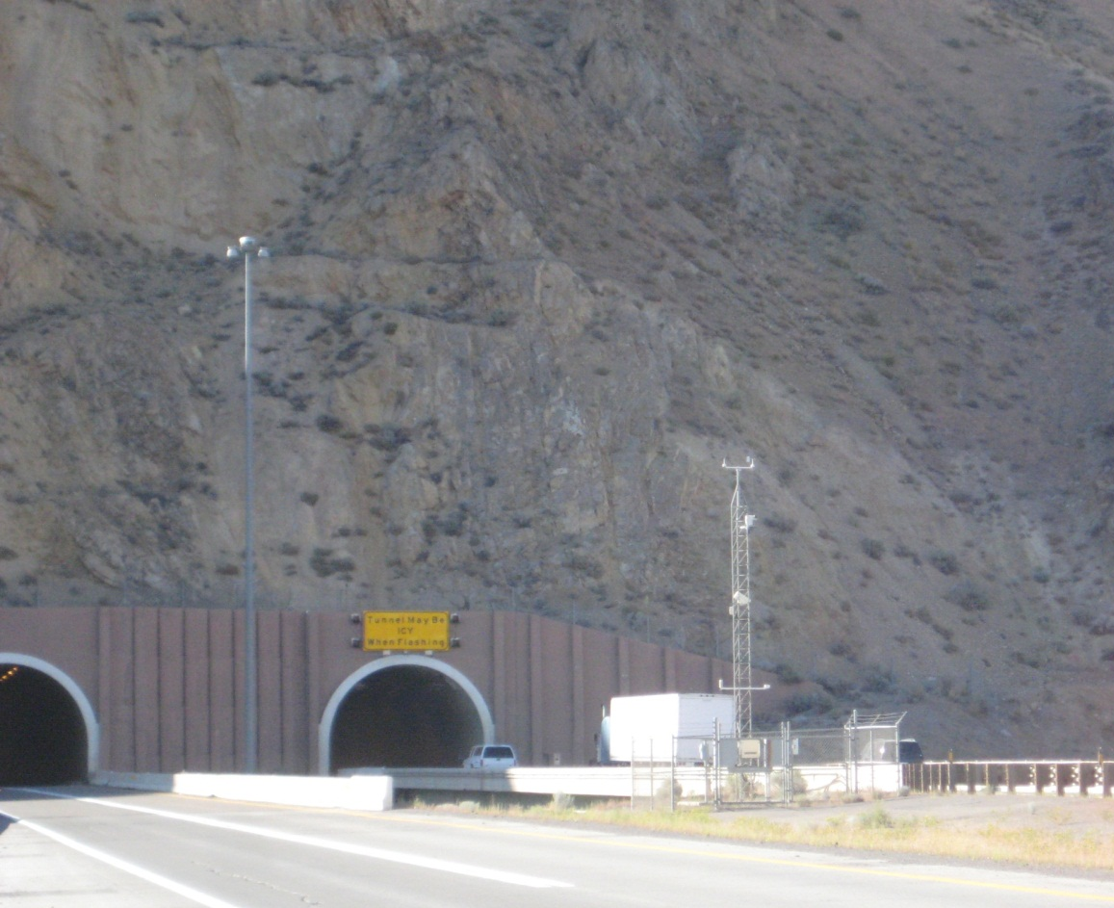
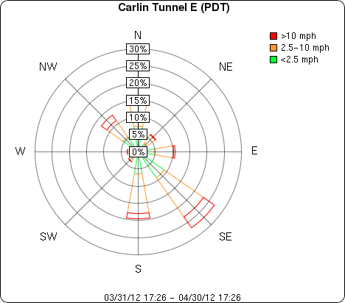
Hodographs over Past Month Two Rural Stations Separated By 3 Miles

Slide 6
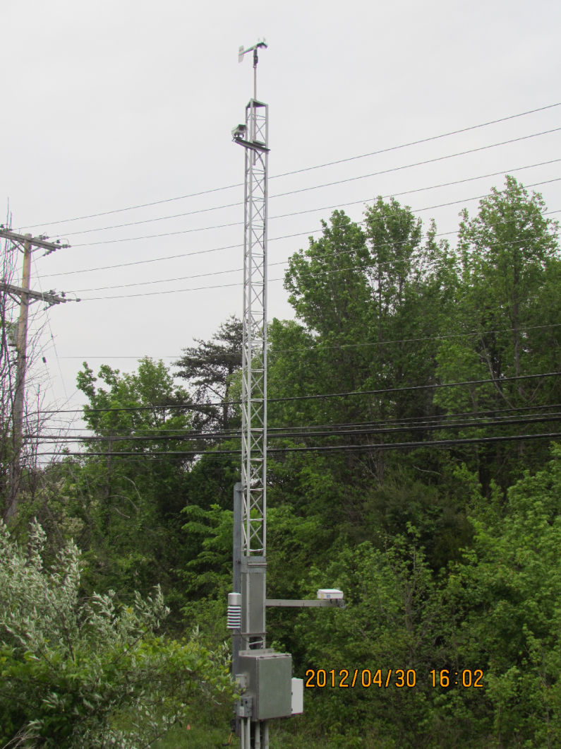
Hodograph over Past Month Maryland DOT MD031

Slide 7
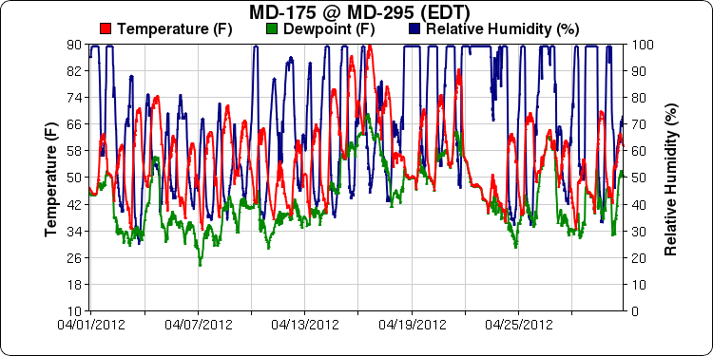
T, DP, RH over Past Month Maryland DOT MD031

Slide 8
Outline
MesoWest
Analysis of surface observation impact
Real-time evaluation of observation impact for assessing observation quality

Slide 9
http://mesowest.utah.edu
Goal: promote and support access, storage, and use of weather observations across the nation
Collect provisional data as they become available from hundreds of sources
Archive the data in relational databases
Provide access to the data via the web and through variety of data pushes and pulls
(point for ost- we provide access to federal agency data as much as state/local/private
Surface observations received asynchronously
from many sources in different formats
Web Displays
MySql Databases
1997-present
Ingest Software
QC Processing
Metadata
Synchronous output in defined formats (csv, xml) via web/LDM to MADIS and other users

Slide 11
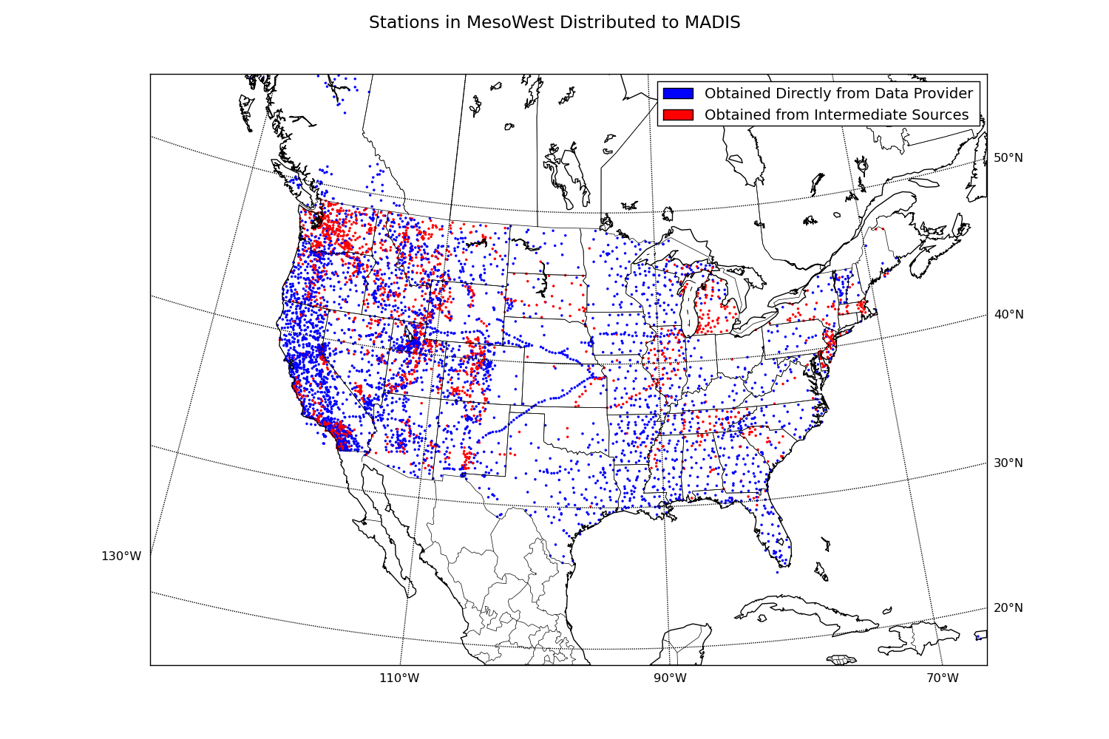
Mesowest currently provides data from 6,415 stations to MADIS

Slide 12
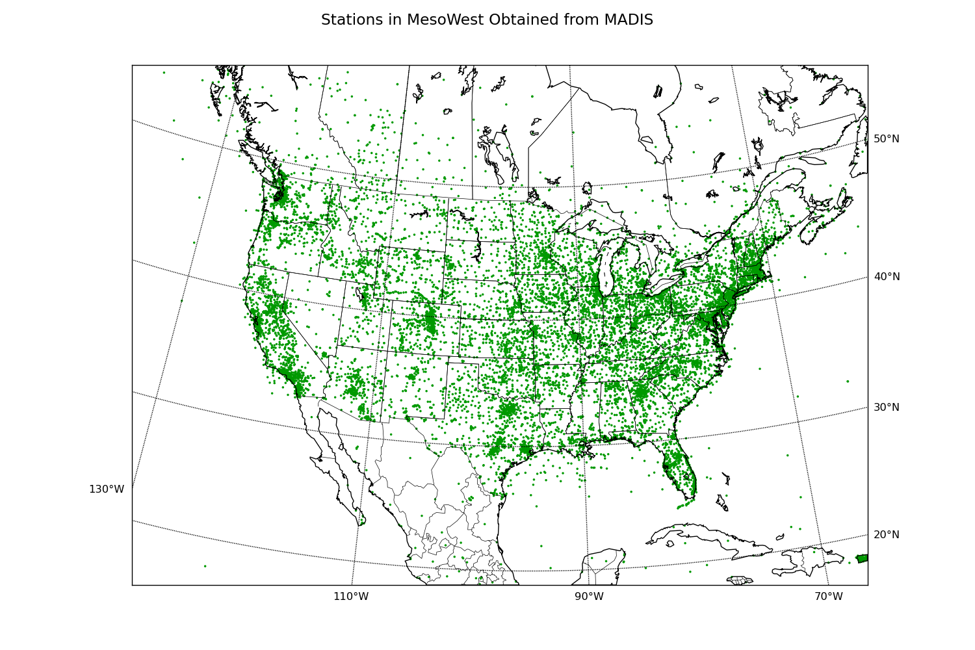
MesoWest currently obtains data from 15,772 stations from MADIS

Slide 13
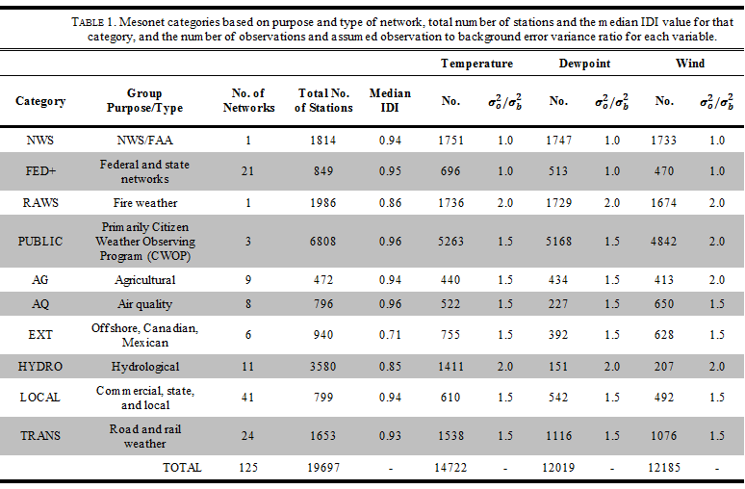
Categorizing Mesonets

Slide 14
Expanded Real-Time Observations
Microbarographs
US Seismic Array
Distributed now to MADIS via MesoWest

Slide 15
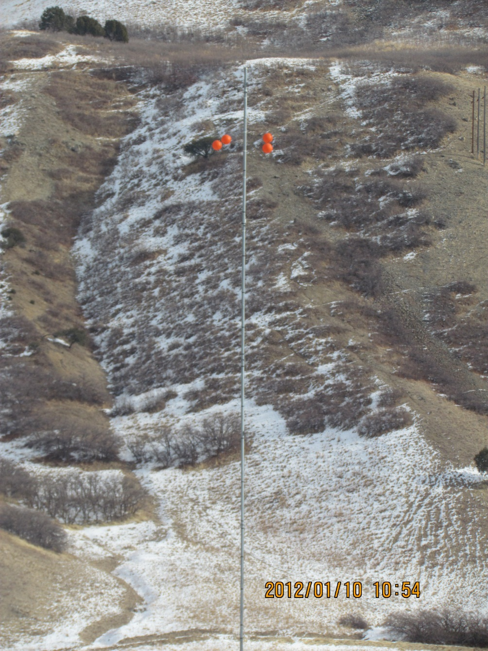
Mouth of Weber Canyon Utah Wind Energy Tall Tower

Slide 16
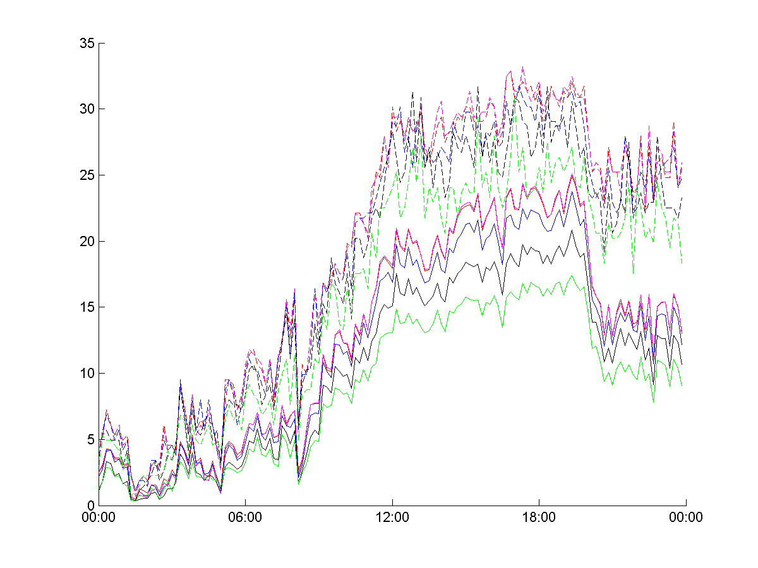
Wind Speed: Mouth of Weber Tall Tower
Red/Purple- 50 m
Blue- 30m
Black- 10m
Green- 3m
Solid- 10 min ave
Dashed- Peak
m/s
Brandon Malman. Salt Lake Community College
Dec 1: UTC

Slide 17
Outline
MesoWest
Analysis of surface observation impact
Real-time evaluation of observation impact for assessing observation quality

Slide 18
For More Details:
Impacts of mesonet observations on meteorological surface analyses
Tyndall and Horel (2012)
Submitted to: Weather and Forecasting
http://chpc.utah.edu/~u0035056/Tyndall_2012.pdf

Slide 19
Evolution in Analysis Systems Used for Research
ADAS/ARPS -> RTMA -> University of Utah Variational Surface Analysis (UU2DVAR) Matlab -> UU2DVAR Python
Core goals:
provide access to and integrate disparate observations as they become available
Use analyses to synthesize the observations for variety of applications
Network design
Observation quality control

Slide 20
Issues we’ve spent a lot of time dealing with but are still a struggle
Specifying background and observation error covariances
Estimating representativeness errors
Impact of heterogeneous observations through data denial and adjoint sensitivity/impact studies
Automated QC of observations used in analyses

Slide 21
Minimizing the Cost Function in Observation Space
Same RAP background ${as RTMA x}_{b}$at 2.5 km
$y_{o}−\text{H}\left(x_{b}\right)=\left(\text{H}{\text{P}}_{\text{b}}{\text{H}}^{\text{T}}+{\text{P}}_{\text{o}}\right)η$
solve iteratively for $η$ at 5km
UU2DVAR analysis $x_{a} at 2.5 km: x_{a}=x_{b}+{\text{P}}_{\text{b}}{\text{H}}^{\text{T}}η$
Matlab (Tyndall)
Advantage: efficient parallelization
Disadvantage: proprietary software
CONUS 5 km required 7 min on 8 processors
Python (Dong)
Advantage: open source and flexible data structure (store ${\text{P}}_{\text{b}}{\text{H}}^{\text{T}}$ as dictionary)
Disadvantage: parallelization less efficient
CONUS 2.5 km requires 12 min on 8 processors

Slide 22
Observation Sensitivity and Impact Using Analysis Adjoint
Define a cost function:
$𝓙=\frac{1}{2}{\left(x_{a}−x_{b}\right)}^{2}$ $\frac{∂𝓙}{{∂x}_{a}}=x_{a}−x_{b}$
Observation sensitivity (Baker and Daley 2000):
$$\frac{∂𝓙}{{∂y}_{o}}=\frac{{∂x}_{a}}{∂y_{o}}\frac{∂𝓙}{{∂x}_{a}}=\left(\text{H}{\text{P}}_{\text{b}}{\text{H}}^{\text{T}}+{\text{P}}_{\text{o}}\right)\text{H}{\text{P}}_{\text{b}}(x_{a}−x_{b})$$
Dependent on observation locations, background and observation errors, and analysis increments
Observation impact (Zhu and Gelaro 2008):
$$𝒢=\frac{1}{2}〈\frac{∂𝓙}{{∂y}_{o}},y_{o}−\text{H}\left(x_{b}\right)〉$$
Dependent on observation sensitivity and observation innovations

Slide 23
What leads to high impact of observations on analysis?
LOW
Observations detect mesoscale features missing from background
Bad observations
Background poor
Observations nearly same as background
Other observations reporting similar conditions nearby
HIGH

Slide 24
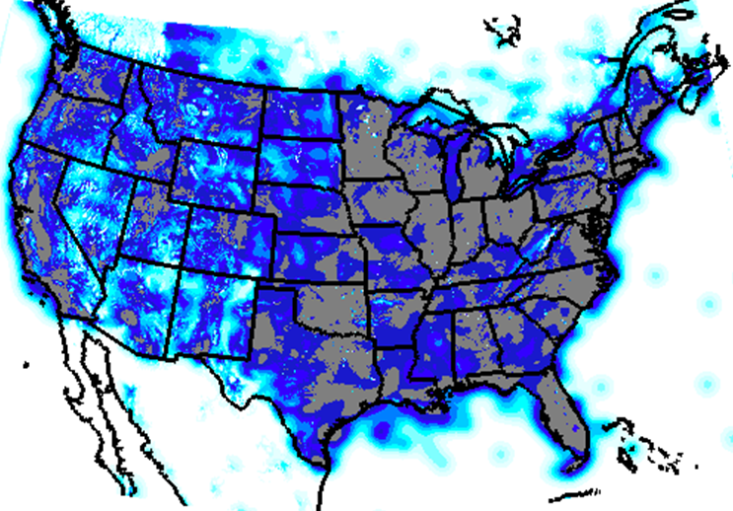
Assessing Existing National Network of Publicly Accessible Surface Observing Sites: Integrated Data Influence
Stations reporting at least 50 times within 100 h sample
Bottom Line:
Undersampled observational network:
~30,000 stations vs.
3 million 2.5 km gridpoints
Oversampled in many urban areas
Dense
Sparse
Background: 0; Observations: 1

Slide 25
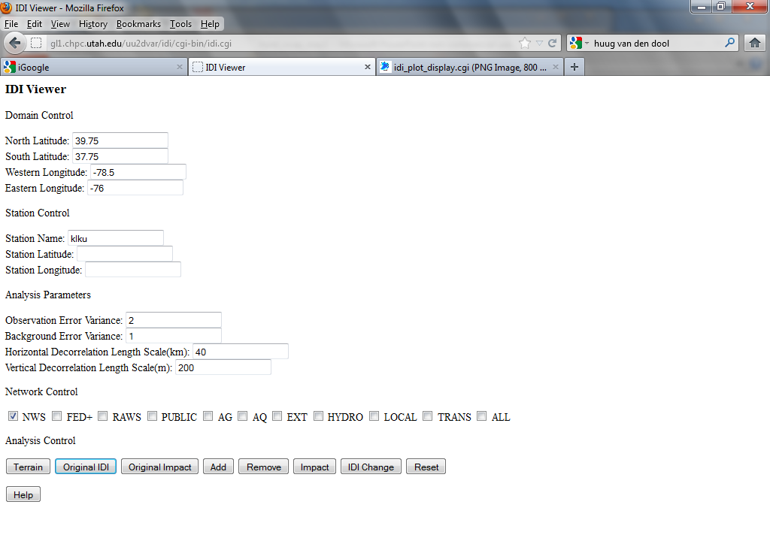
Online OSE GUI available to evaluate:
analysis system
error assumptions
station distributions
Assume background= 0 everywhere and observations always = 1
http://gl1.chpc.utah.edu/uu2dvar/idi/cgi-bin/idi.cgi

Slide 26
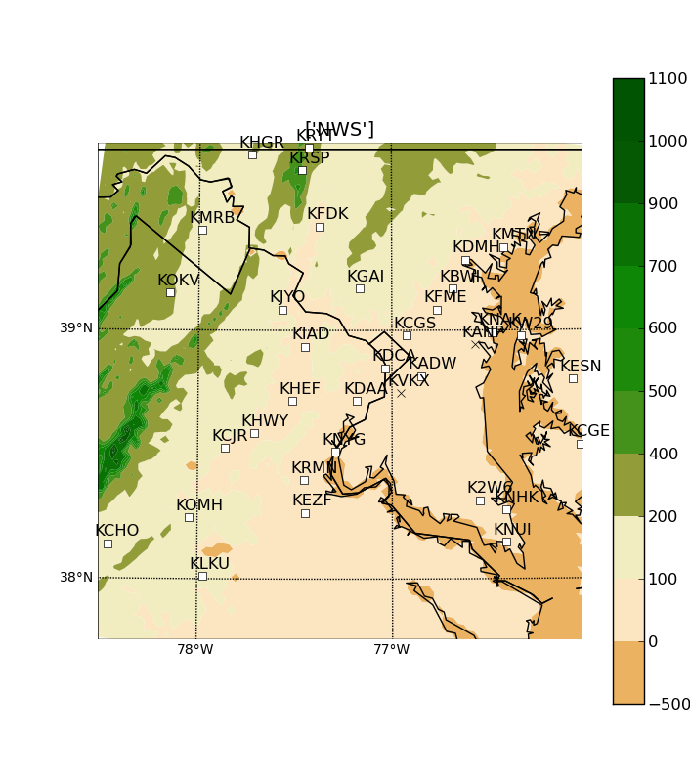
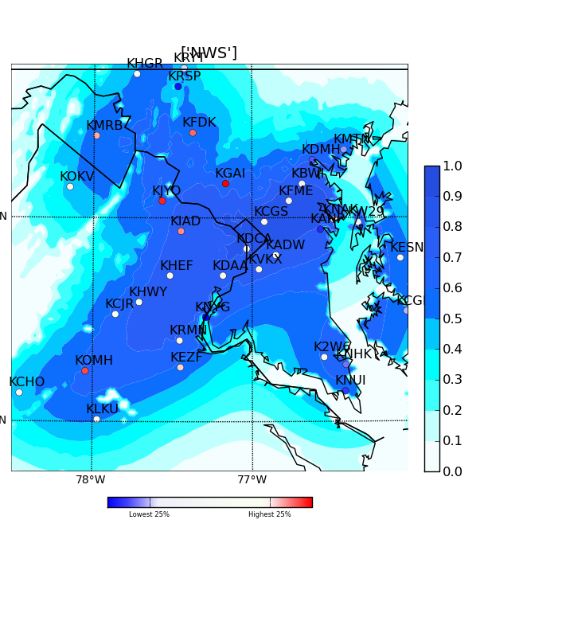
Terrain IDI Analysis w only NWS
$σ_{o}^{2}/σ_{b}^{2}$= 2
Obs
Bgnd
Obs Impact

Slide 27
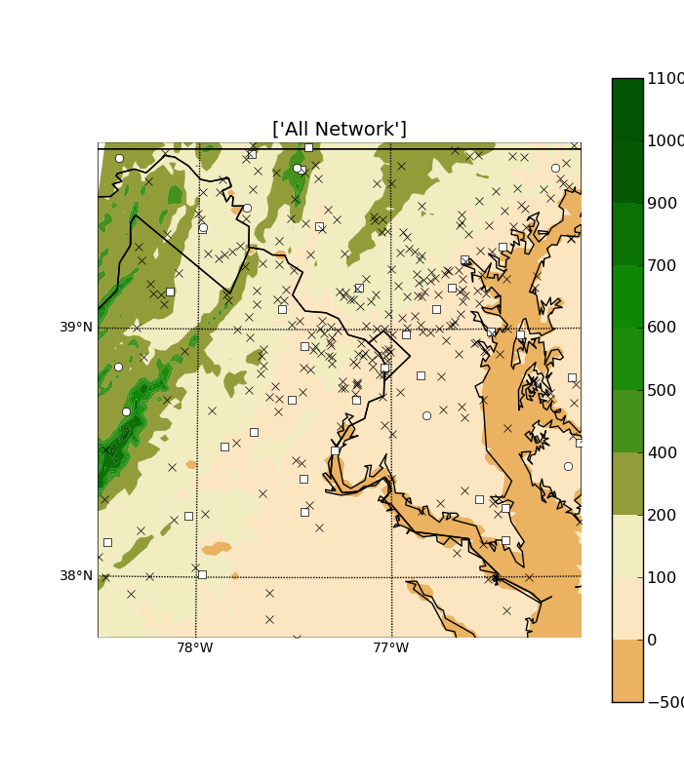
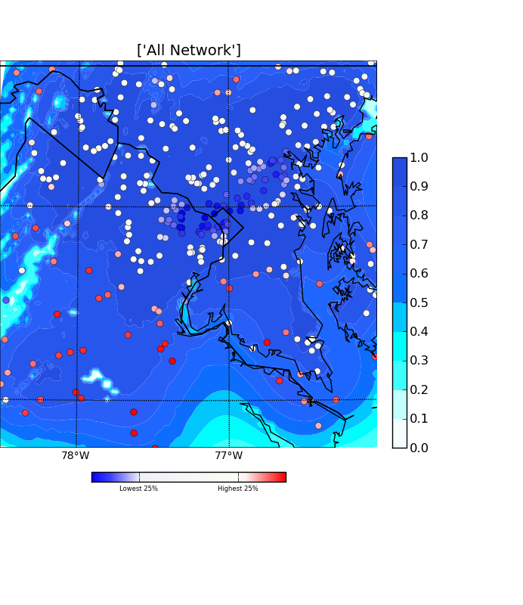
Terrain IDI Analysis w all stns
$σ_{o}^{2}/σ_{b}^{2}$= 2
Obs
Bgnd
Obs Impact

Slide 28
Key Points
Station impact can be high if corroborates other nearby observations
Stations in otherwise data voids are not necessarily the ones with the largest impacts
Depends on observation spacing relative to spatial scales of background errors
Negative impacts (very low percentile impact) indicate an observation departure from the background that differs in sign from others nearby

Slide 29
Assessing Impact of Stations in CONUS Tipping the balance a priori
Trust observations more from some networks based on siting and maintenance standards
observation error comparable to background error: ${{σ_{o}}^{2}}/{{σ_{b}}^{2}\sim 1}$
LOW
Trust observations less from some networks ${{σ_{o}}^{2}}/{{σ_{b}}^{2}\sim 1.5}$
Assume representativeness of observations from some networks lower ${{σ_{o}}^{2}}/{{σ_{b}}^{2}\sim 2}$
Assume background errors decorrelate weakly with increasing distance
HIGH

Slide 30
Categorizing Mesonets (Tyndall and Horel 2012)

Slide 31
100 Analysis Hour Sample 25 Days (00, 06, 12, 18 UTC)
Representative sample cumulatively exceeding $1 billion in damage
Date | Weather | Region |  | Date | Weather | Region
1 Oct. 2010 | Floods | NY, PA |  | 15 Jan. 2011 | Flood; Wildfire | WA, ID; SC
2 Oct. 2010 | Hail | NM |  | 16 Jan. 2011 | Flood | ID, OR
5 Oct. 2010 | Hail, Flash Flood | AZ, NV |  | 1 Feb. 2011 | Cold | TX
24 Oct. 2010 | Tornado | TN, TX |  | 20 Feb. 2011 | Ice Storm | MI
27 Oct. 2010 | Tornado | WI |  | 27 Feb. 2011 | Wildfire | TX
22 Nov. 2010 | Wind; Tornado | MN; NC |  | 28 Feb. 2011 | Wildfire; Flood | TX; IN, OH, TN
10 Dec. 2010 | Winter Storm | IL, WI |  | 7 Mar. 2011 | Flood | NJ
12 Dec. 2010 | Flood | WA |  | 24 Mar. 2011 | Flood | CA
19 Dec. 2010 | Flood | CA, UT |  | 4 Apr. 2011 | Tornado | GA, NC, KY
21 Dec. 2010 | Flood | AZ, CA, NV |  | 25 Apr. 2011 | Tornado | AL, AR, GA, LA, MS, NC, TN, TX, VA
31 Dec. 2010 | Tornado | AR, IL, MS |  | 26 Apr. 2011 | Tornado | “”
 |  |  |  | 27 Apr. 2011 | Tornado | “”

Slide 32
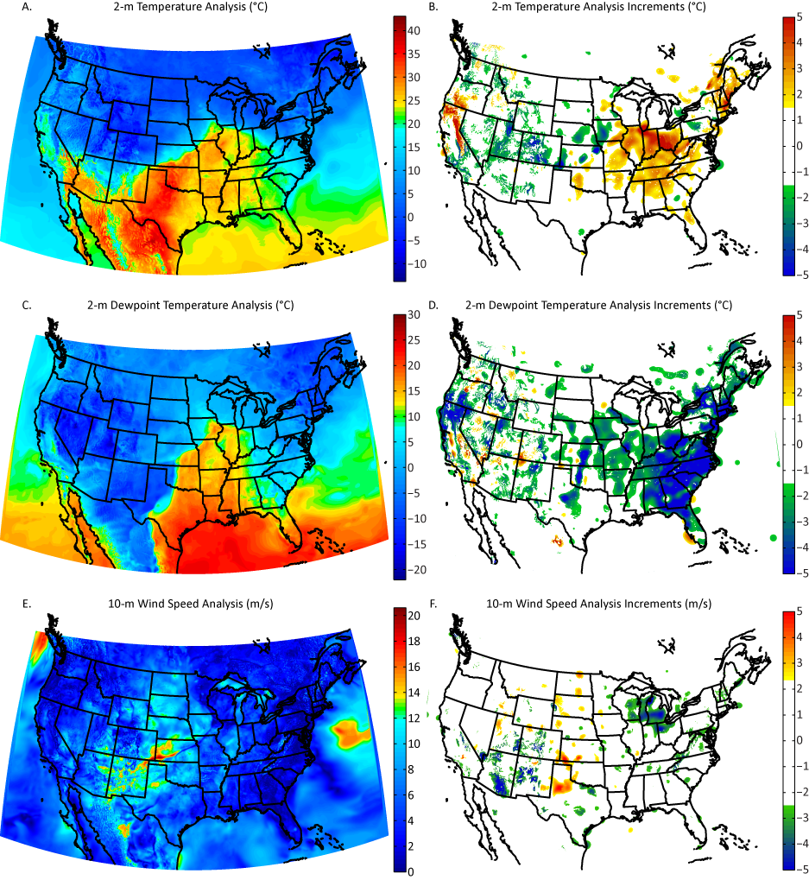

Slide 33
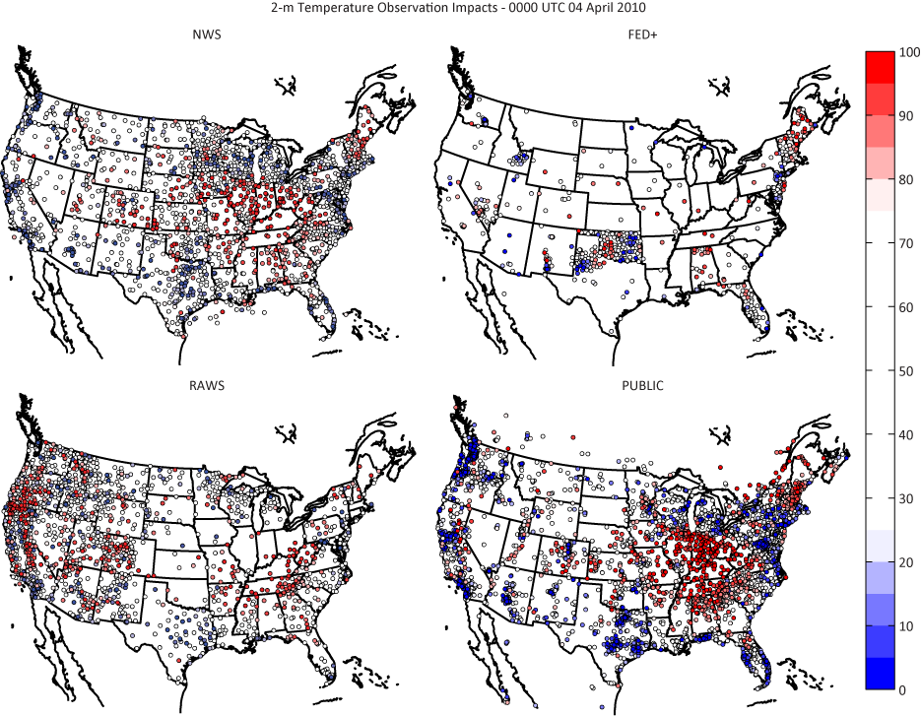
Relative impact of temperature observations from selected categories 0000 UTC 04 April 2011
NWS
FED+
High Impact
RAWS
PUBLIC
Low Impact

Slide 34
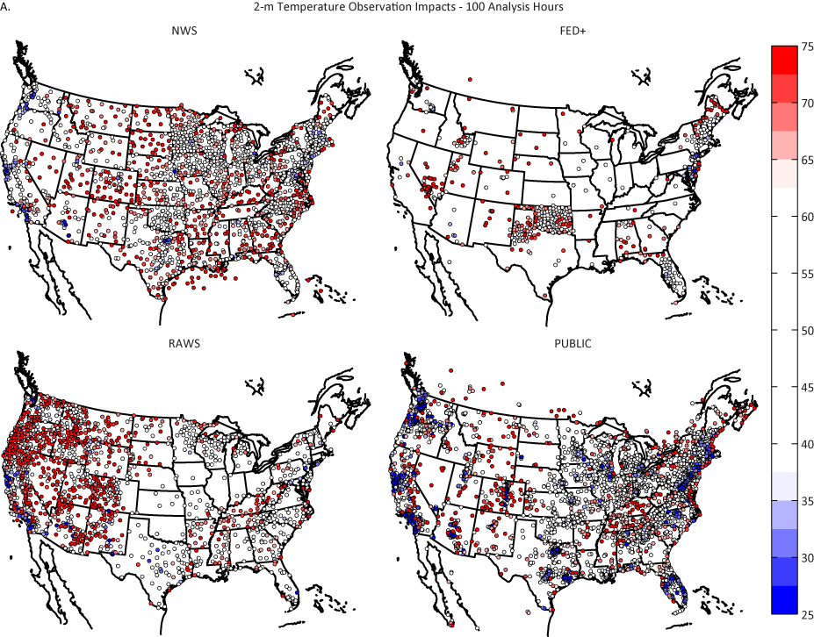
Median Impact of Temperature Observations From Selected Network Categories – 100 Analyses
NWS
FED+
High Impact
RAWS
PUBLIC
Low Impact

Slide 35
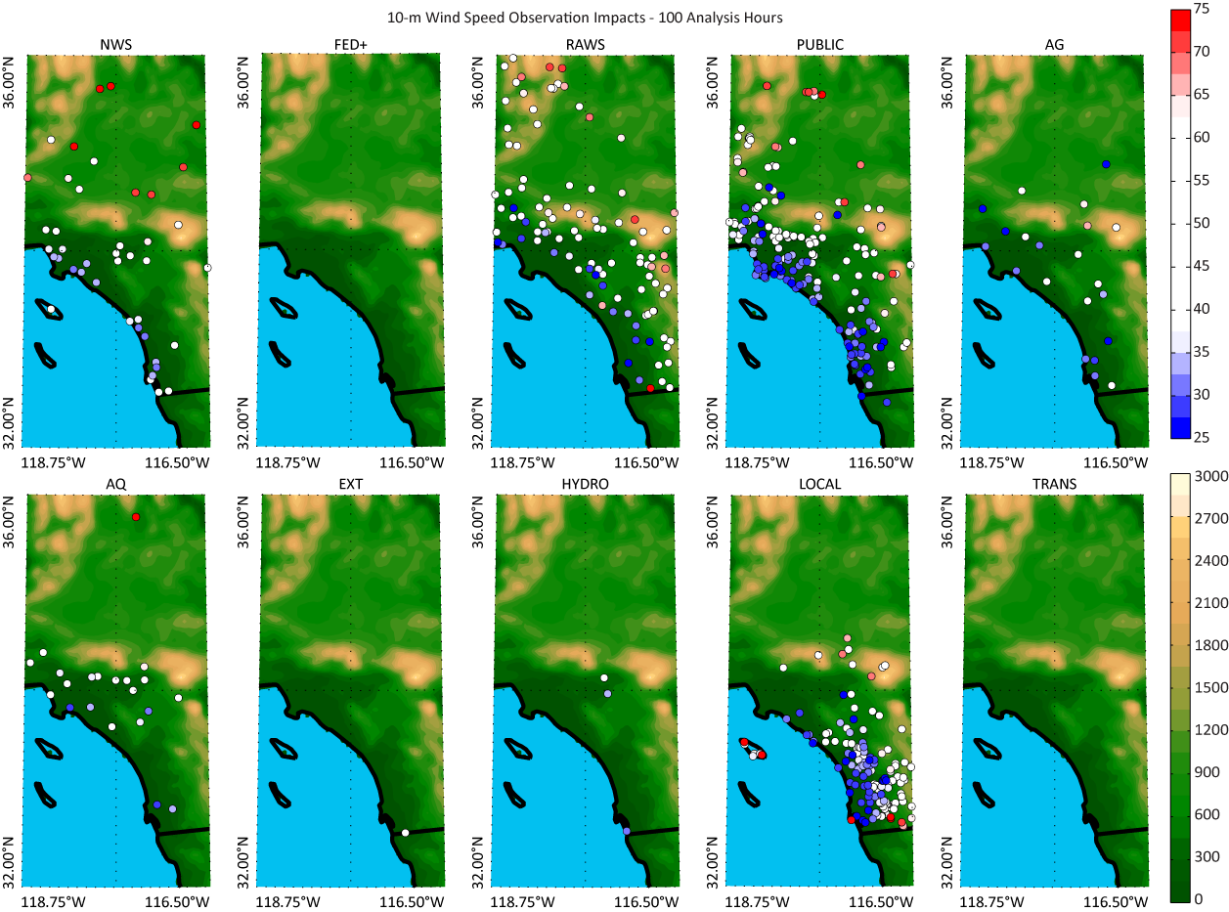
Southern California wind speed

Slide 36
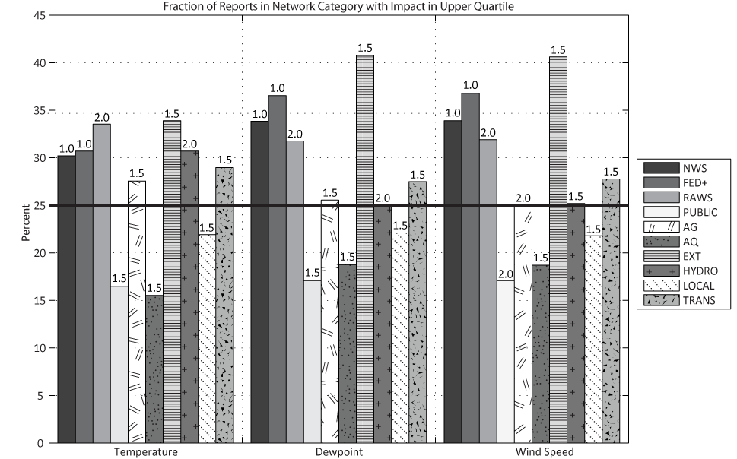
Fraction of Observations in Network Categories with Impact in upper Quartile
If all observations had equal impact, then all categories would have 25% in upper quartile

Slide 37
Fraction of Observations in Network Categories with Impact in upper Quartile
If all observations had equal impact, then all categories would have 25% in upper quartile
Networks with ${{σ_{o}}^{2}}/{{σ_{b}}^{2}=1}$ expected to have more in upper quartile

Slide 38
Fraction of Observations in Network Categories with Impact in upper Quartile
If all observations had equal impact, then all categories would have 25% in upper quartile
Networks with ${{σ_{o}}^{2}}/{{σ_{b}}^{2}=1}$ expected to have more in upper quartile
Networks with ${{σ_{o}}^{2}}/{{σ_{b}}^{2}=1.5 or 2}$ expected to have fewer in upper quartile

Slide 39
Summary
Utilized analysis adjoint to determine impact of surface mesonet observations
For individual analysis hours:
high impact observations are located in regions of significant weather—typically, where the background field fails to define the local weather conditions
Low impact observations tend to be ones where there are many observations reporting similar departures from the background
Networks with larger percentages of high impact observations:
Are those assumed to be of high quality
Have observations in non-urban areas
Have observations in poorly resolved areas of the background field (i.e., offshore, mountains)
Have observations that corroborate others nearby
Depends on spatial scales assumed for background errors

Slide 40
Outline
MesoWest
Analysis of surface observation impact
Real-time evaluation of observation impact for assessing observation quality

Slide 41
Real-Time QC
Standard QC metrics
Developing tools to use pdf’s of observations over available record (can be as long as 1997-present)
Running T, Td, Wind 2.5 km analyses every hour
Computing adjoint impact for each analysis
Accumulating statistics on impact and observation bias relative to 2.5 km RAP/RTMA background for each day and over 3-week period
Graphics & text files being generated
http://gl2.chpc.utah.edu/uu2dvar/

Slide 42
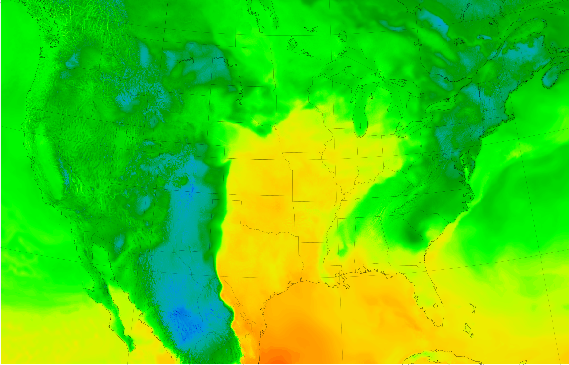
Dewpoint 2.5 km RAP Background for RTMA 18 UTC 14 April 2012

Slide 43
Dewpoint 18 UTC 14 April 2012

Slide 44
Dewpoint 2.5 km Background for RTMA 18 UTC 14 April 2012
Station
Values
Obs - Bkg
Bkg

Slide 45
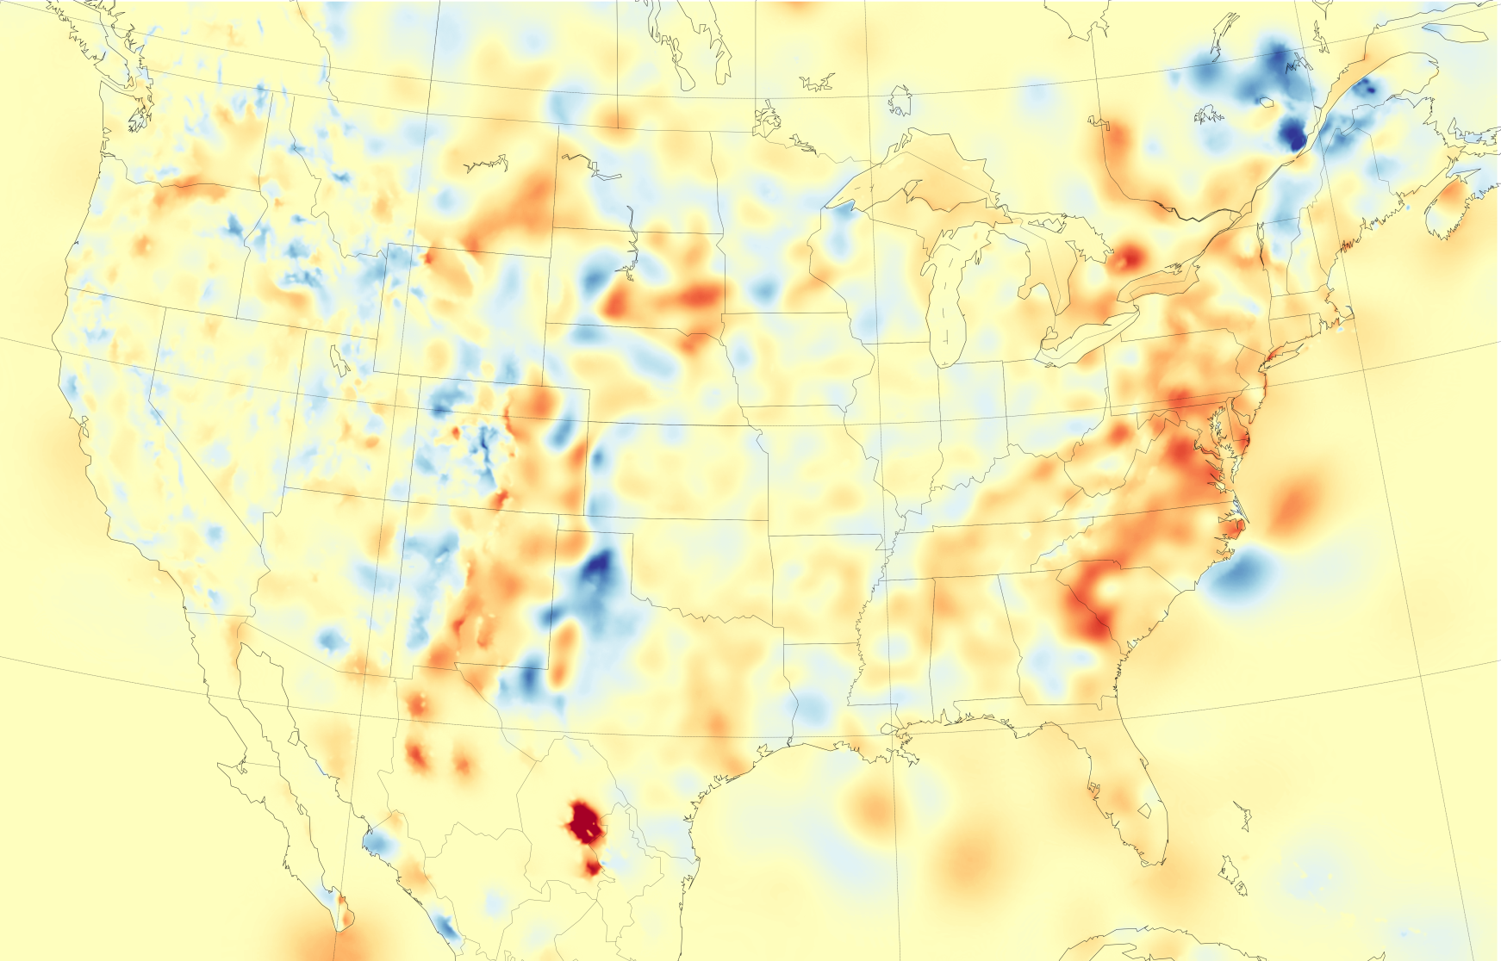
Dewpoint 2.5 km RTMA - Background 18 UTC 14 April 2012

Slide 46
Dewpoint 2.5 km UU2DVAR - Background 18 UTC 14 April 2012

Slide 47
Dewpoint 2.5 km UU2DVAR - Background 18 UTC 14 April 2012

Slide 48
Dewpoint 2.5 km UU2DVAR 18 UTC 14 April 2012 Percentile Impact

Slide 49
Dewpoint
1800 UTC 14 April 2012

Slide 50
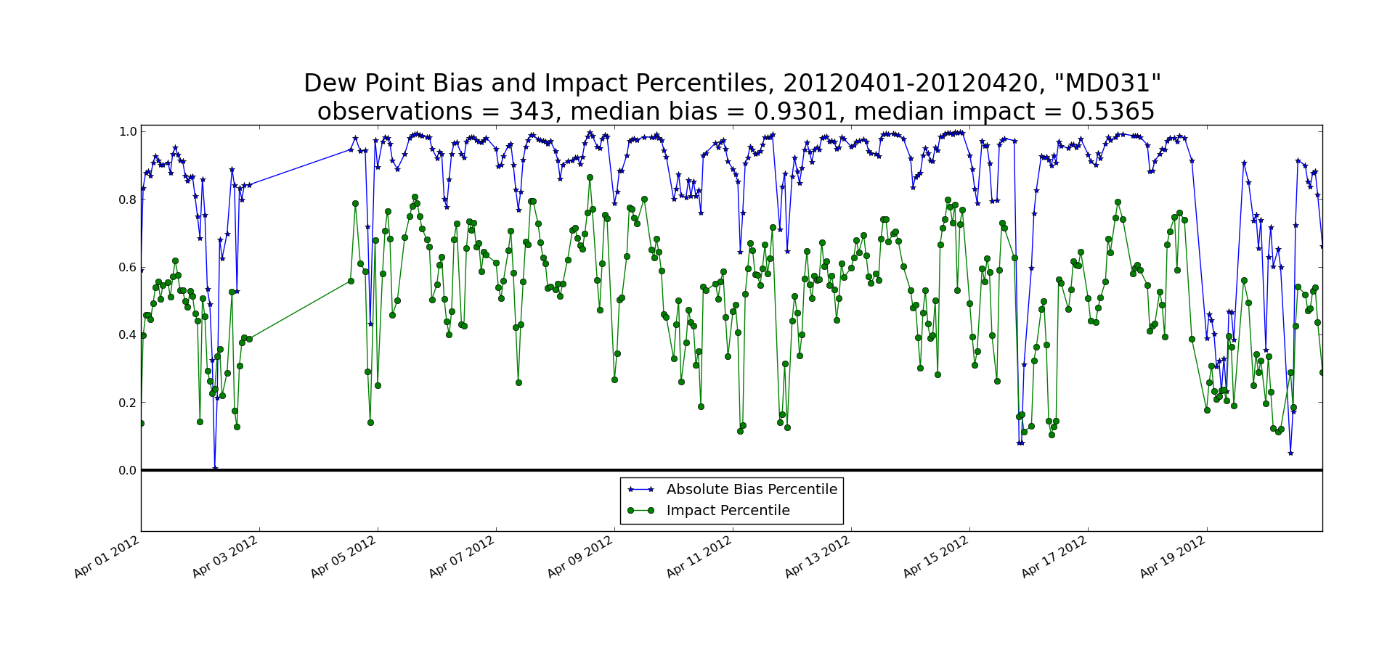
MD031 MD DOT

Slide 51
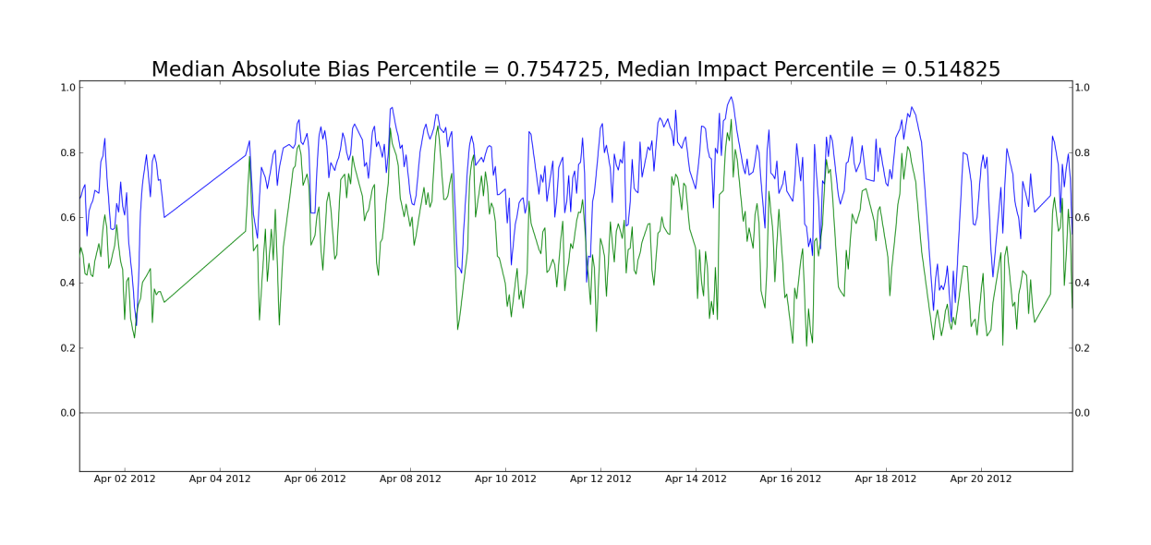
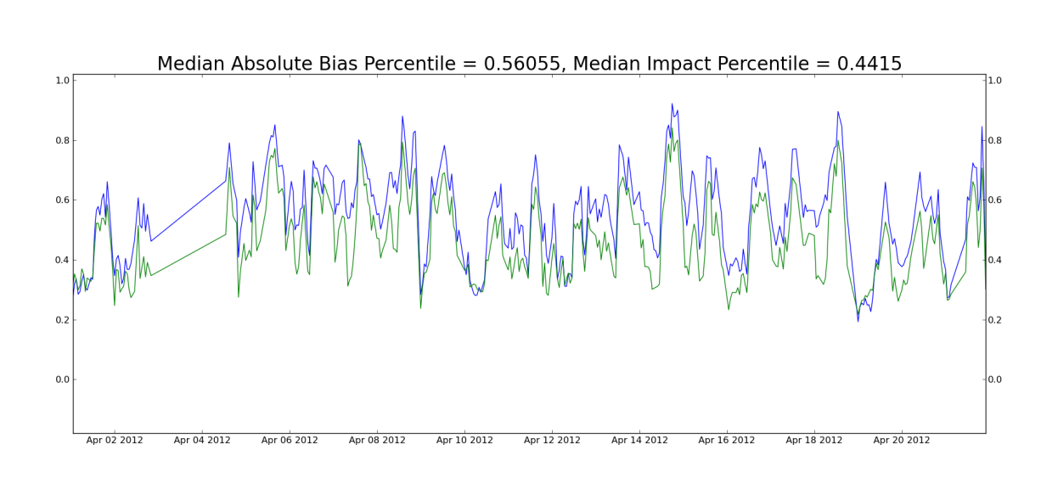
32 MD DOT High Bias and Impact Network Issue ~200 MD stns High Bias and Impact in afternoons only Background Issue

Slide 52
Summary
MesoWest continues to play an important role in the acquisition, archival, dissemination of environmental observations and the software required to do so
The “value” of observations in the context of impact on analyses depends:
more on the number of other observations available in that area and the extent to which the weather variability in that area can be explained by the RAP/RTMA background
less on the network type
CONUS scale analyses can help provide additional metrics to develop automated quality control checks

Slide 53
Next steps
Improve access to MesoWest database of observations for users easier
30,000 time series data tables
API (under development)
Apply some additional QC metrics to all obs in MesoWest database
Incorporate boundary layer observations into MesoWest (tall towers/remote sensors)
Foster an open source community for environmental network info and applications (environets.org)

Slide 54
The open resource for environmental monitoring networks
forum for the continually growing and diverse community of owners, operators, and users of environmental monitoring networks
way to let others know what’s new. Have stations been added or moved or have sensors been added?
foster the exchange of ideas and information on best practices and standards developed within specific user communities (weather, water, air quality, soil, off shore, alternative energy, etc.).
open virtual community that addresses some of the goals expressed in the U.S. National Research Council report― Observing the Weather and Climate From the Ground Up: A Nationwide Network of Networks― including to help foster a U.S. network of networks for meeting multiple national needs related to environmental data.

Slide 55
Extra slides

Slide 56
Network Exchange
Standards
Metadata
Advertisements
Quality Control
Public Domain Data
Contracted Exchange of Data
What is the appropriate business model for the exchange of observations within the Weather Enterprise?
Mesonets
Consumers / Users
Links
AMS ad hoc committee
Network of Networks
Organization / Business
Model
Value Added Products
Combinations
Comparisons

Slide 57
NWS Funded Efforts Directed Towards Network of Networks
Meteorological Assimilation Data Ingest System (MADIS) transition to operations
National Mesonet Pilot Project (FY10)
National Mesonet Expansion (4/11-4/12)
National Mesonet Program Alliance (4/12-9/12)
4 corporations
13 universities
continue efforts to establish a sustainable, quantitative, end-to-end capability for observations collected from mesonets
leverage existing mesonet infrastructure that will effectively enable the NWS to extend its surface based meteorological observing capabilities

Slide 58
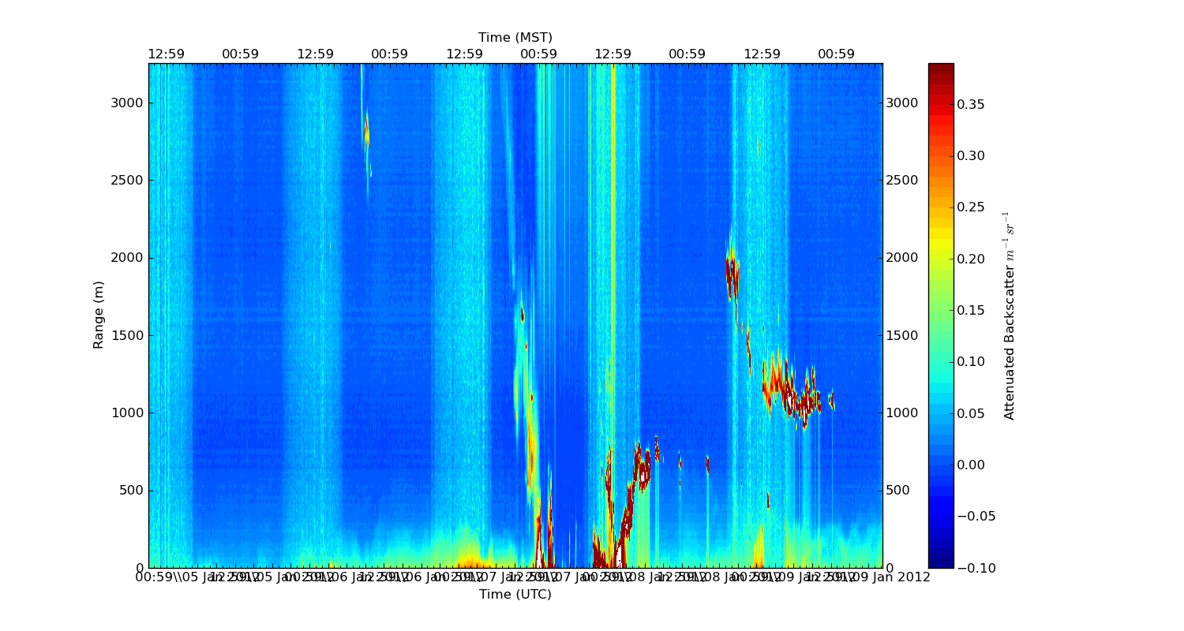
Boundary Layer Depth from Ceilometers
ASOS upgrade of ceilometers
Some of the outdated ceilometers being maintained by universities for education and research applications
University of Utah, Florida Institute of Technology, San Jose State, Texas A&M, University of Virginia
See http://mesowest.net/ceil

Slide 59
MesoWest MySQL Databases
Legacy databases:
all observations stored in YR/MO tables for groups of stations
Extensive metadata tables
New databases:
all variables for all times for each station
Quality Control (QC) tables for each stations with flags for all variables and times
Expanded metadata database with growing metadata content
Able to handle publicly accessible and restricted access observations

Slide 60
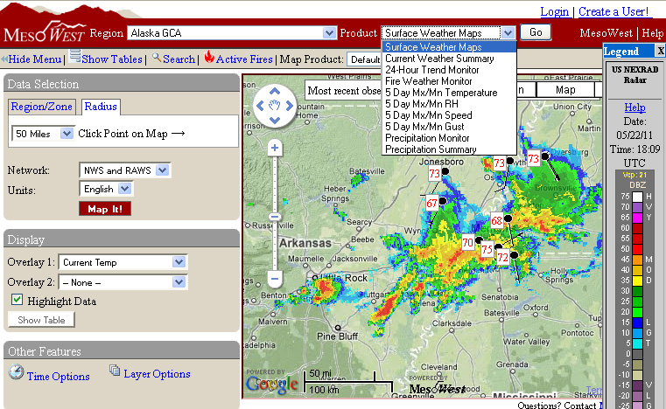
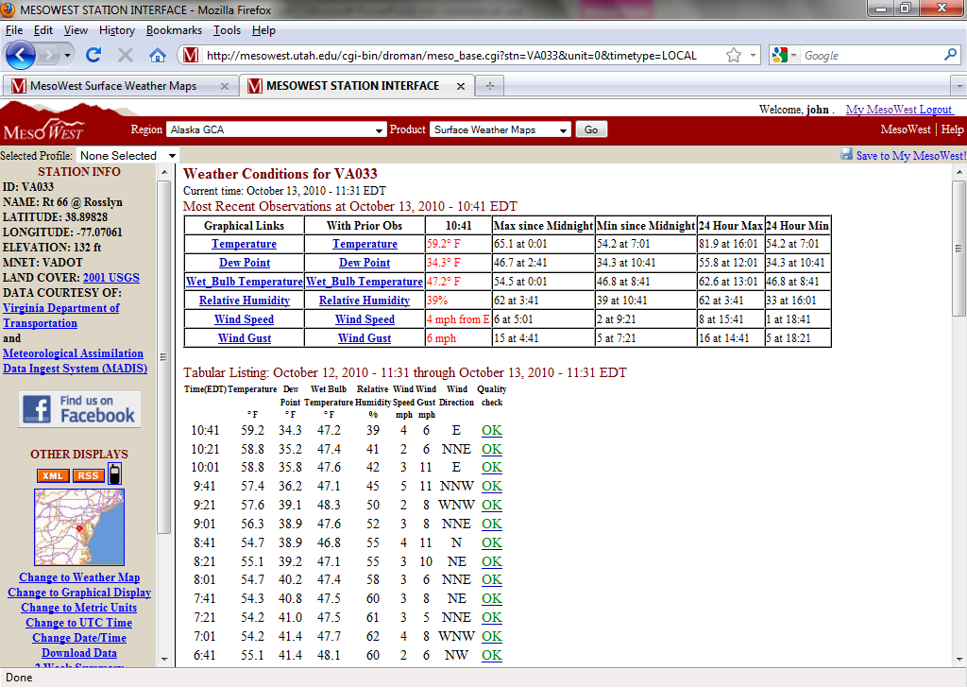
MesoWest Product Examples

Slide 61
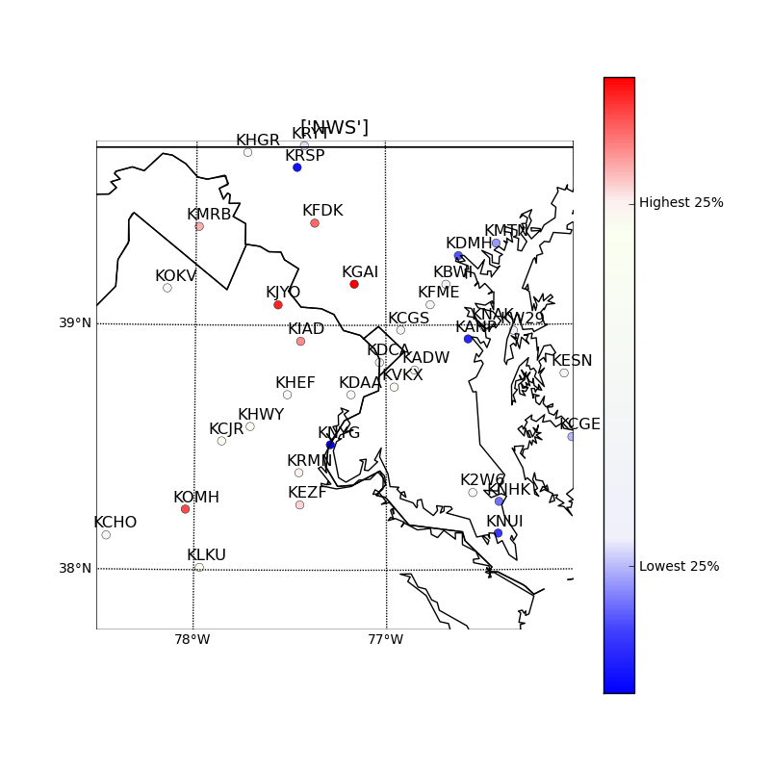
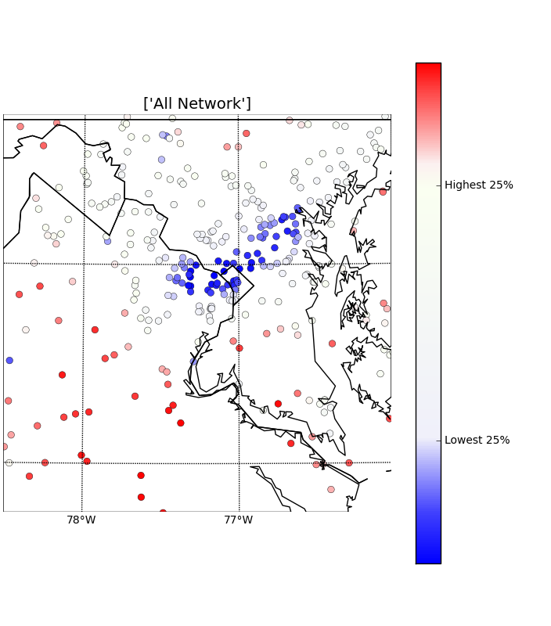
Relative Impact of Observations NWS All Networks
Impact larger for obs that corroboratesother more isolated obs

Slide 62
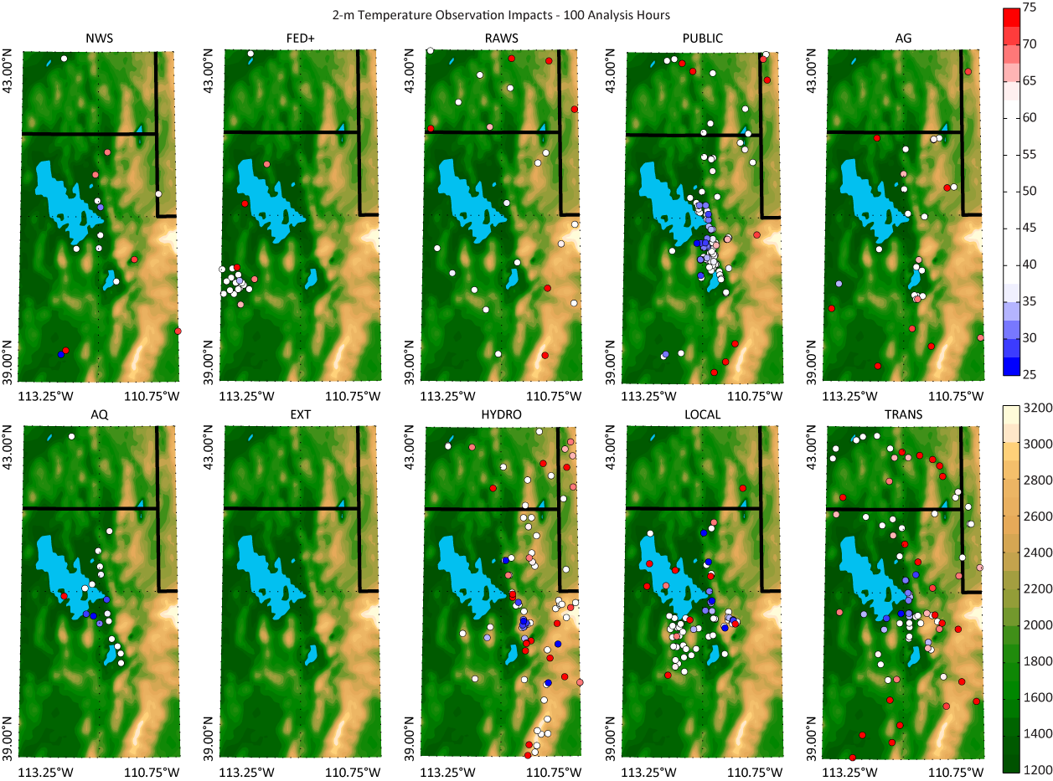
Wasatch Front Temperature

Slide 63
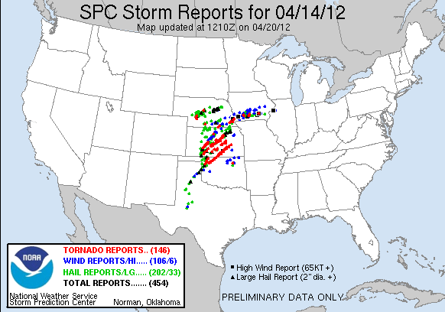

Slide 64
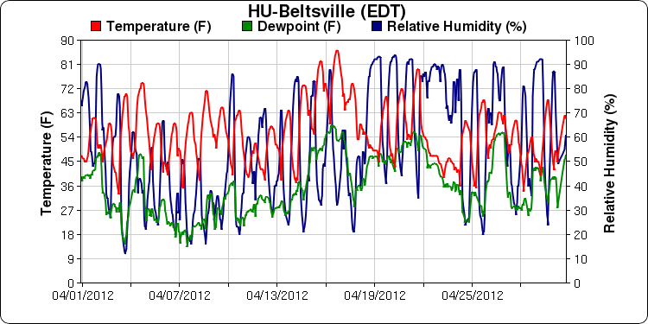
T, DP, RH over Past Month Maryland DOT MD031
MD031
MD DOT
AN273
AirNow
8 mile separation

Slide 65
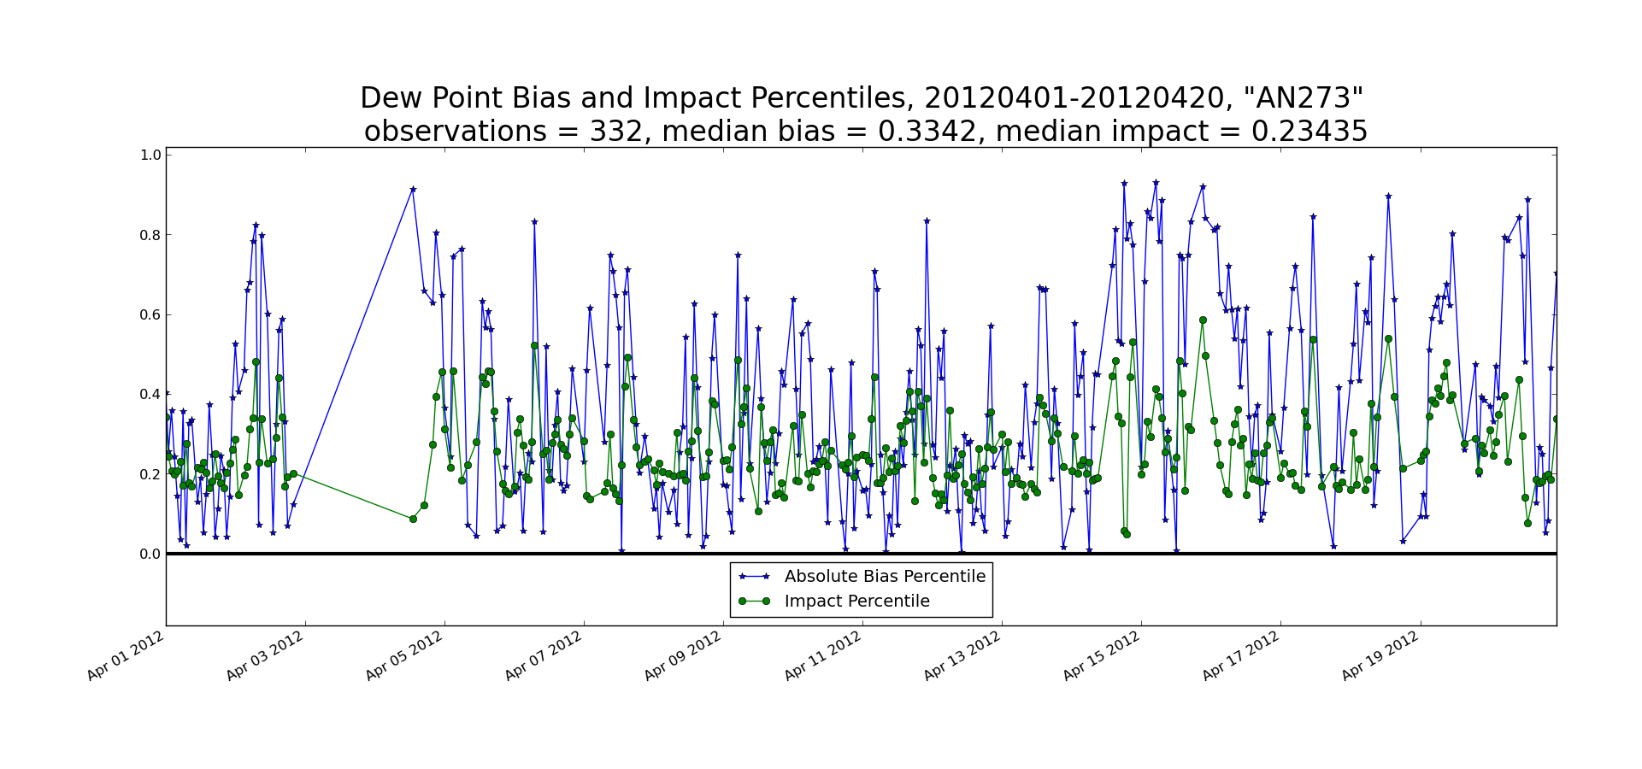
HU-Beltsville AirNow

Slide 66
MesoWest/Utah Surface Analysis Refs
Tyndall, D. and J. Horel, 2012: Impacts of Heterogeneous Mesonet Observations on Meteorological Surface Analyses. Submitted to WAF.
Horel, John D., and X. Dong 2010: An evaluation of the distribution of Remote Automated Weather Stations (RAWS). Journal of Appl. Meteor. and Clim., 49, 1563-1578.
Tyndall, D., J. Horel, and M. dePondeca, 2010: Sensitivity of surface air temperature analyses to background and observation errors. Wea. Forecasting, 25, 852-865
Myrick, D., and J. Horel, 2008: Sensitivity of surface analyses over the western United States to RAWS observations. Wea. Forecasting, 23, 145-158.
Myrick, D., J. Horel, 2006: Verification over the Western United States of surface temperature forecasts from the National Digital Forecast Database. Wea. Forecasting, 21, 869-892.
Horel, J., B. Colman, 2005: Meeting Summary: A community meeting on real-time and retrospective mesoscale objective analysis: An Analysis of Record summit. Bull. Amer. Meteor. Soc., 86, 1477–1480.
Myrick, D., J. Horel, S. Lazarus, 2005: Local adjustment of the background error correlation for surface analyses over complex terrain. Wea. Forecasting, 20, 149-160.
Lazarus, S., C. Ciliberti, J. Horel, K. Brewster, 2002: Near-real-time applications of a mesoscale analysis system to complex terrain. Wea. Forecasting, 17, 971-1000.
Horel, J., M. Splitt, L. Dunn, J. Pechmann, B. White, C. Ciliberti, S. Lazarus, J. Slemmer, D. Zaff, J. Burks, 2002: MesoWest: Cooperative Mesonets in the Western United States. Bull. Amer. Meteor. Soc., 83, 211-226.

