Slide 1
Coupled modeling
Principles and reality from an MMAB perspective
Hendrik L. Tolman
Chief, Marine Modeling and Analysis Branch
NOAA / NWS / NCEP / EMC
Hendrik.Tolman@NOAA.gov

Slide 2
Background
I gave a lecture like his at the GODAE Summer School for Ocean Modeling in January (!) 2010 in Perth Australia. And a similar presentation at the Tropical Cycline Ocean Interaction (TCOI) workshop in Jeju Korea May 2011.
MMAB works mostly on Atmosphere-Wave-Ocean coupling (including wave-surge). This is a minor upgrade of a presentation made to the coupled modeling work group (group 8) for HFIP.
Focusing on MMAB coupling work.
Recognizing previous GFDL / URI work in this field.
Recognizing previous CFS work in this field.

Slide 3
What is coupling
“What is coupling ?”
The better question to ask is “How does (computational) science make progress?”
Any kind of model typically begins with trying to get the simplest possible description of a problem that has some chance to be useful.
This means that many models focus on well-defined, isolated problems like
Weather.
Ocean circulation.
Wind waves.
Storm surge / coastal inundation.
and many more ….

Slide 4
What is coupling
Even though these models are stand-alone models, they could be considered as a combination of sub-models, for instance:
Ocean circulation models can include
Equation of state model.
Mixed layer / turbulence (closure) models.
Weather model can include
Cloud models,
Boundary layer models.
Land surface models
Tracer models.
As these elements are clearly “coupled” the term coupling relates more to semantics than physics.

Slide 5
What is coupling
Moreover, typical output of one model is often essential input of another, for instance:
Winds used for ocean and wave models.
SST’s used by weather and wave models.
Ice coverage used by wave and ocean models.
Nesting of models (1 or 2-way).
This is another way in which conventional models already are “coupled”.
Here, coupling means dynamic interaction between full numerical models.
Essential to dynamically describe interface processes between models.

Slide 6
How to couple
First thing to do: run the models that need to be coupled side-by-side under a single control structure This sounds trivial, but it is not:
Constituent models are typically highly advanced models with specific optimization and other run-time requirements.
Programming practices can stand in the way of running with other models.
Conflicting (optimization) requirements can make coupled modeling inefficient or difficult.
What kind of control structure will be used:
For the US government modeling centers the Earth System Modeling Framework (ESMF) is the accepted standard for coupled models, but
there are many other systems, and
we still use ad-hoc couplers too.

Slide 7
How to couple
Second thing to do: figure out when the models will exchange information. Determining factors are:
Time scales of processes considered:
What time intervals of data exchange are needed to resolve the time scales of the processes.
Less data exchanges generally makes for more efficient codes.
More data exchanges generally makes for more accurate description of the physical processes.
What time scales should be considered
Processes to be considered (e.g., mesoscale winds versus turbulence).
Predictability of scales.
Aliasing and/or averaging.

Slide 8
How to couple
When, time scales cont’ed:
Are all time scale the same, or are there large differences.
If one data transfer direction requires higher resolution data, the coupling will have a more one-way nature.
Looser coupling with higher numerical efficiency possible.
Over-commit of resources for one model guarantees efficiency.
Is two-way coupling needed at all?
Running models side-by-side with one-way data flow is much easier than two-way coupled.
Data transfer through memory or file system.

Slide 9
How to couple
When, cont’ed:
How many models are considered.
Two models. Staggering the model runs allows for most accurate coupling numerics (central in time).
This could require you to run the models serially, one time step of model 1 followed by one time step of model 2 on the same computing resources.
time step
Alternative: “build a single model”
Example: ADCIRC and UNSWAN
model 1
time
model 2
time step

Slide 10
How to couple
When, how many models cont’ed:
More than two models (with similar time scales) will always result in a time lag of exchanged data …
Unless you are willing to run a predictor-corrector scheme with multiple copies of each model.
Run models forward one time step to generate exchange data.
Rerun time step with this exchange data.
coupling time step
model 1
time
model 2
As with complex “single model”
model 3

Slide 11
How to couple
When, cont’ed:
Are the models to be run serially or in parallel on the available resources:
Exchange scheme on previous slides.
IT considerations:
Optimization (compiler) and memory considerations (including hardware and cache, parallel coms).
Optimization considerations:
Serial implementation makes load balancing between models irrelevant.
Parallel implementation favors Amdahl’s law per model, but makes load balancing between models an issue.
.

Slide 12
Coupler design
Tropical cyclone forecasting main elements:
Weather
Ocean circulation
Wind waves
Additional physical elements:
Land surface
Inundation
Future expansions:
Tracer and particle modeling (pollution).
Ecosystems
Morphology
Just the three models to start with is sufficiently complex !!!

Slide 13
Atmospheric Boundary Layer
Wave
Boundary
(Surface)
Layer
Momentum & KE Flux
Heat & Humidity Flux
Turbulence
Sea Sprays
Air-Sea Interface
Wave induced stress↑
Reynolds stress ↓
Airflow separation
Intermittency
Nonbreaking Waves
Breaking Waves
Stokes drift
Momentum & KE Flux
Bubbles
Intermittency of
Momentum & KE injection
(Langmuir) Turbulence
Gas Flux
Ocean Boundary Layer
Courtesy Isaac Ginis

Slide 14
Coupler design
Ideal coupler in ideal world
Ocean GCM
Wind waves
Atmosphere GCM
Coupler
Data flow
Coupler only moves data between models.

Slide 15
Coupler design
We do not live in an ideal (modeling) world:
Often data needs to be modified when moving from model to model.
Modeling inconsistencies.
Scale inconsistencies
Coupling approaches need model data from various models at the same time (e.g., wind speed and temperatures across ocean interface in boundary layer models):
Additional coupling computations needed.
Where and how to combine information from different models.
“Coupling package” becomes another modeling element:
Separate from models, or
integrated in models.

Slide 16
Coupler design
Realistic coupler in real world
Ocean GCM
Wind waves
Atmosphere GCM
A
B
C
Coupler
D
X
Coupling code
Data mod.
Data flow
Additional functionality in the coupler and in the models may be needed.

Slide 17
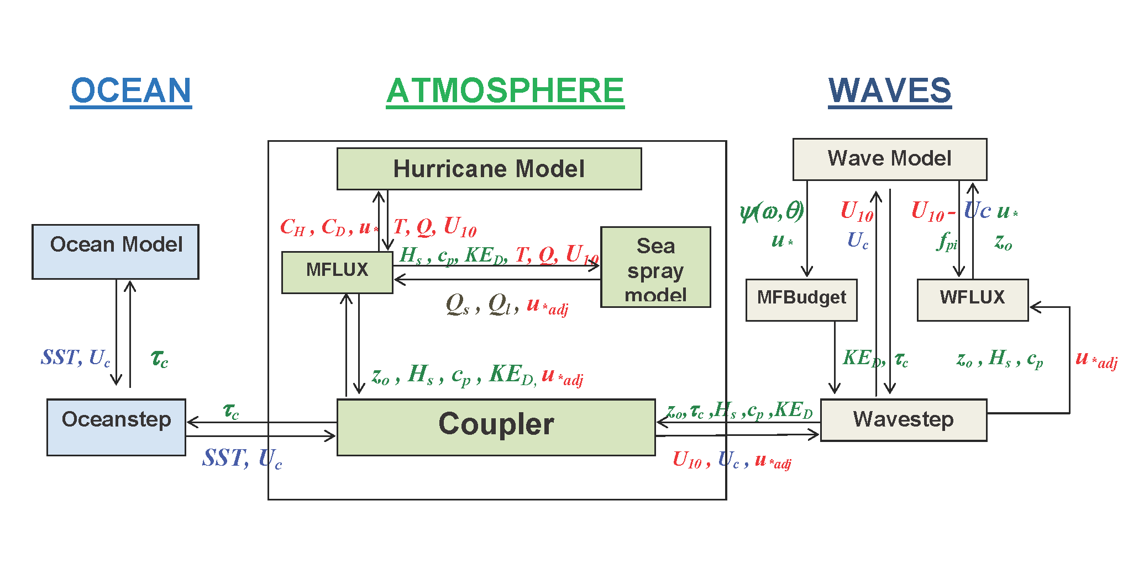
Coupler design
This can become very complicated, with an almost automatically has an ad-hoc nature.
Example of three-way coupling design from Isaac Ginis.
Needs to be more modular for coupler with exchangeable components.

Slide 18
Coupler design
Maximum modularity can be achieved by:
Containing data modifications in coupler:
General corrections (biases corrections etc.) on entry of data in coupler.
Specific modifications for receiving model.
Coupling software should be build fully plug compatible so that it can be used either in the coupler or in the individual models.
Capability of computing coupling parameters in stand-alone model components.
Identical duplicate coupling software used throughout.
Need for option in terms of input and output.
Mostly code management issue.
A “general coupler” still needs specific handling of each possible component model.

Slide 19
Coupler design
Realistic coupler in real world
Ocean GCM
Wind waves
Atmosphere GCM
X
X
X
Coupler
X
General corrections
Specific corrections
Coupling software can literally be everywhere, in any possible distribution between models and coupler.

Slide 20
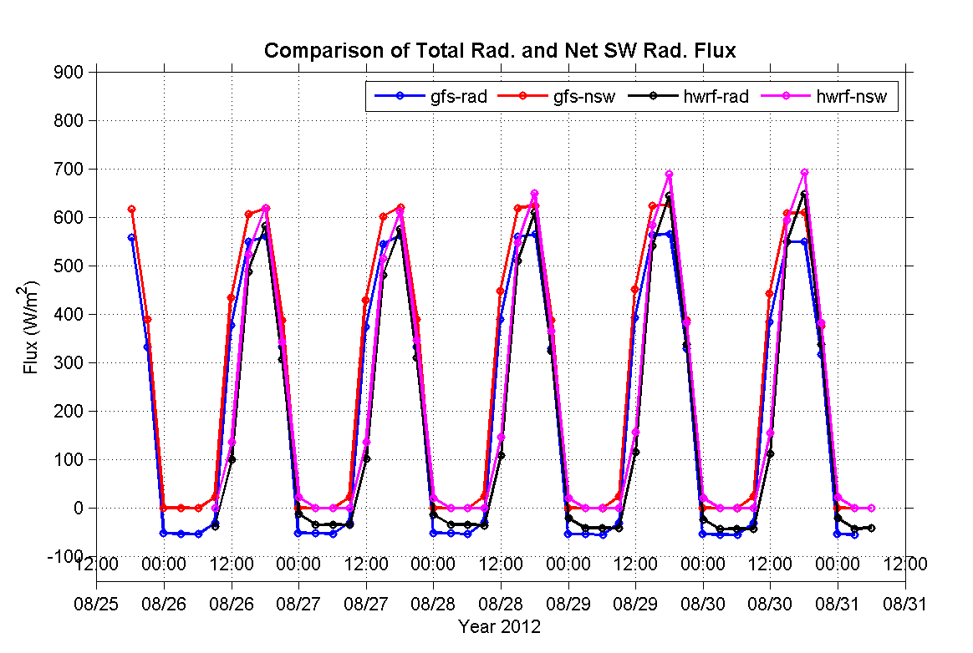
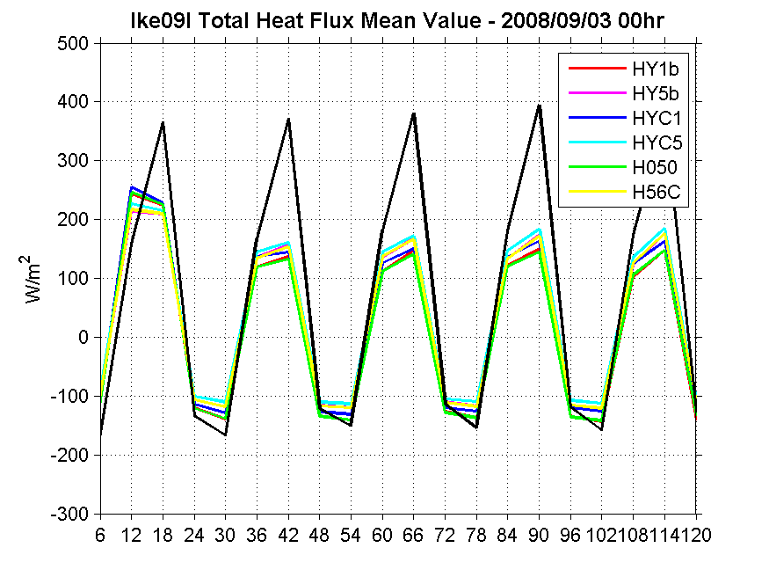
HWRF-HYCOM example
Coupling HWRF weather model to HYCOM ocean model.
Regional ocean model nested in basin scale ocean model.
Basin scale ocean model set up to work well with GFS fluxes.
HWRF fluxes are systematically different from GFS fluxes resulting in SST drift issues:
No drift in RTOFS ← GFS.
Drift in RTOFS ↔ HWRF.
Short term fix in coupler.
Successful.
Long term NWS issue
Will require collaboration.
2012
Courtesy Hyun-Sook Kim and Jamese Sims

Slide 21
HWRF-HYCOM example
Ocean GCM
Wind waves
Atmosphere GCM
Coupler
Needed modification in coupler for HWRF-HYCOM coupling (and any other ocean).
Coupler needs to know which atmosphere and ocean models are used.

Slide 22
Winds / waves example #1
Coupling of codes with relatively small time steps of data exchange gives high resolution wind fields for the ocean and wave models.
Example from Tolman and Alves, Ocean Modelling, 2005.
Looking at effects of temporal wind field resolution on wind wave model.
Moving grid
resolves wind
in time unlike
fixed grid
Improvement achieved simply by resolution in time of wind field, has nothing to do with physics.

Slide 23
Winds / waves example #1
Unresolved in time
Resolved in time
wind
waves

Slide 24
Winds / waves example #2
So, coupling gives you better resolution of parameters in time, and therefore gives a better wave model.
I believe this, and not coupling physics, is the reason why the coupled wave-weather model at ECMWF gives improved wave prediction.
However, if you go to high spatial resolution coupled modeling, time scales of coupling also become smaller, and …….
Waves in a traditional model become higher and higher and less and less reliable, but ….
If wind fields are smoothed before passing them on to the wave model, wave model behavior remains reliable.

Slide 25
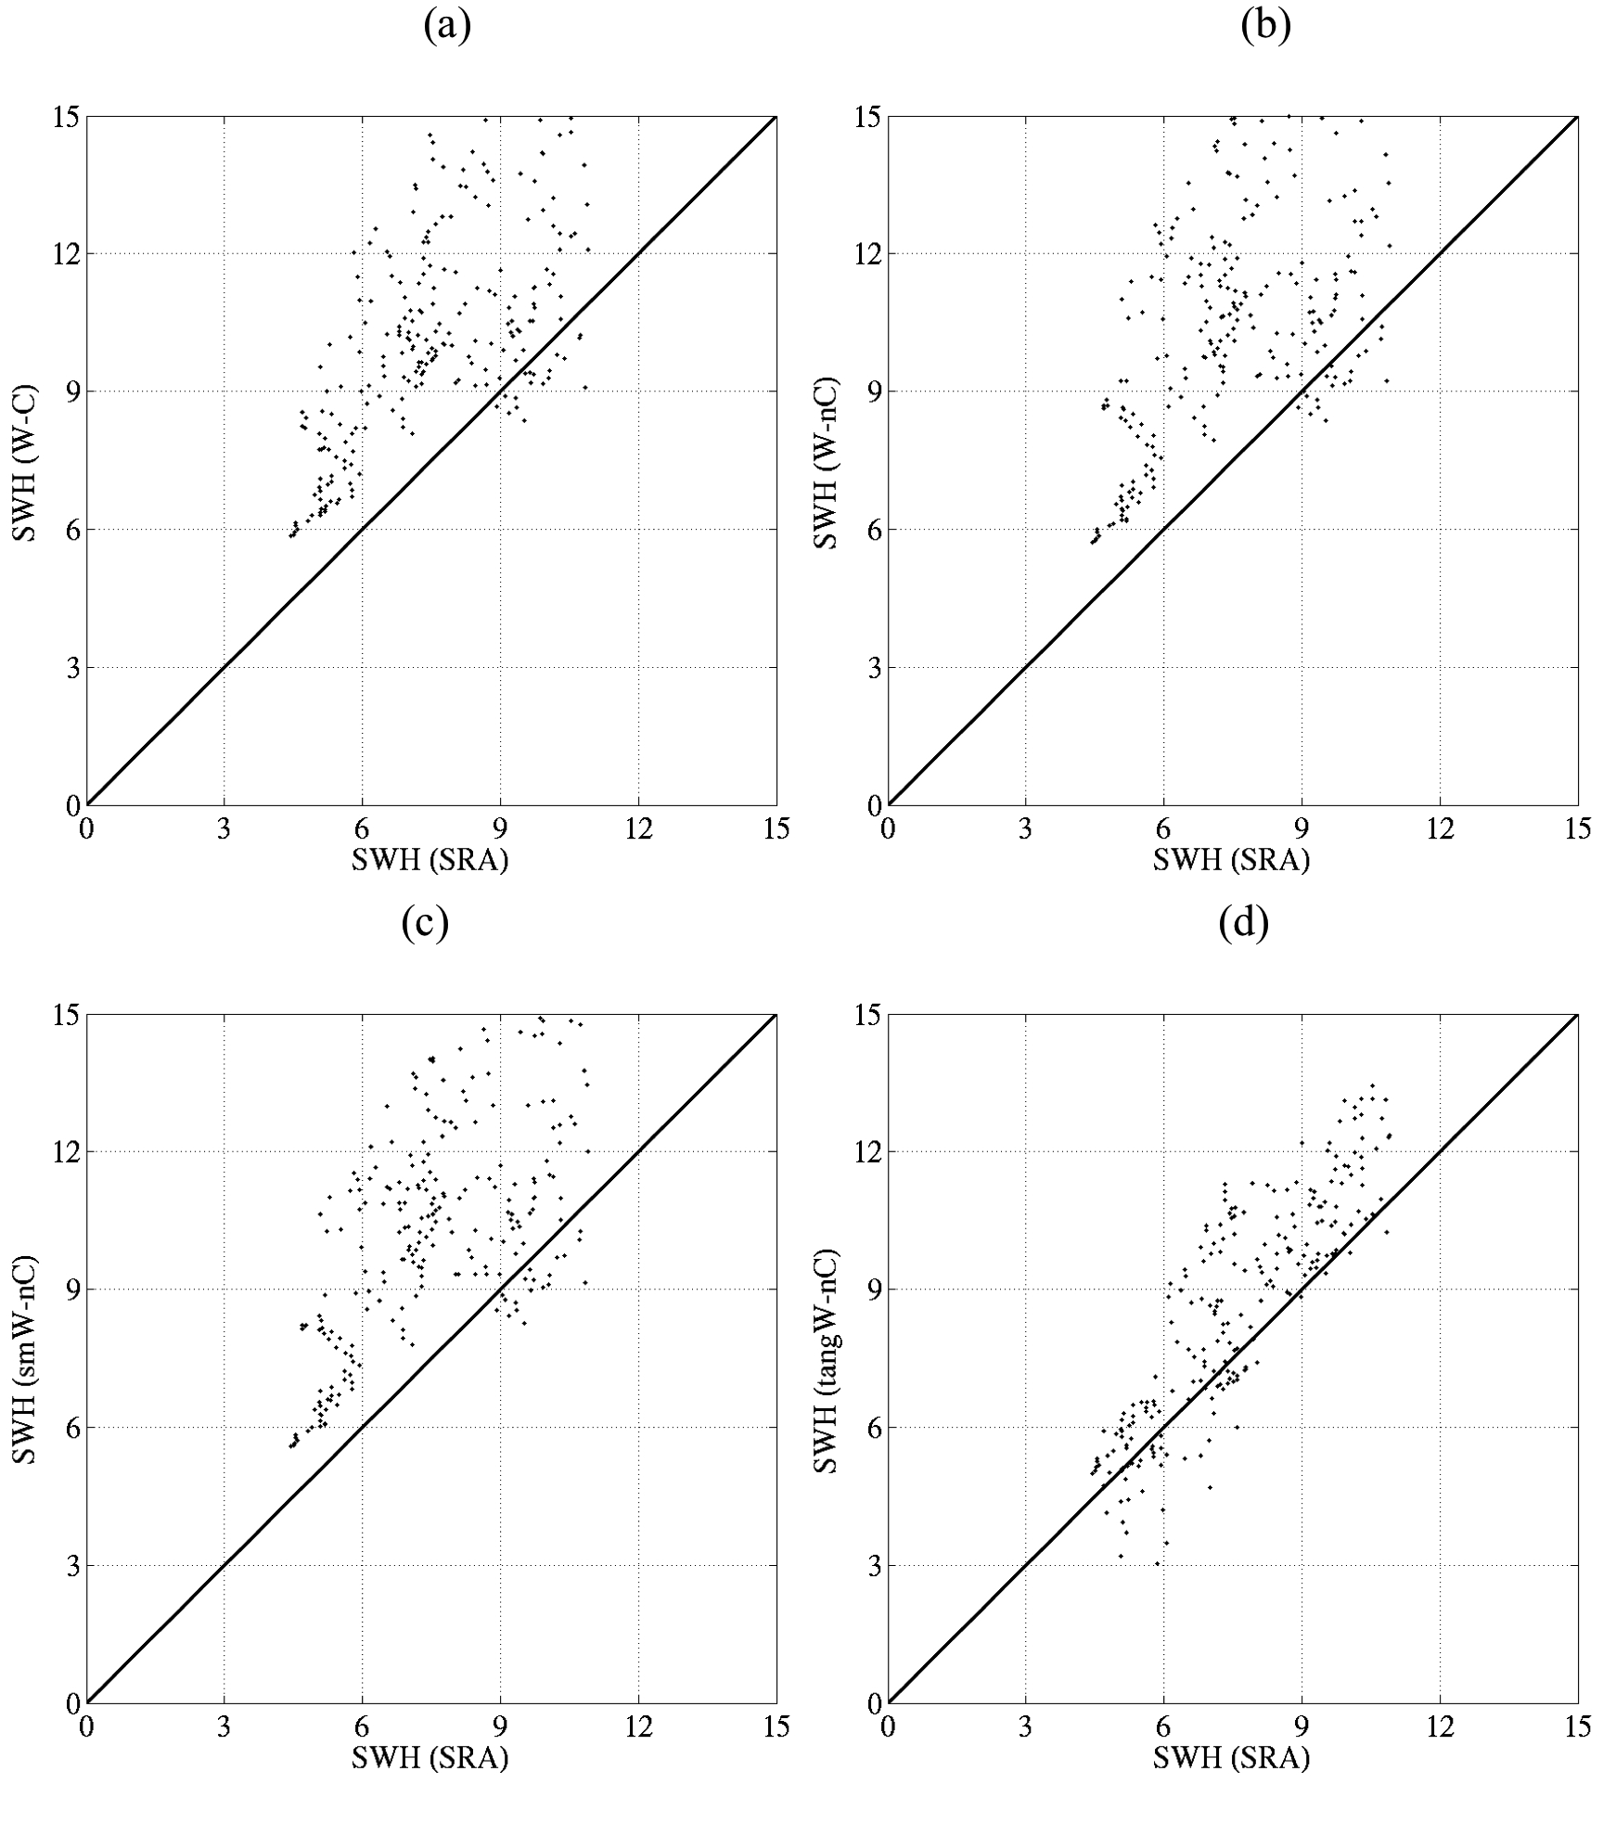
Winds / waves example #2
Coupler moved data only
Model
Model
High-resolution model resolving rain bands (gustiness for wave model)
Obs.
Obs.
Model
Model
Using smoothed winds
Obs.
Obs.
Courtesy Wei Zhao and Shuyi Chen

Slide 26
Winds /waves example #2
What is happening:
If wind scales (space and time) are better resolved due to direct data exchange in coupled models, in principle results will get better in wave model, until ….
Resolution gets so high that “gustiness” gets resolved in the model.
It is a little known fact that wave model are generally calibrated to implicitly account for unresolved gustiness,
If gustiness becomes resolved, double counting of growth occurs.
Solutions:
Remove gustiness scales in coupler,
Or update physics in wave model to become resolution dependent.

Slide 27
Winds examples
Ocean GCM
Wind waves
Atmosphere GCM
Coupler
Coupler needs to know scales in atmosphere used for waves.
Or wave model physics need to be modified to account for wind scales resolved.
Generic coupler needs both.

Slide 28
Conclusions for coupling models
There is a great benefit in having generic couplers for ocean-wave-atmosphere modeling of tropical cyclones.
Scientific interest.
Operational interest.
Toward MME approach.
We need to put some effort in doing the proper software design to make this work efficiently.
Need for having coupler process rather than pass information between models.
Need to use modular plug-compatible coupling code for sanity of modelers.
Multiple-input multiple-output tools.

Slide 29
Lessons learned
As mentioned before:
Better physics should result in better models.
But there is a more subtle reasons too:
Coupling forces you to take a closer look at details of the constituent models, in ways that are often complimentary to the way the models are conventionally validated.
ECMWF wave-atmosphere coupling.
This often leads to systematic improvement of the constituent models, that often has a positive impact on the constituent models, even if the actual coupling is found to be unnecessary or unsuccessful.
HYCOM - HWRF coupling.

Slide 30
Lessons learned
Lessons learned:
Coupled model makes further development of modeling system a little more complicated.
For me, this is an unavoidable side effect of doing things physically better.
The key of this kind of coupled modeling is in the fluxes.
A weather model with a fixed or climatological SST is naturally constrained in terms systematic seasonal – climate shifts, but,
in a coupled model there is no natural and automatic constraint to the ocean state, in particular to the mixed layer and SST.
Spurious drifts of the SST and mixed layer in general in the ocean wil result in spurious drifts in the weather model, with a strong possibility of (nonlinear) feedback

Slide 31
Lessons learned
Better physics makes for a better model.
But …, better physics in a well tuned model will almost always detune the model.
Developing this coupled model is a cyclic process:
First emphasis on getting the ocean right,
In the process, we found many issues with HWRF.
Not necessarily major issues for HWRF, but critical for realistic coupling with a realistic ocean model.
POM appears less sensitive to these errors as ocean responses appear suppressed to gain a more robust system.
Fixes and updates in the HWRF model require a return to making sure that all ocean responses are realistic.
…. and this will never stop …..

Slide 32
Lessons learned
For coupled HWRF:
Focus on bests possible description of physical states for all models.
Deal with de-tuning of model due to “improved” physics in two ways, as makes most sense.
Deal with this as bias treatment in coupler (quick and dirty).
Retune as possible, particularly when individual processes are documented to describe nature better (long term systematic approach).
We need to have a set of metrics for HWRF that reflects this, track and intensity alone will never work.

Slide 33
Lessons learned
In general:
Focus on bests possible description of physical states for all models.
“Flux correction” in coupler so that :
Major model does not deteriorate.
Added model represents physical state most accurate.
With best possible added model, get to work on the “major model”.
Automate flux corrections for added model?
Question: where does dev become ops?

Slide 34
Thank you !

