Slide 1
Observation impact study for tropical cyclones using WRF-based ensemble data assimilation system
March 6, 2012, NCEP EMC Seminar
Masaru Kunii and Takemasa Miyoshi
University of Maryland, College Park
kunii@atmos.umd.edu

Slide 2
Goals and approaches
Goal: Improve TC forecasts by
improving the initial conditions
WRF-LETKF system (Miyoshi and Kunii 2012)
  LETKF: Local Ensemble Transform Kalman Filter (Hunt et al. 2007)
  Adaptive inflation method (Miyoshi 2011)
Estimating observation impact using the ensemble-based method (Kunii et al. 2012)
  Based on the ensemble sensitivity method of Liu and Kalnay (2008)

Slide 3
WRF-based ENSEMBLE DA
̶ development of the WRF-LETKF ̶
Miyoshi and Kunii (2012, Pure and Appl. Geophys.)

Slide 4
WRF-LETKF flowchart
Atmospheric fields
Low boundary condition

Slide 5
The LETKF code is available at:
http://code.google.com/p/miyoshi/

Slide 6
Experimental settings
LETKF settings
WRF settings
Ensemble size | 20
Lateral boundary conditions | Unperturbed
Covariance inflation | Adaptive (Miyoshi 2010) Fixed 20% (smaller above level 20)
Covariance localization | 400 km, 0.4 ln p
Analyzed variables | u, v, w, T, ph, qv, qc, qr
Observation data | NCEP PREPBUFR
Domain size | 137 x 109 x 40
Horizontal grid spacing | ~ 60 km
WRF version | WRF-ARW 3.2.1

Slide 7
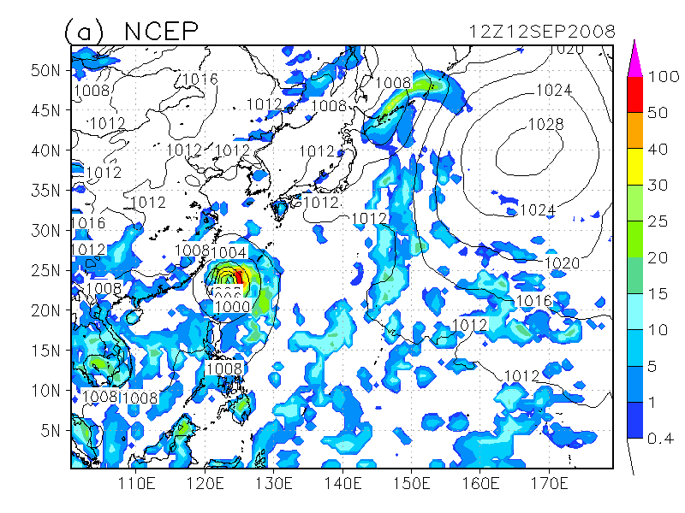
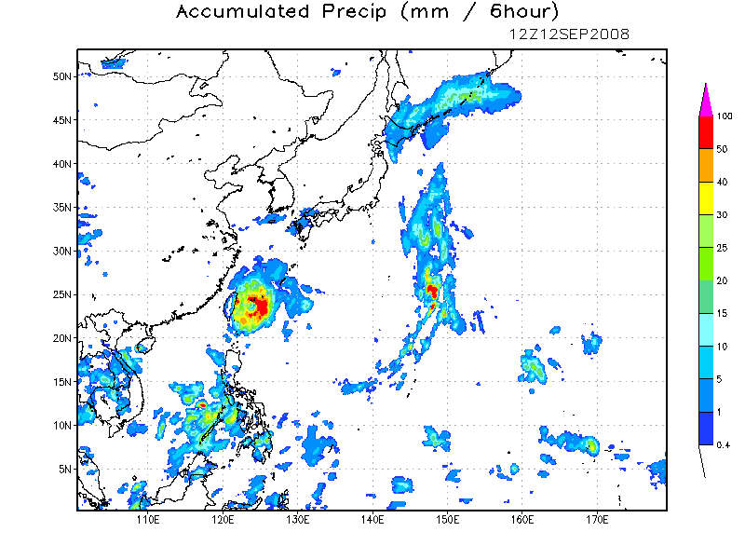
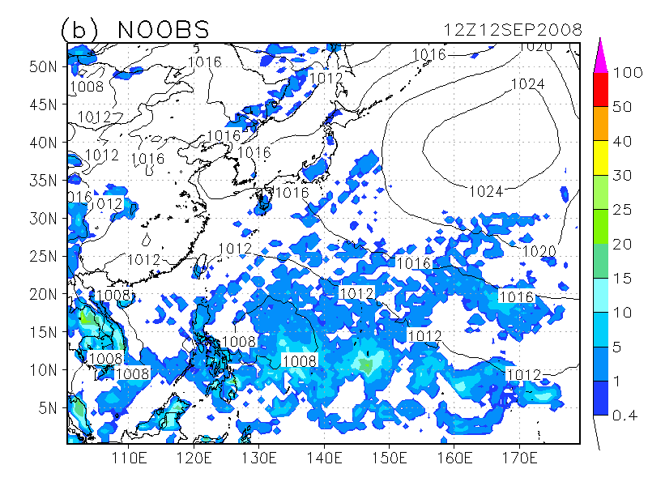
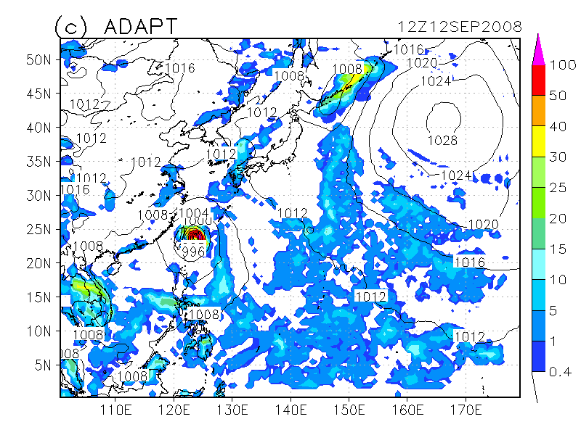
WRF-LETKF working properly
WRF 6-h forecast using each initial field (after 9 days cycle)
NCEP
GSMAP
NOOBS
LETKF
NOOBS: without observations (BC is updated every 6-h)

Slide 8
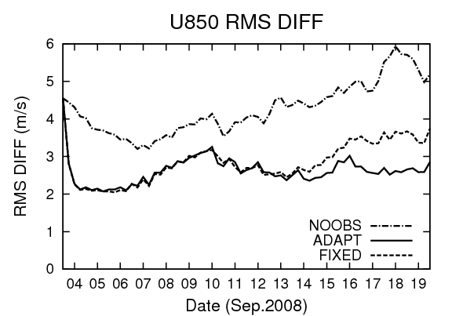
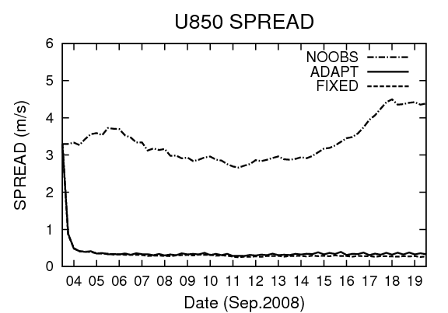
Time series (U850)
relative to GDAS
LETKF performs properly.
ADAPT shows significantly smaller RMS after 10 days cycle.
  It takes a while to spin-up the adaptive inflation parameters
Lateral boundary does not dominate the inner domain.

Slide 9
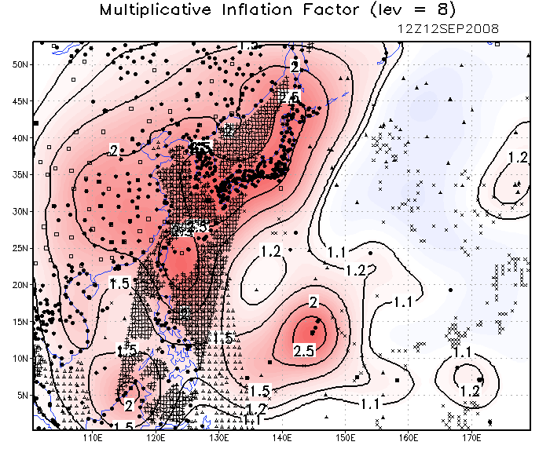
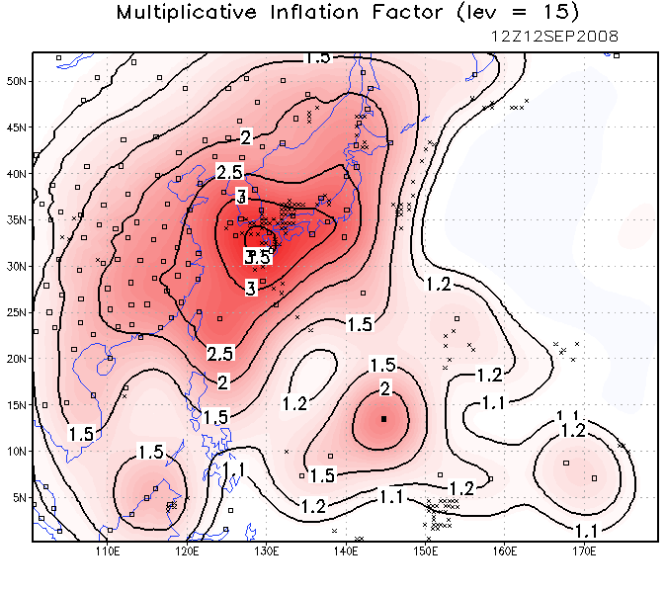
Adaptive inflation
Lower troposphere
Middle troposphere
● ADPSFC
▲ SFCSHP
□ ADPUPA
◇ AIRCFT
○ PROFLR
× SATWND
■ VADWND
△ SPSSMI
＋ QKSWND
Adaptive inflation accounts for imperfections such as model errors and limited ensemble size.
The large adaptive inflation values are estimated over the densely observed areas, which make the ensemble spread significantly larger in the densely observed areas.

Slide 10
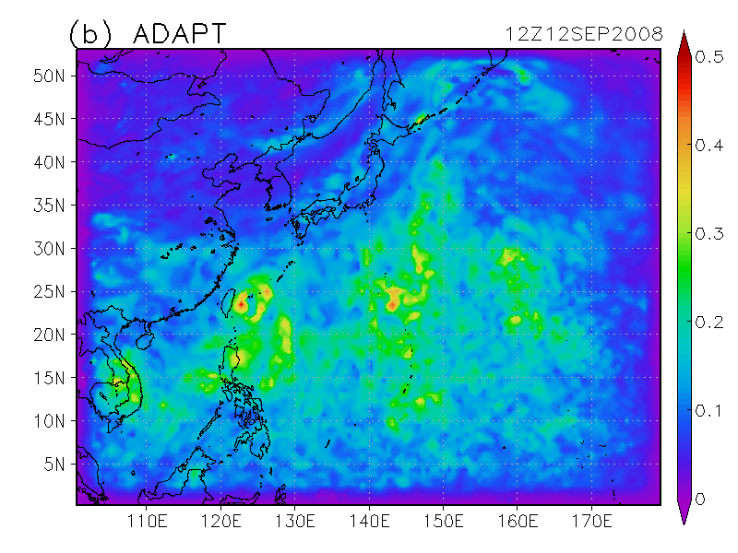
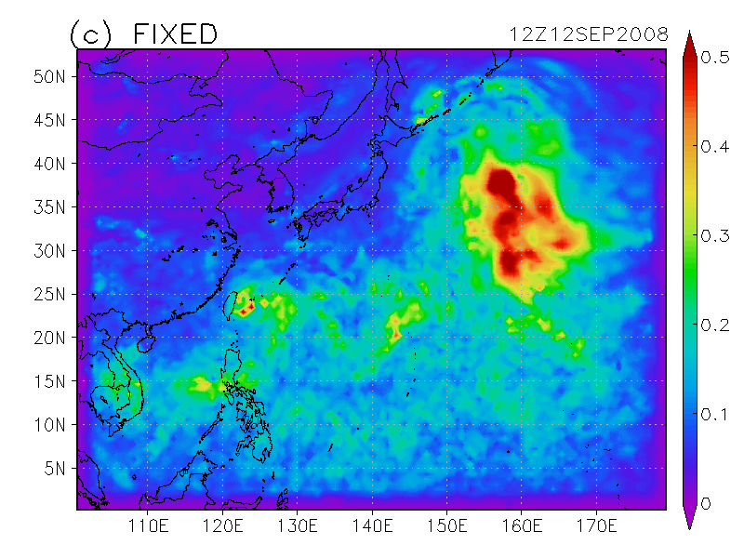
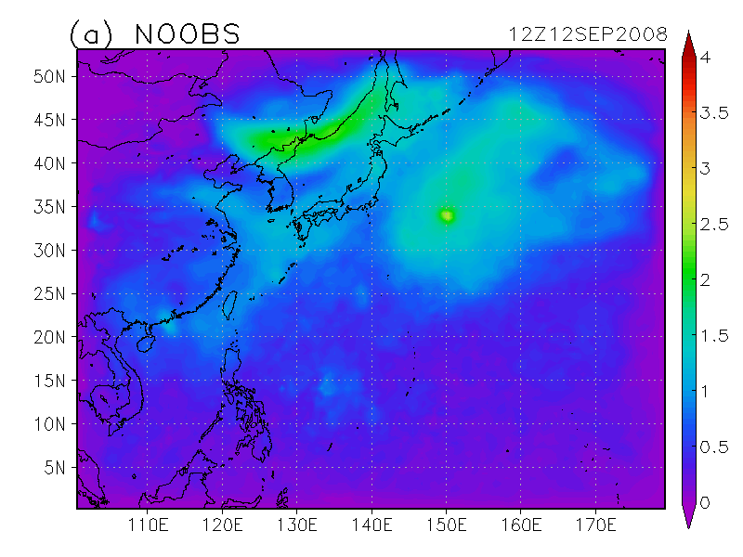
Ensemble spread (T500)
ADAPTIVE
FIXED20%
Too small (large) over the densely (sparsely) observed areas
Unperturbed BC is limited near the boundaries
NOOBS

Slide 11
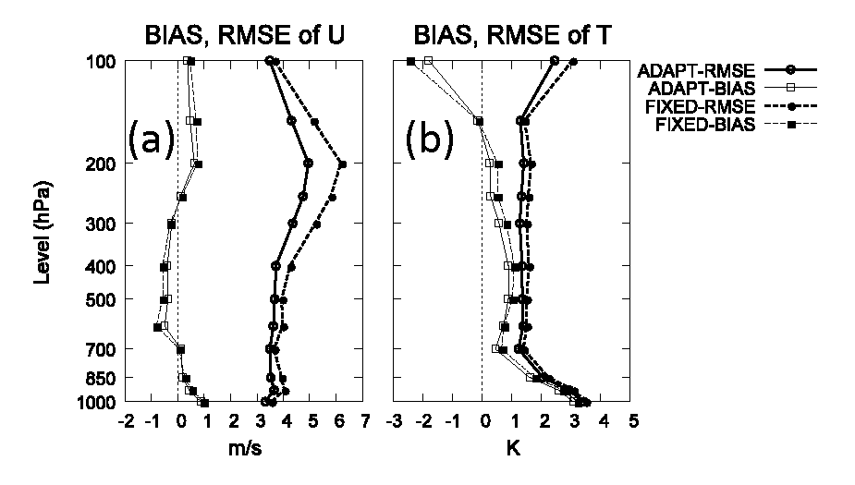
6-hr forecast vs. radiosondes
Adaptive inflation performs well.

Slide 12
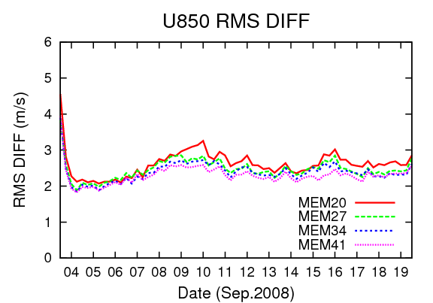
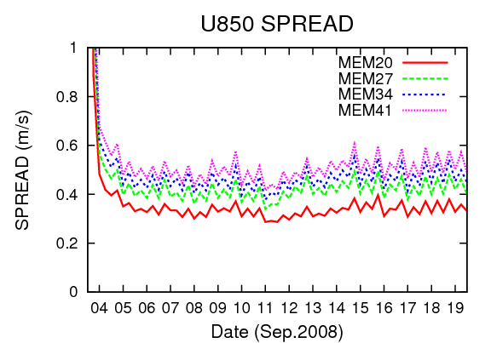
Sensitivity to the ensemble size
relative to GDAS
Consistently better with more members.
More members, the larger the ensemble spread.

Slide 13
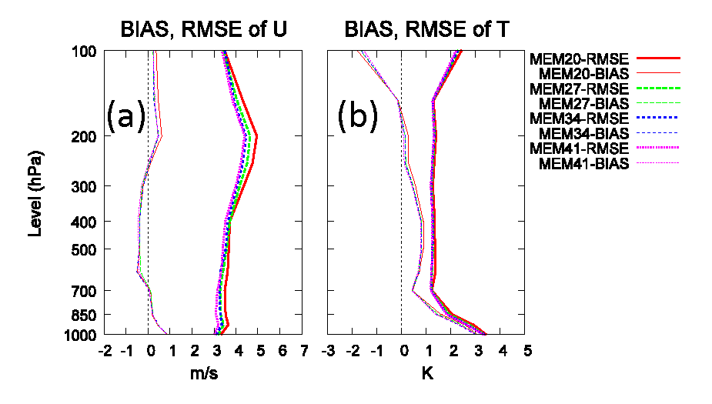
Sensitivity to the ensemble size
Consistently better with more members.
For temperature, increasing the ensemble size more
than 27 does not show much improvement.

Slide 14
Conclusions (1)
The WRF-LETKF system performed properly with real observations.
Adaptive inflation performed very well.
More ensemble members yielded consistently better analyses.
  Roughly linear increase of the computational time

Slide 15
Ensemble sensitivity
̶ estimating impact of observations ̶
Kunii, Miyoshi and Kalnay (2012, Mon. Wea. Rev.)

Slide 16
Introduction
Traditionally, observation impact has been estimated by carrying out the data denial experiment (expensive).
Methods to estimate observation impact without data denial experiment:
  Adjoint-based method (Langland and Baker 2004)
  Ensemble-based method (Liu and Kalnay 2008; Li et al. 2010)
In this study
  Estimate impact of real observational data with the WRF-LETKF system using the ensemble-based method.

Slide 17
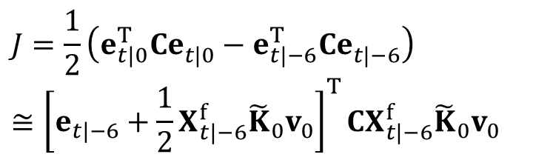
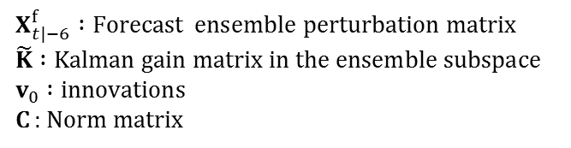
Ensemble Sensitivity
Observation impact is calculated without an adjoint model (Liu and Kalnay 2008; Li et al. 2010).
We applied the above method to real observations using the WRF-LETKF system.
This difference comes from obs at 00hr

Slide 18
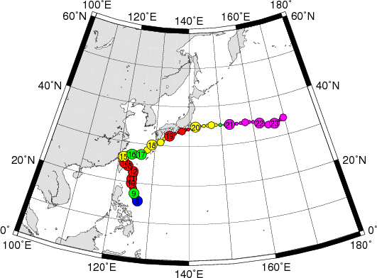
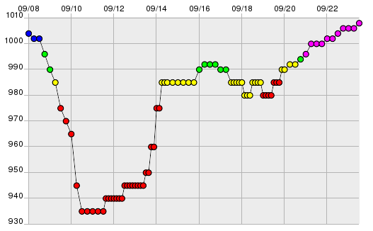
Experimental settings
OBSIMP settings
Verification time | 12 h
Norm | Kinetic Energy (KE)
TY0813 (SINLAKU)
Track
MSLP

Slide 19
Total observation impacts
The observation impacts and the number of observations
(summed from 1200 UTC 8 September to 0000 UTC 13 September 2008)

Slide 20
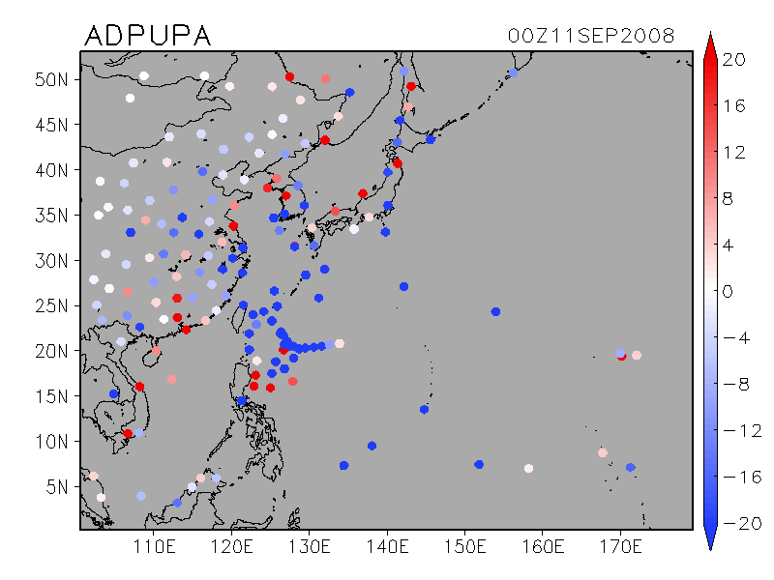
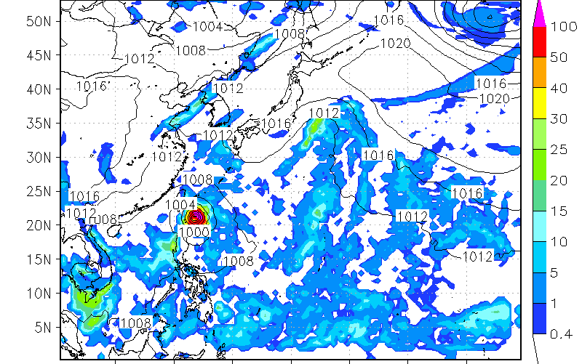
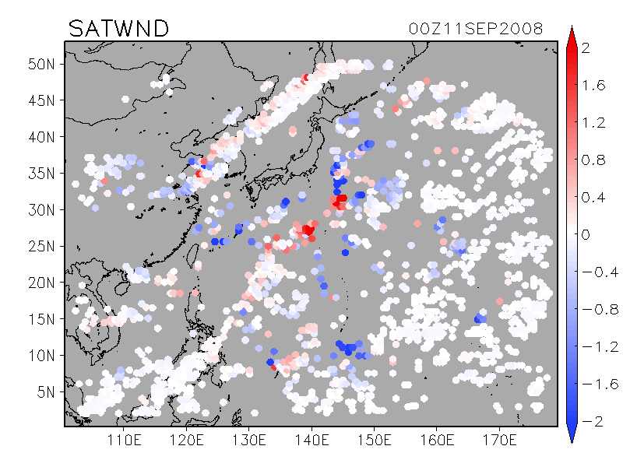
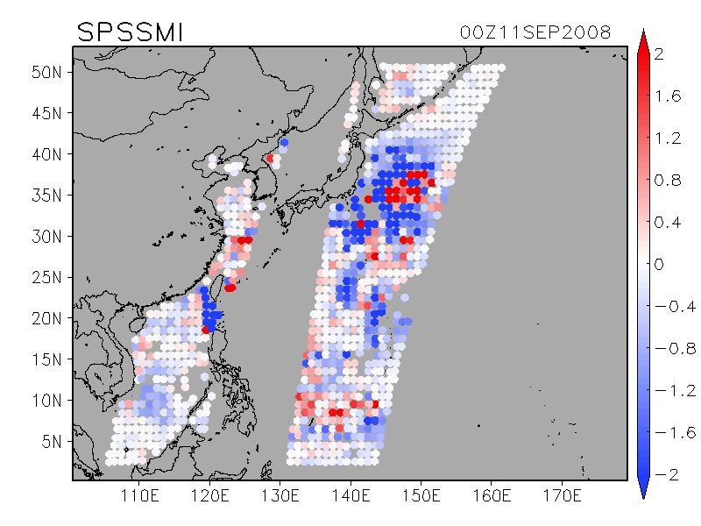
Impacts of each observation
00UTC Sep. 11 2008
Forecast error reduction (J/kg, KE)
SONDE
Degrading
TY Sinlaku
Improving
AMV
SPSSMI
Degrading
Degrading
Improving
Improving

Slide 21
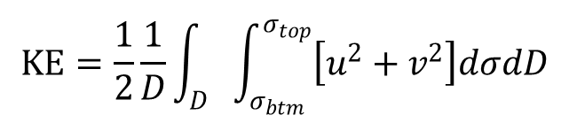
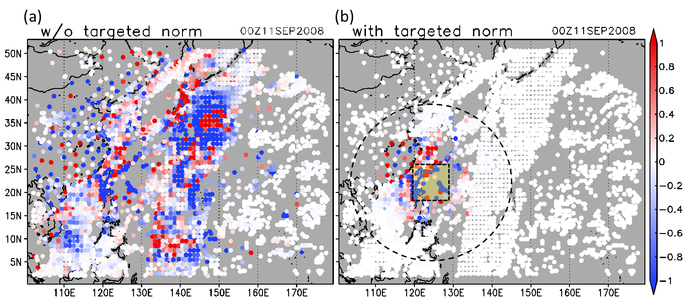
Targeted norm
Targeted kinetic energy norm
The observation impact is estimated for a particular weather event.
Target area (10° by 10°) around Sinlaku

Slide 22
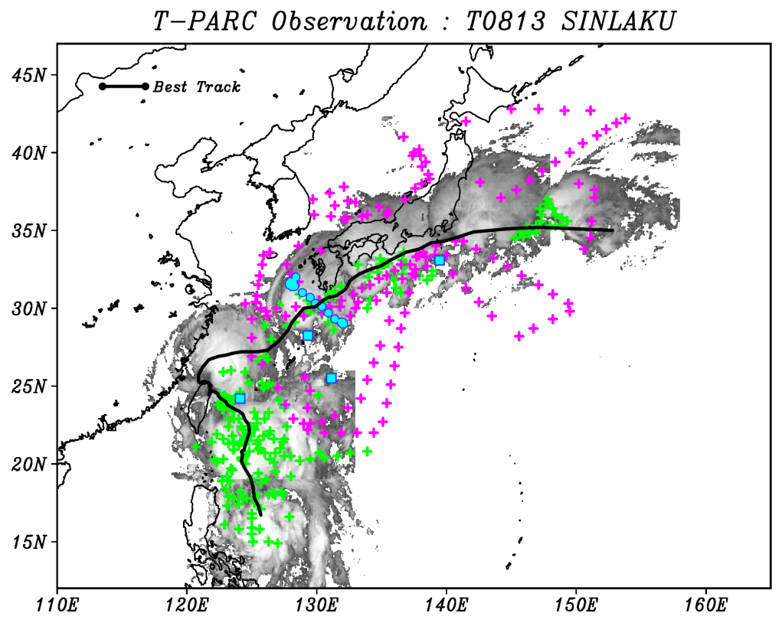

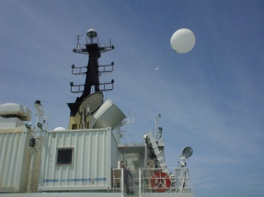

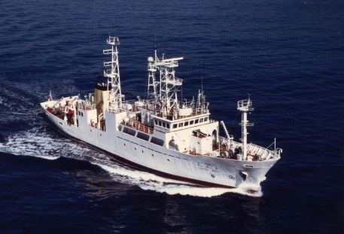
Dropsonde OBS in T-PARC2008
T-PARC2008
  THORPEX Pacific Asian Regional Campaign
  Research the mechanism of genesis, recurvature and extratropical transition for tropical cyclones in the northwestern Pacific.
  Improve the performance of numerical weather prediction for tropical cyclones.
Aircrafts
-- : Best track
+ : Falcon
+ : P-3, WC-130, DOTSTAR
● ■：JMA Observatories and Vessels
Vessels

Slide 23
Impact of dropsondes on Sinlaku
Estimated observation impacts
06 UTC Sep. 10 2008
00 UTC Sep. 11 2008
06 UTC Sep. 11 2008
Degrading
Improving

Slide 24
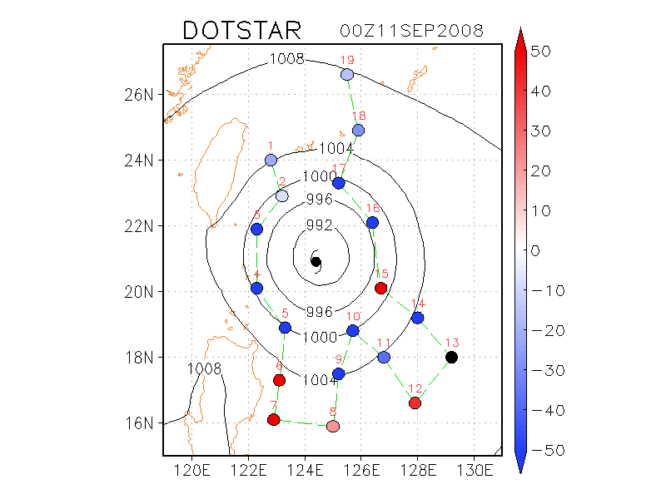
Impact of dropsondes on Sinlaku
Estimated observation impact
Degrading
Do the impact estimates correspond to actual degradation or improvement of the forecast ?
OSE Experiment
Denying 5 negative-imp obs
Denying 5 positive-imp obs
TY Sinlaku
Improving

Slide 25
OSE (denying negative-impact obs)
Estimated observation impact
Typhoon track forecast is actually improved!!
OSE forecast
36-h forecasts
Observedtrack
FT=12
TY Sinlaku
Original forecast

Slide 26
OSE (denying positive-impact obs)
Estimated observation impact
Typhoon track forecast is slightly degraded.
OSE forecast
36-h forecasts
Observedtrack
FT=12
TY Sinlaku
Original forecast

Slide 27
Forecast error changes in OSEs
The ensemble sensitivity method underestimates the actual error change. ← localization, sampling error
OSE
(denying positive-imp obs)
OSE
(denying negative-impact obs)

Slide 28
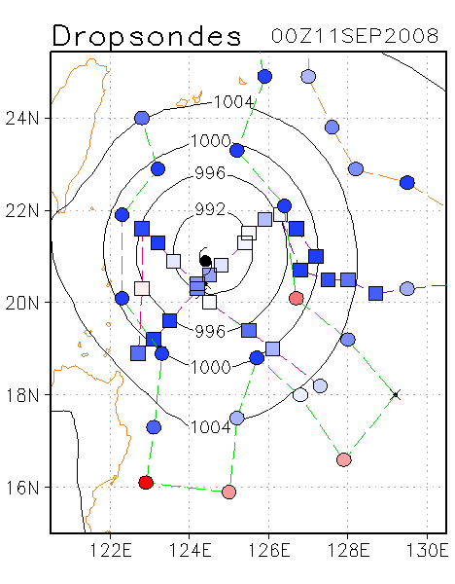
A new question arises.
Impact of multiple flights
○ Upper level (> 600 hPa)
□ Lower level (< 600 hPa)
DOTSTAR
DLR Falcon
What level or what kind of observations tend to have large positive impacts on the TC forecasts?
NRL P-3
WC-130J
Investigate the impacts of dropsondes deployed in the
T-PARC2008 and ITOP2010.

Slide 29
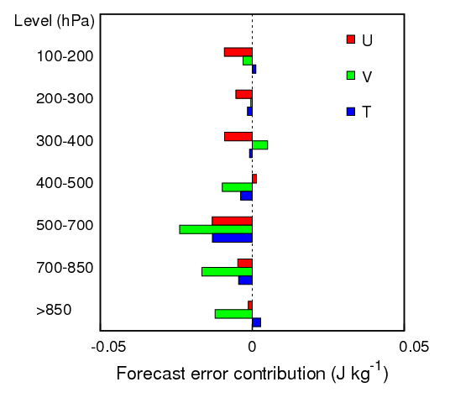
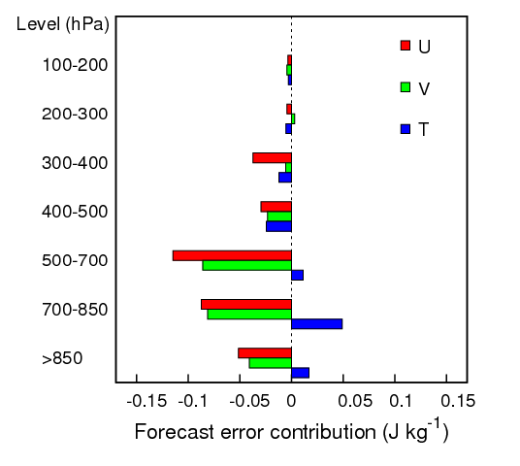
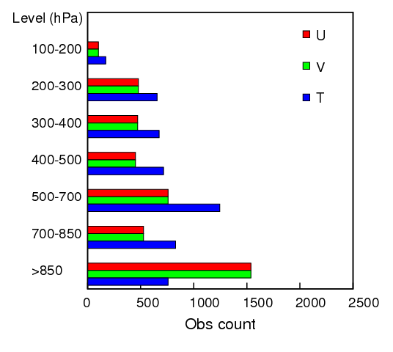
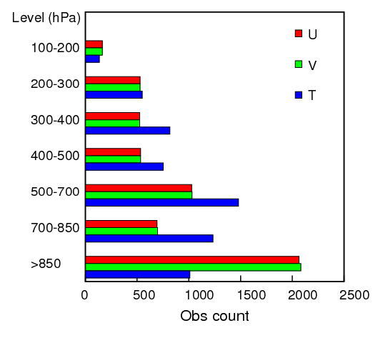
Overall impacts of dropsondes
T-PARC 2008
ITOP 2010
improving
degrading
improving
degrading

Slide 30
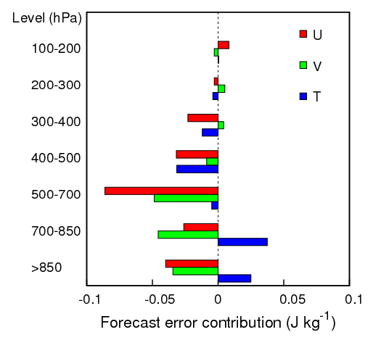
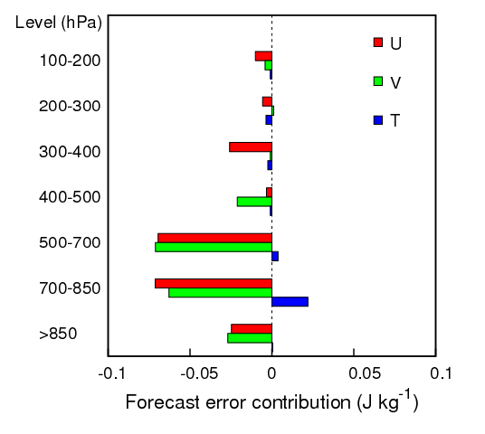
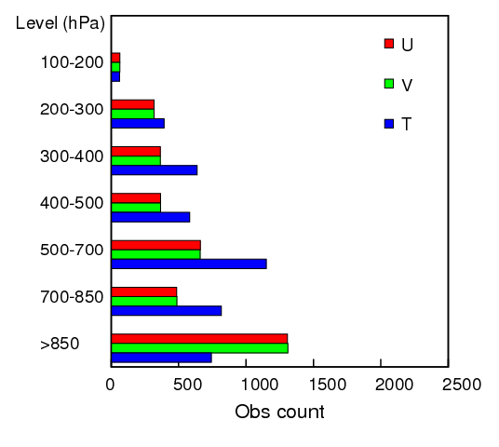
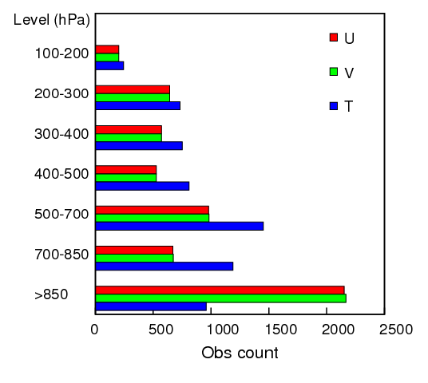
Overall impacts of dropsondes
CAT 2 - 4
CAT 5
improving
degrading
improving
degrading

Slide 31
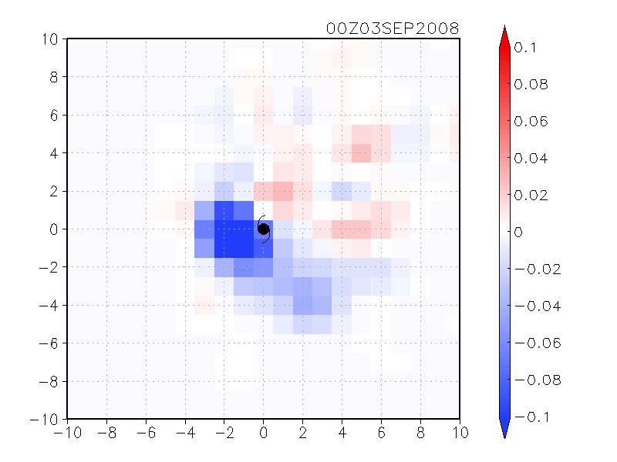
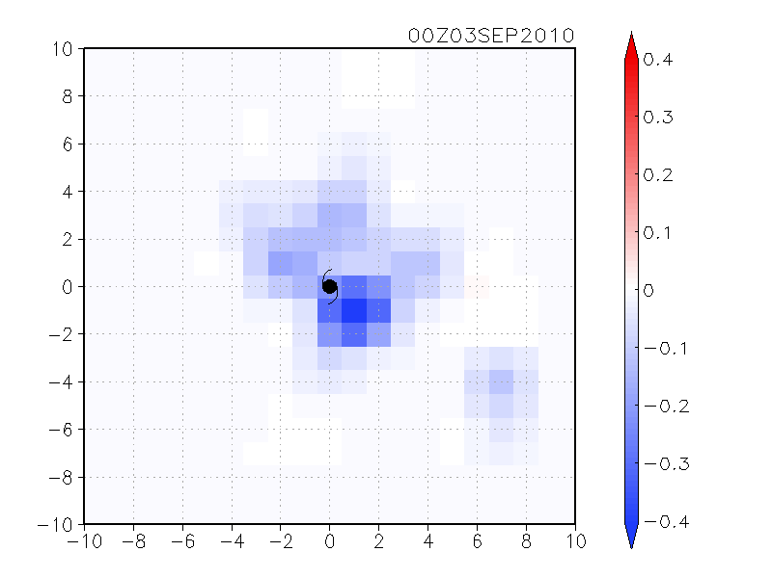
Composite of dropsonde impacts
Dropsonde impact (J kg⁻¹) per observation count
Location relative to the TC center
T-PARC 2008
ITOP 2010
N
×100 km
×100 km
Further statistical investigations are currently in progress.

Slide 32
Conclusions (2)
The ensemble sensitivity method successfully estimated the impact of real observations with the WRF-LETKF system.
The OSE experiments were consistent with the ensemble-based sensitivity estimates.
Dropsondes around TCs have large positive impact at middle and lower levels.
More statistical investigations are currently in progress.

