Slide 1
Spatial Error Metrics for Model Verification
Sean Ziegeler
Notes:
A new type of error metric that could be used for model validation
- here as ocean, but weather, or any computational model needing verification

Slide 2
Overview
Model Validation
  Traditional validation
Deformable Registration
  3 Components of Registration
Effectiveness Study
  Design & Implementation
  Pre-trials
  Final trials
  Results
Notes:
* Model val & trad
* Def Reg used to determine Spatial Error
* A study on the effectiveness of Spatial Error

Slide 3
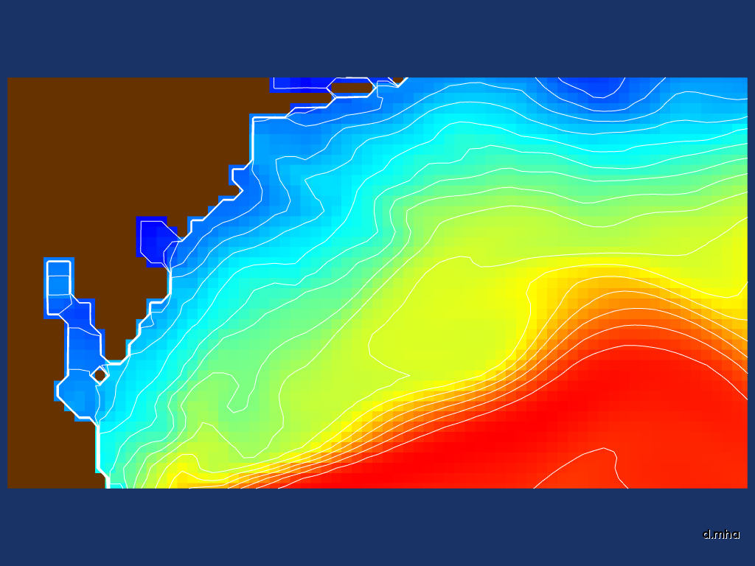
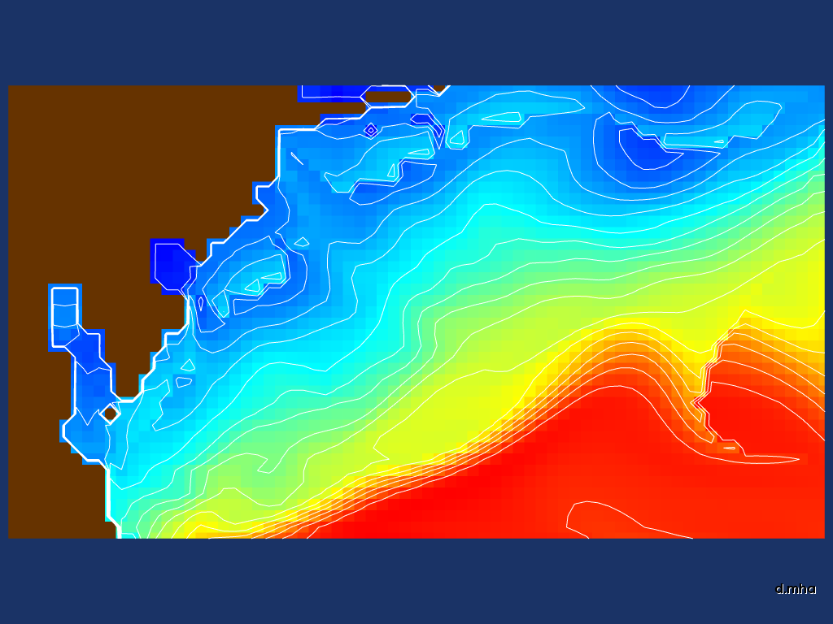
Notes:
Climate, Weather, and Ocean models must be validated before they can be trusted for operational scenarios. Validation is performed by comparing a model forecast to the later known “ground truth.”
- Example: take 24 hour forecast of temperature, wait until tomorrow
compare to actual temperature, using satellite data
- This isn’t using satellite data, but what’s called an analysis field

Slide 4
= 0.579
= 0.978
Notes:
The most common validation methods include computing metrics – single or a few numbers that reflect the statistical similarity between the forecast and ground truth.
AFTER:
This does not indicate the differences in feature location. That is, a slight shift in the location of a feature can heavily penalize these scores, even if the model is mostly correct.

Slide 5

Notes:
One traditional means of comparison is simple visualization; in this example, switching between the forecast result and ground truth. BUT not just a simple swap but a “morphing” between the two. This is good for showing differences in both values and locations but doesn’t provide a quantitative result.

Slide 6
Notes:
Another method is to subtract a forecast from the ground truth point-by-point, creating a difference image. In this example, the brighter areas indicate locations of greater difference between the forecast and truth. Although, this also does not provide a quantitative result, and suffers from the same spatial offset penalization as the trad. metrics.

Slide 7
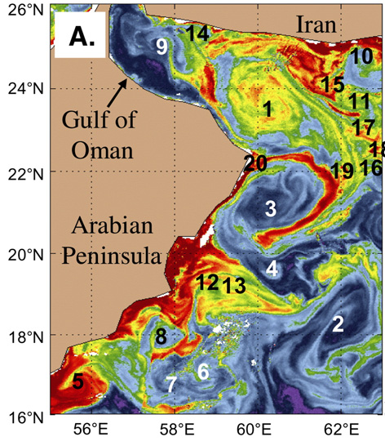
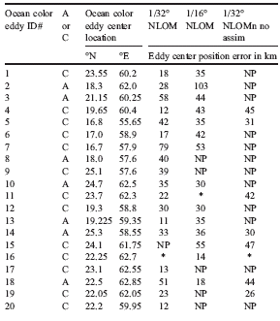
From: “1/32º real-time global ocean prediction and value-added over 1/16º resolution,” J.F. Shriver, H.E. Hurlburt, O.M. Smedstad, A.J. Wallcraft, R.C. Rhodes, Journal of Marine Systems, 65, 2007, pp. 3-26
Notes:
An accurate method has an expert manually locate features, such as eddies or fronts, in one or more forecasts and the truth, then measure the error distance between the features by hand. This can be condensed into quantitative results, but is quite laborious.

Slide 8
Deformable Registration
Forecast
Truth
Notes:
We’re proposing an automated method for determining these spatial displacements. “Registration” is a method that warps or “displaces” one image to look like another. CLICK
This creates displacements everywhere along the forecast data, which can be represented by vectors. The displacement can be utilized as a form of error measurement.

Slide 9
Deformable Registration
Value added:
  Provides consistent spatial error units
  (e.g., meters) instead of scalar units
  (e.g., degrees-C)
  Accounts for proper representation of features, even if features were displaced
Probably best as accompanying metrics, not necessarily a replacement
  Handling of missing features
Notes:
Different kinds of registration: using “deformable,” i.e., non-linear transforms to effect the displacements.

Slide 10
Spatial Vs Amplitude Error
Notes:
Imagine some location, region of interest, … has a feature
THEN in the ground truth

Slide 11
Spatial Vs Amplitude Error
−
+
~ 0
|e₋| + |e₊| + … or
(e₋)² + (e₊)² + …
Notes:
Amplitude/intensity error near zero where overlapping
|abs| or squares add up
Not really an amplitude error → Spatial

Slide 12
Registration Process
Analysis
Difference Criterion
Optimizer
Transformed
Forecast
Forecast
Displacement
Field
Transform
Notes:
Registration consists of three recurrent operations: the difference criterion, the optimizer, and the transform.
[click]
Occur in a loop.

Slide 13
Transform
Analysis
Difference Criterion
Optimizer
Transformed
Forecast
Forecast
Displacement
Field
Transform

Slide 14
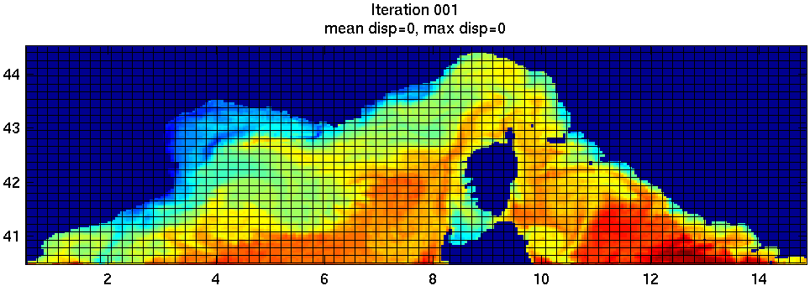
Transform
Notes:
The transform is a B-spline grid imposed on the forecast data. The B-splines are adjusted at the control points, where the splines intersect, and create the warping in the underlying data.

Slide 15
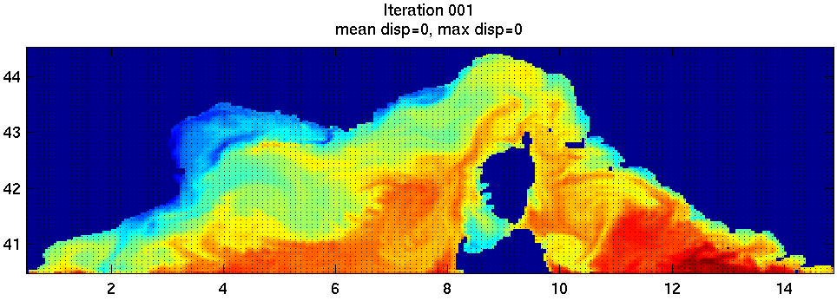
Transform
Notes:
The B-splines can be converted directly to displacement vectors at each data point. The displacement represents the shift in position of the data points from the forecast to the truth.

Slide 16
Difference Criterion
Analysis
Difference Criterion
Optimizer
Transformed
Forecast
Forecast
Displacement
Field
Transform
Notes:
Measure of difference between forecast and ground truth
… how you know if transform warping is actually improving
(aka. Cost function, …)

Slide 17
Difference Criterion
Mutual Information (MI)
Notes:
The difference criteria measures the difference between the two data sets while the displacement is applied
… might look familiar

Slide 18
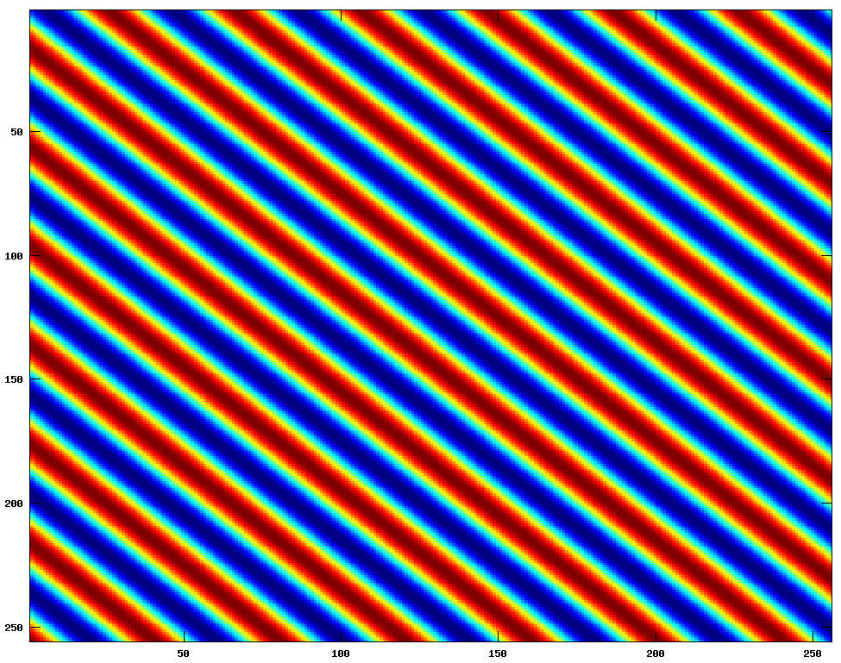
Mutual Information
Information Entropy
Notes:
- Basics of concept of info entropy
PDF est. by hist

Slide 19
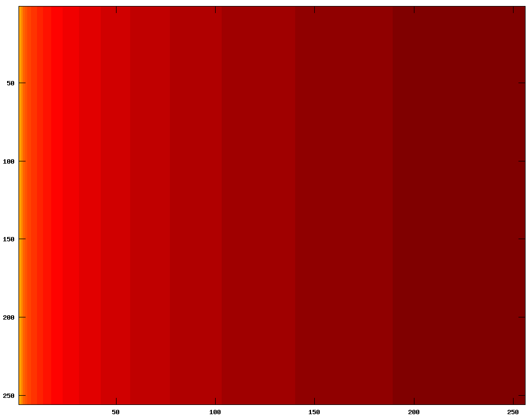
Mutual Information
Information Entropy

Slide 20
Joint Entropy
Notes:
So can be computed with a bunch of histograms.
Though tend to use more advanced PDE estimations (e.g, kernel density estimators) in practice.

Slide 21
I(F;G)
H(F,G)
Notes:
Can show first equation is just the same as H1+H2-H12
Talking a lot about the math, but conceptually, it’s just the information shared between the two.

Slide 22
Optimizer
Analysis
Difference Criterion
Optimizer
Transformed
Forecast
Forecast
Displacement
Field
Transform
Parameter space is x/y of each control point
Result is the difference criterion value
Several methods available:
  Gradient Descent, Quasi-Newton (L-BFGS-B), Conjugate Gradient (FR), Stochastic and Evolutionary

Slide 23
Configuration Issues
Which difference criterion?
Which optimizer?
Other options:
  Multi-resolution (use or not; # of levels?)
  Spacing of control points for transform
  Linear vs cubic interpolation in transform
  Mutual information histogram bins
  Direct metric or use gradient
  How to handle masks for land / non-data

Slide 24

Study Implementation
Insight Segmentation & Registration Toolkit (ITK)
  Provides classes for transform, metrics, optimizers, …
  Even options for mask handling
  Has examples for multi-resolution
  Oriented toward medical image processing
http://www.itk.org/

Slide 25
Synthetic Displacement
Create a “fake” transform
  Use current vector field as basis for the displacement
  How closely can registration reconstruct the synthetic displacement field?
Synthetic displacement + synthetic biases
  Simple addition of a constant value
  Addition of low and high frequency sinusoidal

Slide 26
Synthetic Displacement
First, run several pre-trials with a few (5) arbitrarily selected data sets
  Start with configurations/parameters recommended by the literature
  Determine which parameters universally work
  Determine which don’t have a clear, single setting
Based on pre-trials, run full study with:
  20 data sets from NCOM model output in 2009
  & 24 time steps (2 per month) each

Slide 27
Pre-trial Results
Transform
  Control point spacing of 6 or 8 works best
    Which of the two varies from one data set to the next
    Except very small data sets (32x32), 4 is better
  Must use multi-resolution data
    Use enough levels to get smallest level to ~64x64
  Must also resample control points to be spaced 6-8 at each resolution
  Linear vs. Cubic interpolation varies between data sets

Slide 28
Pre-trial Results
Difference Criterion
  MI seems best, but no clear winner, especially in bias situations
  MI is fastest, NC very slow
  MI requires enough histogram bins, especially for low-gradient areas in data sets
    Minimum of 64 bins for lowest resolution
    Also need to double bins at each higher resolution
  Effectiveness of using gradient varies between data sets

Slide 29
Pre-trial Results
Optimizer
  Regular-step gradient descent (RSGD) too slow to converge and too sensitive to initial step size
  Fletcher-Reeves (conjugate gradient) and L-BFGS-B much faster due to better adaptive step size
  Simultaneous Perturbation Stochastic Approximation (SPSA) and One-Plus-One Evolutionary (OPOE) too slow to converge due to not accounting for gradient

Slide 30
Pre-trial Results
Land Masks
  Must be handled properly to get good convergence
  Improper handling caused:
    Convergence to poor results
    Results sometimes better not using masks at all

Slide 31
Pre-trial Results
Land Masks: Needed the following:
  Re-implement multi-resolution interpolation to ignore masked data points
  Leave masked data points out of MI min/max
  Propagate a continuous boundary condition throughout masked area
    For gradients and interpolations near land

Slide 32
Final Trial
Run synthetic displacements on all data sets
Compare the following variations:
  MS vs. NC vs. MI difference criteria
  Direct value vs. gradient criteria
  Linear vs. cubic interpolation
  6 vs. 8 control point to data point spacing

Slide 33
Final Trial Results
Normalized Displacement RMSE
Mean Square
Normalized Correlation
Mutual Information
Linear Interp
Cubic Interp
Value
Grad
6
8
Notes:
-- Gradient is consistently worse except “Add C” for MS, but still worse than MI for “Add C”
-- MS worst for “Add C”; MI best -- MI seems best for “No Bias” -- Sin’s inconclusive
-- Linear vs. Cubic inconclusive -- 8 maybe slightly better than 6

Slide 34
Final Trial Results
Can discard gradient-based metric in this case
Each of MS/NC/MI can be compared respectively
  Choose the minimum of each optimized metric

Slide 35
Final Trial Results
Normalized Displacement RMSE
Notes:
-- MS much worse for Add C; MI best -- MI best for No Bias
-- Sin-low roughly same -- MI slightly worse for Sin-high

Slide 36
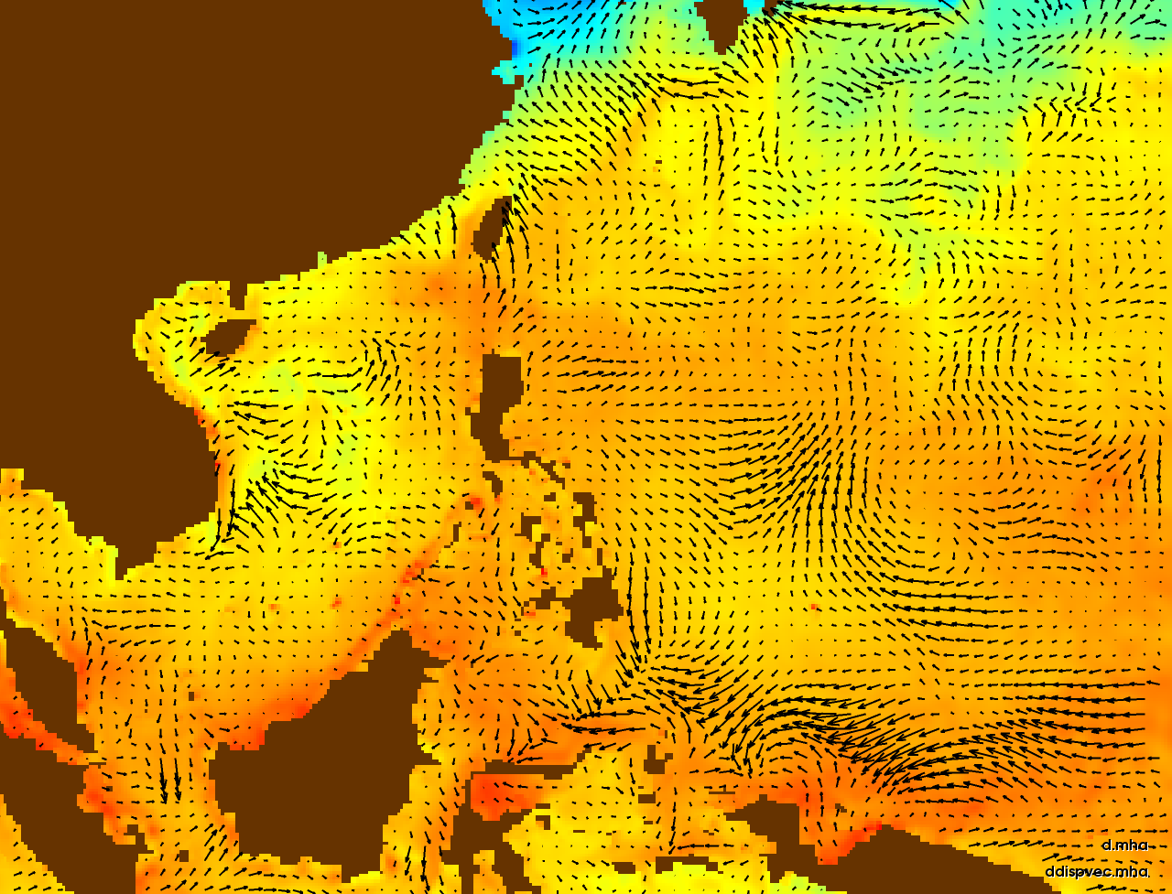
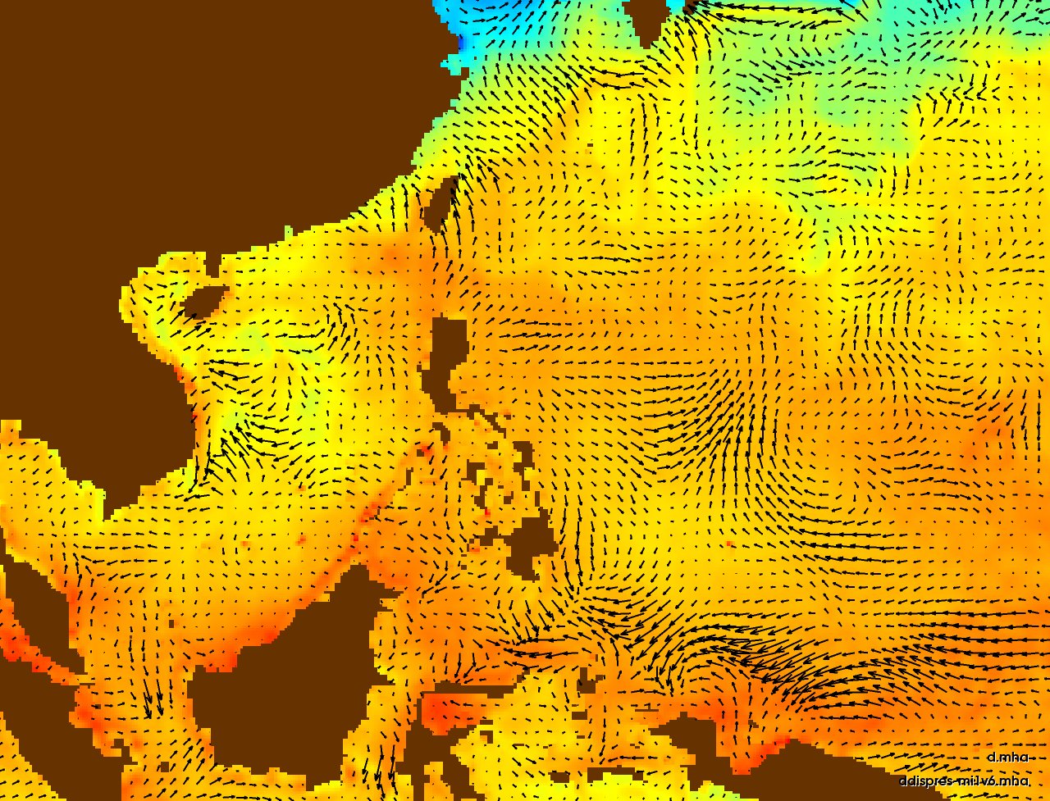
Synthetic displacement field
Displacement field recovered by registration (mutual information, linear, 6-spacing, no gradient)

Slide 37
Synthetic displacement field
Displacement field recovered by registration (mutual information, linear, 6-spacing, no gradient)

Slide 38
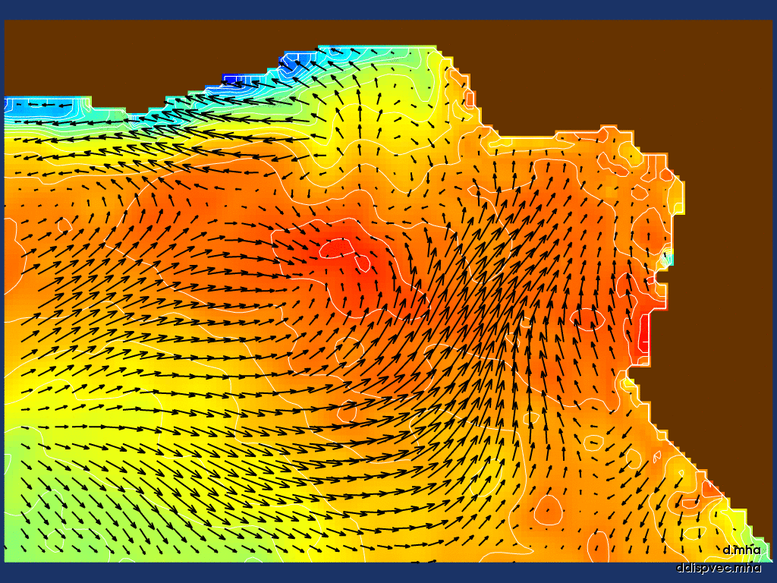
Vectors: Synthetic Displacement
Scalars: Animating from Synthetic Forecast to Analysis

Slide 39
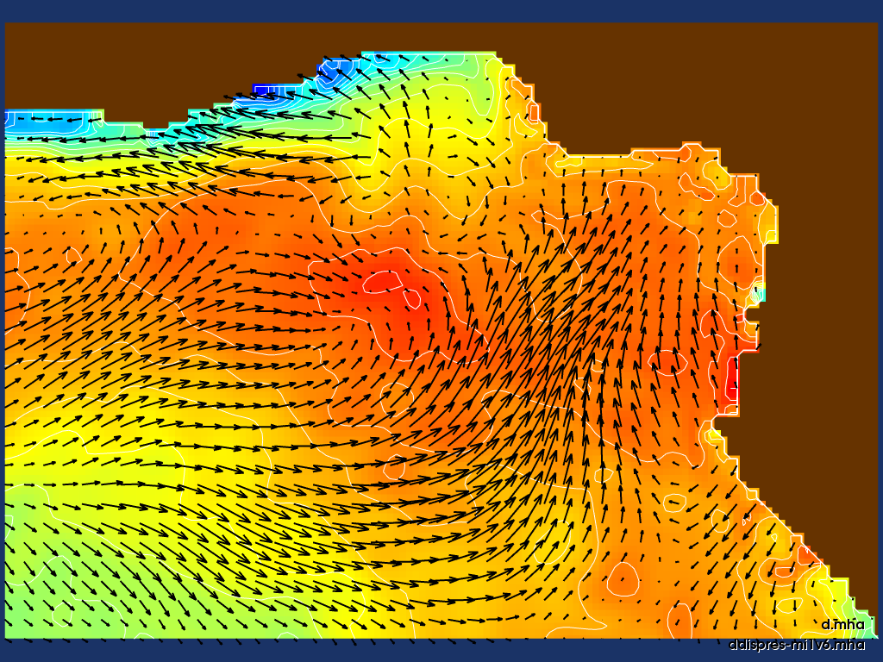
Vectors: Recovered Displacement (mi1v6)
Scalars: Synthetic Forecast (high-freq sinusoid)
Notes:
1: Flip back & forth
2: Notice upper left: strong gradient & moderate displacement

Slide 40
Notes:
Note high-end diff of 0.3
Most of that is near the top with displacement of strong gradient

Slide 41
Spatial Vs Amplitude Error
~ 0
Notes:
Could “correct” the displacement errors, then apply standard metrics…

Slide 42
Notes:
First notice the upper scale of difference
High freq. sin. on land

Slide 43
Conclusions
MI best overall for these test cases
  As expected, handles low-entropy biases
MI also fastest
Gradient not useful in these cases
Linear vs. cubic, and control spacing varies per data set
  But can choose the one that best optimizes criteria
Pay attention to land masks

Slide 44
Future Work
Adaptive KDE MI for difficult areas
User-based study with real displacement
Application to other ground truth types
  Assimilation systems, satellite imagery
Optical Flow & FEM-based deformable registration
  Spatial Uncertainty
Explore MI alone

Slide 45
Acknowledgements
Jim Dykes Meteorology
  Naval Research Laboratory - Stennis
Jay Shriver Oceanography
  Naval Research Laboratory - Stennis

Slide 46
Questions?
Sean Ziegeler
sziegeler@hpti.com

