Slide 1
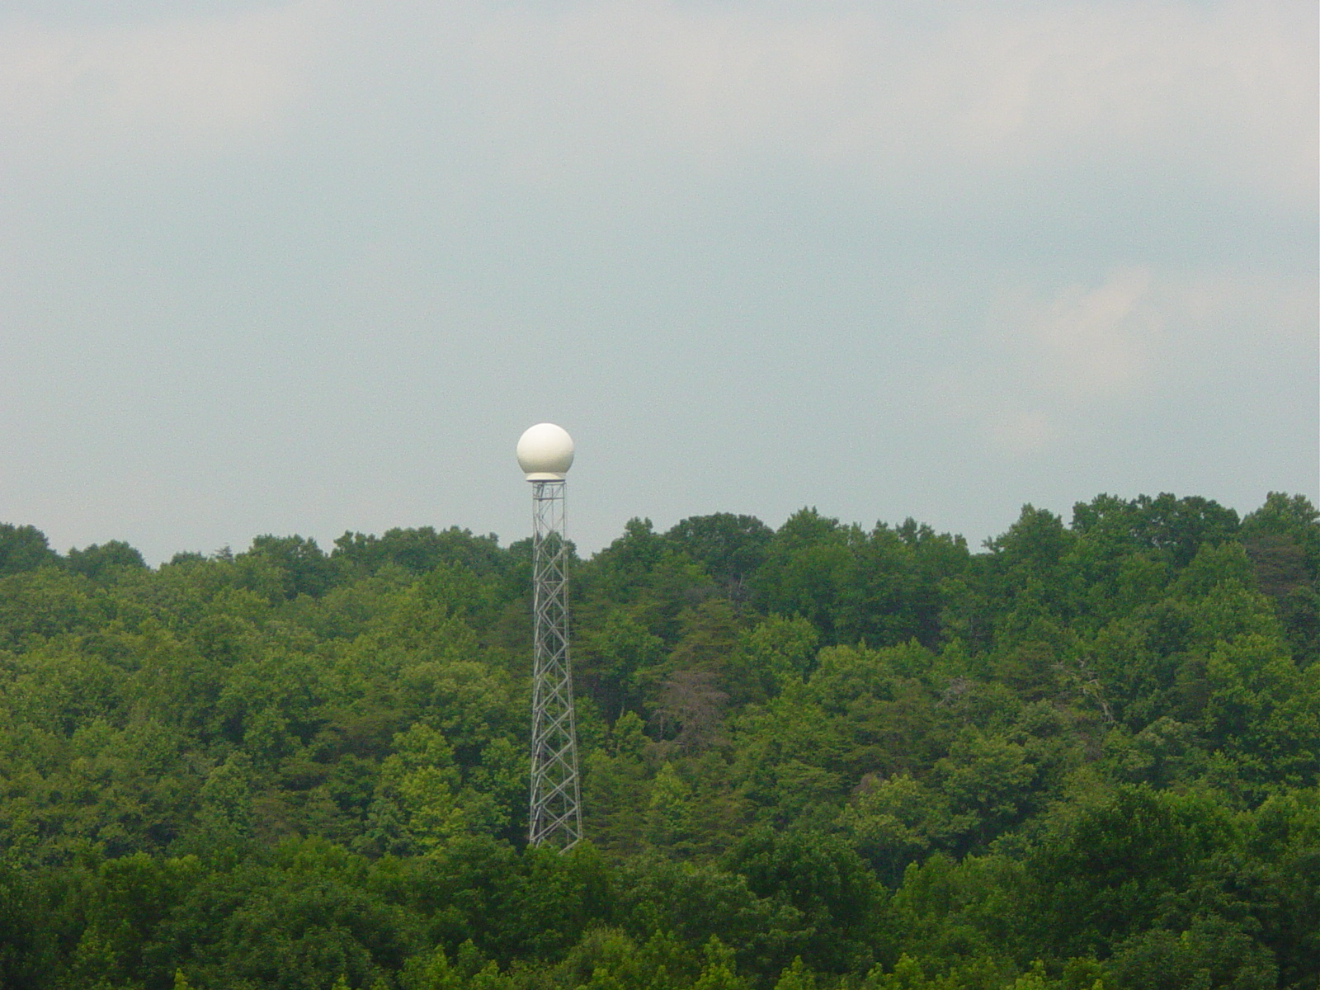
The Regional Atmospheric Chemistry Mechanism, version 2 & The Effects of Daytime and Nighttime Atmospheric Chemistry on Forecasts of Tropospheric Ozone and Aerosol Formation
William R. Stockwell and Charlene V. Lawson
Department of Chemistry Howard University,

Slide 2
Atmospheric Chemistry for Air Quality Forecasting

Slide 3
Tropospheric O₃ Chemistry
Sun
O₃ Formation
NO₂ + hν → O(³P) + NO
O(³P) + O₂ (+ M) → O₃ (+ M)
Ozone Destruction
NO + O₃ → NO₂ + O₂
Steady-State Ozone Concentrations
d[NO]/dt = J[NO₂] - k[NO][O₃] ≅ 0
[O₃] = {J / k} {[NO₂] / [NO]}

Slide 4
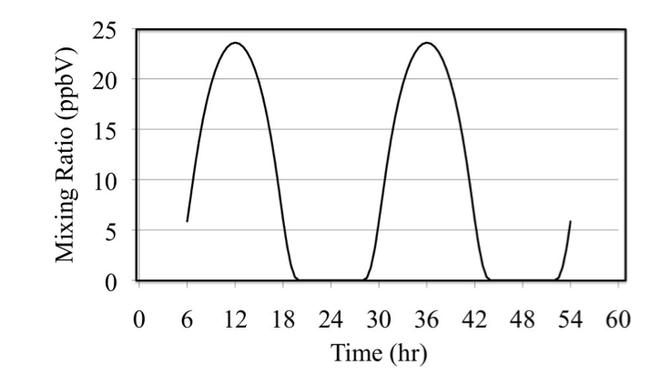
Ozone for Atmosphere Containing only NO_{x}
Stockwell, W.R., C.V. Lawson and W.S. Goliff, A Review of Tropospheric Atmospheric Chemistry and Gas-Phase Chemical Mechanisms for Air Quality Modeling, Atmosphere, Submitted, June 7, 2011. (Open Access)

Slide 5
HO Radical Production
Sun
O₃ + hν → O(¹D) + O₂
O(¹D) + N₂ (+O₂) → O₃
O(¹D) + O₂ (+O₂) → O₃
O(¹D) + H₂O → 2 HO•

Slide 6
Alkene Oxidation
HO• + CH₂=CH₂ → HOCH₂CH₂•
HOCH₂CH₂• + O₂ → HOCH₂CH₂O₂•
HOCH₂CH₂O₂• + NO → HOCH₂CH₂O• + NO₂
HOCH₂CH₂O• + O₂ → HOCH₂CHO + HO₂•
HO₂• + NO → HO• + NO₂

Slide 7
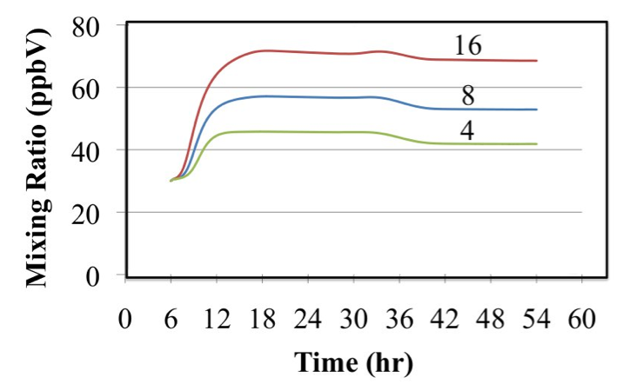
Ozone mixing ratios for atmospheres initially containing ozone, ethene and nitrogen dioxide. The number indicates the initial VOC/NO_{x} ratio in ppbC/ppbN.

Slide 8
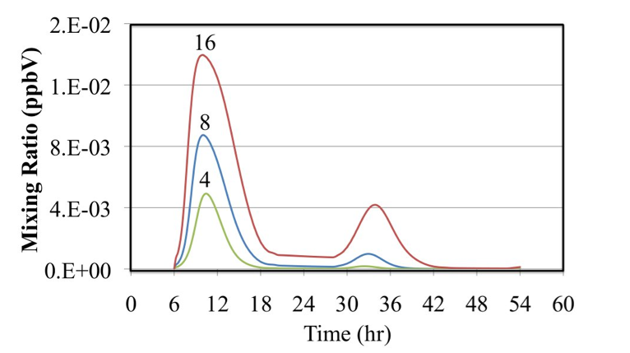
Hydroperoxy radical, HO₂•, mixing ratios for atmospheres initially containing ozone, ethene and nitrogen dioxide. The number indicates the initial VOC/NO_{x} ratio in ppbC/ppbN.

Slide 9
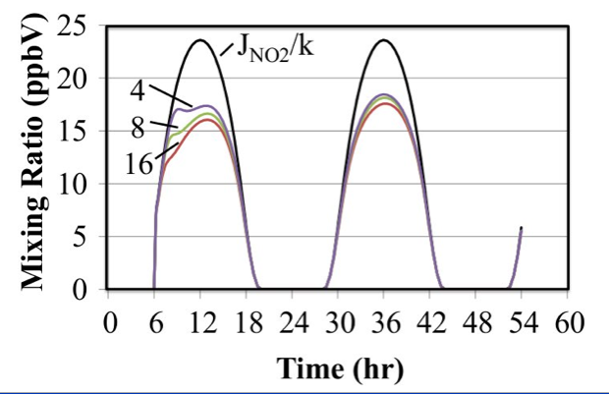
The time dependent ratio of the photolysis frequency of nitrogen dioxide to the rate constant for the O₃ + NO reaction is plotted along for the ratio, [O₃]×[NO]/[NO₂] for the three ethene cases.

Slide 10
Ozone Formation Depends Upon the Photolysis of Ozone, Nitrogen Dioxide and Other Trace Gases
hν
+ SO₂
Aq. Chem
Aerosol
Secondary
Organic Aerosol
+ NH₃
hν

Slide 11
Air Quality Equations
Meteorological
Transport
t = time
c_{i} = concentration of i^{th} species
V_{H} = horizontal wind vector
η = net vertical entrainment rate
z = terrain following vertical coordinate
h = layer interface height
ρ = atmospheric density
K = turbulent diffusion coefficient

Slide 12
Chemical Mechanisms – What are some problems and questions?
Models do not predict full range of ozone and other pollutant mixing ratios from minimum to maximum.
Forecasted pollutant mixing ratios do not respond as much as measured to emission changes.
Models do not well handle vertical concentration variations
Modeled oxidation of NO₂ appears to be too fast.
Do we really understand HO and HO₂ chemistry?

Slide 13
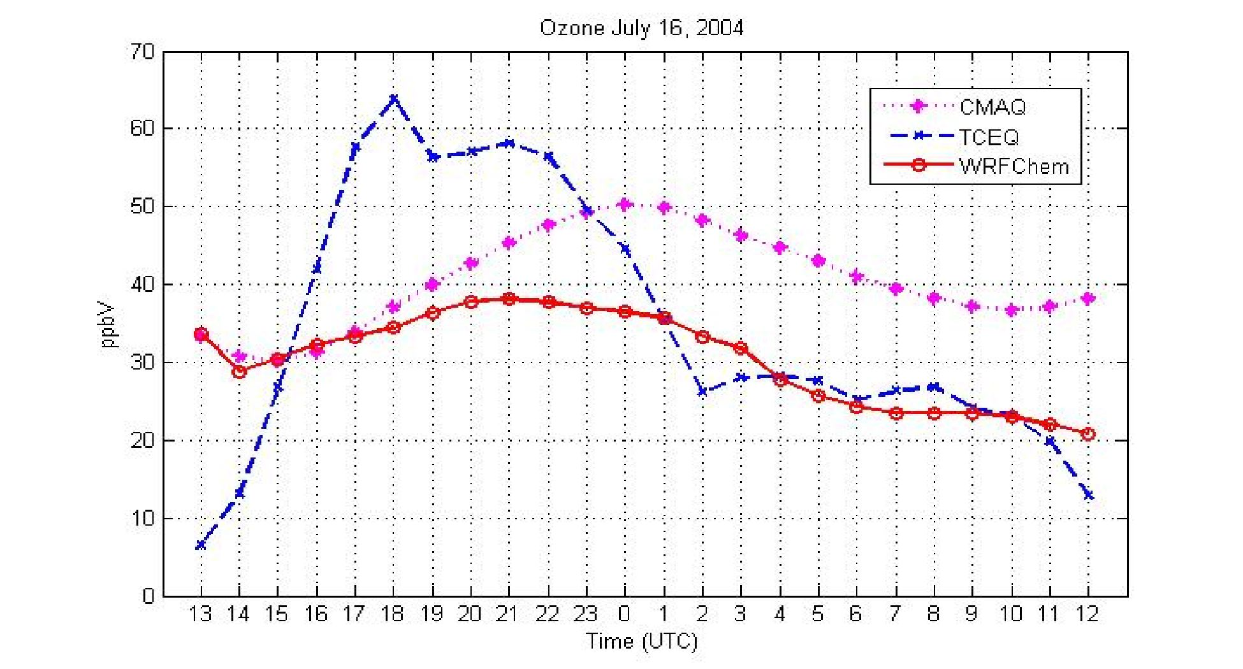
Ozone Summertime El Paso, TX July 16, 2004
70
Obs-TCEQ
CMAQ
60
50
40
Ozone (ppbV)
30
20
WRF-CHEM
10
0
06
08
10
12
14
16
18
20
22
24
02
04
06
Average error: WRFCHEM-TCEQ: 30.20%
CMAQ-TCEQ 38.86%

Slide 14
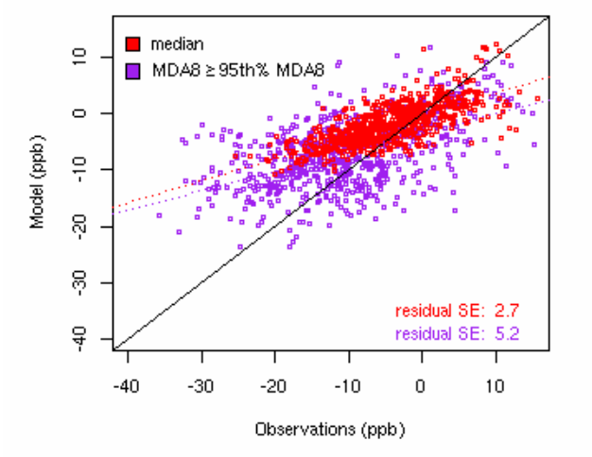
Overall comparison of observed (CASTNet and AQS) and CMAQ (v4.5) modeled change in daily maximum 8-hour O₃ between summer 2002 to summer 2004 (2004 – 2002) and summer 2005 (2005-2002). Mechanisms used are CB4 and SAPRC. The change in O₃ is shown for the median (red) and the average of the ≥ 95% of the distribution (purple).
Model Ozone (ppb)
Observed Ozone (ppb)
Gilliland, A.B., C. Hogrefe, R.W. Pinder, J.M. Godowitch, K.L. Foley and S.T. Rao, Dynamic Evaluation of Regional Air Quality Models: Assessing Changes in O3 Stemming from Changes in Emissions and Meteorology
09

Slide 15
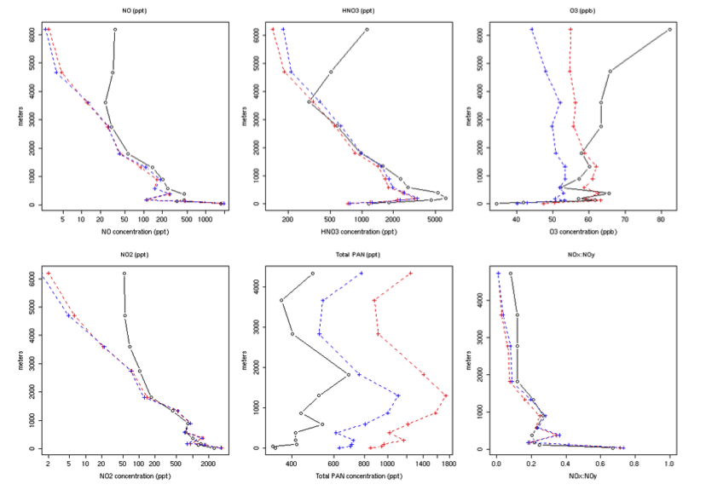
Vertical Profiles of NOy: ICARTT Obs, CMAQ-SAPRC, CMAQ-CB5
NO
HNO₃
O₃
6000 (m)
0 (m)
5
(ppt)
1000
200
(ppt)
5000
40
(ppb)
80
NO₂
PAN
NO_{x}/NO_{y}
6000 (m)
4000 (m)
4000 (m)
0 (m)
0 (m)
0 (m)
2
(ppt)
2000
400
(ppt)
1600
0.0
1.0
EPA- Oak Ridge Institute for Education and Research

Slide 16
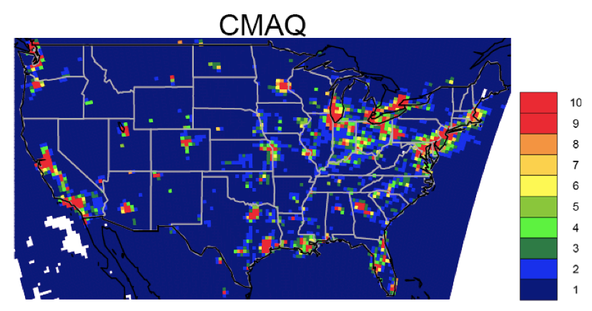
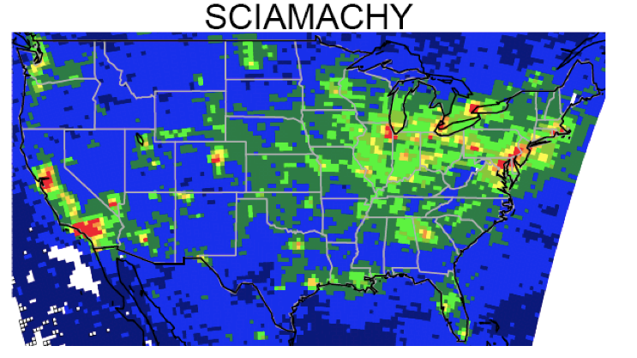
Tropospheric NO₂ column density (molecules 10¹⁵ cm⁻²) as observed from space (SCIAMACHY) and as estimated by the CMAQ air quality model for the summer of 2004.
Air quality model overestimates
NO₂ in source regions and it decreases much too rapidly away from sources.
Source EPA

Slide 17
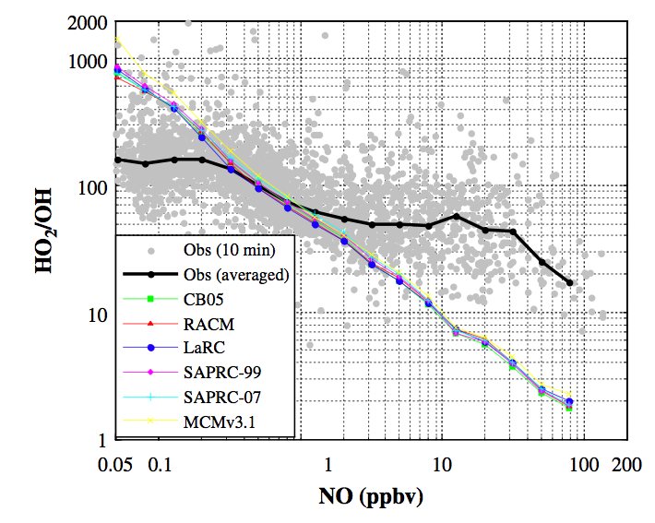
Measured and modeled HO₂/HO ratio as a function of NO concentration. Grey dots are all measured HO₂/HO based on 10-min average data.
HO₂/HO
in press: Chen, S., et al., A comparison of chemical mechanisms based on TRAMP-2006 ﬁeld data, Atmospheric Environment (2009), doi:10.1016/j.atmosenv.2009.05.027

Slide 18
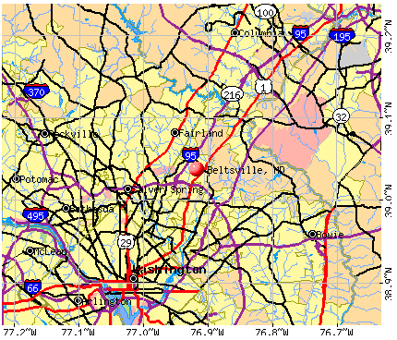
Beltsville Location

Slide 19
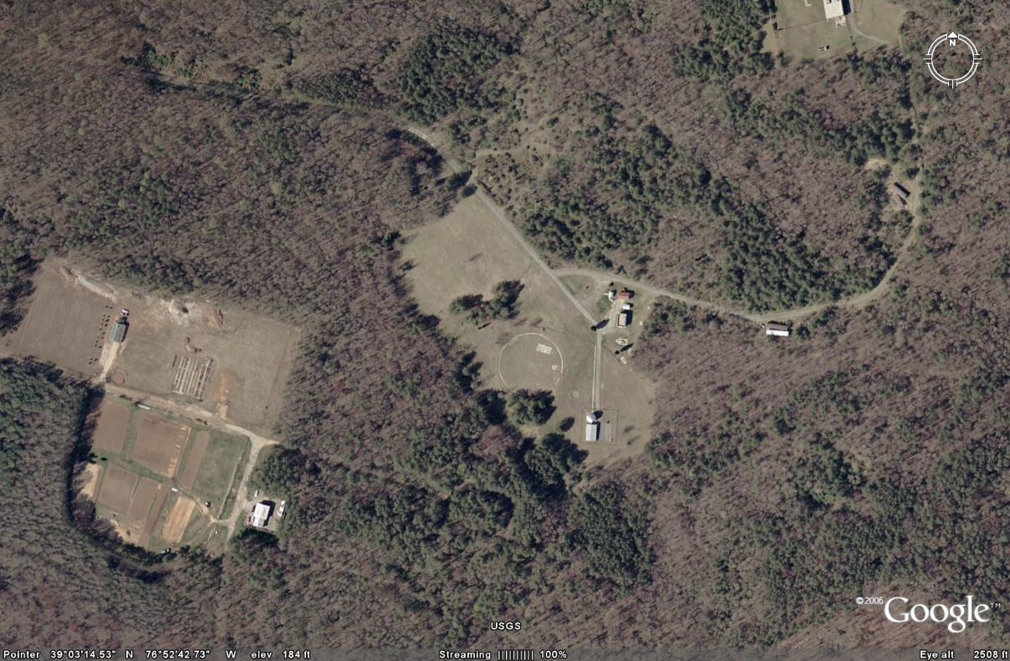
Howard University Atmospheric Research Site
Beltsville, MD
Notes:
For diurnal days, inlet at 28 meters
For vertical days, inlets at 1.5, 10, 18, 28 meters
Canopy @ 15m

Slide 20
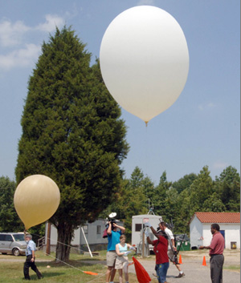
Ozone-Sondes

Slide 21
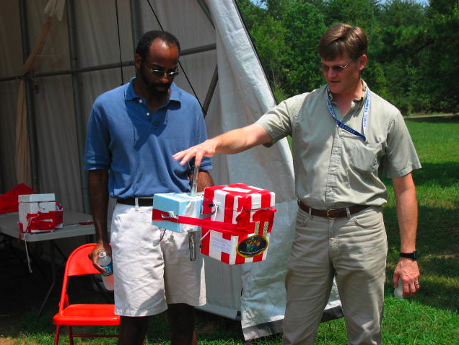
Ozone Instrument Package

Slide 22
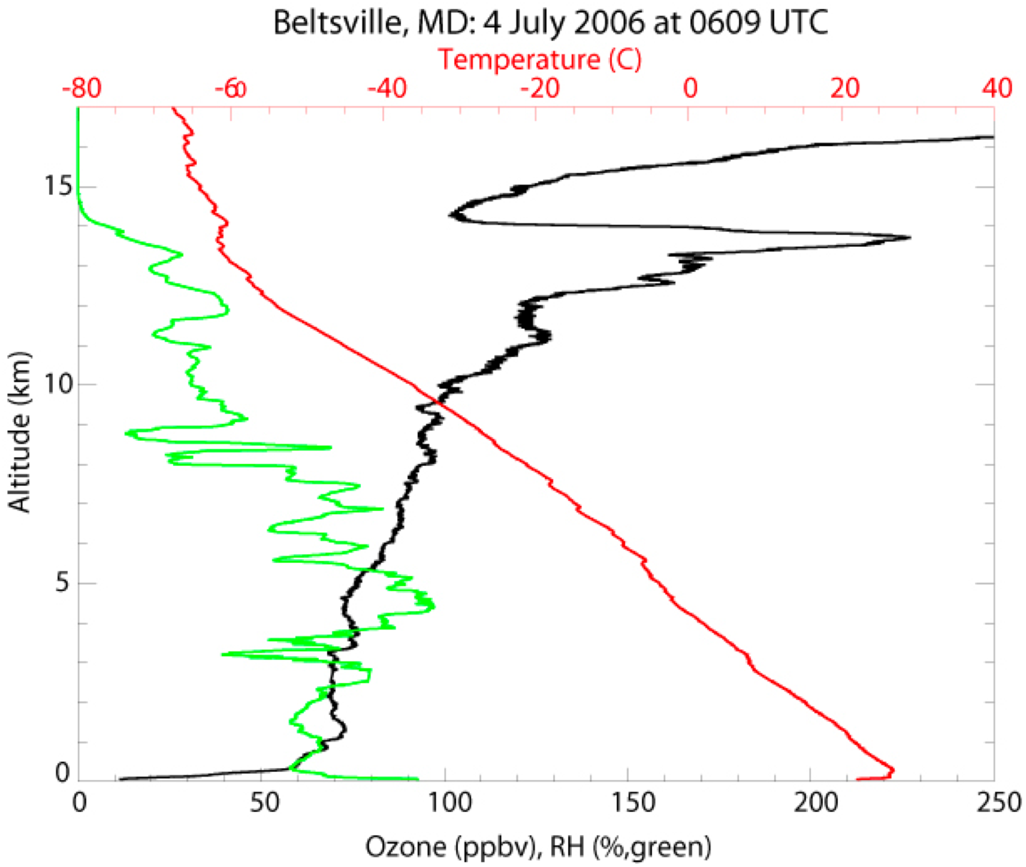
Ozone Vertical Profile
Ozone
Temperature
Humidity
York, Thompson, et al.

Slide 23
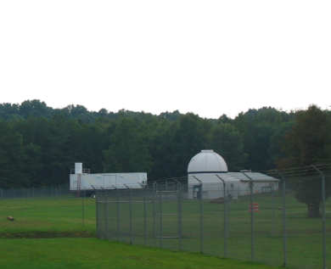
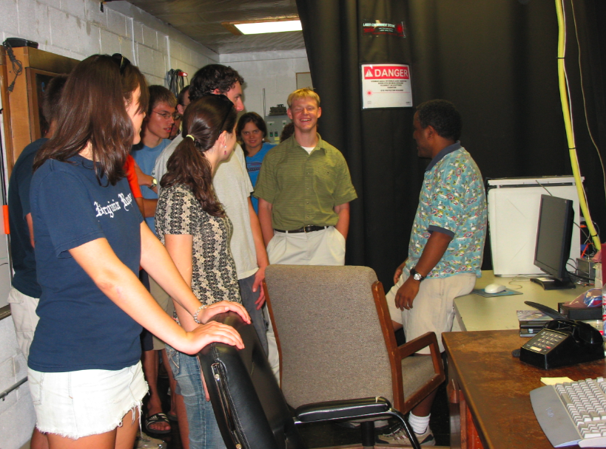
LIDAR at Beltsville

Slide 24
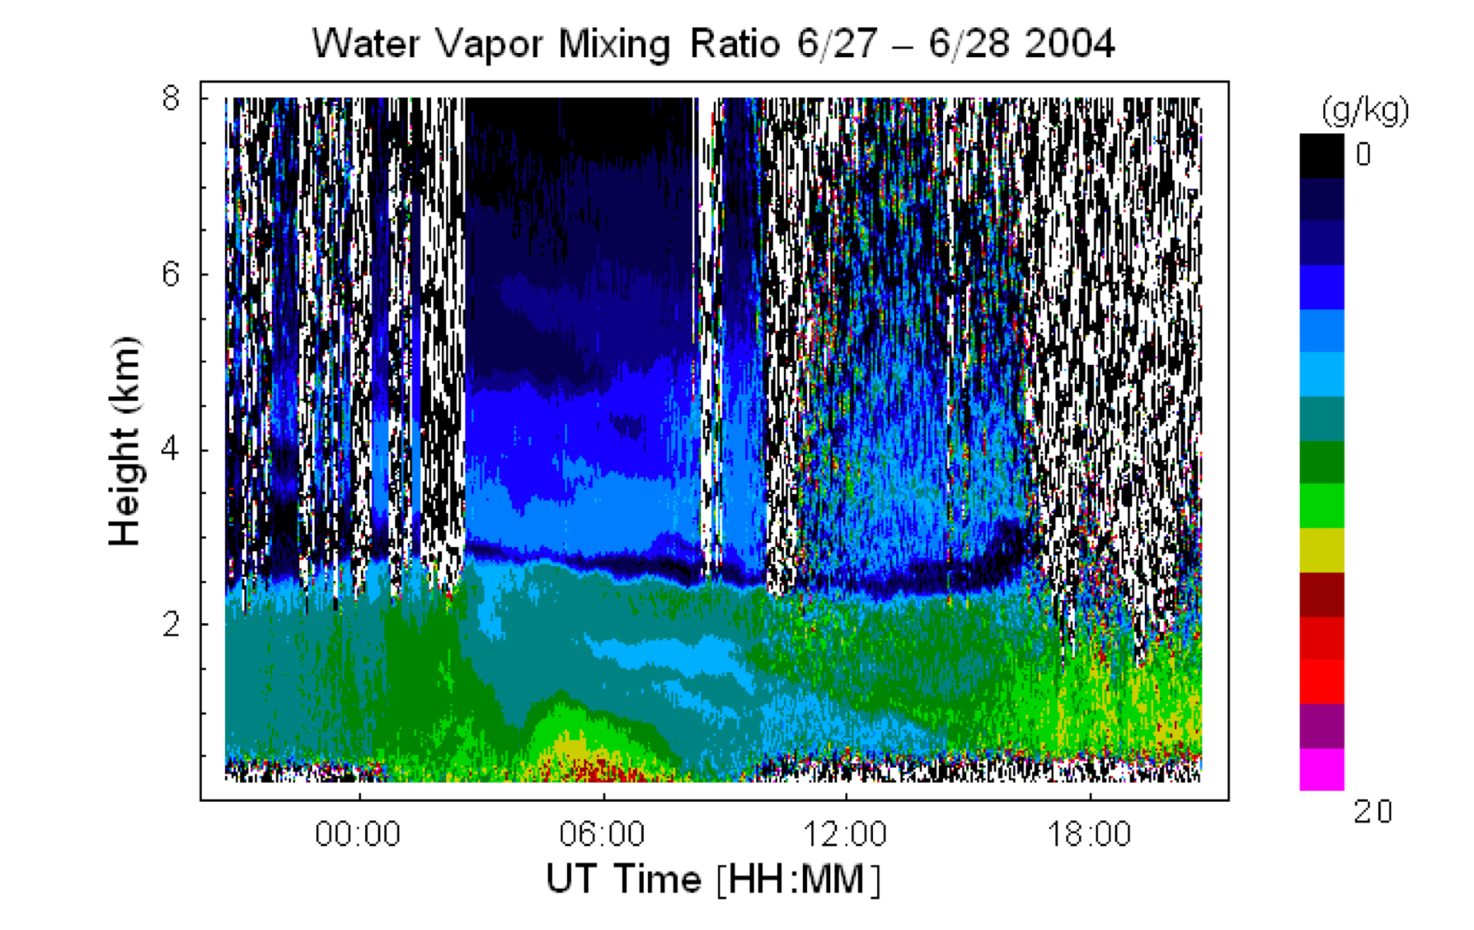

Slide 25
Beltsville Trees

Slide 26
“Natural” Emissions
α-pinene
isoprene
β-pinene
limonene
NH₃
H₂S
CH₄
Hg
NO

Slide 27
Biogenic Compounds

Slide 28
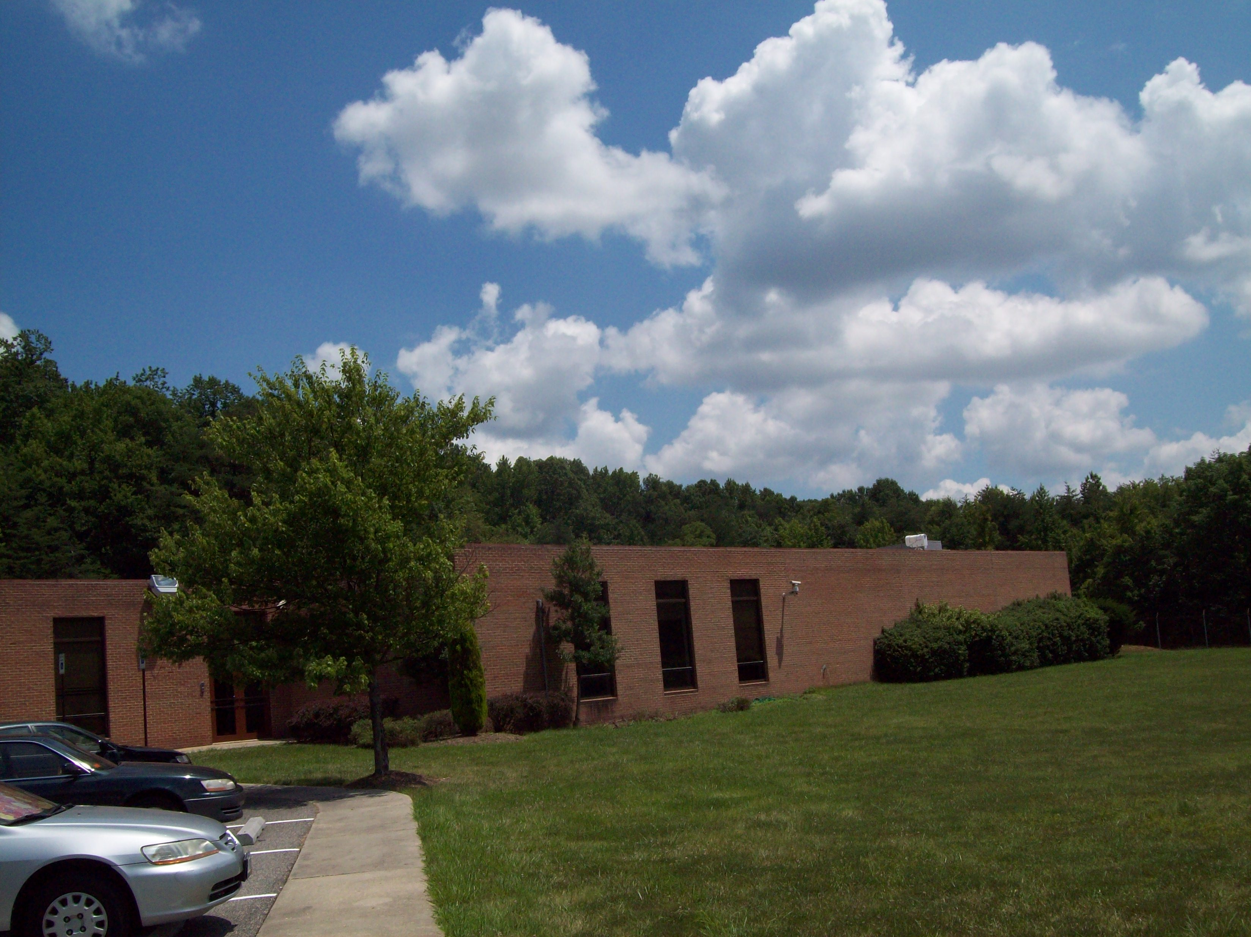

Slide 29
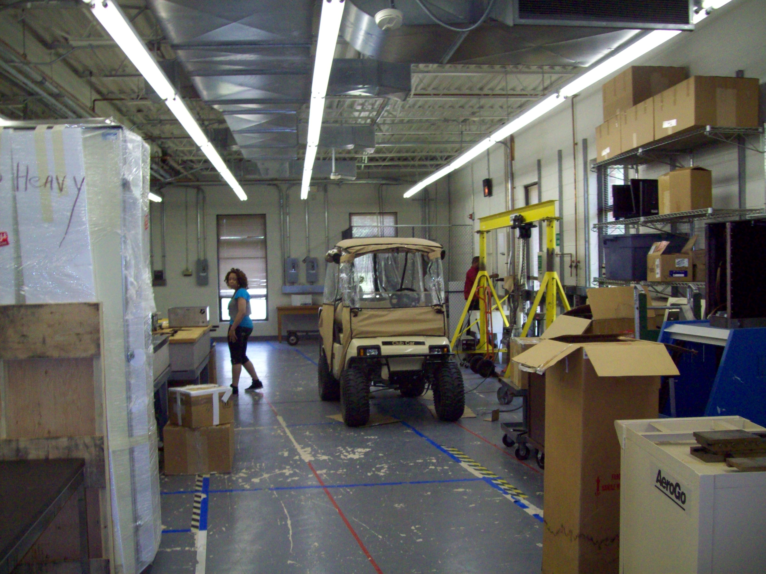

Slide 30
Beltsville
Meteorological Tower
Collection Points for
VOC Samples

Slide 31
Sample Collection
Whole air samples are analyzed by gas chromatography to distinguish the various types and concentrations of Volatile Organic Compounds within each canister.

Slide 32
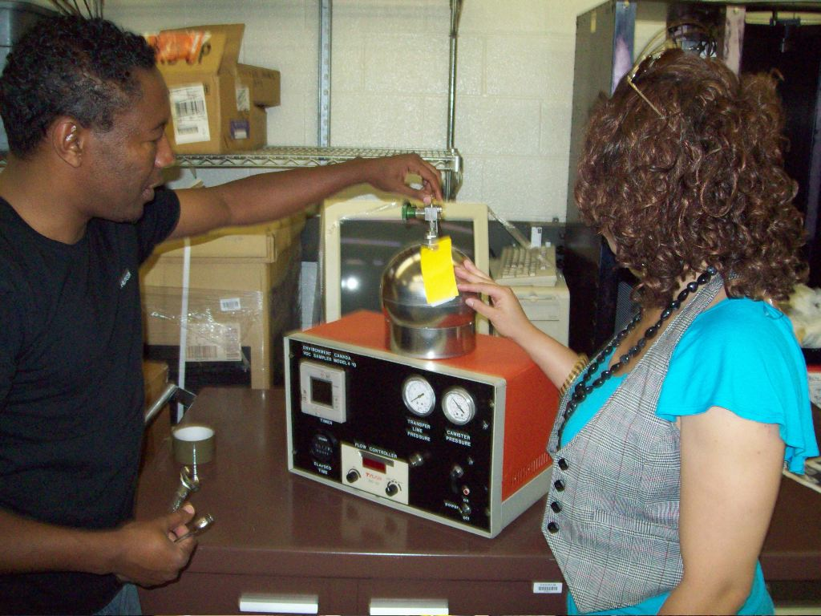
VOC Sampling System

Slide 33
Summer 2009

Slide 34
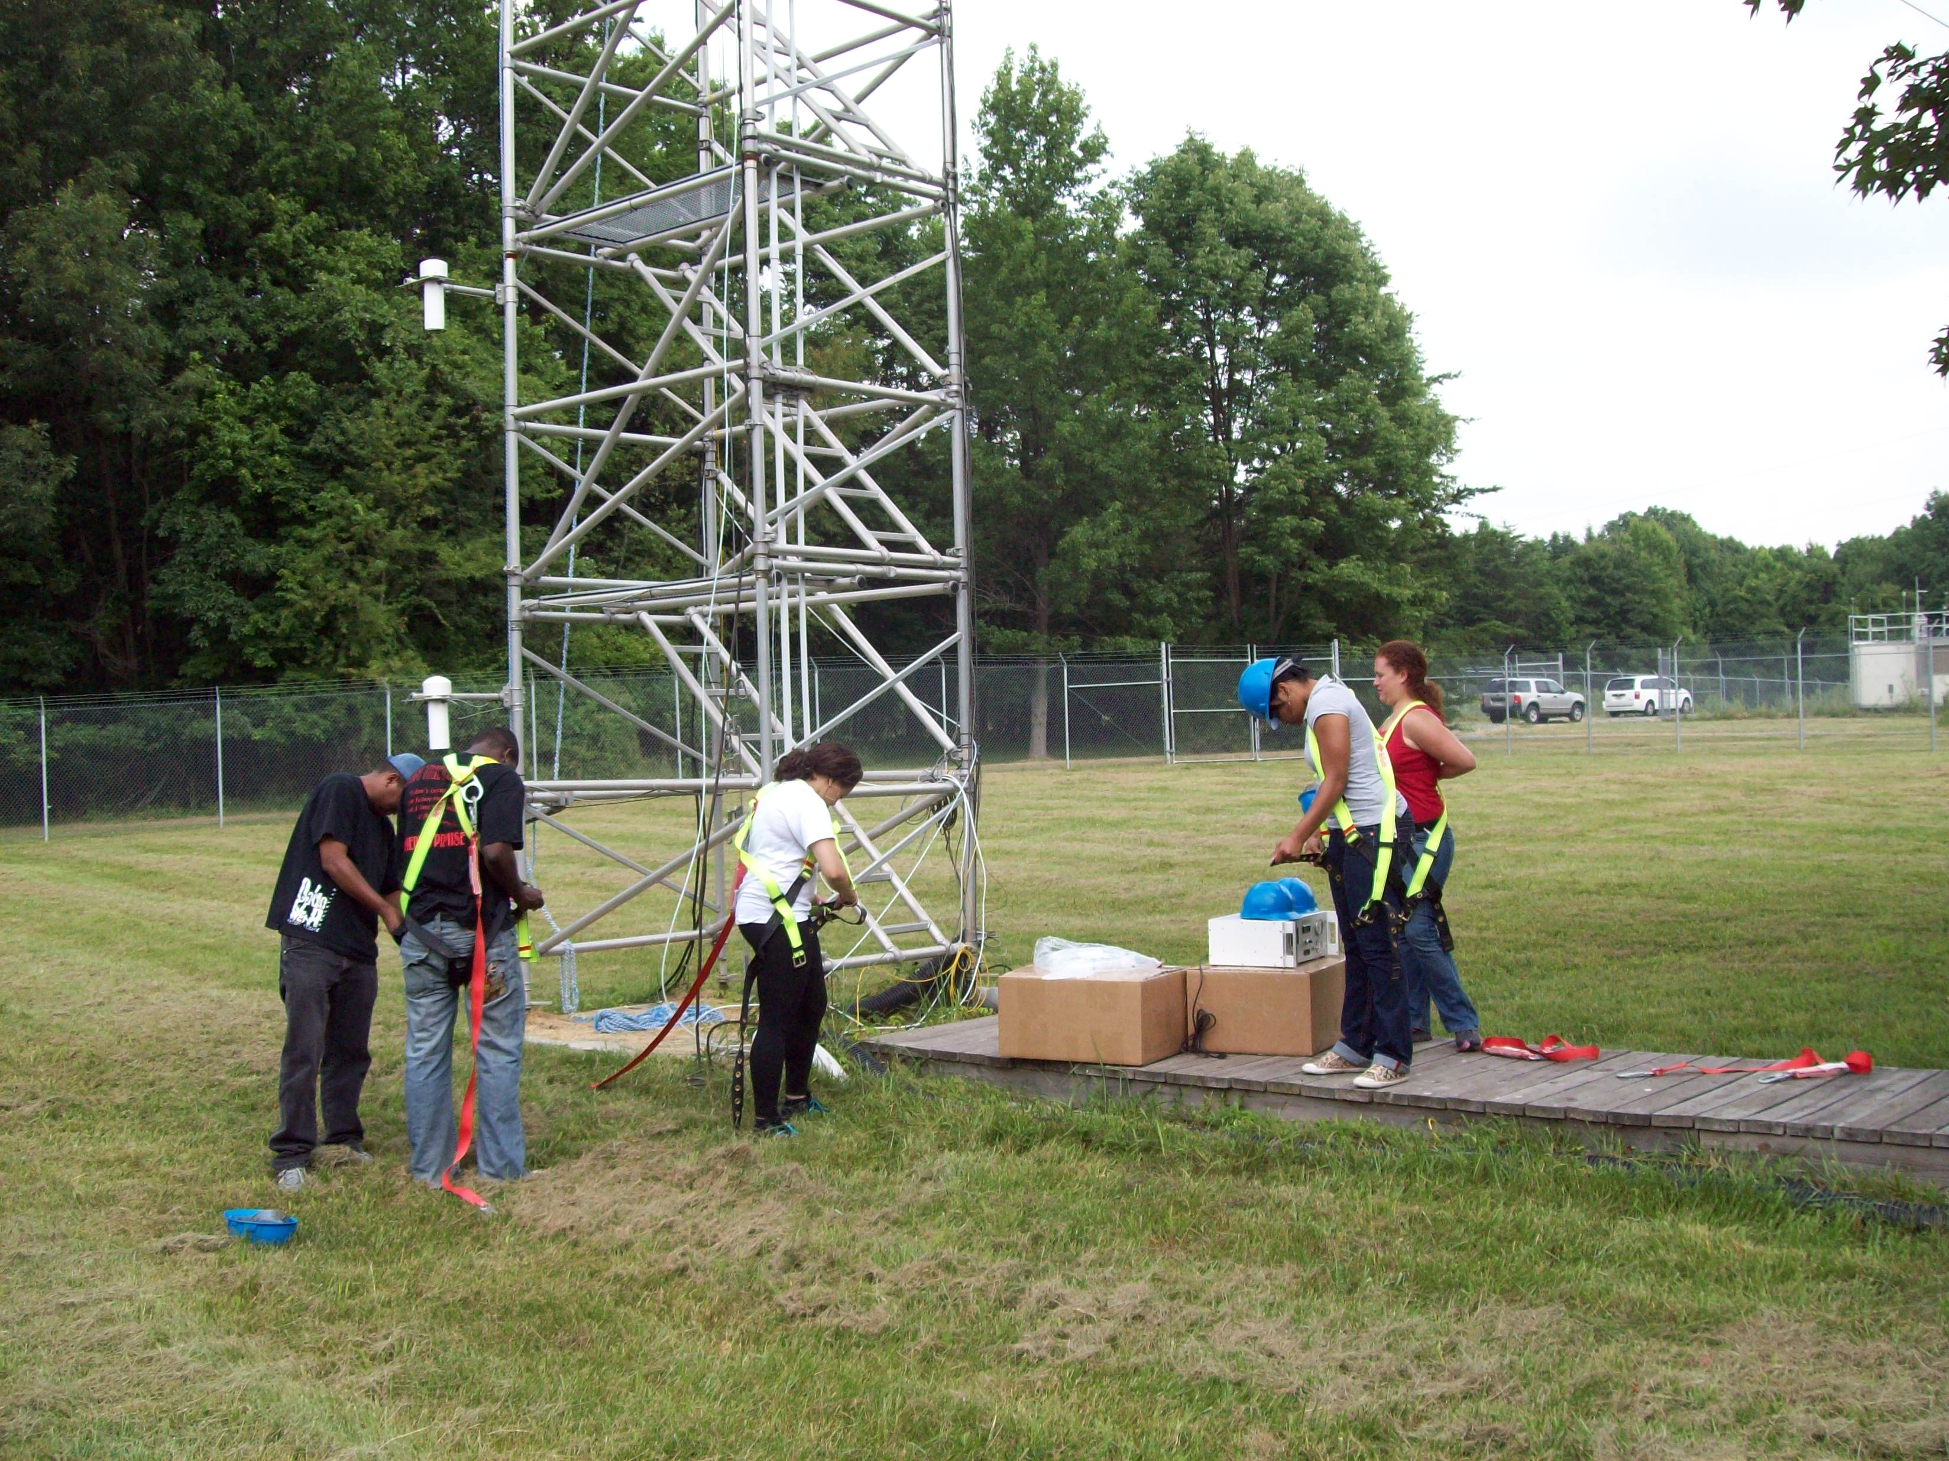

Slide 35
VOC Measurements

Slide 36
People Who Really Do the Work

Slide 37
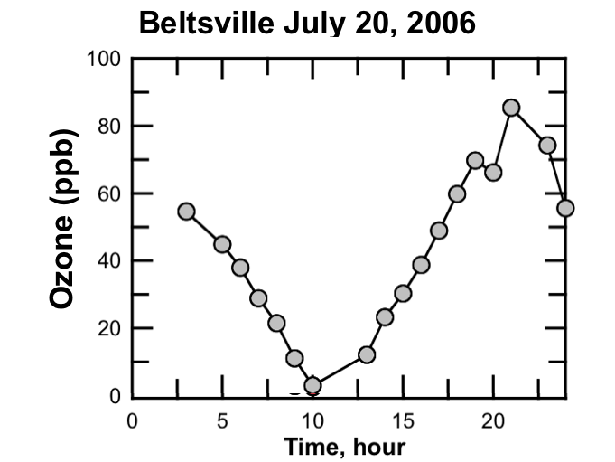
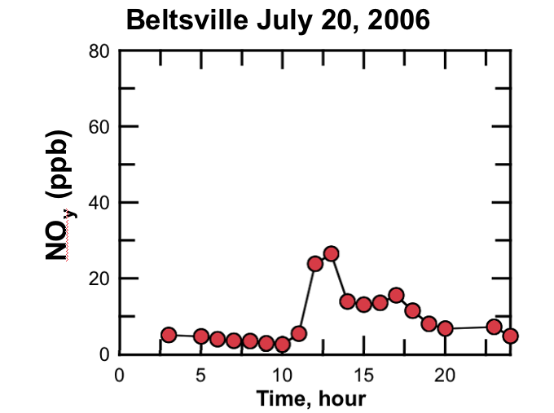
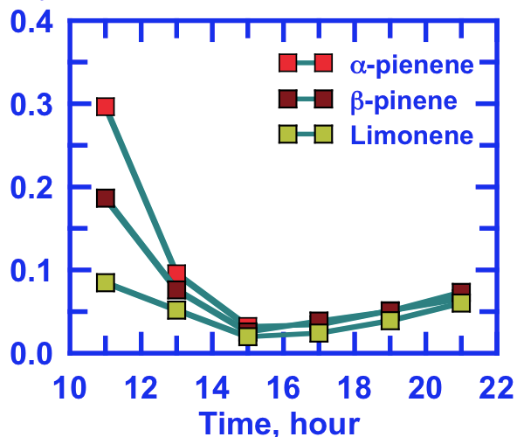
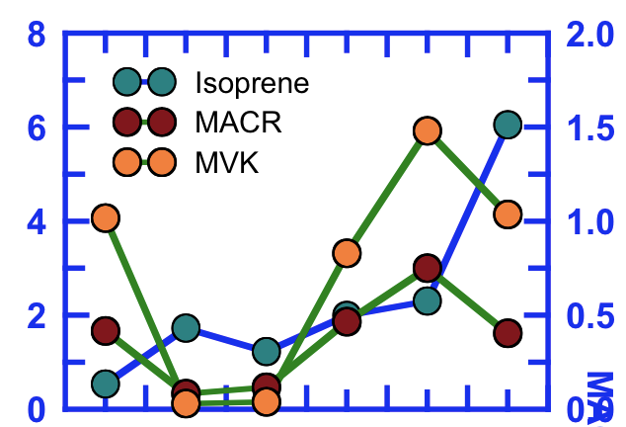
Mixing Ratio (ppb)
Isoprene (ppb)
MACR, MVK (ppb)
0.0
Notes:
We focus on one day. This is the measured ozone mixing ratio for a rather polluted day. It falls to zero when the NOx mixing ratios rise during the early morning rush hour. The decrease is due to titration of the ozone by the fresh emissions of NO.

Slide 38
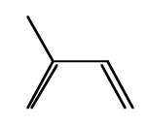
Beltsville Average VOC Summer 2009
Alkanes
Ketones
Alkenes
Biogenic
Aldehydes
Aromatics

Slide 39
Regional Atmospheric
Chemistry Mechanism, version 2
RACM2 has been developed from RACM1.
Versions in WRF-Chem
Being Implemented in CMAQ by EPA/RTP
Contains a new schemes for:
Acetone
Aromatic compounds (based upon Calvert et al. (2002))
Isoprene (based upon Geiger et al. (2003) and improved by adding methyl vinyl ketone explicitly)
α-Pinene
d-Limonene
118 Chemical Species in 356 Reactions

Slide 40
Isoprene
ISO + HO → ISOP
ISOP + NO → 0.95 HO2 + HCHO + 0.42 MACR +
0.58 MVK + 0.05 ISON + 0.95 NO2
ISOP + HO2 → ISHP → → → MCAR
ISOP + MO2 → 1.50 HCHO + 0.50 HO2 + 0.58 MVK +
0.42 MACR
ISOP + ACO3 → 0.50 HO2 + 0.50 MO2 + 0.50 ORA2 +
HCHO + 0.42 MACR + 0.58 MVK
ISOP + NO3 → HO2 + HCHO + 0.42 MACR
0.58 MVK + NO2

Slide 41
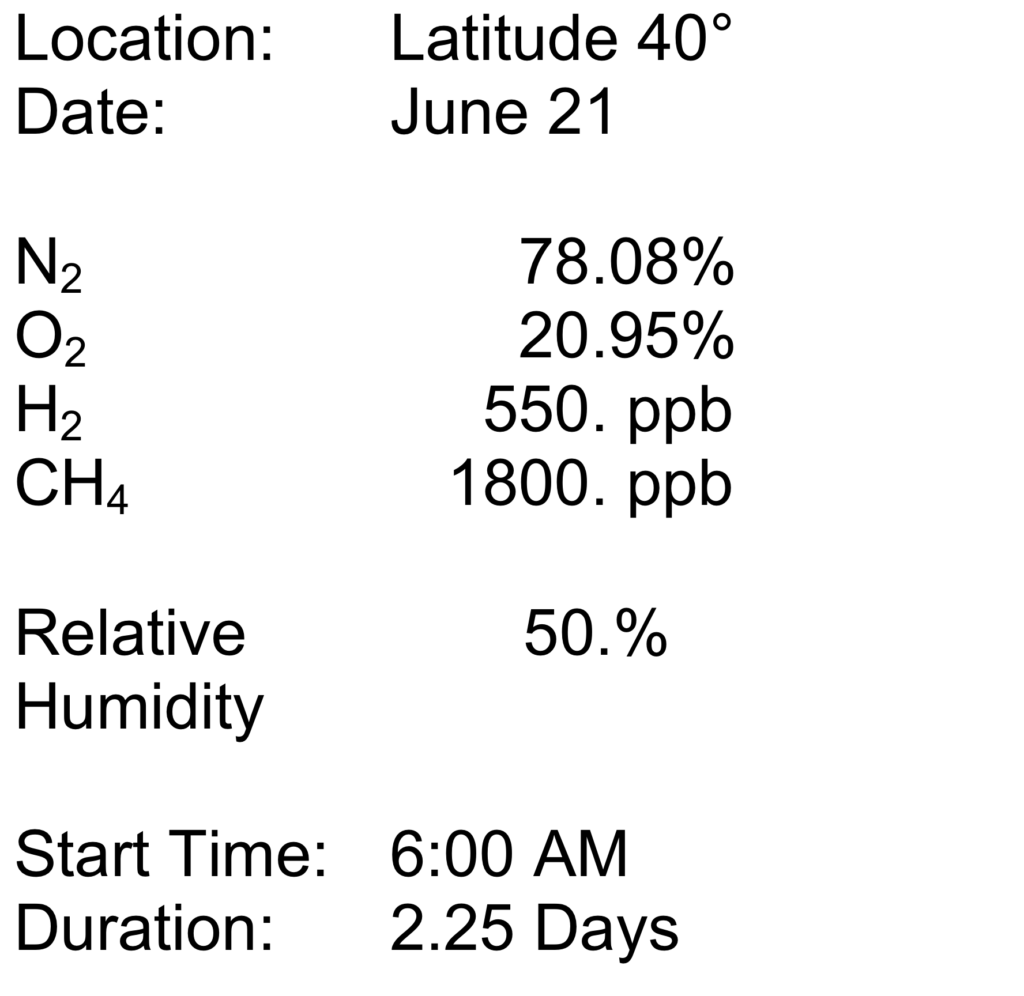
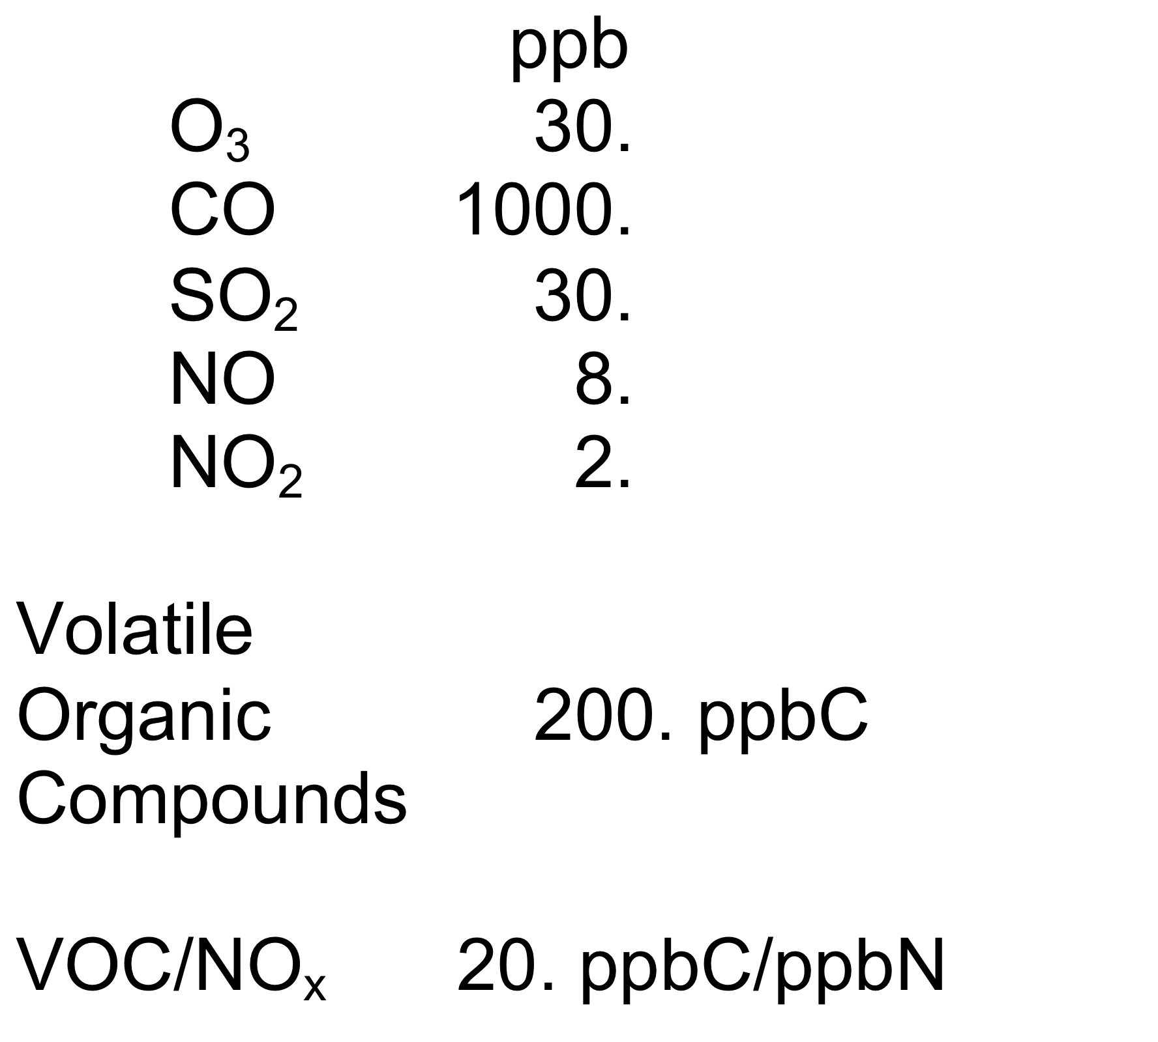
Base Case Initial Conditions

Slide 42
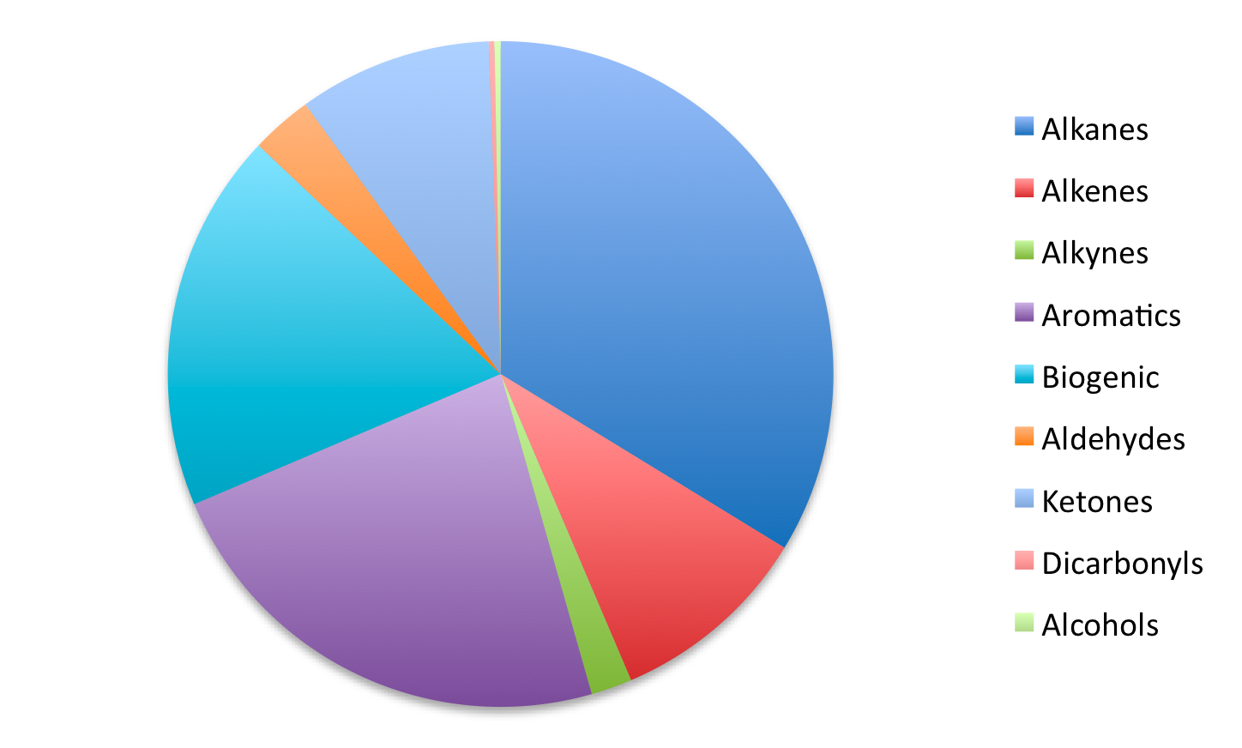
Organic Initial Conditions = 200 ppbC
Ketones
Alcohols, Dicarbonyls
Aldehydes
9%
3%
Alkanes
Biogenic
34%
18%
10%
23%
Aromatics
Alkenes
2%
Alkynes

Slide 43
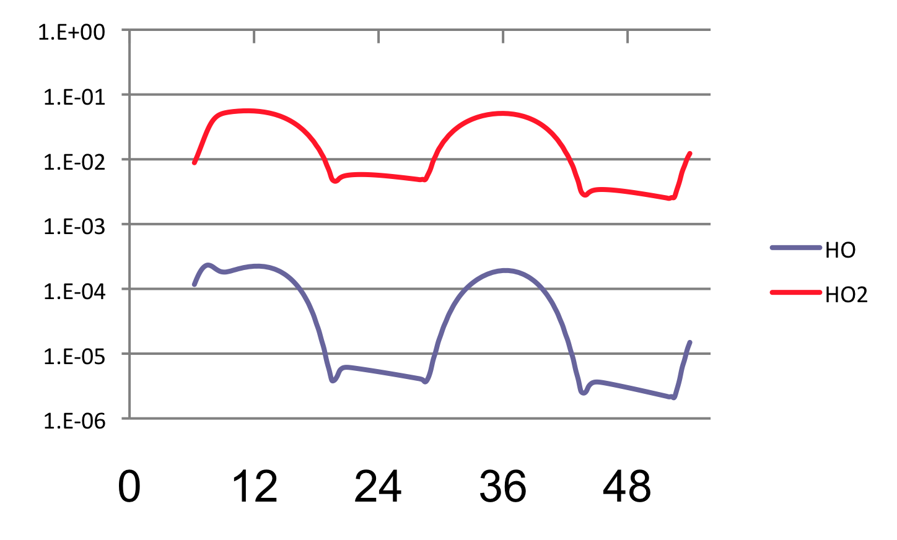
HO_{x} Radicals
1×10⁰
HO₂
1×10⁻¹
1×10⁻²
1×10⁻³
Mixing Ratio (ppb)
HO
1×10⁻⁴
1×10⁻⁵
1×10⁻⁶
Time (hr)

Slide 44
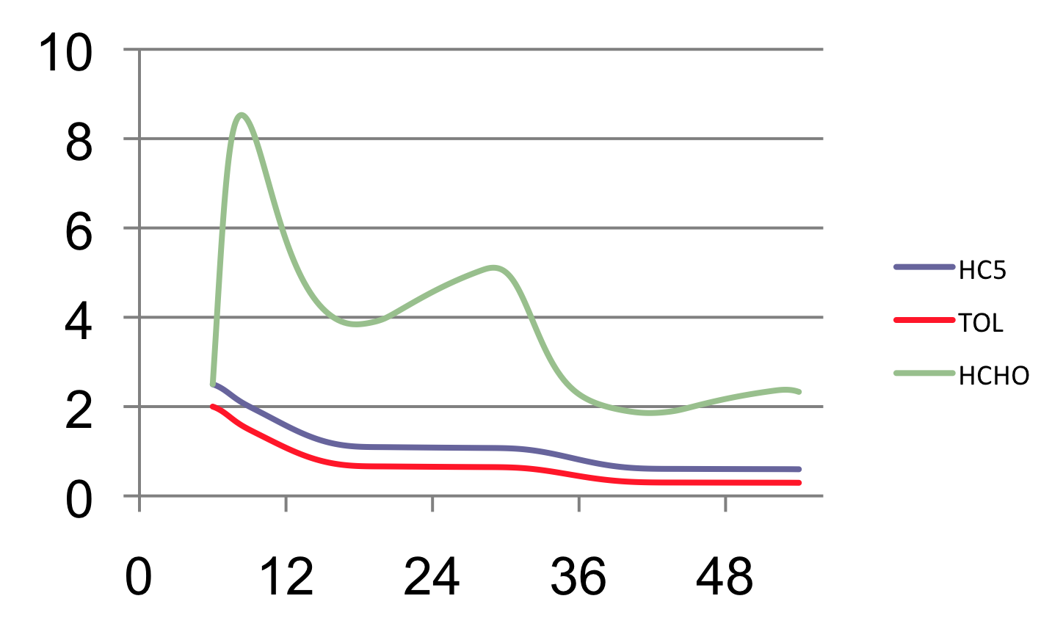
Representative Organic Species Mixing Ratios
Formaldehyde
Mixing Ratio (ppb)
Alkane
Toluene
Time (hr)

Slide 45
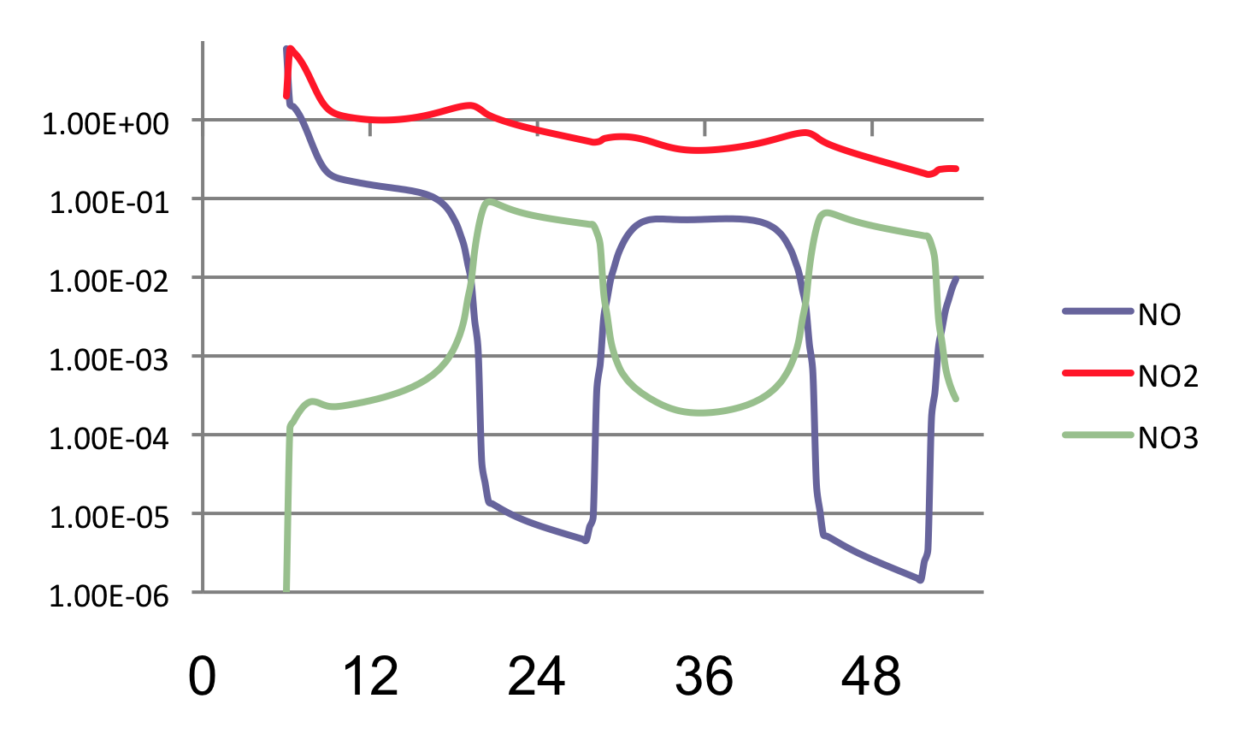
Reactive Nitrogen Oxides
NO₂
1×10⁰
1×10⁻¹
NO
1×10⁻²
1×10⁻³
Mixing Ratio (ppb)
1×10⁻⁴
NO₃
1×10⁻⁵
1×10⁻⁶
Time (hr)

Slide 46
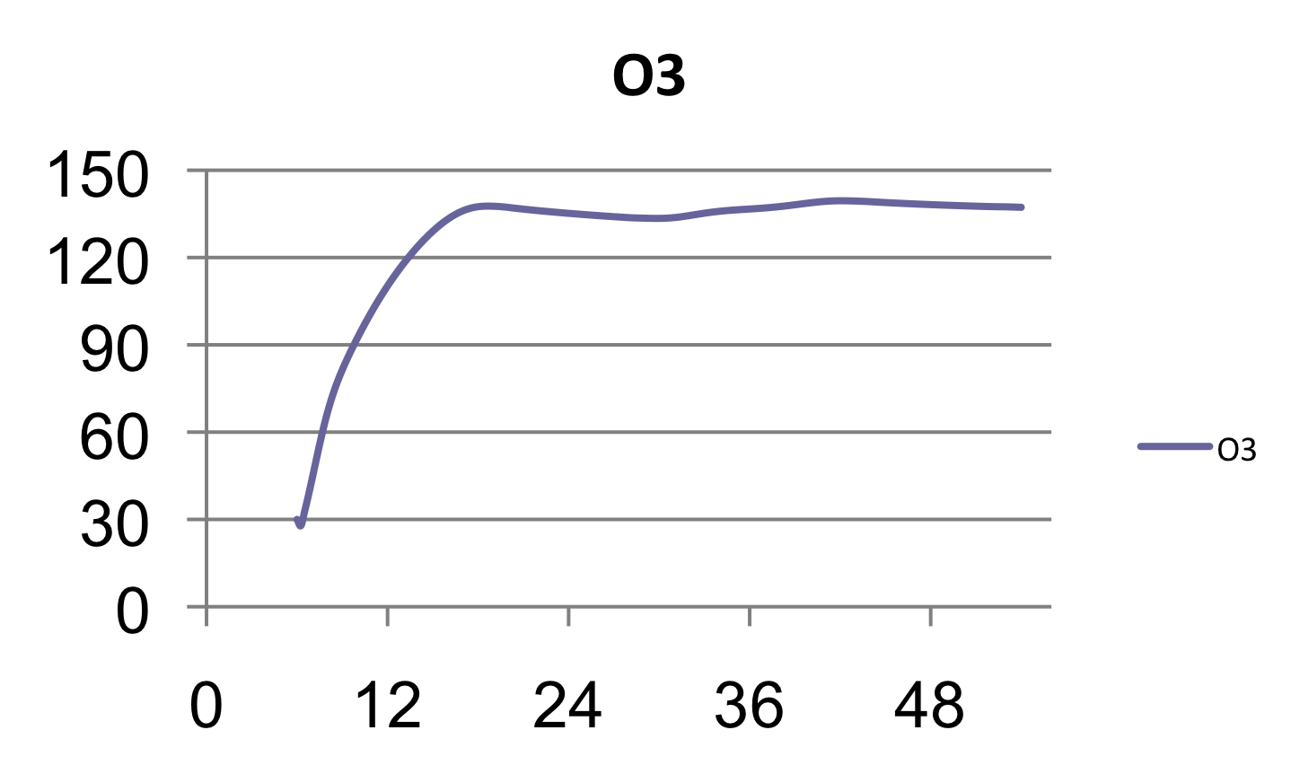
Ozone Mixing Ratios
Mixing Ratio (ppb)
Time (hr)

Slide 47
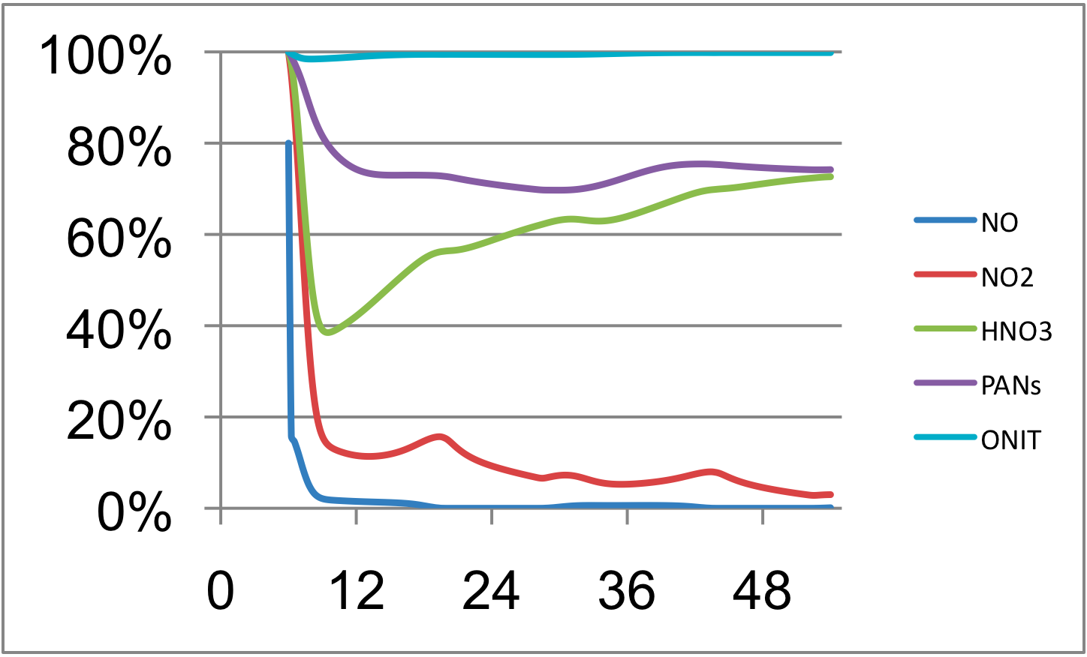
Major Nitrogen Compound Distribution
Organic Nitrate
PANs
Nitric Acid
Percent Nitrogen
NO_{x}
Time (hr)

Slide 48
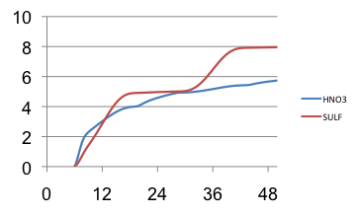
Sulfate and Nitric Acid Mixing Ratios
Mixing Ratio (ppb)
SO₄
HNO₃
Time (hr)

Slide 49
SO₂, Sulfate and Total Peroxide
SO₂
Mixing Ratio (ppb)
SO₄
ROOH
Time (hr)

Slide 50
Secondary Organic Aerosol Potential
BVOC
Aromatics
Mixing Ratio (ppb)
Time (hr)

Slide 51
Forecast Predictability
Meteorological &
Chemical Variables
Forecast
Forecast
Uncertainty
Reality Line
Nowcast
Data Assimilation
Uncertainty
Time

Slide 52
You expect the forecast uncertainty
to increase with time
Now
Forecast Uncertainty
Time

Slide 53
VARIATIONS
TEMPERATURE: 298 K ± 2.5 K
PHOTOLYSIS RATE CONSTANT: JNO₂ (±30%)
PHOTOLYSIS RATE CONSTANT: JO₃ → O1D(±30%)
NO₂ and NO VARIED TOGETHER (NO_{x}) (±30%)
NO₂/NO RATIO (±30%)
HCHO (±30%)
TOL (±30%)

Slide 54
+ 2.5 K
Base case

Slide 55
+ 2.5 K
Final
Uncertainty
Maximum Uncertainty

Slide 56
+ 30%

Slide 57
NO₂
+30%
O₃
-30%
O₃
NO₂
-30%

Slide 58
Ozone Uncertainty to Initial Conditions

Slide 59
Ozone Uncertainty to Initial Conditions

Slide 60
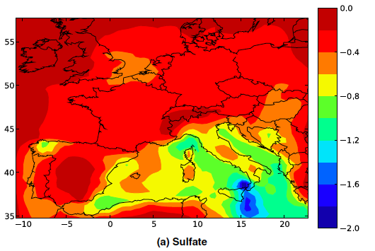
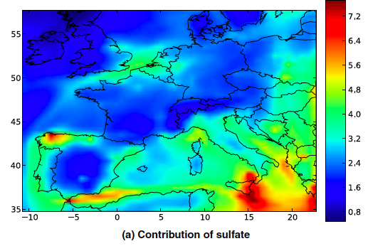
Sulfate
ug / m³
Kim, Sartelet, and Seigneur, 2010

Slide 61
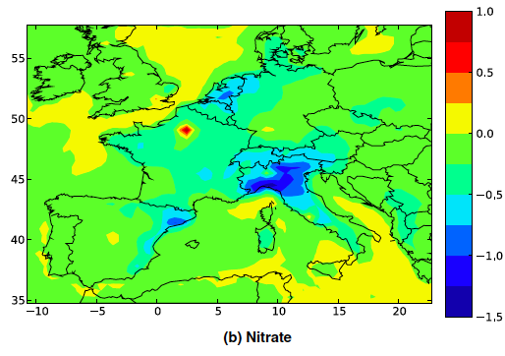
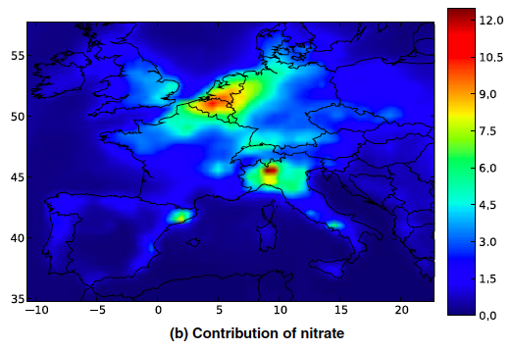
Nitrate
ug / m³
Kim, Sartelet, and Seigneur, 2010

Slide 62
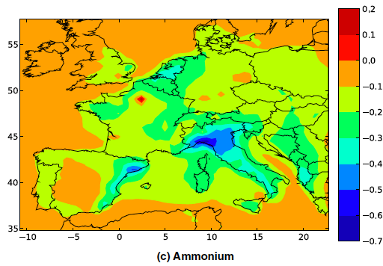
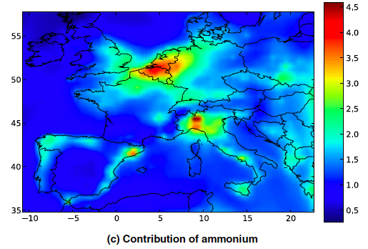
Ammonium
ug / m³
Kim, Sartelet, and Seigneur, 2010

Slide 63
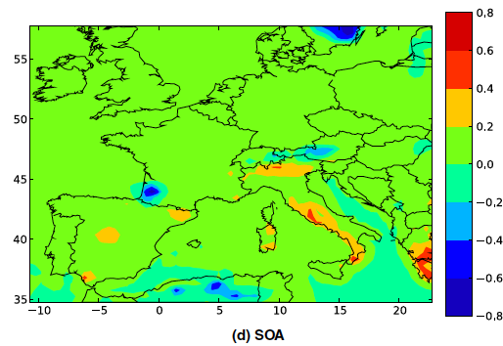
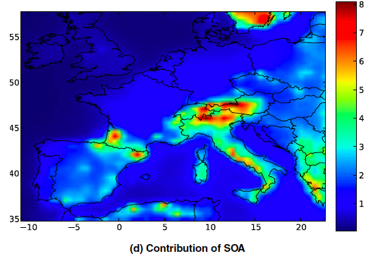
Secondary Organic Aerosol
ug / m³
Kim, Sartelet, and Seigneur, 2010

Slide 64
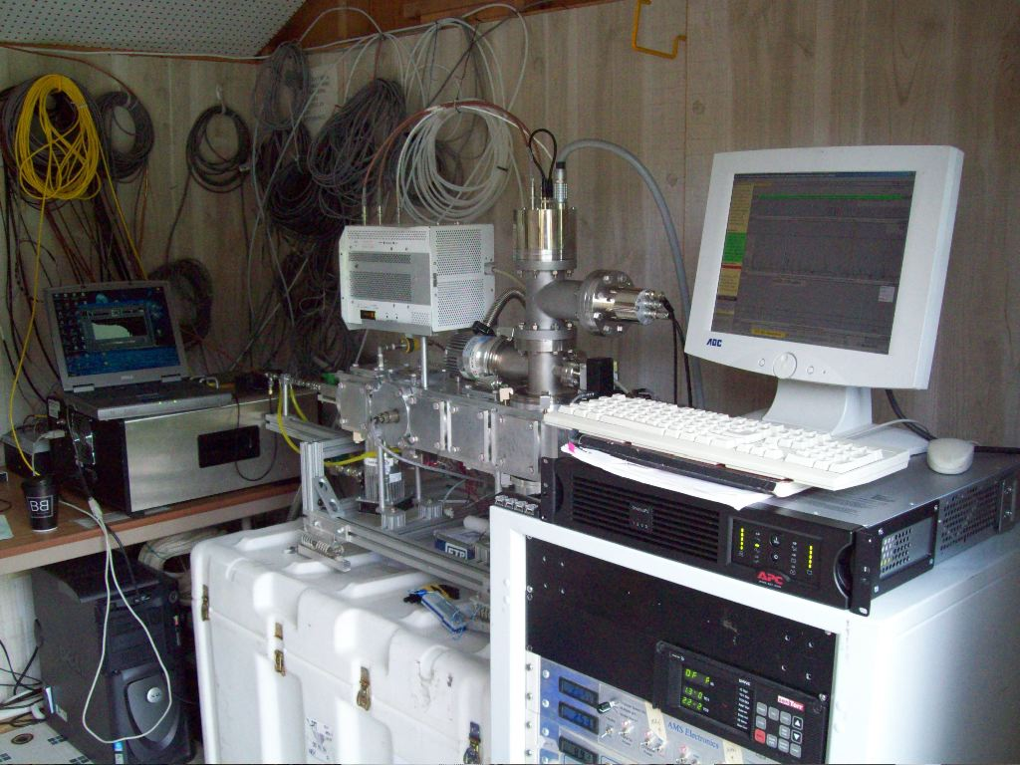
Aerosol Mass Spectrometer

Slide 65
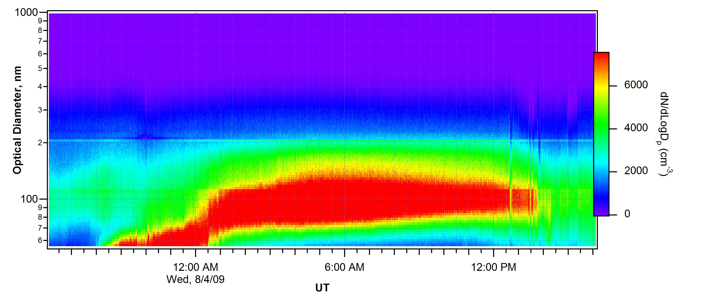
Particle growth events at Beltsville
August 4, 2009
Fuentes, et al. 2010

Slide 66
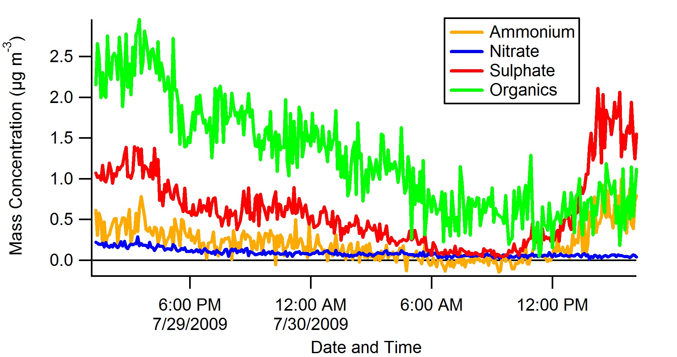
IOP 2009: Aerosol chemistry
29 July 2009
30 July 2009
Fuentes, et al. 2010

Slide 67
Conclusions
Air quality forecasting is an important driver of new efforts in chemical data assimilation.
Data assimilation methods for weather forecasting are well established.
Meteorology and chemistry are highly coupled.
Photochemical reactions of nitrogen oxides and volatile organic compounds produce ozone and aerosols.
The sensitivity of ozone and other pollutants to the chemical initial conditions need to be considered in the development of assimilation schemes.

Slide 68
Future Work and Considerations:
Improved model physics and chemistry for the air quality models are needed.
Further progress can not be made with the current chemical mechanism used by U.S. EPA.
Evaluations show that modeling alone is insufficient for further development. New laboratory, chamber and field measurements are required.

Slide 69
Project Collaborators
Faculty Include
Dr. R.M. Fitzgerald - University of Texas at El Paso
Dr. Renate Forkel - IMK-IFU
Dr. J.D. Fuentes - Penn State
Dr. W.S. Goliff – University of California Riverside
Dr. Dongchul Kim - NASA/UMBC
Dr. J.M. Lewis - NOAA/NSSL
Dr. Menachem Luria – Hebrew University
Dr. K. Schere - NOAA/ARL/EPA
Dr. A.M. Thompson - Penn State
Dr. Y. Zhang - North Carolina State Univ.
Howard University Graduate Student
Ms. T. Gonzalez
Howard University Undergraduates Desayo Ajisegiri
Opeyemi Ayodeji Ajisegiri
Gadini Delisca
Adaobi Ikpeze
Ifunanya Uzomah

Slide 70
Special thanks to these agencies for their support:
NSF
NOAA
NASA
EPA
CARB
UC, Riverside
Howard University
DRI
HOWARD
UNIVERITY

