Slide 1
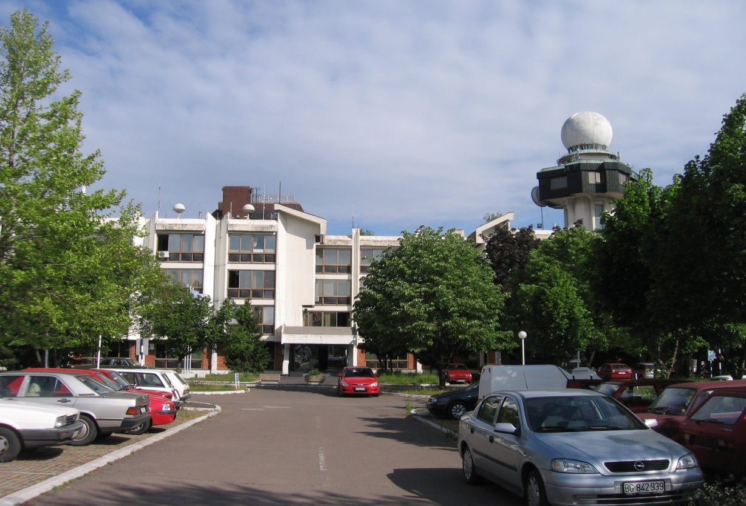
Republic Hydrometeorological Service of Serbia
Goran Pejanovic
Visit of RHMSS to NCEP/NOAA
Washington, D.C., USA, 2–5 November 2011
Notes:
1

Slide 2
Numerical Weather Models & Products in use in RHMSS

Slide 3
WMO RA VI-Europe RCC Network SEEVCCC :
● Climate Data Node
Lead: KNMI/Netherlands (consortium member SEEVCCC/RHMS-Serbia)
South East European gridded model datasets for 1961-1990 (ready)
● Climate Monitoring Node
Lead: DWD/Germany (participate SEEVCCC/RHMS-Serbia)
collecting data from the stations (monthly, 400-500 stations; main source for data KNMI-ECA&D, other climate bulletins NCDC)
mean temperature and accumulated precipitation,
temperature anomaly and precipitation percent of normal,
all available monthly/three-monthly
● Long Range Forecast Node
Lead: Météo-France & ROSHYDROMET (participate SEEVCCC/RHMS-Serbia)
Once a month ensemble run of a regional long range forecast - 7 months ahead:
dynamical downscaling ECMWF 41 ensemble with RCM-SEEVCCC
Notes:
Ovde reci stvari koje su iz Iplementation plan-a. Produkti dostupni na sajtu Centra. Analiza monitoring biltena pokazuje da broj stanica nije dovoljan za regionalni monitoring klime. Kroz MoU I striktne data policyje u razmeni veceg obima podataka doboce se bolji kvalitet produkata monitoring klime I LRF produkata. U toku operativnog rada naseg LRF sistema uocili smo da bi kvalitet mogao da se popravi kroz intenzivnu razmenu podataka. Narocita sa aspekta analize klimatski ekstrema I anomalija. Takodje se nadamo da ce druga inicijativa DRR WMO da pomogne. Ne postoje daily podaci vec samo monthly.

Slide 4
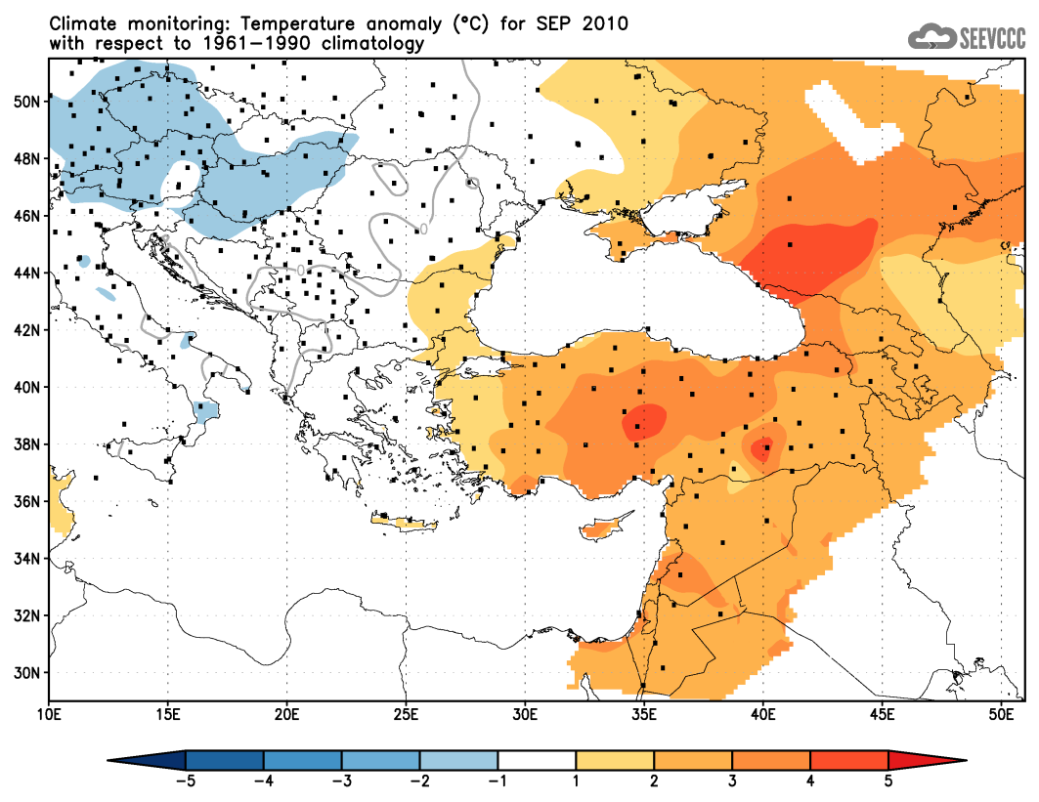
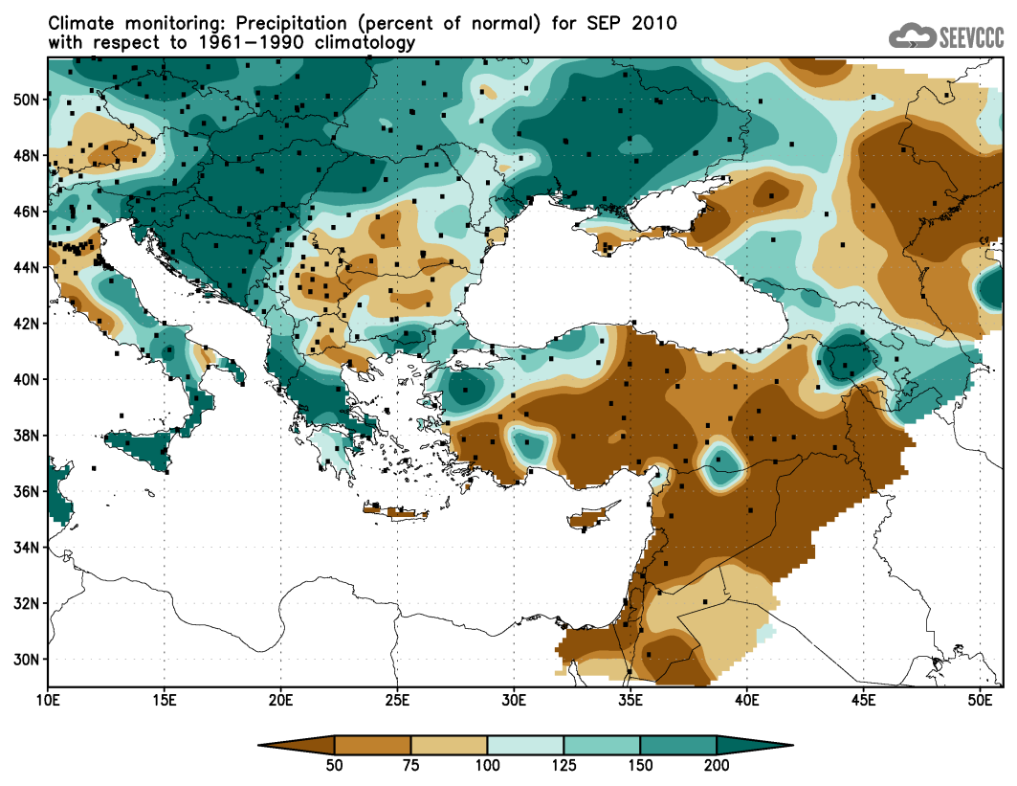
Climate Monitoring Node - Climate Watch Advisory for SEE -
● Example of the product : September 2010
Temperature anomaly
Precipitation (percent of normal)
● available maps:
for each month and for 3 months:
● mean 2m temperature, acc. precipitation,
● temperature anomaly, precipitation percent of normal (with respect to 1961-1990)
Notes:
Vazno reci da se ovaj monitoring sprovodi samo za potreba Climate Watch-a u SEE. Radi operativno. Tako da mozemo da koristimo anomalije za potrebe climate watch-a. eksperimentalno racunamo climate indices npr SPI2 standardized precip index u monitoring modu I LRF modu. Planirali smo da do kraja godine u operativan rad uvedemo proracun I drugih klimatskih indeks, a prema preporukama IPCC AR4 preporukama za region juzne evrope. Primer kako je NMHS Serbia iskoristila monitoring I LRF prognozu indeksa SPI2 bice dat sutra Mr. Pejanovic.
Centar je u skladu sa preporukama WMO obezbedjuje Climate Watch ADVISORY – It is up to the NMHSs to issue warnings on their jusrisdiction.

Slide 5
Long Range Forecast Node - Seasonal forecast for SEE -
● Probabilistic forecast
provides statistical summary of the atmosphere and ocean state
in coming season.
● RCM-SEEVCCC LRF (Long Range Forecast – Seasonal Forecast)
regional dynamical downscaling using fully coupled atmosphere-ocean
Regional Climate Model
model start: 16th of each month
forecast duration: 7 months (~215 days)
model resolution: ~35km atmosphere ; ~20km ocean
model domain: Euro - Mediterranean region extended toward Caspian Sea
41 ensemble members
initial and boundary conditions: ECMWF, resolution:125km
results prepared for South East European region in form of:
mean ensemble maps (mean 2m temperature, precipitation accumulation, temperature
anomaly and precipitation anomaly with respect to CRU data 1961-1990)
for month and three months (season)
diagrams (probabilistic forecast of mean monthly temperature and monthly precipitation
accumulation for specific place)
Notes:
LRF prica je da kroz SEECOF mehanizam analiziramo kljucne sezone koristeci produkte GPCs i to ECMWF I MeteoFrance I ROSHYDROMET.
Pored GPC produkata u SEECOF procesu koristi se i LRF produkt SEEVCCC za SEE, kao i produkti zainteresovanih NMHS iz regiona SEECOF.
Kroz SEECOF su dati conseus forecasts.
SEECOF proces se sprovodi zajedno sa Slovenijom (DMCSEE) centar u kojem i Srbija ucestvuje. SEEVCCC centar je spreman da sve nase produkte stavimo na raspolaganje preko MoU za njihove drought management advisories.

Slide 6
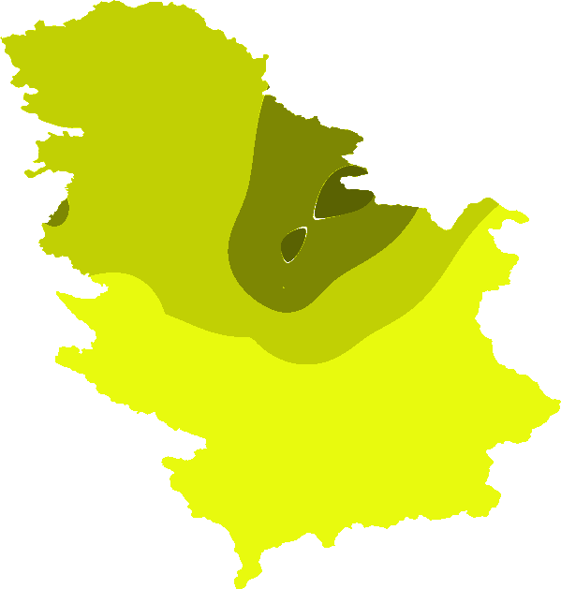
R&D: Earth Modeling System
Climate Watch example – precipitation anomalies and extremes
Example: Extremely wet SPI2 for February 2010, using LRF forecast (start January 1st 2010)
New! Under development
RCM-SEEVCCC
ensemble forecast
corrected LRF
RCM-SEEVCCC
ensemble forecast
observed

Slide 7
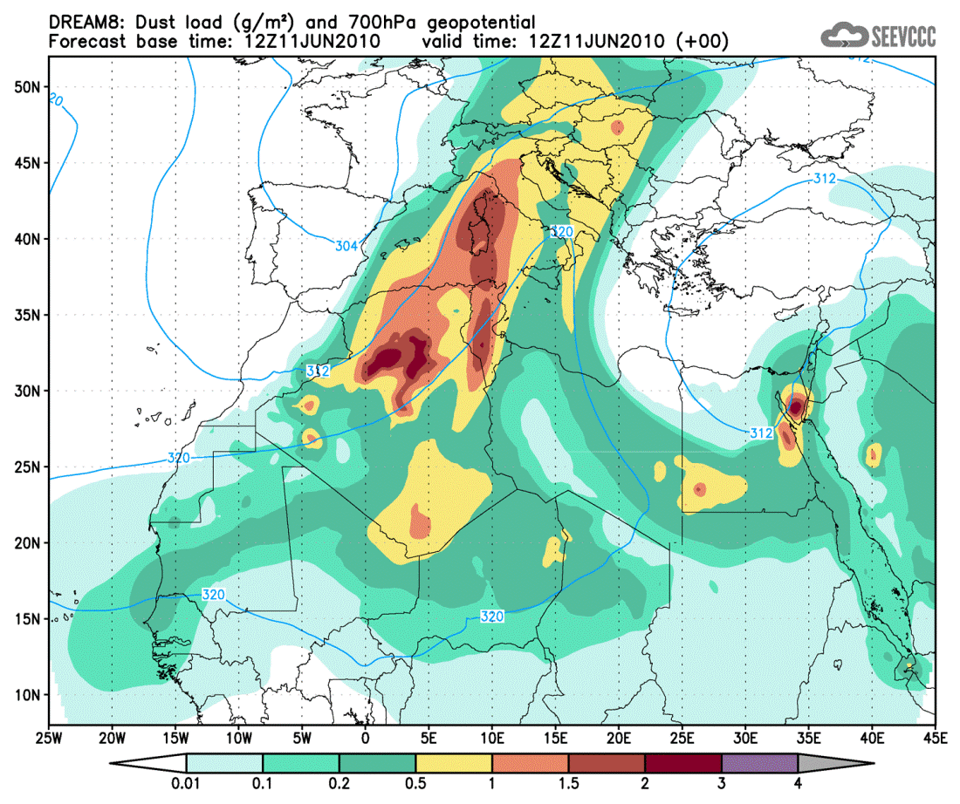
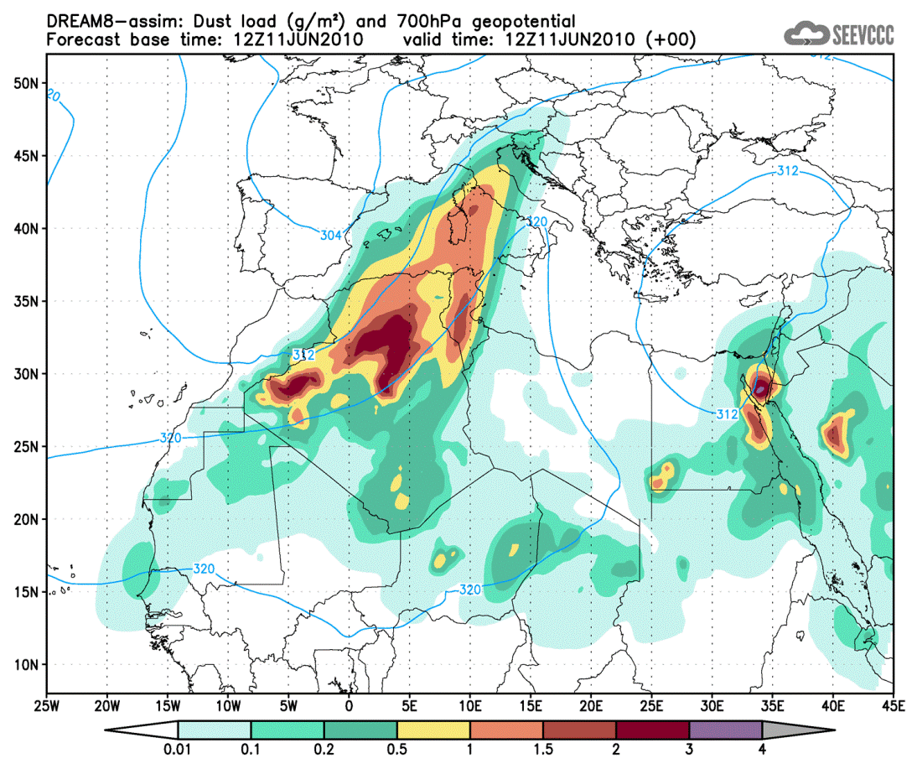
Operational dust forecast: DREAM
● DREAM8: Dust Regional Atmospheric Model with 8 categories for particle sizes
model runs: 12UTC start ; +72h forecast
model resolution: 1/3 degrees (~35km)
models: DREAM8 and DREAM8-assim (assimilation using ECMWF dust aerosol analysis)
presented: model run from June 11th 2010 12UTC
DREAM8
DREAM8 – assim

Slide 8
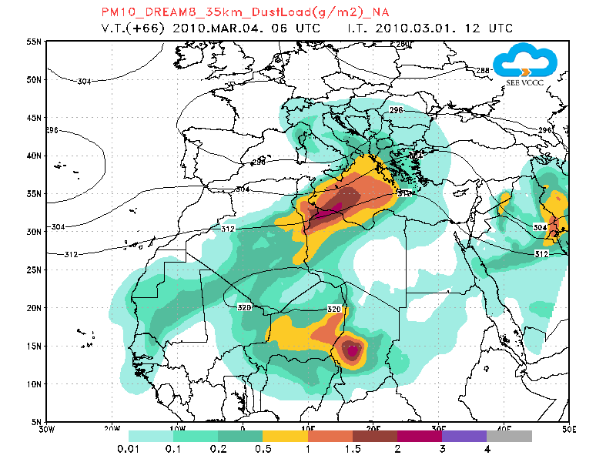
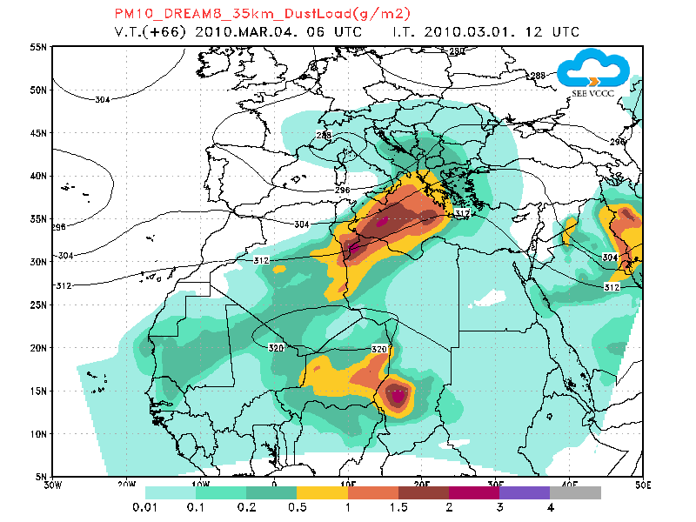
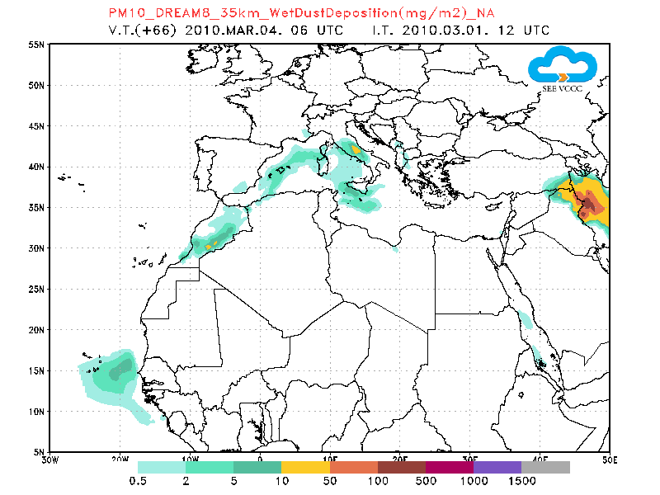
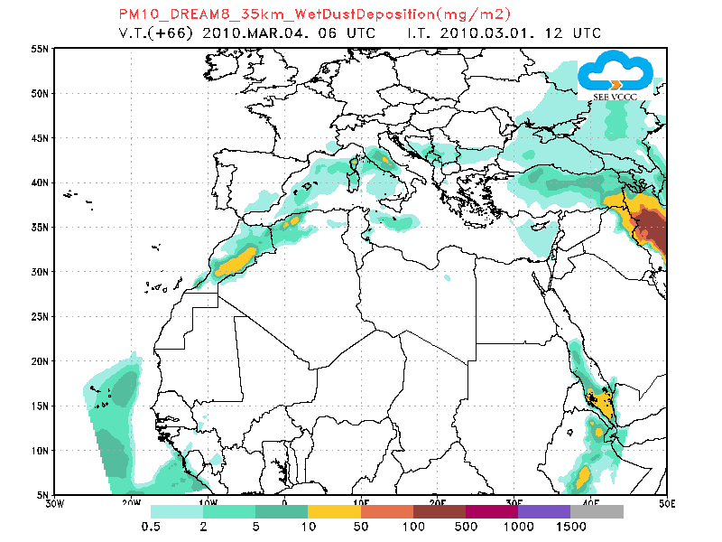
DREAM model – assimilation using ECMWF dust aerosol analysis
Case: March 4th 2010; Yellow snow at Kopaonik
NO ASSIMILATION
WITH ASSIMILATION
DUST LOAD
WET DEPOSITION

Slide 9
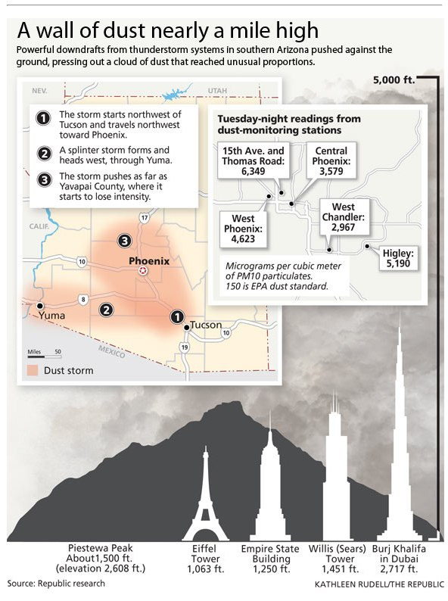
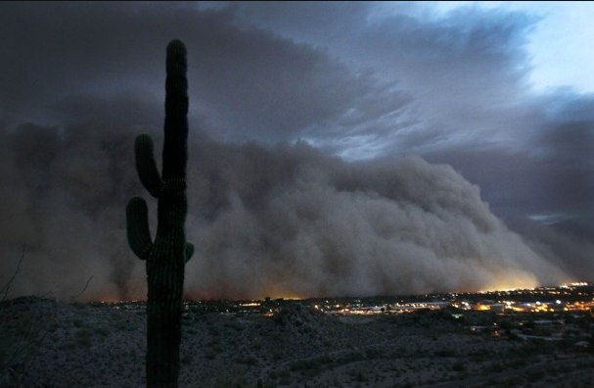
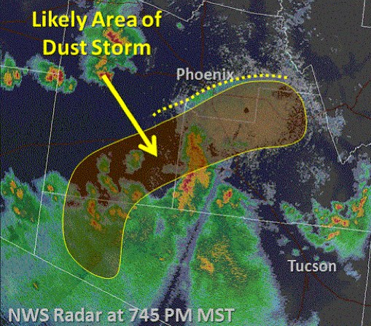
110mi
leading edge

Slide 10
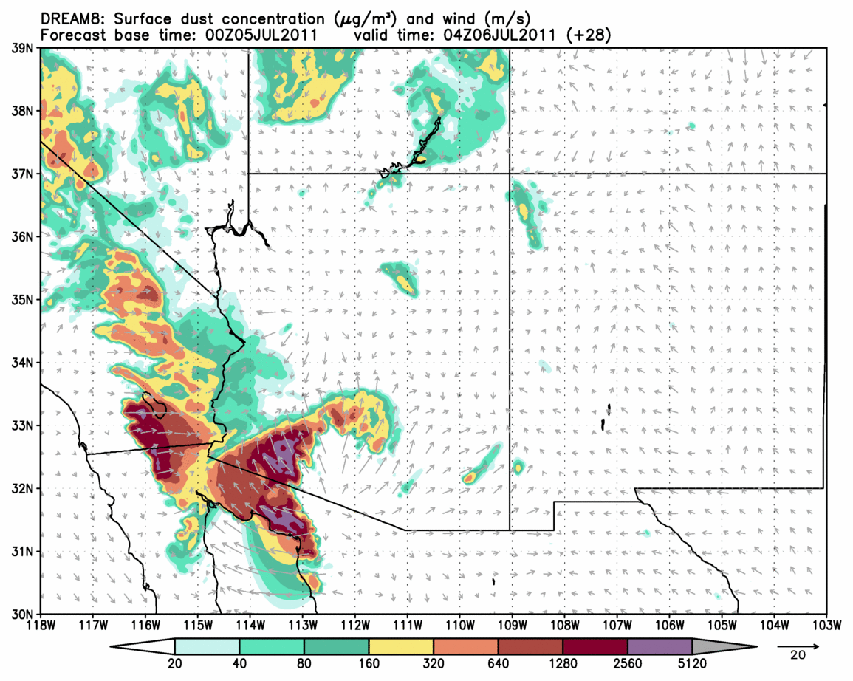
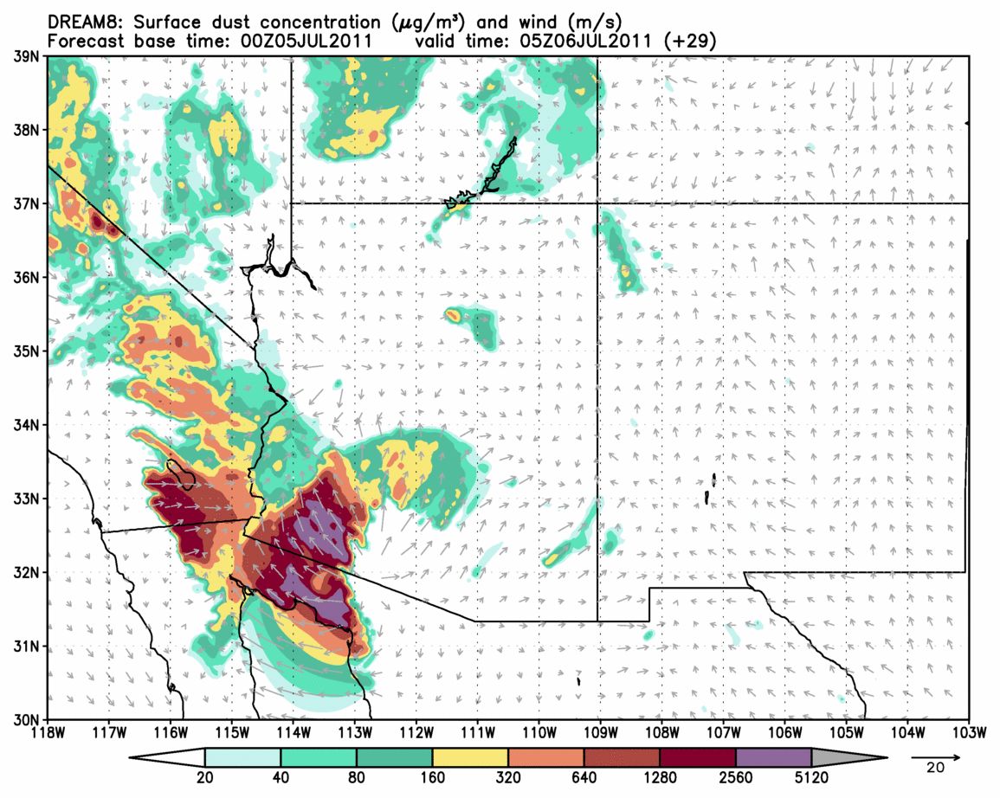
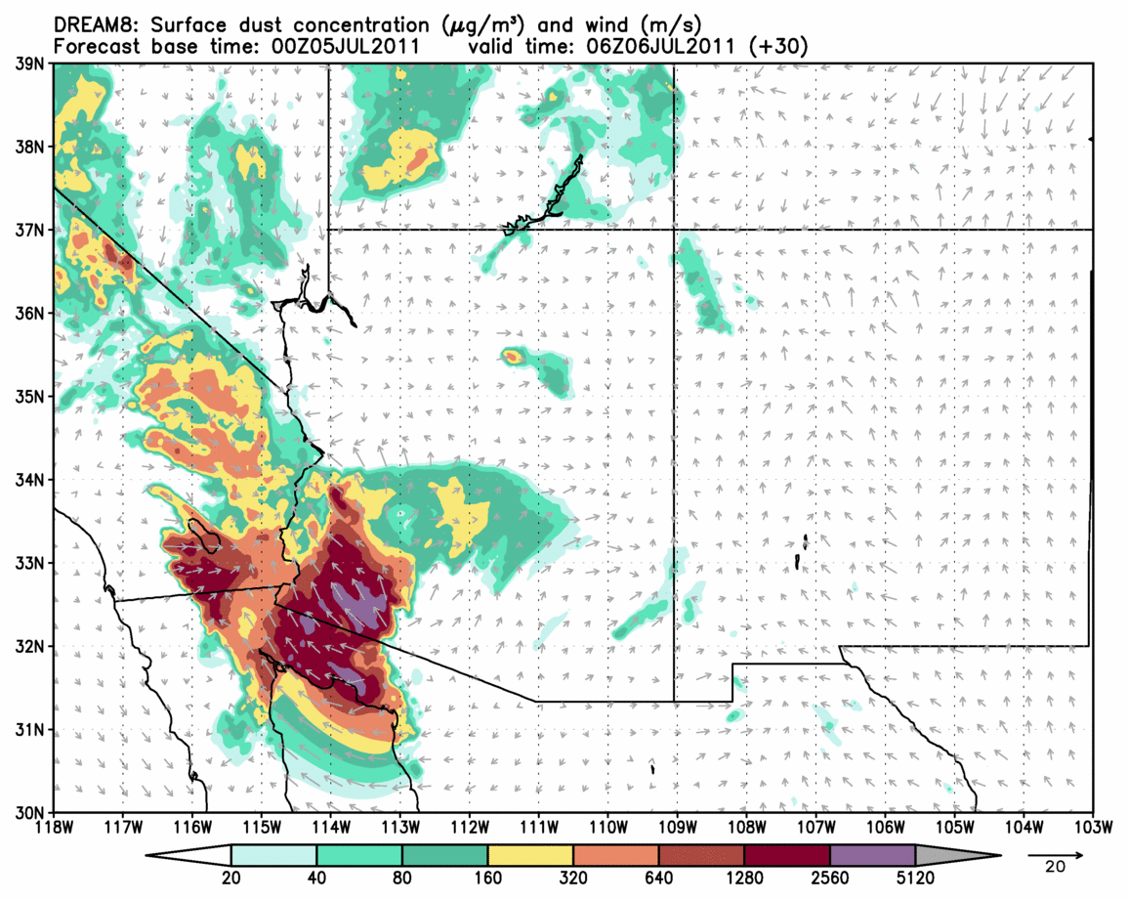
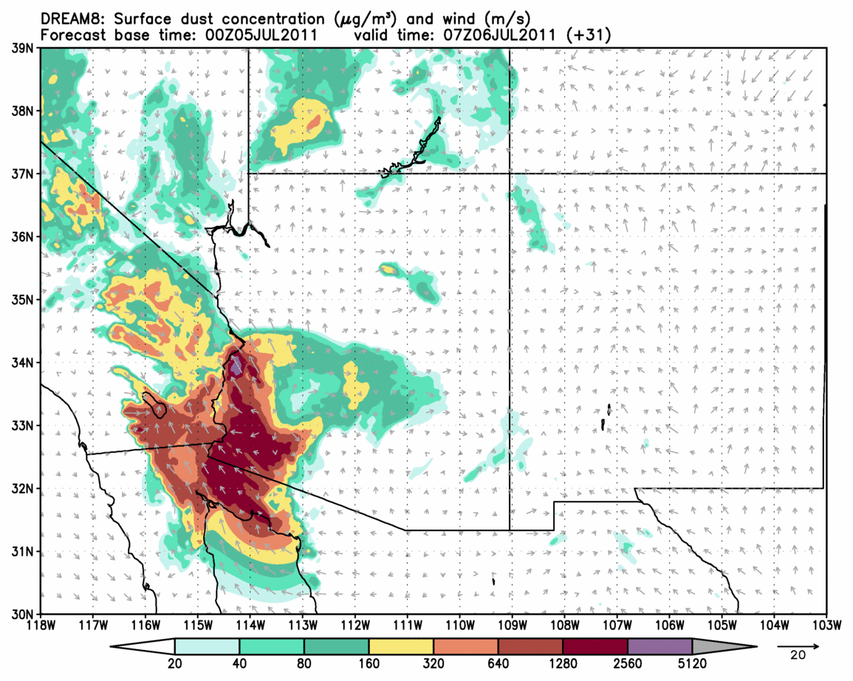
Simulations specification: model: DREAM with NMM as atmospheric driver; simulation: start at July 5th 2011 00UTC +48h; resolution: 6km and 3.7 km; mask: mcd12_jun0110
04h UTC
05h UTC
leading edge
leading edge
06h UTC
07h UTC

Slide 11
Mineral composition of arid soils
dust is composed of minerals that differ in physical and chemical characteristics
each mineral has different impact on environment, atmospheric radiation, ice nucleation
important impacts on: human health, ocean bio-productivity, cloud formation
GMINER30: High-resolution global dataset on surface mineralogy in arid areas
- data on mineral fraction for 9 most common minerals in arid regions
- based on Claquin et al., 1999, but improved
- minerals are sorted by size in clay and silt populations
silt | clay | silt & clay
feldspar | illite | calcite
gypsium | kaolinite | hematite
 | smectite | quartz
+ phosphorus
- dataset is global on 30 arc-seconds resolution (~ 1 km)
- available for download at: http://www.seevccc.rs/GMINER30/

Slide 12
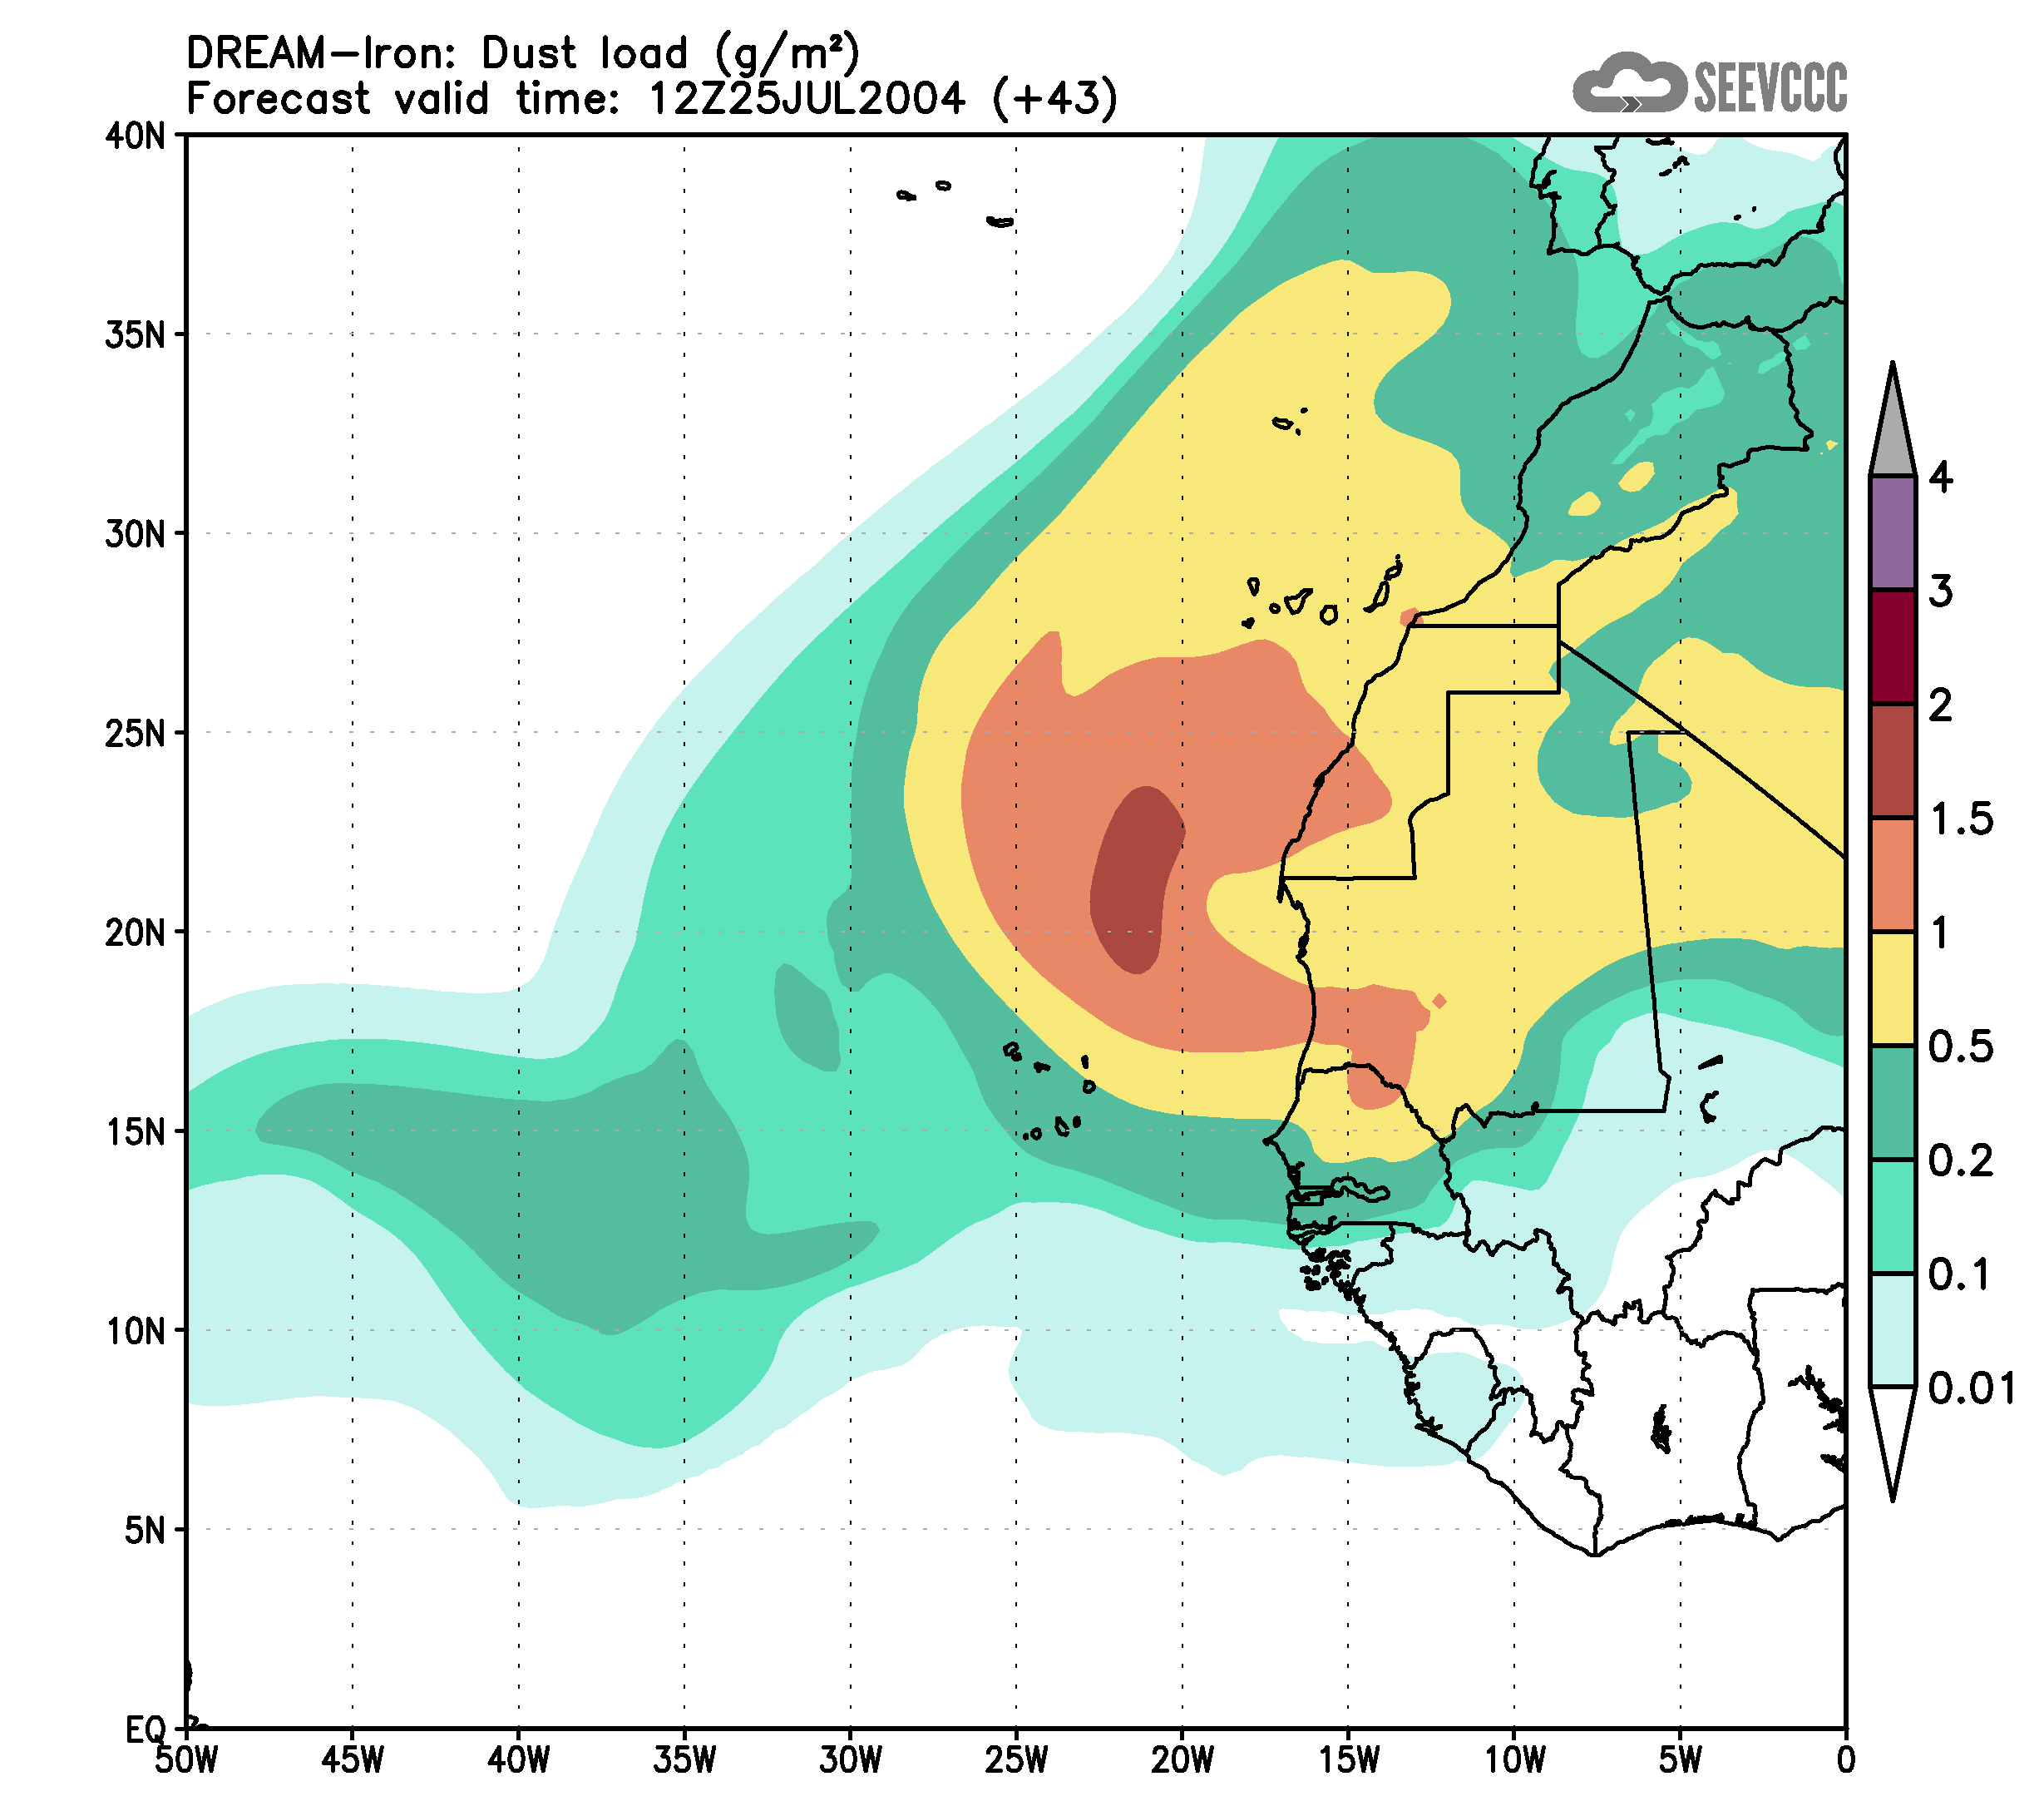
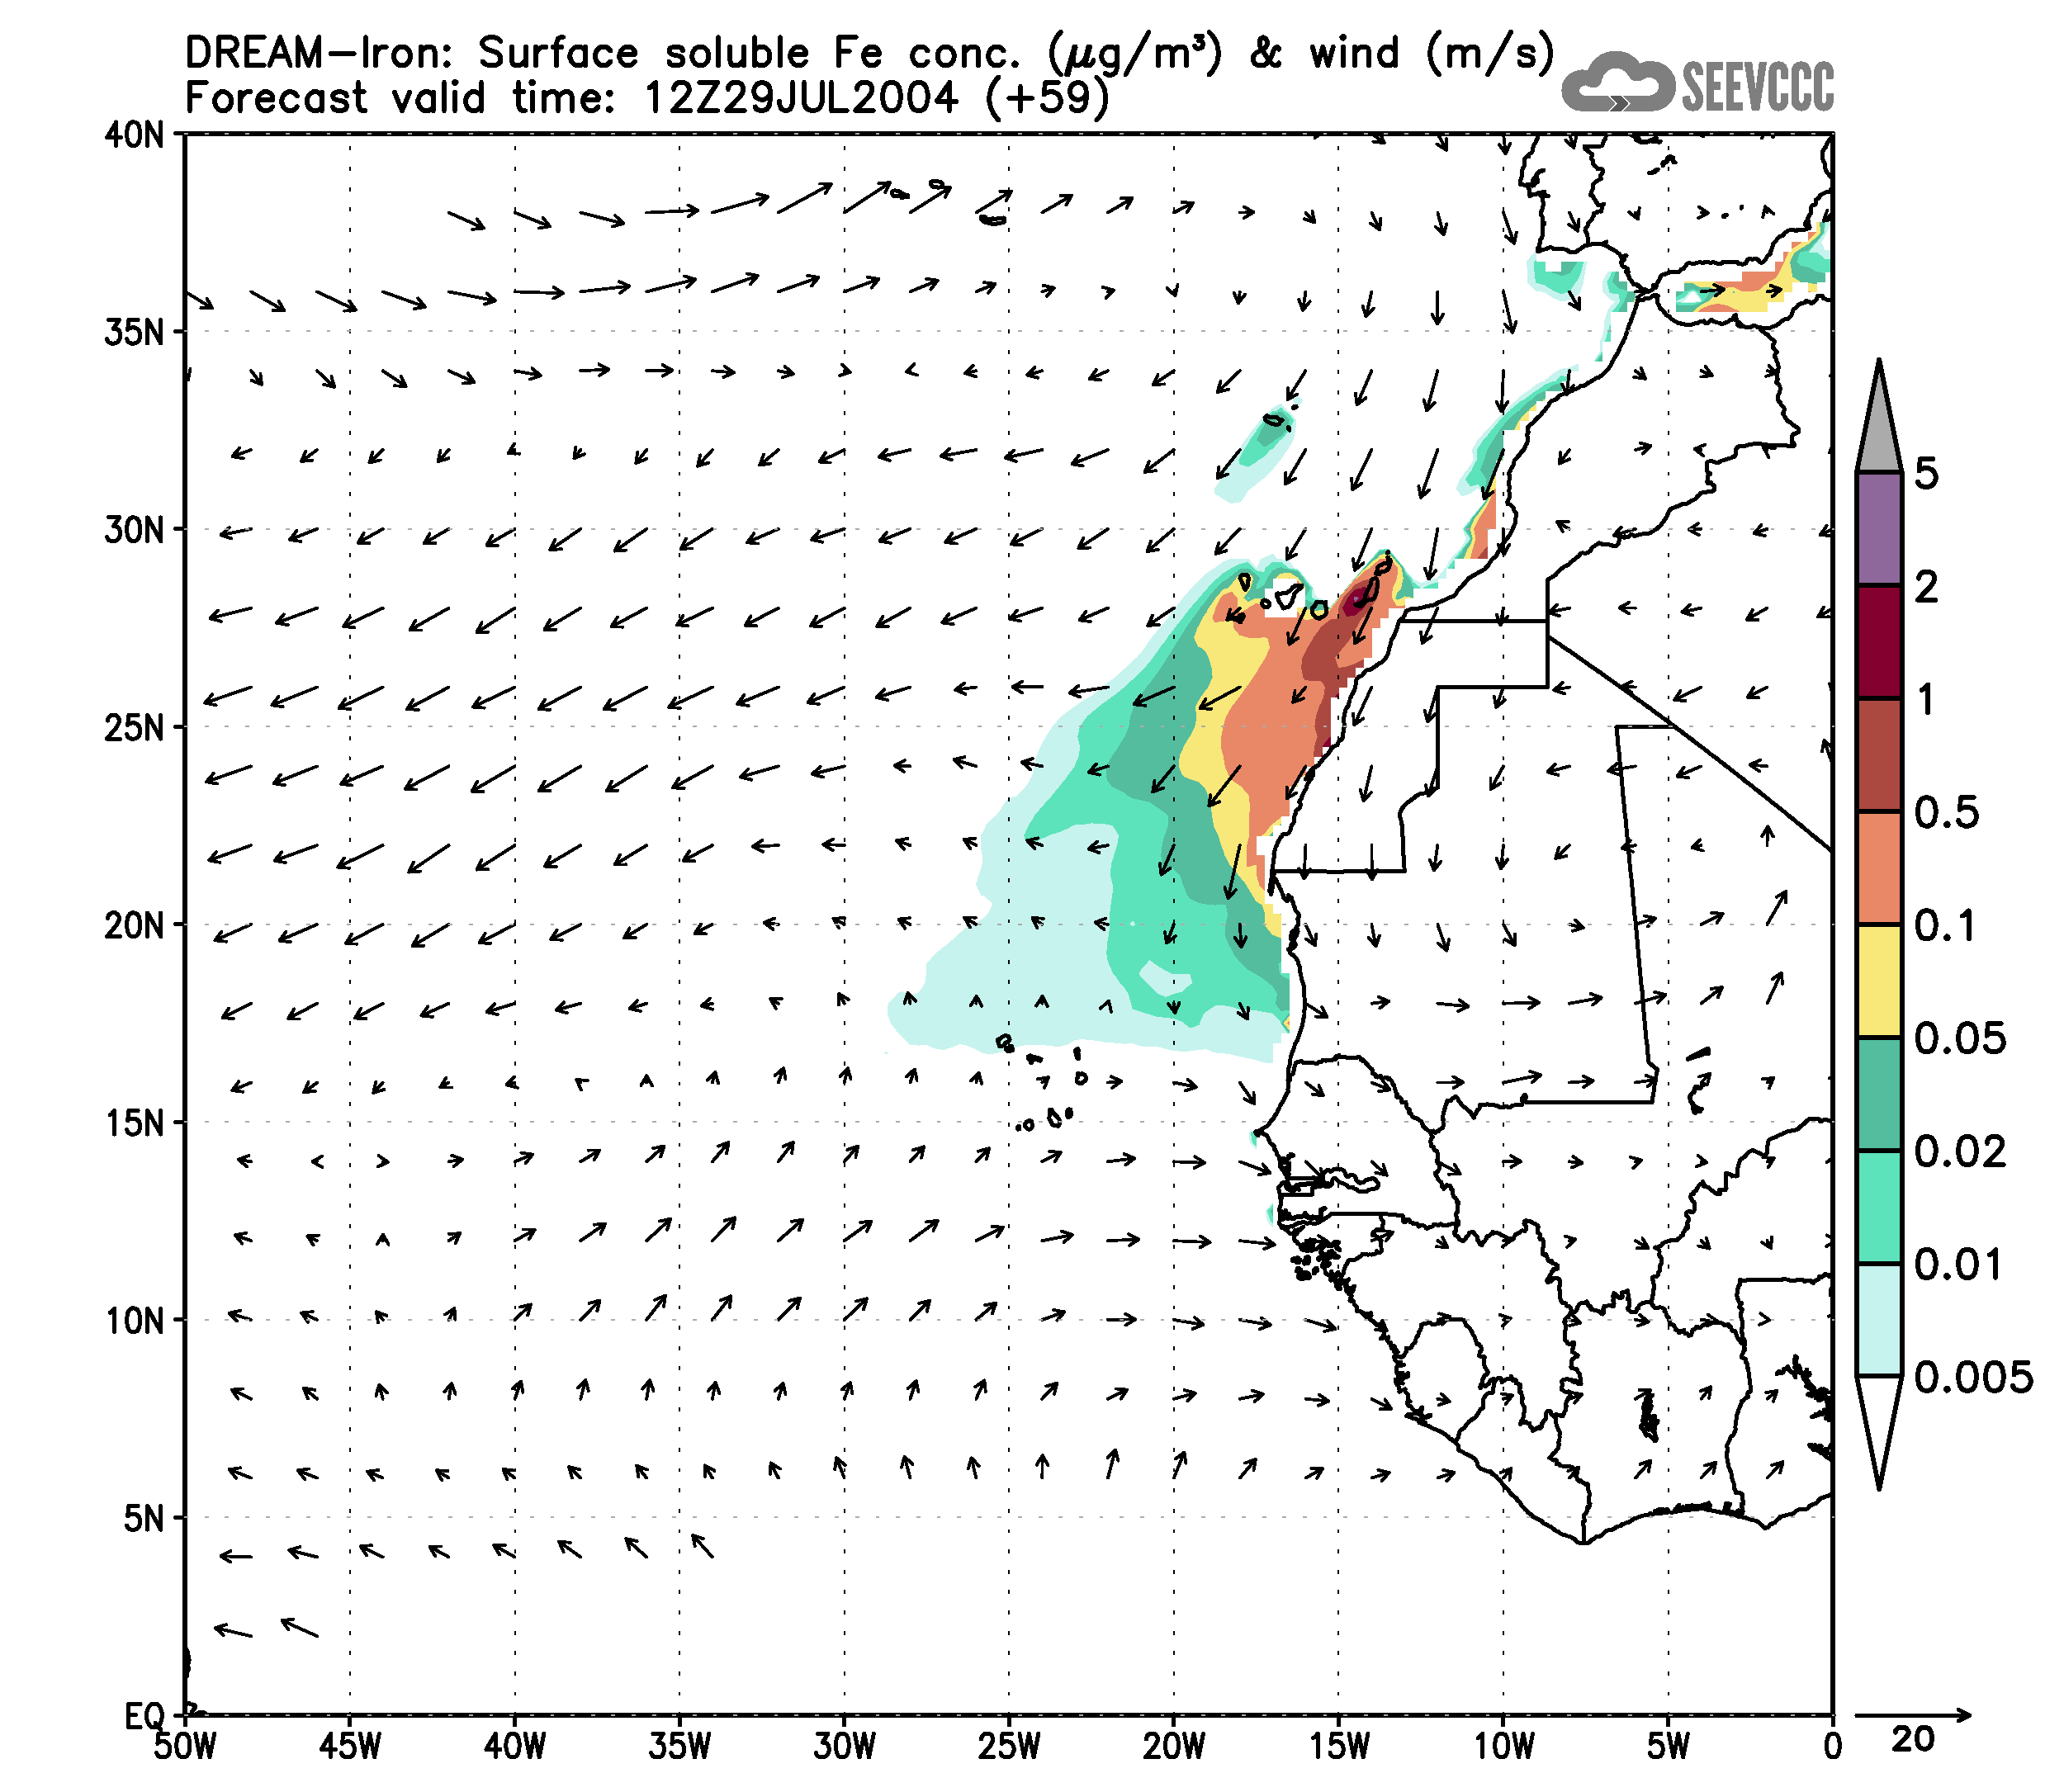
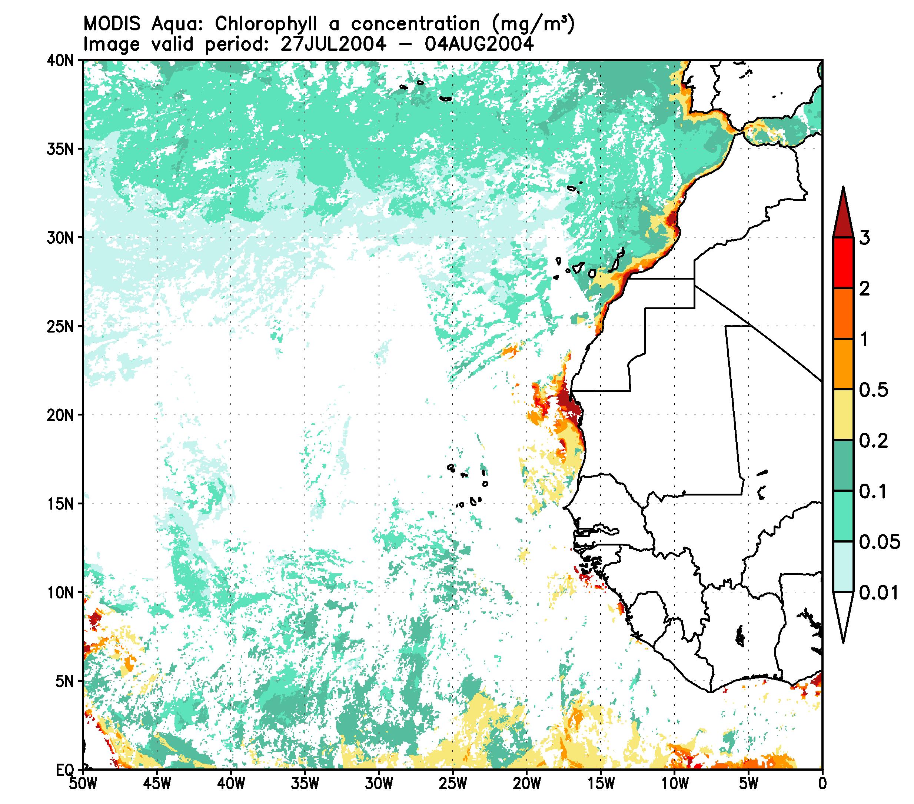
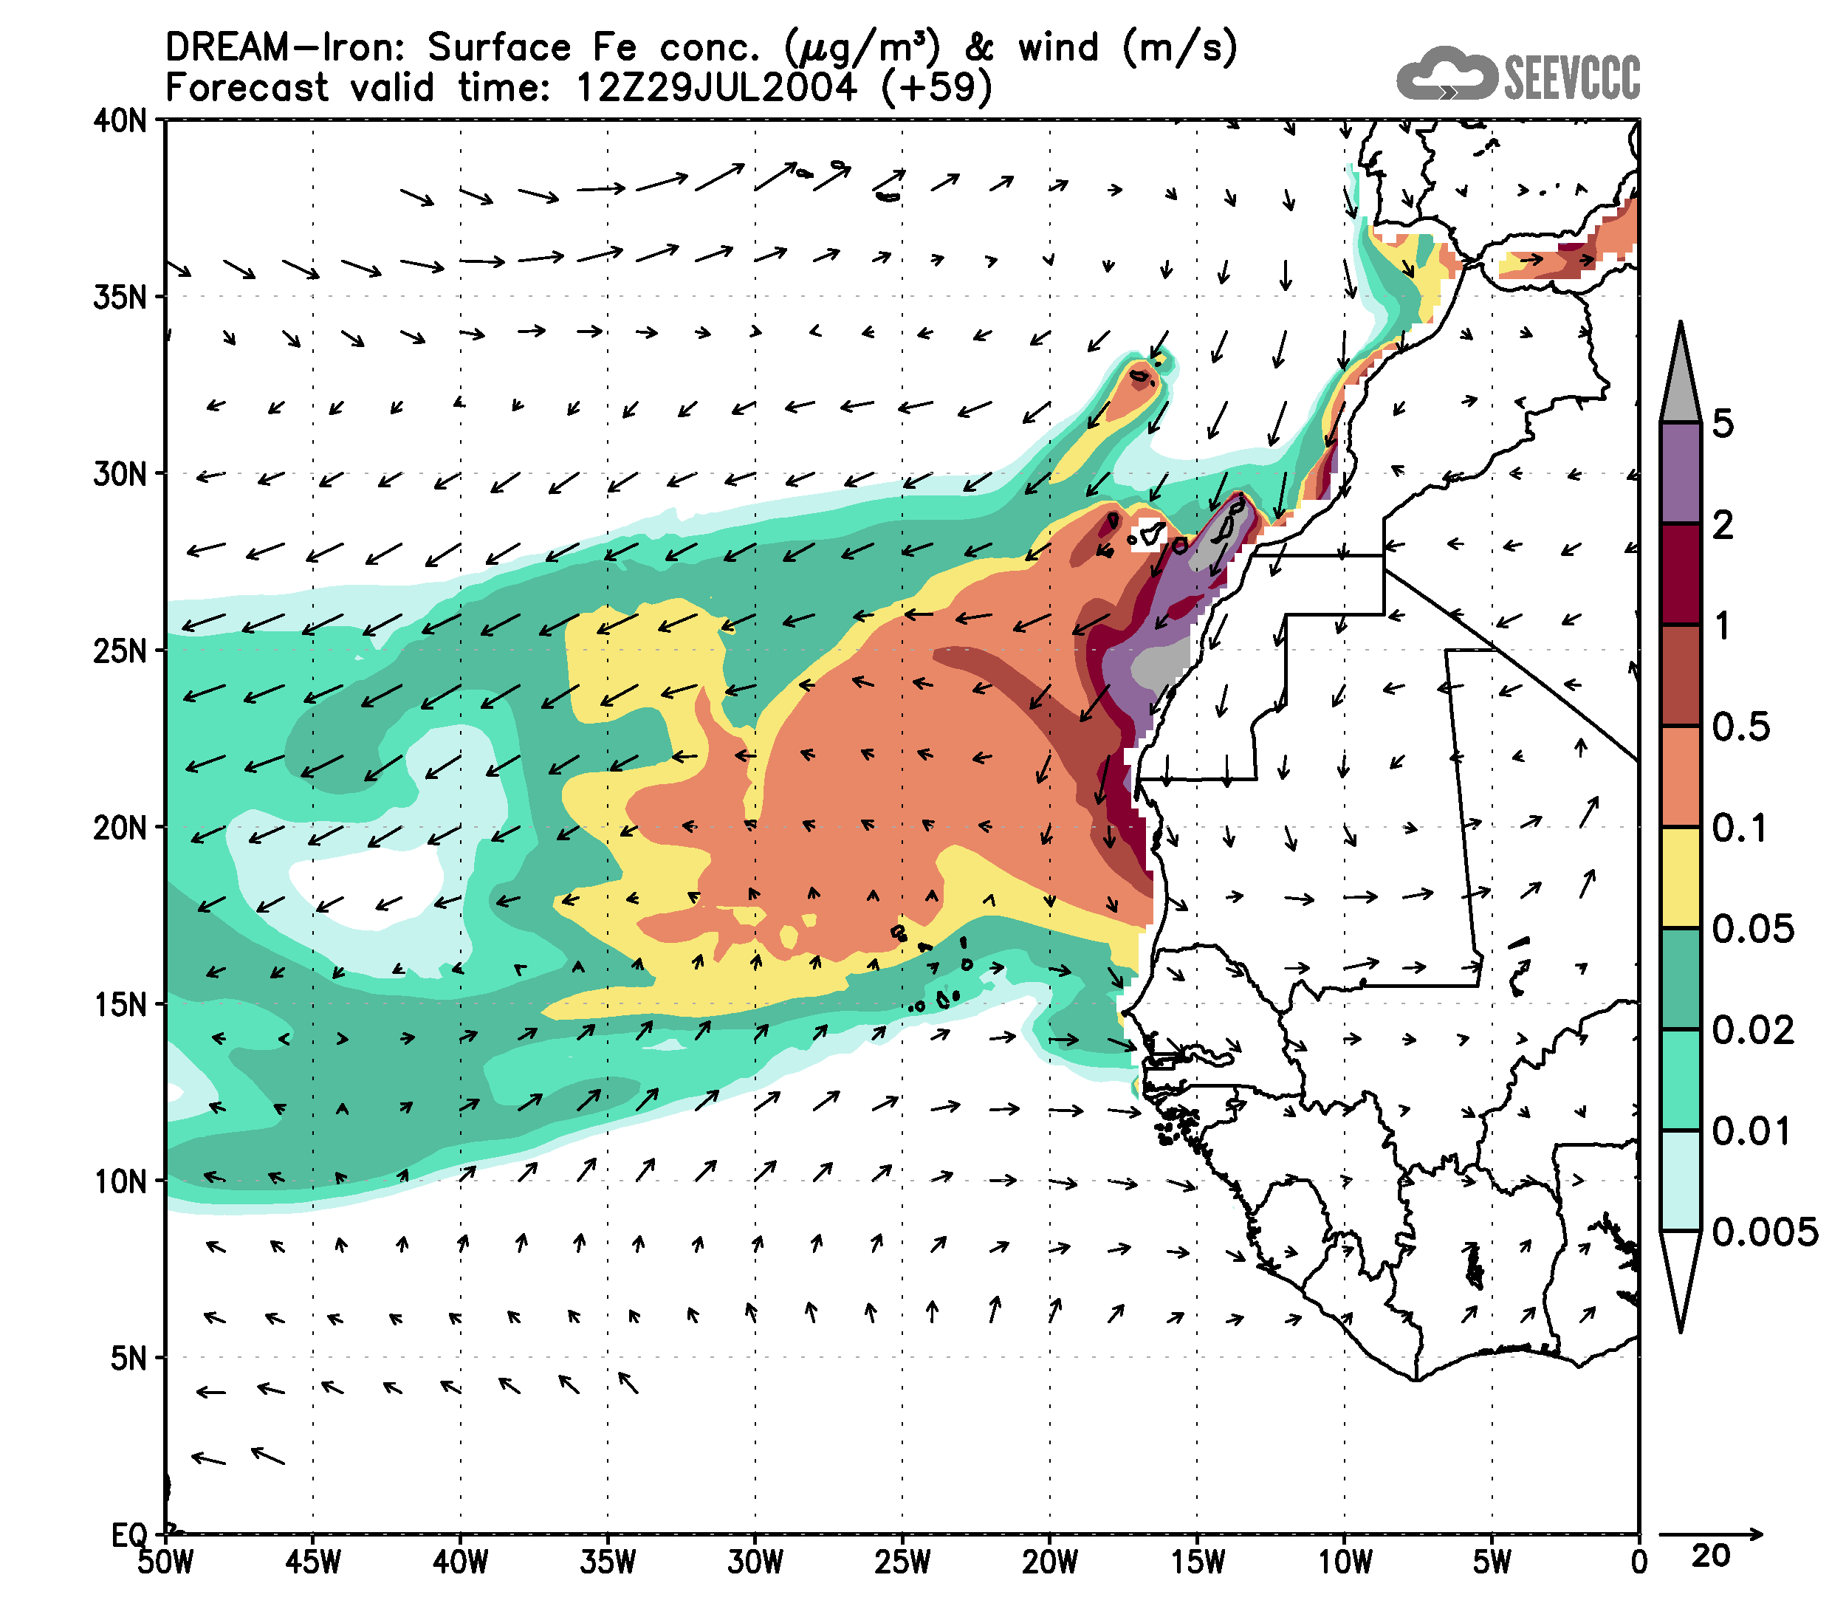
Atmospheric iron transport modeling
Example of mineral database application

Slide 13
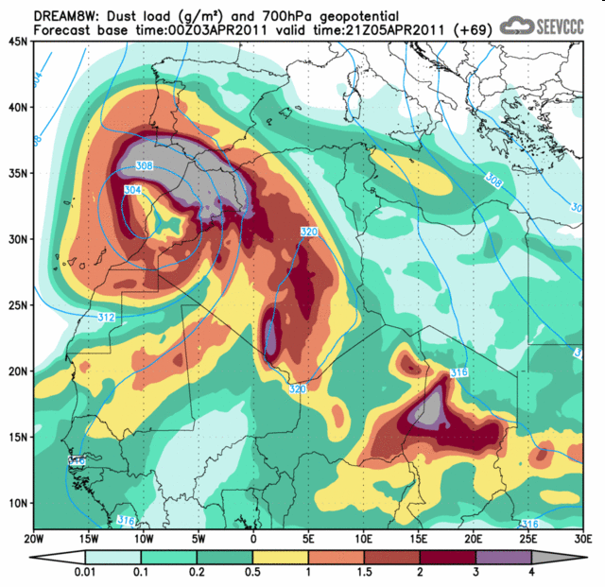
Fennec Project: Dust Forecast
Models: DREAM (syntetic initial soil temperature and wetness) DREAMW (initialized soil temperature and wetness) Resolution: 1/6 degrees Forecast: 2 per day start at 00UTC for 72 hours start at 12UTC for 72 hours Initial field: +06h ECMWF global forecast | dc: surface dust concentration and wind on lm dl: dust load and 700mb geopotential da: aerosol optical depth 500nm dd: cumulative dry dust deposition dw: cumulative wet dust deposition dp: 3h accumulated precipitation and MSL pressure d9: relative humidity and wind at 925mb d7: relative humidity and wind at 700mb d5: relative humidity and wind at 500mb

Slide 14
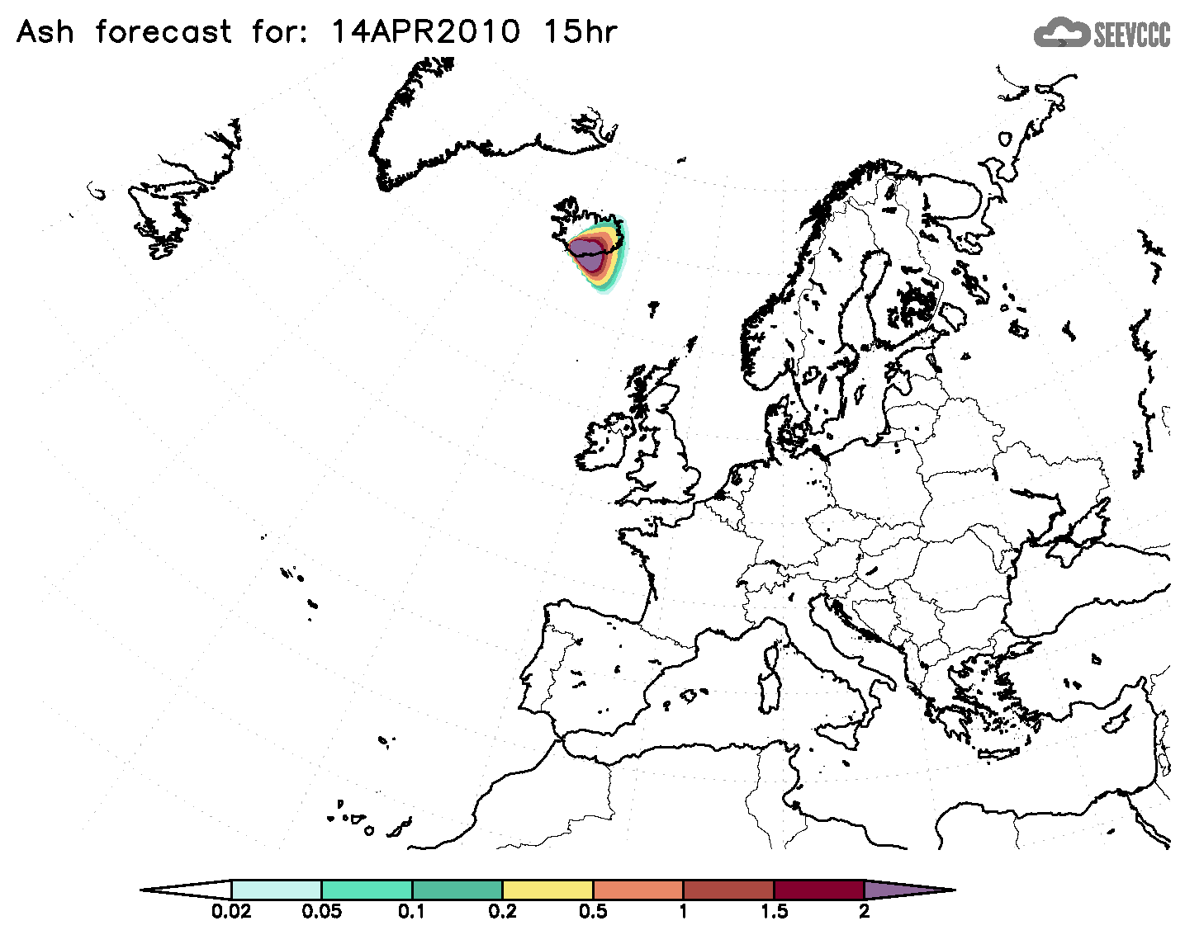
Volcanic Ash Transport
DREAM modification for purpose of volcano ash transport simulation
Eyjafjallajokull
starting date:
April 14th 2010

Slide 15
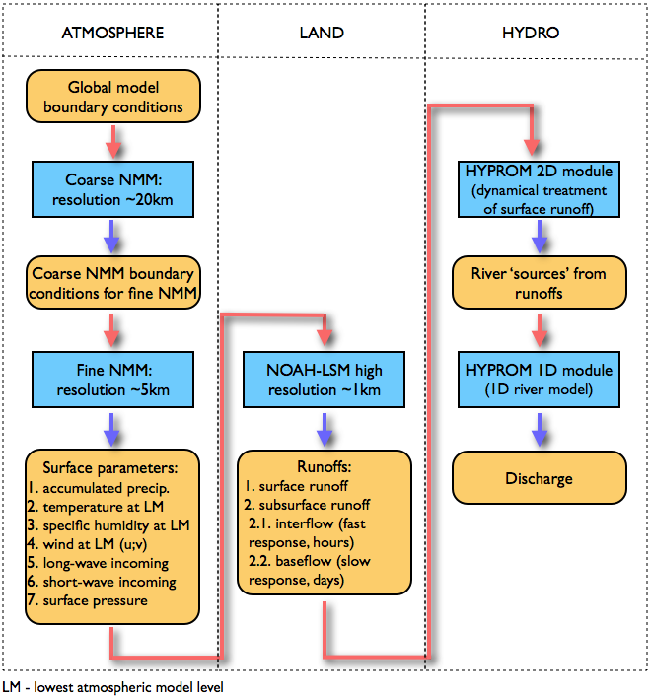
Hydrology component - HYPROM model
Precipitation and river
discharge forecast at flash
floods events and for regional
climate simulations
integrated system
S. Ničković, G. Pejanović,
V. Djurdjević, M.Vujadinović

Slide 16
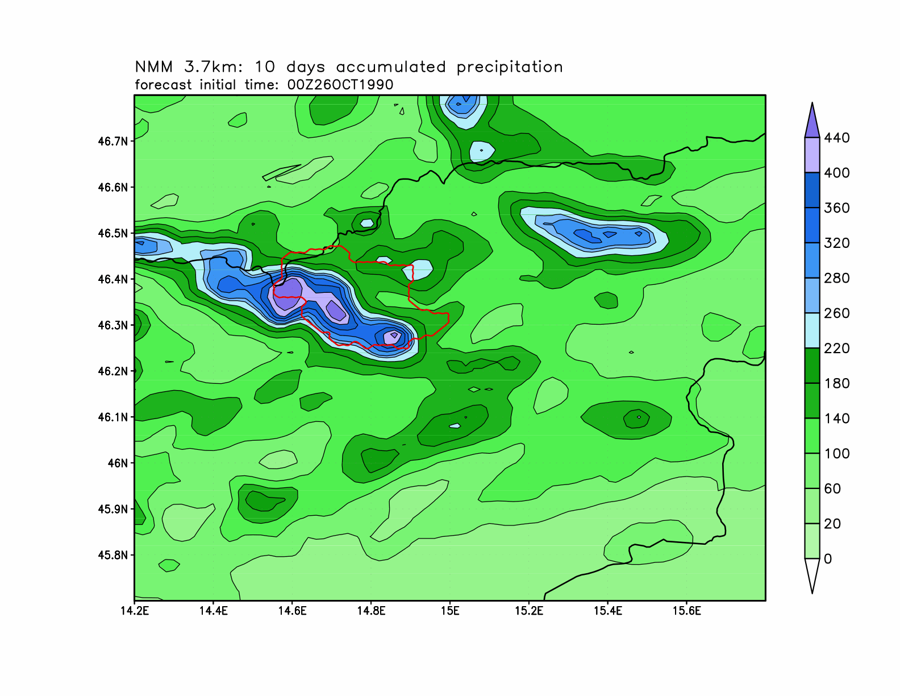
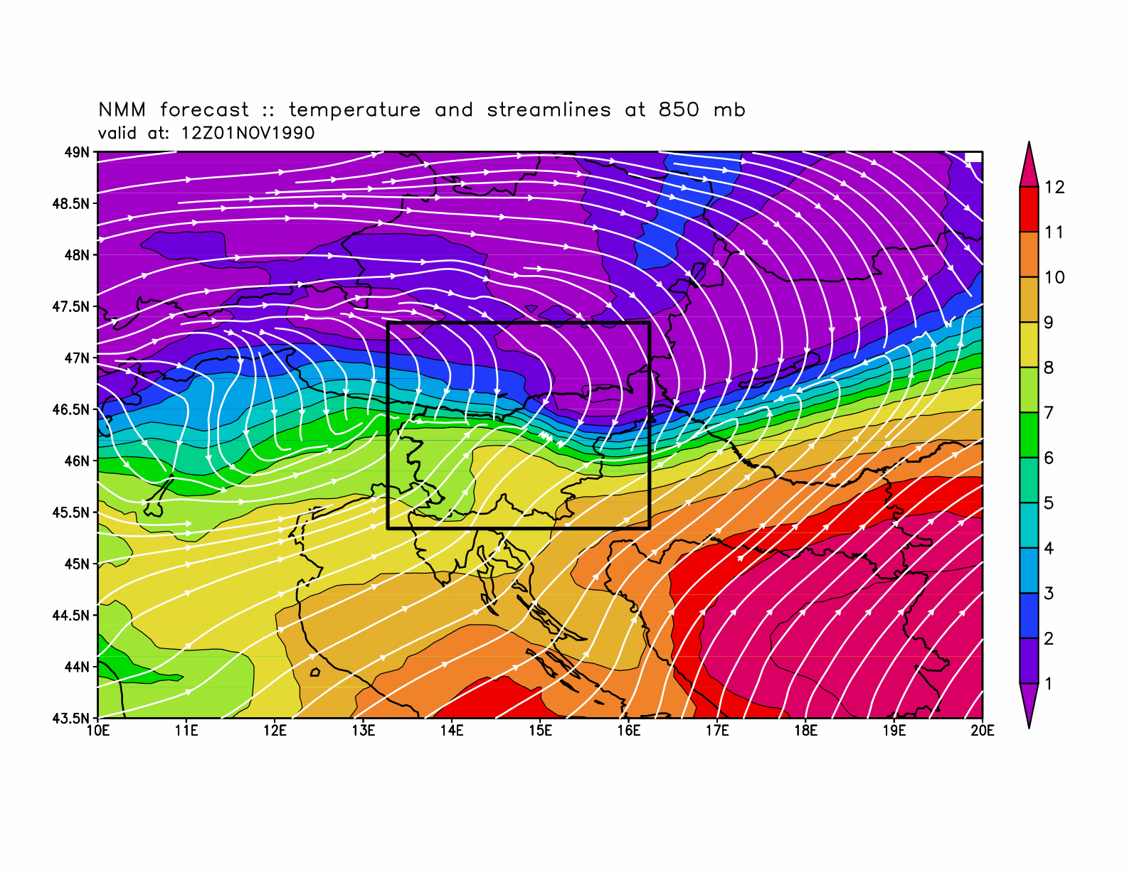
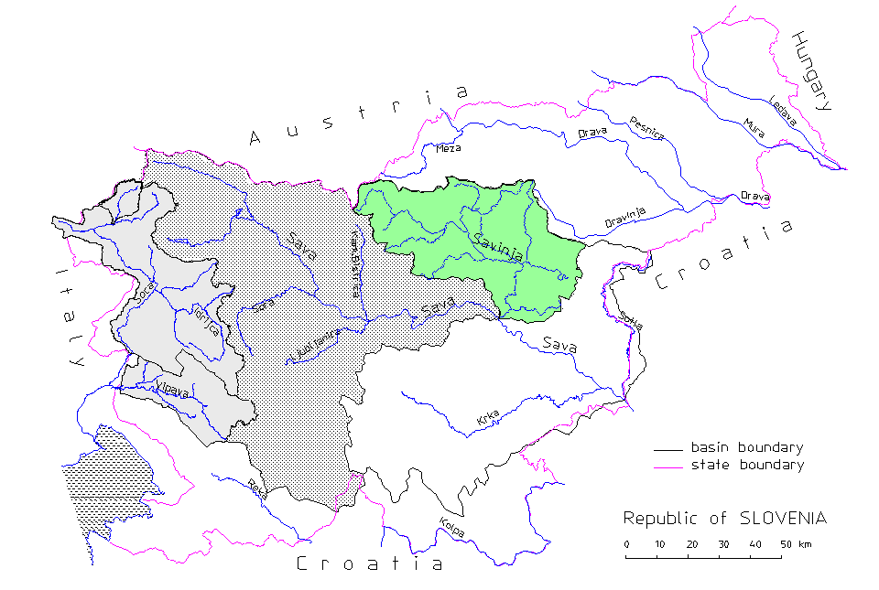
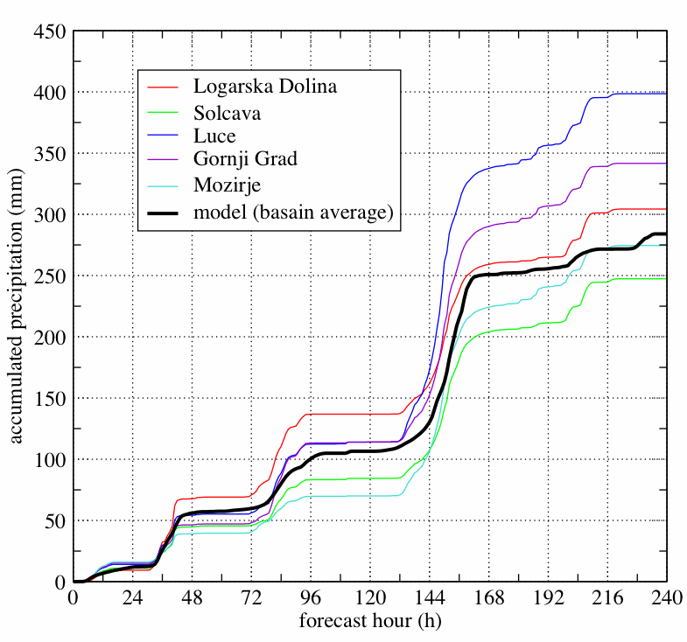
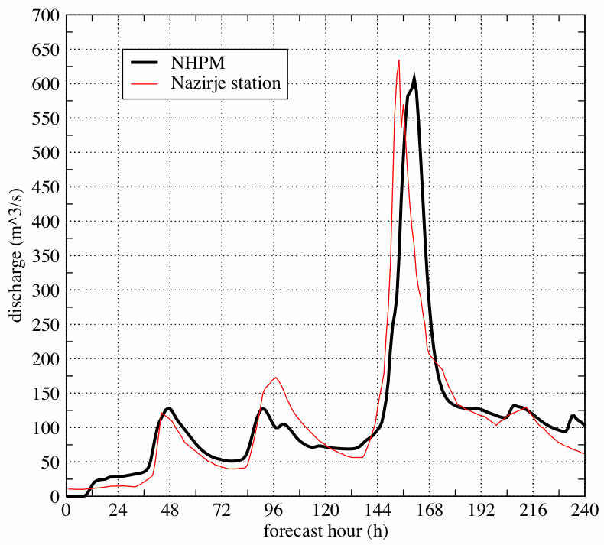
Savinja (Slovenia)
NMM model
26/10 – 6/11 1990
T and V at 850 hPa,
1Nov1990
acc. rainfall
26 Oct – 6 Nov1990
accumulated precipitation (mm)
model vs. observations
river discharge (m^3/s)
forecast hour (h)
forecast hour (h)

Slide 17
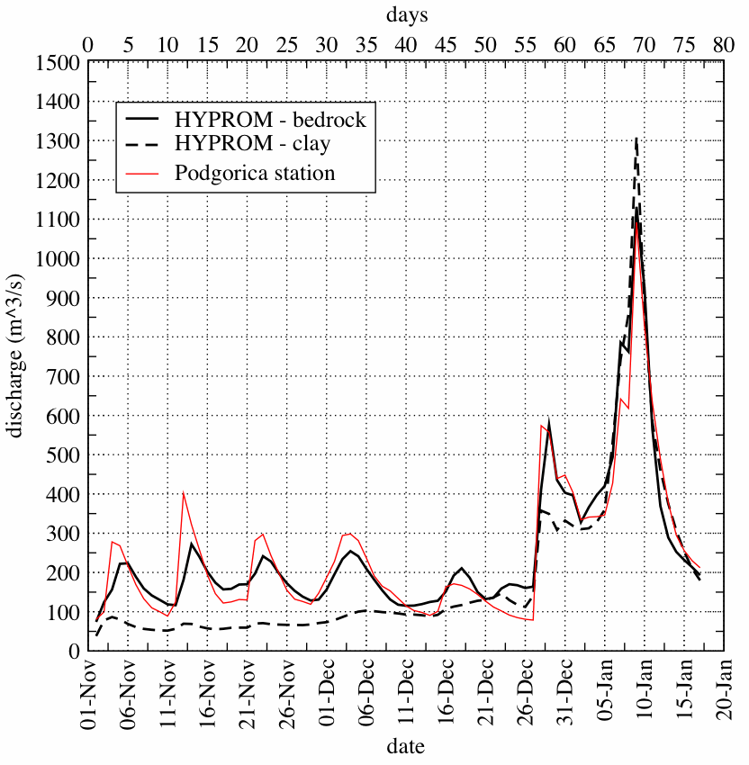
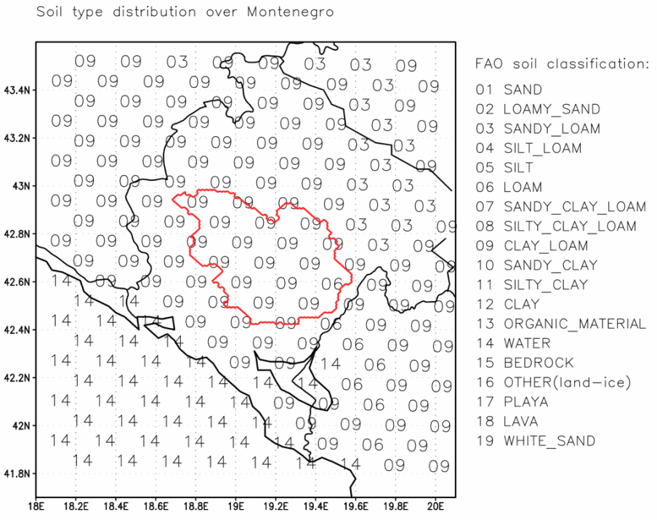
Land Surface Modelling
Hydrology component - HYPROM model
Sensitivity to soil type
parameter | Clay Loam (09) | Bedrock (15)
sat. diffusivity | 0.113 x 10⁻⁴ | 0.136 x 10⁻³
sat. conductivity | 2.45 x 10⁻⁶ | 1.41 x 10⁻⁴
porosity | 0.465 | 0.20
CH constant | 8.17 | 2.79

Slide 18
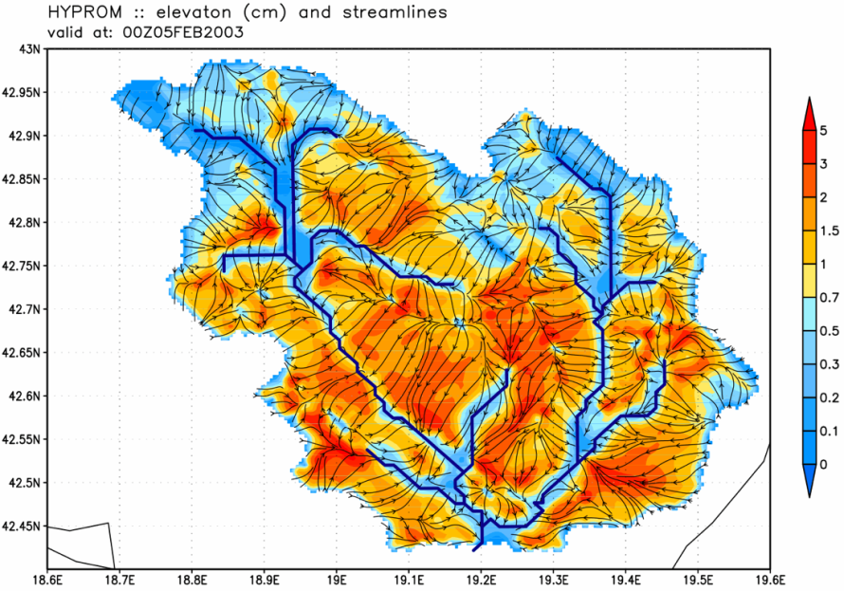
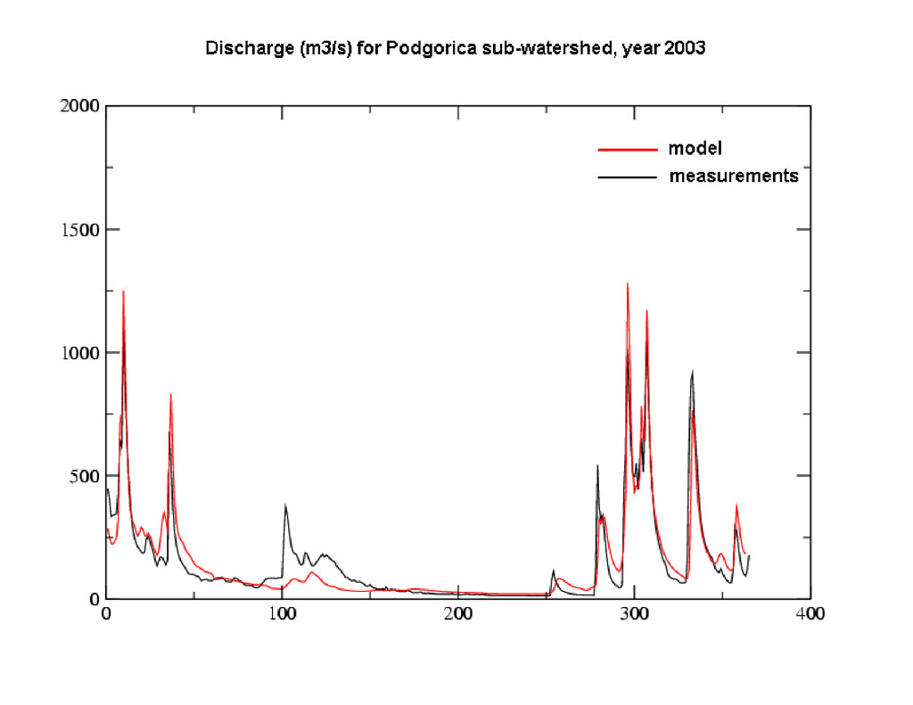
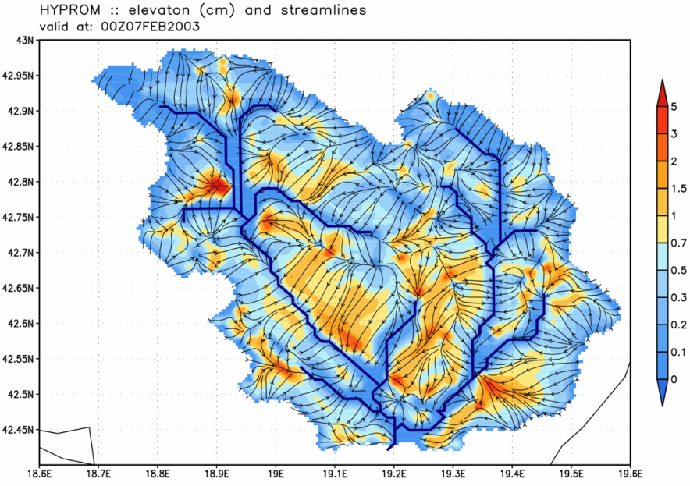
Morača (Montenegro)
HYPROM - example of dynamical treatment of surface runoff after heavy rains
05. feb. 2003.
discharge (m^3/s) at
Podgorica measuring point
elevation (cm) and stream lines
model vs. measurements
year 2003
07. feb. 2003.

Slide 19
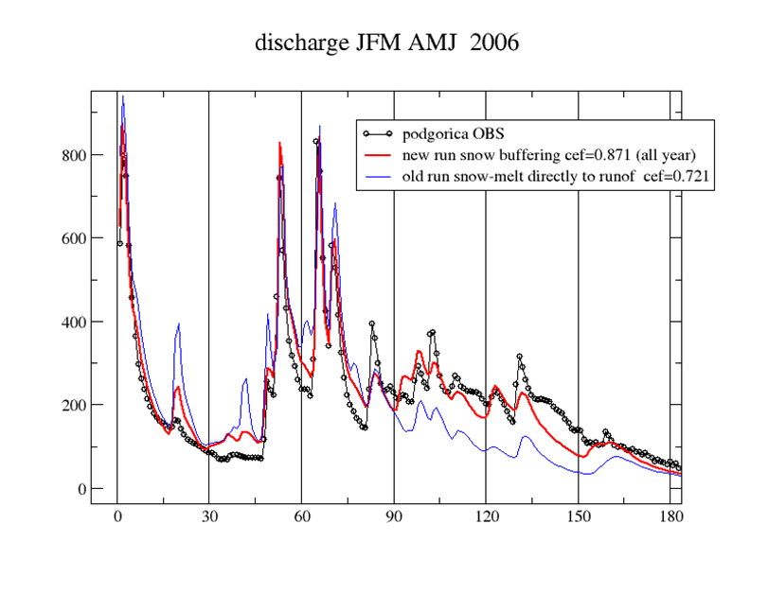
Hydrology component - HYPROM model
Recommendation for
further work
Natural conditions simulation
Stations and year | Mean Observed | ME % | ME | MAE | RMSE | CORR | CEFF | No
Mor.Podg.06 | 140.2 | 5.7 | 7.972 | 63.056 | 80.218 | 0.864 | 0.698 | 363
Mor.Podg.07 | 125.3 | 8.1 | 10.124 | 48.737 | 81.144 | 0.818 | 0.55 | 364
Mor.Podg.08 | 142.8 | 6 | 8.522 | 44.921 | 68.29 | 0.925 | 0.841 | 364
Mor.Podg.09 | 159.3 | 13.9 | 22.119 | 50.595 | 70.416 | 0.943 | 0.864 | 363
Mor.Podg.10 | 233.7 | 2.9 | 6.748 | 68.405 | 105.127 | 0.924 | 0.854 | 345
New snow melting parametrization
Stations and year | Observed Mean | ME % | ME | MAE | RMSE | CORR | CEFF | No
Mor.Podg.06 | 140.2 | 9.5 | 13.374 | 38.314 | 51.399 | 0.941 | 0.876 | 363
Mor.Podg.07 | 125.5 | 7.9 | 9.904 | 37.747 | 65.789 | 0.858 | 0.705 | 363
Mor.Podg.08 | 142.7 | 6.5 | 9.31 | 38.099 | 61.559 | 0.935 | 0.871 | 363
Mor.Podg.09 | 159.3 | 10.7 | 16.978 | 37.21 | 57.195 | 0.958 | 0.91 | 363
Mor.Podg.10 | 233.7 | 3.9 | 9.058 | 52.523 | 86.713 | 0.953 | 0.901 | 345

Slide 20
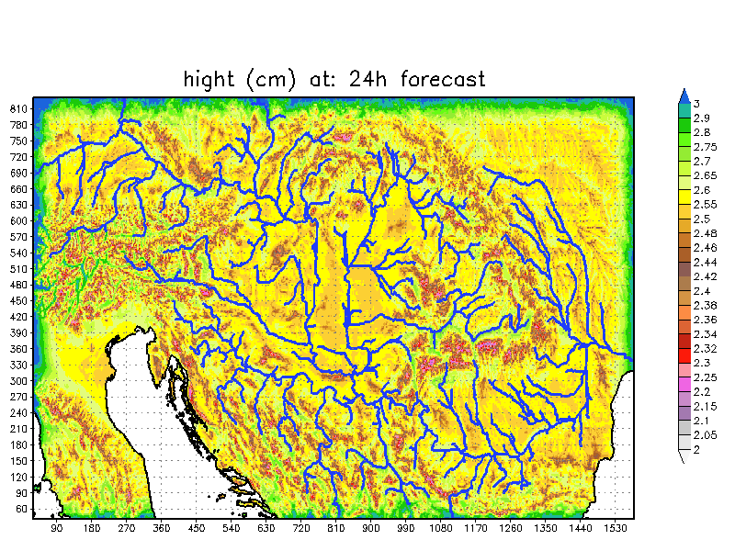
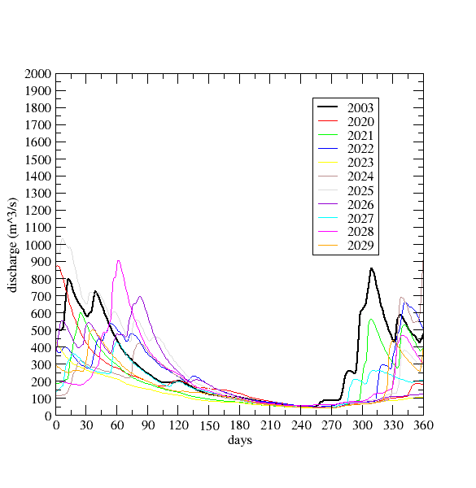
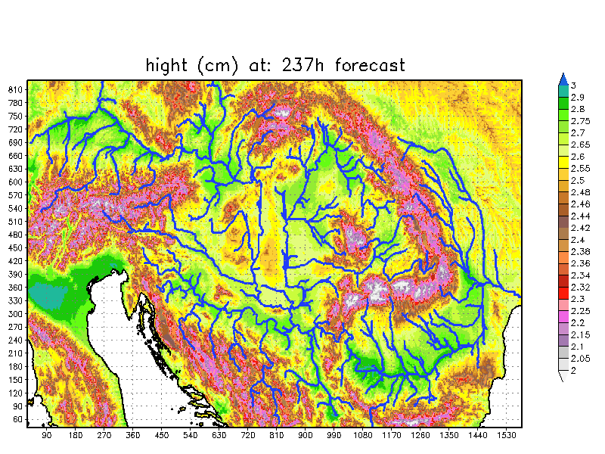
Extension of HYPROM to large basins and climate assessments
at 24h of forecast
Danube basin experiment:
first 24h 1inch precipitation
over the whole domain
Climate simulations
for Morača river 2020-2029
Buna bridge discharge
at 237h of forecast

Slide 21
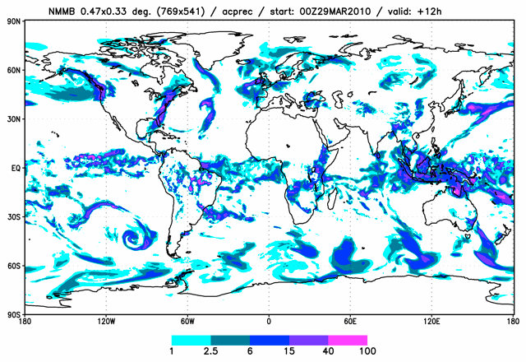
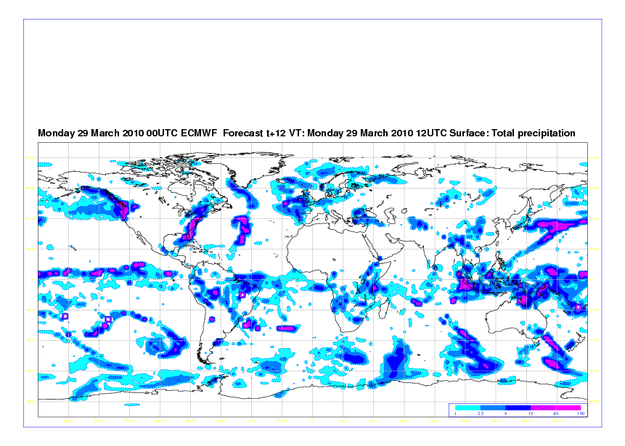
SEEVCCC Earth Climate Modeling System: NMMB
Results obtained with
NMMB in SEEVCCC:
global forecast
Future plans:
● SEEVCCC perform
10 days (global) forecast
NMMB
● testing model on regional
and local scales
● coupling with ocean,
aerosols, hydrology
● perform seasonal forecast
● climate projections
● ……
ECMWF

Slide 22
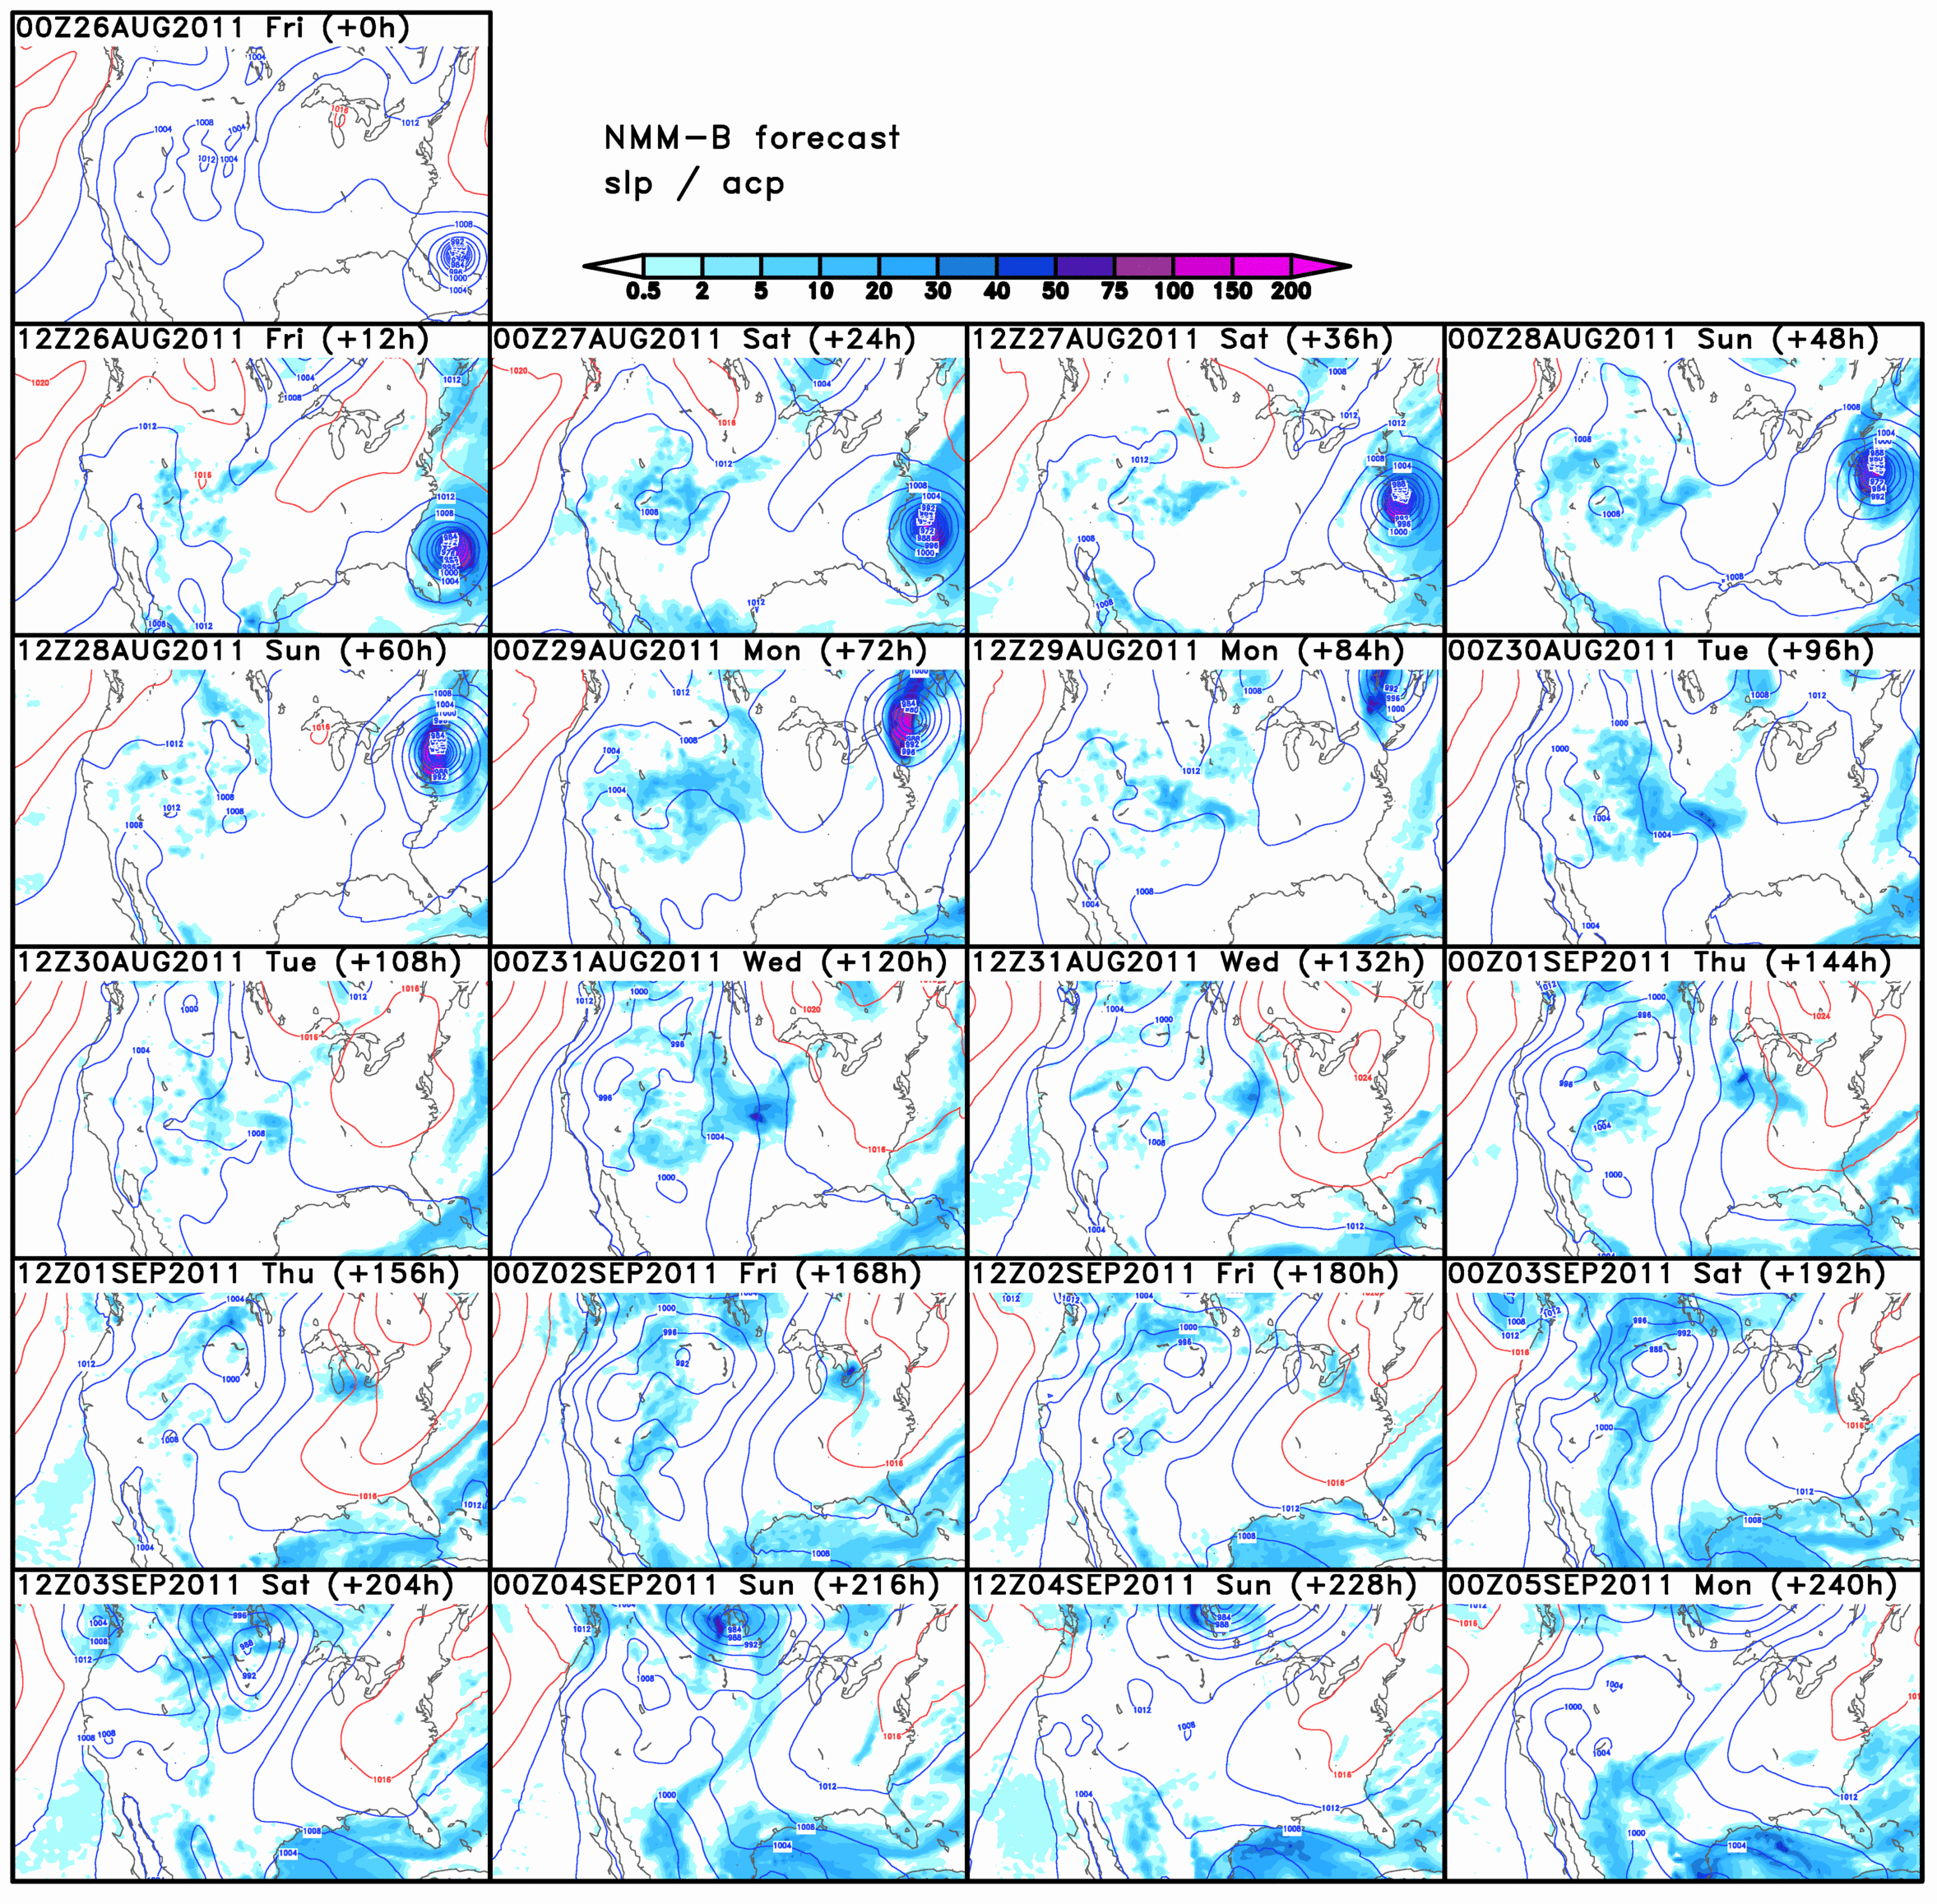
Operational Global Weather Forecast – 10 days

Slide 23
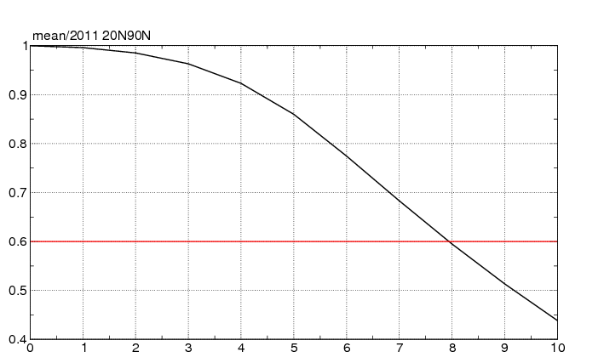
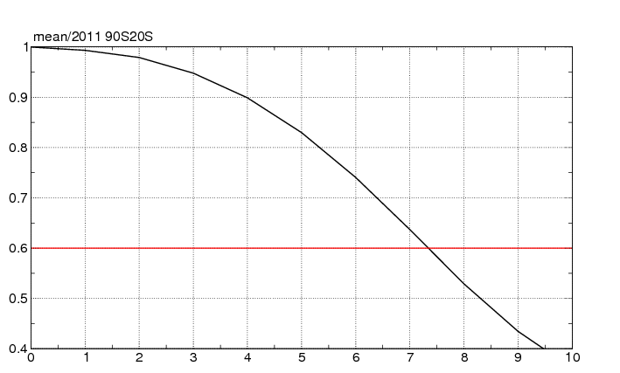
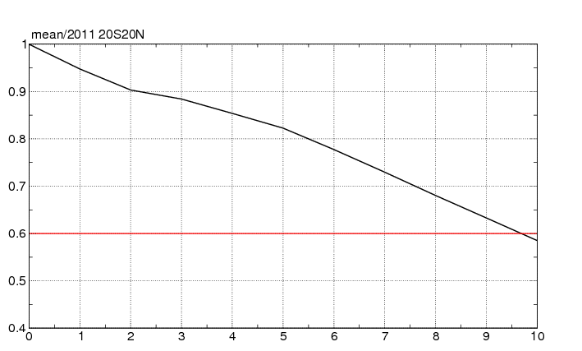
Operational Global Weather Forecast – 10 days
NMMB ACC score for Z at 500 hPa
1/1/2011 to 31/6/2011
North hemisphere
South hemisphere
Tropics

