Slide 1


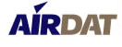
Tropospheric Airborne Meteorological Data Reporting
Optimization and utility of TAMDAR for NWP
Neil Jacobs
August 13, 2011

Slide 2
Who is AirDat and what is TAMDAR?
AirDat is a company that has developed and deployed an atmospheric observing system called TAMDAR (Tropospheric Airborne Meteorological Data Reporting)
The TAMDAR system delivers a unique real-time high resolution data stream for improved aviation situational awareness, atmospheric analysis and weather forecasting
Key components of the system include an aircraft mounted sensor, dedicated global satcom, and ground processing systems
The satcom solution provides real-time global tracking of aircraft, as well as voice and data communication with each aircraft at all times
This real-time global communication capability is flexible, and allows retrieval of aircraft performance/systems information (including DFDR)
This fully certified system has been in operation on commercial aircraft since 2004
Motivation: Fill in the space-time gap between radiosondes and AMDAR
Notes:
2

Slide 3
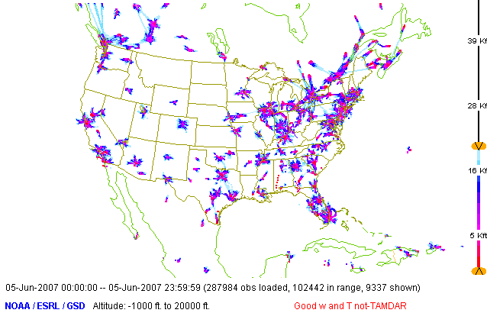
Coverage is limited to major hubs below 20 Kft, (without TAMDAR)
Moninger, W. R., S. G. Benjamin, B. D. Jamison, T. W. Schlatter, T. L. Smith, E. J. Szoke, 2010: Evaluation of Regional Aircraft Observations Using TAMDAR. Wea. Forecasting, 25, 627–645.

Slide 4
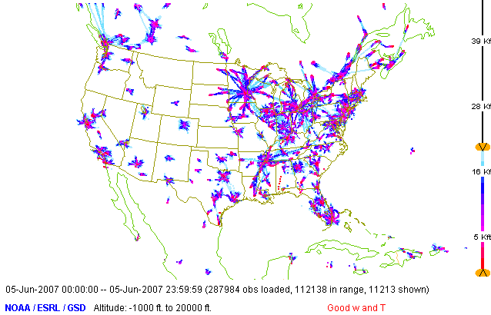
Below 20 Kft, with TAMDAR – better regional coverage in the Midwest
1 fleet of TAMDAR
(Mesaba)
Moninger, W. R., S. G. Benjamin, B. D. Jamison, T. W. Schlatter, T. L. Smith, E. J. Szoke, 2010: Evaluation of Regional Aircraft Observations Using TAMDAR. Wea. Forecasting, 25, 627–645.

Slide 5
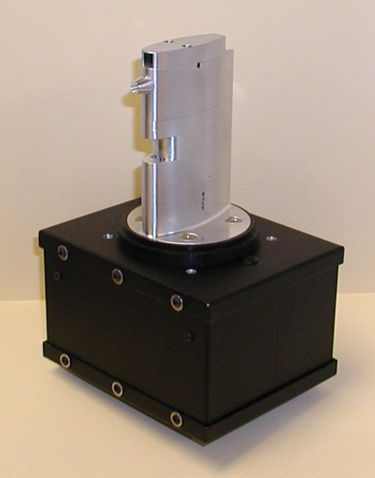
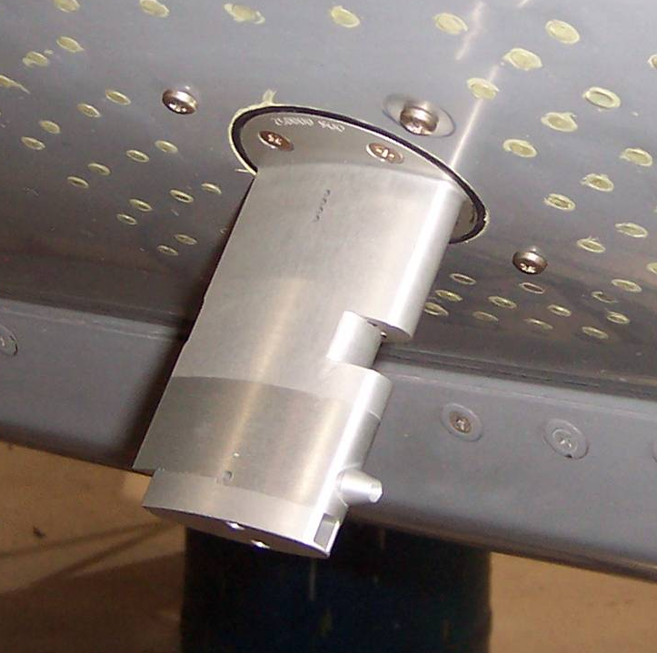
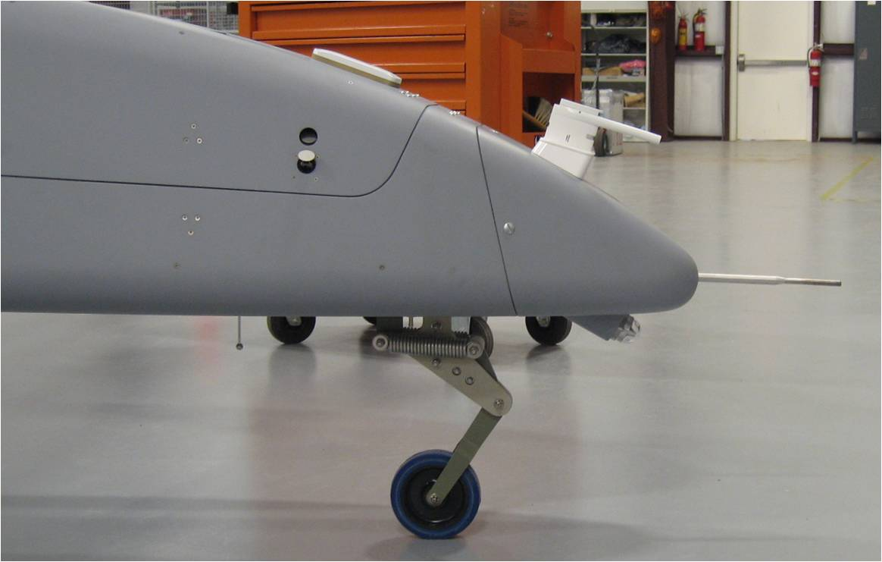
TAMDAR-U
(UAS Optimized) – Low SWaP
TAMDAR Sensor
Measures and Reports
-Ice presence -Relative Humidity
-Median and peak turbulence -Indicated and True Airspeed
-Static pressure and pressure altitude -Winds Aloft
-Air temperature (Mach corrected) -GPS Position and Time
-Additional sensing possible (CBRN) -Encryption Possible
-Variable sampling rate -Global latency ~15 sec

Slide 6
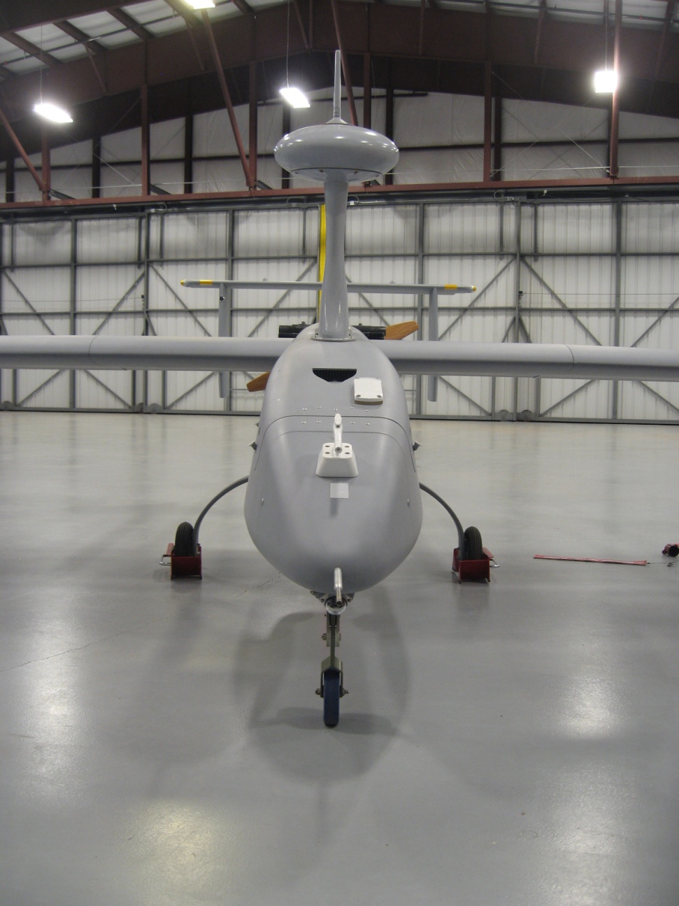
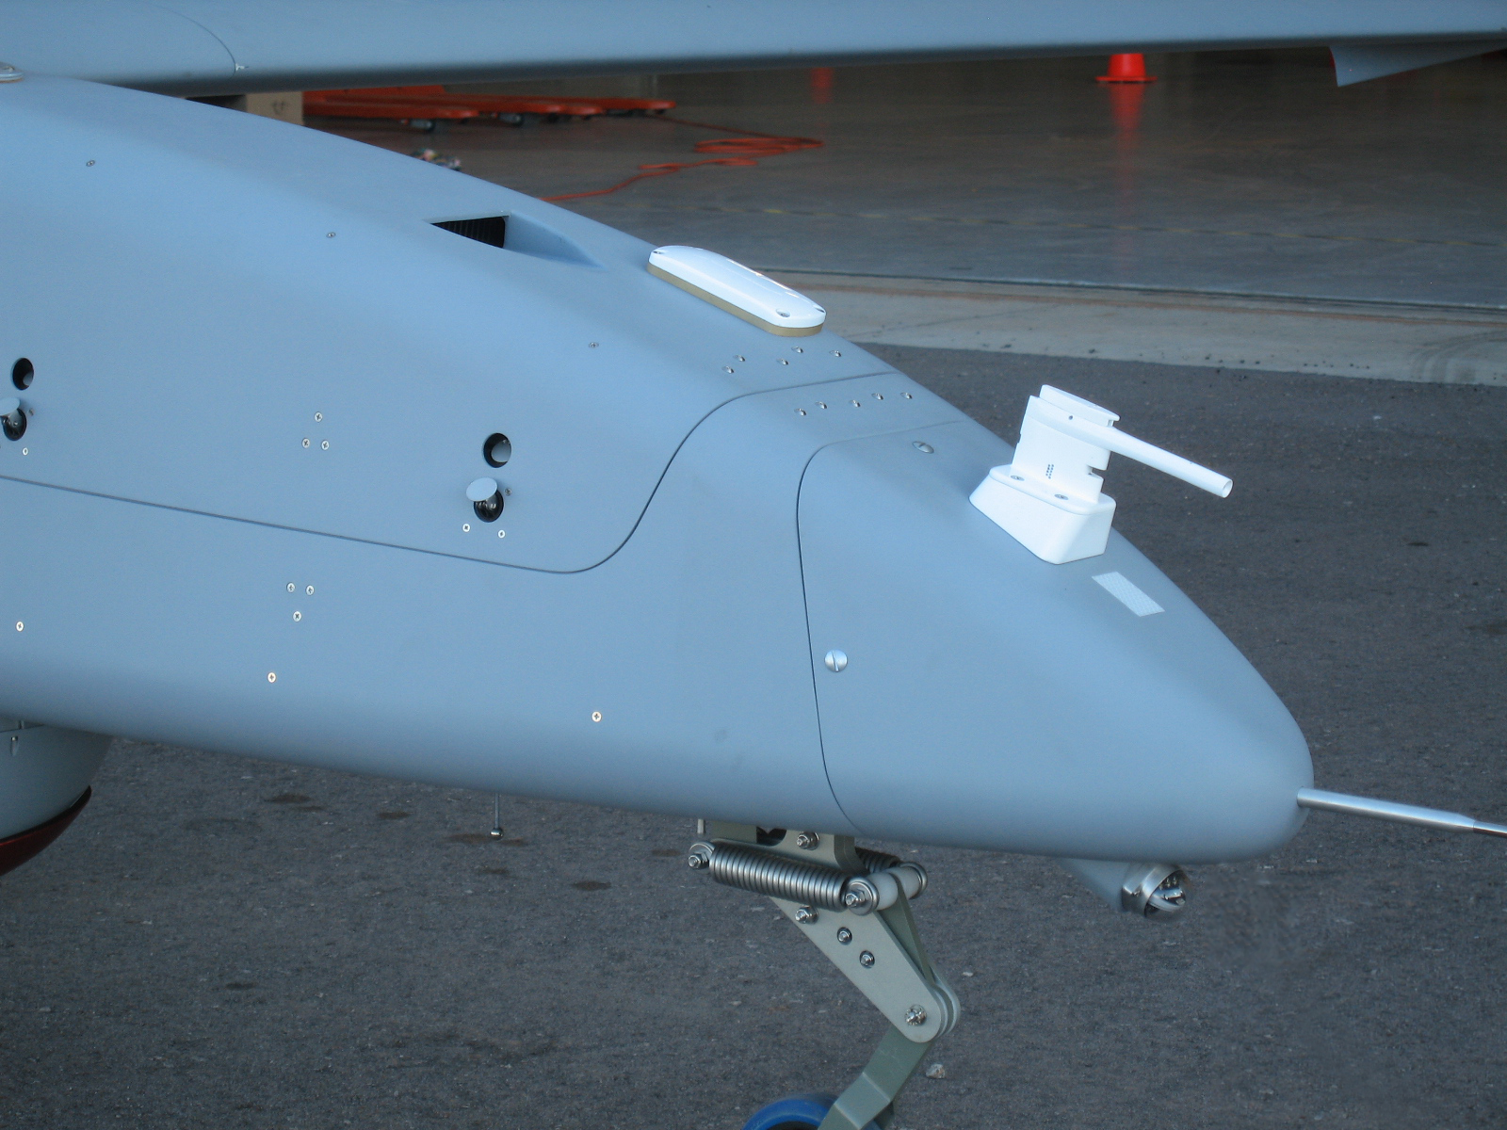
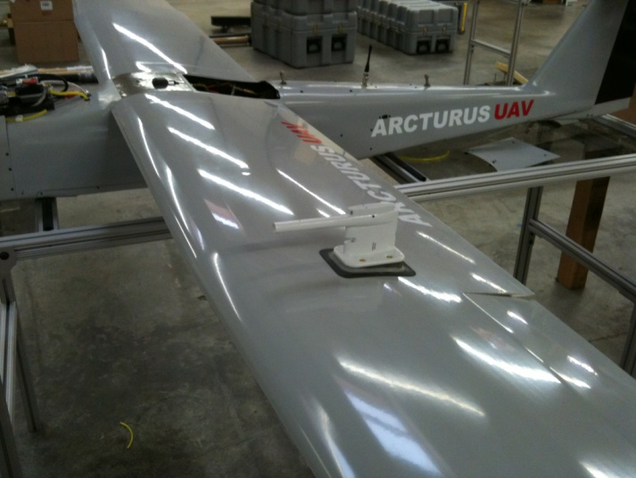
TAMDAR-U
AFWA, ARL, and NMSU/PSL
Integrate prototype TAMDAR-U on medium tactical UAS (Aerostar)
Determine impact on short term battlefield forecasts
Excellent data quality
  Space: 40.8 cu-in internal
  Weight: 14oz (0.4kg)
  Power 8.4W
Iridium antenna
TAMDAR
Test mount for angle adjustment – not needed for standard install
AAAI UAV
Aerostar UAV
Notes:
6
Association for the Advancement of Artificial Intelligence (AAAI)

Slide 7
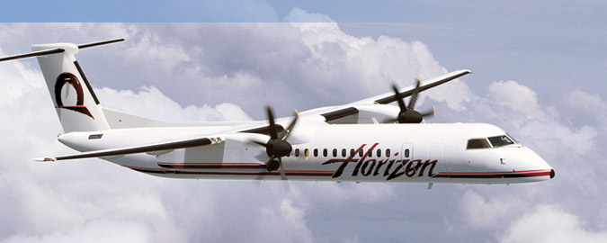

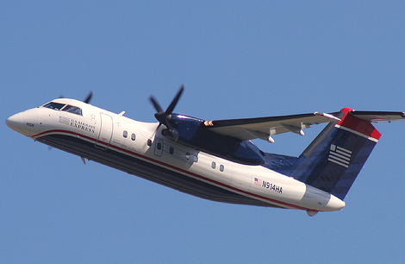
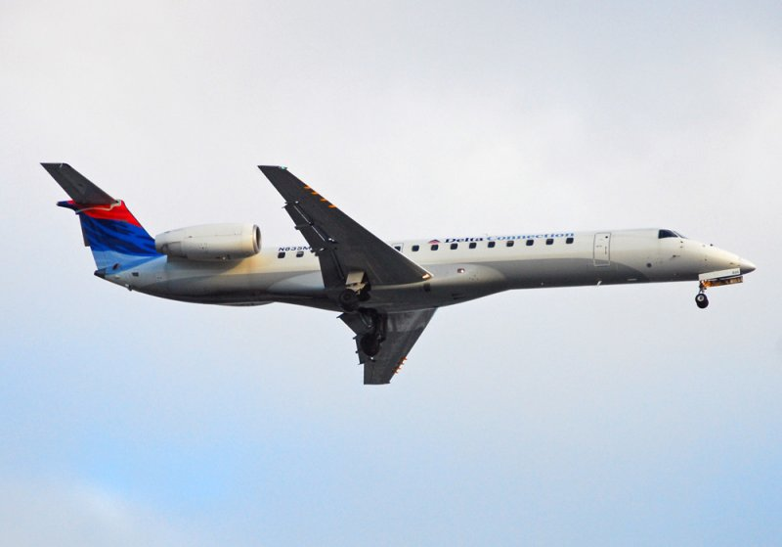

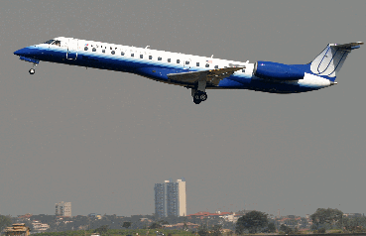
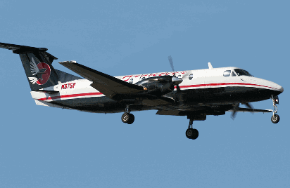

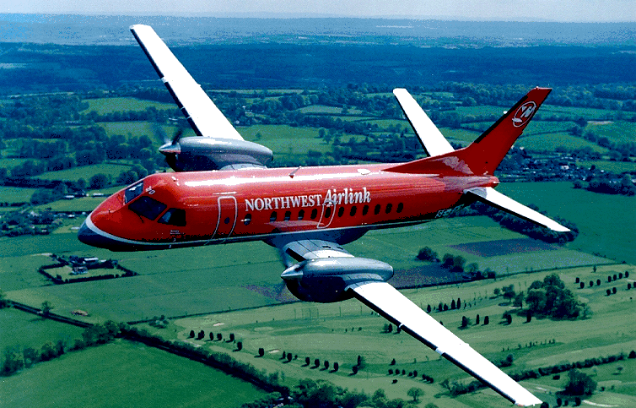
Partial list of participating airlines
HORIZON AIR
CHAUTAUQUA (CONTINENTAL EXPRESS)
PIEDMONT (US AIRWAYS EXPRESS)
CHAUTAUQUA (DELTA CONNECTION)
HORIZON AIR
CHAUTAUQUA (UNITED EXPRESS)
AEROMEXICO CONNECT
7
ERA ALASKA
PENAIR
MESABA AIRLINES (DELTA)
Notes:
7
7

Slide 8
Benefits to airlines:
Enhances aviation/UAS safety
- Improves situational awareness
- Improves accident investigation capabilities (tracking, flight histories, DFDR)
- Provides additional real-time data access
- Provides additional communication support
Enhances aviation/UAS security
- Real-time global aircraft position reports
- Data base of all flight histories
Supports environmental programs
- ”Green” approaches (reduced noise and emissions)
Improves operations
- Global voice & data channel
- Asset tracking
- Automated OOOI and other metrics
- Cost savings (fuel, CDA, and other)
- Aircraft database

Slide 9
TAMDAR coverage
  Daily Soundings (approx): Current Planned
  CONUS 1,600 5,000
  Alaska 120 200
  Mexico* 306 450
  UK/Europe - 900 (Phase 1)
  Others - TBD
  Total 2,026 6,550
  *Example: TAMDAR generates 306 daily soundings from 50 locations versus current raob program yielding 32 soundings from 16 locations
Notes:
9

Slide 10
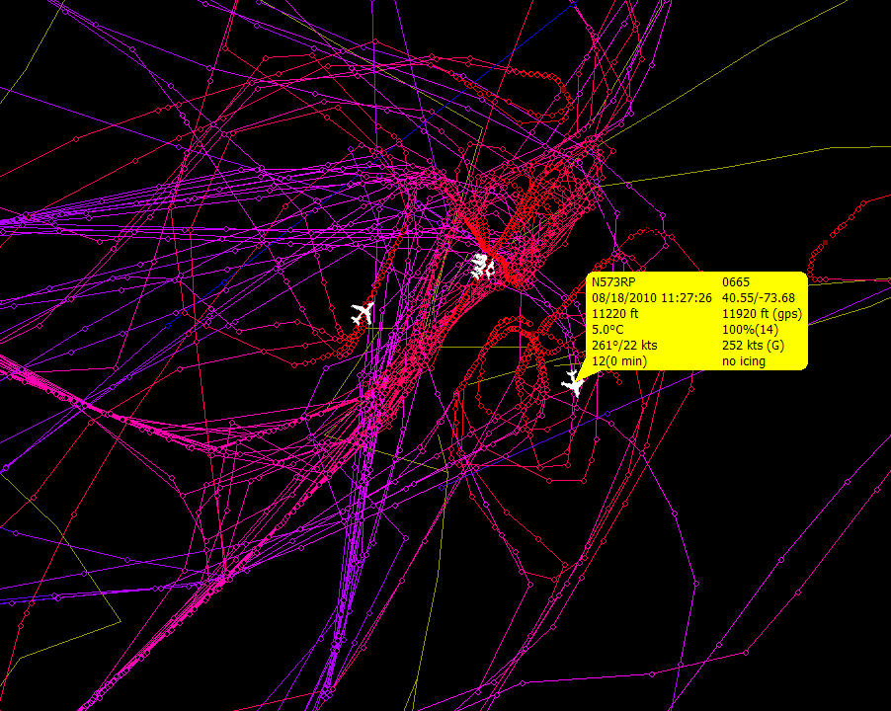
NYC TAMDAR observations over 24 hr
8/17/2010 11:29:53 – 8/17/2010 11:29:15
Notes:
10

Slide 11
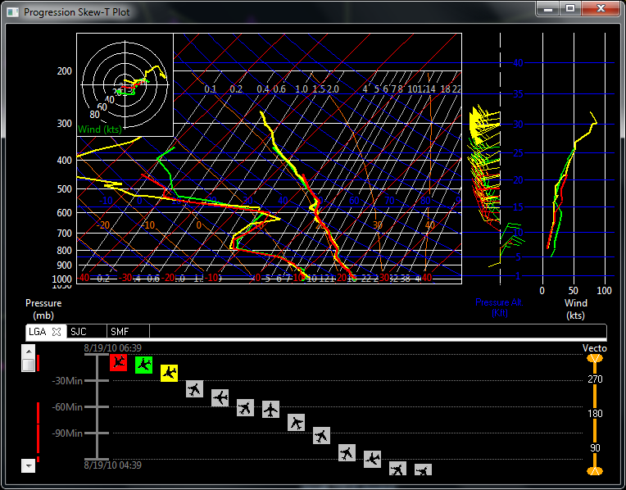
Background
Note: Over 100 daily soundings from
LGA, JFK, EWR
11

Slide 12
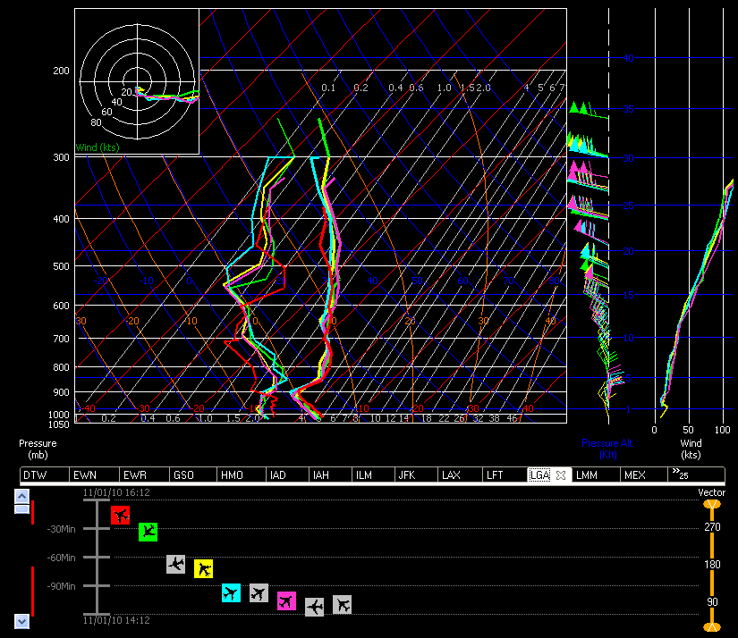
Using a skew-T to visualize TAMDAR “soundings”
Notes:
12

Slide 13
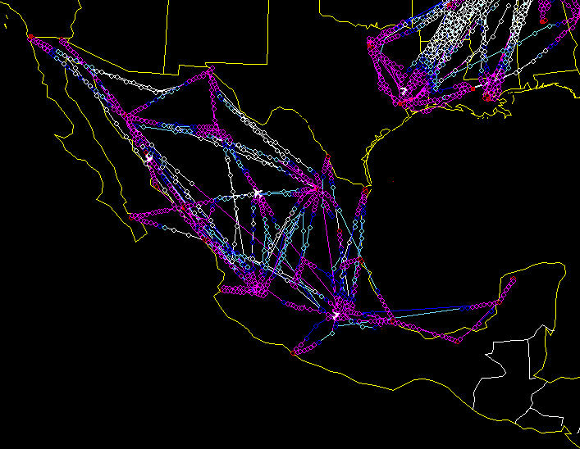
TAMDAR coverage in Mexico

Slide 14
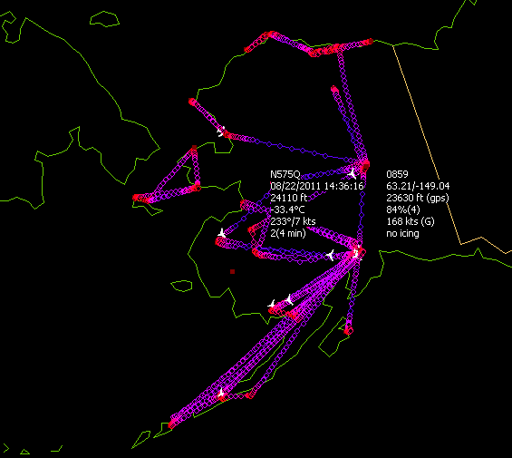
TAMDAR in Alaska

Slide 15
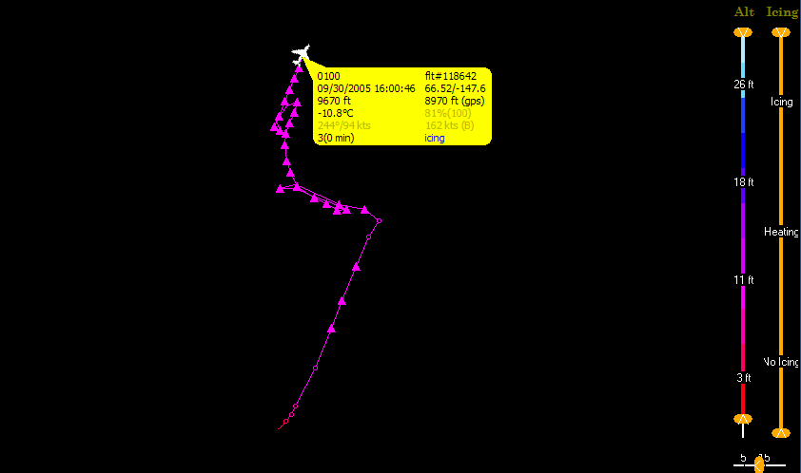
Archived tracking and conditions data
UND Citation research aircraft

Slide 16
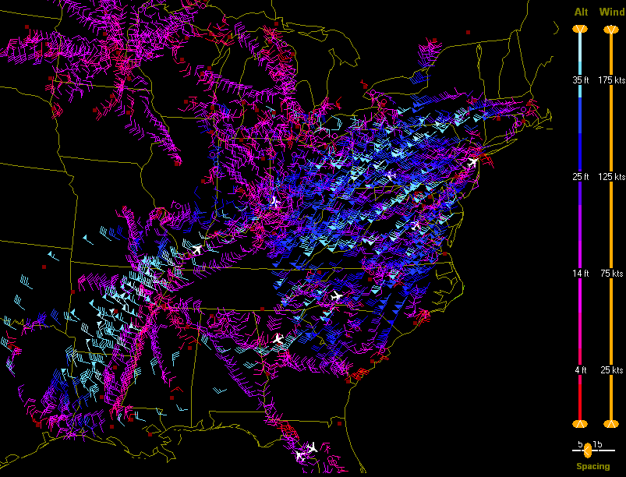
TAMDAR winds

Slide 17
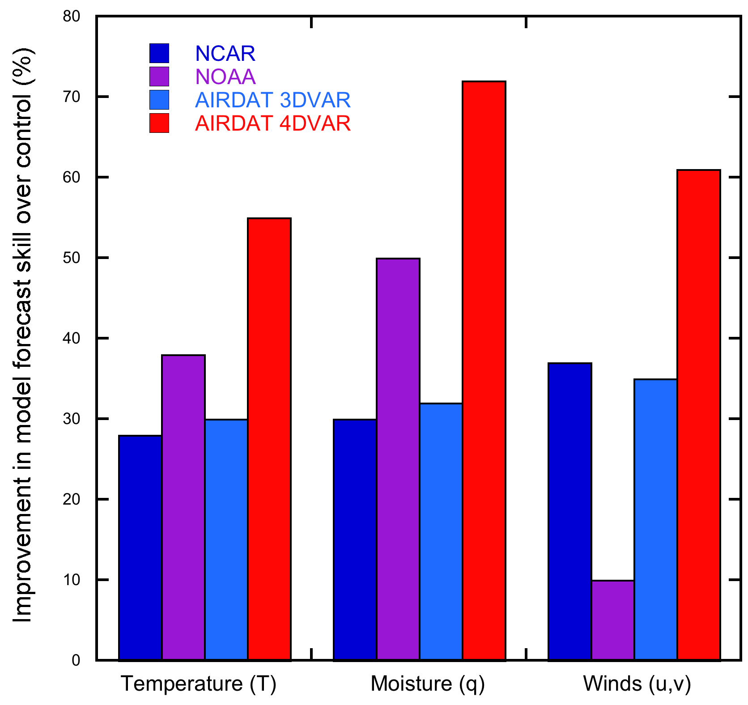
FAA-funded 4 Year TAMDAR impact study
(using limited data, existing low res government model and 3D assimilation)
Chart of improvements in forecast skill of the experimental (with TAMDAR) over the control (without TAMDAR). All forecasts were verified using RAOBs as "truth".
NCAR's 3DVAR MM5/WRF
NOAA GSD RUC
Moninger et al. (2010) WAF:
“The lower quality of the wind data from TAMDAR is likely due to the less accurate heading information provided to TAMDAR by the Saab-340b avionics system. Accurate heading information is required for the wind calculation, and the Saab heading sensor is magnetic and known to be less accurate…”
Moninger, W. R., S. G. Benjamin, B. D. Jamison, T. W. Schlatter, T. L. Smith, E. J. Szoke, 2010: Evaluation of Regional Aircraft Observations Using TAMDAR. Wea. Forecasting, 25, 627–645.
Benjamin, S. G., B. D. Jamison, W. R. Moninger, S. R. Sahm, B. E. Schwartz, T. W. Schlatter, 2010: Relative Short-Range Forecast Impact from Aircraft, Profiler, Radiosonde, VAD, GPSPW, METAR, and Mesonet Observations via the RUC Hourly Assimilation Cycle. Mon. Wea. Rev., 138, 1319–1343.
17

Slide 18
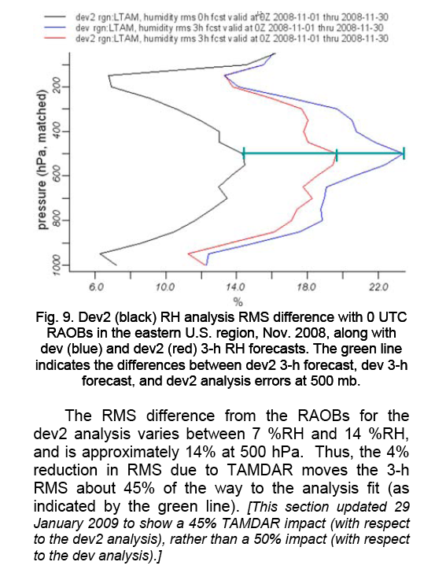
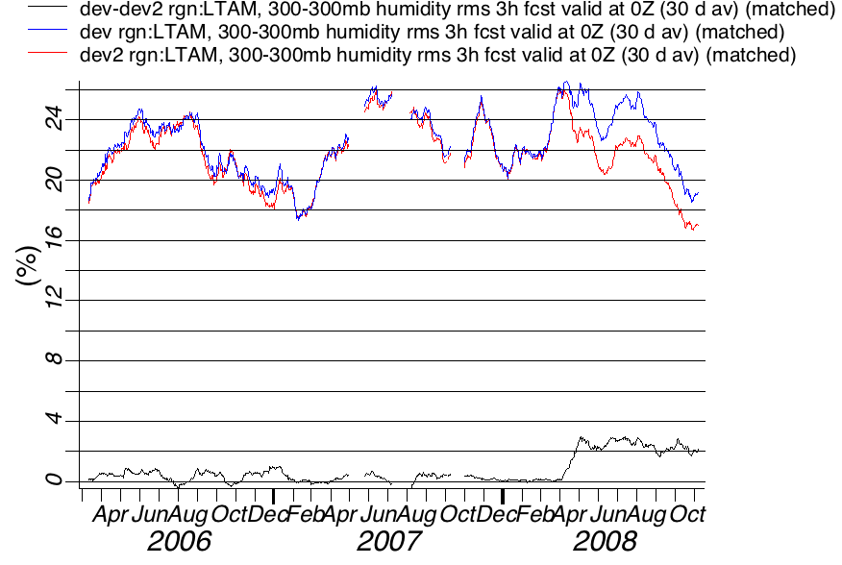
Forecast model RH error showing Chautauqua Airlines contribution
to error reduction using a 30-day average (3DVAR RUC CONUS)
Dev (No TAMDAR)
Dev2 (TAMDAR)
300 mb above Mesaba FL
Forecast skill improvement from 40 Chautauqua ERJs added to NOAA feed April '08
Moninger, W. R., S. G. Benjamin, B. D. Jamison, T. W. Schlatter, T. L. Smith, and E. J. Szoke, 2009: TAMDAR jet fleets and their impact on Rapid Update Cycle (RUC) forecasts, (IOAS-AOLS), AMS, Phoenix, AZ.

Slide 19
MAGNETIC DEVIATION CORRECTION
Designed to characterize heading MDE as a function of heading on a particular plane using the standard TAMDAR report data.
Minimum required data: time, date, lat/lon and wind speed/dir.
Calculate ground track vector based on the latitude and longitude
Calculate air track vectors (TAS and heading) in 2 ways:
  Subtract TAMDAR wind vector from ground track vector (essentially recreating the air track used by TAMDAR).
  Subtract the model analysis reference wind vector from the ground track vector.
Subtract the heading of the air track vector from the heading on the ground track vector to get a heading error.
Using a curve fit to the table of heading errors versus heading, and develop parameters for the magnetic deviation function in TAMDAR (1 yr +).
Upload function and factors back to unit.

Slide 20
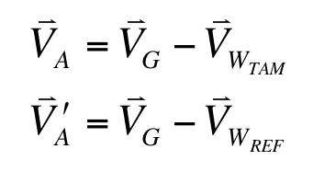

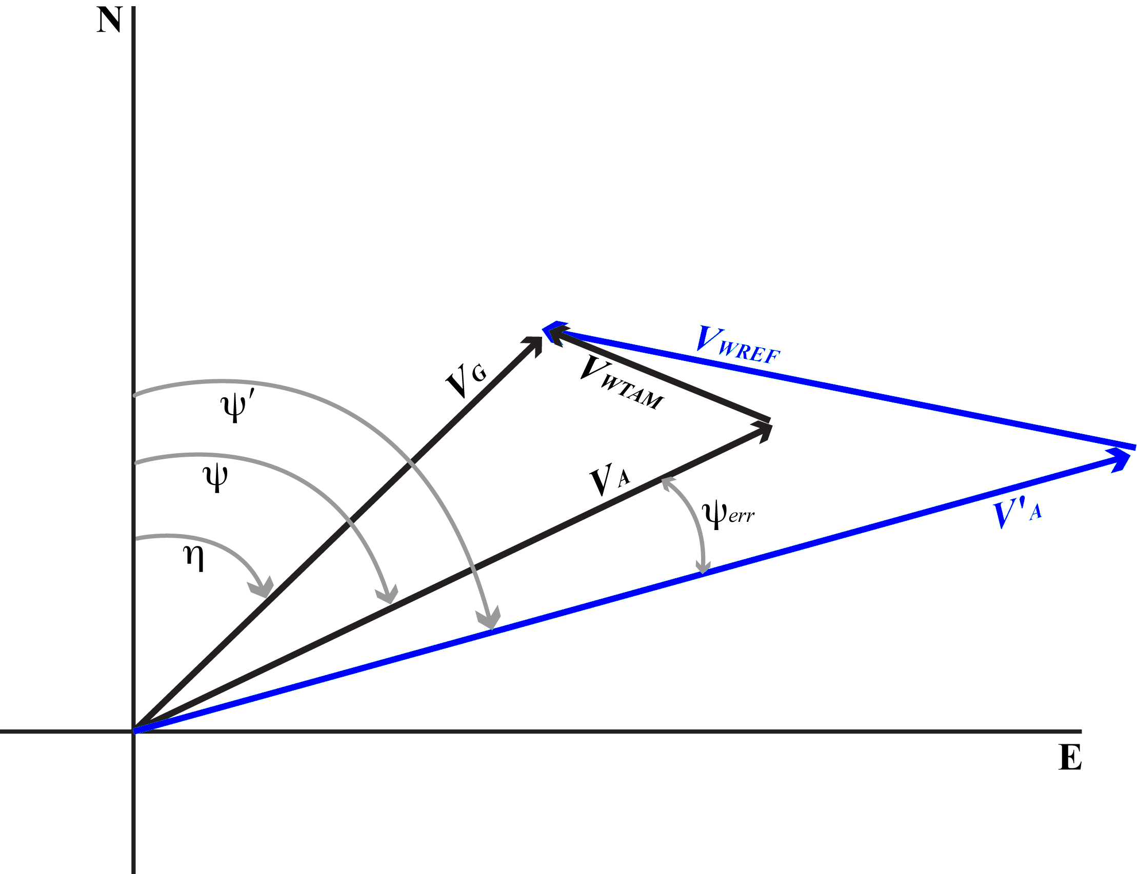

MAGNETIC DEVIATION CORRECTION
V_{A} and V_{A}’ are the aircraft track vectors (TAS and ψ)
V_{G} is the ground track vector (speed and angle η)
V_{W,TAM} and V_{W,REF} are the wind vectors.
The heading error is defined by:
ψ is the heading based on TAMDAR winds
ψ' is the heading based on reference winds.

Slide 21
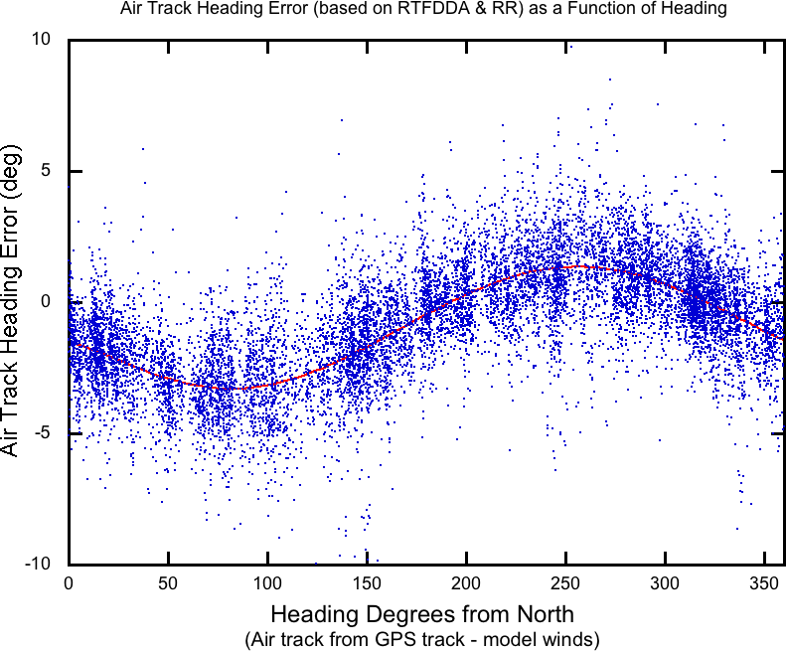
MAGNETIC DEVIATION CORRECTION
1 year of RUC/RR and RTFDDA data from July 2008 to July 2009 were used for each plane. An example of the raw data for one plane:
Note the sinusoidal trend, which is common for magnetic deviation corrections.
Every plane studied had a similar sinusoidal appearance to the data with differing phase, offset and amplitude.

Slide 22
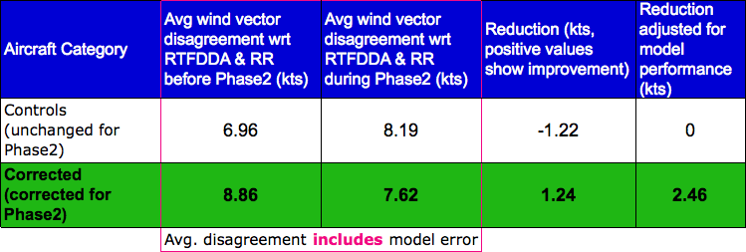
MAGNETIC DEVIATION CORRECTION
On 20 October 2009, correction data were uploaded to the associated TAMDAR units.
Current statistics:
This is roughly a 30% reduction in wind error off the sensor (assuming model error and representitiveness error are fairly consistent over period of months)

Slide 23
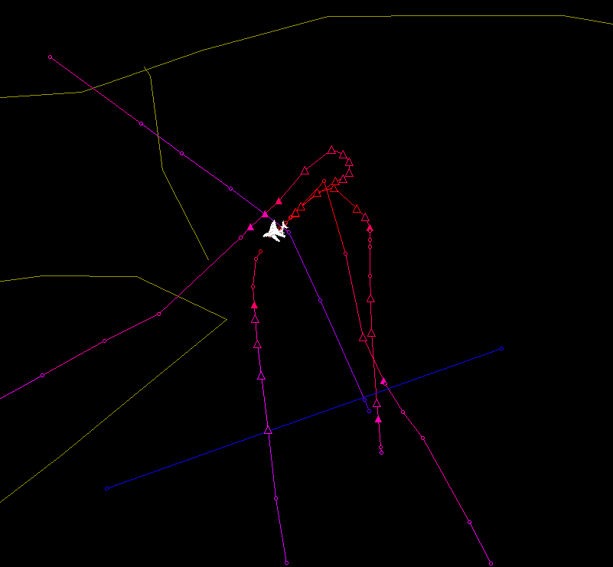
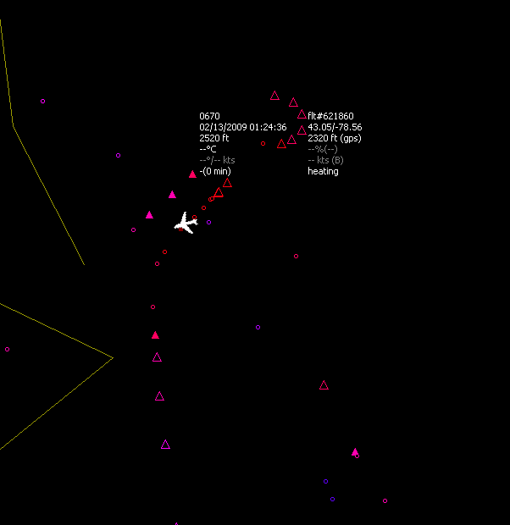
The 2 images show TAMDAR data from flights into/out of BUF +/- ~3h from 10 pm. The solid triangles indicate icing, and the hollow triangles indicate icing with heaters activated.
Crash site
BUF
Crash site
BUF
The fact that the TAMDAR heater remains activated throughout the descent suggests that the ice accretion rate is greater than 0.02" per minute, and in some cases (based on ob times) it was significantly greater.

Slide 24
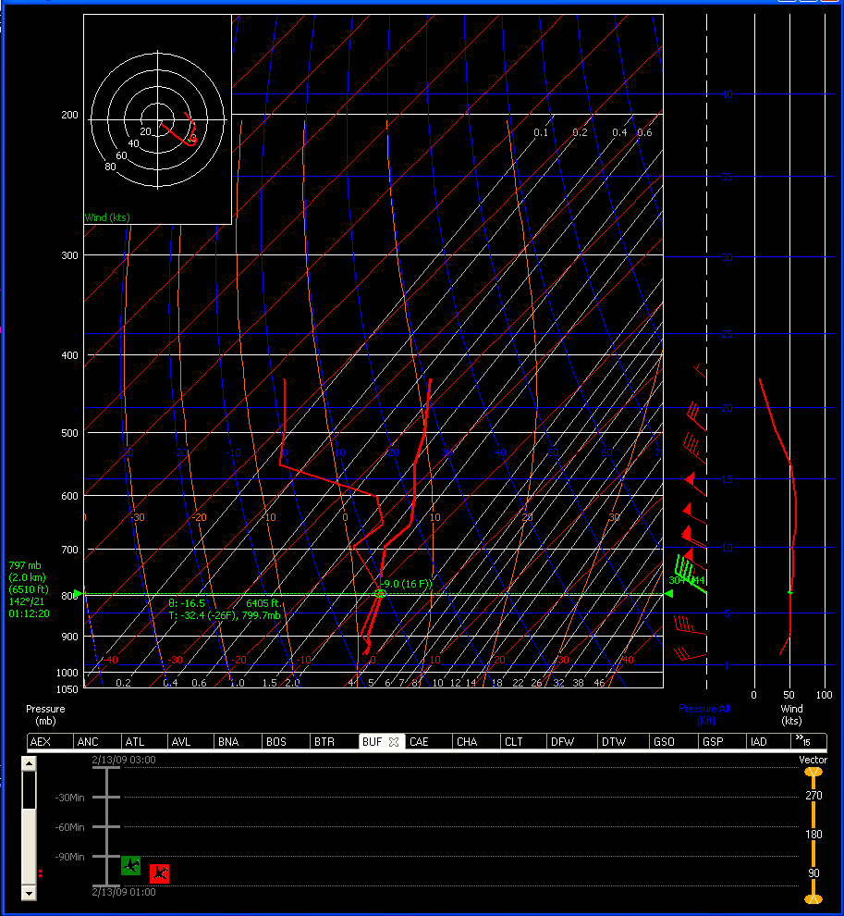
The first sounding (BUF_skew), which is valid around 9 pm, shows a substantial layer of saturated air below 6000' between -9 and -2C -- the temperature window that most supports the existence of supercooled water.
Note: The red lines oriented to 1 o'clock are temp in C.

Slide 25
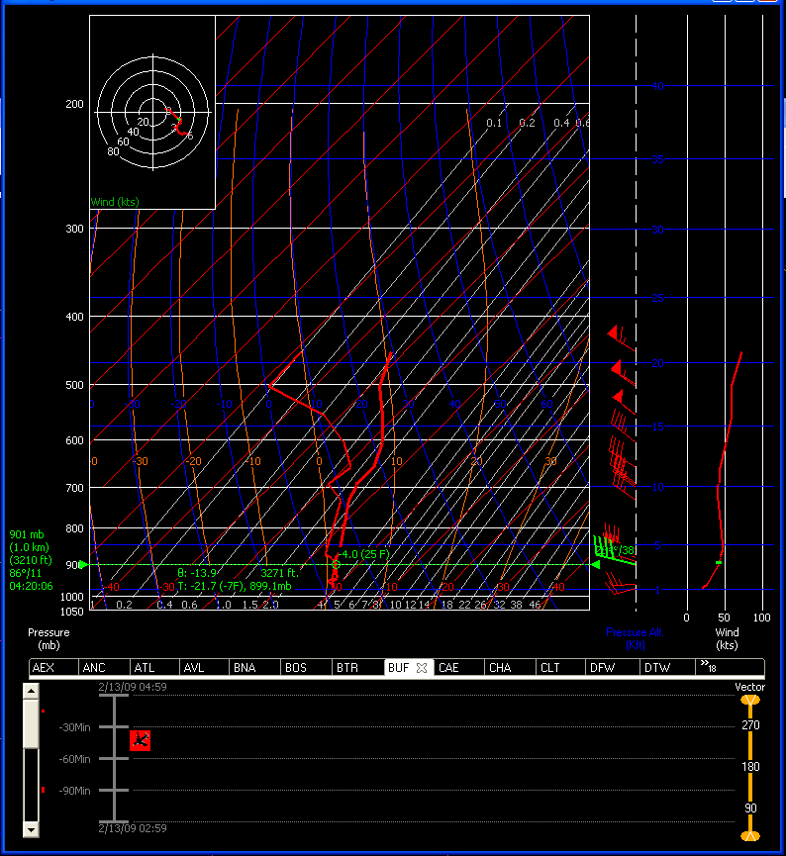
The second sounding (BUF_skew2), which is valid around 11:20 pm, shows the saturated layer has dropped to 3000' and below, but the temperature profile remains the same.
Both soundings suggest favorable conditions for supercooled water to freeze upon airframe contact.
Also, the vertical profiles show winds between 25 and 45 kts within this layer throughout the duration of the sampling.

Slide 26
Soundings from Dillingham (DLG)
6 soundings reported at DLG between 20Z 8/9 and 06Z 8/10. The yellow sounding shown here was reported at 21:08Z (1:08 pm LT) 8/9. The top of the cloud layer is located at 9887'. From this point all the way to the surface, a saturated atmosphere and IFR conditions were present.
First 4 of 6 DLG soundings between 20Z 8/9 and 06Z 8/10.

Slide 27
Soundings from King Salmon (AKN) and Anchorage (ANC)
11 soundings reported at King Salmon (AKN) between 20Z 8/9 and 06Z 8/10. The sequence of soundings shown here are from 2:10Z 8/10 to 3:50Z 8/10. The top of the cloud layer can be seen about 9880’, and this appears to be holding steady over the duration of observations.
As seen at DLG, a fairly saturated environment, and IFR conditions, exist between 9880' and the surface.
24 soundings reported at Anchorage (ANC) between 20Z 8/9 and 06Z 8/10. The series of soundings shown here were observed between 20:01 and 22:01Z 8/9.
As with the other locations, the observed cloud tops were 10k'. However, unlike AKN and DLG, there was actually clear sky below the cloud deck. The profiles here show a broken ceiling at 4950'. Below this, it appears to be relatively clear with good visibility.

Slide 28
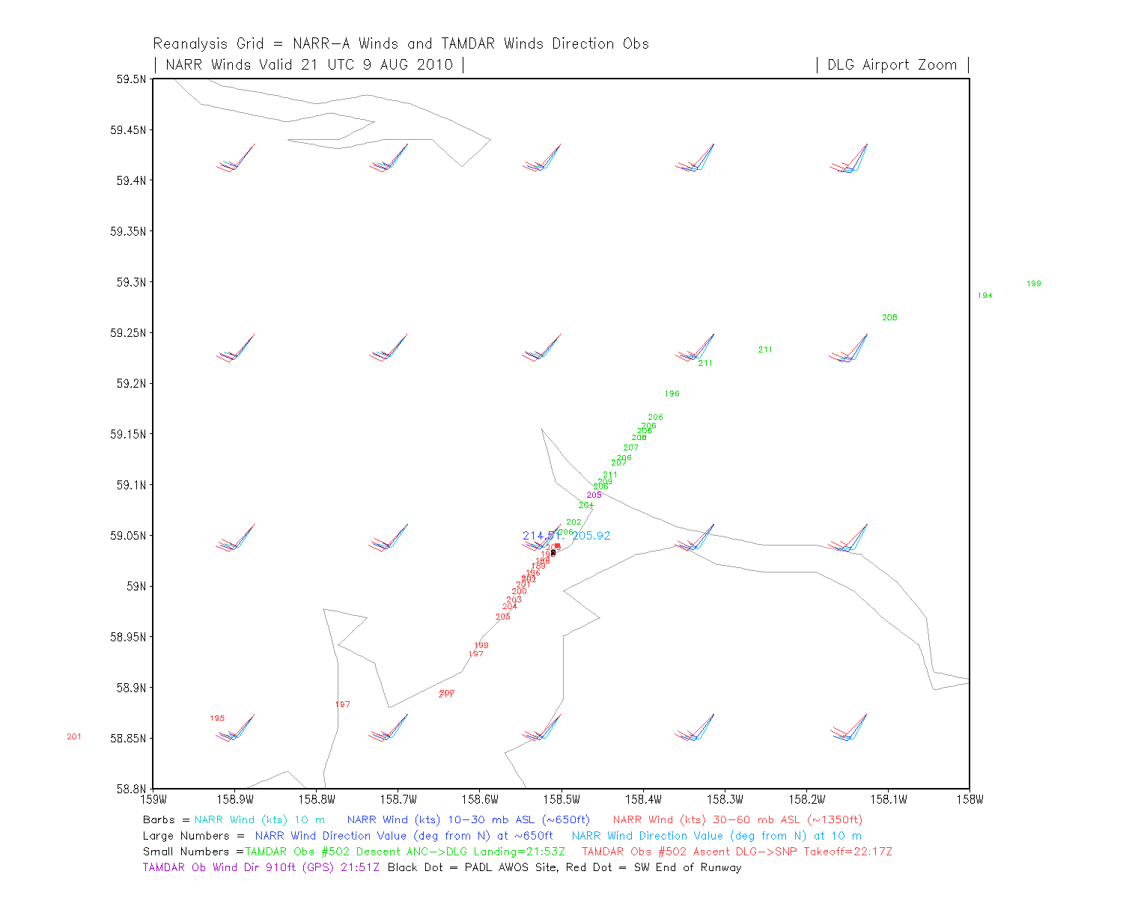

Slide 29
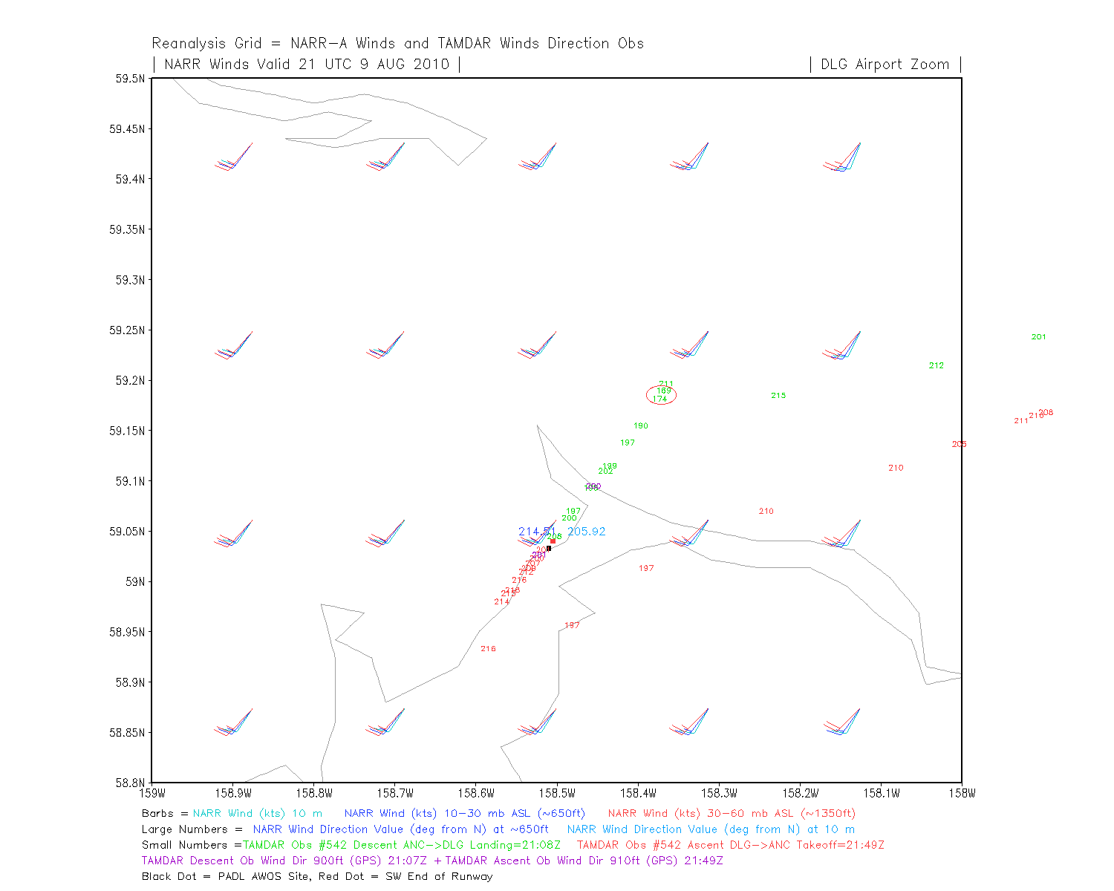

Slide 30
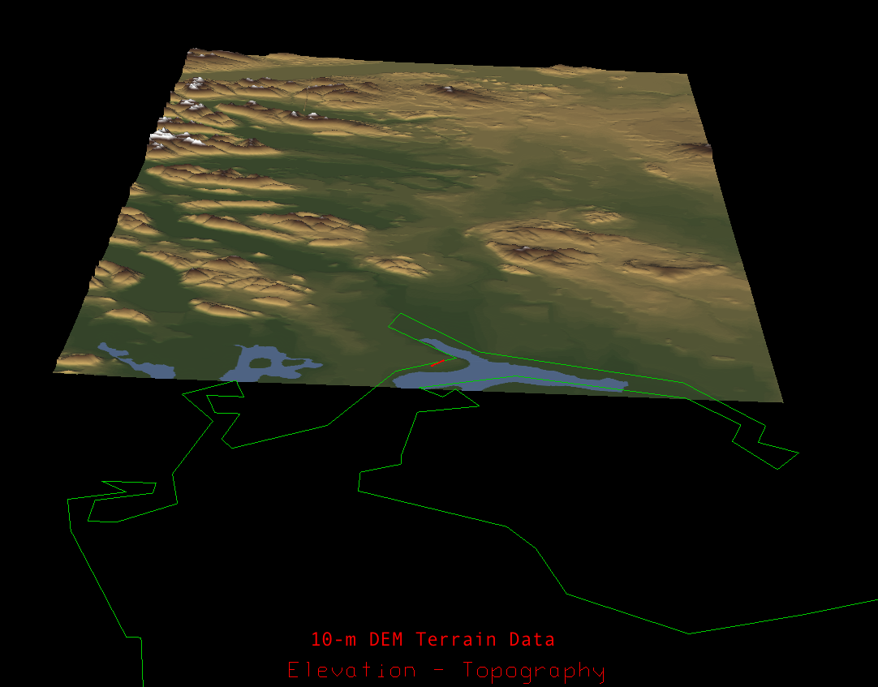

Slide 31
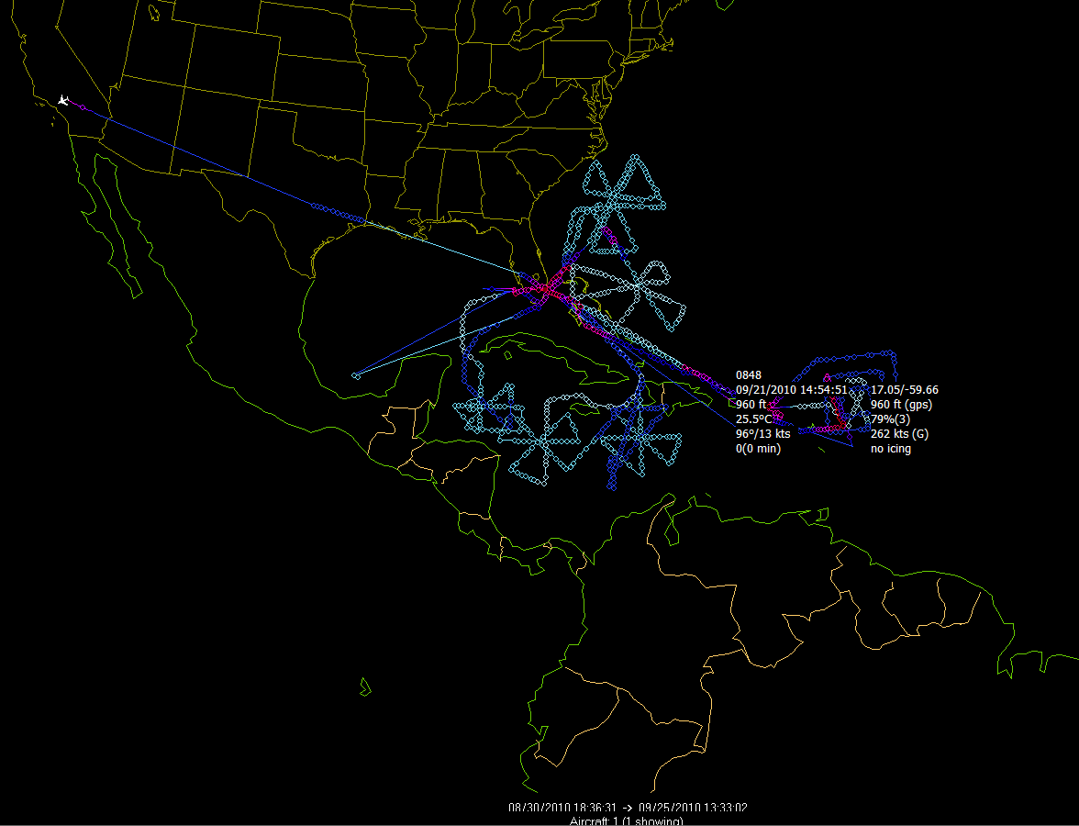
Composite of NASA DC-8 GRIP flights

Slide 32
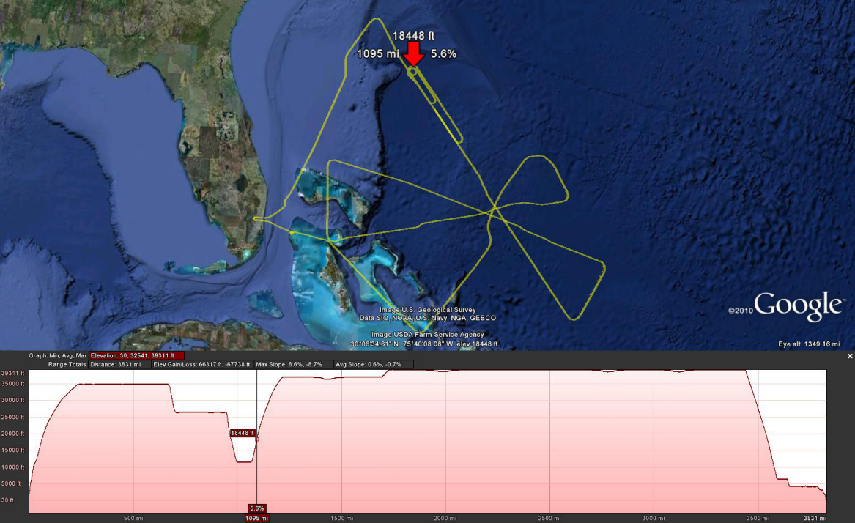
NASA DC-8: circling with altitude change, open ocean

Slide 33
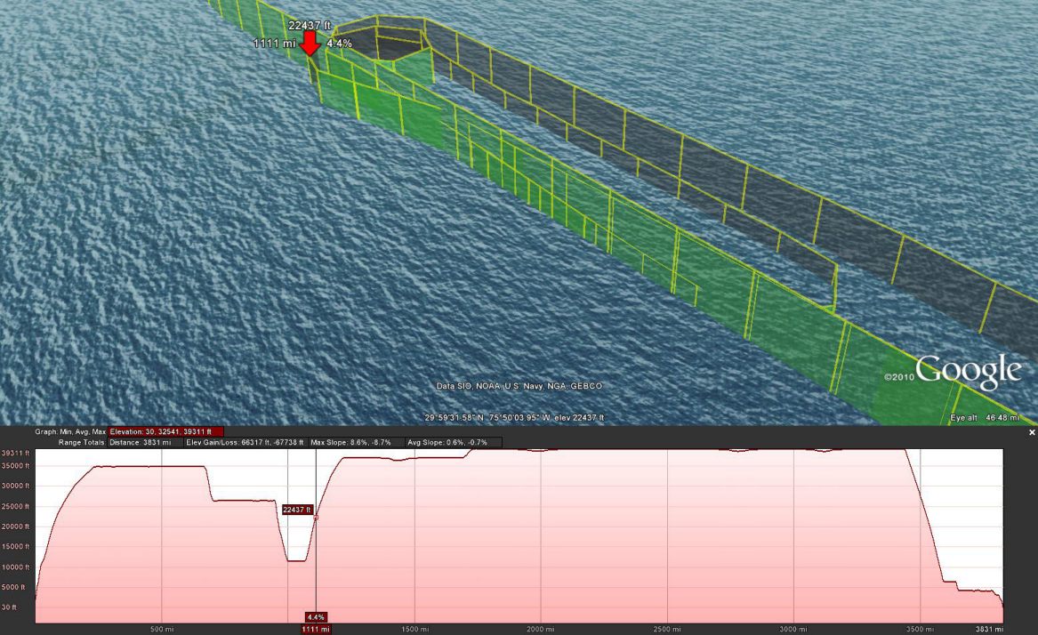
NASA DC-8: circling with altitude change, open ocean

Slide 34
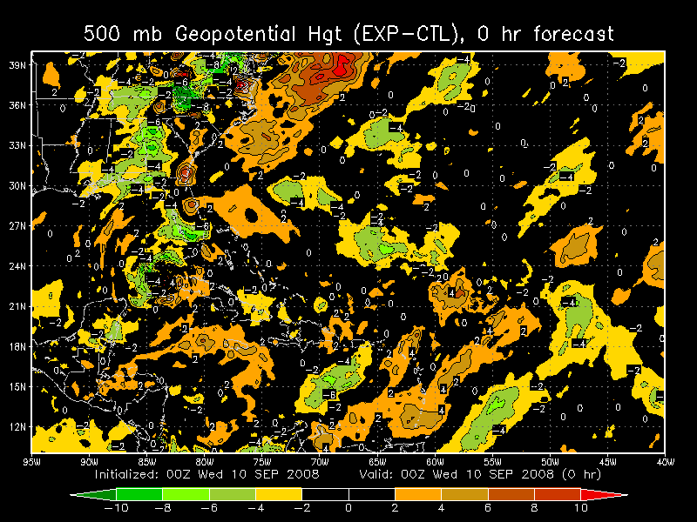
TAMDAR Analysis Differences
but 9th cycle from coldstart
Lower heights in EXP over the Gulf states
...likely cause for forward and northward shift
Forward motion phase shift in trailing heights
34

Slide 35
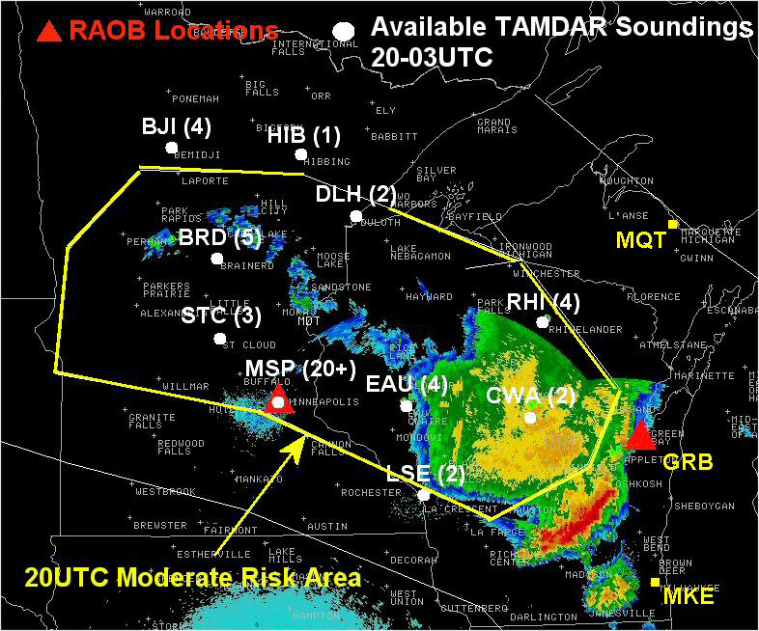
July 23, 2005 Null Case
A Moderate Risk for severe thunderstorms was highlighted in the 20 UTC Convective Outlook
Standard RAOBs were too sparse to adequately assess short-term severe weather potential
Bewteen 20 and 03 UTC, > 45 regional aircraft soundings (white circles) versus 2 RAOBs (red triangles) were available to forecasters to assess short-term convective potential within and near the Moderate Risk area.
Brusky, E. S., and P. Kurimski, 2006: The Utility of TAMDAR Regional Aircraft Sounding Data in Short-term Convective Forecasting. 10th Symposium on Integrated Observing and Assimilation Systems for Atmosphere, Oceans, and Land Surface (IOAS-AOLS), AMS, Atlanta, GA.

Slide 36
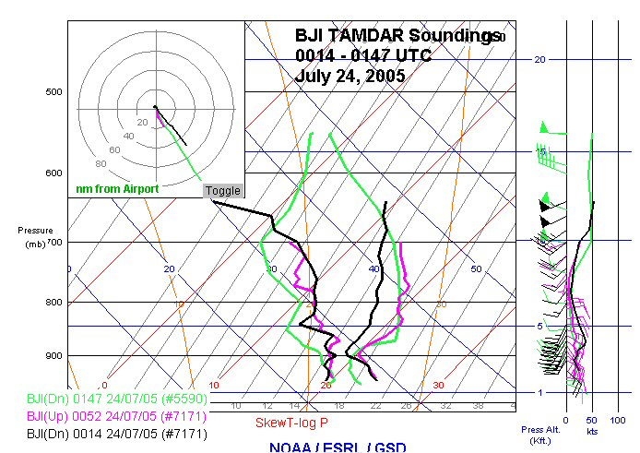
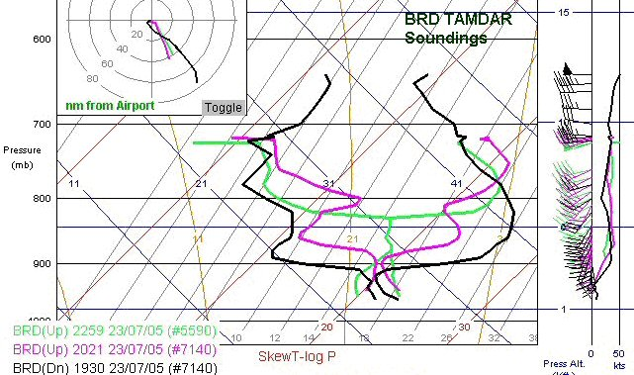
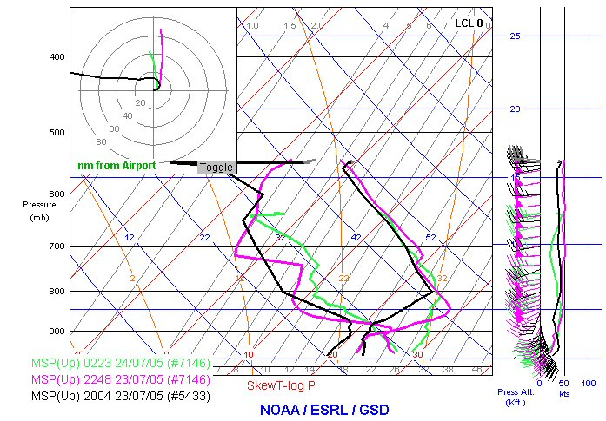
BJI soundings indicate strengthening CAP and decreasing boundary layer moisture.
CAP
BRD soundings indicate deepening moisture but persistent & strong CAP.
MSP soundings indicate persistent strong CAP and boundary layer moisture becoming more shallow.

Slide 37
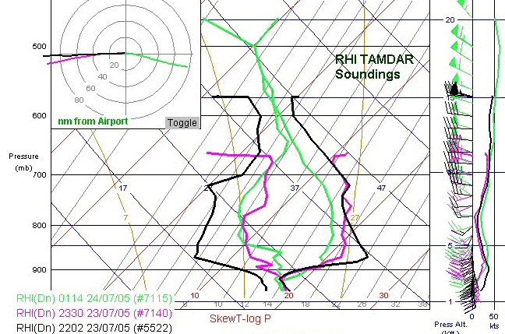
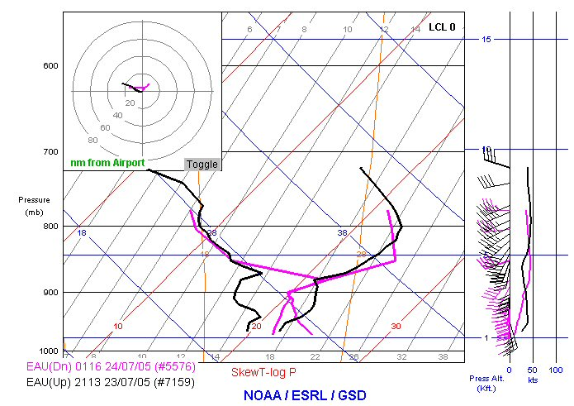
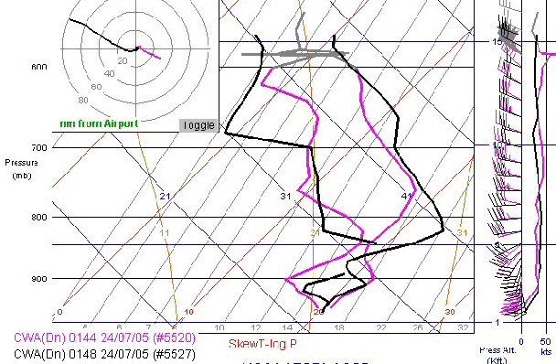
Assessment of convective potential over eastern portion of outlook area
RHI soundings reveal deepening moisture and weakening CAP. Shortwave also approaching from west.
CAP
EAU soundings indicate deepening moisture but persistent strong CAP.
CWA soundings around same time but from aircraft approaching from opposite directions indicate CAP still strong but notably weaker to the east.

Slide 38
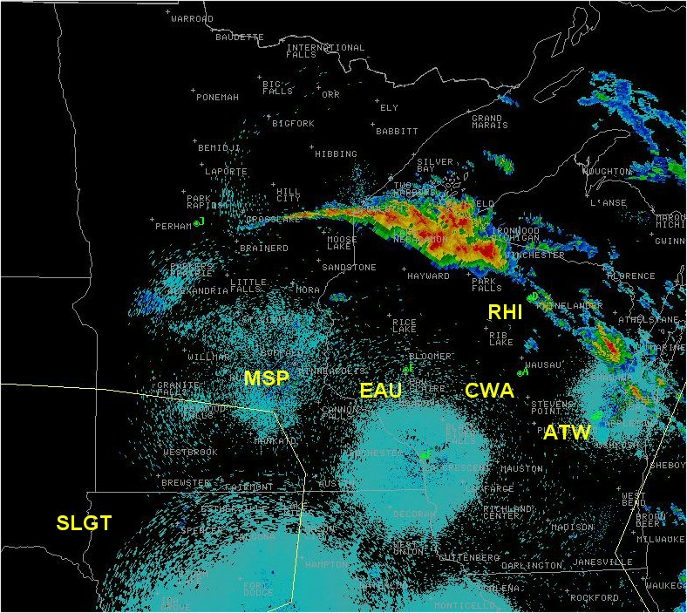
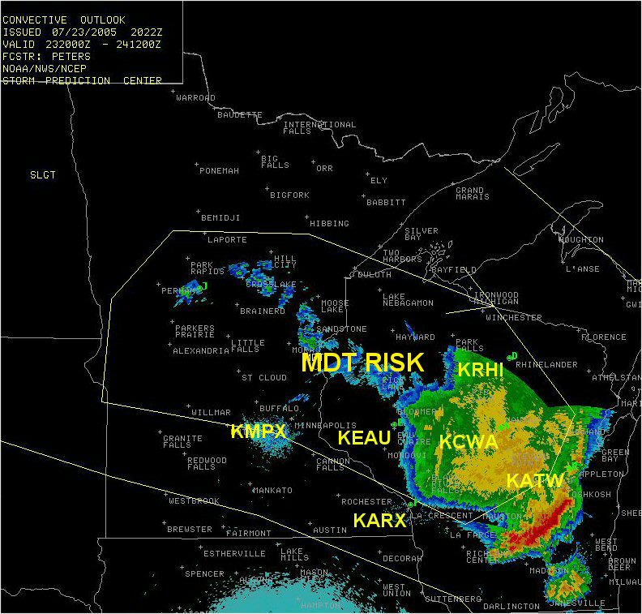
July 23, 2005 Null case
06Z July 24 Outlook
Thunderstorms eventually developed shortly before midnight ahead of the mid-level disturbance but were confined to far northern Wisconsin (as suggested by the supplemental regional aircraft soundings) near the northern periphery of the capping inversion.
Only marginally severe weather was reported.
CAP
Previous 20Z July 23 Outlook
Regional aircraft soundings were invaluable in helping forecasters better define the area of greatest convective potential.
Brusky, E. S., and P. Kurimski, 2006: The Utility of TAMDAR Regional Aircraft Sounding Data in Short-term Convective Forecasting. 10th Symposium on Integrated Observing and Assimilation Systems for Atmosphere, Oceans, and Land Surface (IOAS-AOLS), AMS, Atlanta, GA.

Slide 39
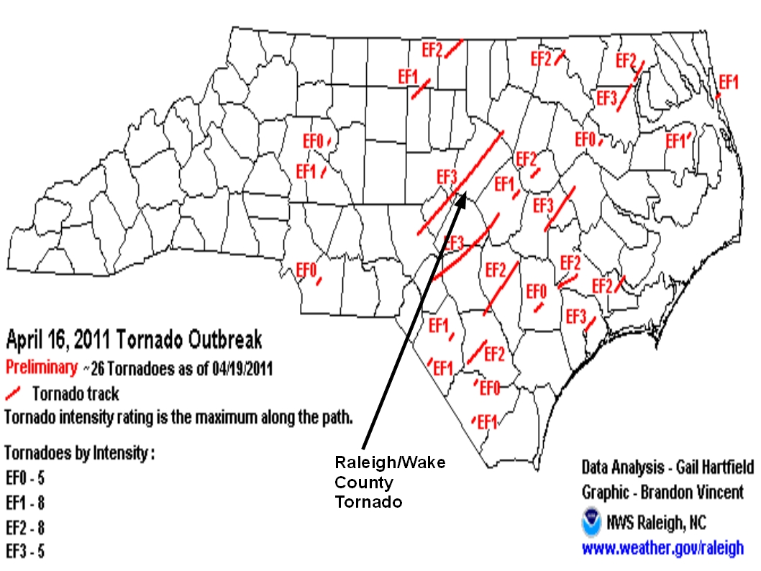
Raleigh Tornado Outbreak April 16th 2011

Slide 40


Slide 41




Brasseur, O.: 2001, Development and application of a physical approach to estimating wind gusts, Mon. Wea. Rev. 129, 5 – 25.

Slide 42

TAMDAR turbulence

Slide 43



Turbulence impact on airplane motion
Turbulent eddies from shear vorticity and curvature vorticity
(Lester 1994)

Slide 44

TAS derivation from ICAO EDR standard (2006)
Airspeed velocity vector =
inertial velocity – wind velocity
n
a
b
Binominal expansion approximation
TAS small angle assumption
0
Very large denominator – fraction goes to 0
1
0
0
Same answer!

Slide 45


Observed TAS and TAS fluctuations
The TAMDAR turbulence algorithm is based on:
  True airspeed (TAS) values
  Sampled at 10.67Hz
  Anti-aliasing filter applied
  32 (64) -point window
  Maximum likelihood algorithm

Slide 46


TAMDAR EDR vs. UW King Air Reference Data
Good Correlation (0.912) - Spectrum has -5/3 Slope.
R = 0.9115
Notes:
46

Slide 47
TAMDAR/TAMDAR-U Specifications
Parameter | Range | Accuracy | Resolution | Latency
Temperature | -55 to +65 C | +/- 0.5C | 0.1C | 10 sec
Pressure | 100 - 1010 hPa | 1 hPa | 0.5 hPa | 10 sec
Humidity | 0 - 100% RH | +/- 3% (<Mach 0.4) | 0.1% RH (<10%) | 10 sec
 |  | +/- 6% (>Mach 0.4) | 1% RH (>10%)
Ice Detection | 0.020 in | N/A | N/A | 10 sec
Heading | 0-360 deg | Plane dependent | 0.1 deg | 10 sec
Pressure Alt | 0-25,000 ft | +/- 150 ft | 10 ft | 10 sec
 | 25,000-70,000 ft | +/- 250 ft
Indi. Airspeed | 30-330 knots | +/- 1 knots | 1 knot | 10 sec
True Airspeed | 30-520 knots | +/-1 knots | 1 knot | 10 sec
Turbulence (EDR) | 0 - 1 m ^{2/3} s⁻¹ |  |  | 3 sec
Wind Vector | 0-360 deg | Vector Error
(Dir and Mag) |  | +/- 4-6 knots | 1 knot

Slide 48
Recent Experiments and Error Analysis

Slide 49







TAMDAR-UAS Flight Test (TUFT)
Naval Air Station Patuxent (PAX) River
UAV flight tests: Pelican, Aerostar, Prescott
Global Hawk
IKHANA / Predator
TAMDAR integrated on Pelican
Former TAMDAR UAV Simulator
New smaller TAMDAR for Aerostar
Notes:
49

Slide 50




TAMDAR-UAS Flight Test (TUFT)
RH (%) 1-h FCST Diff PEL_CONV minus CONV Valid 16Z Aug 19
~180,000 GTS-based conventional obs and 63 Pelican obs
End of assimilation window diff.
PEL-CON 700 hPa RH
6-h fcst 700 hPa RH Diff. PEL-CON

Slide 51




TAMDAR-UAS Flight Test (TUFT)
T (K) 1-h FCST Diff PEL_CONV minus CONV Valid 16Z Aug 19
~180,000 GTS-based conventional obs and 63 Pelican obs
End of assimilation window diff.
PEL-CON 850 hPa T
6-h fcst 850 hPa T Diff. PEL-CON

Slide 52




TAMDAR-UAS Flight Test (TUFT)

Slide 53
Estimation of TAMDAR Observational Error
Error analysis for 3-way collocation statistics following O’Carroll et al. (2008)
V_{G} is ground track vector – GPS-observed speed and angle η
V_{A} is aircraft track vector – TAS and heading ψ ψ error >> η error
O’Carroll (2008): Statistical method to calculate standard deviation of observational error between 3 sources i, j, k
Observation x, bias / mean error b, random error ε, true value of x is (x_{T})
Collocated and uncorrelated (assumption) types: i = TAMDAR, j = sondes, k = WRF 6h fcst
Variance of the difference between any two types
Standard deviation σ, correlation coefficient r
Solve equation set to obtain error variance
O’Carroll, A. G., J. R. Eyre, and R. W. Saunders, 2008: Three-Way Error Analysis between AATSR, AMSR-E, and In Situ Sea Surface Temperature Observations. J. Atmos. Oceanic Technol., 25, 1197–1207.
Gao, F., X. Zhang, N. Jacobs, X.-Y. Huang, X. Zhang, P. Childs, 2011: Estimation of TAMDAR Observational Error and Assimilation Experiments. Wea. Forecasting. Submitting this week.

Slide 54
Estimation of TAMDAR Observational Error
Error analysis for 3-way collocation statistics following O’Carroll et al. (2008)
If we include variance of representativeness error , which is always present…
TAMDAR
Collocation match cond: Time = 1 h, Vertical = 25 m
Horizontal: 10 km below 775 hPa, 20 km 775 - 450 hPa, 30 km above 450 hPa
RAOB
Assumption (if match cond. met):
WRF 6-h
So, this method provides an upper bound for TAMDAR error because
is very small, but still present.
…but what about WRF 6-h?
June
P T RH SP DIR
1000 0.999977665 9.215063205 1.387843048 20.23052788
850 0.886348035 10.46825217 1.300846774 11.78541599
700 0.482909997 10.48592576 1.513703491 12.75652182
500 0.510779086 10.20071055 2.071206706 19.01977744
400 0.372098132 11.57429938 2.052824675 26.41890618
January
P T RH SP DIR
1000 1.133783859 9.165983629 0.961545423 15.14730918
850 0.984297272 10.64437939 1.012268383 *
700 0.459417163 9.051897317 1.472582874 7.642665685
500 0.203793045 10.88275753 1.809059409 *
400 0.094622546 12.32461919 2.251329752 *
Is it really possible that ?
?

Slide 55
To drift, or not to drift…
GTS NCEP prepbufr obs has drift (so it appears to me?)
MADIS does not (at least on our feed)
In some of our WRFDA, we use the prepbufr, but in RTFDDA, we use MADIS
Some of this data is tagged 00/12Z and some is tagged 11/23Z (mainly Europe and China)?
Unless we have the exact time of launch, how much does applying a drift with constant 5m/s ascent rate mean?
RT-FDDA:
Obs-nudging should adjust based on downstream model flow.
Larger horizontal influence radius at higher levels.
Subjective glance at tests show no obvious benefit?
WRFDA:
In some of out configs. we are using “drifted” sondes, and others we are not.
What about verification without drift?

Slide 56



TAMDAR
RAOB
RAOB according to model
Strong wind
WRF obsproc output
450
775
Not to scale!
We see a lot of prepbur soundings with “drift” that are cut off. Is that because data at some level along the way up failed the QC?
Choice: MADIS with no drift, or cut off sounding with no data.
If QC rejects level b/c U,V OMB is large, are we throwing out the baby with the bathwater?

Slide 57
TAMDAR
RAOB
RAOB according to model
Meets match conditions
Reality is over here
450
Is it really possible that ?
My Hypothesis is YES.
Mainly appears in U,V
…and even more probable in Jan than June
Not Good
775
Good
Not to scale!
Ignore DA, and just consider verification… We are still using MADIS full profiles for verification (NCAR, GSD, AirDat).

Slide 58






Estimation of TAMDAR Observational Error
Error analysis for 3-way collocation statistics following O’Carroll et al. (2008)
Estimated error based on this method
Observation count per level for June

Slide 59




Testing of TAMDAR Observational Error (T and RH)
3 Parallel runs: OldErr_noT = No TAMDAR, OldErr_T = TAMDAR (default AIREP error), NewErr_T = TAMDAR (New error)
WRF (WRFDA 3D-Var) 20 km North America grid June 2011 4 x daily cycles 0-24 h forecast

Slide 60


Estimation of TAMDAR Observational Error
Error analysis for 3-way collocation statistics following O’Carroll et al. (2008)
Now lets talk about wind…
Not particularly surprising:
Wind speed error increases with speed
Wind direction error decreases with speed

Slide 61




Testing of TAMDAR Observational Error (U and V)
3 Parallel runs: OldErr_noT = No TAMDAR, OldErr_T = TAMDAR (default AIREP error), NewErr_T = TAMDAR (New error)
WRF (WRFDA 3D-Var) 20 km North America grid June 2011 4 x daily cycles 0-24 h forecast

Slide 62
Potential issues with assimilating wind vector components ?
Aircraft observe the environment in a speed and direction framework.
This is later converted to vector components.
Once this conversion takes place, the ability to isolate directional ob error from speed magnitude ob error is lost.
Presently, only single scheme for assimilating wind obs into WRFDA
Ob error for U,V is based on speed (i.e., m/s), and directional error is considered as a perfect atmosphere state (because it is not recoverable from vector components).
However, direction obs can have significant error, especially when speeds are small.
Hypothesis: Wind ob selection, rejection, and weight can be refined if directional ob error is also considered.
U,V are assimilated (rejected) provided OMB of U,V is smaller (larger) than n times the ob speed error.

Slide 63

Assume equal weight between fg and obs
Analysis wind
is average of fg and obs
U_{obs},V_{obs}
ANA_{asm_UV}
U_{fg},V_{fg}

Slide 64
Assume equal weight between fg and obs
Analysis wind
7.5°
ANA_{asm_wind}
U_{obs},V_{obs}
U_{fg},V_{fg}
30°
15°

Slide 65
ANA_{asm_wind}
U_{obs},V_{obs}
ANA_{asm_UV}
U_{fg},V_{fg}

Slide 66

The most boring slide in here
Basic 3DVar formulation
Nonlinear observation operator H
Tangent linear process H
Adjoint process H^{T}

Slide 67
Assume the speed observational error is 2.0 m/s
Rejection threshold: OMB is 5 times assigned error.
Case 1
Ob assimilated based on conventional U,V
Ob rejected based on speed/direction method
Case 2
Ob rejected based on conventional U,V
Ob assimilated based on speed/direction method
Speed < 5m/s, Angle 180°
Speed > 10m/s, Angle 60°
Speed > 10m/s, Angle 15°
fg
ob
ob
fg
fg
ob
OMB_{u} (and/or OMB_{v}) < 10m/s
OMB_{u} > 10m/s
OMB_{v} > 10m/s

Slide 68

Mainly seen in upper levels with higher speeds
Case 2
Case 1
Mainly seen in lower levels with smaller speeds

Slide 69




Observational error curves for TAMDAR winds
June 1-25 test:

Slide 70
RTFDDA Data QC Scheme
Key: use Nowcasts as references
  Hollingsworth et al. 1986:
  The 6-hour global forecasts were used to estimate the observation quality.
  The high-resolution, full-physics, rapid-cycling mesoscale RTFDDA produces reliable, “spun-up”, 1 – 6 hour forecasts (nowcasts).
  These accurate nowcasts provide synthetic 4-D dynamically and physically consistent atmospheric states for examining the observation data quality.

Slide 71
Design of the Data QC Scheme
(Obs – Model) Contains the Error Info
Concept: |A_{obs} – A_{model}|
What is hidden in the model-observations difference?
  Forecast (background) error (E_{m})
  Observation error (E_{o})
  Representativeness error (E_{r})
  If E_{m} = 0, E_{o}= 0 and E_{r} = 0: |A_{obs} – A_{model}| = 0
  If E_{m} = 0 and E_{o}= 0: |A_{obs} – A_{model}| = E_{r}
  If E_{m} = 0: |A_{obs} – A_{model}| → E_{o}+ E_{r}
In the real world, E_{m} , E_{o} and E_{r} co-exist
For assimilation, we do not separate E_{o}and E_{r}
For data QC purposes, we need define E_{o}

Slide 72
RTFDDA Data QC Scheme Formulations
By using statistical model forecast error (σ) to approximate the forecast error (σ ≈ E_{m}), we can estimate and grade the (E_{o} + E_{r}) of (each) individual observation based on |A_{obs} – A_{model}|.
Q_{F} → Quality flag (0 <= Q_{F} <= 1) of the Obs A_{obs,} ξ → A scaling parameter that may depend on measuring platforms, variables, model accuracy, and the usage of quality flags. 0.5 <= ξ <= 3.

Slide 73
Analysis of the Data QC Scheme
Physical explanation:
If |A_{obs} – A_{model}| < σ, |A_{obs} – A_{model}| is more possibly due to the E_{m} ;
If |A_{obs} – A_{model}| > σ, |A_{obs} – A_{model}| is more possibly due to the E_{o} +E_{r} ;
Given |A_{obs} – A_{model}| , the larger σ is, the less possible |A_{obs} – A_{model}| is due to the E_{o} +E_{r} .
ξ is scaling factor to inflate (deflate) σ.

Slide 74

Tune the QC Scaling Factor ξ
Grade QC flag: 0 – 1 using |Obs – Model|
σ = 1.5
ξ is “tuned” to recognize 70-80% of obs as good (typically)
Traditional
(binary ob flag)
ξ = 3
OLD
New
ξ = 1

Slide 75
Considerations
  Approach includes observation error and representativeness error.
  A perfect observation in a convective cell, which is 10C warner than 3 km away, will be flagged as bad observation.
  The QC scaling is based on the statistics of the model errors. Thus it is good statistically, but may not be good for all particular cases.
  If the model performs much worse for a given time, a good observation will be labeled with low QC flag.
  Therefore:
  QC is best suited for NWP and verification. Q_{F} can also be used in a weighting function for DA.
  Not good for instrument error identification.

Slide 76
QC Values of Temperature for SYNOP
P>900hPa
P>900hPa
Notes:
Though improved a lot, we still have some problem in dealing with online QC for SYNOP observations, especially the the temperature. Compared to the previous version, the new schemes do the temperature correction due to the discrepancy between the model elevation and that of observations.

Slide 80

Delta Hound report provides a summary of probe health and problems by day.
100%
0%

Slide 81

Example Report – Flight profile provides a quick overview of
conditions encountered by a TAMDAR during a given time period.

Slide 82

Example Report – Temperature scatter plots let us quickly see how well temperature measurements correspond to short-term predictions.

Slide 83

Example Report – showing the details of how specific measurements
compare to short-term model predictions.

Slide 84

Example Report – Relative humidity statistics and a scatter plot depicting measurement agreement for the two TAMDAR humidity sensors.

Slide 85

Example Report – Relative humidity statistics and a scatter plot depicting measurement slight disagreement for the two TAMDAR humidity sensors.

Slide 86

The Dog Whistle program provides high performance access to important quality assessment information (in addition to the various HTML reports).

Slide 87
Hardware Review
Operational Forecast Systems
IBM Power 6 p575 – 14 compute nodes (448 P6 cores)
~100 TB high-speed storage
Dell Blade Cluster
160 Compute Nodes (12 Intel Westmere 3.3GHz cores/node w 48 GB physical memory)
1920 total cores, 7.7 TiB total RAM
Nodes connected via high-performance Mellanox QDR Infiniband fabric.
Storage provided by dual-redundant , Infiniband, high performance Lustre file system
Lustre filesystem targets use DDN drive shelves and dual controllers, total capacity of 150TiB

Slide 88

WRF-RTFDDA
D1
D2
Domain1:
DX: 12 km, 741 x 693
Domain2:
DX = 4 km, 1282 x 916

Slide 89
AirDat RTFDDA-WRF
Operational Configuration Domain 1 Domain 2
Grid Spacing 12km 4km
Microphysics Morrison Morrison
Cumulus Kain-Fritsch None
Boundary Layer YSU* YSU*
Land Surface NOAH NOAH
Radiation Goddard/RRTM Goddard/RRTM
*AirDat/NCAR Modified
4 Cycles Daily (00,06,12,18 UTC) to 72-hrs
Complete forecast cycle requires ~180 minutes wall-clock time, including observation quality control, data assimilation, prognostic forecast, and postprocessing.
23 blades with 12 3.3 GHz Westmere cores with 48 GB memory per blade.
AirDat WRFDA
Also running operational North America scale 3DVAR-WRF, as well as a 3(4*)DVAR-WRF tropical forecast system over the Atlantic Basin
*4DVAR-WRF Tropical running in parallel for 2011 Hurricane Season

Slide 90
Next-Generation Forecast Models
WRFDA-based
4DVAR CONUS scale forecast system (operational release mid ~2012)
Hybrid WRFDA ETKF-3DVAR Tropical Forecast System (June 1, 2012)
Hybrid EnKF-4DVAR CONUS scale Forecast System (mid ~2013?)
Hybrid EnKF-4DVAR Tropical Forecast System (June 1, 2013?)
Hybrid RTFDDA – FDDA-WRFDA Hybrid (operational release Dec. 2011)
European on-line WRFQC (operational release April 2012)
50 member Ensemble RTFDDA (operational release spring 2012)
4-Dimensional Relaxation Ensemble Kalman Filter (operational release spring 2013?)
FDDA-based

Slide 91
Additional steps to optimize for 3/4D-Var WRF
H observation operator (tangent linear H and adjoint operator H^{T} ) – NCAR
RAOB as template
B background error covariance matrix
gen_be NMC method
R observation error covariance matrix
OBSPROC (subdivide by POF, frame, etc?)
Single time stamp and launch point (vertical interp)
Split into obs (not split into profiles)
Error characteristics different for different POF
Error characteristics different for different plane types
Ascent and descent typically have opposing thermal bias -- can be accounted for based on a rate of altitude change
T stats derived for both jointly may cancel bias… but this is not sufficient to assign on a per-ob basis
Maneuvering on descents can result in larger wind vector errors compared to cruise or ascent
Step 1 – Withhold descent winds
Step 2 – Split into POF and apply larger ob error
Step 3 – Isolate Saabs (main offender) and apply mag dev correction. Much better!!
Step 4 – Maneuvering is mainly a function of airport-specific approach patterns.
Perhaps we should consider sorting descents based on airport (along w/ plane type)?
Initial spot checking shows some airports appear very stable, and others are quite “squirrely”.

Slide 92
What’s next?
POF error statistics per frame
Dynamic variable sampling rate?
Satellite calibration/verification
European expansion
Clean / rime ice
PSLV?
Wind speed/dir OSSE

Slide 93
Thank You!
Acknowledgements:
RTFDDA-WRF
Yongxin Zhang (QC)
Yubao Liu (QC)
Peter Childs
Thomas Nipen
Luca Delle Monache
Arthur Mizzi (EnKF-Hybrid)
Gregory Roux
Andrzej Wyszogrodzki (MOS/KF)
William Cheng
Wei Yu
Rong-Shyang Sheu
RUC Comparisons
Stan Benjamin
Bill Moninger (verification)
WRFDA
Hans Huang
Feng Gao (ob error)
Xiaoyan Zhang (ob error)
Xin Zhang
Instrumentation error
Dan Mulally
Allan Huffman
Jamie Braid
Alan Anderson
Hardware / Case studies
Peter Childs
Allan Huffman

Slide 94







Wind tunnel test
Atmospheric scientists vs. beards r²=1?
Wind tunnel pretest

Slide 95





TAMDAR AERIBAGO Validation Experiment (TAVE) - Memphis
Wayne Feltz, Erik Olson, John Short, Sarah Bedka, Kristopher Bedka, Tim Wagner, and Scott Cultice
University of Wisconsin - Madison SSEC/CIMSS

Slide 96



TAMDAR circa 2004
Memphis ANG Deployment

Slide 97
Kalman Filter Bias Correction
Post-processing predictor bias correction method:
→ linear, adaptive, recursive, and optimal
→ recent past forecasts and observations used to revise the estimate of the current raw forecast.
→ predicts the future bias as equal to the old bias plus uncertainty, but corrected by a linear function of the difference between the previous prediction and the verifying bias.
Delle Monache, L., T. Nipen, X. Deng, Y. Zhou, and R. Stull (2006), Ozone ensemble forecasts: 2. A Kalman filter predictor bias correction, J. Geophys. Res., 111, D05308, doi:10.1029/2005JD006311.

Slide 98
Energy spectrum in inertial subrange
Where TAS = Avg. TAS + fluctuations in TAS
Conservation of energy in wavenumber to frequency conversion
Where u is the longitudinal fluctuation in wind speed (von Karmen 1948)
We know A₁ and the avg. TAS, so how do we get u?

Slide 99
TAS derivation from ICAO EDR standard (2006)
Airspeed velocity vector =
inertial velocity – wind velocity
n
a
b
Binominal expansion approximation
TAS small angle assumption
0
Very large denominator – fraction goes to 0
1
0
0
Same answer!

Slide 100

From previous slide
TAS = Avg. TAS + fluctuations in TAS
Wind = Avg. wind + fluctuations in wind
0
Assume the inertial velocity is essentially equal to the average inertial velocity because changes in ground speed are much less than changes in wind.
We now have u -- the longitudinal fluctuation in wind speed.
Recall the EDR equation. We can substitute for u.

Slide 101
Assume N samples of TAS are taken at rate F_{s}(Hz) so that F_{s} = 1/T_{s}
DFT to approximate E(f)
Power of each component assuming single-sided spectrum
Frequency
To convert sequence of power at each f to power spectral density (PSD), divide by the f bin size (F_{s}/N).
Final step to calculate EDR

Slide 102

RR (1-3h fcst), RTFDDA (6h)
Larger reference obs. space-time window = larger ob error stats.

