Slide 1

Tailoring ensemble output to meet forecasters' needs - some highlights from the Met Office and ECMWF
Tim Hewson
(ECMWF and UK Met Office)

Slide 2
Topics
The Problem with using Ensembles..
Cyclone-tracking products for the extra-tropics
Forecasting Extreme Weather : The Extreme Forecast Index (or ‘EFI’)
Plans for a high resolution ensemble at the Met Office

Slide 3
1. The Problem with Ensembles…
Huge volumes of data – how does the forecaster take it all in ?
We need to combine and compress data into useful and manageable formats, carefully tailored towards the requirements of forecasting
Adverse weather is a key focal point, both for ECMWF and UKMO. Products must recognise this.
Product generation is non-trivial; considerable effort required not only in distilling data in new ways (the focus of this talk) but also in graphical design, interface design, web programming, colour selection….

Slide 4
2. Cyclone-tracking products for the extra-tropics
2.1 Motivation / strategy
2.2 Identification of fronts
2.3 Identification of cyclonic features
2.4 Tracking of cyclonic features
2.5 The EPS-based Web Products (ECMWF and UKMO)
2.6 Verification

Slide 5
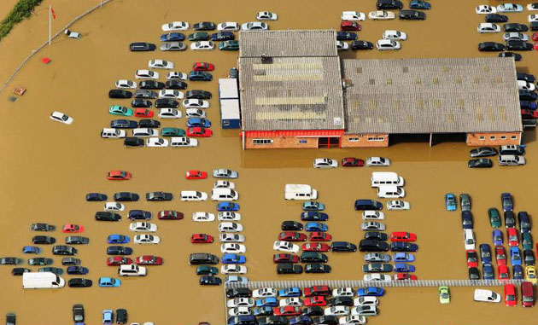
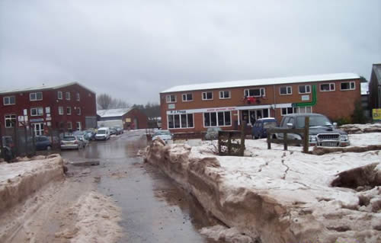
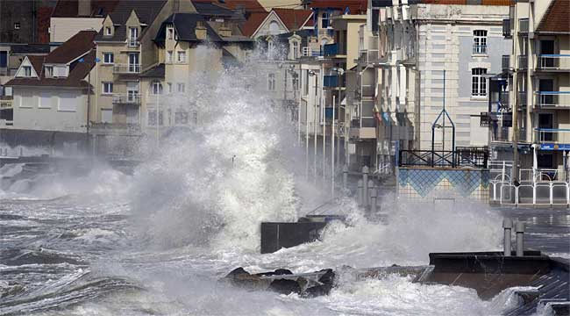
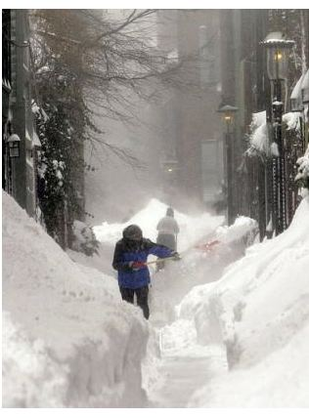
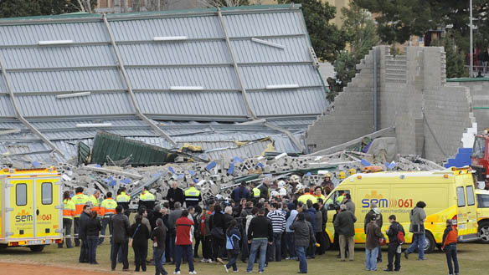
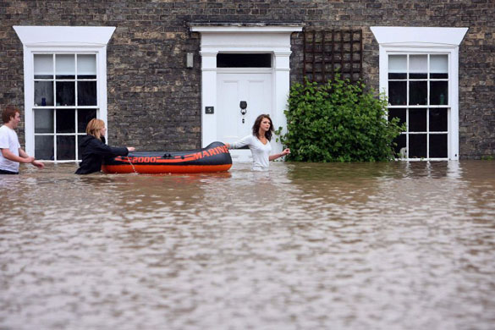
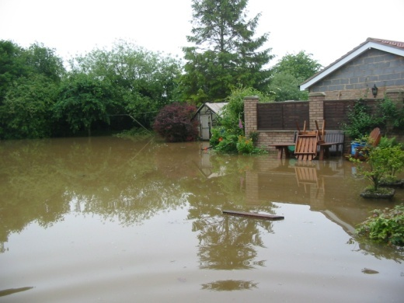
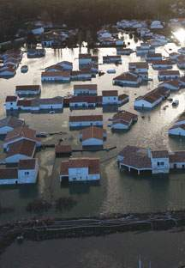
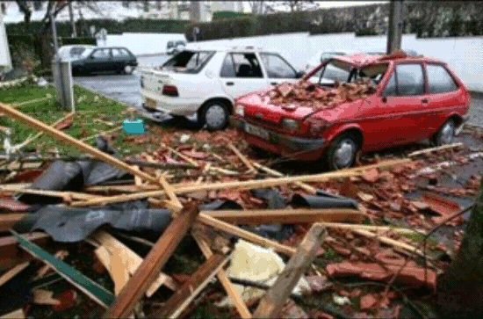
2.1 Motivation and strategy

Slide 6
Why track cyclones automatically ?
Forecasters make daily use of feature identification (e.g. fronts, troughs, frontal waves, lows,…), mainly because of those features are responsible for bad (or extreme) weather
Nowadays manual identification of features is based largely on model data
If we can identify features automatically, in a manner consistent with everyday forecasting, we will have:
    1. A range of new EPS-based tools for assisting the forecaster to predict adverse weather (Products)
    2. A means by which adverse weather can be verified, by proxy, by comparing the forecast features with features identified in model analyses (Verification)

Slide 7
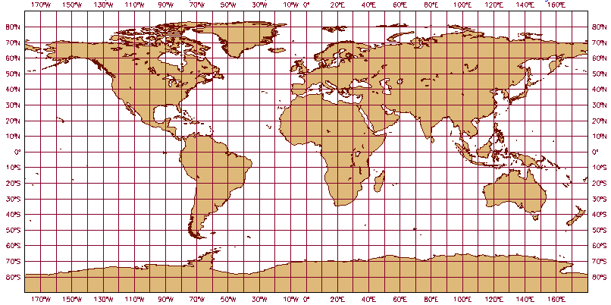
So why is this difficult ? - Tropics vs Extra-tropics
DIFFICULT
-Mostly asymmetrical
-Wide range of types
-Much harder to identify
-Track velocity varies greatly
-Cyclones are common
EASY
-Symmetrical
-Uniform structure
-Clearcut
-Slow-moving
-Cyclones are rare
DIFFICULT
Affects Feature Identification Affects Feature Trajectory Calculation

Slide 8
Our Approach (1)
In most cyclone tracking work input data is at low resolution – eg 500km
In reality synoptic scale cyclones, as recognised for many years by forecasters (with good reason!), vary in scale from about 100km to over 1000km
Here we set out to overcome several problems related to input data resolution, in order to identify the full range of cyclones
Work ongoing for more than 10 years. Further improvement is possible…

Slide 9
Our Approach (2)
Key aspects of our system, which make identifying the full range of features possible, are:
  We use a hybrid identification system, based on vorticity & mean sea level pressure. With one exception other studies have used these variables in isolation.
  Many of the features are required to lie on fronts (objectively defined). This accords with synoptic practice.
  A multi-parameter tracking scheme is employed to correctly associate features. One key aspect is the use of ‘half-time tracking’.

Slide 10
Realisation
Code now exists to identify many feature types. This was originally developed at the Met Office, and applied to the MOGREPS ensemble there, providing real-time products for forecasters.
The code has now been ported to ECMWF, further developed, and applied to the ECMWF ensemble. Web-based products have been available in real-time since late December 2010.
Essentially there are 3 stages in the cyclone tracking. First we identify fronts (as many cyclones lie on these) [1.2], then we identify the cyclonic features themselves [1.3], then we match up cyclonic features at different times (=tracking) [1.4]

Slide 11
2.2 How do we identify the fronts?
This is done by first computing appropriate diagnostic quantities on a near-horizontal level that lies 1km above the model topography, using the model wet bulb potential temperature field (Ө_{w}) as input. The diagnostics are designed to identify a front along the warm air side of each baroclinic zone.
The diagnostics are then plotted using standard graphical devices – contouring and colour filling, and then colouring-in of the remaining line segments based on thermal advection, to denote warm (red) or cold (blue) fronts
Simple demonstration follows (uses theta-w at 900mb, not 1km, but principle is the same)….

Slide 13
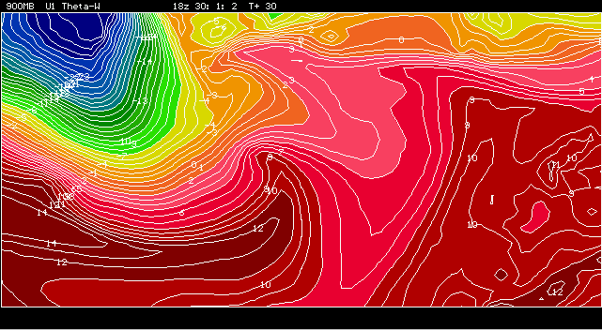

Slide 14
2.3 How do we identify the cyclonic features?
As most such features in the extra-tropics start out on fronts, the first stage in cyclone identification is to identify the fronts
Then various algorithms, broadly based on a revised conceptual model of cyclone development, pinpoint cyclonic features of different types, mostly on the fronts themselves
Only a brief overview is provided here..

Slide 15
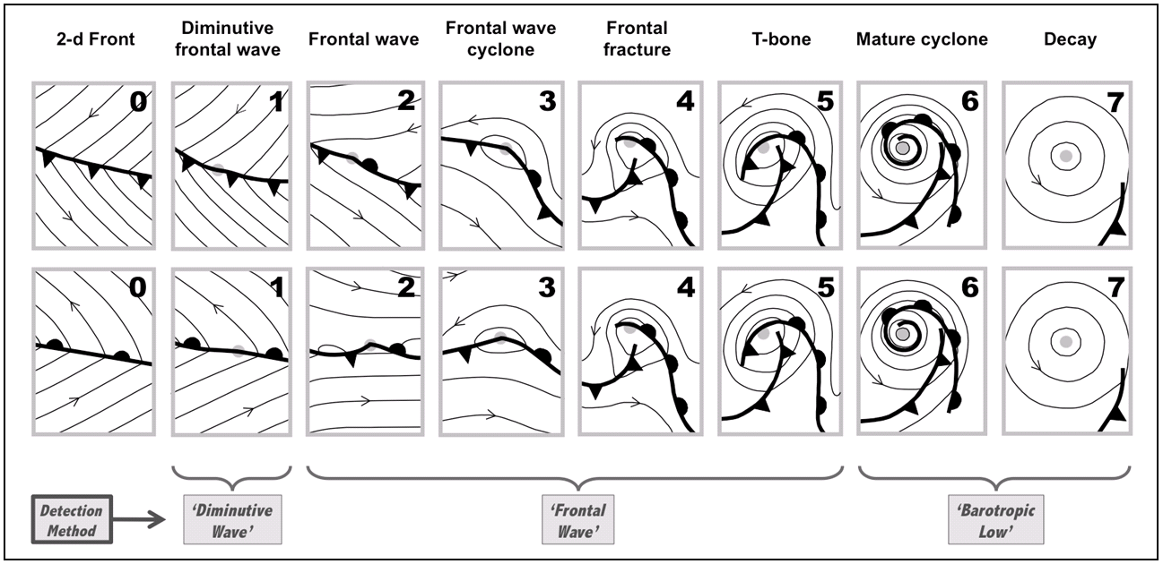
Identification methodology is based around this conceptual model of extra-tropical cyclone development (but is not constrained by it):

Slide 16
Lows, Frontal Waves and Diminutive Waves
Barotropic lows are simply low pressure centres
Frontal waves should be well known – they represent a meeting point of cold and warm fronts (where the vorticity of the cross-front wind is positive)
Diminutive waves are less well known, they represent the first sign on a synoptic chart that a frontal wave may be developing – usually signified by slight opening out of the isobars
Diagnostic-graphical techniques are used to identify each type of feature

Slide 17
Identifying Cyclonic Features in the EPS
Pressure level data provides input
(T, q, u, v, Z @ 1000,925,850mb,..)
Data is reprojected at a resolution of about 50km
12-h time interval used, so that EPS-based products can be calculated in time to be used by forecasters (Shorter interval might be better and could be used in research)
Range of diagnostics computed from input data
Diagnostics plotted and post-processed using a graphical package
Output initially comprises ‘synoptic animations’ and simple ASCII text files showing attributes of each identified feature (‘cyclone database’)

Slide 18
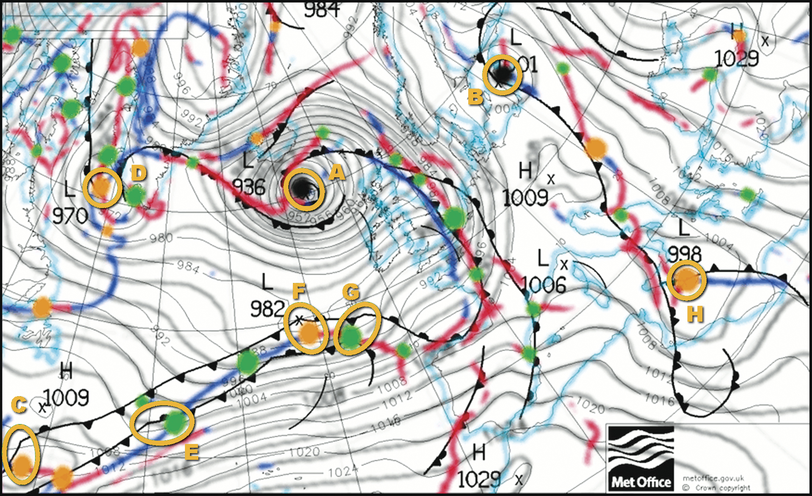
Manual and (control run) objective synoptic charts interlaced
12Z 22/1/09

Slide 19
Accuracy of the identification method
A systematic comparison between cyclonic synoptic features marked on UKMO synoptic charts near the UK (low centres and frontal waves) and objective features in model analyses was carried out, for 5 x 6month winter periods.
For clearcut cases the hit rate was 84%, and the false alarm ratio 17%, implying good agreement.

Slide 20
2.4 Defining Feature Tracks
Aim is to ‘join the dots’ between successive time frames, recognising also genesis and lysis of cyclonic features
Several input parameters are used in the tracking scheme – i.e. in the output of the identification stage – for example:
500mb wind velocity above feature point (for steering)
previous movement of feature also used, if available
+…
Output is a simple ASCII feature-track text file, showing lat/lon, VT and other feature attributes, for each computed track – this is then graphically represented in a number of ways
An important innovation is the use of ‘half-time tracking’…

Slide 21
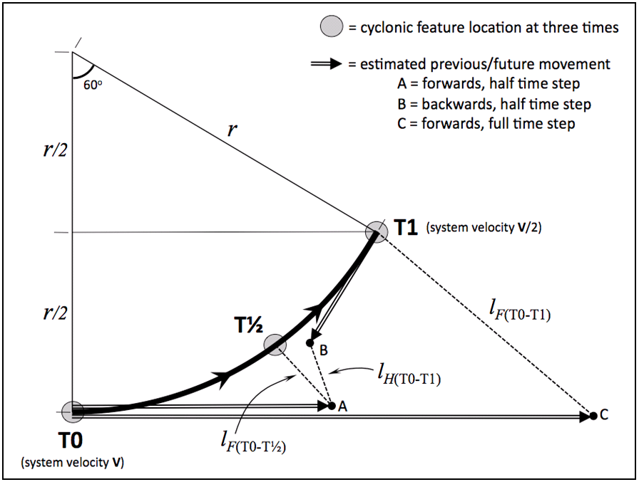
An illustration of ‘half-time tracking’
Full-time tracking
error
Half-time tracking
error

Slide 22
Tracking windstorm-generating cyclones
In tailoring the algorithms special attention was paid to coping with typical windstorm-generating cyclones. Characteristics catered for include:
  Originate on fronts – frontal wave or diminutive wave
  Rapid movement (beneath strong upper level jets)
  Rapid deceleration (in the jet’s left exit)
  Features can be very small-scale

Slide 23
2.5 Product Examples

Slide 24
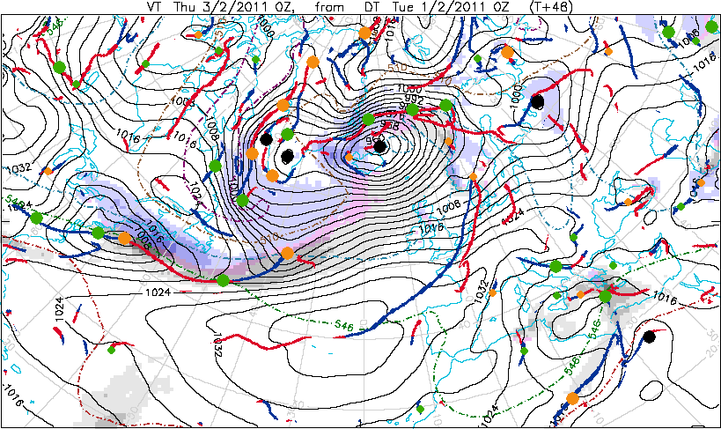
Snapshot of Synoptic Feature Chart
12h precipitation shown by shading – greys for mainly rain, pinks for rain-snow mix, blues for mainly snow
Ranges, in mm water equivalent: 2-8mm, 8-20mm, 20-50mm, >50mm

Slide 25
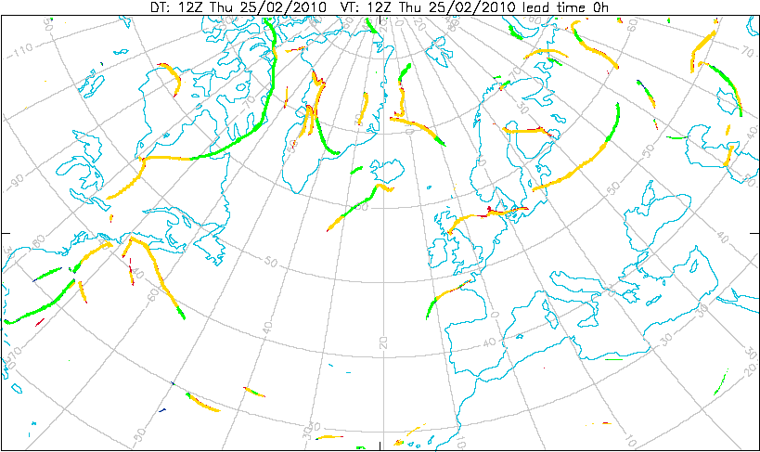
Fronts Spaghetti Plot
52 forecast runs (EPS + Control + Deterministic)

Slide 26
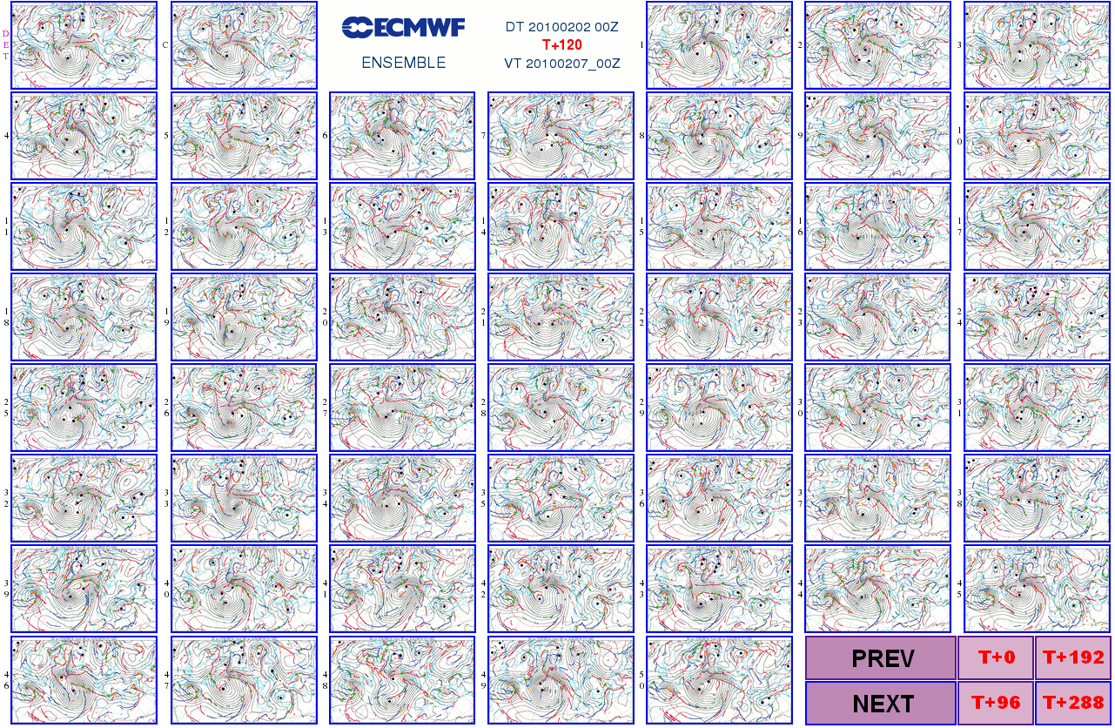
Postage stamps (various options)

Slide 27
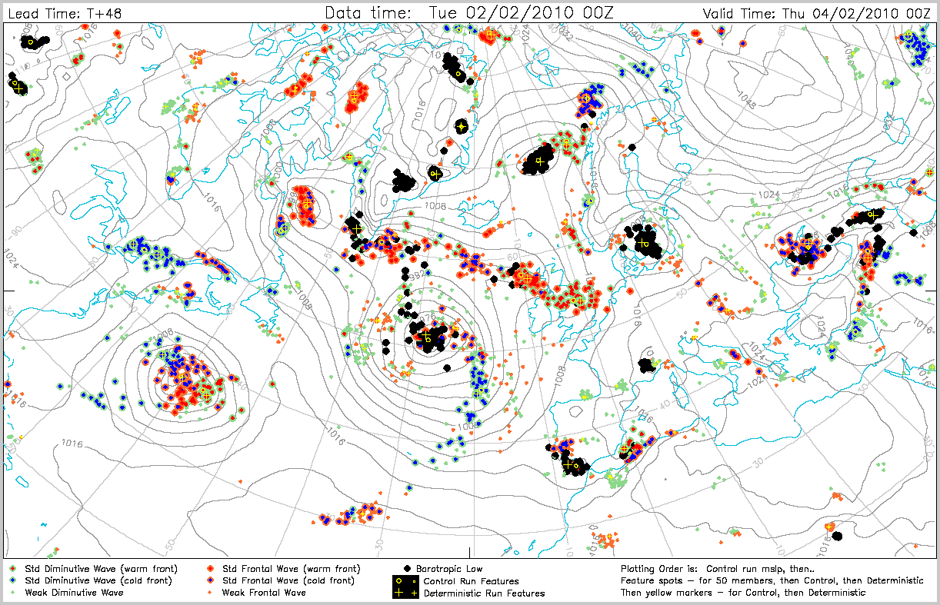
Dalmatian Chart (feature type)

Slide 28
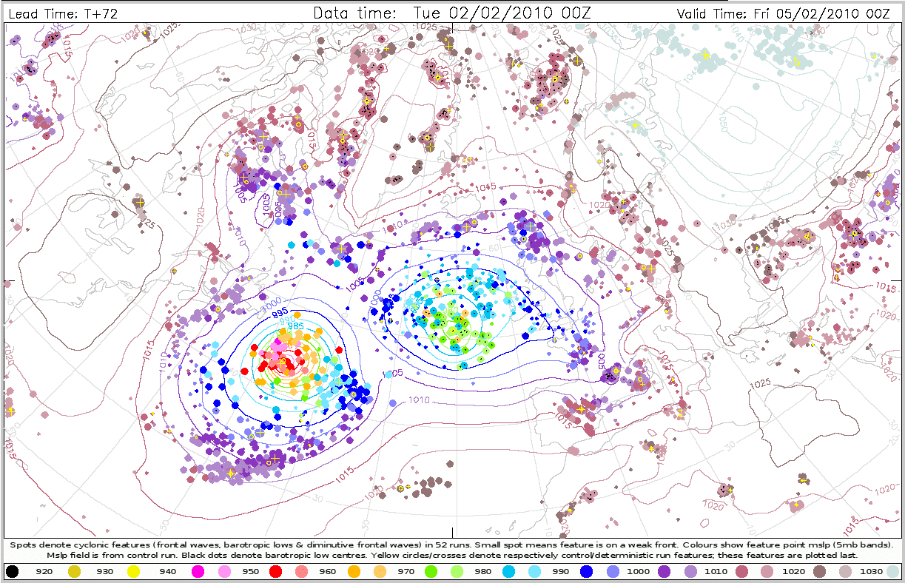
Dalmatian Chart (mslp)

Slide 29
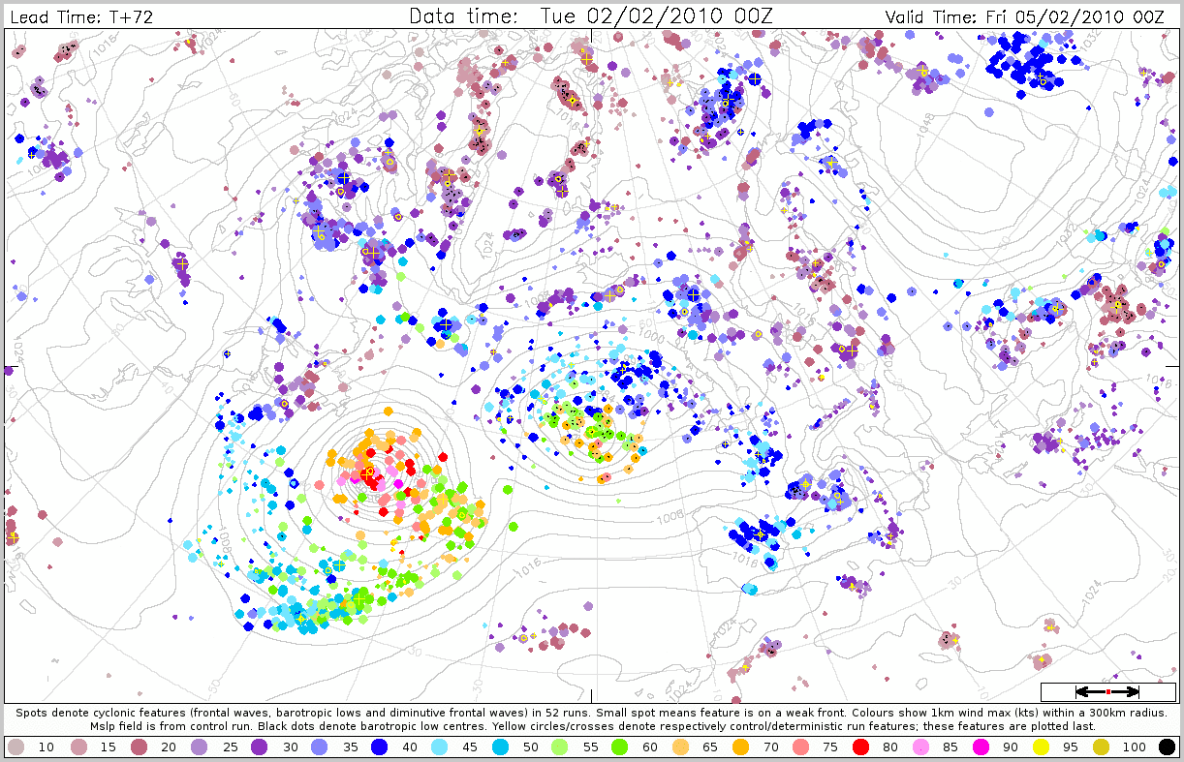
Dalmatian Chart (max 1km wind, 300km radius)

Slide 30
Portraying Feature Tracks
At longer leads we tend to use strike probability plots, that represent the probability that a feature (ie any feature) reaching a specified intensity threshold, will pass within 300km, within a period of 24 hours
  Here we are using time windowing, and spatial windowing, to ‘blur the edges’ for ensemble forecast output, to aid the forecaster needing to issue regional alerts, or early warnings
  Point forecasts less useful (probs generally low at long leads)
At shorter leads strike probability plots also available, but in addition we use feature-specific plume diagrams to show tracks of pre-selected cyclones from time zero
One example of each, highlighting the outcomes first…

Slide 31



Strike Probability Animations (15 day)
- three severity thresholds (DT 12Z 25/2/2010)
51 forecast runs (EPS)

Slide 32
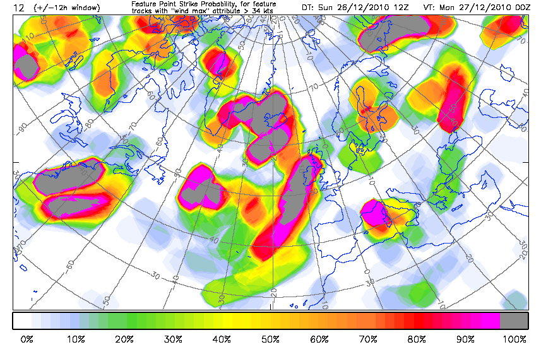
New York Snowstorm – successive forecasts, fixed VT

Slide 33
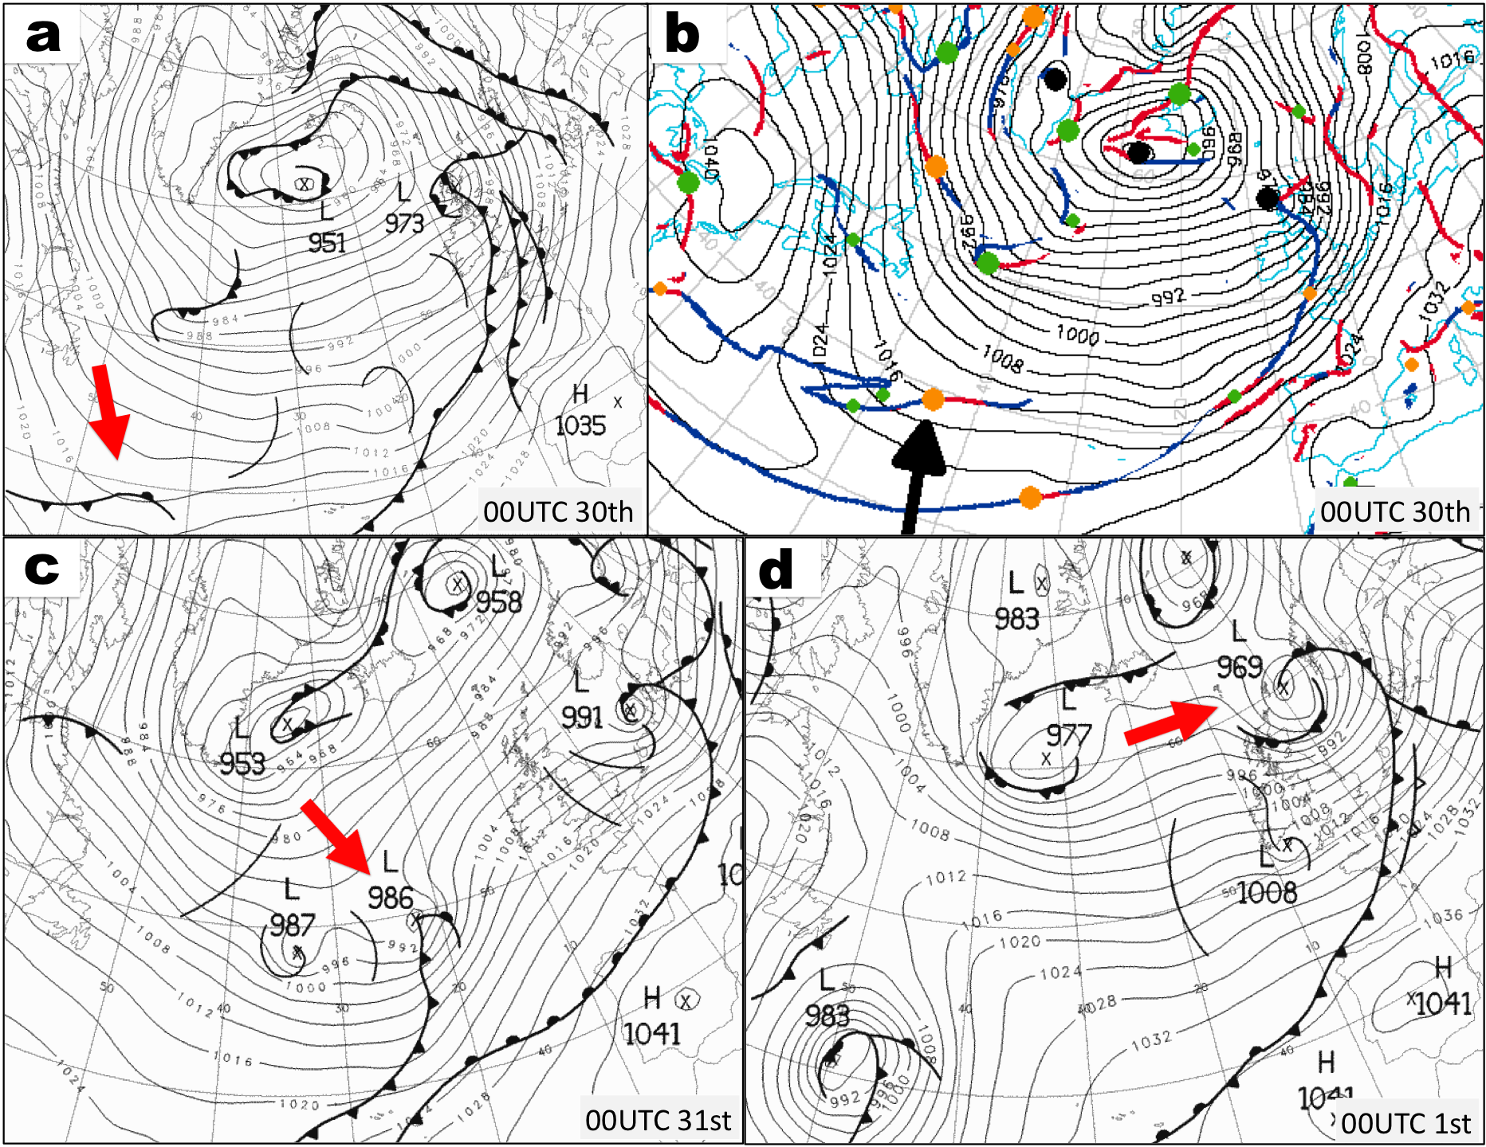
A New Years Eve Windstorm

Slide 34
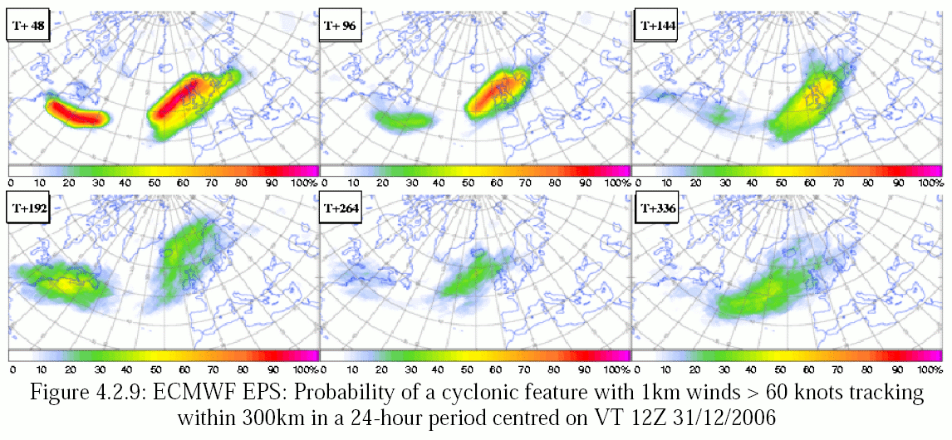
Strike Probability Plots – severe storm class
Shows forecasts for fixed VT - 12Z 31st, +/-12h, when windstorm was approaching northern UK. Hints of skill in week 2.
Verifying track segment has been added (black line)
lead (days)
2 d
4 d
6 d
8 d
11 d
14 d

Slide 35
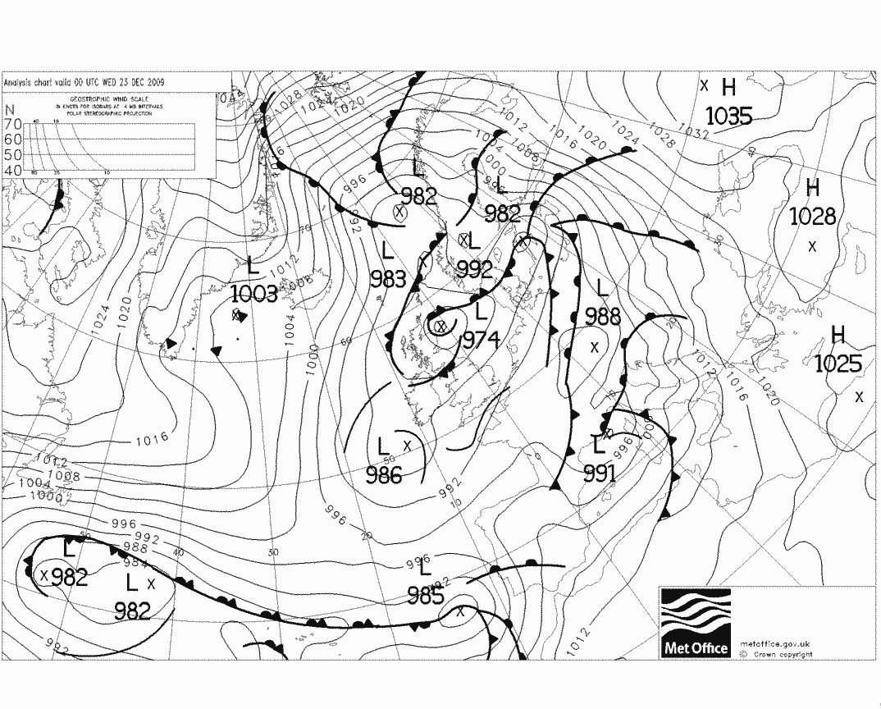
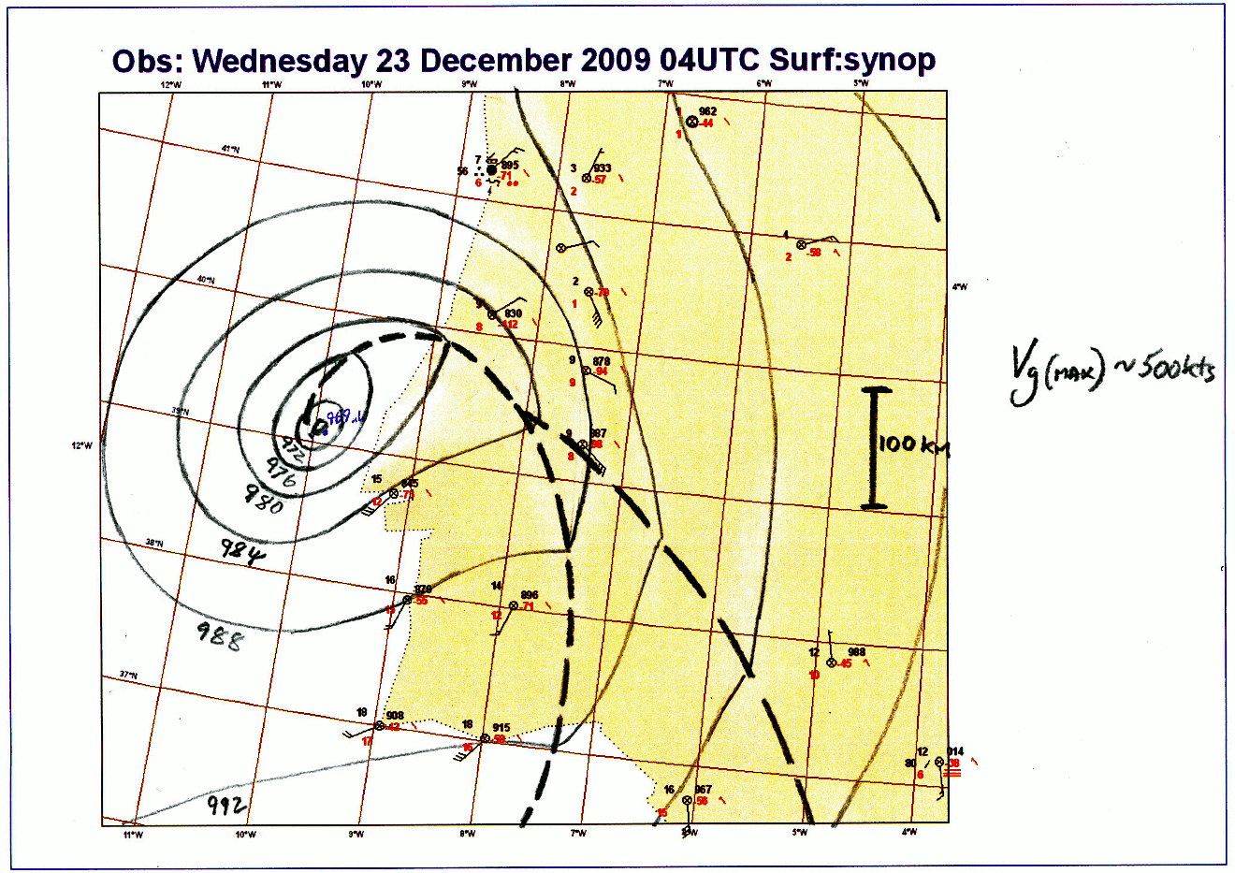
Portugal Storm example
“Micro-storm”
23 Dec 2009
967

Slide 36
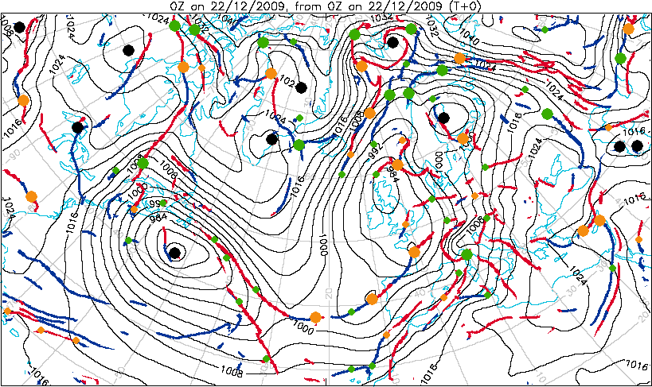
Synoptic animation

Slide 37
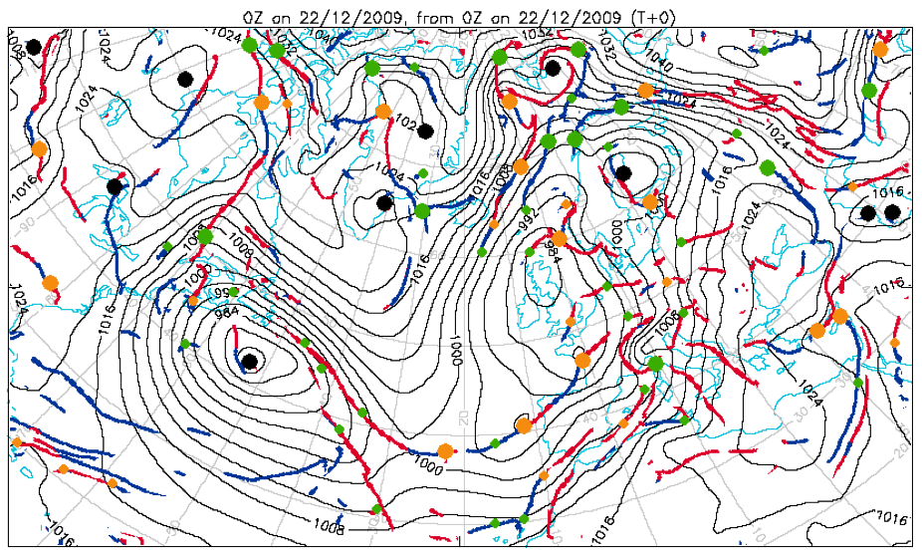
Feature-specific plumes
On the web interface the user can click on any spot (= cyclonic feature) to see how that feature evolves in the EPS

Slide 38
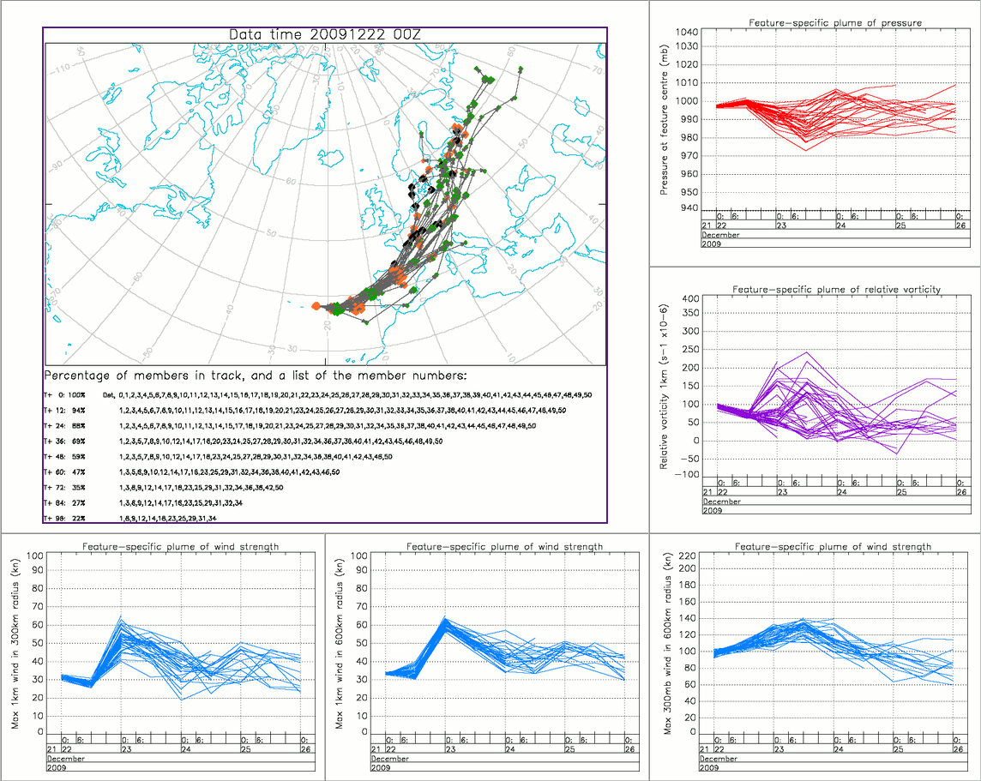
24h lead plumes

Slide 39
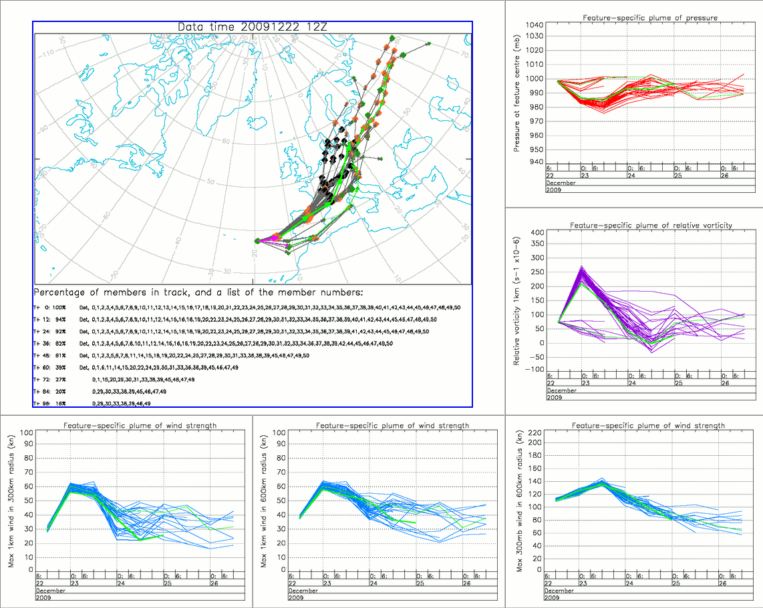
12h lead plumes

Slide 40
2.6 A recent example
A small frontal wave that affected southern parts of the UK on Fri last week
Caused significant forecasting problems – sunny day or rainy day in Reading ?

Slide 41
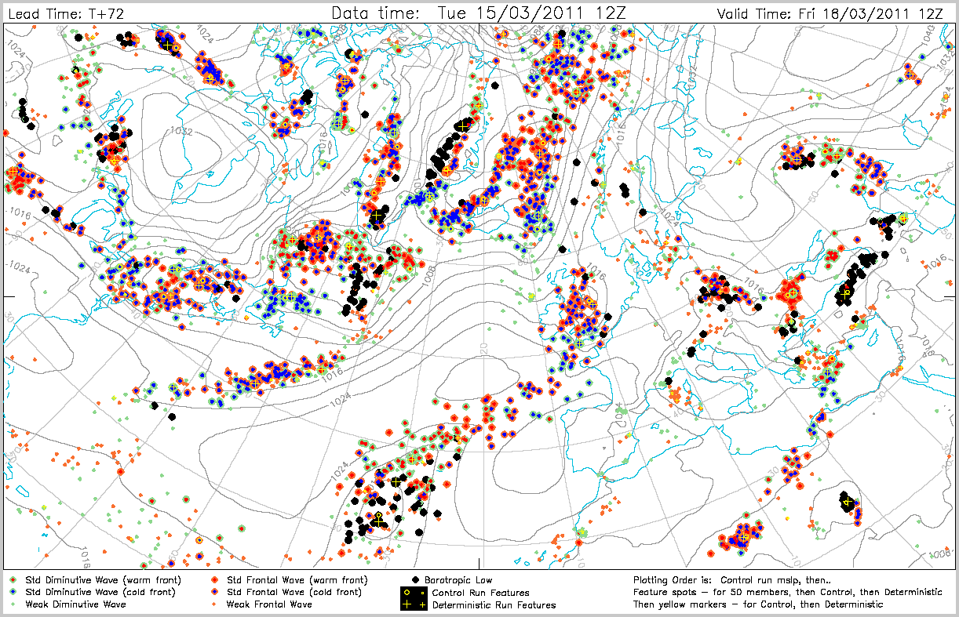

Slide 42
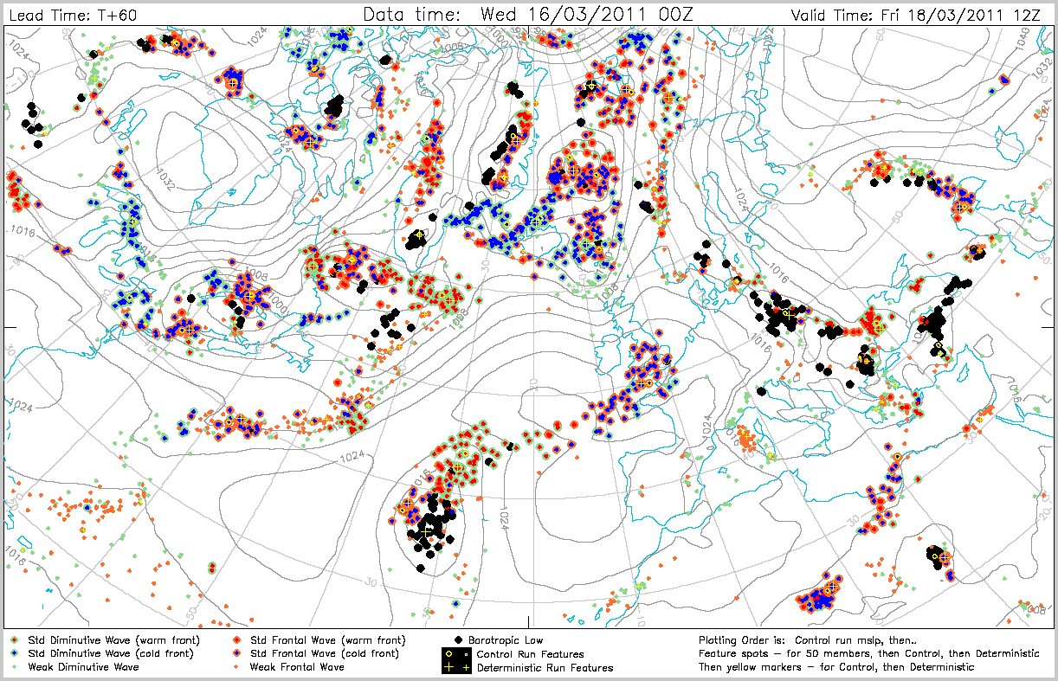

Slide 43
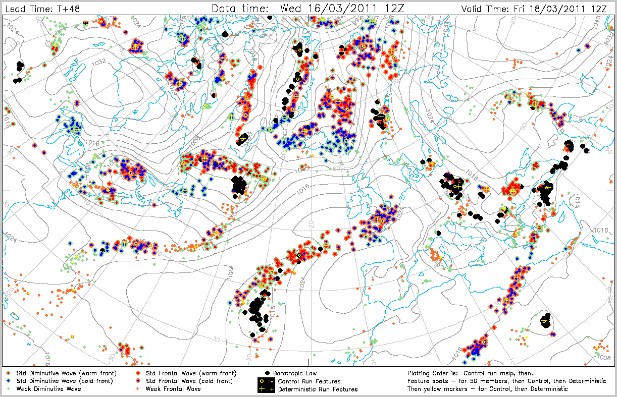

Slide 44
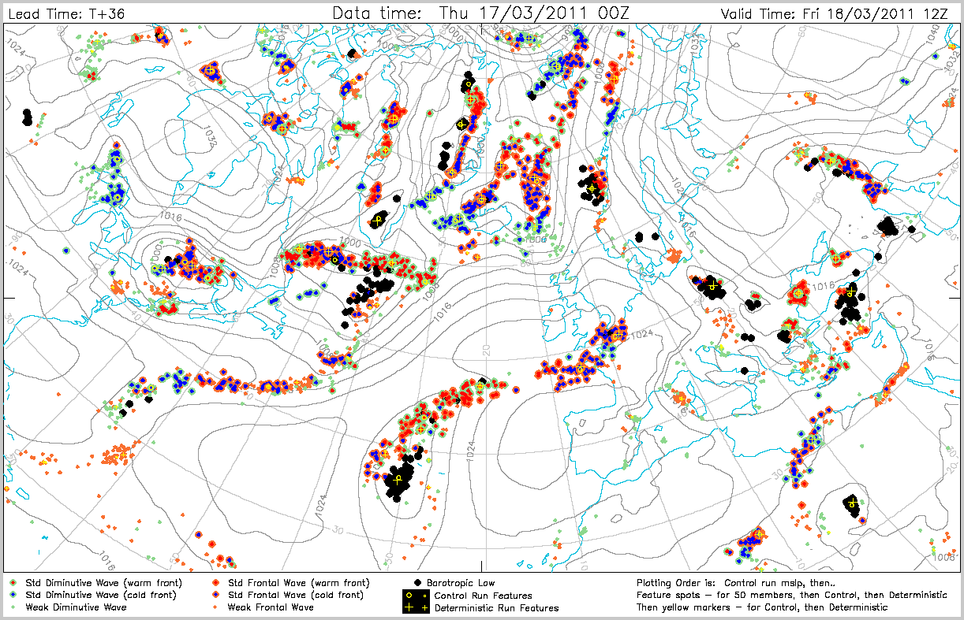
Deterministic forecast
predicted a sunny day
in Reading – cyclonic
features were far enough
away to allow this

Slide 45
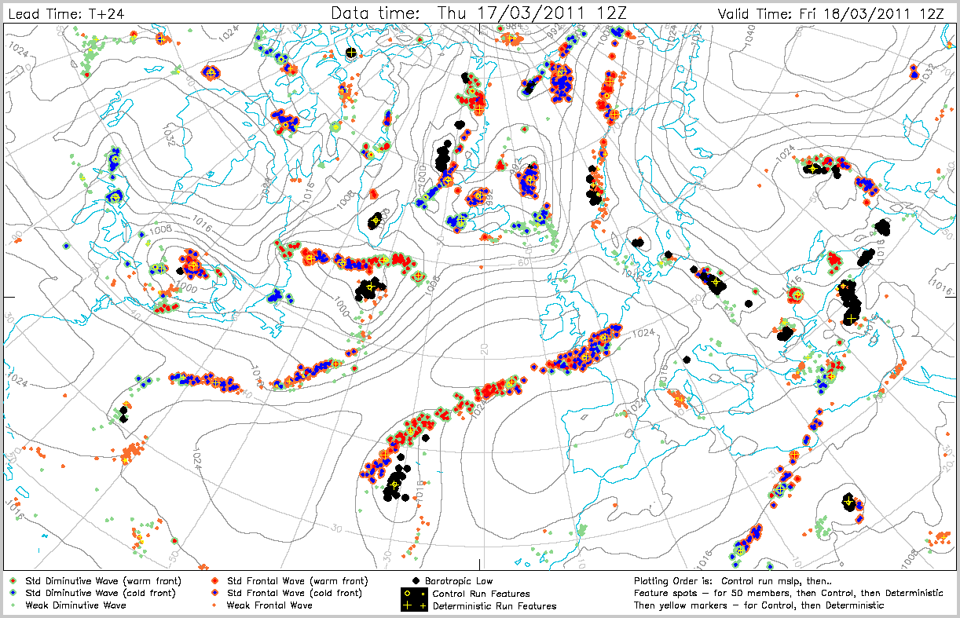

Slide 46
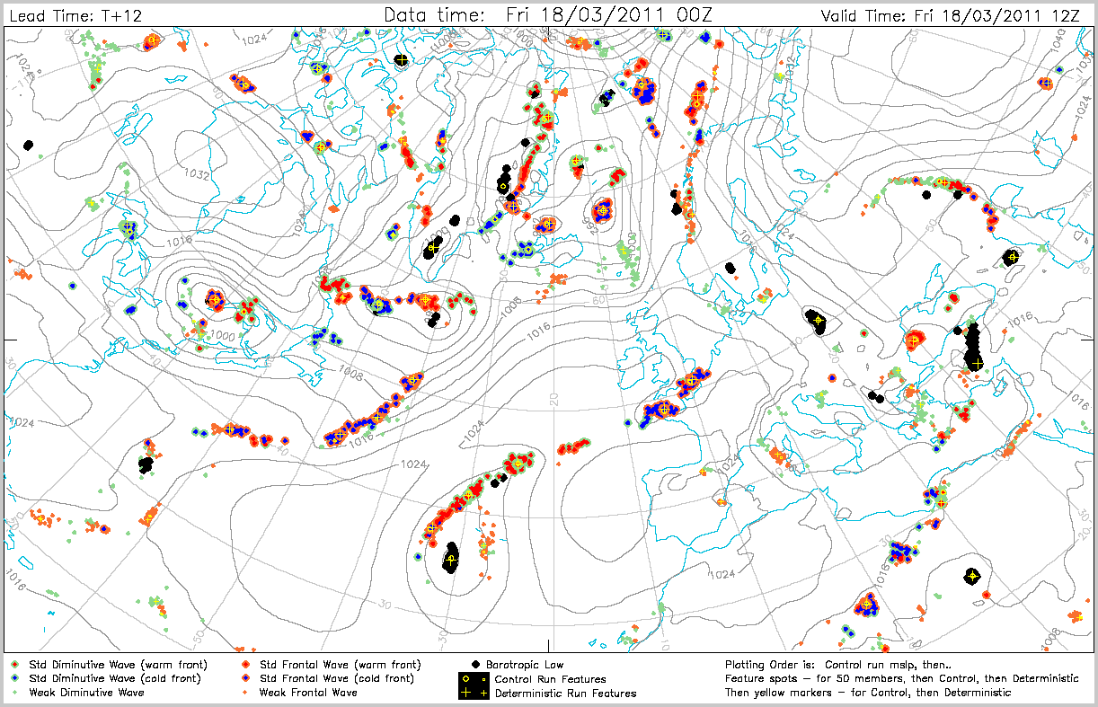

Slide 47
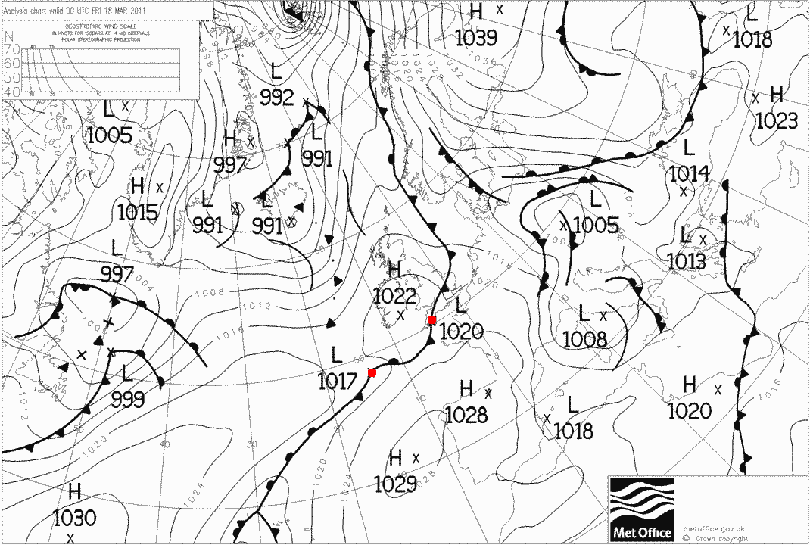

Slide 48
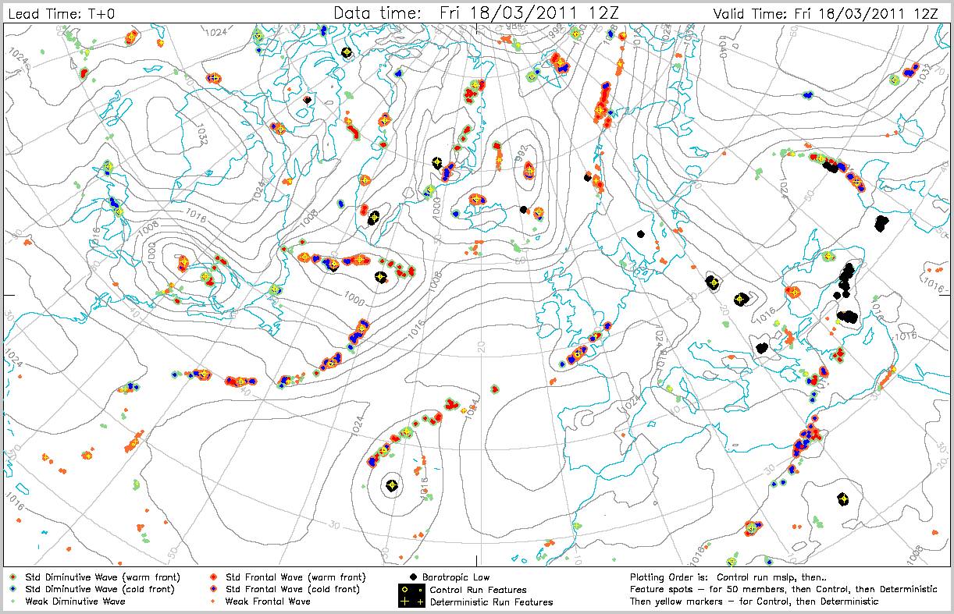

Slide 49
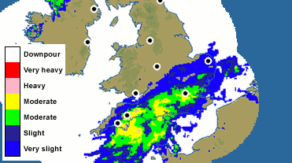
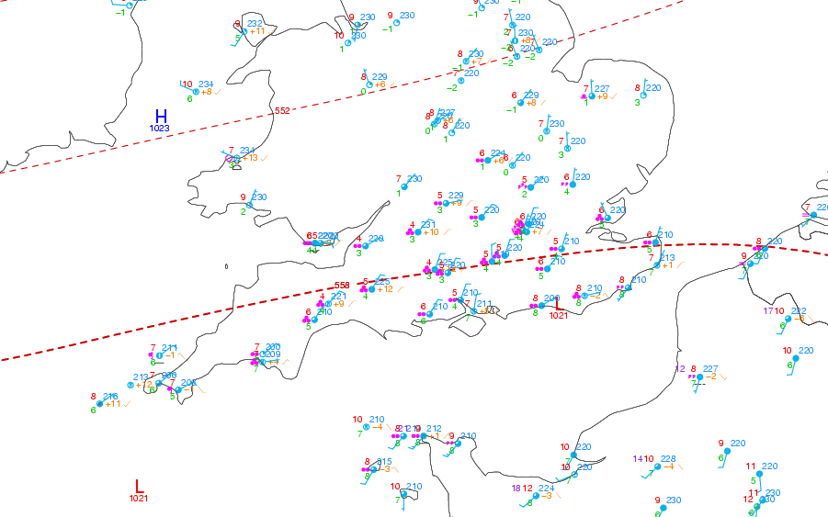
18 Mar 2011:
1130UTC radar
12UTC synops

Slide 50
What does this teach us ?
Frontal waves are a critical forecasting problem
Considerable care is needed in wording forecasts even at day 2 and 3 – regional details (eg ‘rain in S England’) are very likely to be wrong, more vague wording better (e.g. ‘risk of rain in the S of the UK’)
The deterministic forecast can be an outlier at short range; on average, in such cases, it will probably be better to adjust towards the ensemble signal. Dalmatian plot provides an instant reference point for the representivity of the deterministic (and control) forecasts.
There is uncertainty in small scale feature positions even at analysis time, especially in data sparse regions. Uncertainty primarily concerns position on the front. The T+0 front positions themselves are more certain.
There may be potential to ‘narrow a pdf’ using a principal of interactive EPS member selection – e.g. by deselecting those members portraying a pattern that departs from current observational evidence (eg at T+0 / T+12)

Slide 51
2.7 Verification of cyclonic features

Slide 52
Some Verification Details
Mainly based on the trial version of the now operational higher resolution IFS (period = ~6 weeks from ~25 Nov 2009 to 5 Jan 2010).
Use tracks from successive analyses as ‘truth’
We compare the Deterministic, the Control, a randomly selected EPS member (no 25) and the Ensemble feature mean
“Ensemble feature mean” – what is this?
  It is the centre of gravity point of feature points recognised in the EPS members.
  It is NOT based on features identified from the ensemble mean fields themselves; that would not work as these are highly smoothed fields
  For inclusion in statistics we require that a specific feature persists in 5 or more members
    At longer leads therefore the sample size for this category tends to be much larger than for the other 3 categories

Slide 53
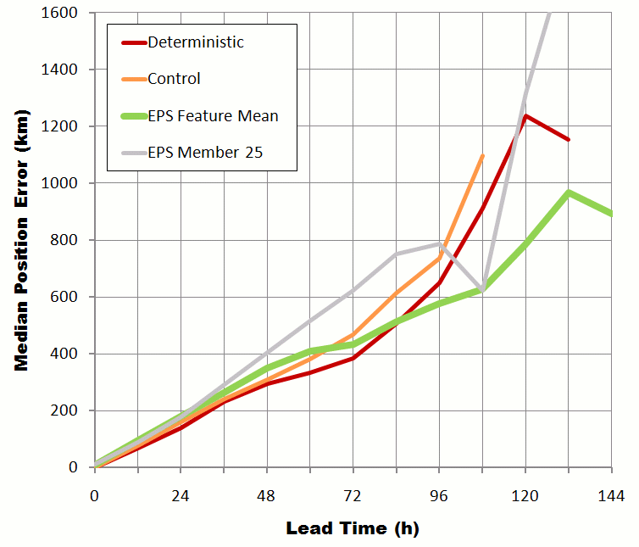
Position error

Slide 54
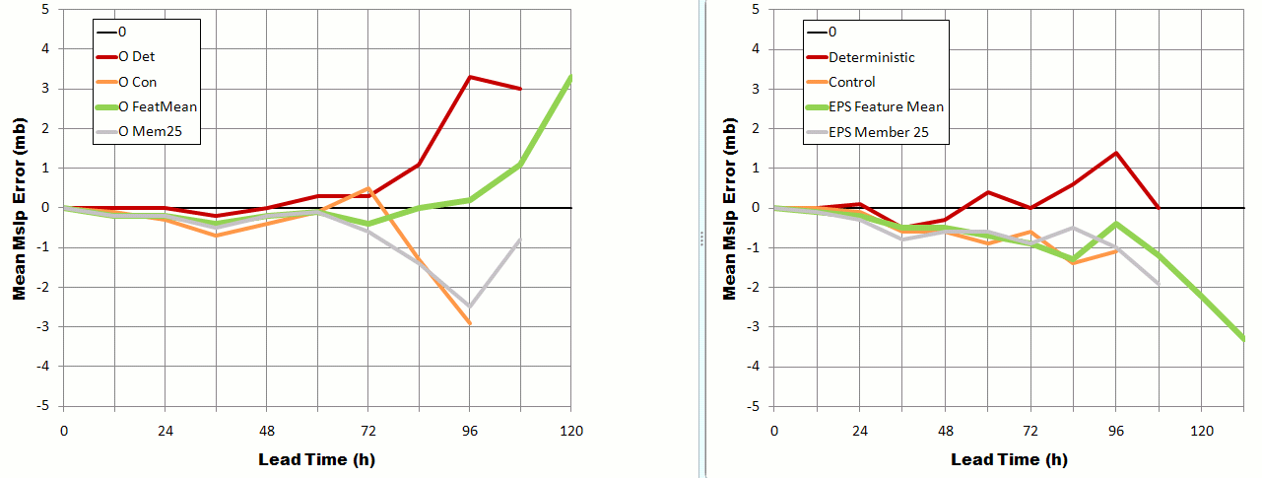
Bias in Mslp at feature point
Old Lo-Res
New Hi-Res

Slide 55
3. Forecasting Extreme Weather :
The Extreme Forecast Index (or ‘EFI’)

Slide 56
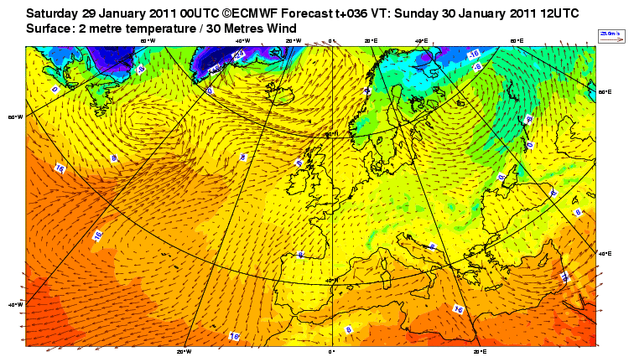
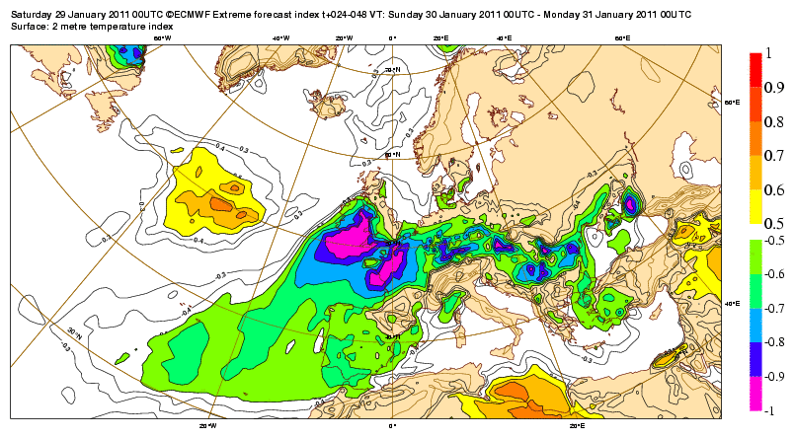
A recent EFI for Europe
For mean 2m Temp, for 00-24UTC Sunday (30 Jan 2011), from DT 00UTC Sat 29 Jan 2011

Slide 57
3. The Extreme Forecast Index (EFI)
3.1 Overview
3.2 The Model Climate (‘M-Climate’)
3.3 Computing the EFI
3.4 Operational EFI-related products, and how to use them
3.5 EFI Verification

Slide 58
3.1 Overview: How can we forecast ‘extreme weather’ ?
What can be used to define ‘extreme’, right across the globe ?
Particular Thresholds ? NO
Return Periods ? Effectively YES. Highly relevant because infrastructure (transport, buildings, etc) is commonly based on the return-period concept. In part warnings relate to resilience of infrastructure.
So we need reference threshold levels, for each weather parameter of interest, everywhere across the globe
Return Periods from observational data are not available everywhere
However global model forecasts provide output everywhere
Therefore global model forecasts can be used to provide the climatology from which to extract Return-Period-type information
Hindcasts are performed each time a model is upgraded, to provide the relevant climatology – some resolution-related imperfections, but overall a very useful dataset
This forms the basis for the EFI, or ‘Extreme Forecast Index’, whereby, for each gridpoint, the range of solutions (pdf) from the current ensemble, is compared with that gridpoint’s climatology from the hindcast data, to see how extreme these solutions are

Slide 59
Extreme Forecast Index (EFI)
The EFI is defined using Cumulative Distribution Functions (CDFs). The ‘rarity’ of the EPS forecast is determined by the position and shape of such distributions.
CDF’s can be constructed by extracting the value of the parameter (eg temperature at a given time) from each ensemble member, putting them in order (=rank), then plotting…
0 7 9 11 12 13….
12 0 9 7 13 11….
model climate
1 2 3 4 5 6…
eps forecast
CDF
PDF
1
1
Probability
of not
exceeding
Threshold
=RANK of
data
Density
per
threshold
Interval
(normalised)
6
5
4
3
2
0
0
1
-10
-5
0
5
10
15
20
25
-10
-5
0
5
10
15
20
25
parameter value
parameter value

Slide 60
How do CDFs and PDFs relate ?
CDF
PDF (probability density function)
Prob (threshold)
Prob (interval)
Parameter value
Parameter value
The PDF (y-axis) value equals the slope of the CDF
Steeper CDF = narrower PDF = higher confidence
A step in the CDF means a bimodal PDF

Slide 61
3.2 The reference EPS Model Climate
For climate related products like the EFI a reliable model climate is essential
Ideally the model climate is a large set of EPS re-forecasts with the latest model configuration (used operationally) for a long enough period (e.g. 30 years)
The current EPS model climate:
  Comes from a full EPS re-forecast suite with 4 EPS members and the Control
  Is always for the last 18 years, with initial conditions taken from ERA-Interim (a high resolution successor to ERA-40).
  Currently runs every Thursday; re-forecasts go out to 32 days
  Uses latest model cycle (resolution/ physics / etc.)
  Allows immediate adaptation of EFI to any EPS model upgrade
  To increase sample size five consecutive Thursday re-runs are combined

Slide 62
Schematic of the EPS M-Climate (for forecasts from ~13 Mar)
 | FEBRUARY |  |  |  |  |  | MARCH
 | 24 | 25 | 26 | 27 | 28 | 29 | 1 | 2 | 3 | 4 | 5 | 6 | 7 | 8 | 9 | 10 | 11 | 12 | 13 | 14 | 15 | 16 | 17 | 18 | 19 | 20 | 21 | 22 | 23 | 24 | 25 | 26 | 27 | 28 | 29 | 30
1990
1991
1992
1993
1994
1995
1996
1997
1998
1999
2000
2001
2002
2003
2004
2005
2006
2007
 | APRIL
31 | 1 | 2 | 3 | 4 | 5
18
-15 days
+15 days
5
5
Goes into Day+1 climate
5
5
Goes into Day+6 climate
5
Sample the available re-forecasts from within ±15 days of the actual day, to create the M-Climate
The climate sample size is: 18 years * 5 members * 5 weekly runs = 450 re-forecast fields

Slide 63
Model Climate
We now call this the ‘M-Climate’, which has a specific meaning…
M-Climate means that it is a function of 3 factors:
  1. Location, clearly
  2. Time of year, to take account of seasonal variations
  3. Forecast lead time
    Forecast lead time factor is needed to cope with model drift (e.g. in tropical rainfall)

Slide 64
3.3 Computing the Extreme Forecast Index (EFI)
The EFI is defined on the basis of the Cumulative Distribution Functions (CDF). The abnormality level in the EPS is determined based on the position and shape of the distributions.
M-climate
CDF
eps forecast
PDF
1
1
Probability
of not
exceeding
Threshold
=RANK of
data
Density
per
threshold
Interval
(normalised)
0
0
-10
-5
0
5
10
15
20
25
-10
-5
0
5
10
15
20
25
parameter value
parameter value

Slide 65
1
Represented by pink
lines below
Retains weight at
extremes of M-climate
EFI takes no direct
account of any EPS
members beyond
M-climate max
Cumulative
1
M-climate
EPS
p
(rank/n) =
0.5
EFI
F_{f} (p)
-1 ≤ EFI ≤ 1
*100% gives
-100% ≤ EFI ≤ 100%
0

Slide 66
EFI example
SPS_{0.7} =

Slide 67
EFI example
Maximum of all 450 values in the M-Climate

Slide 68
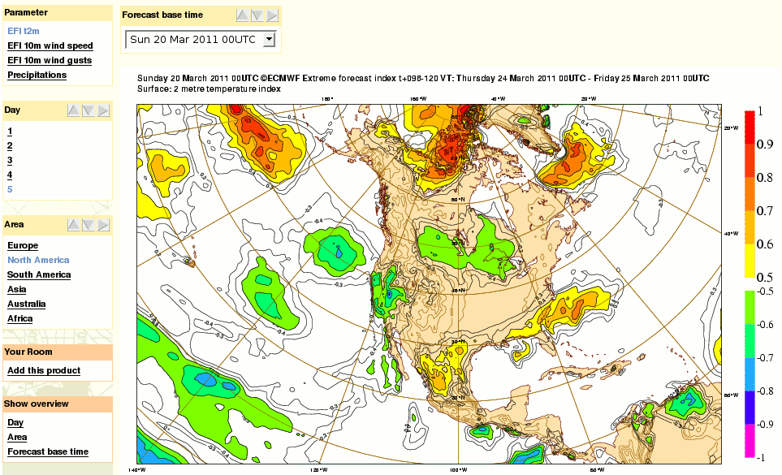
3.4 Operational EFI (web) products
Refer to either an accumulated value (e.g. precipitation), a mean over a period (e.g. temperature or mean wind) or an extremum (maximum or minimum) over that period (e.g. diagnosed wind gust).

Slide 69
Additional EFI-related products
As well as simple EFI map plots, we also provide other related ways of analysing EPS output, in order to:
Make greater use of the M-Climate
  Allowing user to visualise this in different formats
Address the problem of EPS forecasts lying beyond the M-Climate
  Directly compare the CDFs
Provide facility to inter-compare the handling by recent sets of EPS runs
  Site specific, with clickable-map user interface
The basis for each of the above is a composite ‘Anomalous Weather Chart’. This allows the user to see, at a glance, regions in the world that are susceptible to anomalous weather on a given day…

Slide 70
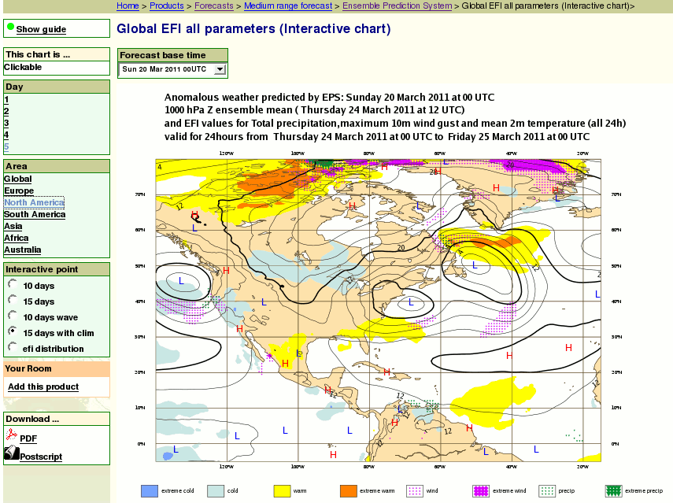
The ‘Anomalous Weather’ chart
EPS grid point data are accessible by clicking
Different displays are possible, e.g.
Standard EPSgrams
EPSgram versions with the model climate information
EPS and climate CDF curves with EFI information…
Click
anywhere
Temperature Wind Precipn

Slide 71
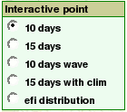
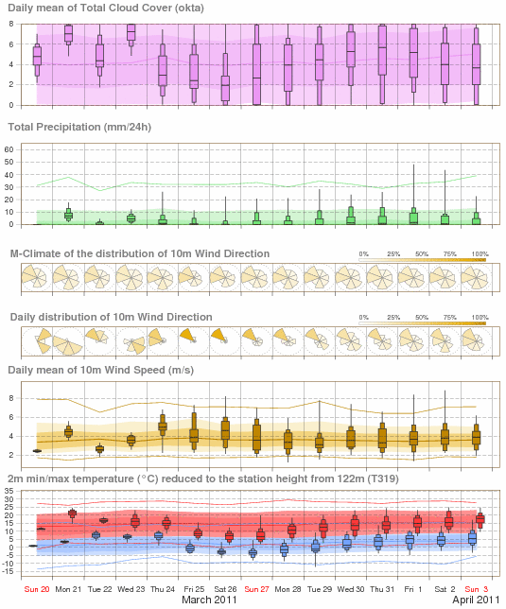

{
~ 1 in 100 day events
{

Slide 72
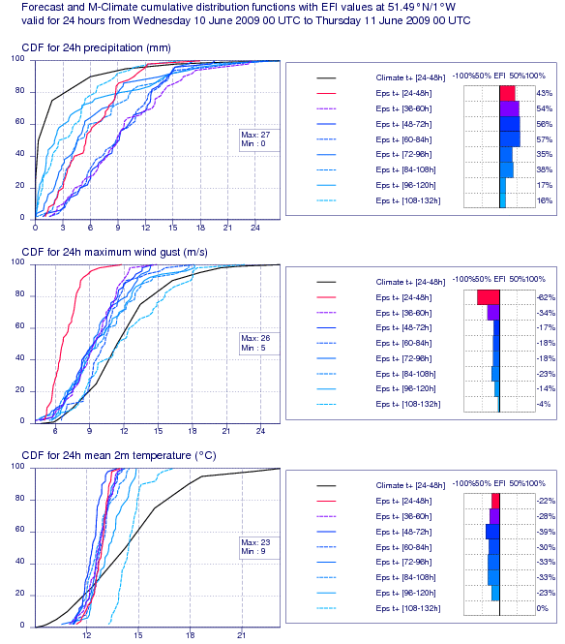

Example:
Reading on one day in June 2009
Y-axes = “probability to not exceed”
45% probability of >6mm (red line)
10% probability of >6mm on an average June day
The 15-year return period 24h rainfall for ~June is 27mm (M-climate). One old forecast had indicated a small risk of reaching this, but the latest forecast (in red) didn’t.
Steeper CDF slope on more recent forecasts signifies increasing confidence
Disadvantage: any model biases and drifts are not accounted for

Slide 73
How ‘should’ CDFs behave in successive EPS runs?
M-climate
rank
Successive
EPS runs
value
At long leads CDF may be similar to the M-climate
Lateral variations in CDF position between successive runs should, mostly, become less (with time)
CDF slope will tend to increase (with time), implying higher confidence
But there will of course be occasional counter-examples; for example an unlikely solution can suddenly become the most likely, or spread may stay large

Slide 74
Impact of ‘Dynamical Instability’
M-climate
rank
Two example
CDFs
parameter value
If there is large uncertainty in the rate of deepening of a cyclonic feature, and/or its track, this will be reflected by a relatively shallow (mean) slope in the CDFs for affected locations (especially wind and rain, but also temperature)
This ‘dynamical instability’ is relatively common in the lead up to extreme events
If track uncertainty is high a step is likely in the CDF (=bimodal PDF)
In all such cases EFI values will not be especially high, because they depend on behaviour of all the members
This is a weaker point of the EFI concept

Slide 75
3.5 EFI verification
ROC Area, based on European observations
(covers 6 years)
10m wind speed
2m temperature (warm)
24h precipitation

Slide 76
4. Plans for a High Resolution ensemble at the Met Office
Downscaling via nested high resolution (1.5km) runs has proved very valuable for certain meteorological issues, e.g.
  Orographic rainfall
  Marine convection moving inland (like lake-effect) – critical during snow events – eg Nov/Dec 2010
In Q1 of 2012 a high resolution ensemble is likely to be introduced
  12 High-res EPS members every 6 hours (resolution tapers to 2.2km from boundaries)
  BC’s from MOGREPS-R (regional “North Atlantic – European” ~12km)
  MOGREPS-R BC’s taken from MOGREPS-G (global, ~40km)
No internal perturbations at T+0, other than those contained in MOGREPS-R members
Post-processing to involve ‘neighbourhood methods’ to extract information on appropriate scales, followed by computation of probabilities etc…
Facility also for ‘Strategic Intervention’ to be invoked – chief forecaster may on occasion select what they view as the most appropriate member, to drive downstream products
Caveat - plans continue to evolve... (thanks to Ken Mylne and Nigel Roberts)

Slide 77
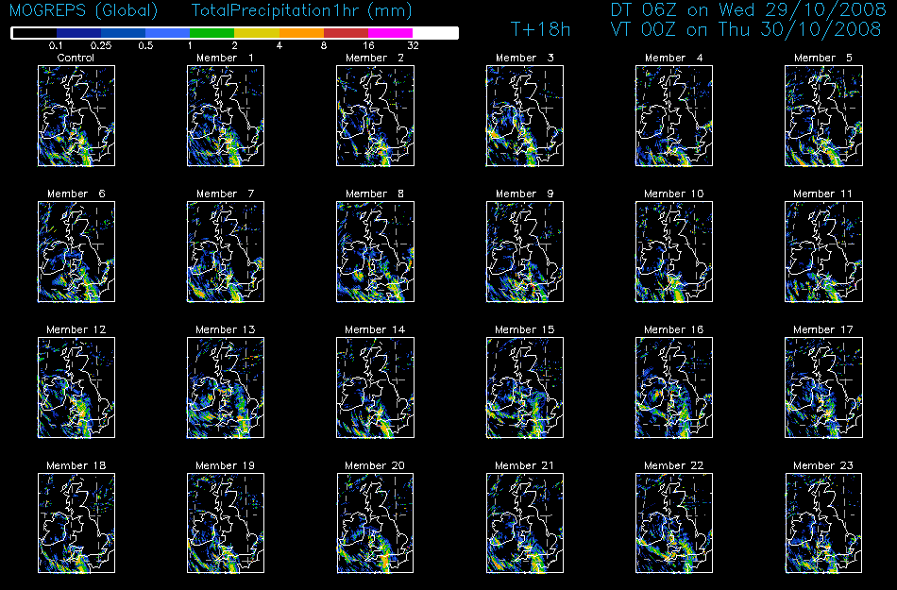
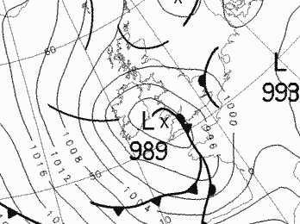
s
Phenomenal
Hailstorm
(km scale)
00Z 30 Oct 2009

Slide 78
Summary
Forecasters are required to manage ever-increasing data volumes that ensembles provide
New products have been introduced to get the best out of this data – these focus on:
  Delivering synoptic-feature-based information (cyclone database)
  Placing EPS forecast distributions into a climatological context (EFI)
Products are very user-oriented; they ‘speak the language of forecasters’, are easy to use and navigate through, and have a very clear focus on adverse weather
Increasingly these various products are being used to good effect in forecasting in the UK, in Europe, and to a lesser extent in other parts of the world
The benefits of all this should be improved warning of severe weather, with resultant reductions in i) loss of life, ii) loss of infrastructure and iii) economic losses in general
The Met Office will be introducing a very high resolution ensemble next year – this has shown skill in highlighting low probabilities at short range for various extreme events that have occurred over the UK
Further reading: “Tracking fronts and extra-tropical cyclones” – ECMWF Newsletter, Autumn 2009, and the references at the end. This article can be freely downloaded from the ECMWF website.

Slide 79

All IFS / EPS Members at T+12 – Scotland snowstorm case

