Slide 1






Overview of decadal climate prediction using coupled climate model MIROC
November 16, 2011
EMC seminar@Maryland
Yoshimitsu Chikamoto
(AORI, University of Tokyo)
M. Kimoto, M. Watanabe, M. Mori, Y. Imada, S. Yasunaka (AORI, University of Tokyo)
M. Ishii (JAMSTEC / MRI, JMA)
T. Mochizuki, H. Tatebe, Y. Komuro, T. T. Sakamoto, T. Suzuki (JAMSTEC)
T. Nozawa, H. Shiogama (NIES)
Members of SPMA (System for Prediction and Assimilation by MIROC)
MIROC
Notes:
Before I talk about the decadal climate prediction, I will introduce the common question. Sometimes, my fried said to me. We can not forecast weather for next week. Why can we predict climate for next century such as global warming? In today’s presentation, I will start to this question.

Slide 2
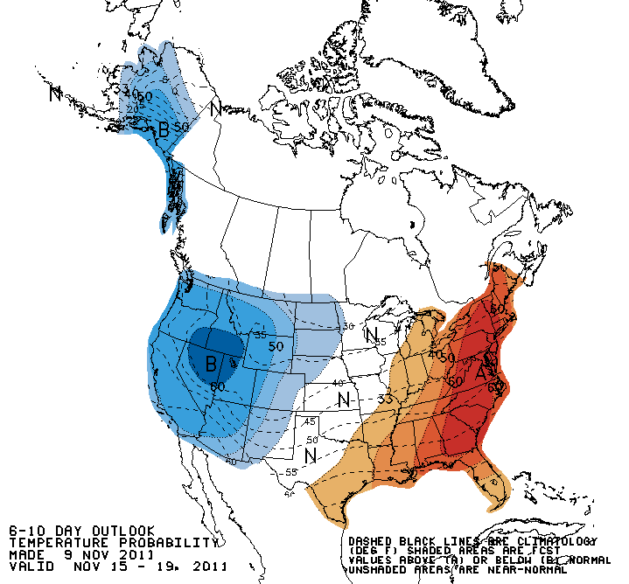

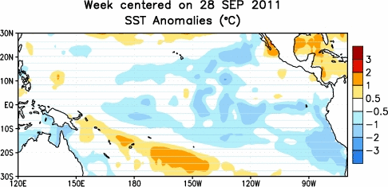
Initial vs Boundary value problem
High-frequency
Low-frequency
Trend
Uncertainty
Initial value
Boundary value
Based on
Hawkins and Sutton (2008)
1mon 1yr 10yr 100yr
Time scale
Weather forecast
Global warming
Decadal prediction
Notes:
Weather is a high-frequency atmospheric variability on timescales less than 1 month. Predictive skill of weather depends on the initial atmospheric states. So weather forecast is known as the initial value problem.
Global warming signal is a trend on a century timescales. This trend depends on external forcing such as greenhouse gas and aerosol concentrations, solar variability, and volcanic activity. Simulation of the trend by climate model is known as the boundary value problem.
Uncertainty on shorter timescales mainly depends on initial value while uncertainty on century timescales depends on boundary value.
This is the reason why we can simulate the climate for coming century.
However, many people does not care about the climate for next century. People or decision makers want to know the regional climate change for next decade not the next century.
To answer this question, we need to perform decadal climate prediction.
The decadal climate variability locates on this timescales. In this timescales, low-frequency phenomena associated with ocean temperature variability is important. On this timescale, we need to take care about not only initial value problem but also boundary value problem. If we succeed in decadal climate prediction, we can theoretically perform seamless prediction from weather forecast to climate simulation. In the next slide, we will see how decadal climate prediction is performed.

Slide 3
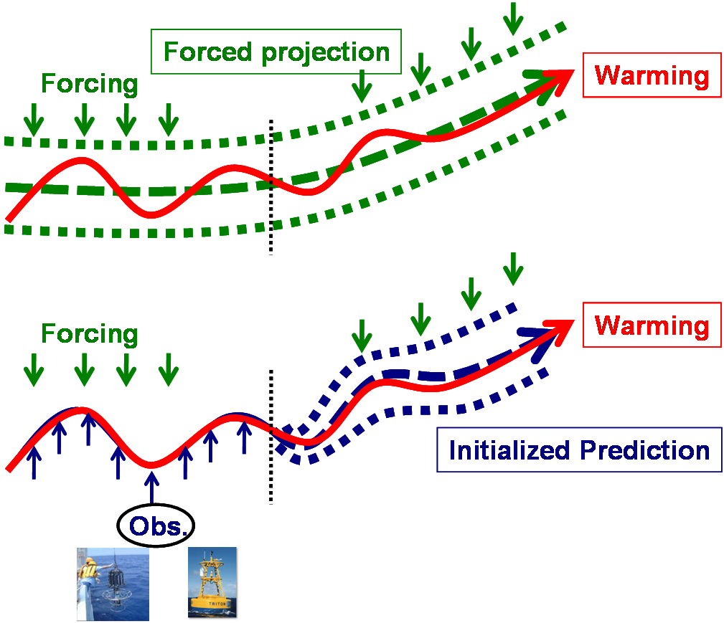
A strategy for decadal climate prediction
External forcing
External forcing
+
Internal variability
Notes:
This is the schematics of the decadal climate prediction. As we have seen in the previous slide, global warming signals are simulated by prescribing the external forcing into the climate model like this. In this simulation, model can capture the warming trend but not the internally generated variability.
To predict the internally generated variability as well as the externally forced variation, observation is incorporated into the climate model. In terms of decadal climate prediction, ocean temperature variability would be important. So oceanic observational data is assimilated into the coupled climate model like this. From this assimilation, we obtain the initial condition, and then perform the decadal climate prediction. As a result, we expect that the initialized prediction capture bath of externally forced and internally generated variations.
Based on this strategy we performed the hindcast experiment.

Slide 4
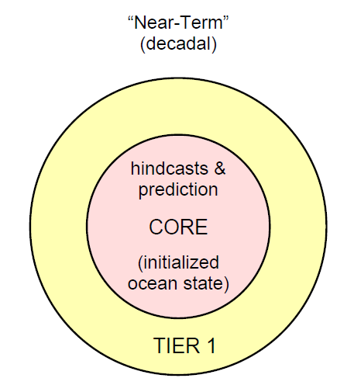

CMIP5 Experimental Design
1960
70
80
90
2000
10
20
30
Year
HCST
Hindcast/Prediction
CORE exp.
Volcano OFF／ON
Data Assimilation
20C3M
RCP4.5
NoAS
Taylor et al. (2008)
5000-Year Integration
for 10 member ensemble,
Notes:
4
4
This is the experimental design proposed by CMIP5 protocol.
To examine the impact of initialization, we need to perform the uninitialized run names as 20th century simulation or NoAS experiment.
And the we perform the data assimilation experiment,
Based on the assimilation experiment, we obtain the initial condition, and the perform the hindcast experiment started from 1960 to 2010 by every 5 years.
These hindcast experiments have 10-year-long prediction.
When we perform the hindcast experiment in this experimental design, there are two big problems.

Slide 5

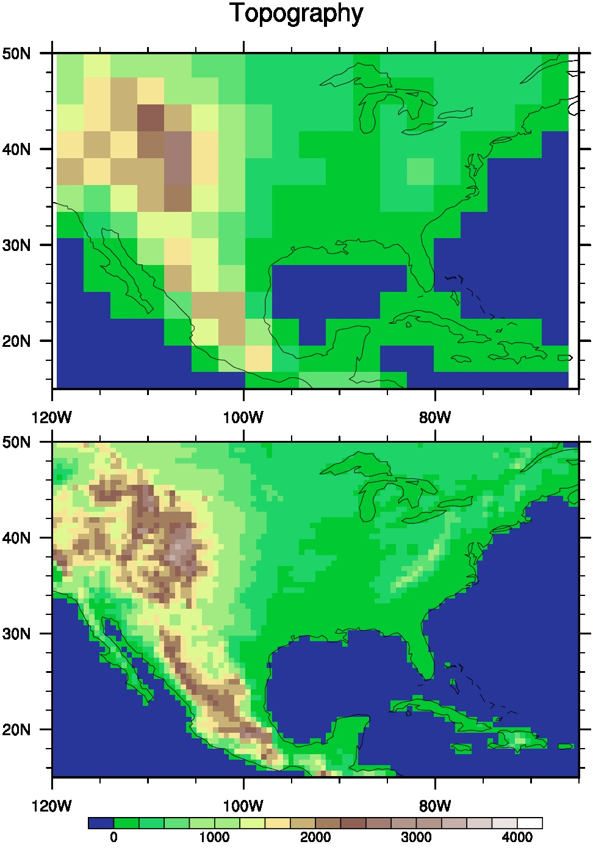
Our computational resources are limited
Limited Resources
Model
Initialization
Ensemble
Simple
Small
Low
Large
EnKF
Hi
Notes:
As you know, our computational resources are limited. So we need to decide how much do our resources spend on. In terms of the computational resources, there are three factors. First one is the model resolution.
When we increases model resolution, we need much computational cost. So a number of ensemble members becomes small. In the decadal climate prediction, computational cost also depends on the initialization method. In our assimilation system, we use simple method like nudging.

Slide 6
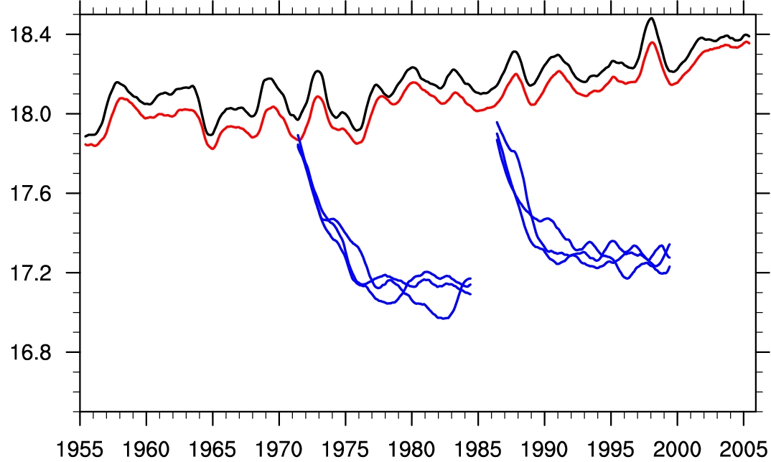
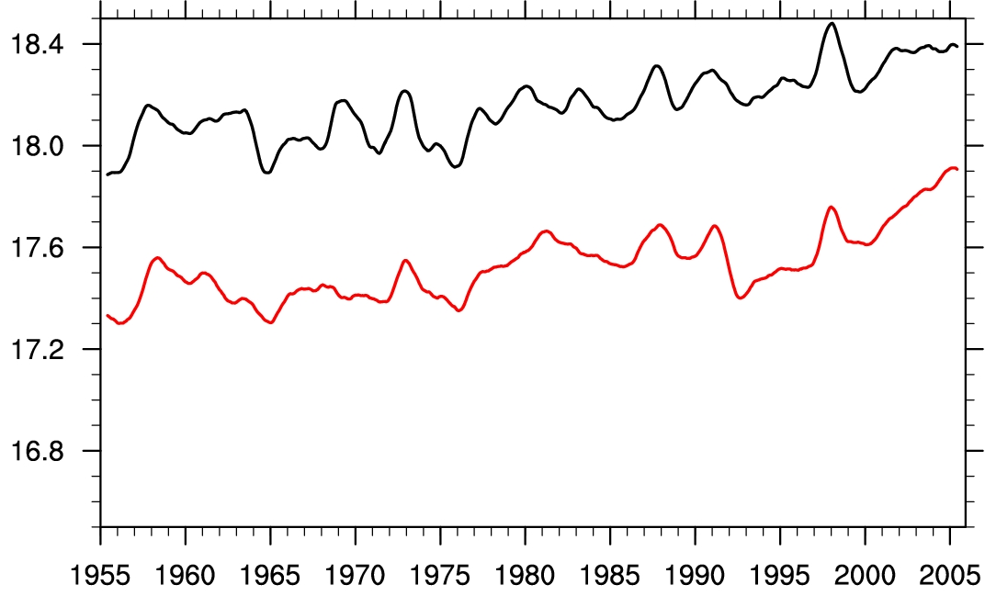
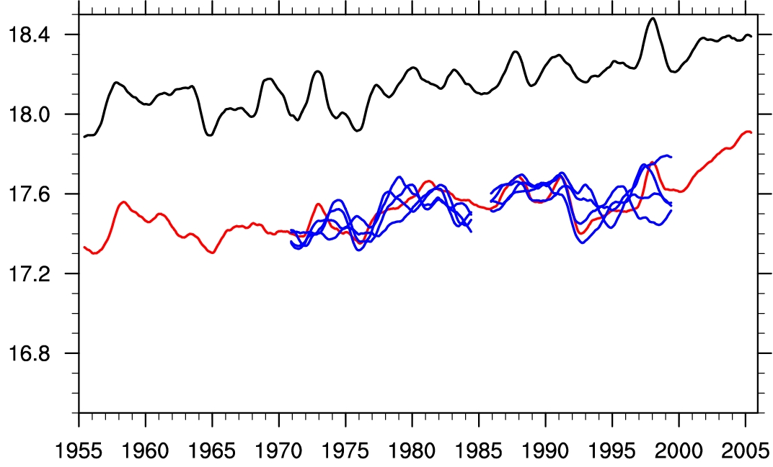


Assimilation: anomaly vs full fields
Full field assimilation
Anomaly assimilation
OBS
ASSM
Notes:
Another problem is assimilation method. In the weather forecast, we try to obtain an initial condition close to the true state. This figure shows the globally averaged SST in observation and assimilation obtained by full field assimilation. From the assimilation, we obtain initial condition and then perform predictions. Unfortunately, model shows a significant drift during prediction.
To reduce the model climate drift during prediction, anomaly assimilation is effective. In the anomaly assimilation, model climatology retains but observed anomaly is assimilated into the model anomaly. That is, model climatology plus observed anomalies are assimilated into the model. As a result, climatology between observation and assimilation is different like this while observed temporal variation is well captured by assimilation.

Slide 7
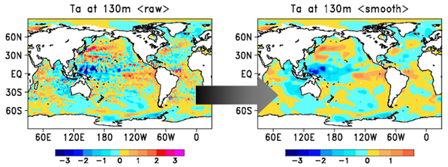
Near-term climate prediction by MIROC
 | MIROC3m | MIROC4h | MIROC5
Atm. | 300km | 60km | 155 km
Ocn. | 1.4º x 0.5-1.4º | 0.28º x 0.19º | 1.4º x 0.5-1.4º
Forcing | CMIP3/SRESA1B | CMIP5/RCP45 | CMIP5/RCP45
Initialization | Ocn.T/S IAU (0～700m) | Ocn. T/S IAU (0～3000m) | Ocn. T/S IAU (0～3000m)
Members | MIROC3m | MIROC4h | MIROC5
NoAS | 10 | 3 | 3
Assimilation | 10 | 1 | 2
HCST | 10 | 3 | 6
Tatebe et al. (2011)
Notes:
This is the summary of our decadal climate prediction.
MIROC3m is the low resolution model. So we performed 10-member ensemble simulation in NoAS experiment that is uninitialized runs. Based on the NoAS experiment, we obtain the model climatology, and then perform the anomaly assimilation experiment with 10-members.
MIROC4h is the high resolution model, and have small number of ensemble members. MIROC4h can resolve ocean eddy. When we calculate analysis increment, assimilation acts to destroy the eddy represented like this. We want to retain the eddy in high-resolution model. So large scale analysis increment like this pattern is assimilated in MIROC4h.
These three models have different characteristics particularly ENSO behavior.

Slide 8
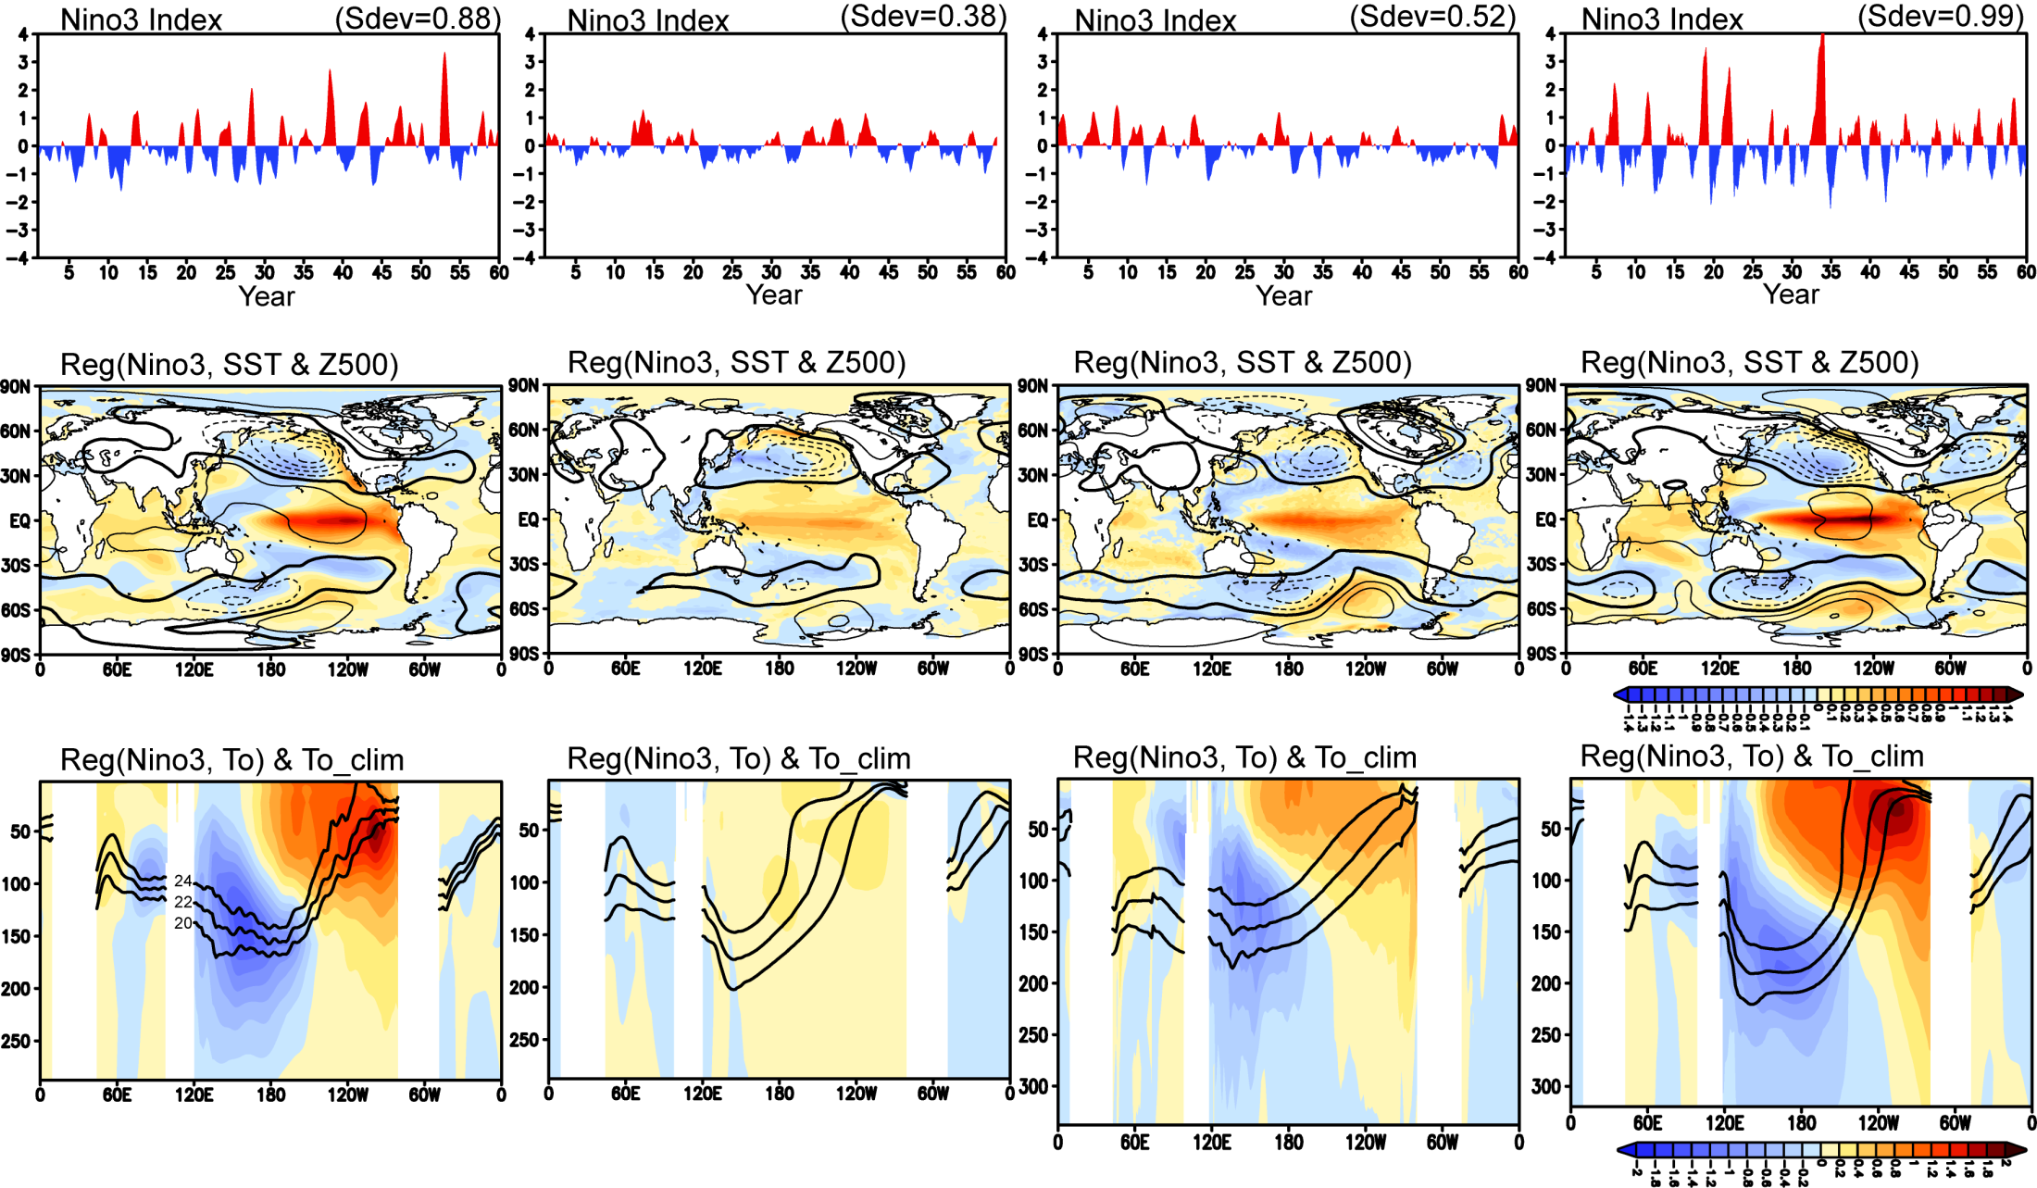
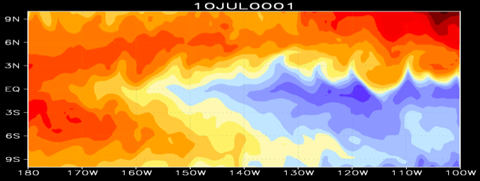
Observed and modeled ENSO
Observation
MIROC3m (T42)
MIROC4h (T213)
MIROC5 (T85)
Imada and Kimoto (2010)
Sakamoto et al. (2011)
Notes:
8

Slide 9
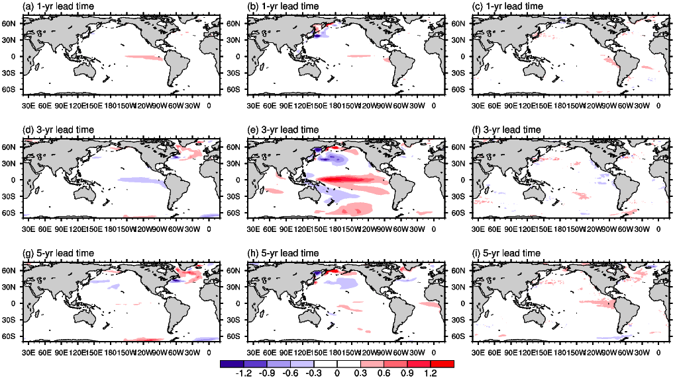
Model drift during prediction (SST)
MIROC3m MIROC4h MIROC5
1yr
3yr
5yr

Slide 10
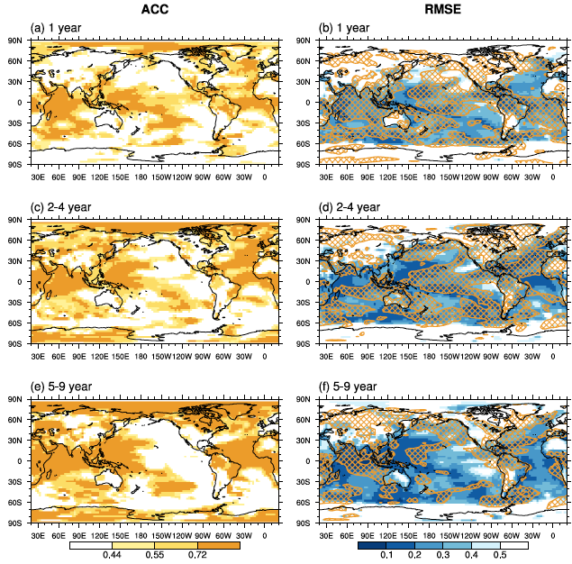
Predictive skill maps of SAT
ACC
RMSE
1 yr
2-4 yr
5-9 yr
Orange hatching:
Impact of initialization
Notes:
This figure shows predictive skill maps of SAT. Left panels are anomaly correlation coefficient and right panels are RMSE. Orange hatching is the region where RMSE in the HCST experiment is less than that in the NoAS experiment. So orange hatching indicates the impact of initialization.
Since we do not assimilate the atmospheric field, main predictable region is over the ocean: Indian ocean, western Pacific, and North Atlantic.
For 1-year and 2-4 year lead times, orange hatching extends the almost entire globe. After 5-year lead time, orange hatching region have shrinked.
This result suggests that the initialization contributes to enhance the predictive skill of SAT anomalies for initial several years while its impacts become unclear afterward in our current hindcast system.
Despite the fact that the model climate is still imperfect to represent the observational climate state, our results in a grid-to-grid comparison imply that some regional climate changes are predictable in our multi-model ensemble.

Slide 11
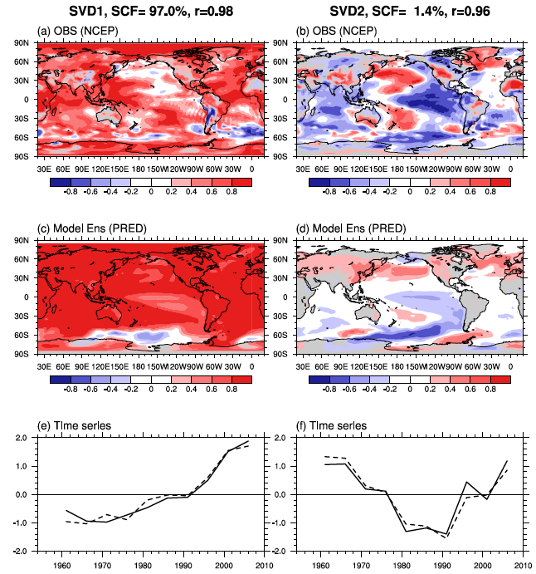
SVD analysis of SAT: OBS vs HCST
SVD1: SCF=97%
SVD2: SCF=1.4%
OBS
(NCEP)
HCST: 1-3yr
(mulit-model)
(Mochizuki et al. 2011)
Notes:
To take care about the model deficiencies, we perform the SVD analysis of SAT between the HCST experiment and observation.

Slide 12
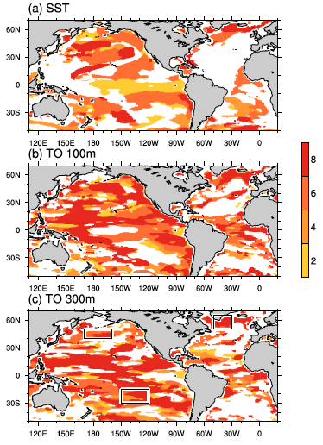
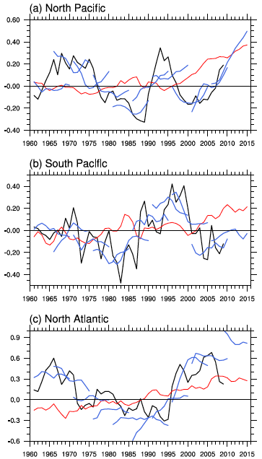
Predictive years in ocean temperature
North Atlantic
SST
(year)
OBS
HCST
NoAS
TO@100m
North Pacific
TO@300m
South Pacific
Notes:
When we focus on subsurface temperature anomalies, predictability becomes longer than the surface.
This figure is the predictable years of 3-year-mean temperature anomalies at surface, 100-m, and 300-m depth.
In this figure, predictable year is estimated by anomaly correlation coefficient at the 95% significant levels and we draw the region where initialization is effective.
Overall, ocean temperature anomalies extends the predictable area and years with depth.
Although ocean temperature variability near the sea surface is affected by high-frequency atmospheric variability, the long-term predictable memory associated with the slow ocean variability would be stored in the subsurface ocean.

Slide 13
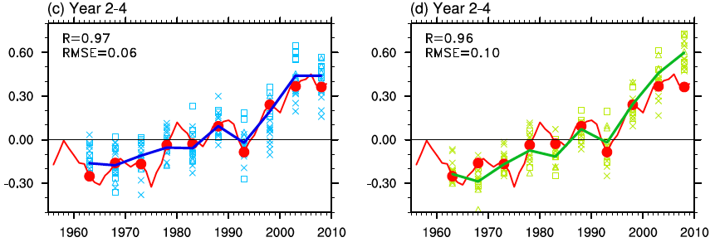
Global mean temperature
HCST
NoAS
OBS
MIROC3m
MIROC4h
MIROC5
OBS
HCST
NoAS

Slide 14
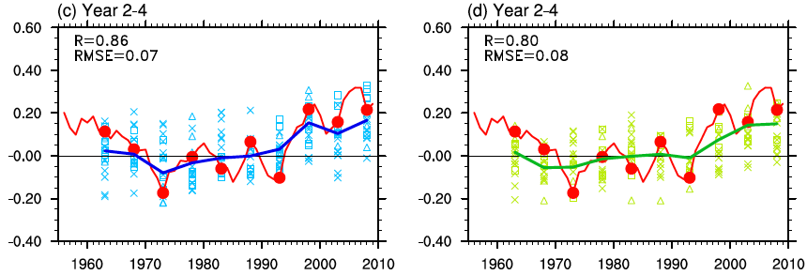
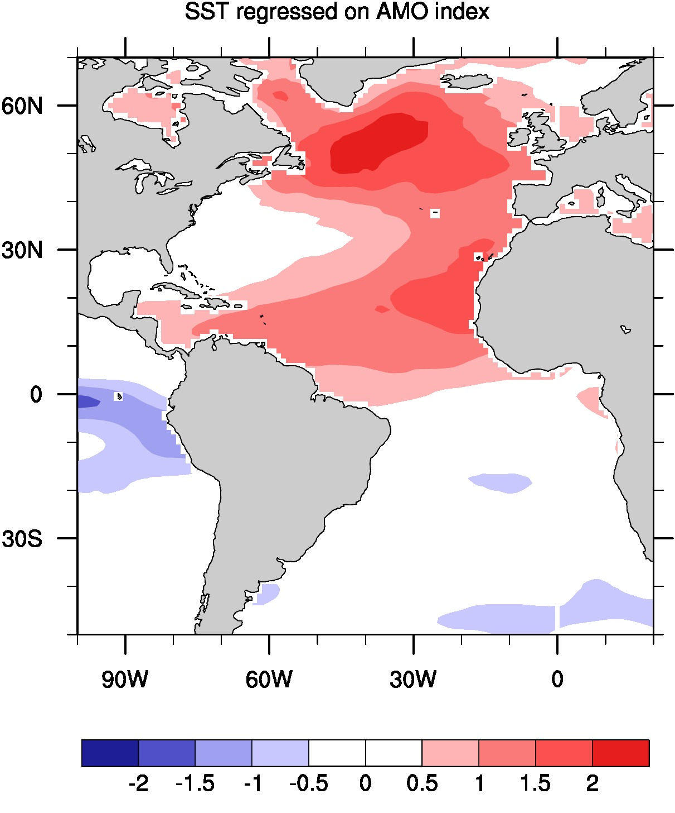
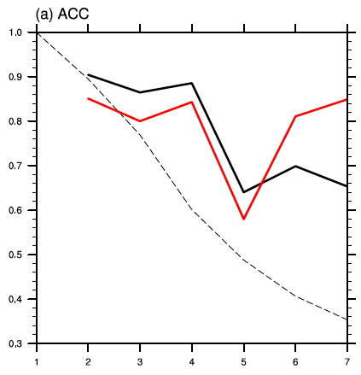
Atlantic Multidecadal Oscillation (AMO)
HCST
NoAS
ACC skill
HCST
OBS
MIROC3m
MIROC4h
MIROC5
OBS
NoAS
HCST
NoAS
0.65
Persistence
Based on Trenberth and Shea (2006)
5 yr

Slide 15
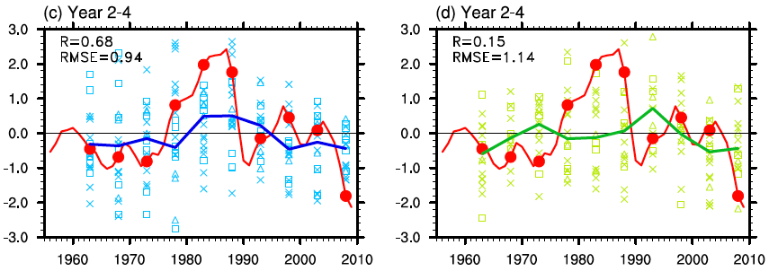
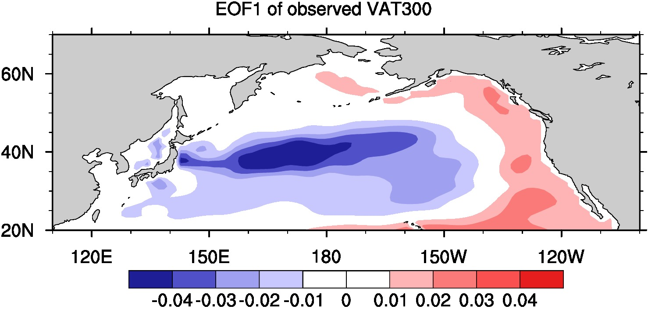
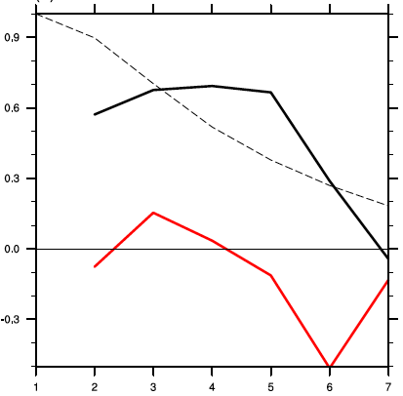
Pacific Decadal Oscillation (PDO)
HCST
NoAS
ACC skill
OBS
MIROC3m
MIROC4h
MIROC5
HCST
0.65
OBS
HCST
Persistence
NoAS
NoAS
5 yr

Slide 16
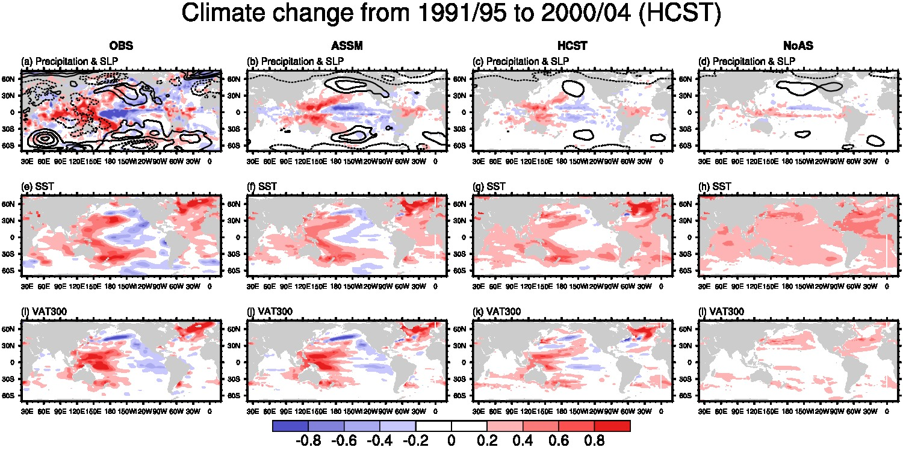

Climate shift during the late 1990s
HCST
OBS
NoAS
Pr & SLP
SST
VAT300

Slide 17

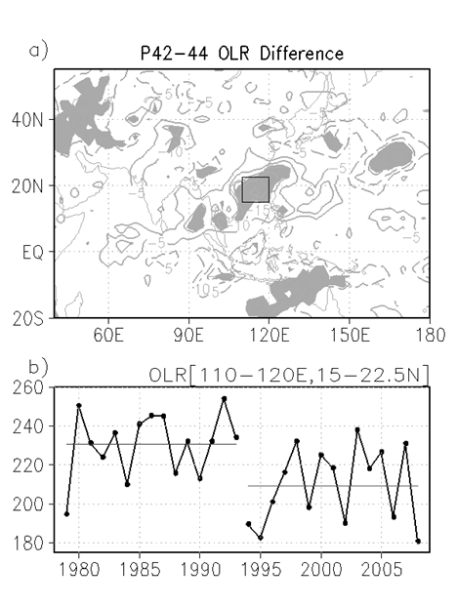
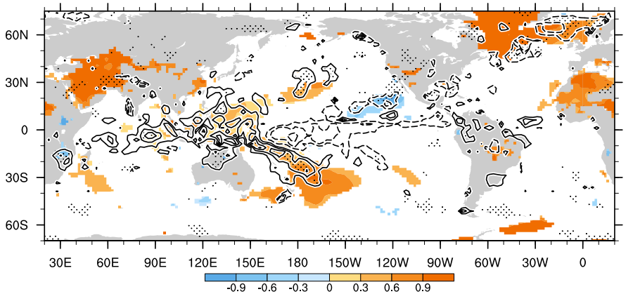
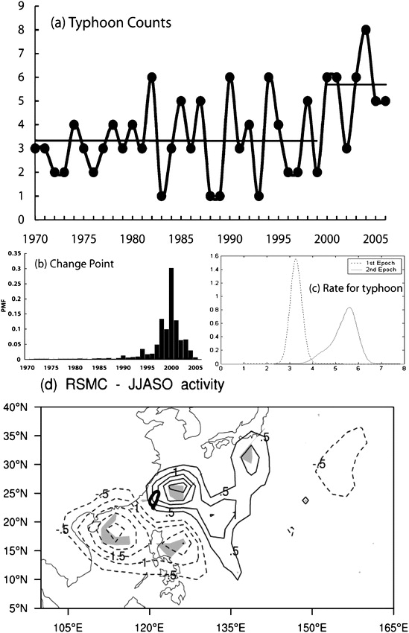
Observed climate shift in the late 1990s
Minobe (2002)
Observed temperature and precipitation shifts
Kim et al, (2010)
TC regime shift
Tu et al. (2009)
Tatebe and Yasuda (2005)

Slide 18
Summary
We have performed decadal climate prediction in three versions of MIROC.
Most predictable component of SAT is externally-forced variation while initialization contributes to improve predictive skills in the subsurface ocean.
Our hindcast experiments show that reasonable predictive skills for several years are obtained in AMO, PDO and climate shift during the late 1990s.

