Slide 1
42 Years in Meteorology
VIVA LA REVOLUCION!
Glenn White
gw15911@gmail.com

Slide 2
An earlier, perhaps greater revolution…
The Weather Experiment: The Pioneers Who Sought to See the Future by Peter Moore
Telegraph invented-led to daily weather analyses
--Joseph Henry, Smithsonian 1858
After the wreck of the Royal Charter in a terrible storm in 1859, Robert Fitzroy wrote : “Man cannot still the raging of the wind, but he can predict it. He cannot appease the storm, but he can escape its violence…”
He was funded to produce analyses of oceanic winds from ship reports. Four people produced storm warnings and short range forecasts based on daily weather analysis from telegraph reports six days a week.

Slide 3
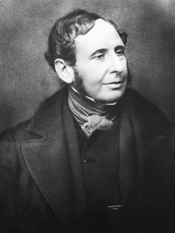
After his suicide, review committee found little value in his warnings and forecasts and recommended ending them.
After further scientific review supported Fitzroy’s work and due to popular demand for warnings and forecasts, they were eventually resumed.
we were like dwarfs seated on the shoulders of giants. If we see more and further than they, it is not due to our own clear eyes or tall bodies, but because we are raised on high and upborne by their gigantic bigness.—Bernard of Chartes (12th century)

Slide 4
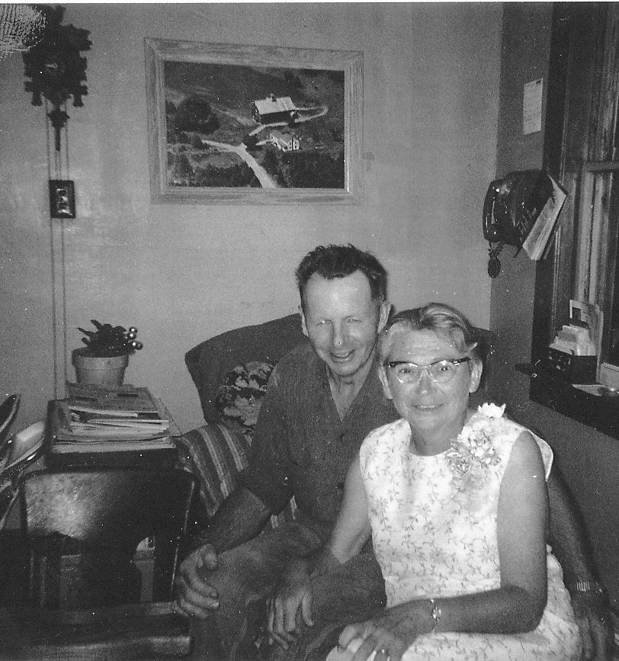
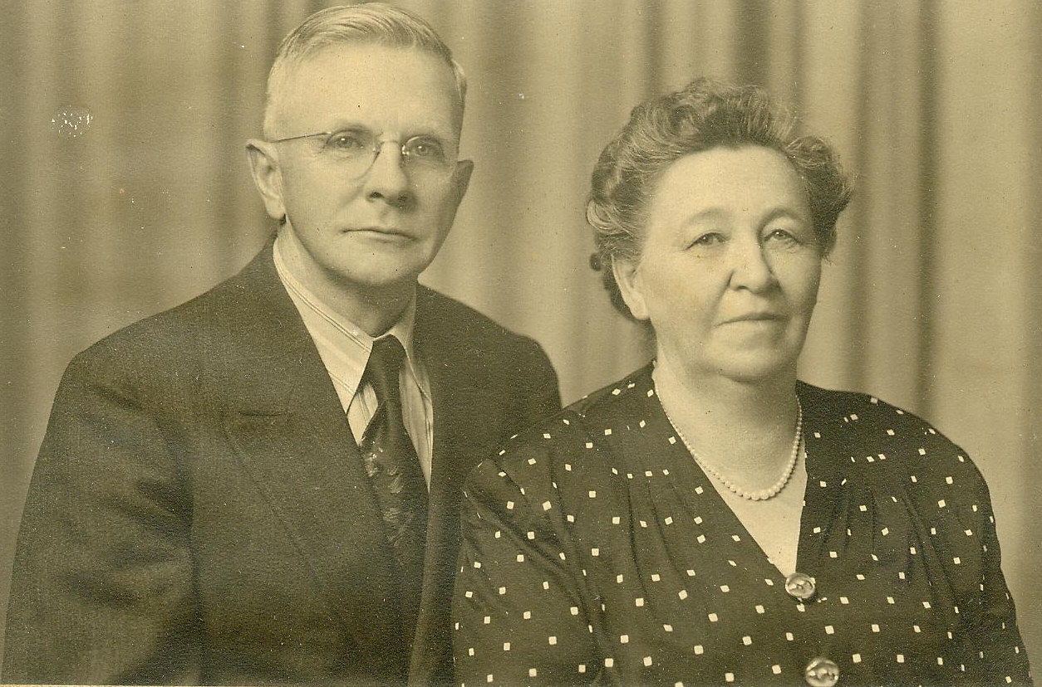
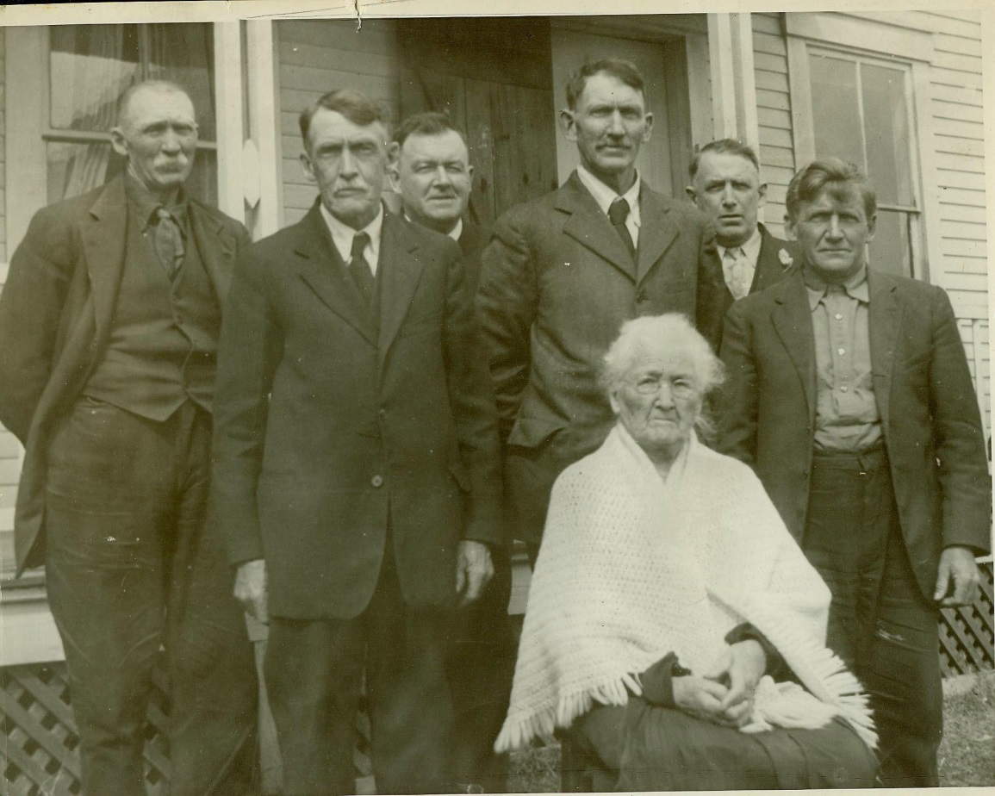
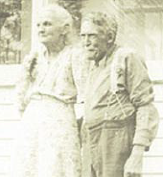
Some of
my giants

Slide 5
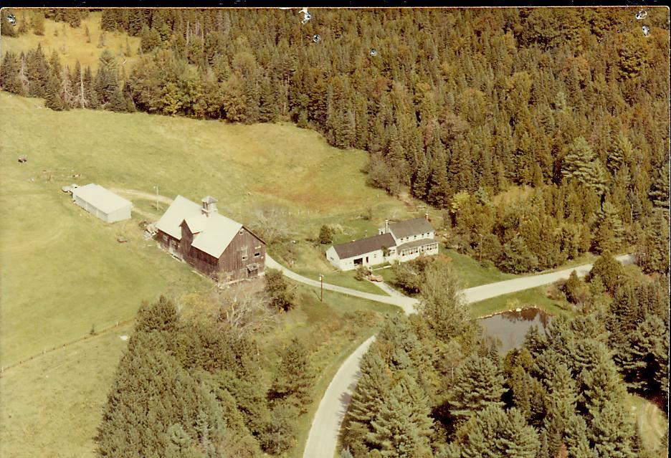
42 years in meteorology—beats milking cows for a living
Growing up on a dairy farm --GREAT
Living on a dairy--GREAT
Milking cows for a living—HARD WORK

Slide 6
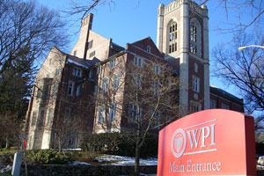
Rejected by MIT, went to Worcester Polytechnic Institute
BS Physics 1971
fellow alumni John Ward, Dick Reynolds, Jason Tuell
Spring break, freshman year 1968—Martin Luther King assassinated
urban riots
Vietnam and the draft
I wrote a term paper “Why I am an optimist”
turned out to be a great forecast

Slide 7
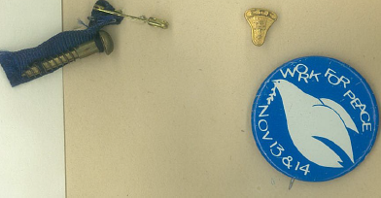
WPI President Hazard—”I hope you have fun.”
Not the best time to concentrate on physics

Slide 8
Entered WPI in fall 1967 all male
Fall 1968 two women admitted
Senior year—About 50 women
Now 34%

Slide 9

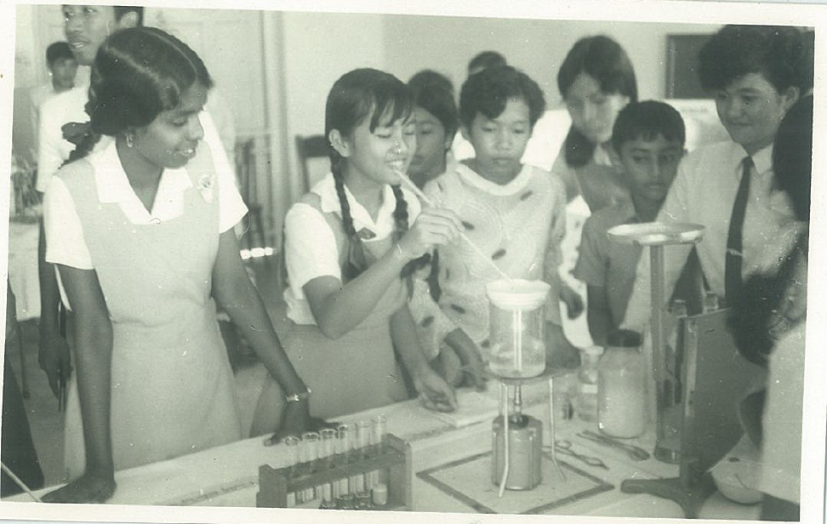
Joined the Peace Corps
Taught secondary school in Seremban, West Malaysia for 2 years
West Malaysia—three fascinating cultures-Malay, Chinese, Indian
Three stages of being a Peace Corps Volunteer:
This is so different—it’s great!
This is so different-it’s horrible!
It’s really not that different.

Slide 10
Wanted to apply my math and science background to something useful that
I could get paid for—atmospheric science
1974—concern about Sahel drought
global food supply
climate change
My life has NOT been carefully planned,
more or less stumbled into great opportunities,
I have not always taken full advantage of them
“Call no man lucky until he is dead”—Chinese proverb
But so far so good

Slide 11
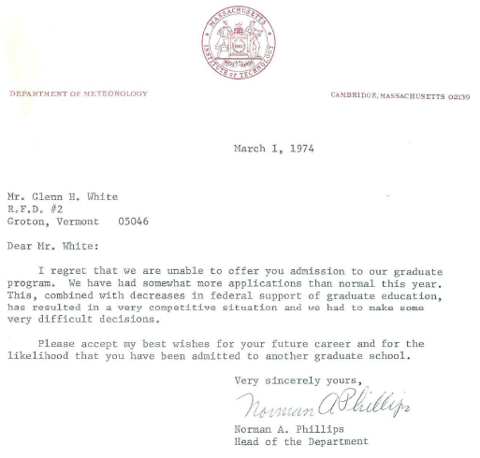

Slide 12
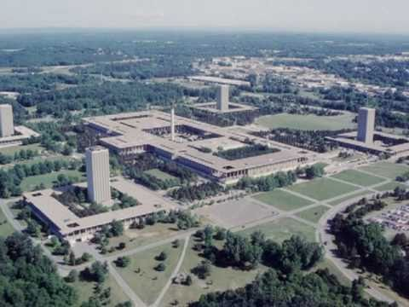
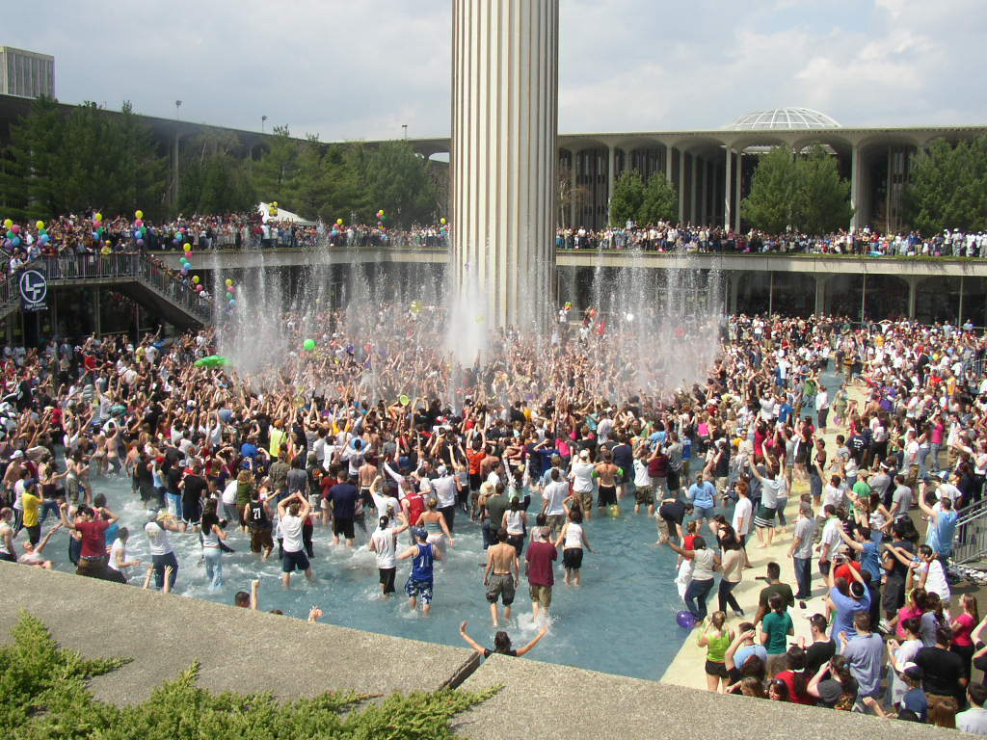
SUNY Albany
Lance Bosart, Petr Chylek, Arthur Loesch, Bernard Vonnegut,
Richard Orville
Geoff Dimego finishing his PhD, Fred Carr post-doc
Bosart’s tests: “From your synoptic experience, …”
“But I don’t have any synoptic experience…”
Albany department chair encouraged me to move on after master’s

Slide 13
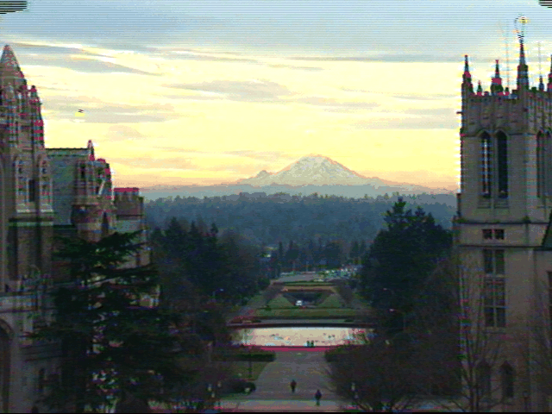
Went to University of Washington
Wallace and Hobbs, Holton, Fleagle and Businger,
Houze, Dick Reed, Dennis Hartmann, Leovy
Steve Payne, Cliff Mass, Dave Parsons, Jim Wilczak, John Gamache, Ed Rappaport,
Lau Ngar-Cheung, Bill Lau, Brad Ferrier, Mark Iredell, John Horel, Dave Gutzler, Rahul Mahajan
Brian Hoskins, Bob Dickinson, Michael McIntyre, Jim McWilliams, Alan O’Neill

Slide 14
Maurice Blackmon, Mike Wallace, Lau Ngar-Cheung, Steve Mullen
--observational studies of atmospheric general circulation
Earlier circulation studies had used radiosonde data
Mike et al. used twice daily NMC operational analyses 20-90N 1965-1977, applied spatial and temporal filtering
(worked with Roy Jenne at NCAR, who saved many vital data sets)
Until June 20, 1972– 0Z 6 layer 381 km primitive equation model
12Z 3 layer 381 km baroclinic model
After June 20 used 6 layer model at both times
September 1974 switched from hemispheric model with rigid, impenetrable wall near equator to global model
Affected mean meridional wind near 20N
NMC analyses used gradient wind equation to obtain first guess fields, ageostrophic wind in analyses underestimated
After October 1974 Hough analysis produced essentially nondivergent wind
interesting spinups in first 6 hours

Slide 15
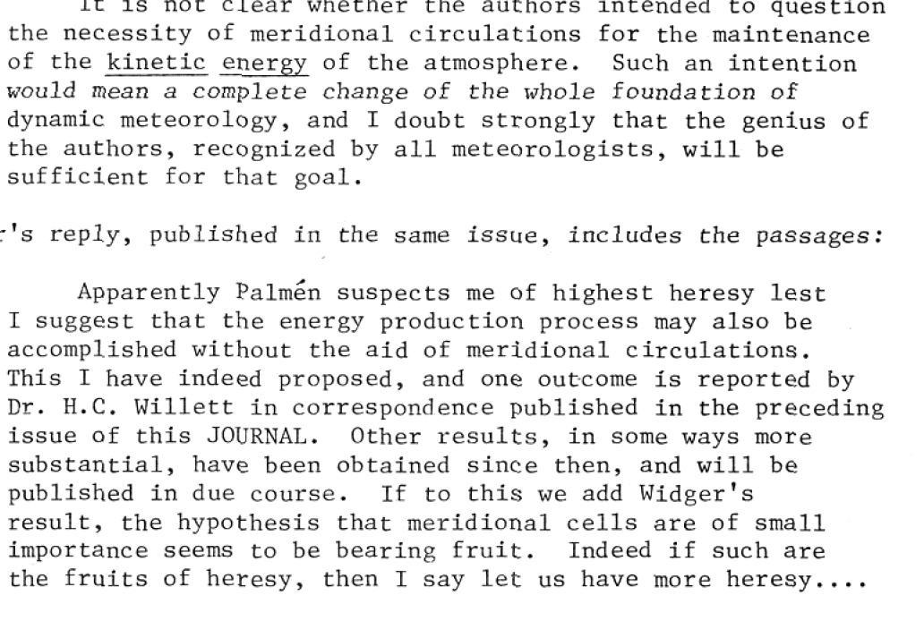
Disagreement over the relative roles of transient eddy momentum flux and mean meridional circulation in forcing and maintaining mean jet streams.
Namias and Clapp-meridional circulations drive the jet steams-regional perspective
Starr and Rossby—transient eddy momentum flux drives the jet streams
—zonal mean perspective
Palmen:
Starr:

Slide 16
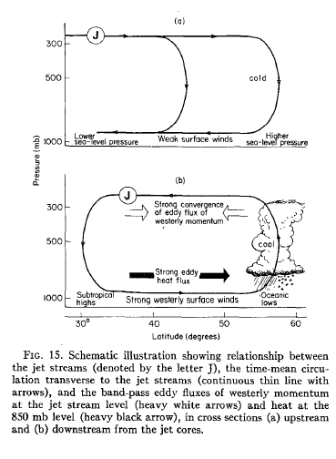
Blackmon et al.—examined 3-D circulation, showed importance of meridional circulation
Lau—documented wintertime extratropical Northern Hemisphere circulation and transient eddies
Mike suggested I look at skewness and kurtosis of geopotential heights
--are heights normally distributed
--low kurtosis might reveal two states in atmosphere—normal and blocking

Slide 17
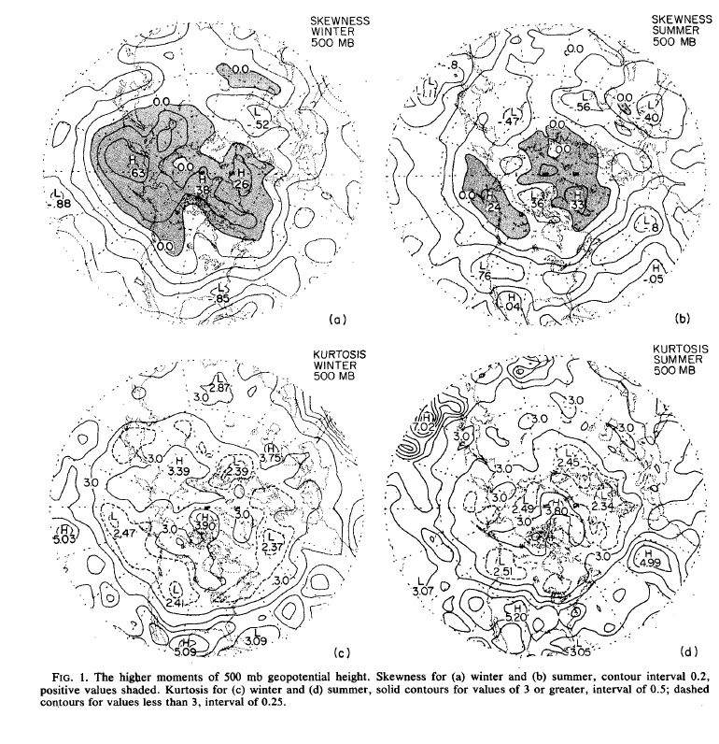
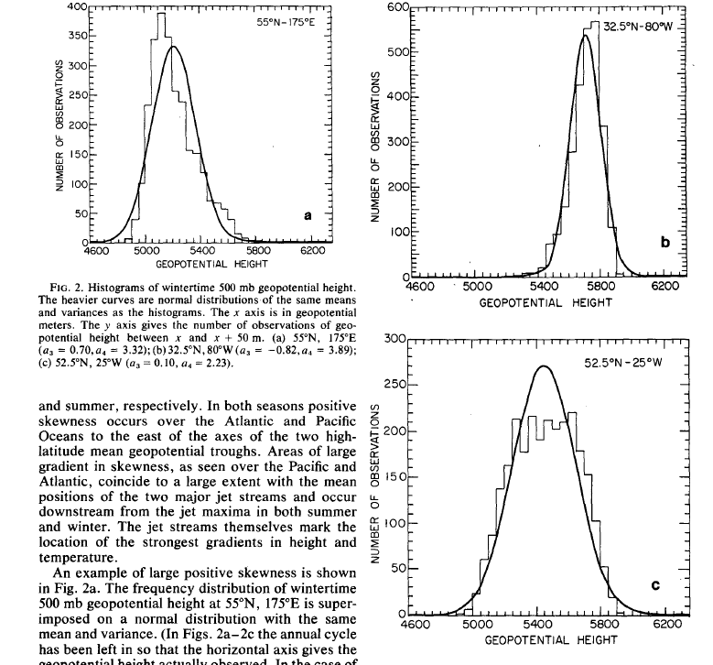

Slide 18
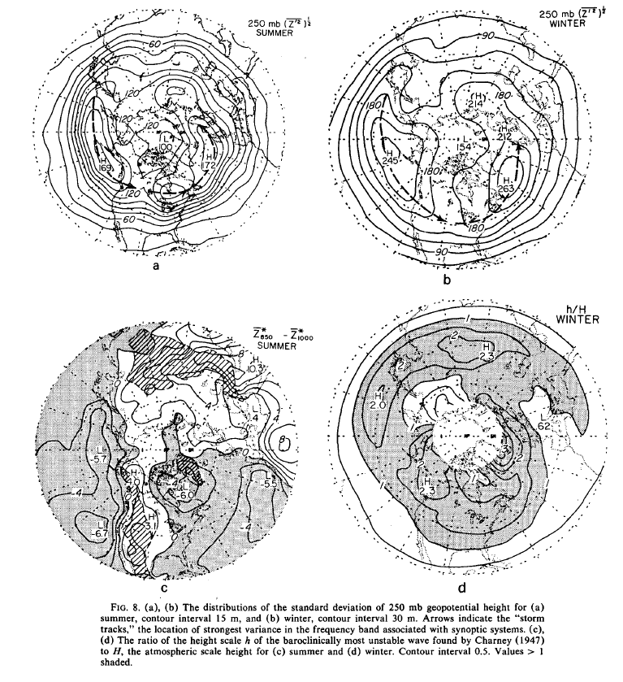
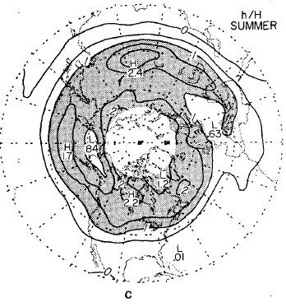
Mike suggested I look at trends in surface air temperatures.
I said no, missing a chance to be investigated by the Attorney General of Virginia for bad statistics.
Looked at summertime general circulation of extratropical
Northern Hemisphere

Slide 19
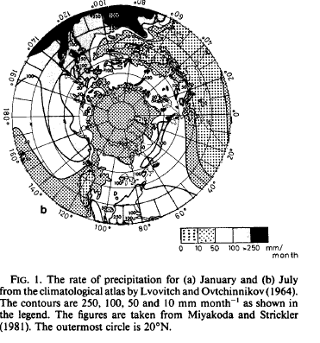
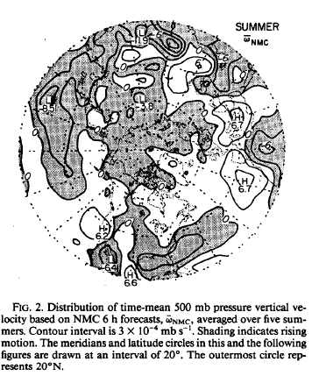
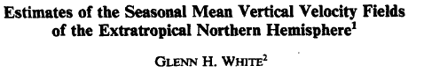
1983, Mon. Wea. Rev., 111, 1418-1433.

Slide 20
Wallace, J.M., and
J. K. Woessner, 1981:
An analysis of forecast
Error in the NMC
Hemispheric primitive
Equation model.
Mon. Wea. Rev., 109,
2444-2449.
Day 3 error averaged
Over 7 winters

Slide 21
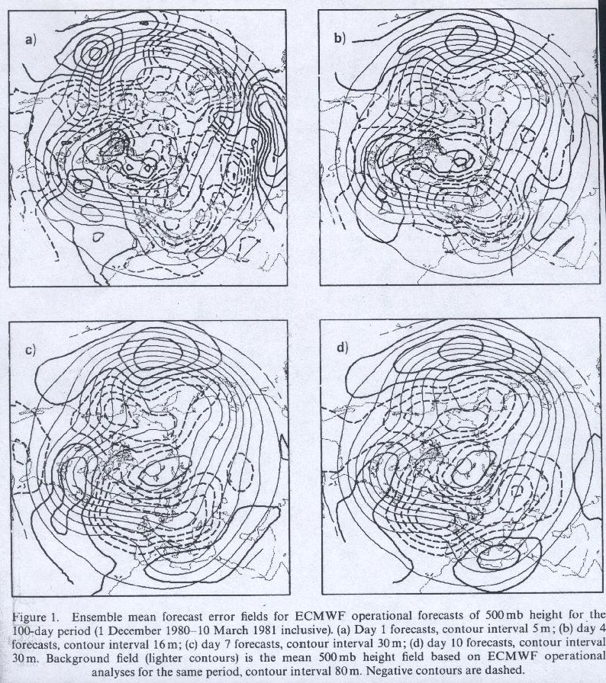
Wallace, J.M., S. Tibaldi, and A.J. Simmons, 1983: Reduction of systematic forecast errors in the ECMWF model through the introduction of an envelope orography. QJRMS, 109, 683-717.
Used systematic error to identify specific problems
in nwp
Ongoing problem in NWP:
How to represent
effect of orography
Solutions:
--envelope or silhouette orography
--gravity wave drag
--mountain blocking

Slide 22
Started 40 years of critically examining the ability of numerical weather analyses and forecasts to depict the global atmosphere realistically
Important concern-how do analysis-forecast systems handle divergent circulations, physical forcing?
Did not take any boundary layer courses
—worked on air-sea fluxes later
Did not take any synoptic courses, ended up in MEG

Slide 23
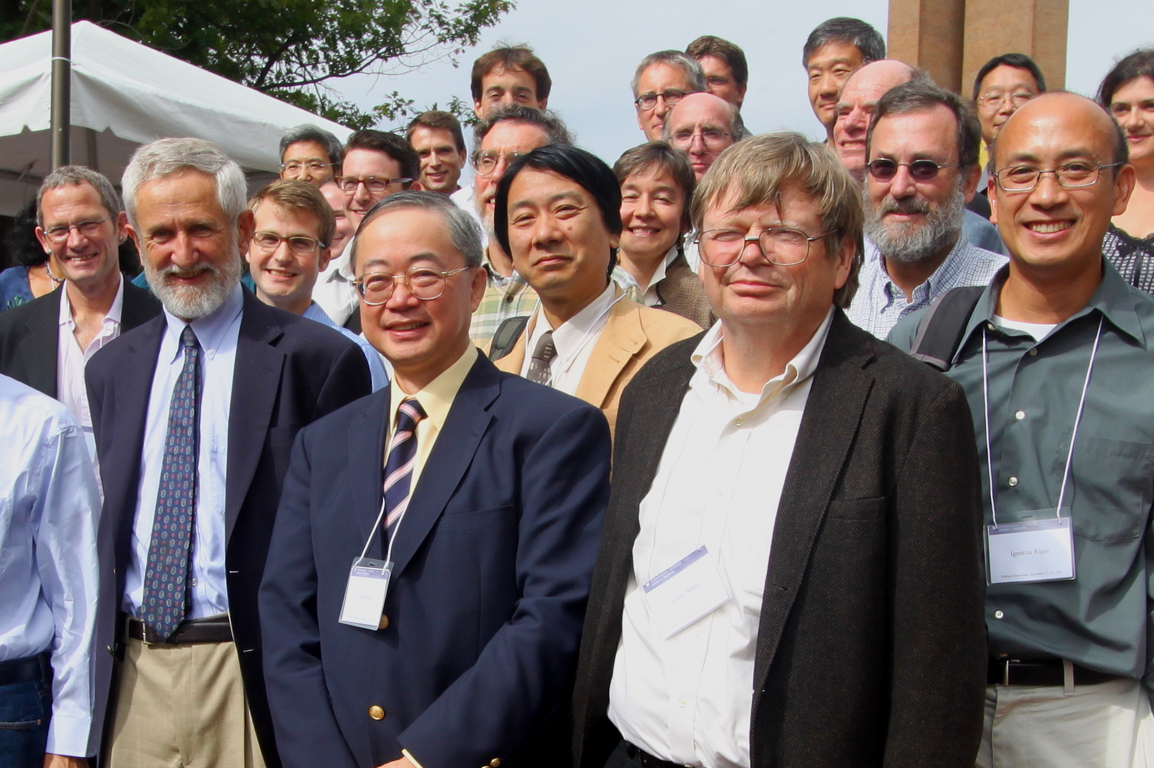
Mike’s 70th Birthday Symposium

Slide 24
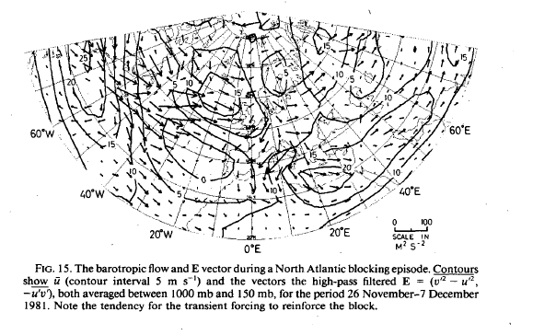
Post-doc at University of Reading with Brian Hoskins
Joint diagnostic project with Met Office
Used ECMWF operational analysis to diagnose and depict the global atmospheric circulation
Bob Pearce, Mike Pedder, Hew Davies, Ian James, Tony Hollingsworth, Bill Gray
Atmospheric forcing—diabatic heating, divergent circulation
1983, J. Atmos. Sci., 40:1591-1612

Slide 25
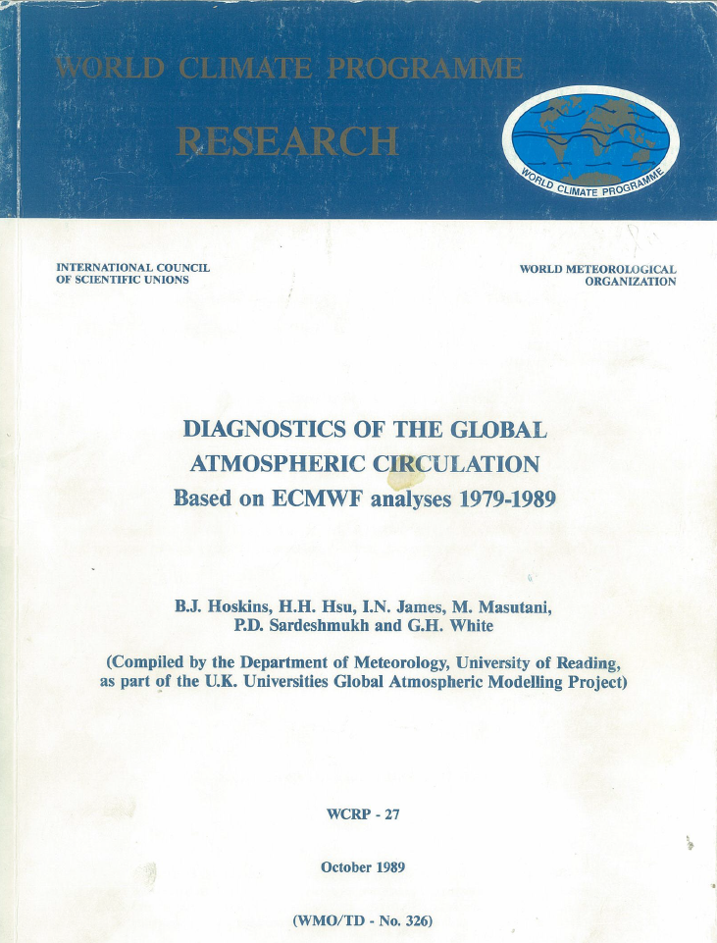
I was on a sabbatical year at the Met Office, wrote a 21-page introduction
critically examining ECMWF analyses
And how they changed over 10 years.
Tony Hollingsworth’s response:
“If that’s what you think of our analyses, why do you bother to use them?”
We added a reference to “the
unsurpassed quality of the ECMWF analyses”, which made Eugenia Kalnay unhappy.

Slide 26
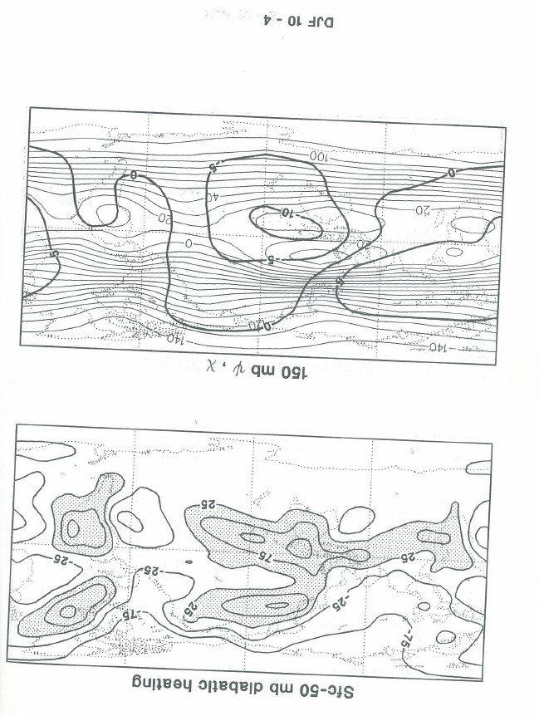
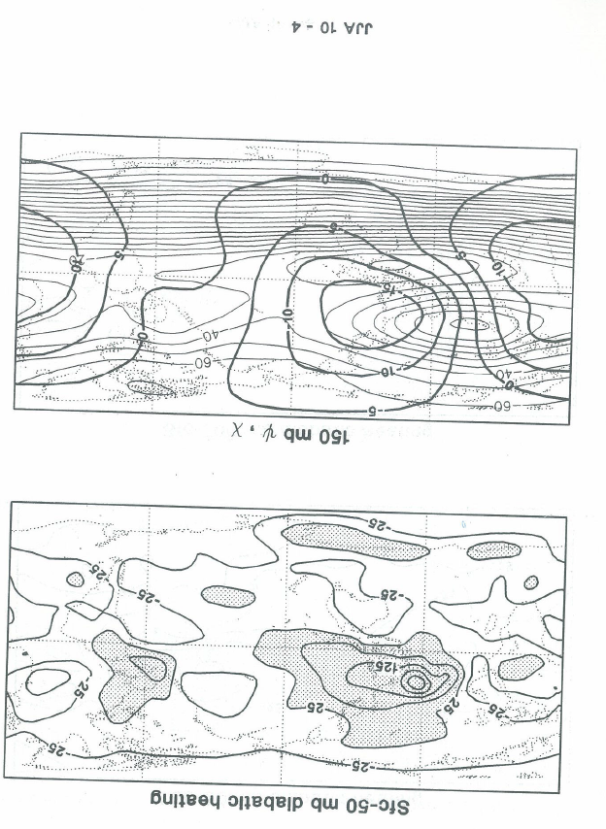

Slide 27
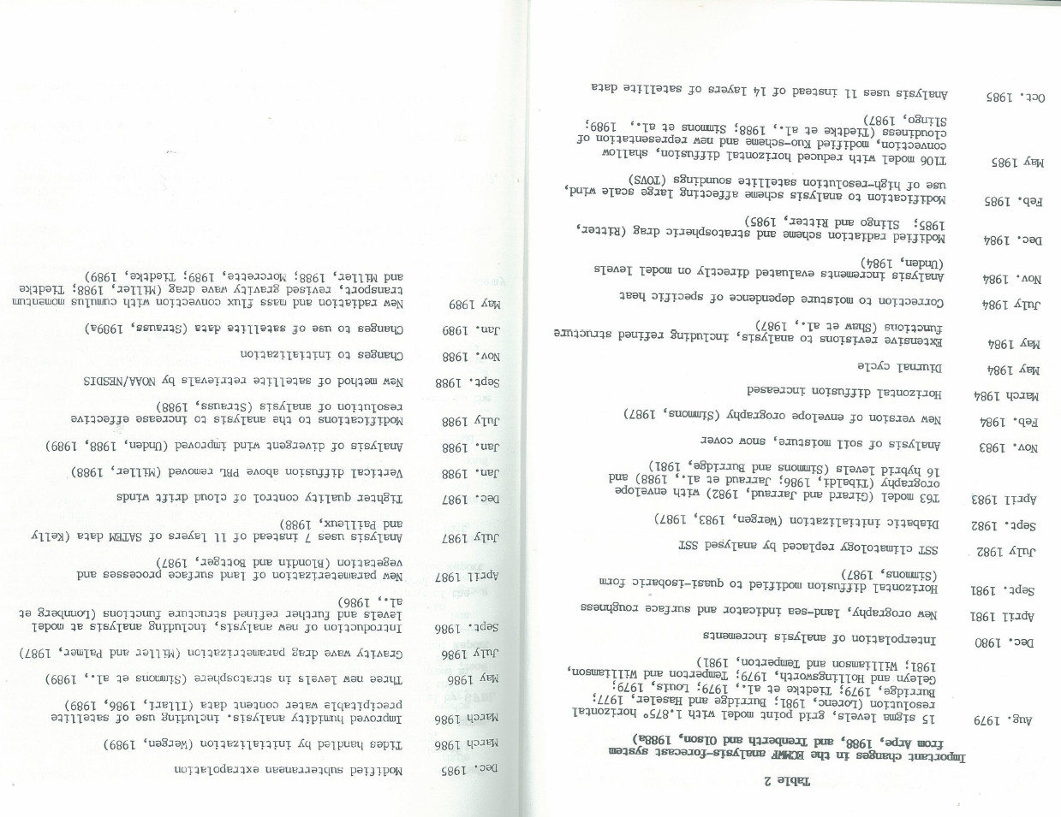
Good argument for reanalysis!

Slide 28
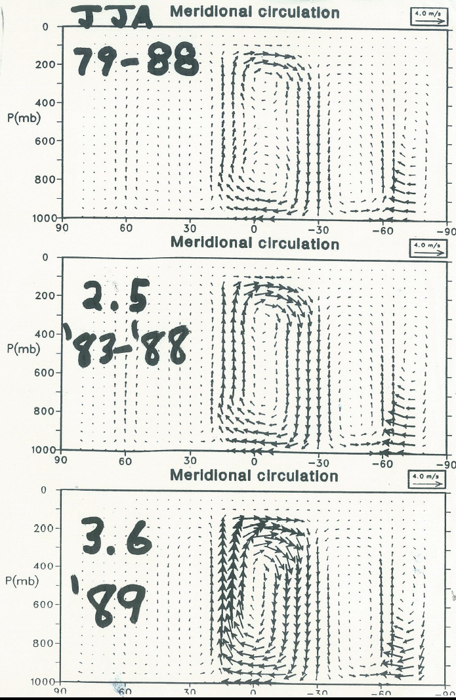
Tony Hollingsworth, 1989: “we were a little too weak before and a little too strong now”.

Slide 29
Mike served on 1984 panel that reviewed Development Division (now EMC) at National Meteorological Center (now NCEP) and recommended they hire
someone to do diagnostics. NMC hired me in 1985.
Mike advised and supported NCEP over the years, particularly the NCEP/NCAR reanalysis.
Mike, Maurice and Brian were and are great examples as scientists and as human beings. They show that nice guys finish first.
Most importantly, Brian found me living quarters in Bridges Hall, where
I met a beautiful young woman whom I eventually persuaded to marry me
and made my life worthwhile.

Slide 30
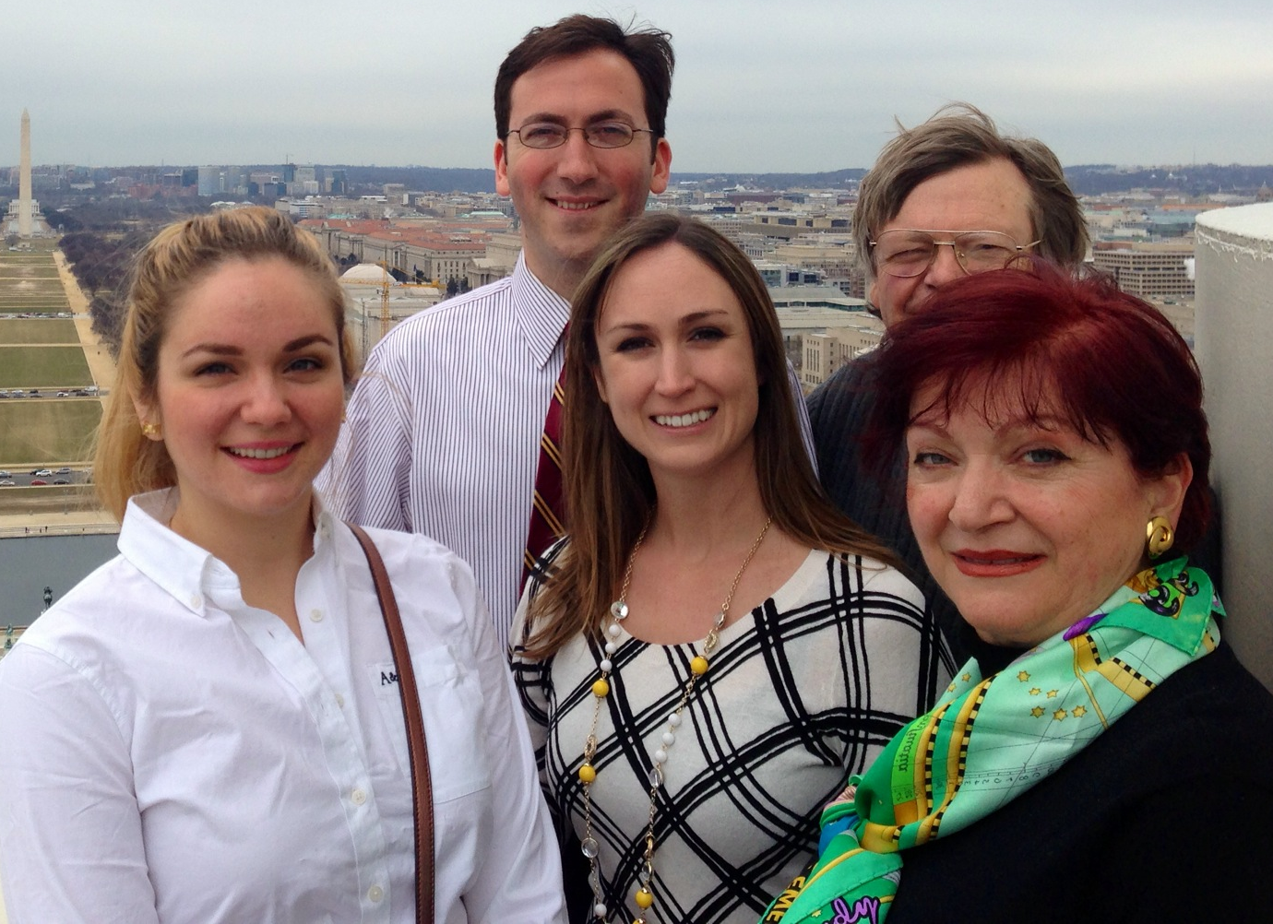

Slide 31
Two years at Goddard Spaceflight Center as a post-doc
Shukla my official advisor
Milt Halem, Bob Atlas
Eugenia Kalnay, David Randall
Steve Bloom, Jerry North, Bill Lau, Louis Uccellini
Huge scientific enterprise

Slide 32
Joined NMC Development Division Feb. 15, 1985
John Brown, Ron McPherson, Joe Gerrity, Desmaris,
Geoff Dimego, Bob Kistler, Ken Campana, Pete Caplan,
Cliff Dey, Paul Long, Bill Bonner, Jim Hoke, Dave Parrish,
Laurie Morone, John Ward
“We make mistakes and we correct most of them.”—Cliff Dey
Prediction is the ultimate test of understanding

Slide 33
Klaus Arpe of ECMWF explained to my wife in 1987 what he and I did :
“We tell the modelers what’s wrong with their models—
That’s why they hate us.”

Slide 34
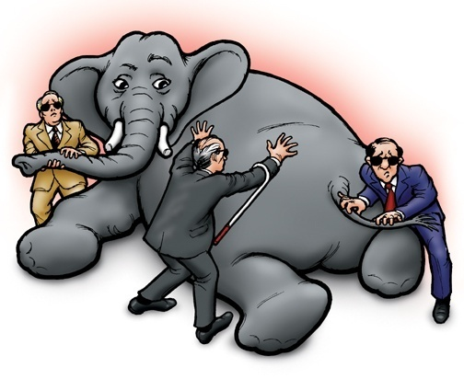
How I view my work at EMC
(except for the coat and tie,
) thanks to Norm Phillips)

Slide 35
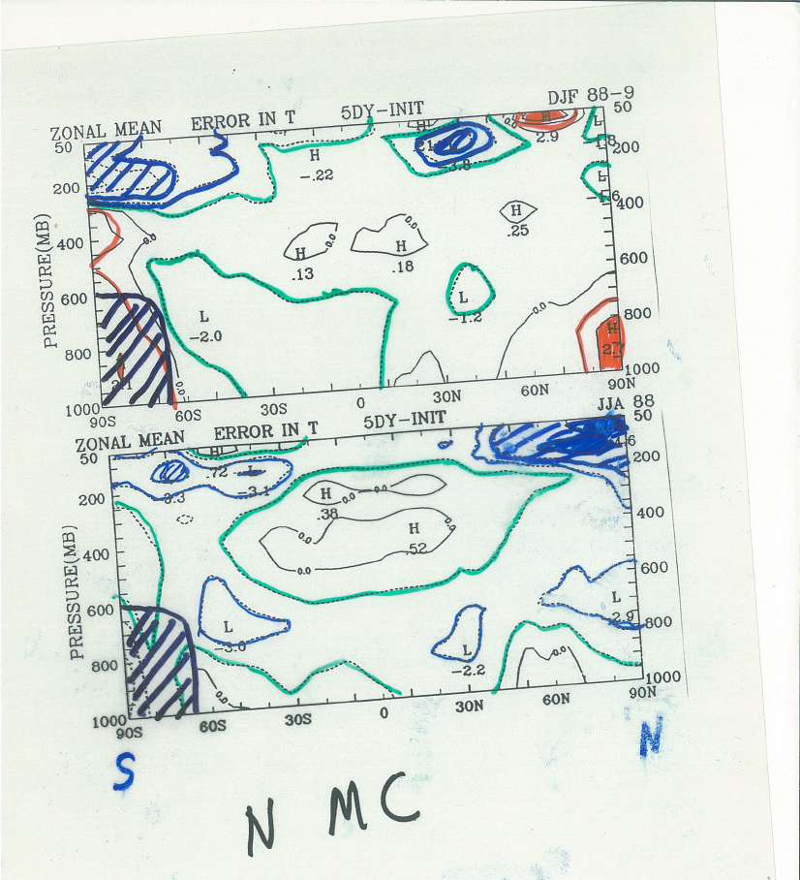
In early years
much of my time
spent coloring
transparencies

Slide 36
Thirty-day forecasts (Bob Kistler)
--DERF 10 30-day forecasts
--DERFII 108 30-day forecasts
Tracton et al., 1989: Mon Wea Rev, 117, 1604-1635.
--CFS
--CFSv2
Air-sea fluxes
--fluxes in DERFII 30 day forecasts
--fluxes in operational and experimental GFS
--fluxes in operational global models—WGNE Report
--Air-sea flux workshop at ECMWF
--fluxes in reanalyses
--Joint WCRP-SCOR Working Group on Air-Sea Fluxes
--Air-sea flux workshop in Potomac

Slide 37


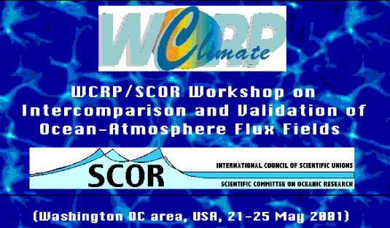
INTERCOMPARISON AND VALIDATION OF
OCEAN-ATMOSPHERE ENERGY FLUX
FIELDS
by
Members of the WGASF
Edited by P.K.Taylor
June 2000
http://www.noc.soton.ac.uk/ooc/WGASF/

Slide 38
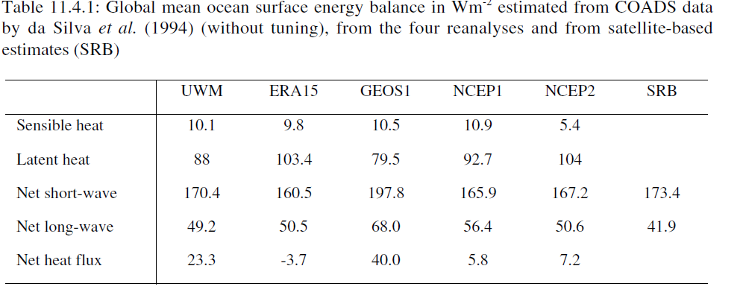
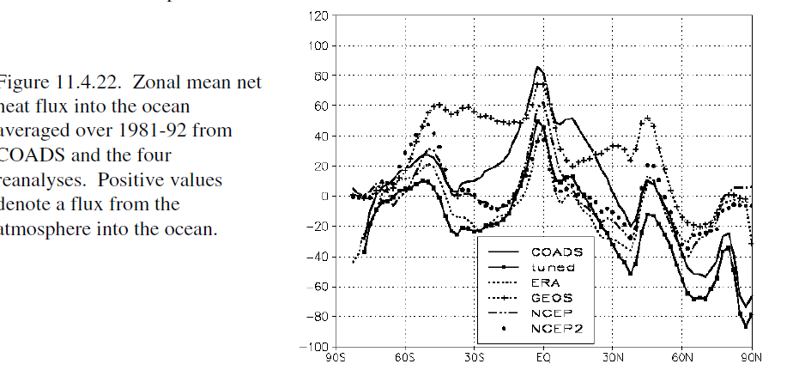

Slide 39
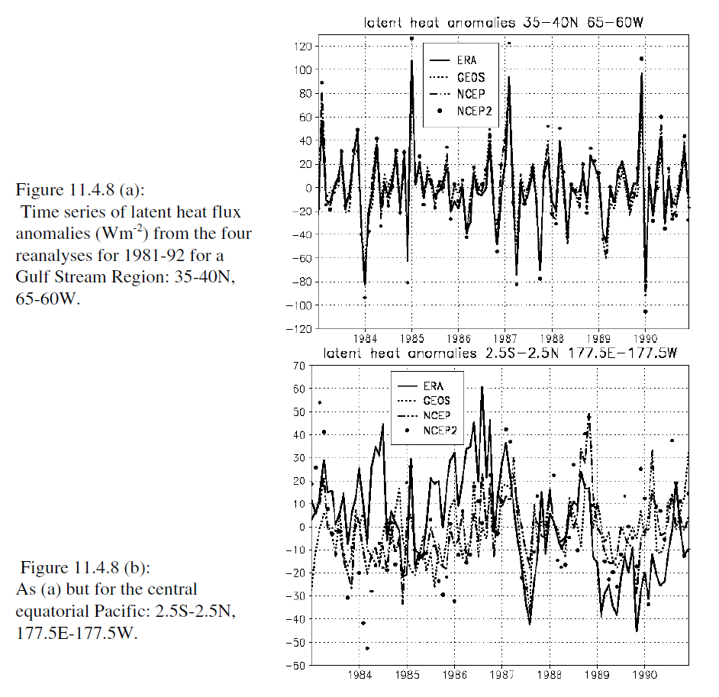

Slide 40
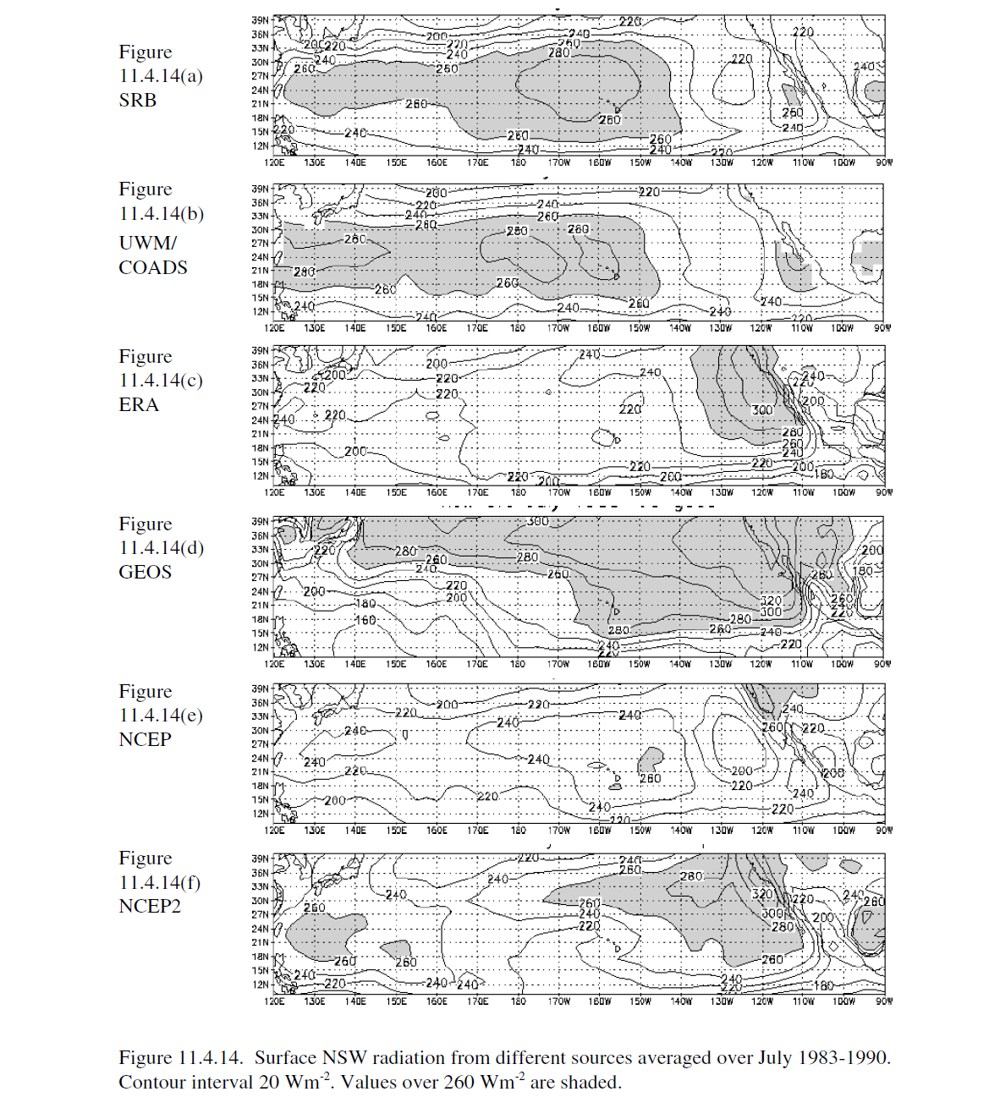

Slide 41
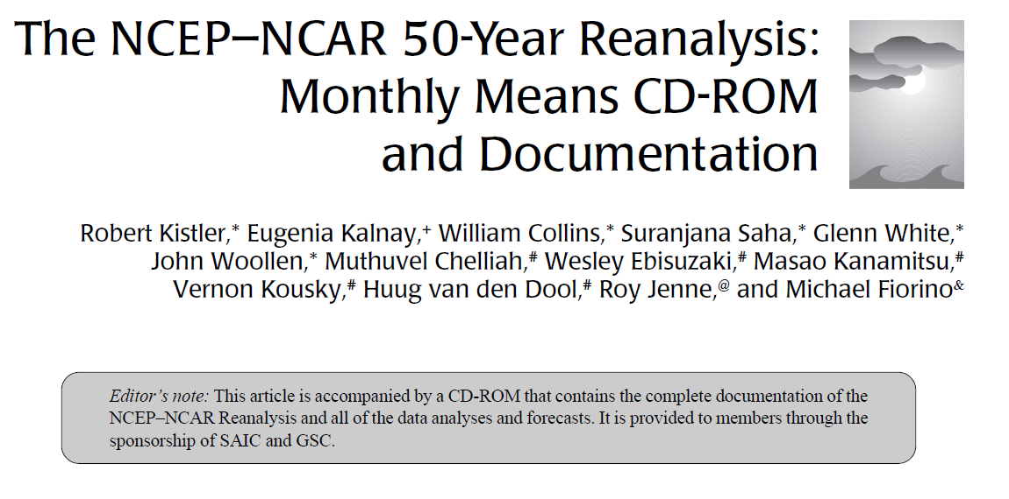
28, 013 citations--Google Scholar
“They will criticize it, but they will use it.”
—Mark Cane

Slide 42
1948-present (now a 70-year reanalysis)
T62 (210 km), 28 sigma vertical layers
equivalent to operational GFS implemented 10 Jan. 1995 (except GFS resolution T126 (105 km))
3DVAR SSI analysis
TIROS TOVS vertical temperature soundings
Subsequent reanalyses used radiances, led to discontinuities
Yearly CD-Roms 1950-2008 (last few DVDs with other centers’ operational analyses)—Wesley Ebisuzaki
50 year monthly mean CD-Rom
Synoptic CD-Rom of daily fields 1979-1996

Slide 43
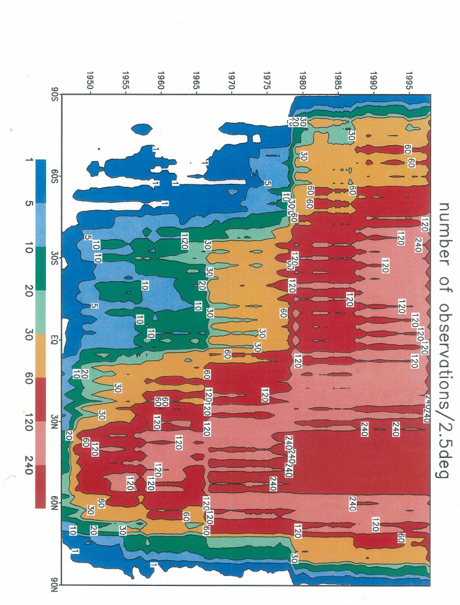
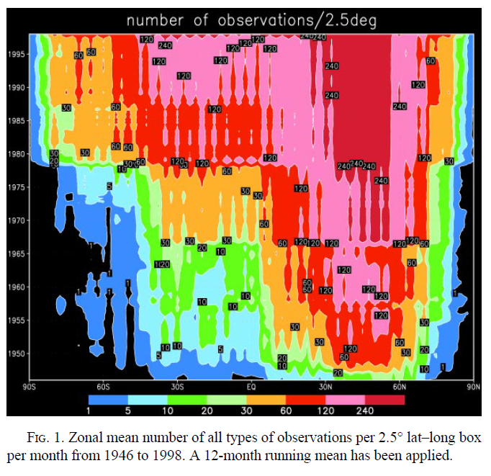

Slide 44

Joe Sela created the global spectral model and improved it for more than 30 years
Implemented Aug.12, 1980
R30/L12
T1534/L64 semi-Lagrangian implemented Jan. 14, 2015
Final version of GFS to be
Implemented June 2017

Slide 45
Change History of GFS Configurations
Mon/Year |  | Levels | Truncations | Z-cor/dyncore | Major components upgrade
Aug 1980 | 12 |  | R30 (375km) | Sigma Eulerian | first global spectral model, rhomboidal
Oct 1983 | 12 |  | R40 (300km) | Sigma Eulerian
Apr 1985 | 18 |  | R40 (300km) | Sigma Eulerian | GFDL Physics
Aug 1987 | 18 |  | T80 (150km) | Sigma Eulerian | First triangular truncation; diurnal cycle
Mar 1991 | 18 |  | T126 (105km) | Sigma Eulerian
Aug 1993 | 28 |  | T126 (105km) | Sigma Eulerian | Arakawa-Schubert convection
Jun 1998 | 42 |  | T170 (80km) | Sigma Eulerian | Prognostic ozone; SW from GFDL to NASA
Oct 1998 | 28 |  | T170 (80km) | Sigma Eulerian | the restoration
Jan 2000 | 42 |  | T170 (80km) | Sigma Eulerian | first on IBM
Oct 2002 | 64 |  | T254 (55km) | Sigma Eulerian | RRTM LW;
May 2005 | 64 |  | T382 (35km) | Sigma Eulerian | 2L OSU to 4L NOAH LSM; high-res to 180hr
May 2007 | 64 |  | T382 (35km) | Hybrid Eulerian | SSI to GSI
Jul 2010 | 64 |  | T574 (23km) | Hybrid Eulerian | RRTM SW; New shallow cnvtion; TVD tracer
Jan 2015 | 64 |  | T1534 (13km) | Hybrid Semi-Lag | SLG; Hybrid EDMF; McICA etc
May2016 | 64 |  | T1534 (13km) | Hybrid Semi-Lag | 4-D Hybrid En-Var DA
Vertical layers double every ~11 yrs; change of horizontal resolution is rapid (~30 times in 35 years); sigma-Eulerian used for 27 yrs!
45
Source http://www.emc.ncep.noaa.gov/gmb/STATS/html/model_changes.html

Slide 46
http://www.emc.ncep.noaa.gov/gmb/STATS/html/model_changes.html
08/80: R30L12
year spent converting codes to Cyber205
10/83: R40L12
04/85: MRF85 R40L18 - GFDL physics, silhouette orography
06/86: MRF86 R40L18 - convection to tropopause
08/87: MRF87 T80L18 - diurnal cycle, L18 moisture, gravity wave drag
01/88: MRF88 T80L18 - interactive clouds
03/91: T80L18 to T126L18, silhouette to mean orog, new SST, marine stratus, reduced horizontal diffusion
06/91: SSI analysis
08/93: Arakawa-Schubert convection, 28 layers
01/95: SSM/I PW over sea
10/95: Satellite radiances instead of T retrievals
02/97: SSM/I water vapor discontinued

Slide 47
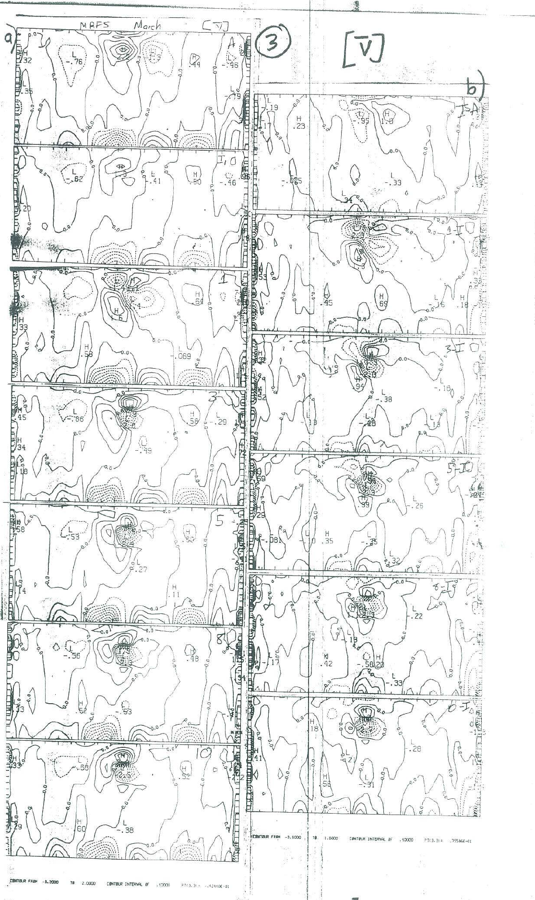
March 1985
Analysis
Initialized-analysis
Initialized
1 day-initialized
1 day fcst
3 day-initialized
3 day fcst

Slide 48
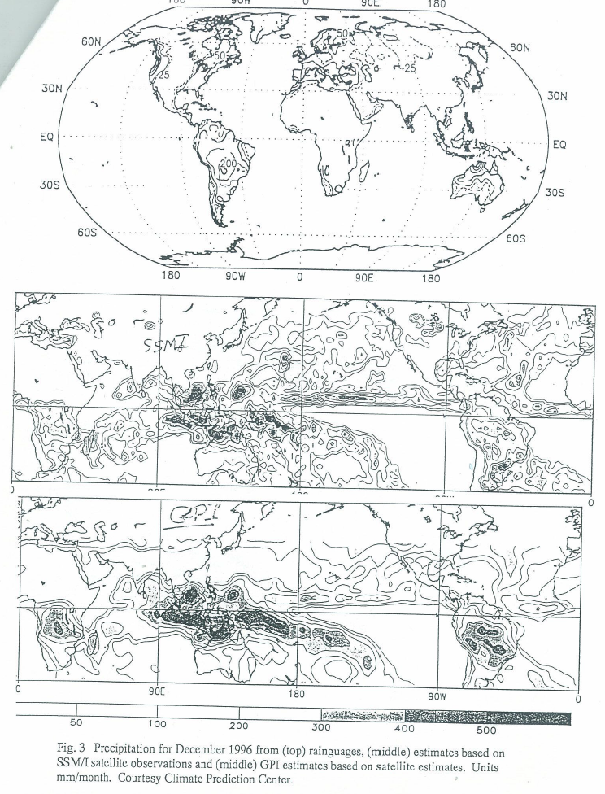
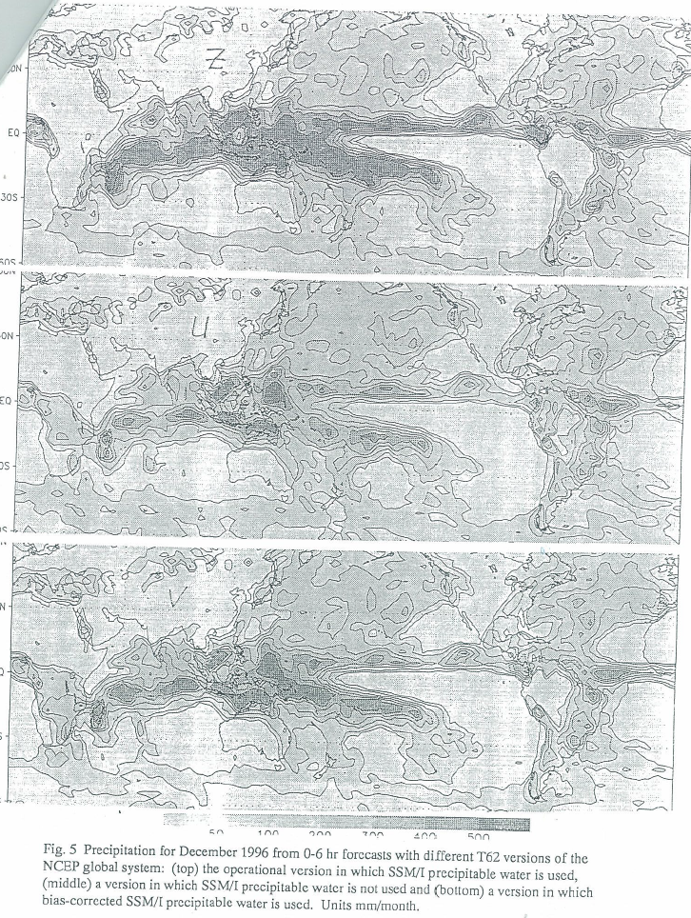
SSMI precip water
PRECIP Dec. 1996
Observational estimates
No SSMI precip water

Slide 49
06/15/98: T170L42 to day 3.5; physics changes; 3D ozone; analysis changes(Implementation from hell) not enough iterations in analysis, analysis drifted from observations,
not permitted to increase run time,
evaluation did not include fit to obs
10/06/98: Second emergency implementation: Back to T126L28, better fits to data, more iterations in analysis, physics changes
07/06/2000: Hurricanes and tropical storms in guess field relocated to official Tropical Prediction Center position
05/15/01 12Z: Inclusion of cloud condensate, use in radiative transfer
Momentum mixing included in deep convection

Slide 50
03/05/02 : AVN four times a day to 384 hours. T170L42 to 180h, then T62L28.
04/23/02 00Z: MRF is replaced by the 00Z AVN
10/29/02: T254L64 to 84h, T170L42 to 180h, T126L28 to 384h
02/24/04 12Z: Mountain blocking: Parameterization of separation of airflow in the vertical with passage over mountainous terrain.

Slide 51
Major implementation May 31, 2005
--higher resolution 50 km to 35 km T382
--enhanced orographic height by 10% of mountain variance in calculation of mountain blocking dissipative forces (Alpert)
--reduced both background diffusion in free atmosphere and turbulent diffusion length from 150 to 30 m in stable cases (Moorthi)
Last two carefully tested (and carefully tuned) in 1-day experiments on winter cases (Kistler and Lord)

Slide 52
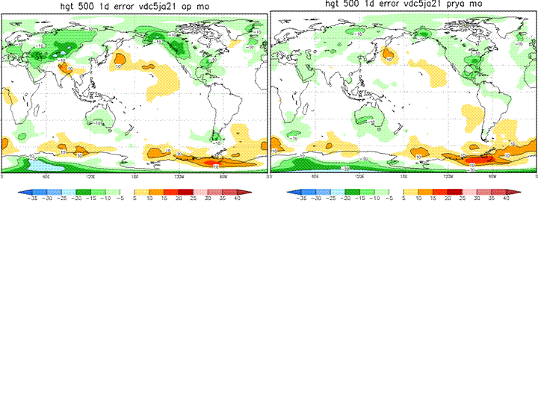
Day 1 error in 500 hPa height 47 day mean Dec-Jan
OLD
NEW
Day 1 error (left) implies problem with orography
Enhanced mountain blocking reduced error over Himalayas, Rockies

Slide 53
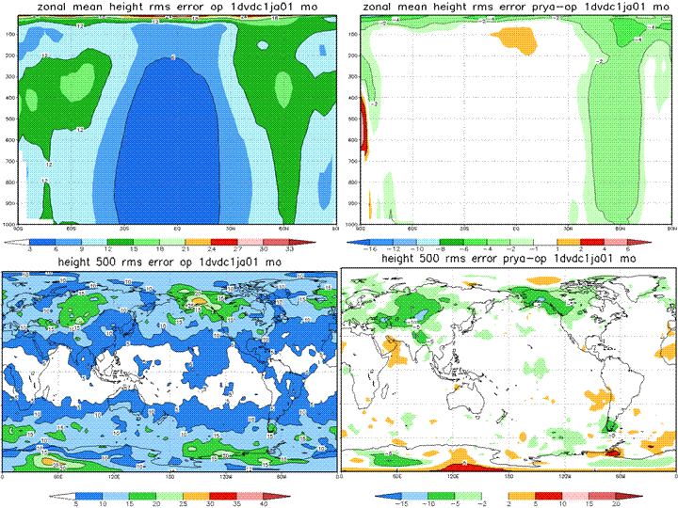
RMSE 1 day error 500 hPs height 47 days Dec.-Jan.
OLD
NEW-OLD
Day 1 rms height error reduced over mountains

Slide 54
Major implementation July 27, 2010
Resolution increase: T382 (35 km) -> T574 (27 km) to 192 hrs
T190 192-384 hrs
Changes in model physics include:
  Gravity wave drag one half as strong
  Mountain blocking four times stronger (Alpert and Yang)
  New mass flux shallow convection (Han and Pan 2010)
  New planetary boundary layer
  Updated deep convection
  Background diffusivity for momentum substantially increased
  To 3.0 m²s⁻¹ everywhere to reduce wind forecast errors

Slide 55
Parallel tests of higher resolution, mountain forcing
Fanglin Yang, Jordan Alpert
Pre1: T382
pre2: T574
Outstanding Issues: large tropical wind RMSE in the upper troposphere and stratosphere; large NH height bias near surface and in the lower troposphere in week one.
pre2a: T574 with adjusted GWD and mountain block.
What's Good: removed the large NH height bias near surface and in the lower troposphere in week one.
Outstanding Issues: large tropical wind RMSE in the upper troposphere and stratosphere
Many more parallel tests run to determine best tuning of mountain forcing
Pre4: As pre2a, plus new radiation and albedo
Pre5a: As pre4,except with doubled GWD
Pre5b: As pre5, except with doubled mountain blocking
Pre5c: As pre5, except with 4 times stronger mountain blocking
Pre5d: As pre5, except with 8 times stronger mountain blocking
Pre5e: As pre5, except with 4 times stronger mountain blocking and half GWD
Pre5f: As pre5c, except with correction to remove negative water vapor

Slide 56
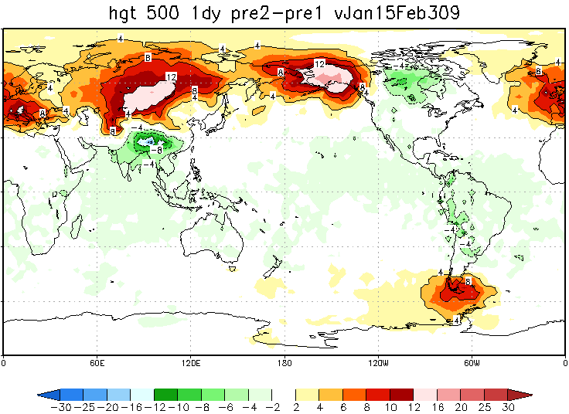
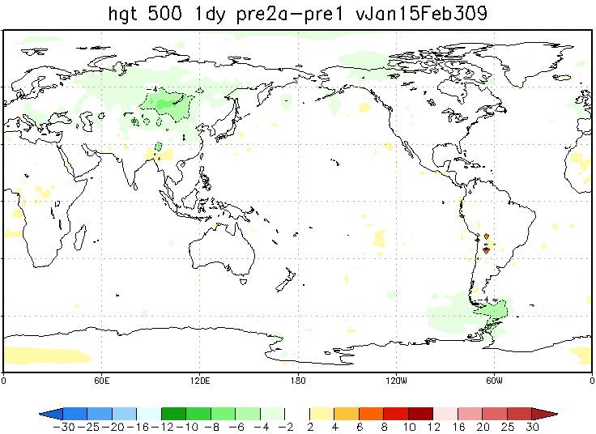
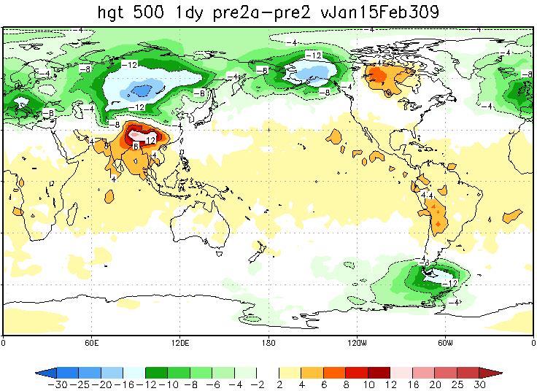
Higher resolution plus
Tuning of orographic forcing
Effect of higher resolution
Higher resolution by itself
Changes time-mean flow
Adjusted drag removes change
To time-mean flow
Effect of tuning of
orographic forcing

Slide 57
Example: New Mass-Flux Based Shallow Convection
By Jongil Han and Hua-lu Pan
Mass flux analogy (de Roode et al., 2000) :
A_{u} (updraft area)=0.5
A_{d} (downdraft area)=0.5
Operational shallow convection scheme (Diffusion scheme, Tiedke, 1983)
A_{u}~0.0; A_{d}~1.0
Environment is dominated by subsidence resulting in environmental warming and drying.
New shallow convection scheme (Mass flux scheme)

Slide 58
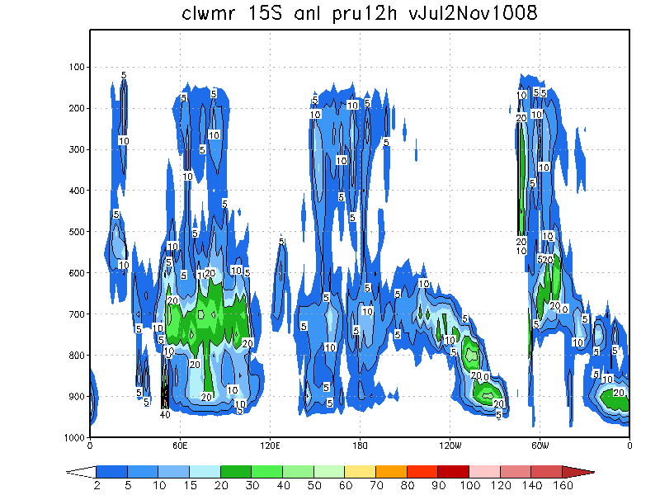


T382 operational
T574
New convection increases
Low level stratus, realistic tilt
With longitude
Decreases CLW near 700
Cloud liquid water 15S
Analyses
T574 with new convection

Slide 59



T382 operational
T574
New convection maintains
Eastern ocean stratus in 7 day
forecasts
Cloud liquid water 15S
7 day forecasts
T574 with new convection

Slide 60

Note weaker
Winds
at jet level
In NH, better
fits to
radiosondes
Old T382
NewT574
Note weaker
winds in tropics
At low levels—
Potential
Aviation hazard
East Caribbean

Slide 61
05/22/2012 12Z: GSI Q3FY2012 Major Upgrade. Hybrid variational/ensemble assimilation system. Background error used to project the information in the observations into the analysis created by a combination of a static background error (as in the prior system) and a new background error produced from a lower resolution (T254) Ensemble Kalman Filter.
09/05/2012 12Z: GFS Minor Change. A look-up table used in the land surface scheme to control Minimum Canopy Resistance and Root Depth Number was updated to reduce excessive evaporation. This update is aimed to mitigate GFS cold and moist biases found in the late afternoon over the central United States when drought conditions existed in summer of 2012.
Physics “Whack-a-mole”
Or “wheel of pain”

Slide 62














588. EMC’s Model Evaluation Group
Geoffrey Manikin¹, Glenn White¹, Tracey Dorian^{1,2}, Corey Guastini^{1,2}
¹EMC/NCEP/NWS/NOAA/DOC ²IMSG
MEG presents weekly synoptic model evaluations to
Improve NOAA forecast systems
Improve communications between model developers and model users.
MEG’s Role in New Implementation Process
Work with forecasters to find model problems,
present to developers
Developers address problems,
MEG examines tests of model fixes
Initial briefings from developers on upgrades
Alert field on what to look for before evaluation begins
Longer scientific evaluation before, separate from
30 day IT test
Greater forecaster involvement
Set up and maintain web pages for each implementation
Review cases and stats
Must find effective way to get parallel data to the field
Bring in visitors to evaluate tests with developers
New process improved GFS 2016 implementation
Recent West Coast Storms
GEFS plume plots for Los Angeles (top) and Emigrant Gap, Blue Canyon Nyack Airport, CA (right)
Grey GEFS ensemble members
Black GEFS ensemble mean
Blue GFS
Purple dots observed
Mode verification given by numbers
Check mark human judgment
WV Flooding Review
Greater involvement with NWS regions, forecast offices
MEG involved in Science Technology Integration teams with NWS SOOs
Global: Involved in GFSX evaluation effort, providing recommendations on global model development
Hi-Res Ensemble: Evaluating hi-res guidance to provide recommendations on construction of future convection-permitting ensemble
Communication/Dissemination: Working on better ways to get model data to forecast offices
MEG Visiting scientist program
MEG personnel visited 5 WFOs last fall
Plans for WFO forecasters to visit EMC
Questions
geoffrey.manikin@noaa.gov glenn.white@noaa.gov tracey.dorian@noaa.gov
corey.guastini@noaa.gov
rain snow sleet freezing rain
Hurricane Matthew
Winter storm Jan. 7, 8, 2017 Individual pies show how many
GEFS ensemble members forecast that category
The MEG meets each Thursday 11:30 AM EST NCWCP
ALL ARE WELCOME TO ATTEND
Webinar access available, presentations recorded
Contact mary.hart@noaa.gov for MEG announcements/agendas

Slide 63


Slide 64
01/14/2015 12Z: T1534 Semi-Lagrangian GFS Model Changes
* Upgrade from current operational T574 Eulerian (~23km) to T1534 Semi-Lagrangian (~13km)
* Use high resolution daily RGT SST instead of weekly OI SST, and use daily sea ice analysis
* Extend high resolution forecast from 8 days to 10 days.
* Reduced drag coefficient at high wind speeds
* Hybrid EDMF PBL scheme and TKE dissipative heating
* Retuned orographic gravity-wave forcing and mountain block etc
* Divergence damping in the stratosphere to reduce noise
* Stationary convective gravity wave drag
* Replace Bucket soil moisture climatology by CFS/GLDAS
* Add the vegetation dependence to the ratio of the thermal and momentum roughness
* Fixed a momentum roughness issue
GSI Changes
* increase horizontal resolution of ensemble from T254 to T574
* changes in radiance assimilation: upgrade to CRTM v2.1.3
* move to enhanced radiance bias correction scheme

Slide 65
05/11/2016 12Z: Data Assimilation and Model Upgrade ( NWS TIN )
Data Assimilation Upgrade
* Upgrade the 3D Hybrid Ensemble-Variational to 4D Hybrid Ensemble-Variational Data Assimilation System
* Assimilate all-sky (clear and cloudy) radiances
* Bias correct aircraft data
Model Upgrade
* Corrections to land surface to reduce summertime warm, dry bias over Great Plains
* Hourly output fields through 120-hr forecasts

Slide 66


Improved Fit to Obs
Tracey Dorian

Slide 67
GFS2017 changes
NEMS superstructure and infrastructure
Upgraded land parameterizations, higher resolution land surface climatologies, new surface albedo data
Fix to excessive cooling of 2m temperatures during sunset (00Z)
Changes to cumulus convection parameterization to improve summertime precipitation forecasts
NSST’s that represent diurnal warming effects and sub-layer cooling

Slide 68
It’s not all about 500 hPa height anymore…
CONUS Precipitation
Reduced drizzle
Increased bias light to medium amounts
Significant improvements in skill
for thresholds of 0.2 to 15 mm/day
forecast lengths 0-24 to 72-96 hrs
AWC, WPC improvements in tropical convection

Slide 69
Number of regions in US in which bias decreases in 96 hr forecasts
2m T | 000GMT | 0600GMT | 1200GMT | 1800GMT
May-Oct. 2016 | 10/16 | 9/16 | 7/16 | 10/16
May-Dec. 2015 | 10/16 | 8/16 | 8/16 | 6/16
Dec. 2015-May 2016 | 15/16 | 12/16 | 9/16 | 14/16
2m dew point | 000GMT | 0600GMT | 1200GMT | 1800GMT
May-Oct. 2016 | 10/16 | 15/16 | 15/16 | 13/16
May-Dec. 2015 | 9/16 | 16/16 | 15/16 | 12/16
Dec. 2015-May 2016 | 13/16 | 8/16 | 8/16 | 9/16

Slide 70
Change in rms fit to station observations May 1, 2015-Dec. 28, 2016
96 hr forecasts
 | 0000GMT | 0600GMT | 1200GMT | 1800GMT | AVERAGE
T 2m
west | -6.9% | -3.6% | +1.1% | -1.8% | -2.8%
east | -8.6% | -1.6% | +2.3% | -1.2% | -2.2%
T_{d} 2m
west | -4.3% | -4.4% | -3.8% | -5.2% | -4.4%
east | -2.1% | -3.4% | -1.3% | -2.4% | -2.0%
Winds 10m
west | +0.1% | +0.8% | +0.1% | +0.1% | +0.3%
east | -1.2% | -1.8% | -1.5% | -1.1% | -1.4%
RMS fit to obs decreased in GFS2017
RMS fit to obs increased in GFS2017

Slide 71
Links to Case studies and evaluation/analysis by MEG/EMC
Tracey Dorian, Geoffrey Manikin, Corey Guastini
Case Studies | Case Studies
Louisiana flooding case study | Christmas Day 2016 Northern Plains Blizzard
January 23, 2016 East Coast Blizzard | January 22-23, 2017 California precipitation event
Hurricane Matthew | Portland heavy snow Jan. 10-11, 2017
Hurricane Joaquin | Long-range predictability of high-impact west coast atmospheric river
February 7-8, 2016 explosive cyclone | West Virginia flooding case
MODE Jet Verification | MODE Precipitation Verification
Minnesota Blizzard November 18-19, 2016 | MODE CAPE Verification
Weather Prediction Center case studies | Hurricanes Joaquin and Matthew
Central Region case studies | Systematic Biases Summer2016
Hurricane Joaquin precipitation
California precipitation January 9-10, 2017
Most requested by other NCEP centers,
regional headquarters, forecast offices

Slide 72
Endorsements from Stakeholders
Region/Center | Recommendation | Remarks
Western Region | Implement | GFSX precip lighter in valleys GFSX more jumps 120-180 h fcsts in December
Central Region | Implement | No significant improvements nor detriments
Southern Region | Implement | GFSX slightly better Matthew, worse on Louisiana flooding
Eastern Region | Implement | Some beneficial improvements and upgrades
Pacific Region | No evaluation
Alaska Region | Implement | Forecast improvements largely neutral
WPC | Implement | Slight improvement, Better tropical convection So. America
NHC genesis | Oppose | 9-10% less skill in track forecast at 48-72h in Atlantic Forecasts of tropical storm genesis improved

Slide 73
Endorsements from Stakeholders
Region/Center | Recommendation | Remarks
AWC | Implement | Significant improvements to tropical convection and ceiling and visibility over CONUS
CPC long range stratosphere | Implement | Stratospheric fields improved, slight improvement D+8, week 2
OPC | Implement | Small scale features improved; large scale features similar
SWPC | No evaluation
MDL | Implement | see little to suggest any dramatic MOS impacts from implementing new GFS
OWP | Implement | Mixed results, extremely limited testing
SPC report | Implement | Slightly improved 2-m dew point and instability bias

Slide 74
Barry Lynn, Jerusalem
“I appreciate the efforts of NCEP to improve its forecast products and provide researchers, private firms, and the public with this very useful information on a timely and very useful basis. I don't think you can find another government organization that provides this kind of service in such a responsible and consistent way.”
Jose Manuel Jimenez, Meteorologica SA, Madrid, global weather service uses GFS forecasts
wants access to hourly retrospective data
Aleksandr Korolokov, Meteorological Center, FOBOS, Moscow—GFS main source for forecasts
extreme short cold waves in GFS forecasts—GFSX better
Year earlier, complaint from Argentina that GFS too hot, dry over pampas
GFS2016 contained partial fix

Slide 75




Contour interval 1ºC

Slide 76



Slide 77

CMORPH
T. Galarneau

Slide 78



Slide 79


Slide 80
CMORPH
T. Galarneau

Slide 81


Slide 83


1995, BAMS, 76, 201-212.

Slide 84



Slide 85

Jan. 24-25, 2000
Major Snowstorm Ambushes Washington
4 PM NWS forecast for next day “Cloudy and cold. Chance of snow …
Accumulation of an inch possible.”
10 PM 4-8 inches forecast

Slide 86
One week before NWS Headquarters announced that new supercomputer “puts us closer to reaching our goal of becoming America’s no-surprise weather service.”
Forecasters disregarded radar and satellite,
relied on deterministic models
SREF retrospective—at least 40% chance of significant snow
Pat Oliphant cartoon—”with our new equipment, supercomputer models and enhanced programming, we will now be able to be wrong much quicker.”

Slide 87
March 2013—heavy snowfall forecast for DC
DC got rain, several inches of snow in western suburbs
too warm at surface for snow
“Washington meteorologists, for promising a snowquester and delivering a noquester, you had the worst week in Washington”
January 2015 NWS forecast up to three feet of snow in New York— less than foot fell
more than foot forecast in Philadelphia—two inches fell
very accurate forecast of heavy snow in New England
NWS did said there was uncertainty, but not too loudly
cable TV pumped up high end of snow predictions
“National Weather Service, for getting snowed on the forecast, you had the worst Week in Washington”
Similar problems this winter with northeast blizzard
Much better forecasts than in January 2000
Problems with exact location and temperatures

Slide 88


Slide 89
Annual Mean 500-hPa HGT Day-5 Anomaly Correlation
http://www.emc.ncep.noaa.gov/gmb/STATS_vsdb/longterm/
Fanglin Yang

Slide 90
Annual Mean NH 500hPa HGT Day-5 AC
Fanglin Yang

Slide 91

Fanglin Yang

Slide 92

Fanglin Yang

Slide 93


Slide 94


Slide 95


Hurricane Tracks
National Hurricane Center
HWFI best model at 48 h in 2014.

Slide 96

Forecaster skill

Slide 97

GFS 24/48/72h FSS, 2002 (dashed) vs. 2014(solid)
10 mm/day
Fractions skill score
On larger spatial scales, day 3 2014 nearly as good as day 1 2002
On smaller spatial scales, day 2 2014 nearly as good as day 1 2002
5km
300km
Ying Lin

Slide 98

Forecaster skill

Slide 99
GFS analyses and forecasts every 6 hours out to 16 days available
to everyone for free a few hours before ECMWF
Model code freely available
Open, frank discussion and web sites
—GFS evaluations on public web site
GFS very widely used
Improved communication with GFS users recently
GFS and EMC sometimes underappreciated
Global branch has done an amazing job
BUT ECMWF shows we can and should do better

Slide 100
Why the revolution in
weather forecasting?
Why is numerical weather precition one of the
wonders of the modern world?

Slide 101

Advances in technology

Slide 102

Leadership

Slide 103

The main reason
Early 1990s

Slide 104

2013

Slide 105
Worked on something very important
with direct benefits to humanity,
with great people who produced amazing improvements
and as part of a global community.
Very stable employment with great benefits.
Family friendly
Flexible
Government shutdowns
Computer fire
Bureaucracy
Outside the NWS:
Hype
Unfair and unbalanced criticism
Vilification and demonization of science and scientists
--climate primarily, but some instances in weather

Slide 106
Thanks to Georgette for putting up with me for 33 years
Thanks to Hazen, Noor, Emily for lighting up my life
Thanks to Suru, Mark, Hui-ya and Geoff for making this day necessary
Thanks to my “go to” guys—Bob Kistler, Fanglin Yang, Jordan Alpert
Thanks to Geoffrey Manikin—working with you on MEG has been awesome
Thanks to Tracey, Corey, Parth-great to work with you
Thanks to Mary, Tammy, Julie for their help
Thanks to good bosses—Joe Gerrity, Kanamitsu, Hua-lu, Mark, John Ward, Vijay
Thanks to Steve Lord and Eugenia Kalnay for their support over the decades
Thanks to Bill Lapenta for letting me see the amazing work the rest of EMC does
and for starting the process that led to MEG, welcome changes
Thanks to Michiko and Jim for a long friendship
Thanks to Mark Klein, Mike Bodner, Andy Edman, Jeff Craven, Jack Settelmaier
and many others for their help
Thanks to Roy Jenne, Roger Newson, Tony Hollingsworth, Sergey Gulev, Peter Taylor
and many, many others
Thanks to the rest of you—the list’s too long and I’m having a senior moment….

Slide 107
I seem to have been only like a boy playing on the sea-shore and diverting myself in now and then finding a smoother pebble or a prettier shell than ordinary, whilst the great ocean of truth lay all undiscovered before me.--Isaac Newton
Whatever you do in life, you pay a tax on—Georgette White

Slide 108

It’s been fun!
Thanks!
Ocean City sunrise

Slide 109
Extra slides

Slide 110
An earlier, perhaps greater revolution…
The Weather Experiment: The Pioneers Who Sought to See the Future
by Peter Moore
Middle of the 19th century
Two conflicting theories of weather:
Rotating gyres of wind
b) Rising columns of air
First soundings of atmosphere by manned balloons
Telegraph invented-led to daily weather analyses
--Joseph Henry Smithsonian 1858

Slide 111
Robert Fitzroy—took Charles Darwin to Galapagos which
he came to regret
After the wreck of the Royal Charter in a terrible storm in 1859, he wrote : “Man cannot still the raging of the wind, but he can predict it. He cannot appease the storm, but he can escape its violence, and … the effects of these awful visitations might be wonderfully mitigated.”
Times of London called this unscientific.
Office funded to produce monthly climatology of oceanic winds from ship reports. Four people produced storm warnings and short range forecasts based on daily weather analysis from telegraph reports six days a week.
Fitzroy’s system not at all clear.

Slide 112



Slide 113


Slide 114


Heating by Shallow Convection
Ops GFS
New shallow convection scheme
Han and Pan, 2010

Slide 115

Significant improvement of biases for near surface variables

Slide 116




Contour interval 15m

Slide 117



Slide 118




DJF 87/88
Contour interval 15 m

Slide 119



Slide 120


Slide 121


Slide 122
Annual Mean SH 500hPa HGT Day-5 AC
122

Slide 123


Slide 124

500 hPa height 48 hr forecasts
12 month running means
verified against 110 raob stations
over North America
30
NAM
Eta [1993-2006],
WRF-NMM [2006-2011], NEMS-NMMB [2011-]
RMSE
GFS
RMSE cut in half in 22 years
16
Vlcek
1993
Perry Shafran
2015

Slide 125


Slide 126


Slide 127
Entered WPI in fall 1967 all male
Fall 1968 two women admitted
Senior year—About 50 women attended WPI
now 34%
Test for those under 40:
“Had to get married”
Parietal hours
Slide rules
Pay phones
Postage stamps
Film
Card decks
Phonograph needles
Typists
Space race
Fallout shelters

Slide 128
Went to NCAR for summer symposium on stratosphere
Concerns about the effect of super sonic transports, aerosol sprays on the ozone layer
Met my first “denier”, Richard Scorer
Went to Woods Hole for GFD summer colloquium
Worked with Gerry North
Wally Broecker—deduced from deep sea cores
effect of Milankovitch cycles on ice ages
Albany department chair encouraged me to move on

Slide 129

Salstein et al., 1993, BAMS, 74: 67-80.
Changes in length of day highly correlated to changes in atmospheric angular momentum

Slide 130

Iskenderian and Salstein, 1998: Mon. Wea. Rev., 126, 1681-1694.
Based on my calculations from GFS analyses and forecasts

Slide 131


Slide 132
April 2016-March 2017
Fanglin Yang

Slide 133


GFS 24/48/72h annual FSS, 2002-2015 at horizontal scale of 62km
10mm/day
25mm/day
Ying Lin

Slide 134

Hoskins’ Q vector
Quasi-geostrophic
Omega equation
Vertical motion
Extremely important
Hard to determine
A 40 year problem
For me

