Slide 1
Optimizing Global Hawk flight tracks
Relative to Meteorological Features and
Supplemental Observations to maximize TC Model
Intensity and structure forecast improvements
Peter G. Black
Cherokee Nation Technologies, LLC
NOAA Unmanned Aircraft Systems Program Office
Monterey, CA

Slide 2
Global Hawk
TC Observational/ Research Objectives (HS3)
Measure TC outflow layer jets and inner core ‘roots’:
pattern,
strength,
structure and
orientation
Relate to:
Hurricane intensity change and size: Vmax, Pmin, Rmax
Boundary layer and inner-core structure
Satellite GAP Mitigation (SHOUT)
Operational Impact: With and without concurrent satellite data
TC Model Real-Time Data Assimilation (SHOUT)
Improve targeting (timing/location/ pattern) of Real Time dropsondes
Provide input for BALANCED initialization of TC models: HAMSR/ IWRAP

Slide 3
HYPOTHESIS
TC Life Cycle, including Rapid Intensification (RI)
and Rapid Decay (RD), is associated with
environmentally-forced and inner-core convectively-forced
outflow jet evolution:
TC development- Single Equatorward-directed Jet
Intensification and RI: Dual Equatorward and Poleward Jets
Mature & decay (ET): Primarily, single Poleward-directed Jet

Slide 4
OUTLINE
Motivation
HS3 flight patterns
HS3 features undersampled vs ensemble uncertainty
Possible sampling strategies
HS3 sampling examples: feature-based inferences based on generic
racetrack/ grid point sampling: can we do better?
Data gaps, undersampling and system-relative sampling errors in DA ‘windows’
Observational ‘combo sampling’ strategies
EPAC ‘High Impact Weather’ sampling strategies
Summary

Slide 5
HS3 Flight Tracks

Slide 6
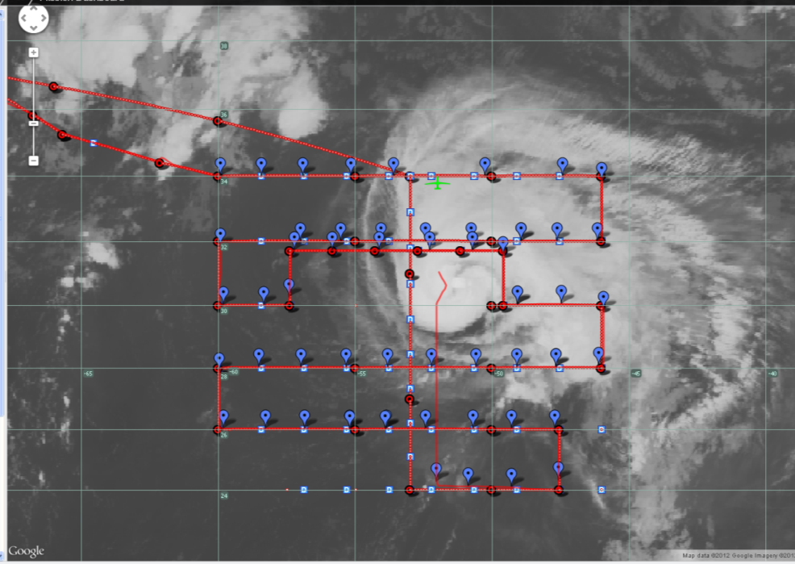
SHOUT 2015
Typical HS3 and SHOUT flight patterns
Butterfly
Racetrack
Racetrack
Rotated
Butterfly
Nadine flight and rapid launch sequence 14 September 2012
Question: What is optimal flight track type,
orientation, sonde numbers to improve model
forecast?
Relative importance of targeting uncertainty
regions vs resolving key features?
Hurricane Edouard, 16 September 2014

Slide 7
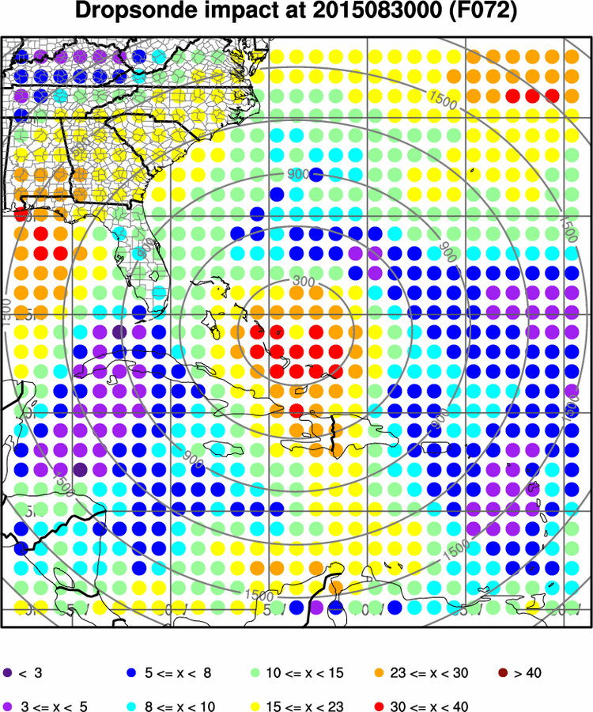
Track sensitivity for Tropical Storm Erica, 2015
Demonstration of forecast sensitivity
targeting with HWRF ensemble, courtesy
Ryan Torn.
Question: What is sufficient number and
location of dropsonde observations to
create an improved positive impact?

Slide 8
Global Hawk operations should be focused on environmental and TC
inner core features with at least as much emphasis, if not more, than
targeting strategies based on model ensembles:
Align storm-relative flight tracks and pattern relative to forecast shear vector.
Fly pattern feature-relative to both TC inner core and environmental features such as:
convective bursts,
outflow jets,
upper cold lows and
subtropical jet streaks
Phasing of flight track modules and sonde deployment should be relative to:
model run time,
Data assimilation times
Estimated RI onset time
Phase of convective diurnal cycle

Slide 9
Further:
Flight pattern and sonde deployment needs to consider timing relative to
concurrent aircraft and satellite spacial coverage and observation times, i.e:
NHC-tasked WC-130J flights,
HRD-tasked WP-3D research flights
EMC-tasked WP-3D Tail Doppler Radar flights
NHC/ EMC-tasked G-IV surveillance flights
Satellite MW imager pass times,
AIRS pass times
AMV wind vector acquisition times.
Scatterometer and SAR pass times and coverage
Flight pattern and sonde deployment needs to consider timing relative to
ocean feature location
and to timing and location of supplemental ocean feature observations from
aircraft and satellite

Slide 10
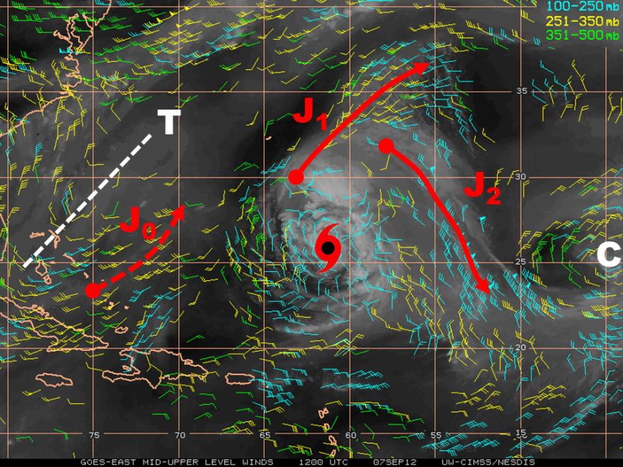
Leslie (7 Sept, 2012) Outflow Jet
Leslie
Outflow jet (J₁ & J₂) configuration established
in response to environmental features:
Mid-Atlantic trough (TUTT), T
Subtropical Jet, J₀
Upper cold low, C

Slide 11
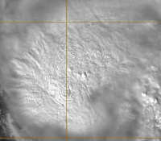
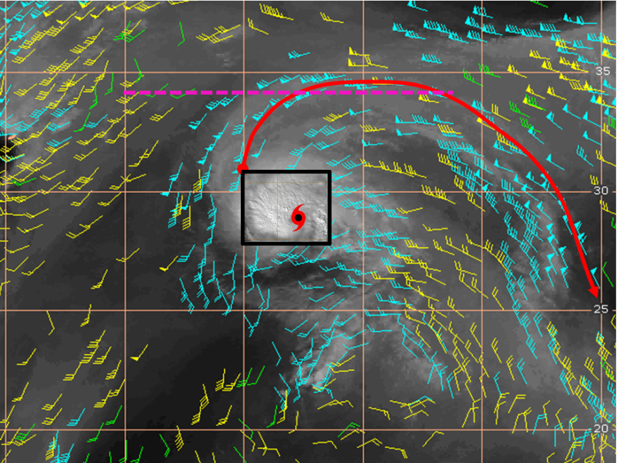
0240-0435Z,
2240-0035L
200 mb
Pre-Gabrielle
4 Sept 18Z, 14L
Convective box
Nadine
14-15 Sept
Nadine
5 Sept 00Z, 20L
5 Sept 06Z, 02L
Outflow Boundary box
2012
2013

Slide 12
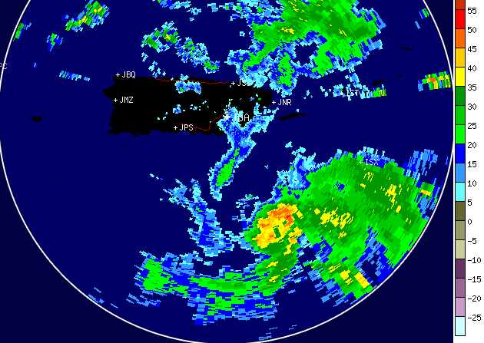
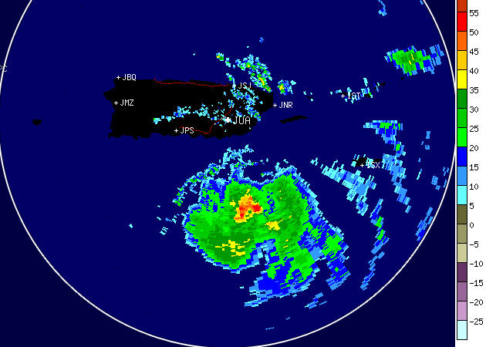
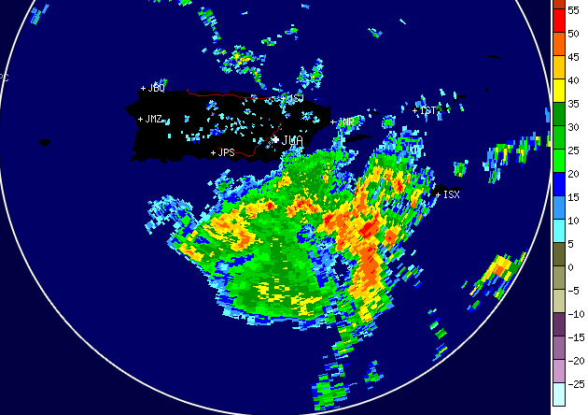
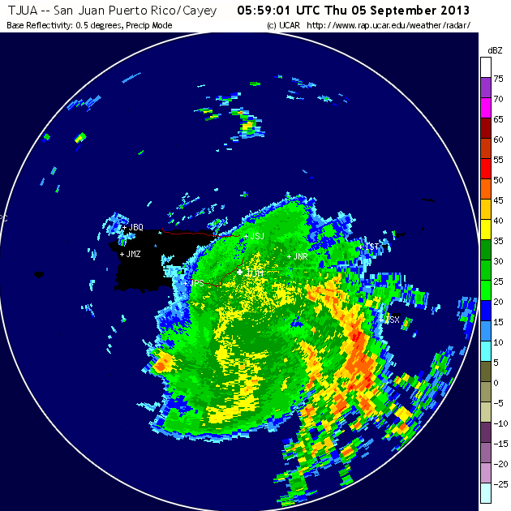
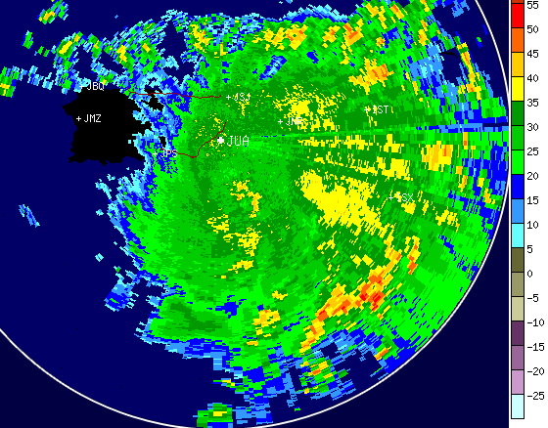
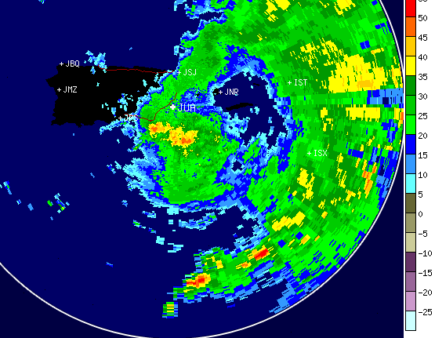
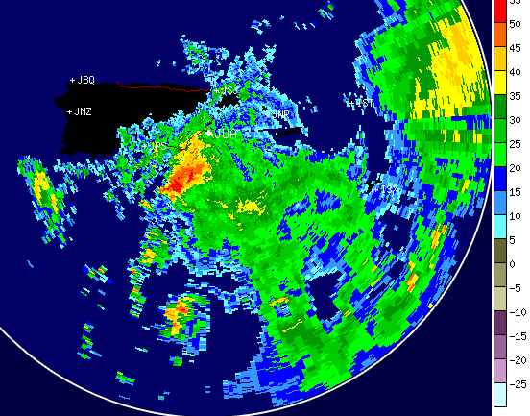
Pre-Gabrielle Convective Development
Cloud Ht
Lhtng
04/2130Z
04/1730L
05/0000Z
05/0330Z
05/0600Z
SJU
radar
04/2130Z
05/0000Z
05/0330Z
05/0600Z
05/0600Z
05/0900Z
05/1200Z
05/1500Z
Pre-Gabrielle 2013

Slide 13
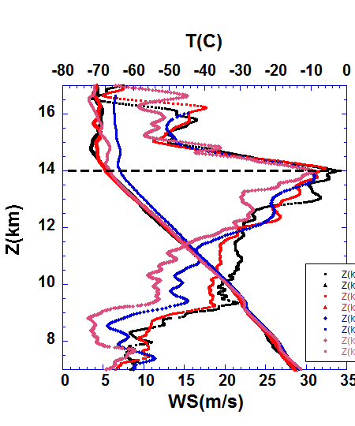
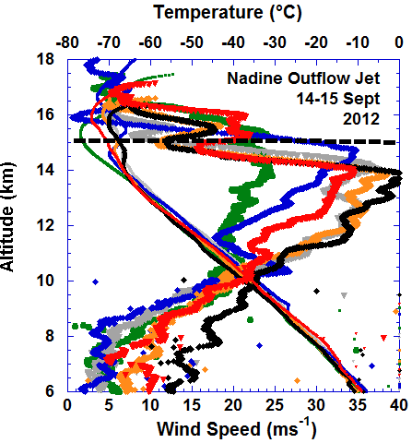
Leslie, 2012
Nadine, 2012

Slide 14
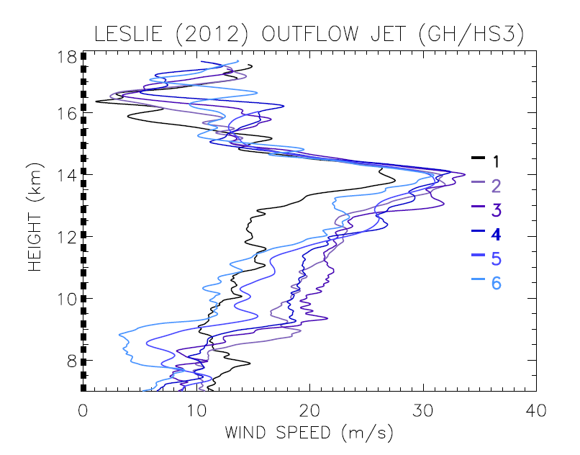
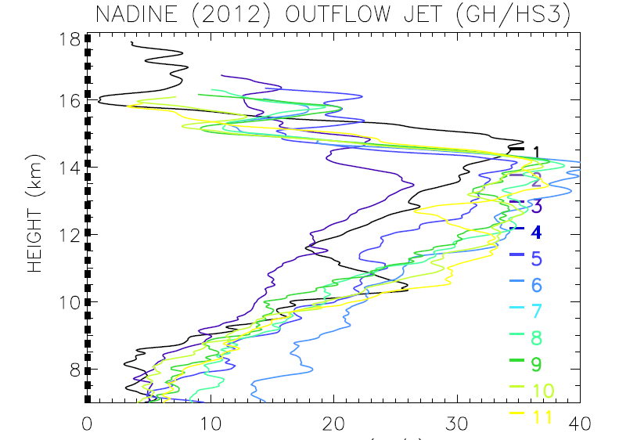
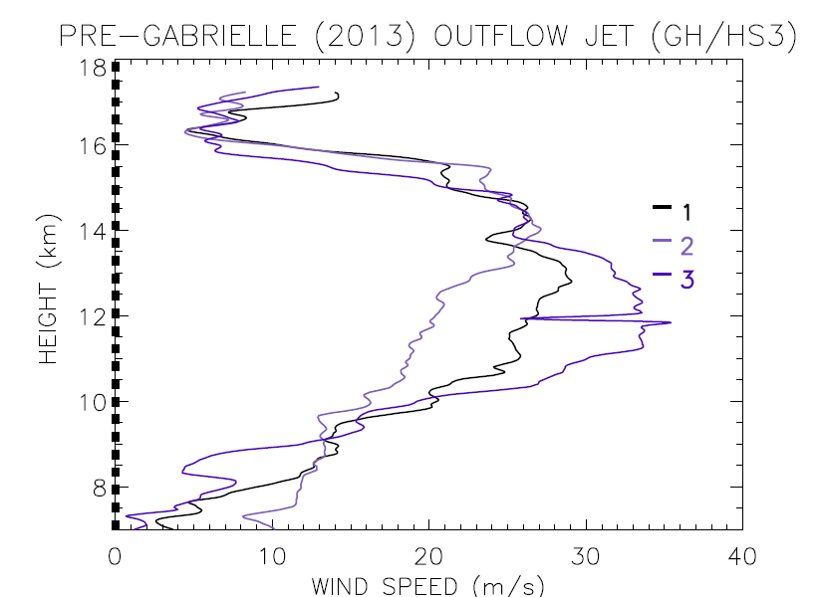
Outflow WIND Profiles:
Different profiles in different storms

Slide 15
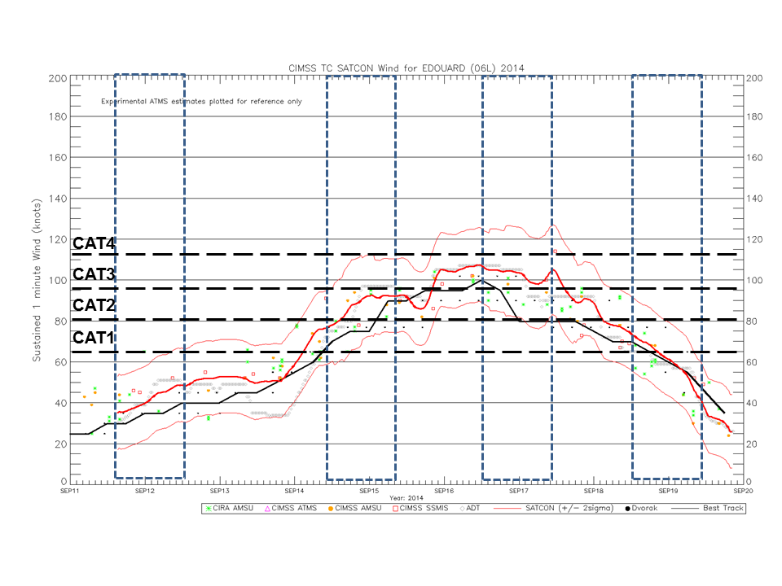
Sampling Strategy I:
Sondes over storm and environment for 18-24 Hr every other day for ~one week.
Edouard 2014
Global Hawk UAV
AVAPS Minisondes
Synoptic Forcing

Slide 16
Phase II
Phase II
Phase I
(Sonde plots courtesy Scott Braun, NASA Goddard)
(Rapid-Scan AMVs courtesy Chris Velden, CIMMS)

Slide 17
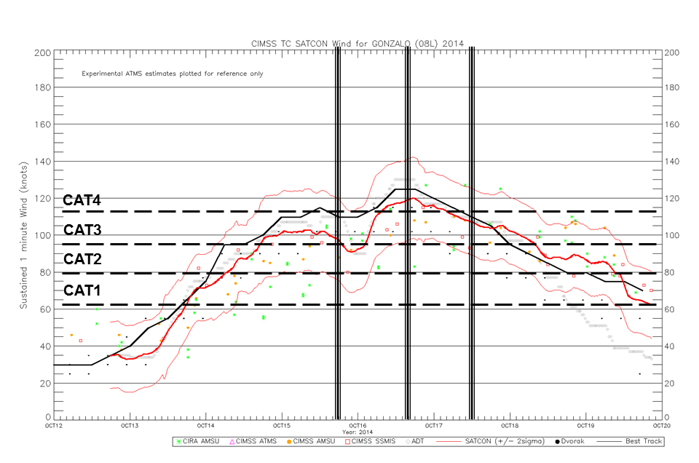
Sampling Strategy II:
Sondes over storm and near-environment for ~3 Hr every 18 Hr for 3-4 days.
Gonzalo 2014
WB-57F
HDSS/ XDD sondes
Convective Forcing

Slide 18
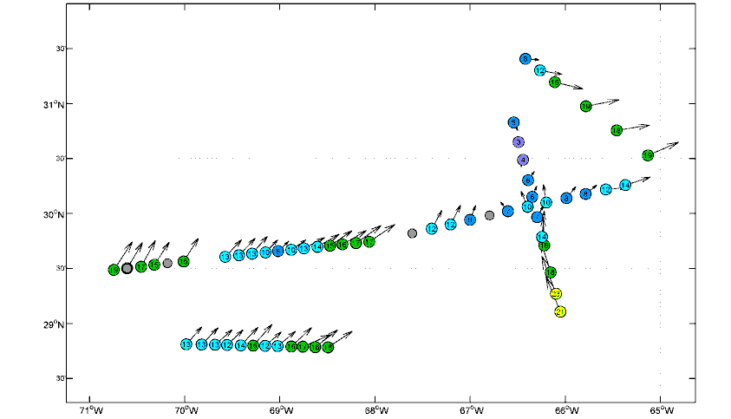
Gonzalo
17 Oct 12Z
Phase II
Phase I

Slide 19
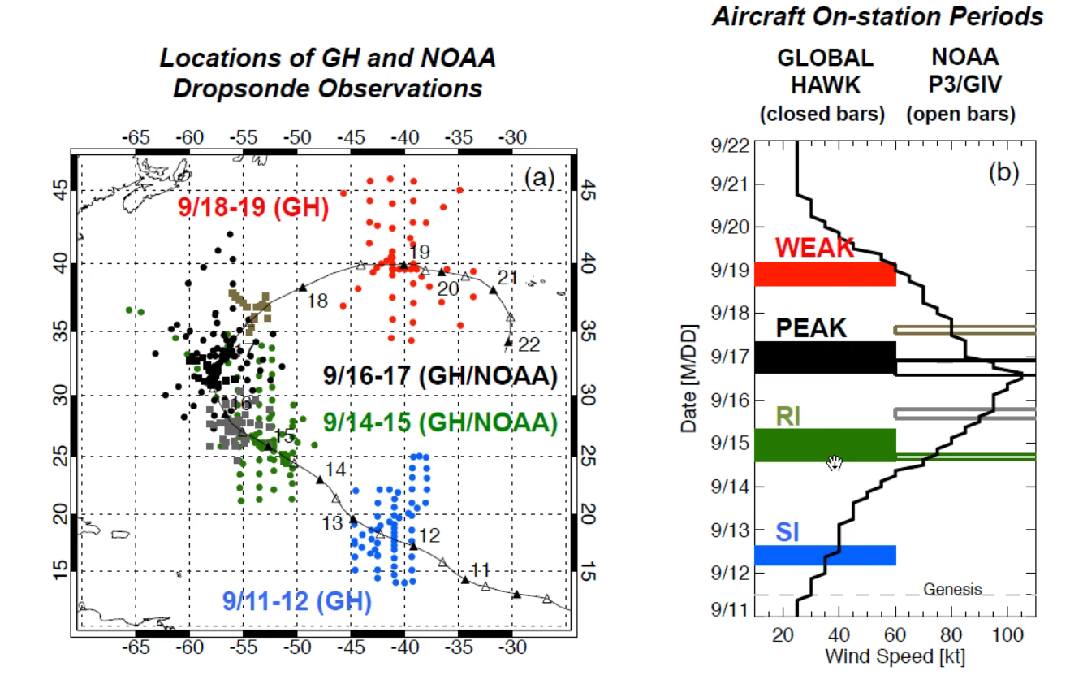
Zawislak, 32HURR

Slide 20
Aksoy, Christophersen, Dahl,
SHOUT Brief 22May16

Slide 21
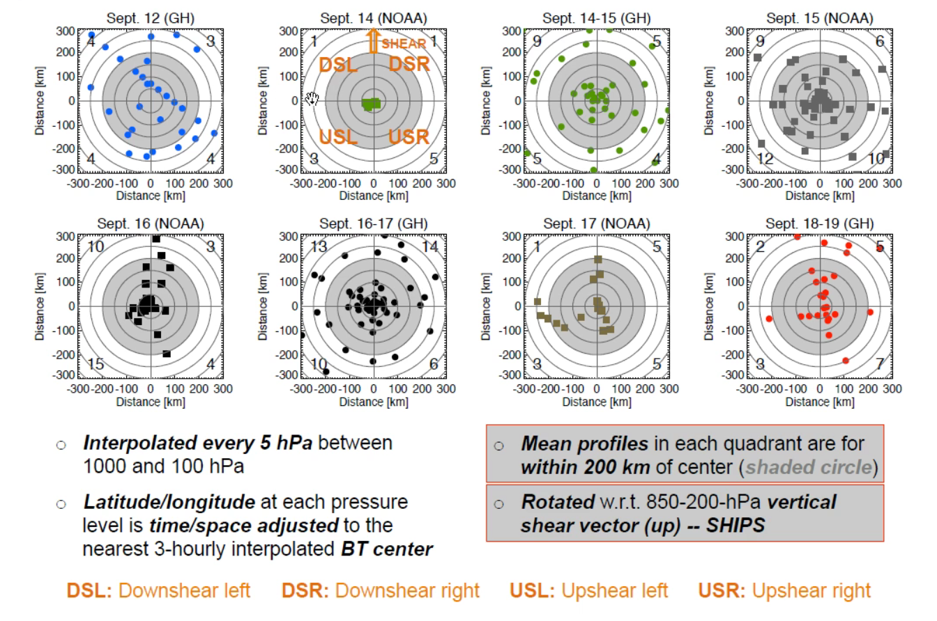
Zawislak, 32HURR Edouard, 2014: Geo-relative drops transformed to shear-relative
Missing Data Domain

Slide 22
Rogers, 32HURR
WP-3D Tail Doppler Radar Reflectivity Vertical Velocity
GH HIWRAP fields to be added

Slide 23
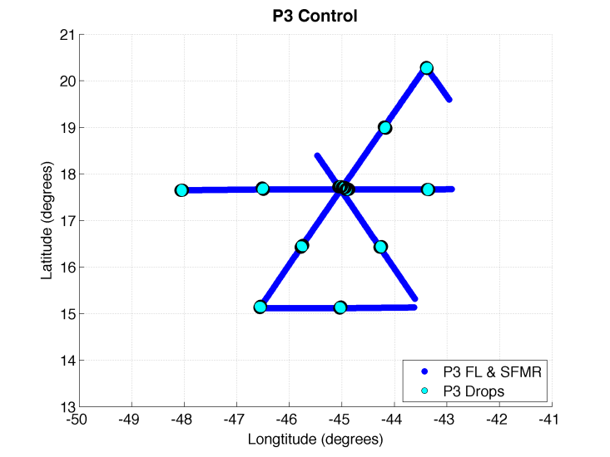
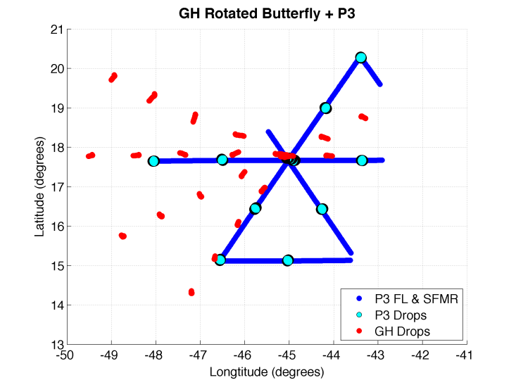
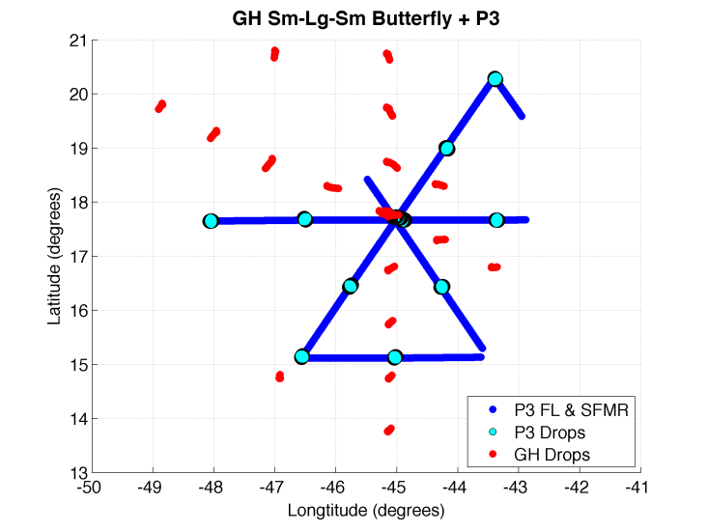
Assimilated Observation Location
Dahl, Christophersen, Aksoy- 32HURR
Full GH flight pattern ~24 hr length, so only a portion falls within the 4-hr data assimilation window.
Control
(P3 only)
+ GH Rotated Butterfly
+ GH Sm-Lg-Sm Butterfly

Slide 24
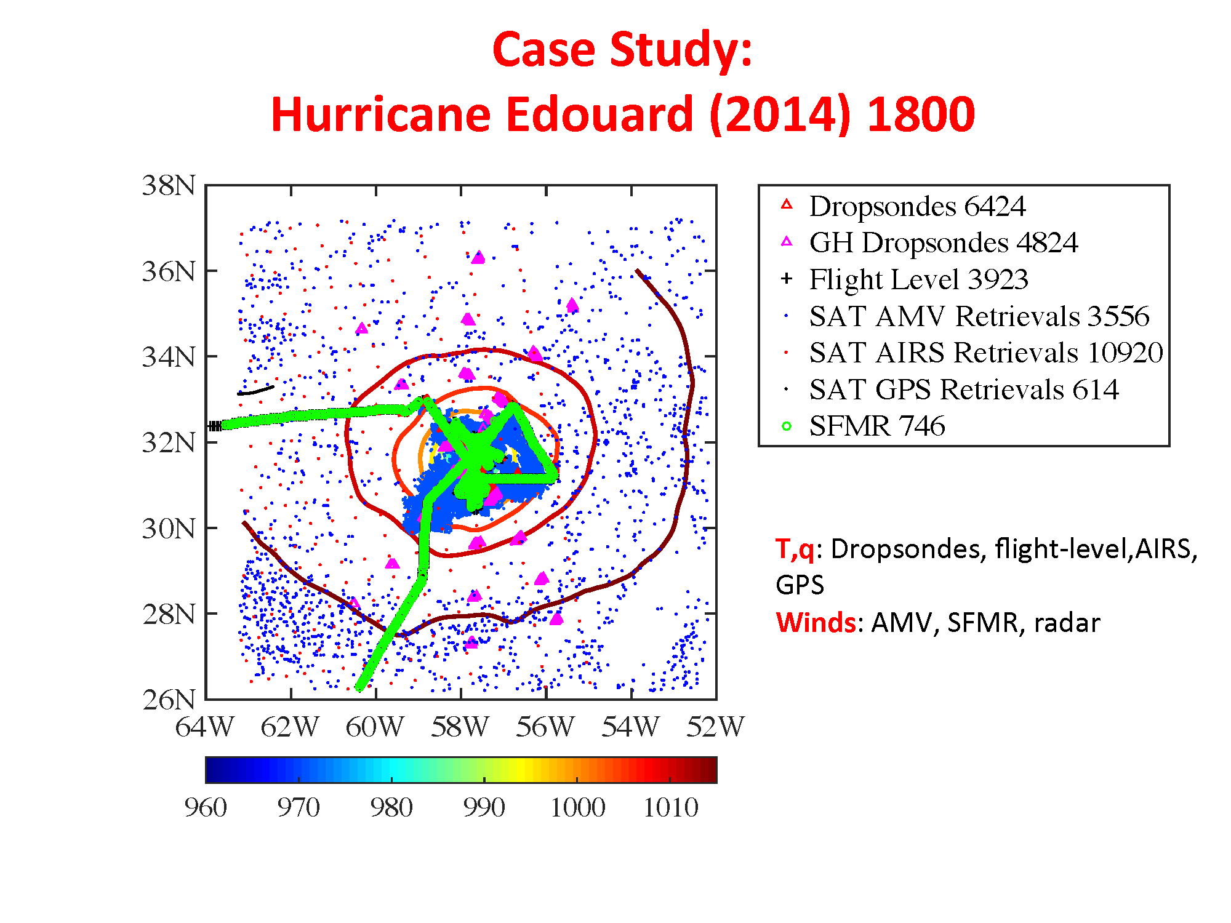
Aksoy, Christophersen, Dahl- 32HURR
AIRS swath
Aircraft drops/ SFMR relative to AIRS & AMVs

Slide 25
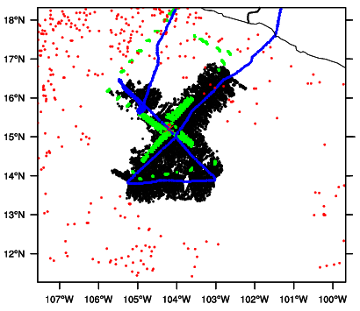
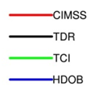
Patricia: TCI
22 Oct, 2015 1800 UTC
X. Lu & X. Wang, 32HURR
Shear
Motion
No AIRS
AMVs
P3
WB-57F
HDSS XDDs
P3 SFMR

Slide 26
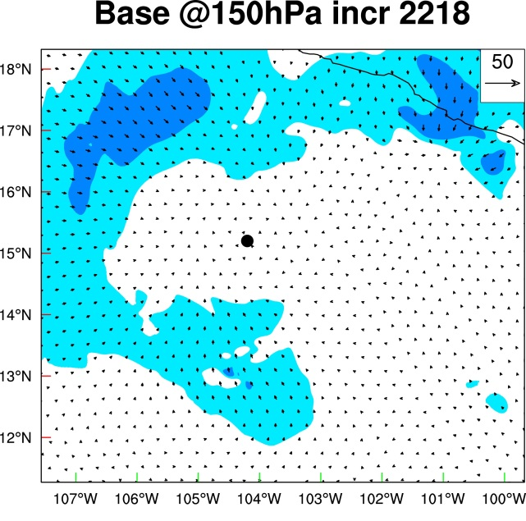
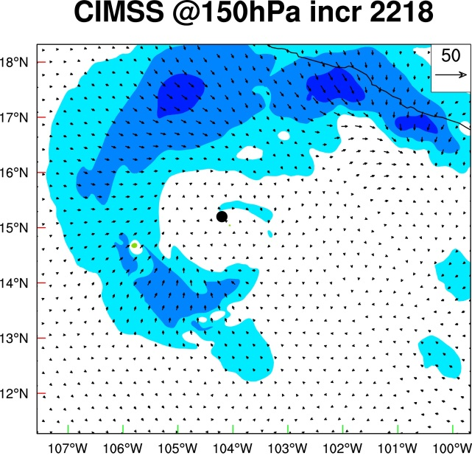
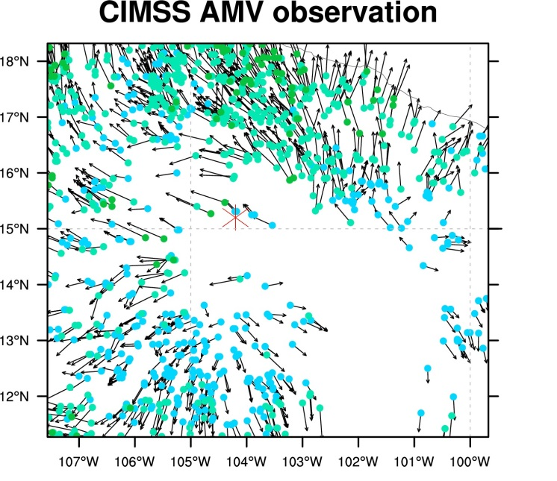
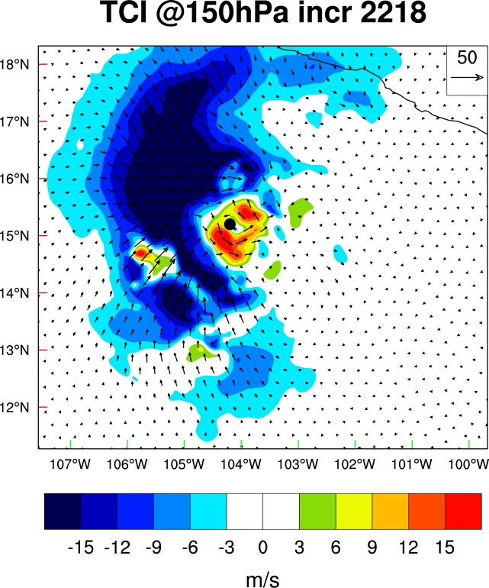
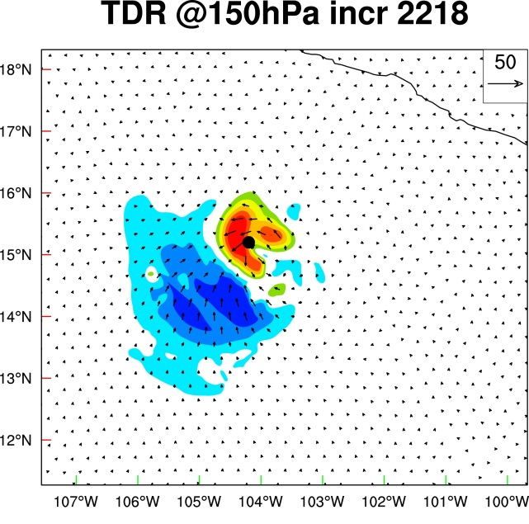
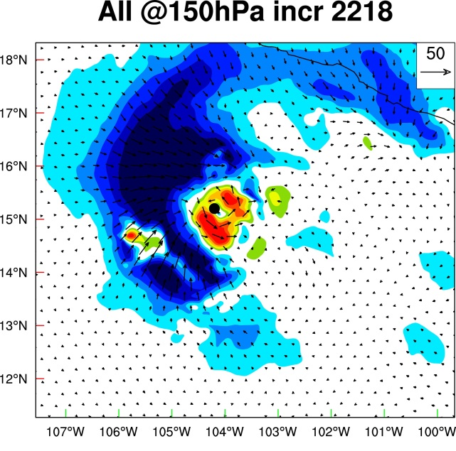
Patricia,
2015
X. Lu & X. Wang, 32HURR- AMV & XDD sondes improve Base

Slide 27
15 Feb 2016
ENRR#2

Slide 28
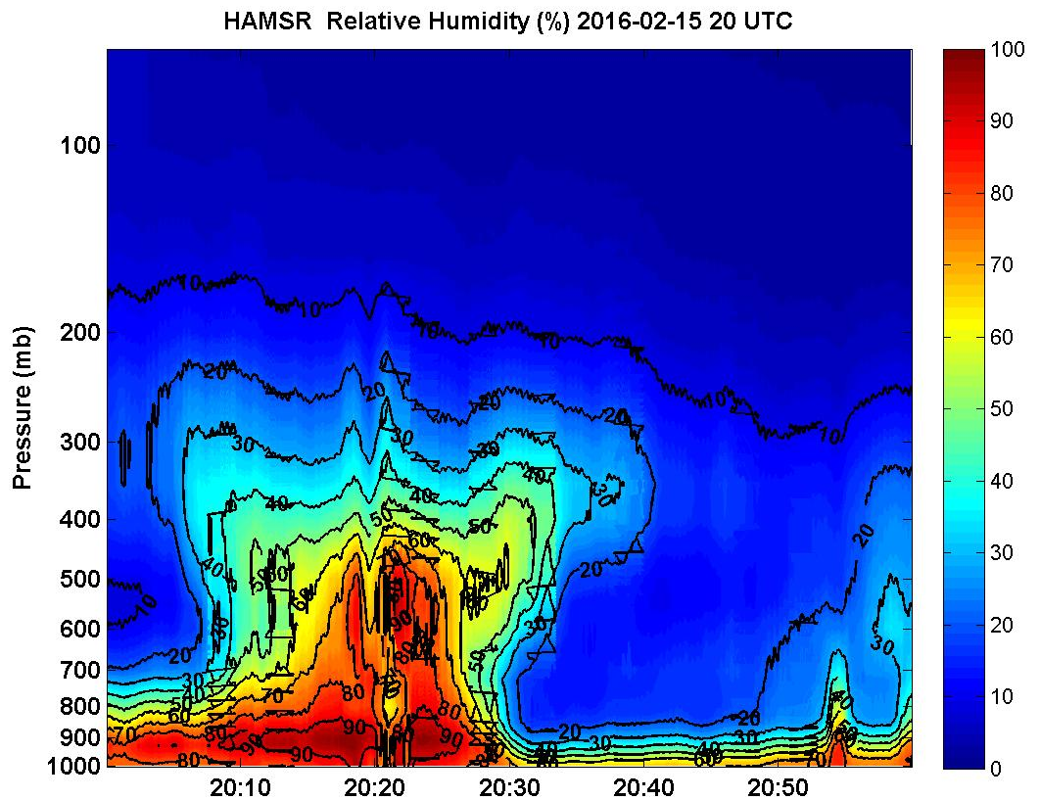
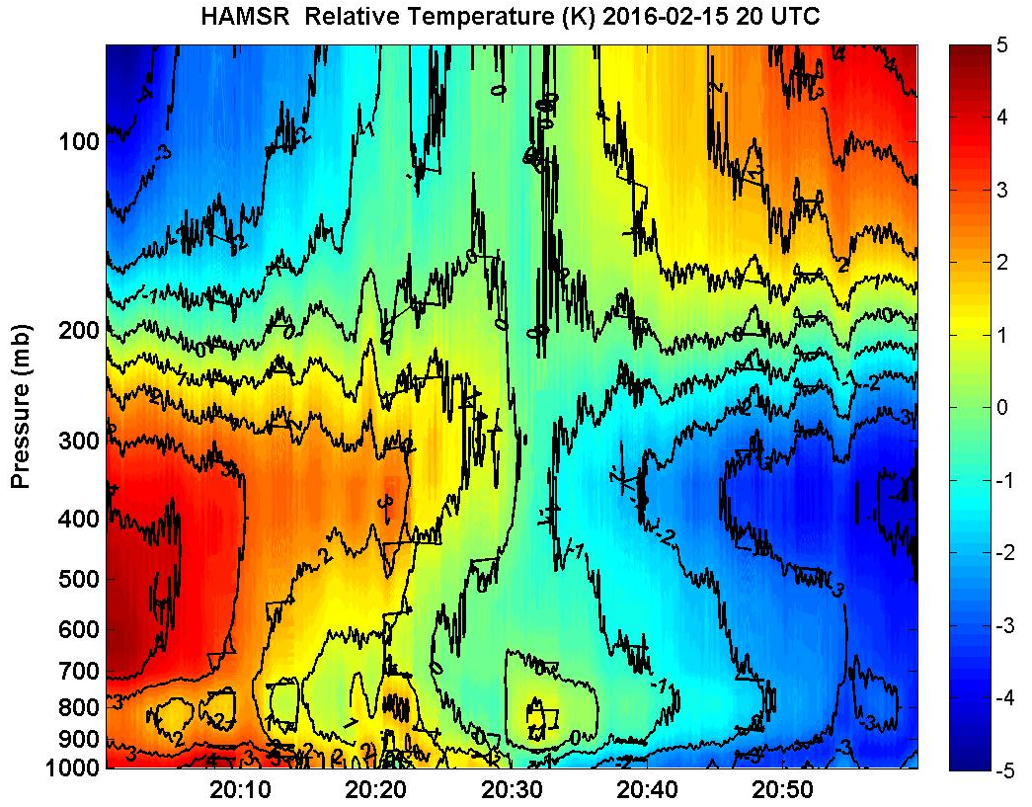

Slide 29
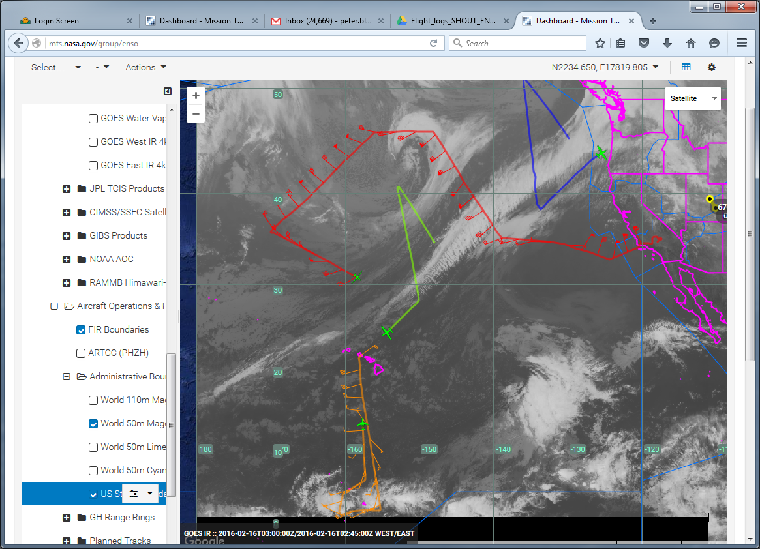
PJ
ETL
AR
AF1
STJ
GH
AR
AF2
STL
GIV
CEF
15 Feb 2016
ENRR#2

Slide 30
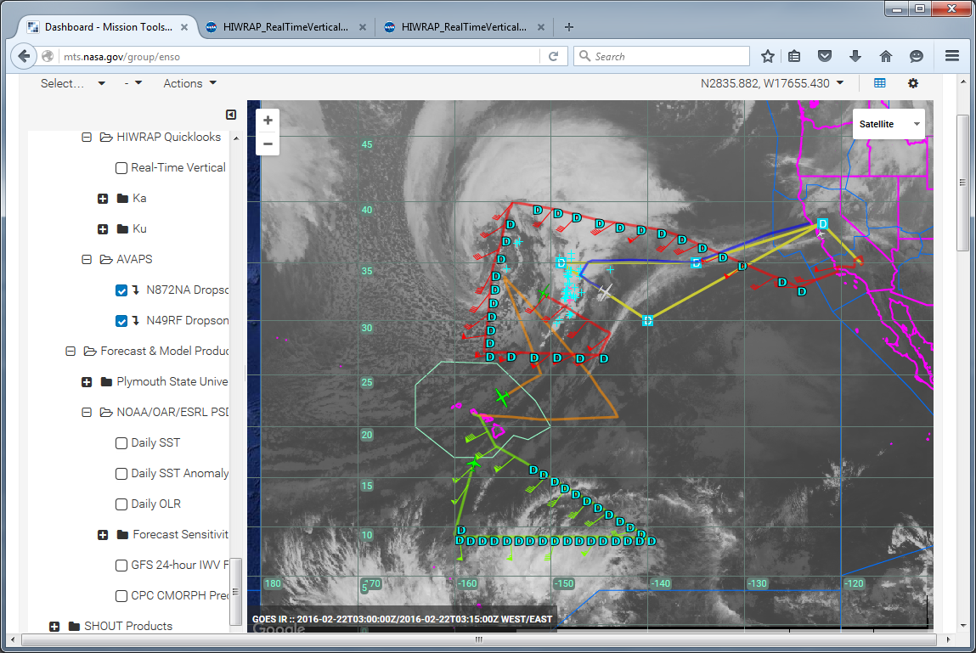
AR
PJ
ETL
STJ
AF1
GH
AF2
AR
GIV
CEF
22 Feb 2016
ENRR #3

Slide 31
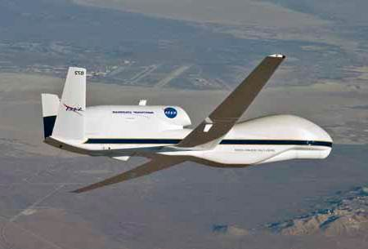
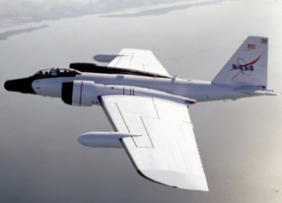
Observational Summary
Six TC outflow layers sampled 2012-14 HS3/ Global Hawk: Leslie, Nadine, Pre-Gabrielle, Edouard; One partial 2014 TCI/ WB-57: Gonzalo; One partial dissipating TS: 2015 SHOUT/GH: Erika; 2 CAT5 2015 TCI/ WB-57: Patricia, Joaquin
Outflow layer jets sometimes precede intense inner core convection
Some thin peripheral outflow jets appear to be forced by environmental features: Leslie
Subtropical jets
Upper cold lows
Tropical Upper Tropospheric Troughs (TUTTs)
Thick inner-core outflow jets associated with convective bursts: Nadine, Pre-Gabrielle, Edouard: enhanced outflow pre-conditions TC
for future intensification or RI: dual outflow jet development
Dual poleward and equatorward jets associated with RI: Edouard, Gonzalo
Here-to-for unknown outflow jet fine-structure may lead to instabilities which enhance outflow layer mixing not yet adequately modelled.
Outflow jets appear to have diurnal modulation in response to convective bursts.

Slide 32
Flight Plan
Strategy
Summary
Pattern alignment
Storm-relative
Shear-Relative
Earth-relative
Feature-Relative
Inner-core features
Convective bursts
Outflow Roots
Environmental features
Outflow jets
Upper cold lows
Subtropical jet streaks
Ocean features
Pre-existing eddies
Cold wake
Pattern Temporal Phasing
DA cycle
RI onset time
Diurnal convective/outflow surge onset
Collaborative Observation times
Aircraft
Satellite

