Slide 1
Recent developments towards a seamless prediction in JMA global ensemble prediction system
EMC seminar 5/20/2016
Yoichiro Ota and Daisuke Hotta
(Japan Meteorological Agency / Numerical Prediction Division)

Slide 2
Introduction
JMA operates three global ensemble prediction systems (EPS) for medium range to sub-seasonal prediction.
There are ongoing developments toward unifying these existing EPSs into one global EPS.
  Seamless prediction from short to sub-seasonal timescales.
  Update the forecast model to the latest version of the Global Spectral Model (GSM).
  Better representations of the errors in EPS
    Use of the EnKF perturbations as initial perturbations
    Introduction of SST perturbations
Focus of this talk

Slide 3
Operational global EPSs in JMA
 | Typhoon EPS | One-week EPS | One-month EPS
Main targets | Typhoon forecast | One-week forecast | Two-week to one-month forecast
Frequency | 4 times a day (at maximum) | 2 times a day | Sat., Sun. and Tue., Wed.
Forecast range | 5.5 days | 11 days | 18 days(Sat., Sun.) 34 days(Tue., Wed.)
Ensemble size | 25 | 27 | 50 (25x2 with LAF)
Resolution | TL479L60 (Model top: 0.1hPa) |  | TL319L60 (0.1hPa)
Initial Perturbations | SV (NW Pacific, TC areas) | SV (NH, TR and SH) | BGM (NH and TR)
Model ensemble | Stochastically Perturbed Physics Tendency (SPPT)
Boundary Perturbations | None
Different configurations for each EPS depending on the main target
Significant costs on developments and maintenance of multiple EPSs
→ Plans to unify three existing EPSs to one global EPS

Slide 4
Plan of new global EPS
 | Global EPS
Main targets | Typhoon forecast, One-week to One-month forecast
Frequency | 4 times a day when TC exists, 2 times a day otherwise
Forecast range | 5.5 days (06,18UTC), 18 days (00,12UTC) 34 days (00,12UTC on Tue. and Wed.)
Ensemble size | 27 upto 11 days, 17 afterwards
Resolution | TL479L100 (Model top: 0.01hPa) upto 18 days, TL319L100 afterwards
Initial Perturbations | SV (NH, TR and SH) + LETKF
Model ensemble | Stochastically Perturbed Physics Tendency (SPPT)
Boundary Perturbations | Perturbations on SST
New Global EPS will cover from Typhoon forecast to One-month prediction
More efficient developments and maintenance of the operational EPS using a single global EPS
Plans to implement with the latest version of the GSM
Target on 2017 spring implementation

Slide 5
Upgrades on GSM
Recent major upgrades to GSM
  March 2014: Enhance the number of vertical layers from 60 to 100, raise model top from 0.1hPa to 0.01hPa and improvements on the parametrizations
  March 2016: Significant upgrades to the parametrizations
  Noting significant changes and improvements on the analysis and forecast accuracy.
Current operational global EPSs use old version of GSM before 2014 upgrades
  Plans to use the latest version of GSM with some additional features for the developments towards next version of GSM.

Slide 6
Use of the EnKF perturbations

Slide 7
Initial perturbation of operational one-week EPS
Evolved SV
Initial SV at the past analysis time evolved with linear model
+/- pairs
+
Initial Perturbations
Initial SV
Linear combinations
Initial SVs can grow fast and capture
  Baroclinic instability for mid-latitudes
  Convective mode in the tropics
Initial SVs have very limited spatial coverages
Evolved SV is the initial SV at the past analysis time evolved with a linear model
  Crude approximation of analysis error
  Mitigate the issue of the limited spatial coverage of initial SVs

Slide 8
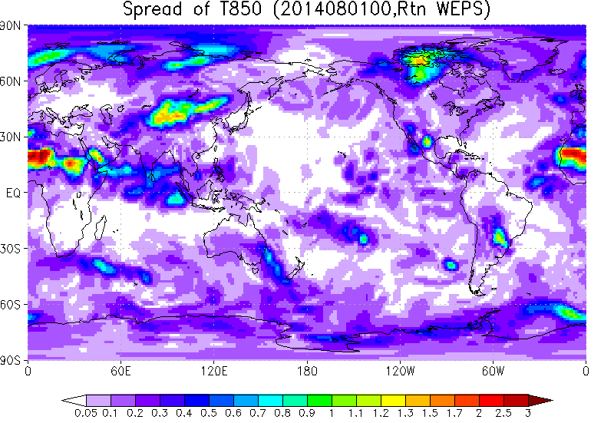
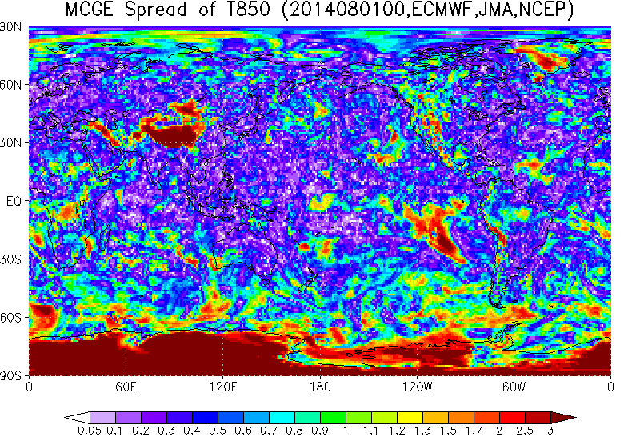
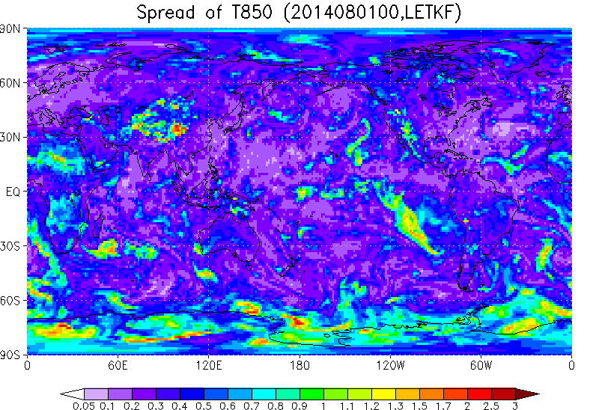
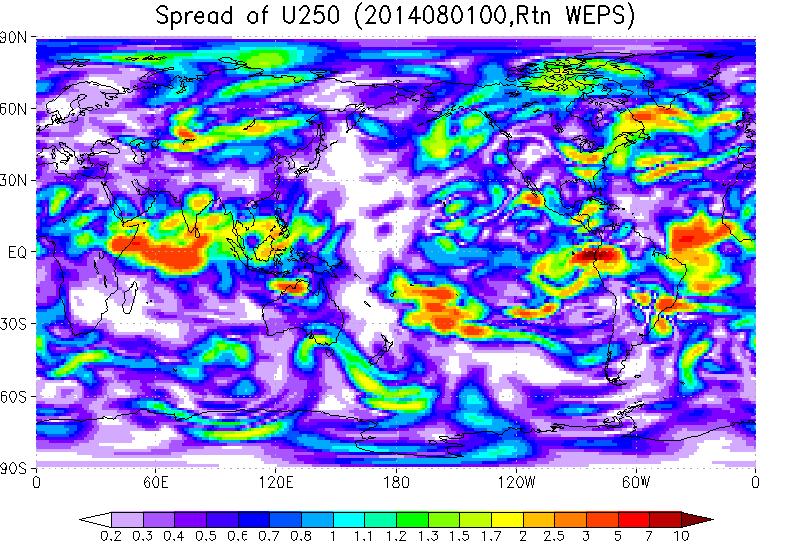
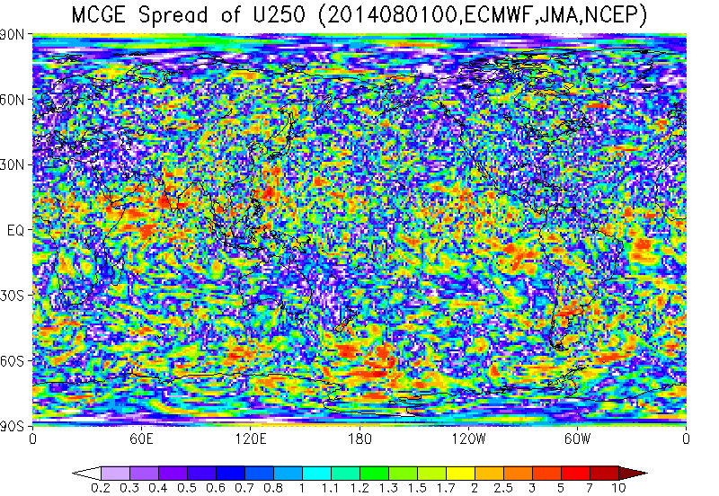
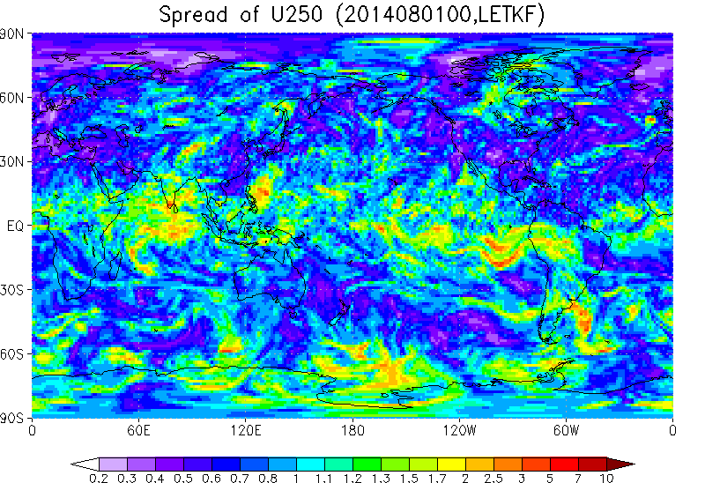
Comparison of the initial spreads (Aug. 1, 2014)
T850
U250
Operational One-week EPS
Spread of the multi-center analysis (ECMWF, NCEP and JMA)
Spread of LETKF analysis
Better representations of analysis uncertainty with LETKF
Initial perturbations constructed from SVs can grow fast but not be a good approximation of analysis error covariance.
Try to use LETKF perturbations as initial perturbations.

Slide 9
Experimental Settings
LETKF
  TL319L100 with 50 member ensembles
  Localization scale 400 km in horizontal, 0.4 scale height in vertical
  Adaptive multiplicative inflation
  Assimilate all operationally used observations except for AIRS and IASI
  Initialization based on surface pressure tendency analysis (Hamrud et al. 2015)
  Replace ensemble mean analysis with deterministic (4DVar) analysis
Ensemble forecasts
  1 control run + 12 perturbed runs
  5.5 days forecast using GSM with TL479L100
  LETKF: use LETKF perturbations
  SV: use perturbations of operational one-week EPS, but the initial amplitude in tropics is an half of the operational setting

Slide 10
Errors verified against observations and spread
Let x_{t} is truth and
is ensemble mean forecast.
Forecast error against observation y_{o}:
Observation error:
When the forecast has no systematic bias and spread s is adequate,
…(1)
m: ensemble size
<>: expectation
Underdispersive
Check initial spread using the verification against observations (radiosonde)
Adequate
spread
Square root of LHS of (1)
Overdispersive
Equal size binned average sorting with RHS of (1)
Square root of RHS of (1)

Slide 11
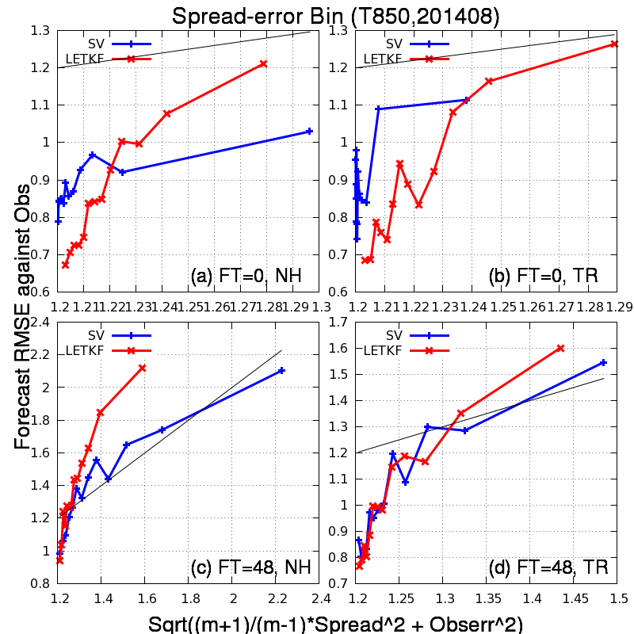
Error against observations and spread
T850
Slightly overdispersive for both experiments on initial time
SV (blue lines)
Most bins have small spread and the largest bin is separated from others.
Unclear spread-error relations
Adequate spread on 48 hour lead time.
LETKF (red lines)
All bins are distributed evenly
Clear spread-error relations
Underdispersive on 48 hour lead time for large RMSE

Slide 12
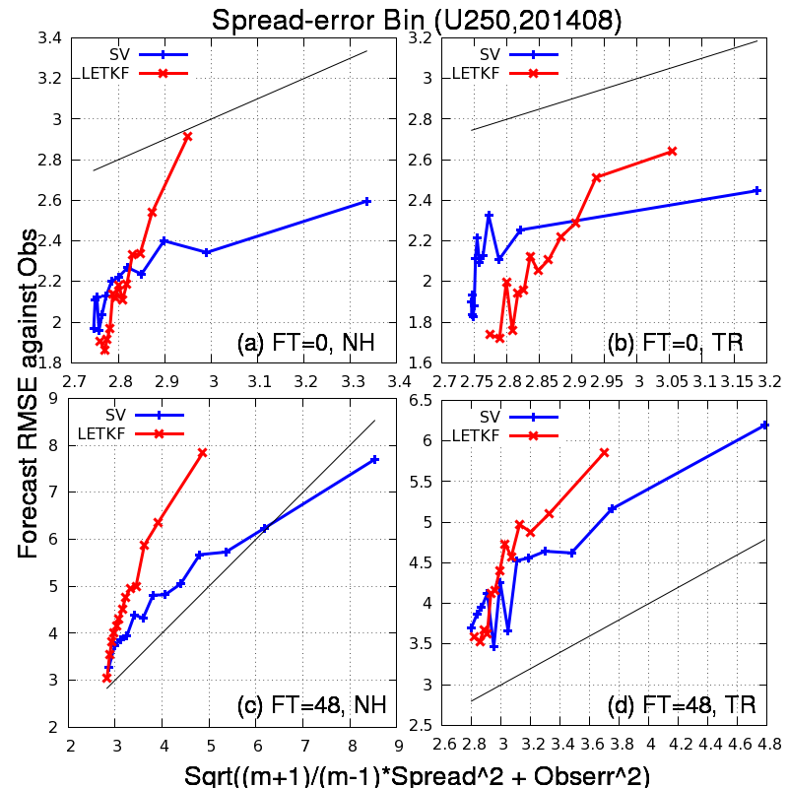
Error against observations and spread
U250
Slightly overdispersive on initial time and underdispersive on 48 hours lead time in Tropics.
SV (blue lines)
Most bins have small spread and the largest bin is separated from others.
Unclear spread-error relations
Slightly underdispersive on 48 hour lead time in Tropics but better than LETKF
LETKF (red lines)
All bins are distributed evenly
Clear spread-error relations
Significantly underdispersive for large error bins on 48 hour lead time.

Slide 13
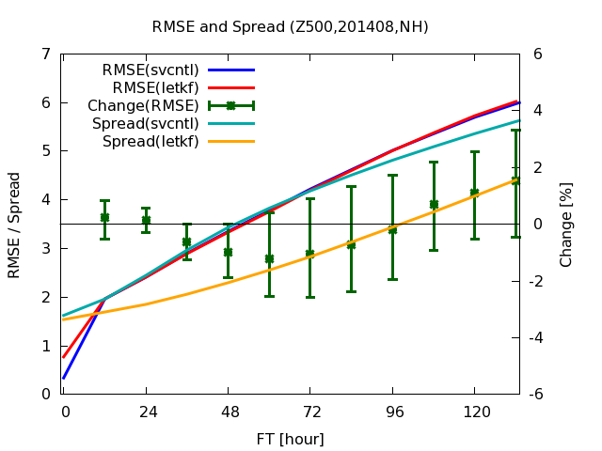
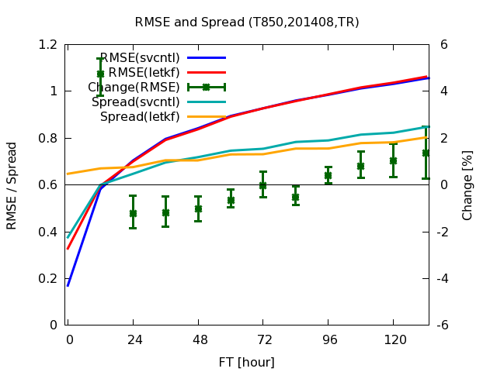
Ensemble mean RMSE and spread
Degrade
NH Z500
TR T850
Improve
Ensemble mean RMSE (Blue:SV, Red:LETKF), spread (Aqua:SV, Orange:LETKF) and normalized RMSE difference (green). Error-bars represent 95% confidence intervals
Neutral to positive impacts for short-range forecasts, but degraded for medium-range.
Underdispersive for LETKF on longer forecasts especially in extra-tropics.
LETKF represents forecast error covariance better for short-range.
But, perturbation growth is slower and medium-range forecasts are degraded.

Slide 14
Possible reasons of underdispersiveness
Covariance localization may destroy large-scale correlations on perturbations and the dynamic balance between control variables
  Using limited ensemble size, localization is necessary to reduce sampling error
  It is desirable to use larger ensembles
Uncertainty and imperfectness of the forecast model and boundary conditions are not represented enough.
  Need more sophisticated model ensemble and perturbations on boundary conditions.
We have to take some measures to implement the EnKF perturbations to the operational EPS.

Slide 15
LETKF + Initial SVs
Initial perturbations from LETKF are supposed to approximate analysis error covariance. → Use LETKF perturbations instead of evolved SVs
Use initial SVs as a temporal solution to mitigate the underdispersiveness on medium-range forecast.
Based on above ideas, LETKF and initial SVs are combined for global EPS experiment.
Decide initial amplitudes
Amplitude of initial SVs is set almost equal to that of the operational one-week EPS.
Minimal adjustments to the amplitude of the LETKF perturbations for adding initial SVs

Slide 16
Experimental settings
SV
  Combinations of Initial SVs and Evolved SVs
  NH, SH: 0.3 times of the climatological variance of T500
  TR: 0.15 times of the climatological variance of T850
LETKFSV
  Combinations of Initial SVs and LETKF
  NH, SH: 0.24 times of the climatological variance of T500
  TR: 0.07 times of the climatological variance of T850
  LETKF: 0.85 times of the original analysis perturbations
Ensemble size: 13, Forecast range: 11 days
Experimental periods
  Summer: 00UTC initials from August 1 to August 31 of 2014
  Winter: 00UTC initials from January 1 to January 31 of 2014 (not shown)
  TC season: 12UTC initials from September 13 to October 13 of 2014
  (Verification results are compared with the Typhoon EPS)
Based on Initial SV+Evolved SV
Initial SV only
Check if this setting can replace Typhoon EPS

Slide 17
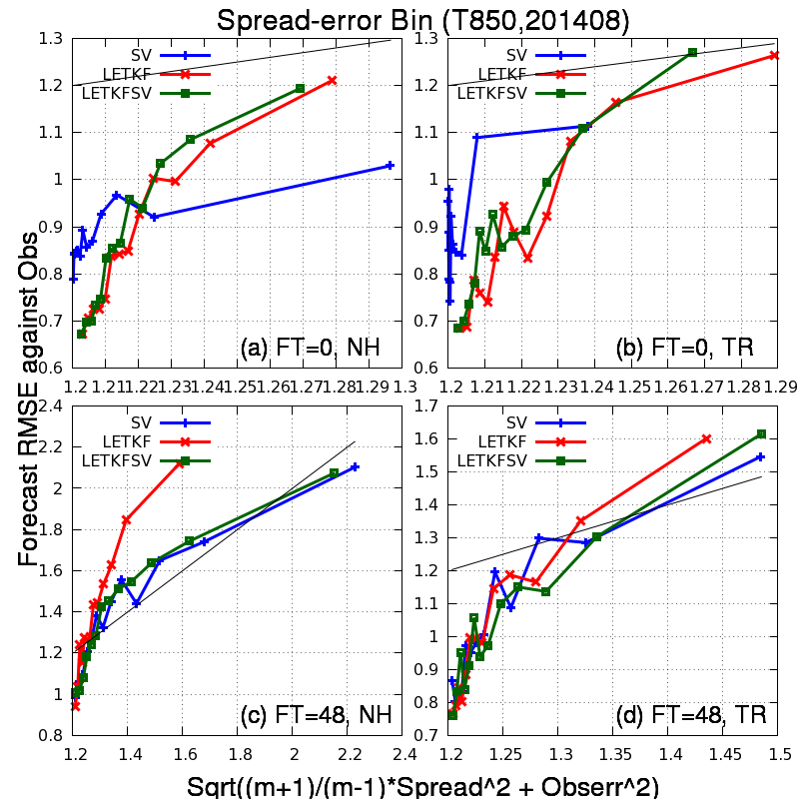
Error against observations and spread
T850 (Summer)
Blue: SV
Red: LETKF
Green: LETKFSV
Similar to LETKF on the initial time
Clear spread-error relation
All bins are evenly distributed.
Similar to SV on 48 hour forecasts
Almost appropriate spread
Could mitigate the underdispersiveness seen on LETKF

Slide 18
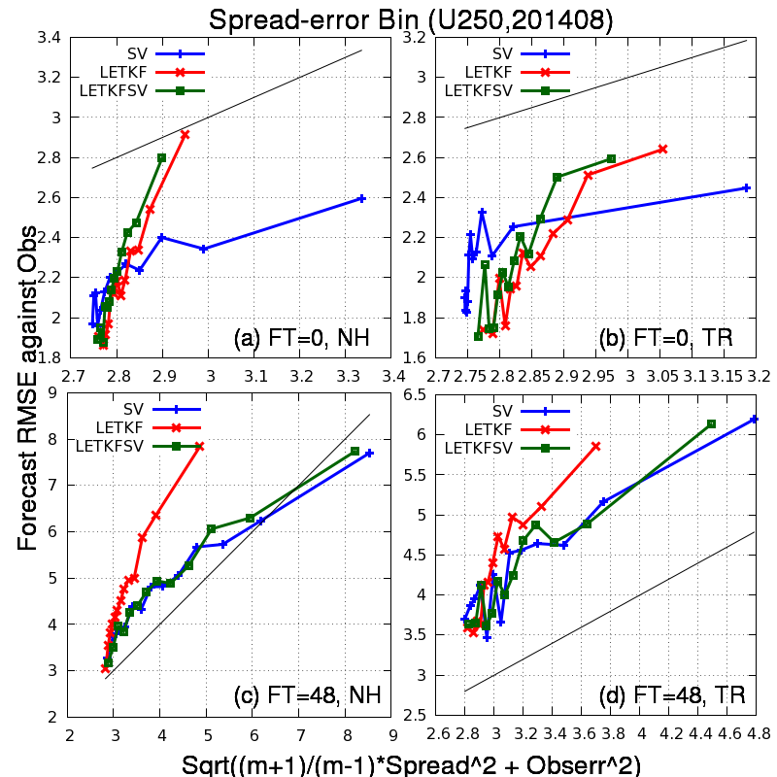
Error against observations and spread
U250 (Summer)
Blue: SV
Red: LETKF
Green: LETKFSV
Similar to LETKF on the initial time
Clear spread-error relation
All bins are evenly distributed
Similar to SV on 48 hour forecasts
Almost appropriate spread
Still underdispersive in Tropics, but better than just using LETKF

Slide 19
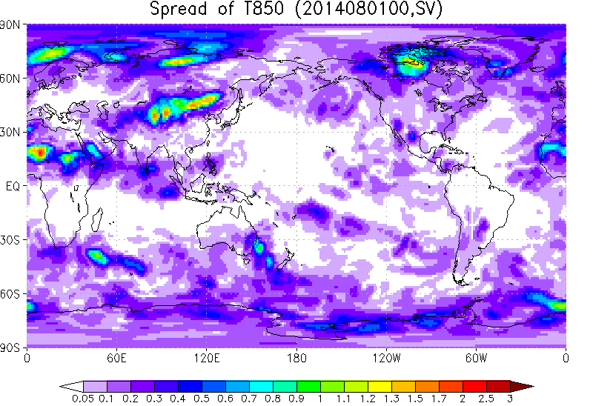
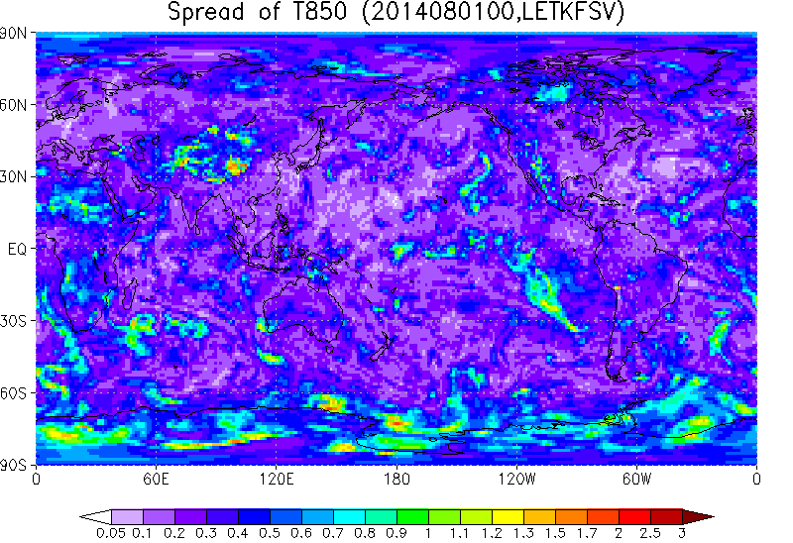
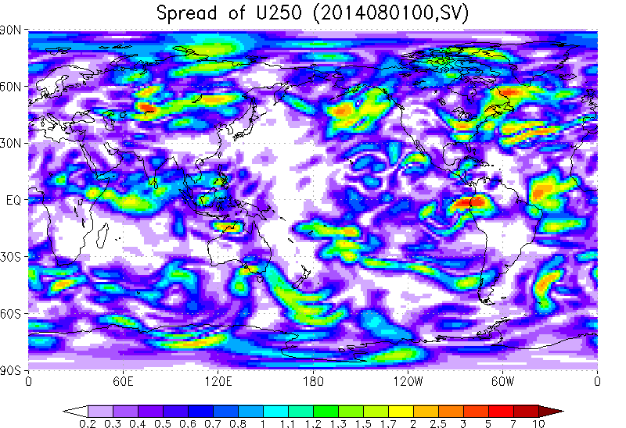
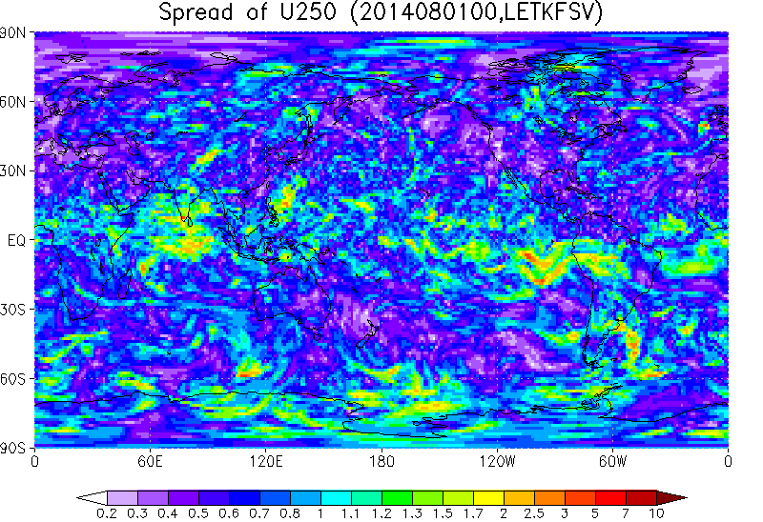
Comparison of spread (initial time)
SV
LETKFSV
LETKF
Initial spread on 00UTC August 1, 2014 (upper: T850, lower: U250)
Initial spread of LETKFSV is similar to that of the LETKF.

Slide 20
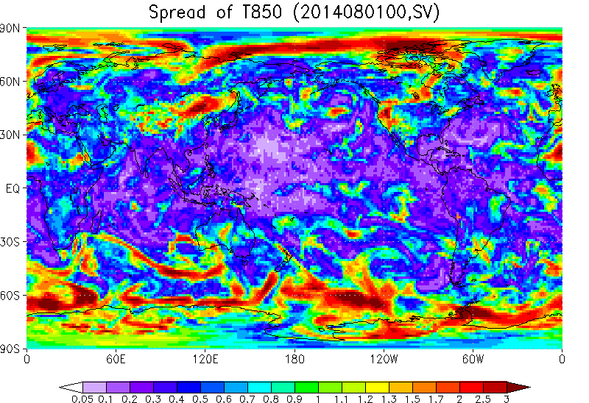
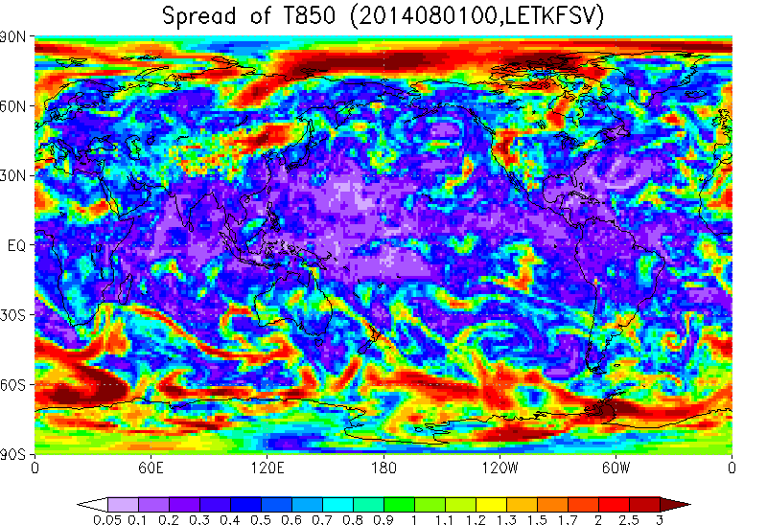
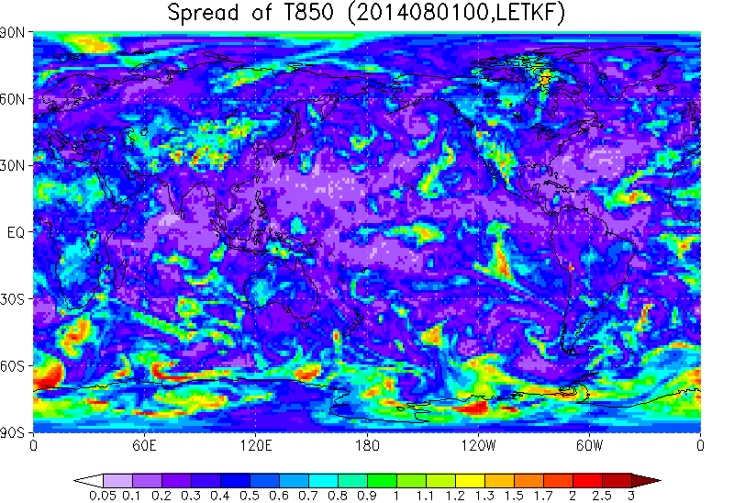
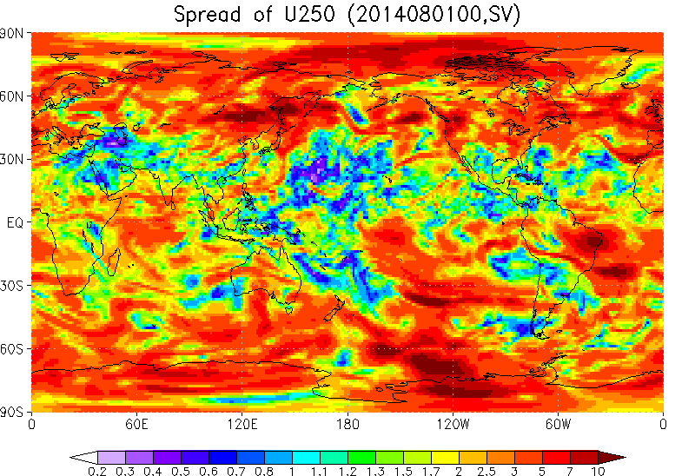
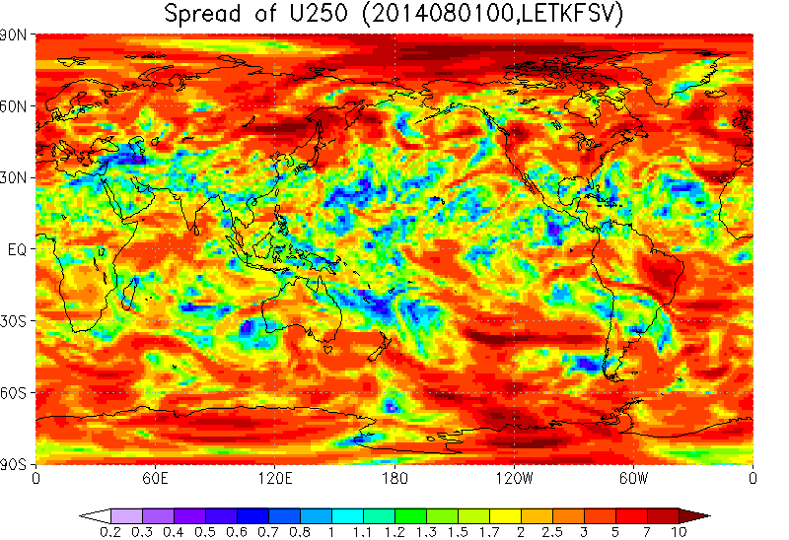
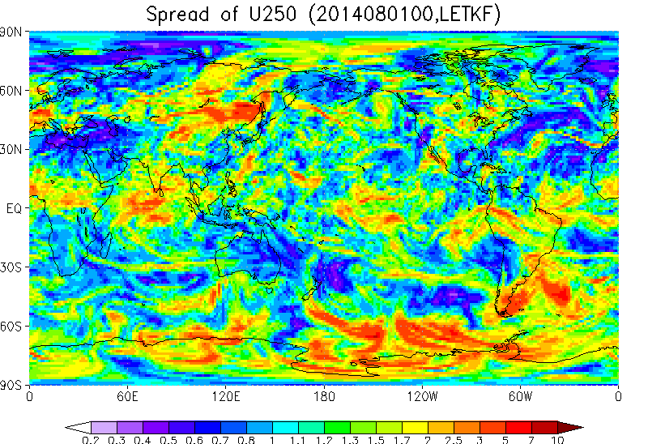
Comparison of spread (48 hour lead-time)
SV
LETKFSV
LETKF
48 hour forecast spread on 00UTC August 1, 2014 (upper: T850, lower: U250)
Spread of LETKFSV is getting similar to that of SV on 48 hour forecasts
LETKFSV has larger spread where SV has very small spread especially in Tropics.

Slide 21
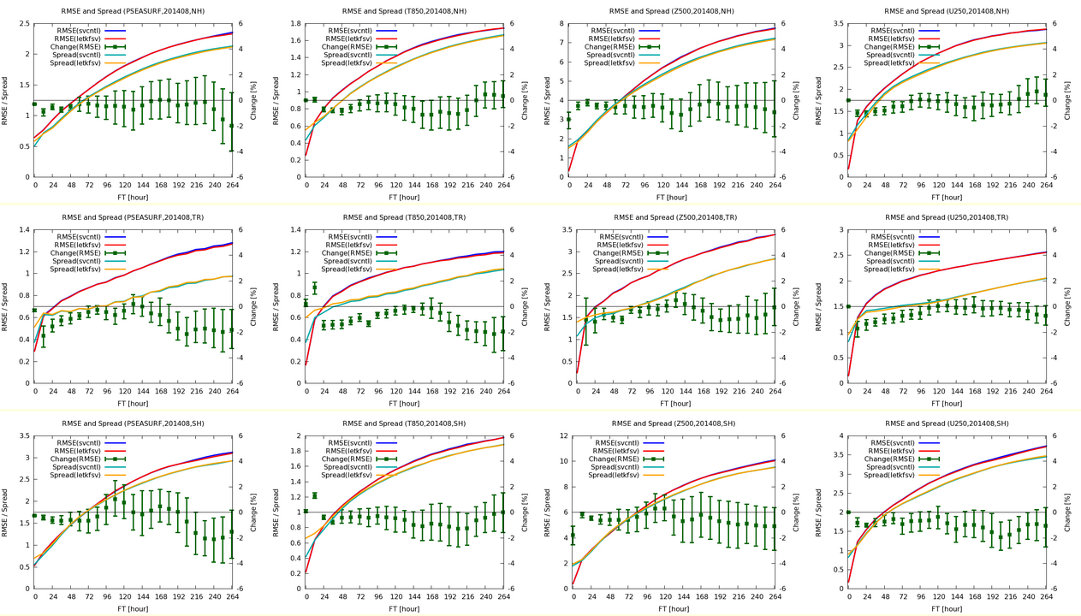
Ensemble mean RMSE and spreads (Summer)
RMSE reduced
NH
TR
SH
PSEA
T850
Z500
U250
Blue: Ensemble mean RMSE (SV), Red: Ensemble mean RMSE (LETKFSV)
Green: Normalized difference of RMSE, Aqua: Spread (SV), Orange: Spread (LETKFSV)

Slide 22
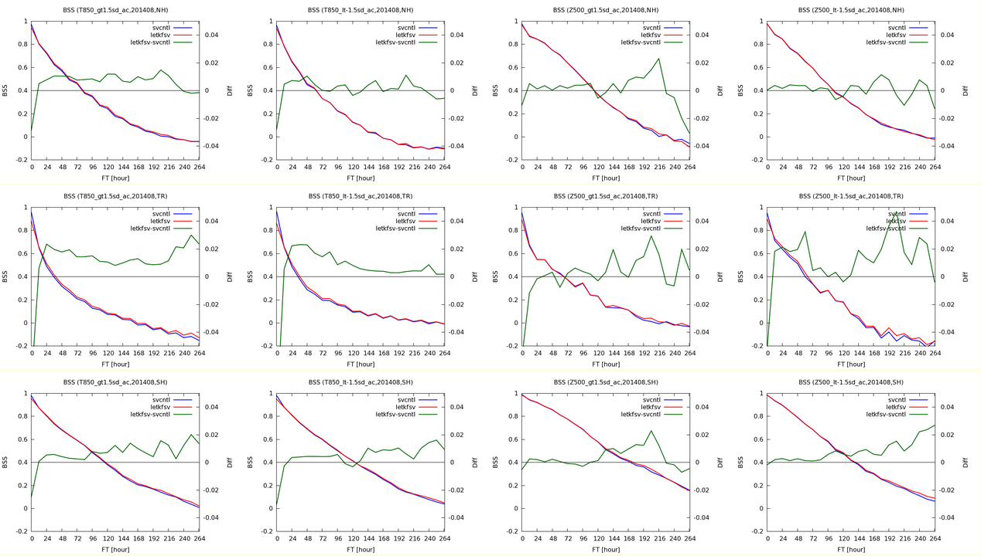
BSS of probabilistic forecasts (Summer)
Larger BSS
NH
TR
SH
T850>+1.5 sigma
T850<-1.5 sigma
Z500>+1.5 sigma
Z500<-1.5 sigma
Blue: BSS (SV), Red: BSS (LETKFSV), Green: BSS difference (LETKFSV-SV),
sigma: climatological variance

Slide 23
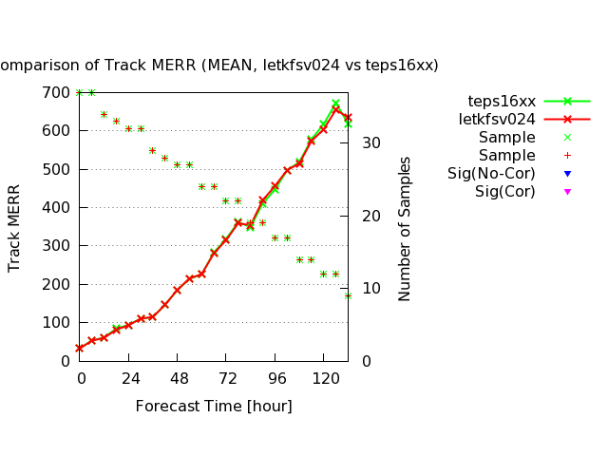
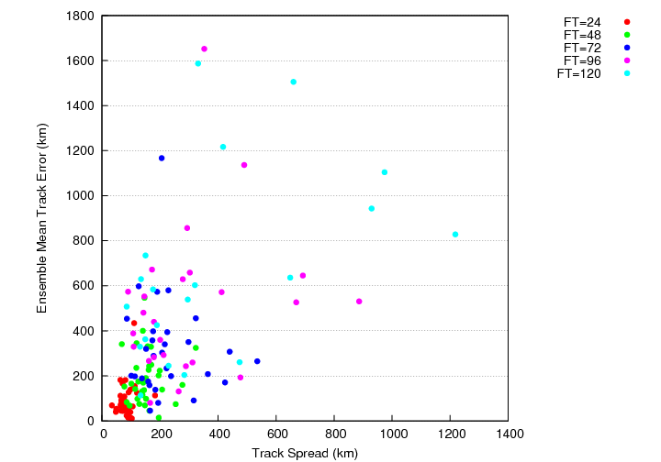
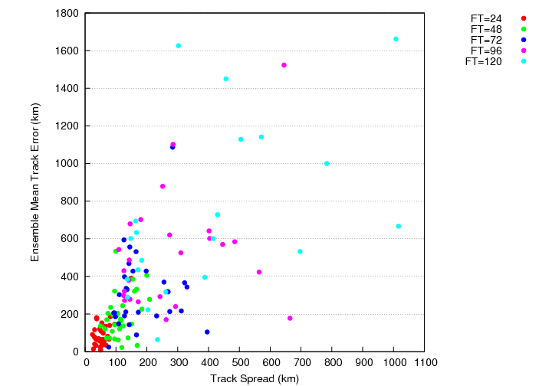
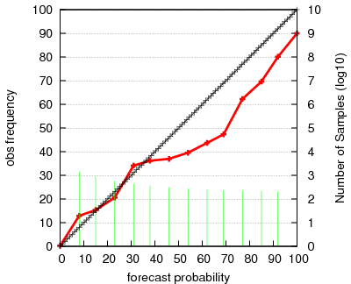
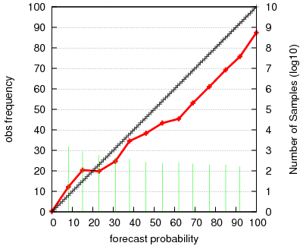
Typhoon forecasts (vs Typhoon EPS)
Error
Typhoon EPS
Ensemble mean position errors
Green: Typhoon EPS
Red: LETKFSV
Spread
Typhoon EPS
BSS=0.3965
LETKFSV
BSS=0.4018
LETKFSV
Almost neutral impact on ensemble mean tracks. LETKFSV is slightly better on the strike probability skills. Spread of TC central positions are slightly smaller, but better spread-error relation for LETKFSV

Slide 24
Summary of this part
Perturbations from LETKF analysis are used to improve initial perturbations of global EPS.
Although, LETKF can represent initial uncertainties better, significant underdispersiveness on medium-range forecast could be a problem for operational EPS.
Combination of initial SVs and LETKF perturbations is tried as a temporal solution to above problem.
  Spread-error relation and accuracy of ensemble forecasts are better than just using SVs or LETKF.
  Probabilistic skills on Typhoon track forecast have improved over Typhoon EPS. →It would make possible to unify Typhoon EPS and One-week EPS.
More sophisticated model ensemble and perturbations on boundary conditions are necessary to reduce the amplitude of initial SVs for future developments.

Slide 25
Perturbations on SST

Slide 26
Lower boundary conditions of operational EPS in JMA
Land surface: fully coupled land model
  Represents uncertainties stem from land-atmosphere interaction
  Initial condition is the same for all members → need initial perturbations
  The same land model is used for all members → need model ensemble for land model
Sea Surface: SST prescribed as a persistent climatological anomaly (anomaly fixed SST)
  The same SST is used for all members.
  Need perturbations on SST representing analysis and forecast uncertainties
  In future, atmospheric model should be coupled to ocean model.
Sea Ice: Ice concentration prescribed as a persistent climatological anomaly
  The same ice concentration is used for all members. Ice or no ice conditions are determined from certain threshold (0.55).
  Need perturbations representing analysis and forecast uncertainty of ice concentrations.
The goal here is to introduce SST perturbations consistent with its forecast uncertainty.

Slide 27
Previous studies on SST perturbations
UKMO (Tennant and Beare 2014)
  SST perturbations are made from random patterns that have spatial and temporal correlations (similar as SPPT scheme).
  Amplitude and correlations of the perturbations are determined from the statistics of the past SST analysis
  Noting larger spreads on lower atmosphere and slight improvement on ensemble mean RMSE.
Duc et al. (2015)
  Use multi-center SST analysis as the initial perturbations.
  The perturbations are not evolved through the forecast.
  Noting larger spreads on lower atmosphere in the LETKF analysis
Previous studies are mainly focusing on the analysis uncertainty of the SST

Slide 28
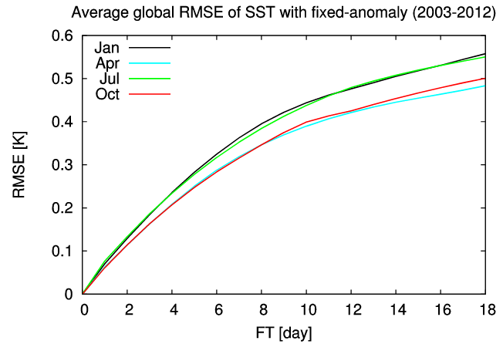
Errors of SST verified against analysis
RMSE (global) of the anomaly fixed SST against the analysis (2003~2012)
Black: January, Aqua: April, Green: July, Red: October
RMSE verified against independent buoys is 0.27K
“Analysis error” of SST analysis is 0.12K
In the medium range forecast, the forecast uncertainty of SST becomes dominant over the initial uncertainty.

Slide 29
Anomaly fixed SST and its error
SST^{ｃ}: Climatology
SST^{f} : Forecast
SSTª : Analysis
SSTA= SSTª － SST^{ｃ}
: Analysis anomaly from climatology
Anomaly fixed SST
SST^{f}(T₀ ; t_{f}) － SST^{f}(T₀ ;0)
= SST^{ｃ}(T₀ + t_{f}) － SST^{c}(T₀ )
Time evolution from the initial SST can be regarded as the climatological prediction.
SST [K]
SST^{c}
＝
SST^{f}
＝
SSTª
SSTA(T₀;0)
T₀
Initial time
T₀ + t_{f}
Time

Slide 30
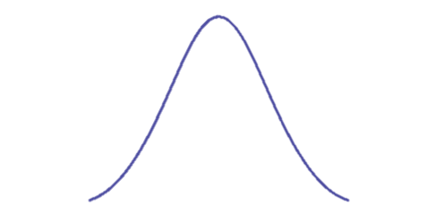
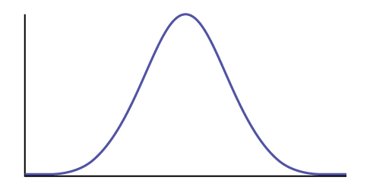
Climatological prediction and the “perfect” ensembles
Perfect ensembles (Murphy 1988, QJRMS):
In presence of the best estimate (control run) x₀ of the truth x^{t}, x^{t} and ensemble forecasts {x_{i}} are the independent draws from P(x|x₀). x^{t} , x_{i} ~ P(x|x₀), i.i.d.
Perfect ensembles w.r.t. climatological predictions: random draw from climatological distributions (Leutbecher and Palmer 2008, JCP)
In case x₀ represents dynamical predictions, it is difficult to derive “perfect ensembles” since P(x|x₀) is not known.
In case of the climatological prediction, the truth x^{t} follows the climatological distribution P^{clim}(x).
If P^{clim}(x) is known, random draw x_{i} from this distribution will be the “perfect ensembles”.
In case x₀ represents dynamical forecast
P(x|x₀)
P^{clim}(x)
x^{c}
^{(Climatology)}
x₀
Truth is in this distribution, each member should be drawn from here
In case x₀ is climatological prediction
P^{clim}(x) ＝P(x|x₀)
When the control-run is climatological prediction, the perturbations should be produced from climatological distribution.
x₀=x^{c}
^{(Climatology)}

Slide 31
SST perturbations representing forecast uncertainty of anomaly fixed SST
“Perfect ensembles” of anomaly fixed SST can be derived by random draws from the difference of SSTs between anomaly fixed SST and the analysis SST of the past analysis.
→ SST perturbations are represented as following:
  (Where T_{i} is a random draw from the same season as the initial time T₀)
Perturbed run: SST^{f}_{i} (T₀ + t_{f}) － SSTª(T₀ ) = SSTª(T_{i} + t_{f}) － SSTª(T_{i} )
Control run: - ) SST^{f} (T₀ + t_{f}) － SSTª(T₀ ) = SST^{ｃ}(T₀ + t_{f}) － SST^{c}(T₀ )
Perturbation: ΔSST^{f}_{i} (T₀ + t_{f}) = SSTA(T_{i} + t_{f}) － SSTA (T_{i} )
SST perturbations are derived from the SST anomaly differences of the past analysis.

Slide 32
Representing analysis uncertainty
Analysis uncertainty is represented with sampling like “NMC-method”.
Where ΔSST_{ini} represents analysis uncertainty of the SST.
In conclusion, SST perturbations are derived as following:
α and ΔT are parameters to be determined from the statistics of the past SST analysis and set 1.0 and 1 day respectively.

Slide 33
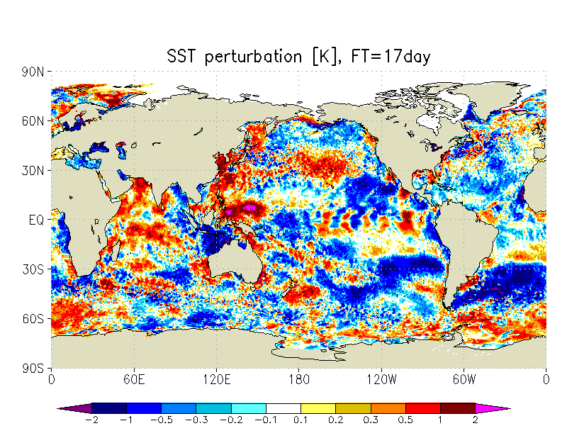
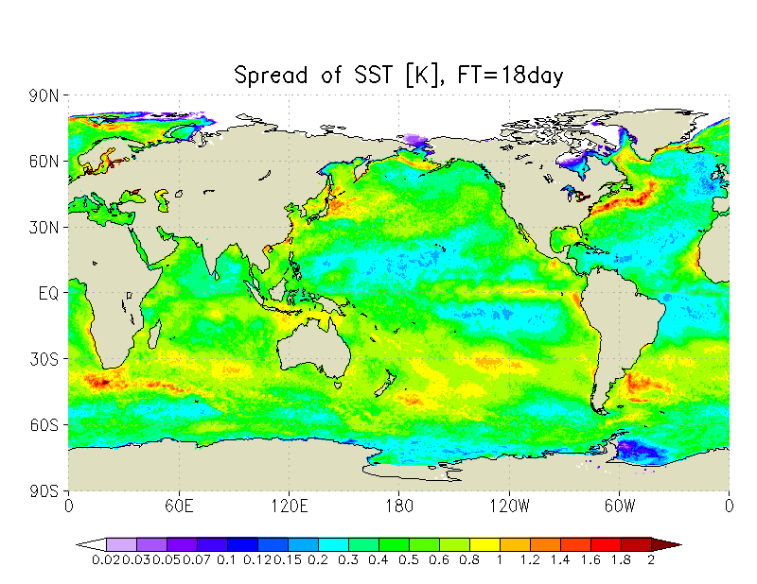

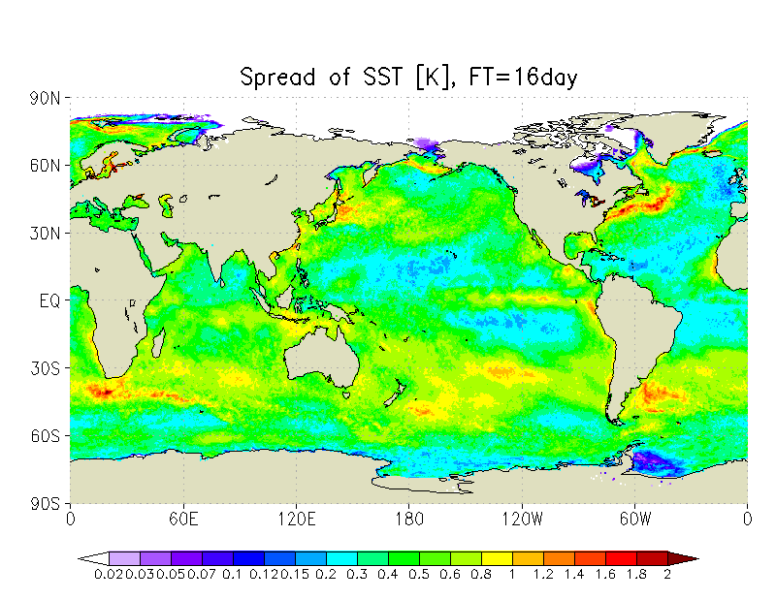
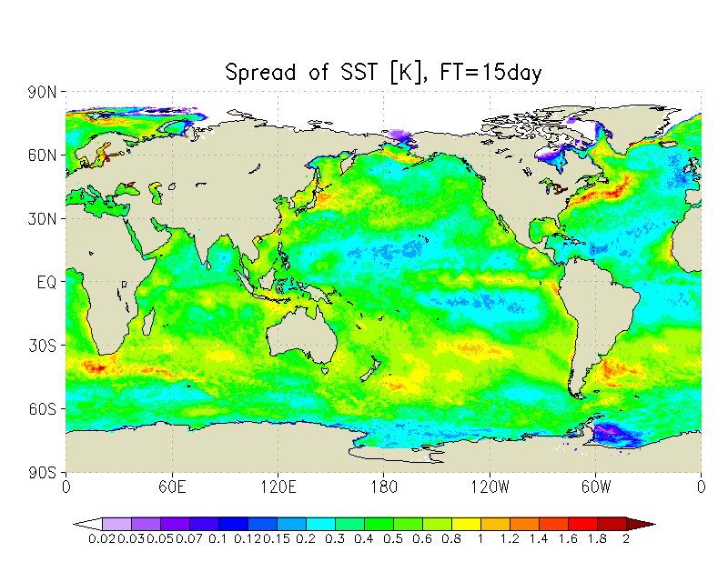

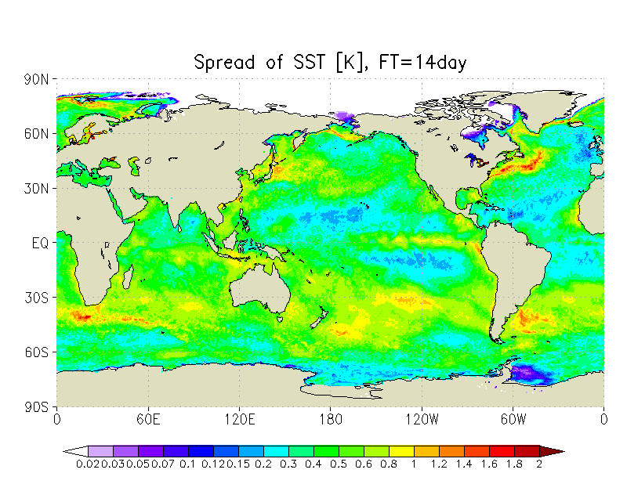
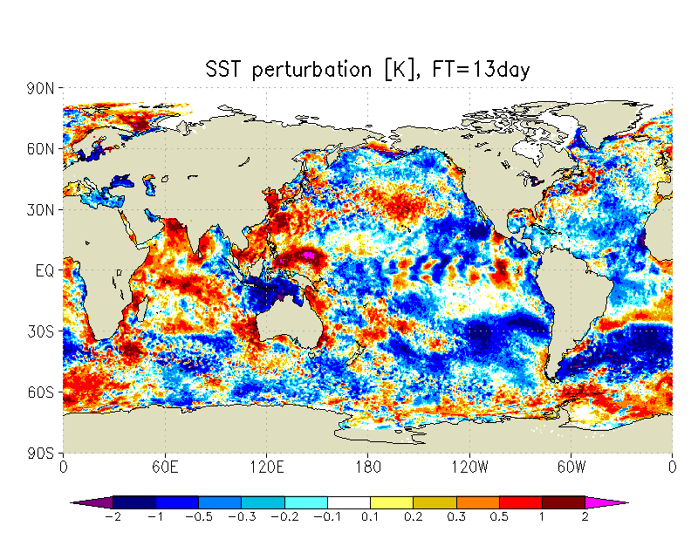


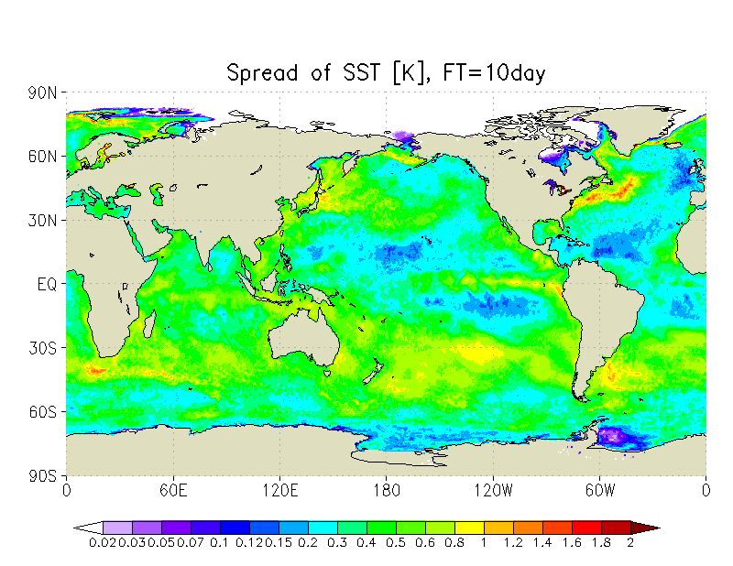
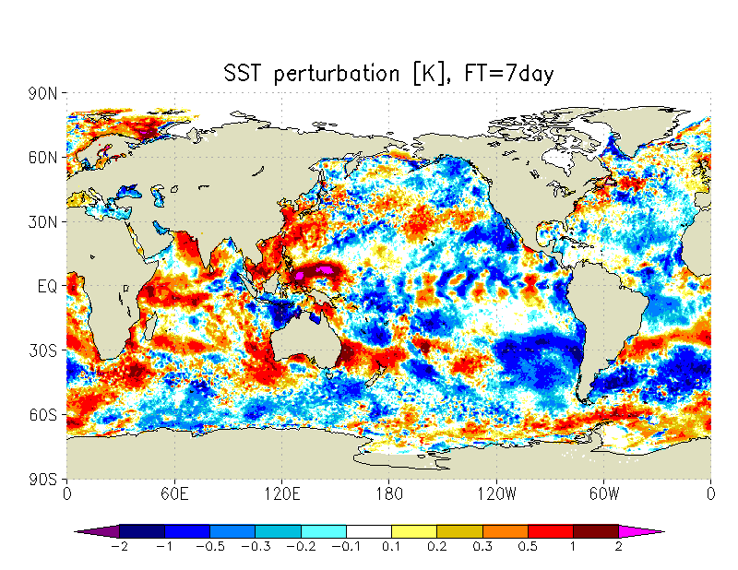
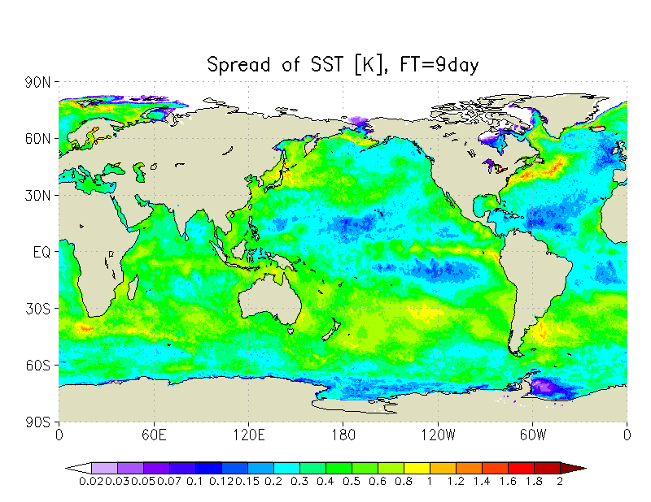
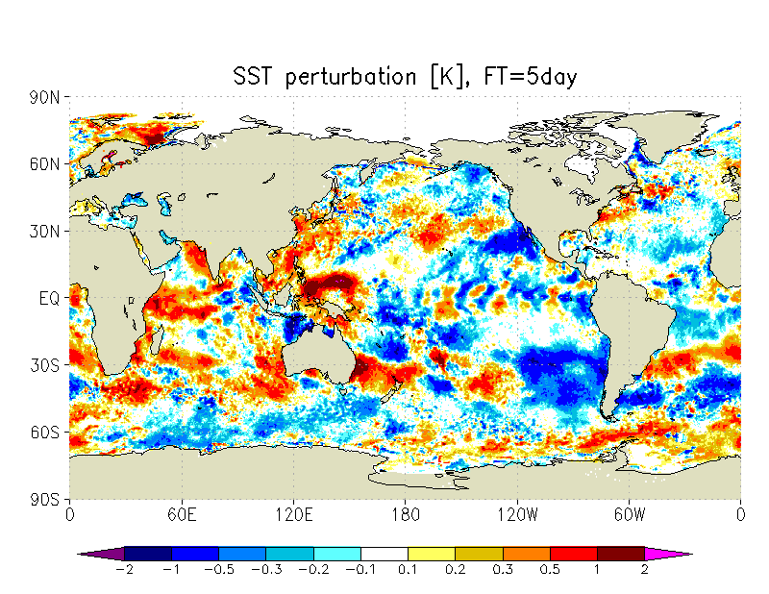
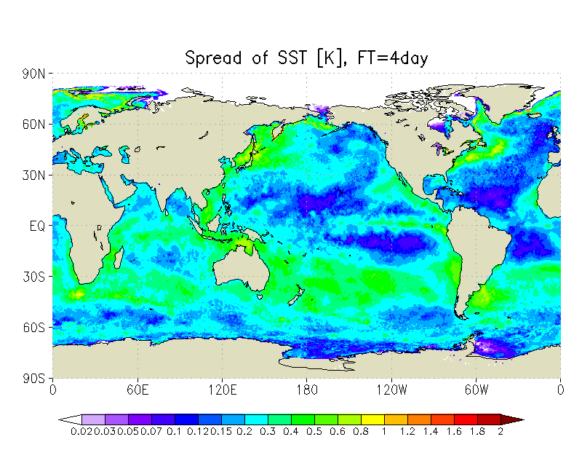
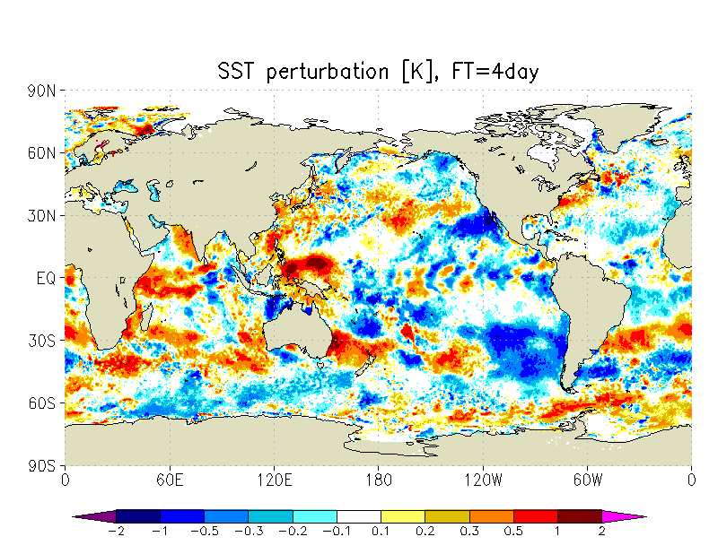
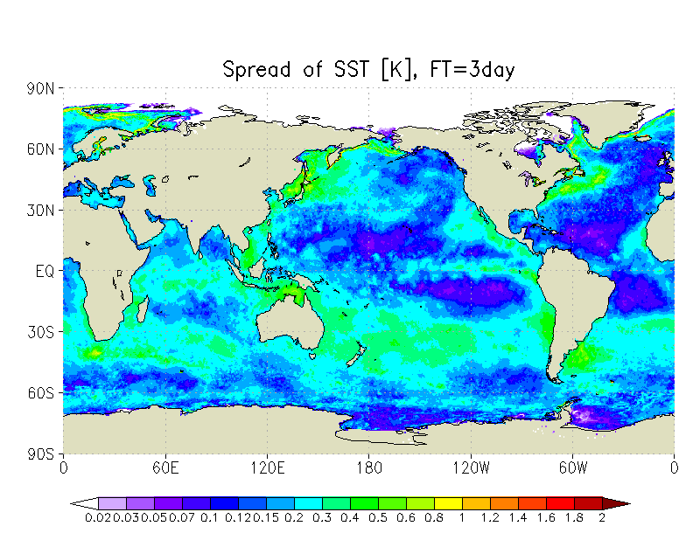
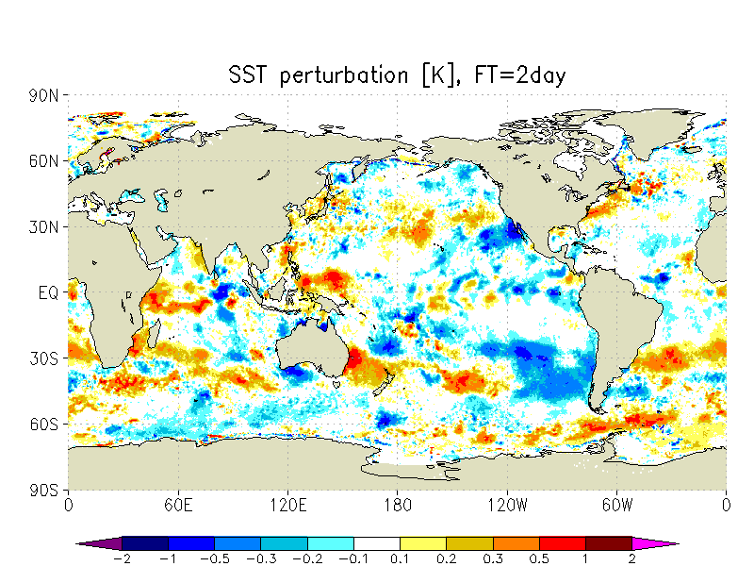
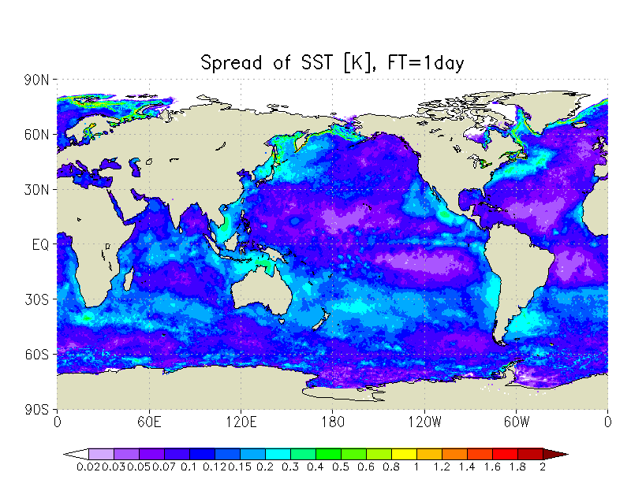
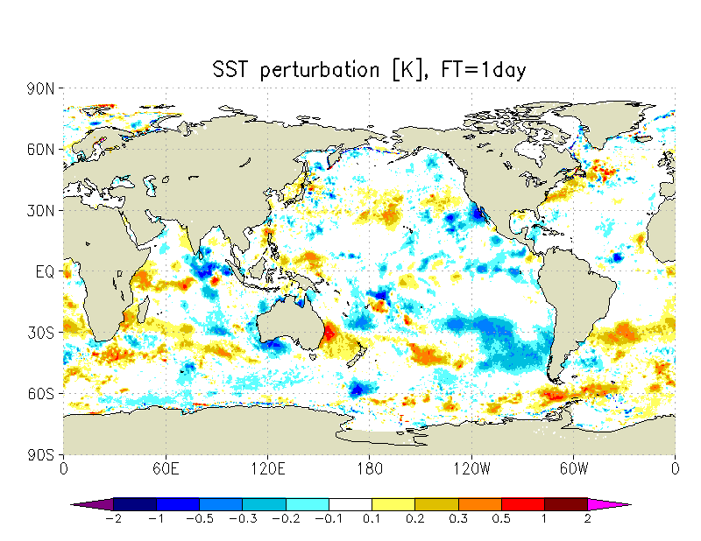
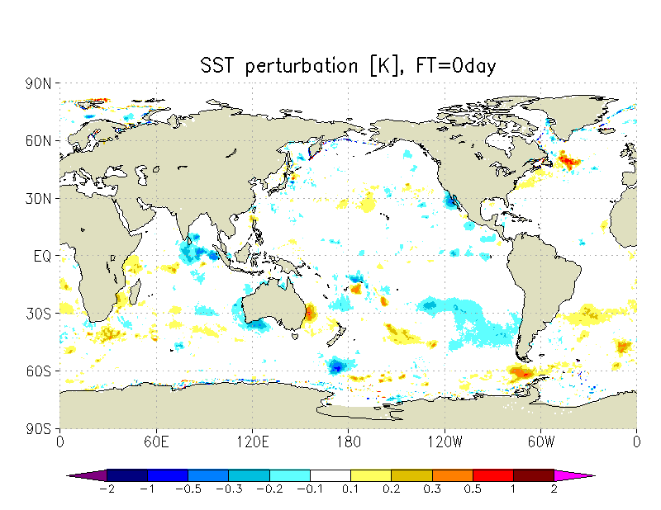
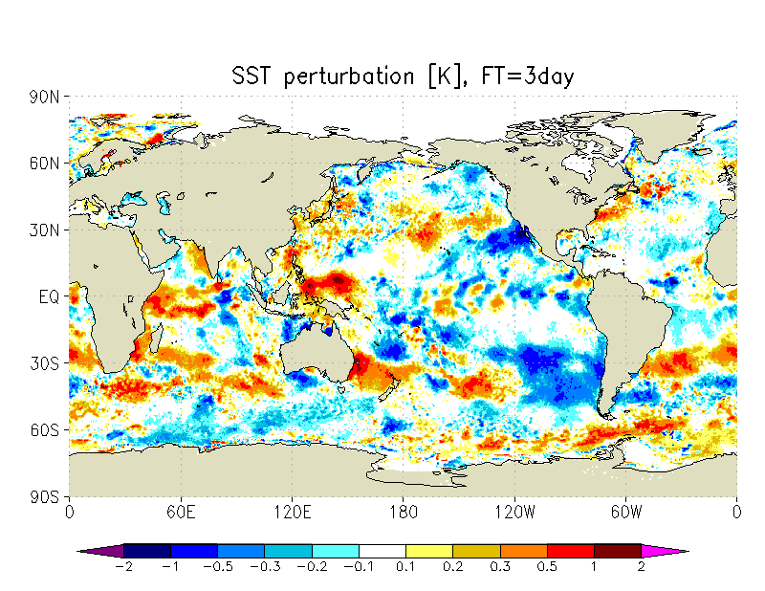
















Example of SST perturbation
SST perturbation of the certain member (left) and the spread of SST (right) used for initial time 00UTC January 1, 2014.
Although it is simple, SST perturbations can represent some modes associated with ocean dynamics (Rossby waves in tropics, meso-scale vortices in mid-latitude) and SST response to the atmosphere
Spread is large where ocean dynamics is active and on the edge of the sea-ice

Slide 34
EPS only with SST perturbations
Forecast with perturbed SST
Forecast with anomaly fixed SST
Atmosphere
Using the same initial conditions and forecast model, impact of SST perturbations is verified against the forecast with SST analysis
Analysis
Forecast with SST analysis
t_{f}=0
t_{f}=T
Sea-surface flux
SST of perturbed-run
SST
Anomaly fixed SST
SST analysis
Check if the forecast spread with SST perturbations could capture the forecast error using anomaly fixed SST instead of the SST analysis.
Verify spread-error relation on the atmospheric forecast.

Slide 35










































Ensemble mean RMSD and spread (summer)
T850
Z500
U250
Ensemble mean RMS difference (RMSD) from reference run (upper)
and spread (lower)
FT=120
FT=72
FT=432
FT=24
FT=48
FT=264
FT=192
Geographical distribution and magnitude of RMSD and spread are quite similar.

Slide 36
Full EPS experiments
Forecast model: GSM with TL479L100
Initial perturbations: the same as the operational one-week EPS but amplitude of Tropics is an half of the operational setting.
Period
  Summer: 00UTC initials from August 1 to August 31, 2014
  Winter: 00UTC initials from January 1 to January 31, 2014
432 hour forecasts with 13 members
SST settings
  CNTL: anomaly fixed SST for all members
  TEST: anomaly fixed SST with SST perturbations
36

Slide 37


















Comparison of spread (summer)
Surface T
T850
Spread of CNTL
Spread normalized with RMSE (CNTL)
Spread TEST/CNTL
Significant impacts on surface temperature. Spread is increased where the ensemble is underdispersive.
Spread of T850 is also increased in Tropics, mitigating the underdispersiveness.
Impact is larger on summer hemisphere.
FT=432
FT=192
FT=72

Slide 38


















Comparison of spread (summer)
Z500
U250
Spread of CNTL
Spread normalized with RMSE (CNTL)
Spread TEST/CNTL
For mid- to upper-troposphere, the impact of SST perturbations is relatively small for short-range forecast, but gradually become evident for longer forecasts
Spread is increased in Tropics where the ensembles are underdispersive.
FT=192
FT=72
FT=432

Slide 39


Impact on full EPS settings
Spread is increased (~3% for most variables)
  → Better spread-skill relation
Large impacts on Tropics, smaller but positive impacts on mid-latitudes
Forecast is improved on all levels in Tropics
In extra-tropics, impact is mainly confined near the surface.
Increased spread
Slightly reduced RMSE
T850 in Tropics
Surface T in SH summer

Slide 40




Impact on one-month prediction
Surface T
T850
Analysis (red line) and forecasts of the operational One-month EPS (blue bars: maximum and minimum) in 2015 (eastern Japan, average of day 6 to day 12).
Surface temperature forecast is underdispersive especially in summer.
w/o SSTPTB
w/ SSTPTB
Surface temperature of analysis (black line) and forecasts in the one-month EPS experiments (blue) (June 30 initials, Okinawa, average of day 3 to day 30).
Using SST perturbations, spread of the surface temperature has increased.
→ Good impact on the one-month forecasts

Slide 41
Summary of this part
New method of generating SST perturbations is proposed and tested on the operational global EPS in JMA
  Statistically consistent perturbations with the error of the prescribed SST
  It can generate realistic structures on SST perturbations
  Spread is increased and ensemble mean RMSE is slightly reduced especially in Tropics.
  Improvements on the probabilistic forecast skill of the surface temperature in One-month EPS are expected by introducing SST perturbations.
Coupling to the ocean model (full model, mixed-layer model or skin SST) will be necessary for future developments.

Slide 42
Summary and Future developments

Slide 43
Toward a seamless prediction with global EPS
There is ongoing developments toward unifying 3 existing operational global EPS (Typhoon, One-week and One-month EPS) into one global EPS.
  It is supposed to cover all timescales that can be treated as the initial condition problem of the atmosphere.
  It is planned to introduce the latest version of the global model in JMA
  Introduction of the LETKF as the initial perturbations (combined with initial SVs).
  Introduction of the SST perturbations
  Possible use of the reforecast dataset for short to medium range forecast
3 challenges for future developments
  Further refinements on the forecast model, perturbations on initial and boundary conditions, model ensembles to improve the accuracy of the EPS
  Close collaborations with data assimilation and forecast model developers are becoming critical for further improvements
  Seamless prediction is a challenge to make system that would satisfy all users from short-range to long-range forecasts.

Slide 44
Backup

Slide 45
List of changes (GSM1403, 1/2)
Raise model top from 0.1 hPa to 0.01 hPa
Enhance the number of vertical model layer from 60 to 100
Changes on diffusion on upper model layers
More stable integration in semi-Lagrangian scheme
Change thresholds for stratocumulus parametrization
Modify energy compensation terms in convective parametrization
New surface boundary layer scheme over land
Refinement on PBL scheme on stable condition
Improvements on long-wave radiance scheme
  Introduce two-way approximation
  Increase the frequency of the computations from 3 hours to 1 hour
  Change on the treatment of the lowest model layer
Update the surface albedo over the desert
Update the ozone climatology

Slide 46
List of changes (GSM1403, 2/2)
Modify interpolation method for the ozone climatology
Modify the treatment of solar zenith angle in radiation scheme
Improvements on gravity wave drug
  Introduce non-orographic GWD scheme (outer model)
  Adjustments (inner) and removal (outer) of Rayleigh friction
Change dissipative effect of kinetic energy in the physical parametrizations
Speed-up
  Output process, transmission regarding wave to grid transformation and semi-Lagrangian scheme

Slide 47
List of changes (GSM1603, 1/2)
Modifications on convective parametrizations
  Convective parametrization (AS scheme)
    Change energy compensation term
    Change static energy on cloud bottom (Jakob and Siebesma 2003). Consistent muss-flux throughout the whole scheme.
    Introduce melting of the solid precipitation
    Add precipitation process from the updraft
    Add perturbations (0.5K) in updraft area to the static energy on cloud bottom
  Cloud parametrization (Smith scheme)
    Remove PDF adjustments driven from convective parametrization
    Remove dependency on the integration time step for fall of cloud ice
Introduce new land model (iSiB)
  Introduce independent snow model
  Refinements on albedo, canopy layer and soil
  Improvements on surface flux
  Update vegetation and various parameters
  Update climatology for soil moisture

Slide 48
List of changes (GSM1603, 2/2)
Sea surface
  Introduce 4-layer sea-ice model
  Update surface boundary layer scheme
  Consideration of mixed open-water and sea-ice grid
Radiation
  Maximum-random overlap (PICA) for short-wave radiation
  Modify parametrization on optical property of cloud water particles
  Update climatology of water vapor on stratosphere and GHG for radiation scheme
  Include the effect of surface emissivity difference
Bug-fixes
Speed-up in Legendre transformation
Decrease the computational cost of non-orographic GWD
Patches for stable integrations

Slide 49
Target areas for Typhoon EPS
Northwest Pacific
Example of the SV target areas for Typhoon EPS (initial time: 00UTC on September 27, 2011)
Around the 24 hour forecast positions of tropical cyclones (3 at maximum)

Slide 50
Initialization on EnKF analysis (Hamrud et al. 2015)
Procedures
Add surface pressure tendency (dps/dt) to the state variables of the EnKF.
Based on the equation of continuity, dps/dt is equal to the convergence of the mass flux. Distribute the difference between analyzed and diagnosed dps/dt to the divergence of the upper atmospheric column.
where p_{s}: surface pressure, v: horizontal wind, S_{wind}: ensemble spread of wind, dp_{k}: thickness of the kth model layer
Weights w_{k} are determined by the analysis spread of the wind speed.
Assuming dp_{k} is constant before and after the initialization, the wind increments are derived.

Slide 51


















Comparison of spread (winter)
Surface T
T850
Spread of CNTL
Spread normalized with RMSE (CNTL)
Spread TEST/CNTL
Large impacts on surface temperature. Spread is increased where the ensemble is underdispersive.
Spread of T850 is increased over the Tropics, mitigating the issue of underdispersiveness.
The impact is larger in summer hemisphere.
FT=192
FT=72
FT=432

Slide 52


















Comparison of spread (winter)
Z500
U250
Spread of CNTL
Spread normalized with RMSE (CNTL)
Spread TEST/CNTL
For mid- to upper-troposphere, the impact of SST perturbations is relatively small for short-range forecast, but gradually become evident for longer forecasts
Spread is increased in Tropics where the ensembles are underdispersive.
FT=72
FT=192
FT=432

