Slide 1


Seasonal Climate forecasts from a suite of
16 coupled atmosphere Ocean Models
T. N. Krishnamurti
Department of Earth, Ocean and Atmosphere Science,
Tallahassee, FL 32306, USA.
Collaborator: Vinay Kumar
EMC Sack Lunch Seminar, August 10, 2010

Slide 2
Table 1: Details of sixteen coupled models used in this study
Name of model and affiliated institute | Atmospheric component |  |  | Oceanic component
 | Model | Resolution | Initial Condition | Model | Resolution | Initial Condition
AOR (FSU) | FSUGSM with Arakawa-Schubert convection and new radiation (band model) | T63L14 | ECMWF with physical initialization | HOPE global | 5º longitude, 0.5º-5º latitude, 17 levels | Coupled assimilation relaxed to observed SST
KNR (FSU) | FSUGSM with Kuo convection and new radiation (emissivity-absorptivity model) | T63L14 | ECMWF with physical initialization | HOPE global | 5º longitude, 0.5º-5º latitude, 17 levels | Coupled assimilation relaxed to observed SST
KOR (FSU) | FSUGSM with Kuo convection and old radiation (emissivity-absorptivity model) | T63L14 | ECMWF with physical initialization | HOPE global | 5º longitude, 0.5º-5º latitude, 17 levels | Coupled assimilation relaxed to observed SST
CFS (NCEP) | CFS | T62L64 | CFS SST forecast | MOM3 | 1ºx1/3º, 40 levels | Ocean data assimilation
POAMA1.5 | Bureau of (BMRC) Atmospheric Model (BAM3) | R47L17 | From latest atmosphere and ocean conditions from Global Atmospheric Sampling Program | Model 2 (ACOM2) | -2ºx0.5º-1.5º, 31 levels | From ocean assimilation that was based on optimum interpolation (OI) technique.
CERFACS | ARPEGE | T63L31 | ECMWF 40-yrs Re-analysis (ERA-40) | OPA 8.2 | 2ºx2º, 31 levels | Forced by ERA-40
ECMWF | IFS | T95L40 | ERA-40 | HOPE-E | 1.4ºx0.3º-1.4º, 29 levels | Forced by ERA-40
FRCGC (SINTEX-F) | ECHAM-4 | T106L19 | NCEP/DOE Reanalysis-2 | OPA 8.2 | 2º(lon)x2ºcos(lat), 31 levels | SST nudging scheme

Slide 3
Continued…
GFDL | AM2.1 | 2.5ºx2º, 34 levels | NCEP/DOE Reanalysis-2 | OM3.1 (MOM4) | 1ºx1/3º, 50 levels | Ocean data assimilation
INGV (Italy) | ECHAM-4 | T42L19 | Coupled AMIP type | OPA 8.1 | 2ºx0.5º-1.5º, 31 levels | Forced by ERA-40
LODYC | IFS | T95L40 | ERA-40 | OPA 8.2 | 2ºx2º, 31 levels | Forced by ERA-40
MPI | ECHAM-5 | T42L19 | Coupled run relaxed to observed SST | MPI Open Model Interface (MPI-OMI) | 2.5ºx0.5º-2.5º, 23 levels | Coupled run relaxed to observed SST
MetFr | ARPEGE | T63L31 | ERA-40 | OPA 8.0 | 182x152 GP, 31 levels | Forced by ERA-40
SNU | SNU | T42L21 | NCEP/DOE Reanalysis-2 | MOM2.2 | 1ºx1/3º, 32 levels | SST nudging scheme
UH | ECHAM4 | T31L19 | NCEP/DOE Reanalysis-2 | UH Ocean | 2ºx1º, 2 levels | Thermocline-Depth nudging
UKMO | HadAM3 | 2.5ºx3.75º, 19 levels | ERA-40 | GloSea OGCM Third Hadley Center Coupled Ocean-Atmosphere GCM (HadCM3) based |  | Forced by ERA-40

Slide 4
Outline of the TALK
Objective of the talk
Synthetic Superensemble Methodology
Downscaling Technique (use of a dense raingauge network over monsoon Asia)
Model used and experiments performed
Results:
  Comparison with coarse resolution outputs
  Skills for rainfall anomaly forecasts
  Superensemble probablistic forecasts
  Case Studies during extreme years
  Skills on regional scale
Some results for Japan region
Summary and Future work

Slide 5
Multimodel FSU Conventional Superensemble
The superensemble forecast is constructed as,
where,
are the i^{th} model forecasts.
are the mean of the i^{th} model forecasts over the training period.
is the observed mean of the training period.
are the regression coefficient obtained by a minimization procedure during the training period. Those may vary in space but are constant in time.
is the number of forecast models involved.
The coefficients a_{i} are derived from estimating the minimum of function,
the mean square error.
Multimodel bias removed ensemble is defined as,
In addition to removing the bias, the superensemble scales the individual model forecasts contributions according to their relative performance in the training period in a way that, mathematically, is equivalent to weighting them.

Slide 6
Multimodel Synthetic Ensemble/Superensemble Prediction System
Generating Synthetic Data Using EOF
Training
PC
EOF
Forecast
N - Actual Data Sets
i = model
n = mode
Observed Analysis
Estimating Consistent Pattern
What is matching spatial pattern in forecast data Fi(x,t), which evolves according to PC time series P(t) of observed data, O(x,t) ?
Forecasts
Obs
Normalized Weights
N - Synthetic Data Sets
Observation

Slide 7
Synthetic Superensemble Technique
Training Phase
Forecast Phase
Weights are passed to forecast phase
Multiple Linear Regression
Weights are obtained by minimizing the error
Superensemble Forecast
Model 1
a₁
Model 1
Model 2
a₂
Model 2
Generating Synthetic Data in EOF Space
Model 3
a₃
Model 3
Multimodel Dataset
Superensemble
Forecast
Model N
a_{N}
Model N

Slide 8
Downscaling Methodology
Bi-linear Interpolation Method
Preparation of
higher resolution datasets
Least Square Method
Calculation of Regression Coefficients
Downscaled
datasets
Model 1
Model 1
Model 1
Model 2
Model 2
Model 2
Model 3
Model 3
Model 3
Models datasets with course resolution
Model N
Model N
Model N

Slide 9
Downscale Methodology
Coarse resolution precipitation data from 16 coupled climate models (resolution 2.5 degree) were bi-linearly interpolated to 0.25 degree grid to conform with the APHORDITE observations.
Regression coefficients a and b were obtained by least square linear fit of the model interpolated precipitation with that of the high resolution observational data sets.
A cross-validation technique was adopted in which the year to be forecasted was excluded from the calculations in obtaining the regression coefficients. Coefficients vary in space and for every month of the years.
Now, these regression coefficients were applied to the forecast year to obtain downscaled model forecasts for that year.
The above steps (1-4) were repeated for each year of the period 1987 to 2001 to obtain downscaled forecasts of individual models.
The final outcome of this methodology is precipitation forecast at 0.25 degree grids over the South Asian region from 16 coupled models for forecast on monthly basis.

Slide 10
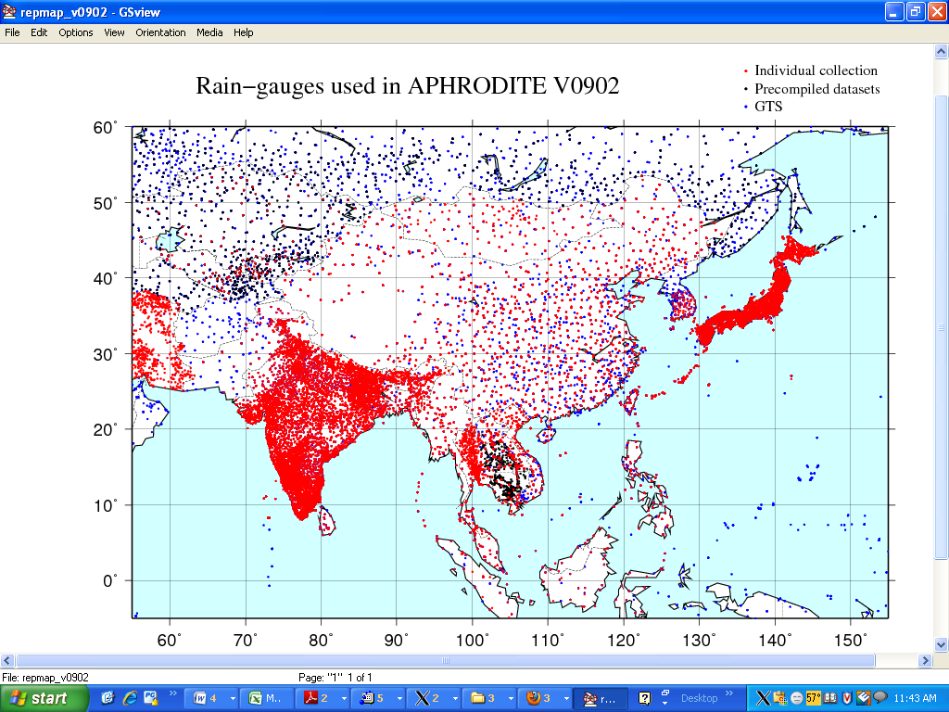
APHORDITE’s Precipitation datasets collection
For Monsoon Asia (Station List)
Yatagai, A. O. Arakawa, K. Kamiguchi, H. Kawamoto, M. I. Nodzu and A. Hamada (2009): A 44-year daily gridded precipitation dataset for Asia based on a dense network of rain gauges, SOLA , 5, 137-140, doi:10.2151/sola.2009-035.

Slide 11
Various Acronyms used in this presentation
ANR – FSU Coupled model with Arakawa-Schubert convection and New Radiation (band model)
BMRC – Bureau of Meteorology Research Center, Australia (also POAMA1)
CERF - European CEntre for Research and Advanced Training in Scientific Computation, France (CERFACS)
ECMW - European Centre for Medium-Range Weather Forecasts, International Organization, UK
GFDL - Geophysical Fluid Dynamical Lab, USA
INGV - Istituto Nazionale de Geofisica e Vulcanologia, Italy
LODY - Laboratoire d’Océanographie Dynamique et de Climatologie, France
KNR - FSU Coupled model with Kuo convection and New Radiation (band model)
KOR - FSU Coupled model with Kuo convection and Old Radiation (emissivity-absorptivity model)
MAXP - Max-Planck Institut für Meteorologie, Germany
METF - Centre National de Recherches Météorologiques, Météo-France, France
NCEP – National Center for Environmental Prediction, USA
SINT – Scale INTeraction Experiment-FRCGC
SNU – Seoul National University, South Korea
UH – University of Hawaii, USA
UKMO – The Met Office, UK
-------------------------------------------
CC – Correlation Coefficient; EM – Ensemble Mean; SSE/SE – SuperEnsemble
RMSE – Root Mean Square Error; AC- Anomaly Correlation

Slide 12
CMAP
Observed Precipitation Climatology - January
APHRODITE
CMAP is a product of , Merging rain gauge observations and precipitation estimates from satellites.
APHRODITE is a product based on dense Rainguages over
Monsoon Asia and more.
Observed Precipitation Climatology - July

Slide 13
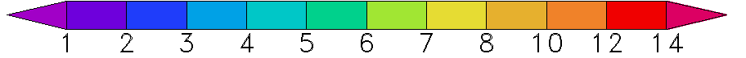
Seasonal Precipitation Climatology – APHRODITE
MAM
JJA
SON
DJF

Slide 14
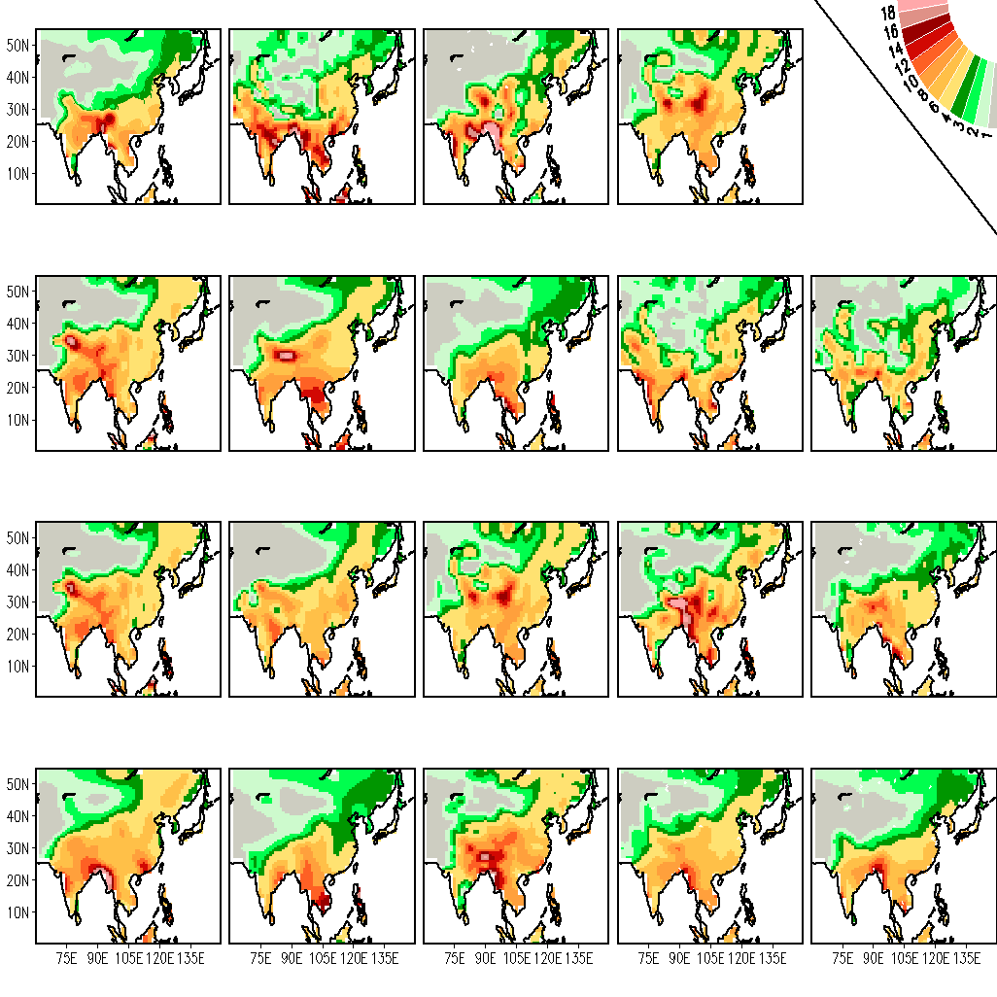
Precipitation climatology, JJA (1987-2001) – Coarse Resolution 2.5x2.5
APHRODITE
ANR 0.62
BMRC 0.69
CERF 0.52
SC
4.56
4.02
3.14
RMSE
ECMW 0.60
GFDL 0.71
INGV 0.79
KNR 0.58
KOR 0.57
5.54
3.54
2.85
3.75
3.56
LODY 0.62
MAXP 0.69
METF 0.54
NCEP 0.67
SINT 0.81
5.00
3.02
3.05
3.79
2.45
SNU 0.75
UH 0.72
UKMO 0.74
EM 0.81
SSE 0.92
3.04
3.24
2.85
2.50
1.72

Slide 15
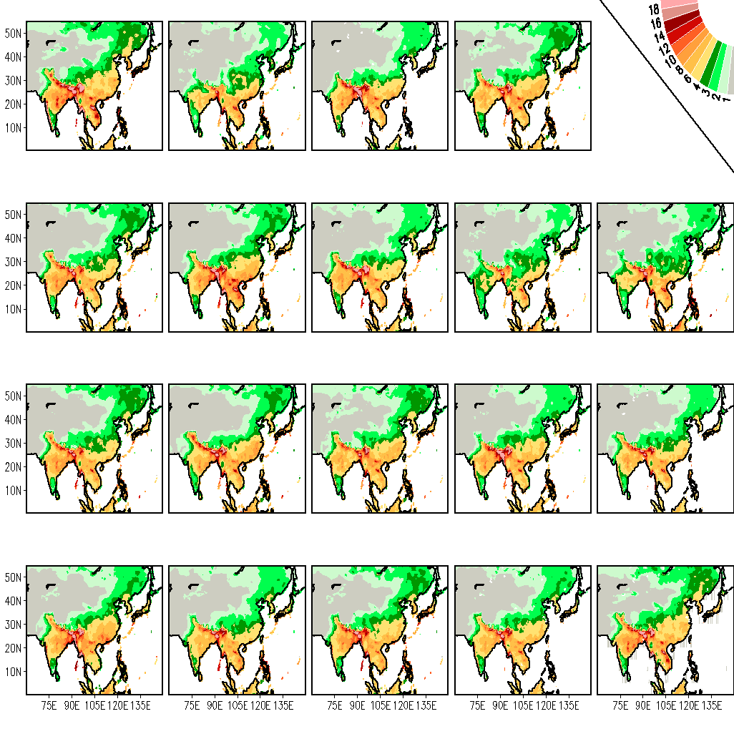
Precipitation climatology, JJA (1987-2001) – Downscaled to 0.25x0.25 Resolution
APHRODITE
ANR 0.91
BMRC 0.95
CERF 0.96
2.34
1.60
1.70
ECMW 0.95
GFDL 0.95
INGV 0.95
KNR 0.92
KOR 0.84
1.77
1.65
1.71
2.55
2.65
LODY 0.79
MAXP 0.93
METF 0.95
NCEP 0.96
SINT 0.96
2.65
2.10
1.75
1.50
1.62
SNU 0.95
UH 0.93
UKMO 0.96
EM 0.97
SSE 0.99
1.65
2.06
1.46
1.59
0.19

Slide 16
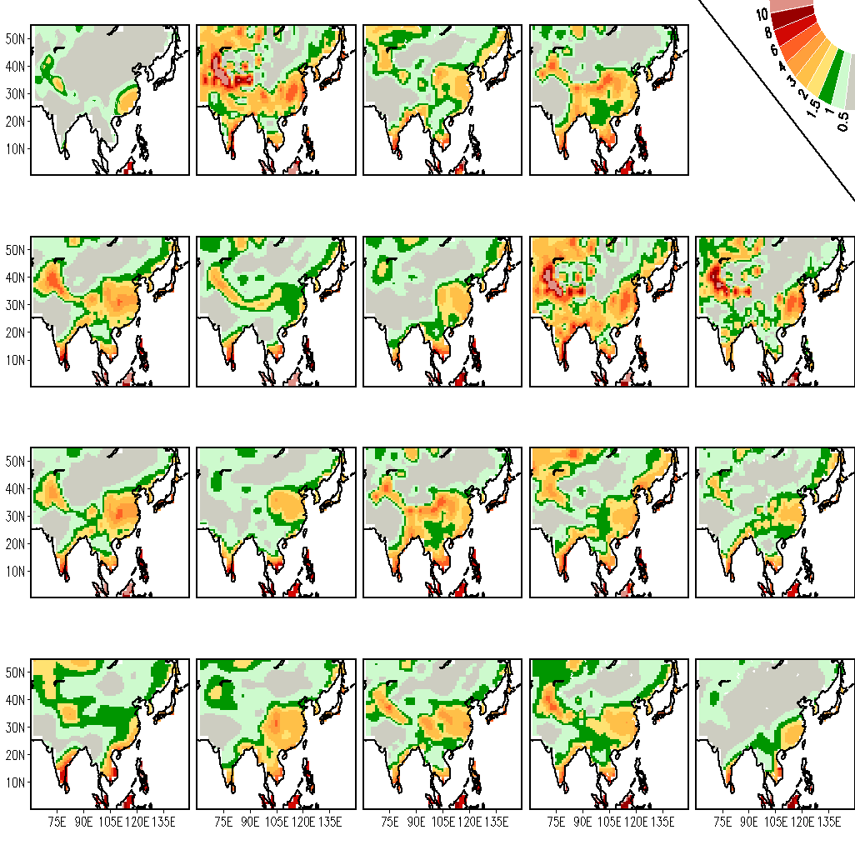
Precipitation climatology, DJF (1987-2001) – Coarse Resolution 2.5x2.5
APHRODITE
ANR 0.66
BMRC 0.78
CERF 0.70
3.55
2.66
2.33
ECMW 0.78
GFDL 0.87
INGV 0.82
KNR 0.57
KOR 0.61
4.22
2.92
2.33
3.58
2.10
LODY 0.80
MAXP 0.73
METF 0.70
NCEP 0.79
SINT 0.80
3.95
2.30
2.29
2.64
1.79
SNU 0.78
UH 0.82
UKMO 0.80
EM 0.84
SSE 0.91
2.61
2.62
1.81
2.33
1.59

Slide 17
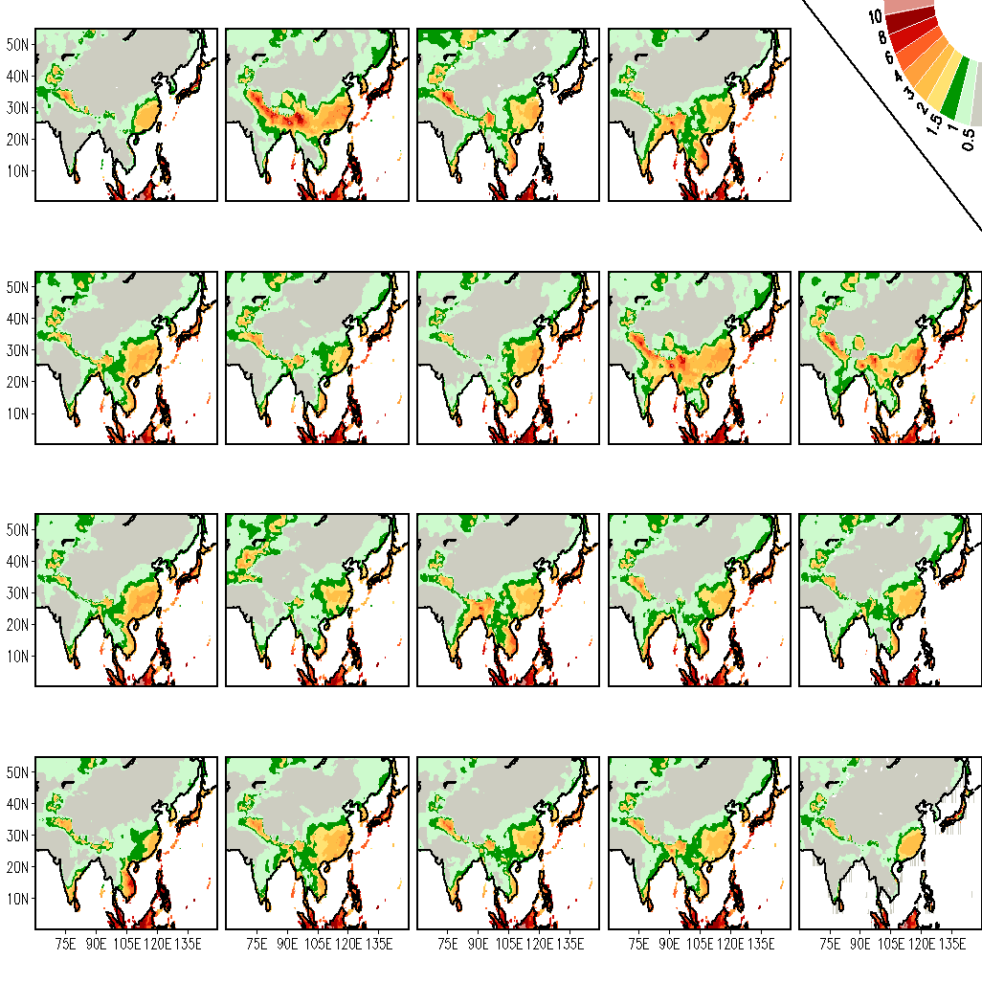
Precipitation climatology, DJF (1987-2001) – Downscaled to 0.5x0.5 Resolution
APHRODITE
ANR 0.78
BMRC 0.90
CERF 0.84
1.42
1.21
1.53
ECMW 0.89
GFDL 0.91
INGV 0.89
KNR 0.83
KOR 0.68
1.23
1.07
1.28
1.43
1.63
LODY 0.88
MAXP 0.87
METF 0.84
NCEP 0.88
SINT 0.92
1.24
1.28
1.56
1.28
1.07
SNU 0.87
UH 0.89
UKMO 0.91
EM 0.91
SSE 0.99
1.44
1.20
1.13
1.13
0.08

Slide 18
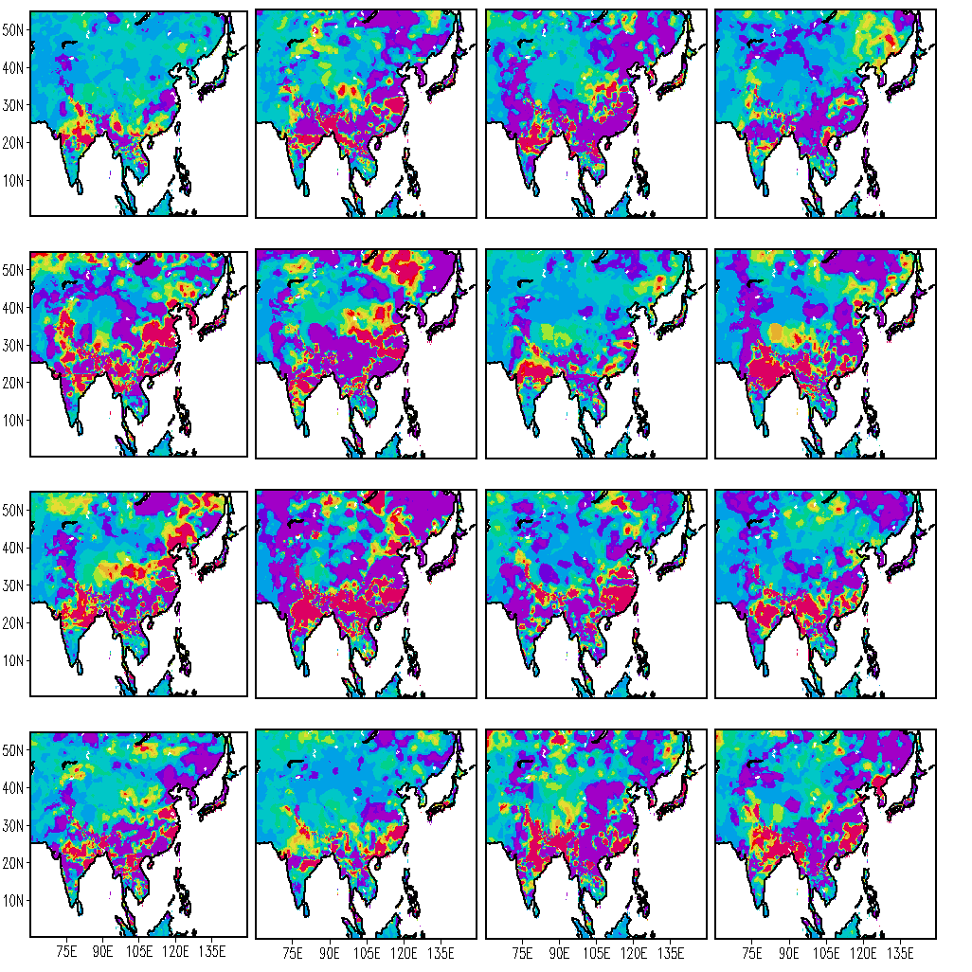
Spatial Distribution of Regression Coefficients- ‘a’ SLOPE, for July
ANR
BMRC
CERF
ECMW
GFDL
INGV
KOR
KNR
LODY
MAXP
METF
NCEP
SINT
SNU
UH
UKMO

Slide 19
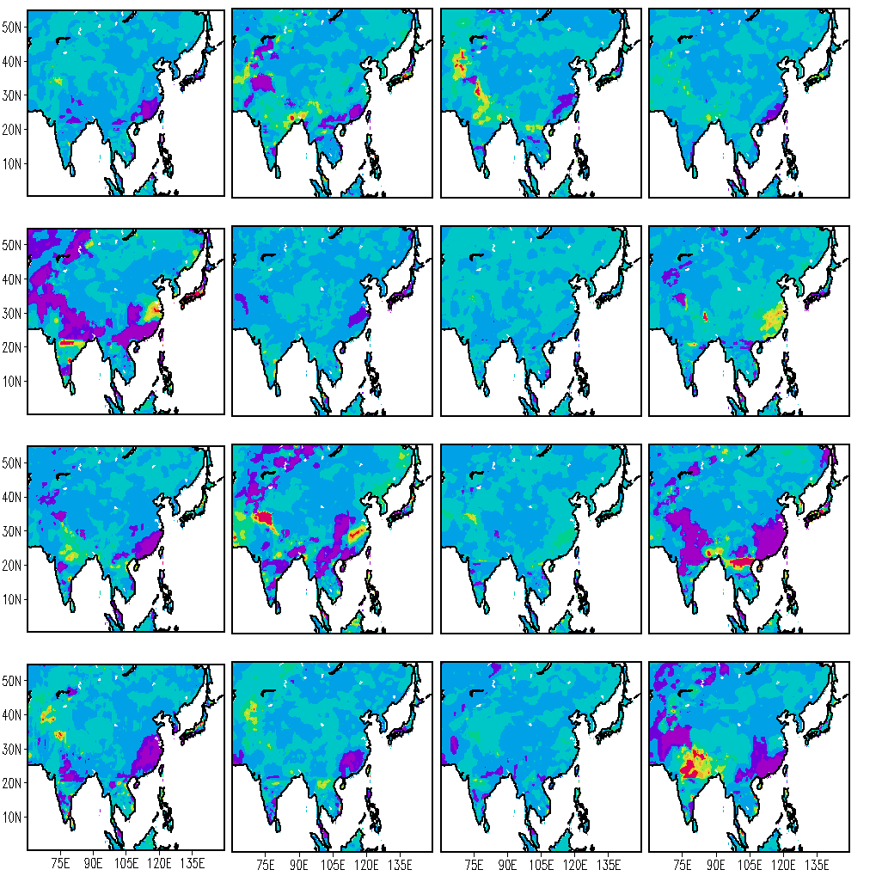
Spatial Distribution of Regression Coefficients- ‘a’ SLOPE, for December
ANR
BMRC
CERF
ECMW
GFDL
INGV
KOR
KNR
LODY
MAXP
METF
NCEP
SINT
SNU
UH
UKMO

Slide 20
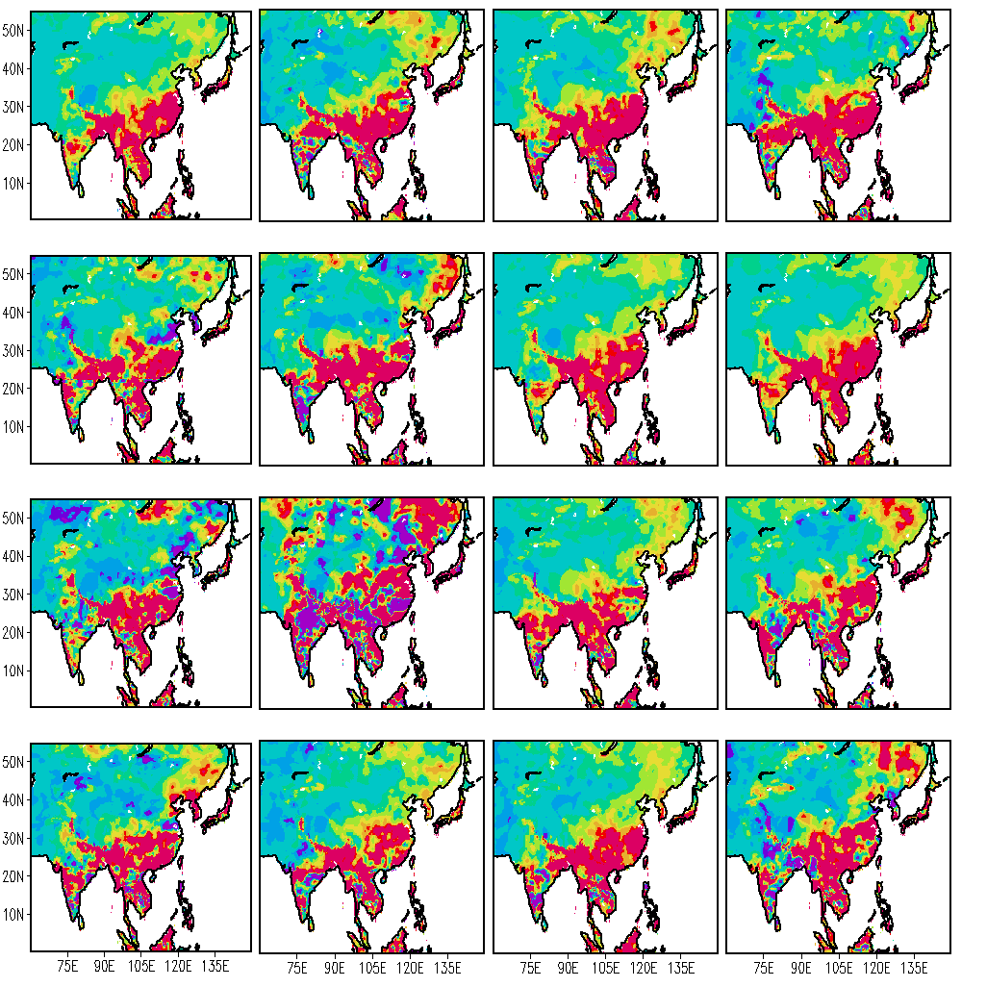
Spatial Distribution of Regression Coefficients- ‘b’ INTERCEPT, for July
ANR
BMRC
CERF
ECMW
GFDL
INGV
KOR
KNR
LODY
MAXP
METF
NCEP
SINT
SNU
UH
UKMO

Slide 21
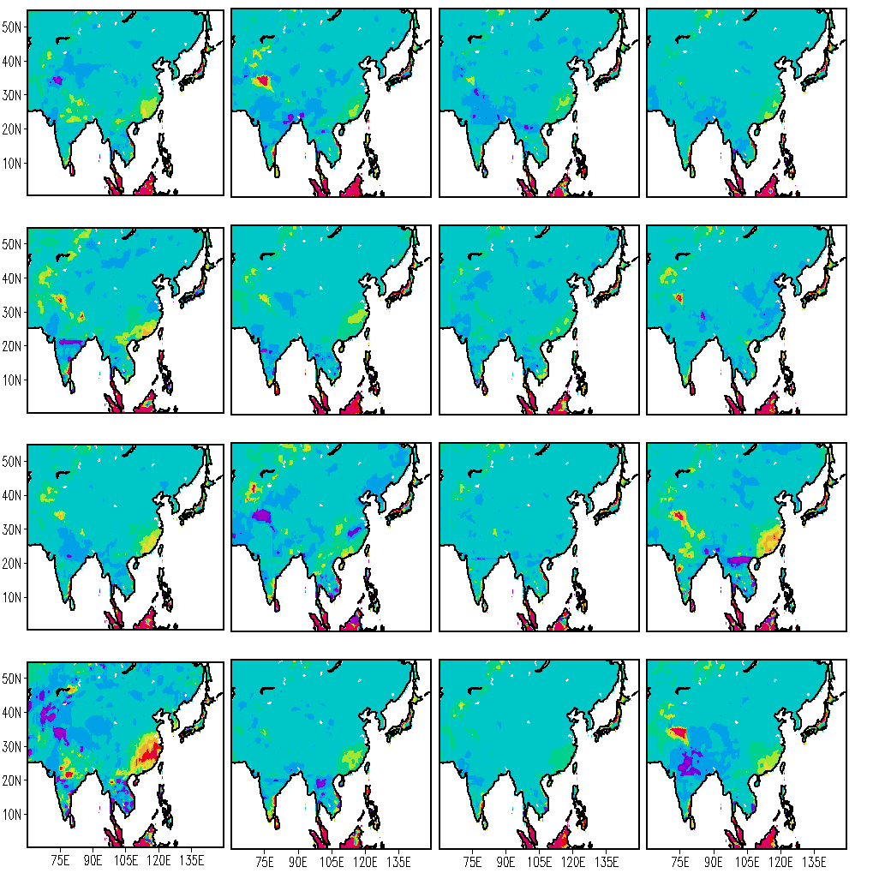
Spatial Distribution of Regression Coefficients- ‘b’ INTERCEPT, for December
ANR
BMRC
CERF
ECMW
GFDL
INGV
KOR
KNR
LODY
MAXP
METF
NCEP
SINT
SNU
UH
UKMO

Slide 22
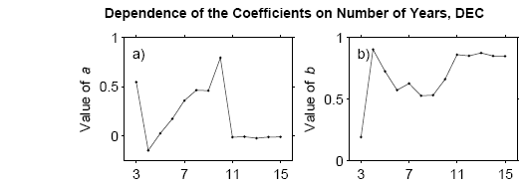
Dependence of downscaling coefficients (a & b) on the number of years in the training period, from FSU Coupled models forecasts at 75.5ºE, 13.5ºN. The values of the regression coefficients get stable when more than 10 years of data is used in training.
Spin up of
Slope and
intercept

Slide 23
Dependence of Superensemble forecast on the number of years in the training period, from FSU Coupled models forecasts at 75.5ºE, 13.5ºN. The values of the weights for each member model get stable when more than 10 years of data is used in training.
Stabilization of climate runs as a function of training length
Value of Weights
YEARS

Slide 24
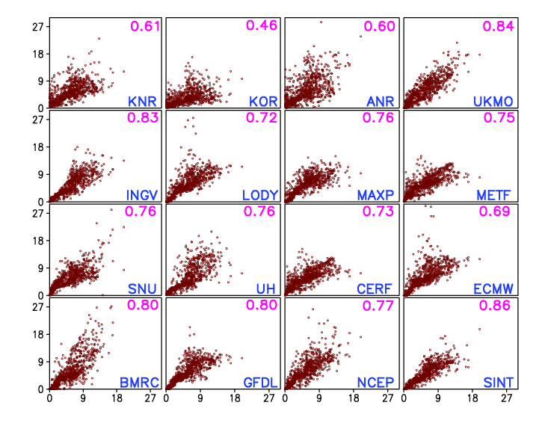
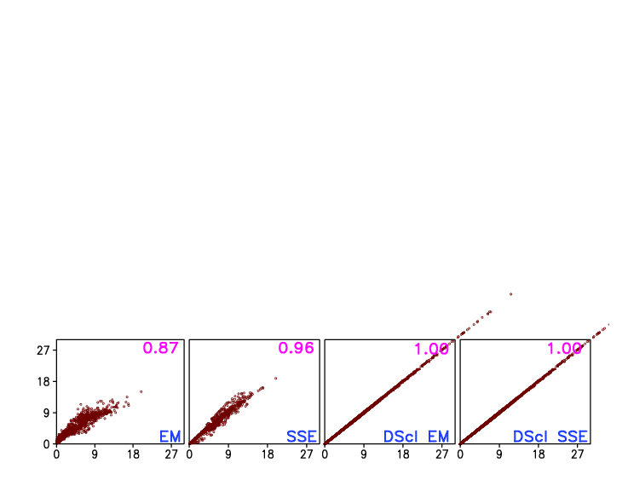
Observed vs. Forecasts of JJA Precipitation Climatology (1987-2001) for Asian Monsoon Region
CERFACS and MetFr used similar models for their Atmospheric (ARPEGE) and Oceanic (OPA) components.
UKMO, which used HadAM3 atmospheric model and GloSea ocean model, showed higher skill compared to CERFACS and MetFr.
ECMWF and LODYC used IFS model as their atmospheric component.
Two different versions of ECHAM were used by INGV and MPI as their atmospheric model.
Top corner shows Correlation Coefficient between simulated and observed precipitation for JJA.
It appears that models with same atmospheric component show similar pattern in precipitation forecast over this region.

Slide 25
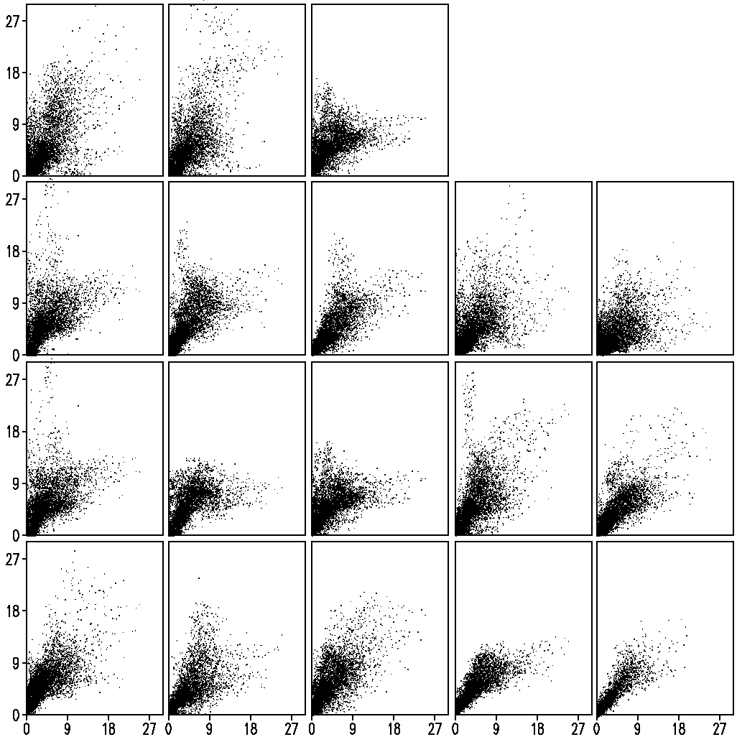
Relation between simulated and observed precipitation (grid by grid) over the monsoon Asia during Jun-Aug of 1987–2001 from 16 CGCMs, their EM, and the superensemble - COARSE
ANR 0.32
BMRC 0.64
CERF 0.42
The correlation coefficient between the simulated and observed precipitation is indicated at the top of the panels, followed the model name.
ECMW 0.45
GFDL 0.53
INGV 0.49
KNR 0.17
KOR 0.45
LODY 0.64
MAXP 0.23
METF 0.37
NCEP 0.26
SINT 0.35
SNU 0.71
UH 0.51
UKMO 0.20
EM 0.66
SSE 0.73

Slide 26
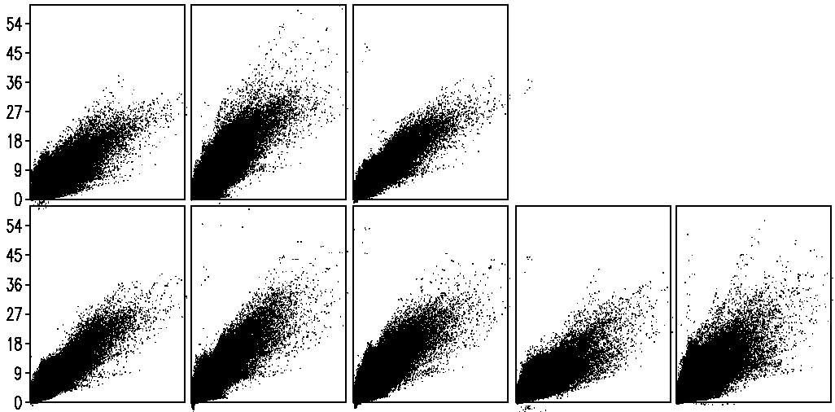
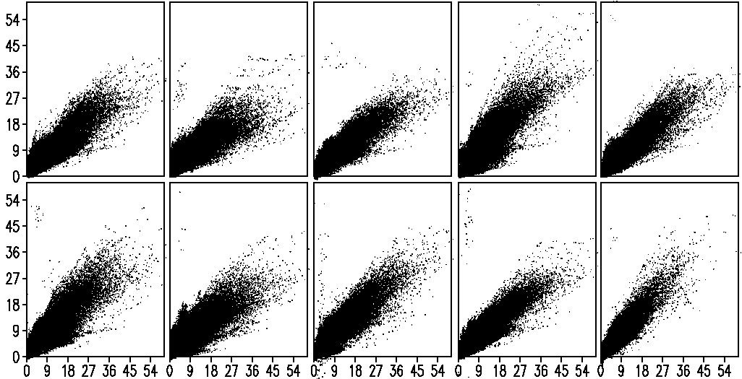
ANR 0.39
BMRC 0.68
CERF 0.55
Relation between simulated and observed precipitation (grid by grid) over the monsoon Asia during Jun-Aug of 1987–2001 from 16 CGCMs, their EM, and the superensemble - DOWNSCALING
ECMW 0.58
GFDL 0.56
INGV 0.54
KNR 0.32
KOR 0.69
The correlation coefficient between the simulated and observed precipitation is indicated at the top of the panels (followed by the model name).
LODY 0.74
MAXP 0.30
METF 0.48
NCEP 0.31
SINT 0.42
SNU 0.78
UH 0.53
UKMO 0.29
EM 0.68
SSE 0.86

Slide 27
Equitable Threat Score of precipitation over Monsoon Asia (JJAS)
Average skill during the years 1987-2001
ANR
BMRC
CERF
ECMW
GFDL
INGV
KNR
KOR
ETS
LODY
MAXP
METF
NCEP
SINT
SNU
UH
UKMO
Threshold (mm/day)
For the period 1987-2001 before and after downscaling

Slide 28
Equitable Threat Score of precipitation over Monsoon Asia (JJAS)
Covering the years 1987-2001
Ensemble mean
Superensemble
ETS
Threshold (mm/day)
Threshold (mm/day)

Slide 29
Seasonal forecast skills of precipitation over the South Asian monsoon region (69.25°–149.75°E;0.25°S–54.75°N) during June-August of 1987–2001: RMS errors
RMSE, mm/day

Slide 30
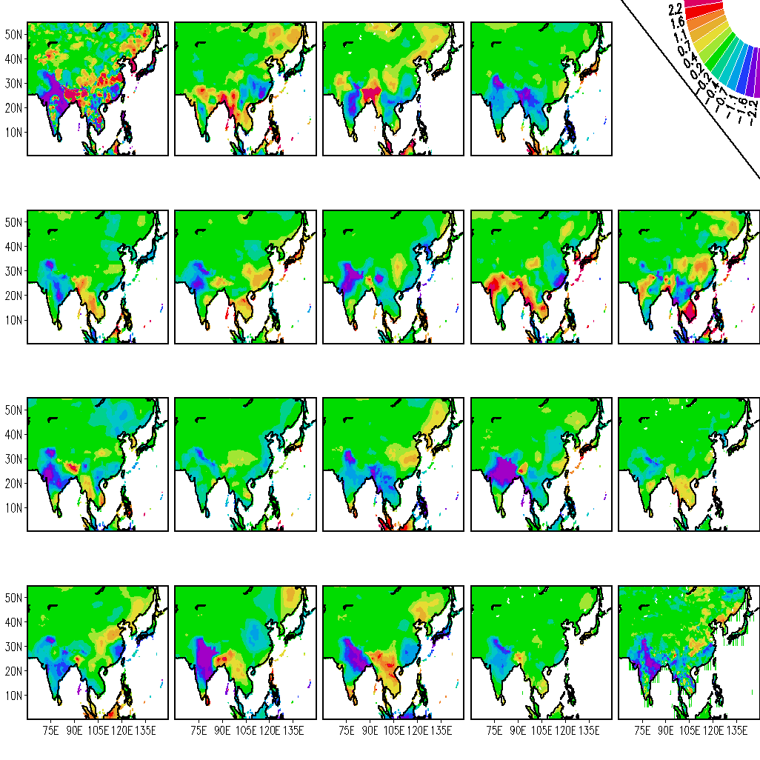
JJA Precipitation anomaly for 1987
APHRODITE
ANR -0.01
BMRC 0.33
CERF 0.14
1.96
1.68
1.62
ECMW 0.25
GFDL 0.21
INGV 0.25
KNR -0.04
KOR 0.05
1.59
1.64
1.62
2.05
2.11
LODY 0.26
MAXP 0.23
METF 0.21
NCEP 0.23
SINT -0.05
1.61
1.48
1.65
1.58
1.73
SNU 0.32
UH 0.39
UKMO 0.12
EM 0.40
SSE 0.43
1.50
1.54
1.80
1.51
1.36

Slide 31
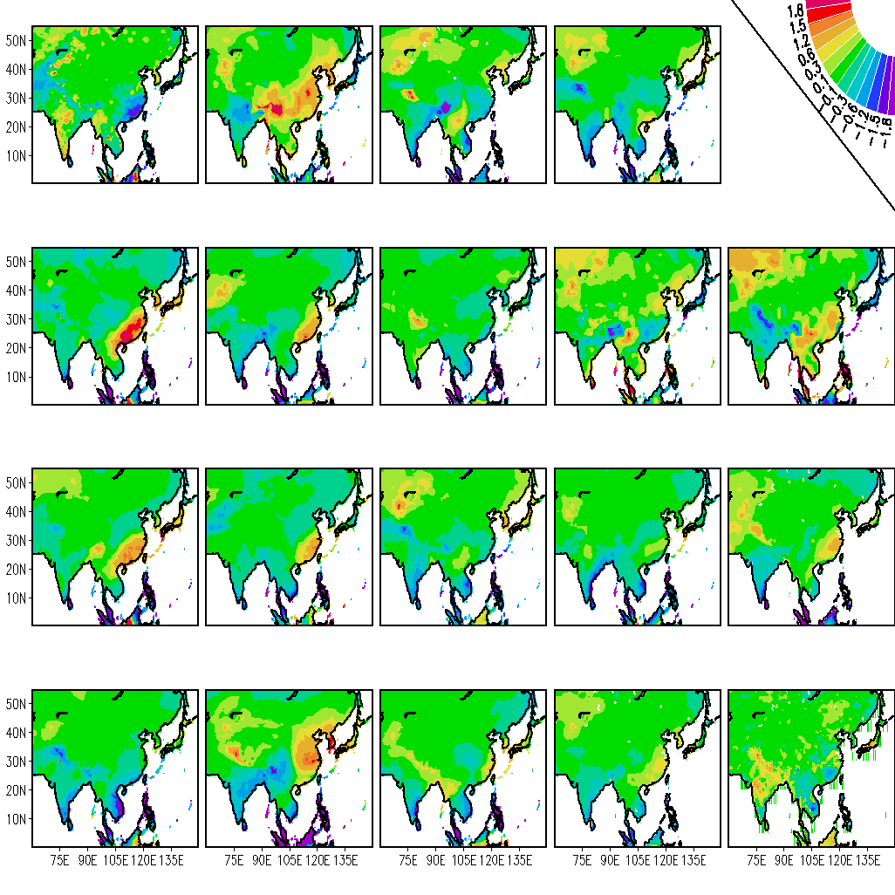
DJF Precipitation anomaly for 1987
APHRODITE
ANR -0.03
BMRC 0.35
CERF 0.11
1.06
0.95
0.98
ECMW -0.04
GFDL 0.10
INGV 0.32
KNR 0.19
KOR -0.14
1.12
1.05
0.93
0.98
1.54
LODY 0.01
MAXP 0.06
METF 0.20
NCEP 0.23
SINT 0.17
1.08
1.01
0.93
0.89
1.07
SNU 0.36
UH 0.20
UKMO 0.28
EM 0.22
SSE 0.34
0.95
1.15
0.80
0.82
0.76

Slide 32
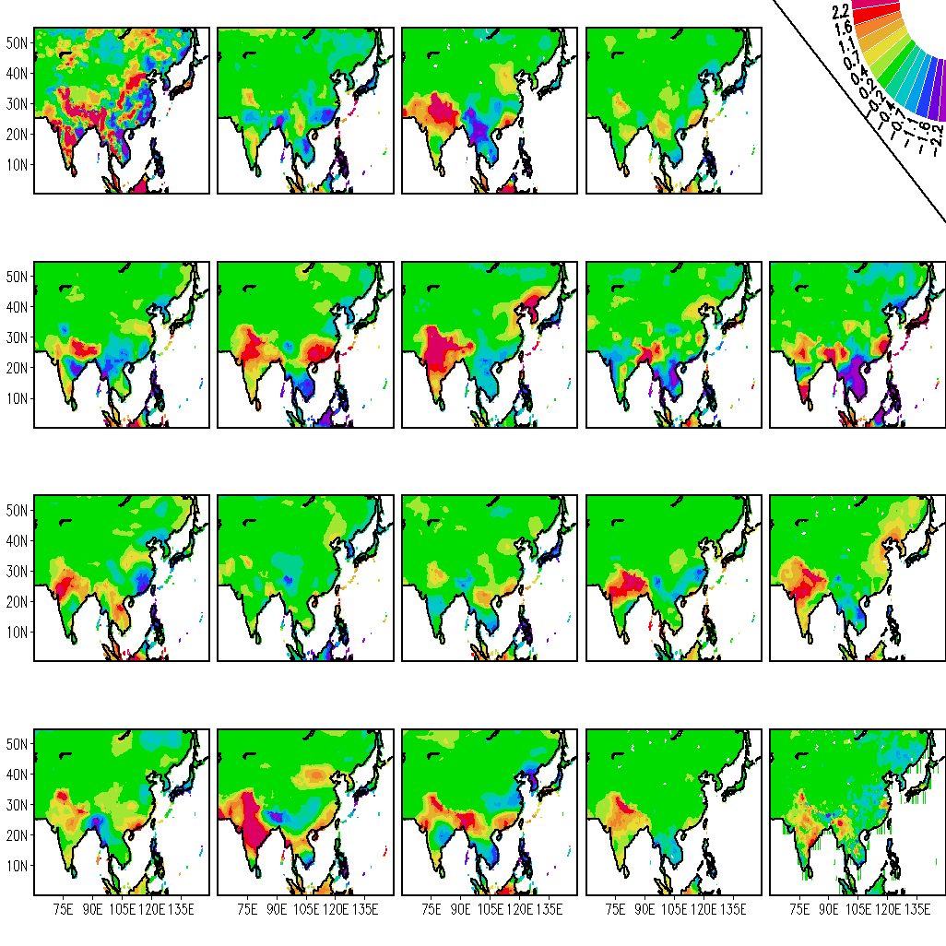
JJA Precipitation anomaly for 1988
APHRODITE
ANR 0.13
BMRC 0.30
CERF 0.17
1.55
1.67
1.44
ECMW 0.37
GFDL 0.10
INGV 0.23
KNR 0.35
KOR 0.26
1.42
1.81
1.74
1.51
2.22
LODY 0.24
MAXP 0.08
METF 0.04
NCEP 0.21
SINT 0.27
1.53
1.77
1.52
1.53
1.41
SNU 0.03
UH 0.20
UKMO 0.46
EM 0.39
SSE 0.50
1.54
1.81
133
1.37
1.58

Slide 33
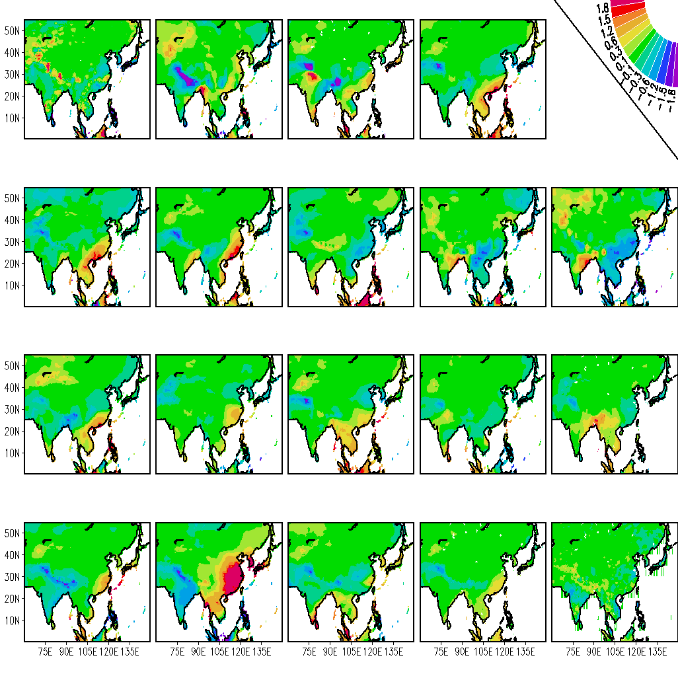
DJF Precipitation anomaly for 1988
APHRODITE
ANR 0.00
BMRC -0.18
CERF -0.02
0.97
1.16
1.07
ECMW -0.09
GFDL -0.05
INGV -0.10
KNR 0.21
KOR 0.16
1.03
0.95
1.27
0.82
0.92
LODY -0.18
MAXP -0.09
METF -0.01
NCEP -0.10
SINT -0.07
1.10
0.87
1.07
0.96
1.02
SNU -0.12
UH -0.03
UKMO -0.24
EM -0.11
SSE 0.23
1.01
1.12
1.19
0.89
0.78

Slide 34
YES/NO proposition
Details of extreme rainfall for those grid point values of the precipitation which are more/less than ±1.5 mm, expressed here in percentage against observation.
 | AOR | KNR | KOR | BMRC | CERF | ECMW | GFDL | INGV | LODY | MAXP | METF | NCEP | SINT | SNU | UH | UKMO | EM | SSE
1987 | 48.9 | 30.4 | 41.5 | 24.3 | 10.3 | 10.6 | 5.6 | 23.5 | 17.3 | 6.9 | 7.6 | 37.3 | 21.6 | 15.7 | 32.2 | 17.7 | 4.5 | 30.1
1988 | 40.3 | 36.4 | 39.4 | 48.3 | 0.0 | 32.6 | 22.6 | 63.6 | 30.0 | 15.4 | 21.4 | 37.1 | 25.4 | 18.4 | 47.7 | 19.3 | 13.4 | 36.8
1989 | 17.5 | 37.0 | 42.2 | 42.9 | 14.5 | 37.0 | 28.6 | 48.0 | 20.4 | 31.2 | 3.2 | 34.2 | 17.3 | 12.9 | 33.1 | 11.8 | 0.0 | 30.6
1990 | 16.9 | 18.9 | 32 | 43.0 | 30.9 | 24.1 | 18.6 | 20.5 | 18.7 | 5.5 | 21.0 | 18.5 | 50.0 | 13.6 | 13.9 | 13.6 | 0.0 | 29.7
1991 | 40.1 | 48.0 | 38.2 | 27.7 | 0.0 | 22.7 | 10.7 | 30.4 | 28.3 | 2.7 | 10.3 | 14.9 | 29.5 | 7.6 | 43.5 | 28.1 | 3.1 | 25.4
1992 | 11.2 | 42.5 | 28.6 | 33.3 | 7.8 | 32.2 | 15.3 | 45.3 | 12.6 | 40.9 | 15.2 | 34.1 | 14.5 | 2.2 | 41.2 | 18.1 | 0.0 | 45.5
1993 | 32.0 | 17.3 | 42.7 | 45.1 | 4.8 | 30.8 | 43.0 | 19.4 | 39.9 | 21.4 | 0.0 | 11.3 | 40.0 | 12.6 | 48.6 | 25.5 | 1.5 | 33.3
1994 | 17.4 | 22.1 | 20.8 | 20.6 | 31.1 | 34.0 | 3.7 | 27.6 | 8.9 | 11.5 | 28.4 | 20.6 | 29.3 | 16.2 | 30.7 | 19.7 | 25.0 | 39
1995 | 48.0 | 37.9 | 41.1 | 32.0 | 7.2 | 10.9 | 19.5 | 13.7 | 27.5 | 3.7 | 2.8 | 20.2 | 16.0 | 35.6 | 45.1 | 12.9 | 0.0 | 42.7
1996 | 19.3 | 40.5 | 36.2 | 43.1 | 25.2 | 29.0 | 18.8 | 18.9 | 8.1 | 25.0 | 2.0 | 23.3 | 29.0 | 17.4 | 34 | 31.6 | 18.2 | 34.9
1997 | 34.6 | 35.1 | 39.2 | 30.4 | 12.6 | 23.2 | 43.6 | 51.3 | 32.4 | 0.0 | 16.2 | 32.0 | 14.3 | 7.3 | 28.8 | 47.4 | 9.0 | 38.2
1998 | 28.4 | 32.7 | 29.2 | 36.9 | 11.1 | 32.5 | 17.9 | 27.8 | 27.0 | 16.9 | 22.0 | 27.7 | 19.6 | 7.8 | 32.3 | 14.7 | 8.6 | 24.7
1999 | 19.4 | 35.6 | 40.5 | 45.8 | 8.0 | 28.2 | 38.5 | 37.1 | 45.5 | 35.7 | 17.1 | 28.5 | 10.0 | 39.8 | 41 | 31.6 | 17.1 | 66
2000 | 41.3 | 43.3 | 38.2 | 31.7 | 14.3 | 21.0 | 12.8 | 56.8 | 29.1 | 18.2 | 11.9 | 43.3 | 28.4 | 27.4 | 41.2 | 19.0 | 14.7 | 46.1
2001 | 26.3 | 30.7 | 34.4 | 34.8 | 14.0 | 17.4 | 20.5 | 17.8 | 15.6 | 0.0 | 18.4 | 9.1 | 16.1 | 2.6 | 14.6 | 29.3 | 2.5 | 22.5
Mean | 29.4 | 33.9 | 36.3 | 35.3 | 12.8 | 25.8 | 21.3 | 33.5 | 24.1 | 15.7 | 13.1 | 26.1 | 24.1 | 15.8 | 35.2 | 22.7 | 12.0 | 36.4

Slide 35
ETS for JJA Precipitation anomaly over Monsoon Asia
Downscaling
ETS
Coarse
Threshold (mm/day)

Slide 36
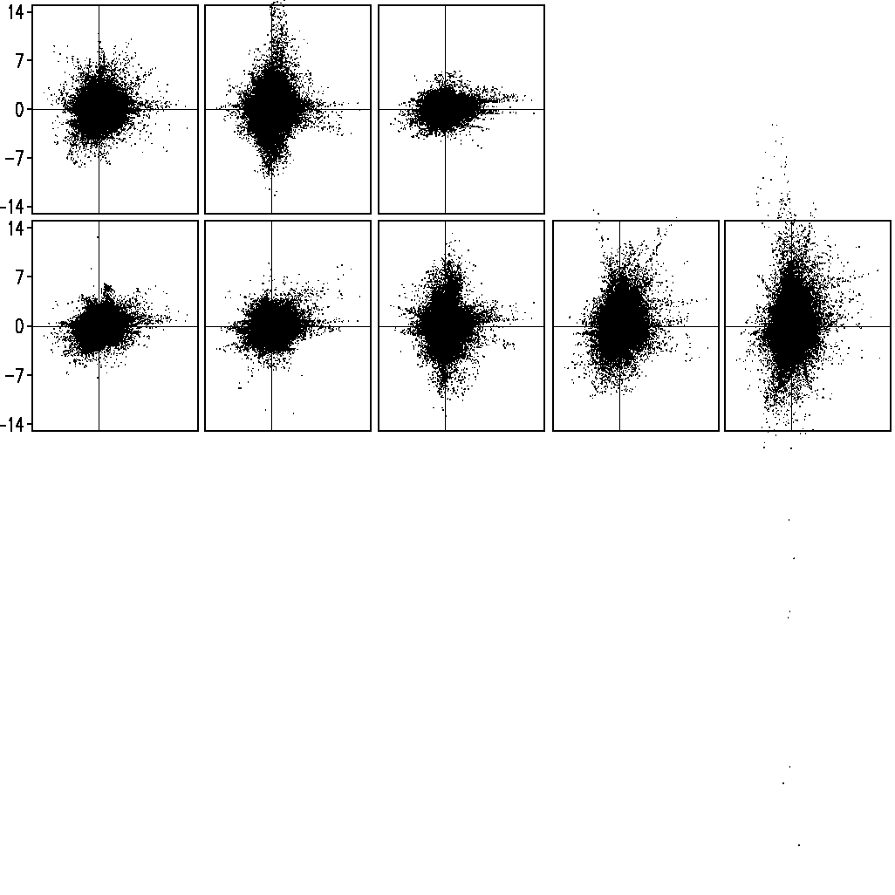
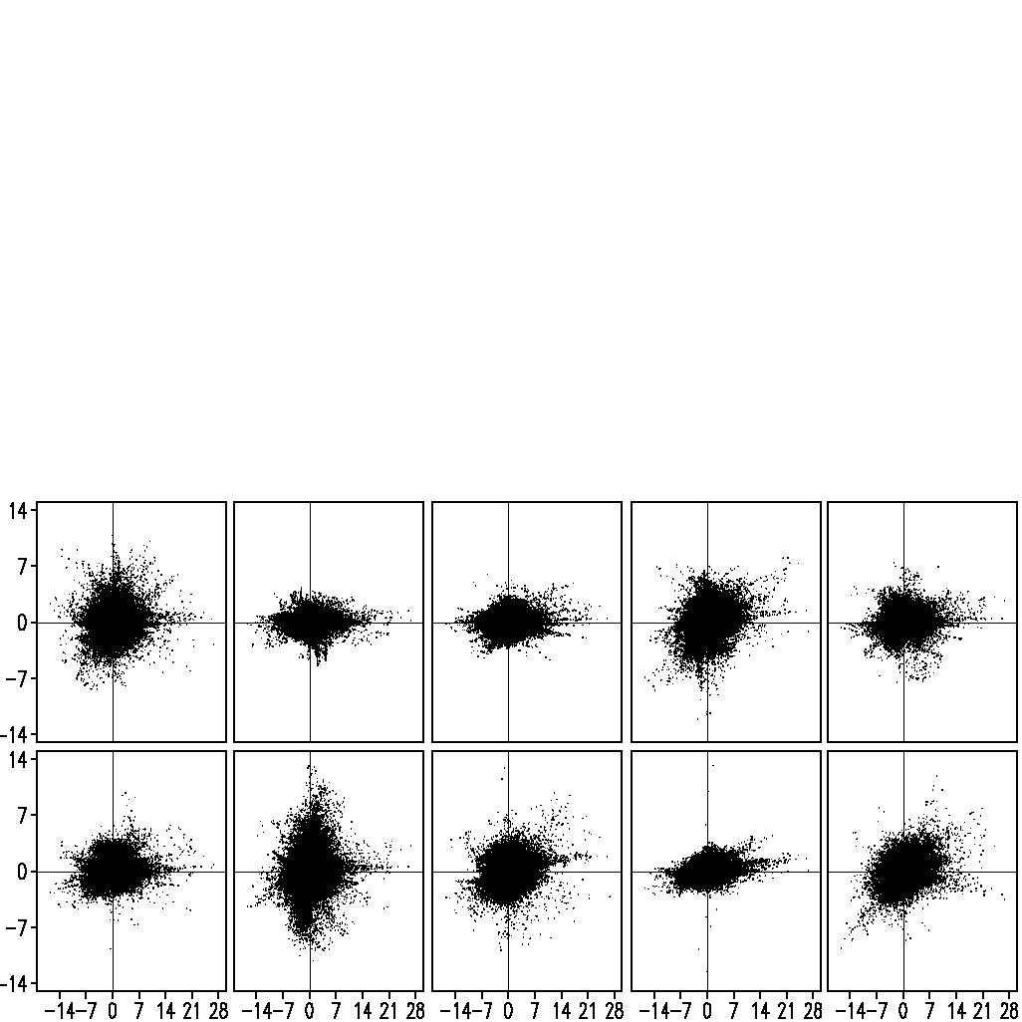
ANR 0.18
BMRC 0.50
CERF 0.49
Scatter plot for JJA Precipitation anomaly over
Monsoon Asia Region
ECMW 0.55
GFDL 0.30
INGV 0.65
KNR -0.10
KOR 0.40
LODY 0.64
MAXP 0.64
METF 0.49
NCEP 0.46
SINT 0.61
SNU 0.30
UH 0.57
UKMO 0.64
EM 0.58
SSE 0.70

Slide 37
Probabilistic forecasting
is the unconditional mean
frequency of occurrence of the event .
One of the most widely used methods for verification of probability forecasts is the Brier skill score.
Following Wilks (1995), the Brier score is then defined as
Where k=forecast-observation pairs, n = total numbers of such pairs
Stefanova, L., and T.N. Krishnamurti, 2002: Interpretation of Seasonal Climate Forecast Using Brier Skill Score,
The Florida State University Superensemble, and the AMIP-I Dataset. J. Climate, 15, 537–544.

Slide 38
Methods used in Superensemble probability forecasts
Methods-1
Where w_{i} are weights used to construct superensemble; λ = 0.5 (empirically chosen)
Methods-2
Where w_{i} are statistical weights to the hit rate for the event and nonevent during the training period to construct superensemble; c_{i} is the sum of the hit rate for the event and the hit rate for the nonevent for the ith model over the training period and k is an empirically chosen constant fixed, best choice, at 3.

Slide 39
Superensemble probability forecasts for JJA over Monsoon Asia Region
Observed relative frequency
Precipitation anomaly >0.5 mm/day
Precipitation anomaly >1.0 mm/day
Reliability diagrams for precipitation anomaly
Precipitation anomaly >1.5 mm/day
Precipitation anomaly >2.0 mm/day
Forecast frequency level
MME – Mulimodel Ensemble; Mth1 – Superensemble using Method-1
Mth2 – Superensemble using Method-2; Mdls – Member models

Slide 40
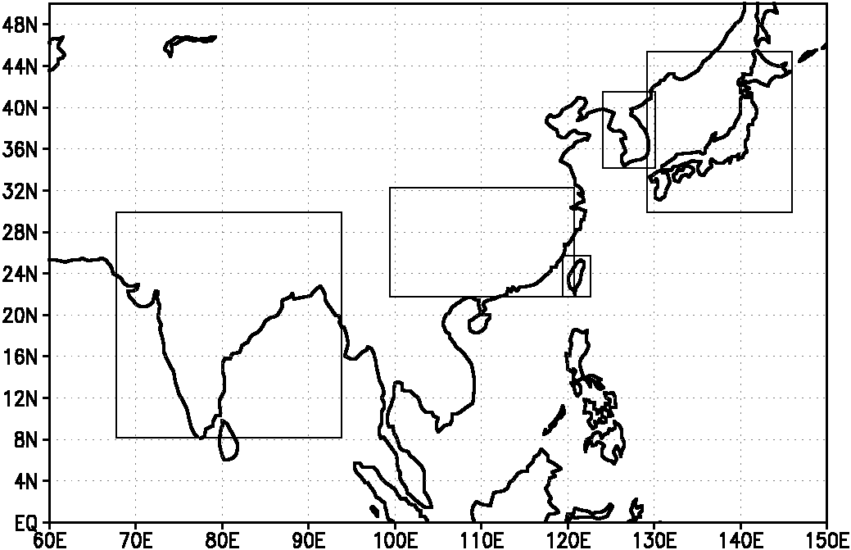
Regions of Study over different parts of Monsoon Asia
China Region
(99-121E;22-30N)
Japan Region (129-147E;30-46N)
Indian Region
(69-92E; 8-30N)
Korea Region (126-130E;34-42N)
Taiwan Region (119.757-122.25E; 21.75-25.5N)

Slide 41
Percentage departure of rainfall (JJA) over India
(69-92E; 8-30N)

Slide 42
RMSE over Indian Region
CC over Indian Region
Models | RMSE India Region
ANRM | 8.35
KNRM | 8.10
KORM | 8.39
BMRC | 8.15
CERF | 9.95
ECMW | 8.40
GFDL | 9.10
INGV | 7.78
LODY | 8.11
MAXP | 7.94
METF | 8.93
NCEP | 7.73
SINT | 7.36
SUT1 | 8.08
UHT1 | 8.52
UKMO | 8.08
EM | 8.16
SSE | 4.06
Models | CC over Indian Region
ANRM | -0.48
KNRM | -0.35
KORM | -0.52
BMRC | -0.41
CERF | -0.79
ECMW | -0.29
GFDL | -0.79
INGV | -0.16
LODY | -0.25
MAXP | -0.31
METF | -0.73
NCEP | -0.01
SINT | 0.11
SUT1 | -0.17
UHT1 | -0.44
UKMO | -0.25
EM | -0.83
SSE | 0.85

Slide 43
Percentage departure of rainfall (JJA) over Taiwan
(119.757-122.25E; 21.75-25.5N)

Slide 44
RMSE over Taiwan Region
CC over Taiwan Region
Models | RMSE over Taiwan Region
ANRM | 24.51
KNRM | 25.74
KORM | 24.34
BMRC | 23.35
CERF | 25.61
ECMW | 25.16
GFDL | 24.82
INGV | 25.20
LODY | 23.63
MAXP | 26.21
METF | 26.02
NCEP | 23.79
SINT | 25.07
SUT1 | 24.13
UHT1 | 23.66
UKMO | 23.41
EM | 24.31
SSE | 14.61
Models | CC Taiwan Region
ANRM | -0.37
KNRM | -0.77
KORM | -0.59
BMRC | -0.02
CERF | -0.41
ECMW | -0.71
GFDL | -0.37
INGV | -0.74
LODY | -0.15
MAXP | -0.51
METF | -0.57
NCEP | -0.43
SINT | -0.52
SUT1 | -0.39
UHT1 | -0.25
UKMO | 0.03
EM | -0.81
SSE | 0.78

Slide 45
Percentage departure of rainfall (JJA) over China
(99-121E; 22-30N)

Slide 46
RMSE over China Region
CC over China Region
Models | RMSE over China Region
ANRM | 15.10
KNRM | 14.27
KORM | 13.70
BMRC | 13.99
CERF | 13.77
ECMW | 13.52
GFDL | 14.50
INGV | 12.49
LODY | 12.82
MAXP | 13.70
METF | 15.12
NCEP | 13.52
SINT | 12.91
SUT1 | 13.40
UHT1 | 14.36
UKMO | 14.68
EM | 13.52
SSE | 11.34
Models | CC over China Region
ANRM | -0.74
KNRM | -0.73
KORM | -0.19
BMRC | -0.63
CERF | -0.18
ECMW | -0.14
GFDL | -0.70
INGV | -0.16
LODY | -0.17
MAXP | -0.25
METF | -0.35
NCEP | -0.42
SINT | 0.01
SUT1 | -0.04
UHT1 | -0.77
UKMO | -0.69
EM | -0.91
SSE | 0.50

Slide 47
Percentage departure of rainfall (JJA) over Korea
(126-130E; 34-42N)

Slide 48
RMSE over Korea Region
CC over Korea Region
Models | RMSE over Korea Region
ANRM | 19.84
KNRM | 22.14
KORM | 19.74
BMRC | 20.12
CERF | 19.46
ECMW | 17.27
GFDL | 20.32
INGV | 21.56
LODY | 19.88
MAXP | 17.45
METF | 18.22
NCEP | 18.46
SINT | 21.05
SUT1 | 20.74
UHT1 | 18.72
UKMO | 19.50
EM | 19.01
SSE | 15.76
Models | CC over Korea Region
ANRM | -0.73
KNRM | 0.78
KORM | -0.33
BMRC | -0.56
CERF | -0.30
ECMW | 0.16
GFDL | -0.48
INGV | -0.44
LODY | -0.57
MAXP | 0.12
METF | 0.19
NCEP | 0.18
SINT | -0.52
SUT1 | -0.57
UHT1 | -0.13
UKMO | -0.23
EM | -0.71
SSE | 0.46

Slide 49
Sensitivity experiments of Superensemble against number of models. Best models selected based on their RMSE over monsoon Asia region for precipitation.

Slide 50
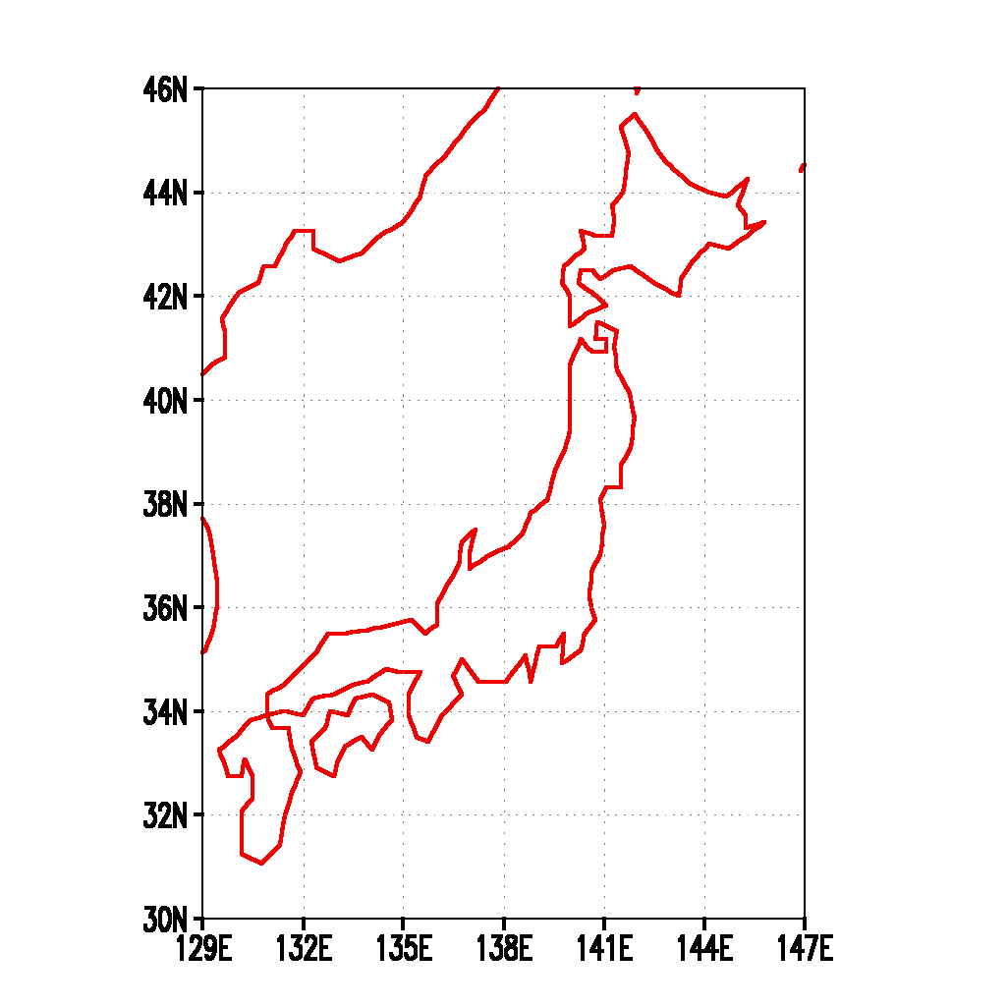
Japan region used in this study Topography

Slide 51
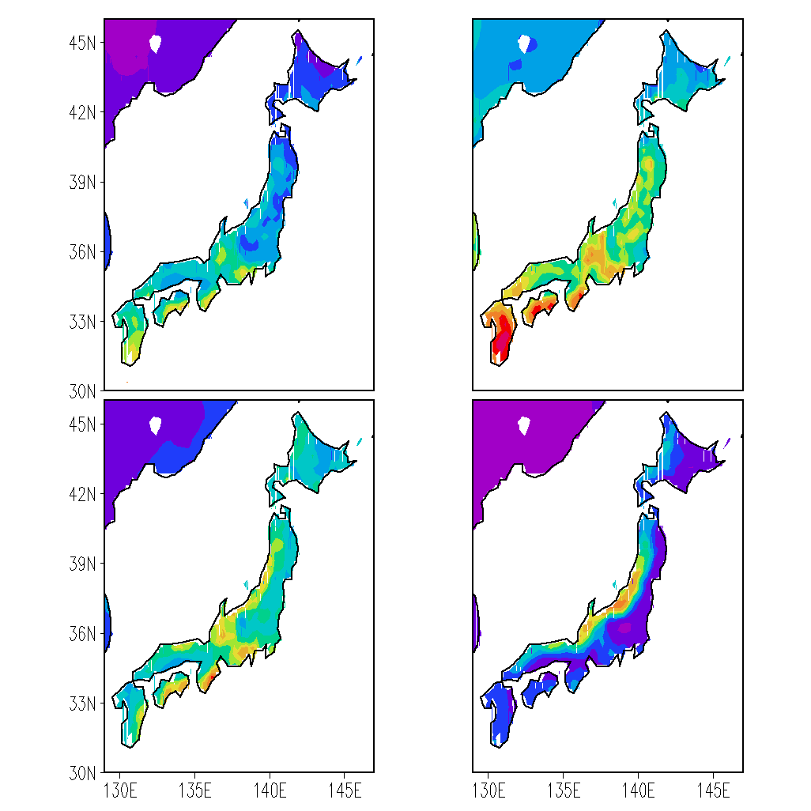
Seasonal Precipitation Climatology – APHRODITE
MAM
JJA
SON
DJF

Slide 52
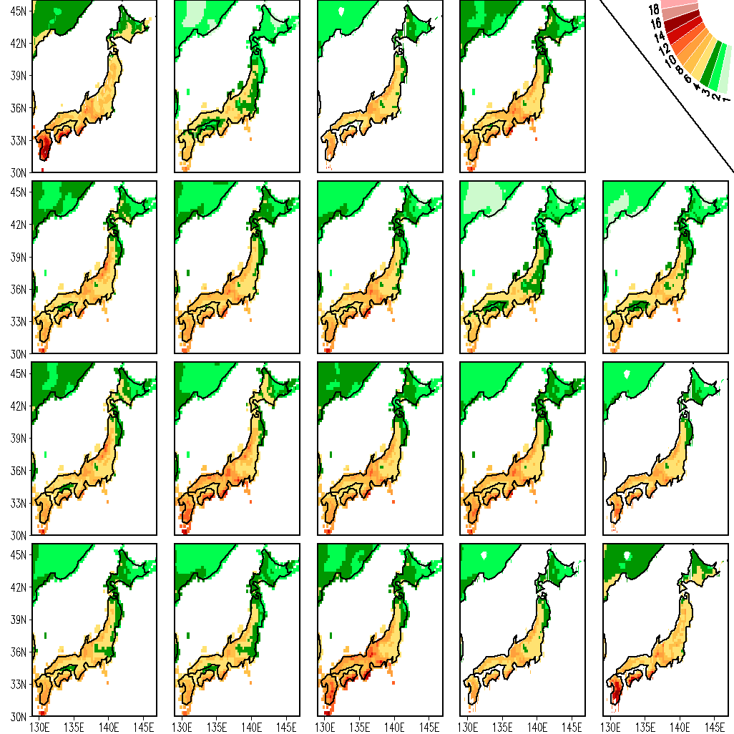
Precipitation climatology, JJA (1987-2001) – Downscaled to 0.25x0.25 Resolution
ANR 0.88
BMRC 0.90
CERF 0.85
APHRODITE
3.09
1.80
2.00
ECMW0.84
GFDL 0.88
INGV 0.86
KNR 0.89
KOR 0.85
2.18
1.97
2.04
2.91
2.74
LODY 0.85
MAXP 0.87
METF 0.85
NCEP 0.90
SINT 0.92
2.08
1.47
1.93
1.71
1.61
SNU 0.91
UH 0.91
UKMO 0.89
EM 0.89
SSE 0.99
1.93
2.29
1.44
1.97
0.13

Slide 53
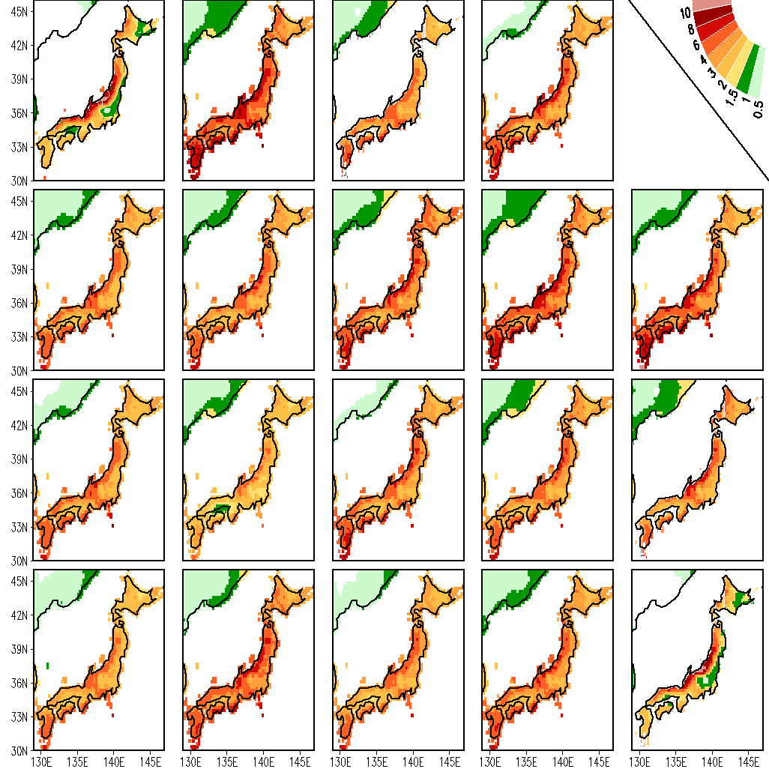
Precipitation climatology, DJF (1987-2001) – Downscaled to 0.25x0.25 Resolution
ANR 0.78
BMRC 0.71
CERF 0.80
APHRODITE
2.69
1.81
1.86
ECMW0.78
GFDL 0.81
INGV 0.79
KNR 0.80
KOR 0.73
1.57
1.64
2.02
2.45
2.76
LODY 0.77
MAXP 0.79
METF 0.76
NCEP 0.80
SINT 0.87
1.59
1.36
1.91
1.70
1.41
SNU 0.76
UH 0.80
UKMO 0.80
EM 0.80
SSE 0.99
1.45
1.93
1.44
1.75
0.05

Slide 54
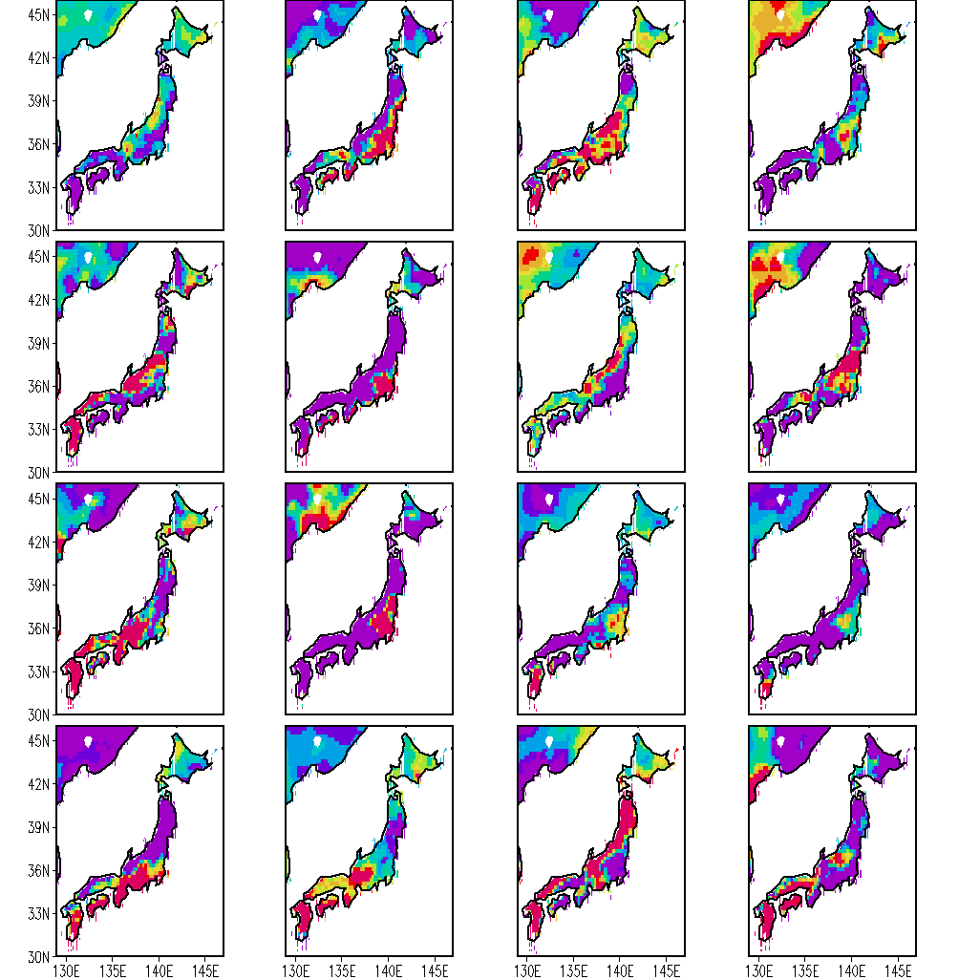
Spatial Distribution of Regression Coefficients- ‘a’ slope, for July
ANR
BMRC
CERF
ECMW
GFDL
INGV
KNR
KOR
LODY
MAXP
METF
NCEP
SINT
SNU
UH
UKMO

Slide 55
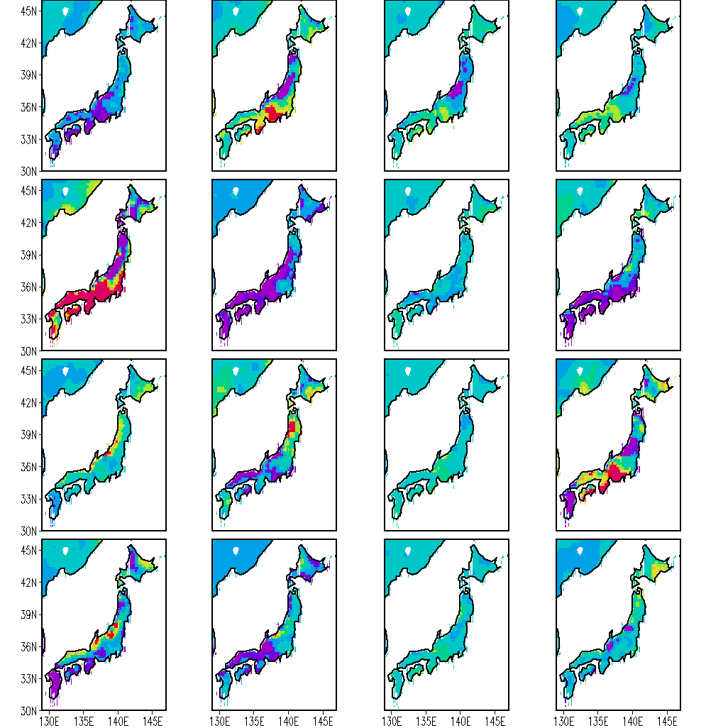
Spatial Distribution of Regression Coefficients- ‘a’ slope, for December
ANR
BMRC
CERF
ECMW
GFDL
INGV
KNR
KOR
LODY
MAXP
METF
NCEP
SINT
SNU
UH
UKMO

Slide 56
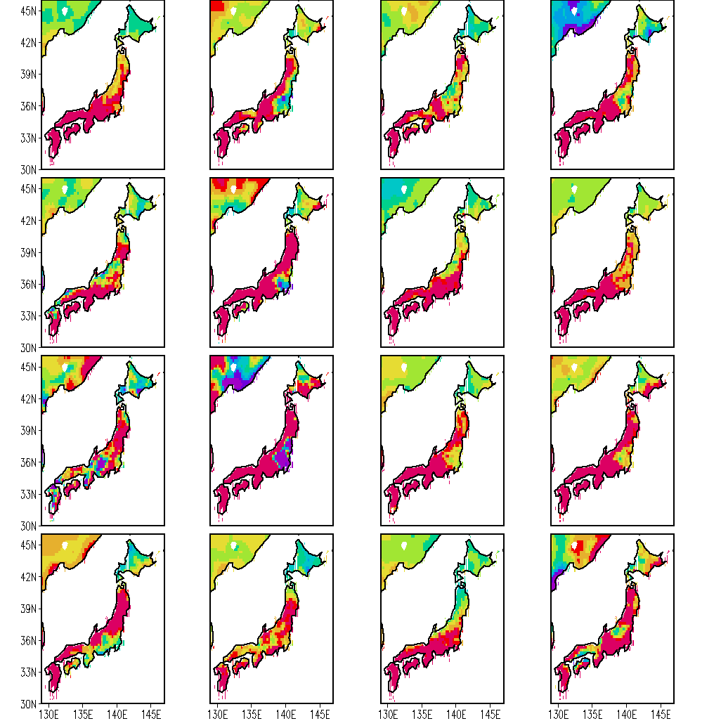
Spatial Distribution of Regression Coefficients- ‘b’ INTERCEPT, for July
ANR
BMRC
CERF
ECMW
GFDL
INGV
KNR
KOR
LODY
MAXP
METF
NCEP
SINT
SNU
UH
UKMO

Slide 57
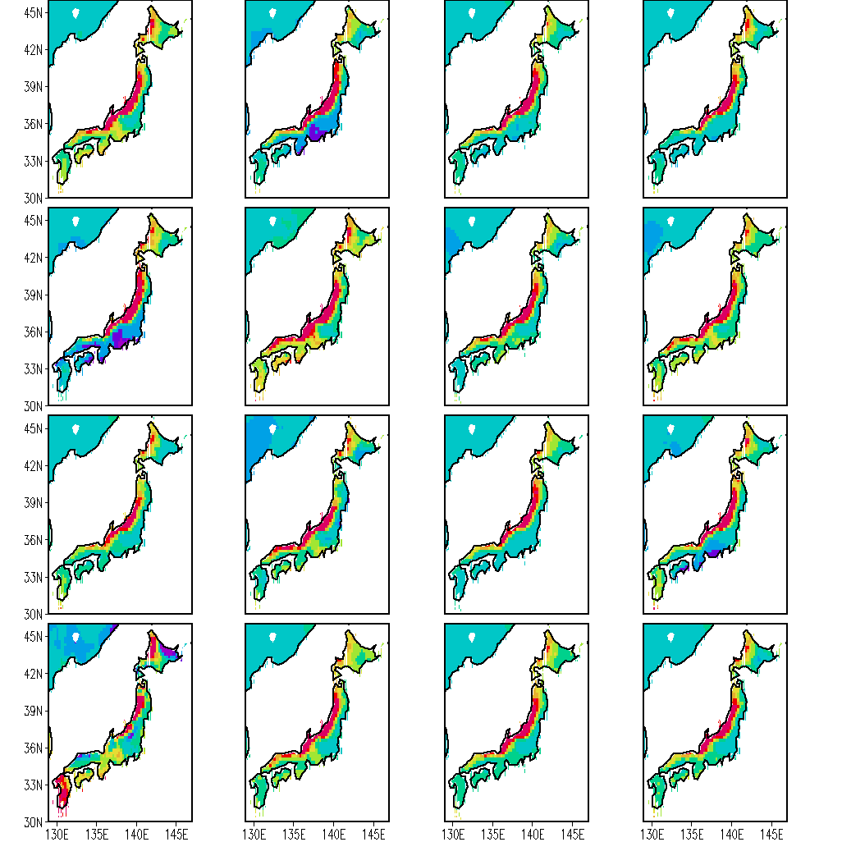
Spatial Distribution of Regression Coefficients- ‘b’ INTERCEPT, for December
ANR
BMRC
CERF
ECMW
GFDL
INGV
KNR
KOR
LODY
MAXP
METF
NCEP
SINT
SNU
UH
UKMO

Slide 58
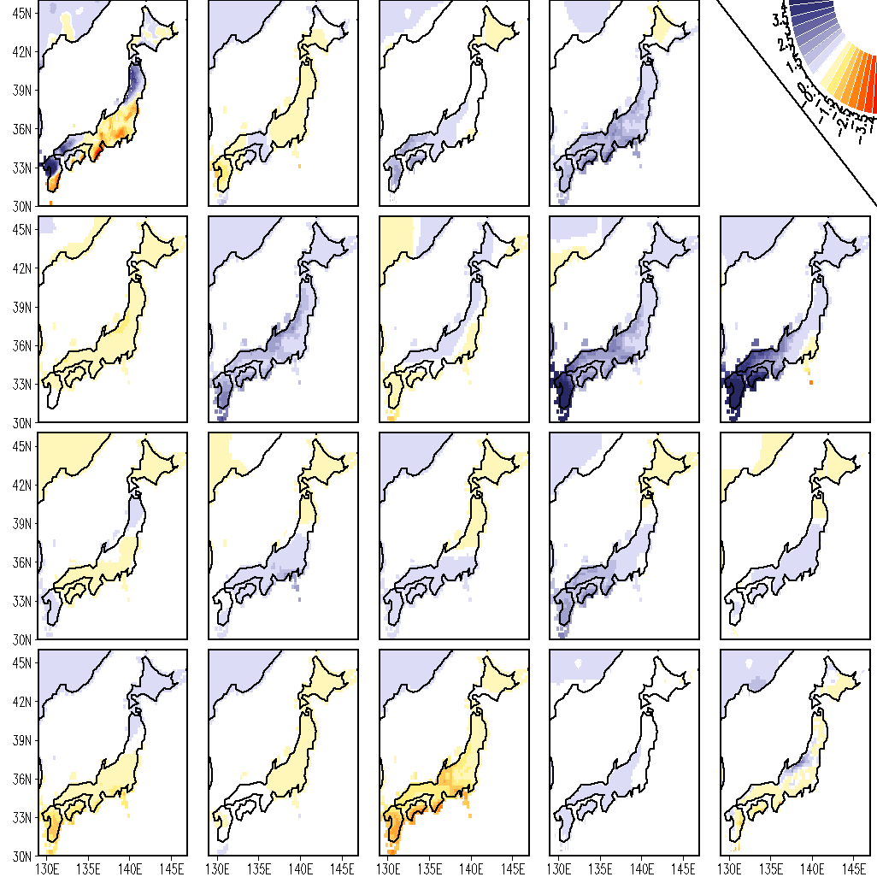
JJA Rainfall anomaly for 1987
ANR -0.28
BMRC 0.07
CERF -0.37
2.18
2.15
2.37
ECMW0.17
GFDL -0.23
INGV 0.09
KNR -0.04
KOR 0.03
1.96
2.54
1.72
4.05
3.66
LODY 0.19
MAXP-0.44
METF 0.03
NCEP -0.14
SINT -0.44
1.86
2.09
2.01
2.38
1.98
SNU 0.22
UH 0.06
UKMO 0.29
EM -0.09
SSE 0.19
1.74
1.97
1.88
2.08
1.75

Slide 59
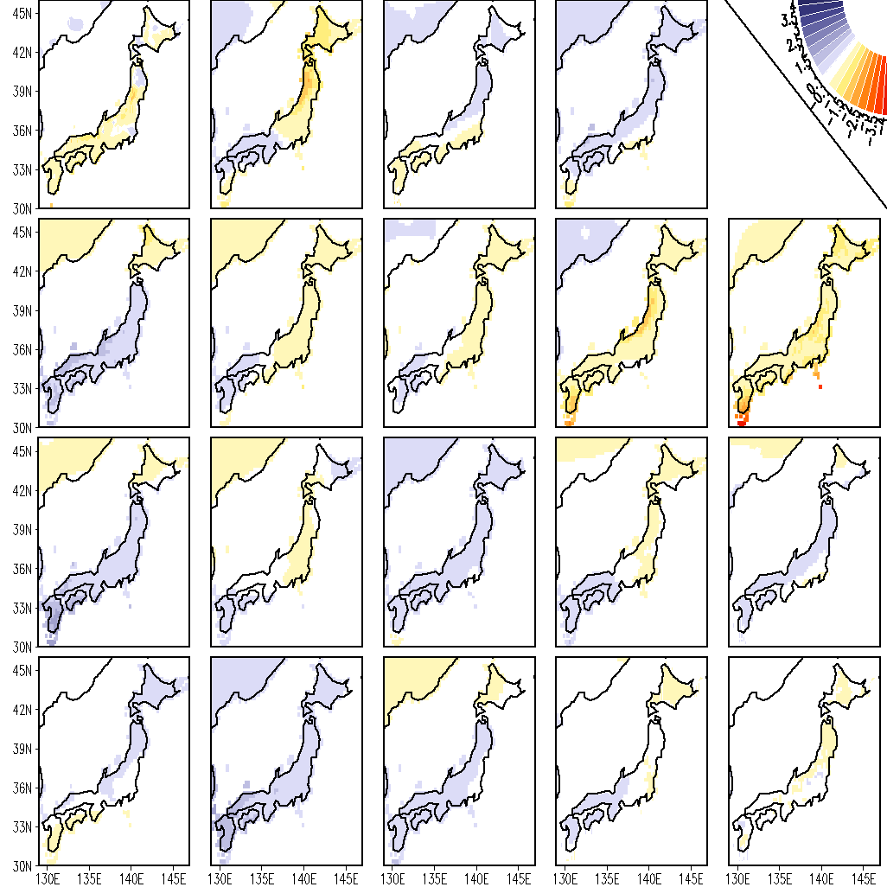
DJF Rainfall anomaly for 1987
ANR -0.04
BMRC 0.41
CERF 0.10
0.82
0.59
0.83
ECMW-0.66
GFDL -0.32
INGV -0.15
KNR 0.54
KOR 0.45
1.29
0.69
0.67
0.62
0.99
LODY -0.69
MAXP -0.32
METF -0.33
NCEP -0.51
SINT -0.53
1.45
0.88
0.98
0.92
0.90
SNU 0.25
UH -0.51
UKMO -0.68
EM -0.36
SSE 0.30
0.60
1.29
1.08
0.70
0.65

Slide 60
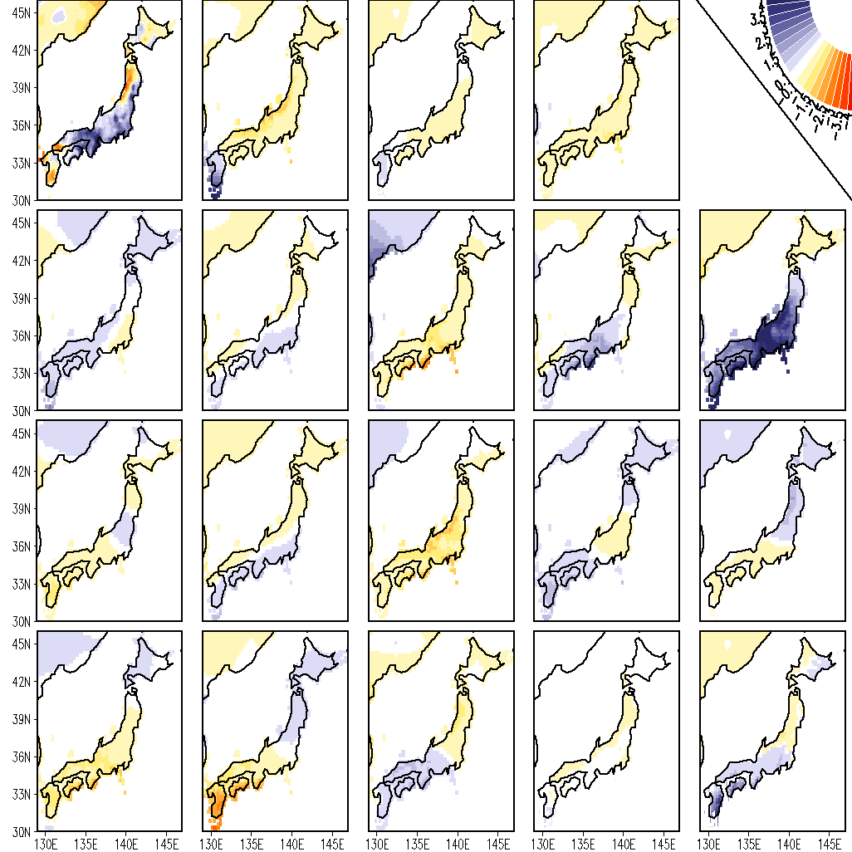
JJA Rainfall anomaly for 1988
ANR -0.32
BMRC 0.60
CERF -0.50
2.47
1.81
1.75
ECMW-0.22
GFDL 0.50
INGV -0.48
KNR 0.62
KOR 0.56
1.86
1.57
2.06
1.43
2.78
LODY -0.09
MAXP 0.48
METF -0.52
NCEP -0.19
SINT -0.45
1.61
1.56
1.92
1.84
1.90
SNU -0.51
UH -0.17
UKMO 0.45
EM -0.09
SSE 0.40
1.87
1.94
1.51
1.63
1.69

Slide 61
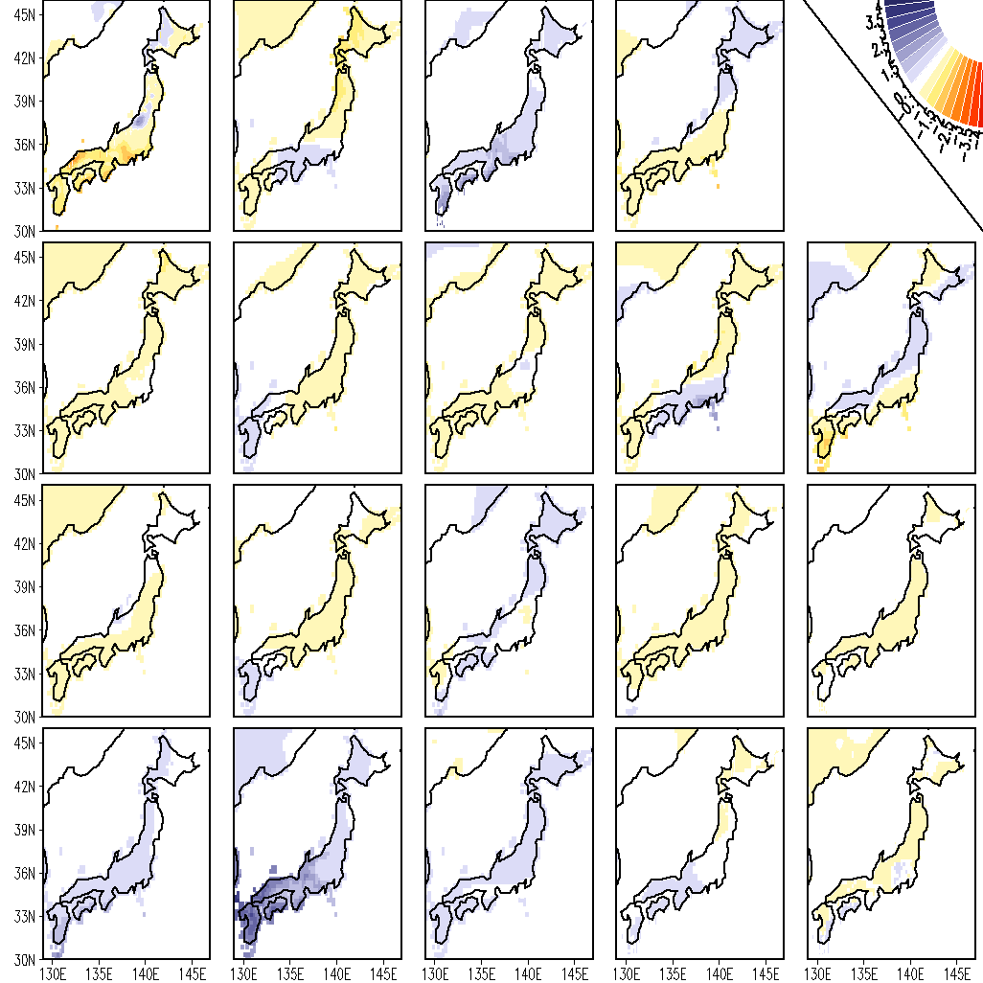
DJF Rainfall anomaly for 1988
ANR -0.46
BMRC -0.66
CERF 0.64
1.00
2.03
0.80
ECMW-0.52
GFDL -0.13
INGV 0.15
KNR -0.51
KOR 0.36
0.89
1.04
0.82
1.06
0.82
LODY 0.32
MAXP 0.06
METF 0.19
NCEP 0.00
SINT 0.22
0.86
1.02
1.16
0.93
0.88
SNU -0.68
UH -0.68
UKMO -0.19
EM -0.72
SSE 0.10
1.61
2.26
1.27
1.18
1.08

Slide 62
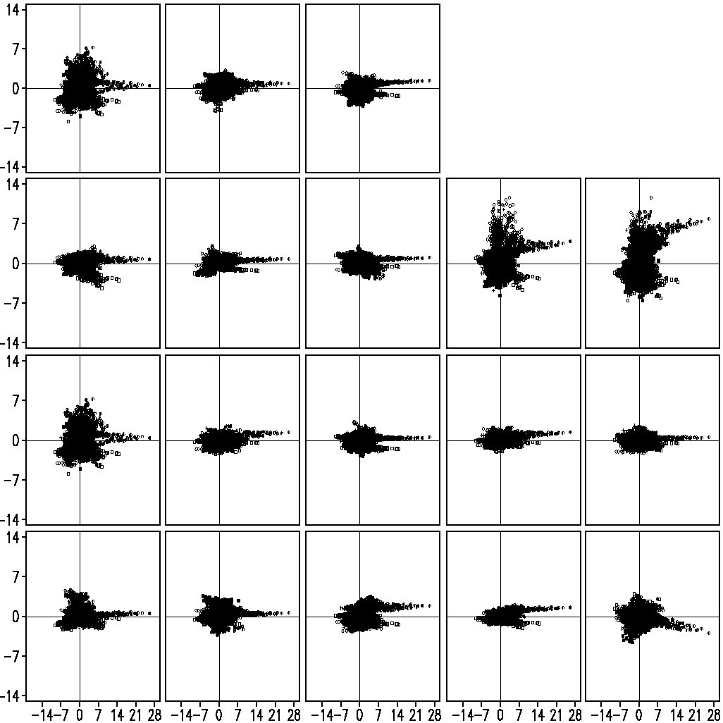
JJA Rainfall anomaly over Japan Region (129-147E; 30.0-46.0N)
ANR 0.51
BMRC 0.32
CERF 0.20
ECMW -0.04
GFDL 0.33
INGV -0.06
KNR 0.04
KOR 0.43
LODY 0.07
MAXP -0.05
METF 0.32
NCEP 0.29
SINT 0.55
SNU 0.27
UH 0.30
UKMO 0.46
EM 0.32
SSE 0.38

Slide 63
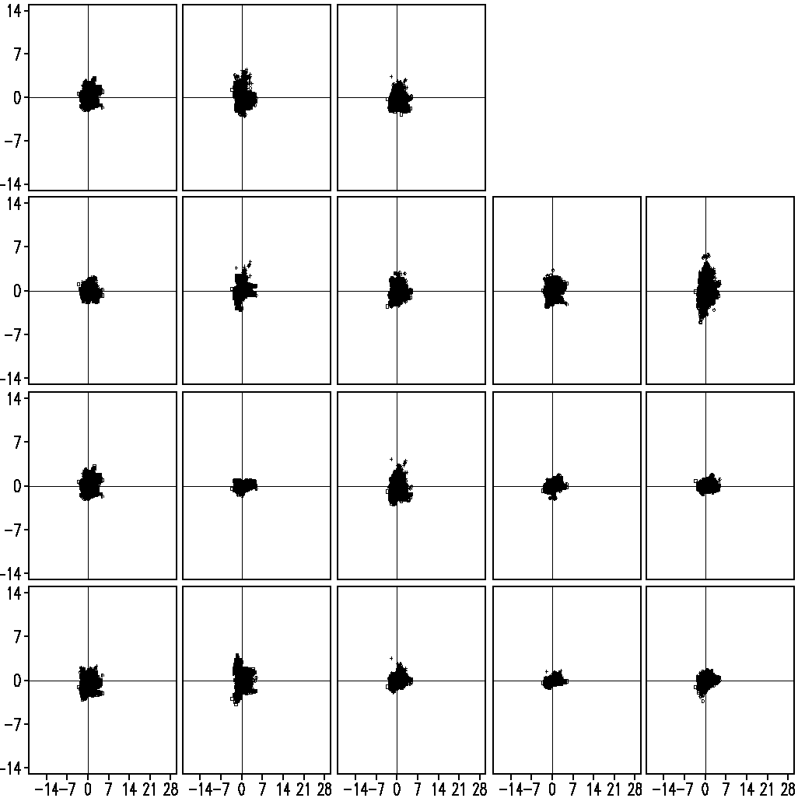
DJF Rainfall anomaly over Japan Region (129-147E; 30.0-46.0N)
ANR 0.21
BMRC -0.01
CERF 0.15
ECMW 0.51
GFDL 0.42
INGV 0.15
KNR 0.54
KOR 0.23
LODY 0.34
MAXP 0.40
METF 0.20
NCEP 0.47
SINT 0.25
SNU 0.06
UH -0.04
UKMO 0.18
EM 0.41
SSE 0.43

Slide 64
JJA Rainfall anomaly over Japan (129-147E; 30-46N)

Slide 65
RMSE over Japan Region
CC over Japan Region
Models | RMSE over Japan Region
ANRM | 17.79
KNRM | 17.56
KORM | 18.00
BMRC | 17.85
CERF | 16.67
ECMW | 17.87
GFDL | 16.79
INGV | 18.32
LODY | 18.15
MAXP | 15.71
METF | 16.57
NCEP | 17.61
SINT | 17.28
SUT1 | 17.43
UHT1 | 17.57
UKMO | 17.87
EM | 17.03
SSE | 16.30
Models | CC over Japan Region
ANRM | -0.25
KNRM | -0.34
KORM | -0.38
BMRC | -0.19
CERF | 0.11
ECMW | -0.82
GFDL | -0.16
INGV | -0.63
LODY | -0.71
MAXP | 0.25
METF | -0.00
NCEP | -0.21
SINT | -0.09
SUT1 | -0.37
UHT1 | -0.16
UKMO | -0.72
EM | -0.63
SSE | 0.10

Slide 66
DJF Rainfall anomaly over Japan (129-147E; 30-46N)

Slide 67
RMSE over Japan Region
CC over Japan Region
Models | RMSE over Japan Region
ANRM | 16.37
KNRM | 16.17
KORM | 16.30
BMRC | 13.21
CERF | 15.86
ECMW | 15.00
GFDL | 13.74
INGV | 15.82
LODY | 16.82
MAXP | 15.76
METF | 15.70
NCEP | 17.25
SINT | 15.65
SUT1 | 16.15
UHT1 | 17.83
UKMO | 14.60
EM | 14.96
SSE | 13.76
Models | CC over Japan Region
ANRM | -0.31
KNRM | -0.22
KORM | -0.55
BMRC | 0.39
CERF | -0.11
ECMW | 0.08
GFDL | 0.28
INGV | -0.09
LODY | -0.33
MAXP | 0.16
METF | -0.18
NCEP | -0.41
SINT | -0.52
SUT1 | -0.58
UHT1 | -0.50
UKMO | 0.08
EM | -0.37
SSE | 0.31

Slide 68
Derived from anomaly correlation as a function of forecastsdays for Z-500hPa Northern Hemisphere (0-360; 20N-90N).
RTDC = Radiative Transfer by Diagnostic Clouds
RTPC = Radiative Transfer by Prognostic Clouds

Slide 69
Summary
THIS STUDY UTILIZES 16 COUPLED ATMOSPHERE OCEAN MODELS. WE COVER SEASONAL CLIMATE FORECASTS COVERING THE YEARS 1997 THROUGH 2002.
THE COMBINATION OF FEATURES SUCH AS THE HIGH RESOLUTION GAUGE BASED RAINS, THE DOWNSCALING OF EACH MODELS FORECASTS AND THE MULTIMODEL SUPERENSEMBLE OF THE DOWNSCALED MODELS PROVIDES VERY ACCURATE LONG TERM MEAN CLIMATOLOGY. THAT IS OUR STARTING POINT FOR ADDRESSING RAINFALL ANOMALY FORECASTS.
WE HAVE EXAMINED THE RAINFALL ANOMALIES FOR THE ASIAN MONSOON DOMAIN.
THE DOWNSCALING COMPONENT IMPROVES THE LARGE SCALE PRECIPITATION FORECASTS FOR EACH MEMBER MODEL FOR EACH MONTH OF FORECAST.

Slide 70
Continued…
MOST MEMBER MODELS CARRY RATHER POOR RESULTS FOR THE RAINFALL ANOMALY FORECASTS. BUT MANY OF THEM CARRY RATHER PERSISTENT SYSTEMATIC ERRORS. THAT FEATURE IS EXPLOITED BY THE DOWNSCALED MULTIMODEL SUPERENSEMBLE. EVEN WHEN MANY MODELS CARRY NEGATIVE CORRELATIONS WITH RESPECT TO THE OBSERVED RAINFALL ANOMALIES, THE SUPERENEMBLE IS ABLE TO USE THE USEFUL FEATURES OF THE POORER MODELS AND PROVIDE MUCH IMPROVED RAINFALL ANOMALY FORECASTS. THIS IS ALSO SEEN TO BE TRUE REGIONALLY FOR JAPAN, KOREA, INDIA AND TAIWAN.
THE BRIER SCORE IS A PROBABILISTIC SKILL MEASURE FOR THE QUALITY OF A FORECAST. THE RELIABILITY FACTOR OF THE BRIER SKILL SCORE OF THE DOWNSCALED MULTIMODEL SUPERENSEMBLE IS THE MOST RELIABLE AMONG ALL OF THE MEMBER MODEL FORECASTS .

Slide 71
-:References:-
Krishnamurti, T.N., A.K. Mishra, A. Chakraborty, and M. Rajeevan, 2009: Improving Global Model Precipitation Forecasts over India Using Downscaling and the FSU Superensemble. Part I: 1–5-Day Forecasts. Mon. Wea. Rev., 137, 2713–2735.
Chakraborty, A., and T.N. Krishnamurti, 2009: Improving Global Model Precipitation Forecasts over India Using Downscaling and the FSU Superensemble. Part II: Seasonal Climate. Mon. Wea. Rev., 137, 2736–2757.
Wang, B., and co-authors, 2009: Advance and Prospect of Seasonal Prediction: Assessment of the APCC/CliPAS 14-model ensemble retroperspective seasonal prediction (1980-2004). Climate Dyn., 33, 90-, DOI: 10.1007/s00382-008-0460-0.
Stefanova, L., and T.N. Krishnamurti, 2002: Interpretation of Seasonal Climate Forecast Using Brier Skill Score, The Florida State University Superensemble, and the AMIP-I Dataset. J. Climate, 15, 537–544.

Slide 72


