Slide 1
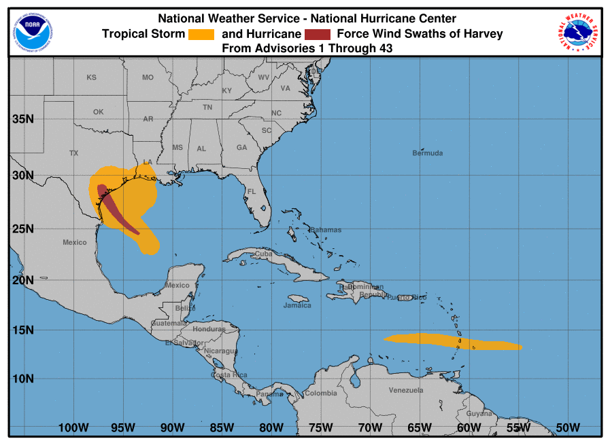
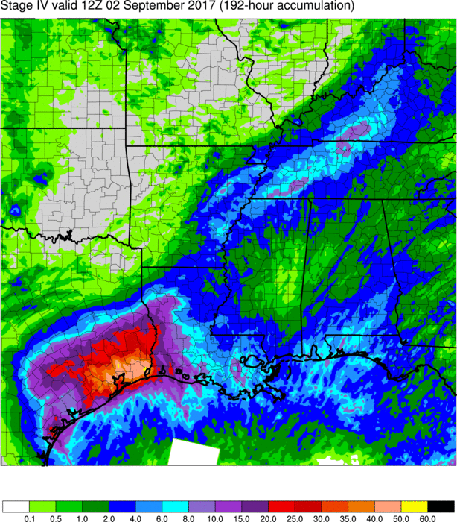
Highlights of 8/31 and 9/7 MEG Discussions on Hurricane Harvey (2017)
NCEP/EMC Model Evaluation Group and Hurricane, Wave, and Water Model Teams

Slide 2
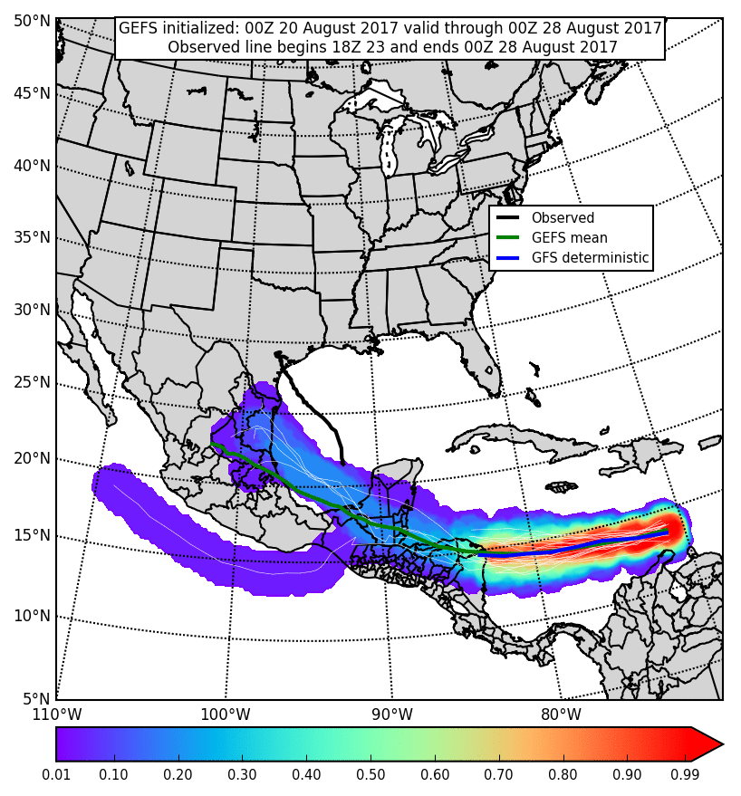
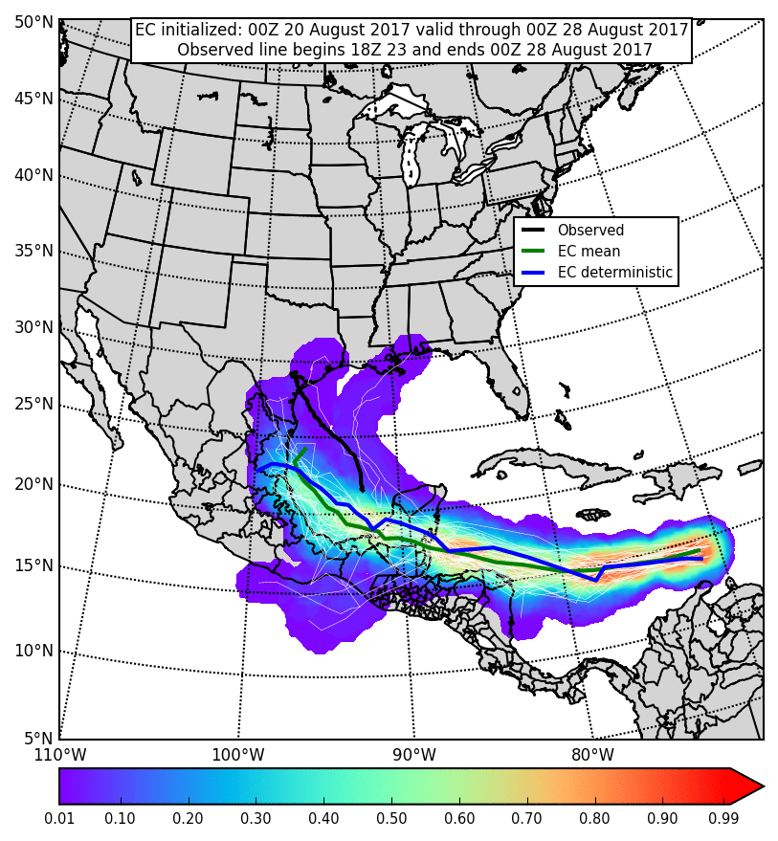
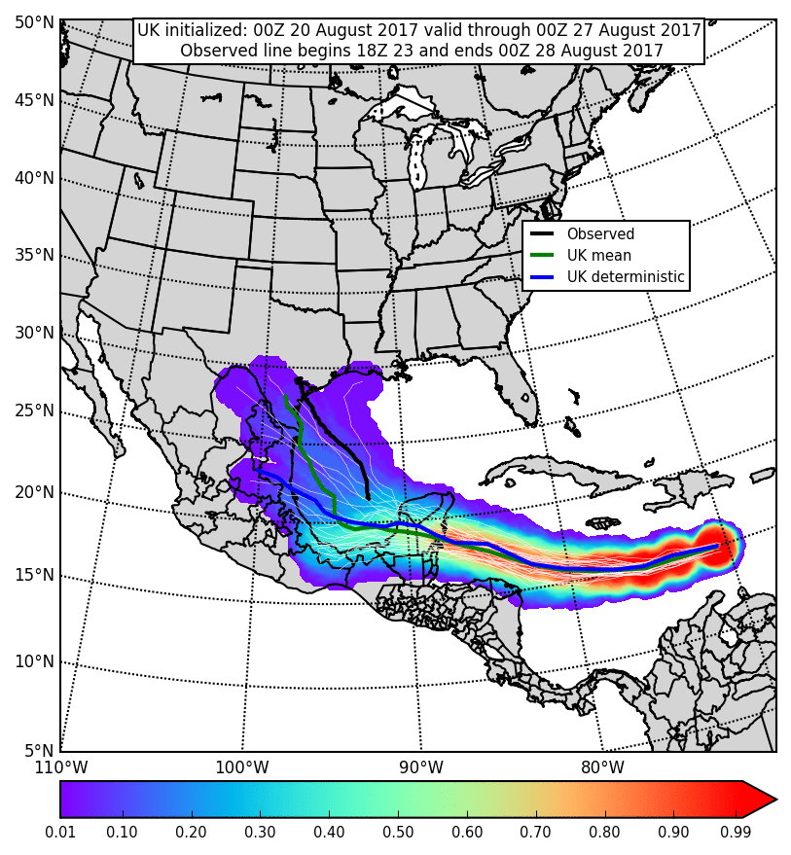
Medium-Range Ensemble Guidance from 00Z Sunday, 20 August 2017
GEFS
EC
UK
Six days prior to Harvey’s landfall in Texas, deterministic and ensemble global models indicated a low probability for Harvey to impact the United States
Most GEFS members and the GFS deterministic dissipated Harvey in Central America
GEFS tracks beyond the Yucatán Peninsula entered northern Mexico
Most EC members and the EC deterministic indicated Harvey would cross the Yucatán and was more likely to impact Mexico than Texas
Some UK members maintained Harvey beyond the Yucatán, but a potential threat to Texas was evident in the UK ensemble mean

Slide 3
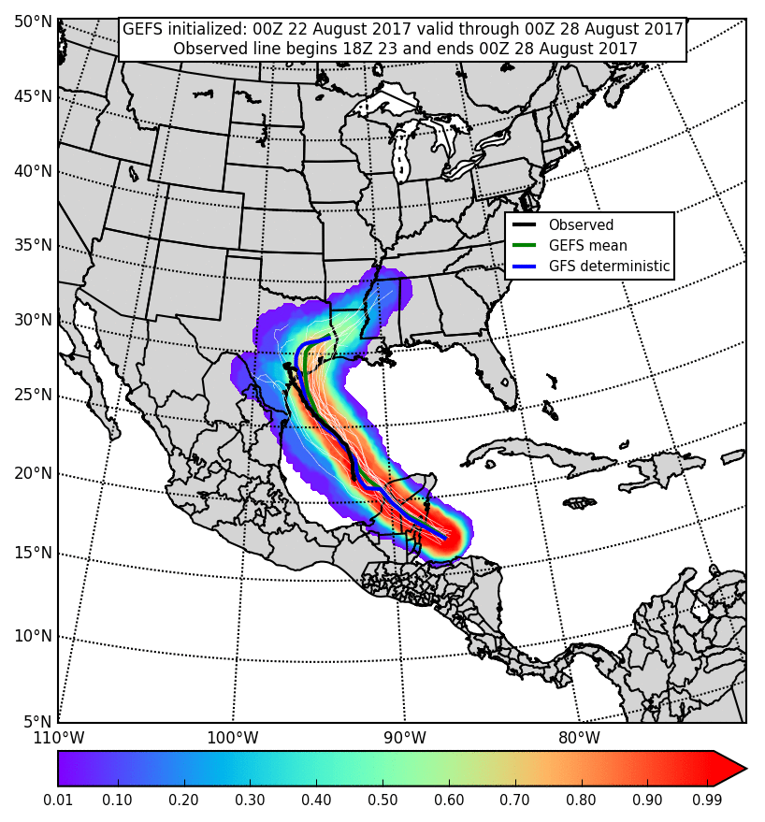
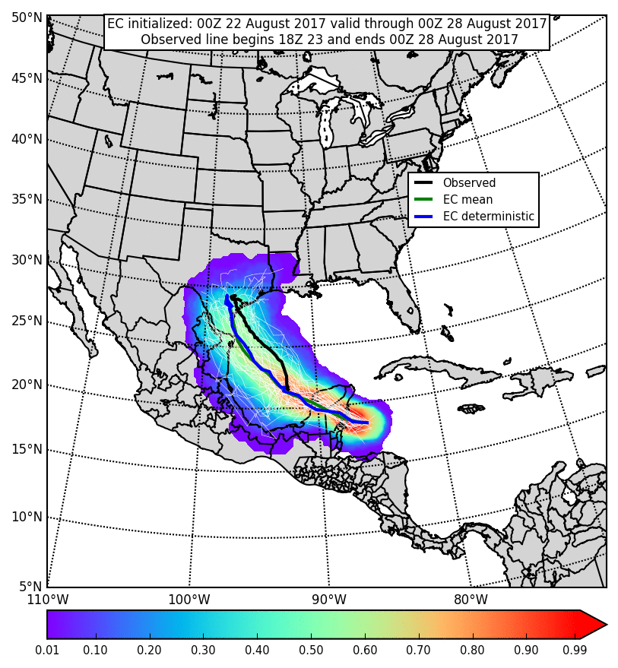
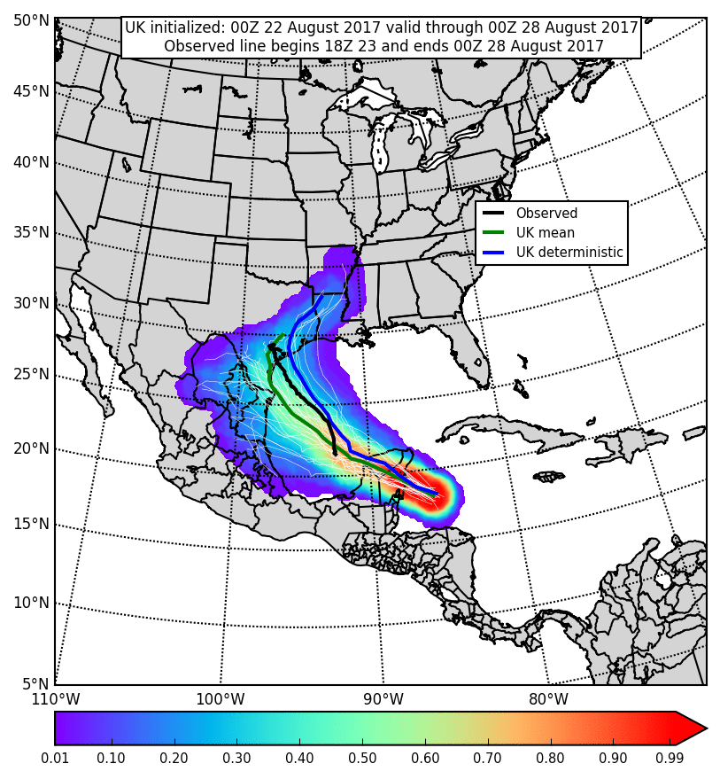
Medium-Range Ensemble Guidance from 00Z Tuesday, 22 August 2017
GEFS
EC
UK
Four days prior to Harvey’s landfall in Texas, deterministic and ensemble global models were more certain Harvey would cross the Yucatán Peninsula and make landfall in Texas
GEFS members and the GFS deterministic indicated a high probability of a Texas landfall. They also indicated a progressive storm with tracks through 8/28 ending in AR/LA/MS
EC members and the EC deterministic showed a slightly wider range of potential landfall locations, but indicated Harvey would stall shortly after landfall
UK members and UK deterministic showed an even wider range of potential landfall locations and also suggested a more progressive storm after landfall

Slide 4
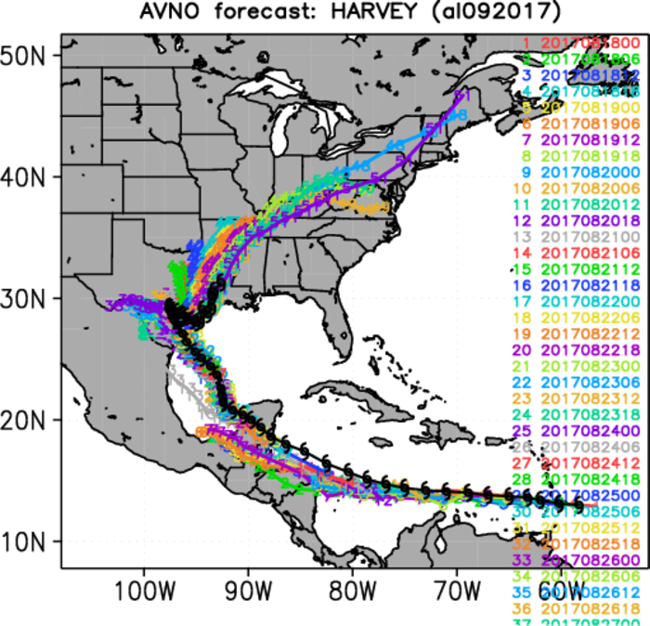
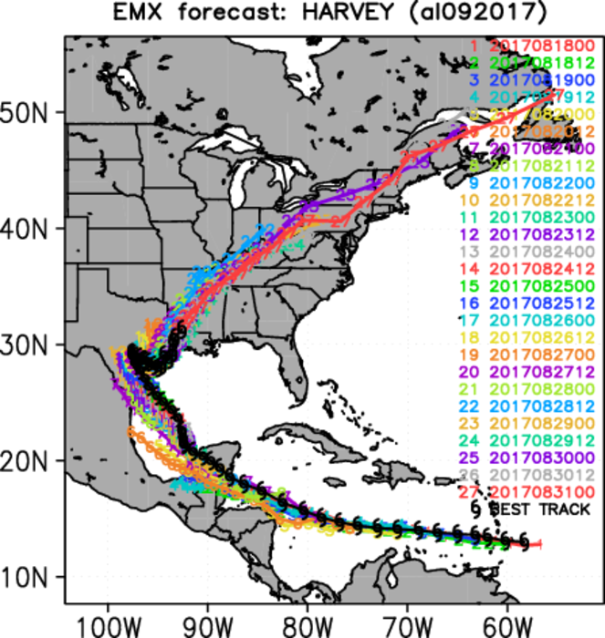
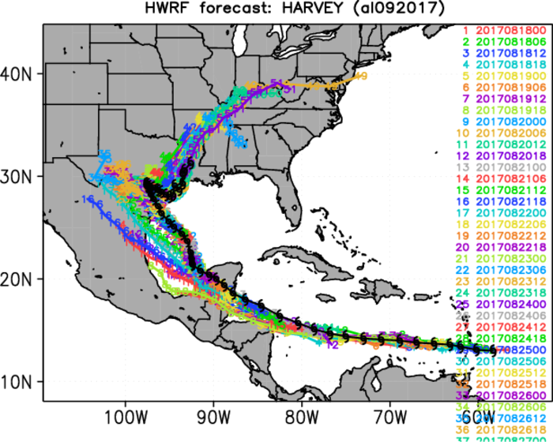
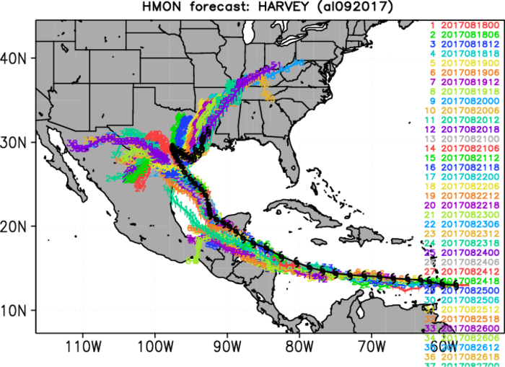
Composite Track Forecasts
When Harvey was in the Caribbean Sea, most cycles of the four models shown had a southern/western bias
This persisted with the initial cycles that tracked Harvey across the Yucatán indicating landfall in northern Mexico
Later, ECMWF had lower track errors than GFS by showing landfall and stall out in Texas
HWRF had lower track errors than HMON, which continually tracked Harvey’s remnants west into Mexico
GFS
ECMWF
HWRF
HMON

Slide 5
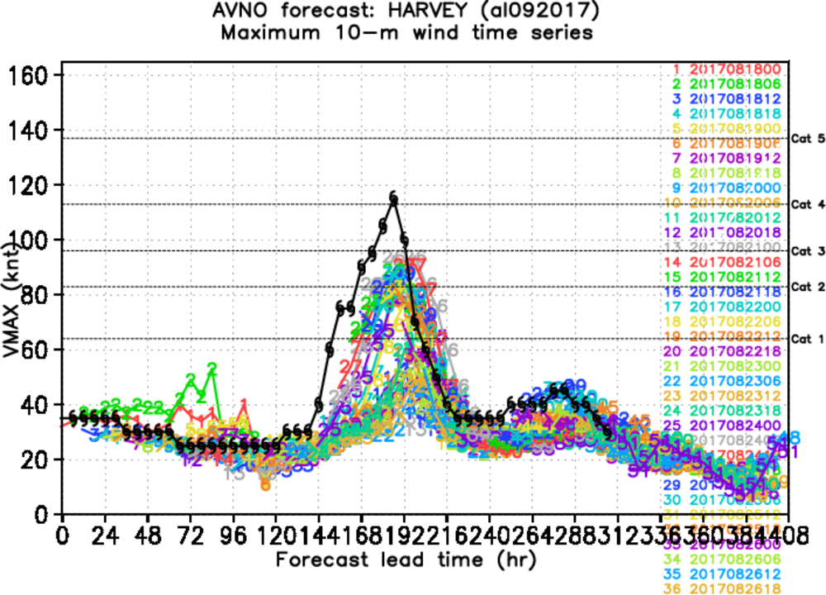
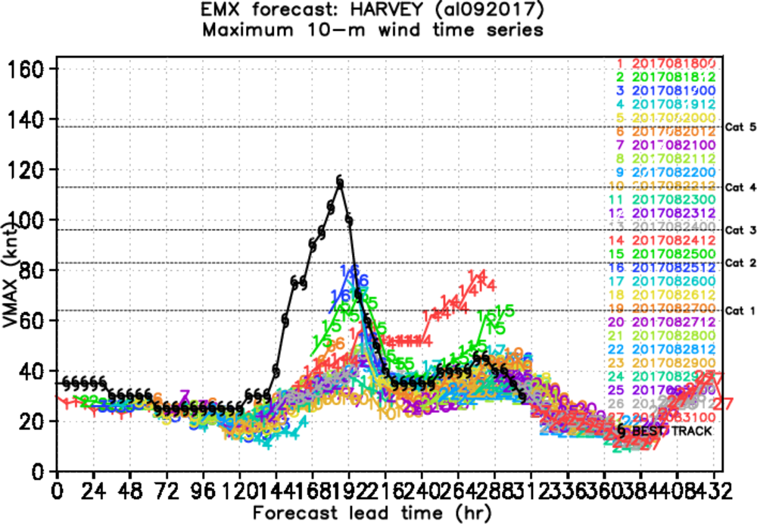
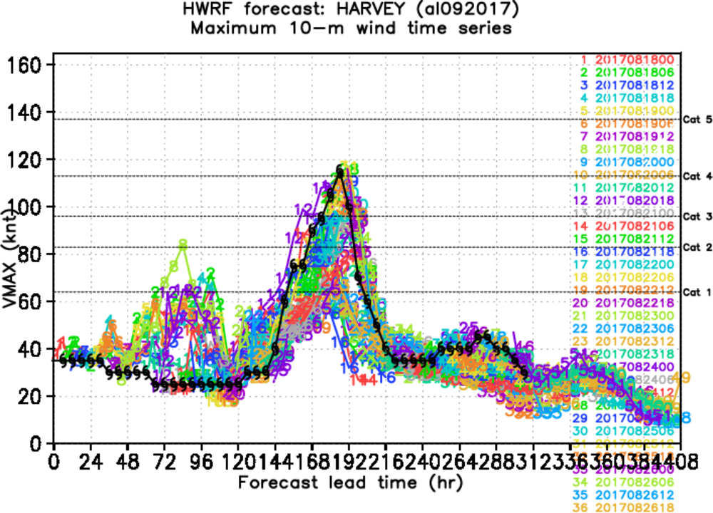
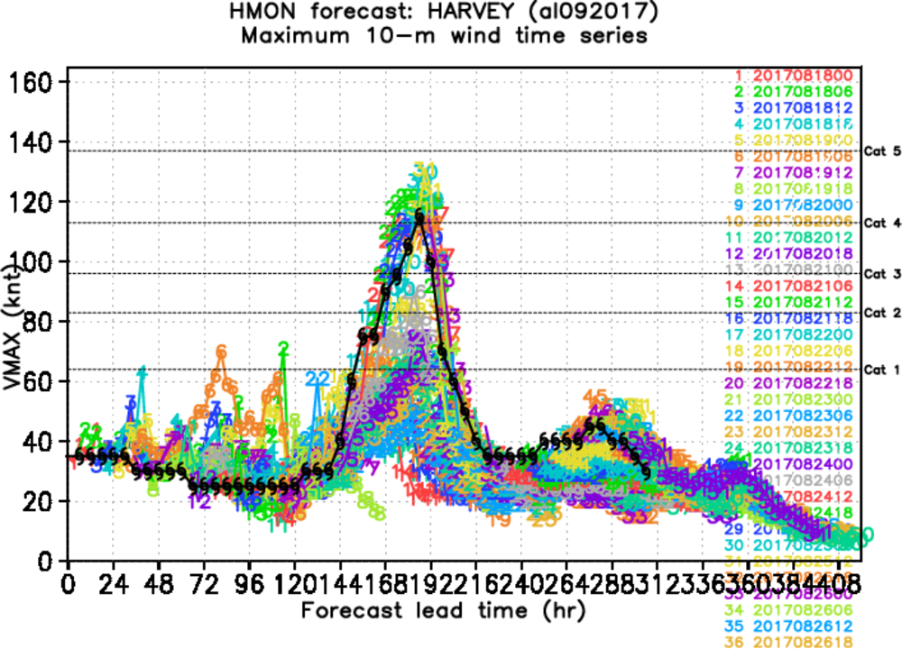
Composite Intensity Forecasts
GFS
ECMWF
HWRF
HMON
GFS, HWRF, and HMON predicted the rapid intensification while ECMWF did not. HWRF and HMON had high biases for early intensity, and HMON was often too strong

Slide 6
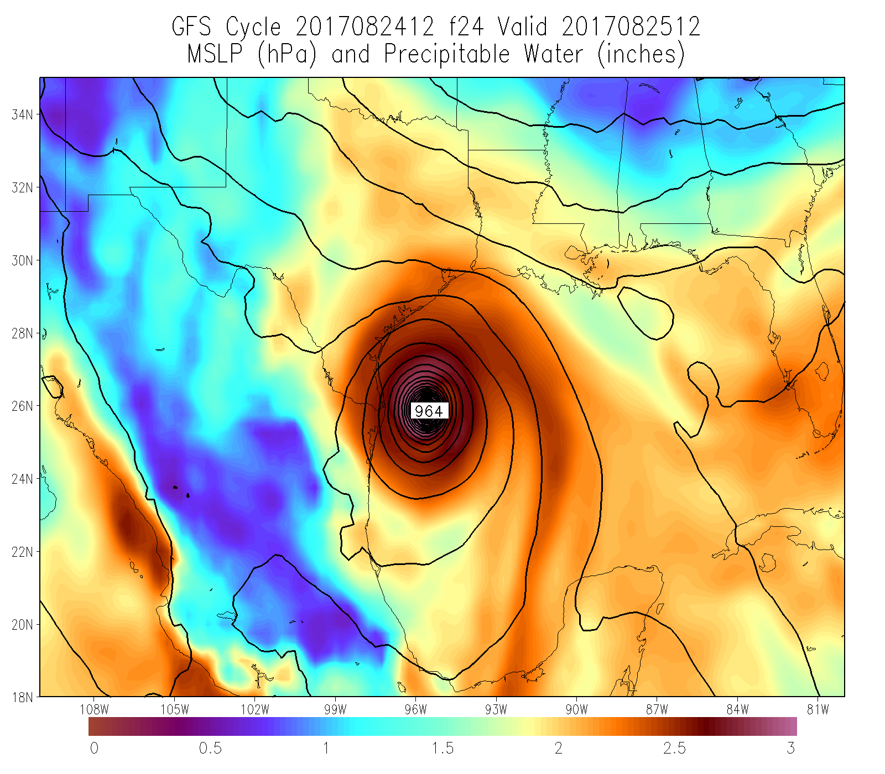
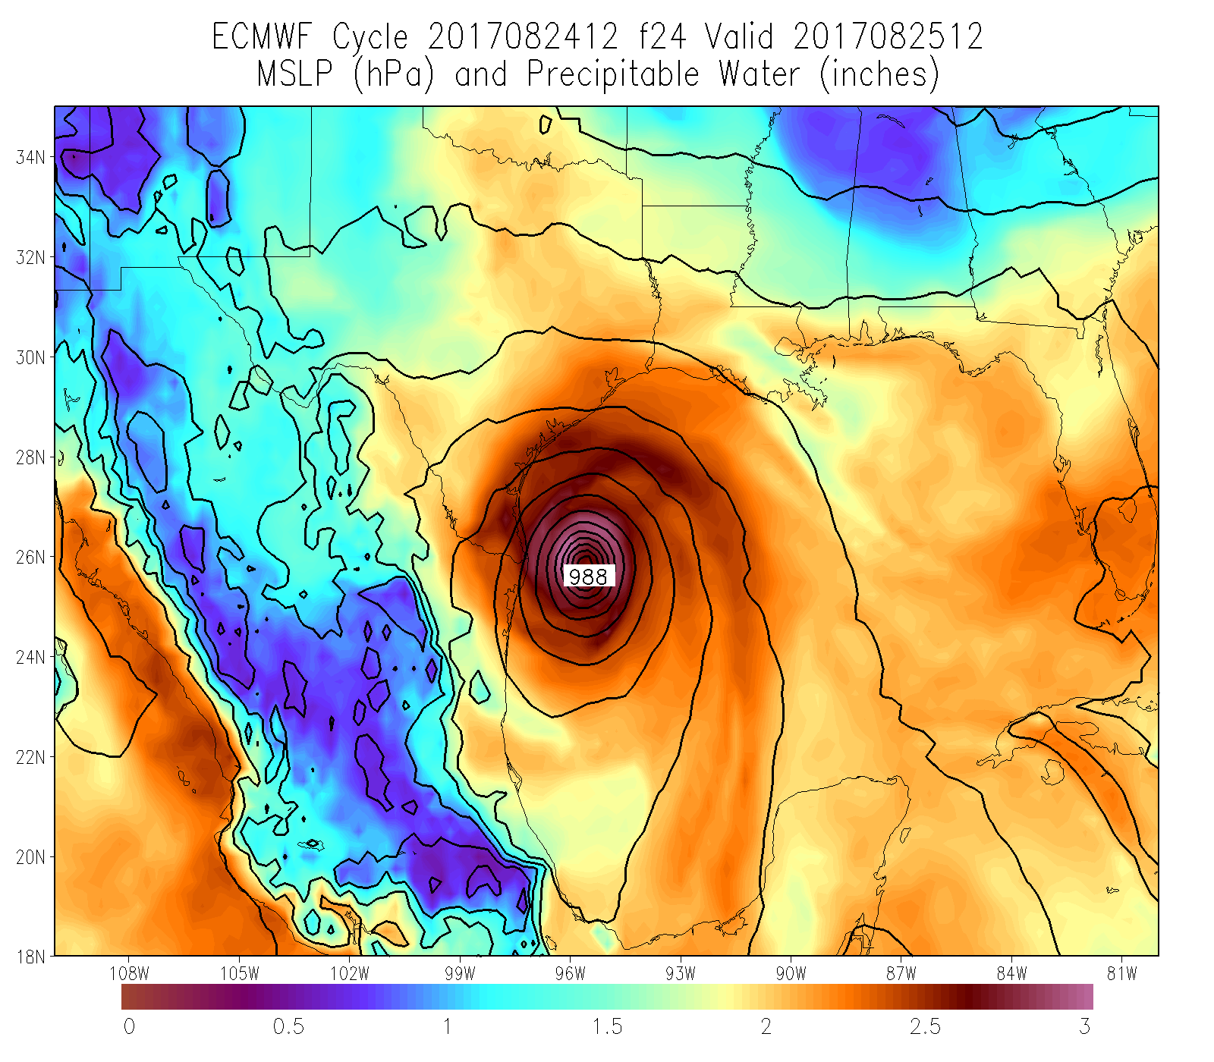
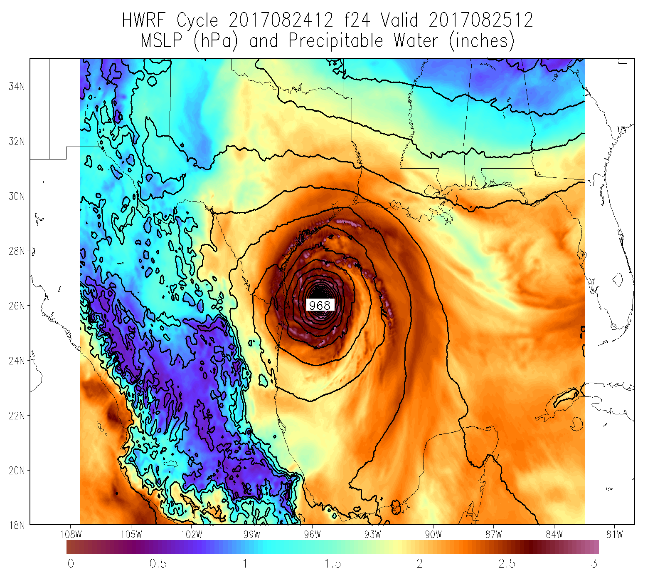
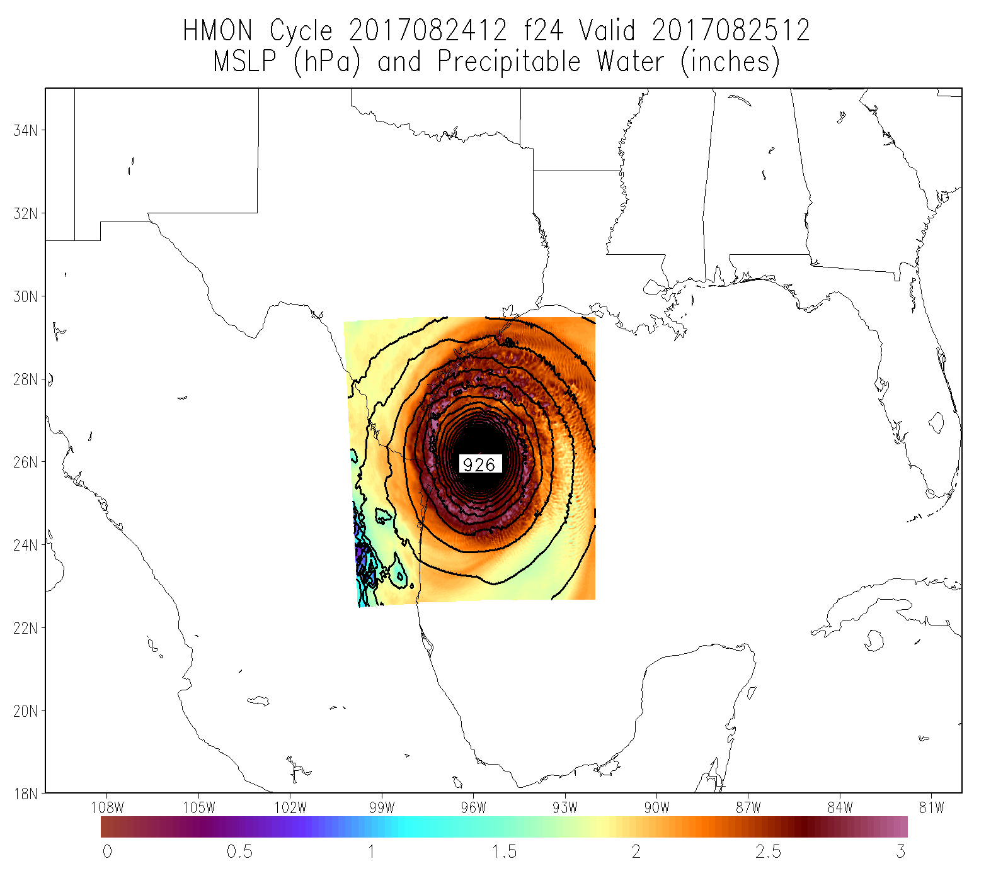
Example of Low (High) Intensity Bias in ECMWF (HMON)
12Z 8/24 GFS
Central Pressure: 964 mb
12Z 8/24 ECMWF
Central Pressure: 988 mb
12Z 8/24 HWRF
Central Pressure: 968 mb
12Z 8/24 HMON
Central Pressure: 926 mb
Observed Central Pressure: 950 mb
MSLP and PWAT forecasts valid at 12Z Friday, 25 August (F024)

Slide 7
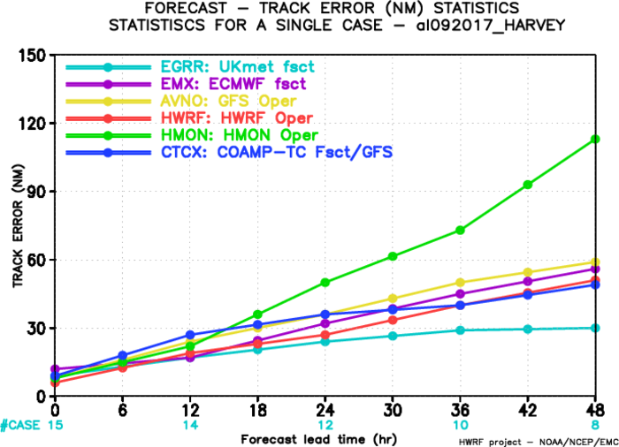
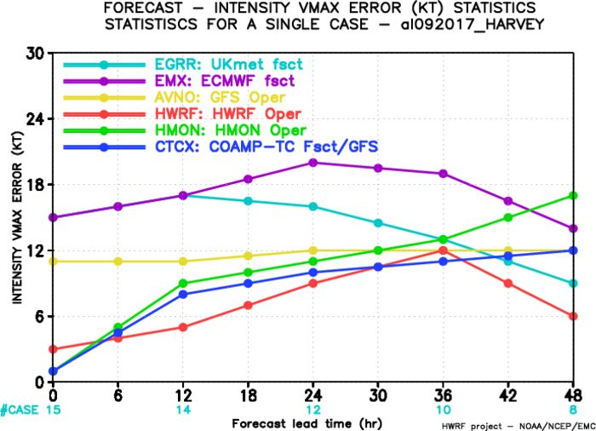
Track and Intensity Error Statistics
Track errors for regional models (except HMON) were comparable to global models
However, the regional models exhibited much better intensity skill, especially for the first 36 h
HMON had the highest track errors while ECMWF had the highest intensity errors
UK had the lowest track errors while HWRF had the lowest intensity errors

Slide 8
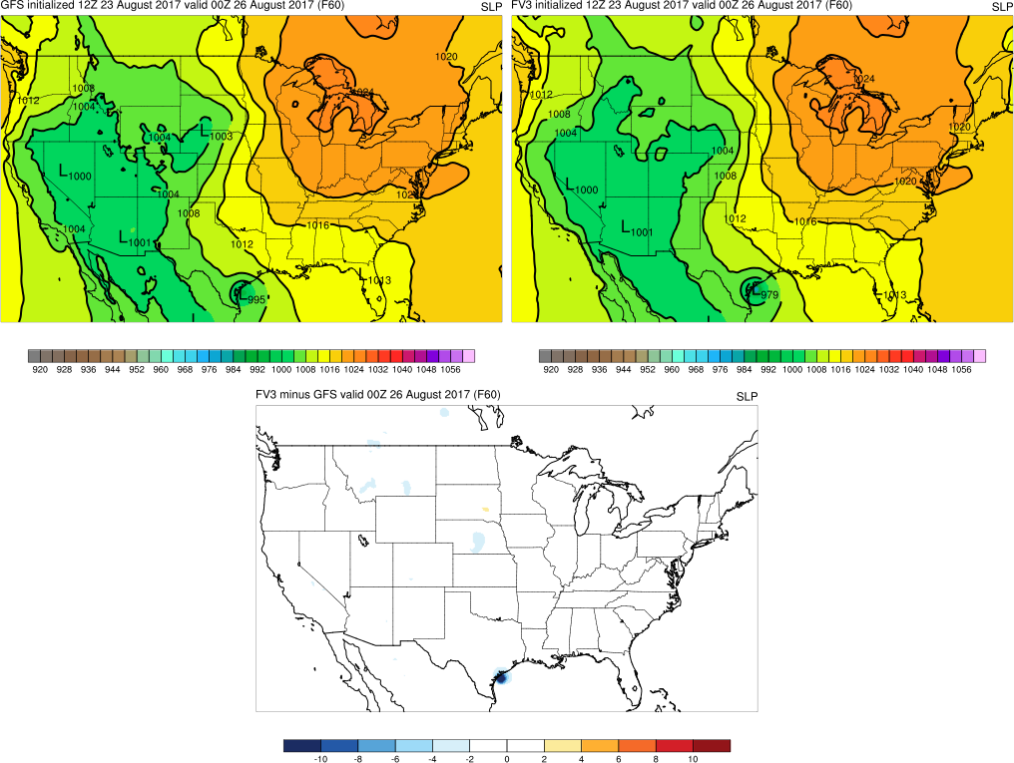
Experimental FV3 Global Runs Were Comparable to GFS Forecasts
12Z 8/23 GFS
Central Pressure: 995 mb
12Z 8/23 FV3
Central Pressure: 979 mb
FV3 - GFS
MSLP forecasts and difference field valid at 00Z Saturday, 8/26 (F060)
During the first five days of each cycle, GFS and FV3 generally provided similar guidance with some subtle differences
Example above shows FV3 suggested rapid intensification and a deeper storm at landfall before the GFS (which caught on in later cycles)

Slide 9
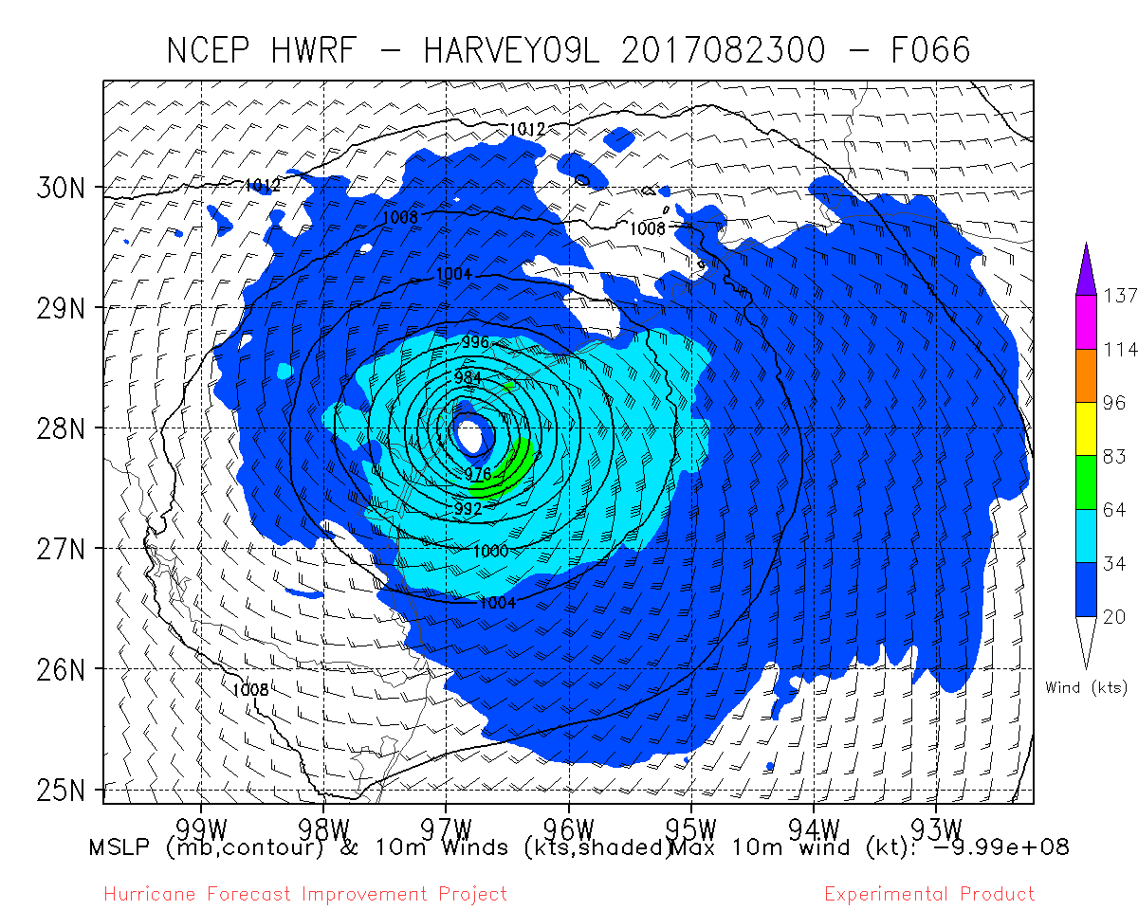
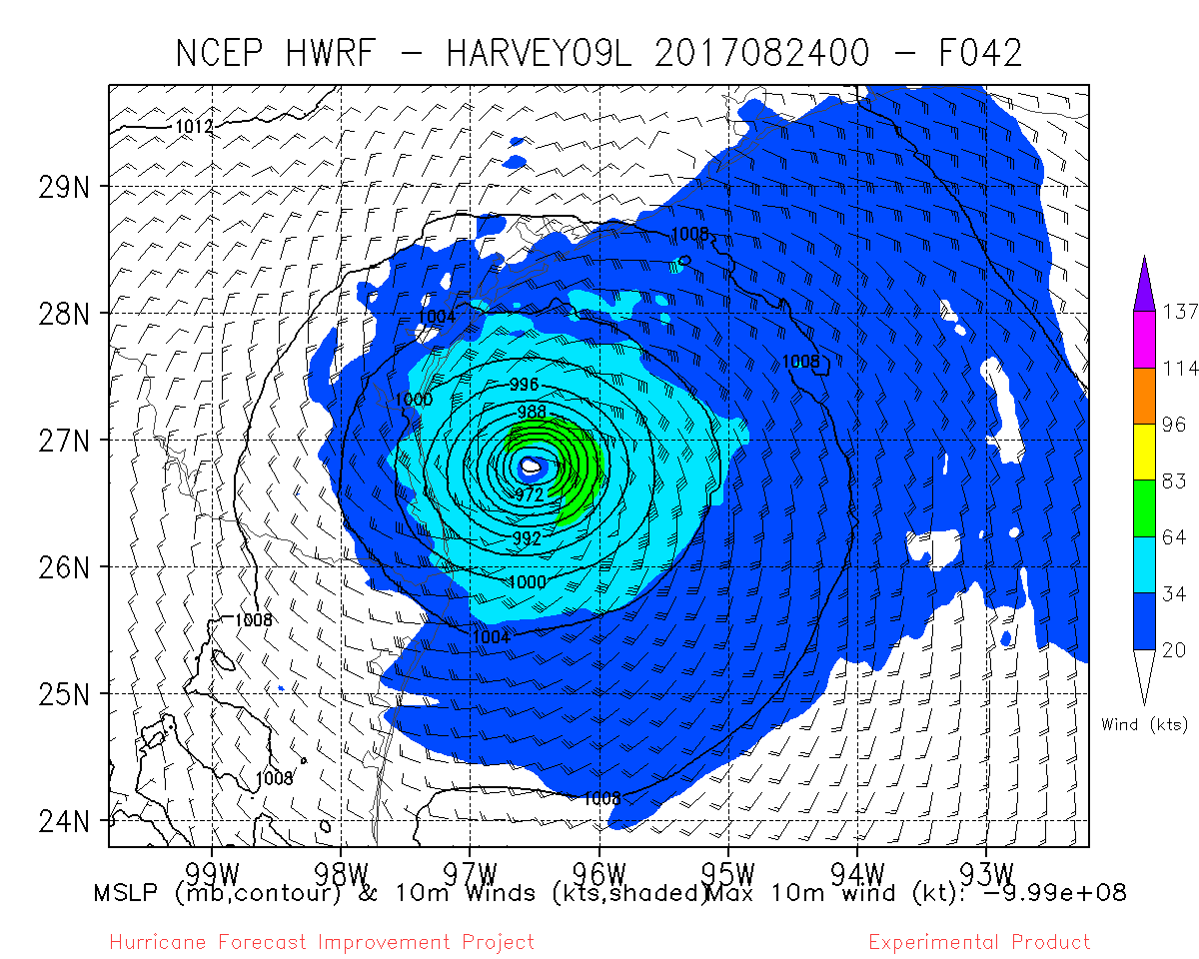
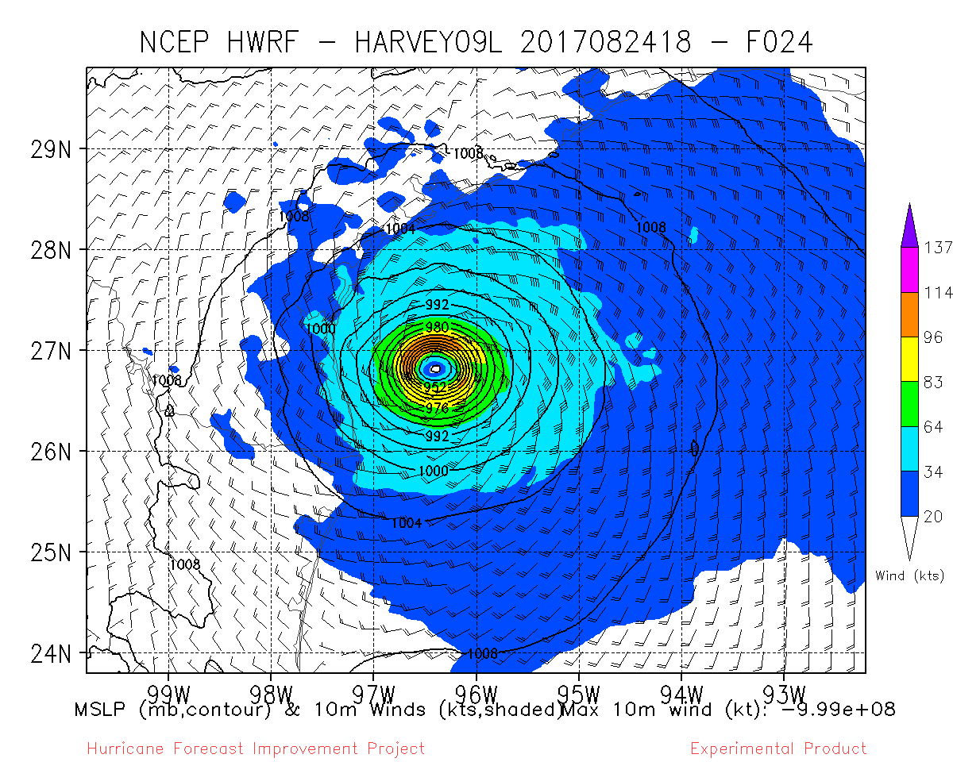
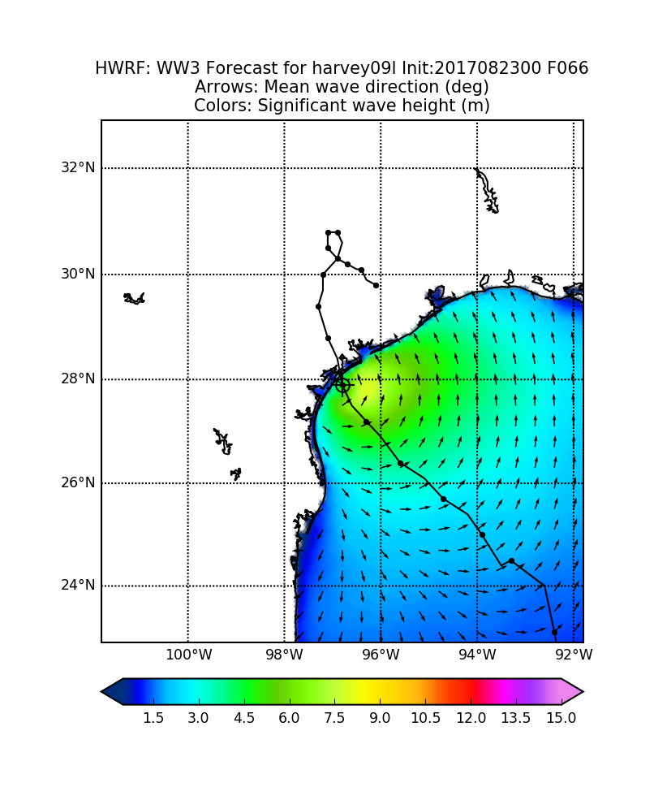
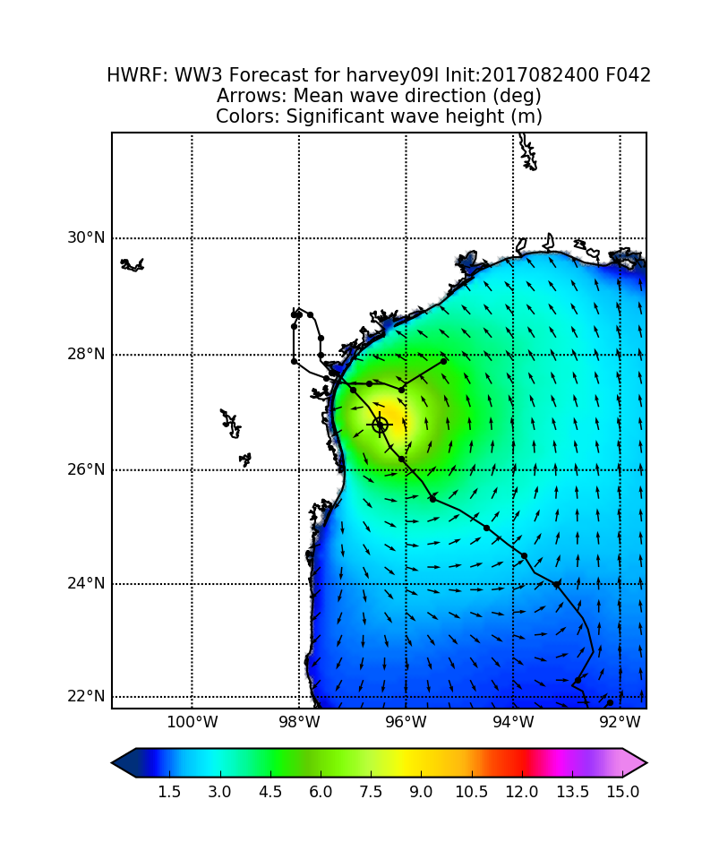
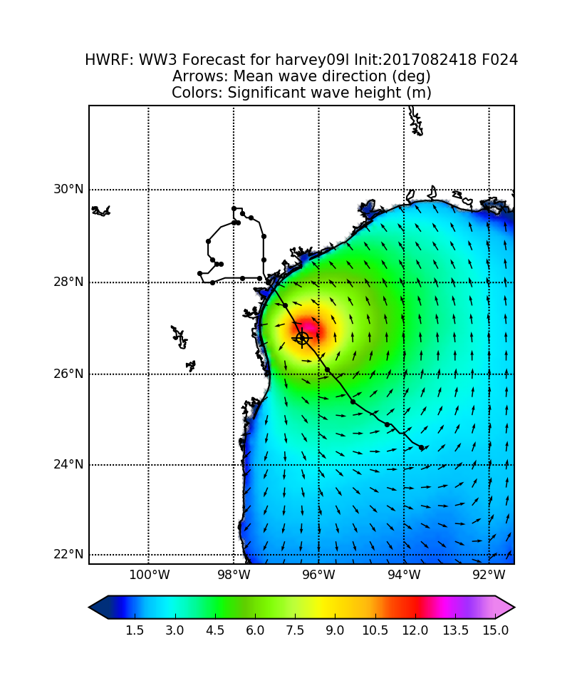
Wave Height Guidance from HWRF
10-m wind (top) and wave height (bottom) forecasts valid at 18Z 8/25
00Z 8/23 cycle (F066)
00Z 8/24 cycle (F042)
18Z 8/24 cycle (F024)
As successive HWRF cycles caught on to the rapid intensification of Harvey, HWRF wave height forecasts responded accordingly with increased wave heights
Also seen in WW3 Multi_1 wave forecasts driven by GFS 10-m winds (not shown)

Slide 10
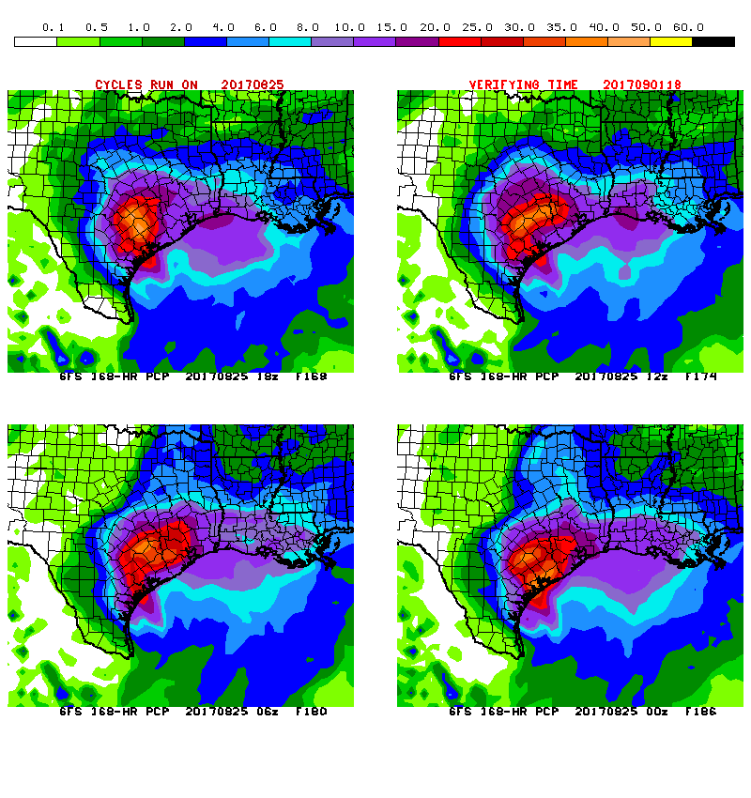
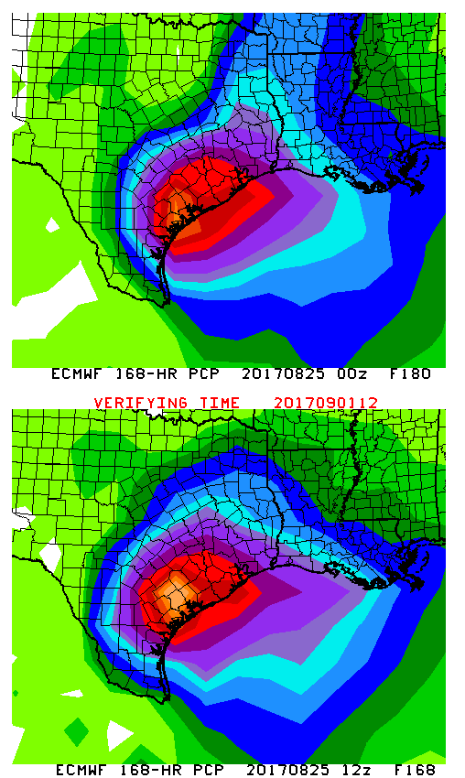
Global Models Indicated the Potential for Extreme Precipitation Totals
Friday 8/25 Cycles
18Z GFS
12Z GFS
00Z ECMWF
06Z GFS
00Z GFS
12Z ECMWF
One-week QPF totals exceeded 40 inches in portions of southeast Texas

Slide 11
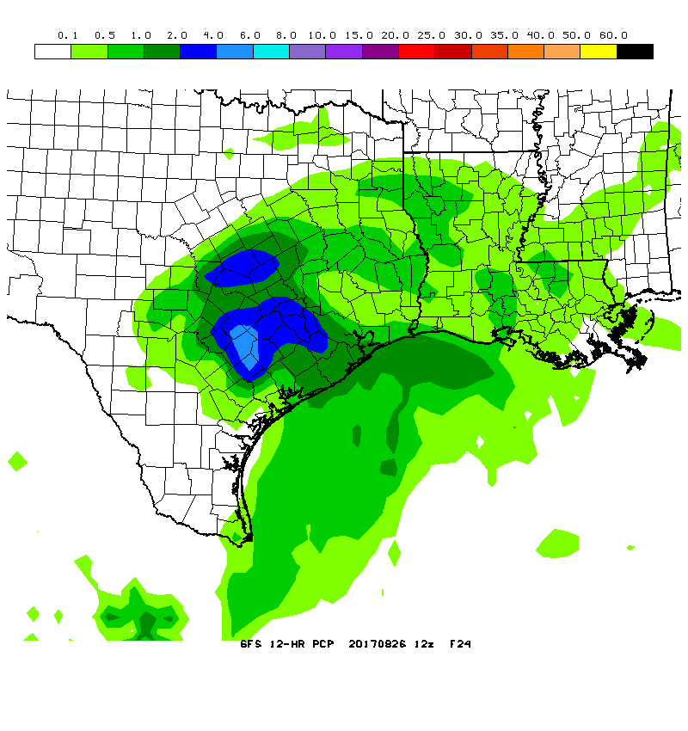
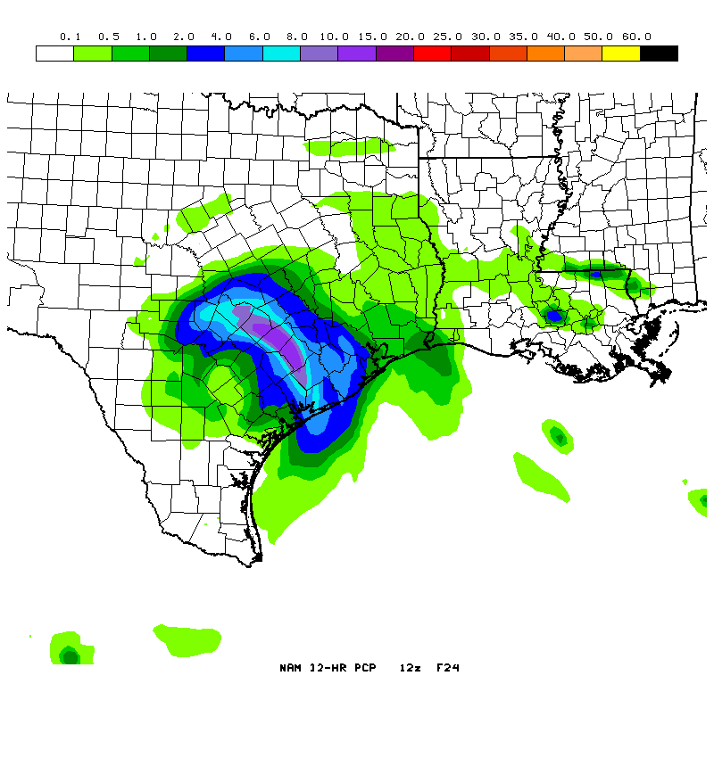
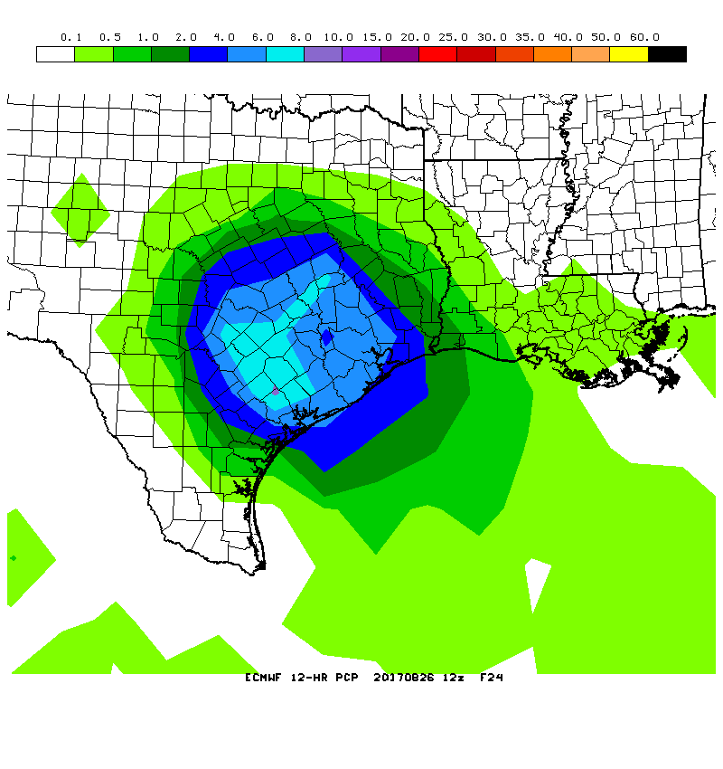
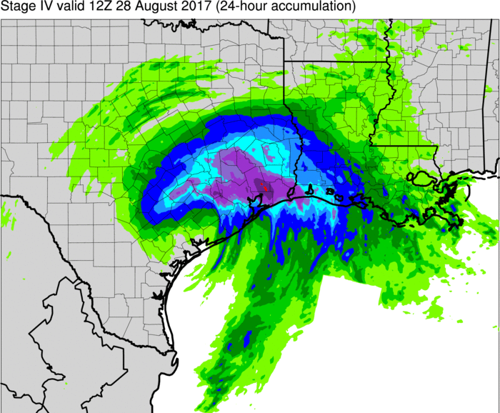
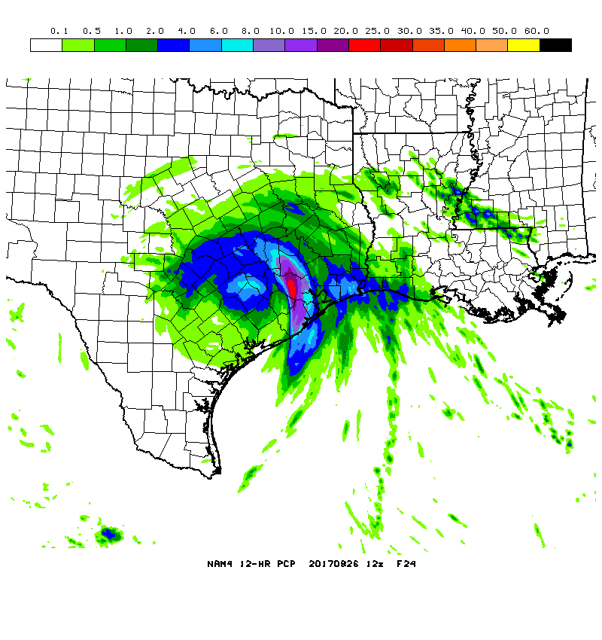
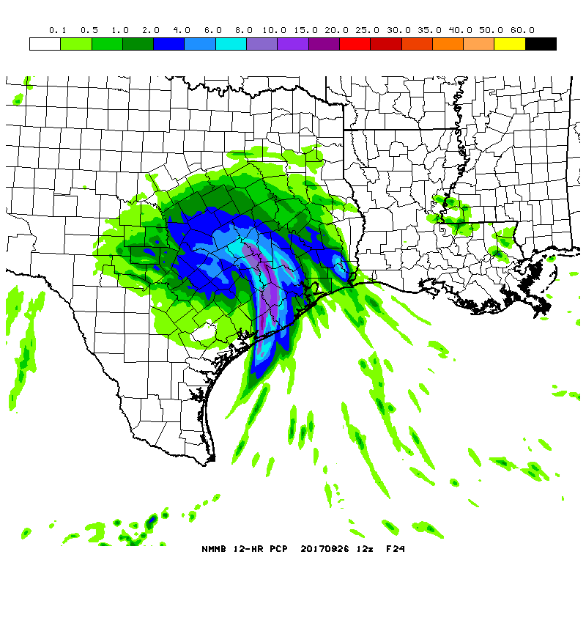
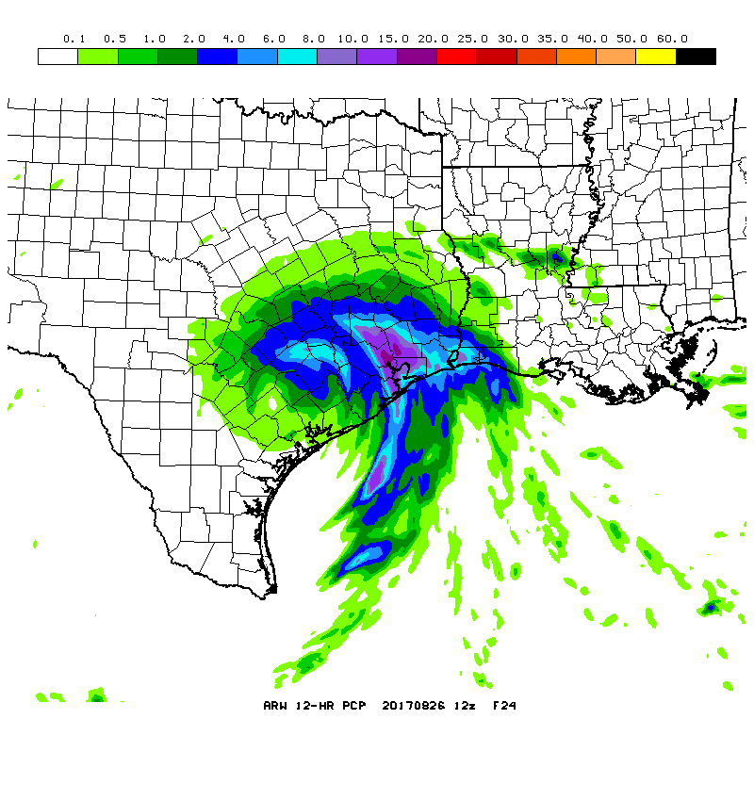
Hi-Res Models Were Better at Predicting Extreme Rainfall in Houston
GFS
NAM
ECMWF
Stage IV analysis
HIRESW
NMMB
HIRESW
ARW
NAM3
24-h QPF totals from forecasts initialized at 12Z Saturday, 26 August
Explicit convection likely aided hi-res models in predicting training convective bands

Slide 12
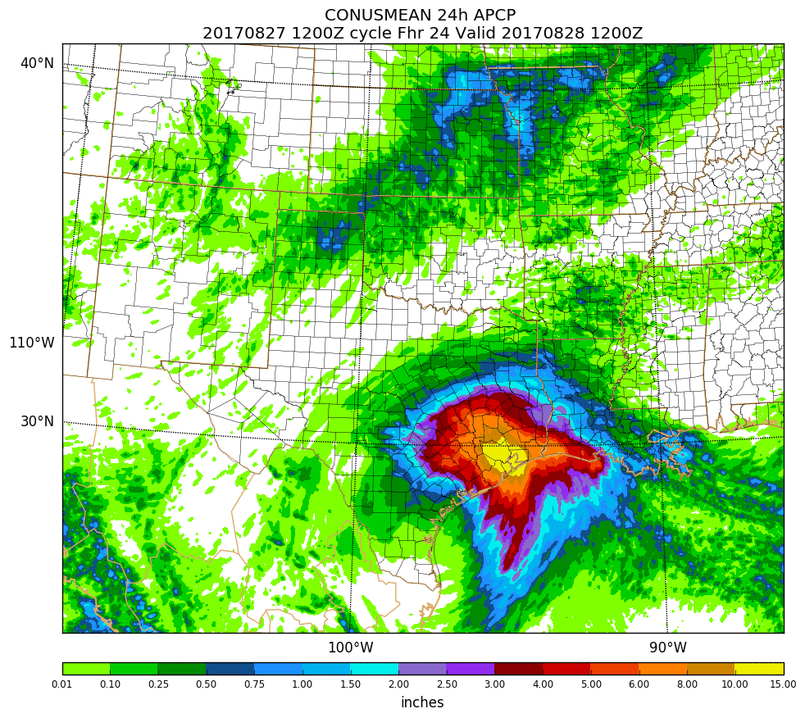
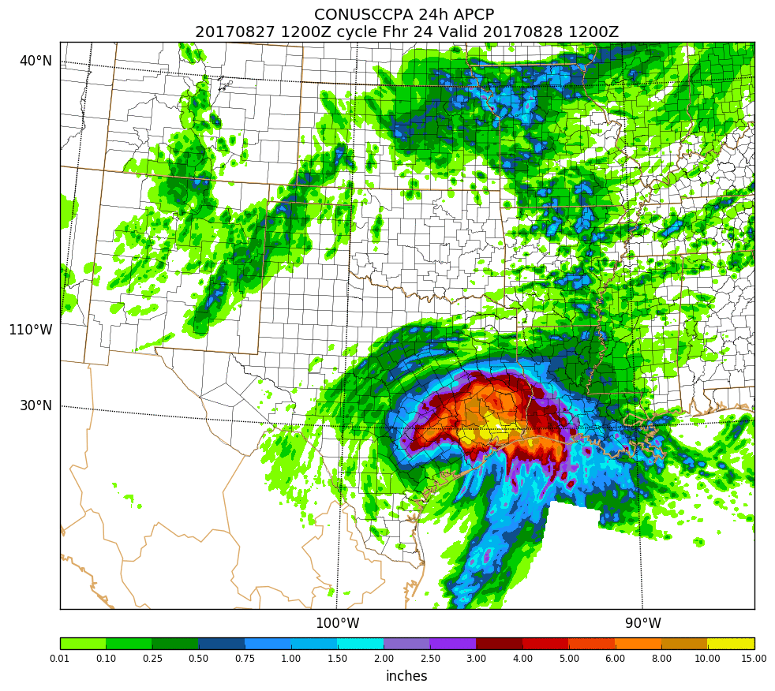
HREFv2 Showed Skill in Predicting Extreme Rainfall in Houston
HREFv2 ensemble mean 24-h QPF (left) and CCPA 24-h QPE (right) valid at 12Z 8/28
Beginning in October, HREFv2 will be the operational implementation of the SPC SSEO

Slide 13
Differences in SREF QPF in Houston Were Tied to Representation of Upper Ridge in ARW members vs. NMMB members
QPF at HOU from 21Z 8/24 SREF (valid through 12Z 8/28)
ARW mean ≈ 2.8”
ARW control
NMMB mean ≈ 9”
ARW members incorrectly placed a strong ridge north of Harvey. This ridge steered Harvey to the west and limited precipitation totals in Houston.
NMMB control

Slide 14
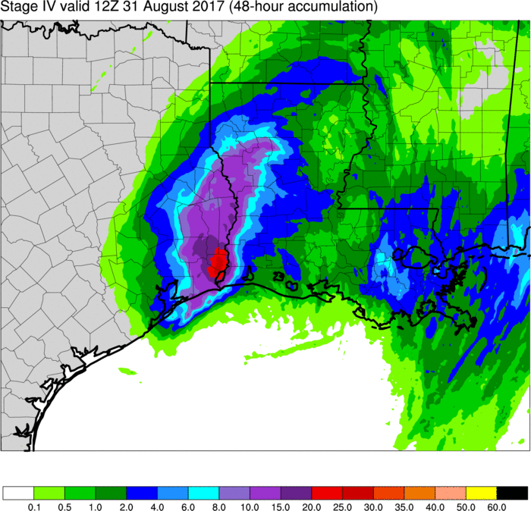
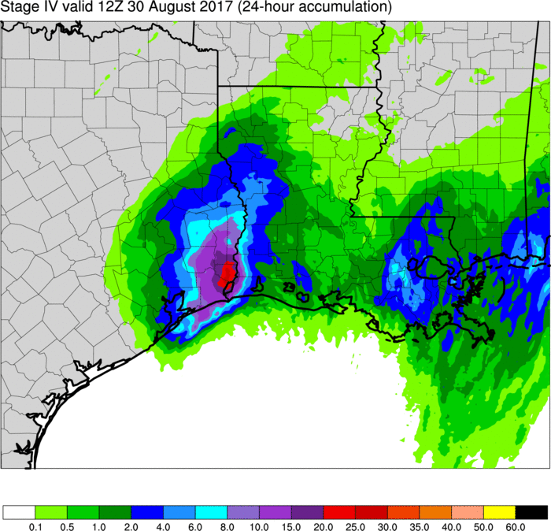
Beaumont–Port Arthur Rains Were Dependent on Correct Placement of Harvey and Associated Deformation Zone
Stage IV analysis
48-h accumulation ending at 12Z Thursday, 8/31
Stage IV analysis
24-h accumulation ending at 12Z Wednesday, 8/30
44.5” between 12Z Sunday, 27 August and 12Z Wednesday, 30 August
The vast majority of rain fell during the final 24 hrs (see image on upper right)
Predictability was limited, and correct placement of heavy rain depended on models getting Harvey’s track and second landfall correct
Resulted in short lead-time on extreme precipitation totals near Beaumont & Port Arthur

Slide 15
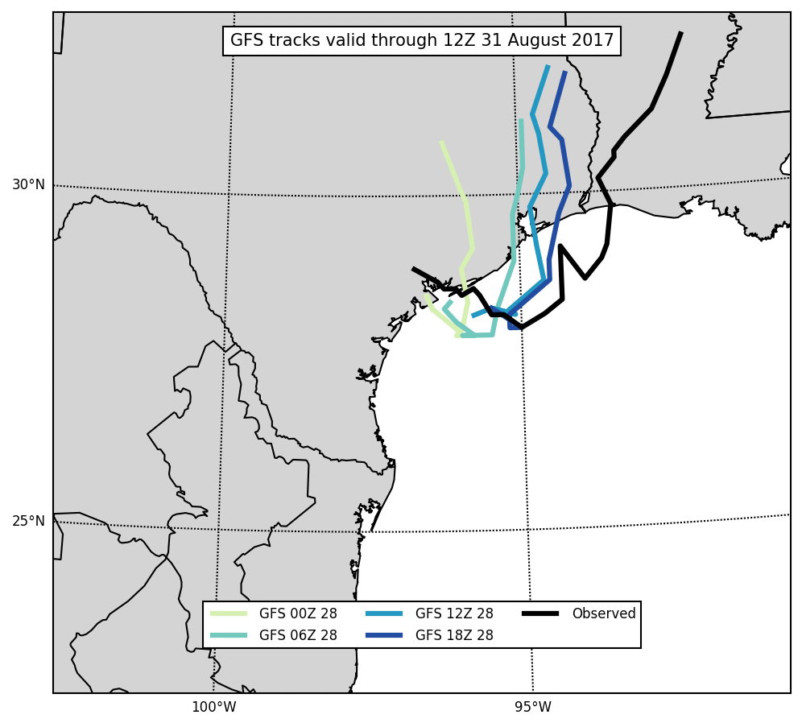
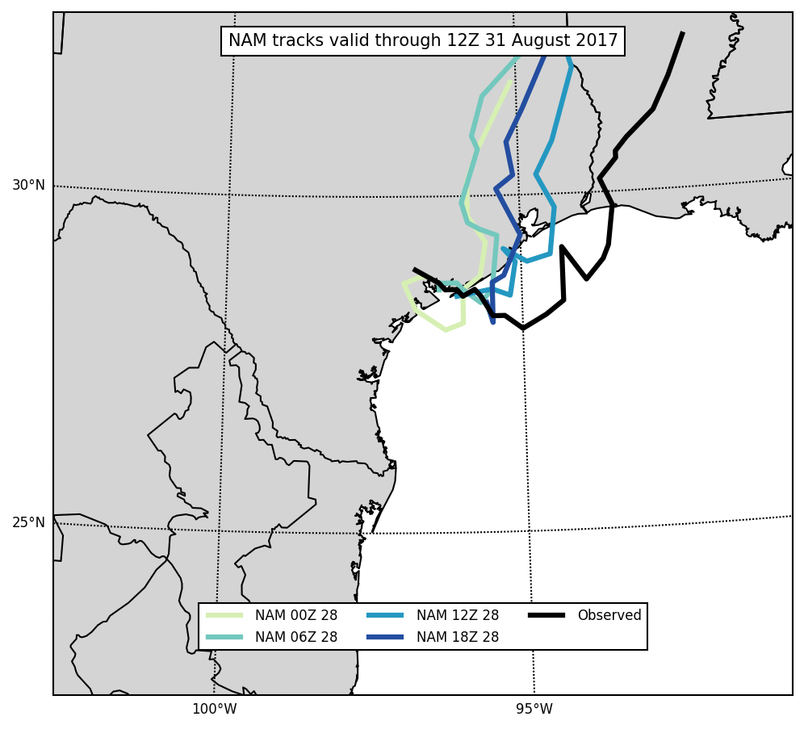
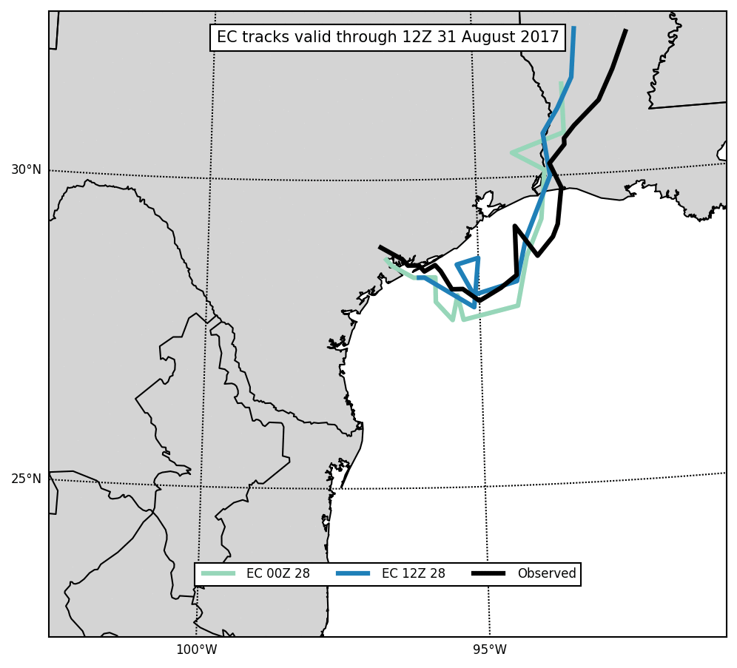
Beaumont–Port Arthur Rains Were Dependent on Correct Placement of Harvey and Associated Deformation Zone
GFS
NAM
ECMWF
Tracks made from GFS, NAM, and ECMWF cycles on Monday, 28 August
ECMWF forecasts generally had closest agreement with observed track back into the Gulf of Mexico and subsequent landfall in Louisiana
Successive cycles of the GFS and NAM gained more agreement with observed track
However, small track errors were still significant for placement of extreme rainfall totals

Slide 16
Beaumont–Port Arthur Rains Were Dependent on Correct Placement of Harvey and Associated Deformation Zone
NAM
06Z RAP Analysis
GFS
850 mb wind analysis and 24-h forecasts valid at 00Z Wednesday, 8/30
Western displacement in the low center caused poor representation of deformation zone
Led to western displacement of heavy rain

Slide 17
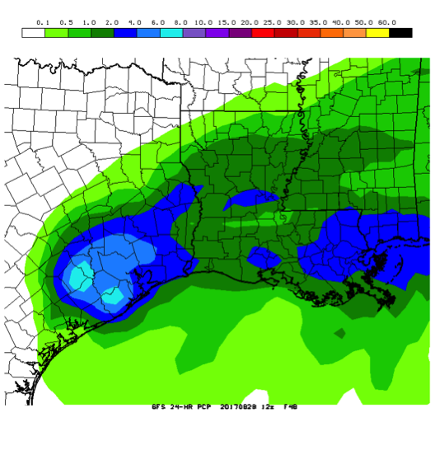
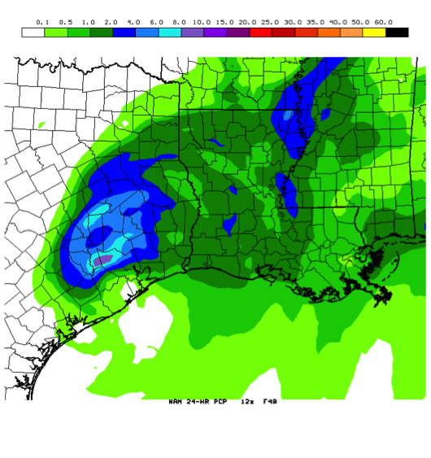
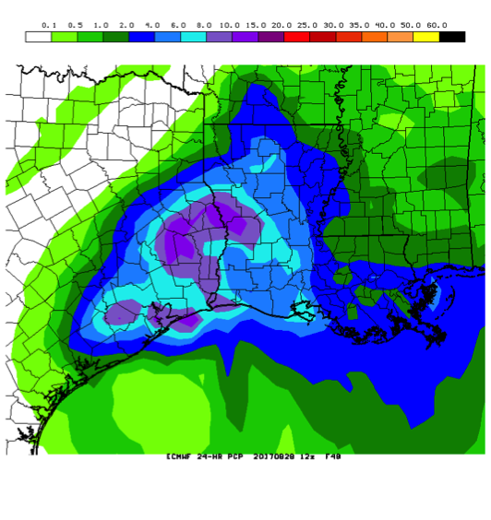
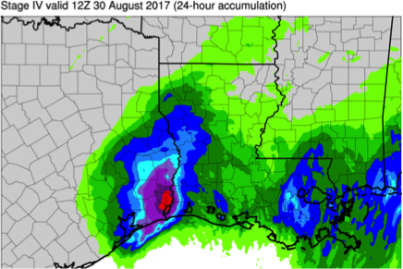
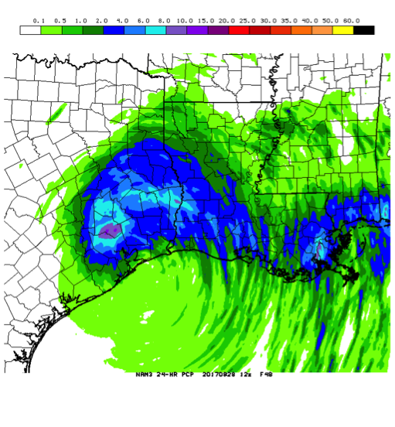
Beaumont–Port Arthur Rains Were Dependent on Correct Placement of Harvey and Associated Deformation Zone
GFS
NAM
Stage IV analysis
ECMWF
HIRESW
NMMB
HIRESW
ARW
NAM3
24-h QPF totals from forecasts initialized at 12Z Monday, 28 August (F048)
Location of the low determined location of deformation zone and highest rainfall totals

Slide 18
Beaumont–Port Arthur Rains Were Dependent on Correct Placement of Harvey and Associated Deformation Zone
GFS
NAM
Stage IV analysis
ECMWF
HIRESW
NMMB
HIRESW
ARW
NAM3
24-h QPF totals from forecasts initialized at 12Z Tuesday, 29 August (F024)
Location of the low determined location of deformation zone and highest rainfall totals

Slide 19
Experimental Guidance from National Water Model (NWM v1.1)
NWM v1.1 Experimental Guidance
Depicts Streams Forecast to Rise Above Bankfull
Based on NWM MRF v1.1 Peak Flow
Prior to Hurricane Harvey’s landfall, the Texas Department of Emergency Management requested that the National Water Center provide NWM hydrologic guidance and interpretation
Experimental guidance complemented official river forecasts from the West Gulf River Forecast Center (WGRFC)
QPF from operational NWP models helps to drive the NWM
Products such as time-to-reach peak streamflow and flood inundation maps can provide guidance away from RFC forecast points and beyond the RFC forecast time horizon

Slide 20
Summary
About one week prior to Hurricane Harvey’s landfall in Texas, global ensembles indicated uncertainty in whether:
The initial remnants of Harvey would redevelop after crossing the Yucatán Peninsula
The potential regenerated storm would make landfall in Mexico or the US
After an imminent Texas landfall became clear, global and regional guidance signaled the potential for significant rainfall totals in southeast Texas
Extreme rainfall in the Houston metropolitan area was better predicted by high-resolution models (compared to global/regional models)
Predictability of extreme rainfall in the Beaumont–Port Arthur area was limited. Correct placement depended on correctly predicting Harvey’s location and the associated deformation zone prior to the second landfall in Louisiana
Experimental global FV3 forecasts were comparable to GFS forecasts
Guidance from models such as GFS and HWRF helped drive additional modeling systems for impacts such as waves and inland flooding

