Slide 1
Evaluation of the new results
ARL
6/25/2014

Slide 2
Two updates:
Dust size distribution: 20% of dust into PM2.5 → 5% into PM2.5, based on the minimum value from observed dust data from the IMPROVE network (Tong et al., ACP 2012);
Vertical dust distribution: Change the unrealistic all-surface allocation into multi-layer distribution - will be in the new CMAQ release (Tong et al., JGR, 2014).
Results to be shown here: a) new PM2.5 surface fields; 2) evaluation against AIRNOW and MODIS AOD.

Slide 3
Surface PM2.5 Concentrations
date | Time (UTC) | Maximum of PM25
 |  | ARL 6/17 forecast* | EMC 6/17 forecast
06/17/2014 | 19 | 54.78 | 1294.96
 | 20 | 93.10 | 1541.18
 | 21 | 142.02 | 1748.42
 | 22 | 173.30 | 1868.06
 | 23 | 178.97 | 1893.15
06/18/2014 | 00 | 165.52 | 1772.08
 | 01 | 134.99 | 1451.98
*: cmaq4.6.3 run using the updated fengsha code from Daniel

Slide 4
PM2.5 NAAQS: What are we forecasting?
http://www.epa.gov/air/criteria.html
24-h PM2.5 not exceeding 35 ug/m3

Slide 5
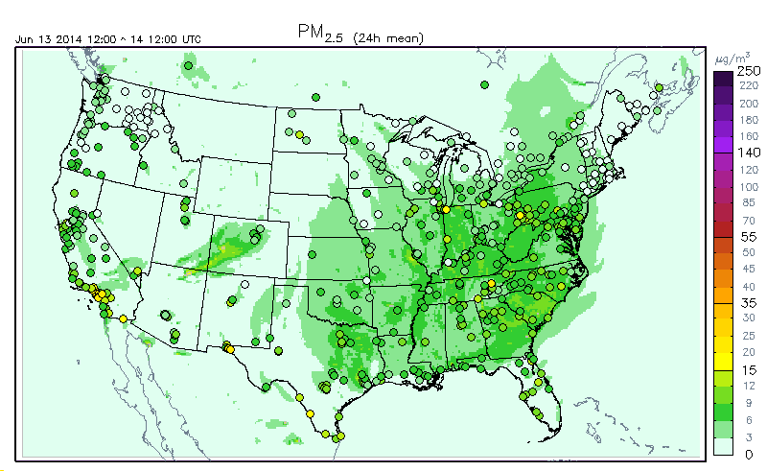
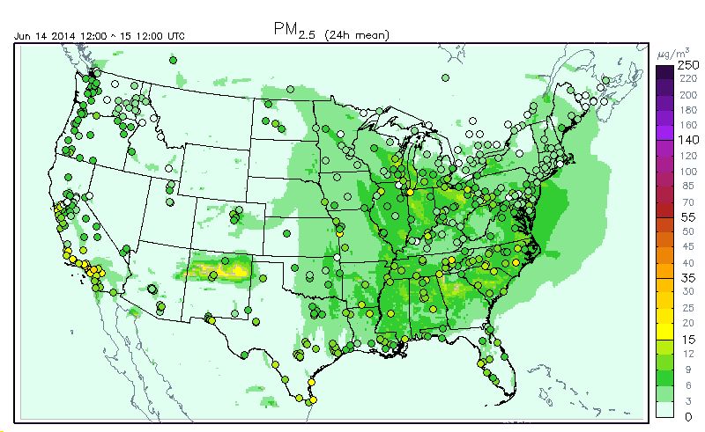
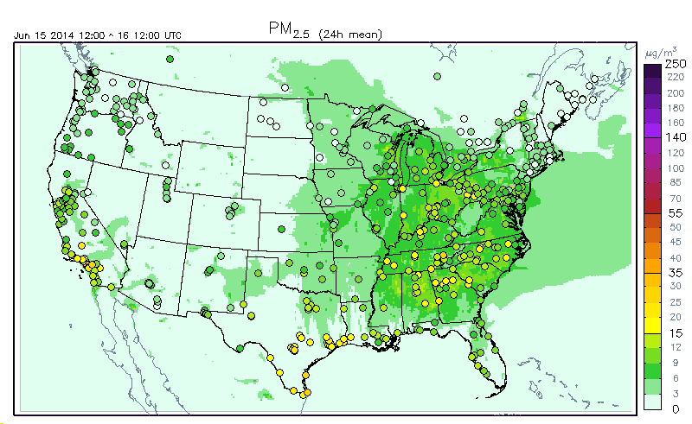
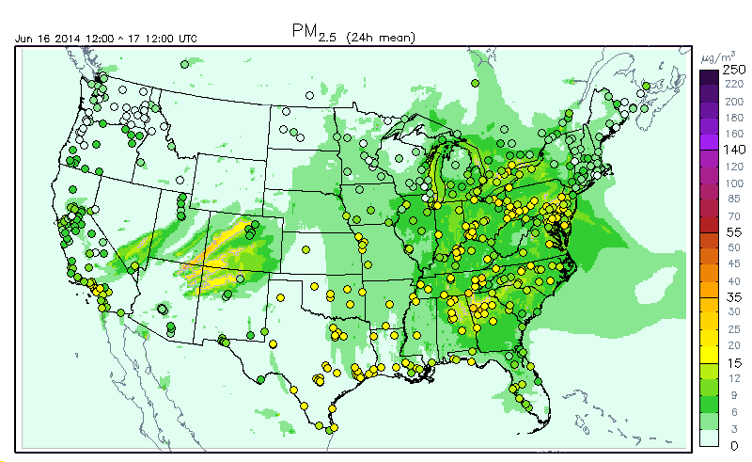
Daily PM2.5 (6/13 – 6/16)

Slide 6
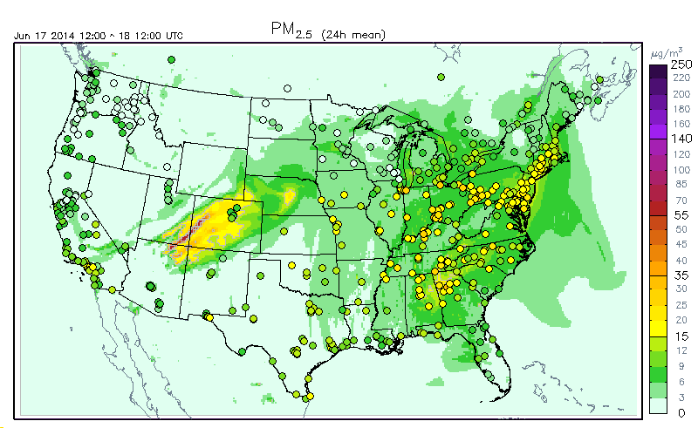
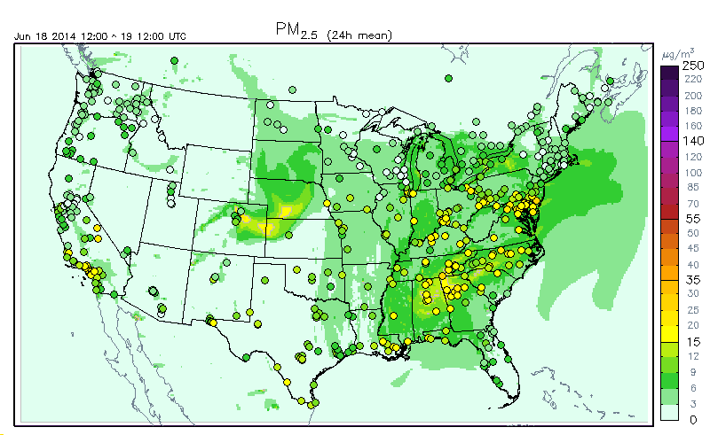
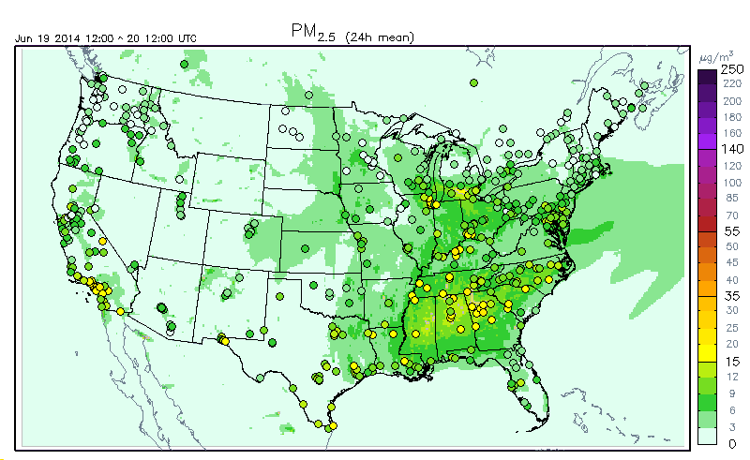
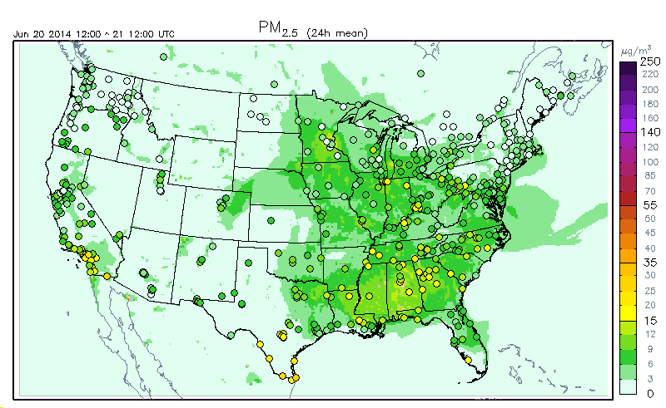
Daily PM2.5 (6/17 – 6/20)

Slide 7
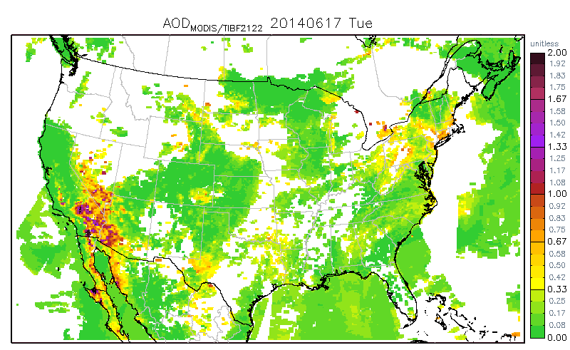
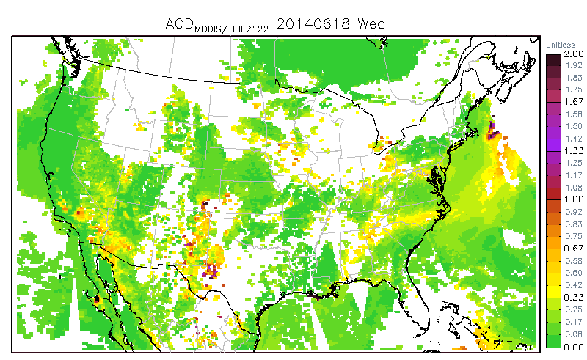
MODIS AOD on 6/17 and 6/18
High AOD over desert regions, thin and wide plume over the SW.
Residuals seen in 6/18.

Slide 8
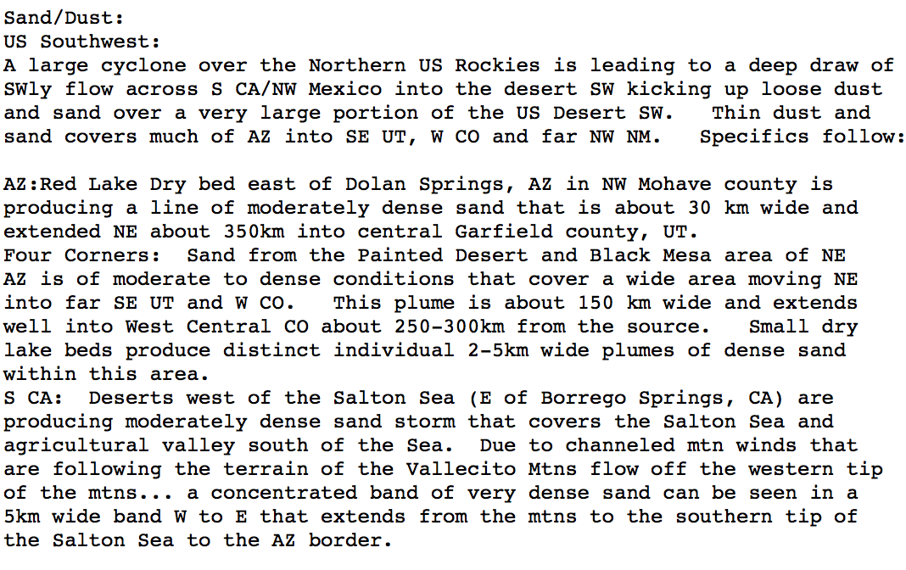
NESDIS HMS Dust for 6/17
http://www.ssd.noaa.gov/PS/FIRE/DATA/SMOKE/2014F180253.html

Slide 9
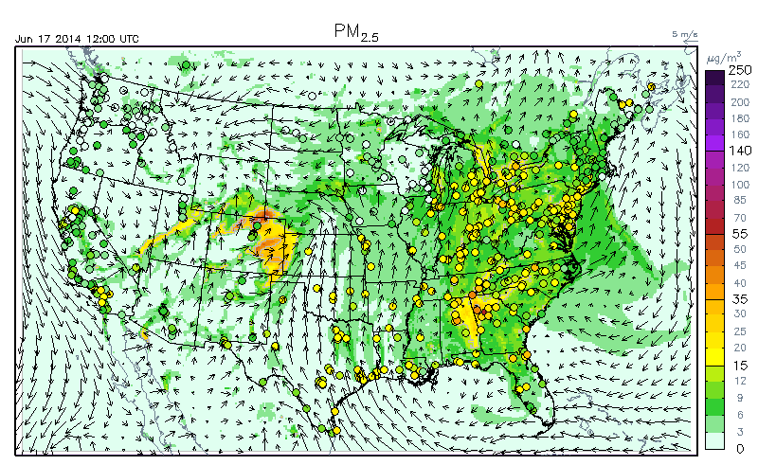
Dust Movie on 6/17

Slide 10
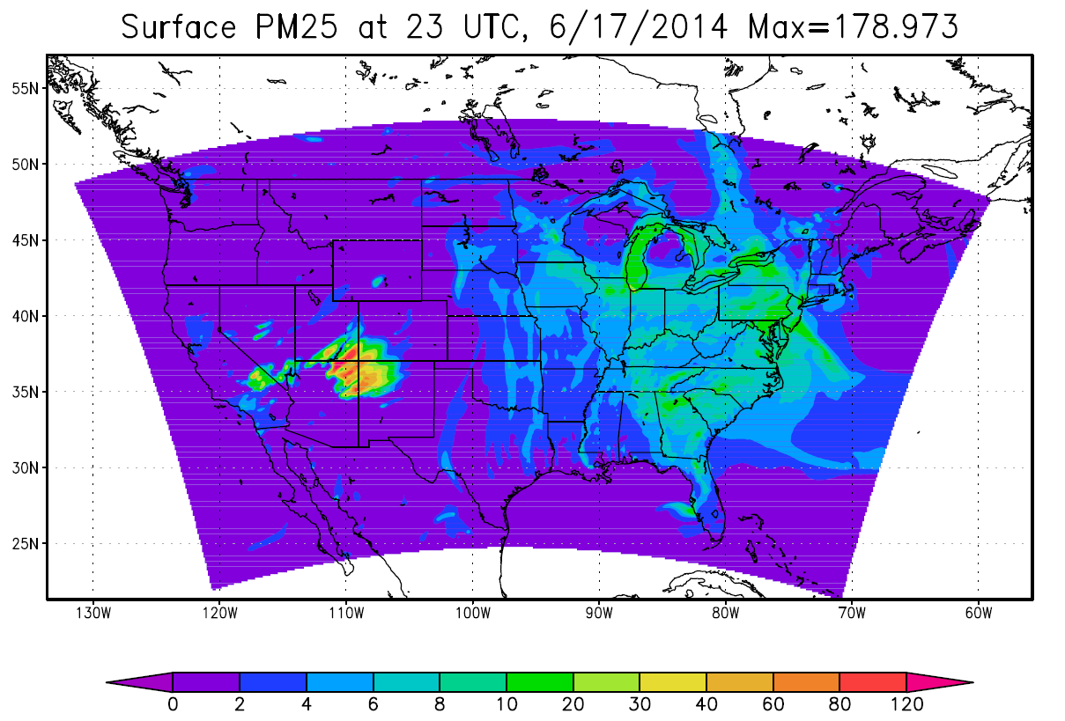
Side by Side Comparison (Specifics in AZ)
Red Lake Dry bed in NW Mojave … a line of moderately dense sand that is … extended NE about 350km into central Garfield county, UT.
Four Corners: Sand from ..NE AZ is of moderate to dense conditions that cover a wide area moving NE into far SE UT and W CO. This plume … extends well into West Central CO.
Small dry lake beds produce distinct individual 2-5km wide plumes of dense sand within this area.

Slide 11
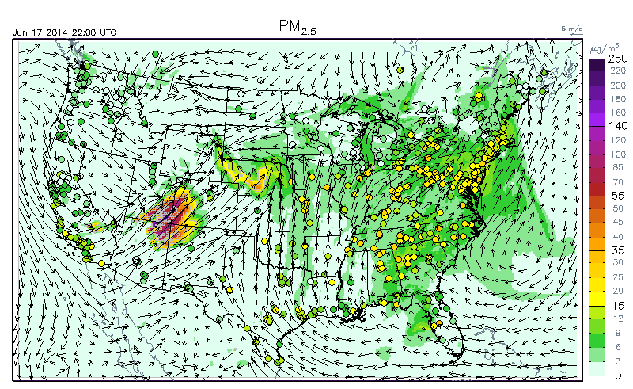
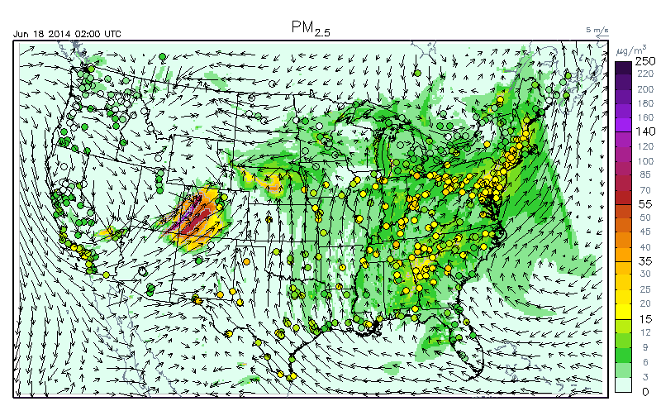
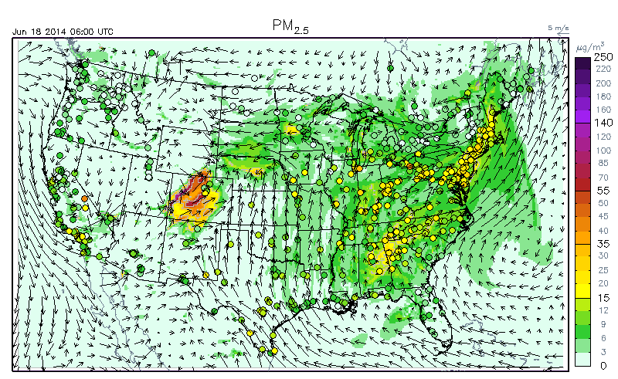
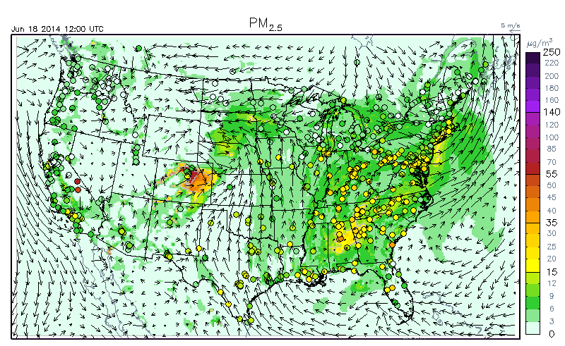
Worst case – hourly overprediction

Slide 12
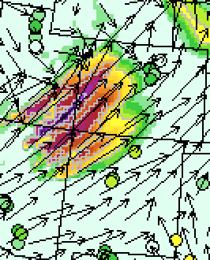
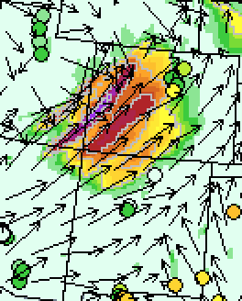
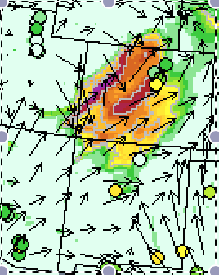
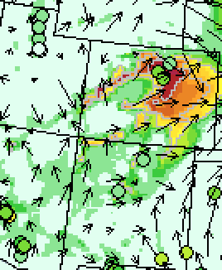
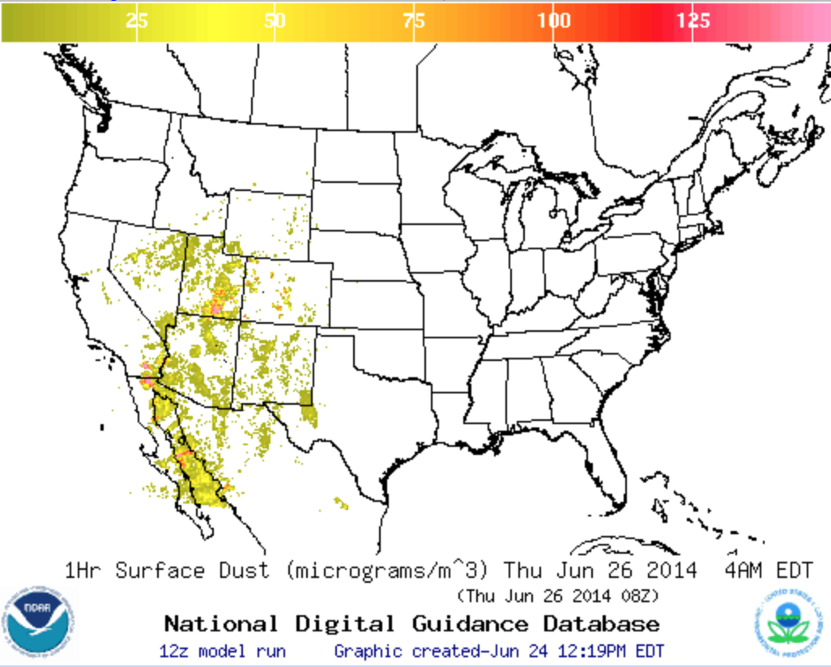
Worst Case – a closer look
22Z
02Z
06Z
11Z
Daily PM2.5 – No false alarm
NAQFC Op. Dust

Slide 13
Conclusion from the new evaluation results
New updates reduced surface concs;
The dust model has reproduced the spatial pattern of observed large dust storms, with reasonable accuracy.
Overprediction remains (to a less extent).
No false alarm even in the worst case (limited period).

Slide 14
Options to move forward
No need to change the run script; All changes are implemented in the executable;
ARL will deliver a new executable if dust has to be switched off. No impact on the delivered scripts.
ARL is willing to continue to do numerous additional case and sensitivity studies even beyond Aug 1 2014, after NCO starts to run the package. With the scripts in place, any upgrade should be much easier.

