Slide 1
Review of GFS Forecast Skills in 2012
Fanglin Yang
IMSG - Environmental Modeling Center
National Centers for Environmental Prediction
Acknowledgments: All NCEP EMC Global Climate and Weather Modeling Branch members are acknowledged for their contributions to the development and application of the Global Forecast Systems.

Slide 2
Outline
Major GFS changes in 2012
Forecast skill scores
AC and RMSE
Hurricane Track and Intensity
Precipitation
Comparison with Surface and Rawinsonde Obs

Slide 3
Major GFS Changes
3/1999
AMSU-A and HIRS-3 data
2/2000
Resolution change: T126L28 → T170L42 (100 km → 70 km)
Next changes
7/2000 (hurricane relocation)
8/2000 (data cutoff for 06 and 18 UTC)
10/2000 – package of minor changes
2/2001 – radiance and moisture analysis changes
5/2001
Major physics upgrade (prognostic cloud water, cumulus momentum transport)
Improved QC for AMSU radiances
Next changes
6/2001 – vegetation fraction
7/2001 – SST satellite data
8/200 – sea ice mask, gravity wave drag adjustment, random cloud tops, land surface evaporation, cloud microphysics…)
10/ 2001 – snow depth from model background
1/2002 – Quikscat included

Slide 4
Major GFS Changes (cont’d)
11/2002
Resolution change: T170L42 → T254L64 (70 km → 55 km)
Recomputed background error
Divergence tendency constraint in tropics turned off
Next changes
3/2003 – NOAA-17 radiances, NOAA-16 AMSU restored, Quikscat 0.5 degree data
8/2003 – RRTM longwave and trace gases
10/2003 – NOAA-17 AMSU-A turned off
11/2003 – Minor analysis changes
2/2004 – mountain blocking added
5/2004 – NOAA-16 HIRS turned off
5/2005
Resolution change: T254L64 → T382L64 ( 55 km → 38 km )
2-L OSU LSM → 4-L NOHA LSM
Reduce background vertical diffusion
Retune mountain blocking
Next changes
6/2005 – Increase vegetation canopy resistance
7/2005 – Correct temperature error near top of model

Slide 5
Major GFS Changes (cont’d)
8/2006
Revised orography and land-sea mask
NRL ozone physics
Upgrade snow analysis
5/2007
SSI (Spectral Statistical Interpolation) → GSI ( Gridpoint Statistical Interpolation).
Vertical coordinate changed from sigma to hybrid sigma-pressure
New observations (COSMIC, full resolution AIRS, METOP HIRS, AMSU-A and MHS)
12/2007
JMA high resolution winds and SBUV-8 ozone observations added
2/2009
Flow-dependent weighting of background error variances
Variational Quality Control
METOP IASI observations added
Updated Community Radiative Transfer Model coefficients
7/2010
Resolution Change: T382L64 → T574L64 ( 38 km → 23 km )
Major radiation package upgrade (RRTM2 , aerosol, surface albedo etc)
New mass flux shallow convection scheme; revised deep convection and PBL scheme
Positive-definite tracer transport scheme to remove negative water vapor

Slide 6
Major GFS Changes (cont’d)
05/09/2011
GSI: Improved OMI QC; Retune SBUV/2 ozone ob errors; Relax AMSU-A Channel 5 QC; New version of CRTM 2.0.2 ; Inclusion of GPS RO data from SAC-C, C/NOFS and TerraSAR-X satellites; Inclusion of uniform (higher resolution) thinning for satellite radiances ; Improved GSI code with optimization and additional options; Recomputed background errors; Inclusion of SBUV and MHS from NOAA-19 and removal of AMSU-A NOAA-15 .
GFS: New Thermal Roughness Length -- Reduced land surface skin temperature cold bias and low level summer warm bias over arid land areas; Reduce background diffusion in the Stratosphere .
5/22/2012
GSI Hybrid EnKF-3DVAR : A hybrid variational ensemble assimilation system is employed. The background error used to project the information in the observations into the analysis is created by a combination of a static background error (as in the prior system) and a new background error produced from a lower resolution (T254) Ensemble Kalman Filter.
Other GSI Changes: Use GPS RO bending angle rather than refractivity; Include compressibility factors for atmosphere ; Retune SBUV ob errors, fix bug at top ; Update radiance usage flags; Add NPP ATMS satellite data, GOES-13/15 radiance data, and SEVERI CSBT radiance product ; Include satellite monitoring statistics code in operations ; Add new satellite wind data and quality control.
09/05/2012
GFS : A look-up table used in the land surface scheme to control Minimum Canopy Resistance and Root Depth Number was updated to reduce excessive evaporation. This update was aimed to mitigate GFS cold and moist biases found in the late afternoon over the central United States when drought conditions existed in summer of 2012.

Slide 7
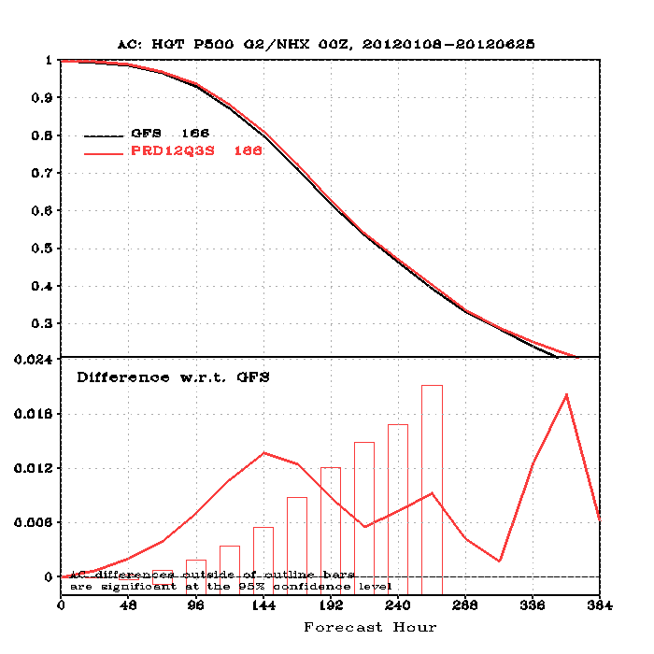
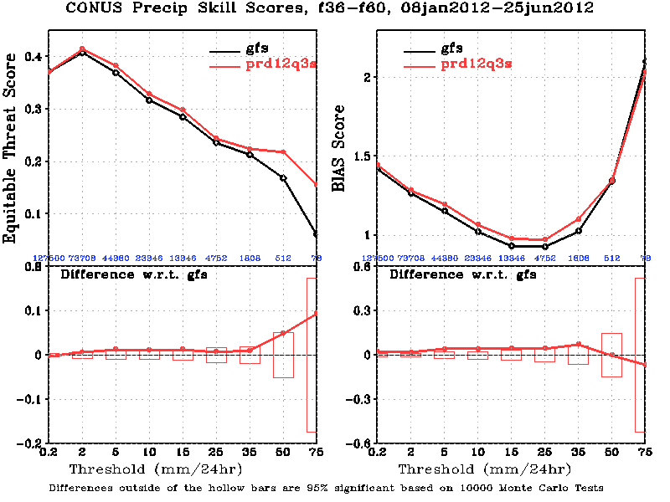
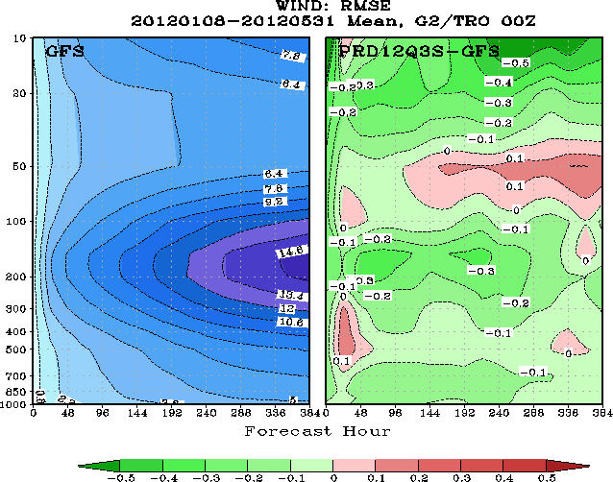
Sample Results from GSI Hybrid EnKF-3DVAR Implementation
http://www.emc.ncep.noaa.gov/gmb/wd20rt/experiments/prd12q3s/vsdb/

Slide 8
Day at which forecast loses useful skill (500-hPa Height AC=0.6) 3D-Var Operational GFS vs Hybrid-Ensemble GFS Parallels
1. Summer (retrospective parallel prd12q3i): 27 August 2011 ~ 16 October 2011
 | Operational | Parallel | parallel minus Operational
Northern Hemisphere | 7.68 | 7.79 | 0.11 (2.6 hrs)
Southern Hemisphere | 7.89 | 7.94 | 0.05 (1.2hrs)
2. Winter and Spring (real-time parallel prd12q3s): 8 January 2012 ~ 21 May 2012
 | Operational | Parallel | parallel minus Operational
Northern Hemisphere | 8.43 | 8.65 | 0.22 (5.3 hrs)
Southern Hemisphere | 7.62 | 7.73 | 0.11 (2.6 hrs)

Slide 9
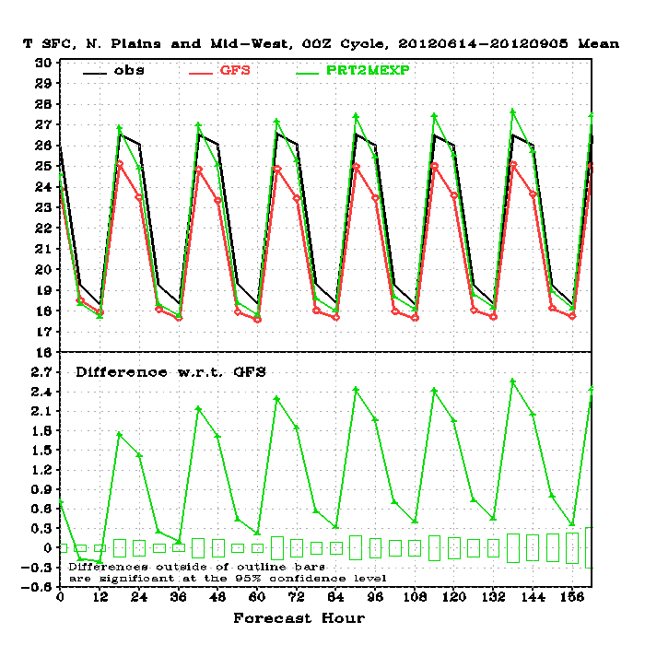
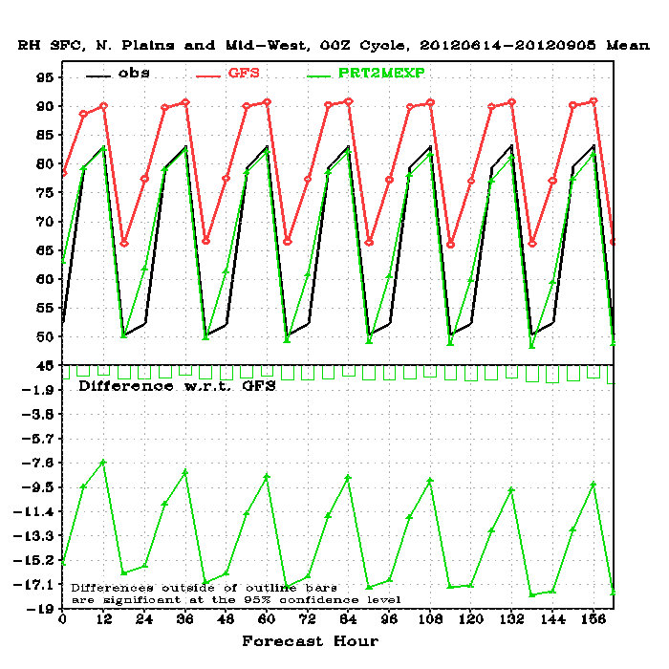
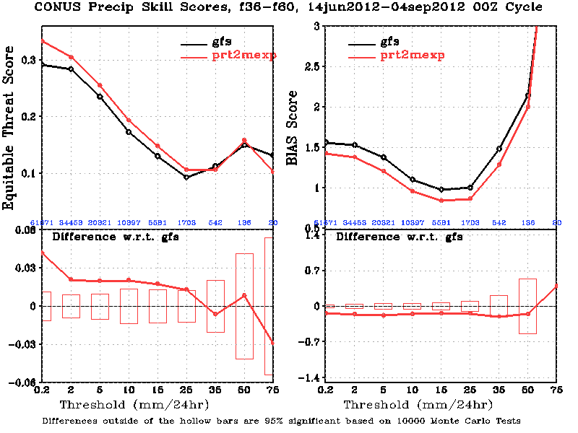
Sample Results from 09/05/2012 GFS Soil Table Update
http://www.emc.ncep.noaa.gov/gmb/wx24fy/para/t2mbias/exp2012/

Slide 10
Outline
Major GFS changes in 2012
Forecast skill scores
AC and RMSE
Hurricane Track and Intensity
Precipitation
Comparison with Surface and Rawinsonde Obs

Slide 11
Annual Mean 500-hPa HGT Day-5 Anomaly Correlation
CDAS is a legacy GFS (T64) used for NCEP/NCAR Reanalysis circa 1995
CFSR is the coupled GFS (T126) used for reanalysis circa 2006

Slide 12
Annual Mean 500-hPa HGT Day-5 Anomaly Correlation GFS minus CDAS
Best Year,
For both NH and SH

Slide 13
Annual Mean 500-hPa HGT Day-5 Anomaly Correlation GFS minus CFSR
Best Year,
For both NH and SH

Slide 14
Annual Mean NH 500hPa HGT Day-5 AC
ECMWF, GFS and CMC were better in 2012 than in 2011. GFS has the largest gain.
UKM and FNOMC were slightly worse in 2012 than 2011.

Slide 15
Annual Mean SH 500hPa HGT Day-5 AC
2012 was a difficult year to forecast, namely, both CFSR and CDAS scores dropped.
Most models, except for GFS and CMC, had lower scores in 2012 than in 2011.

Slide 16
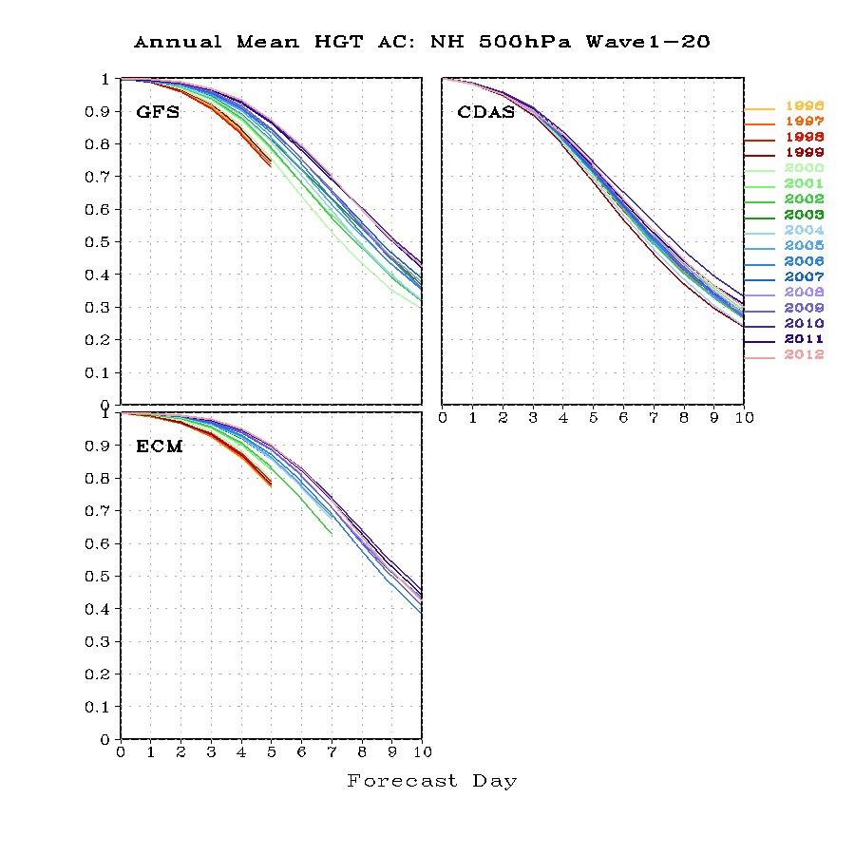
Die-off Curves of Annual Mean NH 500hPa HGT AC
0.6 – useful forecast
For 2012
GFS: 8.0 day
ECMWF: 8.2 day
CDAS: 6.4 day
ECMWF ‘s useful forecast in 2012 was not as good as in 2010 and 2011. GFS had no change in past three years.

Slide 17
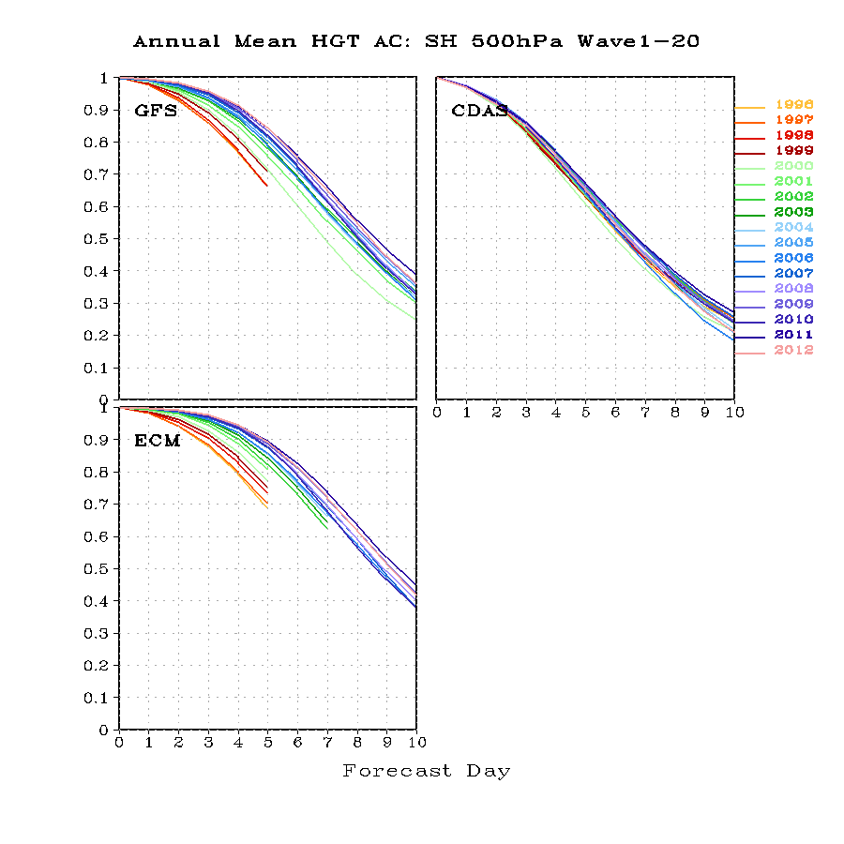
Die-off Curves of Annual Mean SH 500hPa HGT AC
0.6 – useful forecast
For 2012
GFS: 7.6 day
ECMWF: 8.2 day
CDAS: 6.5 day

Slide 18
Day at which forecast loses useful skill (AC=0.6) N. Hemisphere 500hPa height calendar year means
8d
Forecast day
2012

Slide 19
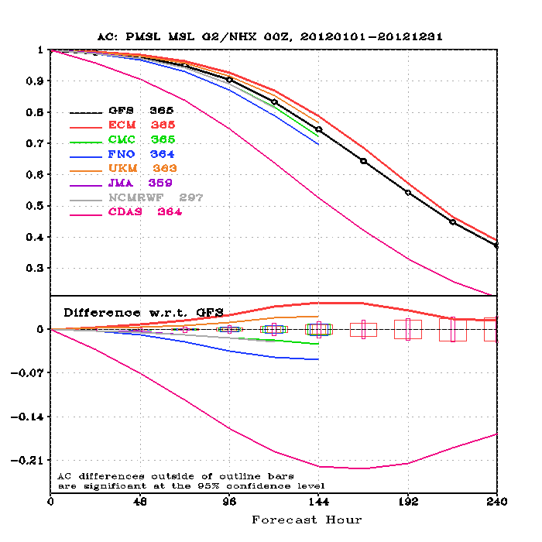
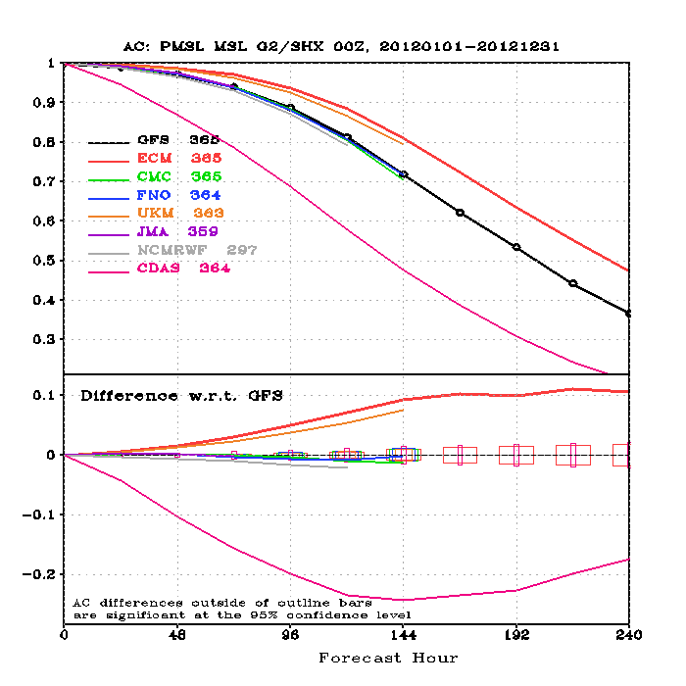
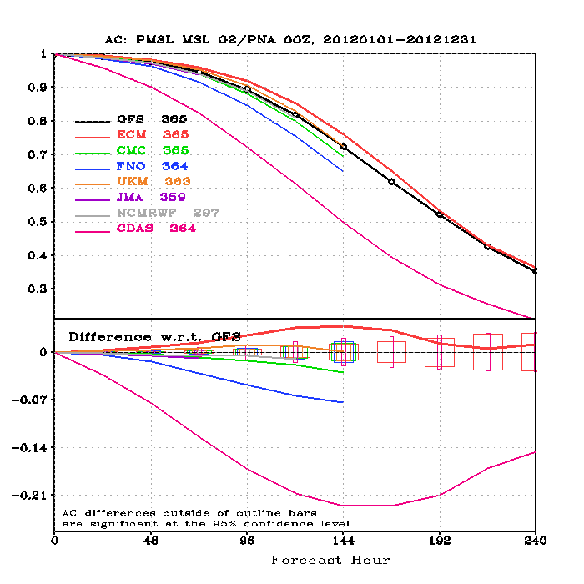
Die-off Curves of 2012 Annual Mean Sea-Level Pressure AC
NH
SH
PNA
GFS lags behind ECMWF more in the SH than in the NH

Slide 20
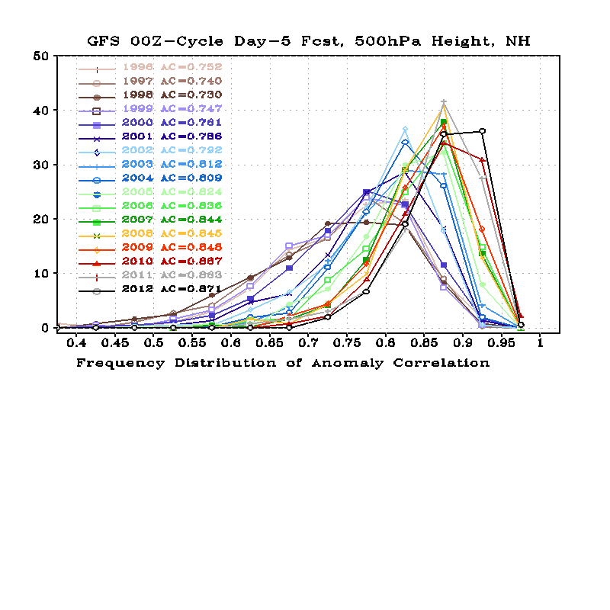
AC Frequency Distribution
Twenty bins were used to count for the frequency distribution, with the 1st bin centered at 0.025 and the last been centered at 0.975. The width of each bin is 0.05.
More GOOD forecasts
GFS NH
Jan 2000: T126L28 → T170L42
May 2001: prognostic cloud
Oct 2002: T170L42 → T254L64
May 2005: T254L64 → T382L64;
2-L OSU LSM →4-L NOHA LSM
May 2007: SSI → GSI Analysis;
Sigma → sigma-p hybrid coordinate
July 2010: T382L64 → T574L64; Major Physics Upgrade
May 2012: Hybrid-Ensemble 3D-VAR Data Assimilation

Slide 21
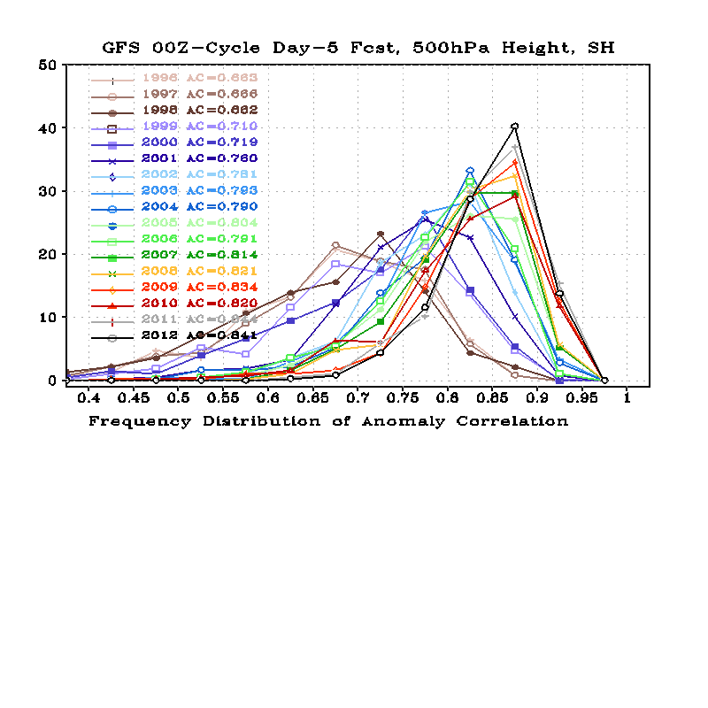
AC Frequency Distribution
GFS SH
Jan 2000: T126L28 → T170L42
May 2001: prognostic cloud
Oct 2002: T170L42 → T254L64
May 2005: T254L64 → T382L64;
2-L OSU LSM →4-L NOHA LSM
May 2007: SSI → GSI Analysis;
Sigma → sigma-p hybrid coordinate
July 2010: T382L64 → T574L64; Major Physics Upgrade
May 2012: Hybrid-Ensemble 3D-VAR Data Assimilation

Slide 22
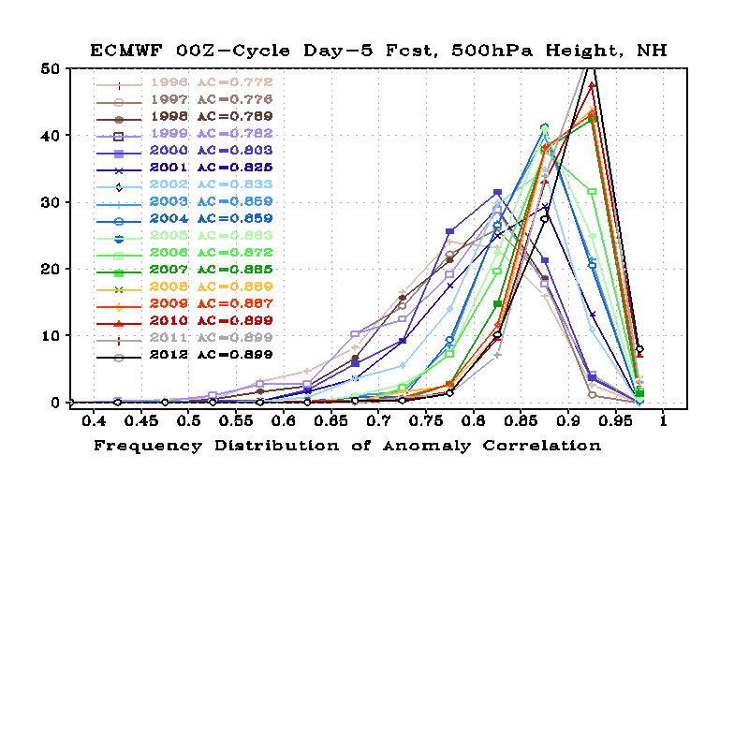
AC Frequency Distribution
ECMWF NH

Slide 23
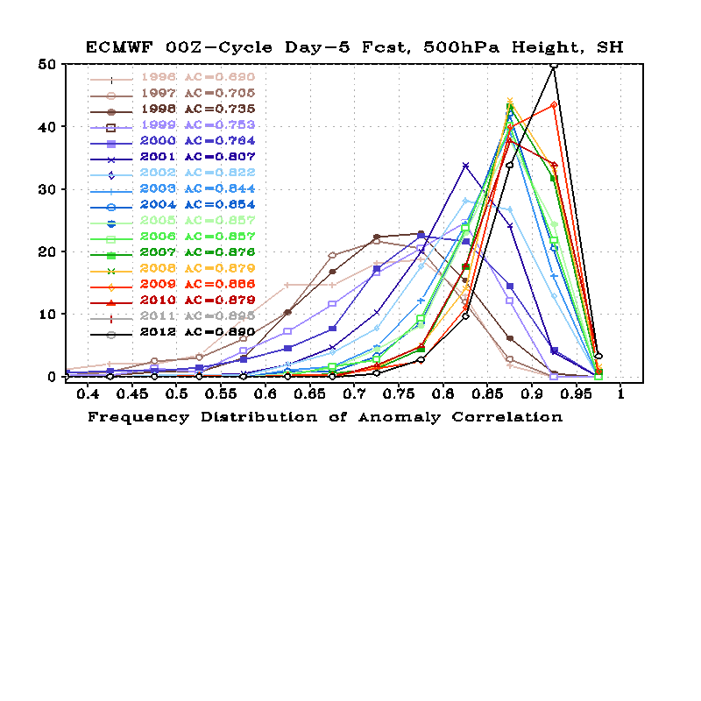
AC Frequency Distribution
ECMWF SH

Slide 24
Jan 2000: T126L28 → T170L42
May 2001: prognostic cloud
Oct 2002: T170L42 → T254L64
May 2005: T254L64 → T382L64;
2-L OSU LSM →4-L NOHA LSM
May 2007: SSI → GSI Analysis;
Sigma → sigma-p hybrid coordinate
July 2010: T382L64 → T574L64; Major Physics Upgrade
May 2012: Hybrid-Ensemble 3D-VAR Data Assimilation

Slide 25
Jan 2000: T126L28 → T170L42
May 2001: prognostic cloud
Oct 2002: T170L42 → T254L64
May 2005: T254L64 → T382L64;
2-L OSU LSM →4-L NOHA LSM
May 2007: SSI → GSI Analysis;
Sigma → sigma-p hybrid coordinate
July 2010: T382L64 → T574L64; Major Physics Upgrade
May 2012: Hybrid-Ensemble 3D-VAR Data Assimilation

Slide 26
2012 is the first year for which GFS has no “BAD” forecast in the Northern Hemisphere
Jan 2000: T126L28 → T170L42
May 2001: prognostic cloud
Oct 2002: T170L42 → T254L64
May 2005: T254L64 → T382L64;
2-L OSU LSM →4-L NOHA LSM
May 2007: SSI → GSI Analysis;
Sigma → sigma-p hybrid coordinate
July 2010: T382L64 → T574L64; Major Physics Upgrade
May 2012: Hybrid-Ensemble 3D-VAR Data Assimilation

Slide 30
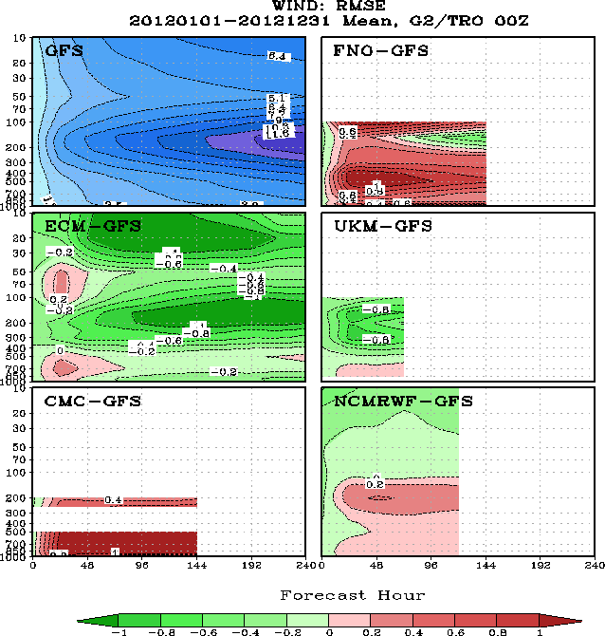
2012 Annual Mean Tropical [20S-20N] Wind RMSE

Slide 31
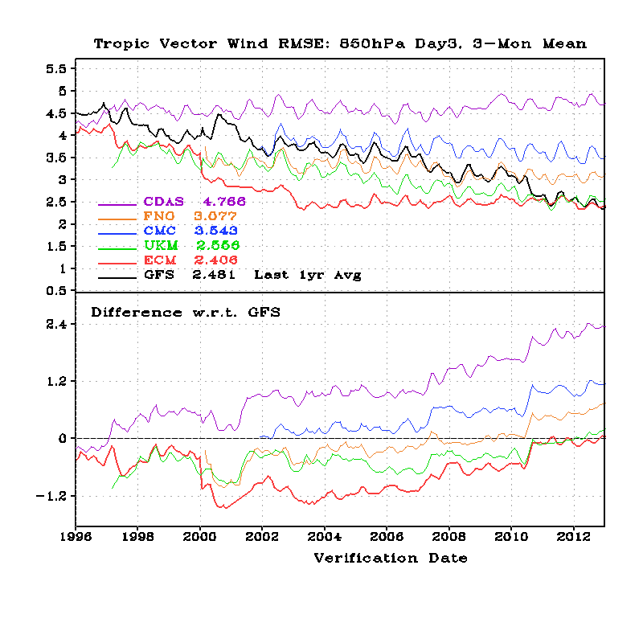
Tropical Wind RMSE, 850-hPa Day-3 Forecast
July2010 T574 GFS Implementation

Slide 32
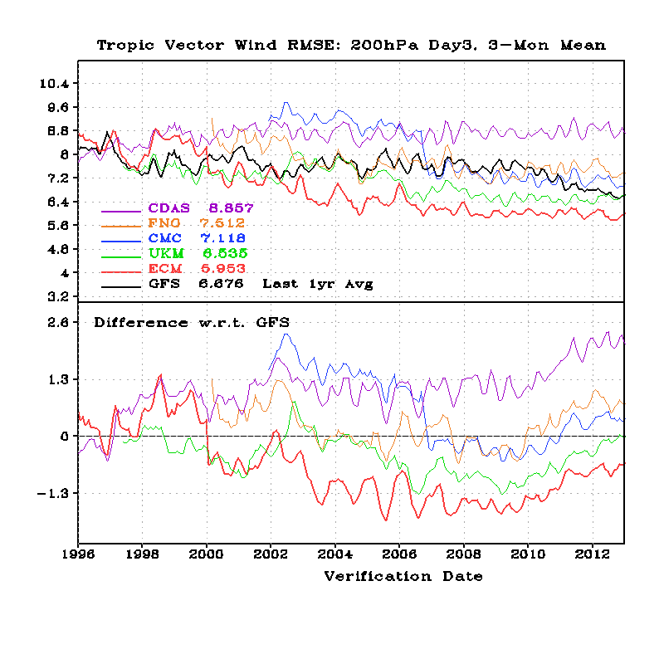
Tropical Wind RMSE, 200-hPa Day-3 Forecast
GFS matched UKM after
Hybrid EnKF Implementation

Slide 33
Outline
Major GFS changes in 2012
Forecast skill scores
AC and RMSE
Hurricane Track and Intensity
Precipitation
Comparison with Surface and Rawinsonde Obs

Slide 34
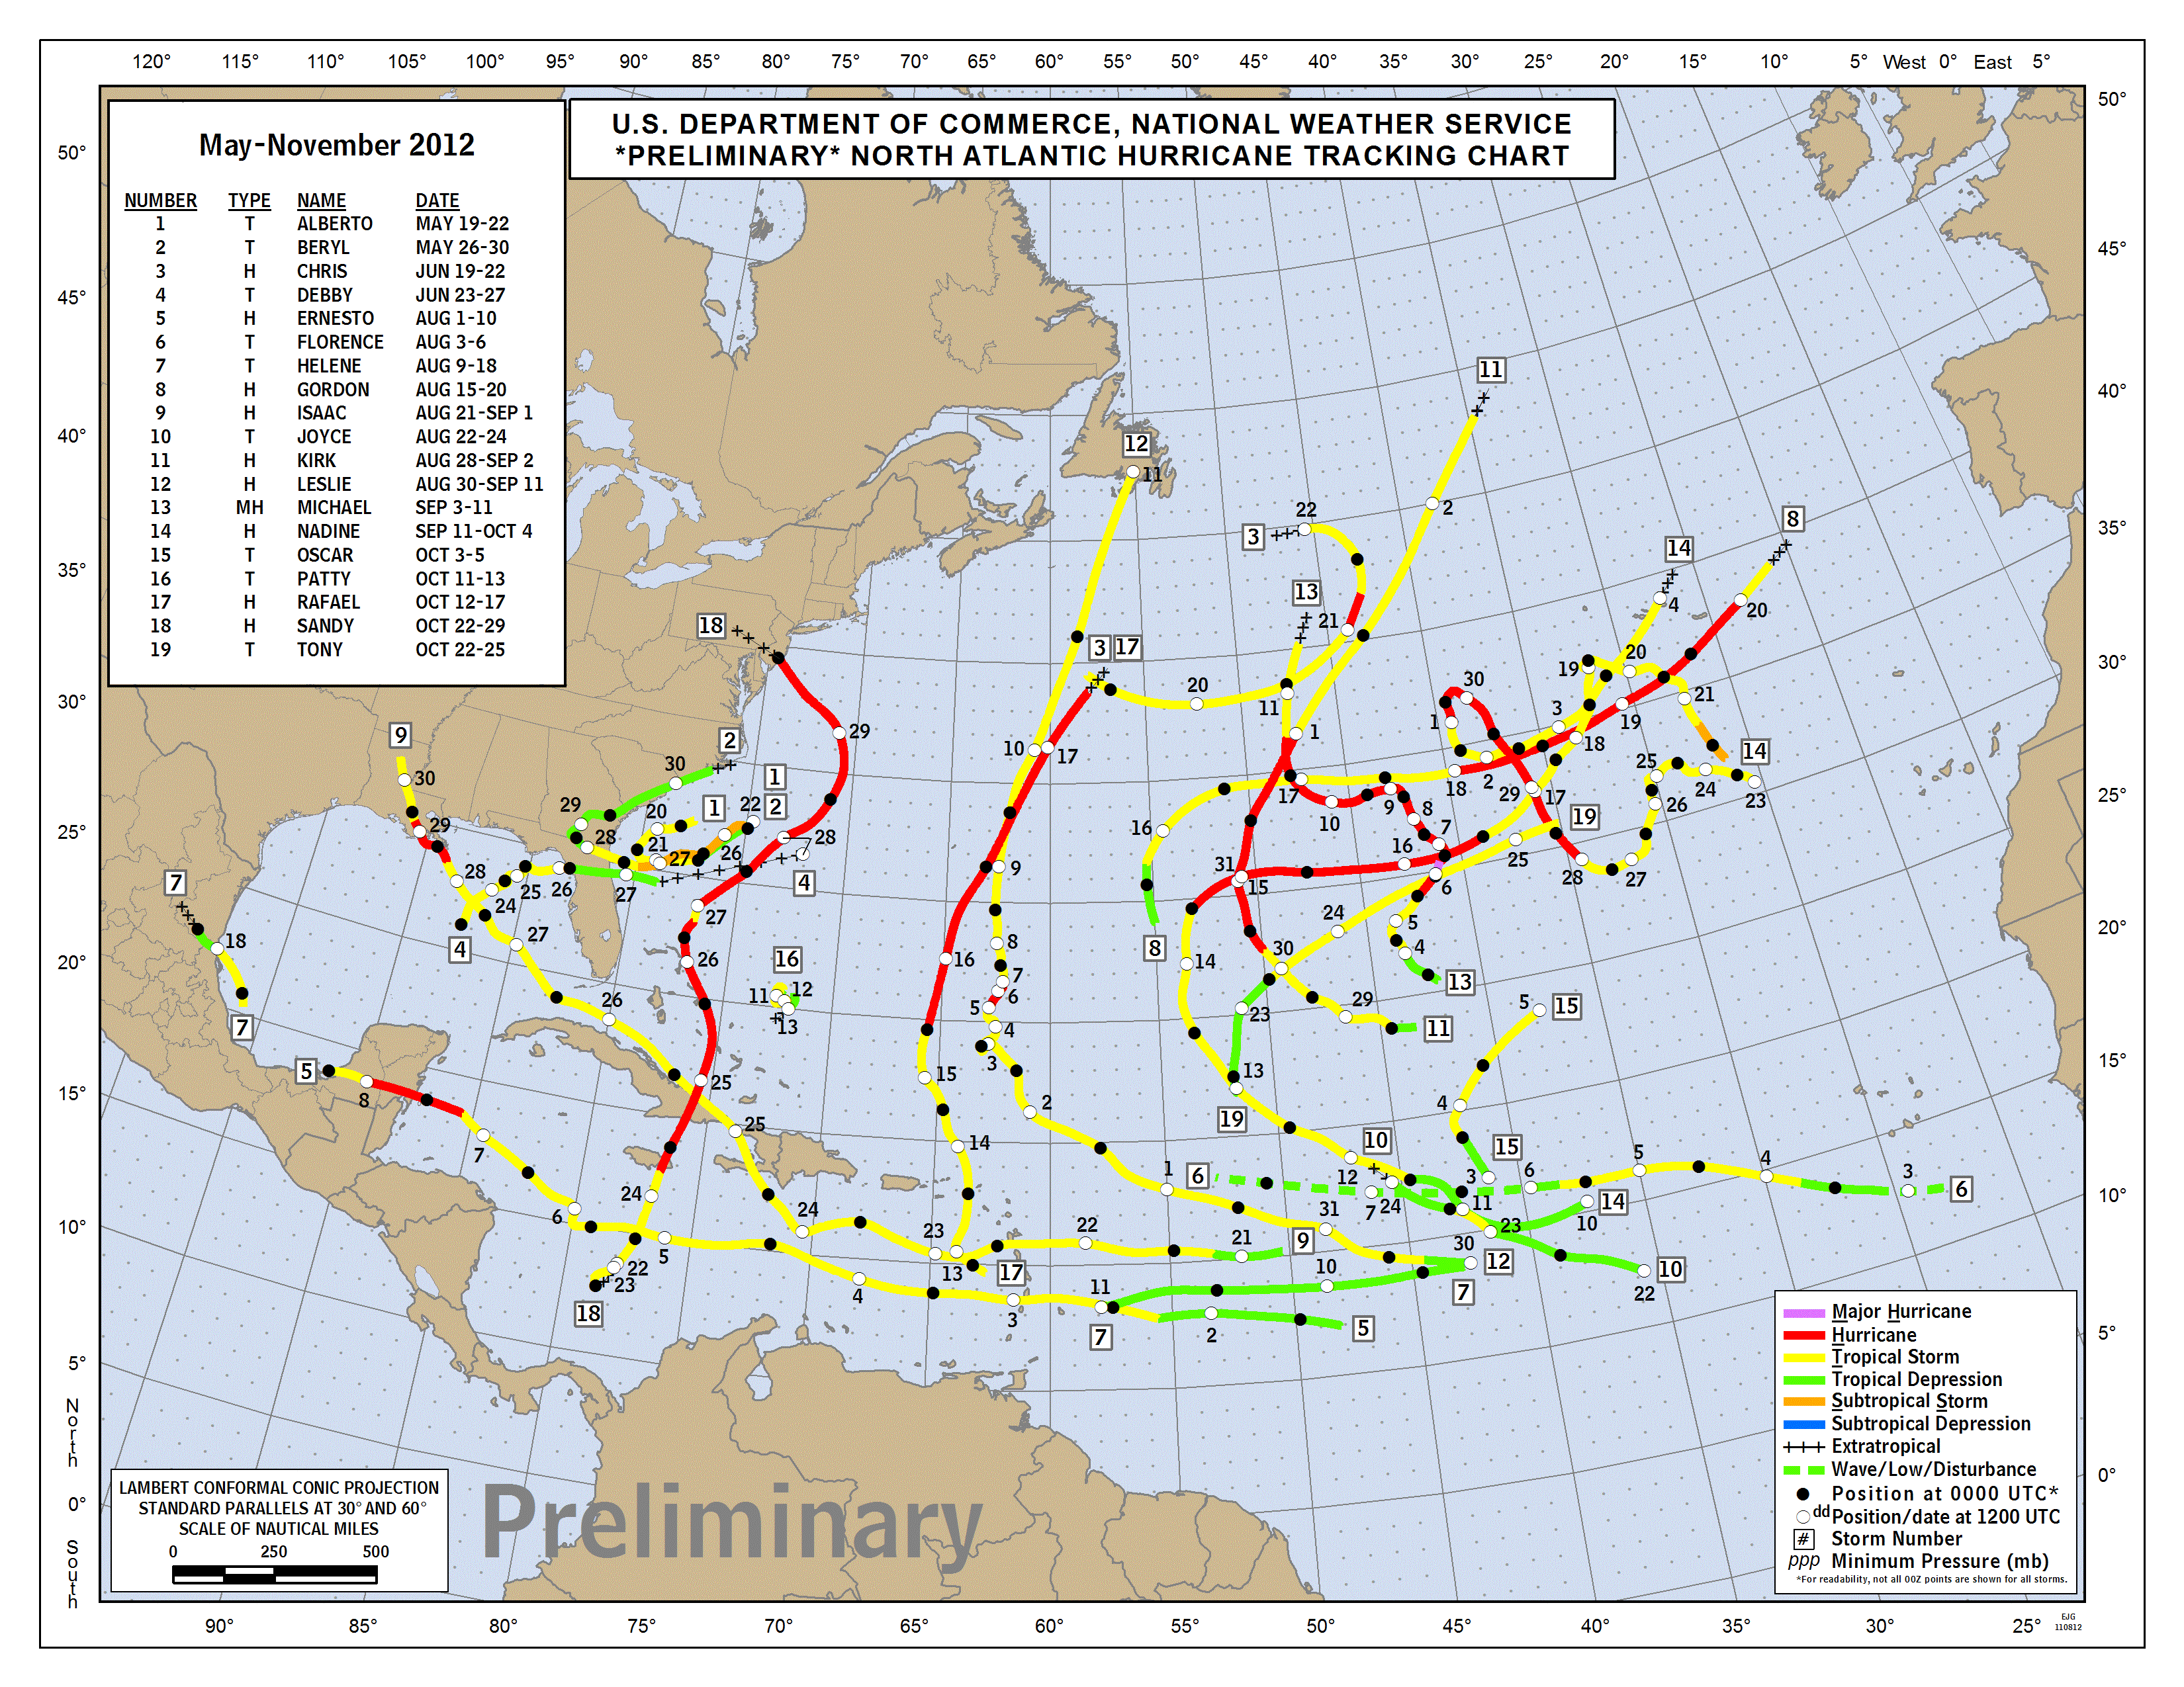
2012 Atlantic Hurricanes
First storm formed | May 19, 2012
Last storm dissipated | October 29, 2012
Strongest storm | Sandy – 940 mbar (hPa) (27.77 inHg), 110 mph (175 km/h)
Total depressions | 19
Total storms | 19
Hurricanes | 10
Major hurricanes (Cat. 3+) | 1
Total fatalities | 316 direct, 12 indirect
Total damage | At least $68.48 billion (2012 USD)
www.nhc.noaa.gov/
http://www.wikipedia.org

Slide 35
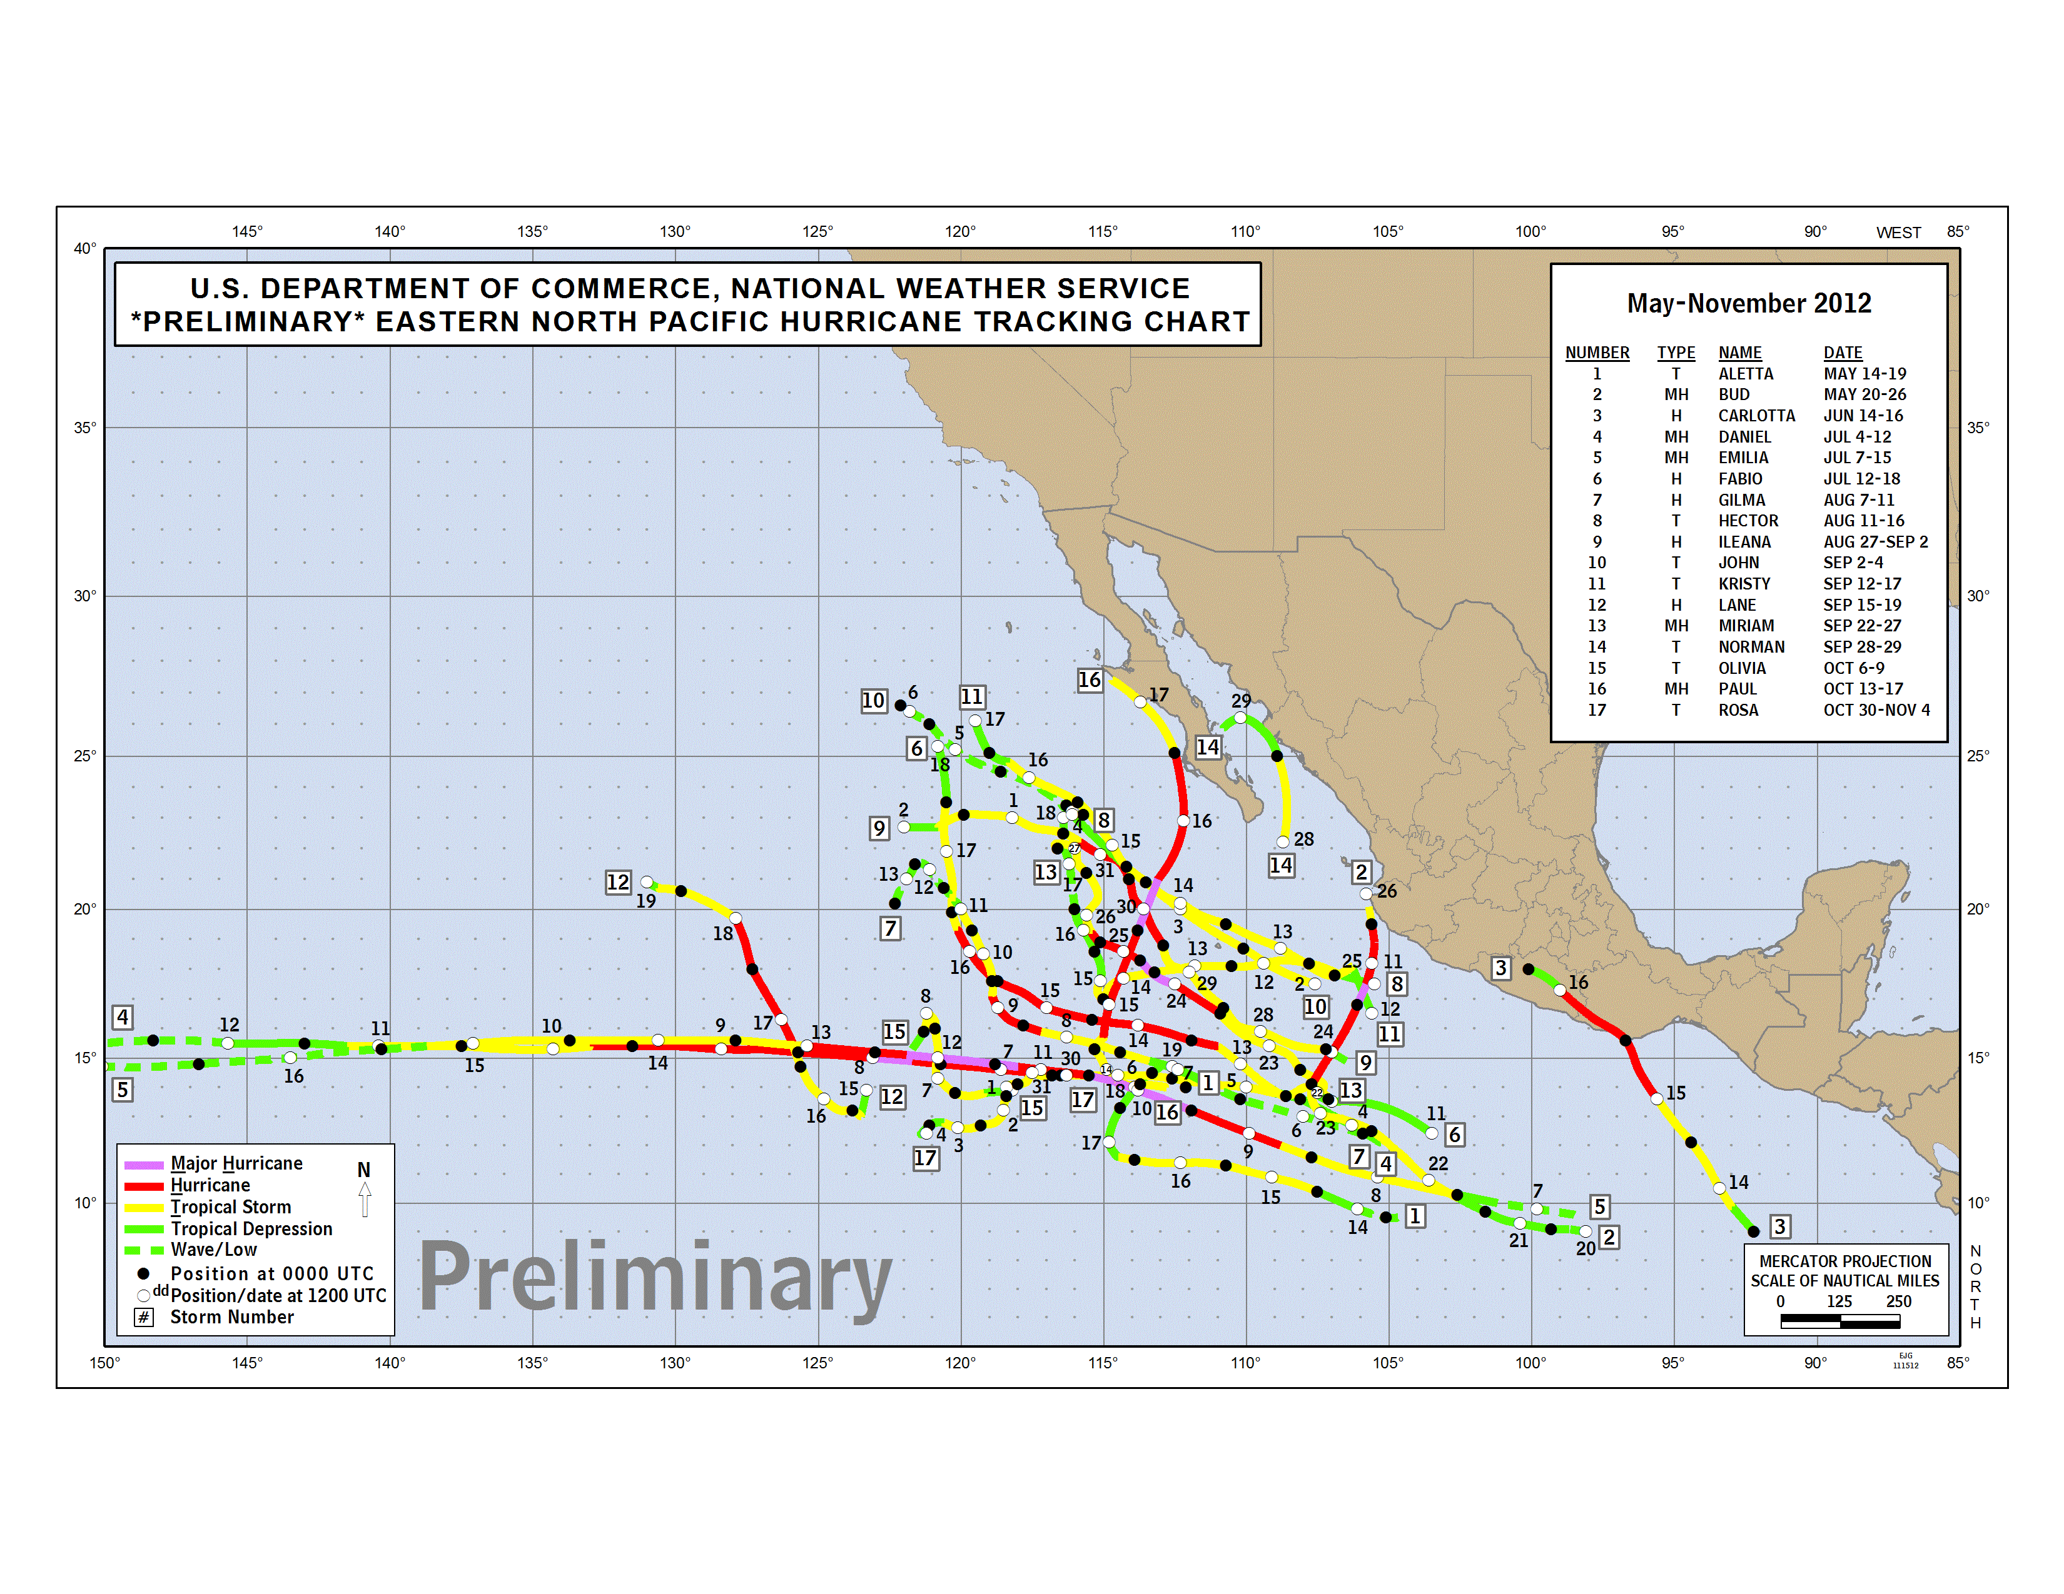
2012 Eastern Pacific Hurricanes
First storm formed | May 14, 2012
Last storm dissipated | November 3, 2012
Strongest storm | Emilia – 945 mbar (hPa) (27.92 inHg), 140 mph (220 km/h)
Total depressions | 17
Total storms | 17
Hurricanes | 10
Major hurricanes (Cat. 3+) | 5
Total fatalities | 8 total
Total damage | $123.2 million (2012 USD)
www.nhc.noaa.gov/
http://www.wikipedia.org

Slide 36
2012 Atlantic Hurricane Track and Intensity Errors
AVNO = GFS EMX = ECMWF
00Z and 12Z cycles

Slide 37
2012 Eastern Pacific Hurricane Track and Intensity Errors
AVNO = GFS EMX = ECMWF
00Z and 12Z cycles

Slide 38
Sandy Track Forecasts Global Deterministic NWP Models
Formed | October 22, 2012
Dissipated | October 31, 2012 (extratropical after October 29)
Highest winds | 1-minute sustained: 110 mph (175 km/h)
Lowest pressure | 940 mbar (hPa); 27.76 inHg
Fatalities | 253 total
Damage | At least $65.6 billion (2012 USD) (Second-costliest hurricane in US history)
www.wikipedia.org
www.livescience.com

Slide 39
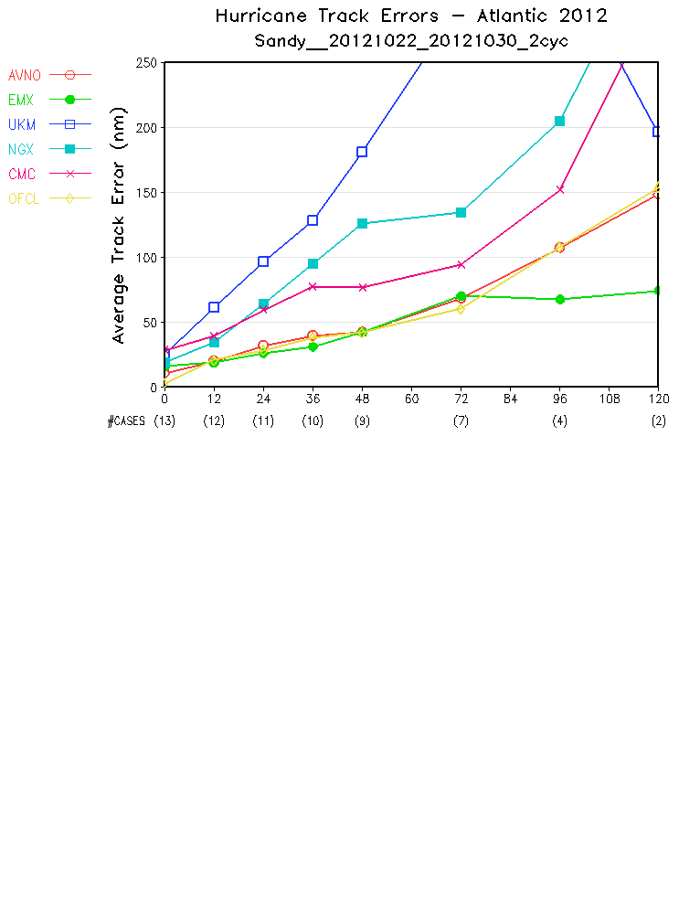
Mean Track Errors: 22OCt2012 – 30Oct2012

Slide 40
6 days before landfall
Tuesday, 20121023, 00Z and 12Z Cycles of Forecasts

Slide 41
5 days before landfall
Wednesday, 20121024 , 00Z and 12Z Cycles of Forecasts

Slide 42
4 days before landfall
Thursday, 20121025, 00Z and 12Z Cycles of Forecasts

Slide 43
3 days before landfall
Friday, 20121026, 00Z and 12Z Cycles of Forecasts

Slide 44
2 days before landfall
Saturday, 20121027, 00Z and 12Z Cycles of Forecasts

Slide 45
one day
before landfall
Sunday, 20121028, 00Z and 12Z Cycles of Forecasts

Slide 46
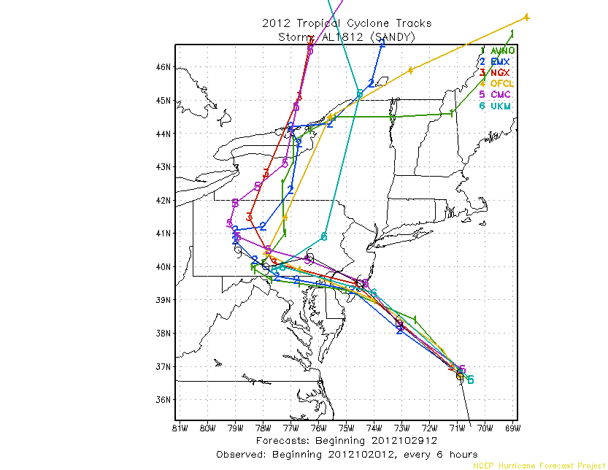
Monday, 20121029, 00Z and 12Z Cycles of Forecasts

Slide 47
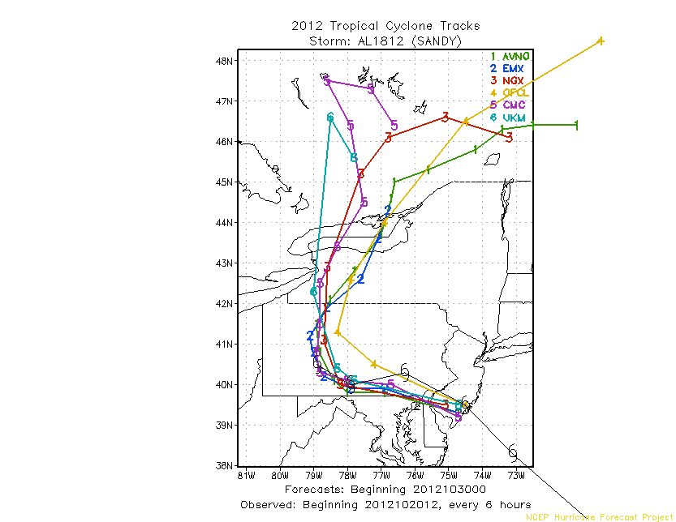
Tuesday, 20121030, 00Z Cycle of Forecast

Slide 48
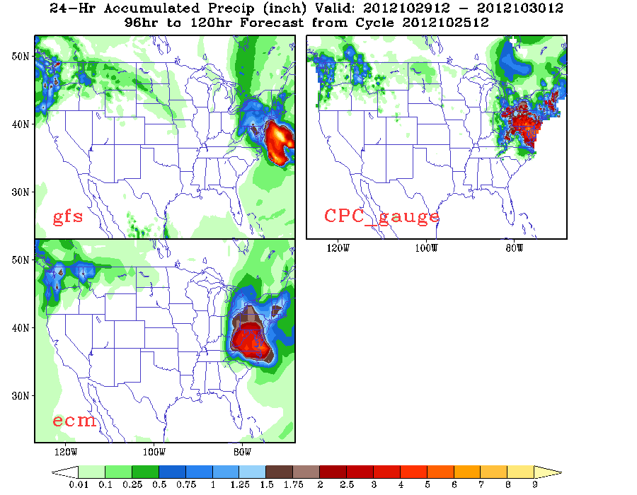
GFS and ECMWF Rainfall Forecasts for Sandy, 5 days before landfall

Slide 49
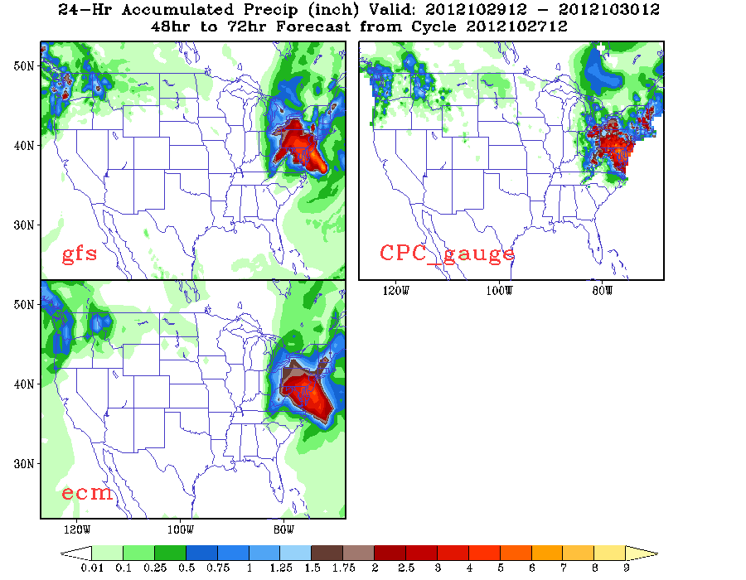
GFS and ECMWF Rainfall Forecasts for Sandy, 3 days before landfall

Slide 50
Hurricane Track and Intensity Forecast Errors NCEP GFS : 2001 ~ 2012

Slide 51
Fcst Hour

Slide 54
Fcst Hour

Slide 55
Outline
Major GFS changes in 2012
Forecast skill scores
AC and RMSE
Hurricane Track and Intensity
Precipitation
Comparison with Surface and Rawinsonde Obs

Slide 56
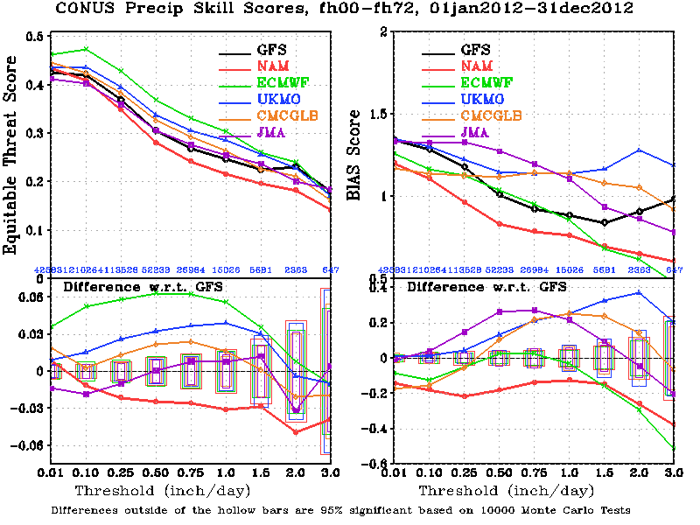
2012 Annual Mean CONUS Precipitation Skill Scores, 0-72 hour Forecast
BIAS=1
is perfect
Larger ETS is better
ECMWF has the best ETS, but it tends to underestimate heavy rainfall events.
GFS’s ETS score is only better than NAM; however, GFS has better BIAS score than most of the other models..

Slide 57
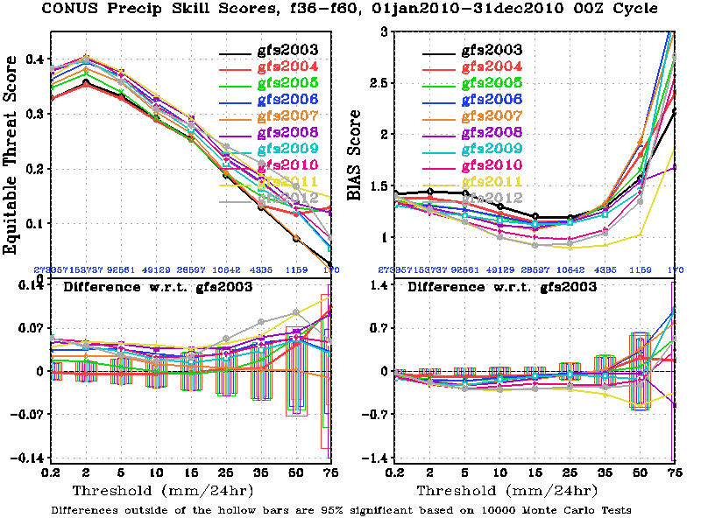
GFS CONUS Precipitation Skill Scores, Annual Mean, 2003 ~ 2012
In the past three years (2010~2012), GFS annual mean ETS was improved; BIAS was reduced, especially for medium rainfall events.

Slide 58
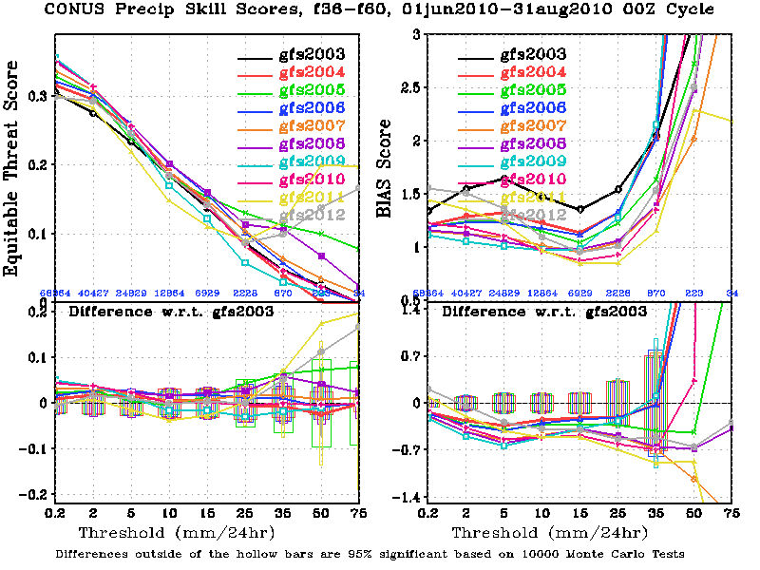
GFS CONUS Precipitation Skill Scores, Summer ( JJA) Mean, 2003 ~ 2012
In the past two years (2011~2012), GFS summer QPF scores were degraded for light rainfall events (lower ETS and larger BIAS).
This degradation was caused by excessive evaportranspiration in warm season. A soil table (Minimum Canopy Resistance and Root Depth Number) was changed in May-2011 Implementation.
This table has been reversed back to its older version since 09/05/2012. See slide 9 for the improvement of light rainfall QPF scores.

Slide 59
Outline
Major GFS changes in 2012
Forecast skill scores
AC and RMSE
Hurricane Track and Intensity
Precipitation
Comparison with Surface and Rawinsonde Obs

Slide 60
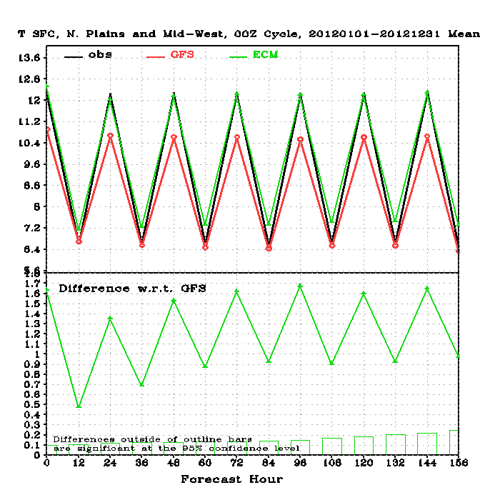
US Northern Plains, T2m Verified against Surface Station Observations
Early Morning
Late afternoon
For 2012, ECMWF had almost perfect forecast of surface temperature in the afternoon, but was slightly too warm in the morning.
GFS had good T2m forecast in the morning, but was too cold in the afternoon in the warm season.

Slide 61
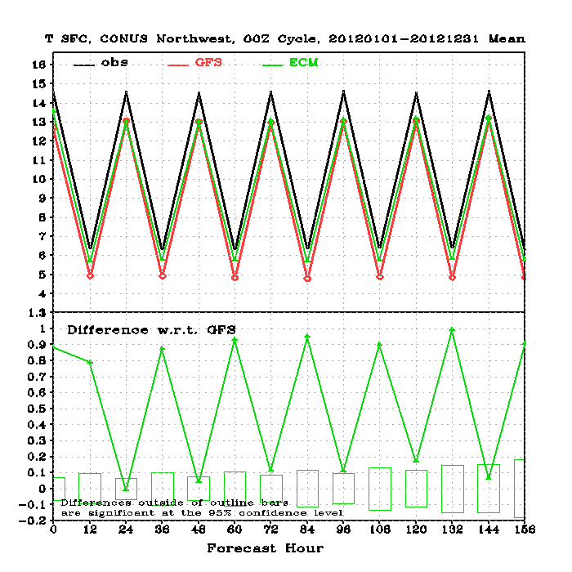
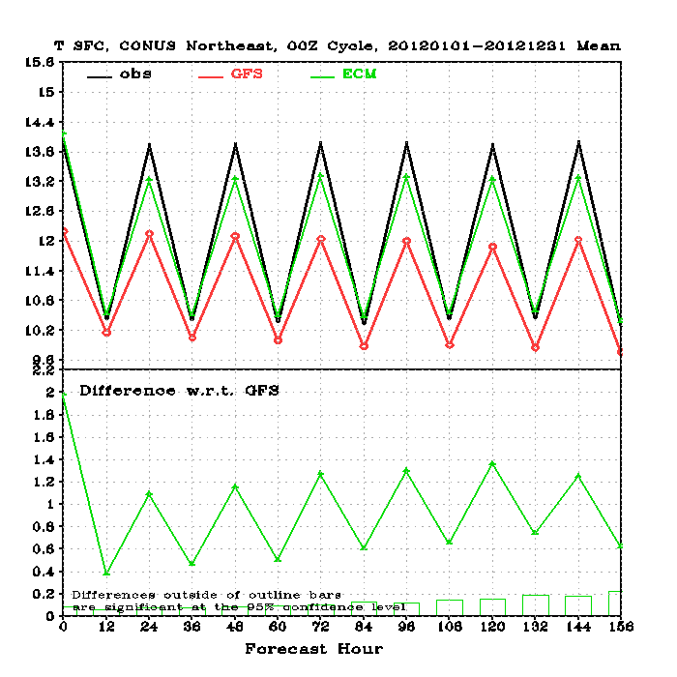
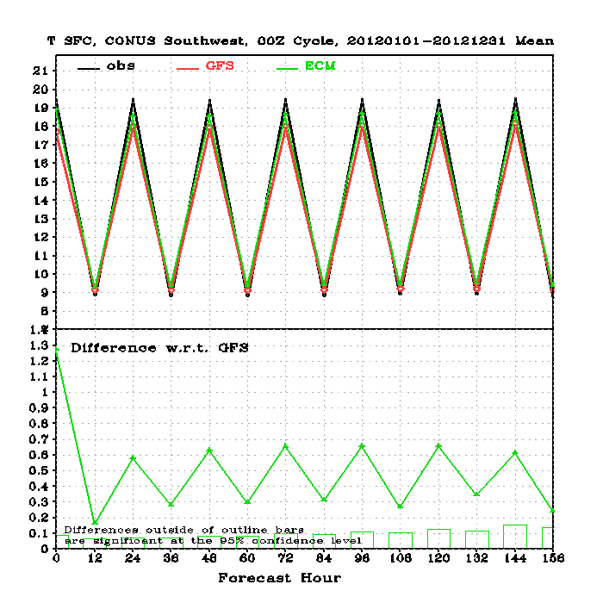
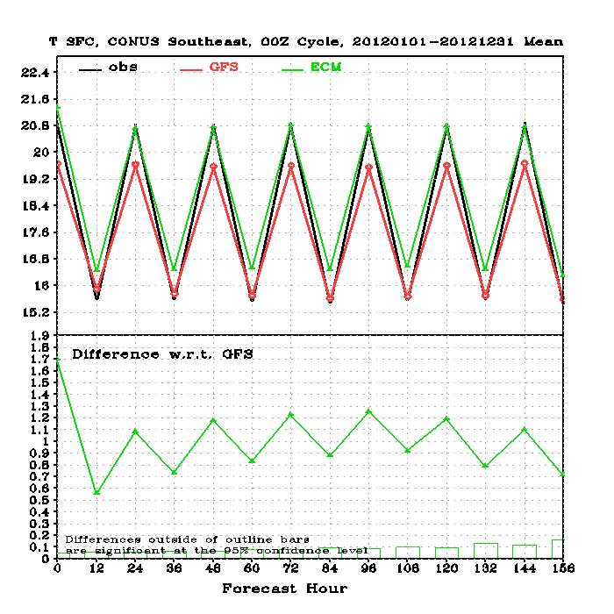
US T2m Verified against Surface Station Observations
Northwest
Northeast
GFS and ECMWF were similar in the west
GFS is too cold in the east
Southwest
Southeast

Slide 62
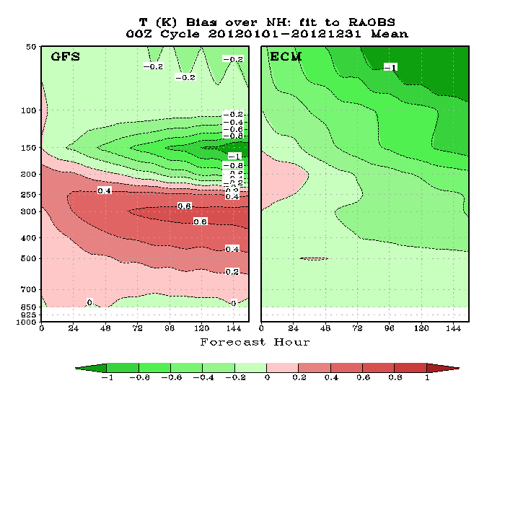
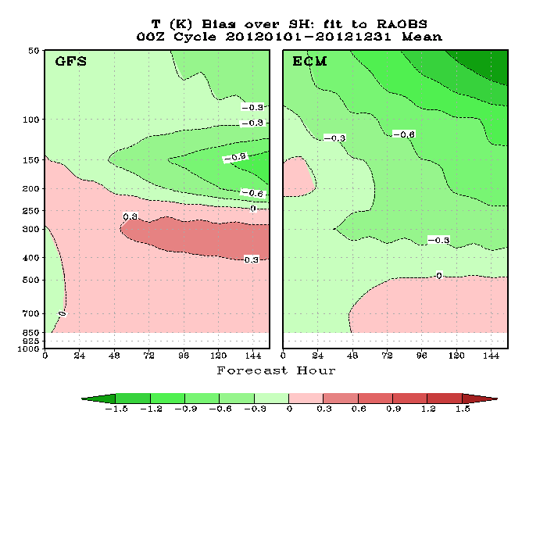
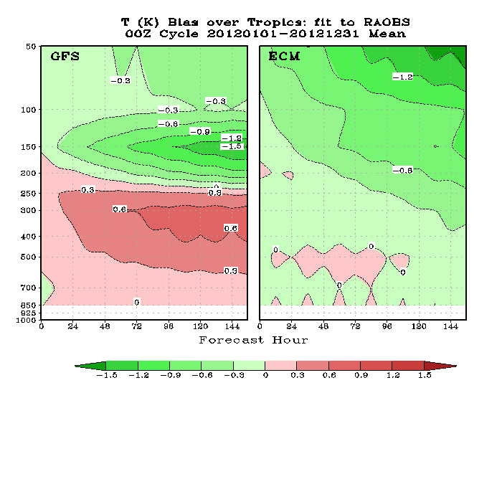
Temperature Bias , Verified against Rawinsonde Observations, 2012 Annual Mean
NH
SH
Compared to RAOBS
GFS was too warm in the upper troposphere and too cold at the tropopause and lower stratosphere.
ECMF was too cold in the stratosphere.
ECMWF was better than the GFS in the troposphere but worse in the stratosphere.
Tropics

Slide 63
Temperature Bias Verified against RAOBS, Northern Hemisphere, 120hr Fcst
150 hPa
50 hPa
It seems GFS cold bias near the tropopause was reduced after the May-2012 Hybrid EnKF implementation.
No seasonal variation in the upper troposphere.
ECMWF cold bias in the stratosphere was the worst in the first few months.
300 hPa

Slide 64
Configuration of Major Global High-Res NWP Models (2012)
System | Analysis | Forecast Model | Forecast Length and Cycles | upcoming
NCEP GFS | Hybrid 3DVAR (T382) + EnkF (T254) | Semi-implicit Spectral T574L64 (23km, 0.03 hPa) | 4 cycles 16 days | semi-lag T1148
ECMWF IFS | 4DVAR T1279L91 (T255 inner loops) | Semi-Lag Spectral T1279L91 (16km, 0.01 hPa) | 2 cycles 10 days | T7999 (2.5km) convection permitting?
UKMO Unified Model | Hybrid 4DVAR with MOGREPS Ensemble | Gridded, 70L (25km; 0.01 hPa) | 4 cycles 6 days
CMC GEM | 3DVAR | Semi-lag Gridded (0.3x0.45 deg; 0.1 hPa ) | 2 cycles 10 days | Non-hydrostatic; 4DVAR
JMA GSM | 4DVAR | Semi-lag spectral T959 L60 (0.1875 deg; 0.1 hPa) | 4 cycles 9 days (12Z)
NAVY NOGAPS | NAVDAS-AR 4DVAR | Semi-implicit Spectral T319L42 (42km; 0.04hPa) | 2 cycles 7.5 days | NAVGEM T359L50 semi-lag

Slide 65
Summary -- Progress Made
Hybrid 3DVAR-EnKF implementation improved GFS useful forecast (AC >0.6) by up to 5 hours.
Soil Table Update reduced GFS warm season surface temperature cold bias and surface moisture wet bias over the central to western US.
2012 is a difficult year to forecast. CDAS and CFSR forecast scores (measured by 500hPa HGT AC) dropped in both hemispheres. Still, GFS performed better in 2012 than in 2011, having the largest gain among all major global NWP models.
GFS useful forecast (measured by 500hPa HGT AC) reached to 8 days in the NH and 7.6 days in the SH. However, GFS still falls behind ECMWF by 0.2 days in the NH and 0.6 days in the SH.
GFS had no bad forecast (AC <0.7) in the NH in 2012. This is unprecedented. GFS good forecasts (AC>0.9) reached 37% in the NH and 13% in the SH. However, ECMWF had 61% good forecast in the NH and 52% in the SH.
GFS hurricane track forecast for the Atlantic in 2012 was the best among all major global NWP models, despite that ECMWF had better long-lead track forecast for Sandy than did the GFS.
In the past ten years, GFS hurricane track and intensity forecast had been greatly improved in both the Atlantic and Pacific basins.
GFS CONUS summer precipitation scores, especially for light rains, was degraded since the May 2011 model upgrade. A parameter table used in the soil model was found to be responsible for the degradation.

Slide 66
Summary -- A few things to consider
The gap between GFS and ECMWF in the Southern Hemisphere is much larger than that in the Northern Hemisphere. How to reduce the gap?
There are large surface temperature cold biases in summer in the US Northeast. Land model issue or could-radiation issue?
Even though the GFS CONUS precipitation skill scores has been improved after the soil table update, it still falls behind ECMWF, UKM and CMC.
Compared to RAOBS, GFS has large warm bias in the upper troposphere and large cold bias in the lower stratosphere. Does this imply the GFS tropoapuse is too low ? Is it a dynamics problem , or physics problem related to deep convection, high cloud and radiation?

