Slide 1
Review of 2011 GFS Forecast Skills
Fanglin Yang
NCEP/EMC Global Branch
02/23/2012
http://www.emc.ncep.noaa.gov/gmb/STATS_vsdb/

Slide 2
Annual Mean 500-hPa HGT Anomaly Correlation

Slide 3
Annual Mean 500-hPa HGT Anomaly Correlation
Best Year, NH

Slide 4
Annual Mean NH 500hPa HGT AC
FNOMC: little change from 2005 to 2009, large improvement after 2009

Slide 5
Annual Mean SH 500hPa HGT AC

Slide 6
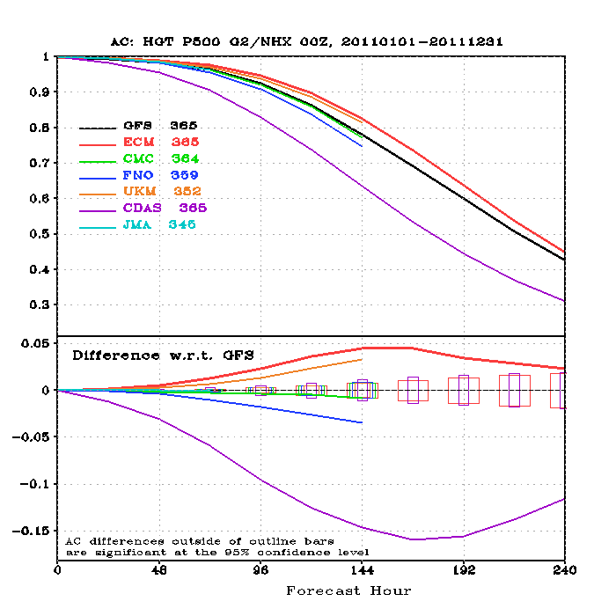
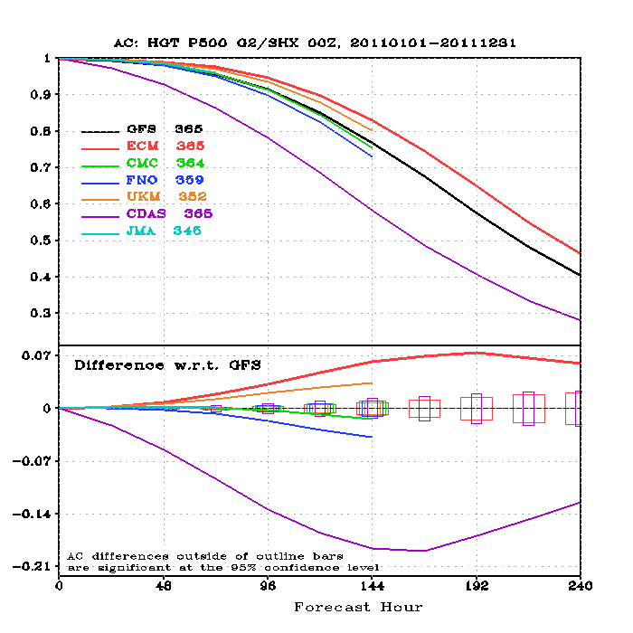
2011 Annual Mean 500hPa HGT AC
0.6 – useful forecast
SH
NH
GFS falls behind ECMWF and UKM, but is better than CMC, FNO and JMA.
GFS useful forecasts (>0.6) reached 8.0 days in the NH and 7.8 days in the SH.

Slide 7
Day at which forecast loses useful skill (AC=0.6)
N. Hemisphere 500hPa height calendar year means
Louis AMS Diagram
8 d
Forecast day
Credit:, Peter Caplan, Yujian Zhu, Fanglin Yang

Slide 8
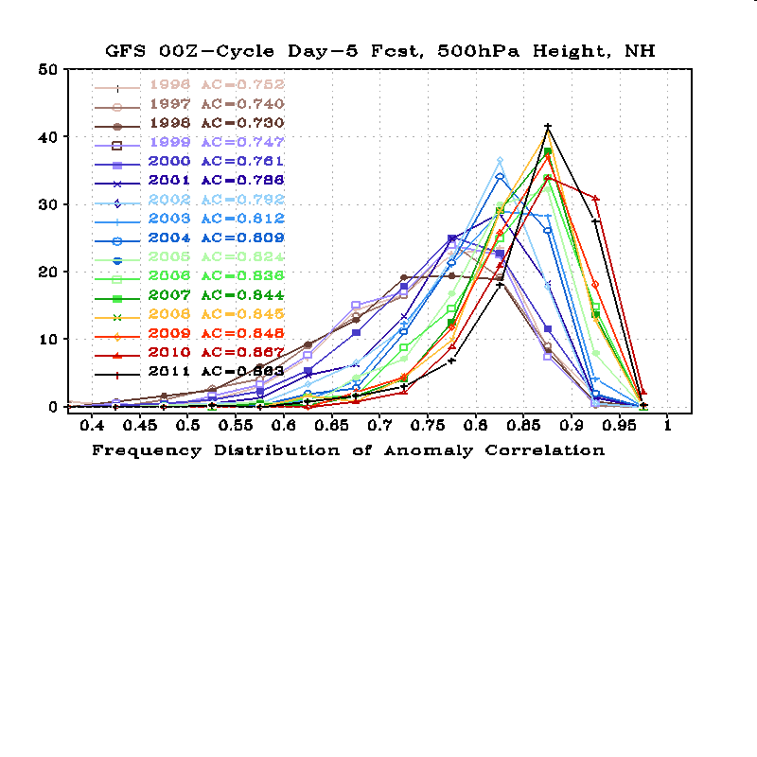
Reduced poor
forecasts
Look at the history of extremes in the distribution
  Poor Forecasts (AC < 0.7 )
  Excellent forecasts ( AC > 0.9 )
Twenty bins were used to count for the frequency distribution, with the 1st bin centered at 0.025 and the last been centered at 0.975. The width of each bin is 0.05.

Slide 9
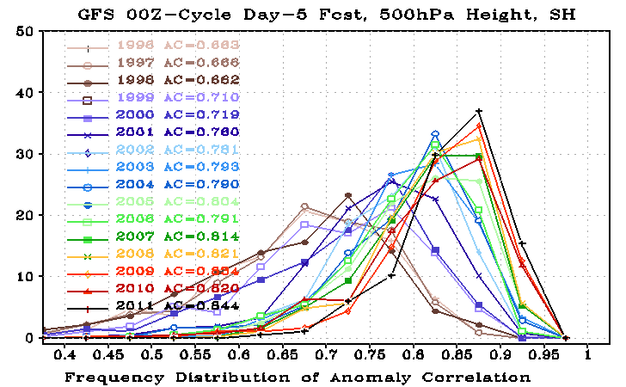
Look at the history of extremes in the distribution
  Poor Forecasts (AC < 0.7 )
  Excellent forecasts ( AC > 0.9 )
Twenty bins were used to count for the frequency distribution, with the 1st bin centered at 0.025 and the last been centered at 0.975. The width of each bin is 0.05.

Slide 10
2011: SH reached historical high; NH was the second best.

Slide 11
Percent of Excellent Forecasts (AC >0.9)

Slide 12
Percent of Poor Forecasts (AC < 0.7)

Slide 13
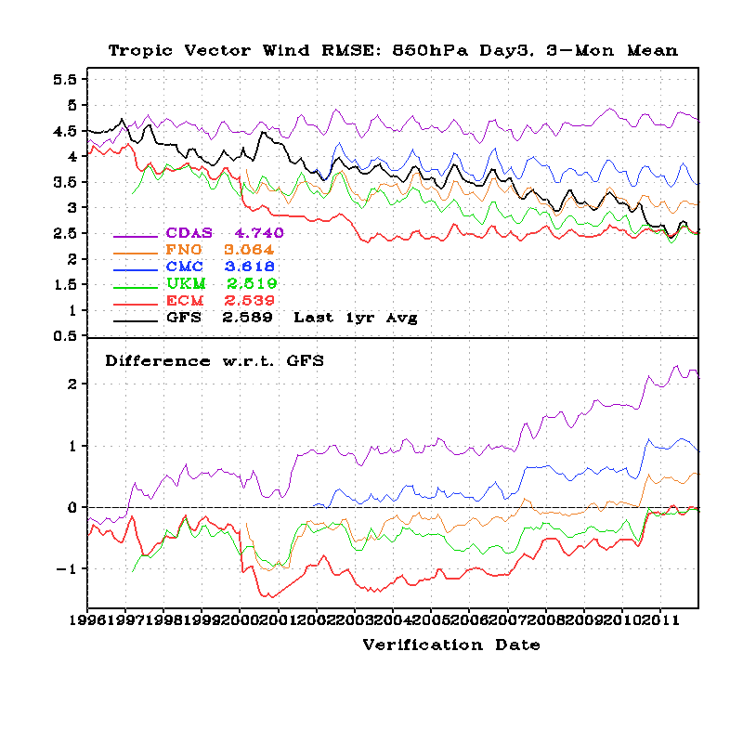
Tropical Wind RMSE, 850-hPa Day-3 Forecast
July2010 T574 GFS Implementation

Slide 14
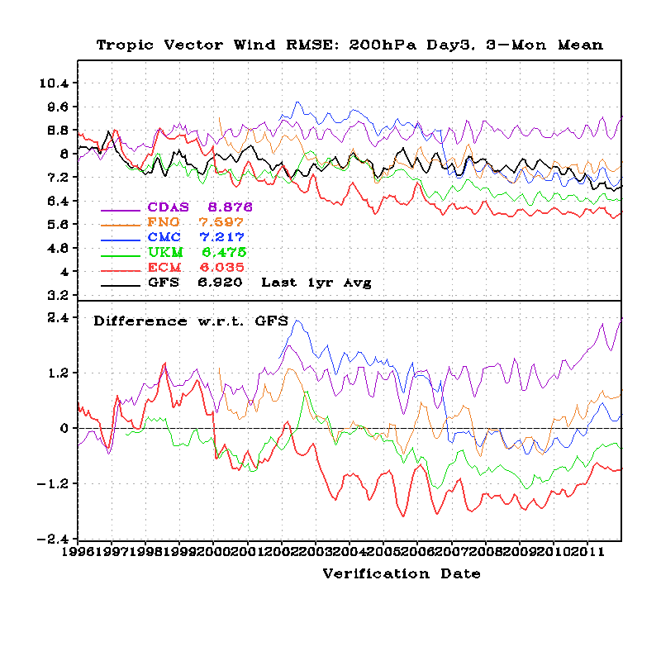
Tropical Wind RMSE, 200-hPa Day-3 Forecast

Slide 15
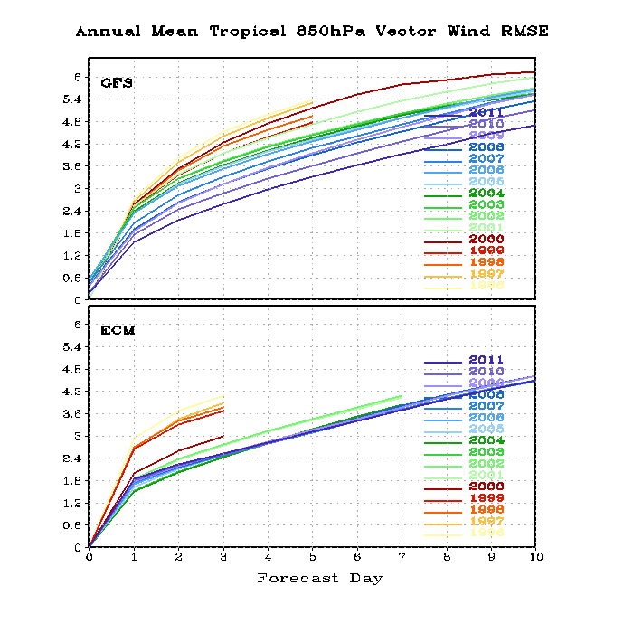
Annual Mean 850-hPa Tropical Wind RMSE, Error Growth

Slide 16
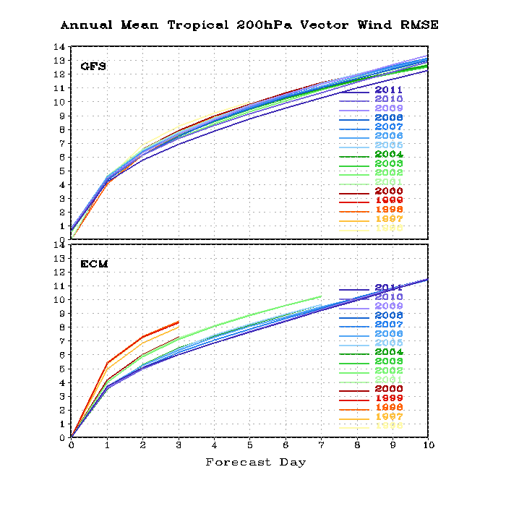
Annual Mean 200-hPa Tropical Wind RMSE, Error Growth

Slide 17
Major GFS Changes
3/1999
  AMSU-A and HIRS-3 data
2/2000
  Resolution change: T126L28 → T170L42 (100 km → 70 km)
  Next changes
    7/2000 (hurricane relocation)
    8/2000 (data cutoff for 06 and 18 UTC)
    10/2000 – package of minor changes
    2/2001 – radiance and moisture analysis changes
5/2001
  Major physics upgrade (prognostic cloud water, cumulus momentum transport)
  Improved QC for AMSU radiances
  Next changes
    6/2001 – vegetation fraction
    7/2001 – SST satellite data
    8/200 – sea ice mask, gravity wave drag adjustment, random cloud tops, land surface evaporation, cloud microphysics…)
    10/ 2001 – snow depth from model background
    1/2002 – Quikscat included

Slide 18
Major GFS Changes (cont)
11/2002
  Resolution change: T170L42 → T254L64 (70 km → 55 km)
  Recomputed background error
  Divergence tendency constraint in tropics turned off
  Next changes
    3/2003 – NOAA-17 radiances, NOAA-16 AMSU restored, Quikscat 0.5 degree data
    8/2003 – RRTM longwave and trace gases
    10/2003 – NOAA-17 AMSU-A turned off
    11/2003 – Minor analysis changes
    2/2004 – mountain blocking added
    5/2004 – NOAA-16 HIRS turned off
5/2005
  Resolution change: T254L64 → T382L64 ( 55 km → 38 km )
  2-L OSU LSM → 4-L NOHA LSM
  Reduce background vertical diffusion
  Retune mountain blocking
  Next changes
    6/2005 – Increase vegetation canopy resistance
    7/2005 – Correct temperature error near top of model

Slide 19
Major GFS Changes (cont)
8/2006
  Revised orography and land-sea mask
  NRL ozone physics
  Upgrade snow analysis
5/2007
  SSI (Spectral Statistical Interpolation) → GSI ( Gridpoint Statistical Interpolation).
  Vertical coordinate changed from sigma to hybrid sigma-pressure
  New observations (COSMIC, full resolution AIRS, METOP HIRS, AMSU-A and MHS)
12/2007
  JMA high resolution winds and SBUV-8 ozone observations added
2/2009
  Flow-dependent weighting of background error variances
  Variational Quality Control
  METOP IASI observations added
  Updated Community Radiative Transfer Model coefficients
7/2010
  Resolution Change: T382L64 → T574L64 ( 38 km → 23 km )
  Major radiation package upgrade (RRTM2 , aerosol, surface albedo etc)
  New mass flux shallow convection scheme; revised deep convection and PBL scheme
  Positive-definite tracer transport scheme to remove negative water vapor

Slide 20
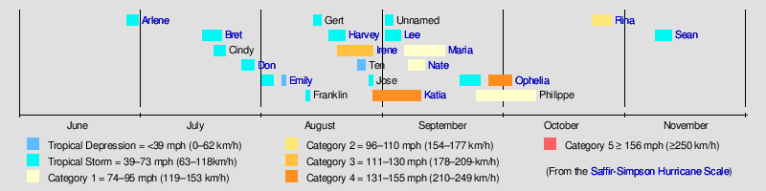
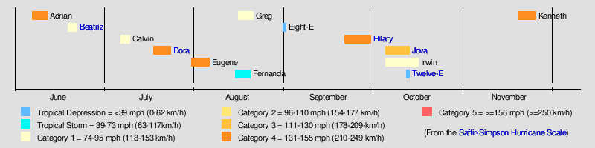
Major International NWP Models
2011 Hurricane Track and Intensity Forecast Errors
2011 Atlantic Hurricanes
2011 Eastern Pacific Hurricanes
http://www.wikipedia.org

Slide 21
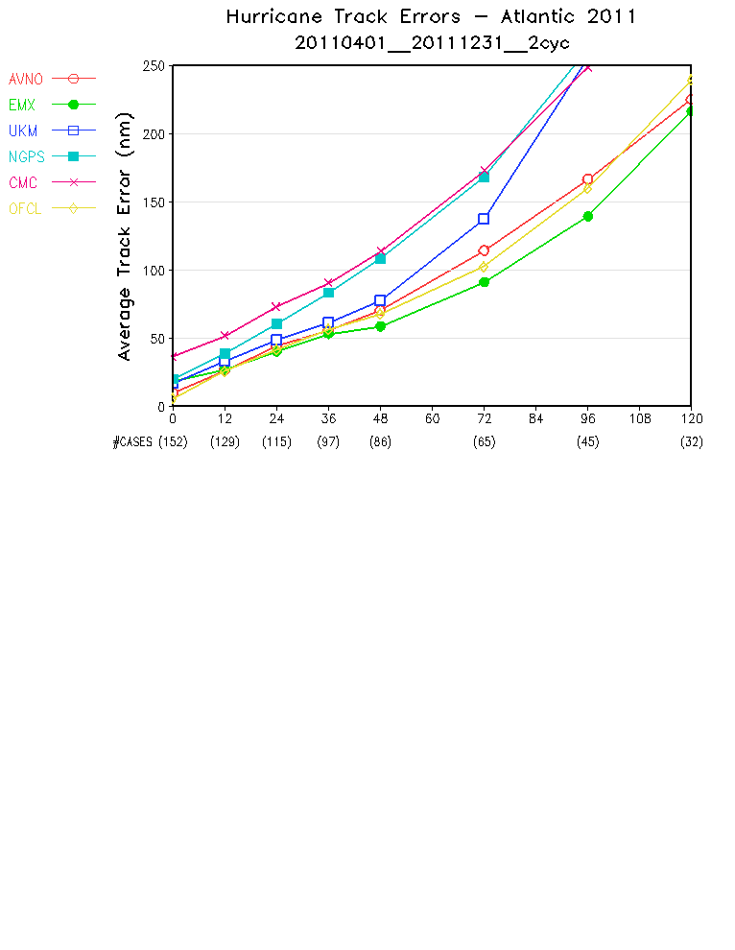
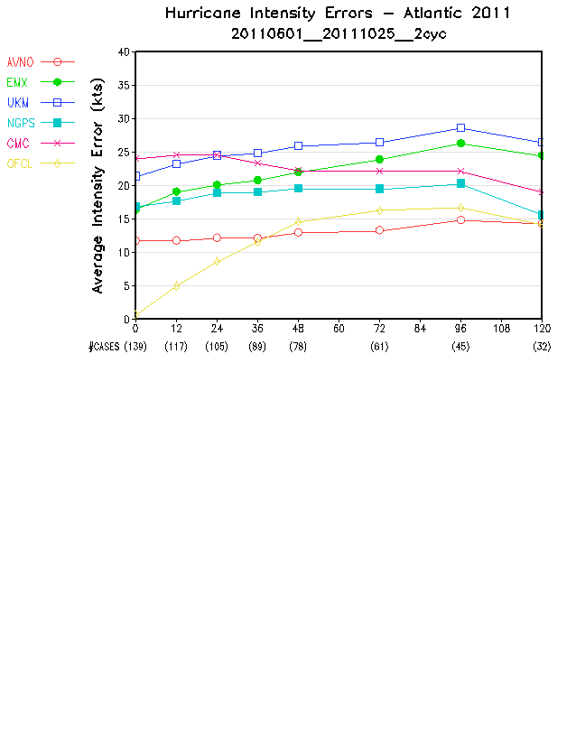
2011 Atlantic Hurricane Track and Intensity Errors
AVNO = GFS
EMX = ECMWF
00Z and 12Z cycles

Slide 22
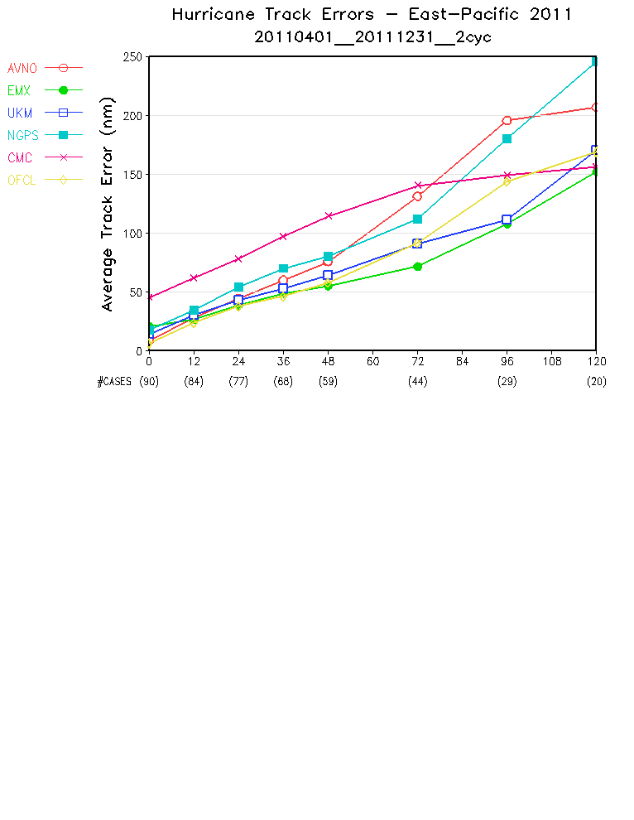
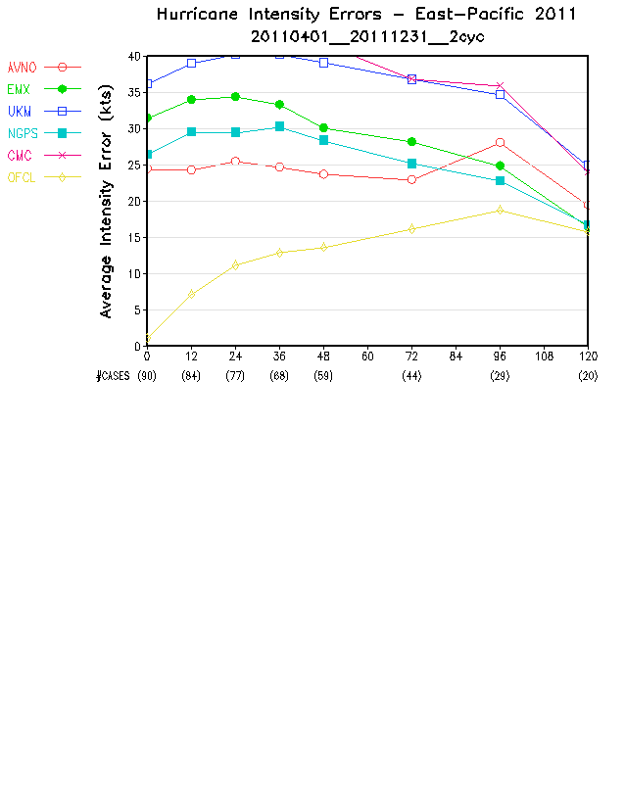
2011 Eastern Pacific Hurricane Track and Intensity Errors
AVNO = GFS
EMX = ECMWF
00Z and 12Z cycles

Slide 23
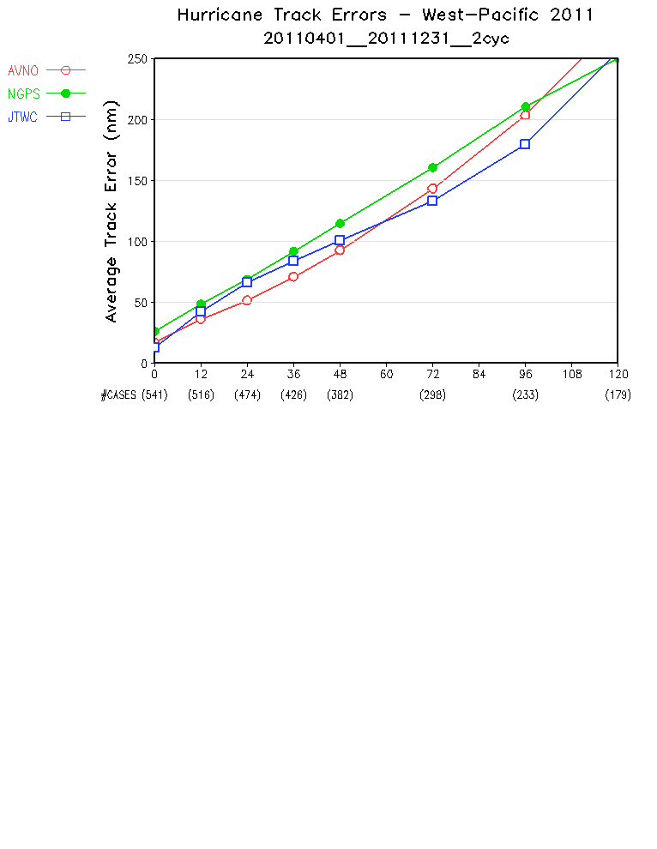
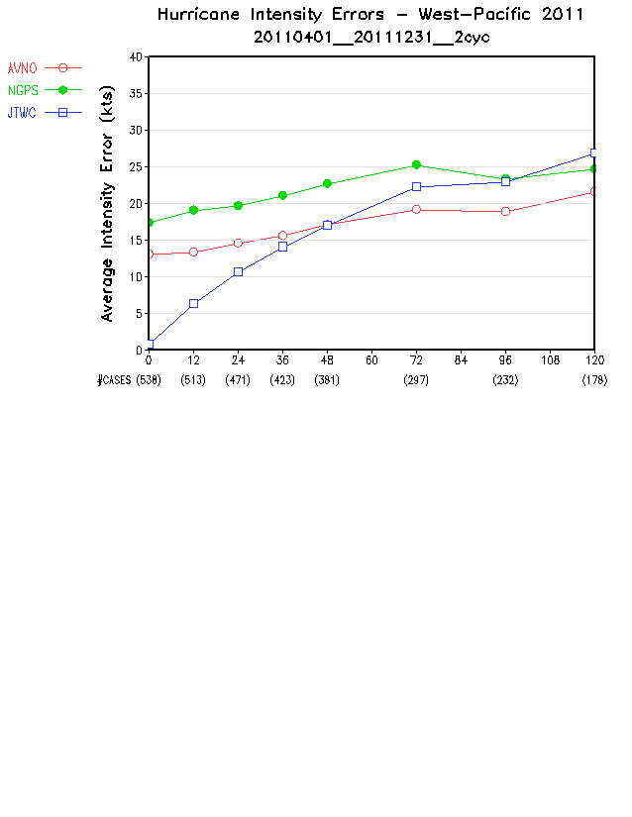
2011 Western Pacific Hurricane Track and Intensity Errors
AVNO = GFS
EMX = ECMWF
00Z and 12Z cycles

Slide 24
Hurricane Track and Intensity Forecast Errors
NCEP GFS : 2001 ~ 2011

Slide 29
2011 CONUS Precipitation Forecast Threat Skill Scores

Slide 30
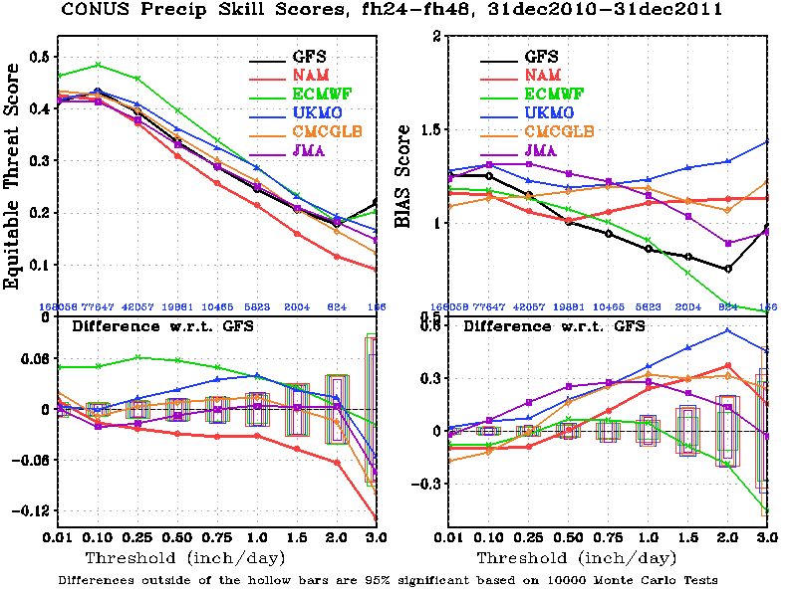
CONUS Precipitation, Day-2 Forecast

Slide 31
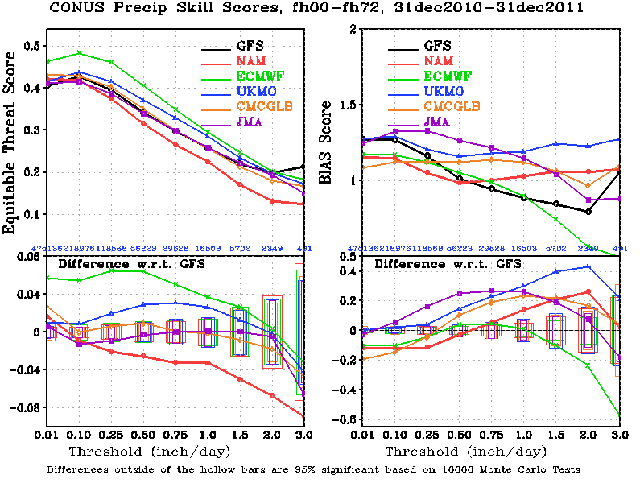
CONUS Precipitation, 0-72hr Total

Slide 32
2011
A Year with Record-Breaking
Billion-Dollar Weather Disasters

Slide 33
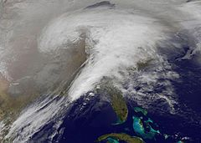
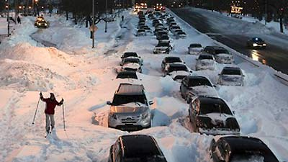
2011: A Year with Record-Breaking
Billion-Dollar Weather Disasters
29Jan ~ 2Feb: Groundhog Day Blizzard: $2 billion
Blizzards, ice storms, snow storms brought major U.S. cities to a standstill, killed 36 people, caused $2 billion in damages. Maximum snowfall 27 inches.
http://www.wikipedia.org
http://www.thedailygreen.com/

Slide 34
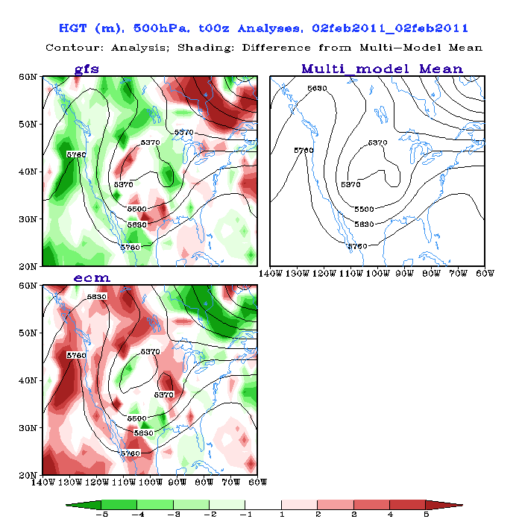
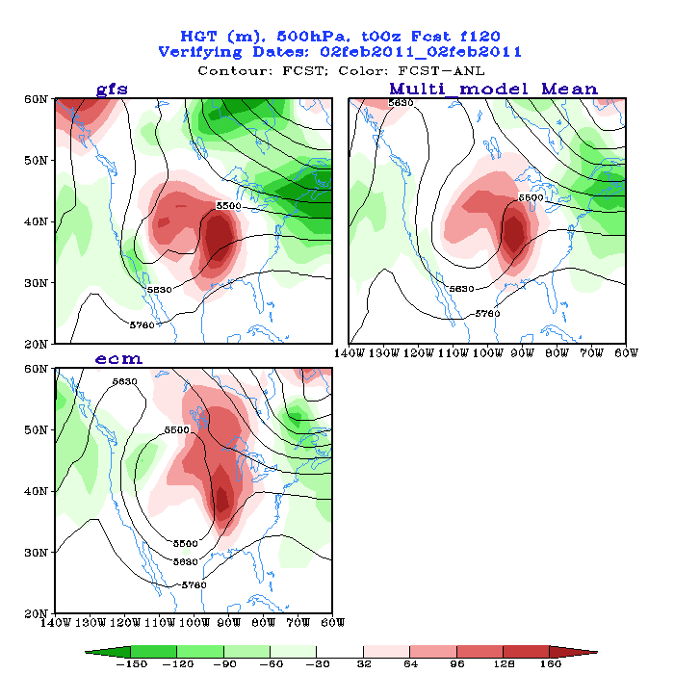
500 hPa Height Valid for 00Z 02Feb2011
GFS and ECMWF Analyses and Forecasts
Analysis
120-hr Fcst
Both models predicted quite well the system

Slide 35
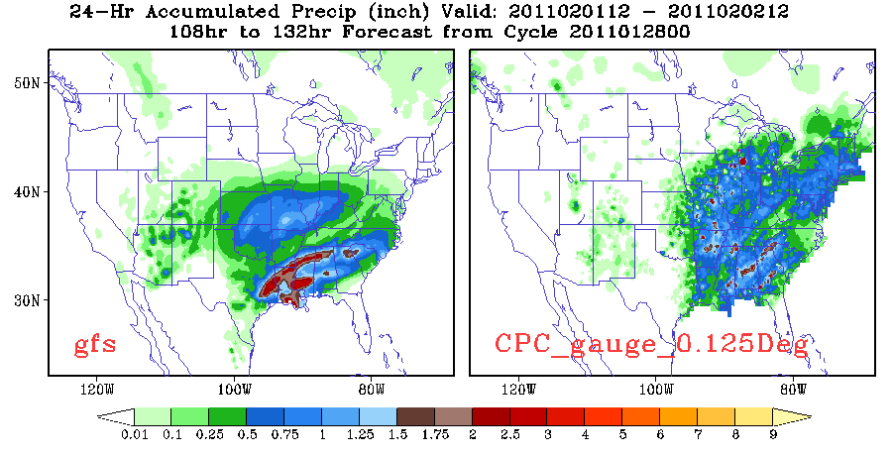
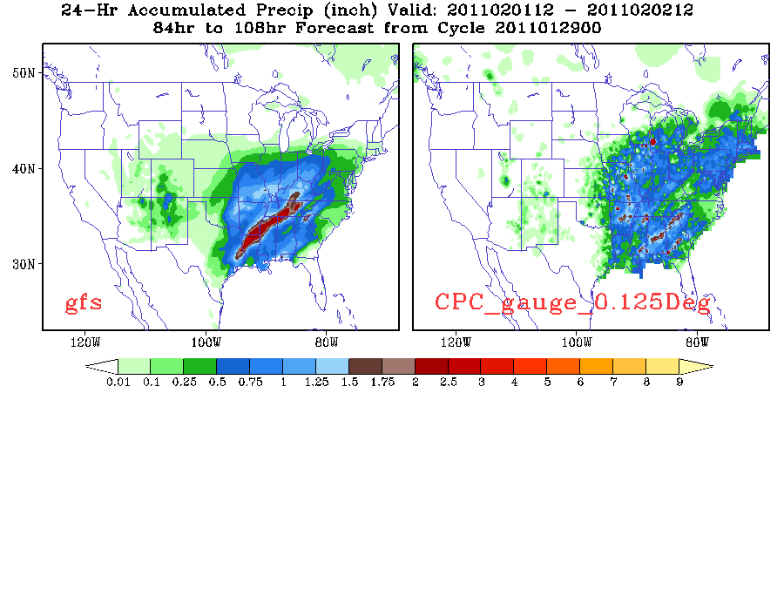
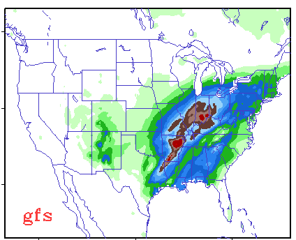

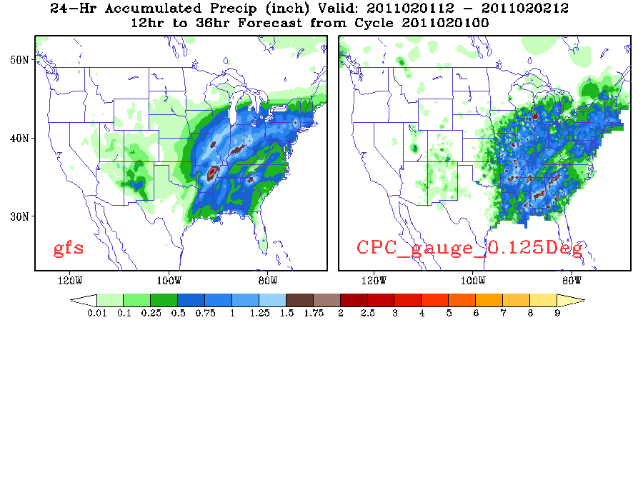
GFS Rainfall Forecast, 24hr Accumulation Ending at 12Z02Feb2011
5-d fcst
obs
4-d fcst
3-d fcst
2-d fcst
1-d fcst

Slide 36
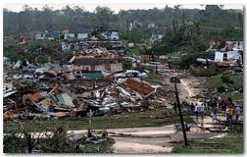
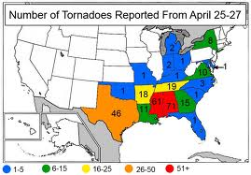
2011: A Year with Record-Breaking
Billion-Dollar Weather Disasters
Tornado Outbreaks: 22 billion
1,559 confirmed tornados, killed at least 550 people in the US (compared to 564 deaths in the 10 years prior combined).
April 4-5: 46 tornadoes in the Midwest and Southeast.
April 8-11, ~ 60 tornadoes in the central and southern US.
April 14-16: ~ 160 tornadoes in the southern and central U.S.
April 25-30: ~ 305 tornadoes ripped through the Southeast, Midwest and Ohio Valley, killing 327 people.
May 22-27: 180 tornadoes killed 177, most of them in Joplin, Mo.

Slide 37
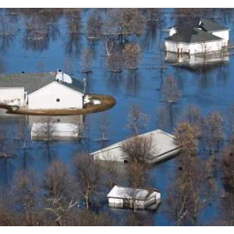
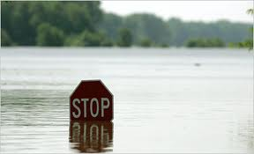
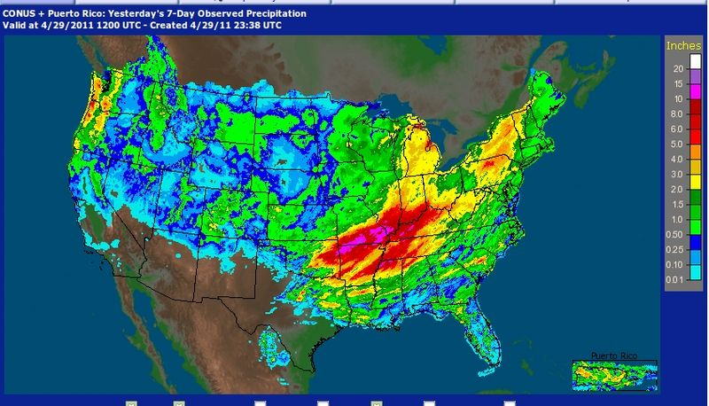
2011: A Year with Record-Breaking
Billion-Dollar Weather Disasters
Mississippi River Flooding: $2-4 Billion
The Mississippi River floods in April and May 2011 were among the largest and most damaging recorded along the U.S. waterway in the past century, comparable in extent to the major floods of 1927 and 1993, led to at 20 deaths and a cost of between $3 and $5 billion.
Rainfall totals for the week ending April 29.

Slide 38
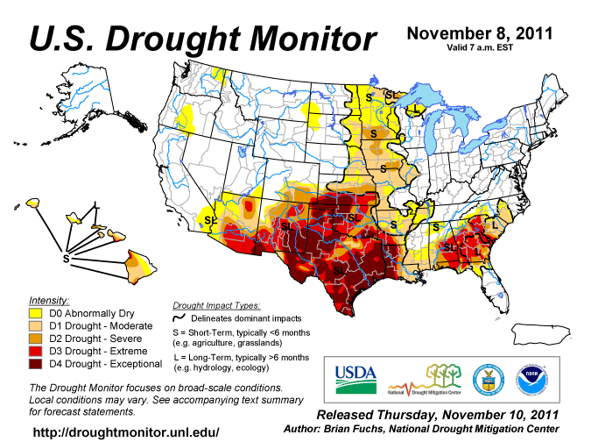
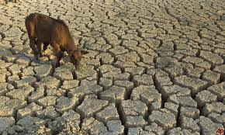
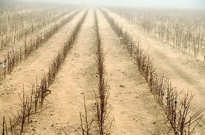
2011: A Year with Record-Breaking
Billion-Dollar Weather Disasters
Southern U.S. Drought: $5 Billion
A historic drought centered on Texas, the driest 12-month (Oct-Sept) period in Texas since 1895. Ruined a majority of crops and cost $1 million a day in wildfire-fighting costs. The disaster's cost was more than $5 billion.

Slide 39
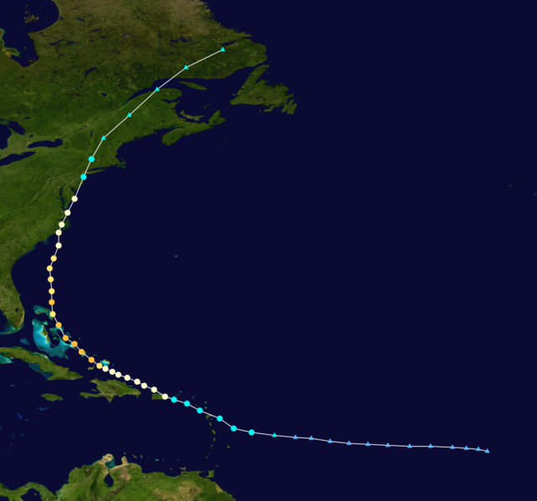
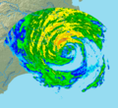
2011: A Year with Record-Breaking
Billion-Dollar Weather Disasters
Hurricane Irene: 10 billion
August 20-29, Cat 3
56 deaths

Slide 40
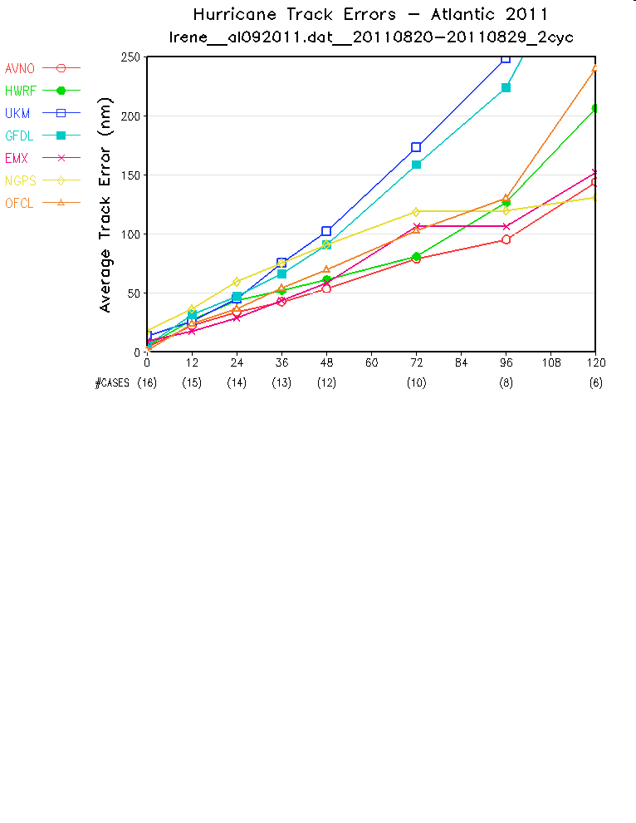
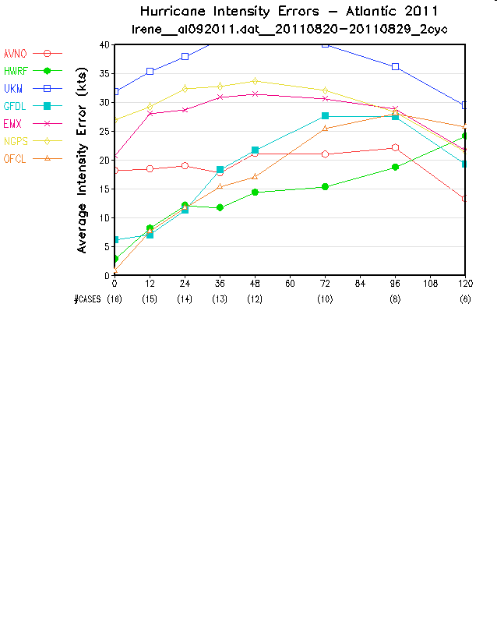
Hurricane Irene
GFS
track
intensity
GFS track forecast was one of the best
GFS intensity forecast was also better than other global NWP models

Slide 41
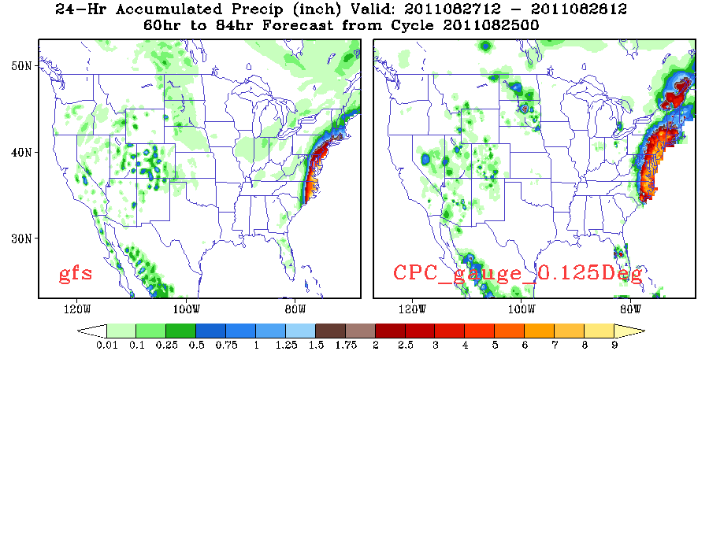
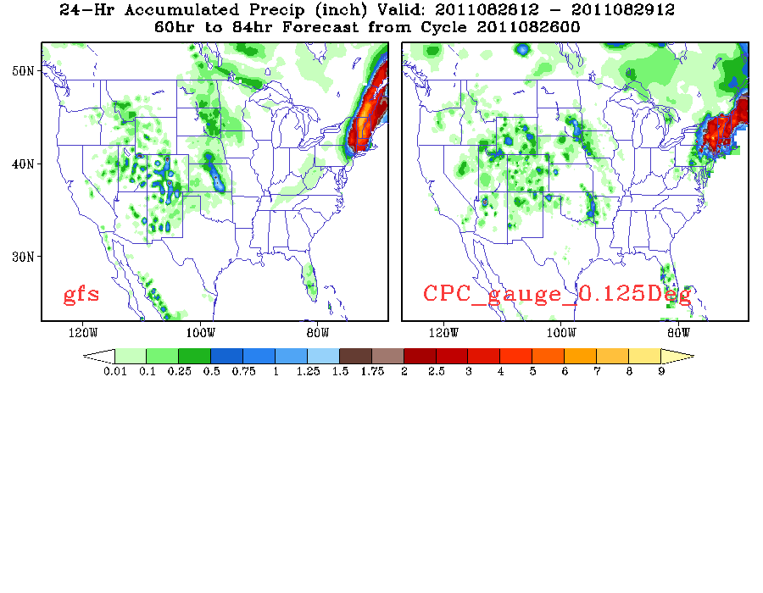
GFS 60-84hr Rainfall Forecast: Hurricane Irene
24-hr rainfall, valid at 12Z28Aug2011
24-hr rainfall, valid at 12Z29Aug2011

Slide 42
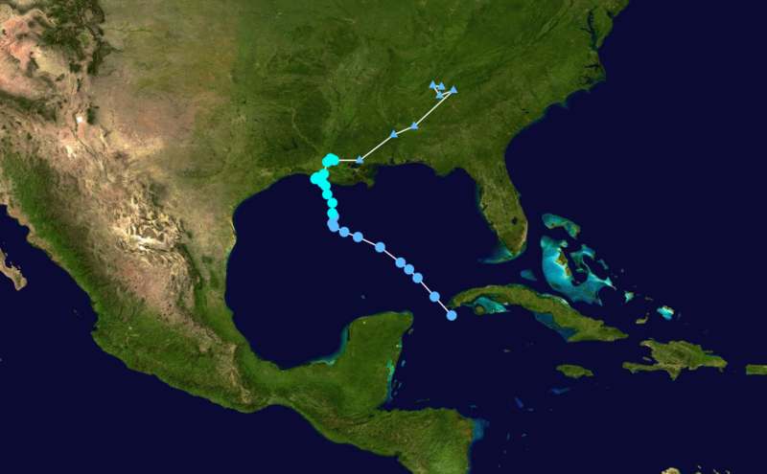
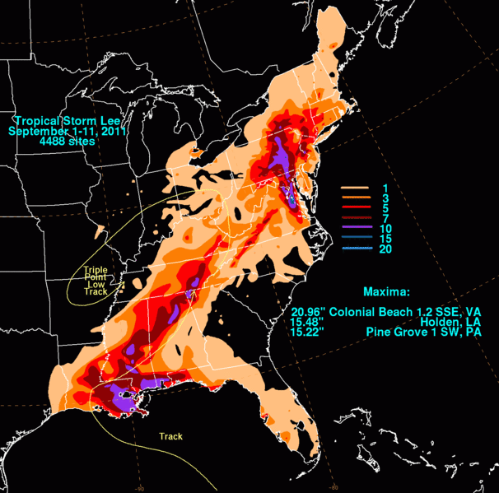
2011: A Year with Record-Breaking
Billion-Dollar Weather Disasters
Tropical Storm Lee: > 1 billion
September 1-5
21 deaths
Due to the large size, as well as the slow forward movement of the storm, heavy rainfall occurred in southern Louisiana, Mississippi, Alabama, and the Florida panhandle, and caused historic flooding in Pennsylvania, New York, and elsewhere.

Slide 43
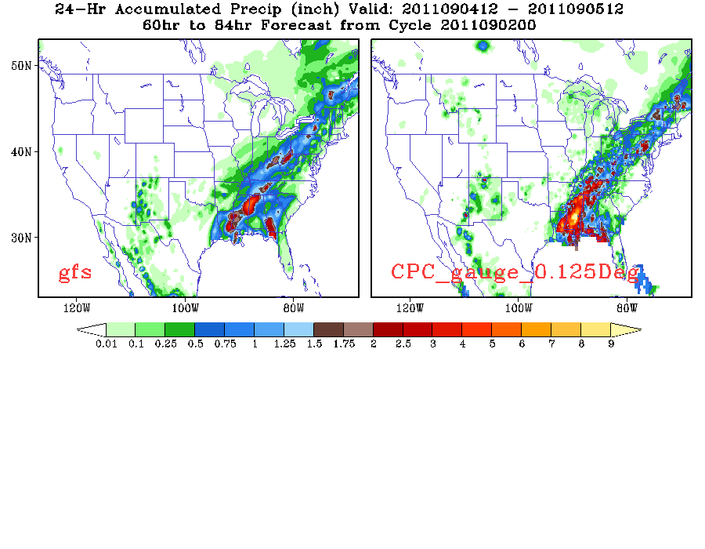
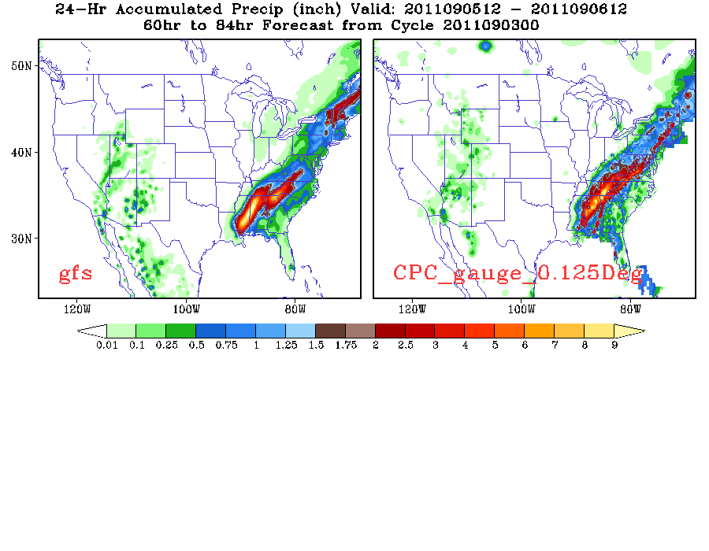
GFS 60-84hr Rainfall Forecast: Tropical Storm Lee
24-hr rainfall, valid at 12Z05Sep2011
24-hr rainfall, valid at 12Z06Sep2011

Slide 44
Supplemental Material

Slide 45
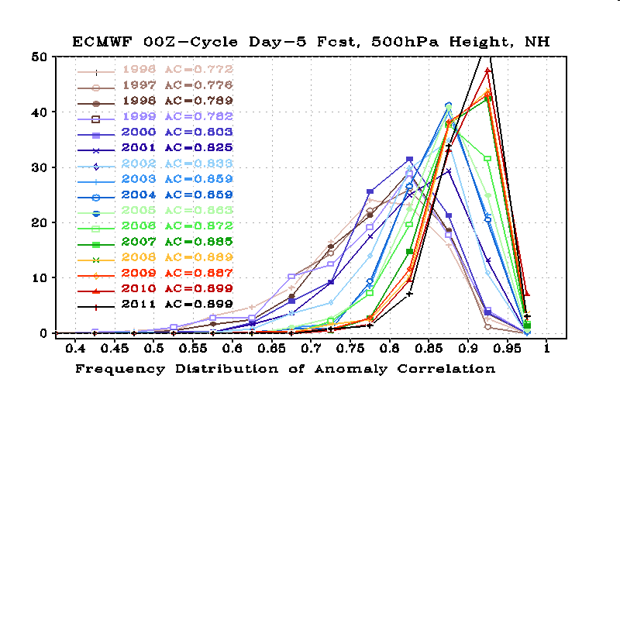

Slide 46
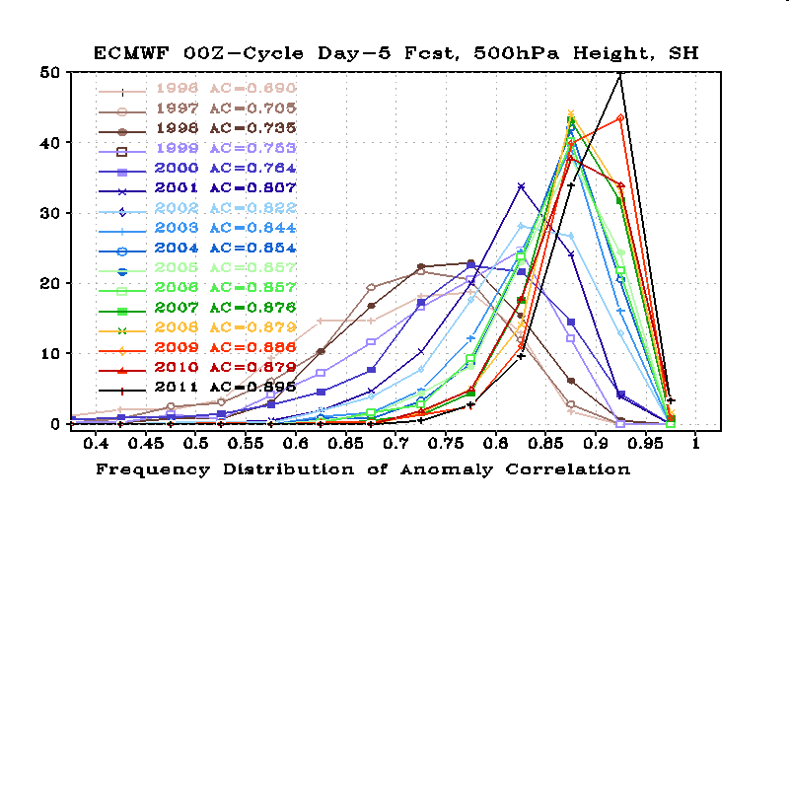

Slide 48
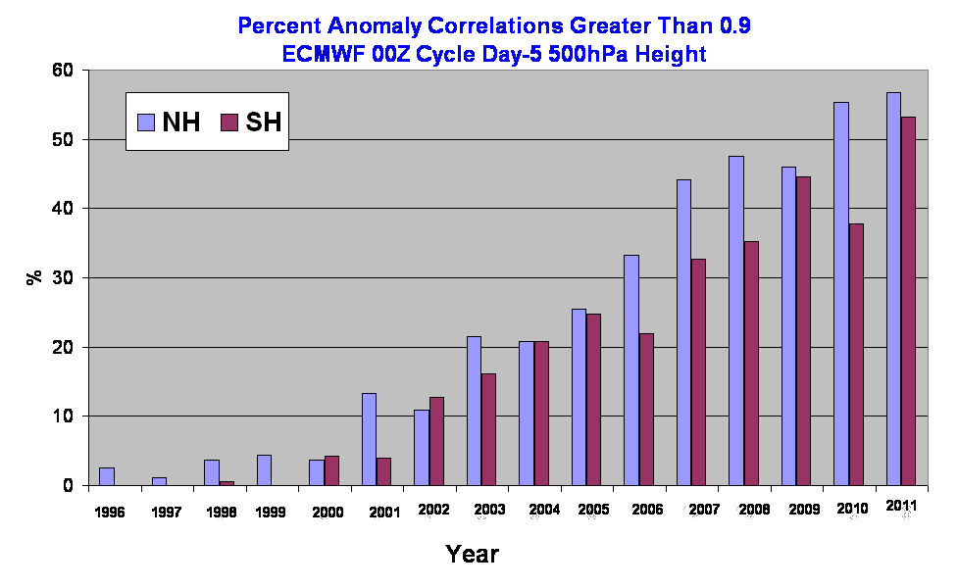

Slide 49
